Slide 1

THE CHRISTIAN CHURCH 4
Its peoples, theologies, and practices
A Short History
PART 1: From the Apostles to the Renaissance

Slide 2

THE RENAISSANCE
The Rediscovery of Classical Thought and the Rise of Humanism

Slide 3
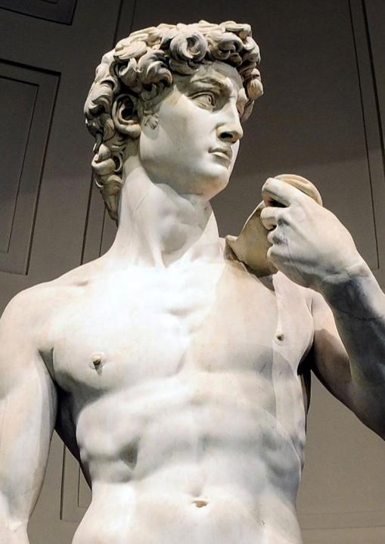
Birth of the renaissance
The end of the Middle Ages in the 14th and 15th centuries was characterized by a surge of interest in classical scholarship and values.
This re-birth included the discovery and exploration of new continents, the Copernican view of the universe, the decline of feudalism, the invention of paper and printing, and the use of the mariners’ compass and gunpowder.
Primarily, it was a revival of classical learning and wisdom after many centuries of cultural decline and stagnation.
Michelangelo’s David

Slide 4
classical thought
The intellectual basis for the Renaissance was Humanism derived from classical Roman and Greek thinkers.
First centered in Florence, Italy, it spread throughout Europe, affecting education, mathematics, physics, astronomy, the arts, literature, and nearly every aspect of life.
Renaissance scholars scoured the libraries of Europe in search of works by Latin authors such as Cicero, Lucretius, Livy, and Seneca, along with Greek authors like Plato, Aristotle, Protagoras, and others.
Renaissance artists recaptured the realism, perspective, and psychological features of human nature in both sculpture and painting through the work of Leonardo da Vinci, Michelangelo, and Raphael.

Slide 5
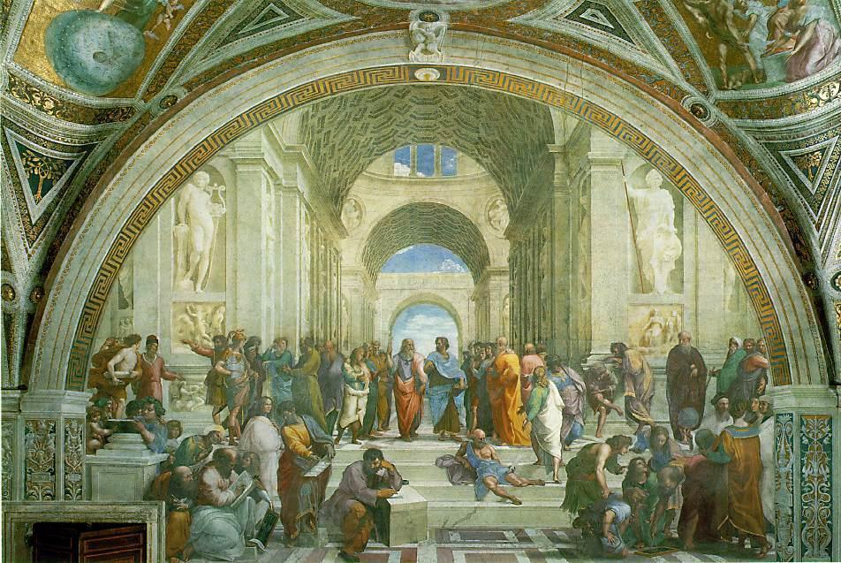
The School of Athens (Raphael)

Slide 6
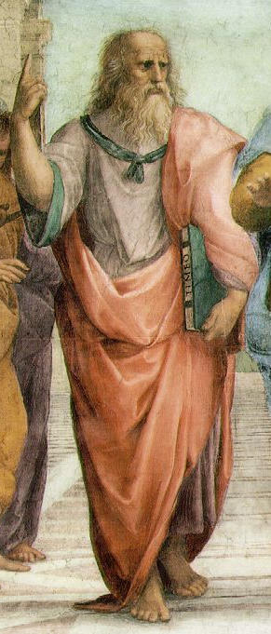
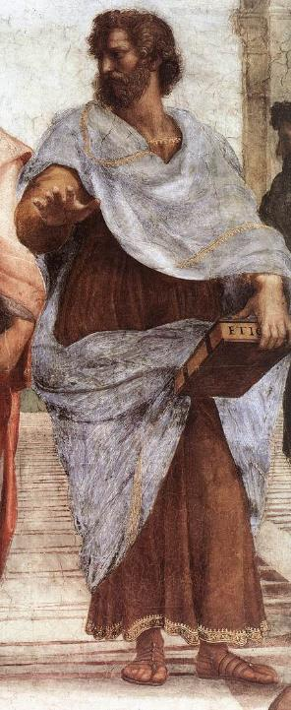
PLATO symbolizes those philosophies that see reality in higher forms. His finger pointing upward suggests ideals or absolutes.
ARISTOTLE symbolizes those philosophies that see reality in observable details. His hand thrust downward suggests particulars or individual things.

Slide 7
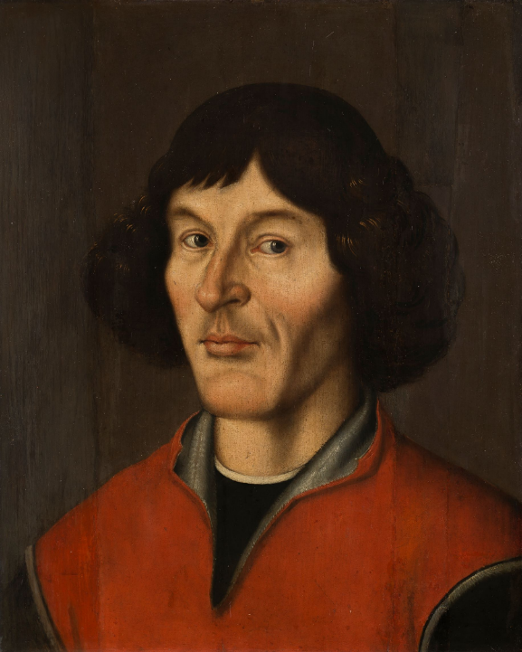
The Copernican revolution
The Copernican Revolution was a major paradigm shift in astronomy.
Whereas in the Medieval Period, the earth was believed to be the stationary center of the universe, it now became apparent that the sun was the center of the solar system in a delicate balance of rotating planets.
The two most important figures were Copernicus of Poland and Galileo of Italy.
In March 1616, the Roman Catholic Church issued a prohibition against the Copernican Theory leading to the condemnation of Galileo. It would take the Roman Church three centuries before admitting that Galileo was right and clearing his name of heresy.
Torun Portrait of Copernicus, ca. 1590

Slide 8
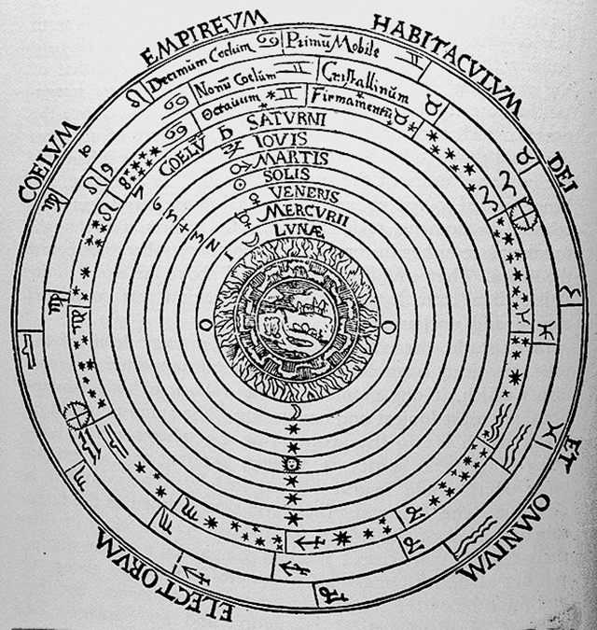
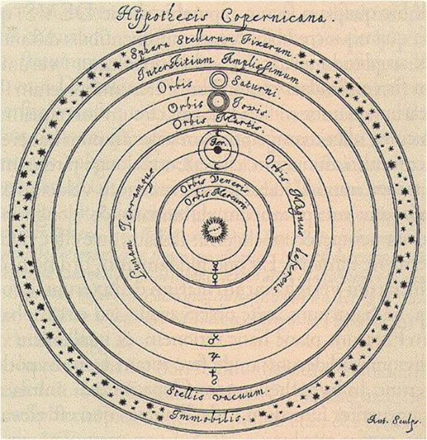
Ptolemaic Geocentric Model of the Universe
Copernican Heliocentric Model of the Universe

Slide 9
renaissance and church
In the broader sense, the Renaissance increased curiosity about original sources.
Many Greek classics became available in western Europe, and scholars were now able to read them in the original languages.
The Renaissance prompted the realization that the older Medieval order was no longer sustainable; new scientific discoveries and technological innovations made clear just how inadequate were the old structures.
Many humanists began applying the new principles to the study of the Bible, and beyond that, to the liturgical and theological principles by which the hierarchy of the church governed its flock.
The more they studied Greek, the more they came to realize that their older translations as well as other texts had simply been wrong in many places, so new translations with corrections began to appear.

Slide 10
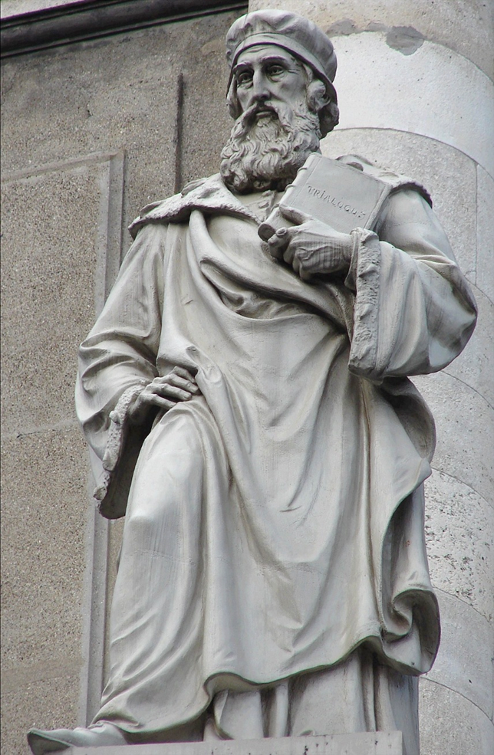
Statue of Wyclif at Frederick’s Church, Copenhagen, Denmark
THE WYCLIF BIBLE
With the Norman Conquest (1066), Anglo-Saxon translation faded because the Normans did not speak it and the language of Britain was shifting toward Middle English.
Wyclif, a professor at Oxford University, assisted by some scholarly friends, completed a translation of the whole Bible into Middle English in 1382.
The primary disadvantage was that this translation was made from the Latin Vulgate, so it was a translation of a translation.

Slide 11
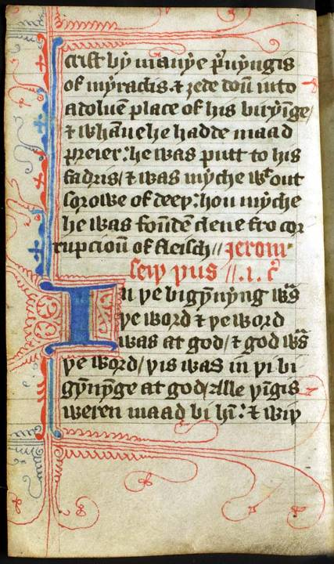
Late 14th century page from John Wyclif’s Version (the beginning of John’s Gospel is signified by the large blue capital “I” about two-thirds of the way down the page).
This edition was pocket-sized and probably was used by a traveling (Lollard) preacher.
Public Domain

Slide 12
“These thingis Jesus spak; and whanne he hadde cast up hise eyen into hevene, he seide: ‘Fadir, the our cometh; clarifie thi sone, that thi sone clarifie thee; as thou hast yovun to hym power on ech fleische, that al thing that thou hast yovun to hym, he yyve to hem everlastynge liif. And this is everlastynge liif, that thei knowe thee very God aloone, and whom thou has sent, Jesu Christ.”
Wyclif’s Version
Middle English
John 17:1-3

Slide 13
WYCLIF'S CONDEMNATION
Beyond his translation work, Wyclif leveled some poignant criticisms of the Medieval Church.
He objected to:
Transubstantiation
Purgatory
Sale of indulgences
Simony (buying church offices)
His views were condemned by Pope Gregory XI in 1377.
Wyclif was forced to leave Oxford University.
His followers, however, continued to produce hand-written copies of his Middle English Bible.
After his death, Wyclif was condemned at the Council of Constance, his writings destroyed, and his bones exhumed and burned.

Slide 14
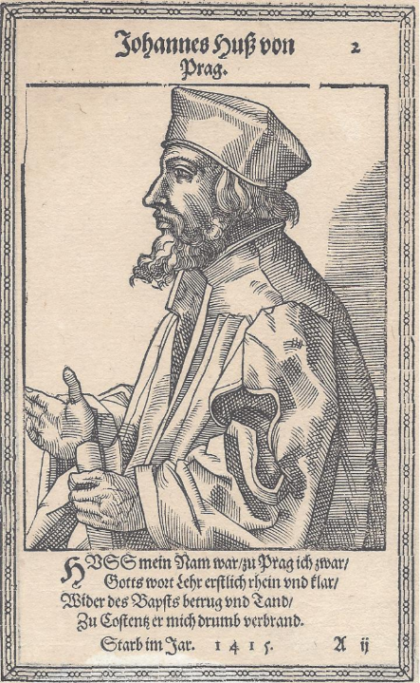
Jan hus (ca. 1370-1415)
At about the same time that Wyclif was stirring up resistance in England, a priest and rector at the University of Prague began stirring rumblings further east.
He publicly defended the propositions of Wyclif, which was especially dangerous, since Wyclif’s writings had been condemned.
He denounced the moral failures of the clergy, spoke out against indulgences, and asserted that the pope had no right to take up the sword in the name of the church.
He argued that one obtains forgiveness by true repentance, not money.
Because of Hus, Prague was placed under interdict (excluded from the sacraments, even funerals and burial).

Slide 15
Council of constance
On October 18, 1412, Hus appealed to Jesus Christ as the supreme judge, thereby bypassing the laws and structures of the Medieval Church.
The Council of Constance became the 16th Ecumenical Council recognized by the Roman Catholic Church, and Hus agree to go to Constance under the promise of safe-conduct, arriving on November 3, 1414.
He was imprisoned on November 28, and his protector, Sigismund of Hungary, who had guaranteed his safety, was now convinced by Hus’ enemies that promises made to a heretic were not binding.
At his trial in Constance, Hus was called to retract his errors, and when he did not answer satisfactorily, he was condemned on July 6, 1415.

Slide 16
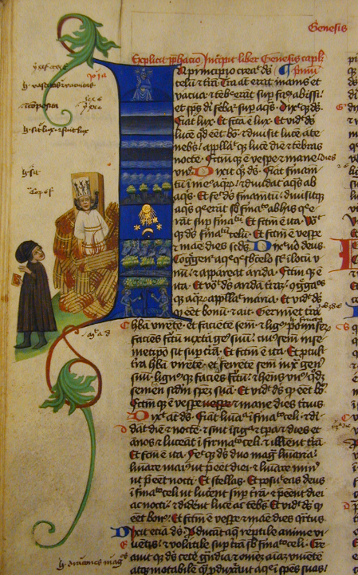
Execution
At the place of execution, Hus knelt, spread out his hands, and prayed aloud.
With his hands tied behind him, his neck bound with a chain to a pile of wood and straw so that it covered him to the neck, he was burned to death.
His final words were: “God is my witness…in the same truth which I have written, taught, and preached, drawing upon the sayings and positions of the holy doctors, I am ready to die today.”
As he was about to expire, he cried out, “Christ, son of the Living God, have mercy on us!”
His ashes were thrown in the Rhine River to prevent their being honored by his supporters.
Oldest known representation of Jan Hus, Martinicka Bible, 1430

Slide 17
aftermath
In 1999, Pope John Paul II expressed “deep regret for the cruel death inflicted” on Hus and added “deep sorrow” for Hus’s death, praising his moral courage.
The Hussite community included most of the Czech population of the Kingdom of Bohemia.
Students returning to England brought with them Hus’ writings.
The seeds of Reformation thought are clear.
The Moravians, one of the oldest Protestant denominations, split from the Roman Catholic Church in the 1400s due to the teaching of Hus.
They became the first Protestant missionaries.

Slide 18
Technological Advances
Two technological advances contributed significantly to the possibility of widespread access to the Scriptures.
The invention of paper, made from rags, reduced the price of writing materials substantially; previously, written materials were produced on vellum (from animal skins).
Gutenberg’s invention of the printing press with moveable type made possible the rapid reproduction of written texts (1445).
The first complete book to have been printed in the Christian world was the Latin Bible (1452).

Slide 19
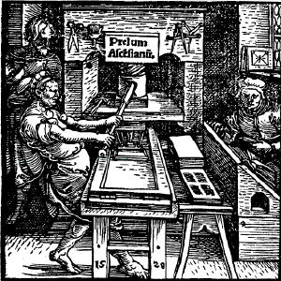
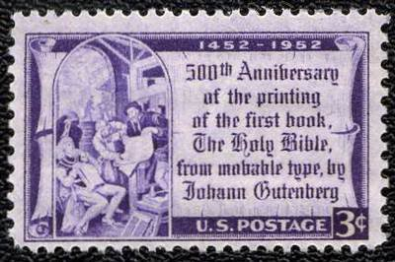
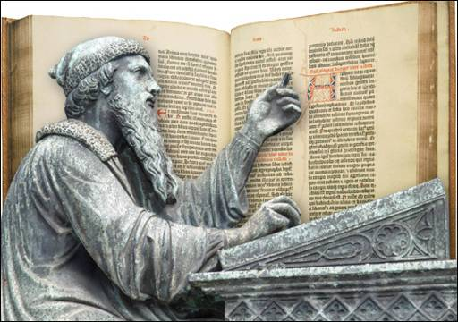
1952 American stamp commemorating the Gutenberg Bible
A Printing Press from a title page of a Parisian printer, 1520
Bronze of Gutenberg superimposed on his 1452 Bible.

Slide 20
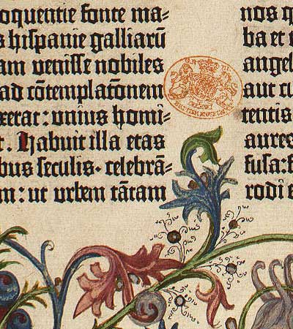
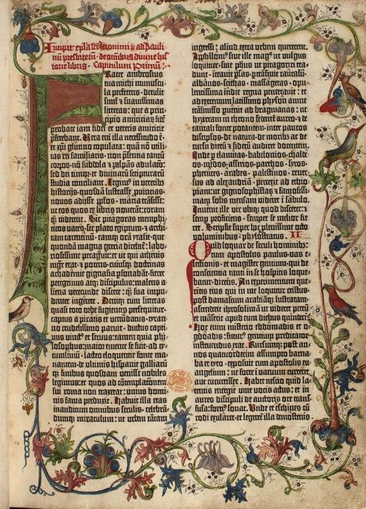
The Gutenberg Bible
The British Library, London

Slide 21
STANDARDIZED LANGUAGE
Printing brought about the standardization of language.
Literacy grew rapidly in all parts of Europe and the British Isles.
The “King’s English” spoken in the London court of southern England was now carried to Yorkshire and Wales in printed form.

Slide 22
THE CONSTITUTIONS OF OXFORD
In 1408, the English Parliament passed laws that forbade translating or even reading any part of the Bible in the English language without express permission of church authorities.
People were burned at the stake for teaching their children the Apostles’ Creed, the Lord’s Prayer, and the Ten Commandments in English.
Nevertheless, as Greek scholarship was moving westward, especially after the storming of Constantinople, and as the printing press became available, it was now possible (though not legal) to publish the Bible.

Slide 23
HEBREW AND GREEK
With renewed access to ancient texts, those who wished to do Bible translation could now work from the original languages.
By the mid-1400s, the reading of ancient Greek texts was firmly established, meaning that ancient Greek texts of the New Testament also were being studied.
The Jews by this time had added vowel points to the text of the Hebrew Bible.
In 1488 the Jews at Soncino, Italy printed a complete Hebrew Bible with further editions to follow.
The Complutensian Polyglot contained the Hebrew Bible, the Septuagint, the Greek New Testament, and the Latin Vulgate.
By the mid-1500s, a French printer began publishing a critical text of the Greek New Testament leading to what later would be called the Textus Receptus (the text generally accepted).

Slide 24
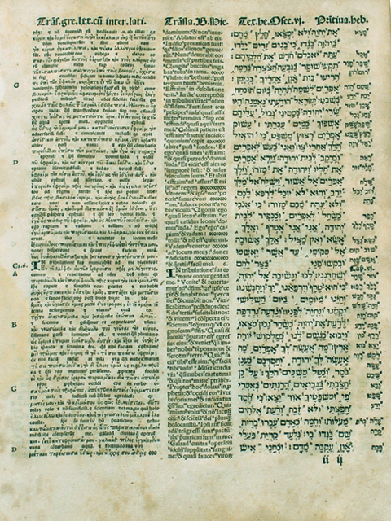
Page from the 1521 Complutensian Polyglot showing columns of Old Testament text in interlinear Septuagint/Latin (left), Latin Vulgate (middle) and Hebrew (right).

Slide 25
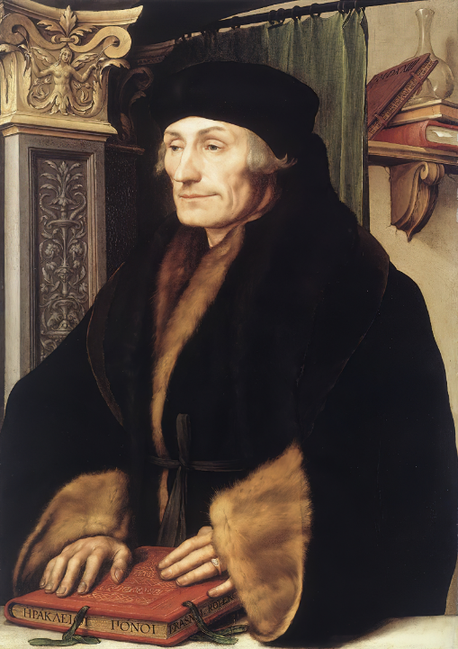
erasmus
The Dutch scholar Erasmus of Rotterdam (1466-1536), a true “renaissance man,” was a Christian humanist, Roman Catholic priest, theologian, philosopher, and linguist.
He published an edition of the Greek New Testament in 1516, Novum Instrumentum Omne, with substantial scholarly annotations, the first printed Greek New Testament.
An estimated 300,000 copies were printed in his lifetime, and this work was the basis for the majority of New Testament translations in the 16th-19th centuries, including those by Luther, Tyndale, and the King James Version.
Portrait of Erasmus by Hans Holbein, the Younger (1523)

Slide 26
the Fall of constantinopLE
For well over a thousand years, the two centers of Christendom had been Rome in the West and Constantinople in the East.
When Constantinople fell to the Ottoman Turks on May 29, 1453, it was a defining moment in world history.
Throughout the 14th and 15th centuries, it had faced continual threats from the Ottomans, Latins, Serbs, and Bulgarians. Furthermore, the Black Death had drastically reduced the population.
Mehmed II, the Ottoman conqueror, converted the Hagia Sophia into a Muslim mosque.
The escape of Greek scholars to Europe with their Greek texts contributed to the revival of Greek and Roman learning in the Renaissance.

