Slide 1
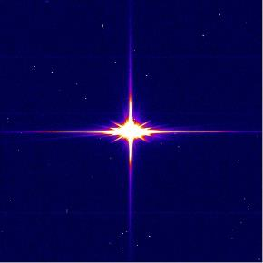
THE BIRTH AND INFANCY NARRATIVES IN MATTHEW AND LUKE
The Annunciations

Slide 2
Luke, Historian and Theologian
Loukas was a 2nd generation Christian, a physician and companion of Paul (cf. Col. 4:14).
  Though not an eyewitness of the life of Jesus, he researched carefully through the eyes of others who were eyewitnesses (1:2-3).
  As a historian, he sought to compose “an orderly account” (1:1)
  As a Christian theologian, he wrote to convince others about the truth of the claims of Jesus.
  Together with the Book of Acts, Luke wrote approximately 28% of the NT, slightly more than Paul at 25%.

Slide 3
On Writing History
Several important features are apparent in Luke’s work as a historian:
  He provides an historical framework for his account, linking the story of Jesus with known world figures like Herod the Great (1:5), Augustus Caesar (2:1), Quirinius (2:2), Tiberias Caesar, Pontius Pilate, Herod Antipas, Herod Philip, and Lysanias (3:1-2).
  He also provides a Jewish context during the high priesthoods of Annas and Caiaphas (3:2).

Slide 4
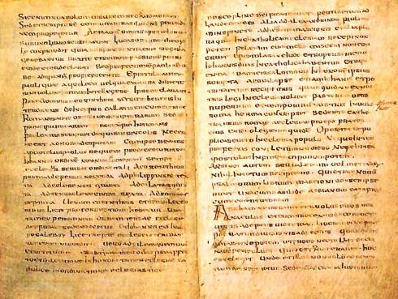
MURATORIAN FRAGMENT
The earliest extant listing of books in the New Testament (ca. AD 170)
It is a Latin text translated from Greek.
The opening of this document has suffered mutilation; hence, the existing half-line that can be read at the beginning probably refers to Mark. Matthew, presumably, is the first book in the list, since Luke is referred to as the “third book.”
“…at these, however, he was present and so he set them down. The third book of the gospel: according to Luke…”

Slide 5
Date
The date of Luke can only be approximated.
  It must be earlier than Acts (cf. 1:1).
  Since Acts does not describe the fall of Jerusalem, some scholars put both works as early as the mid-60s.
  The more conventional dating is related to the scholarly conclusion that Luke drew from Mark’s Gospel, which likely dates to about AD 64 or 65 at the death of Peter. Hence, a suggested date in the mid-80s is not uncommon.
  Whenever it is dated, Luke clearly claims to have composed it within the living memory of those who knew Jesus personally (1:2), people who then served as guarantors for the accuracy of his record.

Slide 6
Discussion Points
Why is it important that the New Testament gospels were all composed within the lifetimes of those who had known Jesus personally?

Slide 7
Renewal of God’s Redemptive Work in the History of Salvation
The birth narratives in Luke set the stage for his entire gospel.
  Like Matthew, they tell the birth stories of Jesus, but unlike Matthew, they do so from the standpoint of the women rather than the men.
  God, who had been silent in speech for four centuries, was now once more speaking through the Spirit.

Slide 8
The Birth Narratives
LUKE
(from Mary’s view)
Annunciation of John (1:5-25)
Annunciation of Jesus (1:26-38)
Mary visits Elizabeth (1:39-56)
Birth of John (1:57-80)
Birth of Jesus (2:1-7)
Adoration of shepherds (2:8-20)
Temple dedication (2:21-40)
MATTHEW
(from Joseph’s view)
Genealogy (1:1-17)
Virginal Conception of Jesus (1:18-25)
Visit of the Magi (2:1-12)
Flight to Egypt (2:13-18)
Return to Nazareth (2:19-23)

Slide 9
Primary Themes
Several important theological themes emerge in Luke’s birth & infancy narratives:
Jesus’ birth was attended by the gift of the Holy Spirit (Zechariah, Elizabeth, John, Mary, Simeon).
Jesus’ birth was a miracle of virginal conception.
Jesus was the direct descendant of King David through Mary (natural pedigree).
Heaven itself (angels) attended this climactic event, unlike anything else in the entire history of Israel.
An international motif is present: Luke traces Jesus’ lineage back to Adam.
Even at an early age, Jesus demonstrated that his rightful place was among those interpreting Scripture.

Slide 10
Now when Zechariah was serving as priest before God when his division was on duty, according to the custom of the priesthood, he was chosen by lot to enter the temple of the Lord and burn incense. And the whole multitude of the people were praying outside at the hour of incense. And there appeared an angel of the Lord standing on the right side of the altar of incense.
Do not be afraid…your wife Elizabeth will bear you a son, and you shall call his name John. …he shall go before him in the spirit and power of Elijah…to make ready for the Lord a people prepared.
^{Luke 1:8-17}

Slide 11
The Pattern of Annunciations
The annunciations of the birth of John as well as Jesus follow a stereotypical pattern from the Old Testament (cf. Ge. 16:7-12; 17:1-3, 15-21; 18:1-2, 9-15; Jg. 13:2-21).
  Appearance of an angel
  The person is saluted by name and urged not to be afraid.
  A pregnancy is announced and explained.
  The child is named in advance with an explanation of the meaning of the name.
  The future accomplishments of the child are indicated.

Slide 12
The Annunciation to Zechariah (Lk. 1:5-25)
Luke does not immediately introduce the reader to Jesus. Rather, he begins with the birth of John which serves to lead the reader more gradually into the story of Jesus.
  Zechariah, a priest in the 8th of the 24 orders established by David (1 Chr. 24:1-19)assigned to serve in rotation twice per year, was chosen by lot to burn incense.
  Because he was struck mute, he was unable to give the priestly benediction after emerging from the sanctuary (cf. Sirach 50:19-24).

Slide 13
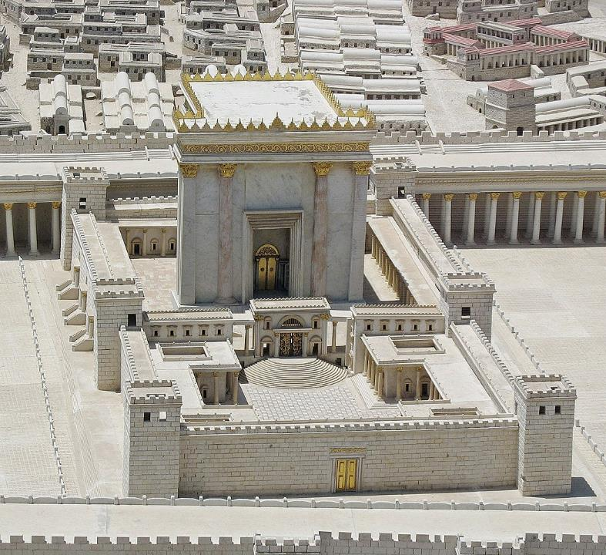
The 2nd Temple was the largest religious sanctuary in the ancient world.
This model shows the interior courts that were open only to Jews.
The priestly benediction normally would be made from the top of the half-circle of steps.

Slide 14
The Priestly Benediction (Sirach 50:19-21)
¹⁹ …as the people pleaded with the Lord Most High and prayed in the presence of the Merciful, until the service of the Lord was completed and the ceremony at an end.
²⁰ Then he [the priest] would come down and raise his hands over the whole assembly of the Israelites, to give them the Lord's blessing from his lips, being privileged to pronounce his name;
²¹ and once again the people would bow low to receive the blessing of the Most High.

Slide 15
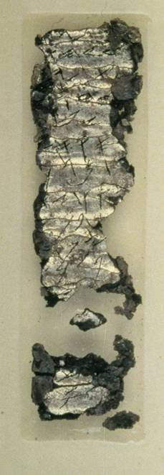
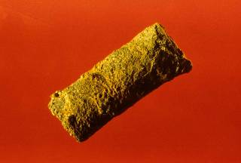
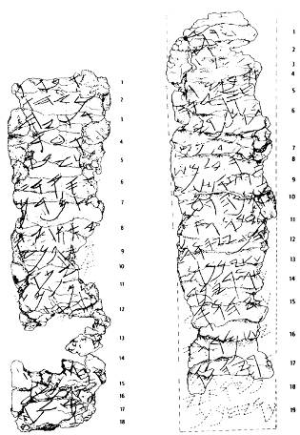
The Silver Amulet
Discovered in 1980 in a tomb dating to the end of the Judean monarchy, this 1” long roll of silver foil, when unrolled, revealed an inscription of the ancient priestly blessing in Nu. 6:
“May Yahweh bless you and watch over you. May Yahweh make his face shine upon you and grant you peace.”
This is the blessing Zechariah was supposed to pronounce but could not since he was now mute.
Israel Museum, Jerusalem

Slide 16
Discussion Points
How is a gospel different than a biography?
Why is the connection between John and Elijah significant?

Slide 17
In the sixth month, the angel Gabriel was sent from God to a city of Galilee named Nazareth, to a virgin betrothed to a man whose name was Joseph, of the house of David. And the virgin’s name was Mary. And he came to her and said, “Greetings, O favored one, the Lord is with you.”
And the angel said to her, “Do not be afraid, Mary, for you have found favor with God. And behold, you will conceive in your womb and bear a son, and you will call his name Jesus.”
And Mary said to the angel, “How will this be, since I am a virgin?” And the angel answered her, “The Holy Spirit will come upon you, and the power of the Most High will overshadow you; therefore, the child to be born will be called holy—the Son of God.”
^{Luke 1:26-35}

Slide 18
Angels
The OT word and NT word for angel (j`xAl;ma and a@ggeloj) means “messenger.” These spirit-beings are described as “winds” and “flames of fire” (Ps. 104:4//Heb. 1:7), servants who do God’s will (Ps. 103:21).
The fact that there are archangels (Jude 9) and that some are called “chief princes” (Da. 10:13) suggest that they have rank.
Only two angels are given names in the Old Testament, Michael and Gabriel (Da. 8:16; 10:13; Lk. 1:19; Rv. 12:7), though other names are found in the Apocrypha and Pseudepigrapha.
While angels are said to “fly” (Da. 9:21; Rv. 14:6), the popular imagery of all angels as having wings has only marginal support (two classes of angels, Seraphim and Cherubim, are described with wings, Is. 6:2; Eze. 1:5-6; 10:5).

Slide 19
The Annunciation to Mary (Lk. 1:26-38)
Six months later, Mary, a young girl engaged to be married to Joseph, was confronted by the angel Gabriel.
  The name of her son would be called Yeshua (Jesus in Greek; Joshua in Hebrew).
  In language parallel to the ancient promises, he would revive the long-hoped-for Davidic kingship (compare Lk. 1:32-33 with 2 Sa. 7:9, 13-14, 16).
  Mary responded to this annunciation with humility and faith.

Slide 20
Pattern of Jewish Marriage in the 1st Century
STAGE ONE: BETROTHAL
Usually arranged for the young woman (girl) between 12 and 12 ½ years of age
Parentally arranged
Gift of the Mohar (bride price) in the presence of witnesses
Betrothal was permanent; it could be broken only by divorce
STAGE TWO: HOMETAKING
Usually about a year after betrothal (sometimes longer)
Transfer of the bride from her parental home to her husband’s home
Wedding feast

Slide 21
The Striking Verbal Parallels
PROMISES ABOUT DAVID
2 Sa. 7:9, 13, 14, 16
PROMISES ABOUT JESUS
Lk. 1:32-33
a great name
the throne of his kingdom
he will be my son
your house and kingdom will endure forever
your throne will be established forever
he will be great
the throne of his father David
he will be called the Son of the Most High
he will reign over the house of Jacob forever
his kingdom will never end

Slide 22
Discussion Points
Knowing the likelihood that Mary was quite young at the time of the annunciation, what might this say to us about her level of faith at this early age?
Why is the virginal conception of Jesus so central to the Christian faith?
How likely is it that the residents in Nazareth accepted the story of the virgin birth, and what sort of stigma would Mary have carried if they did not?

Slide 23

THE BIRTH AND INFANCY NARRATIVES IN MATTHEW AND LUKE
Mary Visits Elizabeth; John is Born

Slide 24
At that time Mary got ready and hurried to a town in the hill country of Judah, where she entered Zechariah’s home and greeted Elizabeth. When Elizabeth heard Mary’s greeting, the baby leaped in her womb, and Elizabeth was filled with the Holy Spirit. In a loud voice she exclaimed: “Blessed are you among women, and blessed is the child you will bear! But why am I so favored, that the mother of my Lord should come to me? As soon as the sound of your greeting reached my ears, the baby in my womb leaped for joy. Blessed is she who has believed that what the Lord has said to her will be accomplished!”
^{Luke 1:39-45}

Slide 25
Mary Visits Elizabeth
After the annunciation, Mary went southward to Judea to stay with relatives, Elizabeth and Zechariah.
Elizabeth was now at the end of her second trimester.
When the two women met, the infant in Elizabeth’s womb “leaped for joy,” and Elizabeth was now filled with the Holy Spirit and greeted Mary:
Blessed [are] you among women,
And blessed [is] the fruit of your womb.
But why am I so favored that the mother of my Lord should come to me?

Slide 26
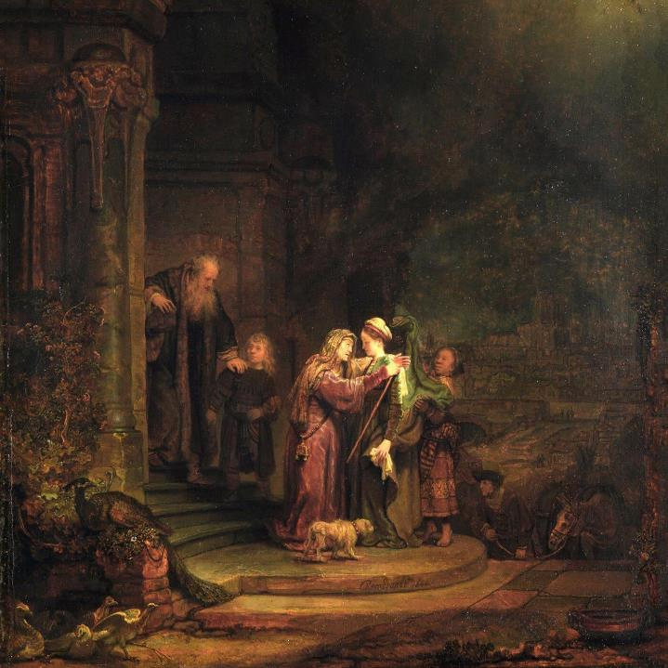
“The Visitation” by Rembrandt
(Detroit Institute of Arts)
Rembrandt sought to capture the moment when “the babe leaped in my womb for joy.”
The face of Elizabeth is reminiscent of the artist’s mother, who died in 1640, just as his wife was about to give birth.

Slide 27
Kyrios (ku<rioj), Luke’s Favorite Title
Appearing some 219 times in Luke-Acts, the title Kyrios, used by Elizabeth, is Luke’s favorite.
This is the term normally used for the translation of the Hebrew name hvhy (Yahweh) into Greek from the Hebrew Bible.
It is striking that Elizabeth uses this title, “the mother of my Lord,” so very early, implicitly suggesting that even in his prenatal state, Jesus was the complete Master of all.
Indeed, this is why in Medieval Art, the infant Jesus is often depicted with a halo and sometimes with the face of an aged person, an icon representing eternal wisdom and knowledge.

Slide 28
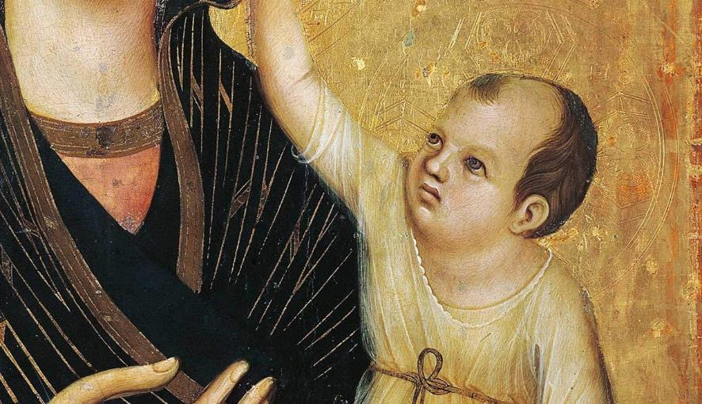
In the Madonna and Child by Duccio di Buoninsegna (1283-84), the infant Jesus appears with the face of a grown man. Such religious iconography was common and intended to make a theological statement.
The Web Gallery of Art, Washington, D.C.

Slide 29
Theotokos
One of the important titles for Mary in the early church, beginning in the 3rd century, was Theotokos (Qeoto<koj), meaning “God-bearer.”
This title was officially accepted at the 3rd Ecumenical Council in Ephesus (AD 431).
While the terms “God-bearer” and “Mother of God” are sometimes used interchangeably, there is a subtle theological difference between them, the first describing Mary as the object of special grace and the second implying that she is to be worshipped as co-redeemer.

Slide 30
As Jesus was saying these things, a woman in the crowd called out, “Blessed is the mother who gave you birth and nursed you.” He replied, “Blessed rather are those who hear the word of God and obey it.”
^{Luke 11:27-28}

Slide 31
Discussion Points
In early Christianity, Mary is given the title Theotokos, which means, “God-bearer” (3rd Ecumenical Council at Ephesus, AD 431). What might early Christian leaders have been trying to emphasize by using this title?
Why do you think Jesus responded in the way he did to the woman who called out a blessing upon his mother?

Slide 32
The Magnificat (Lk. 1:46-55)
Four early Jewish-Christian canticles became part of the liturgical tradition of the early church (the Magnificat, the Benedictus, the Gloria in Excelsis Deo, and the Nunc Dimittis).
The Magnificat, the Song of Mary, is the first, and it deliberately draws from the language and imagery of the ancient Son of Hannah (1 Sa. 2:1-10) as well as the prophets and Hebrew Psalter.
In this poem, Mary considers herself to be the object of God’s salvation in which she joyfully acclaims “God my Savior.”

Slide 33
Counter-Cultural Divine Titles and Acclamations
LORD ku<rioj
Common 1st century acclamation for Caesar Augustus
SAVIOR swth<r
Acclaimed for Caesar, “benefactor of the world”
EPIPHANEIA e]pifa<neia
Appearance of a god (also used of Caesar)
MAKARIA ELPIS maka<ria e]lpi<j
The “blessed hope,” acclaimed for Caesar
PHILANTHROPIA filanqrwpi<a
Love for humanity (also used to extol Caesar)
CHRESTOTES xrhsto<thj
Kindness (used to extol Caesar’s benevolence to the world)

Slide 34
And Mary said: “My soul praises the Lord and my spirit rejoices in God my Savior, for he has been mindful of the humble state of his servant.
For now on all generations will call me blessed, for the Mighty One has done great things for me—holy is his name.”
^{Luke 1:46-49}

Slide 35
The Great Reversal
The Magnificat heralds a great reversal, and this reversal is expressed in socio-political categories:
The reversal will benefit “those who fear him [God],” which in turn depends on the prophets’ vision of a remnant of faith.
The proud, the ruling class, and the wealthy stand in sharp contrast to the humble and the hungry—language that anticipates Jesus’ words in the Sermon on the Mount (Lk. 6:20-26).
Most important, the reversal is a fulfillment of the ancient covenant promises to Abraham.

Slide 36
The Four Jewish-Christian Canticles
The four “songs” (poems) punctuate the birth stories, all of them focusing on promise-fulfillment in the transition between the Old Testament and the New Testament. The titles all derive from the Latin Vulgate, and they all appear in the Anglican liturgical tradition.
MAGNIFICAT (“Magnifies…” Lk. 1:46-55)
Mary’s song used in Evening Prayer (1928 BCP page 26).
BENEDICTUS (“Blessed be…” Lk. 1:68-79)
Zechariah’s song used in Morning Prayer (1928 BCP page 14).
GLORIA IN EXCELSIS DEO (“Glory to God in the Highest” Lk. 2:14)
The angels’ song used in Evening Prayer (1928 BCP page 25).
NUNC DIMMITUS ( “Now dismiss…” Lk. 2:29-32)
Simeon’s Song used in Evening Prayer (1928 BCP page 28).

Slide 37
Discussion Points
Mary’s Song speaks of the great reversal. Has this been accomplished yet?
Why do you think the four prophetic speeches are all given in the form of poetry? What does poetry accomplish that might not be the same for prose?

Slide 38
The Birth and Naming of John (Lk. 1:57-66)
When the child was born, the attending relatives assumed he would be named after his father.
Elizabeth, however, said he was to be called John.
When they appealed to Zechariah, he requested a wax tablet upon which he wrote: Nn!HOy4 Omw; (= “His name [is] John”).
Instantly, Zechariah’s speech returned, and filled with the Holy Spirit, he uttered a prophetic praise for God’s fulfillment of his ancient promises.

Slide 39
The Benedictus (Lk. 1:67-79)
Zechariah’s “song” falls into two parts, the first celebrating God’s fulfillment of the messianic promise (given in the 3rd person), and the second addressing the future role of the newborn son (given in the 2nd person).
Like Mary’s Song, some of the language is in the past tense, not because it has all happened already, but to denote the certainty of fulfillment and that the fulfillment has already begun.
John’s role was to be a prophetic forerunner to prepare the way for the advent of the Lord.

Slide 40
Critical Vocabulary
A number of important words/phrases punctuate Zechariah’s Song, all drawing from the Old Testament.
“He has redeemed his people” (Redemption carries the idea of reclaiming something, usually by buying it back.)
“A horn of salvation” (The horn is a common Old Testament metaphor for strength or power.)
“The oath he swore to our father Abraham” (The oath recalls God’s unbreakable promise, Ge. 12:1-3; 22:15-18; He. 6:16-18.)
“The forgiveness of sins” (The new covenant heralded by Jeremiah promised that God would “remember their sins no more,” Je. 31:34b.)

Slide 41
John, the Forerunner
John’s role would be to prepare the way for the coming Messiah.
Like the voice in the desert that called the Israelites home from Babylonian exile (Is. 40:3), John would call Israel back to God.
He would be the “messenger” preparing the way (Mal. 3:1), and he would fulfill the prediction of the coming of Elijah (Mal. 4:5-6), for he would come in the spirit and power of Elijah (Lk. 1:17; cf. Mt. 17:12-13).

Slide 42
THE BIRTH AND INFANCY NARRATIVES IN MATTHEW AND LUKE
The Genealogies

Slide 43
Remember Jesus Christ, raised from the dead, descended from David. This is my gospel…
^{2 Timothy 2:8}
…the gospel he [God] promised beforehand through his prophets in the Holy Scriptures regarding his Son, who as to his human nature was a descendant of David…
^{Romans 1:3}
Does not the Scripture say that the Christ will come from David’s family…?
^{John 7:42}
All the people were astonished and said, “Could this be the son of David?”
^{Matthew 12:23}
The crowds that went ahead of him and those that followed shouted, “Hosanna to the Son of David! Blessed is he who comes in the name of the Lord!”
^{Matthew 21:9}

Slide 44
Family Pedigrees
Family pedigrees were extremely important in the Jewish world of the 1st century. In the return from Babylonian exile, the people had been categorized as:
Pure Israelites with verifiable genealogies (Ezr. 2:3-20).
Those with unclear status (2:59-63)
The most important family in Judah was the family of David, since the messianic hope was linked to this family. Hence, the New Testament begins with: “A record of the genealogy of Jesus Christ the son of David…”

Slide 45
The “First” and the “Last” In Jewish Society
  One of Jesus’ famous repeated sayings was, “There are those who are last who will be first, and the first who will be last” (Lk. 13:30; cf, Mk. 9:35; 10:31; Mt. 20:16). Various lists would later appear in the Jewish Mishnah ranking people from “first” to “last” based on racial purity.
The “First”
Priests and Levites
The Lay Nobility
Scribes
Pharisees
Israelites
Pure ancestry
Those with despised trades
Slaves
Those with slight pedigree blemishes
Proselytes
Bastards, eunuchs, foundlings
The “Last”
Samaritans
Gentiles

Slide 46
The Genealogies of Jesus
Two gospels, Matthew and Luke, offer genealogies of Jesus (Mt. 1:2-17; Lk. 3:23-38).
The immediate problem is that they are not the same.
They match between Abraham and David, but after David they seem to follow two branches of the family, Matthew following Solomon (2 Sa. 12:24) and Luke following Nathan (2 Sa. 5:14).

Slide 47
Matthew | 1 Chronicles | Luke
1st Set of 14 Generations
 |  | Adam to Abraham
Abraham | Abraham | Abraham
Isaac | Isaac | Isaac
Jacob | Israel | Jacob
Judah | Judah | Judah
Perez | Perez | Perez
Hezron | Hezron | Hezron
Ram | Ram | Ram
Amminadab | Amminadab | Amminadab
Nahshon | Nahshon | Nahshon
Salmon | Salma or Salmon | Salmon or Sala
Boaz | Boaz | Boaz
Obed | Obed | Obed
Jesse | Jesse | Jesse
David | David | David
IDENTICAL BETWEEN ABRAHAM AND DAVID; LUKE CARRIES THE GENEALOGY BACK TO ADAM

Slide 48
Matthew 1 Chronicles Luke
2nd Set of 14 Generations
Solomon ben David | Solomon ben David | Nathan ben David
Rehoboam | Rehoboam | Mattatha
Abijah | Abijah | Menna
Asa | Asa | Melea
Jehoshaphat | Jehoshaphat | Eliakim
Joram | Joram | Jonam
Uzziah (Ahaziah) | Ahaziah (Uzziah) | Joseph
 | Joash | Judah
 | Amaziah | Simeon
 | Azariah | Levi
Jotham | Jotham | Matthat
Ahaz | Ahaz | Jorim
Hezekiah | Hezekiah | Eliezer
Manasseh | Manasseh | Joshua
Amon | Amon | Er
Josiah | Josiah | Elmadam
 | Jehoiakim | Cosam
Jeconiah (Jehoiachin) | Jeconiah (Jehoiachin) | Addi
MATTHEW AND LUKE DIVERGE;
MATTHEW ABRIDGES SOME NAMES

Slide 49
3rd Set of 14 Generations
 |  | Melki
 |  | Neri
Shealtiel | Pedaiah | Shealtiel
Zerubbabel | Zerubbabel | Zerubbabel
Abiud | Hananiah | Rhesa
Eliakim | Shecaniah | Joanan
Azor | Neariah | Joda
Zadok | Elioenai | Josech
Akim |  | Semein
Eliud |  | Mattathias
Eleazar |  | Maath
Matthan |  | Naggai
Jacob |  | Esli
 |  | Nahum
 |  | Amos
 |  | Mattathias
 |  | Joseph
 |  | Jannai
 |  | Melki
 |  | Levi
 |  | Matthat
 |  | Heli
Joseph/Mary |  | Joseph
Jesus |  | Jesus
MATTHEW INCLUDES MARY; LUKE INCLUDES JOSEPH “SO IT WAS THOUGHT”

Slide 50
Distinctive Features of Luke’s Genealogy
Luke traces Jesus’ ancestry all the back to Adam.
This indicated that Jesus was a real human being and that he was related to the entire human race.
However, he also describes Adam as the “son of God” (3:38), which in turn implies that just as Adam was the beginning of the original creation, Jesus was the beginning of a new creation and order for humanity.

Slide 51
Distinctive Features of Matthew’s Genealogy
Matthew arranges the genealogy of Jesus into three sets of 14 generations each.
He even abridges the genealogies of the Old Testament in order to achieve the 14 names in each set.
Clearly, this number is highly significant, and he climaxes his genealogy with the statement, “Thus there were fourteen generations in all from Abraham to David, fourteen from David to the exile to Babylon, and fourteen from the exile to the Christ” (1:17).

Slide 52
Discussion Points
Modern people trace their ancestries through search vehicles like 23 and Me, CRI Genetics, and Ancestry. How do the concerns of ancient Jewish ancestry compare with modern ones?
Why was the ancestry of Jesus so important to early Christians.
With respect to Jewish concerns about racial purity, what did John the Baptist mean when he said, “Do not think you can say to yourselves, ‘We have Abraham as our father.’ I tell you that out of these stones God can raise up children to Abraham.”

Slide 53
The Method in Matthew’s Madness
Matthew’s three symmetrical groups of 14 generations each (1:17):
The reasoning behind the number 14 is not immediately clear to the modern reader, but if Matthew was using the Jewish technique of gematria (adding together the numerical values of the alphabetical letters), then the name David spells out the number 14.
In the final group, either Matthew counts a name twice (i.e., David or Jeconiah) or else he includes Mary’s name.

Slide 54
GEMATRIA symbolically expressing an idea through the numerical value of alphabetic letters
d-v-d (D-V-D) = David
(spelled in ancient Hebrew without vowels)
Each alphabetic letter stood for a number prior to the development of Arabic numbers
D = 4 (4th letter of the Hebrew alphabet)
V = 6 (6th letter of the Hebrew alphabet)
D = 4 (4th letter of the Hebrew alphabet)
The combined value of the letters in the name David is 14.

Slide 55
Critical Junctures
In Matthew’s Genealogy
The junctures between the three sets of 14 generations demarcate the ancient covenants.
Abraham, who heads the first set, was given the original covenant that all the earth’s families would be blessed through his posterity (Ge. 12:1-3).
David, who heads the second set, was given the covenant promise that his throne would be established forever (2 Sa. 7:16).
Jeconiah (Jehoiachin), who heads the third set, carried the Davidic covenant promise into Babylonian exile.

Slide 56
Joseph, Jesus’ Legal Father
Jewish ancestry shifted from patrilineal to matrilineal in the mid-1st century.
However, at the time of Jesus’ birth his ancestry would have been reckoned through Joseph, his legal father, which seems to be the ancestry Matthew traces.
However, Matthew is equally clear that Jesus was born “from Mary.” The phrase e]c h$j e]gennh<qh ]Ihsou?j (= “out of whom was born Jesus”) uses the feminine relative pronoun h$j, which could refer only to Mary, not Joseph.
All the verbal forms in the genealogy are aorist active verbs (e]ge<nnhsen) until the birth of Jesus, but here Matthew shifts to an aorist passive form (e]gennh<qh), leaving the father unnamed.

Slide 57
“…who is called Christ.” (Mt. 1:16b)
The titles “Messiah” and “Christ” are the same.
The ancient Hebrew title HaywimA (= messiah, the anointed), which was used of priests and kings throughout the OT, by the intertestamental period had come to refer to the Coming One promised by the prophets.
The corresponding Greek title in the LXX was Xristo<j (= Christ, the anointed), and this was carried over into the NT.

Slide 58
The Women in Jesus’ Genealogy
In a patriarchal society, it was unusual to have a woman’s name in a genealogy. Matthew has no less than four of them.
Tamar, a Canaanite (Ge. 38:2, 6)
Rahab, a Canaanite (Jos. 2:1)
Ruth, a Moabitess (Ru. 1:4)
Bathsheba, the wife of a Hittite and presumably a Hittite herself (2 Sa. 11:3)
The fact that all four of these women seem to be non-Jewish anticipates Matthew’s ultimate theme that the message of Jesus was for the nations (Mt. 28:19).

Slide 59
Irregularities
In the case of all four women, there were irregularities.
Tamar who had been deprived of her levirate rights, seduced her father-in-law, and gave birth to Perez and Zerah (Ge. 38:6-30).
Rahab was a prostitute at Jericho, but she was spared because she hid the spies (Jos. 2:1).
Ruth gave birth to a son through levirate marriage (Ru. 3:2, 9; 4:9-13).
Bathsheba was seduced by David and later became his wife, bearing to him Solomon (2 Sa. 11:2-27; 12:24).
All four women were outside the normal patriarchal structures of ancient society, yet all four were brought under God’s protection.

Slide 60
Discussion Points
Matthew’s Gospel seems to be written to the Jewish community, whereas Luke’s Gospel seems to be written to the Gentile community. How do these two audiences shape the way the evangelists tell the story of Jesus birth?
It has been a long-standing tradition of English Bible translation to render the word “messiah” in the OT as “the anointed.” Why might the translators have adopted this approach?
Why do you think Matthew included the four women in his genealogy, and what might be the significance of their back-stories and irregularities?

Slide 61
THE BIRTH AND INFANCY NARRATIVES IN MATTHEW AND LUKE
The Virginal Conception of Jesus

Slide 62
The First Gospel
Matthew is listed first among the four gospels as far back as we can trace it.
An early treatise in Syriac describes a conference in Rome in AD 119 in which the title “according to Matthew” was accepted.
The Muratorian Fragment, the earliest canon list (ca. AD late 2nd century), is damaged at the top, but it lists Luke as the “third” and John as the “fourth” gospel. Presumably, “Matthew” and “Mark” were the first and second, and this order has been followed by the various early church fathers.
In all other early canon lists, Matthew is listed first.
Matthew is an admirable bridge between the Hebrew Bible and the New Testament, since Matthew seems to have been composed with a sustained interest in portraying Jesus in the context of Judaism.

Slide 63
Matthew the Apostle…
His Greek name Matthaios is a transliteration of the Aramaic matta’y deriving from the noun mattan (= gift).
Both Mark and Luke, in parallel accounts, give his name as Levi bar Alphaeus (Mk. 2:14; Lk. 5:27, 29).
Perhaps, “Matthew” was his Christian nickname while “Levi” was his given name.
He held the position of a local official responsible for customs on commercial traffic transported through Capernaum on the Damascus-Palestine road (Mt. 9:9; 10:3).
He probably was not well-liked by his fellow Jews, because he would have been perceived as a collaborator.
Presumably, he was reasonably well-to-do, since he staged a large dinner party for Jesus (Lk. 5:29).
He was chosen by Jesus as one of the Twelve.

Slide 64
Matthew’s Use of the Old Testament
Matthew’s Gospel contains over sixty explicit quotations from the Old Testament (usually from the LXX) as well as many more allusions.
A favorite term he uses is plhro<w (= fulfill, fill, make full, bring to completion).
His usage, however, suggests much more than simply prediction and verification:
  He does not depend strictly upon a historical-grammatical reading of the texts.
  Rather, he often develops a sensus plenior (= deeper sense meaning) which includes the clarification of enigmatic passages (cf. 22:41-46) and the recapitulation of Old Testament events in the life of Jesus along the lines of typology (cf. 2:17-18).
  Most important, he sees a link between the Israelite nation and Jesus so that Jesus was in every way the “true” Israel, i.e., Jesus fulfilled what Israel was intended to be but never became (cf. 2:15; 3:17; 17:5).

Slide 65
The story of Israel is fulfilled in the story of Jesus…
…Jesus, called out of Egypt (Mt. 2:14-15; Ho. 11:1)
…Jesus, who passed through the waters and was tempted in the desert (Mt. 3:16—4:2; Dt. 8:3; 6:13)
…Jesus, the anointed Servant of Yahweh (Mt. 3:17; 42:1)
…Jesus, the prophet like Moses (Mt. 5-7; Dt. 18:18)
…Jesus, the Shepherd of Israel struck down (Mt. 26:31; Zec. 13:7)
…Jesus, betrayed by Israel’s leaders (Mt. 26:55-56)
…Jesus, the Servant of Yahweh given over to suffering and death (Mt. 26:53-56; Is. 53)

Slide 66
…Jesus, the one who suffered exile on the cross (Mt. 27:46; Ps. 22:1; La. 3:1-20)
…Jesus, whose resurrection is the triumph of God over the world’s kingdoms (Mt. 26:63-64; Da. 7:13-14, 27)
…Jesus, whose resurrection is the epitome of vindication and restoration (Mt. 27:51-53; 28:5-7; Is. 26:19; Eze. 37:1-4)
…Jesus, the one at God’s right hand who receives full authority over all things (Mt. 28:18; Ps. 110:1)
All that Moses and the prophets have said are fulfilled in Jesus! (Mt. 5:17-18)

Slide 67
Discussion Points
Occasionally, you may hear someone express the viewpoint that Christians no longer need the Old Testament. How would you respond to this idea?
What do you think of Matthew’s retelling the story of Israel in the story of Jesus?

Slide 68
This is how the birth of Jesus Christ came about. His mother Mary was pledged to be married to Joseph, but before they came together, she was found to be with child through the Holy Spirit. Because Joseph was a righteous man and did not want to expose her to public disgrace, he had in mind to divorce her quietly.
^{Matthew 1:18-19}

Slide 69
The Virginal Conception of Jesus (Mt. 1:18-23)
Matthew’s account of the virginal conception of Jesus is told from the viewpoint of Joseph, Jesus’ legal father.
The expression “virginal conception” is more in keeping with Matthew’s narrative, since here he does not yet describe Jesus’ birth.
Between the betrothal and the home-taking, he discovered that Mary was pregnant, he knew not how.

Slide 70
Joseph’s Options
If Pregnancy by Seduction:
If provable, the Torah pronounced a sentence of public exposure or execution (Dt. 22:13-21, 23-24)
If Pregnancy by Rape
If seduction could not be proved, the man was sentenced to execution but the woman was given the benefit of the doubt and exonerated (Dt. 22:25-27); however, divorce (dissolving the betrothal) still was the usual course of action.
The verbs deigmati<sai (= publicly expose) and la<qra a]polu?sai (= secretly divorce) suggest Joseph considered both options but chose the second, sparing Mary the worst.

Slide 71
The Angel of the Lord
In the Old Testament, the Angel of the LORD is a figure who speaks both for God and as God (Ge. 16:11; 21:17; Ex. 3:2-4).
Addressing Joseph as a “son of David,” the angel reassured him and directed him not to hesitate to complete the home-taking of Mary as his wife.
The conception of the child was “through the Holy Spirit.”
In obeying this directive, Joseph would have taken upon himself the stigma of illegitimacy that Mary also had to bear.
Indeed, various ancient sources, including Rabbinic tradition, would contend that Jesus was illegitimate.

Slide 72
The Ancient Creeds
All the statements of faith in the early Christian church agree that Jesus “was born of the virgin Mary.”
The earliest statements were baptismal confessions, such as, those contained in the “Rule of Faith.”
These same statements were incorporated into the earliest creeds, such as, the Apostles’ Creed and the Nicene Creed.

Slide 73
As a baptismal confession…
“Do you believe in God, the Father Almighty?”
“Do you believe in Christ Jesus, the Son of God, who was born by the Holy Spirit of the virgin Mary, and was crucified under Pontius Pilate, and was dead and buried, and rose again the third day, alive from the dead, and ascended into heaven, and sat down at the right hand of the Father, and will come to judge the living and the dead?”
“Do you believe in the Holy Spirit, in the holy church, and the resurrection of the body?”
Hippolytus (early 3rd century)

Slide 74
A Central Christian Theology
Since the beginning of Christianity, the virgin birth of Jesus has been considered a theological essential.
Denial of the virgin birth would be a significant departure from the historic faith of the church.
Non-classical Christians have sometimes expressed skepticism in this regard, but to do so is to put oneself at a distance from historic Christianity.

Slide 75
Discussion Points
The virginal conception of Jesus is a biological mystery. Is it necessary to fully understand a miracle in order to accept it?
Today, it is common to accept the idea that we live in a closed universe, which is to say, a universe closed to anything but natural processes. How does the Christian faith differ from this point of view?
What sorts of things do you think belong “in the center” of the Christian faith—the sorts of things that one cannot do without and remain fully Christian?

Slide 76
All this took place to fulfill what the Lord had said through the prophet: “The virgin will be with child and will give birth to a son, and they will call him Immanuel” – which means, “God with us.”
^{Matthew 1:18-19 (cf. Is. 7:14)}
She [Mary] will give birth to a son, and you are to give him the name Jesus, because he will save his people from their sins.
^{Matthew 1:21}

Slide 77
The Name ]Ihsou?j (Jesus)
Common Jewish 1st century name
A form of the Old Testament name Joshua:
  Iesous (Greek)
  Yeshua (Aramaic)
  Yehoshua (Hebrew)
Combines the short form of the name Yahweh (Yah) with the hiphil verb hoshi’a (= to save) and means “Yahweh saves” or “Yahweh is salvation.”

Slide 78
Syro-Ephraimite Alliance (Isa. 7)
Pekah’s assassination of Pekahiah, Menahem’s son, in the 8th century BC resulted in Assyrian reprisals, since Pekahiah was an Assyrian vassal (2 Kg. 15:29).
In response to this threat, Israel (Ephraim) and Aram (Syria) formed a political alliance.
Pekah and Rezin, their respective kings, intended to force Ahaz of Judah to join them (2 Kg. 15:37; 16:5).
They threatened to depose Ahaz and install a puppet king of their own, a certain Ben-Tabe’el (7:2, 5-6).
When Ahaz went to check the city’s water supply, Yahweh instructed Isaiah to confront him there.

Slide 79
The Immanuel Sign (Isa. 7:10-17)
Yahweh invited Ahaz to ask for a sign to confirm God’s promise of security, but Ahaz, in a gesture of pseudo-humility, refused.
God gave him a sign anyway: a virgin would give birth to a son, naming him Immanuel (= God with us).
Before the child would be old enough to make his own moral decisions, the lands of Aram and Israel would be wiped out.
The name “God with us” was a reflection of God’s promise to protect Judah—if Ahaz would only trust him.

Slide 80
The “Virgin” (Isa. 7:14)
Because this passage is quoted in Matthew (1:23), considerable discussion has arisen over the translation of the word hmAl;fa(= young woman).
Most Old Testament occurrences of the word seem to refer to an unmarried young woman with the strong presumption that she was a virgin at the time she was described. The LXX made this explicit by using the term parqe<noj (= virgin).
Some translations render it “virgin” out of deference to the New Testament citation based on the LXX (so KJV, ASV, NIV, NAB, NASB, ESV, CEV, etc.).
Other translations render it more directly as “young woman” by its basic Hebrew meaning (so RSV, NRSV, NEB, JPS, NET).

Slide 81
The Link with Isaiah’s Sign-Child
Matthew saw a connection between this prophecy given by Isaiah and the birth of Jesus.
The LXX rendering of the word hmAl;fa as “virgin” (parqe<noj) was significant to Matthew.
It fit perfectly with his larger goal of presenting Jesus as the embodiment of the true Israel, especially the name Immanuel.
This instance of history repeating itself made “full” the ancient sign of the child to be born.
Just as the child born in the 8th century BC was a sign to Ahaz of God being present, so the child born to Mary was a sign that God was present in the birth of Jesus.

Slide 82
THE BIRTH AND INFANCY NARRATIVES IN MATTHEW AND LUKE
The Nativity

Slide 83
The Setting (Lk. 2:1-3)
Luke sets the background for the birth of Jesus in its Roman context.
He specifically mentions a census during the emperorship of Augustus Caesar, indicating that it was linked to the tenure of Quirinius in Syria.
While a census was not the same as taxation, it certainly was a prelude to taxation.
Quirinius is a known figure from ancient texts, and he assumed office in AD 6.

Slide 84
The Historical Problem of Quirinius
The census during the tenure of Quirinius’ as governor of Syria, which is known to be in AD 6 after Archelaus was deposed, turns out to be problematic. Herod, who was king in Matthew’s gospel at the birth of Jesus (1:5; cf. Mt. 2), died in 4 BC.
SOLUTION 1: Some suggest that Quirinius may have served two terms, the known tenure beginning in AD 6 but an earlier tenure around 4 BC. Ancient records, however, show nothing of such a double tenure.
SOLUTION 2: The Greek term prw<th (= first) is taken to indicate some census prior to Quirinius.
SOLUTION 3: Historical-critical scholars say Luke was simply mistaken in his historical notation about Quirinius.
SOLUTION 4: Luke is taken to be historical, Matthew as symbolic (but not historical).
To date, there has been no satisfactory resolution to this problem.

Slide 85
The Year of Jesus’ Birth
If we take Matthew’s reference to Herod the Great as historical, then the year of Jesus’ birth would be between 6 BC and 4 BC.
Herod is known to have died in 4 BC, so Jesus’ birth must have been prior to Herod’s death (Mt. 2:1-18).
It does not fall on the zero point between BC and AD due to miscalculations of Dionysius Exiguus in the 6th century AD, who invented the BC/AD dating system.

Slide 86
The Day of Jesus’ Birth
Since the beginning of the 3rd Century, Christians have celebrated the birth of Jesus on December 25th.
Unfortunately, this date cannot be verified other than through ancient tradition.
Sometimes it is argued that Jesus’ birth could not have been on this date, since in the winter shepherds would not be tending sheep in open country. However, this argument is not conclusive, since the Mishnah indicates that sacrificial flocks were indeed kept outside all year long in the vicinity of Bethlehem.

Slide 87
The Birth of Jesus (2:1-20)
The birth of Jesus occurred during a trip from Galilee to Joseph’s ancestral home in Judah to register for Roman taxation.
The earliest Christian traditions indicate that Jesus was born in a cave (Protoevangelium of James, 18-19; Justin Martyr’s Dialogue with Trypho, LXXVIII).
The angelic message to the Bethlehem shepherds included three highly important titles:
  Swth<r (= Savior, a widely used title for the Roman emperor)
  Xristo<j (= Messiah, the anointed, the king from David’s family)
  Ku<rioj (= Lord, the standard LXX rendering of the name Yahweh)

Slide 88
But when the Child was born in Bethlehem, since Joseph could not find a lodging in that village, he took up his quarters in a certain cave near the village…
Justin Martyr, Dialogue with Trypho, LXXVIII (AD 155-160)
And he [Joseph] found a cave there, and led her [Mary] into it…
Protoevangelium of James 1:18-19 (ca. AD 150)

Slide 89
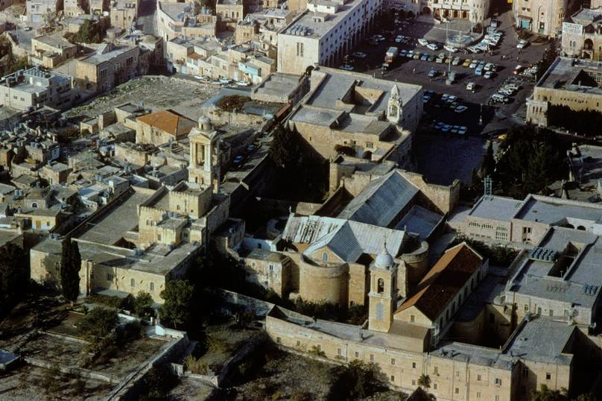
Church of the Nativity, Bethlehem

Slide 90
Non-Biblical Traditions
Several non-biblical traditions, some old and some not so old, have arisen concerning Jesus’ birth.
A manger is a feed trough, not a barn.
An English-style stable is highly unlikely. We do not know if animals were in attendance (much less a drummer boy).
Angels appeared to shepherds, but not at the birth site.
Angels praised God, but we do not know that they “sang.”
The magi seem not to have visited the birth site. Rather, they came to a house (Mt. 2:11).
We do not know how many magi there were. The number “three” is usually derived from the three types of gifts.

Slide 91
Discussion Points
How should we treat unresolved issues like the conflict between the census by Quirinius (AD 6) and the death of Herod (4 BC)?
Would it make any difference if the day of Jesus’ birth turned out to be something other than December 25th?
How should we regard non-biblical traditions that arise concerning biblical stories?

Slide 92
The angel said to them, “Do not be afraid. I bring you good news [eu]aggeli<zw = to announce the gospel] of great joy that will be for all the people. Today in the town of David a Savior has been born to you; he is Christ the Lord.”
^{Luke 2:10-11}

Slide 93
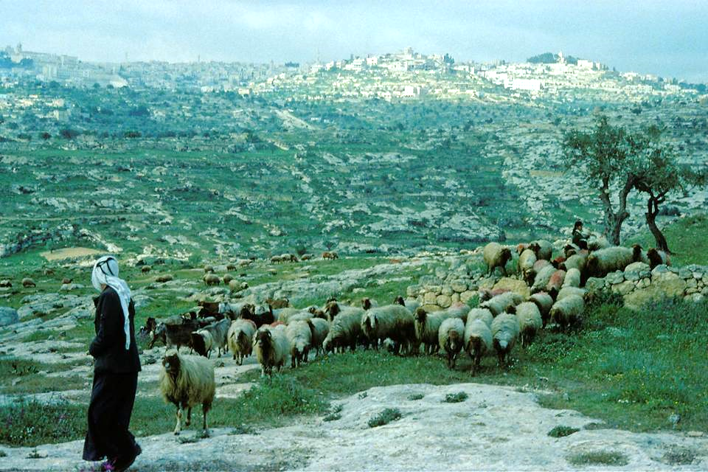
Bethlehem

Slide 94
The Shepherds (2:8-20)
Shepherds were near the bottom of the social and economic scale in 1st century Judea.
They were considered to be lax in their observance of the niceties of ceremonial law.
They were not trusted to give testimony in court.
The announcement of Jesus’ birth to shepherds was a prelude to his later outreach to the poor.
As in the Magnificat, the titles Lord and Savior were loaded vocabulary, since they were current titles for the Caesar in Rome.

Slide 95
The Heavenly Host
The most frequent compound name for God in the Old Testament is Yahweh Tsabaoth (tOxbAc; hv!hy4).
It is the plural form of tsaba, meaning “army”; hence, Yahweh Tsabaoth means “LORD of armies,” and the “hosts of heaven” refer either to the stars (cf. Dt. 4:19) or more generally to the angelic armies of the heavenlies (cf. Jos. 5:15).
While often it carries a militaristic nuance, it also comes to refer to the vast array of celestial beings attending God.
The “multitude of the heavenly host” appeared to the shepherds announcing the incarnation of their Creator, God, the Son, through whom God created all things, both visible and invisible (cf. Col. 1:16).

Slide 96
The Announcement of Peace
In the Gloria in Excelsis Deo, the angels announced peace on earth.
Once again, Luke uses loaded vocabulary.
The Caesars claimed and defended the Pax Romana (Peace of Rome), but it was a peace maintained by the empire’s armies, an external peace based on a political foundation.
The announcement of the angels concerned a peace toward those whom God favored, and there is no hint of a political context.

Slide 97
At the Manger
The shepherds are the only people in the biblical story to visit the infant Jesus in the manger with Mary and Joseph.
After seeing the baby, they told everyone what they had seen, and all who heard their report were amazed.
Mary, for her part, treasured all these things in her heart.
It seems most likely that Luke’s narrative of the birth of Jesus and the surrounding events would have come to him from Mary herself, part of his careful background investigation (cf. Lk. 1:3).

Slide 98
Amazement
Luke’s vocabulary of amazement is rich and plentiful:
  qauma<zw = to marvel (1:21, 63; 2:18, 33; 4:22; 8:25; 9:43; 11:14, 38; 20:26; 24:12, 41)
  e]kplh<ssomai = to be amazed (2:48; 4:32; 9:43)
  e]ci<sthmi = to be astounded (2:47; 8:56; 24:22)
  e]ksta<sij = bewilderment (5:26)
  qa<mboj = wonder (4:36; 5:9)
  fobe<w = to be afraid (2:9; 8:25, 35; 9:34, 45)
  fo<boj = fear (1:12, 65; 2:9; 5:26; 7:16; 8:37)
  a]pore<w = to be at a loss (24:4)

Slide 99
Discussion Points
Why do you think God especially intended the gospel to be for the poor?
Do you think that in the modern world God still interacts with people through angels?
Since God created all things through the Son, both visible and invisible, put yourself in the guise of angels. What might have been in their minds at the birth of Jesus? Compare this with 1 Peter 1:12b.
At the birth of Jesus, God chose an unremarkable couple, shepherds, and the village of Bethlehem. Where and under what circumstances might God have chosen if the incarnation should have happened in the 21st century?

Slide 100
THE BIRTH AND INFANCY NARRATIVES IN MATTHEW AND LUKE
The Dedication

Slide 101
A woman who becomes pregnant and gives birth to a son will be ceremonially unclean for seven days… On the eighth day the boy is to be circumcised. Then the woman must wait thirty-three days to be purified from her bleeding. She must not touch anything sacred or go to the sanctuary until the days of her purification are over.
^{Leviticus 12:2-4}
On the eighth day, when it was time to circumcise him, he was named Jesus, the name the angel had given him before he had been conceived. When the time of their purification according to the Law of Moses had been completed, Joseph and Mary took him to Jerusalem to present him to the Lord.
^{Luke 2:21-22}

Slide 102
Purity & Impurity
(Lv. 11-15)
The basic premise behind the impurity laws is that God is holy, and therefore, his people must prepare themselves to enter his presence.
Diet (11)
Childbirth (12)
Infectious diseases and mildew (13-14)
Bodily discharge (15)

Slide 103
The Impurity System
Persons and objects can contract impurity in one of two ways
Firsthand (from an internal source)
Genital discharge
Scale disease contamination
Secondhand (from an external source)
Ritual contamination
Carcass contamination
Corpse contamination
Significantly, ritual impurity does not in itself include any punishments for becoming impure unless a person brings his/her impurity into contact with the sanctuary. Rather, impurity temporarily restricts the person or object from coming into contact with the sacred (Lv. 22:3).

Slide 104
Purification
Purification of Objects
Some objects can be purified by ablution and waiting until evening (wood, cloth, hide).
Some objects require more vigorous ablutions and waiting until evening (gold, silver, bronze, copper)
Some objects cannot be purified but must be destroyed (earthenware, carcasses, moldly cloth)
For more serious purification, burning is sometimes required.
Purification of Persons (consists of two primary elements)
Waiting a period of either one or seven days
Ablutions (ritual washing with water)

Slide 105
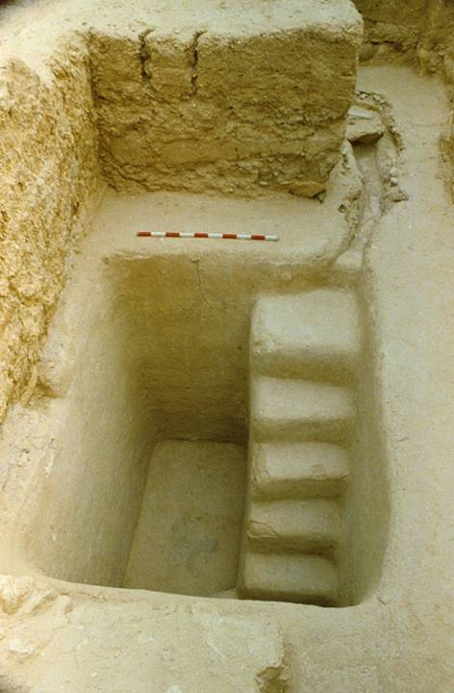
2nd Temple mikveh (purification pool) excavated near the stairway at the southern wall of the temple mount.
It would have been in use during the time of Mary’s purification.

Slide 106
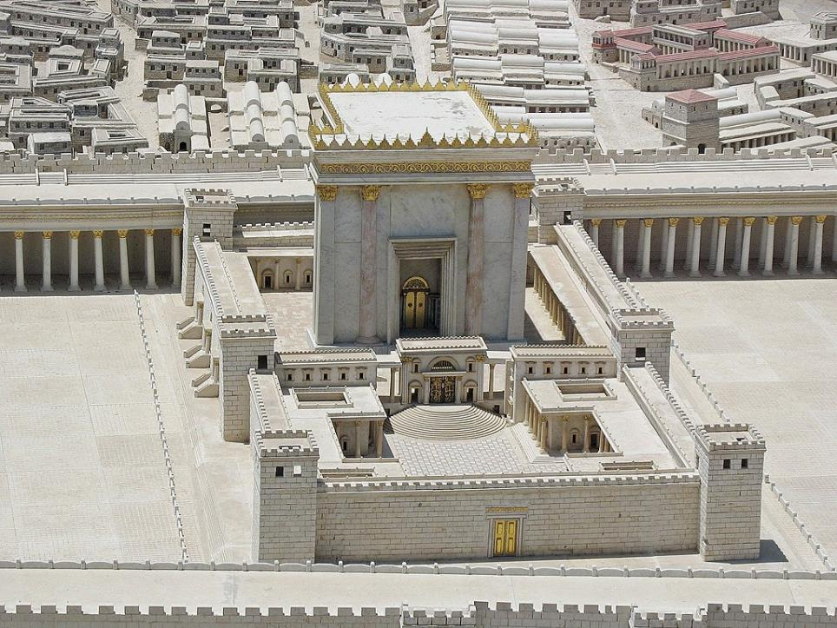
.
Model of Herod’s Temple based on Josephus and archaeological excavation

Slide 107
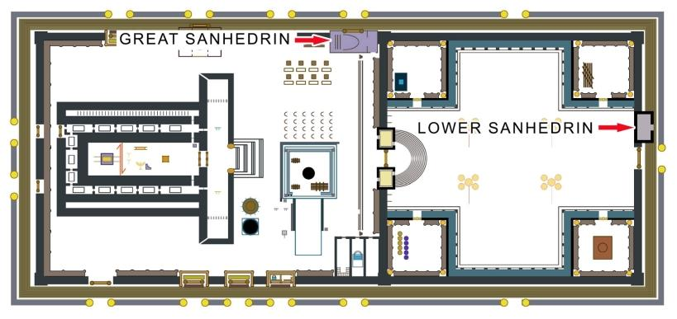
The Court of the Women
COURT OF THE WOMEN

Slide 108
Discussion Points
The Torah with its purity laws demonstrates a high view of the sacred as opposed to the secular. How are the ideas of sacred space and sacred time treated by various modern Christians?
What did Jesus say about the true source of impurity?

Slide 109
Now there was a man in Jerusalem called Simeon, who was righteous and devout. He was waiting for the consolation of Israel, and the Holy Spirit was upon him. It had been revealed to him by the Holy Spirit that he would not die before he had seen the Lord’s Christ
^{Luke 2:25-26}
There was also a prophetess, Anna, the daughter of Phanuel, of the tribe of Asher. …she gave thanks to God and spoke about the child to all who were looking forward to the redemption of Jerusalem.
^{Luke 2:36a, 38b}

Slide 110
The Presentation in the Temple
Both Mary’s purification and the presentation of the first-born were accomplished in the same visit.
As part of a long-standing ritual dating from the exodus, when all first-born sons were marked for death, the Torah required the presentation and redemption of first-born sons to God (Nu. 18:15-16).
The redemption price was five shekels (about two ounces).

Slide 111
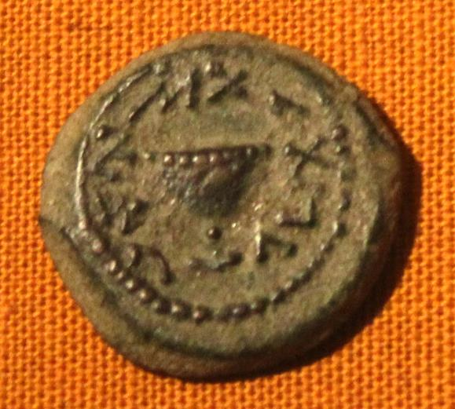
The Shekel
In ancient times prior to the invention of coinage, a shekel was a measurement of weight, roughly 11 grams.
In Israel during the Intertestamental Period, shekels were minted as coins.
Both shekels and half-shekels were available.
Shekel from the 1st Jewish Revolt in the late 1st century AD with the inscription “To the redemption of Zion”

Slide 112
Literary Framing
On several occasions, Luke, following the pattern of Mark, inserts a story within another story, linking the two thematically.
The healing of the woman with the hemorrhage is inserted into the larger narrative of the healing of Jairus’ daughter (Mk. 5:21-24; 5:25-34; 5:35-43; Lk. 8:40-42a; 8:42b-48; 8:49-56).
Inserted in the middle of the presentation of the infant Jesus in the temple are the prophetic oracles involving Simeon and Anna (Lk. 2:21-24; 2:25-38; 2:39-40).
This technique of bracketing serves to emphasize that the requirements of the Torah have their ultimate fulfillment in Jesus’ messianic mission.

Slide 113
Simeon and Anna
The old man and old woman who blessed the Christ child at the temple presentation serve as symbols of the Hope of Israel.
Both were endowed with the Holy Spirit, Simeon to whom it was revealed by the Spirit that he would see the Christ before he died, and Anna, who was a prophetess, and as such, by definition was anointed by the Spirit.
These two individuals, along with Elizabeth, Zechariah, John, and Mary, were signs that the “silent years” were over—the quenched Spirit had returned after four centuries of silence.

Slide 114
The Comfort of Israel
Many centuries earlier, a prophet had announced, “Comfort, comfort, my people, says your God. Speak tenderly to Jerusalem, and proclaim to her that her hard service has been completed…” (Is. 40:1-2a).
This ancient oracle announced the end of the exile of Judah, but inasmuch as there was a wide acknowledgment that the exile was not over, the “comfort of Israel” has special relevance during the Roman occupation as well.
Anna’s heralding of the “redemption of Jerusalem” speaks to the same hope.

Slide 115
The Nunc Dimittis
Simeon’s oracle, repeated during Evening Prayers since the 4th century (“Now, dismiss your servant in peace…” BCP, p. 28), exalts the God who has kept his ancient promises.
His words about salvation point to universal blessing, both for Gentiles as well as for Israel.
The “falling” and “rising” of many in Israel heralds both the rejection of some and the acceptance of others of Jesus as the Christ.
His final words to Mary anticipates her wrenching grief at the crucifixion of her son.

Slide 116
Anna of the Tribe of Asher
The pericope about Anna merits special attention, since she was descended from a family of northern Israelites (Asher) who largely disappeared after being exiled to Assyria.
The ancient promises were for the northern Israelites also (cf. Ho. 2:21-23; Am. 9:11-15).
Anna’s pedigree likely is to be traced backward to some of those northern refugees who fled southward at the invasion of Tiglath-pileser III (1 Chr. 9:3; cf. 2 Chr. 30).

Slide 117
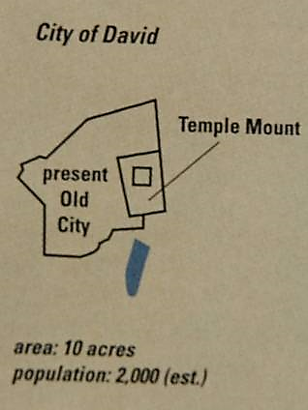
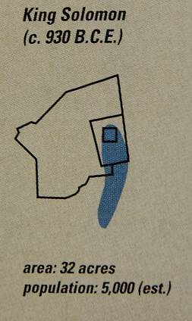
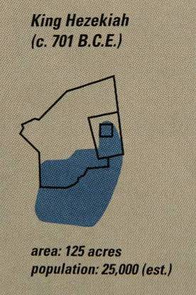
The Shifting Size of the City of Jerusalem
10th century – 8th century BC

Slide 118
The Lost 10 Tribes (2 Kg. 17:24-41)
The disappearance of the northern Israelites from history has occasioned various speculations about their identity.
What we know…
Hebrew-type names show up in various Assyrian texts, showing that the deported Israelites were assimilated into Assyrian culture.
Refugees from Israel fled south to Judah, so some remnants remain identifiable even into the period of the New Testament (1 Chr. 9:3; cf. Lk. 2:36).
Other remnants probably are to be found among the Samaritans.
Speculative theories…
British Israelism (the notion that the lost 10 tribes migrated to Britain and America)
Russian Israelism (the notion that the lost 10 tribes migrated to Moscow and Tobolsk and became the Russians)
Sephardic Jews in Spain may be remnants of the Lost 10 Tribes
Book of Mormon (claims that the lost 10 tribes crossed the Pacific and became the Native Americans)

Slide 119
Return to Nazareth
Luke describes the return of the Holy Family to Nazareth, the home of Mary and Joseph.
He does not describe the sojourn in Egypt, which is narrated in Matthew’s Gospel.
Jesus would have been reared in rural Galilee, growing physically and intellectually, favored both by God and others.
His childhood education was likely at the synagogue schools, where each synagogue had its beth-sepher (school for learning).

Slide 120
Discussion Points
Why do you think the ancient church (followed in modern times by the liturgical churches) placed such emphasis on things like the Song of Zechariah, the Magnificat, the Benedictus, and the Nunc Dimittus?
Is it important that Jesus grew up in a Torah-observant family?
Can you see why ancient prophecies concerning the restoration of Israel from exile in Babylon could be read with special relevance in a later context during the Roman Period?

Slide 121
THE BIRTH AND INFANCY NARRATIVES IN MATTHEW AND LUKE
The Visit of the Magi and the Flight to Egypt

Slide 122
I see him, but not now;
I behold him, but not near.
A star will come out of Jacob;
A scepter will rise out of Israel.
^{Numbers 24:17a}
After Jesus was born in Bethlehem in Judea, during the time of King Herod, Magi from the east came to Jerusalem and asked, “Where is the one who has been born king of the Jews? We saw his star in the east and have come to worship him.”
^{Matthew 2:1-2}

Slide 123
The Magi
The magi, astrologers from “the East,” came to Judea to see the Christ-child.
“The East” is very general, but likely they came from Babylon or Persia, where they would have had access to Jewish scholars and the messianic interpretation of Nu. 24:17 about a “star from Jacob’s family.”
They had seen a star “in its rising,” a technical expression in the ancient world designating a stellar body when it can be seen above the horizon just before the appearance of the sun.

Slide 124
Matthew’s Universalism
For Mathew, the significance of the magi was almost certainly in the interests of his theme of the gospel to the nations.
While Matthew is the most Jewish of the four gospels, and while during Jesus’ public ministry he restricted himself and his disciples to the “lost sheep of the house of Israel” (10:5-6; 15:22-24), the over-arching theme goes beyond the Jewish community (24:14).
That the magi were gentiles from far away anticipates the climax of Matthew’s portrait of Jesus when his great commission was to disciple an baptize people from all nations (28:19.

Slide 125
LEGENDARY ACCRETIONS
Various enlargements to the biblical story of the magi have accumulated through Christian history.
The traditional number is three (probably based on the three gifts mentioned by Matthew).
By the 4th century, Helena, the mother of Constantine, claimed to have found their bones (the bones she found are now enshrined in Cologne).
By the 6th century, they had acquired the legendary names Melchior, Balthazar and Caspar.
By the 8th century, they were believed to represent the three divisions of the human race descended from Noah.
By the 14th century, they were hailed to be from Arabia, Persia, and India.

Slide 126
We Three Kings
Composed by John Henry Hopkins, rector of Christ Episcopal Church, Williamsport, Pennsylvania (1857). It was the first widely popular carol written in America.
ALL We Three Kings of Orient are,
Bearing gifts we traverse afar,
Field and fountain,
Moor and mountain,
Following yonder Star.
REFRAIN O Star of Wonder, Star of Night,
Star with Royal Beauty bright,
Westward leading,
Still proceeding,
Guide us to Thy perfect Light.
GASPARD Born a King on Bethlehem plain,
Gold I bring to crown Him again,
King for ever,
Ceasing never
Over us all to reign.
Refrain
MELCHIOR Frankincense to offer have I,
Incense owns a Deity nigh:
Prayer and praising
All men raising,
Worship Him God on High.
Refrain
BALTHASAR Myrrh is mine; its bitter perfume
Breathes a life of gathering gloom;—
Sorrowing, sighing,
Bleeding, dying,
Sealed in the stone-cold tomb.
Refrain
ALL Glorious now behold Him arise,
King, and God, and Sacrifice;
Heav’n sings Hallelujah:
Hallelujah the earth replies.
Refrain

Slide 127
Discussion Points
Our celebrations of Christmas revolve around the biblical accounts, the development of additional traditions, and the display of the nativity scenes in painting and sculpture. How should we regard these various sources?
Going back to the carol “We Three Kings,” how does Hopkins use the voice of the three wise men to anticipate the gospel?

Slide 128
The Magi and Herod
Since Herod himself was the king of the Jews, the arrival of visitors to his court asking about a newly born king was taken as a direct threat.
Herod would soon die, but the last decade of his life was turbulent, his wives and their sons fighting among themselves over who would succeed him.
He changed his will no less than six times in this period.
He murdered one of his wives and her mother along with three of his sons, all considered threats to his throne.
Hence, Herod’s inquiry about the place of the birth was utter hypocrisy. He only intended to eliminate any threat.

Slide 129
The Star
The star seen by the magi has given rise to several possible explanations.
It was supernatural and need not be correlated with any natural phenomenon.
It was a nova or supernova.
It was Halley’s Comet (which made an appearance in ca. 12-11 BC).
It was a planetary configuration of Saturn and Jupiter, which had high points of conjunction three times in 7 BC.
Traditionally, the magi followed the star all the way from the east. However, the biblical narrative does not say this, only indicating that the star helped them locate the child after leaving Herod.

Slide 130
The Timing
Three details strongly suggest that the visit of the magi may have been a considerable time after the birth of Jesus.
When they saw the child, the family was staying in a “house” (oi]ki<a), possibly the home of Zechariah and Elisabeth (Mt. 2:11).
Herod’s slaughter of the babies in Bethlehem was for those two years old and younger (Mt. 2:16).
Had Mary and Joseph just received expensive gifts from the magi before Jesus’ dedication, they would not have offered the sacrifice of the poor (Lk. 2:22-24; Lv. 12:6-8; 5:7-10).

Slide 131
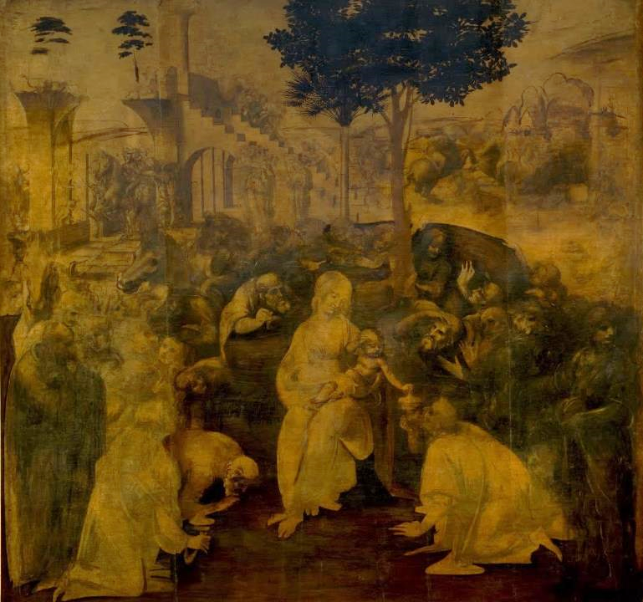
Oil on wood (1481)
Unfinished painting by Leonardo da Vinci commissioned by the Augustinian monks of San Donato in Scopeto, Florence, Italy.
Uffizi Gallery, Florence

Slide 132
The Gifts
The three gifts of the magi were providential, since Joseph would shortly need them to finance a trip to Egypt.
GOLD (usually mined in Ophir [unknown location] or ancient Nubia [modern Sudan])
FRANKINCENSE (gum extracted from trees in southern Arabia and India; used for embalming)
MYRRH (resinous perfume extracted from shrubs in Arabia and Ethiopia)

Slide 133
Slaughter of the Innocents
Herod’s insecurity at the inquiry of the magi resulted in his order to slaughter babies in Bethlehem.
While we have no record of this butchery outside Matthew’s Gospel, it is entirely within keeping of Herod’s violent nature to have done such a thing.
Several expansions have arisen concerning this event as well, including treating the infants as martyrs and inflating the figures to 14,000 and later to 144,000.
Matthew, in a fulfilment of recapitulation, links the slaughter with the OT grief of a ghostly Rachel over the exile of the Joseph and Benjamite tribes (Je. 31:15).

Slide 134
Discussion Points
Can you see the logic behind the two major seasons in the Christian year, the first surrounding the birth of Jesus (Advent, Christmas, Epiphany) and the second surrounding the death of Jesus (Ash Wednesday, Lent, Good Friday, Easter, Ascension Day)?

Slide 135
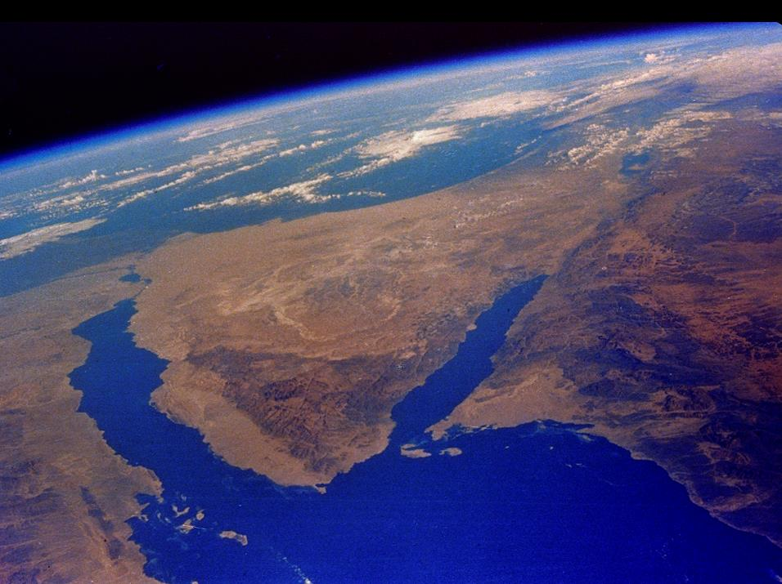
Since both Palestine and Egypt were under Roman occupation, Joseph and Mary probably traveled along the coastal route to the Delta area of Egypt, where a large Jewish population lived in Alexandria, the second largest city in the empire.
Notes:
Sinai Peninsula: The Sinai, Red Sea, Gulf of Suez (left), Gulf of Eilat (right), Nile Delta and lower Israel, as taken from a satellite. [E-8]

Slide 136
PROPHETIC FULFILLMENT
BY RECAPITULATION
“Out of Egypt I have called my son…” (Ho. 11:1)
“Rachel, weeping for her children…” (Je. 31:15)
ORIGINAL REFERENCE: …recalls the exodus from Egypt
RECAPITULATION:
…Jesus, as the embodiment of the true Israel, experiences the trials of the ancient nation
ORIGINAL REFERENCE: …recalls the exile of the Benjamite and Ephraimite tribes
RECAPITULATION:
…Herod’s slaughter of the innocents

Slide 137
In Jesus the promise is confirmed,
the covenant is renewed,
the prophecies are fulfilled,
the law is vindicated,
salvation is brought near,
sacred history has reached its climax,
the perfect sacrifice has been offered
and accepted,
the great priest over the household of God has taken his seat at God’s right hand,
the Prophet like Moses has been raised up,
the Son of David reigns,
the kingdom of God has been inaugurated,
the Son of Man has received dominion from the Ancient of Days,
the Servant of the Lord,
having been smitten to death
for his people’s transgression
and borne the sin of many,
has accomplished the divine purpose,
has seen light after the travail of his soul and is now exalted and extolled and made very high.
F. F. Bruce

Slide 138
Discussion Points
What is your favorite part of the Christmas story and why?
What is your favorite Christmas carol and why?

Slide 139
THE BIRTH AND INFANCY NARRATIVES IN MATTHEW AND LUKE
The Return to Nazareth and the Visit to the Temple

Slide 140
The Death of Herod
Herod the Great, the client king over the Jews, died at Jericho in 4 BC. Augustus honored Herod’s will and divided his kingdom among three sons:
Archelaus was given jurisdiction over Judea, Samaria, and Idumea (4 BC to AD 6).
Antipas ruled over Galilee and Peraea (4 BC to AD 39).
Philip ruled over Iturea, Trachonitis, Batanea, Gaulanitis, Auranitis, and Paneas (4 BC to AD 34).
Augustus would remove Archelaus from power in AD 6, finding him incompetent, and he combined Judea and Samaria to be ruled by Roman Prefects from AD 6-41.

Slide 141
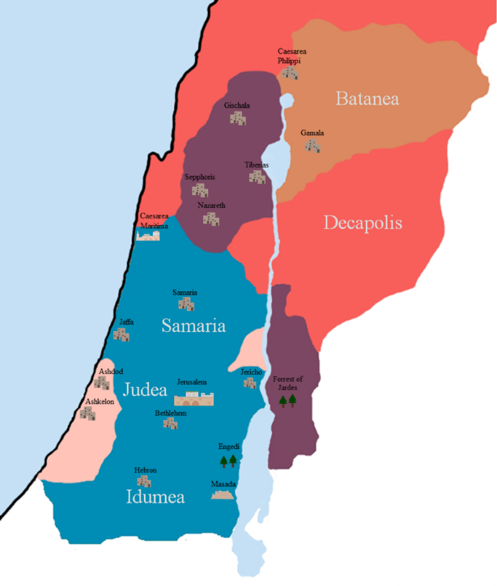
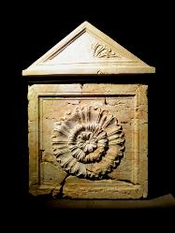
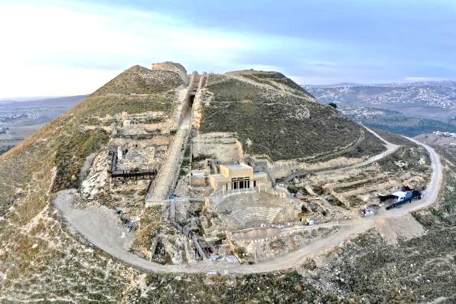
Herod’s sarcophagus (right, Israel Museum) and burial place at Herodium (below)
Archelaus
Philip
Antipas

Slide 142
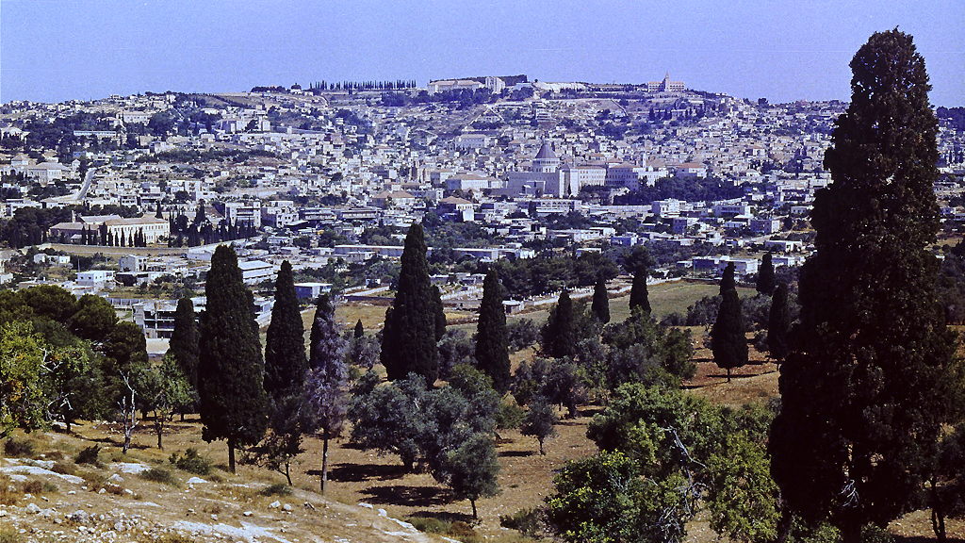
Nazareth is 16 miles west of the southern tip of the Sea of Galilee. Jesus would live in this village with Mary and Joseph until he began his ministry. Modern Nazareth, shown here, completely engulfs the ancient village.

Slide 143
Jesus, the Nazarene
Matthew wrote that Jesus would be called a “Nazarene,” a fulfillment of the words of the prophets.
This fulfillment statement is puzzling, since no such statement is to be found in any Old Testament passage.
Two possible solutions have been suggested:
  The term “Nazarene” is a term of rejection, such as was later used in the Talmud. The prophets certainly indicated that Jesus would be rejected.
  The term “Nazarene” is a play on the Greek word “Nazoraios” (= Nazarene) and the Hebrew word “netser” (= branch), the messianic metaphor used by Isaiah (Is. 11:1).

Slide 144
As a Youth in Nazareth
The four gospels offer us little information about Jesus’ adolescence.
He was obedient and shown favor by God and others (Lk. 2:51-52).
He visited Jerusalem at the age of 12 (Lk. 2:42).
Presumably, he was educated in the local synagogue, as was customary.
He worked in the construction trade of Joseph (Mt. 13:55//Mk. 6:3).
Later Gnostic literature attempted to fill in the gaps, but the early church did not consider these sources to be reliable.

Slide 145
LIFE STATIONS OF JEWISH MALES
(based on the Mishnah and Talmud)
At five, reading Scripture
At ten, learning Mishnah
At thirteen, bound to the
commandments
At fifteen, study of Talmud
At eighteen, marriage
At twenty, pursuit of vocation
At thirty, full vigor
At forty, maturity of reason
At fifty, able to counsel
At sixty, beginning of old age
At seventy, grey age
At eighty, advanced old age
At ninety, bowed down
At one hundred, dead

Slide 146
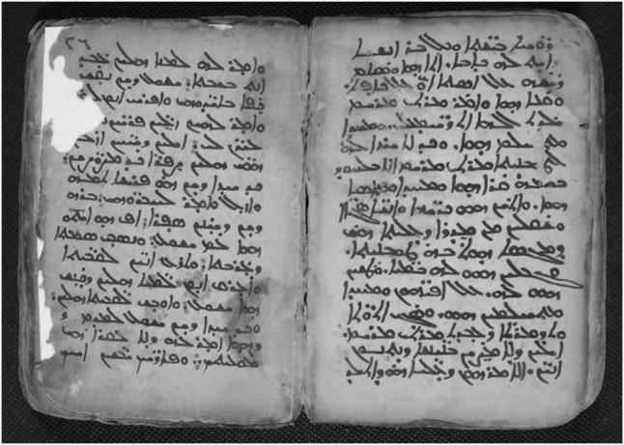
Infancy Gospel
Syriac Version
No author is known for this 2nd century Gnostic text. Irenaeus (AD 180) is the first to allude to it, and he clearly regarded it as apocryphal and spurious. It attempts to fill in details of Jesus’ childhood, showing him:
…causing clay pigeons to fly
…calling down curses on people he didn’t like
…performing healings
…raising the dead

Slide 147
Discussion Points
Inasmuch as Jesus almost certainly worked alongside Joseph in the construction trade, do you think he ever smashed his thumb with a hammer?
If you could ask Mary (or Joseph) about Jesus’ childhood, what question might you ask?
The Letter to the Hebrews says that Jesus was “made like his [human] brothers in every respect” (He. 2:17). Given this, what would have been some of the challenges Jesus must have faced while growing up? As an adolescent? As a teenager? As a young man?

Slide 148
The Literary Genre of Gospel
So far as we know, the kind of literature we call “gospel” did not exist prior to the composition of Mark.
So long as the stories of Jesus circulated in the early Christian communities as oral traditions, presumably they did so as individual units.
A gospel, however, presupposes a narrative structure, linking the stories of Jesus into a larger composition.
The writer had to determine how to organize the material, whether geographically, chronologically or thematically, as well as determine what stories to tell.

Slide 149
Gospels are not Biographies
The focus of the four gospels is upon the public ministry and passion of Jesus, not his entire life.
They offer only very brief accounts of Jesus’ birth and adolescent years (and Mark offers nothing at all along these lines other than that Jesus was the carpenter’s “son,” Mk. 6:3).
However, all four gospels have “bookends,” beginning with the ministry of John the Baptist and climaxing with the passion of Jesus (cf. Ac. 1:21-22).

Slide 150
The Gospels as “Testimony”
The first and most important feature of this testimony is that the gospels all were composed within the living memory of the events they recount (i.e., 30-60 years).
  Eyewitness participants in the events of the gospel narratives moved among the Palestinian Christian communities and beyond for several decades, and their memories were at the disposal of those who sought information.
  These living witnesses, the most important being the apostles themselves, served as guarantors for the accuracy of the traditions about Jesus.

Slide 151
The Pilgrim Festivals (Dt. 16:1-17)
Israel’s annual calendar was punctuated by festivals celebrating God’s redemptive work.
They also were coordinated with the agricultural cycle.
Three of these convocations, the haggim (= pilgrimages), were to be held at the central sanctuary and only there, which is why in order to celebrate these festivals, families would travel to Jerusalem.
Jesus participated in one of these pilgrimages when a boy of 12.

Slide 152
The Haggim
Passover
Commemorated the exodus
Included a full week of eating only unleavened bread
Occurred at the time of the barley harvest
Weeks
Recalled the gift of freedom from slavery
Occurred seven weeks after Passover
Occurred at the time of the wheat harvest
Booths
Recalled the desert sojourn
Featured family camping in booths for a full week
Occurred at the end of the harvest season
Additional details are offered in Leviticus 23 and Number 28-29.

Slide 153
Jewish Months
Nisan
Iyyar
Sivan
Tammuz
Ab
Elul
Tishri
Marchesvan
Chislev
Tebeth
Shebat
Adar
English Months
Mar-Apr
Apr-May
May-Jun
Jun-July
July-Aug
Aug-Sept
Sept-Oct
Oct-Nov
Nov-Dec
Dec-Jan
Jan-Feb
Feb-Mar
Seasons
Flax harvest
Spring rains
Barley Harvest
Dry season starts
Early figs ripen
Grape harvest
Early olives
Summer wheat
Dates
Summer figs
First rains
Late olives
Winter figs
Plowing
Sowing
Rain and snow
Almond blossom
Citrus fruit
Festivals
Passover
Unleavened Bread
First fruits
Weeks (Pentecost)
Trumpets (Rosh Hashanah)
Atonement (Yom Kippur)
Booths (Succoth)
Dedication (Hanukkah)

Slide 154
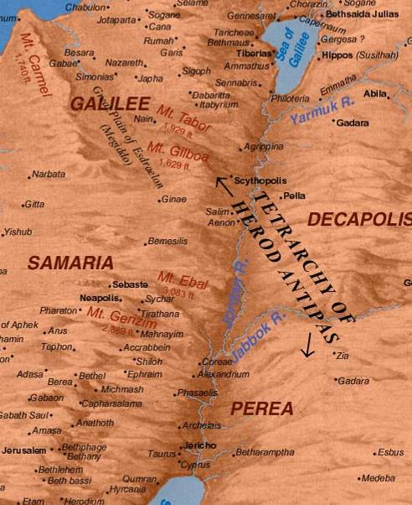
Travel between Judea and Galilee followed one of two routes. The more usual route was to ford the Jordan in the north, travel down the eastern side of the river, and ford again near the southern end of the Jordan near Jericho (thus avoiding Samaria). The less traveled route was more direct, through Samaria, but due to hostile relations between Jews and Samaritans (as well as the risk of ritual impurity), it was rarely used..

Slide 155
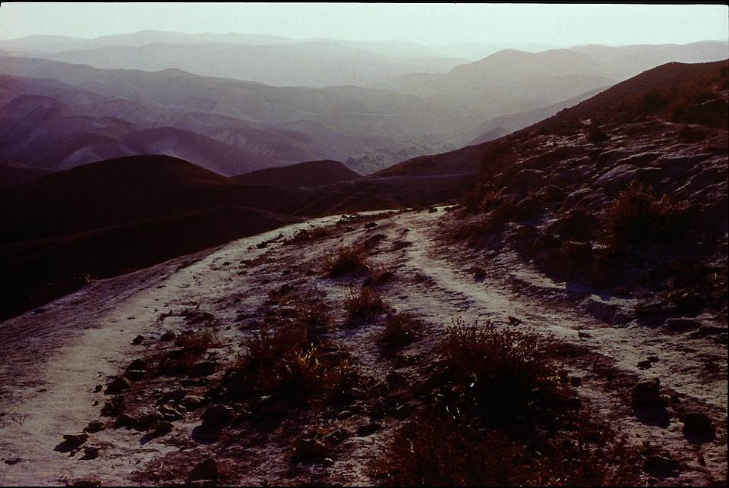
The desolate area surrounding the Jerusalem to Jericho road was notorious as the hideout of bandits in the 1st century. Most people traveled this road in groups, not as single individuals.

Slide 156
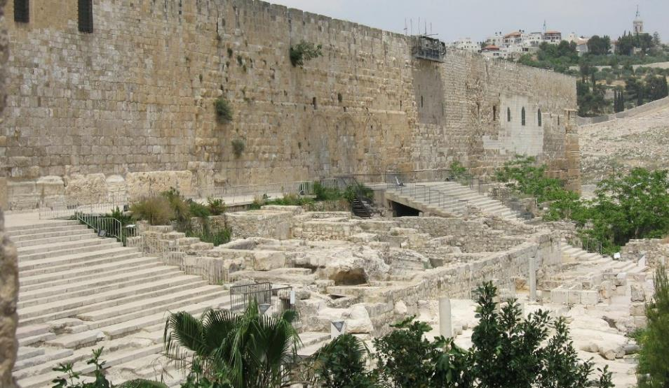
The “Steps of the Rabbis” below the south wall of the temple mount was where Sanhedrin members fielded questions from pilgrims. Possibly this is where Jesus was discovered by Mary and Joseph in dialogue with the Jewish teachers.

Slide 157
The Things of My Father
When Mary and Joseph found Jesus in Jerusalem, discoursing with the learned men, he seemed surprised that they should be upset.
His saying, “Didn’t you know that it was necessary for me to be in the [ ] of my father?” has left translators with the task of filling in the implied object of the preposition (Lk. 2:49).
  “I must be about my Father’s business” (KJV)
  “I must be in my father’s house” (RSV, ESV)
Clearly, Jesus’ reference to his “father” was not intended to refer to Joseph!

Slide 158
Jesus’ Family
Joseph and Mary
Joseph disappears from the biblical record after the birth and infancy narratives in Matthew and Luke (presumably deceased)
Mary appears occasionally during Jesus’ public ministry, watches him die, and gathers with the others at Pentecost; she was likely a source for Luke’s Gospel.
Half-Brothers and Sisters
James, Joses, Judas and Simon (Mk. 6:3)
Nothing is known of his sisters.
Jesus makes a post-resurrection appearance to James, who later becomes the leader of the Jerusalem church (1 Co. 15:7; Ac. 12:17; 15:13ff.; 21:18; Ga. 1:19; 2:9, 12).
The brothers were present at Pentecost (Ac. 1:14).
They were married (1 Co. 9:5).
Judas’ grandchildren appeared before Emperor Domitian and continued as church leaders until the time of Emperor Trajan (Eusebius, Ecclesiastical History 3.19-20).

Slide 159
Three Theories About Jesus’ “Brothers”
Helvidius
Jesus’ “brothers” were children of Mary and Joseph after the birth of Jesus, hence younger.
Epiphanius
Jesus’ “brothers” were children of Joseph by a previous marriage, hence older.
Jerome
Jesus’ “brothers” were cousins, children of Mary’s sister and Clopas, ages unknown.
PROTESTANT
ORTHODOX
ROMAN CATHOLIC

Slide 160
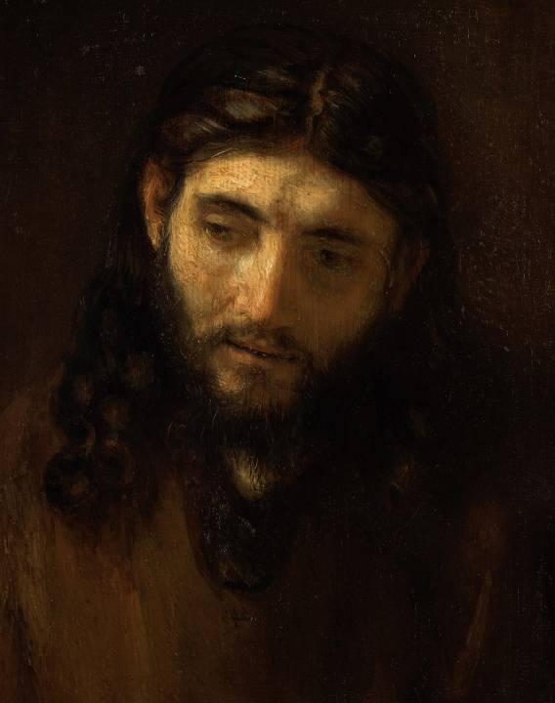
Jesus’ next 18 years at Nazareth are not described. Luke says he was “about thirty” when he began his public ministry in Galilee (Lk. 3:23), and it is here that the central message of the four gospels is written.
Rembrandt van Rijn was the first artist to use Jewish models, Sephardic Jews in Amsterdam, for his portraits of Jesus.

Slide 161
Discussion Points
Jesus’ reference to his “father” when Joseph and Mary found him in the temple raises the question of self-identity and mission. The gospels do not further address this question, but many Christians have wondered at what point Jesus knew who he was and what he was to do. What do you think?
How difficult would it be to grow up in a family where the one brother was “perfect” while the other brothers and sisters were ordinary?

