Slide 1
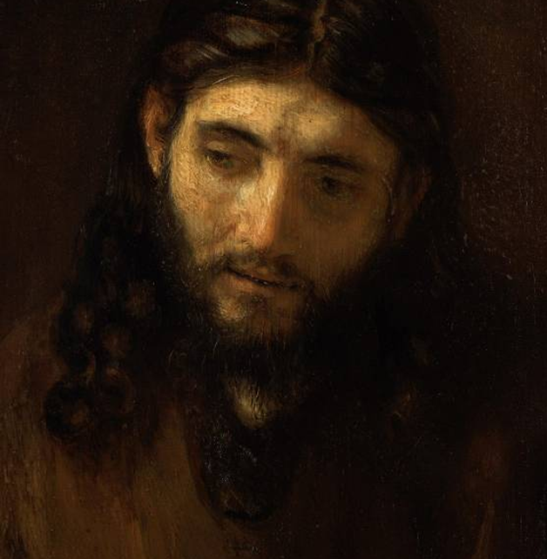
The Parables of Jesus
Understanding Jesus’ parables in their original context
1 - INTRODUCTION

Slide 2
INDEX OF PARABLES
MARK
The Seed Growing Invisibly (Mk. 4:26-29) – Slide 47
Uncleanness (Mk. 7:14-23) – Slide 66
Watchfulness (Mk. 13:33-37) – Slide 140
MATTHEW
The Tares (Mt. 13:24-30, 36-43) – Slide 30
The Hidden Treasure (Mt. 13:44) – Slide 35
The Pearl (Mt. 13:45-46) – Slide 36
The Dragnet (Mt. 13:47-50) – Slide 37
The Two Sons (Mt. 21:28-32) – Slide 86
The Laborers in the Vineyard (Mt. 20:1-16) – Slide 96
The Unmerciful Servant (Mt. 18:21-25) – Slide 118
The Ten Virgins (Mt. 25:1-3) – Slide 141
The Wedding Banquet (Mt. 22:1-14) – Slide 154
The Sheep and the Goats (Mt. 25:31-40) – Slide 164

Slide 3
LUKE
The Shrewd Manager (Lk. 16:1-9) – Slide 56
The Narrow Gate (Lk. 13:22-30) – Slide 58
The Tower Builder & the King Going to War (Lk. 14:28-33) – Slide 60
The Lost Coin (Lk. 15:8-10) – Slide 71
The Prodigal Son (Lk. 15:11-32) – Slide 73
The Two Debtors (Lk. 7:36-50) – Slide 87
The Good Samaritan (Lk. 10:29-37) – Slide 92
The Barren Fig Tree (Lk. 13:6-9) – Slide 99
The Pharisee and the Tax Collector (Lk. 18:9-14) – Slide 106
The Friend at Midnight (Lk. 11:5-8) – Slide 111
The Unjust Judge (Lk. 18:1-8) – Slide 114
Lazarus and the Rich Man (Lk. 16:19-31) – Slide 120
The Servant’s Duty (Lk. 17:7-10) – Slide 132
The Rich Farmer (Lk. 12:16-21) – Slide 133
The Great Banquet (Lk. 14:15-24) – Slide 149

Slide 4
MATTHEW AND LUKE (Q)
The Yeast (Mt. 13:33; Lk. 13:18-19) – Slide 33
The Empty House (Mt. 12:43-45; Lk. 11:24-26) – Slide 49
The Strong Man (Mt. 12:24-29; Lk. 11:15-22) – Slide 52
The Lost Sheep (Mt. 18:12-14; Lk. 15:3-7) – Slide 69
The Two Builders (Mt. 7:24-27; Lk. 6:47-49) – Slide 84
The Ten Minas/Talents (Mt. 25:14-30; Lk. 19:11-27) – Slide 127
The Burglar (Mt. 24:42-44; Lk. 12:39-40) – Slide 138
The Trusted Servant (Mt. 24:45-51; Lk. 12:42-46) – Slide 139
The Playing Children (Mt. (Mt. 11:16-19; Lk. 7:31-35) – Slide 148
ALL THREE SYNOPTICS
The Sower (Mt. 13:3-9, 18-23; Mk. 4:3-9; Lk. 8:5-8) – Slide 27
The Mustard Seed (Mt. 13:31-32; Mk. 4:30-32; Lk. 13:18-21) – Slide 33
The Patch & Wineskins (Mt. 9:16-17; Mk. 2:21-22; Lk. 5:37-39) – Slide 54
The Lamp on the Stand (Mt. 5:14-16; Mk. 4:21-25; Lk. 8:16-18) – Slide 104
The Wicked Tenants (Mt. 21:33-44; Mk. 12:1-11; Lk. 20:9-18) – Slide 157

Slide 5
One of the most memorable things about the teaching of Jesus was his use of parables.
“With many similar parables, Jesus spoke the word to them, as much as they could understand. He did not say anything to them without using a parable. But when he was alone with his own disciples, he explained everything.”
Mark 4:33-34

Slide 6
So, what are parables?
Parables are first of all stories, but stories of a special kind.
Parables draw comparisons using some feature of ordinary life to illustrate a spiritual truth.
As such, they are extended metaphors or similes.
Generally, they are fictional.
However, they draw upon the circumstances of real life, such as, farming, fishing, and village life.

Slide 7
Jesus likely told these same stories on more than one occasion, as good teachers usually do.
“While…people were coming to Jesus from town after town, he told this parable.”
Luke 8:4

Slide 8
The character of Jesus’ parables
What is distinctive about Jesus’ parables is that they stimulate the listener to think about things from a new perspective.
Implicitly, they encourage the listener to dive deeper than the surface in order to discern what he is really talking about.
They are indirect rather than direct, which is why sometimes even Jesus’ own disciples had difficulty understanding them.
They push for a verdict, as in the Parable of the Good Samaritan, where Jesus ends it by asking, “Which of these three do you think was a neighbor to the man who fell into the hands of robbers?”

Slide 9
Parables (about a third of Jesus’ recorded teachings)
Popular stories from real life
5 farming 5 fishing 5 village life
Extemporaneous
5 illustrations 5 explanations 5 rebuttals
Subversive
5 revelation to some 5 concealment from the cynical
Striking for a verdict
5 “What do you think?”
Jesus concludes some of his parables with the aphorism, “He who has an ear to hear, let him hear” (Mt. 13:9).

Slide 10
DISCUSSION
Why do you think Jesus’ parables were so compelling to his original audience?
What parables of Jesus are hard for us to understand today?

Slide 11
In the early church, two schools of thought existed regarding how to read the Bible.
Antiochene School
Alexandrian School
  Centered in Antioch, this approach emphasized literal interpretation.
  It was heavily influenced by Aristotle.
  The emphasis was on historical-grammatical interpretation.
  It included early Christian leaders like St. John Chrysostom and Theodore of Mopsuestia.
  Centered in Alexandria, this approach emphasized allegorical interpretation.
  Here, the approach was heavily influenced by Philo.
  The emphasis was on hidden meaning and symbolism.
  It included early Christian leaders like Clement of Alexandria, Origen, and Cyril of Alexandria.

Slide 12
Allegorical interpretation remained strong until the Protestant Reformation, when under the influence of Luther and Calvin, there was a return to a balanced literalism.
The problem with allegorical interpretation was subjectivism: it told us more about what was in the mind of the interpreter than what was in the mind of the biblical writer.
The problem with literalism was that it was uncomfortable with figurative language and tended to ignore it.
A balanced literalism attempts to avoid the problems of both. It doesn’t deny figurative language, but it also holds that one should treat a passage figuratively only if there is good reason within the text that the biblical writer so intended it.

Slide 13
An example of early Christian allegorical interpretation: the issue is not Augustine’s theology. Rather, it is whether or not Jesus intended all these hidden meanings in the first place.
St. Augustine’s Allegorical Approach to the Parable of the Good Samaritan (Lk. 10:25-37)
The man going from Jerusalem to Jericho was Adam, who left Eden, the city of heavenly peace.
The bandits who attacked him were the devil and his angels, leading him to sin.
The priest and the Levite represented the law and the prophets.
The Good Samaritan was Christ.
The oil and wine were Christ’s comfort and exhortation.
The beast upon which the man rode was the body of Christ.
The inn was the church.
The innkeeper was St. Paul.
Quaestiones Evangeliorem ii.19

Slide 14
Jesus’ own explanation regarding his use of parables
Jesus himself gave a straightforward explanation as to why he taught using parables.
He used a repeating phrase as a preface to a number of his parables, “The kingdom of God is like…”
This preface, in turn, raises the question about Jesus’ understanding of the kingdom of God as opposed to the various popular viewpoints. The Judaism of his day was not monolithic.

Slide 15
Thy Kingdom Come
1st Century AD Jewish responses to the messianic vision of the kingdom of God was varied:
The Pharisees urged intensifying devotion to the Torah as the way to usher in God’s kingdom.
The Sadducees deemed collaboration with the Roman occupation a temporary, but necessary, expedient.
The Essenes and the Qumran Community withdrew into the desert to await an apocalyptic divine intervention.
Zealots urged that only immediate armed resistance to Rome was acceptable.
All sects still embraced the memories of the Maccabean success.

Slide 16
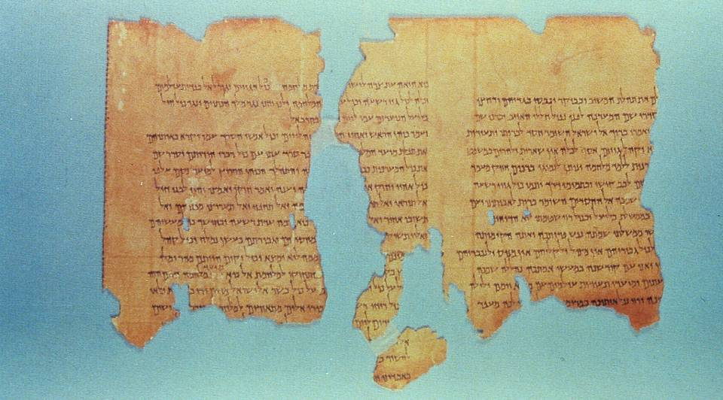
The “War Scroll” (1QM) from the Dead Sea Scrolls (from about the time of Jesus) describes the anticipated 40-year conflict between the Sons of Light and the Sons of Darkness, detailing war preparations, the armaments to be worn, the carnage to be inflicted, and the final victory of the Sons of Light. This victory would usher in the kingdom of God.

Slide 17
There was a wide perception that the kingdom of God would bring about a great reversal.
Referring to this anticipated future, both Mary and Zechariah exult:
  “He has shown strength with his arm;
  He has scattered the proud in the thoughts of their hearts;
  He has brought down the mighty from their thrones
  and exalted those of humble estate…”
Luke 1:51-55
  “As he spoke by the mouth of his holy prophets from of old
  that we should be saved from our enemies and the hand of all who hate us;
Luke 71-74

Slide 18
Insiders and Outsiders
Jesus clearly indicated that his parables would be open to some and closed to others.
For insiders he said, “The secret of the kingdom of God has been given to you, but not to them” (Mt. 13:11).
For outsiders he said, “…everything is in parables; they may indeed see but not perceive, and may indeed hear but not understand…” (Mt. 13:13-15).
Jesus’ parables were used both to reveal as well as to conceal. They call for reflection and interpretation.

Slide 19
DISCUSSION
What do you make of St. Augustine’s interpretation of the Good Samaritan parable?
Every Sunday, we pray the prayer that Christ taught us to pray. Within that prayer, there is the plea, “Thy kingdom come,” which obviously suggests that the kingdom has not yet fully arrived, at least in all its dimensions. What do we mean when we pray this, and what might we expect when God’s kingdom does arrive in its fulness?
What role does faith play in whether or not one is an insider or an outsider when seeking to understand Jesus’ parables?

Slide 20
Categorizing the Parables
NATURE PARABLES
DISCOVERY PARABLES
CONTRAST PARABLES
A FORTIORI PARABLES
These parables illustrate the character of God’s coming kingdom. Agricultural images are often used.
The Sower
The Mustard Seed
The yeast
These parables show the value of God’s kingdom—that it is worth abandoning everything in order to gain it.
The Hid Treasure
The Pearl
The Dragnet
These parables compare negative and positive attitudes, all illustrating God’s surprising mercy for the outcasts.
The Prodigal Son
The Two Debtors
The Ten Virgins
These parables compare the lesser with the greater. The language “how much more” is frequently employed.
The Unjust Judge
Friend at Midnight
The Shrewd Manager

Slide 21
Middle Eastern Context
Jesus’ parables were given to a Middle-Eastern audience, not 4th century Greeks or 21st century Americans or Europeans.
Jesus was himself a Torah-observant Jew, and his listeners were people who lived in both a Jewish and Greco-Roman cultural environment.
For the most part, his parables were given to village people in Galilee, the lower classes who felt Roman oppression most keenly and were fighting a losing battle for survival in the midst of oppressors and elites.
Early and medieval Christians, when allegorism was in vogue, left Jesus looking like a Greek Platonist.
Modern scholars, who treat the parables as vehicles for some sort of universal existential principles, leave Jesus look like a German philosopher.
The challenge is to recapture the culture in which the stories were first told.

Slide 22
DISCUSSION
What is one of your own favorites of Jesus’ parables, and why do you like it?

Slide 23
The Parables of Jesus
Understanding Jesus’ parables in their original context
2 – MATTHEW’S KINGDOM PARABLES

Slide 24
The Back Story
Matthew collects seven parables about the kingdom of God, but to best understand them, one needs to frame them beginning with the ministry of John the Baptist.
John came preaching in the desert that the kingdom of God was near (Mt. 3:1-2).
After his temptation in the desert, Jesus, also, began preaching that the kingdom of God was near (Mt. 4:17).
This immediately raises the question about the listeners of John and Jesus: how did they understand the kingdom of God and why were Jesus’ parables of the kingdom so counter-intuitive?

Slide 25
Yahweh will be king over the whole earth. On that day there will be one LORD; and his name the only name.
Zechariah 14:9
In those days John the Baptist came, preaching in the Desert of Judaea and saying, “Repent, for the kingdom of heaven is near.”
Mt. 3:1-2
From that time on Jesus began to preach, “Repent, for the kingdom of heaven is near.”
Mt. 4:17

Slide 26
The Kingdom and the Parables
All Jews anticipated the day when God would be King over all the earth.
Though there were various opinions within the sects of Judaism about how it would come, many if not most believed it would happen cataclysmically by divine intervention.
Since both John and Jesus used “kingdom language,” it was natural for Jesus’ listeners to wonder about Jesus’ own views concerning the coming of the kingdom.
Hence, Jesus often begins his parables with the introductory phrase, “The kingdom of God is like…”

Slide 27
Parable of the Sower (Mt. 13:1-9)
Utilizing a fishing boat as a sort of platform, Jesus told a story about a farmer scattering seed.
It is helpful to understand that the typical practice at that time was to sow seed prior to plowing, which is why the seed fell on so many kinds of soil.
  Some seed fell on the pathway where the villagers had walked through last year’s stubble.
  Some fell on a thin layer of soil with underlying limestone.
  Some fell among the withered thorns lying fallow.
  Some fell on good ground and produced a bumper crop (10% was considered good, but yields of 30% or 60% or 100% were extraordinary).
Jesus ended the parable by saying, “He who has an ear, let him hear.”

Slide 28
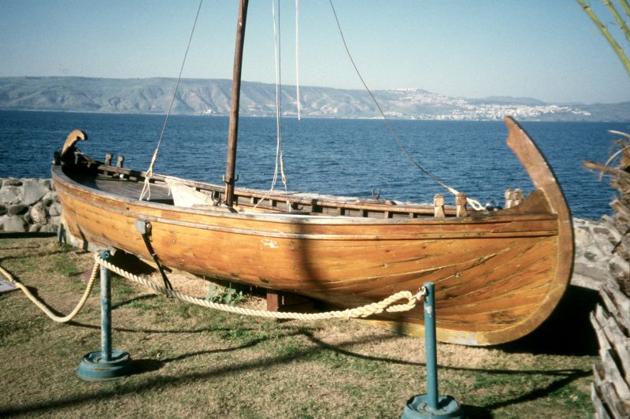
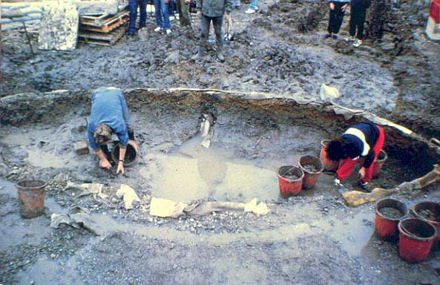
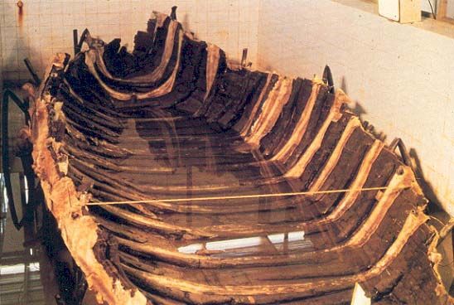
Full-size model of the so-called “Jesus Boat”
Remains of a 1st century fishing craft discovered in 1986.
Jesus taught some of his parables using a fishing boat as a platform, probably one much like this one dubbed “the Jesus boat.”

Slide 29
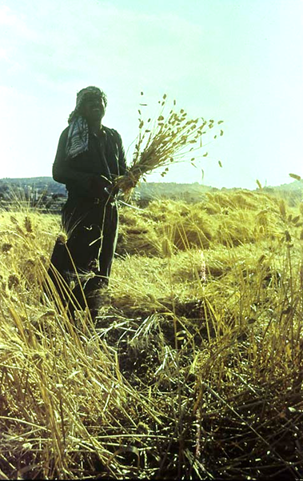
The Meaning of the Parable
Fortunately for us, the disciples asked Jesus about the meaning of this parable, and we are privileged to listen in to his explanation (Mt. 13:18-23).
Not everyone who heard would respond (some seed is snatched by the evil one).
Some would only last a short time because of competing interests or opposition (the seed in rocky ground or thorny ground).
The listeners are left with an implicit question: What kind of soil am I?

Slide 30

Parable of the Tares (Mt. 13:24-30)
In another farming story, Jesus spoke about a farmer whose enemy sowed poisonous weeds (darnel) into his field.
Wheat and darnel look similar, especially in the growing season.
Darnel is host to a poisonous fungus, and it can only be easily identified when the heads are ripe.
Here, Jesus said both would grow together until the harvest, and the darnel would be bundled to use for fuel.
Wheat & Darnel

Slide 31
The Meaning of the Parable
As with the Parable of the Sower, Jesus explained in detail the meaning in his Parable of the Tares and Wheat.
The field is the world, and the good seed are those who belong to the kingdom.
The tares are the evil ones in league with the devil.
The kingdom grows gradually, and both good and bad will grow side-by-side until the end.
The harvest is the end of the age.
At the end, the angels will remove from God’s kingdom all sin and evil, pitching the weeds into the fire.
Only then would the righteous ones—the true members of the kingdom—be revealed.

Slide 32
DISCUSSION
How are the Parable of the Sower and the Parable of the Weeds counter-intuitive with respect to popular Jewish views about the kingdom of God?
What might this parable say to us as Christians in the modern world?

Slide 33
Two Parables of Growth
Already, in the Parable of the Sower, Jesus indicated that there would be exponential growth in the kingdom of God.
In the Parable of the Mustard Seed (Mt. 13:31-32), he compares this phenomenal growth with the tiny mustard seed and its eventual growth into a large tree.
Similarly, in the Parable of the Leaven (Mt. 13:33), a tiny pinch of yeast is sufficient to leaven a large batch of dough.
Could this rag-tag bunch of fishermen and workers be the beginning of God’s reign? Jesus said it was! It would be unremarkable beginnings but unimaginable endings!

Slide 34
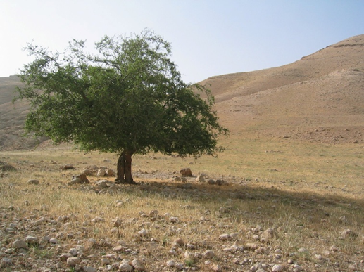

A Palestinian mustard seed and mustard tree.

Slide 35
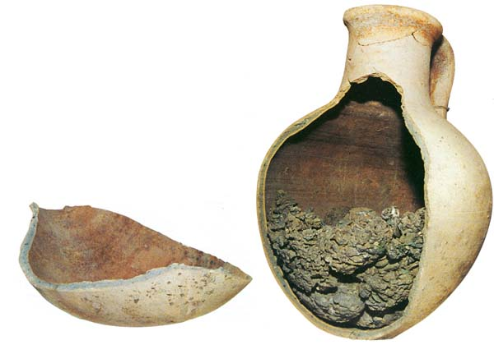
Parable of the Hid Treasure (Mt. 13:44)
Hidden treasure is always exciting, both to ancient and modern people!
In this story, a man discovered a hoard of wealth hidden in a field, perhaps buried in a clay jar filled with coins or jewels.
He was willing to liquidate his wealth in order to purchase the field and so gain the treasure; similarly, people should be willing to give up everything in order to gain the kingdom of God.
This hoard of 20 pounds of silver from around the time of David was stuffed into this clay jar. The owner never retrieved it, and it was discovered by archaeologist Ephraim Stern in 1995.

Slide 36
Parable of the Pearl (Mt. 13:45-46)
The Parable of the Pearl, like the Parable of the Hid Treasure, points to the overwhelming value of the kingdom of God.
Some people stumble into it, like the man who discovered the hid treasure.
Some are on a life-long search.
Either way, one must be willing to surrender everything in order to gain God’s kingdom.
Pliny, the Elder, a 1st century writer, recounts a wager made by Cleopatra with Mark Anthony that she could spend 10 million sesterces on a single dinner (about 5 million U. S. dollars). To win the bet, she dissolved a pearl from her necklace in vinegar and drank it!

Slide 37
Parable of the Dragnet (Mt. 13:47-52)
This story comes from the fishing industry in Galilee, where several of Jesus’ disciples were employed.
Dragnets (seine fishing) was widely practiced in the ancient world.
The net, as long as 1000’ and about 25’ high at the center, was spread some hundred yards or more from shore with towing lines.
The net was then dragged to shore, catching all sorts of fish.
The non-kosher fish (i.e., fish without scales, catfish, etc.) were thrown back, while good fish were saved in baskets.
Similar to the Parable of the Tares, at the end of the age a separation would be made between the good and the bad.

Slide 38
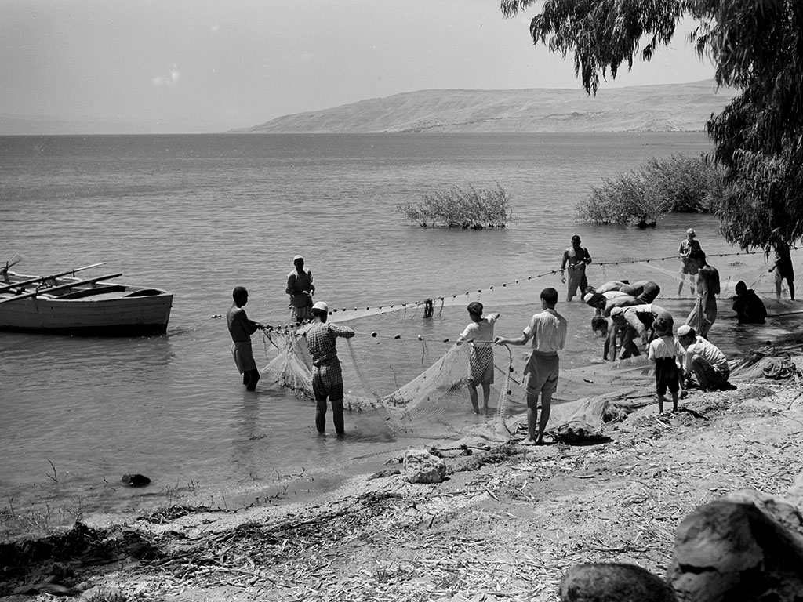
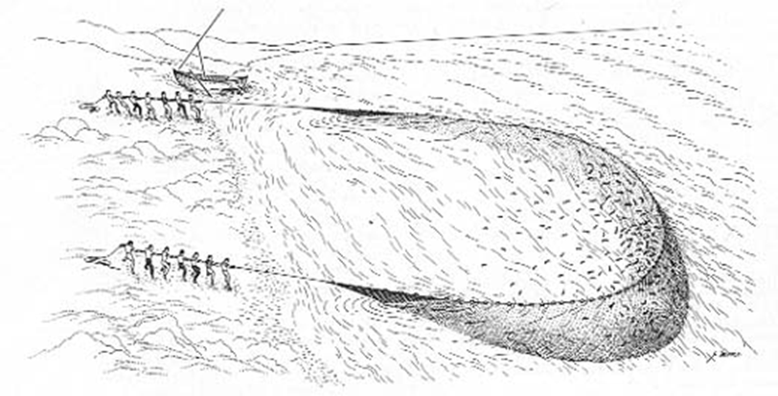
Seine fishing (or dragnet fishing) is the oldest and most important fishing method on the Sea of Galilee. It was a team-based, large-scale method, and it continued up until the 1950s.

Slide 39
DISCUSSION
Of Matthew’s seven kingdom parables, which have similar themes?
How might these parables have shaped the way Jesus’ disciples thought about him and his mission?
How might these parables have shaped how they thought about themselves as Jesus’ disciples?
How might they have shaped how early Christians thought about Christianity and the church?

Slide 40
The Parables of Jesus
Understanding Jesus’ parables in their original context
3 – A SPIRITUAL KINGDOM

Slide 41
The Kingdom of God
It strikes most people as odd that the phrase “kingdom of God” does not appear in the Old Testament, since it was so commonly used by Jesus in the New Testament.
However, the basic idea of the kingdom of God is certainly in the prophets and the Psalms, usually in the phrase “your kingdom” (i.e., God’s kingdom) or “his kingdom,” etc. (Ps. 145:11-13; 103:19).
One of the perennial questions has been whether the kingdom of God should be understood as an abstract idea (God’s sovereignty) or a concrete idea (a realm over which the divine King rules).
The Jews of Jesus’ generation generally though of it as concrete and that it would be ushered in by an abrupt cataclysmic intervention by God.

Slide 42
“From the days of John the Baptist until now the kingdom of heaven has suffered violence, and the violent take it by force.”
Mt. 11:12

Slide 43
Jewish Nationalism and Revolt
In several ways, resistance to the heavy hand of Rome would erupt in the lifetime of Jesus.
About the time Jesus was born in 4 BC, a Galilean zealot named Judas ben Ezekias raided the Roman armory in Sepphoris, about 4 miles from Nazareth, hoping to initiate a full-scale revolt. The Romans burned the city, sold the citizens into slavery, and crucified some 2000 rebels.
In 6 AD, another zealot named Judas, the Galilean, coined the phrase “no King but God,” which according to Josephus inspired other revolts.
In AD 66, a full-scale revolt erupted that ended in AD 70 with the destruction of Jerusalem and the 2nd Temple.
All of these were to greater or lesser degrees messianic and aimed at establishing the kingdom of God.

Slide 44
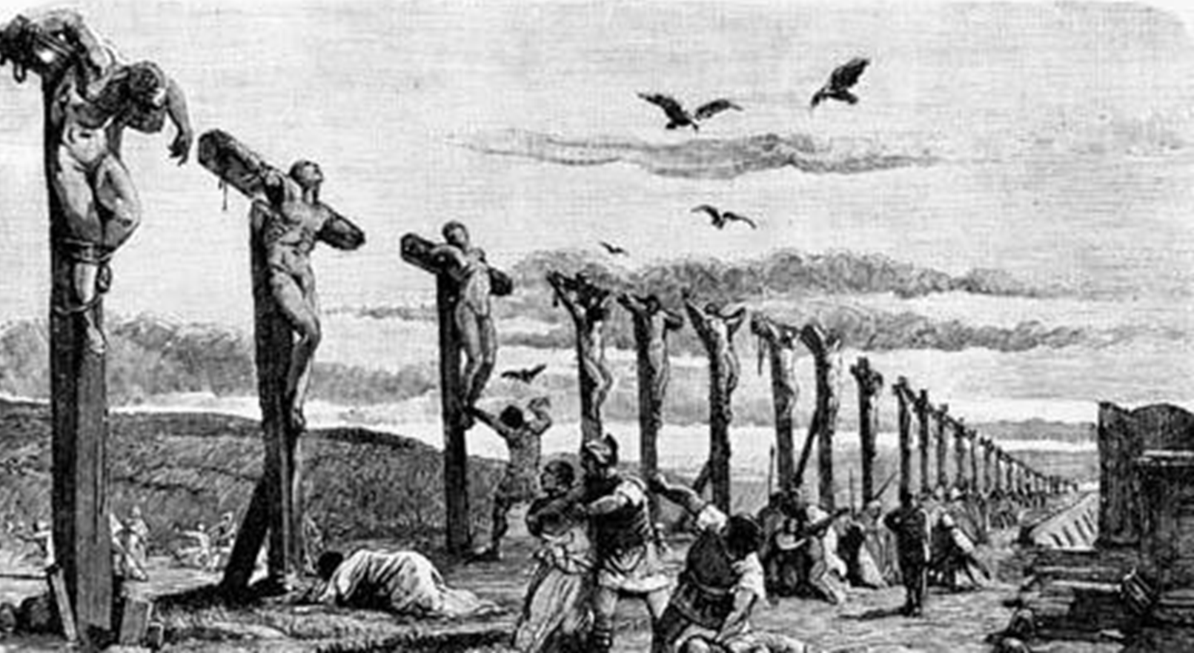
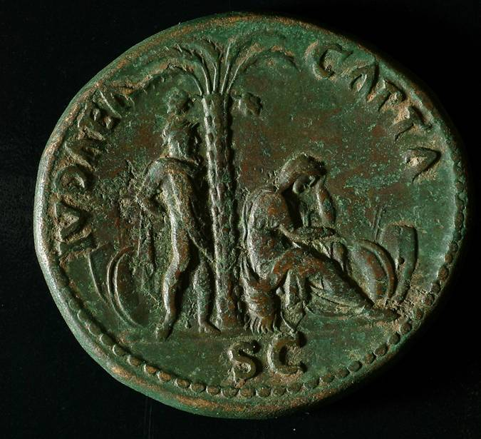
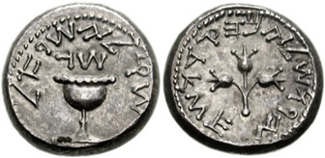
Mass execution of Jewish rebels about the time of Jesus’ birth.
Judea Capta coin portraying a weeping Judah and issued by the Romans after the fall of Jerusalem and the 2nd temple. It was the largest single issue of coinage in Roman history, minted in bronze, silver, and gold.
Coin issued by Jewish rebels in AD 68 inscribed with “Shekel, Israel Year 3,” and on the obverse side “Jerusalem the Holy.”

Slide 45
Once, on being asked by the Pharisees when the kingdom of God would come, Jesus replied, “The coming of the kingdom of God is not something that can be observed, nor will people say, ‘Here it is!’ or ‘There it is!’ because the kingdom of God is in your midst.”
Lk. 17:20-21

Slide 46
“Jesus said, “The kingdom of God is as if a man should scatter seed on the ground. He sleeps and rises night and day, and the seed sprouts and grows, he knows not how. The earth produces by itself, first the blade, then the ear, and then the full grain in the ear. But when the grain is ripe, at once he puts in the sickle, because the harvest has come.”
Mk. 4:26-29

Slide 47
Parable of the Seed Growing Invisibly (Mk. 4:26-29)
In this illustration, Jesus speaks of the hidden growth of the kingdom.
Like seed planted by a farmer that invisibly grows day by day, the seed sprouts, then produces a blade, then the ear, and finally the full grain in the ear. When the grain is ripe, it is time for the harvest.
Thus it is in the kingdom of God: God, not circumstances, is the guarantor of the kingdom’s success. It cannot be humanly manipulated.
The farmer doesn’t go out and dig up the seed every day to see if it is growing; rather, he trusts the process.
Jesus’ followers must trust the process as well.

Slide 48
DISCUSSION
Does the parable of the invisibly growing seed have anything to say about our modern preoccupation with attracting large numbers?
What has this parable to say to Christians who think that they may, by mission evangelism, affect the time of the end of the age?

Slide 49
Parable of the Empty House (Mt. 12:43-45; Lk. 11:24-26
This story is about a restless demon who, after being expelled, moved back into an empty house with seven other demons. It emphasizes that being delivered from evil but failing to allow God to fill the empty space ends in a terrible relapse.
Spiritually speaking, grace, like nature, abhors a vacuum!
When one is set free, a new master must reign.
The real enemy is not Rome, but the invisible power of evil in the world.
Hence, it is the “poor in spirit,” those who realize they are bankrupt with God, who will inherit God’s kingdom.

Slide 50
The Language of Demonization
The expressions describing demonization in the Synoptic Gospels are:
daimoni<zomai = to be demonized, to be “possessed” by a demon (this is the term preferred by Matthew)
e@xw…daimo<nion/pneu?ma a]ka<qartou = to have a demon, to have an evil spirit
Associated verbs:
e]kba<llw = to drive out
ei]se<rxomai = to enter into
e]ce<rxomai = to come out
Demons are largely absent in the Old Testament, but the recognition of demons begins to development more fully in the intertestamental period. During the Persian, Greek, and Roman administrations, Israel directly faced many pagan deities and pagan religions, which were considered fronts for demons (cf. 1 Cor. 10:20).

Slide 51
“But if it is by the finger of God that I cast out demons, then the kingdom of God has come upon you. When a strong man, fully armed, guards his own palace, his goods are safe; but when one stronger than he attacks him and overcomes him, he takes away his armor in which he trusted and divides the spoil.”
Lk. 11:20-22

Slide 52
Parable of the Strong Man (Mt. 12:24-29; Lk. 11:15-22)
Jesus confronted evil in both parable and exorcism.
In this parable, Jesus responded to his critics who said that he used the power of Satan to expel Satan.
Jesus depicted himself as the stronger man who can overpower the evil one.
The Anglican Church has a procedure for exorcism (priests can perform it only with explicit permission from the bishop). It must include a team of experts (including psychiatrists), since many cases have conventional psychological explanations.
The same general protocols are used in the Roman Catholic Church.
Among Pentecostals and Charismatic Christians, on the other hand, many negative experiences or situations are attributed to demons.

Slide 53
DISCUSSION
How does the power of evil manifest itself in the modern world?
Jesus never taught that the real enemy was Rome; rather, the real enemy is within us. What might this perspective say to us today?
St. Paul, in discussing food offered to idols, says that pagan Greco-Roman worshippers offer sacrifices to demons, or to put it another way, that pagan idols are “fronts” for demons (1 Co. 10:20). What might be “fronts” for demons today?

Slide 54
Parable of the Patch and the Wineskins (Mt. 9:16-17; Mk. 2:21-22; Lk. 5:37-39)
In these two short parables, Jesus taught that his followers must be prepared to see the kingdom in a new light.
It was foolish to sew a new patch on an old piece of clothing, since when the new piece shrank with laundering, it would tear the old piece.
Similarly, putting new wine into an old wineskin would end in disaster. The fermentation of the new wine would put too much stress on the old skin, and it would crack and spill the wine.
In the same way, conventional ideas about the kingdom of God would simply not fit with the new message Jesus was preaching.

Slide 55
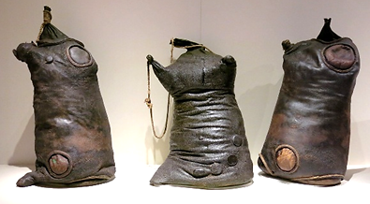
The processed hides of kosher animals were used as containers for wine, hence, wineskins. Because they would eventually lose their elasticity, especially if they dried out, these skins had to be replaced periodically, since the wine continued to ferment after being bagged.

Slide 56
Parable of the Shrewd Manager (Lk. 16:1-9)
This story is confusing for most readers, since it appears that Jesus used a dishonest estate manager as a model.
In the story, an estate manager is given notice, probably because he was suspected of taking money “under the table.”
To secure his future, the manager reduced the bills of his master’s creditors, expecting that in their gratitude they would assist him after he was dismissed.
Jesus then challenged his listeners to be as resourceful as this sacked manager. They, too, were facing a crisis in the message of the kingdom of God, and they must act quickly and responsibly, for everything was at stake.

Slide 57
Was the sacked manager dishonest?
This, of course, is the fundamental issue, and there are two ways of reading the story in a Middle Eastern context.
If the manager had full power of attorney and was entitled to commissions, then he had legitimate control over the interest to be charged.
He could have foregone his commissions in order to endear himself to his master’s debtors.
If the manager changed the bills without authorization (the creditors being unaware of his pending dismissal), they would credit the generosity to the landowner, and to save face, he would overlook the loss.
In a shame-based culture, the master could not help but admire the ingenuity of his former employee.

Slide 58
Parable of the Narrow Gate (Lk. 13:22-30; cf. Mt. 7:13-14)
In answer to a question about whether or not many would be saved, Jesus bluntly warned his listeners that entry into the kingdom of God was like passing through a postern gate.
The question itself likely arose because in the popular viewpoint, all Israelites had a share in the kingdom of God and the world to come.
The Jews were already “in,” so to speak.
In this parable, Jesus emphasized that once the door was shut, no one would be allowed in.
Especially, many would be in horrible anguish to see Abraham, Isaac, Jacob, and the prophets alongside those whom the Jews considered outsiders (the last) at the “table of God,” but they themselves (the first) would be shut out.

Slide 59
People Perceived to be “Last” In Jewish Society
  One of Jesus’ famous repeated sayings was, “There are those who are last who will be first, and the first who will be last” (Lk. 13:30; cf, Mk. 9:35; 10:31; Mt. 20:16). Various lists would later appear in the Jewish Mishnah ranking people from “first” to “last” based on racial purity.
The “First”
Priests and Levites
The Lay Nobility
Scribes
Pharisees
Israelites
Pure ancestry
Those with despised trades
Slaves
Those with slight pedigree blemishes
Proselytes
Bastards, eunuchs, foundlings
The “Last”
Samaritans
Gentiles

Slide 60
Parables of Counting the Cost (Lk. 14:28-33)
In the brief stories of the builder and the king going to war, Jesus underscored the need for total resolution.
The builder of a tower must first be sure he had the resources to finish it.
The king preparing for war must first be sure his army is sufficient to face his enemy.
“So therefore, any one of you who does not renounce all that he has cannot be my disciple.”

Slide 61
DISCUSSION
How compatible is the new wine of Jesus’ teachings to the wineskins of contemporary culture, and what might this say about the attempt to make the church as culturally compatible as possible?
Who are the first and who are the last in our own society?

Slide 62
The Parables of Jesus
Understanding Jesus’ parables in their original context
4 – A KINGDOM OF GRACE

Slide 63
A Kingdom of Grace
Though the Gospel of John does not contain parables in the manner of the Synoptics, it does emphasize that the coming of Christ Jesus was a revelation of divine grace (xarij = undeserved favor).
Jesus came from the Father “full of grace and truth” (Jn. 1:14).
While the law came through Moses, “grace and truth came by Jesus Christ” (Jn. 1:17).
This grace was exemplified in Jesus being a “friend of sinners” (Mt. 9:10-13; 11:19; Mk. 2:15-17; Lk. 5:29-32; 7:34).

Slide 64
Sinners in Jewish Culture
The term “sinner” was used as an idiom for those who were less fastidious about legal observances.
Sinner were often regarded as those under divine disfavor, which was exemplified in them being economically poor, sick, or unclean (as in the case of lepers).
Other “sinners” include tax gatherers, prostitutes, or those who had broken cultic obligations and brought calamity upon themselves. (Mk. 7:1-8, 14).
To all these people, Jesus was a friend, sharing table fellowship as a sign of acceptance, though he was severely criticized for it. Table fellowship was a Middle Eastern sign of acceptance, honor, trust, and brotherhood.
Elites might give to the poor, but they would never eat with them!

Slide 65
“Now tax collectors and sinners were all gathering around to hear him. But the Pharisees and the teachers of the law muttered, ‘This man welcomes sinners and eats with them.”
Lk. 15:1-2

Slide 66
Parable About Uncleanness (Mk. 7:14-23)
To the crowds, Jesus said, “Nothing outside a man makes him unclean by going into him. Rather, it is what comes out of a man that makes him unclean.”
The disciples were puzzled by this parable, so privately they asked Jesus what it meant.
Jesus explained: “Things that you eat don’t go to your heart, but your stomach, and then are excreted from the body.”
“It is what comes out of men’s hearts that make them unclean before God: evil thoughts, sexual deviation, theft, murder, adultery, greed, malice, deceit, lewdness, envy, slander, arrogance, and folly. All these evils come from inside and make a man unclean.”

Slide 67
DISCUSSION
How does the message of grace compare with other religions in the world?
What is the difference between being a friend of sinners and simply being ambivalent about sin?
How was the Parable of Uncleanness counter-cultural, and why might it have been so shocking to Jesus’ first listeners?

Slide 68
Luke’s Trilogy of Parables (Lk. 15)
The Lost Sheep
The Lost Coin
The Lost Son
“I tell you, there is more rejoicing in heaven over one sinner who repents than over ninety-nine righteous persons who do not need to repent” (15:7).
“I tell you, there is rejoicing in the presence of the angels over one sinner who repents” (15:10).
“My son…we had to celebrate and be glad, because this brother of yours was dead and is alive again, he was lost and is found” (15:31-32).

Slide 69
Parable of the Lost Sheep (Lk. 15:3-7)
Jesus told a story about a shepherd who discovered a sheep missing from his flock.
Shepherds were listed in ancient Jewish sources as among those of unclean occupations, so in this sense, they were regarded as “sinners.”
In this case, the shepherd left the 99 sheep to go in search for the missing one. (It would be unlikely for a single shepherd to care for as many as 100 sheep by himself, so presumably he left the 99 in the care of others.)
Carrying the lost sheep on his shoulders (perhaps it was wounded or young?), he brought it to join the others, and there was great celebration in the village.

Slide 70
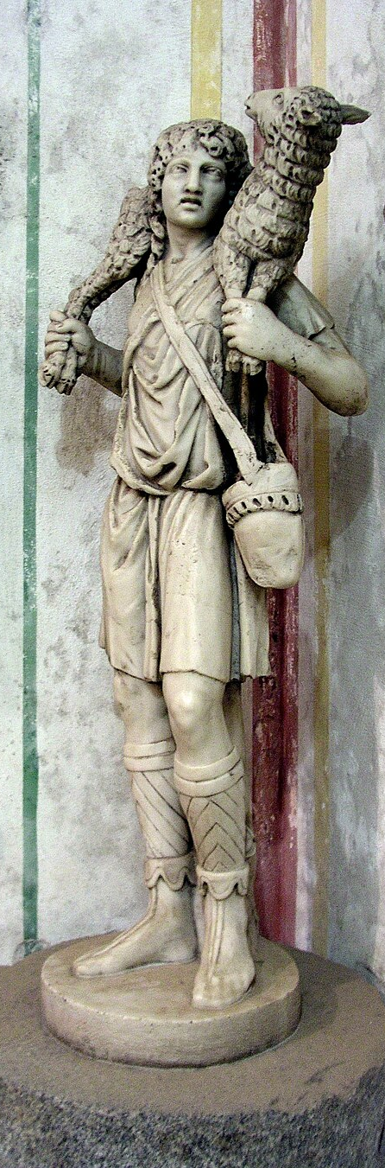
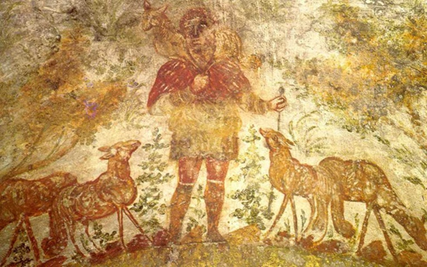
THE IMAGE OF THE GOOD SHEPHERD IS THE MOST COMMON SYMBOLIC REPRESENTATION OF CHRIST FOUND IN EARLY CHRISTIAN ART, ESPECIALLY IN THE CATACOMBS OF ROME.
Discovered in the 18th century in the Catacomb of Callixtus, this image of the Good Shepherd dates to ca. 300-350.
The earliest Christian image of Christ the Good Shepherd with a lamb on his shoulders, depicted in the Catacomb of Domitilla in Rome (ca. 2nd century)

Slide 71
Parable of the Lost Coin (15:8-10)
In the story of the lost coin, a woman with 10 silver drachmas lost one.
The value of the loss was about a day’s wages for a common laborer, but though it was not a huge amount, it probably came from the coins she wore on her headdress as part of her dowry.
Frantic over the loss, she swept the dark corners of her home, probably using a palm-twig broom, until she found it.
With joy, she invited her friends to rejoice with her.

Slide 72
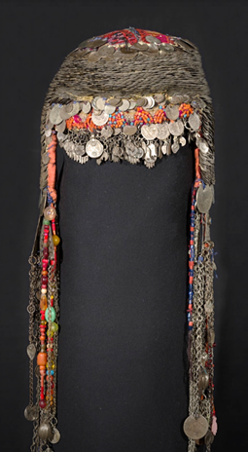
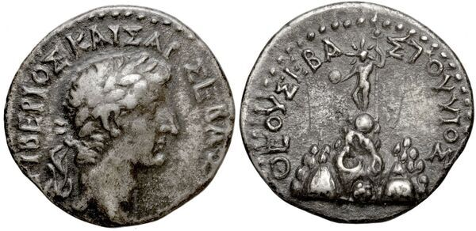
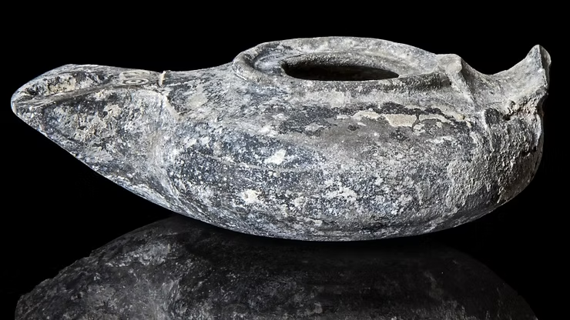
The Coin Dowry Headdress
Silver drachma with the head of Tiberius Caesar, minted in Caesarea in the 1st century
1st century oil lamp, ca. AD 25.
Southern Palestinian headdress with coins, ca. 1840s (largely unchanged since the 1st century)

Slide 73
Parable of the Prodigal Son (15:11-32)
One of the most well-known of Jesus’ parables was the lengthy story about a father and two sons.
For a Middle Eastern listener, the story had several surprising, even shocking elements.
For a son to ask his father to divide the estate, while the father was still alive, was tantamount to saying, “I wish you were already dead.”
Listeners would expect the older son to reprimand his brother and refuse to be a part, but he remained ominously silent.
Inexplicably, the father grants the request.

Slide 74
The Qesasah Ritual
The request of the younger son was also a violation of community, and the whole village would have known what was happening.
Among the Jews of the period, there was a “cutting off” ritual in which such an offense merited a public ceremony entailing the breaking of a jar in the street with the proclamation, “So and so is lost to his family.”
According to the Talmud, the sons of the family carried out the ritual.
The action of the younger son was not only a breaking of relationship with his father and brother, but equally a violation of the whole community.
Whether or not the qesasah ritual was implied in this story is unknown, but the ritual itself demonstrates the deeply offensive nature of the incident.

Slide 75
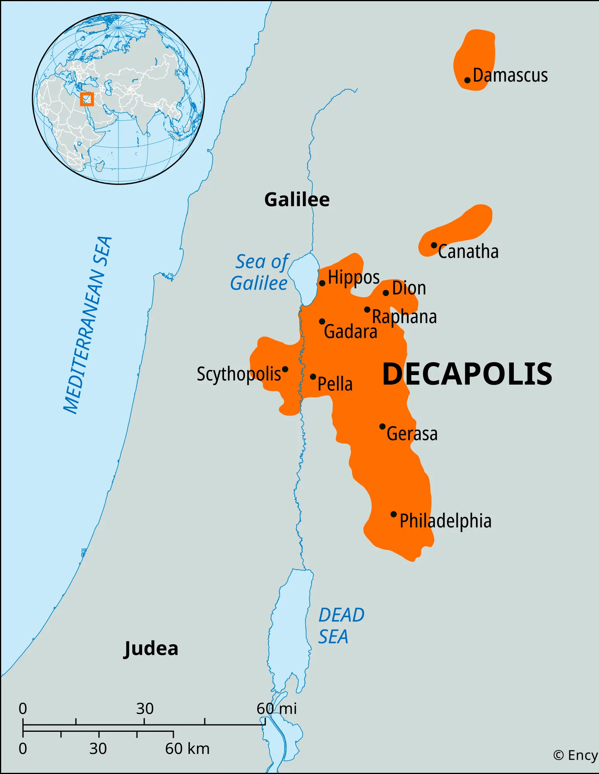
The Far Country
The younger son did not stay around very long; he would have been ostracized by everyone in the village and an object of revulsion.
He cashed out his share of the property and traveled to a “far country.”
The far country is not named in the parable, but inasmuch as the younger son ended up as a swineherd, it was probably a Gentile area, likely the Decapolis (an area to the east of the Jordan with 10 Gentile cities).

Slide 76
The Famine
In this alien territory, a severe famine reduced the younger son to herding pigs in order to survive.
He would even have eaten the pig fodder (wild carob pods, which were bitter and had little nutritional value).
This was a desperate fall for this young Jewish boy. Because he was associated with pigs, he would not have been allowed in a synagogue or a Jewish home, even if such were available.
In this extremity, he decided to go home and plead with his father to become a hired slave

Slide 77
The Waiting Father
To the surprise of the listeners, the father had been waiting.
Throwing aside dignity, he ran to meet his returning son, kissing and embracing him on the public road, which would have been in full sight of the local residents.
This would have prevented the expected shunning by the villagers.
He ordered for him the best robe, new sandals, gave him a signet ring (probably his own), and made arrangements for a celebration.
The meal of a fattened calf immediately suggests that many of the villagers would be invited (a calf was too large for a small nuclear family, since anything uneaten would spoil in a few hours).

Slide 78
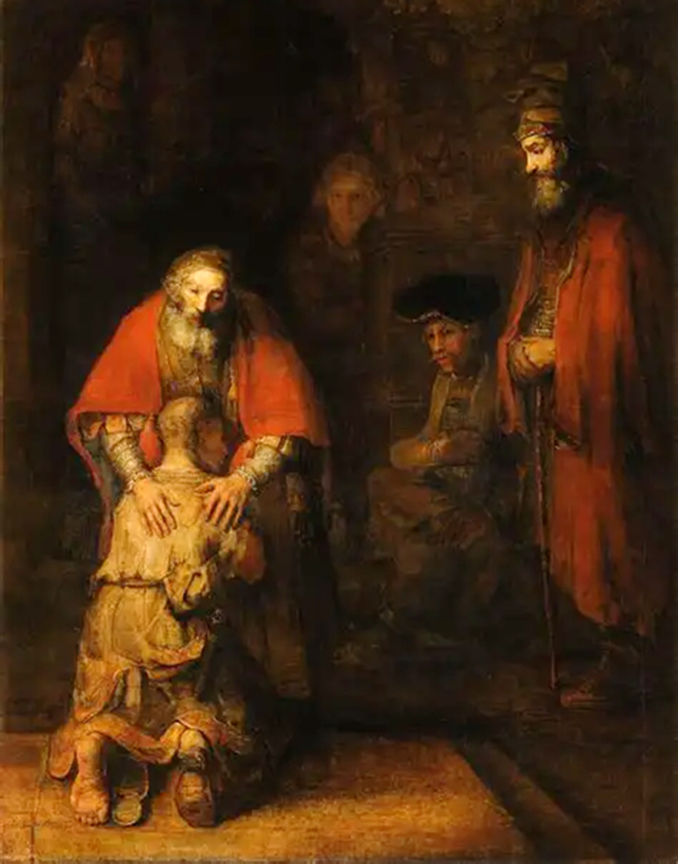
The Language of Grace
This, Jesus implied, is what God is like!
He doesn’t wait for the lost sheep to return—he seeks him out!
He would search every dark corner until he found the lost coin.
He joyfully extended forgiveness and restoration to a wayward son.
Probably not a single Jew in Jesus’ own generation had ever thought about God in quite these terms!
The Return of the Prodigal by
Rembrandt van Rijn
The Hermitage, St. Petersburg, Russia

Slide 79
The Final Question
Jesus’ story ends with the anger of the older son and the gentleness of the father in seeking to persuade him to accept his brother.
There is the sharpest contrast between the older brother’s contemptuous retort “this son of yours who squandered your property” and the father’s gentle “this brother of yours was dead and is alive again; he was lost and is found.”
Middle Eastern listeners would have expected severe chastisement for a son who publicly denounced his father, as did the older son, but here are only gentleness and grace.
There remains only the implied question: who was lost and who was found? Those who criticized Jesus for being a friend of sinners were compelled to answer it, too!

Slide 80
DISCUSSION
What is meant by the term “lost” in Luke’s trilogy of parables? What does it mean to be lost?
How is the vision of God in these parables counter-cultural to many people’s notion of God, especially in the Old Testament?

