Slide 1

4B – APOLOGISTS AND HERETICS
The Early Christians Wrestle with Issues

Slide 2
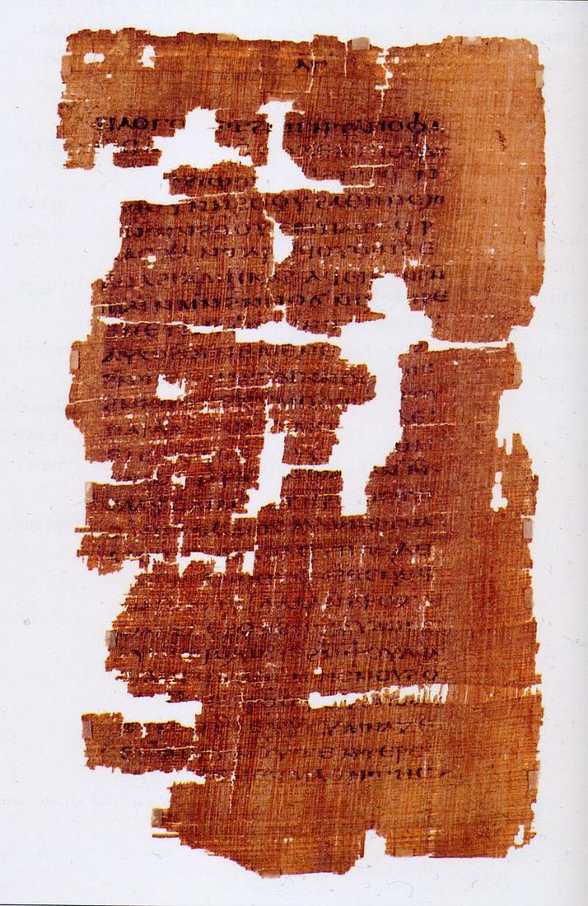
REJECTION OF GNOSTICISM
The early church fathers denounced Gnosticism as heresy and destroyed Gnostic texts.
Our knowledge of Gnostic ideas only derived from secondary sources until the middle of the 20th century.
With the discovery of the Nag Hammadi texts in Egypt in 1945, we gained first-hand access to actual Gnostic writings, which contain several additional gospels and other writings.
Page from the Gospel of Judas

Slide 3
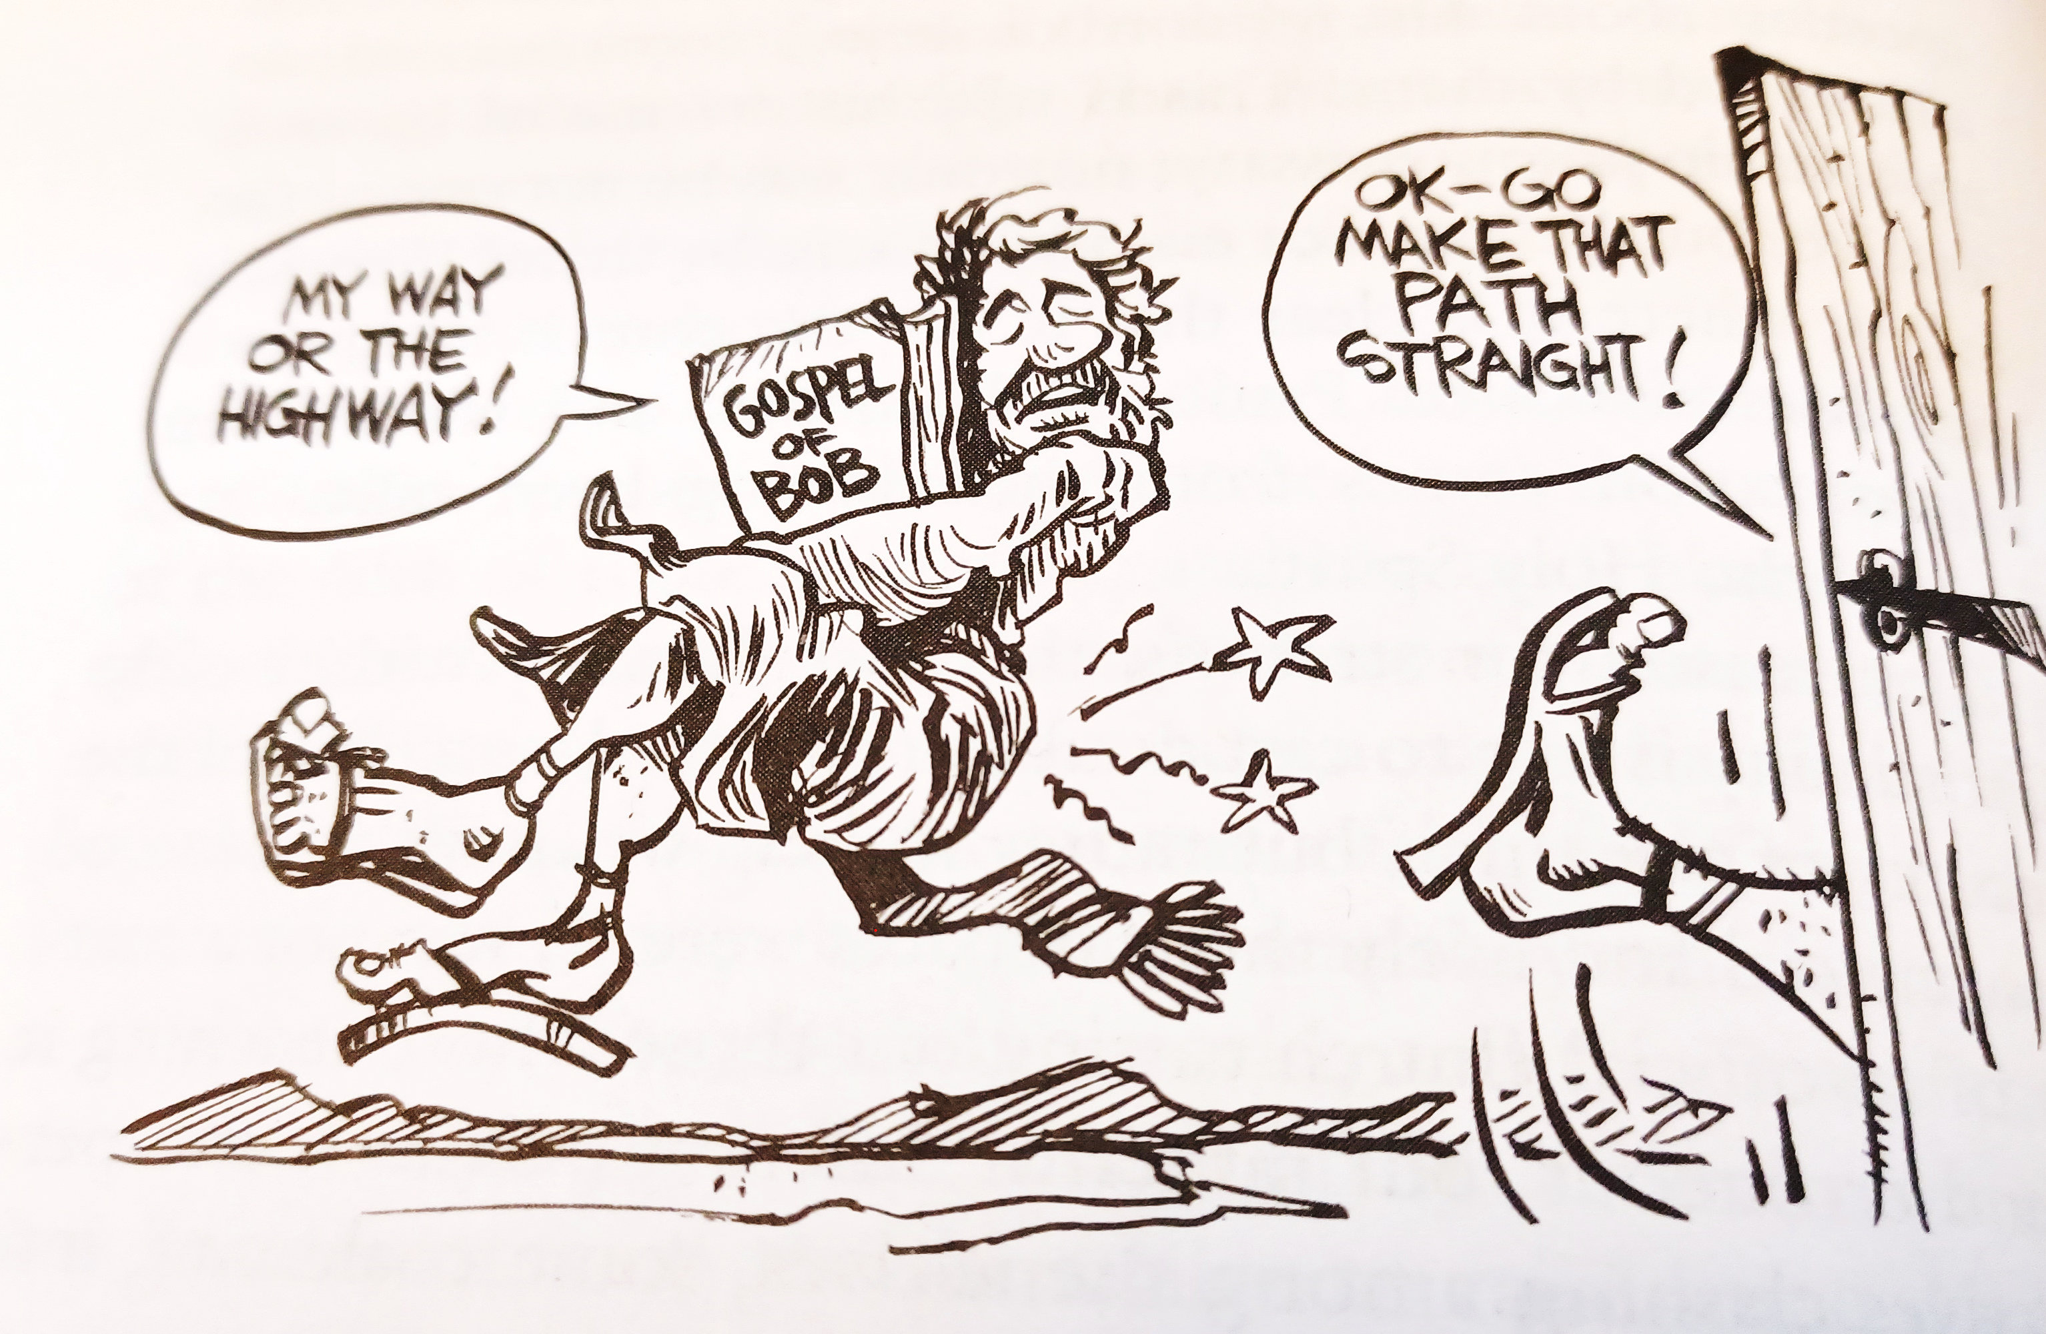
Ron Hill

Slide 4
DISCUSSION
Are there modern apologists for the Christian faith, and if so, what is their value?
Who gets to tell the story of Jesus?
With the discovery of the Gnostic literature, a number of thinkers have decided to accept these works as valid witnesses about Jesus. What do you think about this development?

Slide 5
marcion
Marcion, a teacher in Rome (c. AD 144), determined to sever Christianity from Judaism.
Like Gnostics, he did not believe that Jesus was born or had a true human body.
He also held that Jesus came from a superior God, a God of love (good God), who had nothing to do with the God of Israel, who was a God of laws (bad God).
He believed that the Old Testament should be rejected outright, along with any New Testament books that seemed to conflict with his ideas. Hence, he created his own canon of Scripture, which included 10 letters of Paul and the Gospel of Luke.
In his “two-God-theology,” Marcion held that Jesus’ death was a payment from the God of love to the God of Israel to free humans.
Due to Marcion’s abbreviated canon, the early church was now compelled to wrestle with the task of deciding which Christian writings ought to belong to the canon, so indirectly, Marcion did the church a favor. In the end, the early church would embrace the Hebrew Bible as belonging to the true canon of Scripture.

Slide 6
The montanists
Montanus, a teacher from Phrygia (near the Black Sea) and a convert from paganism, announced that the age of the Father was past, the age of the Son was past, and now the new age of the Holy Spirit had begun. He claimed that he was himself indwelt bodily by the Spirit to announce the new age.
He also announced that the end of the world was at hand, and the New Jerusalem would soon descend from heaven upon a mountain near the village of Pepuza, Phrygia.
Alongside Montanus and supporting him were his two female prophets, Maximilla and Priscilla.
Some Montanists were martyred, and some even volunteered and sought out martyrdom.
Because he was the embodiment of the Holy Spirit, Montanus supported an open canon of Scripture, while the larger church held that new revelation had ended with Jesus and the apostles.

Slide 7

Ron Hill

Slide 8
The triadic language
It is probably fair to say that in view of the triadic language in the New Testament of Father, Son, and Holy Spirit, worship preceded doctrine.
The language of Father, Son, and Spirit was widely used in the New Testament, both in concise sentences (Mt. 28:19; Ro. 15:30; 2 Co. 13:14; Ep. 2:18) as well as in longer constructions (1 Co. 12:4-6; Ga. 4:4-6; Ep. 1:3, 11, 13; 4:4-6; Tit. 4:4-6; Jude 20-21).
The Father was worshipped as God, the Son as God, and the Holy Spirit as God.
Further, while Jesus can be called God (e.g., Jn. 1:18; 1 Jn. 5:20), the Son is never addressed as the Father nor the Father as the Son.
Prayer, invariably, is directed to the Father in the name of the Son and through the Spirit (Jn. 16:23-24; Ro. 8:15b; 15:6; 2 Co. 11:31; Ga. 4:6; Ep. 2:18; 3:14; 5:20; Col. 1:3, 12; 3:17).
At the same time, the monotheism of the Old Testament is clearly upheld in the New Testament (Ro. 3:30; 1 Co. 8:4, 6; Ga. 3:20; Ep. 4:6; 1 Ti. 2:5; cf. Ja. 2:19).

Slide 9
The POST-APOSTOLIC CHURCH
This triadic language in the New Testament continued in the writings of those who followed the apostles:
"Baptize in the name of the Father, and of the Son, and of the Holy Spirit....“ (Didache 7:1, 3) c. AD 95
"....as God lives, and the Lord Jesus Christ, and the Holy Spirit…” (1 Clement 58:2) c. AD 96
“…in the Son and in the Father and in the Spirit…” (Ignatius, Magnesians 13) c. AD 114
…gives praise and glory to the Father of the universe, through the name of the Son and of the Holy Spirit....“ (Justin Martyr, 1st Apology 65) c. AD 140
“…walk according to the doctrine of the gospel of Jesus Christ; with whom be glory to God, the Father, and the Holy Spirit…” (Polycarp, Martyrdom of Polycarp 22) c. AD 155
"We acknowledge a God, and a Son His Logos, and a Holy Spirit united in power...” (Athenagoras, Plea for the Christians 24) c. AD 177

Slide 10
The modalists
Toward the end of the 2nd century, some Christians began to explore theologically the character of this triadic language.
Following the teachings of Praxeas and Sabellius, some decided that the Father, Son, and Spirit should be understood as phrases or modes through God passed: he was the Father in creation and in the Old Testament, he was the Son in the New Testament, and he became the Spirit in the life of the church. Still, essentially God was one person, a simple “one.”
There were some acute problems with this view, however:
  It directly cut across the New Testament affirmation that God created all things through the Son (Jn. 1:3, 10; Col. 1:15-17; He. 1:2)
  It failed to account for the many passages that showed a distinction between the Father and the Son (e.g., Jn. 1:1-2; 8:18; the repeating salutations in Paul’s letters acknowledging both the Father and the Son)
  It seemed in direct conflict with the New Testament affirmation that the Father sent the Son into the world, and the Son returned where he was before (Jn. 3:34; 4:34; 5:23-24, 30; 5:36-38; 6:29, 38-39, 44, 57; 7:16, 28-29, 33, etc. and Jn. 6:62; 17:5).
  It implied that the Father died on the cross (called Patripassionism).

Slide 11
Two Views
MODALISM
God is a simple “one.”
The Son is God only in a particular time and space. Sonship is only a temporary mask.
Father, Son, and Spirit are not the essence of God.
The Holy Spirit is impersonal.
TRINITARIANISM
God is a complex “one.”
Jesus is God the Son incarnate. He is the Son eternally, and this is part of his essential nature.
God is one Substance in three Persons. This IS the essence of God.
The Holy Spirit is personal.
The earliest written appearance of the word “Trinity” (triaj in Greek) to describe God comes in the writings of Theophilus of Antioch (c. AD 180). Slightly later, Tertullian (c. AD 155-220) uses the term (trinitas in Latin) as well.

Slide 12
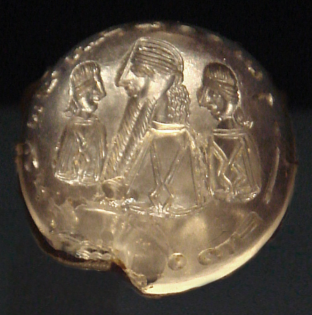
The manichaeans
Mani, a Persian of the 3rd century, claimed to have received the final, universal revelation.
  Reality consisted of two independent and eternal principles, a view similar to Gnosticism:
    Light/God
    Darkness/Matter
  Jesus, along with Zoroaster, Buddha, and others, had come so that the “souls of light” could be released from the material prison of the body. As with Marcionism, Jesus never experienced human birth. His death was in appearance only.
  Manichaeism combined features of Zoroastrianism and Indian thought with Christianity, including the idea of reincarnation.
  Manichaeism survived into the Middle Ages.
Seal of Mani with the inscription “Mani, Messenger of the Messiah”

Slide 13
DISCUSSION
Have any of the ancient heresies arisen in modern times?
Some of the heresies were attempts to blend Christianity with other world views, either philosophical or religious. Is this a problem in modernity?

