Slide 1
THE THIRD GOSPEL
Luke’s First Volume of his Two Volume Work in the New Testament

Slide 2
INTRODUCTION

Slide 3
LUKE, HISTORIAN AND THEOLOGIAN
Loukas was a 2nd generation Christian, a physician and companion of Paul (cf. Col. 4:14).
  Though not an eyewitness of the life of Jesus, he researched carefully through the eyes of others who were eyewitnesses (1:2-3).
  As a historian, he sought to compose “an orderly account” (1:1)
  As a Christian theologian, he wrote to convince others about the truth of the claims of Jesus.

Slide 4
On Writing History
Several important features are apparent in Luke’s work as a historian:
  He provides an historical framework for his account, linking the story of Jesus with known world figures like Herod the Great (1:5), Augustus Caesar (2:1), Quirinius (2:2), Tiberias Caesar, Pontius Pilate, Herod Antipas, Herod Philip and Lysanias (3:1-2).
  He also provides a Jewish context during the high priesthoods of Annas and Caiaphas (3:2).

Slide 5
An Apologia
A number of scholars have observed an apologetic motif in this gospel, an attempt to depict Christianity as harmless to the Roman Empire.
  Caesar Nero blamed the great fire in Rome in AD 64 on Christians, and after the destruction of Jerusalem in AD 70, Christianity became an illegal religion.
  Luke’s dedication of the work to his patron Theophilus (1:3) tends in this direction as does his repeated emphasis that Jesus was pronounced innocent by the Romans (23:4, 13-16, 22, 47).
  Luke depicts Jesus as a “Benefactor” or “Savior”, a title used in the Greco-Roman world to describe a leader who establishes peace (1:47; 2:11).

Slide 6
Luke as Author
Our earliest postapostolic source (Irenaeus, c. AD 180) identifies Luke as the author as does the title in the earliest extant manuscript (c. AD 200).
In the earliest canon list, the Muratorian Fragment (late 2nd century), the “Third Gospel” is listed and presumed to be Luke.
As a Gentile writing to Gentiles, Luke’s Greek diction and style are among the best in the NT.
His prologue is similar to the genre of ancient prefaces to literary works intended to be read by the public.
Together with the Book of Acts, Luke wrote approximately 28% of the NT, slightly more than Paul at 25%.

Slide 7
MURATORIAN FRAGMENT
The earliest extant listing of books in the New Testament (ca. AD 170)
“…at these, however, he was present and so he set them down. The third book of the gospel: according to Luke…”
The opening of this document has suffered mutilation; hence, the existing first line probably refers to Mark. Matthew, presumably, is the first book in the list, since Luke is referred to as the “third book”.

Slide 8
Date
The date of Luke can only be approximated.
  It must be earlier than Acts (cf. 1:1).
  Since Acts does not describe the fall of Jerusalem, some put both works as early as the mid-60s.
  The more conventional dating, however, is related to the fact that Luke is believed to have drawn on Mark’s Gospel, which likely dates to about AD 64 or 65. Hence, a suggested date in the mid-80s is not uncommon.
  Whenever it is dated, Luke clearly claims to have composed it within the living memory of those who knew Jesus personally (1:2), people who then served as guarantors for the accuracy of his record.

Slide 9
The Gospel Tradition
c. AD 100
c. AD 95
c. AD 85
c. AD 65
c. AD 50
c. AD 30
WRITTEN STAGE
Deaths of the last apostles
Gospel of John
Gospels of Matthew & Luke
Gospel of Mark
Beginning of Paul’s letters
Possible existence of small collections of Jesus’ sayings (cf. Lk. 1:1-4)
ORAL STAGE
The living voices of the apostles and other witnesses

Slide 10
The Synoptic Gospels
Matthew Luke Mark
1-28
Much is common to all three Synoptics
1-24
Much is common to all three Synoptics
1-16
Much is common to all three Synoptics
Some is common to Matthew and Luke
Some is common to Matthew and Luke
Unique to Mark
Unique to Matthew
Unique to Luke

Slide 11
Literary Relationships
All biblical scholars recognize a literary relationship between the Synoptic gospels.
They are similar in structure, chronology and content.
Of the 661 verses in Mark, Matthew has parallels for some 600 of them. Luke has parallels for some 300 of them. Matthew reproduces about 90% of Mark, some of it verbatim and much with close verbal agreement.
Matthew and Luke also have parallels to the two of them that are not in Mark.
The most widely accepted theory for these relationships is the so-called Four Source Theory

Slide 12
Four Source Theory
Mark (at the death of Peter)
(c. AD 65)
Matthew Luke
(c. AD 85) (c. AD 85)
Proto-Matthew Proto-Luke
Q?
(sayings)
Quelle = hypothetical source

Slide 13
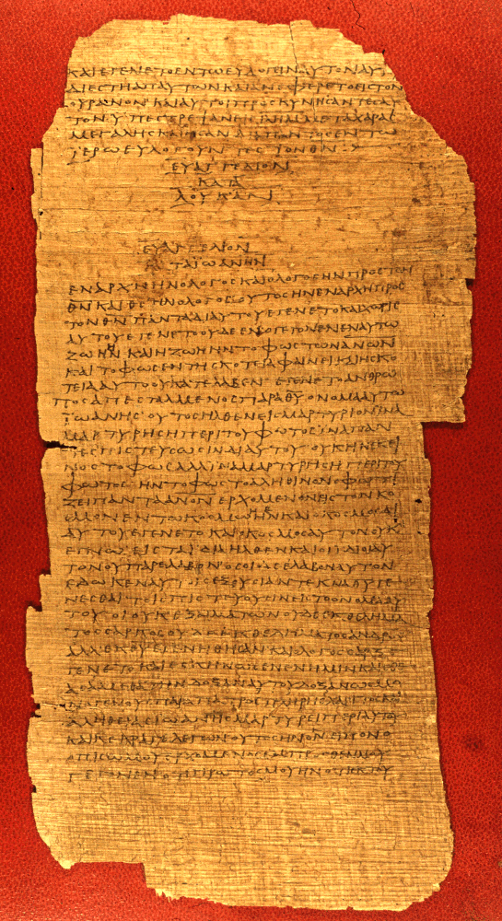
p75
Bodmer Papyrus XIV
51 surviving leaves
10.2 x 5.1 inches per leaf
38-45 lines per page
End of Luke’s Gospel and the beginning John’s Gospel
Early 3rd century

Slide 14
Structure
The Third Gospel easily divides into four major blocks of material:
  The birth and infancy narratives (1-2)
  The Galilean ministry (3:1—9:50)
  The travel narratives (9:51—19:44)
  The passion narratives (19:45—24:53)

Slide 15
GEOGRAPHICAL CHIASMUS
LUKE
ACTS
GALILEE A
SAMARIA/JUDEA B
JERUSALEM C
A’ NATIONS
B’ JUDEA/SAMARIA
C’ JERUSALEM
D
ASCENSION

Slide 16
THREE EPOCHS
In addition to the geographical motif, Luke-Acts has three distinguishable time periods, each with theological significance.
PERIOD OF ISRAEL
Luke demarcates between the Period of Israel and the coming of Jesus (16:16).
PERIOD OF JESUS
The larger portion of the Third Gospel is given to the ministry of Jesus, the Savior and Messiah.
PERIOD OF THE CHURCH
He also demarcates between the Period of Jesus and the Period of the church (Ac. 1:1-2 8).
The law and the prophets were proclaimed until John. Since that time, the good news of the kingdom of God is being preached… (Lk 16:16)

Slide 17
Style
Luke-Acts is written in very excellent Greek, ranging from the formal rhetoric of his prologues to the standard style in the body of the two works. His style follows the ancient practice of prosopopoeia (fitting his style to the occasion).
His “Bible” of choice seems to have been the Septuagint, from which he regularly quotes.
His concern for accurate historicity shows a remarkable knowledge of Roman culture, practices and legal procedures.
“…it is a perpetual puzzle to me how New Testament Greek got the reputation of being easy. …St. Luke I find particularly difficult.” C. S. Lewis

Slide 18
THEOLOGICAL THEMES
Several important themes emerge in the Third Gospel.
  In the theme of amazement, Luke uses a cluster of words to demonstrate the power of the Christ event. People are awed, astonished, perplexed, amazed and afraid.
  There is a marked emphasis on prayer, especially the prayers of Jesus.
  The active work of the Holy Spirit figures prominently in Luke, and this emphasis will continue in the Book of Acts.

Slide 19
Amazement
Luke’s vocabulary of amazement is rich and plentiful:
  qauma<zw = to marvel (1:21, 63; 2:18, 33; 4:22; 8:25; 9:43; 11:14, 38; 20:26; 24:12, 41)
  e]kplh<ssomai = to be amazed (2:48; 4:32; 9:43)
  e]ci<sthmi = to be astounded (2:47; 8:56; 24:22)
  e]ksta<sij = bewilderment (5:26)
  qa<mboj = wonder (4:36; 5:9)
  fobe<w = to be afraid (2:9; 8:25, 35; 9:34, 45)
  fo<boj = fear (1:12, 65; 2:9; 5:26; 7:16; 8:37)
  a]pore<w = to be at a loss (24:4)

Slide 20
Prayer
Both in Jesus’ own prayer life as well as his teachings, prayer occupies a central role:
  Jesus prayed at his baptism (3:21), in lonely places (5:16), sometimes in the mountains (9:28), sometimes all night (6:12), often in private places (9:18), for Peter (22:32), in Gethsemane (22:39-44) and on the cross (23:46).
  It was the striking prayer life of Jesus that prompted the disciples’ question, “Lord, teach us to pray,” and Jesus’ answer with what we call “The Lord’s Prayer” (11:1ff.).
  It is Luke who provides us with Jesus’ parables about prayer (11:5-13; 18:1-8; cf. 10:2).

Slide 21
The Holy Spirit
Beginning with the birth narratives, Luke heralds the return of the quenched prophetic Spirit which had not been active since the last of the writing prophets.
  John the Baptist (1:15), Mary (1:35), Elizabeth (1:41), Zechariah (1:67) and Simeon (2:26-27) were all filled with the Spirit.
  Jesus himself was full of the Spirit (3:22; 4:1, 14, 18; 10:21)
  Jesus would be both the bearer of the Spirit and the giver of the Spirit (3:16; cf. 11:13; 24:49; Ac. 2:33).

Slide 22
THE BIRTH AND INFANCY NARRATIVES

Slide 23
RENEWAL OF GOD’S REDEMPTIVE WORK IN THE HISTORY OF SALVATION
The first two chapters of Luke set the stage for the entire gospel.
  Like Matthew, they tell the birth stories of Jesus, but unlike Matthew, they do so from the standpoint of the women rather than the men.
  In these stories there is a sense of a new beginning—but with pronounced links to the ancient history of Israel and God’s promises.
  God who had been silent in speech for four centuries was now once more speaking through the Spirit.

Slide 24
The Birth Narratives
MATTHEW
(from Joseph’s view)
Genealogy (1:1-17)
Virginal Conception of Jesus (1:18-25)
Visit of the Magi (2:1-12)
Flight to Egypt (2:13-18)
Return to Nazareth (2:19-23)
LUKE
(from Mary’s view)
Annunciation of John (1:5-25)
Annunciation of Jesus (1:26-38)
Mary visits Elizabeth (1:39-56)
Birth of John (1:57-80)
Birth of Jesus (2:1-7)
Adoration of shepherds (2:8-20)
Dedication (2:21-40)

Slide 25
Primary Themes
Several important theological themes emerge in Luke’s birth & infancy narratives:
Jesus’ birth was attended by the gift of the Holy Spirit (John’s father, John’s mother, John, Mary, others).
Jesus’ birth was a miracle of virginal conception.
Jesus was the direct descendant of King David through Mary (natural pedigree).
Heaven itself (angels) attended this climactic event unlike anything else in the entire history of Israel.
An international motif is present: Luke traces Jesus’ line back to Adam.
Even at an early age, Jesus demonstrated that his rightful place was among those interpreting Scripture.

Slide 26
The Pattern of Annunciations
The annunciations of the birth of John as well as Jesus follow a stereotypical pattern from the Old Testament (cf. Ge. 16:7-12; 17:1-3, 15-21; 18:1-2, 9-15; Jg. 13:2-21).
  Appearance of an angel
  The person is saluted by name and urged not to be afraid.
  A pregnancy is announced and explained.
  The child is named in advance with an explanation of the meaning of the name.
  The future accomplishments of the child are indicated.

Slide 27
The Annunciation of John (1:5-25)
Luke does not immediately introduce the reader to Jesus. Rather, he begins with the birth of John which serves to lead the reader more gradually into the story of Jesus.
  Zechariah, a priest in the 8th of the 24 orders established by David (1 Chr. 24:1-19)assigned to serve in rotation twice per year, was chosen by lot to burn incense.
  Because he was struck mute, he was unable to give the priestly benediction after emerging from the sanctuary (cf. Sirach 50:19-24).

Slide 28
Pattern of Jewish Marriage
STAGE ONE: BETROTHAL
Usually arranged for the young woman (girl) between 12 and 12 ½ years of age
Parentally arranged
Gift of the Mohar (bride price) in the presence of witnesses
Betrothal was permanent; it could be broken only by divorce
STAGE TWO: HOMETAKING
Usually about a year after betrothal
Transfer of the bride from her parental home to her husband’s home
Wedding feast

Slide 29
The Annunciation of Jesus (1:26-38)
Six months later, Mary, a young girl engaged to be married to Joseph, was confronted by the angel Gabriel.
  The name of her son would be called Yeshua (Jesus in Greek; Joshua in Hebrew).
  In language parallel to the ancient promises, he would revive the long-hoped for Davidic kingship (compare Lk. 1:32-33 with 2 Sa. 7:9, 13-14, 16).
  Mary responded to this event with humility and faith.

Slide 30
Mary Visits Elizabeth (1:39-56)
Traveling southward from Galilee to Judea, Mary discovered that what the angel told her was true—Elizabeth also was pregnant.
  The reaction of the unborn John to the unborn Jesus reinforces Luke’s emphasis that Jesus had priority over John.
  Mary’s Song, called the Magnificat (Latin), draws deeply from the ancient Song of Hannah (1 Sa. 2:1-10) as well as from the Psalms and the Prophets.

Slide 31
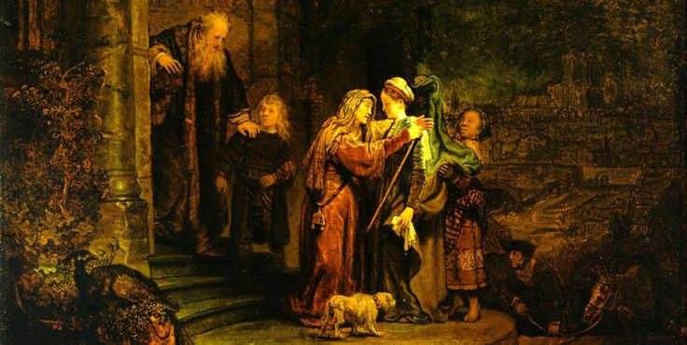
Rembrandt’s “The Visitation” (Detroit Institute of Arts)

Slide 32
The Birth of John (1:57-80)
When John was born, Zechariah named him John, and after naming the child, his speech returned.
  Zechariah’s Spirit-inspired prophecy reinforced the basic theme of the coming of the Davidic son and the redemption of Israel as the fulfillment of God’s covenant promise.
  Further, John, who was born with the “spirit and power of Elijah” (1:17; cf. Mal. 4:5-6), would be the forerunner to prepare the way for Jesus (Isa. 9:2; Mal. 3:1).

Slide 33
The Birth of Jesus (2:1-20)
The birth of Jesus occurred during a trip from Galilee to Joseph’s ancestral home in Judah to register for Roman taxation.
The earliest Christian traditions indicate that Jesus was born in a cave (Protoevangelium of James, 18-19; Justin Martyr’s Dialogue with Trypho, LXXVII).
The angelic message to the Bethlehem shepherds included three highly important titles:
  Swth<r (= Savior, a widely used title for the Roman emperor)
  Xristo<j (= Messiah, the anointed, the king from David’s family)
  Ku<rioj (= Lord, the standard LXX rendering of the name Yahweh)

Slide 34
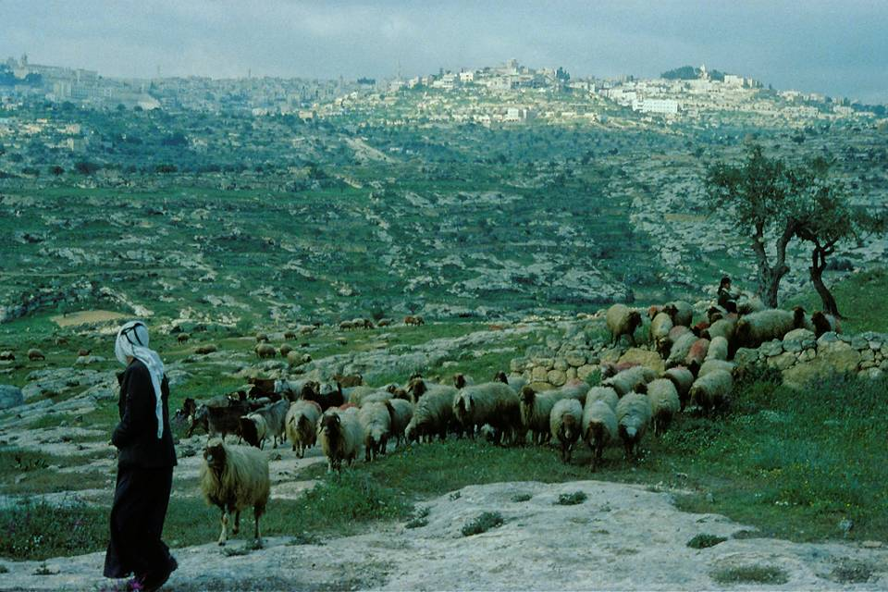
Bethlehem

Slide 35
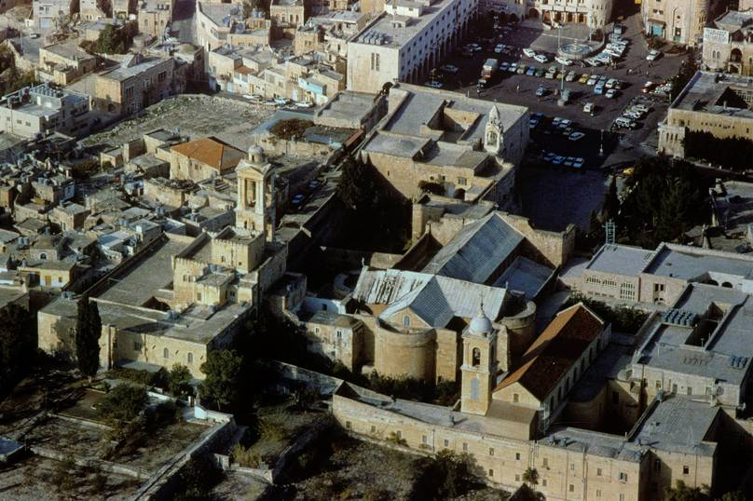
Church of the Nativity, Bethlehem

Slide 36
The Historical Problem of Quirinius
Luke identifies the taxation census for which Joseph and Mary registered as during the tenure of Quirinius’ as governor of Syria, which is known to be in AD 6 after Archelaus was deposed. Herod the Great (1:5; cf. Mt. 2), who was king in Matthew’s gospel at the birth of Jesus, died in 4 BC.
SOLUTION 1: Some suggest that Quirinius may have served two terms, the known tenure beginning in AD 6 but an earlier tenure around 4 BC, but ancient records show nothing of such a double tenure.
SOLUTION 2: Historical critical scholars say Luke was simply mistaken in his historical notation about Quirinius.
To date, there has been no satisfactory resolution to this problem.

Slide 37
The Temple Ritual (2:21-40)
As Torah observant Jews, Joseph and Mary had Jesus circumcised on the 8th day after his birth and then dedicated at the temple 40 days after his birth (cf. Lv. 12:1-8).
  The sacrifice they offered was the offering specified for the poor (cf. Lv. 12:6-8), which in turn implies that the magi in Matthew’s gospel had not yet visited.
  During the presentation, two devout elderly Jews, Simeon and Anna, blessed the child, each prophetically reinforcing the theme of God’s fulfilled promises and the child’s universal mission.

Slide 38
The First Temple Visit (2:41-52)
This account is the only one in the canonical gospels about Jesus between his birth and the beginning of his public ministry.
Later apocryphal gospels attempt to fill in this gap with fanciful stories (e.g., Infancy Gospel of Thomas).
Temple visits were incumbent upon all males, and typically they began these visits a year or two before they were 13, the year they began to assume adult responsibilities.
Luke obviously intends Jesus’ words about “the [affairs] of my Father” to have maximum impact.

Slide 39
BAPTISM, TEMPTATION & REJECTION

Slide 40
THE MINISTRY OF JOHN (3:1-20)
As all four gospels attest, the beginning of Jesus’ ministry was inextricably tied to the ministry of John the Baptist.
  Luke carefully places the ministry of John in the historical context of Greco-Roman and Jewish history, which would be important to an educated Gentile readership.
  Luke introduces John with the familiar Old Testament language of a prophet, “The Word of God came to John…”
  Like the ancient prophets, John’s message was repentance.

Slide 41
John’s Preaching & Baptisms
John’s challenge to repent and be baptized implied that God’s elect needed purification. His warning not to claim a pedigree in Abraham was a frontal assault on the accepted belief that the people of God were defined by birth.
Proselyte baptisms were well-known.
Baptisms before entering the temple precincts were well-known.
Ritual purification baptisms (impurity from menstruation, nocturnal emission, child-birth, or contact with a corpse) were well-known.
Slave baptisms into Jewish households were well-known.
John’s baptism was not directly linked to any of these known baptismal practices, but instead, was directed toward a general “forgiveness of sins”, which in turn implied that the people of Israel were alienated from God.

Slide 42
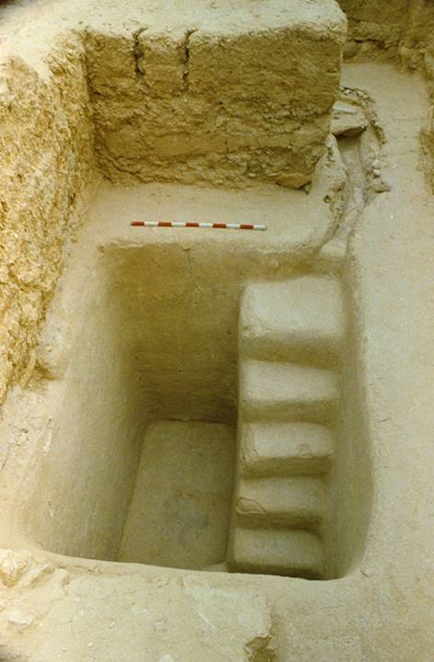
Second temple mikveh (baptismal pool) excavated near the stairway at the southern wall of the temple mount.
It would have been in use during the time of Jesus.

Slide 43

The traditional site of John’s baptism near Jericho and the Desert of Judea (3:1).
Later the Fourth Gospel will also say that John baptized at Aenon (Jn. 3:23), which is much farther north, about 6 miles south of Beth Shan.

Slide 44
John’s Ethical Preaching
Luke gives an expanded account of John’s preaching unavailable in the other gospels, sermons with a strong ethical component.
  He advised the crowds to share their staples of life with the needy, an ethical concern clearly voiced by the ancient 8th century prophets.
  He advised tax collectors and soldiers about fairness, since they often were in positions to exploit others with impunity.

Slide 45
Baptism of Spirit and Fire
John’s prediction of one coming after him who would baptize with the Spirit and fire immediately presupposes the priority of Jesus over John himself.
The first image concerns the gift of the Spirit that would be poured out at Pentecost (Ac.1:5; 11:15-17). Jesus would be both the bearer of the Spirit and the giver of the Spirit.
The second image refers to eschatological judgment (cf. Mal. 4:1).

Slide 46
JESUS’ BAPTISM & GENEALOGY (3:21-37)
The baptism of Jesus has a different emphasis in Luke than in the other gospels.
  Luke’s emphasis is on prayer: Jesus was praying as he was being baptized, and the descent of the Spirit while he was being baptized empowered him for his messianic role.
  Jesus was about 30 when he was baptized, the appropriate age for ministry (Nu. 4:1-3, 47; 8:23-24; cf. 2 Sa. 5:4).
  His descent was traced back through David, Abraham and Adam—the royal family, the Israelite nation and the whole human race.

Slide 47
THE TEMPTATION (4:1-13)
“Full of the Spirit,” Jesus left the Jordan River and was led by the Spirit into the desert where he fasted and was tempted for 40 days by the devil.
  Just as God’s ancient “son” passed through the wilderness of temptation (cf. Ex. 4:22; Dt. 8:2, 5), now his true Son would experience the same test of faithfulness.
  The 40 days of fasting parallels Israel’s 40 years of sojourn.
  That Jesus was led “by the Spirit” suggests that the initiative lay with God, even though the agent of temptation was Satan.
  The ground of the temptation was Jesus’ identity : “…if you are God’s Son…”
  The issue was whether Jesus would trust in the Father or take matters into his own hands to reach his goals.

Slide 48
“Yahweh your God led you all the way in the desert these forty years to humble you and to test you in order to know what was in your heart, whether or not you would keep his commands.” (Dt. 8:2)
In the end, it is more than incidental that the portions of Torah Jesus quoted were all drawn from passages about the ancient sojourn and testing (cf. Dt. 8:3; 6:16; 6:13).

Slide 49
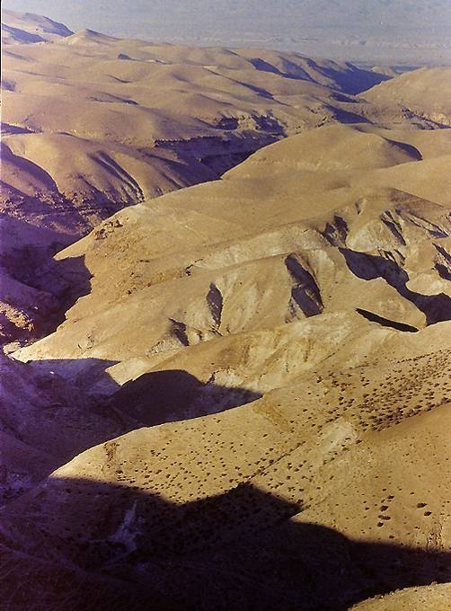
The desert of Judea, the barren wasteland which was the site of the temptations, stretches from the Jordan Rift toward Jerusalem for about a dozen miles.

Slide 50
The Ancient Synagogue Service
(according to the Mishnah)
The ancient synagogue service consisted of two primary activities, prayer and the study of Scripture:
Opening benedictions (call to “bless” the Lord)
Recitation of the Shema (Deut. 6:4-9; 11:13-21; Num. 15:37-41)
Prayer (from the lectern)
The Eighteen Benedictions (from before the Torah ark) to which the congregation responded, “Amen.”
Public reading of the Torah
Public reading of the Prophets
Sermon (exposition of Scripture)
Concluding benediction

Slide 51
REJECTION AT NAZARETH (4:14-30)
Jesus left the desert of temptation “in the power of the Spirit” and began teaching in the Galilean countryside.
  At Nazareth, his home town, he was selected to read from the scroll of Isaiah.
  He unrolled the scroll until he found the passage at 61:1-2, which he read, stopping in the middle of the sentence (omitting the saying about judgment).
  As the congregation sat expectantly awaiting his comments, he said simply, “Today this Scripture is fulfilled in your hearing.”
  Amazement was followed by incredulity, rejection and a charge of blasphemy with the threat of death, but Jesus simply walked away unharmed.

Slide 52
EARLY MINISTRY

Slide 53
THE BEGINNINGS OF MINISTRY (4:31-44)
From Nazareth, Jesus moved to Capernaum on the Galilean lakeshore.
  In broad strokes, Luke sketches Jesus’ early ministry of teaching, exorcisms and healings.
  Jesus sought to keep his messianic identity a secret, demanding that demons not recognize him.
  Luke also begins his language of amazement on the part of the crowds, raising the most basic question, “Who is Jesus?”

Slide 54
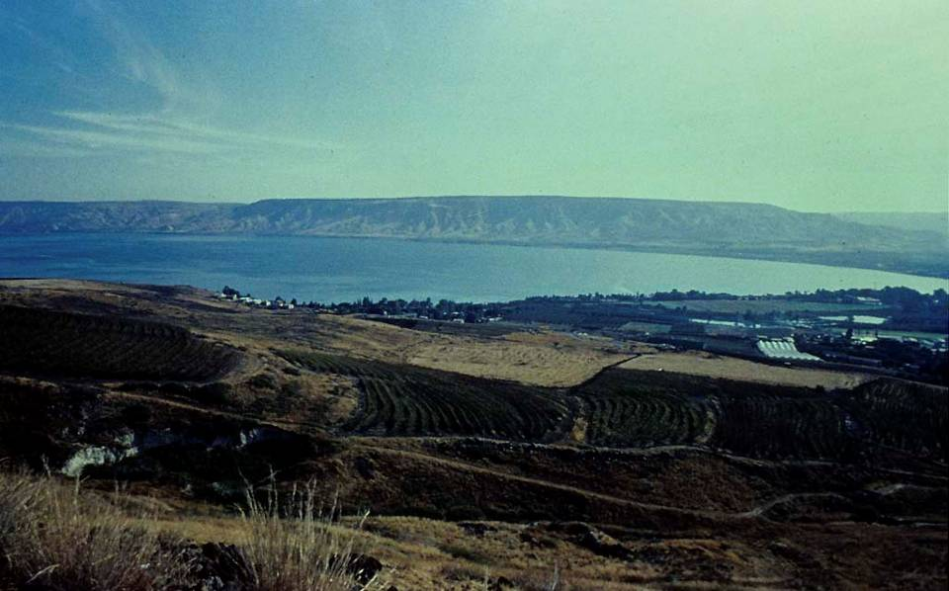
The Geographical Shift
(from Nazareth to Capernaum)
Sea of Galilee looking eastward. The lake is about 8 miles across (east to west) and about 13 miles long (north to south).

Slide 55
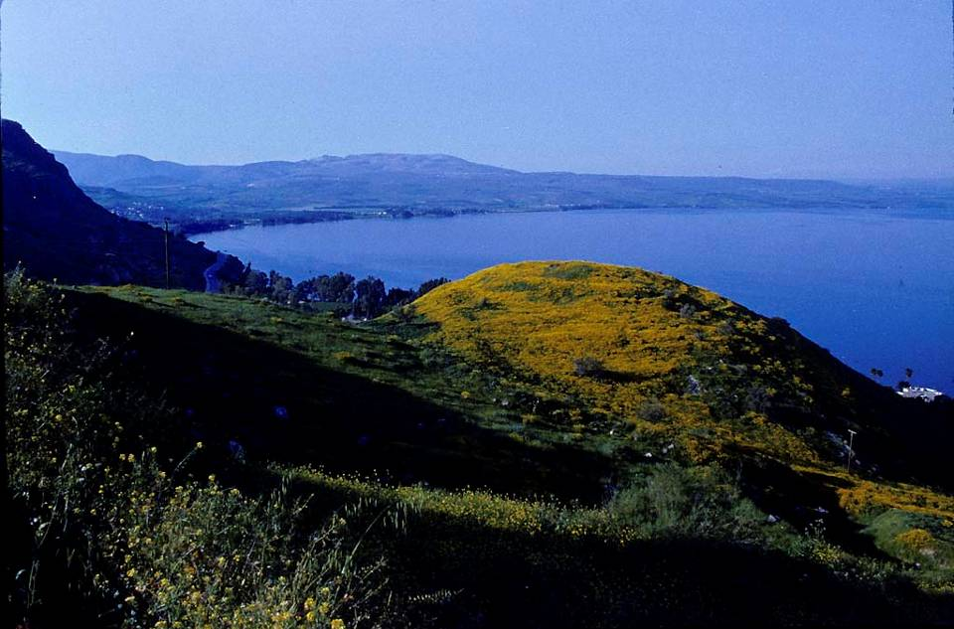
Sea of Galilee

Slide 56
THE FIRST DISCIPLES (5:1-11, 27-32)
Early on, Jesus began choosing special individuals to be close to him and to share in his ministry.
  Luke’s favorite word by which these disciples would address Jesus is e]pista<thj (= “master”), and Luke is the only gospel-writer to use this title, probably because it was more understandable to his non-Jewish audience than the Hebrew term “rabbi”.
  Simon, James and John, who fished together, along with Levi (probably Matthew), were all called.

Slide 57
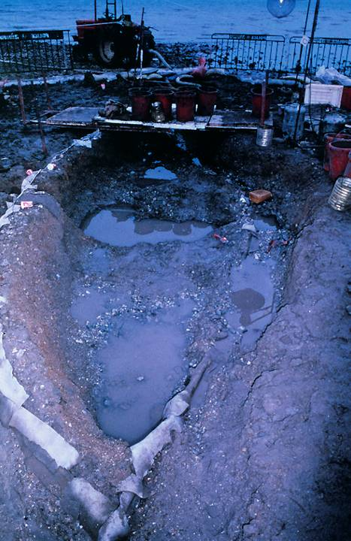
Galilee Boat
In 1986 during a low water level in the Sea of Galilee, an ancient boat was discovered and excavated under the direction of Dr. Rami Arav of the University of Haifa. This is the first ancient boat of its kind to be recovered, and it was dated to the 1st century, based on pottery and coins found inside it. Though there is no indication that Jesus or his disciples ever used it, it has popularly become known as “the Jesus boat”, since it would have been very much like the ones used by fishermen in Galilee in Jesus’ day.
View taken at the beginning of the excavation.

Slide 58
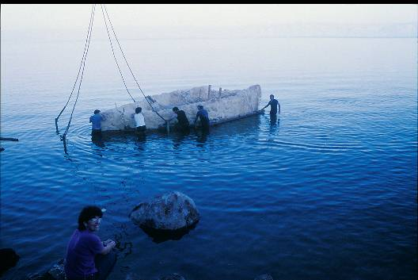
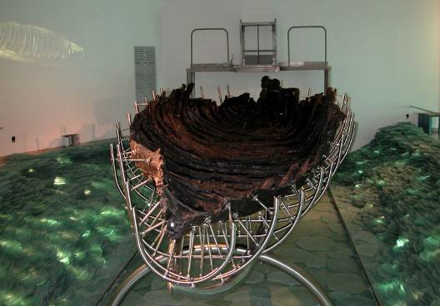
After its excavation, the ancient boat was swathed in polyurethane to preserve it and floated across part of the Sea of Galilee to a site where it could be safely housed and treated for preservation.
The boat was submerged in a chemical bath for several years to fill all the wooden cellular structures with wax (polyethylene glycol) in order to continue its preservation. Now it is on display at a special center at Ginosaur.

Slide 59
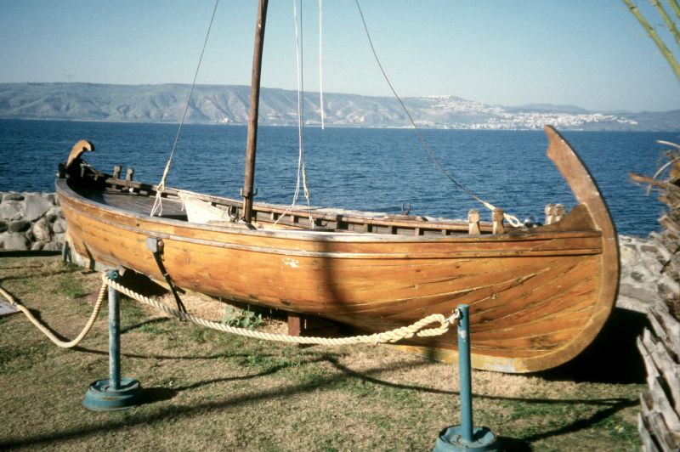
Full-size model of the so-called “Jesus Boat”

Slide 60
LORDSHIP & AUTHORITY (5:12-26, 33-39; 6:1-11)
In several periscopes, Luke describes Jesus’ lordship and authority in healings and teachings.
  The idea of lordship in the ancient world always denoted authority, either by ownership (to slaves), by superiority to inferiors (using the address “lord” or “sir”) or by divine right (when speaking of a deity).
  Jesus shows his authority over sickness (the leper), sin (the paralytic) and religious tradition (the Sabbath controversies).

Slide 61
Sabbath Controversies
Conflict over traditional observances, especially the Sabbath, are prominent in Jesus’ ministry in all four gospels.
  By taking to himself the title “Lord of the Sabbath”, Jesus was effectively putting himself as equal with God, who had created the Sabbath.
  Jesus compared such traditions to putting new wine into old skins (the skins would break because of fermentation) or sewing a new patch on an old garment (the new patch would shrink, causing the garment to tear).

Slide 62
The Heart of the Sabbath Controversies
The Torah (the written law)
The five books of Moses comprised the Torah (= the instruction).
The Torah was the oldest and most revered part of the Holy Scriptures.
Jesus referred to the Torah by the phrase “it is written”.
The Halakah (the oral tradition)
Derived from the Hebrew word “to walk”, the Halakah was the so-called Oral Torah believed to be from God but not contained in the written Torah.
Sabbath regulations generally fell into this category.

Slide 63
“I am trying here to prevent anyone saying the really foolish thing that people often say about Him: ‘I’m ready to accept Jesus as a great moral teacher, but I don’t accept his claim to be God.’ This is the one thing we must not say. A man who was merely a man and said the sort of things Jesus said would not be a great moral teacher. He would be either a lunatic—on a level with the man who says he is a poached egg—or else he would be the Devil of Hell. You must make your choice. Either this man was, and is, the Son of God: or else a madman or something worse. You can shut Him up for a fool, you can spit at Him and kill Him as a demon; or you can fall at His feet and call Him Lord and God. But let us not come with any patronizing nonsense about His being a great human teacher. He has not left that open to us. He did not intend to.”
C. S. Lewis

Slide 64
The Jewishness of Jesus
Jesus’ basic language seems to have been Aramaic (based on the several Aramaic logia in Mark’s Gospel, cf. 5:41; 7:34; 15:34). However, it also is not unlikely that he understood Greek, given the proximity of Sepphoris, a Greco-Roman city, to Nazareth (about 4 miles).
As would have been true of most Jewish boys, Jesus was trained in the trade of his father as a carpenter or mason (cf. Mk. 6:3; Mt. 13:55). The term te<ktwn (= one who constructs) could be used of both wood workers or masons, though Justin Martyr (early 2nd century) records that Jesus made “plows and yokes”, cf. Dialogue with Trypho 88.8.

Slide 65
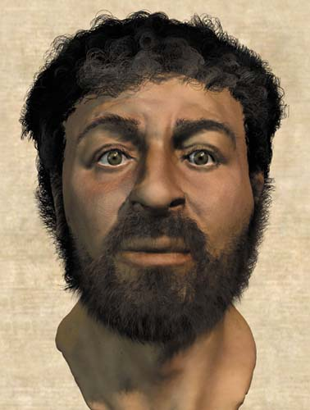

What did Jesus look like?
No one knows, of course, but two images, quite different from each other, have captured the popular imagination
Based on skeletal remains of 1st century Jews, British forensic anthropologists reconstructed a “typical” Jewish face. For more sensationalist reasons, their reconstruction was billed as the “real face of Jesus” (National Geographic, Dec. 2002).
The negative image (here shown as a positive) on the highly controversial Shroud of Turin

Slide 66
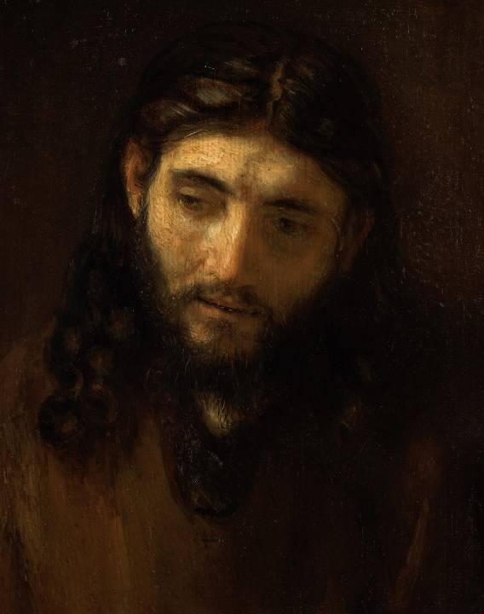
Rembrandt was the first artist to use Jewish models, Sephardic Jews in Amsterdam, for his portraits of Jesus.

Slide 67
Questions Historians Must Answer
N. T. Wright has offered the basic historical questions that must be answered with respect to Jesus:
How does Jesus fit into the Judaism of his day?
What were Jesus’ aims?
Why did Jesus die?
How did the early church come into being, and why did it take the shape it did?
Why are the gospels what they are?
Does it matter?

Slide 68
THE TWELVE APOSTLES (6:12-16) the number “12” seems to have been a deliberate play on the original twelve clans of Israel
SIMON, nicknamed Kephas (Aramaic) or Peter (Greek)
ANDREW, brother of Simon
JAMES, first apostle martyr
JOHN, brother of James, both nicknamed “sons of thunder”
PHILIP, also from Bethsaida
BARTHOLOMEW, presumably the same as Nathanael
MATTHEW, presumably the same as Levi
THOMAS, called Didymas (= the twin)
JAMES BAR ALPHAEUS, sometimes called “James the Less”
SIMON, designated the “Cananaean”, referring to a branch of zealots
JUDAS BAR JAMES, presumably the same as Thaddaeus
JUDAS ISCARIOT, the treasurer of the group who betrayed Jesus

Slide 69
THE GREAT SERMON

Slide 70
THE GREAT SERMON (6:17-49)
Like Matthew (5-7), Luke offers an extended example of Jesus’ teaching.
  There are some differences, and Luke’s version is shorter, but they have several themes in common.
  It is likely that Jesus taught on the same subjects on more than one occasion, which would be natural in that he was traveling from village to village; hence, many scholars suppose that this sermon is a composite of the sorts of things Jesus taught at various times.
  People came from as far away as Jerusalem to the south and Phoenicia to the north to listen to Jesus, many with sicknesses and others with evil spirits, and he healed them.

Slide 71
Four Ways of Understanding the Great Sermon
Perfectionism: You must do all this in order to be saved!
Impossible Ideal: You ought to have done all this—see what poor creatures you are!
Interim Ethic: Pull yourselves together, the world will end soon!
Living Faith: You are forgiven, so live a new life out of thankfulness!

Slide 72
Blessings and Woes
Beatitudes
As in Matthew, Jesus offering blessing to the poor, the powerless and the persecuted.
He assured his disciples that the present life was temporary, but in the future life, the rewards would be great.
Woes
Like the prophets of old, Jesus also voiced woes to the rich, the well fed and the proud.
Their reward was only what they could garner in this life alone.

Slide 73
Loving Others
The reversal of values in the kingdom of God must not be limited merely to one’s physical circumstances in life.
  It must extend to concrete action, including loving one’s enemies and doing good to and praying for those who oppose you (cf. La. 3:30).
  Loves is characterized by generosity and an open hand to those who cannot repay, a true reflection of the grace of God.

Slide 74
Judging Others
Condemnation must give place to forgiveness.
  Just as Jesus offered forgiveness to sinners and compassion to untouchables, so his followers, if they are good learners, should follow his pattern.
  Critique must be turned inward toward self-examination, not outward toward the faults of others.

Slide 75
The Test of Discipleship
The real test of discipleship is not in saying, “Lord, Lord,” but in obeying his teachings.
  The essential goodness of a person will be demonstrated by speech and action.
  Those who are truly obedient are like the wise who build on solid ground; they build against the storm.
  Those who do not build against the storm are those who listen but do nothing to change their ways.

Slide 76
THE COMPASSIONATE TEACHER

Slide 77
DOING GOOD (7:1—8:56)
In Acts, Luke records Peter’s words that Jesus “went around doing good and healing all who were under the power of the devil, because God was with him” (cf. Ac. 10:38).
  The cluster of stories beginning in chapters 7-8 fit this description closely.
  They describe Jesus’ healings, some of his parables and his confrontation with death and demonization.
  At various points he would interact with adherents to one or other of the Jewish religious sects.

Slide 78
Major Jewish Sects described by Flavius Josephus
Pharisees
Middle-class separatists
Lay theologians
Upheld both oral and written Torah
Closely allied with scribes (copyists)
Linked with the synagogues
Essenes
Ascetics with a high value on apocalyptic literature
Held that the priesthood was corrupt and saw themselves as the true Israel in exile
Qumran was possibly Essene
Sadducees
Upper-class, mostly priests
Upheld the supremacy of the written Torah
Primary influence in the Sanhedrin and Second Temple
Rejected resurrection & angels
Zealots
Patriotic freedom-fighters
Upheld Maccabean idealism
Opposition to Rome was an expression of zeal for the Torah
Central to the 1st and 2nd Jewish Revolts

Slide 79
The Issue of Ritual Impurity
Various sorts of contact caused ritual impurity, which meant that one was barred from temple worship. Typically, Jews would have avoided all such contact.
In offering to go with the Roman officer to his home (7:6), Jesus became vulnerable to ritual impurity from contact with pagans (Jn. 18:28).
In touching the dead son of the widow in Nain and the dead daughter of Jairus, he reversed the ritual uncleanness of contact with a corpse by raising them from the dead (7:14; 8:54; cf. Lv. 19:14; Nu. 19).
In allowing himself to be touched by a sinful woman, he reversed her defilement by offering her forgiveness (7:39; 47).
In his robe being touched by the woman with the hemorrhage, the ritual uncleanness of contact with blood was reversed by Jesus’ act of healing (8:44; cf. Lv. 15:25-27, 31).

Slide 80
Jesus and John
John the Baptist had been imprisoned by Herod because of his rebuke to Herod for violating the Torah by marrying his sister-in-law (3:19-20; cf. Lv. 18:16).
John’s question via his disciples has long puzzled interpreters in light of John 1:26-36. Did John have second thoughts about Jesus, and if so, why?
Jesus’ advice to John (“blessed is the man who does not fall away on account of me”) suggested that he must be content without a miracle of deliverance.
This incident with John’s disciples becomes a foil for all the other varied responses to Jesus’ ministry.

Slide 81
Jesus and Women
Luke has a special emphasis on the openness of Jesus to women.
  That he accepted them as his disciples and even allowed them to travel with him was virtually without precedent in a patriarchal society (8:1-3).
  It is no wonder that they were last at the cross and first at the tomb!

Slide 82
The Role of the Women in Jewish Life
That the first century position of women in Jewish life was highly restricted:
Women did not figure in the count of Jews necessary to form a synagogue.
Barriers of lattice, balconies and galleries separated women from men in public worship.
Women could listen but not participate in public worship.
They were restricted from reading and studying the Torah, were not expected to recite the Shema, and were not required to attend the pilgrim festivals.
They could not recite the blessing for family meals.
They could not function as disciples of a rabbi.
They could not go into the temple beyond the Court of the Women, and during their menstrual cycle or the period of childbirth, they could not even go into the Court of the Gentiles.

Slide 83
Role of Women cont.--
In legal matters, except under limited conditions, women were not allowed to give testimony.
Women were not entitled to inheritance.
While men could divorce, women could not.
Up until the age of 12 ½, fathers could arrange for their daughters’ betrothal or even sell them as slaves. Any bride price was kept by the father.
Women, slaves and children were lumped together as the three lowest rungs on the social scale.
A woman leaving her home was obliged to keep her face hidden by a double veil, a head-band covering the forehead with bands to the chin, and a hairnet. To be seen in public without a double veil was grounds for divorce.
Social rules forbade a woman from being alone with a man who was not her husband. The proper response to a married woman in public was to avert the eyes. (An inappropriate conversation was grounds for divorce.)

Slide 84
“Perhaps it is no wonder that the women were first at the Cradle and last at the Cross. They had never known a man like this Man - there never has been such another. A prophet and teacher who never nagged at them, never flattered or coaxed or patronised; who never made arch jokes about them, never treated them either as "The women, God help us!" or "The ladies, God bless them!"; who rebuked without querulousness and praised without condescension; who took their questions and arguments seriously; who never mapped out their sphere for them, never urged them to be feminine or jeered at them for being female; who had no axe to grind and no uneasy male dignity to defend; who took them as he found them and was completely unself-conscious. There is no act, no sermon, no parable in the whole Gospel that borrows its pungency from female perversity; nobody could possibly guess from the words and deeds of Jesus that there was anything "funny" about woman's nature.”
Dorothy Sayers

Slide 85
Parables
The importance of parables may be gauged by the fact that in Jesus’ recorded teaching in the gospels, more than a third consists of parables.
  Parables are comparisons or analogies drawn from daily life in Galilee—fishing, farming, family events and so forth.
  They intend to show the true nature of God’s kingdom to those whose hearts are open, but conceal the same from those who are unbelieving (8:9-10).
  Parables are sometimes subversive, that is, they undermine popular notions and strike for a verdict from listeners, implicitly posing the question, “What do you think?”

Slide 86
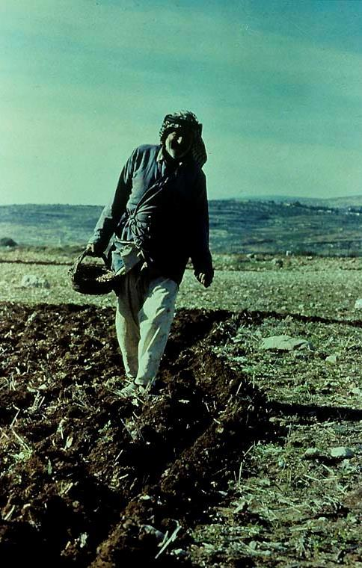
Local Color in the Story of the Sower
Sowing by hand means that some seed inevitably falls on rocks, high ground or the path next to the field.
In some regions, sowing actually precedes plowing, which is an additional reason why seed falls on the different sorts of soil.

Slide 87
Jesus’ Family
While all three Synoptics record the incident of Jesus’ mother and brothers wanting to see him, only Mark indicates that they thought he may have become mentally deranged (cf. Mk. 3:21).
  John’s Gospel adds that his brothers did not believe in him at first (Jn. 7:2-5), though later Jesus would appear to his half-brother James (1 Co. 15:7).
  Jesus made it clear, however, that his ministry held precedence over family loyalties.

Slide 88
Jesus and Nature
The incident of the stilling of the storm became another occasion for amazement.
  That Jesus had power over the elements of sea and weather were incredible signs pointing to his divinity.
  It caused the disciples to ask the most basic of all questions, and indeed, the question that Luke wants to prompt from his readers, “Who is this?”

Slide 89
Demons
Jesus was repeatedly confronted by demonized people (4:31-36, 41; 8:26-39; 9:37-43).
  He compared his power over demons to God’s power over the Egyptian magicians during the exodus (11:20; cf. Ex 8:19).
  Sometimes demonization was linked to sickness and at other times to insanity, though this is not a necessary connection.

Slide 90
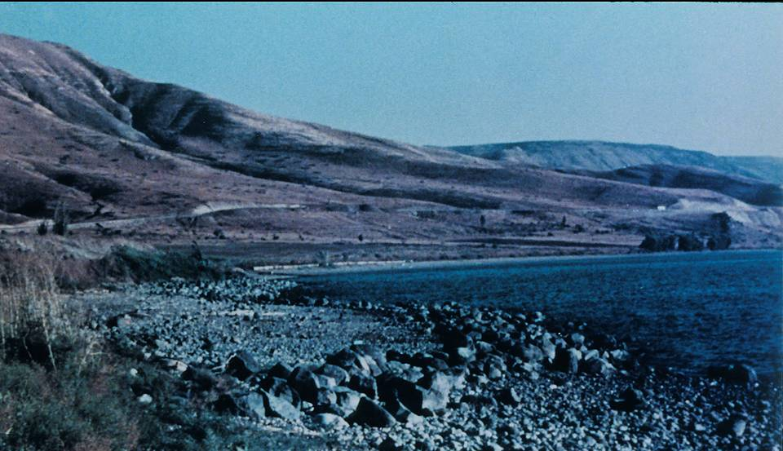
Kursi, probably a Semitic version of Gergesa (which scribes seem to have confused with Gerasa and Gadara), is the sight of the swine miracle (8:26-39). The large stones in the foreground are remnants of the breakwater that created a protected harbor about 325’ long.

Slide 91
The Language of Demonization
The expressions describing demonization in the Synoptic Gospels are:
daimoni<zomai = to be demonized, to be “possessed” by a demon
e@xw…daimo<nion/pneu?ma a]ka<qartou = to have a demon, to have an evil spirit
Associated verbs:
e]kba<llw = to drive out
ei]se<rxomai = to enter
e]ce<rxomai = to come out

Slide 92
THE MISSION OF THE TWELVE (9:1-17)
In commissioning the Twelve to share in his ministry, Jesus seems to have been preparing them for their later mission in the period of the church.
  The ethics of ministry must be directly correlated with the power of the gospel.
    They were empowered to heal and exorcise demons.
    Equally, they were to avoid being mercenary, entrusting their sustenance to God.
  They were to enact a symbol of judgment on those who rejected their message—shaking the dust from their feet.

Slide 93
Feeding the 5000
The miracle of feeding the 5000 is linked to the mission of the Twelve inasmuch as Jesus instructed them, “You give them something to eat.”
  In Jewish theology, one of the symbols of the messianic age was the great banquet, the coronation feast of God (cf. Is. 25:6-9).
  Here, Jesus anticipates this festival in the miracle of feeding.

Slide 94
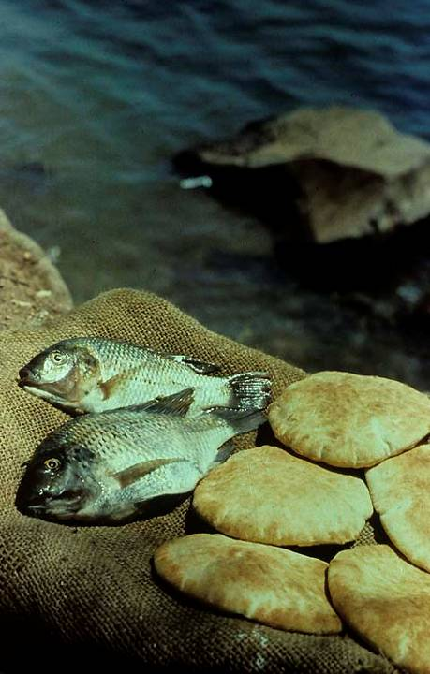
While there is no way of knowing what sort of fish Jesus multiplied, a popular fish from the Sea of Galilee—about 6-10 inches long—has become known as “St. Peter’s Fish”.

Slide 95
THE MESSIANIC IDENTITY

Slide 96
WHO IS JESUS?
This basic question, fundamental to all four gospels, so far has not been addressed directly by Luke (though it has been addressed implicitly in a variety of ways).
  The prenatal response of John to Jesus (1:41-43)
  The angelic annunciation to shepherds (2:8-14)
  The descent of the dove and heavenly voice (3:22)
  The recognition of Jesus by demons (4:3, 9, 34, 41; 8:28)
  Jesus’ pronouncement of forgiveness of sins (5:20; 7:48)
  Jesus’ power to heal, raise the dead and control nature (7:14-15; 8:24-25)

Slide 97
JESUS CONFESSED AND REVEALED (9:18-62)
Now, Luke will offer narratives that more directly address Jesus’ identity.
  The ancient world had a number of famous “divine men”, so-called wonder workers who, according to popular thought, performed healings, miracles and exorcisms
  It was important for Luke’s audience to realize that while Jesus did all the wonderful things attributed to him, he was not to be identified with the qei<oj a]nh<r (= divine man).
  Even Herod Antipas was asking, “Who is this?” (9:9)

Slide 98
Peter’s Great Confession
While Jesus was praying privately and his disciples with him, he posed for them the question directly, “Who do the crowds say I am?”
  The people had various theories, many of them concerning great prophets who were long since dead.
  The more fundamental question was now posed, “But what about you? Who do you say I am?”
  It is to this question that Peter answered “The Messiah of God.”

Slide 99
The Messianic Secret
Jesus urged his disciples not to tell anyone that he was the Messiah (presumably due to the common political vision for the messiah).
For the first time he began frankly talking about his suffering, rejection, death on the cross and resurrection.
If the disciples were ready to accept him as the Christ, it must be on his own terms, not the popular image.
As true disciples, they must embrace the cross daily.
Some would not die before they had seen God’s kingdom come (16:28), a prediction that has been variously interpreted to refer to:
  His transfiguration (17:1-2; cf. 2 Pe. 1:16-18)
  His post-resurrection appearances after Easter
  His coming in judgment on Jerusalem in AD 70
  The whole complex of events attending his death, resurrection and Pentecost

Slide 100
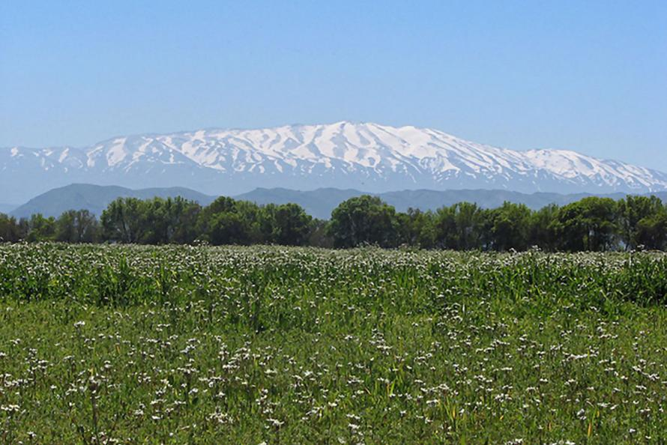
While Luke does not specify the “mountain” in 9:28, it often has been supposed to be somewhere on Mt. Hermon, which rises 9000’ in the south Lebanon range, based on Mt. 16:13.

Slide 101
The Transfiguration
Once again, Luke describes Jesus ascending a mountain to pray, taking with him three of the apostles, Peter, James and John.
  His appearance changed and his clothes became radiant.
  Moses and Elijah, the two most prominent representatives of the law and the prophets, appeared talking to him about his e@codoj (= exodus), a term deliberately paralleling Jesus’ messianic mission with the ancient event of salvation-history.
  While Peter was on the verge of building a memorial to the event, a heavenly voice, similar to the one at Jesus’ baptism, announced, “This is my Son!”

Slide 102
The Repeated Emphasis on Suffering
The next day, Jesus encountered a demonized child and healed him.
  Though everyone was amazed, Jesus once again took opportunity to reemphasize what he had earlier said—he would be betrayed.
  While a variety of messianic pretenders had appeared, usually with political or materialistic aspirations, Jesus shattered almost every messianic expectation with his announcement of his coming suffering and death.

Slide 103
The Travelogue
Luke 9:51 marks a special transition in the Third Gospel. From 9:51 until 19:44, Luke will depict Jesus as “on his way” to Jerusalem. Luke’s language of travel reinforces this motif:
  “…as they were walking along the road” (9:57)
  “…he sent them ahead of him to every town and place where he was about to go” (10:1)
  “As Jesus and his disciples were on their way…” (10:38)
  “…Jesus made his way toward Jerusalem” (13:22)
  “Large crowds were traveling with Jesus…” (14:25)
  “Now on his way to Jerusalem…” (17:11)
  “Jesus said, ‘We are going up to Jerusalem…” (18:31)
  “He went on ahead, going up to Jerusalem” (19:28)
  “As he approached Jerusalem…” (19:41)

Slide 104
The Cost of Following Jesus
In the context of travel, Jesus encountered various people who either offered to follow him or whom he called to follow him.
  He warned them of the hardships of discipleship.
  Some made excuses, such as, waiting until later, but Jesus urged that the call must take priority over all other things with no turning back!

Slide 105
ON THE ROAD

Slide 106
Sending Out the 70
As advance witnesses on the way to Jerusalem, Jesus sent out 70 disciples, two by two.
  As with the Twelve earlier, they were to trust their sustenance to the generosity of their hearers—but those that received them would equally receive Jesus.
  They were to respond to rejection by shaking the dust from their feet as a protest, an action that Christians would later employ as well (cf. Ac. 13:51).
  In the mission of the 70, Jesus said he “saw Satan fall from heaven”.

Slide 107
Parable of the Good Samaritan
Found only in Luke, this parable focuses on the benevolence of a Samaritan in answer to the question, “Who is my neighbor?”
  Given the severe tensions between Jews and Samaritans, it is striking that Jesus formed the story as he did, putting the Samaritan in the best light. Perhaps, had he been in Samaria, he may have told the story of the “good Jew”.
  Both the priest and the Levite avoided the wounded man, probably because they risked defilement from blood or death as much as because of the danger of the situation.
  In the end, Jesus reversed the question from, “Who is my neighbor?” to the much more pointed, “Which of these three was a neighbor to the man who fell among thieves?”

Slide 108
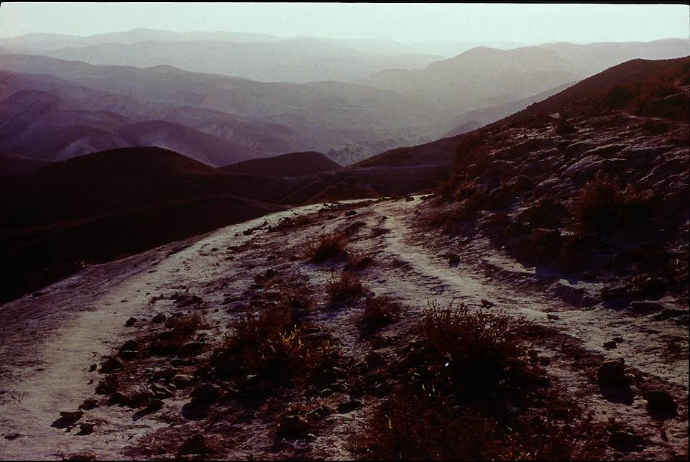
The desolate area surrounding the Jerusalem to Jericho road was notorious as the hideout of bandits in the 1st century. Most people traveled this road in groups, not as single individuals.

Slide 109
Teaching on Prayer
All along, Luke has given a pronounced emphasis on the prayers of Jesus (3:21; 5:16; 6:12; 9:18, 28).
  On one occasion when he was praying (11:1, his disciples approached him, asking him to teach them to pray, just as John the Baptist had taught his disciples.
  Jesus responded with what we call “the Lord’s prayer”, a prayer that at once offers a pattern for prayer as well as actual words to be repeated: “When you pray, say…”

Slide 110
The Lord’s Prayer
Address: “ Father…”
Presumably the Aramaic word “Abba” (cf. Mk. 14:36)
Neither in the OT nor in Judaism was the personal address “my Father” used of God in prayer.
Two “Thou” clauses:
Statement of reverence
Petition for God’s rule
Two “We” Petitions:
For daily sustenance
For forgiveness
Conclusion:
“Do not let me fall victim to temptation” (the final line probably should be read with this nuance)
There is a marked priority of sequence. First, one prays for God’s will and kingdom issues—then for personal needs.

Slide 111
Parable of the Friend at Midnight
In the story of the persistent friend at midnight, Jesus offers a parable of contrast.
  Jesus is hardly saying that God is like a stingy neighbor: the contrast is that God is NOT like this—but instead he gives generously to those who ask and seek him.
  Even more, he will give the Holy Spirit, the greatest gift of all!

Slide 112
The Strong Man and the Stronger Man
In response to his critics, Jesus gave the parable of the strong man.
  Like the miracles of Moses to Pharaoh, Jesus’ mighty works were the “finger of God” (cf. Ex. 8:19), a sign that the kingdom of God has come!
  Still, the spiritual world abhors a vacuum, and if spiritual freedom does not result in allegiance to God, then demon-squatters will return in full force.
  From this time on, Jesus will more and more face opposition from various sects of the Jews as well as from individuals.

Slide 113
Opposition Narratives all four gospels detail a series of conflicts
Matthew
Gerasenes
Pharisees
John’s disciples
Crowds
Herod
Lawyers
Family
Nazarenes
Sadducees
Collectors
Caiaphas
Sanhedrin
Pilate
Mark
Lawyers
Pharisees
John’s disciples
Herodians
Family
Gerasenes
Nazarenes
Caiaphas
Sanhedrin
Pilate
Luke
Nazarenes
Pharisees
Lawyers
John’s disciples
Family
Gerasenes
Crowds
Samaritans
Synagogue ruler
Caiaphas
Sanhedrin
Pilate
Herod
John
The Jews
Mother
Temple
John’s disciples
His own disciples
Brothers
Crowds
Pharisees
Sanhedrin
Lawyers
Caiaphas
Pilate

Slide 114
The Sign of Jonah
The previous request for a sign (cf. 11:16) is now answered (11:29ff.).
  Of course, Jesus’ miracles were signs in themselves, but his critics wanted more.
  No sign would be forthcoming beyond the one Jonah gave, the call to repent!
  Foreigners would rise at the judgment to condemn those who rejected Jesus, for even though they were outsiders, they listened, but the critics would not listen!
  In this teaching of Jesus there is more than a hint toward the eventual Gentile mission of the church.

Slide 115
Six Woes
In response to a Pharisee’s surprise that he ate without first “baptizing” his hands, Jesus used the occasion to address religious hypocrisy in six woes, condemnations very similar to what one finds more extensively in Matthew 23 and what was typical of the ancient prophets (cf. Is. 5:8-23).
The “baptism” of hands was not part of the written Torah, but it was honored from antiquity as a tradition based on the so-called “oral Torah”.
Adherence to external religious traditions might appear to be signs of holiness, but it could mask greed, wickedness, the corruption of death and the rejection of God!

Slide 116
WARNINGS AND PARABLES

Slide 117
The Yeast of the Pharisees (12:1-12)
Using yeast as a metaphor for the encroaching sin of hypocrisy, Jesus gave warning to his disciples.
  The truth will eventually come out!
  Rather than fearing public opinion, one should fear God, who has the power of eternal judgment.
  To turn one’s heart irrevocably against the Holy Spirit is to reject the only path toward forgiveness.
  At the same time, the Holy Spirit will defend and assist those with the loyalty and courage to follow Jesus.

Slide 118
Materialism (12:13-34)
A perennial temptation is to find security in material things.
  The parable of the man building great barns for storage is a story of misplaced priorities.
  The true meaning of life is neither in possession, food, clothing or even longevity.
  Only the reign of God is an eternal treasure.

Slide 119
Watchfulness (12:35-48)
In the parable of the watching servants, Jesus prepared his disciples for a coming crisis.
  This crisis is the interval between his return to the Father and his second coming at the end of the age.
  Already, the disciples had heard Jesus speak about his “exodus” from the world (cf. 9:31).
  However, he had not yet described to them the interval before his return.
  In this interval, his disciples must be faithful to their tasks, even though the time of the Lord’s return is unknown.

Slide 120
The Immediate Crisis (12:49—13:8)
Closer at hand was yet another crisis, Jesus’ coming passion in Jerusalem.
  It would be a baptism of suffering and death.
  The crisis of Jesus would equally be the crisis for the nation, and the nation was oblivious. The people could assess the weather, but they were blind to their own spiritual crisis.
  Using two local incidents, one of Pilate’s butchery of Galilean zealots in the temple (known to us also from Josephus, Wars 13.1) and the other of a construction accident, Jesus warned that if the people did not turn to God, they would perish just as surely!

Slide 121
The Presence of the Kingdom (13:10-21)
Once again, Jesus faced hostility over his disregard for Sabbath regulations (cf. 6:1-2, 6-7).
  In this instance, he was confronted with a woman who had a spinal disorder in the synagogue on the Sabbath.
  When criticized, he asserted that it was right and even necessary for this woman to be freed from her affliction on the Sabbath, implying that this was a fulfillment of God’s divine purpose.
  By such means, the kingdom of God, the eschatological Sabbath, was coming! It was working powerfully and silently, like yeast in flour.

Slide 122

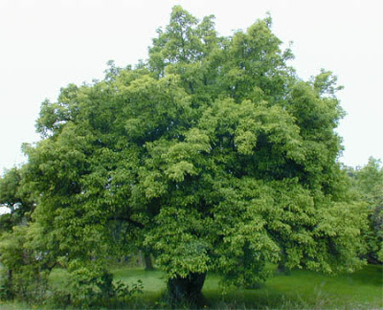
“What is the kingdom of God like? What share I compare it to? It is like a mustard seed, which a man took a planted in his garden. It grew, became a tree, and the birds of the air perched in its branches.”
The mustard tree of the Middle East (Salvadora Persica) grows from a tiny seed into a modest, multi-branched tree.

Slide 123
Rejection and Reception (13:22-35)
The question as to whether there would be many or few saved was not new (4 Ezra 7:45—9:22), and it probably arose out of the common conception that all Israelites had a share in the world to come.
  Jesus did not directly answer the question, but rather, he spoke of the “narrow gate” and a wedding festival in which guests were turned away.
  Some of those listening to him would be shut out of the great eschatological feast, including Jerusalem itself! No one had a monopoly on God’s salvation, and there would be many surprises!

Slide 124
People Perceived to be “Last” In Jewish Society
  One of Jesus’ famous repeated sayings was, “There are those who are last who will be first, and the first who will be last” (13:30; cf, Mk. 9:35; 10:31; Mt. 20:16). Various lists would later appear in the Jewish Mishnah ranking people from “first” to “last” based on racial purity.
The “First”
Priests and Levites
The Lay Nobility
Scribes
Pharisees
Israelites
Pure ancestry
Those with despised trades
Slaves
Those with slight pedigree blemishes
Proselytes
Bastards, eunuchs, foundlings
The “Last”
Samaritans
Gentiles

Slide 125
At a Pharisee’s Home (14:1-24)
Of all the Jewish sects, Jesus probably was closer to the Pharisees than any of the others. He agreed with them on the canon of Scripture, angels and resurrection.
Where he most emphatically disagreed with them was concerning the so-called “oral Torah”.
At a prominent Pharisee’s Sabbath dinner, Jesus healed a man afflicted with dropsy (abnormal swelling and water retention), prefacing his miracle with the double-edged question, “Is it lawful to heal on the Sabbath?”
He concluded with the parable of the great banquet, where the reluctant guests were replaced by the poor, crippled, blind and lame.

Slide 126
Along the Road (14:25-35)
While en route to Jerusalem, Jesus warned those traveling alongside him about the cost of discipleship.
  At various times, Jesus used hyperbole to underscore his meaning (cf. Mt. 5:29-30), and he does so here by speaking of “hating” one’s own family.
  The parables about building a tower or going to war, both of which require forethought and complete resolution, were analogies of total commitment.
  Insipid followers, on the other hand, were like salt cut with gypsum—useless!

Slide 127
MORE PARABLES

Slide 128
LUKAN PARABLES (15:1—16:31)
Already, Luke has mentioned that Jesus’ teaching was often sprinkled with parables, and several of them have been unique to the Third Gospel (Two Debtors, Good Samaritan, Friend at Midnight, Rich Fool, Wedding Feast, Wise and Negligent Stewards, Barren Fig Tree, Great Banquet).
  Now, Luke will offer several more parables, again all of them unique to his gospel.
  Several of them were aimed at his critics, especially the Pharisees (cf. 15:1-2; 16:14-15).

Slide 129
Three Parables on Welcoming Sinners
Luke’ especially emphasizes Jesus’ openness to “sinners” (5:29-32; 7:34, 39; 15:1, 7, 10; 18:13; 19:7).
The Lost Sheep
The Lost Coin
The Two Lost Sons
God’s love takes the initiative!
It does not merely wait, but seeks out the sinner.
God rejoices more over sinners who repent than the righteous who think they do not need to do so.
In the ancient Near East, a woman’s headdress was decorated with coins as part of her dowry.
To lose one was a great loss, and the woman would search thoroughly to find it!
This parable is on the father’s love.
The father had two sons, both were lost, but only one was “found”.
Jesus’ critics would have had little trouble seeing themselves as the elder brother.

Slide 130
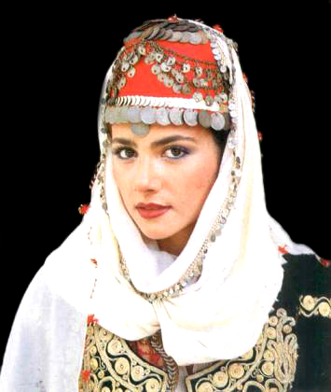
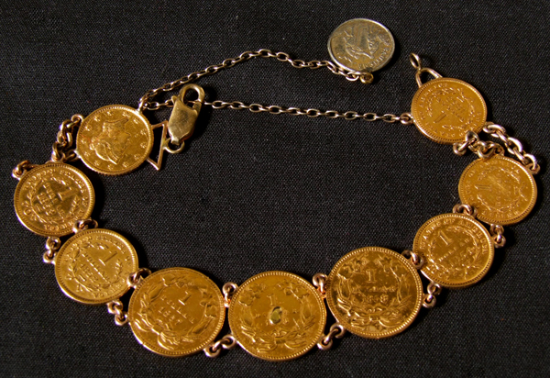
The Coin Dowry Headdress
Even today Middle Eastern women may wear such a headdress.

Slide 131
Parable of the Shrewd Manager
This story concerns a steward who was accused of swindling his master.
  Upon receiving a termination notice, he secured his future by rewriting the bills of some of his master’s creditors.
  Either he did this with full power of attorney (in which case he was only shrewd) or he did this without authority (in which case he was a swindler). Either way, he saved his future, since the creditors would praise the master for his generosity, and the master would be inclined to overlook the matter in order to save face.
  Jesus’ listeners confronted a far greater crisis than a job termination, and they must act quickly, for the time of reckoning was near!

Slide 132
Lazarus and Dives
This story is likely a remake of another popular story brought by Alexandrian Jews to Palestine, the story of a rich man with an elaborate funeral who ended up in torment, and a poor man, buried without honors, who was rewarded in the afterlife.
  The point of the parable is not to describe the afterlife so much as to point out that those who refuse to hear Moses and the prophets will not be convinced even by a resurrection.
  The imagery of fiery torment is drawn from Jewish apocalyptic literature (2 Enoch 9-10).

Slide 133
MORE TEACHING & MIRACLES

Slide 134
ALONG THE WAY (17:1-37)
As Jesus continually drew closer to Jerusalem, his teaching alternated between the crowds and his disciples.
  To the disciples, Jesus taught on offenses, forgiveness and discipleship.
  Among the crowds, he continued to reach out in compassion, such as the healing of the 10 lepers.
  The message was clear: the kingdom of God was not as popularly expected. It was internal before it would become external. Suffering must precede apocalyptic glory.

Slide 135
APPROACHING JERICHO (18:1-34)
Jericho (18:35), where pilgrims forded the Jordan on their way to the festivals, was the beginning of the mountainous ascent toward Jerusalem.
  Jesus gave another parable on prayer, the persistent widow, and like the previous one (cf. 11:5-13), it is a parable of contrast.
  This parable was followed by the parable of the two worshipers.
  As they neared Jericho, Jesus once more emphasized that his arrival in Jerusalem would be attended by rejection, death and resurrection (cf. 9:22, 44-45; 12:50; 13:33; 17:25).

Slide 136
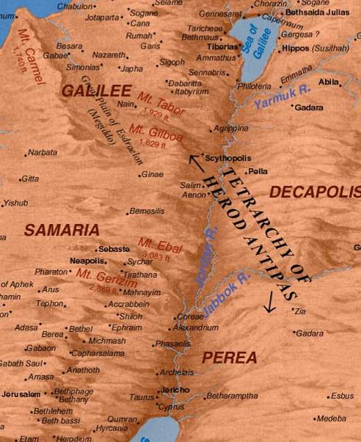
Travel between Judea and Galilee followed one of two routes. The more usual route was to ford the Jordan in the north, travel down the eastern side of the river, and ford again near the southern end of the Jordan near Jericho (thus avoiding Samaria). The less traveled route was more direct, through Samaria, but due to hostile relations between Jews and Samaritans (as well as the risk of ritual impurity), it was rarely used.

Slide 137
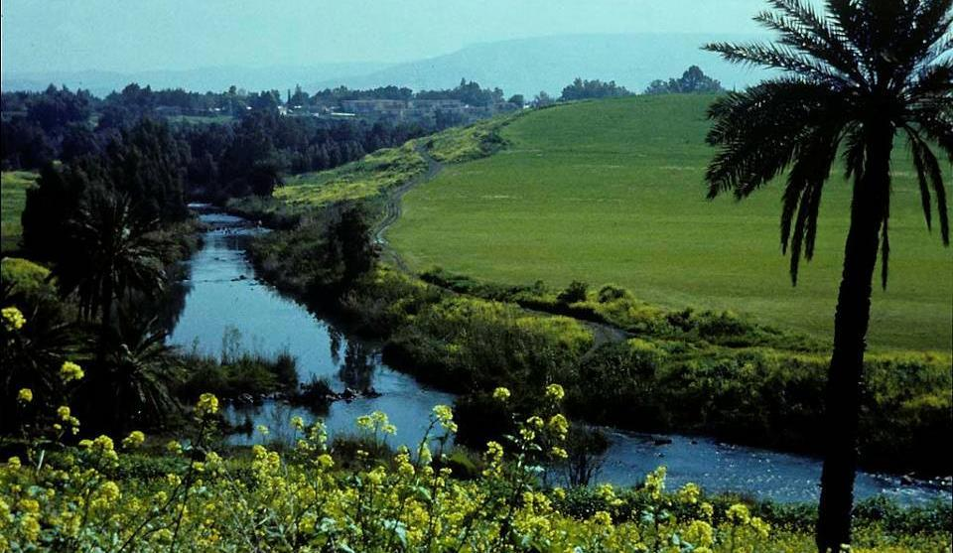
The Jordan River divided Perea (west) from Judea (east).

Slide 138
The Challenge of Wealth (19:16-29)
Jesus’ response to the ruler who maintained he had kept the commandments was that he should renounce his wealth.
It is exceedingly difficult for the rich to submit to God’s rule as the various Christian interpretations of this passage demonstrate.
  By the 5th century, interpolations began appearing in some manuscripts that said, “How hard it is for those who trust in riches…”
  Some have suggested that since the Greek word for “camel” is similar to the word for “cable”, Jesus intended the latter.
  Others have referred to the “eye of the needle” as a small opening in the larger city gate, but this idiom is much too late and is anachronistic.
Still, the apostles who renounced wealth in order to follow Jesus would be rewarded in the end.

Slide 139
AT JERICHO (18:35—19:27)
At Jericho, Jesus began the last leg of the journey to Jerusalem.
  He healed a blind beggar.
  Luke offers yet another narrative unique to his gospel, the repentance of the tax-collector, Zacchaeus.
  He told the parable of the 10 minas, which he gave precisely because the pilgrims going to Jerusalem anticipated the arrival of the kingdom of God almost immediately. In the parable, Jesus emphasized the interval between his first and second advent, an interval that must have been puzzling to them all. The idea of a “first” and “second” coming of the Messiah was unknown in Judaism.

Slide 140
IN JERUSALEM

Slide 141
THE TRAVELOGUE IS COMPLETE (19:28—21:38)
With the travelogue finished that began in 9:51, Luke now brings his gospel to a climax by describing “the things that happened in Jerusalem” (cf. 24:18).
  Jesus’ so-called “triumphant entry” sets the stage.
  His cleansing of the temple turned the Jewish leadership against him (19:47).
  His teachings further alienated him from the temple authorities (20:1-8, 19-26).
  His teaching to his disciples about the fall of the temple was his last extended discourse before his arrest.

Slide 142
The Triumphant Entry
At Bethphage and Bethany, the last two villages on the Jericho Road prior to reaching Jerusalem, Jesus sent two disciples to find an unbroken colt upon which to ride into the city.
  As the pilgrims accompanying Jesus saw the city break into view, they began to chant the Egyptian Hallel (Psalm 118).
  The Pharisees were furious, not because the Psalm was chanted, but because it was chanted in honor of Jesus as the coming messianic king.
  Jesus, for his part, began to weep over the disastrous future that awaited the city a scant 40 years into the future.

Slide 143
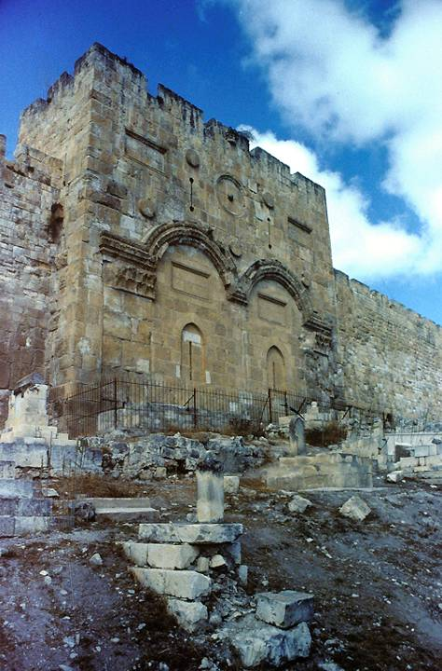
The sealed Golden Gate in the eastern wall of Jerusalem is on the side of the city which Jesus would have entered en route from Bethany.
This gate dates to the Byzantine Period, but beneath it in 1969 archaeologists discovered an older gate which likely would have been the one through which Jesus entered.

Slide 144
The Cleansing of the Temple
All four gospels describe Jesus cleansing the temple, driving out the money-exchangers and merchants selling sacrificial animals.
  He quoted from Jeremiah’s Temple Sermon (Je. 7), and his actions, like Jeremiah’s sermon, implied the judgment of God upon the temple.
  This seemed to seal the intent of the temple authorities to seek Jesus’ death.

Slide 145
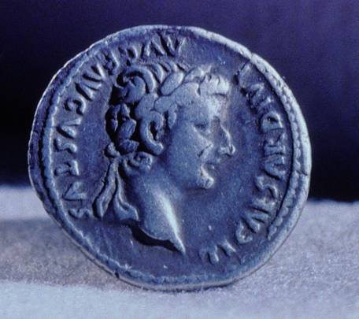
Roman coinage, such as this Denarius with the impress of Tiberius Caesar’s profile, was considered a violation of the 1st and 2nd commandments. Hence, Roman coins had to be exchanged for temple coinage to avoid sacrilege.

Slide 146
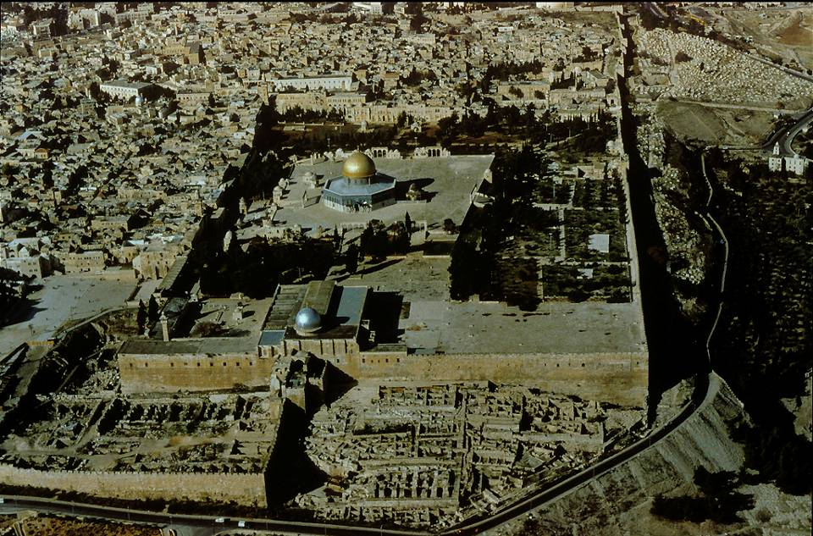
The Temple Mount (facing northward)

Slide 147
Jesus’ Temple Ministry
Daily Jesus stayed in full public view in the temple, teaching the people and addressing difficult theological questions that were intended to entrap him.
  Some questions he deflected with other questions (the question about his authority).
  Some he addressed in parables (the parable of the vineyard tenant farmers who killed the owner’s own son, based on Isaiah’s Song of the Vineyard in Isaiah 5).
  Some he handled with adroit responses (such as the question about paying taxes to Caesar).
  Some he confronted by citing passages from the Torah (such as the question about marriage in the afterlife).

Slide 148
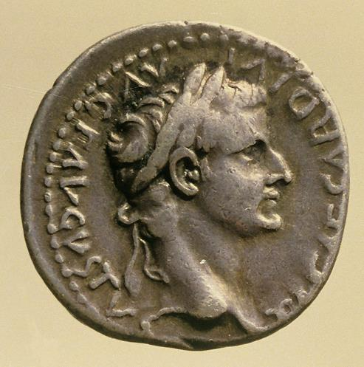
Paying the Imperial Tax (22:15-22)
By appealing to the image of Caesar in the coin, Jesus avoided both pitfalls as well as implied an even more profound question: if the image of Caesar is in the coin (meaning that one should give to Caesar what is his), what image resides in every human? (the Imago Dei from the creation, meaning that one should give to God what belongs to Him—one’s own self!)
The question about the imperial poll tax intended to put Jesus in a “lose-lose” situation.
If he supported the tax, he would lose popular support.
If he objected, he could be reported as a resister.

Slide 149
The Final Question
For the final question, Jesus took the initiative and posed a question for his critics, counter-questioning them about Psalm 110:1.
All agreed that the messiah would be a descendent of David.
There are three figures in view in Psalm 110, Yahweh (LORD), Adonai (my Lord), and David (the author of the Psalm). Jesus seemed to know his opponents would agree that Adonai in Psalm 110:1 referred to the messiah.
If this was so, then how could Adonai, who was David’s Lord (“my” Lord) at the same time be his descendent?
The implications were profound: no one could have been greater than great David except a divine figure. If Adonai was greater than David, he must have been divine!

Slide 150
The Discourse About the Temple
Reminiscent of Jeremiah’s Temple Sermon, Jesus now launched into a lengthy treatment of the temple’s future.
  As did Jeremiah, Jesus predicted the destruction of the temple (which would happen in AD 70).
  In his diatribe, he describes the temple’s fall in apocalyptic language.
  All three Synoptic Gospels contain this discourse, but in Luke the emphasis is on the temple itself, while in Mark and Matthew there is more emphasis on the “coming” of the Son of Man.

Slide 151
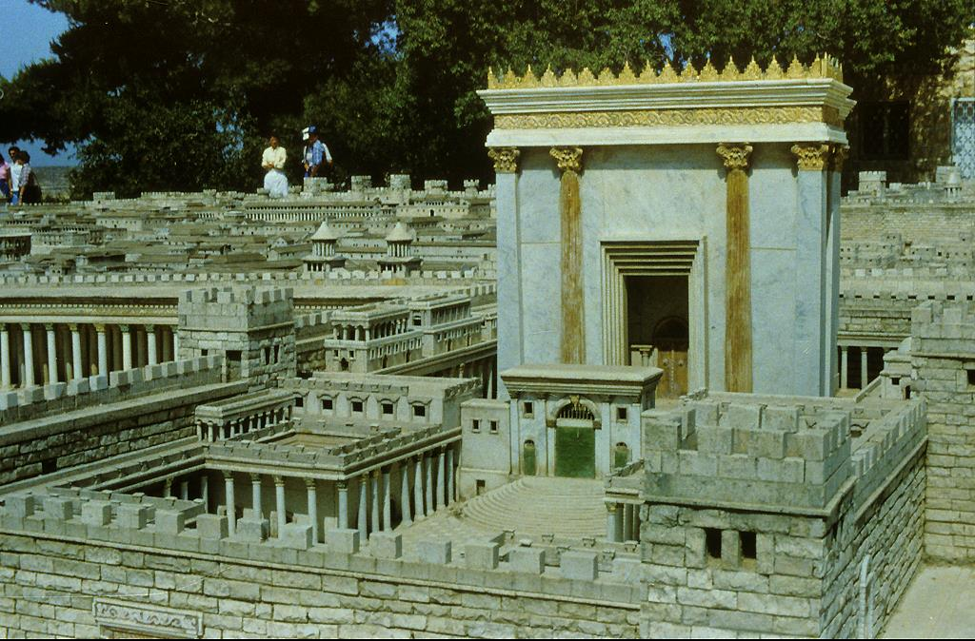
Model of Herod’s Temple

Slide 152
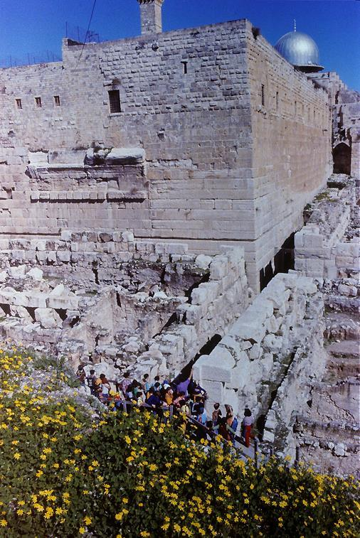
Many of the huge stones tumbled by the Romans from the temple in AD 70 still remain at the southwest corner of the temple mount.

Slide 153
Discourse About the Temple
Jesus’ teaching in this last great discourse addressed:
The destruction of the temple (21:20-24)
The “coming” of the Son of Man (21:27)
  Does the references to the “coming” refer to Jesus’ 2nd advent at the close of history, or might it refer to his “coming” in judgment on the temple itself?
The “fulfillment of all things” (21:32)
  Does the “fulfillment of all things” envision the end of the temple or the end of the age?
While there is little disagreement that Jesus predicted the end of the 2nd temple, there is considerable disagreement about the meaning of the “coming of the Son of Man” and the “fulfillment of all things”.

Slide 154
Three Major Interpretive Positions
Dispensational
The destruction of the temple concerns both AD 70 and a third temple yet to be built.
The “coming” is Jesus’ second advent at the end of the age.
The “fulfillment of all things” is the end of history, the end of the present era.
Preterist
The destruction of the temple concerns what would happen in AD 70.
The “coming” is Jesus’ coming in judgment on Jerusalem in AD 70.
The “fulfillment of all things” is the end of the 2nd temple.
Mediating
Both the destruction of the 2nd temple and the 2nd advent of Christ are subsumed into the scope of this single prophecy.
The near event becomes a double entendre for the far event.

Slide 155
Two Paths into the Future without temple, land or Jewish sovereignty
Jesus
Prediction: the temple will be destroyed!
The body of Christians become the temple of the Holy Spirit.
Worship and good deeds become the daily sacrifice.
Every believer is a priest before God.
Atonement for sin has been completed once, for all, on the cross.
Judaism
The reality: the temple WAS destroyed!
The synagogue succeeds the temple.
Daily prayer replaces the daily sacrifice.
The rabbis inherit the authority of the priests.
Altar of atonement is replaced by the family table.

Slide 156
THE REJECTION AND DEATH OF JESUS

Slide 157
THE EVENTS OF JESUS’ PASSION (22:1—23:56)
The final events leading to Jesus’ predicted death began with the festival of Unleavened Bread (Passover).
  Judas Iscariot, one of the Twelve, was prompted by Satan to make arrangements for Jesus’ betrayal.
  On the evening of Passover, Peter and John prepared an upper room for Jesus’ final meal with his apostles.

Slide 158
The Last Meal
All four gospels describe the last meal, but the Synoptics follow a different course than the Fourth Gospel.
Synoptics Only
Disciples prepare the room
Institution of the Eucharist
Teaching on Servanthood
John Only
Washing of feet
New Commandment
Teaching on the Paraclete
Common to Both
Farewell meal
Prediction of Peter’s denial
Departure for Gethsemane

Slide 159
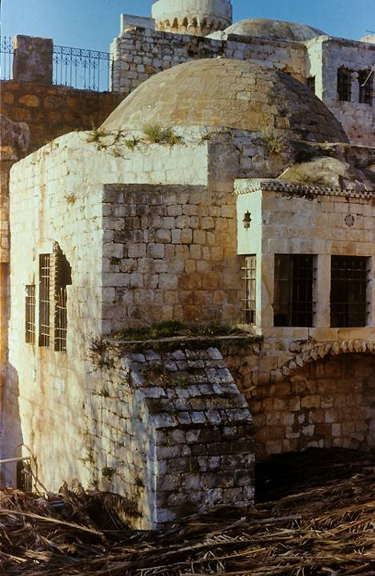
Traditional site of the Last Supper
Though the present structure only dates to the Crusader Period, foundations beneath it may go back as far as the time of Jesus. This is the traditional site of the Last Supper (Mk. 14:13, 15), called the Cenacle (from Jerome’s Latin Vulgate). Its earliest foundation seems to be from either an ancient synagogue or church that may have existed prior to the destruction of the 2nd temple.

Slide 160
The Passover Tradition
Stage 1
Blessing and first cup of wine
Preliminary dish
Placement of the meal and mixing of the second cup of wine
Stage 2
Recounting the Passover story
Singing of Psalm 113-114
Drinking the second cup of wine
Stage 3
Blessing of the unleavened bread
Meal
Blessing and drinking the third cup of wine
Stage 4
Singing Psalm 115-118
Blessing and drinking the fourth cup of wine
Clearly, Jesus linked the meaning of his death with the covenant, also echoing the language of the suffering servant (Is. 53:12).

Slide 161
Prelude to the Arrest
Jesus predicted the denial of Peter.
Peter protested that he was ready to die for Jesus
In Gethsemane (= olive press), Luke tells us that Jesus prayed with such intensity that his sweat congealed until it was thick like blood.
The “cup” was a symbol of his coming death and suffering.

Slide 162
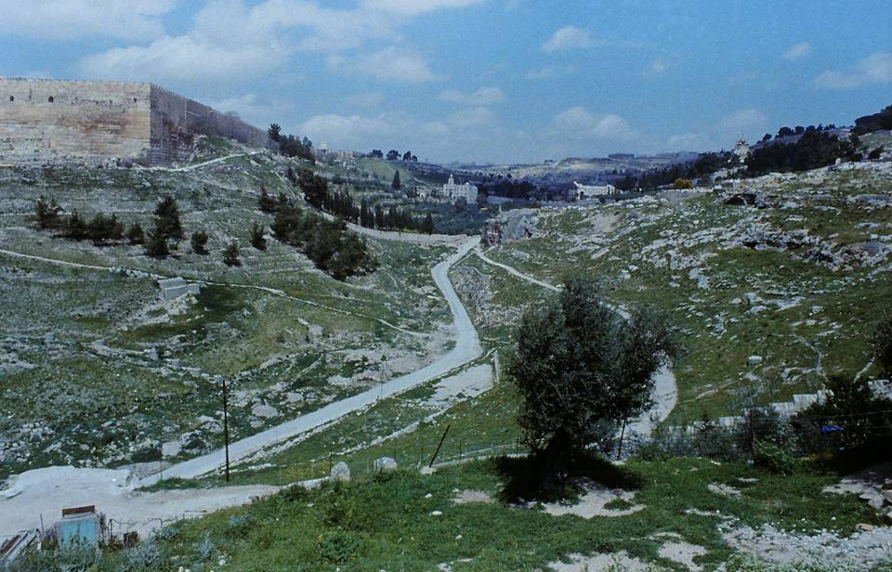
The Kidron Valley facing northward (southeast corner of the temple mount visible on the left; lower slopes of the Mt. of Olives on the right)

Slide 163
The Arrest and Trial in the Four Gospels
Matthew
Gethsemane
Judas’ betrayal
Before Caiaphas
Before the Sanhedrin
Peter’s denials
Before Pilate
Death of Judas
Release Barabbas
Soldiers mockery
Mark
Gethsemane
Judas’ betrayal
(High Priest unnamed)
Before the Sanhedrin
Peter’s denials
Before Pilate
Release Barabbas
Soldiers mockery
Luke
Gethsemane
Judas’ betrayal
(High Priest unnamed)
Before the Sanhedrin
Peter’s denials
Before Pilate
Before Herod
Pilate declares Jesus innocent
Release Barabbas
John
Gethsemane
Judas’ betrayal
Before Annas
Before Caiaphas
Peter’s denials
Before Pilate
Pilate declares Jesus innocent
Release Barabbas
Soldiers mockery

Slide 164
The Trial of Jesus Proceeded in Two Stages with Different Indictments
The Jewish Stage
Preliminary examination before Annas (John)
Appearance before Caiaphas (all four gospels)
Condemnation by the full Sanhedrin (Synoptics)
Indictment
Blasphemy
The Roman Stage
First appearance before Pontius Pilate (all four gospels)
Appearance before Herod Antipas (Luke)
Final appearance before Pilate (all four gospels)
Indictment
Treason

Slide 165
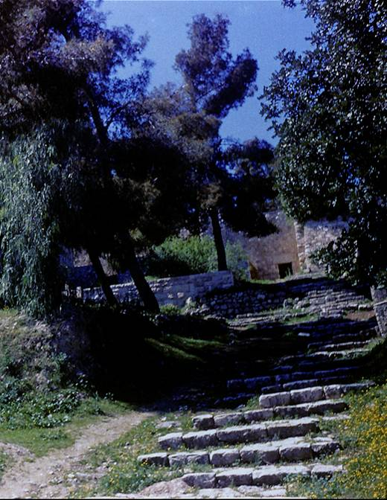
Church of St. Peter in Gallicantu (in galli cantu = “as the cock crowed”, Latin)
These ancient steps, excavated in 1887, date to the 1st century and mark the probable path that Jesus would have walked on his way to the hearing before the Chief Priest and the Sanhedrin.

Slide 166
Legal Irregularities
If Jesus’ hearing before the Sanhedrin was a formal trial, there were several breaches in procedure as outlined in the Talmud.
A trial at the high priest’s home was illegal.
A trial at night was illegal.
A trial during a festival was illegal.
A capital crime resulting in a guilty verdict could not be settled in a single session.
Hence, either Jesus’ trial was not a “formal” trial, or else, the Sanhedrin acted out of desperation, throwing out their own judicial procedure.

Slide 167
Peter’s Denials
Luke’s account of Peter’s denials is similar to the accounts in the other gospels.
  Luke, however, adds one important detail: when Peter was vehemently making his final denial that he knew Jesus, at that very moment Jesus apparently was being moved from the High Priest’s residence, and when Jesus stepped outside, he heard Peter’s words.
  Luke tells us that Jesus looked straight at Peter—the rooster crowed, and Peter went outside and wept.

Slide 168
The Hearing Before Pilate (27:11-26)
The Roman Prefect had the final decision in matters of execution (cf. Jn. 18:31b; 19:10), and this policy is corroborated by Flavius Josephus (Antiquities xviii.1.1).
Pilate seemed to suspect that this issue was more religious than political, which explains his reluctance to give an execution order. Jesus might be a religious eccentric, but he was no threat to Rome, and Pilate knew it.
He even attempted to refer the case entirely to Herod (found only in Luke’s gospel).
Still, the Sanhedrin pressed for an execution and called for the release of Barabbas.
Pilate consented to Jesus’ execution and delivered Jesus over for scourging.

Slide 169
Crucifixion & Burial in the Four Gospels
Matthew
Via dolorosa
Crucifixion
Spectators mock
Two thieves
Death
Burial
Guard at the tomb
Women come on Easter
Mark
Via dolorosa
Crucifixion
Spectators mock
Two thieves
Death
Burial
Women come on Easter
Luke
Via dolorosa
Crucifixion
Spectators mock
Two thieves
Death
Burial
Women come on Easter
John
Via dolorosa
Crucifixion
Mary given to the beloved disciple
Two thieves
Death
Jesus is pierced
Burial
Women come on Easter
Peter and beloved disciple at the tomb

Slide 170
Roman Crucifixions
Roman crucifixions generally consisted of three parts:
Scourging (there was no limit to Roman flogging as there was in Judaism, cf. Dt. 25:1-3)
Carrying the patibulum (cross-piece) to the site of execution, usually with the titulus (inscription with charges) hung about the victim’s neck
Nailing (or tying) and lifting: crosses could be T-shaped (crux commissa) or dagger shaped (crux immissa). Also, crosses typically had a sharp projection that fit beneath the pelvis and helped suspend the weight of the body (sedile). Sometimes they also had a foot support (suppedaneum)
Death was by shock or gradual asphyxiation as the lungs collapsed and the victim could no longer raise himself in order to breath. Breaking the legs of the victims would hasten asphyxiation. For more clinical-medical details on crucifixion, see W. Edwards, W. Gabel and F. Hosmer, Journal of the American Medical Association (March 21, 1986), pp 1455-1463.

Slide 171
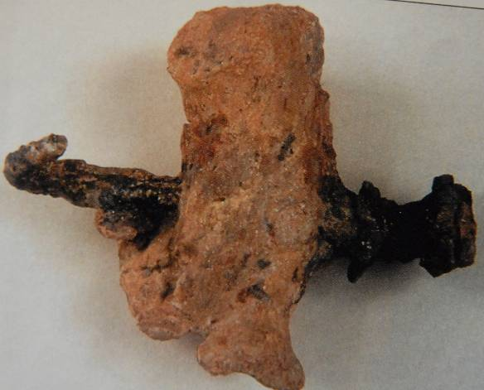
Although thousands of prisoners and slaves were crucified in antiquity, the remains of only one victim so far has been discovered, a Jewish male from about the mid-1st century AD.
Excavated in 1986 in Jerusalem, the remains of this man of about 24-28 years old were found in an ossuary that named him as Yehohanan.
His heel bone was transfixed sideways by a single spike, which had sunk deep into a knot so that the only way to remove the body was to amputate the feet.

Slide 172
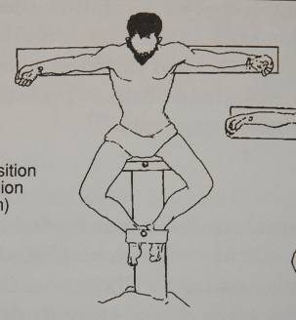
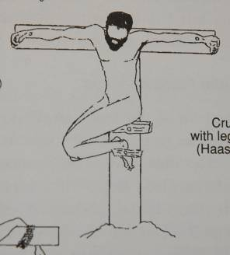
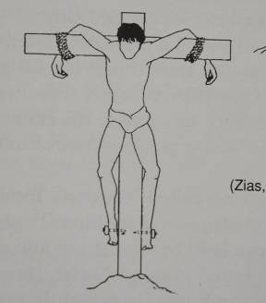
Possible Positions of Crucifixion
Based on the remains of Jehohanan, archaeologists have theorized about his position on the cross, given that his heels were nailed with a single spike
It remains an open question as to whether or not the crucifixion of Jesus may have been similar.

Slide 173
The Seven Logia from the Cross
Matthew
“My God, my God, why have you forsaken me?” (Ps. 22:1)
Mark
“My God, my God, why have you forsaken me?” (Ps. 22:1)
Luke
“Father, forgive them, for they do not know what they are doing.”
“Amen, I say to you, today you will be with me in paradise.”
“Father, into your hands I commit my spirit.” (Ps. 31:5)
John
“Woman, here is your son.”
“Here is your mother.”
“I am thirsty.”
“It is finished.”

Slide 174
The Death of Jesus
Jesus’ death occurred about 3:00 PM (the 9th hour from sunrise in Roman reckoning).
  The great darkness was noted by an ancient historian, Thallus, who wrote in about the mid-1st century and attributed it to an eclipse (he is the first non-Christian to refer to Jesus in writing).
  The tearing of the inner curtain in the temple was a potent symbol that access to God was now possible in a new and powerful way.
  The final exclamation of the Roman centurion, like Pilate, pronounced Jesus to be innocent!

Slide 175
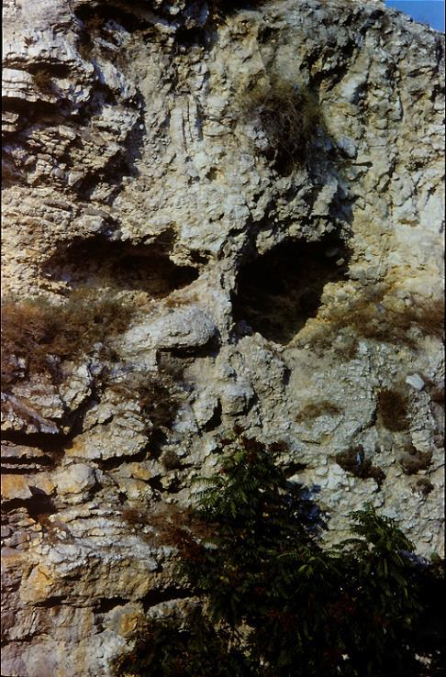
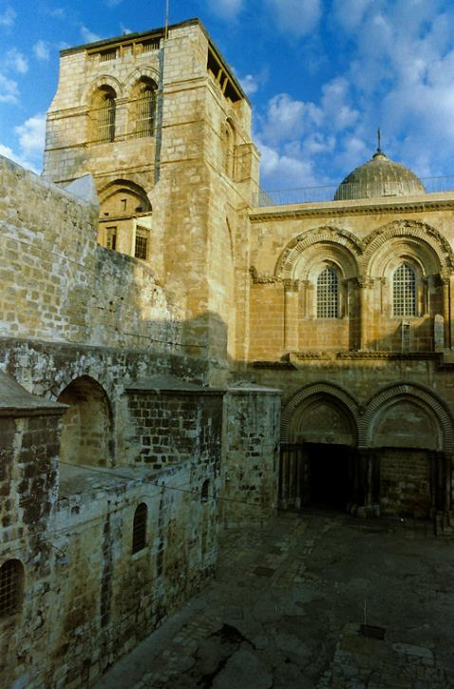
Locating Calvary
The exact site of the crucifixion has been elusive, exacerbated by the destruction of the city in AD 70 and its rebuilding by Trajan in the 2nd century. Two primary sites have been defended (as well as several that are less popular), Gordon’s Calvary and the Church of the Holy Sepulchre. The only clear identity marker in the gospels is that it was outside the city wall (Mt. 19:20; cf. He. 13:12-13).
Gordon’s Calvary (left) was identified by British General Charles Gordon for mystical reasons. The shape of the hill somewhat resembles a skull.
The Church of the Holy Sepulchre (right) has the best attestation in antiquity (Eusebius and Jerome). In general, the question is still open.

Slide 176
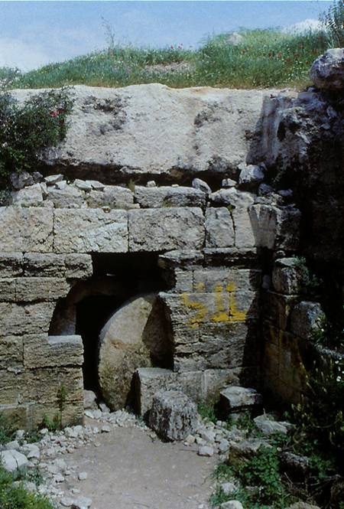
The Shame of Jesus’ Burial
Normal Jewish burial was in a family tomb, where the loved one was reverently mourned. Jesus, by contrast, was denied customary burial rites. Instead, he had a dishonorable burial in a new tomb (23:53) whose very newness was in itself shameful. There was no traditional procession to the tomb, no public expressions of condolence to the family, and no one to sit shiv’ah (intense grieving).
While the site of Jesus’ burial is also unknown, it would have looked similar to this excavated 1st century tomb with its rolling stone. Square blocking stones were used also, but the gospels’ records make clear that this stone was a rolling stone.

Slide 177
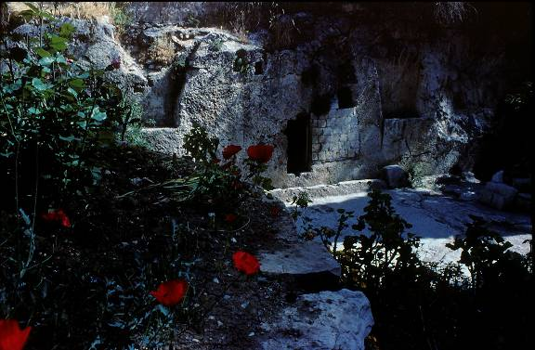
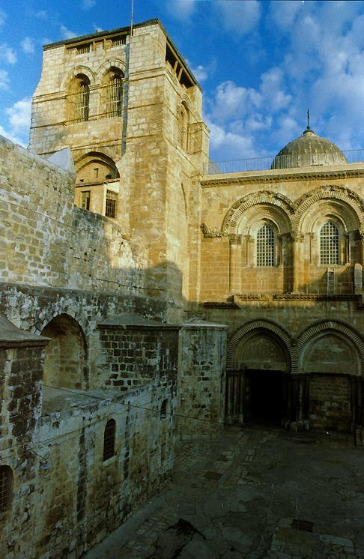
The two most popular sites for the location of Jesus’ burial
The Garden Tomb was located by Protestant missionaries. However, archaeologists believe this tomb to be too old (8th-6th centuries BC) to be the tomb of Jesus.
The Church of the Holy Sepulchre has been revered as Jesus’ burial place since the early 4th century AD.

Slide 178
THE RESURRECTION

Slide 179
Resurrection in the Four Gospels
Matthew
Jesus appears to the women
The report of the guard
Appears to eleven in Galilee
Mark
Jesus appears to the women
(summary of appearances and ascension in the long ending)
Luke
Jesus appears to the women
Appears to Cleopas and his companion
Appears on Easter evening
Leads disciples to Bethany and ascends into heaven
John
Jesus appears to the Magdalene
Appears on Easter evening
Appears to the disciples with Thomas
Appears to seven in Galilee

Slide 180
The First Witnesses
Having marked where Jesus was buried late on Friday evening, the Galilean women waited until the Sabbath was past and returned to the tomb early Sunday morning.
  Finding the tomb empty, they were confronted by two figures who announced to them that Jesus had risen, reminding them that Jesus had predicted this very thing.
  They reported what they had seen and heard to the Eleven, and while their story seemed incredible, Peter, at least, went to investigate and also found the tomb empty.

Slide 181
Easter Faith the gospels offer two kinds of testimony
INDIRECT
(the empty tomb)
Women’s testimony
Angels’ announcement
Guards’ report (Matthew)
Investigation by Peter and the beloved disciple (Luke & John’s Gospel)
DIRECT
(appearances)
To the women
To Mary Magdalene (John’s Gospel)
To two on the Emmaus Road (Luke’s Gospel)
To the apostles on several occasions

Slide 182
Appearance to Cleopas & Companion
Only Luke tells us the account of Jesus appearing later on Sunday to Cleopas and an unnamed companion on the Emmaus Road a few miles from Jerusalem.
  They did not recognize him, but they did discuss with him the events of the past few days.
  In all the sections of the Hebrew Bible—the Torah, the Prophets and the Writings (Psalms)—Jesus explained how his death was a fulfillment of the Scriptures.
  In the end, they finally recognized him by the familiar gesture of the breaking of the bread—and then he disappeared.

Slide 183
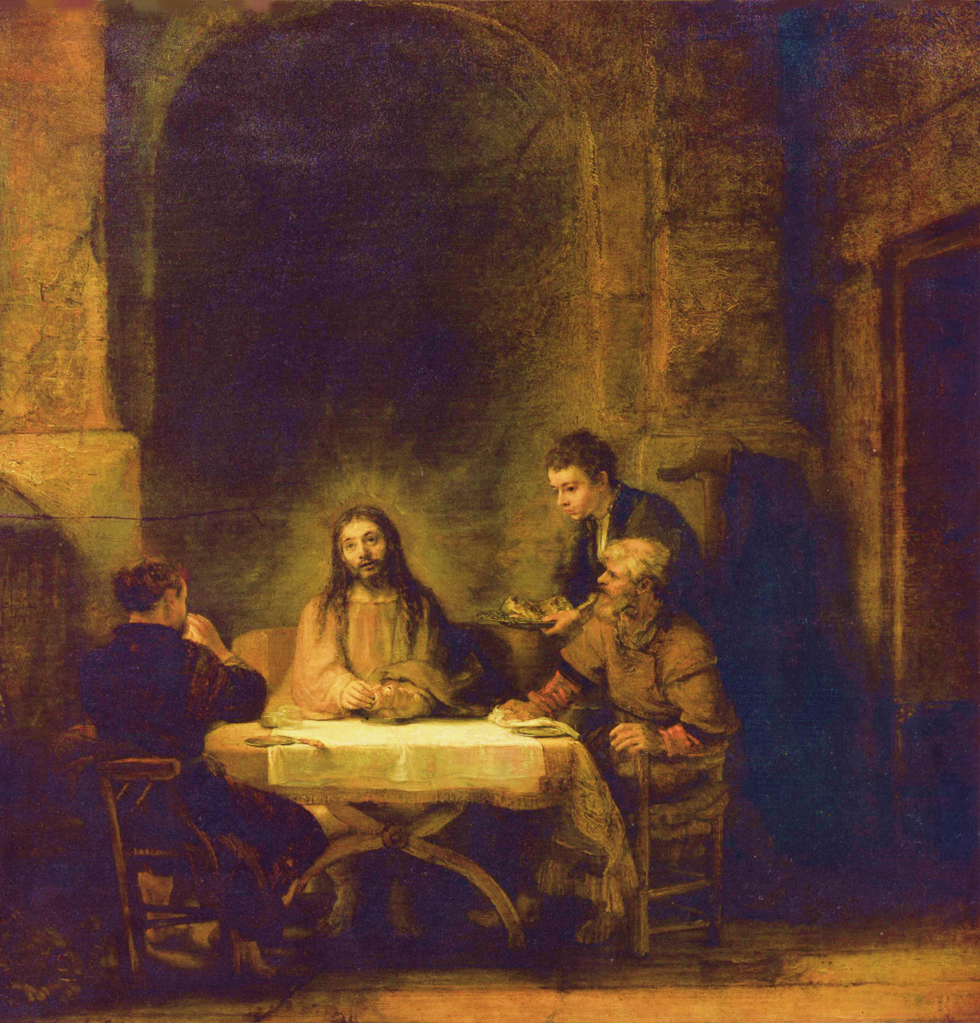
Rembrandt, 1648
The Lourvre, Paris

Slide 184
The Appearance to the Eleven
Cleopas and his companion hurried to report their encounter with Jesus to the Eleven.
  That Luke uses the term “the Eleven” presumes both the demise of Judas, the absence of Thomas (cf. Jn. 20:24) and the eventual addition of Matthias (cf. Ac. 1:15-26).
  While Cleopas and his companion were reporting, Jesus suddenly stood among them, inviting them to examine his hands and feet which still bore the marks of crucifixion.
  He ate with them (cf. Ac. 10:41) and then opened their minds to the fulfillment of the Scriptures, commissioning them to preach the gospel to the nations.

Slide 185
The Ascension
Luke closes his gospel with the ascension of Jesus at Bethany.
  This ending will now be taken up in more detail in the Book of Acts, Luke’s second work.
  He leaves the disciples in the Jerusalem temple, where they would await the gift of the Spirit.

Slide 186
In Jesus the promise is confirmed,
the covenant is renewed,
the prophecies are fulfilled,
the law is vindicated,
salvation is brought near,
sacred history has reached its climax,
the perfect sacrifice has been offered
and accepted,
the great priest over the household of God has taken his seat at God’s right hand,
the Prophet like Moses has been raised up,
the Son of David reigns,
the kingdom of God has been inaugurated,
the Son of Man has received dominion from the Ancient of Days,
the Servant of the Lord,
having been smitten to death
for his people’s transgression
and borne the sin of many,
has accomplished the divine purpose,
has seen light after the travail of his soul and is now exalted and extolled and made very high.

