Slide 1

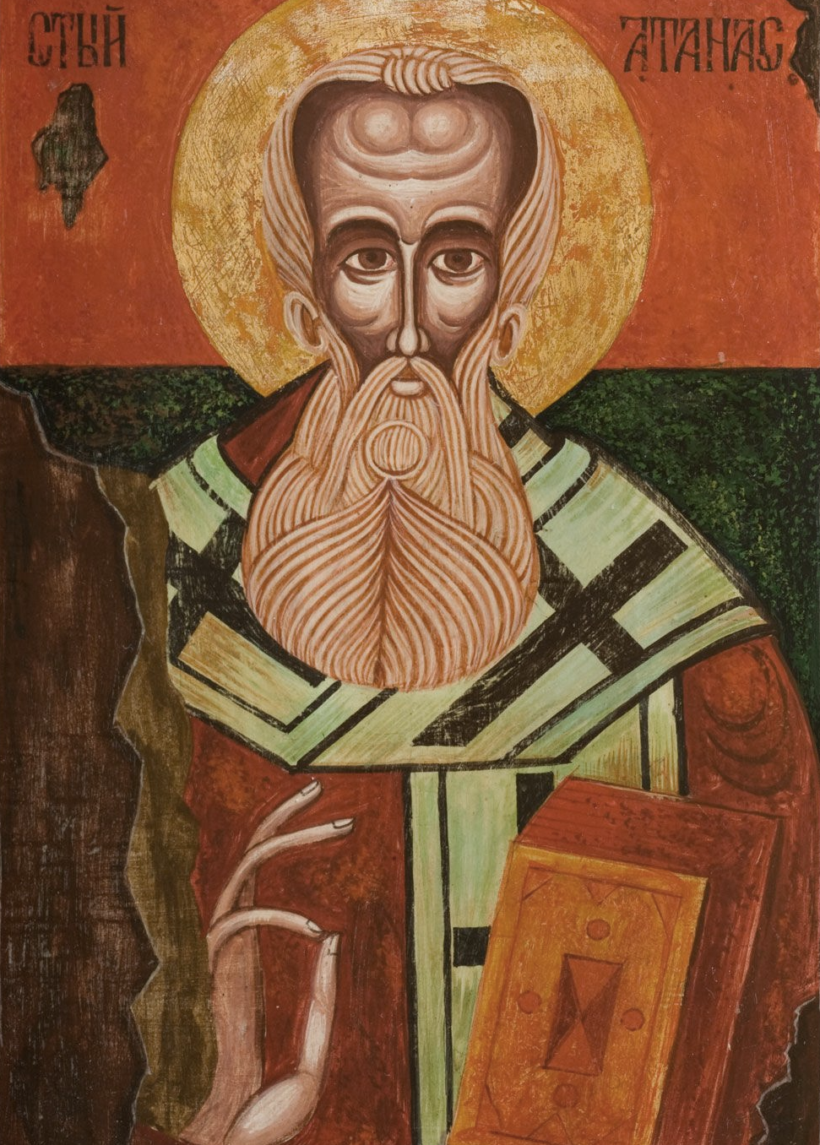
New Testament Canon: Part 1
Athanasius composed his 39th Easter Letter in AD 367 naming the 27 books of the New Testament

Slide 2

Introduction
IN 2003, AUTHOR DAN BROWN PUBLISHED HIS NOW INFAMOUS NOVEL WITH AN OPENING PAGE LABELED “FACT.”
He claimed: “All the descriptions of artwork, architecture, documents, and secret rituals in this novel are accurate.”
The critical word here was “documents,” for he claimed to offer little known “facts” about the canon of the New Testament.

Slide 3
More than 80 gospels [were] considered for the New Testament (actually, there were 37 texts, not all of them gospels, and none made the final cut)
DAN BROWN’S “FACTS”
Emperor Constantine was the moving power behind the reduction of the gospels to four (actually, Constantine had nothing whatsoever to do with the formation of the New Testament canon)
The Nicene Council decided that Jesus was God by a “close vote” (actually, the vote was 305 to 2—not especially close)
Jesus was married to Mary Magdalene as supported in thousands of early documents (actually, there were only two, both Gnostic)

Slide 4
While all these claims were demonstrably false, in a culture that was fascinated by avant-garde intellectualism, the uncritical acceptance of Brown’s claims exerted a significant influence upon how people thought about such things.
So, what really happened, and how is it that we have 27 books in the Christian New Testament?

Slide 5
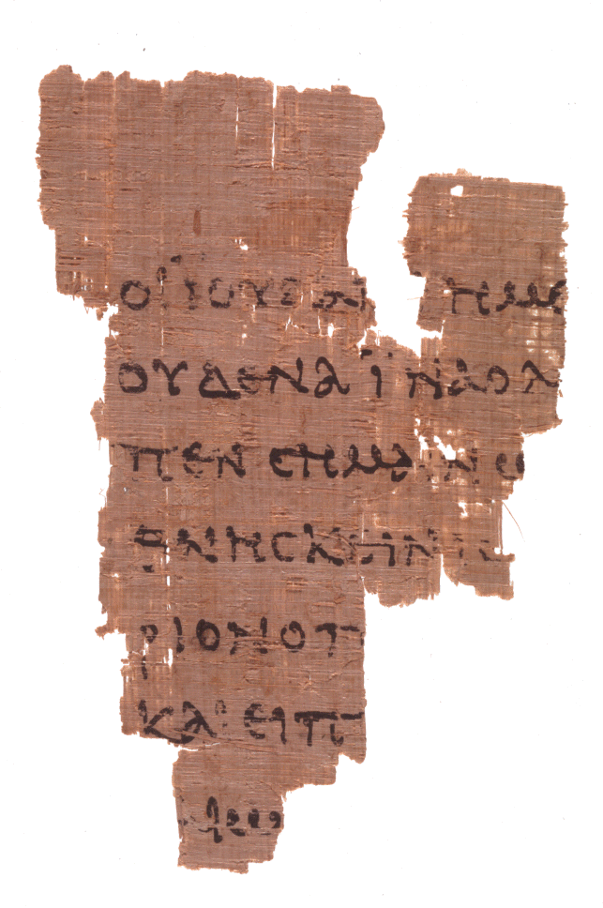
p52
Gospel of John 18:31-33
John Rylands Fragment
Earliest fragment of a New Testament text so far discovered, dating to ca. AD 125.
JESUS LEFT NO EXTENSIVE BLUEPRINTS FOR HIS COMMUNITY OF DISCIPLES.
He did not command his followers to write texts.
They only began to do so about two decades after his ascension, and these were in the form of letters to Christian congregations.
Later, as important early eye-witnesses began to die, gospels were composed to preserve the story of Jesus.
All the texts of the New Testament were composed in less than a century.

Slide 6
Why was the New Testament written?
Though there is no formal statement, the NT writers offer glimpses into what prompted them to write.
“I have written to you…because of the grace God gave me to be a minister of Christ Jesus to the Gentiles with the priestly duty of proclaiming the gospel…” (Ro. 15:15-16)
“Since I myself have carefully investigated everything from the beginning, it seemed good to me to write an orderly account…so that you might know the certainty of the things you have been taught.” (Lk. 1:3-4)
“But these are written that you may believe that Jesus is the Christ, the Son of God, and that by believing you may have life in his name.” (Jn. 20:31)

Slide 7
Dialogue
Why do you think that Jesus did not leave more extensive instructions to his disciples prior to his ascension?
What did he leave?
If you had only the Old Testament, how would you go about telling the story of Jesus?
If you believed Jesus would return in your own lifetime, how would this affect the way you thought about writing Christian texts.
What do we mean by the word “canon?”

Slide 8
Paul’s Instructions
“After this letter has been read to you, see that it is also read in the church of the Laodiceans and that you in turn read the letter from Laodicea.”
St. Paul, Colossians 4:16
“I charge you before the Lord to have this letter read to all the brothers.”
St. Paul, 1 Thessalonians 5:27
“…devote yourself to the public reading of Scripture…”
St. Paul, 1 Timothy 4:13a

Slide 9
The Exchange of Documents
The first step toward canon was the exchange of documents. Such an exchange immediately presumes the authority of the writer(s).
Literacy in the Greco-Roman world was only about 10%.
Sharing documents assumes public reading, and this ancient tradition underlies the public reading of Scripture in the liturgical churches today.
Naturally, those able to publicly read texts were held in high esteem by the congregations, often rising to become leaders.

Slide 10
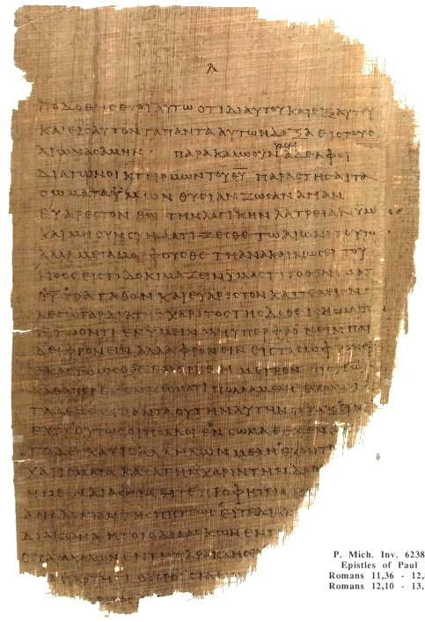
Sharing Documents entailed Making Copies
Each handmade copy was unique.
All reading, public or private, was done aloud in antiquity (cf. Ac. 8:30).
In principle, copies became public property and disseminated without regulation through an informal network of interested people.
Texts made their way into general circulation gradually, slowly, and somewhat haphazardly.
Early copy of Paul’s Letter to the Romans
Ro. 11:36—12:8
ca. AD 200
University of Michigan,
Hatcher Library

Slide 11
Factors for Circulation
Texts were circulated between congregations more often than between individuals.
Christian groups had different language bases, Greek, Latin, Aramaic, Syriac, and Coptic, among others, so translation work began quite early.
Some texts were intended for more than a single audience, such as, “all [the house churches] in Rome” (Ro. 1:7), the “churches of Galatia” (Ga. 1:2), possibly Ephesians (Ep. 1:1, some early manuscripts do not say “in Ephesus” leading to the theory of a circular letter), the “twelve tribes scattered among the nations” (Ja. 1:1), God’s “scattered elect” (1 Pe. 1:1), and the “seven churches of Asia” (Rev. 1:4, 11).
Multiple recipients would require multiple copies.

Slide 12
The Importance of Broad Circulation
In the absence of controlled transmission, an ancient text acquired stability by the broad circulation of enough copies to establish a consistent textual tradition.
For some Christians, the many manuscripts of the Greek New Testament (with some variants) might seem threatening.
Actually, the reverse should be true. The many manuscripts of the Greek New Testament point to a broad textual tradition that was considered trustworthy in all parts of the Roman world.

Slide 13
A Religion Oriented Toward Texts
Unlike all other religions in the Roman world save Judaism, Christianity was oriented toward texts.
Not all Christians could read, of course, but in public reading, all Christians could listen.
Texts, therefore, were essential to the life of a Christian congregation.
The two central parts of every Christian worship service were the public reading of Scripture and the celebration of the Eucharist, still followed in liturgical worship as the Service of the Word and the Service of Communion.

Slide 14
An Early Christian Description
“On the day called Sunday, all who live in the cities or in the country gather together in one place, and the memoirs of the Apostles or the writings of the prophets are read, as long as time permits…”
Justin Martyr (d. 166)
Apology 1.67
Mid-2nd Century

Slide 15
The Challenge of Gnosticism
Gnosticism was a collection of religious ideas flourishing in the mid-2nd century among some Christians.
Rather than focusing on sin and repentance, as was true of the apostles, the Gnostics focused on enlightenment.
The goal was to escape the physical world.
Salvation was being liberated from the prison of the body.
The Gnostics emphasized personal spiritual knowledge as their name implies (gnwsij).
They wrote their own versions of the gospels (many decades later than the canonical gospels and not within the era of any eyewitnesses).
They held that their writings contained the only true version of Jesus.

Slide 16
COPTIC GOSPELOF THOMAS
The earliest Gnostic gospel consisted of 114 “sayings” of Jesus without narratives
SOME SAYINGS ARE VERY SIMILAR TO THE CANONICAL GOSPELS (and probably were borrowed from them)
Jesus said, “If a blind man leads a blind man, both of them fall into a pit.”
Jesus said, “It is not possible for one to enter the house of the strong [man] and take him by force unless he binds his hands; then will he ransack his house.”
Logia 34-35
OTHER SAYINGS ARE STRANGE AND ESOTERIC
His disciples said, “When will you be revealed to us and when will we see you?”
Jesus said, “When you take off your clothing without being ashamed, and take your clothes and put them under your feet as the little children and tread on them, then [you shall behold] the Son of the Living One and you shall not fear.”
Logion 37

Slide 17
Who Gets to Tell the Story of Jesus?
The early church was very firm: only the apostles and those from the apostolic era of eyewitnesses to the life, death, and resurrection of Jesus were trustworthy witnesses to tell his story.

Slide 18
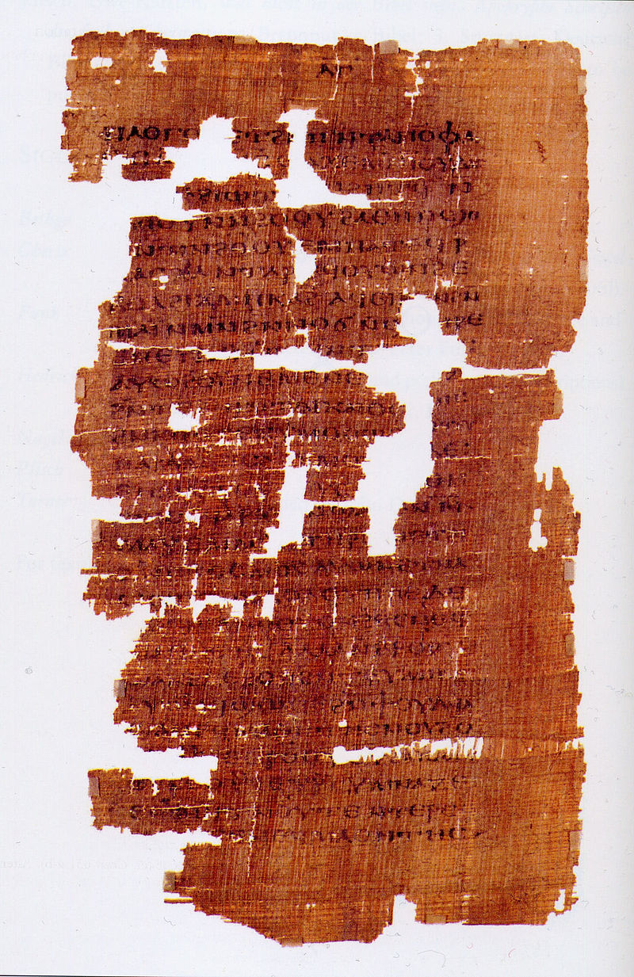
REJECTION OF GNOSTICISM
The early church fathers rightly denounced Gnosticism as heresy and destroyed Gnostic texts.
Until the middle of the 20th century, our knowledge of Gnostic ideas only derived from secondary sources.
With the discovery of the Nag Hammadi texts in Egypt in 1945, we gained first-hand access to actual Gnostic writings, which contain several additional gospels and other writings.
These are the ones that people like Dan Brown are so eager to have accepted as legitimate.
Page from the Gospel of Judas

Slide 19
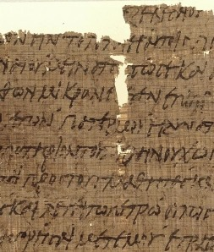
Early Canon Lists
By the late 2nd Century, Christian leaders began to produce lists of writings that were considered authentic and acceptable for public reading in the churches.
The earliest of these was the Muratorian Fragment, which included the four gospels, the 13 letters of Paul, Jude, the Letters of John, and the Book of Revelation.
Such lists also stood opposed to people like Marcion of Rome, who had created his own canon list that only included the Gospel of Luke and 10 letters of Paul—and nothing from the Old Testament.
Opening of the Muratorian Fragment

Slide 20
Dialogue
How is the ancient practice of the public reading of Scripture handled in modern churches?
Why is it important to address the question even in modern times, “Who gets to tell the story of Jesus?”
Why do you think the writings of the Gnostics have become so popular in modern culture?

Slide 21
New Testament Canon: Part 2
Athanasius composed his 39th Easter Letter in AD 367 naming the 27 books of the New Testament

Slide 22
The Canonical Process
The earliest recognition of New Testament writings was spontaneous and instinctive.
Within the NT itself is the implied recognition of Paul’s letters as Scripture (2 Pe. 3:15).
The Apostolic Fathers, our earliest Christian writings outside the New Testament, quote from the apostles in the same way they quote the Old Testament.
Of course, no official canon could be recognized until all the documents had been produced.

Slide 23
Circulation in Smaller Units
The documents of the New Testament at first circulated in smaller units.
The letters of Paul, for instance, circulated in groups of seven, ten, and thirteen letters.
The four gospels circulated together.
The “libraries” of various congregations grew as they received new copies of texts.
Presumably, Christians followed the pattern of the synagogues with a receptacle for storing texts, and congregational libraries would have been widespread from a very early period.

Slide 24
Geographical Families
Because handwritten copies were being made in various parts of the Roman world, it is not surprising that manuscripts from the same geographical region took on a distinctive character.
Slight variations tended to be repeated in copies from the same region, since they used the same exemplar.
As time progressed, we can now identify textual families in Egypt (Alexandrian), Greece (Byzantine), Palestine (Caesarean), and Italy (Western).

Slide 25
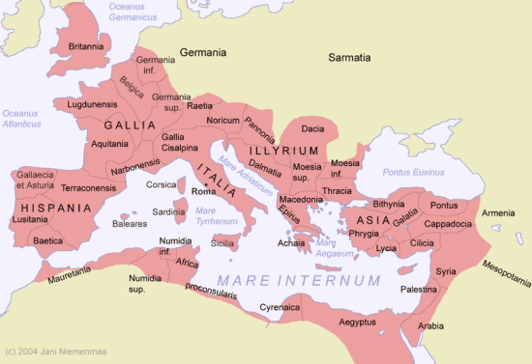
GEOGRAPHICAL TEXTUAL FAMILIES
Western Text
Byzantine Text
Alexandrian Text
Caesarean Text

Slide 26
The Codex
The innovation of the codex also had a bearing on the development of the canon.
Scrolls, where each biblical document was written on a single scroll, had no fixed order.
A codex, by its very nature, requires a fixed order of books.
The earliest fixed order was of the four gospels, and in all our early listings, they are always in the order of Matthew, Mark, Luke, and John.
Paul’s letters, on the other hand, had some variation in the order of books. In general, his longer letters appear first.

Slide 27
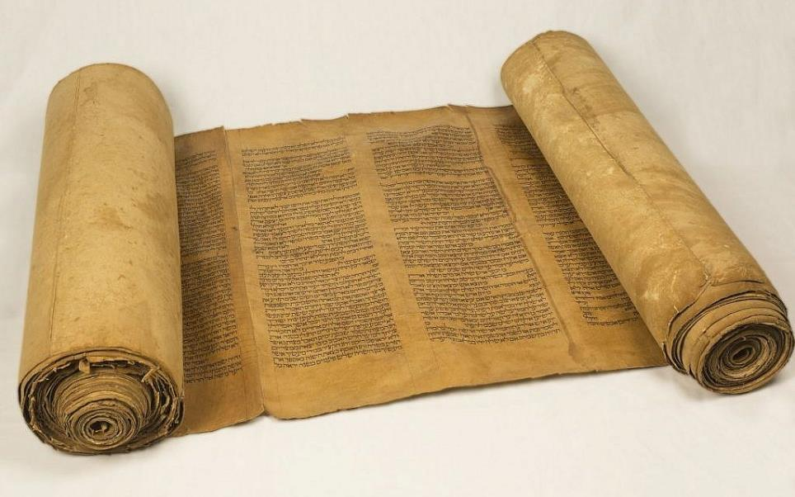
The Hebrew scroll was made of individual sheets of papyrus or leather glued or sewn together.
Writing was from right to left in columns.
Typical scroll length was 3.5 meters.

Slide 28
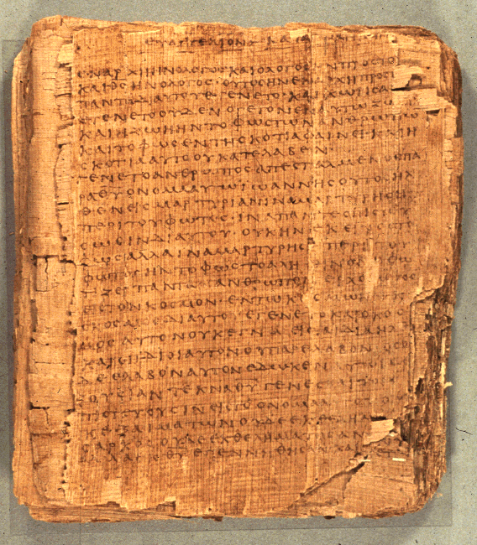
Christian texts were composed as codices, such as, p66
Bodmer Papyrus II
Opening of the Gospel of John
75 leaves and 39 fragments
6.4 inches x 5.6 inches
14-25 lines per page
The codex was more economical (about 25% less expensive than a scroll).
It also was more compact and less bulky.

Slide 29
Codex Construction
The size of early biblical codices was approximately 8-10” in height and 4-6” in width.
Most were constructed of a single quire (i.e., one set of sheets stacked and folded vertically at the center) and stitched along the fold. About 50 sheets per codex were the practical upper limit, which when folded and written on both sides, produced a document of about 200 pages.
Some were constructed using multiple quires (i.e., 4-12 sheets per quire stacked, folded, and stitched).
  p46 (Paul’s Letters) – 208 pages (single quire)
  p47 (Revelation) – 46 pages (single quire)
  p52 (Gospel of John) – 130 pages (single quire)
  p66 (Gospel of John) – 156 pages (multiple quire)
  p75 (John and Luke) – 144 pages (single quire)

Slide 30
Dialogue
What do you make of the fact that early Christian texts are divided into geographical families? How might this affect the way we read them?
How do we handle small variations in the New Testament texts?
What might be some advantages of a codex as opposed to a scroll?

Slide 31
Evaluating Texts
In the midst of this slow process of publication and distribution, the church also had to evaluate texts.
Which texts were authentic and apostolic?
While the four gospels did not originally have titles, titles were added quite early so that “The gospel according to Matthew,” or “Luke”, etc. preserved the earliest traditions.
How should the church handle anonymous letters, like the Letter to the Hebrews?
The implicit question was always near the surface: “Were these books inspired by God?”

Slide 32
Twin Criteria for Canon kanw<n (canon = rule, standard)
INSPIRATION
In the use and testimony of the church from earliest times, was the document accepted as inspired by God?
Was it read alongside the Scriptures in the Old Testament?
APOSTOLICITY
Did the testimony of the church credit the document to an apostle or someone close who carried apostolic authority?
Did it come from the period when there were still living eyewitnesses of Jesus?

Slide 33
The Categories of Eusebius
By the 4th century, Eusebius divides the Christians’ writings into three classes (Ecclesiastical History III.25)
Known to be Canonical
Four Gospels
Acts
Pauline Letters
Hebrews
1 John
1 Peter
Revelation
Widely accepted though disputed by some
James
Jude
2 Peter
2 & 3 John
Not Canonical
Acts of Paul
Shepherd of Hermas
Apocalypse of Peter
Epistle of Barnabas
Didache

Slide 34
Over the years, it became important to know what books were being quoted as Scripture by the earliest Christian leaders.
This included which books were translated into second languages.
It also include preliminary canon lists which, even though incomplete, carried considerable weight in assessing a work to be apostolic and authentic.

Slide 35
Early gospels or works that purport to give information about Jesus that were not accepted as canonical (mostly Gnostic)
Protoevangelium of James
Infancy Gospel ofThomas
Pseudo-Matthew
Armenian Infancy Gospel
Assumption of the Virgin Mary
History of Joseph the Carpentar
Gospel of Peter
Gospel of Nicodemas
Gospel of the Nazarenes
Gospel of the Ebionites
Gospel of the Hebrews
Gospel of Eve
Gospel of Judas
Gospel of the Egyptians
Gospel of Matthias
Pistis Sophia
Gospel of Thomas
Gospel of Philip
Gospel of Truth
Books of Jeu

Slide 36
Early acts or works that purport to give information about the apostles that were not accepted as canonical
Acts of Paul and Thecla
Acts of Peter
Acts of John
Acts of Andrew
Acts ofThomas
Acts of Thaddaeus
Acts of Philip
Acts of Andrew and Matthias
3 Corinthians
Laodecians
Alexandrians
Paul and Seneca
Epistle of the Apostles
Didascalia
Letter of Jesus
Clementine Homilies
Letter of Lentulus
Sunday Letter

Slide 37
Early apocalypses that were not accepted as canonical
Ascension of Isaiah
Apocalypse of Peter
Coptic Apocalypse of Peter
Apocalypse of Paul
Christian Sibylline Books
Apocalypse of John (not the Book of Revelation)

Slide 38
Fixing the Canon
The earliest canon lists and translated codices are not uniform:
Marcion’s canon (consists of Luke and ten letters of Paul)
Muratorian fragment (omits Hebrews, James and 1 & 2 Peter)
Old Syriac (omits 2 Peter, 2 & 3 John, Jude and Revelation)
Old Latin (omits Hebrews, James and 1 & 2 Peter)
Codex Sinaiticus (includes the Letter of Barnabas and the Shepherd of Hermas)

Slide 39
Athanasius’ 39th Easter Letter
Gradually, there was more and more unanimity. The earliest full canon listing of New Testament books as we know them today was made by Athanasius in AD 367.
It contains the full 27 books of the New Testament, no more and no less.
Augustine supported this canon list.
Jerome’s Vulgate also supported this canon list.

Slide 40
Preservation
The Greek text of the New Testament is easily the best documented text in the history of the world.
This text is supported in six broad categories, the first three being the most valuable because of their antiquity.
  Papyri Lectionaries
  Uncials Versions
  Minuscules Church Fathers
Today, our manuscript base numbers nearly 6000 documents containing either all or part of the New Testament.

Slide 41
Dialogue
What does it mean to say that something is “apostolic?”
What do you think about those who advocate re-opening the canon, i.e., either adding or taking way texts?
Can you accept that the process of canonization was guided by God in the history of the early church?

