Slide 1
THE LATE PROPHETS WEEK
Habakkuk
Zephaniah
Jeremiah
Lamentations
Ezekiel
Obadiah
Daniel

Slide 2
PROPHETS IN THE
ANCIENT NEAR EAST
Widespread phenomenon (Canaan, Syria, Anatolia, Mesopotamia and Egypt)
Balaam ben Beor, a biblical example
    Agreed to prophecy for a “fee” (Nu. 22:7, 16)
    Resorted to sorcery (Nu. 24:1)
Prophets of Ba’al, other examples
    Raving and self-mutilation (1 Kg. 18:29)
ANE prophecies often took the form of transcendental ecstasy
    Fits or violent trances
    Leaping, wild dancing
    Contortions, constriction of muscles
    Unintelligible utterances

Slide 3
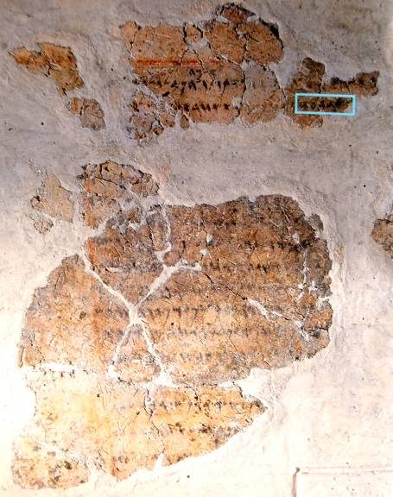
Balaam Inscription
A reference to “Balaam, son of Beor” was discovered at Deir Alla (biblical Succoth) in the transjordan in 1967 (probably from the mid-8th century BC). It appears on a plastered wall and reads in part:
“Inscription of [Ba]laam [son of Beo]r, the man who was a seer of the gods. Lo, the gods came to him at night and [spoke to] him.
“…And the Mighties [Shaddayin, plural of Shadday] have fixed a date, and they said to Sha[ma]sh [the sun]: Sew shut the skies with your cloud! There, let there be darkness and no shining…”

Slide 4
UNIQUENESS OF ISRAEL’S PROPHETS
Prophetic revelations typically were given as sermons, not visionary ecstasies
The content was primary, not the psychic state of mind (the standard formula = “The word of Yahweh came to ________”
The tests of legitimate prophecy were:
    Fidelity to the Torah, not signs and wonders (Dt. 13:1-11)
    Accuracy of prediction (Dt. 18:20-22; 1 Kg. 22:28)
    Privileged inclusion in Yahweh’s heavenly council in order to speak his word (Je. 23:16-18, 21-22, 25-32; Eze. 13:2-7, 17)
Israel’s prophets consciously distinguished themselves from the non-cognitive ANE style (Am. 7:14; Is. 28:7-10; Je. 23:9-40; Eze. 13:1-13)

Slide 5
Questions
The ancient law of the prophets indicated that prophecy was not to be accepted uncritically precisely because false prophecy was possible. Should this still be the case for prophecy in the Christian community?
Israel’s prophets were primarily preachers. While they made predictions, their predictions were in service to their basic message. Should this still be the case?

Slide 6
THE HEBREW BIBLE
Three Collections
hrvt Myxybn Mybvtk
(Torah) (Nebiim) (Kethubim)
Genesis Former Prophets Psalms
Exodus Joshua Proverbs
Leviticus Judges Job
Numbers Samuel Megilloth (five rolls)
Deuteronomy Kings Song of Songs
Latter Prophets Ruth
Isaiah Lamentations
Jeremiah Esther
Ezekiel Ecclesiastes
The Twelve Daniel
Ezra-Nehemiah
Chronicles

Slide 7
DATING THE WRITTEN ORACLES
Oracles with internal historical markers based on regnal years of current kings:
8th Century
* Amos * Hosea * Isaiah * Micah
7th Century
* Zephaniah * Jeremiah
6th Century
* Ezekiel
Post-Exile
* Haggai * Zechariah
Correlations between ancient and modern calendars can be fixed due to the careful recording of solar and lunar eclipses by the Assyrians as well as their specific records of Israelite kings whose regnal years are coordinated with those of Assyrian rulers.
Prophetic oracles without internal references to specific historical figures or events are more difficult to date.

Slide 8
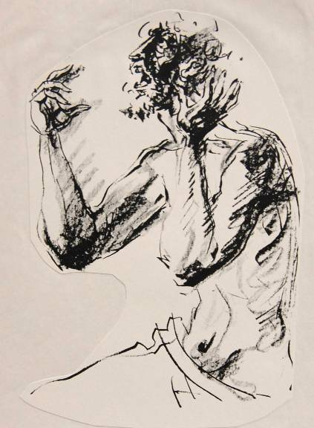
Pathos of the Prophets
The trials and trauma of the prophets reflected the pathos of God. They experienced:
    Abandonment
    Ostracism
    Ridicule
    Loss of love ones
    Depression
    Divorce
    Threats
    Persecution
    Torture
    Death

Slide 9
Questions
Does trauma and pathos still play a role in the ministry of Christians who prophesy?

Slide 10
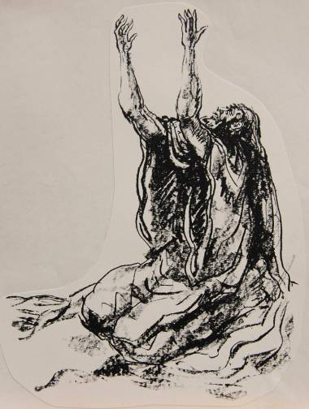
HABAKKUK
Questioning God

Slide 11
THE ORACLES OF HABAKKUK ARE UNIQUE AMONG THE PROPHETS
Rather than pronouncements of judgement on Israel or the nations, Habakkuk addresses questions of theodicy.
The fundamental question concerns divine justice: is God fair in his treatment of Judah and Jerusalem with respect to the coming disaster?
Like the Book of Job, this book explores the sovereignty of God--not the theoretical extent of his power, but whether or not he administrates his sovereignty consistently and in a just way.

Slide 12
The basic questions
Habakkuk’s fundamental questions follow along two paths:
If God is really in control, why is there so much evil in the world?
If God is really righteous, why does he allow wicked empires to swallow up nations less wicked than themselves?
Though posed more than 2500 years ago, these questions of theodicy are as relevant now as they were then!

Slide 13
Questions
How do modern people frame questions of theodicy?
How does belief in the sovereignty of God sharpen such questions?

Slide 14
structure
The book falls into three major parts:
The Dialogue with God
The initial complaint and God’s answer (1:2-11)
The second complaint and God’s answer (1:12—2:5)
Taunt Against Babylon
The five woes against Babylon (2:6-20)
The Divine Theophany
The prophet’s visionary prayer of God’s divine theophanies and judgments in history (3)

Slide 15
The first complaint (1:2-4)
The initial question pertains to what seemed to be divine aloofness with regard to human violence and injustice.
If Yahweh was sovereign, why did he allow anarchy to prevail in the world?
The Torah, God’s instruction for life, seemed to have no effect. Hezekiah had made a valiant effort toward reform (2 Kg. 18:1-8), but after his death, Manasseh plunged headlong back into paganism (2 Kg. 21).
Habakkuk’s implicit question to God was, “Why don’t you do something?”

Slide 16
The first answer (1:5-11)
God’s answer was that he WAS about to do something, something so shocking and terrible that Habakkuk would be hard pressed to even believe it!
He already was putting his plan into action, for he was about to raise up the Babylonians, who would sweep across the ancient Near East in a veritable frenzy or war and annexation.
If the Assyrians had been fearful, the Babylonians would be even more so! Like predators, they would vanquish every opposing force, sending innumerable prisoners of war into exile.

Slide 17
The second complaint (1:12-13)
If anything, Yahweh’s answer made the original complaint more acute.
Yahweh could hardly be faithful to his own covenant promises if he allowed the Babylonians to exterminate the people of Israel; hence, the coming invasion must be a temporary judgment within history.
Even so, this seemed incompatible with Yahweh’s moral character: how could he allow the Babylonians to invade Jerusalem, since they were even more corrupt than the people of Judah?

Slide 18
The Babylonian conquests (1:14-17)
In an extended metaphor, Habakkuk describes the nations like fish in the sea.
The Babylonians would be great “fishers” of men, dropping their military dragnet into the water in order to scoop up nations in order to feed their own political ambitions.
The “net” was Marduk, the Babylonian god of war and chief among the more than 3000 deities in the Babylonian pantheon.
How could Yahweh permit such a pagan “net” to prevail?

Slide 19
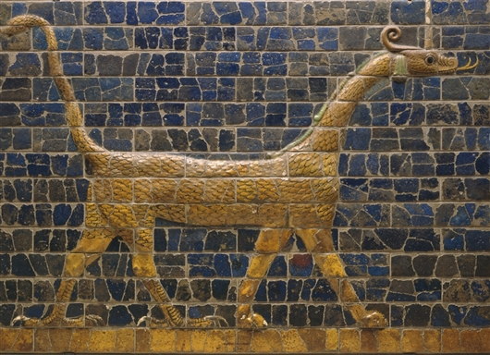
This snake-dragon depiction of the Babylonian god Marduk, originally part of the Ishtar Gate in Babylon and created from terra-cotta glazed and molded bricks, dates to about 604-562 BC. Marduk was the patron god of Babylon.
Detroit Institute of Arts

Slide 20
Waiting on Yahweh (2:1)
Habakkuk resigned himself to wait and see what Yahweh would say.
Like a sentry on duty, he would await God’s answer.
His waiting on God was equally a waiting on the Babylonian doom that was coming.

Slide 21
Questions
While Habakkuk lived in the ancient world with only dim perceptions about the future, how does the coming of Christ affect the way one might answer questions such as those of Habakkuk?
Some modern people wish to eliminate the wrath of God as incompatible with his love. What do you think about such conclusions?
How difficult is it to “wait” upon God?

Slide 22
The second answer (2:2)
Yahweh’s second answer was prefaced by the command to write the answer on tablets, just as Isaiah did (cf. Is. 8:1; 30:8).
The precise type of tablet is unclear, though clay and stone were typical, but here there may be a deliberate echo of the inscription of the Decalogue and its enduring quality (cf. Ex. 34:1).
The text was to be legible (large?) so that anyone reading it could disperse its message.

Slide 23
An answer postponed (2:3-4a, 5)
The answer to Habakkuk’s complaint and the resolution to the universal problem of evil in the world would only appear at “the end,” an unknown time in God’s future appointments.
In the meantime, Habakkuk (and all God’s people) must be content to wait.
Though the answer might seem slow in coming, it would surely arrive!
The antecedent of the “he” in 2:4a goes back to the “wicked one” in 1:15, representing Babylon, the empire of power, greed and pride bent on conquest.

Slide 24
the righteous will live by his faith (2:4b)
In the midst of the times between the promise of justice and the fulfillment to come, the righteous person must live by his faith.
The word hn!Umx$ (= faith, faithfulness, fidelity), related to the word “amen,” refers to the inner attitude of faithfulness and continual conscientiousness.
The righteous person must not fall into the way of the pagans; instead, he must remain steadfast in his trust toward God.

Slide 25
Questions
What do you think it means to say that the righteous person will live by his faith?

Slide 26
Intercession (3:2)
Habakkuk’s prayer, after hearing God’s responses and the charge that he must await God’s timing to see justice in the earth, begins with an intercession for the mighty intervention of Yahweh.
He has heard of God’s mighty acts.
Now, he prays that he might be able to see them.
In particular, even though an evil generation deserves divine wrath, he prays for mercy in the midst of wrath. Would there be mercy for those who lived by faith?

Slide 27
Theophany (3:3-7)
Habakkuk’s prayer was answered by a vision of God’s deliverance of Israel from Egypt, a deliverance in the past, but one that anticipated a deliverance in the future.
This opening line is clearly linked to Dt. 33:
  Paran is the desert wasteland between Kadesh-Barnea and Mt. Sinai.
  Seir is the hill country of Edom.
Both locations are associated with Mt. Sinai, where Yahweh gave the Torah (Dt. 33:2).
The pyrotechnics of theophany when God descended upon Mt. Sinai (cf. Ex. 19:16-19), often repeated elsewhere (Ps. 18:7-15; 2 Sa. 22:8-16), are now repeated to Habakkuk.

Slide 28
But why did god come in this way (3:8-15)?
Was this merely a display of raw power or something more?
It WAS something more!
Yahweh as the divine warrior (3:9-11; cf. Ex. 15:3) was declaring his judgment upon the nations (3:12) and his deliverance of his people from their bondage (3:13-15)! Pharaoh, the god-symbol of Egyptian power, and all his cohorts were crushed!
This vision of the nations arrayed against Yahweh is the same as in Psalm 2, where they are arrayed against Yahweh and his anointed!
Here, as there, total victory belongs to Yahweh!

Slide 29
The final answer
Will God respond to evil in the world?
Absolutely yes!
  He will judge the nations!
Will he allow his very own people to die?
Absolutely not!
  In wrath he will remember mercy, just as he did in ancient times (3:13)!

Slide 30
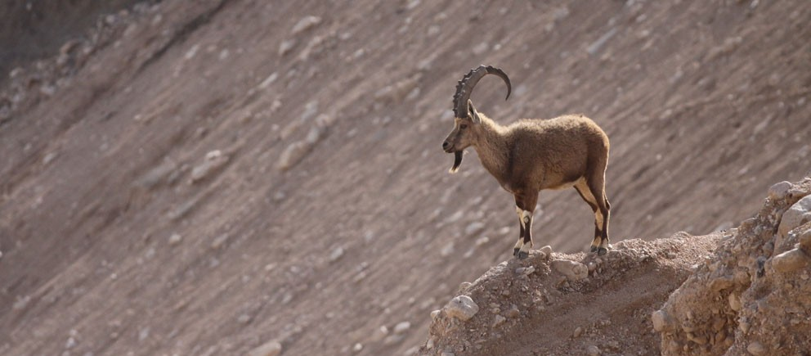
Scholars usually identity the “deer” (hlAY>!xa) in Ha. 3:19 as either the Asian red deer or roe buck, which no longer inhabits Palestine (though some skeletal remains have been discovered); however, a few scholars suggest that it might be the Palestinian ibex (pictured here), which is really a wild goat living in the roughest, steepest terrain it can find.

Slide 31
Questions
Given Habakkuk’s response to his encounter with God, how do you assess those who claim to have had encounters with God and consider them to be fairly ordinary?
How does God’s answer to Habakkuk speak to the modern person who has questions about the problem of evil?

Slide 32
ZEPHANIAH
The Purifying Anger of Yahweh

Slide 33
Manasseh (2 Kg. 21:1-18)
At the age of 12, Manasseh, Hezekiah’s son, began a co-regency with his father.
When Hezekiah died, Manasseh deliberately turned to the Canaanite fertility cult, reinstating the high places, erecting shrines to Ba’al and Asherah, and participating in the astral religions of Mesopotamia.
Like Ahaz, his grandfather (cf. 2 Kg. 16:3), he sacrificed his own son.
He placed an Asherah pole in the temple.

Slide 34
The josianic reform
Two things in particular seem especially significant as spurring on Josiah’s reform movement.
The discovery of a “lost” Torah scroll:
  During a restoration project in the temple, a Torah scroll was discovered, in all probability, the Scroll of Deuteronomy (2 Kg. 22:8-10; 2 Chr. 34:14-18).
  The sworn curses for covenant disobedience (Dt. 28) produced a horrified reaction from the king, and Josiah initiated a renewal of the ancient covenant.
The preaching of Zephaniah:
  The incentive for covenant renewal was probably not due to the rediscovered Torah scroll alone, however.
  Alongside it were the blistering oracles of Zephaniah about the anger of Yahweh for Judah’s covenant failure.

Slide 35
Zephaniah, the man
Zephaniah’s lineage can be traced backward to Hezekiah (1:1), which puts him in the royal family of Judah.
As a resident of Jerusalem, he no doubt was only too familiar with the rash paganizing tendencies of Manasseh.
His descriptions of the shocking idolatrous practices in Jerusalem and Judah suggest that his life experience precedes the great reforms of Josiah.
His name means “Yah has treasured”.

Slide 36
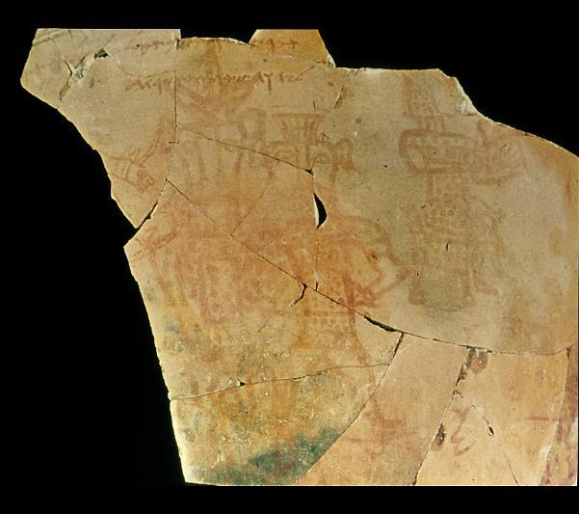
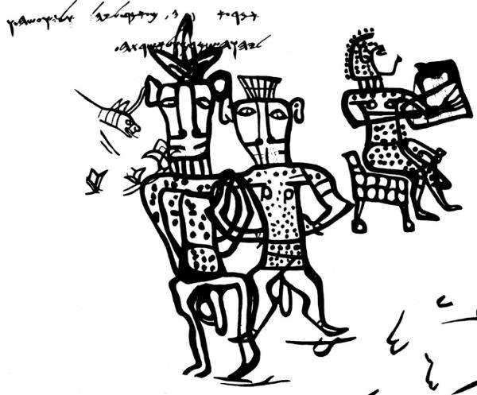
Syncretism in Judah
The mixing of Yahweh worship with the Canaanite fertility cult so typical of Manasseh’s reign is verified by this drawing from a large vessel excavated at Kuntillet Ajrud in southern Judah. The crude pictures show androgynous figures of gods/goddesses, the larger one with the face of a bull and his consort with the face of a cow plus a musician. It bears an inscribed blessing:
“I bless you by Yahweh of Samaria and by his Asherah”

Slide 37
Questions
How many generations does it take to turn from faithfulness to unfaithfulness?
Can the process work in reverse?
What can you take away from the fact that Josiah’s spiritual turning toward God began when he was a teenager?

Slide 38
Vision of the day of Yahweh (1:2-3)
Zephaniah’s initial oracle focuses upon “the Day of Yahweh” (1:7), a designation used by other prophets as well (cf. Am. 5:18; Is. 2:12; 13:9ff.; Joel 2:1, 31).
The term “day of Yahweh” more or less approximates what we mean when we speak of doomsday.
It would be a cataclysm as devastating as Noah’s flood, wiping out the earth’s human population and destroying animal, fish and fowl.

Slide 39
The Eschatological Language of the Prophets
hv!hy; MOy (= Day of Yahweh)
Mymiy0!ha tyr9H3xaB; (= in days to come, in the last days)
Xv0hha MOy0B;(= in that day)
All these expressions are fluid and have a semantic range that includes the near future as well as the indeterminate future.

Slide 40
Day of Yahweh
NEAR FUTURE
Judgment by exile on the unfaithful nations of Israel and Judah
Judgments in history on the nations surrounding Israel and Judah
FAR FUTURE
Judgment on a blasphemous world by universal cataclysm
Disintegration of the universe
Salvation of God’s people
Victory of God’s armies
Universal peace

Slide 41
Jerusalem and Judah (1:4-6)
Zephaniah’s primary concern was with the city and the nation Yahweh had chosen to bear his name.
Her citizens had turned away from the pure faith of Yahweh to follow the Ba’al fertility cult.
They were bowing before the astral deities of the Mesopotamians, where the heavenly bodies were believed to be gods, especially Ishtar, the Queen of heaven, who was linked to the planet Venus.
They were participating in the bloodthirsty offerings of Moloch, whose devotees offered propitiatory child sacrifices, pronouncing oaths in the name of Yahweh and in the name of Moloch as well.

Slide 42
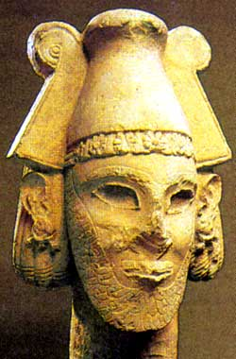
Ammonite deity
Discovered at Ramat Ammon, dating to the 8th-7th centuries BC
The worship of Moloch (the name is based on the ANE word jlm = “king”) is probably to be linked to the OT language about making children “pass through the fire” (Dt. 18:10; 2 Kg. 21:6; Eze. 20:26, 31; 23:37).
Israel Museum, Jerusalem

Slide 43
Other paganizing trends (1:7-9)
In addition to the basic offense of idolatry, the citizens of Jerusalem had adopted…
…the clothing styles of the foreigners, probably neglecting the special clothing stipulated in the Torah (Nu. 15:38-42; Dt. 22:11-12).
  The “tallith” was a garment with specially knotted fringes (“tzitzits”) with blue thread at the four corners, eventually evolving into the post-biblical prayer shawl of Jewish tradition.
  The purpose of the fringes was a reminder to observe the commandments of Yahweh.
…pagan superstitions, such as, “stepping over the threshold”, an obscure custom associated with the Philistines (1 Sa. 5:5). Apparently, it was believed that household demons lay beneath the thresholds of doorways, and stepping on the threshold might anger them.

Slide 44
Coming judgment (1:10-13)
As an act of judgment, Yahweh had determined to allow an enemy to invade from the north.
While the enemy is not named, all the districts under attack are on the northern side of Jerusalem, the “Fish Gate” (probably in the northern wall), the “Second Quarter” (Mishneh) and the “Mortar” (Maktesh). This was the area of the city most vulnerable to assault.
Whether the enemy would be Assyria or Babylon was unclear, but what was clear is that all commerce would be wiped out.
In particular, those who relegated Yahweh to being a “do-nothing” deity would be rudely awakened by his divine wrath!

Slide 45
The day of Yahweh (1:14—2:3)
Doomsday was near and coming fast!
Like Amos (5:18-20), Zephaniah describes it as a day of darkness, sweeping the whole land.
Indeed, as is common among the prophets, the coming judgement of God on Judah would broaden out until it included the whole world. God’s judgment against Jerusalem was only a microcosm of his coming judgment on all nations.
This dire prediction was tempered with a call to repentance. Perhaps it was not too late, or perhaps at least those who maintained their covenant faith might seek the LORD and be hidden from this devastating stroke of judgment.

Slide 46
Questions
Are there dangers of religious syncretism for modern believers, and if so, what form might such syncretism take?
What about superstitions? What superstitions might Christians adopt that are inappropriate?

Slide 47
Yahweh, The international god (2:4-15)
Like all the prophets, Zephaniah’s preaching contained oracles to other nations, too.
Neighboring nations, also, would be called to account on the Day of Yahweh.
Zephaniah spells out only the sins of the Moabites, but it can be assumed that the sins of other nations were apparent.
The oracles to the nations demonstrated that Yahweh was not merely a provincial deity. He was Lord of all nations, not merely Judah.

Slide 48
The fate of Jerusalem (3:1-8)
The capital of Judah, a city of oppressors and rebels, was polluted just like the surrounding nations.
It’s citizens refused to trust in Yahweh, neither obeying him nor accepting his correction.
Her political leaders were predators, gnawing the bones of the people; her prophets and priests were treacherous and defiled.
Still, Yahweh was within the city, dispensing true justice daily, bringing down nations in the hopes that Jerusalem might take warning, but to no avail.
Nothing was left but to await doomsday.

Slide 49
The restoration (3:9-20)
If woe was in the near future, blessing would come in the distant future. Judgment was not Yahweh’s final word.
Then, Judah’s citizens would be purified, standing shoulder to shoulder to serve the LORD in unity.
God’s scattered people, even those from far-off Africa, would bring offerings to Yahweh.
The meek would inherit the earth!
The people of Israel now would celebrate their gift of forgiveness and freedom, and God would live among them.
Yahweh would sing lullabies over Jerusalem, the festivals would be restored and the city’s shame would be exchanged for honor.

Slide 50
Questions
In the context of the ancient Near East, why was it important to understand that Yahweh was the God of all nations?
Judah’s spiritual leaders were hypocrites, both prophets and priests. How might this speak to the importance of integrity among spiritual leaders today?

Slide 51
JEREMIAH
The Deuteronomic Prophet

Slide 52
When does the idea of exile begin?
Exile (estrangement from one’s true home) begins east of Eden (Ge. 3:24; 4:16).
It reaches its climax in the history of Israel with the Assyrian and Babylonian exiles of Ephraim and Judah.

Slide 53
TWO HISTORICAL POLARITIES
EXODUS
(gift of land)
Genesis
Exodus
Leviticus
Numbers
Deuteronomy
Joshua
EXILE
(loss of land)
Judges
Samuel
Kings
Chronicles
8th through 6th century Prophets

Slide 54
False Optimism
“Do not prophesy,” their prophets say. “Do not prophesy about these things; disgrace will not overtake us.” Should it be said, O house of Jacob: “Is the Spirit of Yahweh angry? Does he do such things?” (Micah 2:6-7a)
Yet they lean upon Yahweh and say, “Is not Yahweh among us? No disaster will come upon us.” (Micah 3:11b)
The fall of the north did not shake the confidence of those in the south.
“At that time I will search Jerusalem with lamps and punish those who are complacent, who are like wine left on its dregs, who think, ‘The LORD will do nothing, either good or bad.’” (Zep. 1:12)

Slide 55
“They dress the wound of my people as though it were not serious. ‘Peace, peace,’ they say, when there is no peace.” (Je. 6:14; 8:11)
“Do not trust in deceptive words and say, ‘The temple of Yahweh, the temple of Yahweh, the temple of Yahweh!’ …will you steal and murder, commit adultery and perjury, burn incense to Baal and follow other gods you have not known, and then come and stand before me in this house, which bears my Name, and say, ‘We are safe’—safe to do all these detestable things?” (Je. 7:4, 9-10)
“I warned you when you felt secure, but you said, ‘I will not listen!’ This has been your way from your youth.” (Je. 22:21)

Slide 56
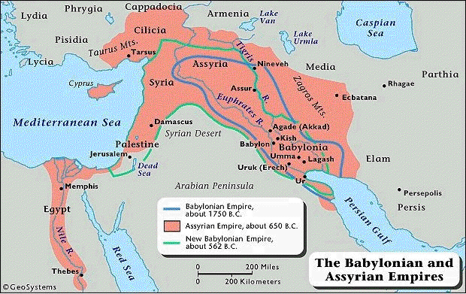
The World of Jeremiah

Slide 57
Jeremiah & Josiah
Jeremiah’s ministry began about five years into the Josianic reforms (Je. 1:2; 25:2-3; cf. 2 Chr. 34:8).
Five years after his ministry began, a Torah scroll was discovered in the temple.
Given the Deuteronomic character of Jeremiah’s ministry, the discovered Torah scroll must have made a deep impression on the young prophet (cf. Je. 11:1-8).
It is unclear how active Jeremiah was in Josiah’s reforms, but he could hardly have been anything but supportive (cf. Je. 22:11, 15-16).
Josiah’s premature death brought the reforms to an end (2 Kg. 22:29-30).
Jeremiah was left to compose funeral dirges for his beloved king (2 Chr. 35:25).

Slide 58
THE TASK OF JEREMIAH
The burden of Jeremiah was that the sentence of exile in the Deuteronomic code would certainly occur because of God’s covenant faithfulness.
He faced an entrenched mood of unmitigated optimism augmented by false prophets who predicted the safety of Jerusalem and Judah.
Even after the 1st deportation, the citizens of Judah concluded that this disaster was only a temporary setback (Je. 28:1-4, 10-11; Eze. 1:2)
It was the task of Jeremiah in Jerusalem (and Ezekiel in Babylon) to confront this optimism with the Word of Yahweh—and his divine word was that worse was yet to come!

Slide 59
Questions
Is false optimism still a problem within the modern Christian community, and if so, how?

Slide 60
Jeremiah, the Man and his Ministry
A Priest:
Born into a family of banished priests in Anathoth, about three miles north of Jerusalem (1 Kg. 2:26-27)
May have descended from Eli (1 Sa. 22:20; 14:3)
Call:
His call to ministry was in 627 BC, the 13th regnal year of Josiah (Je. 1:2; 25:3), which also was the year of Ashurbanipal of Assyria’s death, which in turn heralded Assyria’s decline and Babylon’s rise.
His first scroll was dictated in 605/4 BC, the 4th regnal year of Jehoiakim (Je. 36:1-4), also the year of the Battle of Carchemish, when Egypt, Assyria’s last ally, was defeated by Nebuchadnezzar and when Jehoiakim changed fealty from Egypt to Babylon.
By his own admission, he was only a youth when he was called (Je. 1:6).
His ministry extended until after the fall of Jerusalem in 587/6 BC.

Slide 61
Structure
The book is not autobiographical nor chronological. Rather, it is a collection of oracles written in various literary forms.
Three Types of Material:
Poetic sayings & oracles
Biographical sections of prose
Prose discourses
Four Major Collections:
1-25 Oracles against his own nation, Judah
26-45 Biography written in the third person
46-51 Oracles against foreign nations
52 Historical appendix paralleling 2 Kings 24:18—25:30
Reading Jeremiah Topically:
Call and Early Ministry (1-6)
The Temple Sermon and its
Aftermath (7-10, 26)
Conflicts with Kings and Prophets (14, 21-23, 27-29, 36, 45)
Parables (13, 16, 18-19, 24-25, 32, 35)
Confessions (11-12, 15, 17-18, 20)
Book of Consolation (30-33)
Last Days of Judah (34, 37-44, 52)
Oracles About the Nations (46-51)

Slide 62
Codification
Jeremiah 36
1st Dictation
From the 13th regnal year of Josiah (627 BC) until the 4th regnal year of Jehoiakim (605/4 BC), Jeremiah’s oracles were memorized.
Now, Yahweh commanded that they be inscribed.
The oracles were dictated to Baruch, Jeremiah’s scribe.
Baruch then publicly read the oracles at the temple.
Later, he read them to officials in the royal court.
2nd Dictation
When the oracles were read in the presence of Jehoiakim, the king destroyed the scroll.
Yahweh then commanded the production of a second edition, again by dictation.
In this dictation, Baruch added some expansions that were not contained in the original scroll.
Presumably, Baruch was responsible for the biographical material written in the third person.

Slide 63
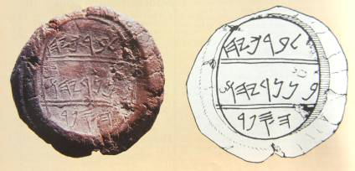
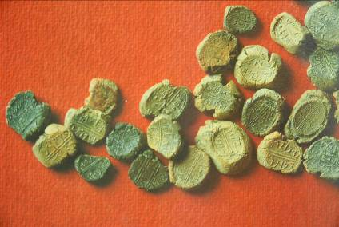
Bulla of Jeremiah’s Scribe
In 1975, a hoard of more than 250 bullae (lumps of clay impressed with a seal) were discovered, one of them containing the name of Baruch (cf. Je. 36:4).
“Belonging to Berekhyahu
Son of Neriyahu
The scribe”
The hoard was discovered in October 1975 in the shop of an Arab antiquities dealer in East Jerusalem. Each bulla was about 1” across. Such seals were used to secure important documents. They were baked hard in the fire that destroyed Jerusalem, 587-6 BC.

Slide 64
Jeremiah’s Call
Chosen and shaped for prophethood from birth (1:4-5)
Similar to:
Moses …both objected to their call on the basis of personal inadequacies (Je. 1:6-8; Ex. 4:12-17)
Isaiah …both their mouths were touched to empower them with the prophetic word (Je. 1:9; Is. 6:6-7)
Controlling principle: Yahweh does not merely call those who are equipped; he equips those whom he calls.
Ministry Agenda:
Judgment …to uproot, tear down, destroy and overthrow (1:10a)
Hope …to build and plant (1:10b)
Personal Requirements:
  Celibacy (16:1-4)
  Forbidden to attend weddings and funerals (16:5-9)
  (All human emotion would be stripped away, a symbol of the shock of God’s future.)

Slide 65
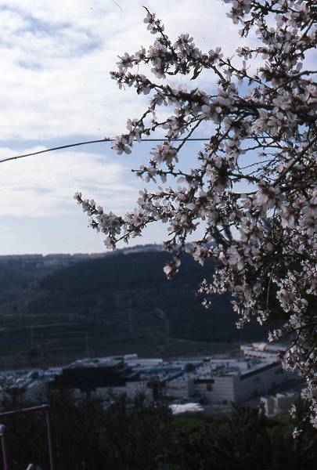
The Almond Tree Branch
Based on a pun in Hebrew
(1:11-12):
dq2wa (shaqed = almond tree)
dq2wo (shoqed = watching)
Yahweh was “watching” to see that his Deuteronomic word was carried out.
Almond blossoms in Jerusalem
Dan Lewis Photo
Notes:
Almond Blossoms: Recalls the word-play in Jeremiah 1:12, where the Hebrew shaqed (= almond) is a pun on the word shoqed (= watching) [II2-21]

Slide 66
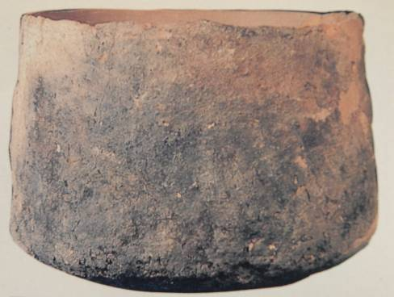
The Boiling Krater
The southward tilt (1:13-14) implies the enemy is from the north (cf. 4:6; 6:1, 2; 10:22; 13:20; 25:9, etc.).
An enemy speaking a foreign tongue (5:15; cf. Dt. 28:49)
Mighty soldiers (5:16)
War chariots, bows and spears (4:13, 29; 6:23)
Cooking krater, Negbite pottery (handmade without a potter’s wheel)

Slide 67
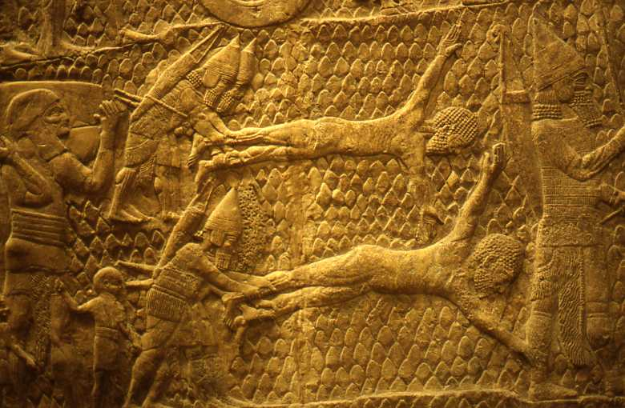
Horror of Ancient Near Eastern Warfare flaying prisoners of war
(British Museum, London)

Slide 68
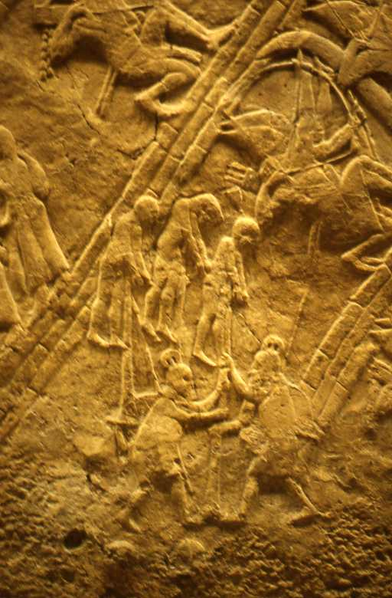
Impaling Victims
(British Museum, London)

Slide 69
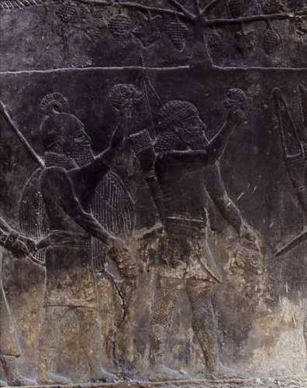
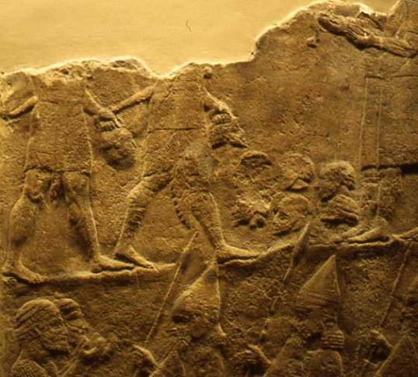
Decapitations
(British Museum, London)

Slide 70
USE OF COURTROOM LANGUAGE IN THE PROPHETS (2)
“Therefore, I bring charges against you…” (2:9)
bYR9 (R’iv = lawsuit)
Domestic (civil case)
Suzerainty-Vassal (international)
Covenant (human-divine)
FORM:
Appeal to witnesses (2:12)
Interrogation & accusation (2:5-6)
Review of past benefits (2:7)
Warning about disloyalty (2:8-11)
Declaration of guilt & punishment (2:31-37)
Byr9 (r’iv = lawsuit)
FpawA (shaphat = to settle a case)
tOmcuf3 (‘etsumoth = arguments)
hHAk;v0An9 (niwwakehah = summons)

Slide 71
Vivid metaphors of adultery are given against the background of the Canaanite fertility cult
Judah was like a faithless wife, brazen and unashamed (3:2-5, 20).
Israel and Judah were like two adulterous sisters (3:6-10).
Yahweh divorced Israel, sending her into exile (3:8).
Judah, because of her adultery, had no right to expect Yahweh to take her back (3:1; cf. Dt. 24:1-4).
In spite of the Deuteronomic code, Yahweh invited his unfaithful wife to return to him (3:12, 14, 22).
However, this return was to be only on his terms (3:13; 4:1-4).

Slide 72
The Temple Sermon (7, 26) a scathing denunciation of religious superficiality
Loyalty to the temple was no guarantee of security (7:4, 8).
True religion must be more than lip service: it must issue in social justice and faithfulness to Yahweh (7:5-6).
The promise of the land “forever” was conditioned on covenant faithfulness (7:7).
If the liturgy in the temple was not matched by covenant faithfulness in life, then the religion was bankrupt (7:9-11a, 21-26).
As Yahweh promised earlier (cf. 1:12), he was “watching” (7:11b).
What once happened at Shiloh (cf. 1 Sa. 2:12-17, 22-36; 4:1-22) would now happen to Jerusalem (7:12-15, 20; 26:4-7).
It was too late; the citizens of Jerusalem were implacable, and it was no use praying for them. They were doomed (7:16, 27—8:3).

Slide 73
Questions
How important is covenant faithfulness for modern believers?
If Jeremiah repeatedly used metaphors of marital unfaithfulness as a sign of Judah’s waywardness from Yahweh, how important is marital faithfulness today as a basic expression of fidelity to the marriage covenant?

Slide 74
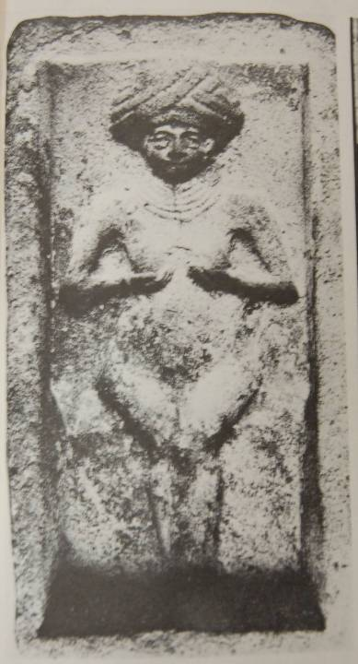
7:18
Cake mold from the palace kitchen of Mari, Mesopotamia.
Used for making cakes in the form of the love-goddess, Ishtar, the Queen of Heaven.
Ishtar, the “Queen of Heaven”, was the Babylonian fertility goddess as well as the goddess of war. She was believed to contain the inseparable powers of life and death.

Slide 75
The Aftermath
Initial response of the priests and court prophets: Jeremiah should be executed (26:10-11).
Jeremiah remained adamant (26:12-16).
The officials and elders argued to spare Jeremiah, since Micah, a century earlier, had been spared (26:17-19, 24; cf. Mic. 3:11-12).
The prophet Uriah ben Shemaiah was not so fortunate (26:20-23).
Jeremiah’s sermon attacked the popular version of the Davidic covenant.
His sermon was considered heretical.

Slide 76
KINGS IN THE A.N.E.
In most nations, the king was considered divine, a son of the gods.
In Judah, Yahweh was the true king, and the earthly king was merely his vice-regent.
Hence, Jeremiah confronted his king with the Word of Yahweh.
COURT PROPHETS IN THE A.N.E.
In most nations, court prophets operated under the wing of the monarchy.
In Judah, court prophets supported the royal status quo, leading Judah toward apostasy.
Hence, Jeremiah confronted the court prophets with the Word of Yahweh.

Slide 77
Since the court prophets were supporters of the royal theology, Jeremiah’s assault upon the Davidic kings brought him into conflict with the prophetic guild as well.
The Canaanite fertility cults were followed to ensure good weather and abundant harvests.
The Deuteronomic code specified drought and crop failure as one of the curses for covenant violation (Dt. 28:18, 22-24, 38-42; 29:19, 22-24).
A severe drought in Judah pointed both toward the ineffectiveness of the Ba’al cult as well as Yahweh’s faithfulness to his covenant stipulations (Je. 14:1-6).
Though the people of Judah acknowledged their sins, they also blamed Yahweh as either unwilling or unable to help them (Je. 14:7-9).
For Jeremiah, this defiance was augmented by the prophetic guild that preached a doctrine of prosperity (14:13-16).

Slide 78
The Third Commandment
You shall not misuse the name of the LORD your God, for the LORD will not hold anyone guiltless who misuses his name.
Exodus 20:7; Deuteronomy 5:11
Two primary ways of breaking the third commandment:
Oath-taking (“As Yahweh lives…”)
Prophecy (“Thus says Yahweh…”)
The third commandment prohibits the use of God’s name in an attempt to harness God’s power for personal ends.

Slide 79
Jeremiah’s Diatribe
Against the False Prophets
The False Prophets:
Abused their positions of influence (23:10b).
Were morally godless (23:11, 14-15).
Mixed the religion of Yahweh with Ba’al worship (23:13).
Spoke false messages in the name of Yahweh (23:16-18, 21-22, 25-29).
JEREMIAH’S MORATORIUM:
To preface an oracle with “thus says Yahweh” proves nothing about authenticity (23:30-32).
Therefore, the expression “thus says Yahweh” should be eliminated altogether (23:33-40).

Slide 80
Jeremiah and Hananiah
The court prophet Hananiah countermanded Jeremiah’s prediction, asserting that within two years the 1st deportation would be reversed (28:1-4, 10-11).
Jeremiah consequently pronounced a death sentence on Hananiah (28:12-14, 17; cf. Dt. 18:29).
Jeremiah acted out a “parable” by wearing an ox-yoke to symbolize the coming servitude to Babylon (27:1-15).
He declared that any prophets who said otherwise were liars and charlatans (27:9-10, 14-22).

Slide 81
Questions
Do you think Jeremiah’s confrontation with false prophets has anything to say to modern Christians with respect to prophecy?
Should Christians be cautious about “misusing” the name of God in prophecy?
What do you think Jeremiah might have said, had he lived in our own time, concerning the so-called “prosperity gospel”?

Slide 82
The Linen Loincloth
13:1-11
Prophetic Action
Jeremiah bought and wore a linen loincloth, the innermost piece of clothing
He was forbidden to launder it.
He hid the loincloth in a cleft of rock near the Euphrates River.
After a long time, he retrieved the loincloth, only to find that it was now rotted beyond usage.
Prophetic Meaning
The loincloth symbolized the intimacy of God’s relationship with his people.
Hiding the loincloth near the Euphrates River symbolized the coming exile to Mesopotamia, where the nation would become spoiled and useless.

Slide 83
The Smashed Wine Jars
13:12-27
Prophetic Meaning
The smashing of the wine jars symbolized the downfall of the dynasty of David and the city of Jerusalem.
Both were under the sentence of death, not merely from Babylon, but from Yahweh.
Both king and queen mother were doomed.
Judah would be like a prostitute, publicly exposed for shame.
Prophetic Action
Jeremiah collected every available wine jar, filling them with wine.
He then smashed the wine jars, spilling all the wine.

Slide 84
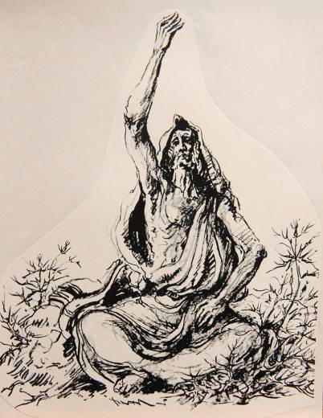
Emotionless Stoicism
16
Prophetic Action
Yahweh forbade Jeremiah to marry or have children.
He forbade him to attend funerals, feasts or weddings.
Prophetic Meaning
By showing neither pity, sympathy nor joy, Jeremiah’s life was a sign pointing to the coming disaster.

Slide 85
The Potter’s House
18
Prophetic Meaning
Though the potter is in control, the condition of the clay is also critical.
Israel is like clay in the potter’s hand.
Because of covenant violation, Yahweh intended to destroy Judah.
Yet, he also stood ready to act in new ways if Judah would respond with new behavior.
Yet, Judah was hardened beyond recovery.
Prophetic Action
Yahweh instructed Jeremiah to visit a local potter.
He watched the potter make a vessel that was marred.
Then the potter made another vessel, this time an acceptable one, from the same clay.

Slide 86
The Smashed Clay Jar
19
Prophetic Action
Jeremiah bought a clay jar from a potter.
He took some elders and priests to the Valley of Ben Hinnom (where ritual child sacrifice was conducted).
They exited the city through the potsherd gate, where potters dumped their wasted vessels.
While they watched, Jeremiah smashed the jar.
Prophetic Meaning
While clay is soft, it is suitable for reshaping.
When it becomes hardened, it is fit only for smashing.
Judah was now hardened in its sin.
The Valley of Ben Hinnom (Topheth) would become the scene of slaughter—not child sacrifice, but the slaughter of the citizens of Judah during the Babylonian siege.

Slide 87
The Cup of Wine
25
Prophetic Meaning
The cup of wine symbolized the wrath of Yahweh.
Judah and the other nations of the Levant would be devastated by the Babylonian war machine.
Yahweh would shout like those treading grapes in a winepress.
He would attack like a lion leaving its lair.
Prophetic Action
In a vision, Yahweh handed Jeremiah a cup of wine.
He was commanded to make the nations drink from the cup, including the citizens of Jerusalem and Judah.
Yahweh’s word to the nations was to drink until they vomited.

Slide 88
The Recabites
35
Prophetic Action
The Recabites were a semi-nomadic Kenite clan that refused to participate in the sedentary life of the city.
Viticulture was unknown to them.
They only had come within the protection of Jerusalem after the land had been invaded.
Jeremiah offered them wine in the temple, knowing they would refuse.
Prophetic Meaning
Their refusal to drink wine, following a tradition of two centuries of loyalty to their ancestor, Jonadab ben Recab, contrasted sharply with Judah’s wanton disloyalty to Yahweh.

Slide 89
The Two Baskets of Figs
24
Prophetic Meaning
The good figs represented those already exiled to Babylon with Jehoiachin; these figs Yahweh would save as a remnant.
The bad figs represented Zedekiah and the citizens of Jerusalem—figs fit only for destruction.
Prophetic Action
Yahweh called Jeremiah’s attention to two baskets of figs in front of the temple.
One basket had very good figs.
The other had poor figs, so poor they could not be eaten.

Slide 90
The Field in Anathoth
32
Prophetic Action
During the final siege of Jerusalem, Yahweh instructed Jeremiah to redeem a field in Anathoth from his cousin.
Jeremiah purchased the land, arranging for deeds to be drawn up.
Prophetic Meaning
Jeremiah’s purchase was a sign pointing toward the restoration of Jerusalem.
In the future, fields, houses and vineyards once again would be occupied in the land.

Slide 91
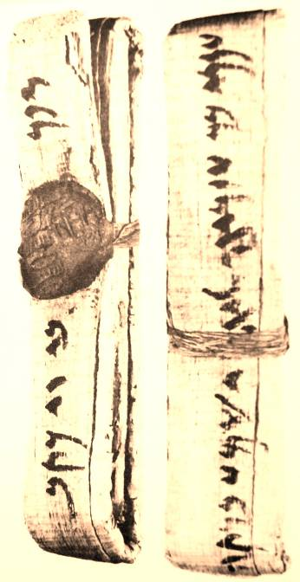
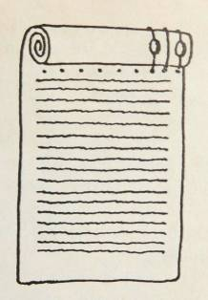
Scrolls normally have writing only on a single side. So-called “Double Deeds” had both a sealed text (permanent legal description) and an open text (abstract available for inspection).
Brooklyn Museum, Brooklyn, New York
Double Deeds
Je. 32:10-15

Slide 92

The “confessions” or “complaints” of Jeremiah are a series of candid, direct and intimate prayers composed after the pattern of laments in the Psalms. Jeremiah gives full vent to his anguish, questioning God and cursing his enemies.
11:18-23 – Like a lamb to slaughter
12:1-6 – The prosperity of the wicked
15:10-21 – The suffering prophet
17:14-18 - Taunted as a false prophet
18:18-23 – Imprecatory prayers for divine vengeance
20:7-13 – Ridiculed with words from his own sermons
20:14-18 – A curse upon the day of his birth

Slide 93
Questions
Jeremiah’s parables were acted out; Jesus’ parables were stories. Is there a place for either of these kinds of parables in modern preaching, and if so, are there controls for how they should be used?

Slide 94
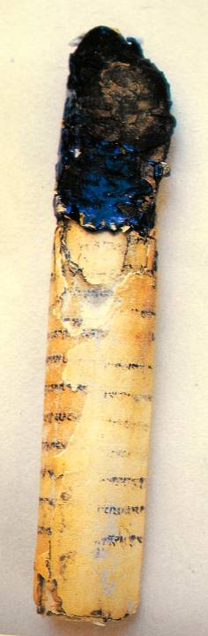
The Scroll
The “book” (30:2) refers to a scroll.
The “book” of consolation collects Jeremiah’s oracles of restoration.
In particular, he anticipated a future on the far side of exile with respect to land, covenant and king.
It is likely that these oracles were interspersed throughout his ministry.

Slide 95
The Land
The central message: Yahweh intends to bring Israel back to the land (30:3; 31:17; 33:7).
The exile is the “time of Jacob’s trouble” (30:7).
Hope remained on the far side of exile, a hope expressed in vivid metaphors (30:10-11):
The incurable wound would be healed (30:12-15, 17; 33:6; cf. 8:22; 10:19).
The purchase of the field in Anathoth was a sign for the future (32:1-15).

Slide 96
The Covenant
Jeremiah’s original commission had a dual orientation: Yahweh was “watching” to…
…uproot, tear down, destroy and overthrow (1:10a)
…but also to build and to plant (1:10b)
In the Book of Consolation, the positive side of this polarity comes to the forefront: Yahweh still is watching…
…but this time, to build and to plant (31:27-28)

Slide 97
A New Covenant was coming!
It was to be established with the remnant from both the northern and southern nations (31:31).
Whereas the Mosaic covenant was contained in external codes, the New Covenant would be deeply internalized (31:33-34a).
Whereas the Mosaic covenant was based on obedience-reward and disobedience-punishment—retributive justice—the New Covenant would be grounded in forgiveness (31:34b).
Whereas the Mosaic covenant could end in a divine rejection of Israel for disobedience, the New Covenant was guaranteed forever (31:35-37; 32:40).

Slide 98
Jeremiah
“The time is coming,” declares Yahweh, “when I will make a new covenant…
“It will not be like the covenant I made with their forefathers…
“I will put my law in their minds and write it on their hearts…
“I will forgive their wickedness and will remember their sins no more…
Jeremiah 31:31-34
Ezekiel
“I will make a covenant of peace with them…
“There will be showers of blessing…
“I will establish an everlasting covenant with you. Then…I will make atonement for you for all you have done…
“I will give them an undivided heart and put a new Spirit in them…
Ezekiel 34:25-31; 16:60-63; 11:1-20

Slide 99
The King
Central to this new covenant was a revival of the Dynasty of David!
Earlier, Jeremiah had used Isaiah’s “Branch” metaphor to describe the restoration of David’s family (Je. 23:5-6; cf. Is. 11:1).
In the time of restoration, the ancient promise to David’s family would be fulfilled (Je. 33:14-26; cf. 2 Sa. 7:16; 23:5; Ps. 89:35-37).

Slide 100
THE ANCHOR POINT:
For Christians, the New Covenant is established in the death of Jesus!
Jesus gave this interpretation at the Last Supper (Mt. 26:28; Mk 14:24; Lk. 22:20; 1 Co. 11:25).
Paul interpreted this fulfillment as including both Jews and Gentiles (Ro. 11:27; 2 Co. 3:4-18).
The Letter to the Hebrews asserts that the old covenant is now obsolete (He. 8:7-13; 9:15; 12:24).

Slide 101
Questions
Given that the new covenant predicted by Jeremiah was directly referenced by Christ at the last supper and linked to his death, how then is one to interpret the promises of Israel’s restoration?
If the promises about the Davidic kingship are fulfilled in Christ, the Son of David, how are the promises of a restored land to be fulfilled?

Slide 102
Nebuchadnezzar’s strategy was first to strip Jerusalem of its defense cities
In 1935 and 1938, ostraca were discovered containing letters between Jewish military personnel who, during Nebuchadnezzar’s attack on Judah, communicated about…
…urgent orders calling for special
arrangements of signal fires
…sending to Egypt for military support
…inspection of the guards
Several names known to us from the Book of Jeremiah appear in these letters, such as, Gemariah, Jaazaniah and Neriah.
Jeremiah predicted that his attack on the defense cities was the beginning of the end (34:1-3).
Lachish had been rebuilt after its destruction by Sennacherib in 701 BC.
At the time of Jeremiah’s oracle, the only two defense cities remaining were Lachish and Azekah (34:6-7).

Slide 103
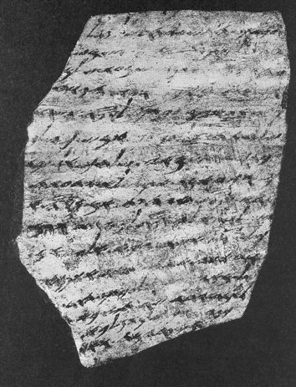
Lachish Letter III
“…And it has been reported to your servant, saying, ‘The commander of the host, Coniah son of Elnathan, has come down in order to go into Egypt; and unto Hodaviah son of Ahijah and his men has he sent to obtain […] from him.’ And as for the letter of Tobiah, servant of the king, which came to Shallum son of Jaddua through the prophet, saying, ‘Beware!’, your servant has sent it to my lord.”

Slide 104
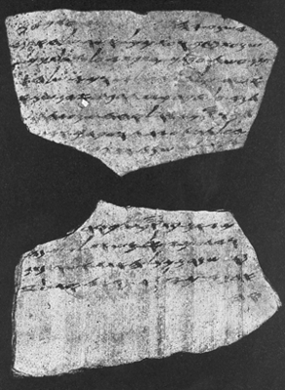
Lachish Letter IV
“…And let (my lord) know that we are watching for the signal (fires) of Lachish, according to all the indications which my lord has given, for we cannot see Azekah.”
These two cities, Lachish and Azekah, are the very ones mentioned by Jeremiah (34:7).

Slide 105
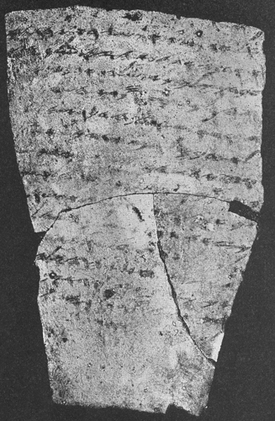
Lachish Letter VI
“…Who is your servant (but) a dog that my lord should have sent (him) the king’s letter and those of the officials asking me to read them? The words of the p[rophet]* are not good—(they are of a kind) to slacken your courage and to weaken that of the men […]”
*restoration by Parker (other restorations read “officials” or “princes” instead of “prophet”)
Could the references to a prophet in Letters III and VI refer to Jeremiah? (cf. Je. 38:1-4)

Slide 106
During the siege on Jerusalem, the Babylonian armies withdrew due to a report that the Egyptians were mobilizing in the south (Je. 37:5).
Jeremiah’s oracle to Zedekiah was that the Egyptian threat was temporary, and Nebuchadnezzar still would return to destroy Jerusalem (Je. 37:6-10).
When Jeremiah attempted to return to Anathoth (possibly in connection with the purchase of the field), he was apprehended, accused of defection, flogged, and imprisoned (Je. 37:13-16).
After a long incarceration, Zedekiah again called for Jeremiah, but the prophet’s message was the same: the city would surely fall (Je. 37:17).
At Jeremiah’s request, Zedekiah allowed him to remain under courtyard arrest (Je. 37:18-21).

Slide 107
The Fall of Jerusalem, 587-6 BC
Jeremiah 39, 52
Famine within (52:6; cf. 2 Kg. 25:1-2; La. 4:7-10)
Exhaustion with defending against the siege works (39:1; 52:4-5; cf. 2 Kg. 25:1-2)
Wall breached (39:2-4; 52:7-8; cf. 2 Kg. 25:4)
The king and the remains of the army attempted escape, unsuccessfully (39:3-7; 52:7-11; cf. 2 Kg. 25:4-7; Eze. 12:12-13; La. 4:19-20)
The Babylonians sacked the city, torched the temple, broke down the walls, and burned to the ground every important building (39:8; 52:12-16; cf. 2 Kg. 25:8-10; 2 Chr. 36:19).
The valuables from the temple were salvaged as plunder and carried to Babylon along with the deportation of the most important citizens (39:9-10; 52:17-30; cf. 27:16-22; 2 Kg. 25:11-21; 2 Chr. 36:18, 20).

Slide 108
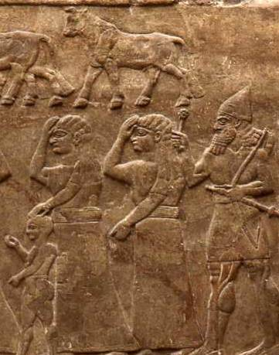
Near Escape
CHAINED FOR DEPORTATION
At first, Jeremiah was prepared for deportation with all the others, in spite of an order for his freedom (40:1; cf. 39:11-12).
When the commander of the guard discovered Jeremiah so chained, he released him, giving him the option of staying in Jerusalem or going to Babylon (40:2-6).
POWS prepared for deportation
British Museum, London

Slide 109
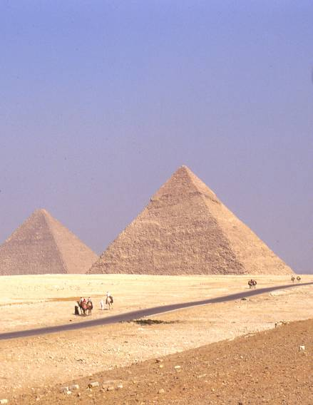
Flight to Egypt
41:16—43:13
Gedaliah’s murder created panic
Would the Babylonians seek reprisals?
Against Jeremiah’s advice, they determined to flee to Egypt.
The Jewish military officers distrusted Jeremiah, accusing him of being manipulated by Baruch, his scribe.
They took both Jeremiah and Baruch with them in the flight to Tahpenes in the northeast Delta (cf. 2 Kg. 25:26).
Jeremiah buried stones in a brick pavement as a sign of Nebuchadnezzar’s coming attack upon Egypt.

Slide 110
Oracles about the Nations
THE PRIMARY THEME IS WAR:
Yahweh directs the wars against the nations (46:10; 47:6-7; 48:10; 49:2, 8, 20, 27, 32b, 35; 50:15, 21, 25; 51:1).
The nations serve as Yahweh’s war club with which he shatters kingdoms under judgment (51:20-23).
Geographical Order
South (Egypt)
West (Philistia)
East (Moab, Ammon and Edom)
North (Damascus, Kedar and Hazor)
Farther North and East (Elam and Babylon)

Slide 111
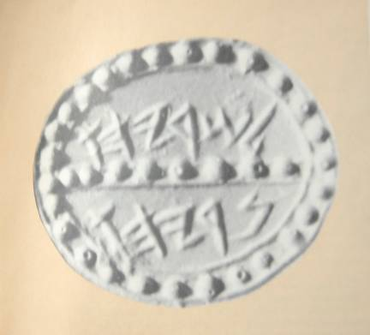
A Sign for the Future
51:59-64
The entire text of the oracle against Babylon was recorded on a scroll and given to Baruch’s brother, Seraiah ben Neriah, so that it might be publicly read in Babylon, ca. 594 BC.
After the reading, it was to be tied to a stone and thrown into the Euphrates River, signifying the eternal sinking of Babylon.
The oracle against Babylon concludes the collection of Jeremiah’s sermons (51:64b).
SEAL IMPRESSION OF SERAIAH from a private collection:
“Belonging to Seriahu / Neriyahu”

Slide 112
LAMENTATIONS

Slide 113
Hamesh megillot
(the Five Rolls)
RUTH
Read at Pentecost (Weeks)
SONG OF SONGS
Read at Passover
ECCLESIASTES
Read at Succoth (Booths)
LAMENTATIONS
Read on the 9th of Ab (June/July)
ESTHER
Read at Purim
In the Jewish liturgical calendar the Five Rolls came to be read on set feast days.
In Christian tradition, these books have been reordered and no longer appear together.
Lamentations now follows Jeremiah, since the tradition of the Septuagint is that Jeremiah was the author.

Slide 114
Questions
In what way was the destruction of Jerusalem and the 1st temple a sign of Yahweh’s covenant faithfulness?

Slide 115
Title and Author
As is typical in Jewish tradition, the book is named after its first word, hkAyx2 (= How…!)
In the LXX and Vulgate, it is titled “Tears” or “Dirges”.
The English title is derived from the Latin superscription: Threni, id est lamentationes Jeremiae prophetae.
Formally anonymous:
It appears to offer a first-hand account of the destruction of Jerusalem and the temple.
Talmudic and early Christian traditions credit it to Jeremiah.
The LXX version of Lamentations contains this superscription in Greek: “And it came to pass, after Israel was taken captive, and Jerusalem made desolate, that Jeremiah sat weeping, and lamented with this lamentation, and said…”

Slide 116
Literary Style
The five poems are composed as dirges for the death of Jerusalem.
The first four poems (chapters 1-4) are composed as acrostics.
Chapters 1, 2 and 4 have 22 strophes, each strophe comprising a single verse; each strophe begins with a letter of the Hebrew alphabet in order.
Chapter 3 also has 22 strophes, each strophe comprised of three lines; the three lines in each triplet begins with a letter of the Hebrew alphabet in order.
Chapter 5 has 22 verses, but it was not composed as an acrostic.

Slide 117
Acrostic Style x b g d h V z H F y k l m n s f p c q r w t
Chapter 1
…hkAyxe 1:1
…OcBA 1:2
…htAl;GA 1:3
…yker4Da 1:4
…UyhA 1:5
…xcey02v1 1:6
…hr!k4zA 1:7
and etc.
Chapter 3
…yn9xE 3:1
…ytiOx 3:2
…j`xa 3:3
…hl.ABi 3:4
…hn!BA 3:5
…MyKiwaHEmaB; 3:6
and etc.

Slide 118
Notations on the First Lament
The first lament is evenly divided into two sections:
Verses 1-11, written in the 3rd person
Verses 12-22, written in the 1st person
Both sections rely heavily on personification:
Verses 1:1ff., Jerusalem is personified as a bereft widow. (Expressions such as “daughter” or “virgin daughter” appear some twenty times in the book.)
Verses 1:12ff., Jerusalem is personified as a refugee of war.

Slide 119
The fundamental symbols of Judah’s national life all are devastated:
The land (1:3)
The temple (1:4, 10)
The royal family (1:6)
The disaster of Jerusalem is clearly set forth as a divine act of judgment:
Retributive justice for Judah’s sin of covenant violation (1:5, 8)
Yahweh trod the grapes; Judah was the victim (1:15).
Jerusalem’s divine punishment is justifiable (1:18, 20)
From the ashes of despair, personified Jerusalem prays for divine judgment on her enemies (1:21b-22).

Slide 120
Notations on the Second Lament
The second lament intensifies the description of tragedy, and in particular, that this destruction was a divine act.
Each of the first 8 verses directly attribute the destruction to Yahweh.
The dirge is rich in verbal metaphors (“hurled down”, ”swallowed up”, “cut off”, “poured out”, “laid waste”, “abandoned”, “handed over” and “tear down”).
Especially poignant is Yahweh’s rejection of the temple, the place he promised security forever (2:6-7; cf. Ps. 46:1-7; 48:8-14; 125:1-2; 133:3; 146:10).

Slide 121
The destruction of Jerusalem was equally a destruction of its social strata.
All leaders—princes, kings, priests and prophets—met the same fate (2:2, 6, 9, 20b).
False prophets, especially, are singled out for censure (2:9b, 14).
The horror of war was no respecter of persons. Young and old, leader and common citizen alike were destroyed (2:10-12, 21).
The city now had become an object of scorn (2:15-16).

Slide 122
Notations on the Third Lament
In the first two laments, the city and the temple are personified. The third lament is offered at a more personal level, and the first person singular pronouns seem to reflect the despair of the author himself.
Several images are similar to experiences of Jeremiah:
Dwelling in a pit (3:52-54; cf. Je. 38:6)
Ridicule of enemies (3:14, 61-63; cf. Je. 15:10; 17:15; 18:18; 20:7-8, 10)
Unanswered prayer (3:8, 44; cf. Je. 15:18b)
Bitterness (3:15; cf. Je. 20:14-18)
Imprecatory prayer (3:64-66; cf. Je. 11:20; 17:18; 18:19-23)

Slide 123
The third lament, at the center of a chiastic structure, raises the vision of hope beyond disaster:
In remembering judgment (3:19-20), the sufferer also remembers hope (3:21).
This hope is grounded in Yahweh’s divine character (3:22-23):
ds,H, (= covenant love)
MHar! (= compassion)
hn!v0mx$ (= faithfulness)
Hope for the future must rest in Yahweh himself, for his unfailing love surpasses his judgment (3:31-33). The sufferer must “wait” on Yahweh (3:24-26).

Slide 124
There are three levels at which the third lament can be read:
Individually—where the author speaks of his personal devastation in the first person singular (3:1ff.).
Collectively—where the author shifts from the first person singular to the first person plural, so speaking in behalf of the community (3:40-41).
Messianically—where the sufferings of the one who waits for Yahweh’s vindication prefigure the sufferings of Christ (3:30; cf. Is. 50:6; Mt. 26:67; Jn. 19:3).

Slide 125
Questions
How do metaphors enrich and make vivid the shattering experience of the loss of Jerusalem?
Why was it important to stress over and over that the fall of Jerusalem was an act of God?
Can you see why it was important to place the expression, “Great is your faithfulness,” and the observation that “your mercies are new every morning” in the very center of the 3rd poem as well as the center of the book?

Slide 126
Notations on the Fourth Lament
Like the second one, the fourth dirge emphasizes the horrors of the national loss:
“Golden” citizens have become clay pots (4:1-2, 7-8).
Parents were so victimized that they neglected their children (4:3-4), like the female ostrich, which had a reputation for neglecting her young (cf. Job 39:13-17).
The siege was so severe that some resorted to cannibalism (4:10; Eze. 5:10).
There was so much death and corruption in the city that priests were defiled to the point that they could no longer serve (4:14-16; cf. Lv.21:1-4).
At various times, Judah looked for help from Egypt, but this help never came (4:17; Eze. 29:6-7).
Refugees who tried to escape, including the king, were caught and killed (4:19-20; cf. Eze. 5:1-4, 11-12; 12:1-14; 2 Kg. 25:4-7).

Slide 127
Notations on the Fifth Lament
The final dirge is not an acrostic describing the disaster in Jerusalem; rather, it is a prayer describing the whole community in the aftermath of that disaster.
Unlike the first four dirges (with the 3 + 2 qinah meter), the final dirge features 3 + 3 and 3 + 4 meters, rhythms more suitable for expressing compassion.
The plea is not only for the people to remember, but for God to remember (5:1). It is a prayer intended to move God’s heart.
Only the sovereignty of God offers hope (5:19).
The final lament ends with an ominous question: would God reject his people finally and forever (5:22; cf. Ps. 13:1; Ro. 11:1)?

Slide 128
The final section (5:20-22) should be read as a chiastic structure.
A Why do you always forget us?
B Why do you forsake us so long?
C Restore us to yourself, O Yahweh, that we may return;
C’ Renew our days as of old
B’ Unless you have utterly rejected us
A’ And are angry with us beyond measure.
This chiastic emphasis is captured in the synagogue reading in which the rabbis always repeat 5:21 after 5:22, so that the final lines end in hope.

Slide 129
Questions
What does this ancient book have to say to the modern Christian?
Why should the church continue to preserve hymns like “Great is Thy Faithfulness” taken from the Book of Lamentations?

Slide 130
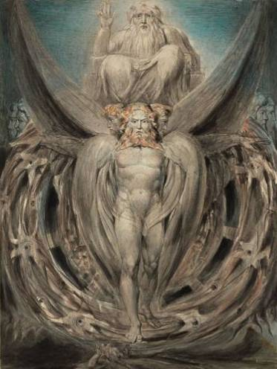
MESSAGE OF DOOM AND HOPE
Ezekiel

Slide 131
Kings During the Last Years of Judah
JUDAH
Hezekiah 715-686 BC
Manasseh 697-642 BC
Amon 642-640 BC
Josiah 640-609 BC
Jehoahaz 609 BC
Jehoiakim 609-598 BC
Jehoiachin 598-597 BC
Zedekiah 597-586 BC
Ezekiel lived during the reigns of the last three of Judah’s kings, and his ministry occurred during the reign of Zedekiah, beginning in his 5th year of exile.
All dating is based on the regnal years of Jehoiachin.

Slide 132
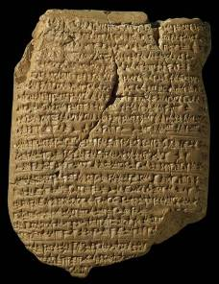
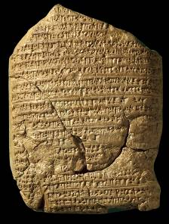
Babylonian Chronicle 5
The record of Nebuchadnezzar II’s early years appear on Chronicle 5 of the Babylonian Chronicle texts. They describe his defeat of Neco II at Carchemish (obverse side), his own severe losses when he invaded Egypt and his siege of Jerusalem (reverse side).
“In the seventh year: In the month Kislev the king of Akkad [Nebuchadnezzar] mustered his army and marched to Hattu [Palestine]. He encamped against the city of Judah [Jerusalem] and on the second day of the month Adar he captured the city (and) seized (its) king. A king of his own choice he appointed in the city (and) taking the vast tribute he brought it to Babylon.”

Slide 133
Jehoiachin’s Reign (2 Kg. 24:8-17)
As a teenager, Jehoiachin’s reign lasted only until his surrender to Nebuchadnezzar.
He, along with his mother, his officials and 10,000 citizens (including Ezekiel) were deported to Babylon.
The temple was stripped for booty.
Zedekiah (Mattaniah), Jehoiachin’s uncle, was installed as a vassal king.
According to Ezekiel, Jehoiachin was the last legitimate king of David’s line (implied, since even in exile he still calls Jehoiachin “the king,” cf. 1:2, etc.).

Slide 134
Zedekiah’s Reign (2 Kg. 24:18—25:7)
Zedekiah’s eleven years as a Babylonian vassal ended in disaster.
In his fourth regnal year (594 BC), he traveled to Babylon, probably to pay tribute, and he took with him a letter from Jeremiah announcing judgment on Babylon (Je. 51:59-64). Ezekiel may have seen him there.
Zedekiah’s reign was marked by a vacillating hope that Judah would survive, but both Jeremiah and Ezekiel regarded such hopes as utterly vain.
In the end, Zedekiah rebelled against Babylon, precipitating the siege that ended Judah’s national life.

Slide 135
Questions
How does one go about convincing people about something they don’t want to believe and theologically have concluded will never happen?

Slide 136
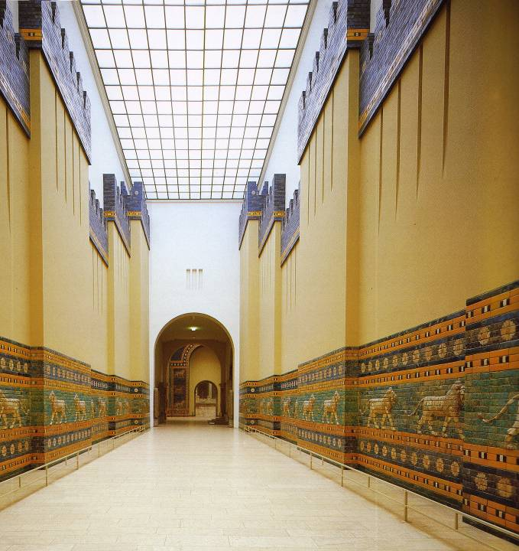
The grandeur of Babylon fostered a spiritual crisis. Was Marduk greater than Yahweh?
Processional Way Leading to the Ishtar Gate
Approximately 20-24 meters wide with central traffic lane and pedestrian walkways
Walls 7 meters thick
250 meters long
Staatliche Museen
Zu Berlin
Vorderasiatisches
Museum

Slide 137
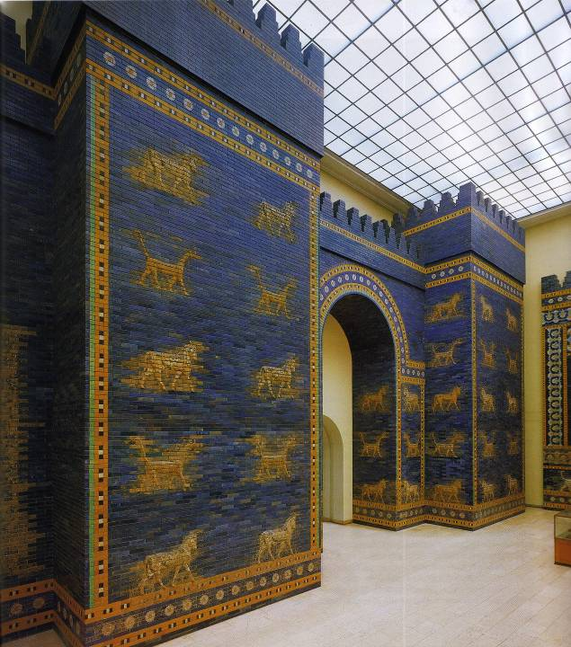
Ishtar Gate with animal friezes representing deities
BULLS (Adad, the weather god)
DRAGONS (Marduk, protector of the city)
(Vorderasiatisches Museum, Berlin)

Slide 138
EZEKIEL BEN BUZI
Ezekiel was a priest (1:3), presumably a Zadokite.
His name means “God [“is” or “makes”] strong.”
He was exiled to Babylon at the age of 30 in the 1st deportation (1:1): this, in turn, means he was in his late teens when Josiah was shot and 19 years old when Jehoahaz was exiled to Egypt, at which time Jehoiakim became King of Judah.
The exiles were settled at Tel Aviv near the Kebar Canal (3:15)
References to Kebar appear in two cuneiform texts from Nippur.
He was married (24:15-18)
He was called to prophetic ministry in the 5th year of his exile, ca. 593-592 BC (1:2-3)
His ministry extended another 20 years (40:1)

Slide 139
STRUCTURE OF EZEKIEL
1-24 Messages of Doom
25-32 Oracles to the Nations
33-48 Visions of Restoration
Thirteen dated oracles are scattered among the three sections, all linked to the 1st deportation in 598-597 BC and, by implication, the kingship of Jehoiachin.
All except three are in chronological order (29:1; 29:17; 32:1). The three exceptions fall within the oracles to the nations and probably were intentionally displaced for thematic reasons.

Slide 140
A QUESTION BEGGED: The divine glory is seen by Ezekiel in Babylon with the deported exiles, NOT in the Jerusalem temple. This immediately raises the question: “How can this be?” (1:1, 28b; cf. 3:22-23).
The answer will be given in due time.

Slide 141
The Idea of a Chariot Throne
The concept that Yahweh’s throne is a type of chariot flanked by cherubim derives from ancient Near Eastern iconography.
Cherubim-decorated thrones are known from ancient times, and cherubim as guardian sphinxes decorated the palaces of Assyrian, Babylonian and Persian courts.
When David drafted plans for Solomon’s temple, he produced plans for the “chariot” of the sacred Ark (1 Chr. 28:18), where Yahweh was enthroned.
One of the Psalms described Yahweh as riding on cherubim as on a chariot (Ps. 18:10).
The divine throne has “wheels” (Da. 7:9).

Slide 142
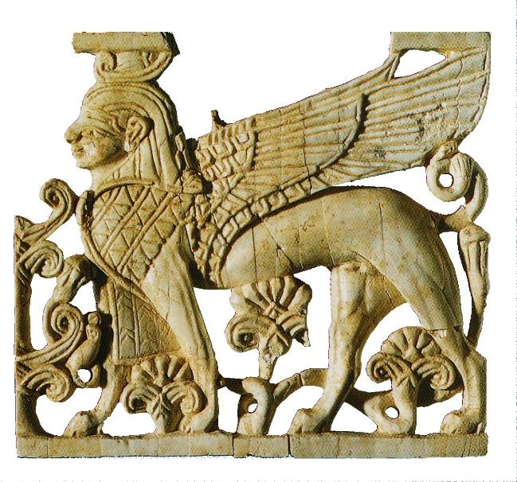
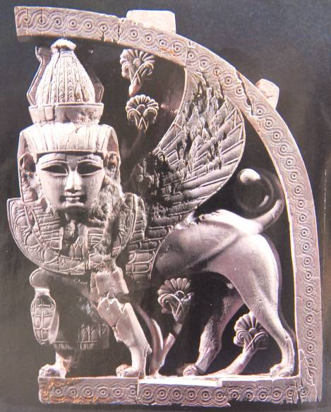
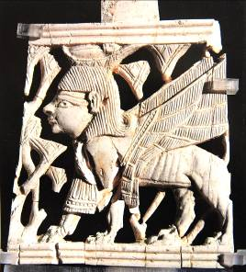
Cherubim
Guardian sphinxes also known as griffins
(British Museum, London)
Assyrian (Egyptian motif)
Assyrian
Israelite from Samaria

Slide 143
Questions
In the Bible, God is depicted as both transcendent and immanent. How does Ezekiel express both these aspects of God?
Which of these aspects do you think modern Christians emphasize most?

Slide 144
TITLE Son of Man
This address appears in Ezekiel about 90 times:
It emphasizes humanness and finitude.
Ezekiel is only a man standing in the power of the Spirit to speak.
Whether the exiles listened or not, they would know that a true prophet had been among them (2:5).
This title in Ezekiel should be distinguished from the way it is used in Daniel 7:13, where it refers to a heavenly figure.
This will become the familiar title that Jesus will use of himself in the gospels.

Slide 145
Ezekiel’s Task
Ezekiel’s commission was to preach to the exiles—especially to those who were determined to resist the Word of Yahweh.
The scroll symbolized the whole counsel of God necessary for the redemption of the remnant.
He was warned in advance that they would not heed his word—because they would not heed God’s word.
Hence, God would make Ezekiel the “irresistible force” against the “immoveable object.”
Whether they listened or not, Ezekiel was responsible to speak what God gave him.

Slide 146
The Model Siege (4:1—5:17)
Ezekiel’s first instructions were to offer a “living parable,” a model siege intended to represent Jerusalem, which soon was to be under siege by Nebuchadnezzar II.
He was to draw a “map” of Jerusalem on a clay tablet or brick, build a siege ramp against it with a war camp outside, and put in place battering rams (4:1-2).
A popular notion, advocated by false prophets, was that the 1st deportation would be short—that Jehoiachin and the exiles would soon be coming home (Je. 28:1-4). It is not unlikely that the exiles in Babylon were aware of this prediction.
Ezekiel’s model siege worked against such false optimism.

Slide 147
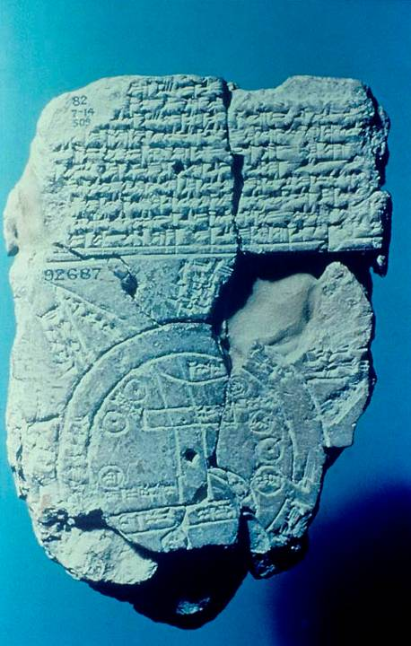
Babylonian Map of the World
Inscribed maps on clay tablets, such as Ezekiel made of Jerusalem, were known from ancient times. Here, a scribe produced a map of the ancient Near East from about the 6th century BC (the time of Ezekiel).
The vertical lines are labeled “Euphrates.”
The city of Babylon is marked.
The upper area is labeled “where the sun is not seen.”
British Museum, London

Slide 148
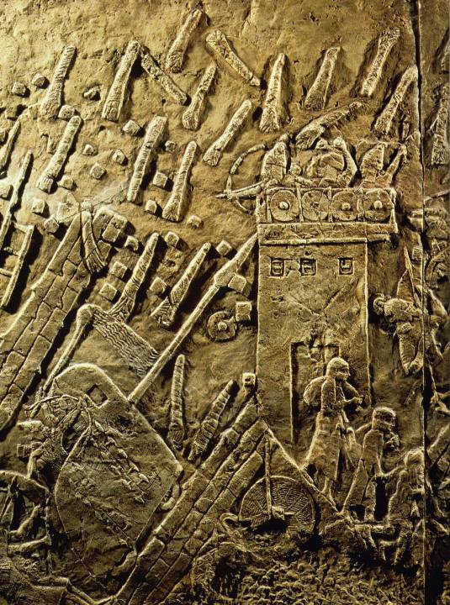
SIEGE RAMPS AND SIEGE MACHINES
Assyrian siege of Lachish, Judah, 701 BC.
British Museum, London

Slide 149
Questions
War was constantly a threat in the life of ancient peoples, but most ancient wars receive no divine comment. Why was Babylon’s coming invasion of Jerusalem different?

Slide 150
EZEKIEL’S ORDEAL (4:4-9)
Ezekiel’s oracle is dated in the 5th regnal year of Jehoiachin (593-2 BC)
‘avon = “sin” or “punishment”
390 DAYS ON HIS LEFT SIDE
40 DAYS ON HIS RIGHT SIDE

Slide 151
Jerusalem’s Day of Reckoning
In the parable of the shaved hair, Ezekiel predicted that Jerusalem would be decimated—a third dying inside the city, a third outside, a third scattered to the winds and only a few stragglers left alive (5:1-4, 12).
Shaving his hair with a sword evoked images of war and disaster, his hair symbolizing the people of Jerusalem to be “shaved” by the sword of war (cf. Is. 7:20).
Before the siege was complete, the citizens of Jerusalem would resort to cannibalism in their desperation for food (5:8-10; cf. La. 2:20; 4:10).

Slide 152
The Idolatrous Mountains (6:1-3)
The “high places” (bamot) were the sites for Canaanite pagan worship where the people of Judah indulged in pagan rituals.
Judgment upon the mountains meant judgment upon the idolatrous worship in the fertility cults, which generally was practiced at “high places” on the mountains.
Our detailed knowledge of Canaanite religion largely derives from a library of ancient cultic texts discovered at Ugarit, Syria (Ras Shamra) as well as from archaeological artifacts excavated in Israel.

Slide 153
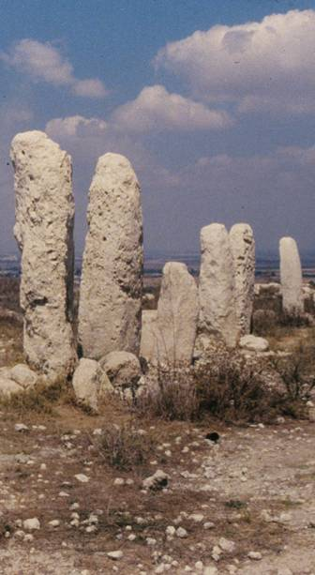
The Bamah (High Place)
Appearing more than 100 times in the biblical text, the bamah (plural = bamoth) was an open-air sacred site on a natural elevation, often with standing stones and/or altars and usually associated with Canaanite religion.
Early in Israel’s history, high places were tolerated and even used for the worship of Yahweh (1 Sa. 9:12-14, 19, 25; 10:5, 13).
Deuteronomy, however, anticipated their demise when a central shrine would be built (Dt 12).
After the building of the temple, they would be outlawed altogether.
Gezer bamah with standing stones

Slide 154
The End Cq2
(7:1-3, 6)
The prophets often use the expression “the end” to refer to specific judgments in history (cf. Am. 8:2; Je. 51:13; La. 4:18; Da. 9:26; Na. 1:8; etc.).
Here, “the end” is the end of Jerusalem, the doom of Judah’s capital city.
Like the iron pan which Ezekiel used to screen his face from the model siege (4:3), Yahweh’s face would be turned away from the city and temple, allowing their destruction and desecration by enemy troops (7:22).

Slide 155
FOUR EXRESSIONS OF PAGANISM
IN THE TEMPLE PRECINCTS
Ezekiel is transported by the Spirit to Jerusalem (8:1-4). Here, he was shown:
1) The Idol that Provokes (Idol of Jealousy)
2) Elders of Judah offering incense before a bas-relief of theriomorphic deities
3) Israelite women weeping for Tammuz, the Sumerian fertility god comparable to Ba’al
4) Israelite elders worshipping Shamash (Mesopotamian god of the sun)

Slide 156
YET ONCE MORE, A QUESTION BEGGED: The divine glory is now seen at the entrance to the temple’s inner court (8:3-4). Why was it not in the Most Holy Place?
This vision of the divine glory will later be linked to the Spirit’s abandonment of the temple (10:3-4, 18-19; 11:22).

Slide 157
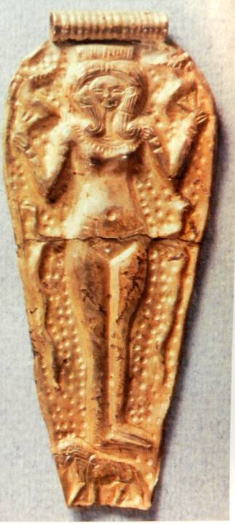
Image of Astarte gold pendant excavated in Ugarit
Ezekiel’s description of the “idol of jealousy” is sufficiently ambiguous to prohibit any firm conclusions as to its precise appearance. However, many scholars suspect that it was a pillar image of the goddess Asherah or Astarte or an Asherah tree, such as the one Manasseh once installed in the temple (cf. 2 Kg. 21:7).

Slide 158
Questions
Why do you think the pagan fertility cults were so attractive to the Israelites?
What features of the modern world are equally attractive and seductive for contemporary Christians?

Slide 159
The Glory Abandons the Temple (10-11)
When Shiloh was destroyed in the time of Eli, the name Ichabod (= no glory) became the final sentence of bitter failure (1 Sa. 4:21; cf. Je. 7:12).
Now, Ezekiel saw the glory of Yahweh departing from the temple Solomon had built.
  It rose from above the cherubim and moved to the threshold (10:4).
  It crossed the threshold, stopping at the east gate (10:18-19).
  Eventually, it departed Jerusalem altogether, moving eastward with the exiles in Babylon (11:22-25).
This was how Ezekiel came to see the glory of Yahweh by the Kebar Canal, Babylonia in the original vision.

Slide 160
Miming a Refugee (12:1-20)
The exiles in Babylon still remained resolute and resistant to Ezekiel’s oracles about the fall of Jerusalem.
Therefore, Yahweh’s next task was for the prophet to mime a refugee trying to escape by digging under the wall, carrying his pack with him.
The mime not only symbolized the imminent exile of the remaining citizens of Jerusalem, it also was a prophetic sign about Zedekiah’s future attempt to escape at the collapse of the city (cf. 2 Kg. 25:4-7).
Here, Zedekiah is referred to as a “prince,” but significantly, he is not called the king (the true king still was Jehoiachin, who already was in exile).
Finally, Ezekiel was to eat his meals while shuddering in terror—a sign of what was to come for Jerusalem.

Slide 161
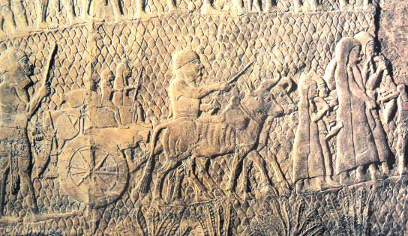
from Sennacherib’s palace showing Israelite refugees carrying their packs and few belongings into exile
British Museum, London

Slide 162
TWO POPULAR CLICHES both betraying false optimism
(12:21-22, 26-27)
The people’s refusal to accept the inevitable was captured in popular sayings.
“The days go by and every vision comes to nothing.”
(Nothing is happening. The prediction of the fall of Jerusalem probably is a false prophecy.)
“The vision he sees is for many years from now, and he prophesies about the distant future.”
(If the prophecy is valid, it probably won’t happen in our lifetimes.)

Slide 163
False Preachers (13:1-23)
The false optimism of the people was exacerbated by prophetic voices claiming to speak for God.
In reality, though many prophets said, “Yahweh says…”, they had no word from God but were preaching by their own spirit and imagination (13:3, 17).
Their “ministry” was like a flimsy wall covered with whitewash (13:10)!
They were aided by prophetesses who used magic charms to predict the security of Jerusalem, enmeshing the people in false hopes.

Slide 164
Deuteronomic Judgment (14:12-20)
The language of Deuteronomic judgment comes from the ancient law code of Moses:
EZEKIEL
Famine (14:13)
Beasts (14:15)
War (14:17)
Plague (14:19)
MOSES
Famine (Dt. 28:17-18, 21b-24)
Beasts (Dt. 32:24)
War (Dt. 28:25-26, 36-37, 49-57; 32:25)
Plague (Dt. 28:21a, 27-29, 35, 38-42)
These same judgments would now be poured out upon Jerusalem, though a few would survive (14:21-23).

Slide 165
The Worthless Vine (15:1-8)
The metaphor of Israel as God’s vine had a long history (cf. Ps. 80:8-11; Is. 5:1-7; Ho. 10:1).
While vines are useful for bearing fruit, their stems, which are quite soft, have little use for fashioning tools.
When burnt, a vine stem is even less substantial than ordinary wood.
Jerusalem, according to Ezekiel, would be like a burnt vine stem—totally useless.

Slide 166
Questions
Both Jeremiah and Ezekiel have a good deal to say about false voices. What are marks of authenticity, and what are signs of falsehood?

Slide 167
Allegory of the Foundling the moral collapse of Jerusalem, personified as a foundling (16)
FATHER
An Amorite (Ge. 15:16)
MOTHER
A Hittite (Ge. 27:46—28:2)
FOUNDLING
Jebus (Jerusalem) personified
SAVIOR/HUSBAND
Yahweh
MARRIAGE COVENANT
Davidic covenant
ADORNMENT
Solomon’s splendor
PROSTITUTION
Fertility cults & foreign alliances
SISTERS
Sodom, Samaria
JUDGMENT
Destruction by former lovers
NEW COVENANT
Redemptive atonement

Slide 168
Fable of the Eagles, Cedars and Vine vacillating policies of Zedekiah
(17; cf. 2 Kg. 24-25; 2 Chr. 36)
FIRST EAGLE
Nebuchadnezzar
CITY OF MERCHANTS
Babylon
BROKEN CEDAR TOP
Jehoiachin
TRANSPLANTED SEED GROWING INTO A VINE
Zedekiah
SECOND EAGLE
Pharaoh of Egypt
(cf. Je. 37:4-8)
CEDAR SPRIG ON A HIGH MOUNTAIN
Messianic King
(cf. Mt. 1:1, 11, 17)
BIRDS
Nations
(cf. Mt. 13:31-32)

Slide 169
Proverb of Sour Grapes
(18)
”The fathers eat sour grapes, and the children’s teeth are set on edge.”
Based on the comparative statements in Ex. 20:5 and Dt. 5:9
Popular among the citizens of Jerusalem (Je. 31:29-30) as well as the exiles of the 1st deportation (Eze. 18:1-2)
REBUTTAL: Based on Dt. 24:16
IMPLIED:
“It’s not our fault.”
“Yahweh is not fair.”

Slide 170
Every Person will be Judged Individually
Based on Dt. 24:16, Ezekiel urges that God will assess each individual in his or her own right.
The righteous will live (18:5-9).
The guilty will die (18:10-13).
The righteous son will live, even though his father is wicked (18:14-20).
The repentant person will also live (18:21-23).
The righteous person who turns to evil will die (18:24).
“I will judge each one according to his ways! Why will you die, O house of Israel? Repent and live!”

Slide 171
Lamentation in Two Metaphors
(19)
Hebrew lament or dirge is composed in the qinah rhythm (five stressed syllables with a 3 + 2 pattern, similar to English iambic pentameter)
In-the-midst of-lions she-crouched
rearing her-whelps (19:2b).
Lamentation in the ANE was used to grieve the deaths of persons as well as to describe the fate of cities, communities and kingdoms.

Slide 172
Metaphor of the Lion Cubs
LIONESS
Judah (figurative) or Hamutal, the king’s mother (literal, 2 Kg. 23:31; 24:18)
1ST CUB DEPORTED TO EGYPT
Jehoahaz (2 Kg. 23:33-34)
2ND CUB BROUGHT TO THE KING OF BABYLON
Either Jehoiakim (2 Chr. 36:6), Jehoiachin (2 Kg. 24:15) or Zedekiah (2 Kg. 25:7)
FACTORS FOR INTERPRETING THE 2ND CUB
If the lioness is Hamutal, the 2nd cub is Zedekiah, since both Jehoahaz and Zedekiah had the same mother.
In the metaphor of the vineyard, the last king is said to be in Babylon “now” (Eze. 19:13), which would favor Jehoiachin.

Slide 173
METAPHOR OF THE VINE (19:10ff.)
Precedents:
Isaiah’s Song of the Vineyard (Is. 5:1-7)
Ezekiel’s Analogy of the Charred Vine (Eze. 15:1-5)
VINE
Judah/House of David
SCEPTER/STEM
Jehoiachin, the rightful king
PLUCKED UP & CAST TO THE GROUND
Surrendered to Nebuchadnezzar
EAST WIND
Nebuchadnezzar/Babylon
TRANSPLANTED IN THE DESERT
Jehoiachin’s exile in the 1st Deportation, 598-7 BC
FIRE BURNING THE STEM
Extermination of David’s line (cf. Je. 22:24-30)

Slide 174
Questions
Why do you think Ezekiel used such diverse literary genres, and how do they serve his basic message?
Given what Ezekiel says about the sins of the fathers not being generational, what do you think about the theory of generational curses?

Slide 175
The Indictment
The historical case against Israel began in Egypt with Yahweh’s oath to redeem them from bondage and give them the land of Canaan.
His covenant requirement was that they must forsake the idols of Egypt.
Instead, they clung to these idols epitomized in the golden calf (Ex. 32:1-6).
The only reason God did not immediately destroy them was in order to protect his “name” (i.e., his reputation for compassion and forgiveness, cf. Ex. 34:5-7).

Slide 176
“So He Gave Them Over” (20:25-26)
For most biblical readers, the language “so he gave them over” is most familiar from Paul’s language in the New Testament (cf. Ro. 1:24a, 26a, 28).
This language, however, begins in Ezekiel with respect to the Israelites—how God “gave them over” to follow their own waywardness.
Paul, later, uses the same language to describe the nations whom God “gave over” to their own depravity.

Slide 177
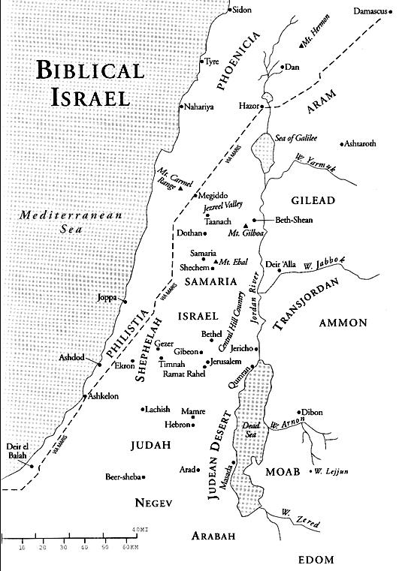
The so-called “King’s Highway” stretched from Damascus southward along the transjordan watershed. The Babylonian armies traversed this route on their way to punish the rebellious vassals in the land of Canaan.
There, the Babylonians had to decide whether to go right or left—to Jerusalem or Rabbah.
Rabbah
Jerusalem

Slide 178
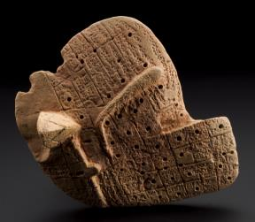
Babylonian Liver Divination
This Babylonian clay model of a liver (ca. 2050-1750 BC) was designed for predicting the future. The liver of an animal was extracted and closely examined. Sticks were placed in the holes of the corresponding clay model. The pattern of sticks was examined and interpreted by priests or diviners.
British Museum, London

Slide 179
THE PROSTITUTE SISTERS fertility cult promiscuity becomes a metaphor for disloyalty to God lH,)x (‘ohel = tent), a word-play on the tents of pagan prostitution at the high places
Oholah (Samaria)
Prostituted herself to Assyria (2 Kg. 15:19; Ho. 5:13; 7:11; 8:9; 12:1)
Yahweh sent Assyria to judge her (2 Kg. 17)
Oholabah (Jerusalem)
Prostituted herself to:
  Assyria (2 Kg. 16:7-10, 18; 18:13-16)
  Then Babylon (2 Kg. 20:12-18; 24:1)
  Then Egypt (2 Kg. 18:21; 24:1, 7; Je. 2:36; 37:5-8)
Yahweh would send Babylon and all its hordes to judge her

Slide 180
The Song of the Cauldron
January 15, 588 BC the day the siege of Jerusalem began
(Eze. 24:1-2; 2 Kg. 25:1; Je. 52:4)
Jerusalem was a pot ready for cooking: the city would be cooked in the crucible of judgment.
Piece by piece, her citizens, like chunks in the stew, would be emptied into exile.
The city would be cooked until all the water had boiled away and the remaining pieces charred.
On the night of January 15, 588 BC, Ezekiel’s wife died. Her death was a symbol of the death of God’s wife, Jerusalem.

Slide 181
The Desecration of the Sanctuary
The death of Ezekiel’s wife symbolized not only the death of Jerusalem, but also the deaths of the relatives of those exiled in Babylon.
To symbolize the total shock of the coming devastation of Jerusalem, Ezekiel was forbidden to mourn the death of his wife in the usual way.
The temple, abandoned by Yahweh, would be defiled by strangers (24:21).
Ezekiel would remain mute until a refugee would come with the news that the city had fallen (24:26-27).

Slide 182
PROPHETIC ORACLES TO THE NATIONS
Substantial sections of the prophetic literature consists of oracles about nations other than Israel and Judah
Amos 1-2 Zephaniah 2
Isaiah 13-21, 23-24, 34, 47 Jeremiah 46-51
Micah 4 Ezekiel 25-32, 35
Joel 3 Daniel 2, 7, 8, 10-12
In Ezekiel, the nations are judged with respect to how they treated Jerusalem and Israel. (25:3-4, 8-9, 12-13, 15-16; 26:2-3; 28:24; 29:6-9a; 36:5-6)

Slide 183
EZEKIEL’S ESCHATOLOGY
GOD, THE GOOD SHEPHERD (34)
Covenant of peace
Binding up the injured
Judgment between sheep & goats
BLESSING ON THE MOUNTAINS OF ISRAEL (36)
Regathering of Israel
Cleansing from sin
Gift of the Holy Spirit
Bounty of the land
VISION OF DRY BONES (37)
Restoration of Israel
Gift of the Holy Spirit
A united nation, north & south
One Davidic king
Covenant of peace
BATTLE OF GOG AND MAGOG (38-39)
Enemies arrayed against Israel
Divine judgment on Gog by earthquake, plague, hail, rain & brimstone
Vultures scavenge the dead
THE NEW TEMPLE (40-48)
Blood sacrifice restored
Family of Zadok established as priests
Priestly prince is vice-regent, who sacrifices for himself as well as the people
Glory returns to the temple
Equal division of the land among the tribes

Slide 184
Five Interpretive Approaches to Ezekiel’s Eschatology
Due to Israel’s moral failure, the predictions fell short of expectation
By analogy, the circumstance was similar to:
  IDEAL: Conquest of Canaan (Joshua 13-21)
  REALITY: Failure at Conquest (Judges 1-2)
1 HISTORICAL VIEW
Prophecy genuinely predicts the future
However, these predictions are often conditional
Ezekiel’s visions for the future were partially fulfilled in the return from exile
His visions describe the way things should have been had Israel been faithful
This is the position of some evangelical interpreters.

Slide 185
2 CONDITIONAL VIEW
Prophecy is not a mandate for history
Rather, all prophecy is conditional
Ezekiel’s vision for the future was speculative hope, the product of a lively imagination
This hope was never realized
This is the viewpoint of most historical-critical scholars, such as, Joseph Blenkinsopp.
Because they do not espouse miracles or predictive prophecy, they cannot treat Ezekiel’s predictions as anything other than wishful thinking.

Slide 186
3 SPIRITUAL VIEW
Prophecy genuinely predicts the future
Ezekiel’s visions are symbolisms or typologies of the future Christian church
They are broadly messianic, and they point to the Christian era
This is the viewpoint of many older evangelical commentators, such as, Matthew Henry.

Slide 187
4 DISPENSATIONAL VIEW
Prophecy predicts the future in strictly literal terms
Ezekiel’s visions describe the close of the final age
The millennial temple will be built during the 1000 years of peace (or before)
The focus is on the Jews at the end of time
This is the position of dispensational commentators such as Dwight Pentecost and Ralph Alexander.

Slide 188
5 NEW HEAVENS & NEW EARTH VIEW
Prophecy genuinely predicts the future
Often, the language of prediction is as though it were through a soft-focus lens
Ezekiel’s visions refer to the new heavens and new earth
This is the viewpoint of some evangelical scholars, such as, D. Brent Sandy

Slide 189
My Approach
(not the hill I would die on)
Many OT prophecies are double entendres, that is, double references within the scope of a single oracle:
NEAR REFERENCE
Soon to be fulfilled
Specifically clear
The prophet probably had a clear sense about what he spoke
Near fulfillment validated the prophet to his own community
FAR REFERENCE
Indefinite future
Somewhat vague
The prophet may very well have spoken beyond what he knew
Long range prediction gave assurance of what was yet to come

Slide 190
PURPOSE OF NEAR PREDICTION: NOT to satisfy curiosity, BUT an ethical call to holiness in the present and an assurance that the prophets are true spokespersons for God.
PURPOSE OF FAR PREDICTION: Assurance that Yahweh is the Lord of all history
  He fulfills his own predictions according to his own sovereign will
  He reserves the sovereign right to interpret his own predictions
EXAMPLES OF NEAR/FAR PREDICTIONS:
  David’s son who would build God’s house and rule forever
  Isaiah’s consolation to the exiles that restoration was coming

Slide 191
Questions
Why should Christians be especially cautious about advancing “hard and fast” interpretations of eschatological passages like the closing chapters of Ezekiel?
With respect to interpreting the future, how capable are modern interpreters of “getting it right”?

Slide 192
The Final Word of Ezekiel
hm0AwA hv!hy4
(Yahweh [is] There)
The final word in the Book of Ezekiel is a declaration that the restoration will bring about a reversal of the abandonment of the temple. Yahweh’s last word was not, in fact, doom, but promise and hope.

Slide 193
OBADIAH
The Doom of Edom

Slide 194
BACKGROUND
Obadiah, the shortest book in the Hebrew Bible, announces the coming judgment of Edom.
Nothing is known of the prophet other than his name, which means “servant of Yahweh”.
The date of the book is also unknown, though it must be coordinated with the Book of Jeremiah because of literary parallels.
Presumably, Obadiah was from Judah, and probably his work follows the collapse of Jerusalem in 586 BC if his remarks in 12-14 are to be linked to Psalm 137:7.

Slide 195
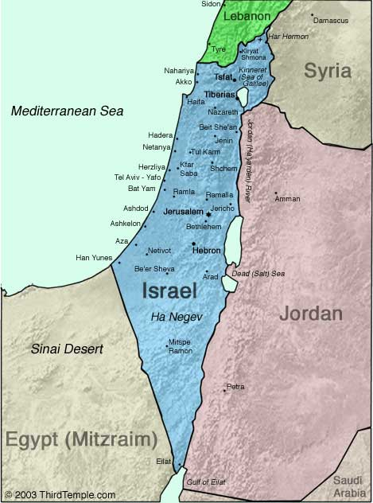
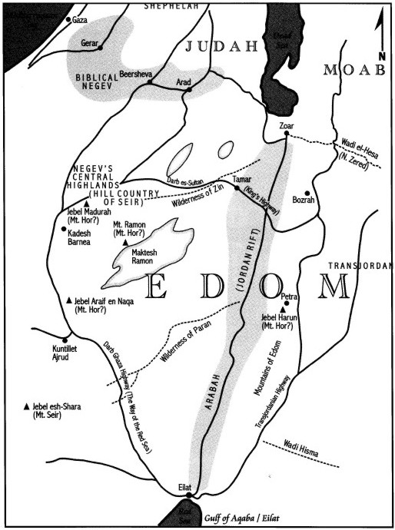
Ancient Edom

Slide 196
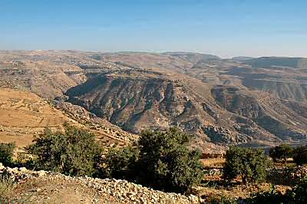
Bozrah, the ancient capital city of Edom 26 miles SSE of the Dead Sea: an important Edomite strong hold from 1200 to 600 BC, it was the home of Jobab the second known king of Edom. Bozrah is a very ancient town, mentioned in tablets by Pharaohs Thutmose III and Akhenaten in the 14th century BC.

Slide 197
Literary Parallels
The parallels between Obadiah and Jeremiah’s oracle against Edom are so striking as to virtually require literary dependency. However, it is unclear whether Jeremiah used Obadiah, Obadiah used Jeremiah, or perhaps an unknown source was common to them both.
Obadiah
1
2
3
4
5a
6
8
9a
16
Jeremiah 49
14
15
16a
16b
9
10a
7
22b
12

Slide 198
Questions
What do you make of the fact that prophets used language from the oracles of other prophets? (A similar parallel can be found between Is. 2:2-4 and Mic. 4:1-3.) Does this fact in any way affect their inspiration or validity?
What might this suggest about the availability of written texts or their canonical recognition?

Slide 199
VISION OF EDOM’S JUDGMENT (1-14)
The oracle begins with a summons to the nations to declare war against Edom.
In a direct address, God speaks judgment to Edom’s cliff-dwellers.
The word for “rock” (3a) is a play on the name Sela, the name of an Edomite fortress (2 Kg. 14:7).
The coming disaster would not be like some petty theft; it would be total destruction!
Though famous for ancient Near Eastern wisdom, Edom’s wise men would be cut down.

Slide 200
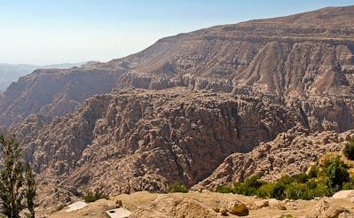
The term “Sela” is used 65 times in the Hebrew Bible, usually meaning “rock,” but six times it is used as a place name. Four or five of the references are apparently to this site that preserves this name near Bozrah.

Slide 201
Cause of Edom’s Judgment
Judgment was due Edom because of the Edomites’ malicious glee at the fall of Jerusalem, presumably at the city’s destruction in 586 BC by Nebuchadnezzar (Ps. 137:7; Eze. 25:12; 35:5).
While Jerusalem burned, the Edomites looted the city and gave up any fleeing refugees to the enemy.
According to the bitter memories of the exiles in Babylon (Ps. 137:7), the Edomites hooted, “Tear it down, tear it down to its foundations!”

Slide 202
VISION OF THE DAY OF YAHWEH (15-21)
Like other prophets, Obadiah uses the expression “The Day of Yahweh” to describe doomsday.
Of course, the Day of Yahweh was due to all nations, not just Edom, for God was the God of all nations, not just Israel. He held them all accountable.
The violence to be turned back upon them was represented by the metaphor of the cup of wine—the wine of God’s wrath (cf. Is. 51:17-23; Je. 25:15-29; La. 4:21; Eze. 23:32-34; Ha. 2:16; Zec. 12:2).

Slide 203
The Redemption of Zion
As the prophets regularly affirm, judgment was not God’s final word.
The Day of Yahweh would also bring salvation for God’s people.
The Israelite exiles would be restored and their territory expanded so that they would occupy not only central Israel, but the Transjordan and the Negev. They would govern the mountains of Edom.
Edom, by contrast, would have no survivors (cf. Mal. 1:4-5).

Slide 204
Questions
How do you think the predictions in the last verses of Obadiah will be fulfilled?
How do the OT references to the “Day of the Lord” help us understand NT references (cf. 1 Th. 5:2, etc.) and vice versa?
Do you think the metaphor of the “cup” may in any way inform us about the similar metaphor used by Jesus in Gethsemane?

Slide 205
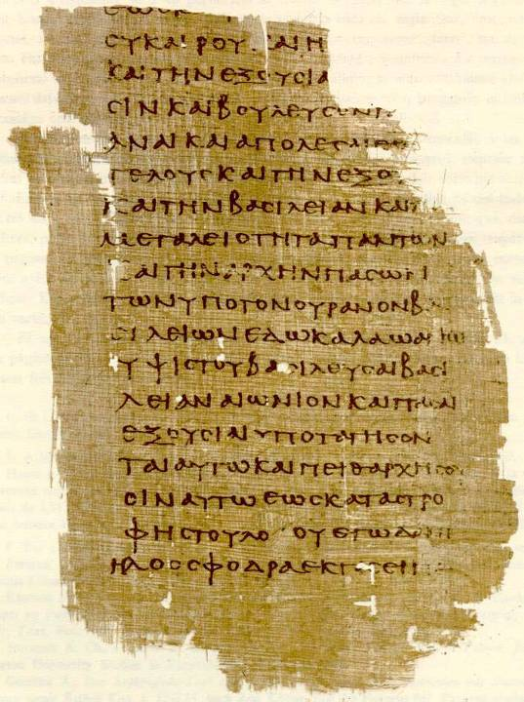
LXX Uncial Text of Daniel 7:25-28 Papyrus 967
3rd Century AD
Cologne
Book of
DANIEL

Slide 206
The Historical Periods for the Jews
Life of Daniel
Visions of Daniel
Babylonians
620-539 BC
Persians (Archaemenids)
539-331 BC
Greeks (Hellenism)
331-164 BC
Hasmoneans
164-63 BC
Romans
63 BC
600 500 400 300 200 100 0
539
Fall of Babylon
331
Alexander the Great defeats Darius III
63
Pompey takes Palestine for Rome
168
Maccabean Revolt
4
Birth of Christ

Slide 207
Author & Date
CASE FOR 2nd CENTURY BC
Daniel is collected with the Kethubim, not the Nebi’im, in the Hebrew Bible.
Visions in Daniel 8 and 11-12 are the most historically detailed, and they concern the 3rd and 2nd centuries BC.
Text includes Greek and Persian loan words that seem anachronistic for the 6th century BC.
Apocalyptic style is more at home in the 2nd century BC.
CONCLUSION: Daniel was written by an unknown Jew using prophecy “after the fact” in order to bolster hope in the Maccabean revolt.
CASE FOR 6th CENTURY BC
Purports to be by Daniel in the 6th century BC (uses first person pronouns).
If one accepts the legitimacy of predictive prophecy, accurate details about the 2nd century BC are not a problem.
Zechariah 9-14, which also contains apocalyptic style, is collected in the Nebi’im.
Jesus credits the book to “Daniel, the prophet” (Mt. 24:15).
CONCLUSION: Daniel was written by the historical figure to whom it is credited.

Slide 208
Interpreting the Book how one answers the question about authorship and date becomes a primary determinate for understanding the book
MACCABEAN (historical-critical)
From the fall of Jerusalem to the oppression of Antiochus IV Epiphanes (587-6 BC to 167 BC)
MESSIANIC (traditional)
From the fall of Jerusalem to the coming of the Messiah
DISPENSATIONAL (developed in 1800s)
From the fall of Jerusalem to the millennial reign of Jesus Christ at the end of the age

Slide 209
The Four Young Men their Hebrew and Babylonian names
DANIEL (= God is my judge)
BELTESHAZZAR (= Lady [wife of Marduk], protect the king, cf. 4:8b)
HANANIAH (= Yahweh has been gracious)
SHADRACH (= I am very fearful [of a god])
MISHAEL (= Who is what God is?)
MESHACH (= I am of no account)
AZARIAH (= Yahweh has helped)
ABEDNEGO (= Servant of the shining one)

Slide 210
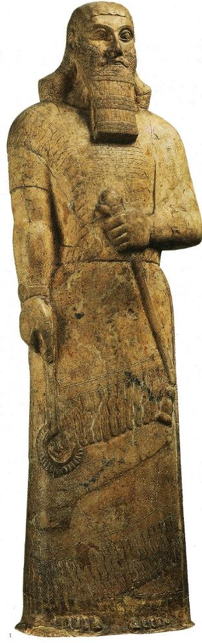
HEAD OF GOLD
Two Critical Interpretive Points Concerning Nebuchadnezzar’s Dream:
The head clearly represents Babylon (“you are the head of gold,” 2:38b); all interpretations must begin here.
“In the days of those kings…” (2:44):
  Are they the kings of the fourth kingdom (cf. 2:40)?
  Could they represent a fifth kingdom?
  What is the nature of the kingdom that will never be destroyed?
CHEST AND ARMS OF SILVER
BELLY AND THIGHS OF BRONZE
LEGS OF IRON
and
FEET OF IRON AND CLAY
Ashurnasirpal II
British Museum

Slide 211
MACCABEAN
Head of Gold
Babylon
Chest & Arms of Silver
Media
Belly & Thighs of Bronze
Persia
Legs of Iron
Greece
Feet of Iron & Clay
Ptolemies & Seleucids
Stone Kingdom
Maccabean kingdom
MESSIANIC
Head of Gold
Babylon
Chest & Arms of Silver
Medo-Persia
Belly & Thighs of Bronze
Greece
Legs of Iron
Rome
Feet of Iron & Clay
Caesars
Stone Kingdom
Kingdom of Christ
DISPENSATIONAL
Head of Gold
Babylon
Chest & Arms of Silver
Medo-Persia
Belly & Thighs of Bronze
Greece
Legs of Iron
Rome
Feet of Iron & Clay
Kingdom of Anti-christ
Stone Kingdom
Millennial kingdom

Slide 212
Chapters 3-4
Further challenges to faith in a pagan culture resulted in religious permission and pagan recognition.
At the close of Chapter 3, Nebuchadnezzar issued a decree that no criticisms would be allowed against the God of the three Jewish young men on pain of death (3:29).
At the close of Chapter 4, Nebuchadnezzar, after his downfall and restoration, recognized the God of the Hebrews (4:37).

Slide 213
The Fourth Man in the Fire
Older English Versions translated Da. 3:25 as: “…the fourth is like the Son of God” (KJV, etc.).
In turn, this led to the belief that the fourth figure in the fire was a pre-incarnation of Christ.
Whether or not the fourth figure was an angel or even Christ himself, it seems unlikely that Nebuchadnezzar, a pagan king, would have recognized him as Christ. He would have had no frame of reference for such an identity.
Later English translations render it as “…a son of the gods” (i.e., a supernatural figure), and only the NKJV retains the older rendering (but adds a footnote “a son of the gods”). The Aramaic NyhilAx$ (= gods) is a plural.

Slide 214
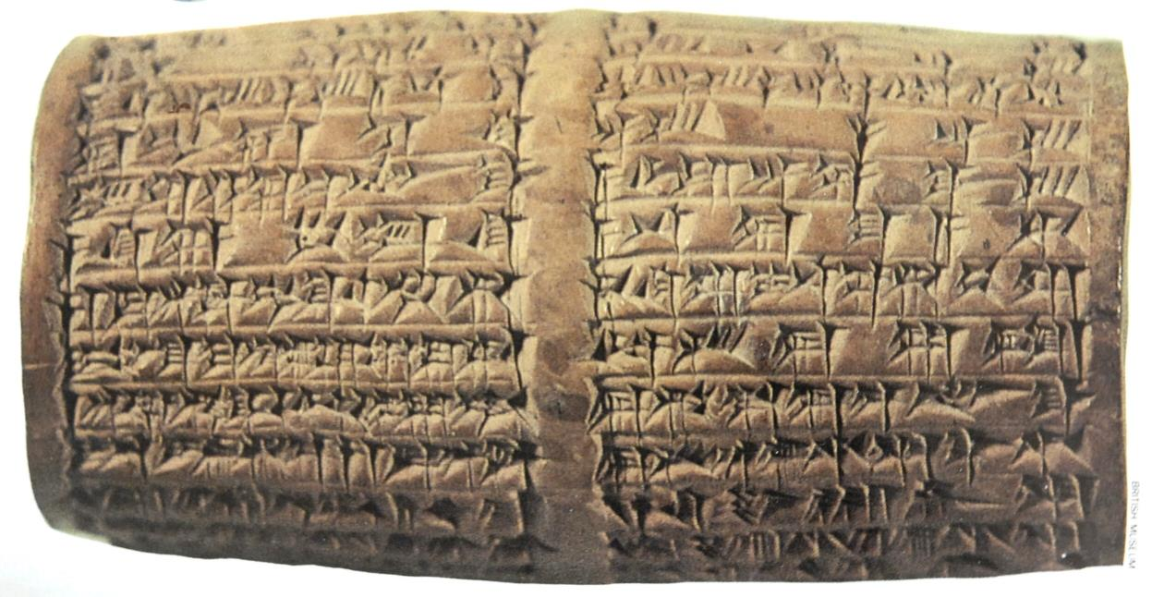
Clay Cylinder Naming Nabonidus and Belshazzar
This 4” cylinder describes Cyrus’ defeat of Nabonidus and his capture of Babylon.
(British Museum, London)

Slide 215
Belshazzar’s wise men could neither “read” nor “interpret” the handwriting (Da. 5:7-8). Daniel could both “read” and “interpret” it (Da. 5:17).
Since the writing was in standard alphabetic letters, the question remains as to why it was difficult to read.
ONE THEORY, BASED ON JEWISH TRADITION, IS THAT THE WRITING WAS VERTICAL INSTEAD OF HORIZONTAL:
Standard Aramaic Vertical Aramaic
Xnm (50 shekels, numbered) s v t m m
xnm y p k n n
Lkt (one shekel, weighed) N r l x x
Nysrpv (and a half-weight, divided)

Slide 216

Rembrandt’s Painting of Belshazzar’s Feast (1634)
(National Gallery, London)

Slide 217


British Museum, London

Slide 218
DREAM OF WORLD EMPIREs
Daniel 2 Daniel 7
Head
Chest & Arms
Belly & Thighs
Legs, Feet & Toes
LION WITH EAGLE’S WINGS
BEAR WITH CARCASS IN ITS MOUTH
FOUR-HEADED LEOPARD
TERRIBLE BEAST WITH TEN HORNS
Critical Interpretive Issues: If the vision of the four beasts parallels Nebuchadnezzar’s dream, then the first beast must be Babylon (cf. 2:38). Is a fifth kingdom represented by the 10 horns? (the text specifically says “the four great beasts are four kingdoms,” cf. 7:17)

Slide 219
THE WAR WITH THE SAINTS
MACCABEAN
The war with the saints (7:21, 25) is to be linked with the rebellion that causes desolation (8:10-14, 24), the decree of desolations (9:26-27), and the abomination of desolation (9:27; 11:30-32).
This abomination was fulfilled in the Maccabean Period when Antiochus IV Epiphanes desecrated the second temple (1 Maccabees 1:54).
MESSIANIC
The war with the saints cannot be exhausted by events in the Maccabean Period, since Jesus regarded the abomination of desolation as still future (Mt. 24:15; Mk.13:14).
The war with the saints and the desolation of the temple are to be linked to the siege of Jerusalem by Titus near the end of the First Jewish Revolt in AD 70 (Lk. 21:20-24).
DISPENSATIONAL
The war with the saints cannot be exhausted by events in the Maccabean Period, since Jesus regarded the abomination of desolation as still future (Mt. 24:15; Mk. 13:14).
The persecution of the saints is to be linked with the attacks of the dragon (Rv. 12:17) and the beast (Rv. 13:7), events to occur during the Great Tribulation at the end of the age.

Slide 220
VISION OF THE RAM & GOAT
Chapter 7 concludes the Aramaic section of Daniel, and Chapter 8 resumes in Hebrew.
Unlike Chapters 2 and 7, there is widespread agreement concerning the interpretation of Chapter 8.
The vision describes the struggle between Persia and Greece.

Slide 221
MACCABEAN VIEW OF THE 70 WEEKS
7 WEEKS
(49 years)
62 WEEKS
(434 years)
1/2 WEEK
(3 ½ years)
1/2 WEEK
(3 ½ years)
Fall of Jerusalem Cyrus’ edict to restore Jerusalem Death of Onias III Hanukkah
587 BC 538 BC 171 BC 164 BC
Rbd (= the word)
Desolating Sacrilege
168 BC
Solar years
FINISH TRANSGRESSION
PUT AN END TO SIN end of the temple sacrilege
ATONE FOR WICKEDNESS
BRING IN EVERLASTING RIGHTEOUSNESS
SEAL UP THE VISION AND PROPHECY rededication of the temple
ANOINT THE MOST HOLY (PLACE)

Slide 222
MESSIANIC VIEW OF THE 70 WEEKS
7 WEEKS
(49 years)
62 WEEKS
(434 years)
½ WEEK
(3 ½ years)
½ WEEK
3 ½ years)
Darius’ decree Jesus’ public ministry Jewish period of
to Ezra, 458 BC begins AD 25-26 Jesus’ crucifixion the church ends
Bvwh (=the returning) AD 30
Titus destroys
the temple, AD 70
Solar years
FINISH TRANSGRESSION
PUT AN END TO SIN termination of the Aaronic system
ATONE FOR WICKEDNESS
BRING IN EVERLASTING RIGHTEOUSNESS
SEAL UP THE VISION AND PROPHECY Christ’s once-for-all sacrifice
ANOINT THE MOST HOLY (ONE)

Slide 223
DISPENSATIONAL VIEW OF THE 70 WEEKS
7 WEEKS
(49 years)
62 WEEKS
(434 years)
CHURCH AGE
(mystery period)
½ WEEK
(3 ½ years)
½ WEEK
(3 ½ years)
Edict of Artaxerxes Jesus’ death Last 7 years of the age
To Nehemiah, 445 BC AD 32 inaugurated by the rapture Christ
returns
Antichrist breaks
his covenant
with the Jews
Lunar years
FINISH TRANSGRESSION
PUT AN END TO SIN the work of Christ on the cross
ATONE FOR WICKEDNESS
BRING IN EVERLASTING RIGHTEOUSNESS
SEAL UP THE VISION AND PROPHECY the millennial reign of Christ
ANOINT THE MOST HOLY (ONE)

Slide 224
VISION OF THE KINGS OF THE NORTH AND SOUTH
This final vision in the book offers the most historical detail of any of the visions.
Among interpreters, there is general unanimity for the meaning of the vision up to 11:36.

Slide 225

The King of the North
The King of the South

Slide 226
“…at that time…”
Daniel 12:1
Maccabean View
The great “distress” (12:1a) refers to the desecration of the temple by Antiochus IV.
Daniel’s “people” refer to the Jews who were persecuted by Antiochus IV.
The “deliverance” (12:1b) and “resurrection” (12:2-3) metaphorically refers to the triumph of the Maccabees.
Eschatological View
The great “distress” (12:1) refers either to Titus’ destruction of Jerusalem or to a great tribulation at the end of the age (Mt. 24:21; Mk. 13:19).
Daniel’s “people” refer either to all the people of faith (messianic view) or the Jewish people at the end of the age (dispensational view).
The “resurrection” (12:2-3) refers to the resurrection of the dead at the end of the age.

