Slide 1
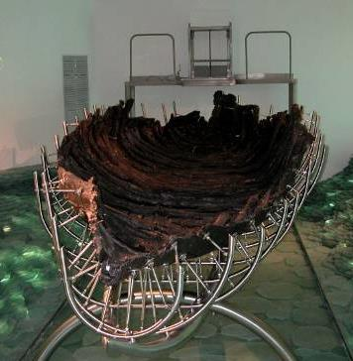
I PETER
Letter from the Big Fisherman

Slide 2
PETER, DISCIPLE,
APOSTLE, MARTYR

Slide 3
THE FOUR NAMES
The NT uses four names for Peter:
Symeon (Simeon): his Hebrew name (Ac. 15:14; 2 Pe. 1:1)
Simon: Greek form of his Hebrew name
Kephas: Aramaic nickname meaning “rock” (Jn. 1:42)
Peter: Greek form for Kephas
His father’s name was John, hence the Aramaic extension Simon bar-John (Mt. 16:17).
Inasmuch as Galilee was a bilingual setting, it would not be unusual for him (and his brother, Andrew) to have Grecianized names.

Slide 4
PETER’S EARLY LIFE
His original home was in Bethsaida, Galilee, a village on the north shore of the lake (Jn. 1:44):
At some point, he moved his family to Capernaum (Mk. 1:21, 29).
He was married (Mk. 1:30; cf. 1 Co. 9:5).
He and his brother Andrew operated a fishing concern along with James and John (Mk. 1:16, 29).
While there is no physical description of him, he may have been exceptionally strong (Jn. 21:6-11).

Slide 5
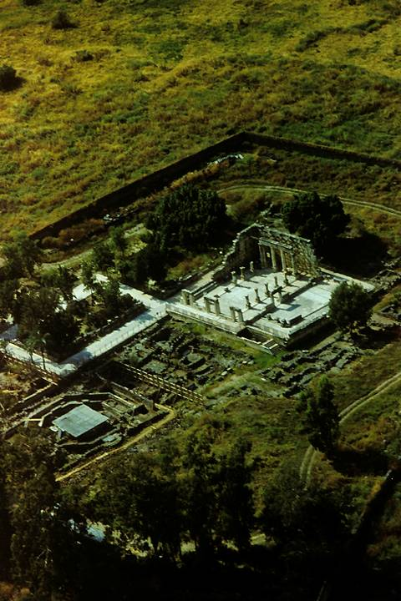
Excavations at Capernaum include a partially-restored synagogue, probably built over the more ancient synagogue which was there in the time of Jesus.
Directly in front of the synagogue and beneath the ancient remains of a church, archaeologists have discovered a domestic structure from the 1st century, and many believe this to have been the home of Simon Peter, where one room was incorporated into a house church.
Graffiti on the carefully plastered walls (more than 100 in Greek, Latin, Aramaic, Syriac and Hebrew) inscribe sayings such as, “Lord Jesus Christ help your servant…” and “Lord have mercy”.

Slide 6
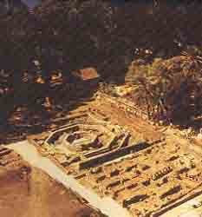
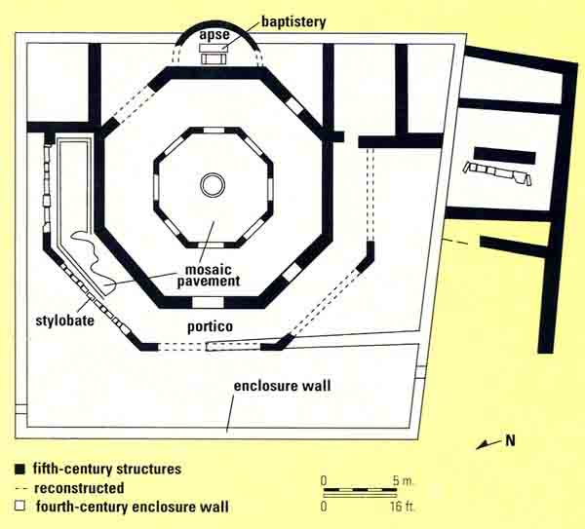
Floor plan of the 5th century octagonal church
Before Constantine’s Edict of Toleration, Christians necessarily had to meet in secret, usually in house churches. However, after Christianity became legal, they began to build churches like this one, often over the ruins of the original church.

Slide 7
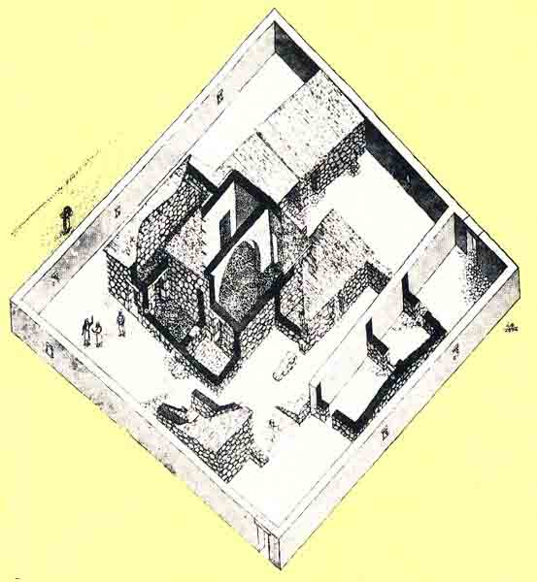
According to the excavators, this house church is from the 4th century, the ruins of which lay beneath the octagonal church. This structure, in turn, was a renovation of a 1st century house. Entrances were added and an arch constructed over the center of the room supporting a two-story high masonry roof.

Slide 8
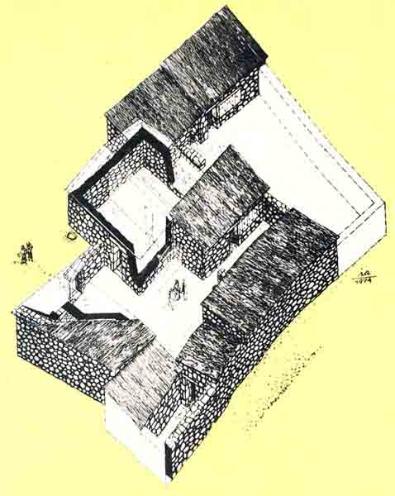
This is an artist’s depiction of the original 1st century house beneath the 4th century church. Here early pilgrims gathered and left Christian graffiti on the plastered walls. The center court served as the “kitchen”, and the largest room was used as a central hall and meetingplace.
Various graffiti mark this as Christian, such as, “Christ” and “Lord”

Slide 9
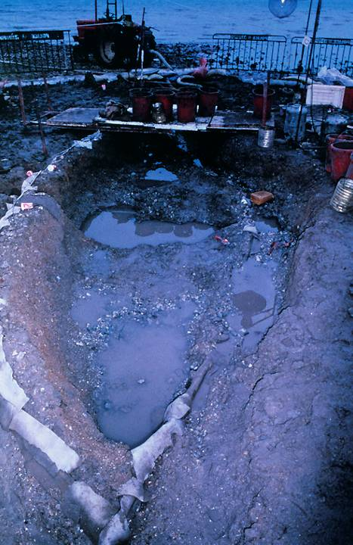
Galilee Boat
In 1986 during a low water level in the Sea of Galilee, an ancient boat was discovered and excavated under the direction of Dr. Rami Arav of the University of Haifa. This is the first ancient boat of its kind to be recovered, and it was dated to the 1st century, based on pottery and coins found inside it. Though there is no indication that Jesus or his disciples ever used it, it has popularly become known as “the Jesus boat”, since it would have been very much like the ones used by fishermen in Galilee in Jesus’ day.
View taken at the beginning of the excavation.

Slide 10
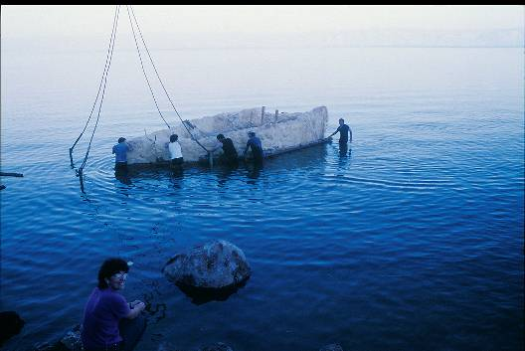
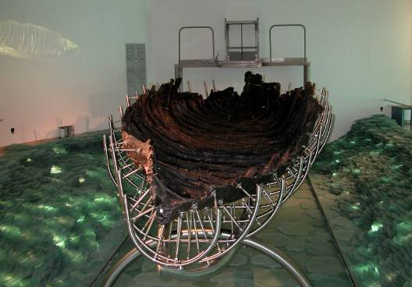
After its excavation, the ancient boat was swathed in polyurethane to preserve it and floated across part of the Sea of Galilee to a site where it could be safely housed and treated for preservation.
The boat was submerged in a chemical bath for several years to fill all the wooden cellular structures with wax (polyethylene glycol) in order to continue its preservation. Now it is on display at a special center at Ginosaur.

Slide 11
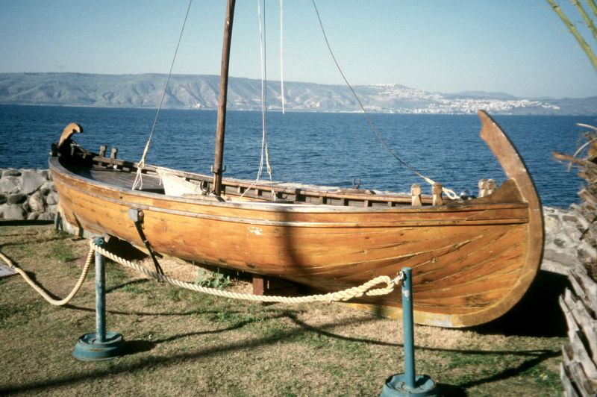
Full-size model of the so-called “Jesus Boat”

Slide 12
DISCIPLE OF JOHN; DISCIPLE OF JESUS
Both Peter and Andrew were initially followers of John the Baptist (Jn. 1:40-42).
Jesus gave Peter his nickname Kephas.
In Galilee, Jesus called Peter to be his disciple, and from that time on, he followed Jesus (Mk. 10:38).
He is always named first among the Twelve Apostles.

Slide 13
PETER’S INITIATIVE AND COURAGE
At critical moments, Peter demonstrated his brash courage and deep loyalty to Jesus:
He volunteered to walk on water to Jesus (Mt. 14:28).
He made the great confession that Jesus was the Messiah, to which Jesus responded that Peter was a rock.
When other disciples were deserting Jesus, Peter stood his ground (Jn 6:66-69).

Slide 14
HIS CAPACITY FOR MISUNDERSTANDING AND BLUNDER
Despite his courage, Peter often spoke out of turn (Mk. 9:5-6):
Jesus severely rebuked him when he objected to the prediction of the cross (Mk. 8:31-33).
He attempted to defend Jesus with violence (Jn. 18:10-11).
On the night of Jesus’ arrest, he denied his Lord, a narrative that appears in all four gospels.

Slide 15
HIS LEADERSHIP ROLE
Peter’s leadership among the apostles is evident in several ways:
Jesus singled him out to be told of the resurrection (Mk. 16:7).
Jesus made a special appearance to Peter on Easter morning (1 Co. 15:5).
Peter served as spokesman for the body of the apostles at Pentecost and afterwards (Ac. 2:14; 3:12).
He was the instrument by which God opened the opportunity for Gentiles to belong to God’s people (Ac. 10).

Slide 16
PETER’S LATER MINISTRY
Before his ascension, Jesus indicated that Peter would die as a martyr (Jn. 21:15-22).
After the council in Jerusalem regarding circumcision (Ac. 15), the later ministry of Peter is not well-attested.
That he went “to another place” (Ac. 12:17) indicates that he left Jerusalem:
  He went to Antioch Syria (Ga. 2:11).
  He traveled throughout the early Christian churches with his wife (1 Co. 9:5).
  Ancient Christian tradition says he was martyred in Rome by crucifixion, probably in AD 64 under Caesar Nero.

Slide 17
INTRODUCTION

Slide 18
THE FIRST READERS
The letter is addressed to Roman provinces on or near the coast of the Pontus Euxinas (Black Sea).
The order of the provinces listed (1:1) likely follows the route of the courier who carried the letter.
The term used for these Christians is the diaspora (= dispersion), a term usually used to refer to the scattered Jews living outside Palestine.
However, the description of their former life (1:8, 14; 2:10; 4:3, 15) has convinced most scholars that the term is probably used metaphorically to refer to predominantly Gentiles (though likely there were some Jewish Christians among them).

Slide 19
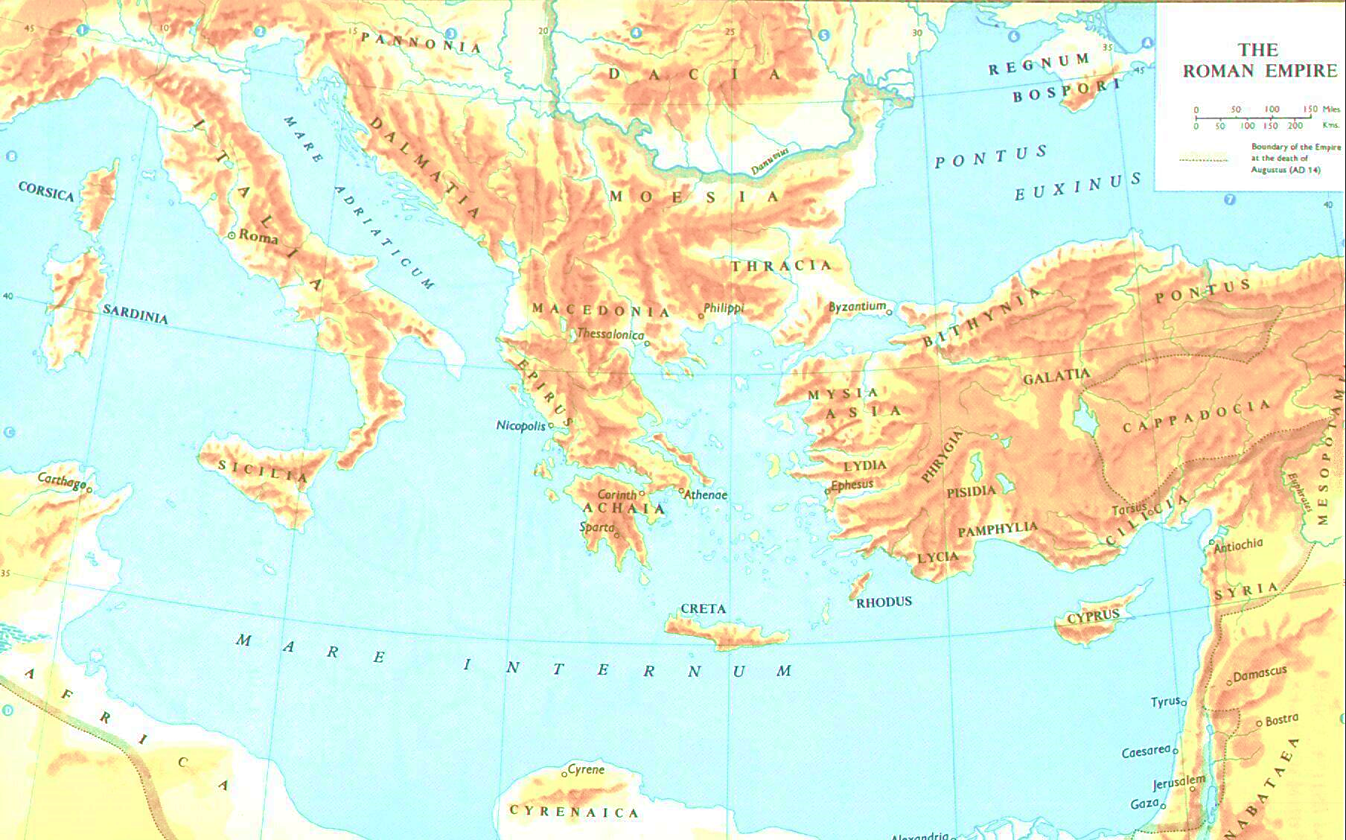
The Roman Provinces

Slide 20
1 PETER IN THE EARLY CHURCH
1 Peter seems to have been highly valued in the post-apostolic church:
The earliest allusions are in 1 Clement in c. AD 96 (1 Clement 2 and 30//1 Pe. 5:5 and 49//1 Pe. 4:8).
Ignatius of Antioch (d. AD 110), also, alludes to the letter (To the Ephesians 5:1//1 Pe. 5:5 and 9//1 Pe. 2:9 and 10//1 Pe. 2:17; 5:5).
Polycarp quotes from it in c. AD 117 (Polycarp 1:1//1 Pe. 1:8 and 2//1 Pe. 1:1, 21; 3:9 and 5//1 Pe. 2:11 and 7//1 Pe. 4:17; 8//1 Pe. 2:24, 22, 21; 4:16 and 10//1 Pe. 2:17; 5:5).

Slide 21
LITERARY CHARACTER
Scholars agree that 1 Peter is written in very polished Greek.
The letter is difficult to translate because of its complicated syntax and extensive vocabulary.
This elevated style may be attributed to Silvanus, the amanuensis who served as the scribe for the letter (5:12).
Because it has a doxology and an “Amen” at 4:11, some scholars suggest that two preexisting shorter pieces may have been brought together, the first a baptismal treatise and the second a message of comfort to Christians in the midst of persecution.

Slide 22
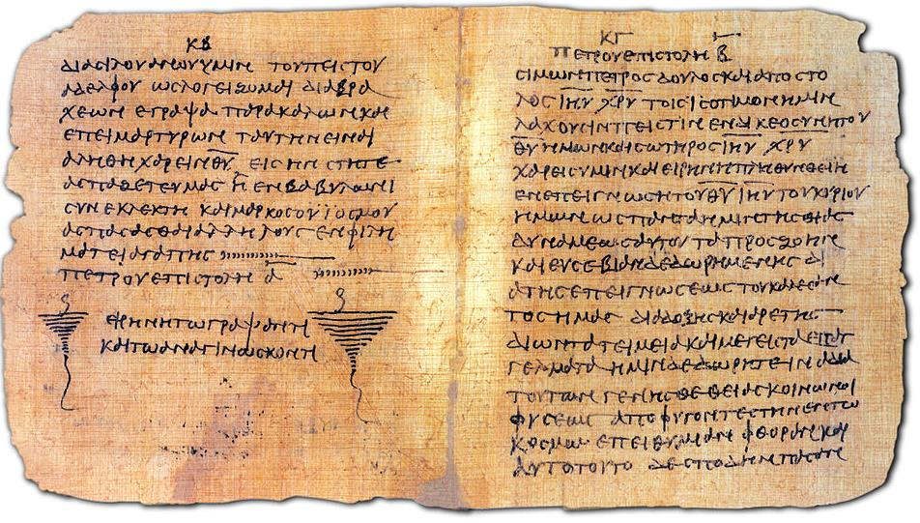
End of 1 Peter and the beginning of 2 Peter p72 (3rd/4th century); earliest known copy of 1 Peter

Slide 23
AUTHORSHIP
Though Simon Peter as the author was never questioned in the early church, historical-critical scholars have suggested alternatives.
The elevated Greek seemed unlikely for a Galilean fisherman, and the context of persecution, if it would have been in the time of Domitian, would be too late.
Against these objections, the elevated style may be attributed to Silas, and there is no necessary reason to suppose that the suffering described in the letter was a state persecution.
Hence, Peter, the apostle, should be regarded as the true author.

Slide 24
PLACE AND DATE OF COMPOSITION
The letter is specifically said to be sent from Babylon (5:13).
Because “Babylon” was a code name for Rome in various 1st century writings, the majority of scholars accept that Peter wrote from Italy.
While the events of Peter’s later life are largely unknown, all ancient traditions associate him with Rome.
The date of the letter is unknown, but it cannot have been later than AD 64, when Peter was martyred in Rome.

Slide 25
OPENING & DOXOLOGY

Slide 26
SENDER & ADDRESSES (1:1)
The opening lines are typical of letters in the Greco-Roman world, citing the writer and the readers and attended with a blessing.
The expression “resident aliens” of the Diaspora,” typically used for dispersed Jewish communities, here becomes a designation for Christians who, because of early missionary efforts, were scattered throughout the Roman world (cf. 1:17).
Peter is trinitarian in his address, mentioning the Father, the Son, and the Holly Spirit.

Slide 27
The Elect
Peter uses the OT concept of “the chosen” to describe the body of Christians, which immediately suggests that the boundaries of “chosenness” have moved well beyond the pedigree of Jewishness.
Given the common viewpoint of corporate solidarity in the ancient world, especially in the OT concept of Israel as God’s chosen people, Peter likely has in mind the whole church (as opposed to simply individuals), a church which was divinely planned and known in advance, set apart for God’s service, and commissioned for obedience in response to the death of Jesus.
The “sprinkling” of Jesus’ blood recalls the sacrificial offerings in the Torah, and Jesus’ death is therefore regarded as the supreme fulfillment of the sacrificial system.

Slide 28
THE BLESSING OF SALVATION (1:3-5)
Peter’s doxology is offered in view of the salvation God has effected in Christ.
He uses the metaphor of being “born again,” a concept that in both Jewish and non-Jewish circles signified a new stage in nature, history, or personal life.
The Christian hope, in contrast to the gloomy forecast in the Greco-Roman world and the loss of so much in the Jewish tragedy of exile and oppression, was oriented toward the imperishable inheritance of eternal salvation—a salvation that is always impending.

Slide 29
The Implicit Contrast
In speaking of an imperishable inheritance, Peter seems to be deliberately contrasting the Christian hope over against the emptiness of other worldviews.
THE GRECO-ROMAN VIEW OF AFTERLIFE
In its world-view of metaphysical dualism, the afterlife consisted of an inactive and meaningless existence in Sheol, and there was no resurrection.
In the underworld, the dead no longer had any strength or influence.
Even heroes were only rewarded by the gods in the present life—and ignored in the afterlife.
THE JEWISH HISTORICAL EXPERIENCE
In the exile, the people of Israel lost their most important national emblems, the land, the temple, and the monarchy.
Even after the return from exile, they continued to exist under the hegemony of pagan empire-builders: Persia, Greece and Rome.
Now, they considered themselves still to be in exile.

Slide 30
CHRISTIAN TESTING AND REWARD (1:6-7)
While God’s salvation promises a wonderful future, it also involves present trials.
Salvation does not exempt believers from the hard realities of life, but it does assure them that such suffering will last only “a little while” (cf. 5:10), a concept that Peter may have borrowed from Jesus (Jn. 14:19; 16:16-19).
Such trials are tests of faith.
Like gold that has been refined, the Christian faith is tested in the crucible of life until Christ is revealed in his second coming.

Slide 31
THE INVISIBLE SAVIOR (1:8-9)
Christian faith is faith without seeing (cf. Jn. 20:29b).
Jesus had told the apostles that they would see him no more (Jn. 16:10).
Though Peter had known Jesus personally, the generations of Christians since depends upon the eye-witness accounts of others, especially the apostles.
Still, the outcome for both is salvation, a cause for overwhelming joy.

Slide 32
THE PROPHETS AND SALVATION (1:10-12)
The ancient prophets eagerly looked toward the timing and circumstances of God’s promised grace (cf. Mt. 13:17; Lk. 10:24).
Indeed, the prophetic Spirit was nothing less than the Spirit of Christ (cf. Rv. 19:10b).
Peter particularly alludes to the figure of the suffering Servant of Yahweh (Is. 49:7; 50:6; 52:13—53:12), drawing, no doubt, from the teachings of Jesus himself (e.g., Mk. 9:12; Lk. 24:25-27).

Slide 33
The Link Between Old and New
Peter links the Old and the New in two ways:
First, the prophets were not merely serving their own times, but also, later generations (cf. Ps. 22:27-31). This promised salvation had come to the five provinces at the eastern edge of the empire by Spirit-endowed missionaries.
Second, even the angelic hosts are fascinated by this mysterious purpose of God, watching it unfold through the centuries. (Some interpreters understand this reference to be related to the Watchers in the pseudepigraphical Book of 1 Enoch, though this is not a necessary conclusion, cf. 1 Enoch 16:3.)

Slide 34
THE CHALLENGE TO LIVE
THE CHRISTIAN LIFE

Slide 35
HOLY CHRISTIAN BEHAVIOR (1:13-17)
Peter uses the strongest inferential conjunction dio< (= for this reason). If what he has said in the introduction is true, then Christians should:
Prepare themselves for action (the metaphor of the race)
Be steady and disciplined (the metaphor of sobriety)
Set their vision upon the future apocalypse of Christ
Pattern their lives after the holiness of God (based on the Levitical command, Lv. 11:44-45; 19:2; 20:7)
Live as aliens in the world (exiles) in godly awe of God as the impartial Judge

Slide 36
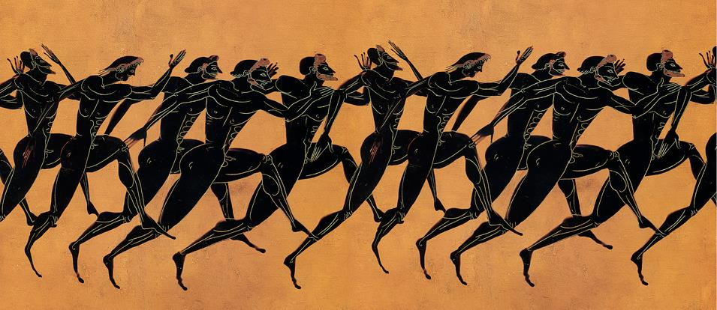
Ca. 530 BC
Metropolitan Museum of Art, New York
Ancient races were measured in stadia ( a stadion = 185 yards), ranging from a 1 stadion length, to 2 stadia, and longer, up to a marathon.

Slide 37
REDEMPTION THROUGH CHRIST’S DEATH (1:18-20)
Peter uses the metaphor of redemption to describe how Christ, in paying the price of his own life, bought back his people from their paganism (cf. Mk. 10:45; Lk. 24:21; Tit. 2:14).
He parallels this redemption with the original Passover and the final plague in Egypt.
Only those who were protected by the lamb’s blood were spared (Ex . 12:7-13).
Christ, then, is the Christian Passover Lamb, planned by the Father before the universe began (cf. Ro. 16:25-26; 1 Co. 5:7; Rv. 13:8).

Slide 38
Redemption
The concept of redemption was familiar to both Greco-Roman and Jewish cultures.
It involved paying a price in order to secure liberation.
For non-Jews it was related to buying back prisoners-of-war or slave emancipation.
For Jews it was God’s action in liberating the Israelites from Egypt as well as transactions of various kinds regulated by the Torah.
Going back to some of the church fathers, elaborate schemes have been built on Christ paying the devil, but the New Testament does not extend the metaphor in this way.

Slide 39
FAITH, HOPE, AND LOVE (1:21-22)
The trilogy of faith, hope, and love follows the gospel of Jesus’ death and resurrection.
The glory of Jesus’ resurrection life is the “seed” of a new birth that points toward the hope of all believers and leads to a life of purity and love.
The “seed” derives its imperishableness from the living and enduring word of God which cannot fail (cf. Is. 40:6-8).

Slide 40
THE CHALLENGE TOWARD MATURITY (2:1-3)
Since believers have been born again into a new creation, they must not fall back into the old pattern of their former lives.
They must “grow up” into salvation.
Uses a clothing metaphor, Peter tells them to “strip off” the old behaviors of vice, deceit, hypocrisy, jealousy, and slander.
Like newborn infants they must be nourished by milk that is logiko>n (= thoughtful) and a@dolon (= unadulterated), which is to say food for the mind, not the stomach.

Slide 41
Greek Word Plays
At various times, biblical authors use word plays to add emphasis, and Peter may well be using one here.
The final line in 2:3, “the Lord is good,” is only a single letter different that “Christ is the Lord.”
xrhsto<j o[ ku<rioj (= the Lord is kind)
xristo<j o[ ku<rioj (= the Lord is Christ)
Hence, Peter may be saying the one while implying the other
Justin Martyr (d. AD 140), for instance, makes a similar play on the same two words (First Apology I.vi).

Slide 42
THE NEW PEOPLE OF GOD

Slide 43
THE TEMPLE METAPHOR
From the birth metaphor Peter now turns to a temple metaphor.
Given that Peter is writing in the 60s prior to the fall of the 2nd temple, it is clear that the early Christians already had begun to understand the concept of temple in a spiritual way while the 2nd temple was still standing.
The apostles’ had taken seriously Jesus’ prediction that the 2nd temple would fall (Mt. 24:1-2).
Stephen had challenged the temple leadership that God could not be contained in any human structure (Ac.7:48-50).

Slide 44
Two Paths into the Future
without temple, land or Jewish sovereignty
Jesus
Prediction: the temple will be destroyed!
The body of Christians become the temple of the Holy Spirit.
Worship and good deeds become the daily sacrifice.
Every believer is a priest before God.
Atonement for sin has been completed once, for all, on the cross.
Judaism
The reality: the temple WAS destroyed!
The synagogue succeeds the temple.
Daily prayer replaces the daily sacrifice.
The rabbis inherit the authority of the priests.
Altar of atonement is replaced by the family table.

Slide 45
THE LIVING STONE (2:4-5)
The imagery of the rejected stone was used at various times to describe the Jewish rejection of Jesus (Mk. 12:10; Ac. 4:11; cf. Ps. 118:22-23).
There was no ark of the covenant in the 2nd Temple, but rather, a large stone upon which the high priest sprinkled blood on Yom Kippur.
Jesus, on the other hand, was a “living stone” by his resurrection from the dead.

Slide 46
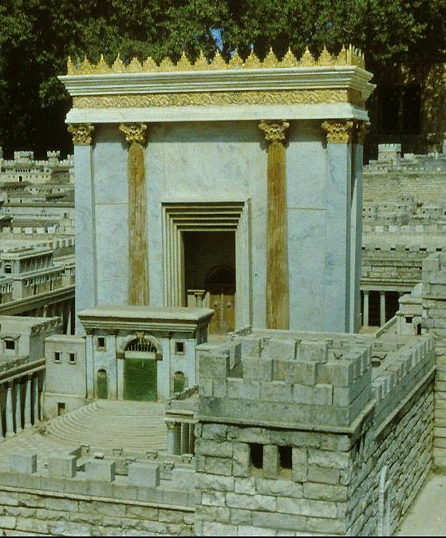
Building the New Temple
If Jesus is the living cornerstone, then the new temple—greater than the 2nd Temple—is built out of believers.
They are the living stones of this new temple.
At the same time, they serve as an unrestricted priesthood offering spiritual sacrifices.

Slide 47
THE ZION STONE (2:6)
The original oracle of the Zion stone (Is. 28:16) had been addressed to the inept leaders of Ephraim and Judah in the 8th century BC.
While the people might trust in many things, including their treaty with Egypt, their only real hope was in the tested Zion stone, a metaphor for the unfailing steadfastness of Yahweh.
Peter, like Paul (Ro. 9:30-33), finds a deeper meaning in this oracle, and the one who believes in Christ Jesus will be vindicated in his faith.

Slide 48
THE STONE OF OFFENSE (2:7-8)
Bringing together yet two more stone metaphors (Ps. 118:22; Isa. 8:14), Peter describes both the honor and dishonor of the varied responses.
The Psalmist describes a stone initially rejected by the construction workers, possibly in the building of Solomon’s temple, that ultimately became the most important stone in the structure.
Isaiah had cautioned his listeners against the general panic in view of Assyrian aggression. The people of Judah must trust in Yahweh as their “Rock” of refuge (Dt. 32:4, 15-30), and if not, he would then become a stone over which they would stumble.

Slide 49
THE NEW ISRAEL (2:9-10)
Unlike skeptics and unbelievers, Peter’s readers had come to genuine faith in Christ, and in doing so, they had become the new people of God.
In a collage of quotations, Peter intends his readers to understand that they are in continuity with the people of God in the Old Testament.
What once was said of ancient Israel can equally be said of them (cf. Ex. 19:5-6; 23:22; Is. 43:10; 2 Sa. 7:11b-13; Dt. 4:20; 7:6; 14:2).

Slide 50
The Transfer of Jewish Vocabulary
The chosen (1:1)
The sojourners (1:1)
The diaspora (1:1)
Those sprinkled with covenant blood (1:2)
The heirs to an imperishable inheritance (1:4)
Those called to be God’s holy people (1:15-16)
Resident aliens (1:17)
The redeemed (1:18)
Those to whom good news is proclaimed (1:25)
The new temple (2:5)
The new priesthood (2:5)
God’s chosen race (2:9)
God’s royal house (2:9)
God’s holy nation (2:9)
God’s special possession (2:9)
Those reclaimed from exile (2:10)
Peter’s rhetoric is cumulative, and his transfer of vocabulary from Old Testament Israel to the New Testament church is extensive.

Slide 51
THE SOCIAL CODE

Slide 52
SOCIAL CODES (2:11-12)
In both the Jewish and the Greco-Roman worlds, ethical lists were common that stipulated appropriate behaviors. As did Paul in several of his letters, Peter offers a Christian social code.
If the Christian community has become God’s new people, then they must live as God’s people.
Peter will address three broad areas: the relationship of Christians to government, slavery, and marriage.
Above all, the Christian is at war with the materialistic, humanistic, orgiastic lifestyles of the larger culture.

Slide 53
DUTIES TO THE STATE (2:13-17)
Submission to human government becomes part of the Christian witness in the world.
Peter’s readers faced serious slander from outsiders, and within a few years, that slander would include accusations of incest, cannibalism, and atheism; Christianity would be categorized as religio prava (depraved religion).
His advice is that Christians should be exemplary, showing honor to everyone, especially to God himself, but also to the emperor.

Slide 54
DUTIES TO THE oi]konomi<a (2:18-25)
The Greco-Roman household community was a large, inclusive unit often composed of a number of families under the authority of the senior male.
Such households included friends, freedmen, and slaves, usually engaged in a common agricultural or mercantile trade.
Peter urges voluntary submission on the part of slaves, even in the face of unjust treatment.
The supreme model is the suffering of Jesus, and Christian slaves are called to endure just as Christ endured, without retaliation or threat.

Slide 55
Sin-Bearing
Drawing from the Torah and the Prophets, Peter describes Jesus’ suffering as bearing the penalty for sin (Nu. 14:33; Eze. 18:20; Is. 53:5-6).
Clearly, however, this was vicarious suffering: Jesus suffered for “our sins” not his own, as is graphically described in Isaiah’s suffering Servant (Is. 53).
Later, Peter will treat Jesus’ death as an expiation for sin (cf. 3:18).
The death of Jesus means the death of sin, and it anticipates the Christian lifestyle that follows the renunciation of sin.
Through Jesus, sinful people, like straying sheep, are brought back to the Great Shepherd and Bishop, who protects, feeds and watches over his flock.

Slide 56
DUTIES TO SPOUSES (3:1-7)
Peter urges wives toward voluntary submission (middle voice verb) and husbands toward good sense.
The goal of such submission is evangelistic, especially toward women with non-believing husbands.
It features a non-confrontational style of evangelism based on character rather than adornment, the sort of quiet conformity found in ancient women like Sarah.
Peter does not follow the typical Greco-Roman household codes which urged wives to “worship the god of their husbands.”
Husbands, for their part, are to give honor and respect to their wives as equal-inheritors of spiritual life.

Slide 57
SUFFERING IN AN ALIEN
SOCIETY

Slide 58
LIVING THE GOOD CHRISTIAN LIFE (3:8-12)
Peter now develops the profile of Christian suffering in an alien world.
The Christian calling is to an ethical life of unity, empathy, compassion and the like (cf. 2:21). Christians are to bless others, even those who show evil intent toward them.
He quotes Ps. 34:12b-16a from the LXX, which says that the good which one enjoys goes hand in hand with the good which one does.

Slide 59
The Face of God
Psalm 34 refers to the “face of Yahweh,” a recurring anthropomorphism in the Hebrew Bible.
The whole personality of God is concentrated in his face, both his love and his disapproval.
The ultimate expression of favor and blessing is to have Yahweh’s face “shine upon you” (Nu 6:25).
To have Yahweh set his face against you is, of course, quite the opposite.

Slide 60
SUFFERING AS EVANGELISM (3:13-17)
The Christian witness in the world has been a central concern all along in the letter (2:9, 12, 15, 3:1).
In taking up this theme again, Peter accentuates the fact that usually Christians who live nonaggressive and nonconfrontational lives will be shown good will.
However, even if Christians suffer for righteousness, they will be blessed by God.
Hence, Christians should not be intimidated by persecution, since their highest allegiance is to Christ.

Slide 61
Non-confrontational Evangelism
Peter’s advocacy of life-style evangelism is that believers should be prepared to respond when outsiders ask them about their faith.
This advice presupposes that Christian character, which Peter has emphasized earlier (cf. 3:8-9), should stand in striking contrast to the usual patterns of life found in the culture at large.
Christians who are belligerent and rude do disservice to the gospel itself, and their witness is discredited when they proceed from behaviors not in line with Christian principles.

Slide 62
JESUS, THE PARADIGM OF SUFFERING AND VICTORY (3:18-22)
The supreme example of innocent suffering was Jesus himself, and Peter offers an apostolic summary of Jesus’ passion.
This summary is rich in the early church’s understanding of the death of Jesus.
His death occurred in the human realm of life (in the flesh), but this human realm sharply contrasts with his resurrected life (in the Spirit).

Slide 63
Preaching to Spirits in Prison
When reciting the Apostles’ Creed (“he descended into hell”), Christians in liturgical churches encounter the idea of Christ descending to the underworld between his death and resurrection.
Peter’s later statement (4:6), that the gospel was preached to those who are dead, along with several other NT passages, convinced the ante-Nicene Fathers that after his death on the cross Christ descended into Hades ( cf. Ep. 4:9; Mt. 12:40; Ac. 2:25ff; Ro 10:6-7).
However, there is more than one understanding of what this might mean.

Slide 64
FOUR VIEWS OF CHRIST’S DESCENT INTO HELL
ANNOUNCING VICTORY
Here, Christ announced his triumph, either to the rebels from the time of Noah, or else to the Old Testament faithful, raising them to life in heaven (Ignatius). This came to be referred to as “the harrowing of hell.”
PROCLAIMING THE GOSPEL
Here, Christ preached the gospel in Hades, either to deceased Israelites or to pagans who had been deprived of hearing it before Christ’s incarnation (Justin Martyr, Irenaeus, Tertullian, Calvin).
THE PREACHING OF NOAH
Here, the spirit of Christ preached through Noah to the ante-diluvian people in the time of Noah (Augustine). The NASB embraces this view and emends the text by adding the word “now” (“those now in prison”).
A GENUINE DEATH
Other interpreters regard this passage in more general terms to stress that Christ truly died, a contradiction to the Docetic view that Christ only seemed to die.
Some versions of the Creed simply say Christ “descended to the dead.”

Slide 65
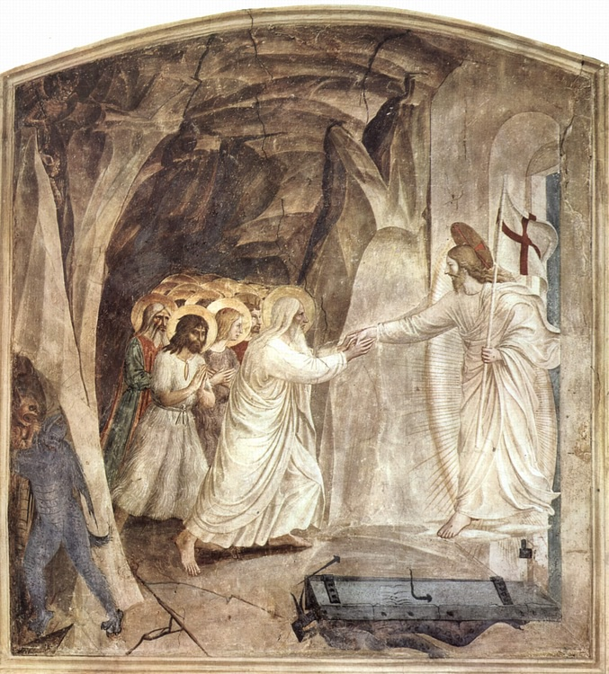
Fresco of “The Harrowing of Hell”
Fra Angelico c. 1441
San Marco, Florence

Slide 66
The Link with Christian Baptism
The eight persons saved from the great deluge “through water” Peter regards as analogous to Christian baptism.
Hence, the flood waters are an antitype in which an Old Testament person, object or event exists in a special correspondence with a New Testament person, object or event.
This type of hermeneutic assumes that God, who is the lord of history, causes earlier occurrences to embody characteristics that will reappear later.

Slide 67
The Meaning of Christian Baptism
Christian baptism is not the removal of dirt (possibly used here as a symbol of moral filth), but rather, is a pledge or request of faith before God for a clear conscience. (The word e]perw<thma = “request” or “pledge” is found only here in the NT. )
If the nuance leans toward the idea of a request, then it may be an appeal by the baptismal candidate to God for the remission of sins (so ESV, NAB, RSV, NRSV).
If the nuance leans toward the idea of a pledge, then it may be a statement of faith made by the baptismal candidate (so NKJV, NET, NIB, NIV, NJB, NLT).
In either case, the saving character of Christian baptism is mediated “through the resurrection of Jesus Christ.”

Slide 68
The Session of Christ
The older theological expression “session” (derived from the word “sitting”) refers to Christ being seated at the Father’s right hand.
In Peter’s apostolic summary of Jesus’ passion, this is the final aspect—that in Christ’s resurrection and ascension he has been exalted as Lord of the universe at God’s right hand.
He is now supreme over all spiritual powers.

Slide 69
LIVING IN GOD’S
WILL

Slide 70
IMITATING THE SUFFERING OF CHRIST (4:1-6)
Returning to the subject of Christian suffering (cf. 3:17), Peter now admonishes his readers that this is not something alien to the Christian life.
The phrase “the one who has suffered has ceased from sin” might be an aphorism, based on the idea that corpses commit no sins.
Peter seems to use this idea to express that when one suffers for Christ, he breaks with the lifestyle of sin.
Christians have abandoned the degenerate lifestyle of their past lives so that they can live for Christ, even in the midst of suffering.

Slide 71
Who Are the Dead to Whom the Gospel Was Preached?
The term Paul uses (nekroi) refers to corpses, so it is unlikely that he is using a metaphor for those spiritually dead.
Many early church fathers linked this passage to 3:19 and understood “the dead” to refer to those in Sheol, the ones released from their underground prison in the harrowing of hell.
Another alternative is that the gospel was preached to those Christians [now] dead, though they were alive when they heard it. They experienced the same death as do all humans, but they now rest in hope of resurrection life.

Slide 72
LIVING IN THE LAST DAYS
(4:7-11)
It was the consensus of NT writers that since the coming of Christ, the “last days” had begun (cf. He. 1:2, etc.).
Because of the imminent return of Christ, believers should live sensible, well-balanced lives, showing love and hospitality and so glorify God.
Peter alludes to Pro. 10:12, expressing a thought similar to Paul’s “love bears all things” (1 Co. 13:7).
Spiritual gifts that God has given should be employed as a stewardship for the benefit of others.

Slide 73
SUFFERING IN GOD’S WILL (4:12-19)
Christian suffering that imitates Christ is suffering within the will of God.
The Christian not only suffers for Christ, he/she suffers with Christ, and in the end, he/she will share in the glory of Christ.
It is to be assumed, of course, that such suffering must be innocent, not deserved.
Peter closes with an allusion to Ezekiel’s vision, where judgment “begins at my house” (Eze. 9:1-8). The woes of the messiah (cf. Mk. 13:8) already had begun, and the doom of the disobedient would shortly follow.

Slide 74
THE ECCLESIASTICAL
CODE

Slide 75
CHARACTER OF CHURCH LEADERSHIP
(5:1-5)
The order for church leaders and church life is a reciprocal relationship between a shepherd and a flock, between the older and the younger.
Peter sees himself in a collegial role with other elders and shepherds, i.e., a fellow-elder.
He warns against using one’s position of leadership to domineer or seek gain.
Younger members should show deference to older leaders, and both older and younger should live in humility.
All leaders are under Christ, who is the Chief Shepherd.

Slide 76
Early Church Administration
It is difficult to reconstruct the earliest forms of church government with precision, and there has been much debate among Christians over the centuries. Peter uses three primary terms to describe church leaders, essentially the same as used by Paul for the Ephesian leaders (Ac. 20:17, 28).
Presbu<teroj (= elder)
This term is borrowed from Jewish life to refer to one who had seniority in the community by age or station.
From this word we derive the term “elder” or “presbyter.”
Poimh<n (= shepherd)
This term derives from the ancient biblical metaphor of leaders as care-takers of a flock of sheep.
From this word we derive the term “pastor.”
Episkope<w (= over-see, take care of)
This term owes more to the Greco-Roman world where it was used both religiously and governmentally.
From this word we derive the term “bishop” or “overseer.”

Slide 77
THE FINAL EXHORTATION
(5:6-11)
While the final exhortation seems applicable to all Christians, in the present context Peter may be particularly directing this toward church leaders.
HUMILITY: The attitude of humility must come from within—”humble yourselves” (cf. Pro. 3:34; Ja. 4:6).
WARNING: The danger from the devil comes from without—he must be firmly resisted.
RESTORATION: After suffering comes restoration.

Slide 78
THE CLOSING

Slide 79
SILVANUS/SILAS
Silas served as Peter’s amanuensis, and the excellent quality of the Greek text may be attributable to him.
It also is possible that Silas was the courier of the letter, and if so, he would have read it publicly to the church, explaining any parts that were unclear.
Peter’s final word concerns standing firm in God’s grace.

Slide 80
BABYLON AND MARK
As mentioned in the introduction, Babylon was an ancient code name for Rome, and most scholars accept this as the place of composition.
That Mark was closely associated with Peter is attested by Papias (early 2nd century), who indicates that Mark’s Gospel was essentially Peter’s memories of Jesus (Eusebius, Ecclesiastical History III.39.15).
The customary kiss of greeting is also attested by Justin Martyr, who wrote, “Having ended the prayers, we salute one another with a kiss” (First Apology 65:2).

