Slide 1

The suffering of job

Slide 2
William Blake’s Illustrations of the Book of Job
In the late 18th century and early 19th century, William Blake, English poet and artist, produced 22 engraved prints plus a number of watercolors illustrating the biblical Book of Job.
Blake apparently found similarities between Job and himself, since he was largely unrecognized and lived in poverty.
Generally, Blake uses the right hand of figures to represent “good,” and the left hand of figures to represent “evil.”

Slide 3
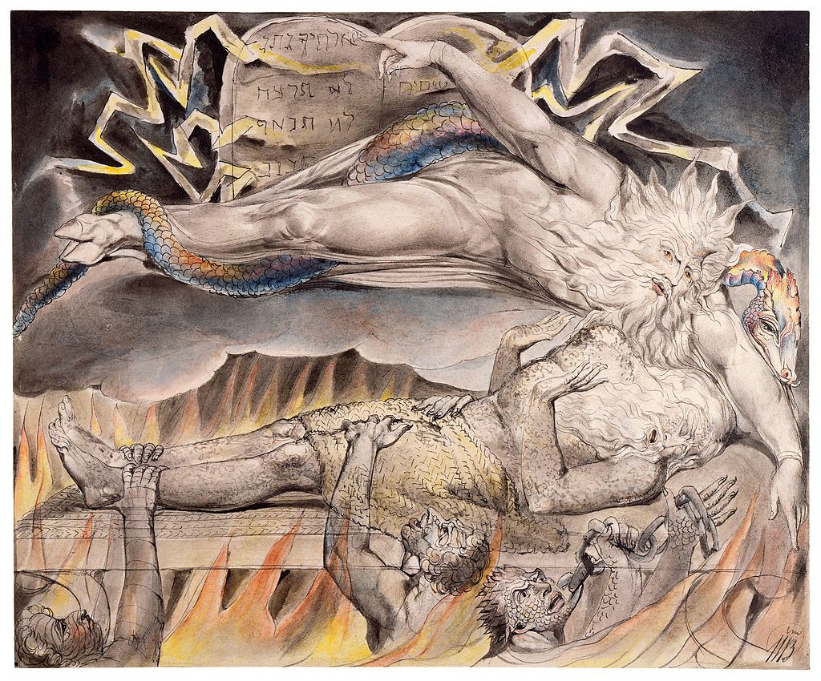
Watercolor by William Blake (1805-6)
The Hebrew script from the Decalogue represents portions of the commandments from Exodus 20, commandments that Job’s friends will suggest he has broken:
Ntn j~yhlx (= “…your God is
giving…” (20:12)
Hcrt xl (= “You shall not
murder” (20:13)
Jxnt xl (= “You shall not
commit adultery” (20:14)
Bngb (= “…steal…” (20:15)
Hy-Mw (= “…name of Yah…”
(20:7)

Slide 4
INTRODUCTION

Slide 5
THE BIG QUESTIONS
The Book of Job falls into the larger category of theodicy, which is to say, it addresses the problem of evil in the face of a sovereign God. The classical statement, as framed by the skeptic, is:
If God is all-good, then he must not be all-powerful, else he would eliminate evil.
If God is all-powerful, then he must not be all-good, else he would eliminate evil.

Slide 6
CHRISTIANS HAVE ALWAYS AFFIRMED:
God is both all-good and all-powerful.
The relevance of the Book of Job is that it addresses an enduring human problem: destitution, sickness, humiliation, depression, and loss.
The problem of evil is most acute for the one who believes in God:
  Why does God tolerate moral evil?
  How is one to account for natural disasters, animal pain, human suffering in general, and inequitable human suffering in particular?

Slide 7
AUTHORSHIP
Who Composed the Book of Job?
The book is anonymous and written in the 3rd person.
It does not seem to have been written by Job himself, since the writer has an insider’s view of the spirit-world, including the satan, something Job never discovered.
The story was known by the time of Ezekiel (cf. Eze. 14:14, 20).
Dates for composition range from almost every century from the time of Solomon and later.

Slide 8
HISTORICAL-CRITICAL ISSUE
Is the book a unity or a composite? This debate involves the following questions:
  Do the opening and closing match (the satan appears in the opening but not in the ending)?
  Is the poem in Chapter 28 a free-standing composition included later (the poem at first seems to be by Job, but the content seems inconsistent with Job’s other speeches)?
  Were the Elihu speeches added later (he does not appear with Job’s other three friends and simply “appears” in Chapter 32 without introduction and vanishes after chapter 37). He is not mentioned at the end with the others.
  Why are there doublets for the divine speeches near the end (38:1 and 40:6).

Slide 9
POSSIBLE STAGES scholars sometimes suggest that the book developed in stages
STAGE 1
They suggest that oldest form was the ancient story preserved orally and likely consisting mostly of the material in the prologue and epilogue.
STAGE 2
The poetic dialogues between Job and his friends were added.
STAGE 3
Later, the Elihu speeches were added as well as the poem on wisdom.
STAGE 4
Last, copyists who were shocked at some of Job’s language, put some of Bildad’s and Zophar’s speeches into Job’s mouth.
Still, it must be conceded that the book “hangs together” as a whole with common literary structures, themes, and a style that would fit the work of a single author.

Slide 10
THE TEXT of JOB
It is generally agreed that the Hebrew text of Job is difficult.
It contains more that 175 words that appear only here and no place else (hapax legomena). The meaning of some words can only be guessed.
In the LXX, some words in the Masoretic Text are simply absent (or omitted), plus the book is some 300-400 lines shorter than in the MT.
In the Dead Sea Scrolls, the Aramaic translation (11QtgJob) is generally closer to the MT than the LXX, but it also has some omisions and additions.

Slide 11
TRANSLATION and INTERPRETATION
The difficulty of the text of Job has proved a challenge for translators and interpreters.
In comparing English Versions, one will find considerable variety in translation, and more recent translations offer alternative readings based on the LXX, the Syriac, and the Vulgate as well as other ancient sources.
Many scholars offer emendations by changing the vowel pointing (which is not original) or exchanging a letter for a similar letter to make sense of the text.
Aramaic elements are scattered throughout the text, especially in the Elihu discourses.

Slide 12
GENRE
It is generally agreed that Job belongs to the genre of wisdom literature, a style widely attested in the ancient Near East.
One work in particular, the poetic monologue “I Will Praise the Lord of Wisdom,” has been dubbed “the Babylonian Job story,” since it depicts a man struggling with the fact that the god Marduk has allowed him to suffer, even though he is righteous.
Another, composed in Egypt, depicts a man contemplating suicide because the times are bad, and justice and love have disappeared.
Still, another, comments on the absurdity of life.

Slide 13
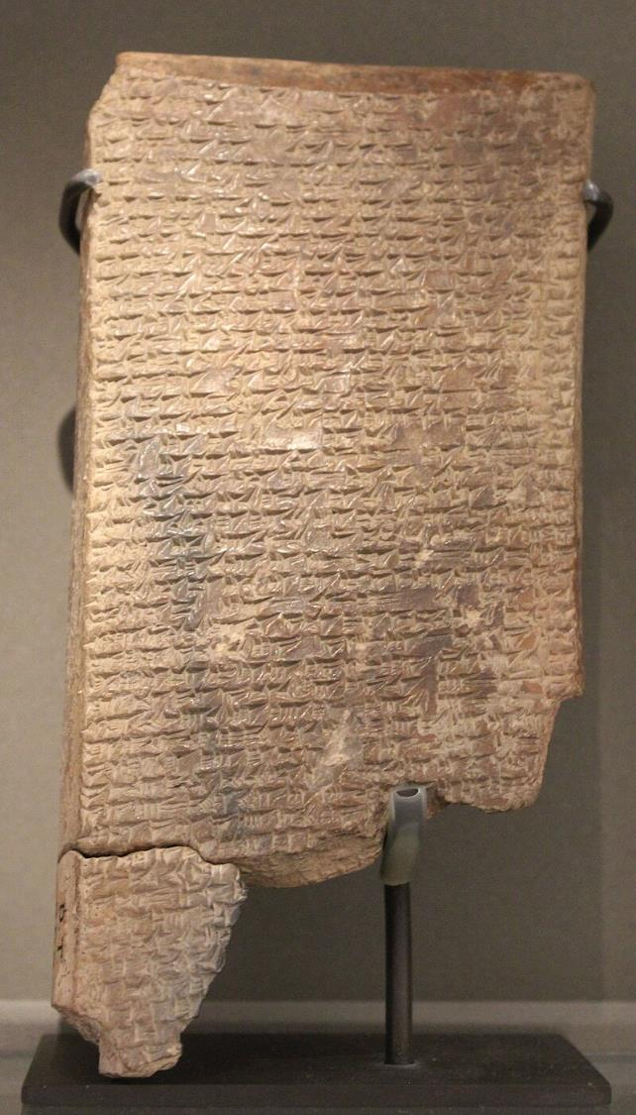
I Will Praise the Lord of Wisdom
Written in Akkadian in the 7th century BC, this Mesopotamian poem concerns the afflictions of a man named Subsi-masra-Sakkan.
He speculates over the question, “Oh, that I only knew that these things [i.e., ritual purity] are well pleasing to a god!”
Though he has been faithful in his duties, he wonders whether what is good to humans might be evil in the eyes of the gods or vice versa.
Louvre, Paris

Slide 14
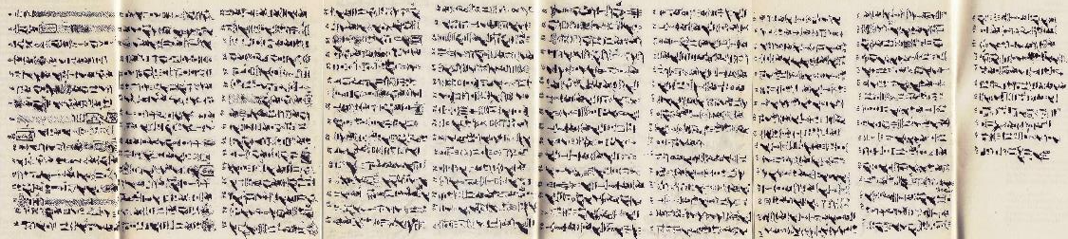
Dispute Over Suicide
Papyrus Berlin 3024
This introspective text, from the Middle Kingdom Period, is written in hieratic on papyrus.
In the text, a man is depicted in internal dialogue with his Ba (soul).
He discusses the possibilities of death and afterlife as better than human earthly life, which is filled with evil and hardship.
His Ba, however, urges restraint and that the man should continue his earthly life and not seek death before its time.

Slide 15
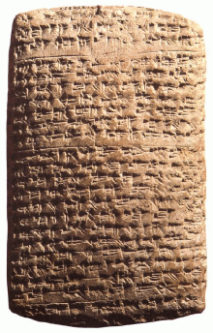
Dialogue About Pessimism
Composed ca. 1000 BC, this Babylonian text consists of short exchanges between a master and a slave.
When the master proposes some action, the slave agrees enthusiastically.
When the master changes his mind, the slave cites all sorts of reasons why the new proposal is better.
In the end, life seems absurd and ambiguous.

Slide 16
Persons of Wisdom
Wisdom in the ancient Near East was a long and respected tradition, and individuals with wisdom formed a special class (cf. Ex. 7:11; Dt. 1:13; Est. 1:13-14; Job 15:17-18; 34:2; Pro. 1:5-6; Je. 8:8-9; 10:7; Ob. 8).
MkAHA (= the wise man or wise woman)
hmAk;HA (= wisdom, technical skill, aptitude, good sense)
hn!yBi (= insight, understanding)
Wise men were an essential part of the royal court, standing as personal advisors to the king (cf. Je. 50:35; 51:57).

Slide 17
Wisdom in the Ancient Near East
Wisdom for the ancients was practical, not strictly intellectual nor necessarily spiritual. It was a combination of intelligence, shrewdness, good sense, sound judgment and moral understanding. It was:
The ability to understand one’s surroundings.
Being able to foresee the reactions of one’s fellows.
Applying one’s own resources at critical points.
The wise man in the ANE studied, observed and meditated.

Slide 18
CULTURAL CONTEXT
A geographical feature of the Book of Job is its link to Edom.
Job is described as “a man of the sons of the east” (1:3), a description usually referring to those areas east and south of the Jordan River.
Edom had a reputation for being a wisdom center (1 Kg. 4:30).
The “land of Uz” is associated with several southern ethnicities, one of which is Edom (Je. 25:20-21; La. 4:21).
Eliphaz, one of Job’s friends, came from Teman, an Edomite city famous for its wisdom (Je. 49:7; Ob. 8), and perhaps his other friends came from there as well.
The LXX has an additional lengthy paragraph at the end of the book that locates Job on the border of Edom and Arabia.

Slide 19
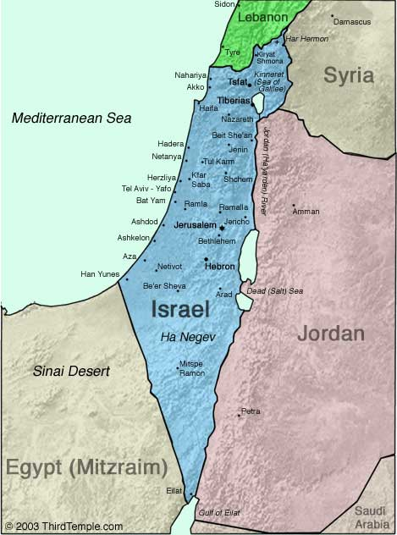
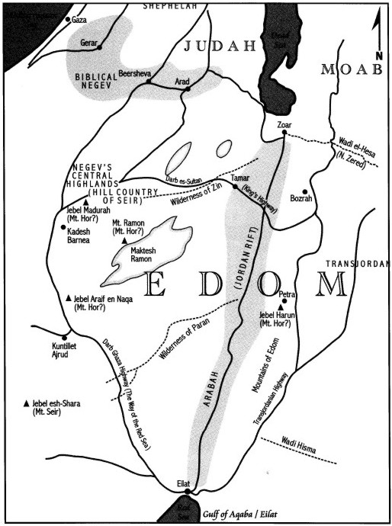
Ancient Edom

Slide 20
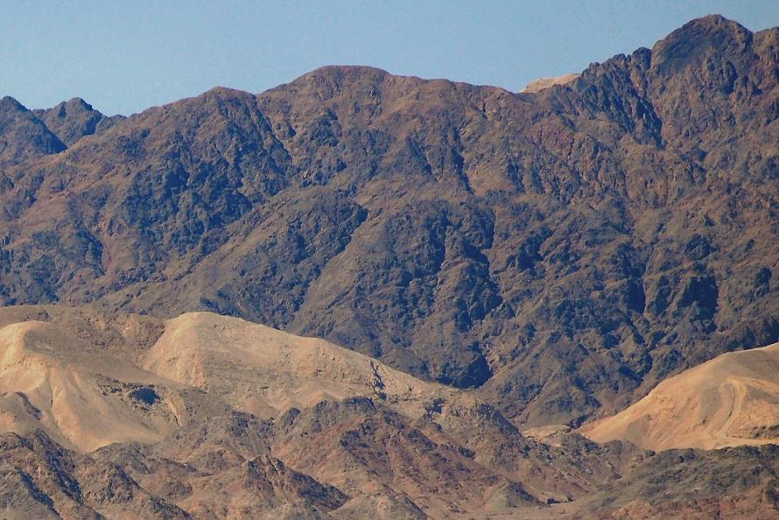
Mountains of Edom, the hills over Eilat near the Gulf of Aqaba.

Slide 21
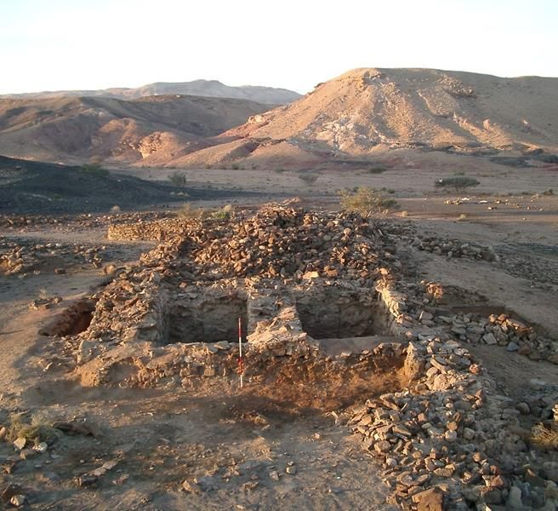
A new study under the direction of University of California, San Diego Professor of Archaeology Thomas Levy, contradicts much recent scholarship which had argued that, because there had been no physical evidence, no Edomite state had existed before the 8th Century BC. Until the current discovery many scholars had said the Bible’s numerous references to ancient Israel’s interactions with Edom could not be valid.
Now, with the discovery of early artifacts, this conclusion is being reassessed.
Excavation of the gate of Khirbat en-Nahas ancient Edom

Slide 22
WAS JOB A NON-ISRAELITE?
That Job was a non-Israelite seems probable, not only because he is described as a “man of the east,” but also because he is enumerated along with other pious non-Israelites (Eze. 14:14, 20).
Noah, of course, preceded the Israelite nation, and Dan’el (spelled differently than the biblical Daniel) was an ancient king famous for his wisdom (Eze. 28:3), whose story is told in the Ugaritic epic of Aqhat.
As to why a non-Israelite might be a worshipper of the one true God, it should be remembered that the Sethites (Ge. 4:26), Melchizedek (Ge. 14:18), and of course, Abraham all preceded the Israelite Nation.

Slide 23
WAS JOB AN HISTORICAL PERSON?
The answer to this question is directly related to the genre of the book.
Given that the book belongs generally to the genre of wisdom literature, it still remains to identify it more specifically as epic, drama (or tragedy), parable, or didactic poem—or a genre unique to itself.
Late in the book the term משל (= parable, proverb) is used to describe two of Job’s speeches (27:1; 29:1). Should this be applied to the whole?
In the Talmud, some Jewish interpreters argued that Job was merely typological, while others argued the reverse.

Slide 24
Job seems to be considered historical by other biblical writers (Eze. 14:14, 20, Ja. 5:11), and it somewhat unlikely that an Israelite who wanted to write a parabolic story about wisdom would choose a descendant of Esau as the protagonist.
Luther, while he did not deny an historical core, suggested it was poetically idealized.
C. S. Lewis, along with others, considered the story to be mythological.
Today, a widely-held view by many scholars is that while there may be a historical core to the story, the author has built upon this core and embellished it in poetry so as to underscore the moral lesson.
Conservative readers must consider whether or not something must be literal and historical in order to be true.

Slide 25
STRUCTURE
Much of the book is written in Hebrew poetry, and the overall character of the composition displays symmetry.
The story has “book ends,” the prose prologue and epilogue that frame the whole (1-2; 47:7-17).
The story begins with Job’s opening lament and closes with his contrition (3; 40:3-5; 42:1-6).
The larger portion of the book consists of three cycles of speeches (4-27).
Near the center of the book is a poem on wisdom (28).
After the poem on wisdom are three monologues by Job, Elihu, and Yahweh (29-40).

Slide 26
Prose Prologue (1-2)
Job’s Opening Lament (3)
The Three Cycles of Dialogues:
Eliphaz and Job (4-7)
Bildad and Job (8-10)
Zophar and Job (11-14)
Eliphaz and Job (15-17)
Bildad and Job (18-19)
Zophar and Job (20-21)
Eliphaz and Job (22-24)
Bildad and Job (25-27)
(Zophar is silent)
Poetic Interlude on Wisdom (28)
The Monologues
Job (29-31)
Elihu (32-37)
Yahweh (38:1—40:2)
Yahweh (40:6—41:34)
Job’s Closing Contrition (40:3-5;
42:1-6)
Prose Epilogue (42:7-17)
Some have suggested that the book is chiastic, though if so, there are disparities to be explained.

Slide 27
MEANING
The lessons from the book are moral and didactic:
Conventional wisdom often falls conspicuously short.
Human suffering is not merely cause-and-effect nor is it necessarily punitive.
Justice may not be achieved in the present life.
Many universal questions remain unanswered.
The problem of evil is bigger than human capacity to understand.
In retrospect, Job’s deepest questions will remain unanswered until the coming of Jesus, the Son of God.

Slide 28
THE PROLOGUE
1-2

Slide 29
THE OPENING (1:1-5)
The primary emphasis in the prose prologue is upon Job’s integrity. His coming trial was not the suffering he deserved but suffering in spite of being righteous.
Though wealthy, like Abraham, he was not a nomad. (Later passages indicate he may have lived in a town, cf. 29:7ff.).
His large number of oxen, which are used for plowing, suggest that he was a wealthy farmer.
Most important was his moral rectitude. He even offered sacrifices for his sons and daughters just in case they had sinned. (Presumably, such sacrifices would have been either earlier or at least outside the Levitical system.)

Slide 30
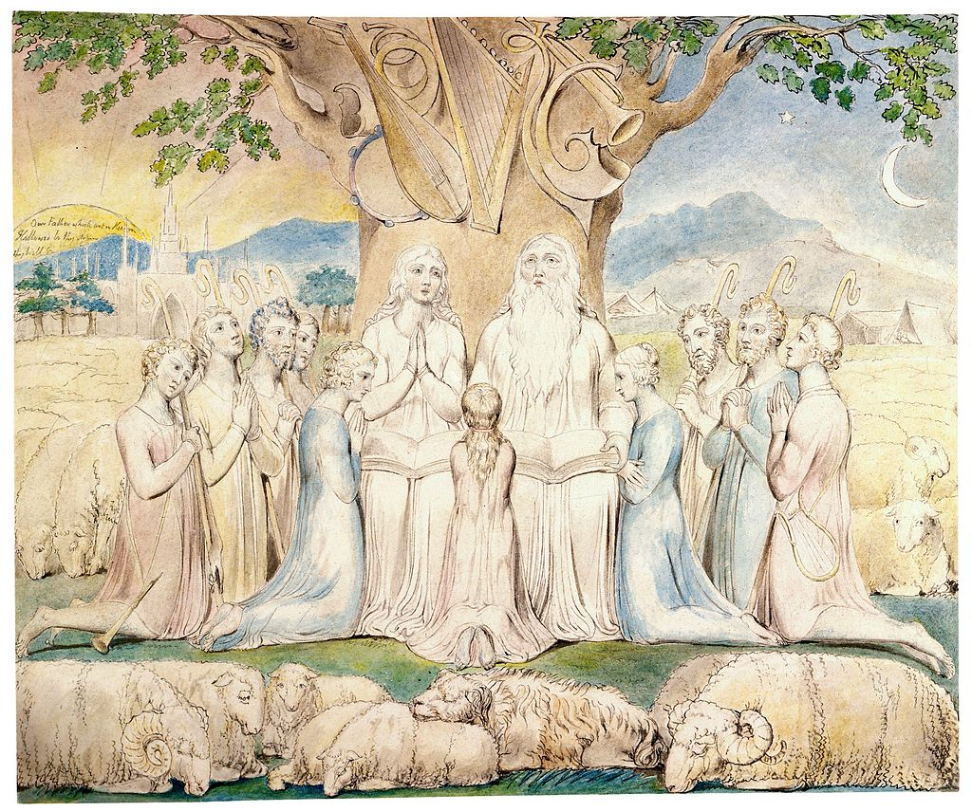
Job and his family during the days of prosperity before his downfall.
Watercolor by William Blake

Slide 31
A HEBREW IDIOM
Like all languages, biblical Hebrew uses idioms. The idiom “to bless” substitutes for “to curse,” since the object is God himself.
When the text in 1:5 says that Job offered a sacrifice for his children in case they had “blessed God in their hearts,” the idiom really means to curse God (and the English Versions invariably translate the verb as “curse.”)
This same idiom will later appear on the lips of the satan (2:5) and Job’s wife (2:9).

Slide 32
The Adversary (1:6-12)
The introduction to the satan among the sons of God offers the reader a glimpse into the invisible world.
The Hebrew word שטן (= satan) can function as both a title and a name (differentiated in Hebrew by the presence or absence of the definite article). In the Book of Job, the word is always used as a title, not a name, even though the tradition in English Bible translation is to capitalize it as a name (the NAB being a notable exception).
Elsewhere, this title is used to describe a human enemy or adversary (1 Sa. 29:4; 2 Sa. 19:22; 1 Kg. 5:4; 11:14, 23, 25), though in Job he is clearly a spiritual entity. In Ps. 109:6 it is used to describe a prosecutor.

Slide 33
Yahweh’s Heavenly Council
(Ps. 82:1, 6; 89:5-7; Job 1:6-7; 2:1-2; 1 Kg. 22:19-23)
Myhilox$ (‘elohim = gods)
MykixAl;ma (mal’akim = angels, messengers)
Mywid2q4 (qedoshim = holy ones)
Mylixe yn2b;/Myhilox$ yn2b; (bene ‘elim/bene ‘elohim = sons of God)
MydibAfE (‘abadim = servants)
Mytir;wAm; (mesharetim = ministers)
Mybiv0rK; (cherubim = intercessors?)
Mypir!W; (seraphim = burning ones)
NFAWA (satan = the accuser)
Deut. 32:8-9
(LXX)
“…when the Most High divided the nations…he set the bounds of the nations according to the number of the angels of God.”
Dead Sea Scrolls & Targums = “gods” or “sons of God” (so NRSV)
MT = “the sons of Israel” (so NIV)

Slide 34
The Great Accuser
Here and elsewhere, the satan seems to depict a spirit-being whose primary function is to accuse persons before God (Zec. 3:1; 1 Chr. 21:1).
Hence, in the New Testament he is called the “accuser of the brothers” (Rv. 12:10).
Since the satan indicts those God favors, implicitly he is the adversary of God, ostensibly making accusation in order to uphold God’s honor, but in reality, opposing him.

Slide 35
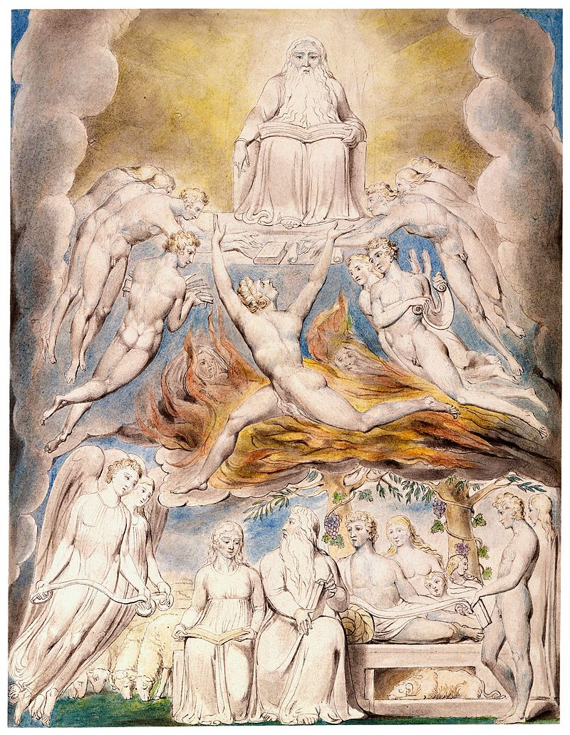
“Satan Before the Throne of God”
The satan and the “sons of God” appear before the divine throne.
The satan is depicted as “going to and fro in the earth, and from walking up and down in it.”
Watercolor by William Blake

Slide 36
The Observation
The blameless character of Job is first raised, not by the satan, but by Yahweh.
The description of the satan as “going to and fro” in the earth may very well underlie Peter’s later description of the devil as “prowling around” (1 Pe. 5:8).
Yahweh is delighted with Job, but the satan is cynical, asking the rhetorical question, “Does Job fear God for naught?”
This, then, becomes the ongoing question in the book: Does Job love God for himself alone, not merely for what he can get from him?

Slide 37
The Challenge
The test challenge of the satan is for God to remove Job’s hedge of protection.
The indictment is that Job’s piety is based on love of self, not love for God.
It is important to note that the satan, while a hostile creature, cannot attack Job without permission. (The Book of Job does not countenance any sort of eternal dualism between good and evil, such as one finds in Zoroastrianism.)
The satan sneers that if Job’s privileges were struck down, he would curse God, not merely in his heart, but to God’s very face.
God consents to the challenge, only with the restriction that the satan cannot attack Job himself, only what he possesses.

Slide 38
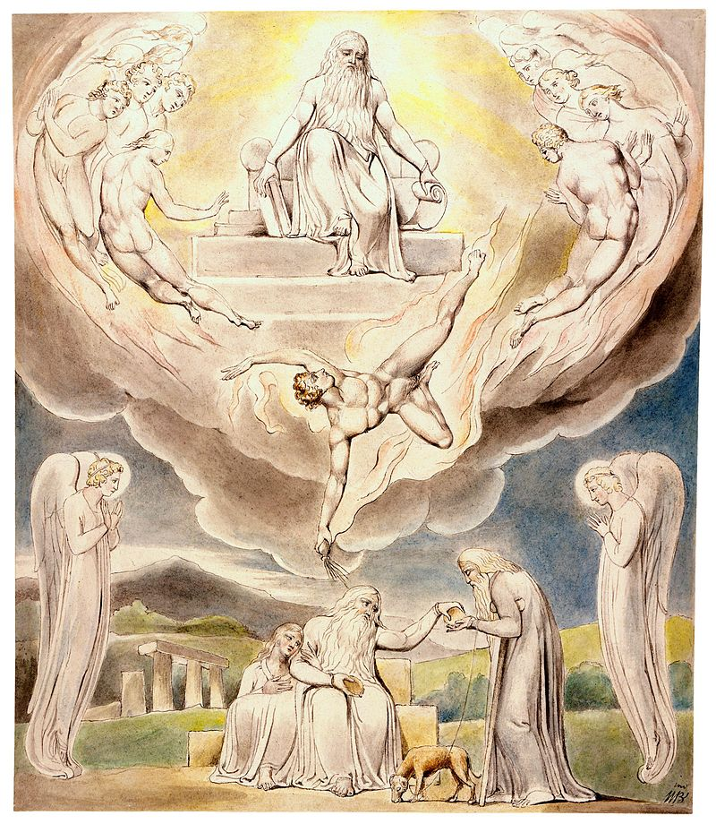
The satan leaves the presence of God to attack Job.
Job, totally unaware of what is coming, continues his life of piety and charity.
Watercolor by William Blake

Slide 39
THE FIRST STROKE (1:13-22)
Taking advantage of Yahweh’s permission, the satan now delivers a series of horrific blows, removing Job’s wealth and his children.
Raiding parties were common in ancient Near Eastern life, plus there were natural disasters, a tremendous lightning strike, and a desert sirocco.
Together, these tragedies represent two kinds of evil, moral evil from malignant invaders and natural evil, where self-consciousness is not a factor.
Job’s complete piety is now matched by complete destruction.

Slide 40
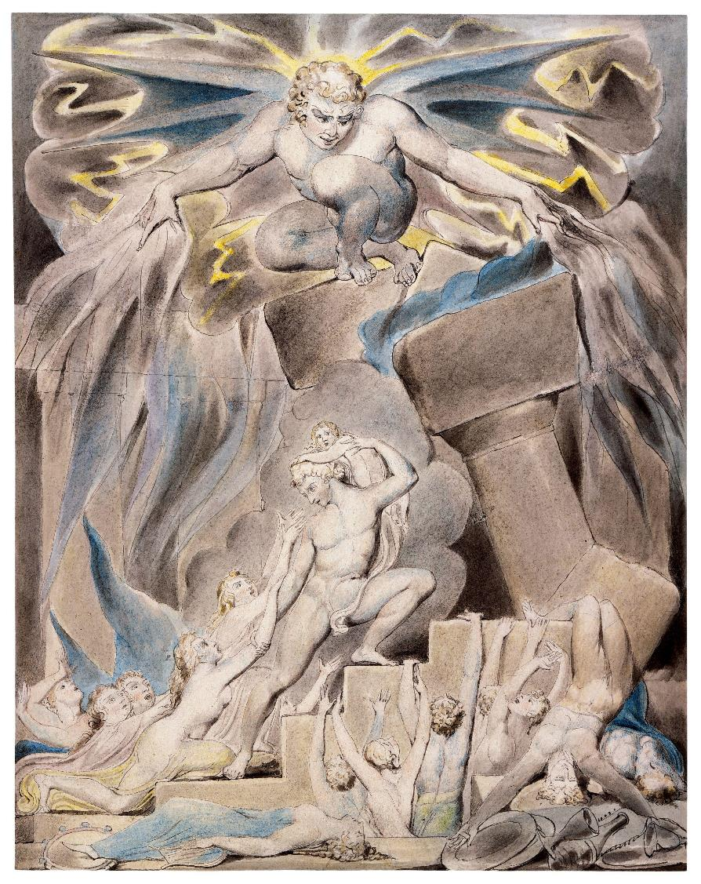
The satan’s attack upon Job’s children.
Watercolor by William Blake

Slide 41
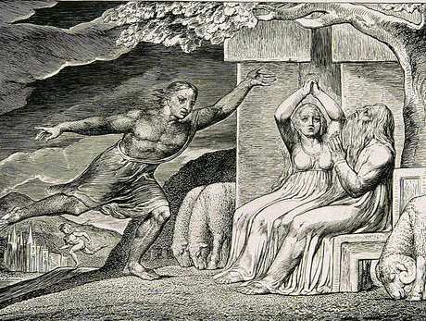
This engraving is accompanied by the quotation, “And I only am escaped alone to tell thee.” (Job 1:15)
Engraving by William Blake (1826)

Slide 42
Job’s Response
With typical gestures of mourning, Job tore his rob in consternation and shaved his head.
Prostrating himself in humility, he worshipped in the midst of disaster. This is the initial answer to the satan’s cynical challenge.
As Soren Kierkegaard insightfully observed, Job does not first say, “The Lord took…” but rather “The Lord gave…”
Job’s loss only accentuated his gratitude, and he does not regard these things a “rights,” as though deserved, but as “blessings.”
The satan had urged that Job would curse God to his face, but in fact, Job’s lips gave forth only blessing, not cursing.

Slide 43
THE SECOND STROKE (2:1-10)
The language describing the second stroke parallels the language of the first.
The satan gives account of himself to Yahweh, and Yahweh calls attention to Job, who has maintained his integrity in spite of tragedy.
The accuser does not abandon his cynicism, however, and his proverb “skin for skin,” while cryptic, is explained by the succeeding line: “All that a man has he will give for his life.”
The satan again asserts that if Job’s own person was afflicted, he would certainly curse God to his face.
Consequently, Yahweh allows the satan to attack Job once again, but he gives the single restriction that he cannot kill him.

Slide 44
C. S. Lewis and Complex Good
Lewis makes a helpful distinction between what he calls the “simple good” and “simple evil” as opposed to “complex good.”
Simple Good & Simple Evil
Simple good is that which comes from God to all his creatures to greater or lesser degrees, and for Job, this would be his initial blessings.
Simple evil is what is produced by rebellious creatures, and for Job, this would be the attacks upon his prosperity.
Complex Good
Complex good is when God exploits evil for his own redemptive purposes, and the acceptance of suffering contributes to this goodness.
The good that comes is not suffering, as such, but rather the way in which the sufferer approaches his trial, where a greater good can be achieved than otherwise.

Slide 45
The Second Attack
The satan’s next attack was upon Job’s person, striking him with sores from head to foot.
Whatever this affliction (suggestions range from boils to leprosy to elephantiasis), it generally concerned his skin (שחין).
The residual effects were miserable, including:
  Unbearable itching (2:8) Rotting teeth (19:20)
  Disfigurement (2:12) Emaciation (16:8; 17:7; 19:20)
  Maggots in the ulcers (7:5) Joint deterioration (30:17)
  Nightmares (7:14) Discolored and peeling skin (30:28)
  Failing eyesight (16:16; 17:7)
  Bad breath (19:17)

Slide 46
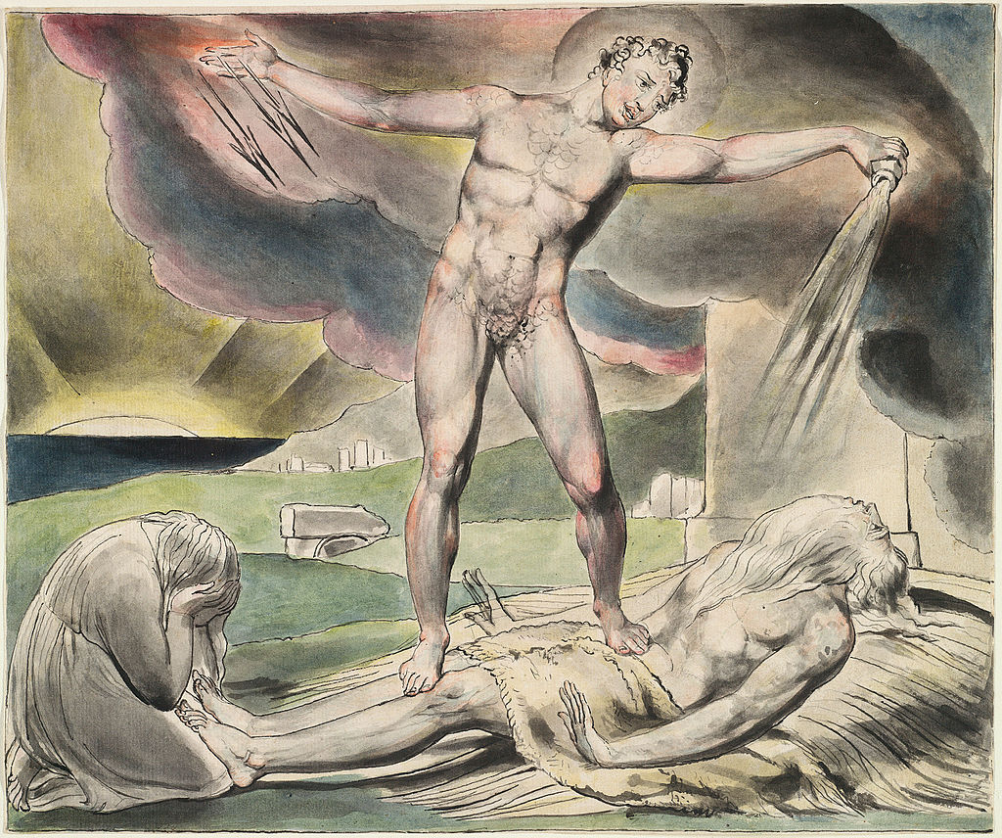
The satan strikes Job with boils.
Watercolor by William Blake

Slide 47
Horrific Misery
Job sewed for himself loose sackcloth for relief (16:15), sat in the ashes at the city rubbish dump (2:8), scraped at his festering sores with a potsherd (2:8), and endured this misery month after month (7:3).
His wife became a sounding board for the satan, urging him to “bless” God and die.
Against the satan’s cynical prediction, however, Job did not sin with his lips, which is to say, he did not curse God. (Some have suggested that perhaps Job sinned in his heart, if not verbally, but this would flatly contradict God’s assessment in the end that Job had spoken faithfully (42:7-8).

Slide 48
THE ARRIVAL OF THREE FRIENDS (2:11-13)
The satan now disappears from the rest of the book, but three friends appear in order to comfort Job.
They seem to have come from some distance, Eliphaz from Teman (an area of Edom, cf. Je. 49:7, 20;Eze. 25:13; Am. 1:12; Ob. 8-9), Bildad from Shua (possibly linked to Shuah, the son of Abraham by Keturah, cf. Ge. 25:1-2, 6), and Zophar (according to the LXX, Zophar was the king of the Mineans in southern Arabia, cf. Ge. 36:11, 15).
For seven days they sat, the customary time in the ancient Near East for mourning the dead (Ge. 50:10; 1 Sa. 31:13), and they joined in the traditional rites of grief, their lack of words an eloquent testimony to their shock, respect, and perhaps even awe at Job’s crucible.

Slide 49
JOB’S LAMENT
3

Slide 50
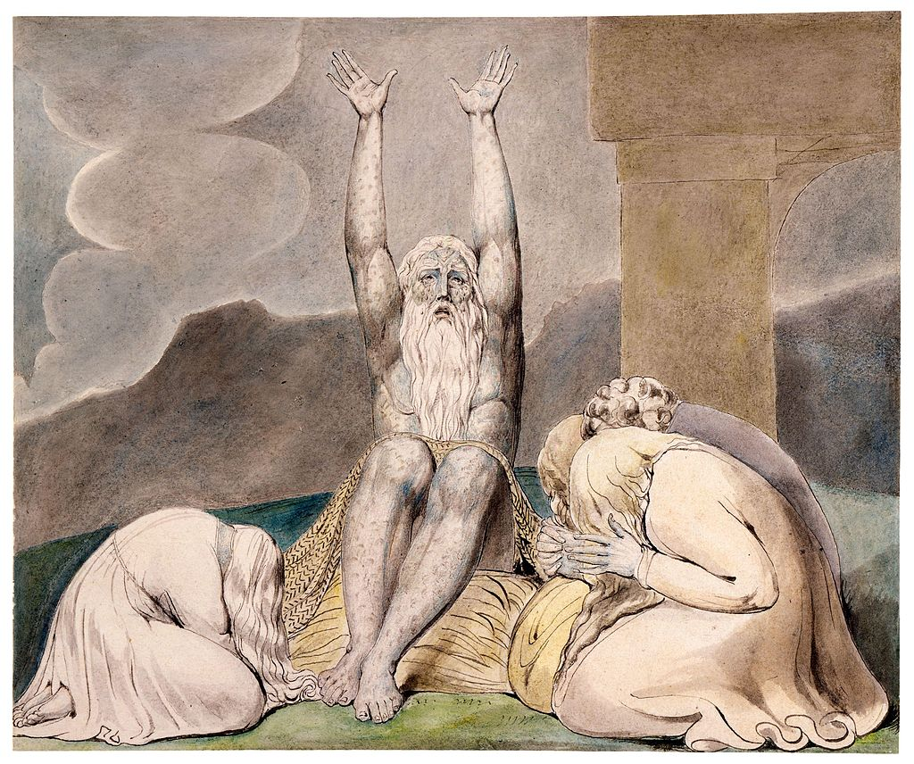
Job’s Despair
Watercolor by William Blake

Slide 51
THE SPEECHES BEGIN (3:1-26)
Job was the first to break the silence.
His lament precedes a series of lengthy poetic speeches and soliloquies between him and his friends, as least 17 in all (perhaps more, depending on how one counts them).
Each speech is a complete piece in itself, though each interacts to greater or lesser degrees with the others.
While there is no indication of an outside audience, the speeches sound as though an outside audience is implied.
Whereas Job’s friends talk about God, Job often talks directly to God as well as to them.

Slide 52
Job’s Initial Questions
Throughout the dialogues, Job will probe deeply why this devastating affliction has come upon him. He begins with a curse and two basic questions reflecting his anguish:
He curses of the day of his birth (3:1-10).
He asks, “Why was I not still-born?” (3:11-19).
He asks, “What meaning does my present existence now have; does life have any significance in the mist of unbearable suffering” (3:20-26)?

Slide 53
Poetic Figures of Speech
Since the dialogues between Job and his friends are in the form of Hebrew poetry, they are replete with figures of speech and parallel lines. Here, in Job’s opening lament, the reader sees:
The night of his birth is personified, the night itself depicted as a barren woman (3:7), waiting but not seeing the sunrise (3:9).
The imagery of the “eyelids of the dawn” (בעפעפי שחר) in 3:9 is particularly expressive (though a number of translations ignore the metaphor and simply render it as “the first rays of dawn” or something less poetic, cf. NIV, NAS, NLT).
The “double doors of the womb” (דלתי בטני) is yet another fascinating figure (3:10).

Slide 54
FIRST CYCLE OF DIALOGUES
4-14

Slide 55
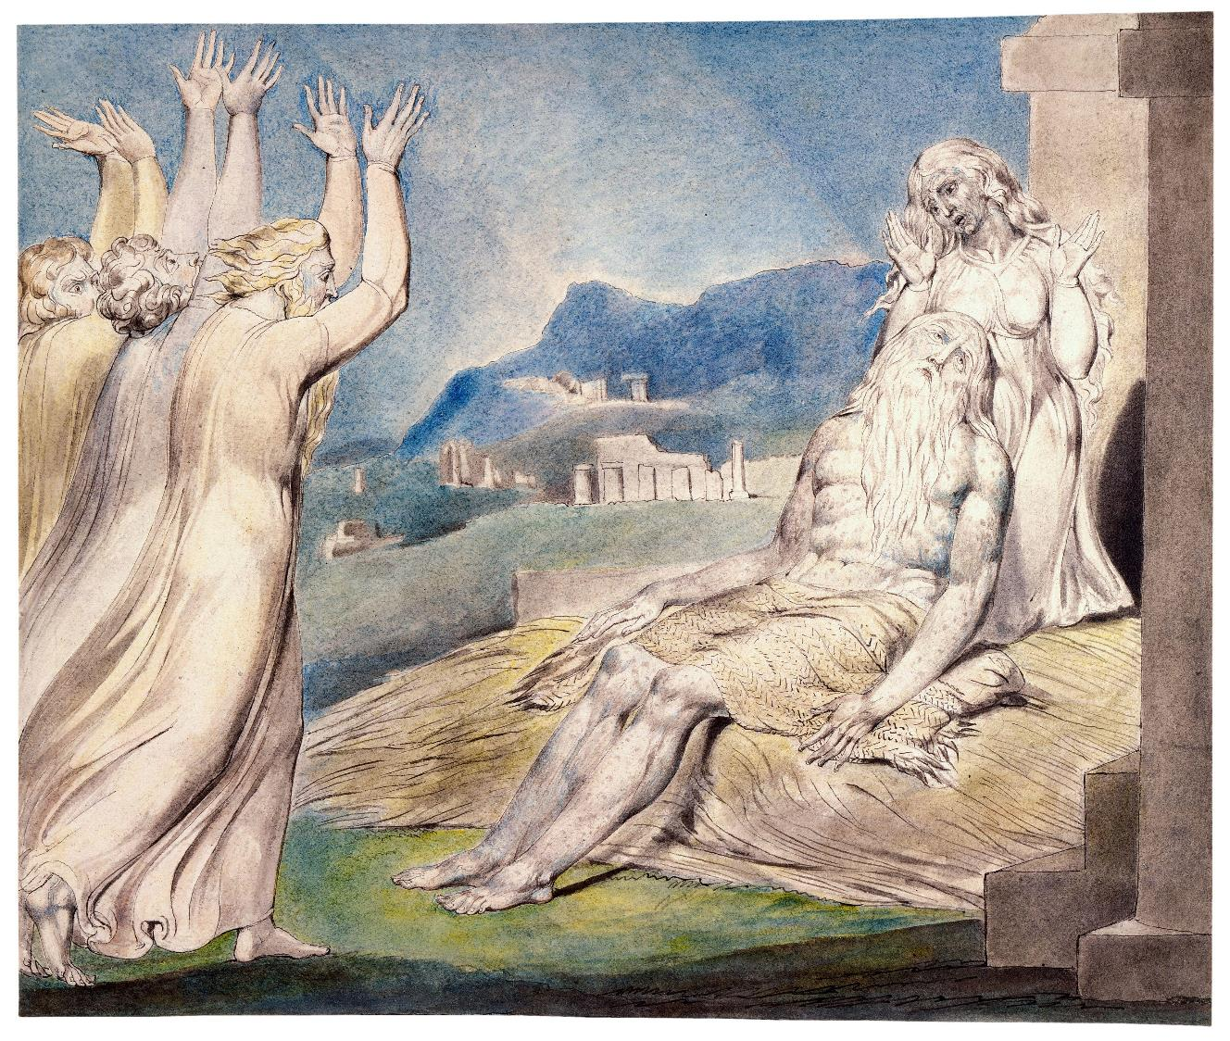
Job’s friends come to comfort him.
Watercolor by William Blake

Slide 56
THE FIRST CYCLE
Job’s lament will prompt attempts by his three friends to explain his tragedy, while Job responds to each of them in turn.
The arguments of his friends will become sharper as Job protests his innocence.
In many ways, their arguments are conventional, and while they will say many true things (St. Paul even quotes one of them, cf. 1 Co. 3:19; Job 5:13), their essential conclusion is wrong—that disaster is simply cause-and-effect.

Slide 57
ELIPHAZ SPEAKS (4-5)
Eliphaz is a moralist, a man for whom there is always a moral explanation.
He begins by reminding Job that in the past Job had comforted others in distress (4:3-5; see also Job’s own account in 29:7-25).
While he concedes in theory that Job might be innocent (4:6), he quickly discards this possibility and asserts that tragedy is punitive (4:7) and that trouble-makers are the ones who get their just deserts (4:8-11).
To prop up his cliché wisdom, so he recounts a mystical experience, complete with ghosts and whisperings, in which he heard an eerie message that mortals cannot be more righteous than God.
This implies an accusation (in this case false) that Job has made such a claim.

Slide 58
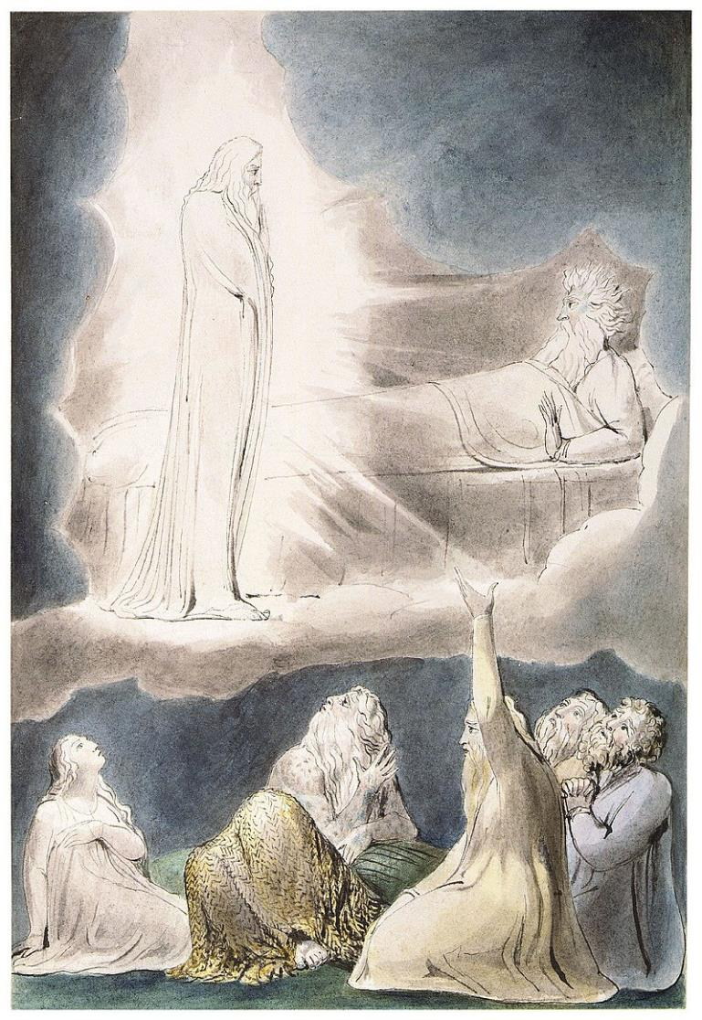
Eliphaz’ Vision with ghosts and whispers, “Shall mortal man be more just than God?”
Watercolor by William Blake

Slide 59
The Fall of Angels?
The reference to God charging his “servants” and “messengers” with error probably refers to the fall of angels (4:18):
By comparison, Eliphaz describes Job, as a mortal human, a mere “house of clay,” as insignificant as a moth (4:19).
Even if Job should appeal to the angelic beings, it would be an exercise in futility (5:1), and in any case, Job must understand that human troubles result from humans themselves (5:2-4), and consequent disaster must be viewed as divine discipline—as inevitable as sparks flying upward from a fire (5:5-7).

Slide 60
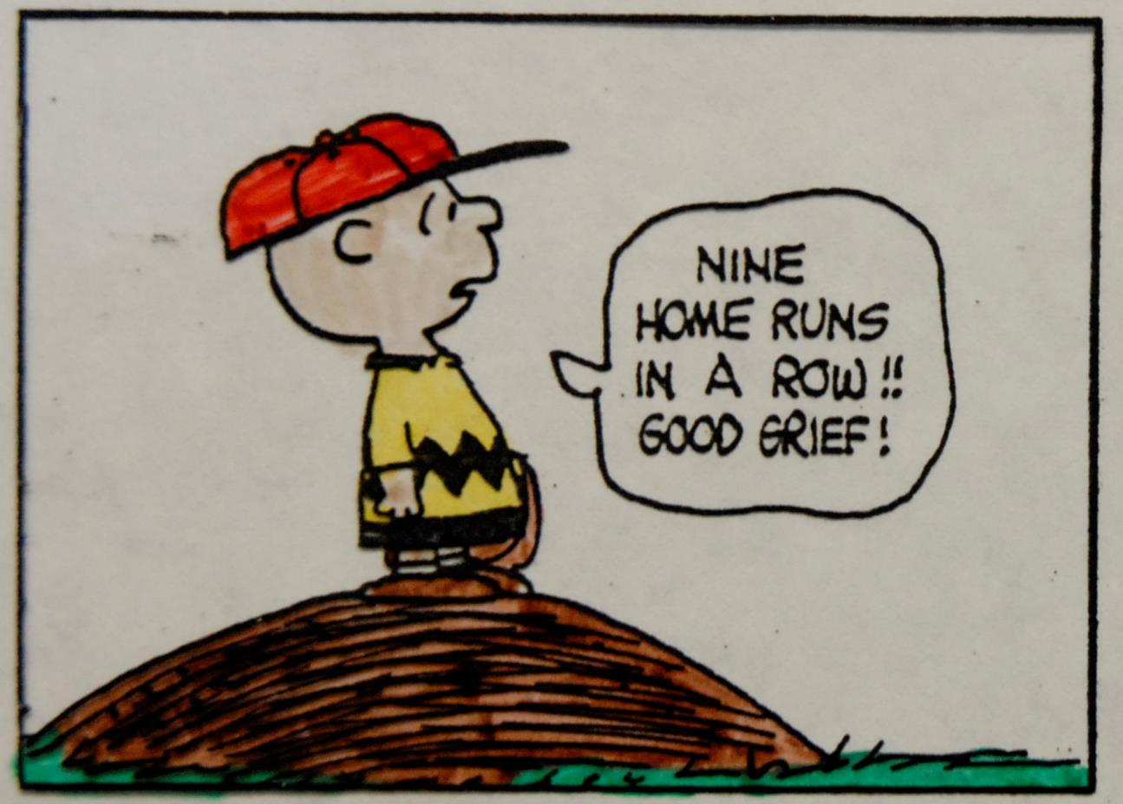

Slide 61
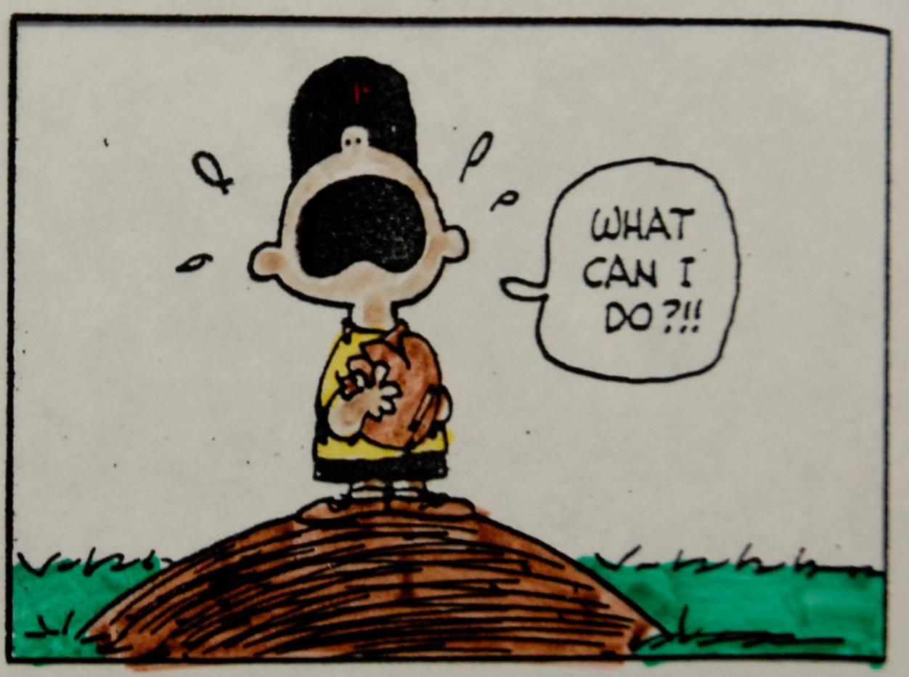

Slide 62
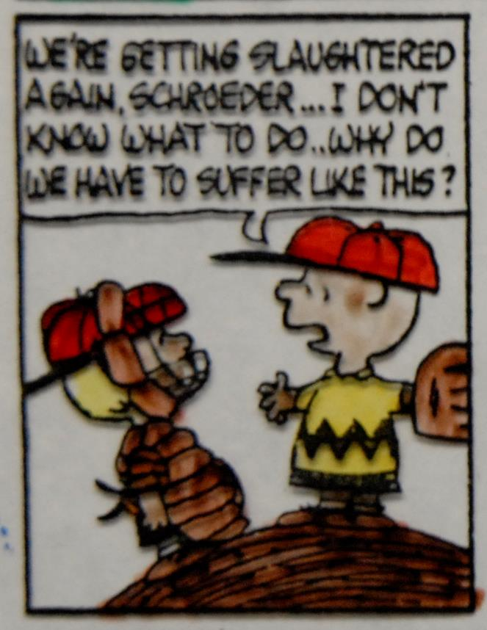

Slide 63
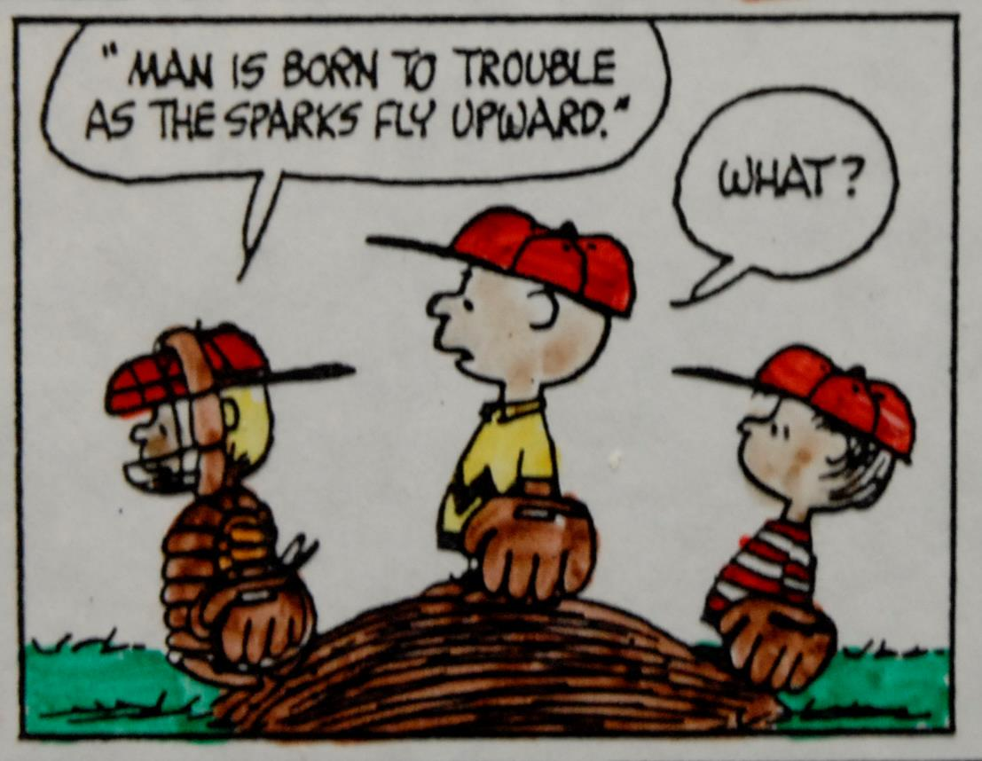

Slide 64
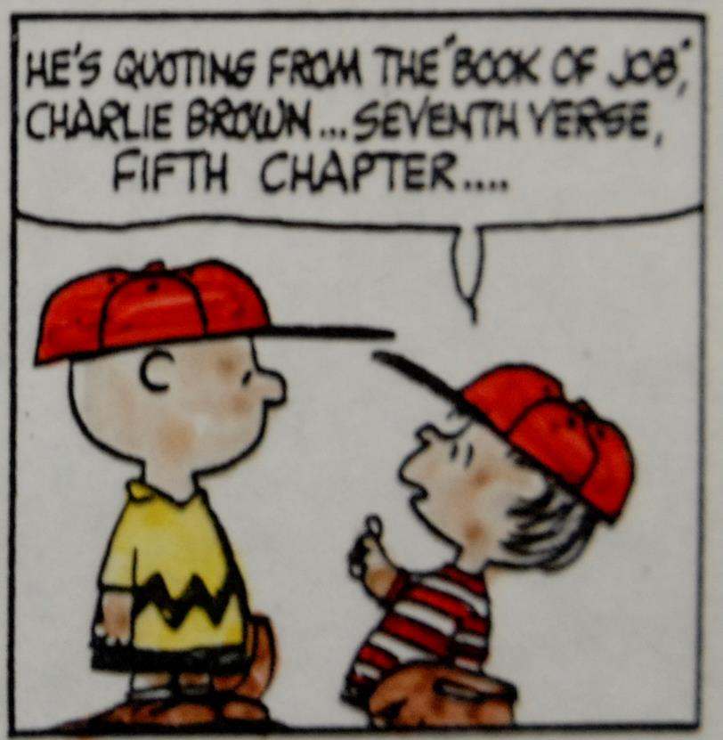

Slide 65
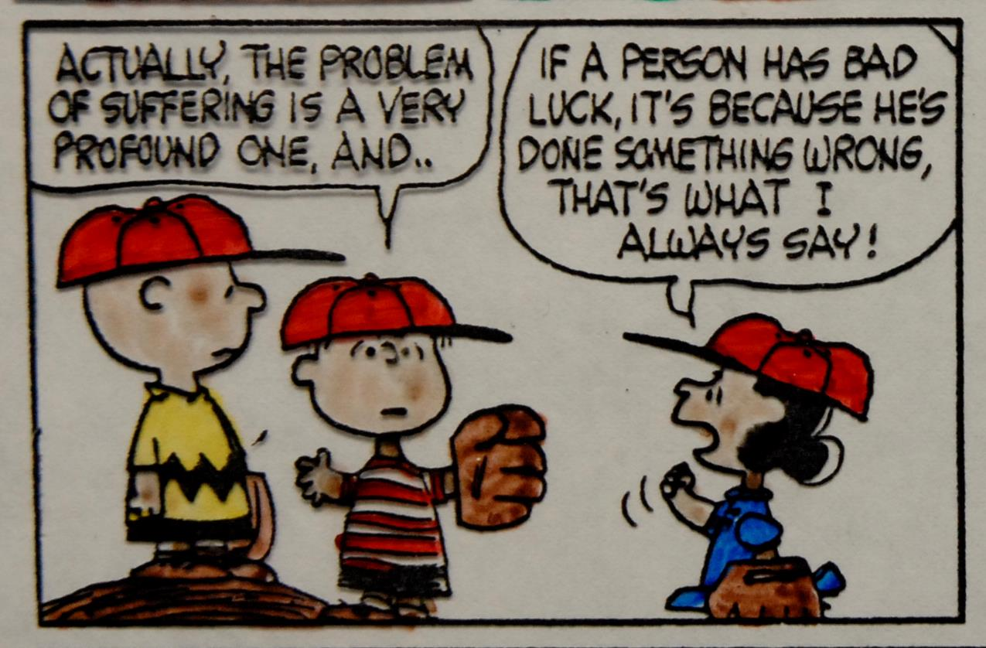

Slide 66
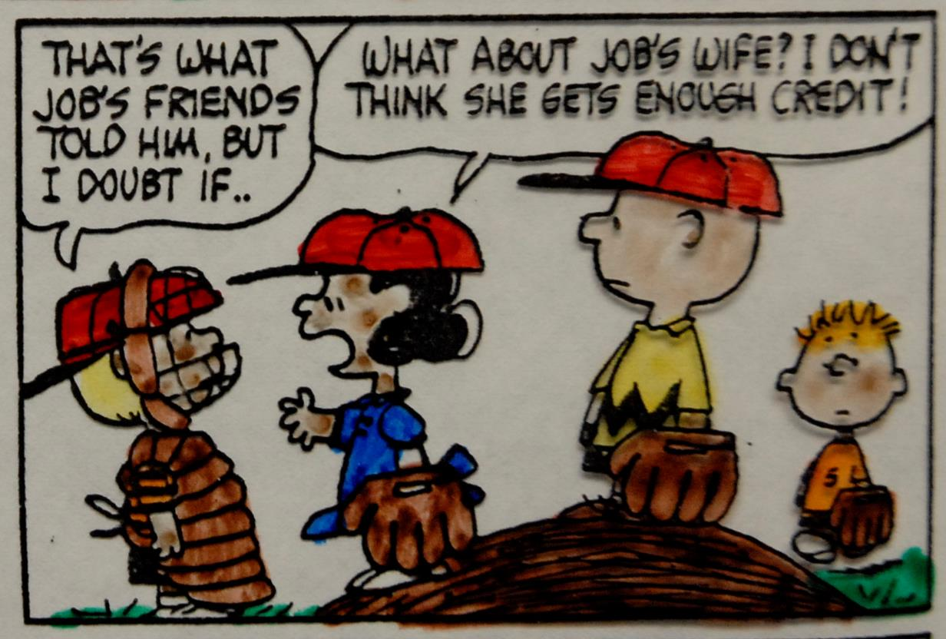

Slide 67
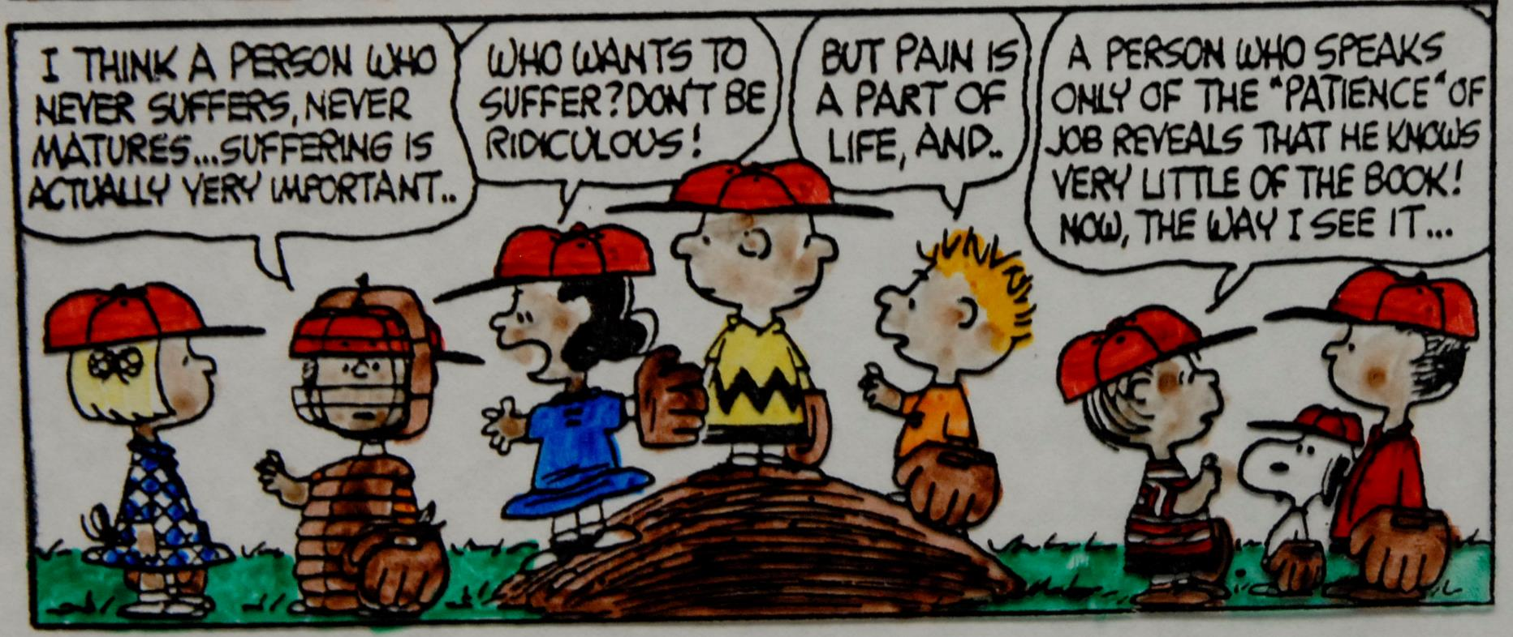

Slide 68
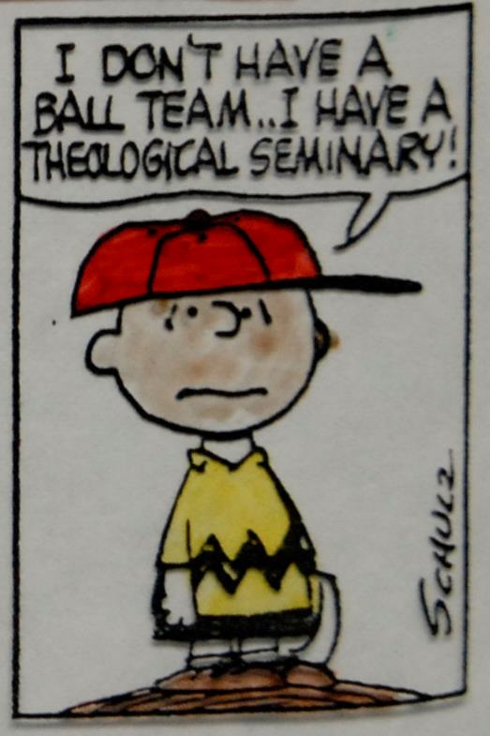

Slide 69
Eliphaz’s Solution
While Eliphaz correctly argues that only God, by his sovereignty, can reverse misfortune (5:8-16), he urges Job to accept his trial as divine discipline (5:17).
Only by such an admission will everything come right (5:18-26).
The reference to Job having more children is especially cruel, coming so soon after the loss of his original children.
Eliphaz closes his opening salvo by exalting of his own ingenuity (5:27).
What makes Eliphaz’ speech so offensive is not that he attempts to integrate suffering into a context of meaning, but that his words are the attempt of someone who is not suffering to silence the “unacceptable” words of one who is.

Slide 70
JOB RESPONDS TO ELIPHAZ (6-7)
Instinctively Job knows that Eliphaz is wrong.
Eliphaz’ discourse was condemnation by insinuation, which is both devious and disingenuous, since it implies guilt without any direct accusation.
Job cannot submit to such arrogant speculation and remain an honest man.
All he wants at this point is sympathy and understanding (6:1-3), and when he replies to Eliphaz, Job often talks to himself as much as to his friends.

Slide 71
Agreement/Disagreement
Both Job and Eliphaz agree that this misfortune has in some way come from God, but they very much disagree that it can be easily explained (6:4-5).
For Eliphaz, all is explainable.
For Job, there is mystery that cannot be easily unpacked.
Job quips that Eliphaz’ explanation is as empty as tasteless food (6:6-7).
Hence, Job wishes that he could simply die; he is not suicidal, however, and he understands that life is given by God and should only be taken by God (6:8-10a).

Slide 72
Joy or Despair?
The Piel verb in 6:10b is problematic, since it appears only here in the Hebrew Bible. The attempt at discovering its meaning is largely on contextual grounds.
Most English versions take it to mean “rejoice” or “exult (so ASV, ERV, ESV, JPS, NAB, NASB, NET, NIV, NIB, NJB, RSV, NRSV).
Other translators take it to mean “recoil” or “harden oneself” (so KJV, WBC).
The final line is obscure as well, which translated literally is, “For I have not hidden the words of the holy.”
Perhaps Job means that even if his affliction has come from God, he has refused to charge God with wrong-doing (cf. 1:11; 2:10). Clearly, he now feels he is at the end of his ability to cope and wishes to die (6:11-13).

Slide 73
The Emptiness of Recrimination
Directing his attention to his friends, for whom Eliphaz has spoken, Job chides their callousness.
At the very least, they should be sympathetic, not accusatory (6:14)!
Their “comfort” was like a dried-up wadi, like melting snow, like caravans lost in the desert, and like anticipated travelers who never arrive (6:15-21)—in a word, profoundly disappointing.

Slide 74
Searching Questions
Job now poses a series of searching questions:
Eliphaz insinuated that Job had sinned, so Job now demands that he be specific (6:24-30): had he ever taken a bribe (6:22), paid a ransom to kidnappers (6:23), uttered some wickedness (6:30)?
Wasn’t Job capable of discerning the truth, even about himself (6:30b)?
Callous insinuations were cruel and heartless (6:26-27).

Slide 75
Life is Very Hard!
Job now comments on the difficulty of life.
Month after month he has struggled through the days and nights with festering sores and maggots in his skin (7:1-5).
He moans that life is short and without hope (7:6).
He prays for God to remember him, for soon, he will be gone forever (7:7-10).

Slide 76
Sheol, the Place of the Dead
In the Old Testament, the realm of the dead is depicted as a shadowy existence in שאול (sheol, the underworld, abode of the dead).
It is the destiny of all living persons (Job 30:23), sometimes described in metaphor as a walled city with gates (Job 38:17; Is. 38:10).
There, the dead join their ancestors (Ge. 15:15; 35:29).
It is a place of silence and gloom (Job 10:21-22; Ps. 143:3; La. 3:6), but it can also be a place of rest (Job 3:16-19).
The ones who go there are called רפאים (Rephaim = ghosts or shades, Job 26:5; Ps. 88:10; Pro. 9:18; 21:16; Is. 14:9; 26:14).
Here, the dead are no longer able to praise God as do the living (Ps. 6:5; 88:12; 115:17-18).

Slide 77
Job Bluntly Speaks to God of His Misery
In his bewilderment, Job struggles to understand how the God he has come to love has allowed this tragedy to happen (7:11). His questions and complaints are not so much expressions of insolence, but sobs of confusion.
He asks if he is like the mythological creatures of chaos, Yam and Tann’in, who must be kept under guard.
He is terrified by horrible nightmares when he tries to sleep, leading him to prefer death to life (7:13-16).

Slide 78
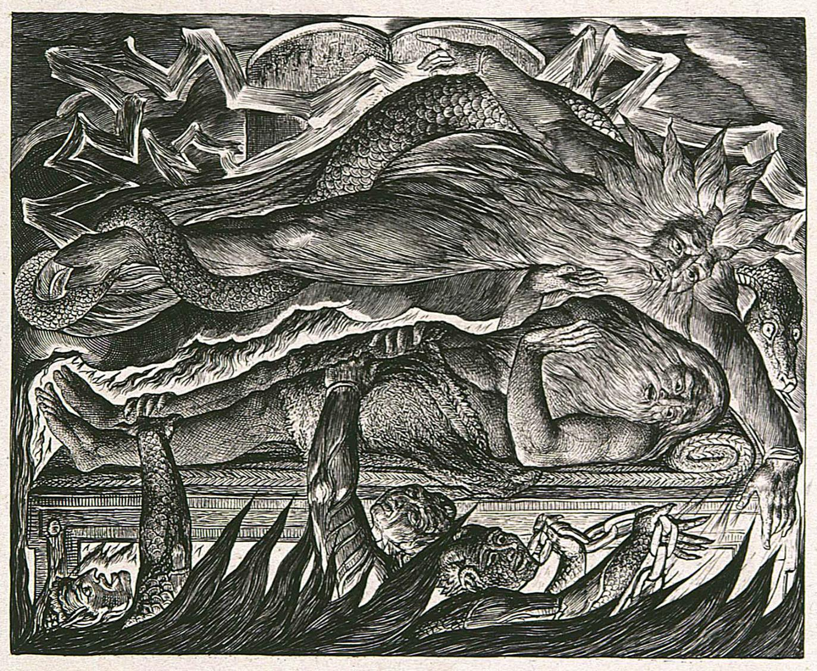
Job is terrified by nightmares.
Engraving by William Blake

Slide 79
Job 7:17-19 and Psalm 8:4-8
There is a striking similarity of language between Job and David, each asking the same question, “What is man?” The answers, however, are strikingly different.
Job asks why God would spend so much time testing a puny human like himself without a moment of reprieve.
David ponders the wonder and dignity of the human creature for whom God continually cares.
Job, in his misery, could not see beyond the agony of the present, which is the common experience of those who suffer greatly.

Slide 80
Job’s Confession
Job makes no claim to moral perfection.
He does not see himself as sinless, despite his protestations to Eliphaz (7:20a).
Still, though a sinner, he remains bewildered that God has not forgiven him (7:20b-21). These are not the words of a doubter, but the expressions of one who faces the dark night of the soul when God seems silent.

Slide 81
BILDAD SPEAKS (8)
Without ceremony, Bildad bluntly accused Job of being an empty windbag (8:1-2).
He took Job’s protestations of innocence as impugning God’s justice (8:3).
The deaths of Job’s children he attributes to their sins (8:4).
The only way forward is for Job to repent and change his erring ways, and if he will do so, his misfortune will be reversed (8:5-7).
This, and only this, is the wisdom of the ages (8:8-10).

Slide 82
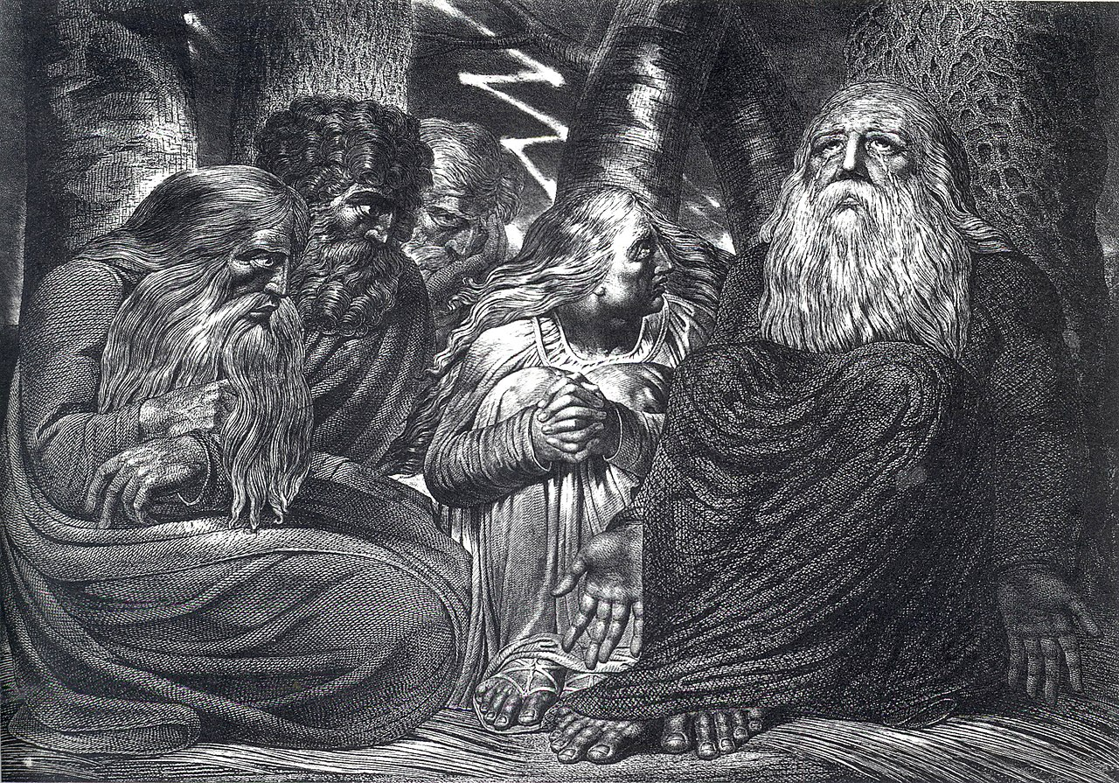
William Blake’s 1793 engraving shows Job’s rebuke by his friends, while his wife looks on.

Slide 83
The Cause-and-Effect Argument
In a series of rhetorical questions and analogies, Bildad presses his cause-and-effect philosophy.
Reeds only grow where there is water. If the reed withers, there must be a reason—and in this case, it is Job forgetting God (8:11-13). This is much the same as the modern aphorism, “There’s no smoke without fire.”
Instead of trusting in God, Job has trusted in other things, so his prosperity was as fragile as a spider’s web, as unenduring as a garden plant shriveling in the desert sun.

Slide 84
The Conclusion
Bildad’s assertion is that since God will not reject a blameless man, Job must be blamed (8:20).
Only by admitting his guilt can he find restoration. (8:21-22).
Bildad’s “comfort” is to offer Job condescending truisms and the logic that if a host of other people agree with him, especially people from the past, he must be right.
Good things happen to good people; bad things happen to bad people: end of story.

Slide 85
JOB RESPONDS TO BILDAD (9-10)
As before, the reader must decide about Job’s tone. It is common to read Job’s response as sarcastic and belligerent, and some would go so far as to say he finally succumbs to the satan’s confident assertion that he would curse God.
This, however, is not the only way to read Job’s sharp language.
Because of his unending physical pain, Job’s language is affected by his extreme circumstances.
People in extreme pain are apt to frame their words in language that reflects their agony, but this need not be taken as an expression of faithlessness.

Slide 86
The Controlling Metaphor
The reader should pay close attention to the metaphor depicting two disputants who appear in court. The Hebrew term used in 9:3 is byr9, the standard term for a lawsuit.
In the ancient Near East, claims were often adjudicated by city elders in the city gate, which served as a small claims court (cf. Ru. 4:1ff.).
Job contemplates what it would be like if he should be able stand alongside God and present his case.
However, he knows that inevitably he will not be able to win such a case over God.

Slide 87
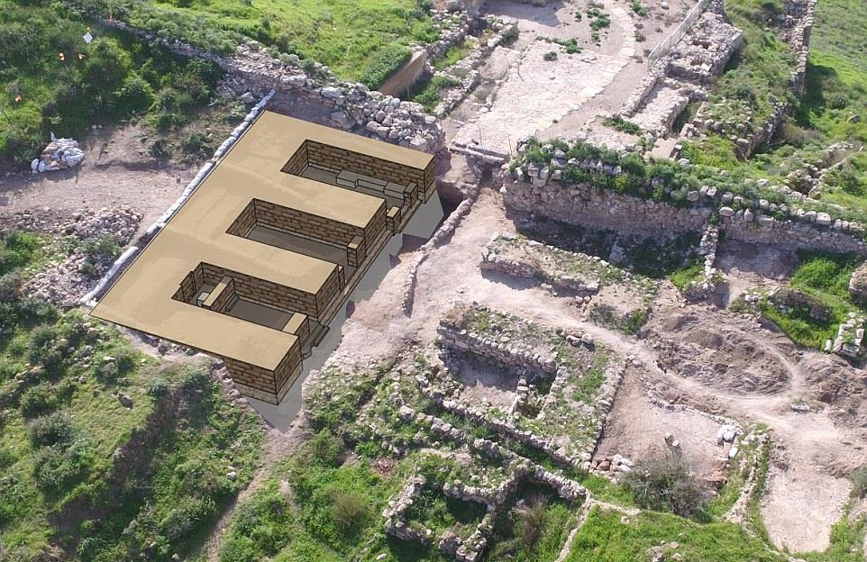
This six-chambered gate excavated at Lachish is typical. In times of peace, such gates served as a small claims court. The city elders would convene to handle disputes between residents of the city.

Slide 88
The Problem with Facing God in Court
While Job concedes the general truth of his friends that no human can be purer than God and that God is just, he also counters that no human could succeed in arguing his case before God (9:1-3).
God has unlimited wisdom and strength: he controls the whole universe, its well-known constellations, its earthquakes, its volcanos—everything (9:4-10).
This only serves to show that God is transcendent and unfathomable, and this is at the heart of Job’s dilemma: God is always beyond him (9:11).
Nothing can thwart God’s work, not even the chaos monster of the deep, much less a puny human (9:12-14).

Slide 89
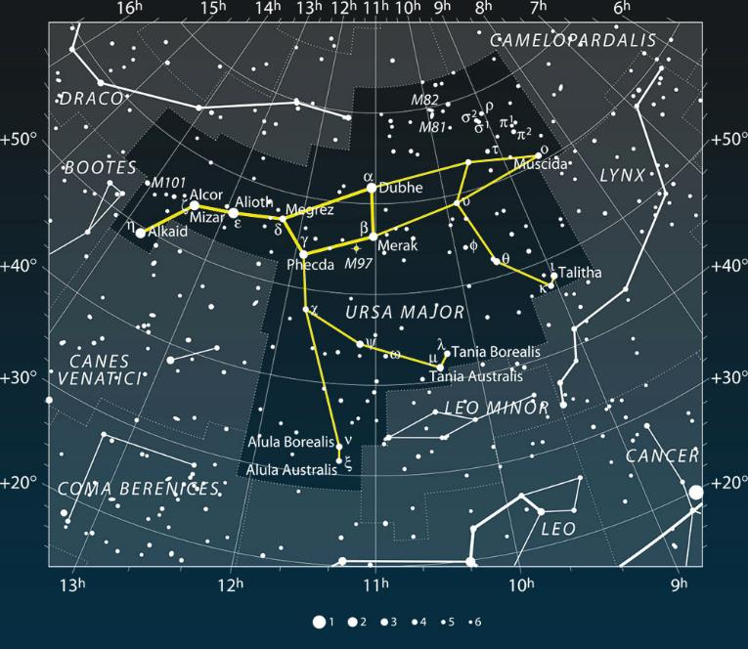


The ancients were much more familiar with the constellations than modern people, whose ambient artificial light makes star-gazing difficult.
The Bear (Ursa Major)
Orion
Pleiades
Orion
Pleiades

Slide 90
Rahab, the Chaos Monster
Rahab is one of several names for the primeval dragon whom Yahweh is poetically described as defeating in creation.
At the dawn of creation, Yahweh subdued a primeval dragon (Ps. 74:12-14; 89:9-10; Is. 51:9-10; Job 9:13; 26:12).
This seven-headed monster symbolizes the power of evil.

Slide 91
References to the Dragon in Ancient Near Eastern Literature
“Because you smote Leviathan, the twisting serpent, (and) made an end of the crooked serpent, the tyrant with seven heads, the skies will become hot (and) will shine.”
Keilalphabetischen Texte aus Ugarit 1.5.I.1
“Surely I lifted up the dragon…[and] smote the crooked serpent, the tyrant with the seven heads.”
Keilalphabetischen Texte aus Ugarit 1.3.III.40-42
In Mesopotamian literature, the defeat of Leviathan is credited to Anat or Baal in the ancient past. In the Bible, of course, it is credited to Yahweh but in the indeterminate future.

Slide 92
The Ongoing Problem
Job’s dilemma is that he simply cannot face up to the Almighty (9:15-24).
Even if he felt he was in the right, he could only plead for God’s mercy.
God can’t be subpoenaed, and even if he showed up, he can’t be forced to listen to a plea of innocence.
In his crucible of suffering, Job felt overwhelmed by God’s immensity.
What does seem clear to Job, however, is that both blameless people and wicked people experience tragedy, not just the wicked as his friends have asserted.

Slide 93
“Young man, your arm’s too short to box with God!”
James Weldon Johnson

Slide 94
The Brevity of Life
Using a series of metaphors, Job now lapses into a reflection on the brevity of life (9:25-26).
He fears to be optimistic, since another tragedy might befall him (9:27-28a).
Being treated like a condemned man, he feels his plight to be hopeless (9:28b-31).

Slide 95
The Deep Longing of Job
What Job really wants for is for a mediator, some friend of the court who could put one arm around God and the other around Job, bringing them together (9:32-35).
But God is not a human, and humans are not divine. How can they possibly be on equal terms in court?
Job faces the truth of what Soren Kierkegaard would call “the infinite qualitative difference,” this unbridgeable gulf between humans and God.
In the meantime, he pleads for the opportunity to speak directly to God without fear.

Slide 96
Exploring the Dark Side
Job’s initial response was a series of “whys” (cf. 7:20-21). Now he voices this same query again (10:1-9).
The age-old question lying behind every tragedy is: “Let me know why you bring this suit against me?” (As in 9:3, Job uses the Hebrew term for lawsuit, byr9).
  Why?
  Why me? (or perhaps, why not me?)
Does God derive some perverse pleasure in watching Job writhe (10:3)?
“He who has a Why to live for can bear almost any How.”
Friedrich Nietzsche

Slide 97
How Does God Work?
The mystery of the divine mind seemed incomprehensible.
Does God operate like humans (10:4-7)? Job instinctively knows this cannot be the case.
The very creation seems to show that God is good. In a series of metaphors (the potter, the cheesemaker, the weaver), Job recalls the creation narrative where God formed the humans (10:8-11).
As the celestial craftsman, God designed creatures for life and extended to them his love and the privilege of overseeing the world (10:12-13).
If this, then, is God’s character, how can it be that such an undeserved tragedy has happened to Job?

Slide 98
Job is struggling with his faith, but there is no reason to think that he has given it up. Indeed, struggle and doubt are constituent parts of any examined faith. Job’s musings should be read in the tone of a man desperately searching for answers from a God who seems hidden.

Slide 99
Does It Make Any Difference?
Job knows that if he sins, God will certainly know it.
But if he is innocent, why is he not vindicated (10:14-17)? In both cases he seems to be condemned, always under threat from God’s “troops.”
So, back to the original question: Why? (10:18; cf. 3:11-12, 16, 20, 23).
Would it not have been better to have been still-born (10:18-19)? (This question also has been asked by others in times of great suffering, cf. Je. 20:14-18).
Wouldn’t it be better if God would just leave him alone and allow him to descend to the underworld of darkness and death (10:18-22)?

Slide 100
Job’s question is much the same as posed by Subsi-masra-Sakkan in the Babylonian Job Tablet
Sometimes called “The Poem of the Righteous Sufferer” from about the 13th century BC, this Akkadian text is concerned with the problem of unjust suffering by an afflicted man.
He is tormented, but he doesn’t know why.
He has been faithful in his religious duties, but he suffers nonetheless.
Hence, the question is age-old, and it is integrally linked to the problem of evil.
Louvre, Paris

Slide 101
ZOPHAR SPEAKS (11)
Job’s third friend is at least less windy than his companions, but he is more severe.
Both Eliphaz and Bildad had insinuated that Job had sinned, and this was the cause of his downfall, but Zophar suggests that Job is so guilt-ridden he has gotten off easy. This is the sort of friend one could do without!
He dismisses Job’s words as so much empty talk (11:1-3).
He flatly contradicts Job’s claim of innocence, and he asserts that if God would speak like Job has asked, Job would find he had received even less than he deserved (11:4-7).

Slide 102
Zophar’s Challenge to Job
Zophar asserts that Job’s search for God is an exercise in futility.
The “deep things” of God are simply beyond any human capacity to access, deeper than Sheol, high than the heavens, broader than the earth, wider than the sea (11:7-9).
None can resist his judgments (11:10).
God knows that humans are stupid and worthless, and for a stupid man like Job to get such understanding is about as likely as a donkey giving birth to a human, or in popular crudity, until hell freezes over (11:11-12).

Slide 103
Acknowledgment of Sin is the Only Way Forward
Hence, Job must turn from his evil ways and plead God’s pardon (11:13-14).
Once he confesses his sin, he will be restored, and his former misery will disappear like water in a desert wadi (11:15-16).
Life will then be bright, Job will be protected, and his fears will be gone (11:17-19).
The alternative, on the other hand, will be disaster ending in a miserable death (11:20).

Slide 104
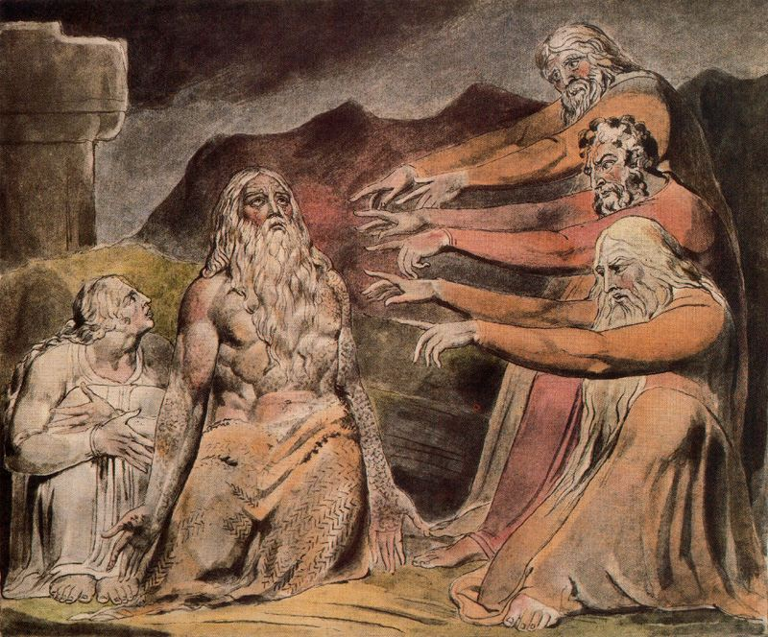
To the man, the accusations of Job’s friends is that everything is his own fault.
Watercolor by William Blake

Slide 105
“Everything Happens for a Reason”
Job’s friends have now concluded their first round.
They claim to speak for God, and if Job will only take their advice and repent, God will be pleased (which really means that they will be pleased)
Often enough, when people say that one must do such and such to please God, if really means one must do such and such to please them.
Everything happens for an explainable reason, they assert, and in this case, the reason must be Job’s sins.
Instinctively, Job knows that this cheap advice is deeply flawed.

Slide 106
JOB RESPONDS (12-14)
Job’s final speech in the first cycle is his longest so far, and he will address both his friends and God.
To his friends, he speaks in finely crafted sarcasm.
Job counters their harshness by pointing out that he has as much right to access God’s wisdom as they do (12:1-3).
In light of their cheap mockery, he says that he also has been reputed in the past to seek God and hear from him (12:4).
More to the point, his friends have utterly failed to explain why a just and blameless man has experienced such misfortune, and especially, why bandits, blasphemers, and idolaters (lit., “he brings his god in his hand,” so RSV, NRSV) seem to escape without censure (12:5-6).

Slide 107
An Aside to Zophar
Job now addresses one friend in particular, probably Zophar (the change from plural to singular is not obvious in an English text, but it is clear in Hebrew).
He points out that tragedies in animal life seem indiscriminate (12:7-9). Every living creature in the hands of God (12:10).
Job is as qualified any anyone to test and “taste” the validity of the so-called wisdom of the ancients (12:11-12).

Slide 108
There Seems No Clear Pattern
The notion that all outcomes are simply cause-and-effect, whether rewards and judgments, doesn’t seem to match God’s activity in the world.
In a litany of examples—builders, droughts, floods, counselors, judges, kings, priests, elders, princes, nations, and chiefs—everything points to one overpowering conclusion: disasters happen to them all under the sovereignty of God, but there is no clear sense of how or why (12:13-25).
In sarcasm, Zophar had asked, “Can you find out the deep things of God” (11:7)? Job’s much more serious answer is, “No!” God’s actions in the world seem profound, mysterious, and inexplicable.

Slide 109
Job, at least, recognizes what his friends do not: God cannot be easily explained by shallow reasoning as though he were a problem to be solved. Job’s God was much bigger than that!

Slide 110
Job’s Longing for God
Job deeply desires to hear from God himself, not just from the friends who offer banal truisms (13:1-2).
It would wisdom for his friends if they would just shut-up (13:3-5).
Job even suggests that their presumptuous attempts to defend God have put them in grave danger, since their arguments are unjust (13:6-8).
What if God decided to examine them! They might be terrified to discover that all their advice has been nothing but ashes and clay (13:9-12).

Slide 111
Shut-up and Let Me Speak!
Job is undaunted in his belief that he will be vindicated (13:13-15).
There is a difference between arrogance and confidence, and Job speaks out of confidence (13:16-19).
More than anything, Job wants God to break the silence. If God would do so, Job promises to heartily respond, or if God should speak, Job promises to accept whatever reply God might give (13:20-23).
He frankly concedes waywardness during his younger years, but if he has done something now, he wants to know what it is (13:24-28).

Slide 112
Job’s Continuing Lament
Job laments the condition of his waning life, indeed, the waning of all human life (14:1-2).
Human life is so fragile and broken, it is amazing that God even pays attention to humans at all (14:3-4).
Why does God not simply leave them alone (14:5-6)?
A felled tree might produce a root, but hardly a human (14:7-10).
Humans are more like a dried-up lake or river with no hope of recovery (14:11-12).

Slide 113
Contemplating an Afterlife
Job askes the old question, “Is death the end?” “Is there more?”
He wishes that he could simply linger in Sheol, the place of the dead, until God remembered him (14:13-14).
He envisions God desiring his fellowship, recalling him from death, and expunging the record of his sins by sealing them away forever (14:15-17).
The hope of resurrection has not yet been given, but Job’s musing anticipates it as a possibility. No clear answer would be given until the coming of God’s Son.

Slide 114
Back to Despair
Lacking any clear hope of life after death, Job swings again to despair. He gropes toward the future, mingling his hopes and fears.
It is common for people in such dire circumstances to have their emotions vacillate back and forth, and Job is no exception.
The imagery of crumbling mountains and eroding landscapes parallels Job’s crumbling hopes (14:18-19).
So, death comes to all, and the deceased is blind to any honors that might come later (14:20-22).

Slide 115
What Have We Learned So Far?
Claiming wisdom, Job’s friends have reduced life to causes and effects. This, from their viewpoint, is the only way God can be just. Job MUST have sinned.
Job, for his part, claims innocence; he can think of nothing he has done that merits his current state of misery.
His friends urge repentance, while Job longs to hear from God himself.
In his best moments, Job contemplates the possibility of life after death. In his worst moments, he flounders in despair.

Slide 116
second CYCLE OF DIALOGUES
15-21

Slide 117
THE SECOND CYCLE
As before, each of Job’s three friends speak in turn, and Job will offer responses.
Previously, the friends sought to defend God; now, they attempt to defend religion, accusing Job of doing away with reverence for God (cf. 15:4).
Though shorter, their rebukes become attacks without reservation.

Slide 118
ELIPHAZ SPEAKS (15)
Eliphaz begins by bluntly charging Job with windy emptiness (15:1-3), a threat to religious reverence (15:4).
He says Job’s claims of innocence are nothing more than a cover-up, little more than outright lies (15:5-6).
In charging Job with sinning with his lips, he flatly contradicts what the narrator said earlier, that Job did NOT sin with his lips (cf. 2:10b).

Slide 119
Sarcastic Questions
In a series of barbed sarcastic rhetorical questions, Eliphaz derides Job’s capacity for wisdom:
  “Are you the original human, older than the hills?” (15:7)
  “Were you privileged to listen in on the divine council, smarter than everyone?” (15:8)
  “How is it that you think you know more than we do, since there is a gray-headed man here older than your own father?” (15:9-10)
  “Are our gentle and consoling words, inspired by God, not sufficient?” (15:11)
  “Why do you allow yourself to get carried away with passionate speeches that end up turning you against God?” (15:12-13)
  “Who among humans is pure? The Almighty could not even trust the angels in heaven, much less an abominable and filthy man like you, who gulps injustice like water!” (15:14-16)

Slide 120
Fallen Angels
Eliphaz returns to the idea he expressed earlier (cf. 4:18), that God did not even trust angels, hinting at their fall (15:15).
Unfortunately, the biblical information about fallen angels is fragmented and incomplete.
The two passages cited most often are Isa. 14 and Eze. 28, but in each of these texts the primary figures are human rulers. If there is information in them about angels who fell, it is indirect rather than direct.
Still, Jesus refers to the “devil and his angels” (Mt. 25:41), and St. Paul speaks of hostile “rulers and authorities” in the heavenlies (Ep. 3:10).
In the end, the reader of the Bible must be content with hints about this rebellion rather than direct descriptions.

Slide 121
The Nature of Divine Retribution
Eliphaz now embarks on a pompous exposition of divine retribution, which he says comes from the wisdom of the ancients (15:17-19).
He continues to bolster his cause-and-effect theology which he expounded earlier, as though in saying it again and more loudly, its veracity will be confirmed.
In short, the wicked pays year after year: he suffers distress and anguish, always haunted by the fear of deserved judgment (15:20-26).

Slide 122
Self-Indulgence is the Ultimate Sin
Bulging with fat, this wicked man scavenges on the remnants of others (15:27-28).
Soon, however, he will be stripped of his wealth, ending his life in emptiness (15:29-31).
He should not deceive himself, for payment will surely come. His life will end as trees or vines that lose their buds and produce no fruit (15:32-33).
This is the destiny of the wicked, who live on bribes and plot evil (15:34-35), and if Job has experienced disaster, he must know that his misery is a divine and fiery judgment!

Slide 123
The Arguments of Eliphaz
The speeches of Eliphaz and the others raise cogent questions about deeper levels of belief and how one defends them. The defense can be grouped into several categories:
Arguments from claimed direct revelation (4:12-17)
Arguments from nature (4:10-11; 8:11-12)
Arguments from the authority of tradition (8:8-10; 15:10, 17-19)
Arguments from experience or observation (4:8; 5:3; 15:17).
In the end, these arguments are not compelling, and in Job’s view, they can be treacherous (6:15; 13:4) and self-deceptive (13:7-8). Hence, Job longs to hear from God directly (10:1-2; 13:3, 15, 22).

Slide 124
JOB RESPONDS (16-17)
Nothing new has been added, and Job’s counterpunch that Eliphaz is at least as windy as Job, seems entirely appropriate (16:1-3).
If their positions were reversed, Job could easily do what they are now doing (16:4).
However, he contends that if their positions were reversed, he, at least, would offer words of comfort and encouragement, not this unrelenting barrage of condemnations (16:5)!

Slide 125
Job Is Completely Shattered
By this time, Job is truly at his wit’s end.
It hasn’t help to vent his feelings, but silence doesn’t help either (16:6).
He feels persecuted and the object of God’s anger (16:7-9). His words describe this attack by God and now by his friends, too (16:10-11). A literal rendering of 16:12-14 is vivid and excruciating!
I was at ease and he shattered me;
He grabbed my gullet, and smashed me.
He set me up as his target,
His archers encircled me.
He chopped my kidneys unsparingly,
And split my guts on the ground.
He wounds me with wound upon wound;
He rushed against me like a champion.

Slide 126
Still, Job Refuses to Retaliate Against God
The vivid description of what seemed to be God’s attack is just that -- a description!
Job never resorts to incriminating God (16:15-17).
God has not spoken, and his friends who have spoken have only mocked and betrayed him.
Still, though he feels death is imminent, he remains confident that there is an intercessor in heaven, and ultimately God will vindicate him (16:18-19). If the blood of Abel once cried out from the ground for vengeance (Ge. 4:10, Job’s blood will cry out for vindication!
With tear-stained face upward, Job pleads for God, to come to his defense (16:20-21).

Slide 127
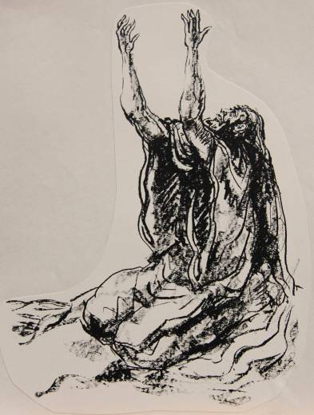
The pleading of Job is very similar to the “confessions” or “complaints” of Jeremiah, a series of candid, direct, and intimate prayers composed after the pattern of laments in the Psalms. Jeremiah gave full vent to his anguish, questioning God and cursing his enemies.
11:18-23
12:1-6
15:10-21
17:14-18
18:18-23
20:7-13
20:14-18
Jeremiah’s Confessions

Slide 128
His Time is Short
Job feels he is near the end of his few short years of existence (16:22; cf. 14:1).
The grave awaits him (17:1).
In view of his extremity, he takes oath (the Hebrew אם לא in 17:2 introduces an oath formula), calling on God to defend him against the unjust accusations of his friends (17:2-5).
He moans that he has become an object of public contempt (17:6); decent people are appalled at his condition (17:7-9).

Slide 129
Job’s Hope is Nearly Gone
Job fully expects his friends to continue their slander to the end (17:10).
He anticipates his death, and the darkness is closing in (17:11-12).
Still, if he resigns himself to death, embracing Sheol, the pit, and the maggot, what hope remains (17:13-15)?
His hope for vindication would sink into the prison of the dead, never to be resolved (17:16), and resolution is the one thing left for which to hope.

Slide 130
BILDAD SPEAKS (18)
Bildad holds true to form, accusing Job of setting a snare with his words (18:1-2a). (Several English Versions offer a dynamic equivalency here, based on an Arabic cognate, “How long will you hunt for words?” so NRSV, RSV, ESV, NAB, NASB, NET).
He adds insult to injury by urging Job to be intelligent (18:2b)!
He questions why Job dismisses their counsel as nothing more than the thought of stupid animals (18:3).
He throws back Job’s imagery of crumbling mountains (cf. 14:18-19) by asserting that Job is the one ripping up the earth in his rage (18:4).

Slide 131
A Rambling Discourse
Bildad then embarks on a rambling discourse about the misfortunes that beset the wicked.
Again, this is cause-and-effect theology, except this version is more blunt and less nuanced with its imagery of extinction of light, entrapment, disease, and death (18:5-20).
Such things are bound to happen, so says Bildad, to the arrogant person who does not recognize God (18:21).

Slide 132
JOB RESPONDS (19)
Job moans under the stinging barbs of his friends. They have been unrelenting in crushing him with accusations that they cannot prove (19:1-3).
Even if they had been right, it was none of their business (19:4)!
Still, Job continues to contend for his innocence, and it is God’s place to judge, not theirs (19:5-6).

Slide 133
Complete Abandonment
Still, Job has not heard from God.
The three friends claim to speak for God, but Job longs to hear from God himself (19:7).
The silence of God in the face of tragedy is like being walled in, stripped of glory, demolished, uprooted, and put to siege (19:8-12).
Utterly alone, Job is estranged from his friends, rejected by his kin, disrespected by servants, and offensive to his closest associates (19:13-20). He deserves pity, not condemnation (19:21-22).
The meaning of the idiom “the skin of my teeth,” though famous, is not immediately clear, but it surely signifies desperation.

Slide 134
Hope and Faith
In desperation, Job turns from his faithless friends to his faith in God.
Somehow deep within him, Job is certain God will vindicate him, and when it happens, he will know it himself.
He even wishes that his claim of innocence could be inscribed on a scroll, embossed on a lead sheet or engraved in stone (19:23-24).
With incredible confidence, Job announces his full expectation that God will speak (19:25-27).
The Hebrew in Job’s final statement (19:28-29) is very difficult, and one will see a great variety of English renderings. What seems clear is that this serves as a warning to his friends to remember that the sword of judgment cuts both ways.

Slide 135
Job’s Confession of Faith and Hope
:MUqy! rpAfA-lfa NOrHExav4 yHA ylixEG* yTif;day! yn9xEv1
And I know my Redeemer lives, and afterward he will stand upon the earth [lit. “dust,” a metaphor for the dust of death]!
:H01Olx< hz@H<x, yr9WAB;miU txz*-Upq04n9 yr9Of rHaxav4
And after my skin has been stripped off, so from my flesh I will see God!
rz!-x|v4 Uxr! yn1yfev4 yl.-Hz@H,x, yn9xE rw,xE
Whom I will see for myself, and my eyes will behold [Him], and not a stranger!
:yq9HeB; ytay*l;ki UlKA
How my “heart” [kidney] is spent in my bosom!
(my translation)
Job anticipates his vindication, even if after death!

Slide 136
ZOPHAR SPEAKS (20)
Zophar claims to be personally insulted by Job, and from an inner dialogue with himself, he claims to offer wisdom (20:1-3).
He seems shocked that Job refuses to follow the wisdom of the ages (20:4-5).
Hence, he resorts to crude analogies—that such prideful wickedness ends up like feces, as ephemeral as a dream (20:6-9).
The children of such a man become beggars, while the man himself is destined to an early death (20:10-12).

Slide 137
Zophar’s Crude Analogies Continue
The wicked man’s ill-gotten gain is like poison food, like sucking snake venom (20:13-19).
Because of his insatiable greed, God will send disasters upon him like weapons of war (20:20-25).
Divine wrath will destroy him as surely as a raging fire (20:26-28).
This is the dark heritage of the wicked man (20:29)!
Zophar seems to have no room for divine mercy, and his generalisms have little to do with Job’s specific circumstance.

Slide 138
JOB RESPONDS (21)
In his closing speech, Job continues to counter the theodicy of his friends, refuting their arguments.
He references their arguments with “you say” (21:28), but even where he does not, this is probably implied (i.e., 21:19a).
It is not always easy to know when Job is referencing statements by his friends, since he does not quote them verbatim, but rather, by allusion.

Slide 139
Job’s Allusions to His Friends
Here are some of Job’s references to his friends’ arguments:
21:2 -- 15:11
21:7 -- 20:11
21:8 -- 18:19
21:9 -- 15:24
21:17 -- 18:5
21:19 -- 20:10
21:28 -- 8:22; 15:34; 20:26
21:29 -- 15:19; 20:4

Slide 140
The Plea to Listen
Job begins his rebuttal by calling for his friends to actually listen to him, and then if they want to mock him they can do so (21:1-3).
He especially directs his comments towards Zophar (the expression (gyfil4ta = “you may mock” is 2nd person singular in Hebrew, which is not apparent in English).
Job knows that what he says will stun them (21:4-5), and he himself regards his thoughts as audacious and frightening (21:6).

Slide 141
The Problem with Cause-and-Effect Theodicy
The basic problem with his friends’ theodicy is that it is not true to life.
Wicked people sometimes live long and healthy lives (21:7-13)!
Though the Hebrew in this passage is problematic, the basic idea seems to be that in Job’s observation of life, divine retribution doesn’t seem to happen consistently (21:14-16).

Slide 142
Job’s Rhetorical Questions
Job now poses his own set of rhetorical questions:
How often do the wicked really experience calamity (21:17-18)?
Job’s friends have argued that God stores up punishment, paying it out to the children even if the parents don’t full experience it (21:19-21), but is this really true?
Who gets to tell God how to run the world (21:22)?
The fates of any two individuals, one healthy and prosperous and the other bereft and poor, are the same—they both die (21:23-26)!

Slide 143
How Can One Understand God’s Justice?
In view of the inequities in the world of experience, Job’s dilemma is how to explain them.
The world seems more characterized by randomness than anything else (see also, Eccl. 9:1-3).
Of course, his friends will continue to cite this or that occasion when some noble has lost everything, but any chance traveler on the road knows that very often the wicked person escapes entirely (21:27-33).
In the end, his friends’ consolations are just so much nonsense (21:34).

Slide 144
What Have We Learned in the Second Dialogue?
Job’s friends continue to press their cause-and-effect theology.
Job, for his part, sees such “wisdom” as deeply flawed and contrary to the broad experience of life.
Their debate often takes the form of sarcastic and rhetorical questions, but they make little progress in solving the problem of how to understand divine justice.
On the positive side, Job tenaciously defends his innocence and voices his full expectation that he will be vindicated by God, even if after death.

Slide 145
third CYCLE OF DIALOGUES
22-27

Slide 146
THE THIRD CYCLE
In the third cycle, Job’s friends become even more severe with sharp accusations of personal transgression.
To be sure, their accusations are not based on any real knowledge: they only have deduced that Job MUST be a heinous sinner, else he would not be suffering.
In this round, Bildad’s speech is quite short and Zophar does not speak at all (apparently, he has said all he intends to say).
Bildad’s brevity and Zophar’s silence may be a literary device for showing that the discussions are grinding to a halt.

Slide 147
ELIPHAZ SPEAKS (22)
As predicted, Eliphaz is shocked by Job’s observations that God seems aloof.
Hence, he poses the question as to whether God even needs humans (22:1-3).
Surely not! God does not dispense judgments or even rewards to better himself; rather, he judges impartially and fairly.
Thus, he asks, was the suffering of Job some sort of unreasonable backlash because Job was blameless (22:4)?

Slide 148
This, of course, is the irony.
Job’s sufferings had come precisely because he was blameless and upright, as the dialogues between God and the satan demonstrate at the beginning:
Neither Eliphaz nor Job were privy to the backstory, so both must argue out of limited knowledge.
  For Eliphaz, the whole notion that a man could suffer blamelessly was ridiculous!
  For Job, he only knows that he is innocent, and he cannot unravel the puzzle of why this has happened to him.
So, Eliphaz presses the same old assertions—Job must be guilty of something.

Slide 149
Wild Speculations
Given his conclusion that Job must be guilty of something, Eliphaz now resorts to wild speculations (22:5).
Maybe Job cheated someone by refusing to return a garment given in pledge (22:6).
Maybe he refused food and water to someone in need (22:7).
Maybe he seized someone else’s property (22:8).
Maybe he neglected widows and orphans (22:9).
Something like this MUST have happened to cause Job’s downfall (22:10-11).

Slide 150
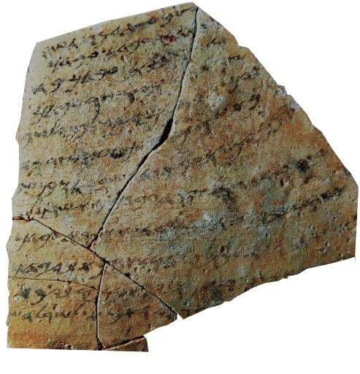
Translation
…your servant was at Ha-saar-Asam (when the following incident occurred). …when your servant had finished (his) reaping and had stored it a few days ago, Hoshayahu ben Shabay came and took your servant’s garment. …all of my companions will vouch for me…(that) I am guiltless of any in[fraction]. [(So) please return] my garment. If the official does not consider it an obligation to return [your servant’s garment, then have] pity upon him [and return] your servant’s [garment] from that motivation. You must not remain silent [when your servant is without his garment].
This 7th century BC ostracon from the Israelite coast specifically mentions the dgb, the “garment” which functioned as a cloak by day and a blanket by night (cf. Dt. 24:12-13).

Slide 151
Job’s Sins are Open to God!
Continuing his diatribe, Eliphaz charges that Job cannot hope to hide his sins from God (22:12-14).
The folly of those who think God is oblivious is apparent in their downfall and premature death (22:15-18).
When the righteous see the ruin of such wicked men, they rejoice (22:19-20).

Slide 152
Eliphaz’s Final Advice
In closing his final speech, Eliphaz urges Job to come to terms and submit to God.
If he will do this, his prosperity will return (22:21-25).
His desire for intimacy with God will be fulfilled (22:26-28).
The Hebrew in the final lines of Eliphaz’s speech is difficult, so some variations appear among translators. Literally, it reads: “When they are abased, you will say [it is because of] pride; and he will save the lowly of eyes. He will deliver [the one] not clean, and he will escape through your clean hands.” Who are the “they” and who is the “he?” Whatever this line means, Eliphaz seems to be exhorting Job that restoration is possible.

Slide 153
JOB RESPONDS (23-24)
Job responds by once more voicing his bitterness and suffering (23:1-2).
Eliphaz asserted that Job must put things right between himself and God, but Job sees no way to do so, since God seems hidden (23:3).
If he could just lay his case before God, he was confident that God would be fair, and he would be vindicated (23:4-7).
But here was the problem: Job has searched in every direction, but he still has been unable to gain access to God (23:8-9).

Slide 154
Job’s Confidence
Despite his frustration over God’s hiddenness, Job instinctively knows that God knows his plight.
In the end, this whole wretched experience will be revealed to be, not a punishment for sin, but a test of Job’s faithfulness (23:10-12).
God is sovereign (lit., “…and he [is] in one…”); he accomplishes his ends without assistance (23:13-14).
Job may not know where to find God, but God surely knows where to find Job, and in this, Job will be satisfied!
Before such a Being, Job can only stand in awe (23:15-17). (The Hebrew in 23:17 is very difficult, nearly unintelligible, which is why there are so many variations in English translation.)

Slide 155
The Challenge in Translating Chapter 24
Translators all agree that the Hebrew text in Chapter 24 is very difficult.
Job’s expressions in 24:18-24 seem at odds with what he has said earlier; here, he appears to argue that God summarily gives judgment, the very thing he argued against in Chapter 21.
  Some scholars have suggested textual dislocations and have rearranged the verse order (so JB).
  Others have attributed these passages to either Bildad or Zophar, especially in light of Bildad’s brevity and Zophar’s silence in this round of dialogues (so NAB).
  Still others have suggested that Job’s words are quotations of his friends, so they insert words like “you say” before 24:18 (so RSV, ESV, NET).
  Finally, some treat the verbs as optatives (i.e., what Job wishes, so LXX, Vulgate, Peshitta) rather than declarations of things as they are.
Hence, any interpretation of Chapter 24 must be offered with a degree of tentativeness.

Slide 156
The Nature of Divine Judgment Postponed
Job begins with the question of why God has no fixed times for judgment (24:1).
His friends have argued that God dispenses judgment quickly, but Job observes that real life indicates otherwise.
Crimes often go unpunished, and Job offers a list to prove his point (24:2-12).
Such crimes even include murderers, adulterers, and burglars (24:13-17).

Slide 157
The “You say…” Section (24:18-25)
The introductory “you say” is not in the Hebrew text, but it may be implied, and there is a precedent in 21:19, where most translators add “you say,” even though absent in Hebrew. However, in 21:28, there is a clear “you say” in the Hebrew text.
If so, then Job is sarcastically parroting his friends’ assertion that crimes are swiftly punished by God, an assertion with which Job vehemently disagrees (so Chapter 21:7-18).
Actually, as Job stated earlier, oppressors often live their lives in security and longevity, and he concludes by challenging his friends to prove otherwise (24:25).

Slide 158
BILDAD SPEAKS (25)
Bildad will now offer his final speech, which is also his shortest.
Here, he contents himself with a series of rhetorical questions about how any lowly human could possibly think he could be justified before God (25:1-4).
Even the celestial bodies seem dim and unworthy, much less a human who is nothing but vermin (25:5-6).

Slide 159
JOB RESPONDS (26-27)
Ostensibly, the whole of chapters 26-31 seem to belong to Job; if so, then this is Job’s longest speech in the book. However, there is good reason to think that chapter 28 is a special interlude from the narrator.
Some scholars have suggested a dislocation and reassigned chapter 28 to either Bildad, whose final speech is short, or Zophar, who offers no final speech at all.
My own view is that this theory of dislocation is unnecessary, but I will treat chapter 28 as an independent unit.

Slide 160
SARCASM IN THE BIBLE
Irony/Sarcasm (expressing one thing when the opposite is expected or intended) is a speech idiom that one occasionally finds in the Bible.
David uses heavy sarcasm in describing Doeg, Saul’s chief shepherd, whom he calls “a mighty man” after he butchered 85 unarmed clergymen and slaughtered other innocent townspeople (Ps. 52; 1 Sa. 21:6-19).
In Isaiah, one finds such sarcasm directed at idolatry, where a craftsman fashions a god and then worships it (Is. 44:12-17).
Job addresses his friends in sarcasm (12:1-2), and he does so here, saying, “How you have helped the powerless” (26:1-3)!

Slide 161
Job to Bildad
Since all the pronoun suffixes in the Hebrew text are singular, Job presumably is addressing Bildad directly.
Bildad has chided Job like a powerless empty-head, while assuming for himself the role of paternalistic counselor and wise man.
Job retorts with dripping sarcasm, and his question, “Whose breath has come out from you,” probably suggests that what Bildad has said has not come from God (26:1-4).

Slide 162
The Majesty of God
Job goes on to eloquently describe God’s majesty, and in doing so, the roles are reversed. Job is now the teacher, and the Bildad listener!
In a flurry of descriptions, Job moves from the underworld to the visible world, both of which are completely dependent on God’s sustaining hand (26:5-14).
The Hebrew word(s) for “throne” and “moon” (xsk) are homonyms, so the English Versions vary between them (26:9).
It must be born in mind that Job’s descriptions are phenomenological, so no one should attempt to draw from his poetic language some scientific approach to cosmology.

Slide 163
Job’s Powerful Metaphors
The language in Job’s description of God is rich in figures of speech.
God is the sovereign master of Sheol and Abaddon (26:5-6).
The word UhTo (= void, emptiness) seems to be drawn from the creation account (26:7; cf. Ge. 1:1-2).
In hanging the world in the void of the heavens, the Hebrew reads, “He hangs the earth on what?”
He fills the clouds with water like a huge wineskin without it bursting (26:8).
He hides the moon behind clouds and inscribes a map of the seas (26:9-10).
Like a huge roof, he suspends the heavens on “pillars” (26:11).
He shattered the great sea monster, Rahab (26: 9:12-13), bringing order out of chaos.
All these things are but a whisper and the barest hint of his majestic works (2:14)

Slide 164
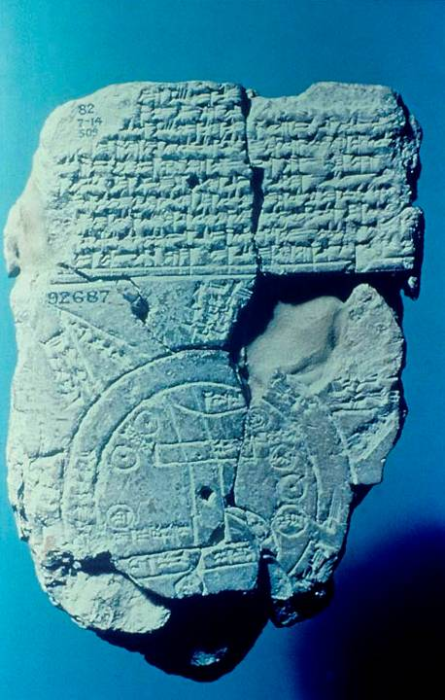
Babylonian Map of the World
Inscribed maps were known from ancient times. Here, a scribe produced a map of the ancient Near East from about the 6th century BC.
One can clearly see the small hole where the ancient cartologist put his compass to inscribe the circles of the outer edges of the known world.
The vertical lines are labeled “Euphrates.”
The city of Babylon is marked.
The upper area is labeled “where the sun is not seen.”
Job’s “map of the seas” (26:10) describes something similar.
British Museum, London

Slide 165
Job’s Final Words to His Friends
The book now marks off Chapter 27 as a closing statement with the phrase, “And Job took up his parable and said…” (Earlier, the opening phrase has always been, “And Job answered and said…”)
He begins with an oath formula, “As God lives…,” affirming the authenticity of his words while knowing that God alone can arbitrate between him and the accusations of his friends (27:1).
For reasons unknown to him, God has allowed this tragedy, but in spite of it, Job holds fast to his claim of moral integrity (27:3-6).

Slide 166
The Curse
The remainder of his closing response amounts to a curse of warning upon his friends and their constant recriminations.
The formula “let my enemies be…” is the form for an imprecatory curse, similar to those imprecatory curses in the Psalms.
It is probably hyperbolic, and the “enemy” (27:7) probably refers to his friends.
In this curse, Job is warning that the very things his friends have said about him might very well recoil on their own heads!

Slide 167
What Have We Learned in the Third Dialogue?
Job’s friends have now exhausted their explanations of cause-and-effect justice. Bildad is brief; Zophar has fallen silent.
They have offered no new ideas but have resorted to wild speculations about what they believe to be Job’s “secret” sins.
Job, for his part, continues to maintain his innocence, but he sees no way forward for gaining access to God?
Job’s final words come in the form of a curse: here, he warns his friends that the seat of the scorner is a dangerous place.

Slide 168
The search for wisdom
28

Slide 169
Reading Chapter 28 as an Interlude
Chapter 28 has aroused considerable scholarly debate.
As a poetic unit, it can stand alone, unconnected to what precedes or follows.
It is not introduced by any identifying clause or speaker.
The content and unruffled style seem very unlike the speeches of either Job or his friends, which have been bombastic, to say the least.
Theoretically, Chapter 28 could be a continuation of Job’s previous speech (so ESV), but most scholars think this unlikely.
The best solution seems to be that this poem should be read as an interlude by the narrator.
The debate between Job and his friends has reached an impasse.
As such, the interlude demarcates what has gone before from what will follow—the monologues of Job, Elihu, and God.
It addresses a fundamental question: Where is wisdom to be found?

Slide 170
The Ingenuous Search for Precious Metals
Using mining as a metaphor for the task of searching, the poet describes the various ways humans have scoured the earth for silver, gold, iron, and copper (28:1-11).
Yet for all their cleverness, humans have been unable to successfully find wisdom, which is more precious than gold dust (28:12, 20).
Unlike precious metals, wisdom cannot be discovered by scouring land and sea (28:13-14).
It cannot be purchased, like some commodity in the market (28:15).
Its value is far beyond the precious objects that humans desire (28:16-19).

Slide 171
The Elusiveness of Wisdom
Wisdom is hidden from all creatures high and low (28:21-22).
God, alone, knows the true path to wisdom, for only he sees all things from horizon to horizon (28:23-24).
He embodies his wisdom in the ordering of wind, water, rain, and lightning (28:25-27).
Hence, true wisdom must derive from reverence for God himself (28:28; Pro. 1:7; 9:10; Ps. 111:10).
Job has not yet found the answer to his dilemma, but he is certainly following the path of wisdom in yearning for God to speak!

Slide 172
The monologues
29-41

Slide 173
The Monologues
Offsetting the cycles of speeches between Job and his friends is now a set of monologues.
They are not soliloquies, since Job is not alone. Still, there is no dialogue as before.
Three voices will be heard: Job, Elihu, and God, and they will bring the reader to the denouement of the book.

Slide 174
JOB’S FINAL APPEAL (29-31)
Job commences his final appeal with a yearning for his past life of happiness.
Then, he was deeply conscious of God’s providential care (29:1-6).
He was held in high regard by the larger community (29:7), and all were aware of his continual benevolence to the poor (29:8-17).
Ironically, these are the very things that Eliphaz accused Job of neglecting (cf. 22:5-9), but Job would hardly have reflected on such things had they not been true and publicly acknowledged.

Slide 175
The Easy and Natural Assumption
In view of his paternal care for those most at risk, Job naturally assumed that he would be rewarded with a long and healthy life (29:18-20).
Other people sought his counsel (29:21-23).
He gave direction to the community like a chief or king (29:24-25).

Slide 176
Then and Now
In the aftermath of his fall, everything was now different. Three times (30:1, 9, 16) Job uses the expression hT!fav4 (= “but now”).
Now, he is mocked by brash youngsters whose family character was even lower than dogs (30:1).
What could such social derelicts offer him, who were no more than scavengers living like bandits in the caves and brush (29:2-8)?
These were the people on the social margins that Job had once helped, but now they held him in utter contempt (29:9-15).

Slide 177
Continual Deterioration
Job still contended with the horrors of disease in his own body.
His bones ached, he lacked sleep, and he lived in constant pain (29:16-18).
The God that he loves seemed silent, while death loomed (29:19-23).
How could this have happened to someone who was a benefactor to the needy (29:24-25)?
Instead of reward, he has only misery and visceral agony, burning with fever, ostracized, and abandoned by God (29:26-31).

Slide 178
The Language of Cursing
To understand the climax of Job’s final appeal, one must understand the language of cursing.
Curses are a speech-act inviting divine judgment.
Job’s appeal comes in the form of a negative curse in which he disowns the accusations against him and invites God’s judgment if he is guilty.
Such an oath of exoneration had wide precedent in the ancient Near East.
Job’s final words, “The words of Job are ended,” are an affirmation and final signature that throws the burden of proof upon the court, and in this case, upon God (31:35).
The lengthy series of “if” clauses invite upon Job’s own head divine repercussions if he has committed any of the crimes he lists.

Slide 179
The Oaths
Job will utter oaths in several categories defending his integrity:
Innocence of sexual dalliance (31:1-4, 9-12)
Innocence of dishonesty (31:5-8)
Innocence in social obligations (31:13-23, 31-32)
Innocence in the use of wealth (31:24-25)
Innocence of idolatry (31:26-28)
Innocence of vindictiveness (31:29-30)
Innocence of harboring hidden sins (31:33-34)
Innocence of exploiting others (31:38-40a)

Slide 180
The Idioms
In the context of his oaths, Job uses a variety of idioms that may not be obvious to the modern reader:
The idiom “if my heart has walked after my eyes” (31:7a) describes coveting the possessions of others, and “if a blemish has clung to my hands” (31:7b) describes the stain of theft.
The idiom “if I have eaten my morsel alone” (31:17a) refers to the refusal to share food with others.
The idiom “if his loins have not blessed me” (31:20a) personifies the body of the poor man that blesses the one who gives him a fleece.

Slide 181
More Idioms
The idiom “because I saw my helper in the gate” (31:21b) refers to some sort of legal transaction conducted in the city gate, and Job has consistently refused to use the advantage of his station to pervert justice.
The idiom “my hand has kissed my mouth” (31:27b) is a pagan gesture of homage tantamount to blowing kisses to the sun or moon as astral deities.

Slide 182
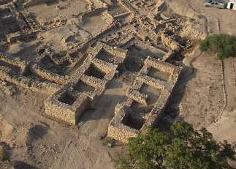
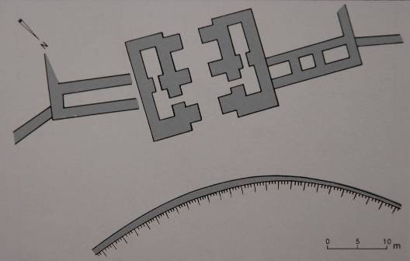
UPPER LEFT: Excavated gate at Hazor (2004)
LOWER LEFT: Architectural drawing of a Middle Bronze Age gate.
City gates in the ancient Near East served as civic centers and courts where the city elders adjudicated small claims.
They were constructed with several benched niches that during war could be fortified with soldiers but in peace could be used by the city elders as a center for community decisions.

Slide 183
The Final Appeal
Earlier, Job had wished that his painful suffering could be recorded on a scroll or inscribed on a lead sheet (19:23-24).
Now, he metaphorically invites a legal document, a record of God’s indictments against his foregoing oaths of innocence (31:35-36).
He would sign it with his own mark and call for God to respond.
The description of the “mark” (the Hebrew t formed like an X in ancient script) is the final letter in the Hebrew alphabet (31:35).
If he had such a document, he would display it prominently (31:36-37)!

Slide 184
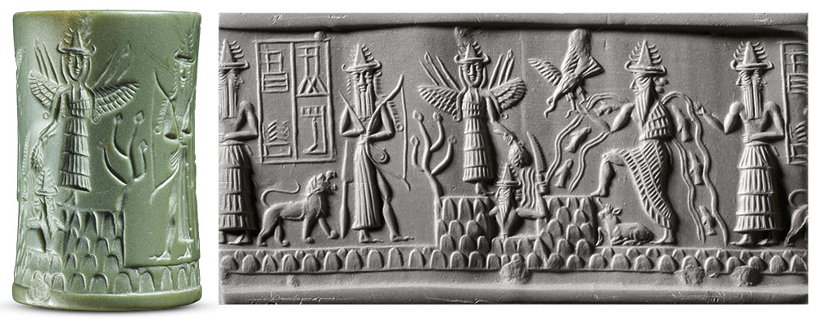
The document that Job said he would carry on his shoulder or wear as a crown might seem odd to the modern reader; however, in his era people wore cylinder seals around their necks (cf. Ge. 38:18, 25).
Cylinder seals were cylindrical shaped stones with engravings to mark ownership.
Appearing in about 3500 BC, they could be rolled into soft clay, leaving a kind of signature.
Morgan Library, New York

Slide 185
The Final Oath
Job’s final oath concerns land ownership.
He denies ever having exploited the land to his own benefit, and if he had done so, he invites upon himself the ancient curses of Adam and Cain (31:38-40; cf. Ge. 3:17-18; 4:11).
Job has now said all he can say, and he resigns himself to await an answer from God.
“The words of Job are ended.”

Slide 186
The SPEECHES OF ELIHU
32-37

Slide 187
The Unexpected Appearance of Elihu
Job has consigned his case to God, praying and hoping that God will speak.
Indeed, God WILL speak, but before he does, a fourth voice is to be heard.
Elihu appears unexpectedly to rebuke both Job and the others. He was not one of the original group of friends, and unlike the others, there is no dialogue between them.
After he speaks, he will disappear altogether.
At the end of the book, God will address Job’s three original friends, but Elihu is left unmentioned, almost as though he hadn’t been there. Is this tacit approval or the ultimate dismissal?

Slide 188
The Role of Elihu
Not a few scholars have speculated that Elihu belongs to a later stage in the book.
For one thing, the story seems quite complete without him.
What he has to say seems theologically and poetically feeble compared to what has gone on before.
While Elihu is notoriously wordy, his contribution is less substantial.
He does allude to the speeches made earlier by Job and the others, so it is to be assumed that he was there and listening though not mentioned.
He will offer a fourth perspective before God adds the divine perspective.

Slide 189
Elihu’s Speeches
Altogether, Elihu will offer four speeches, each introduced by the opening phrase, “And Elihu answered and said…” (32:6; 34:1; 35:1; 36:1).
As a Buzite, he may have been a relative of Job (Ge. 22:21), an eastern desert dweller (Je. 25:23-24).
As a younger man, he customarily would have waited for his elders to finish their dialogue, as the culture required.

Slide 190
ELIHU’S FIRST MONOLOGUE (32-33)
Elihu’s first speech is introduced with a description of his anger both at Job and his three friends (32:1-5).
He begins rather elaborately, commenting on his youth and his elders’ seniority (32:6-10).
He has listened to them, hoping to hear some “wise words,” but rather pompously, he asks whether or not he should remain silent in the face of their inadequate arguments (32:11-16).
He feels compelled to fill the vacuum with knowledge of a better quality; indeed, he is bursting with what he believes to be a better answer offered without partiality or flattery (32:17-22).

Slide 191
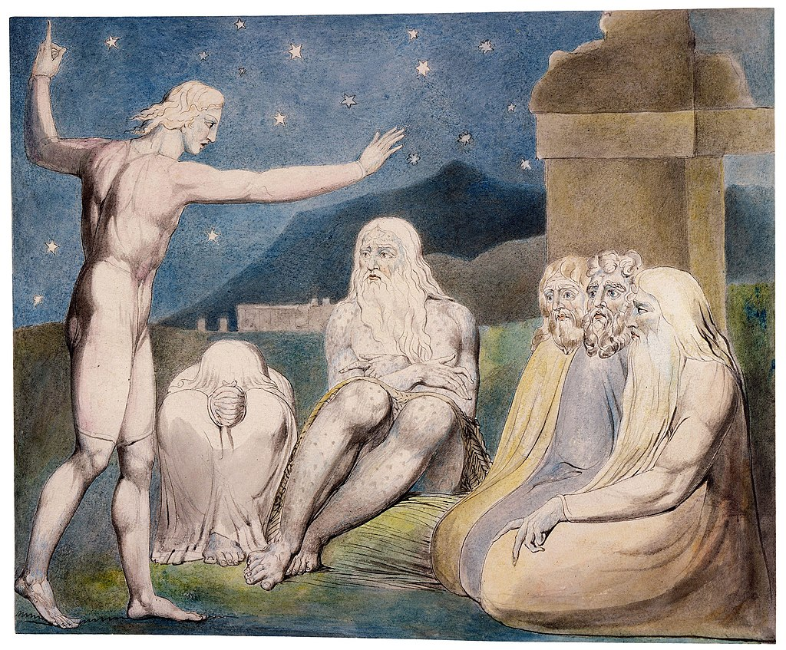
The wrath of Elihu
Watercolor by William Blake

Slide 192
Elihu’s Inspiration and Counsel
All this opening rhetoric seems a bit overstated, which can be summarized as simply, “I’m about to say something important.”
He begins by claiming divine inspiration and challenges Job to answer “if you can” (33:1-7).
Addressing what he believes to be Job’s claim of innocence (he ignores Job’s admission that he was not sinless, cf. 7:21; 13:26; 31:33-34), he asserts that God is greater than humans, and he takes umbrage at Job’s complaint that God is silent (33:8-13).
Against this, he asserts that God does speak, but often indirectly (33:14-22).

Slide 193
The Problem
In Elihu’s way of thinking, God speaks, but humans are simply not listening.
Job has admitted to having nightmares (cf. 7:14), and Elihu uses this confession to suggest that God is trying to break through to Job (33:15-16).
Sickness, also, can be a redemptive chastening from God, so Job needs to view his suffering in this way (33:19-22).
Sometimes God uses a mediator, such as an angel, who tells him the way forward (33:23-28).

Slide 194
The Solution
In all these subtle ways, God repeatedly reveals himself so that humans can be corrected and redeemed from death (33:29-30).
Hence, Elihu advises Job to observe and learn (33:31).
If he has anything to say, he can speak; if not, he should remain silent and continue to listen to Elihu’s great wisdom (33:32-33).

Slide 195
ELIHU’S SECOND MONOLOGUE (34)
Elihu now solicits help from other listeners to dismantle Job’s defenses (34:1-4).
He repeats the former accusations—that Job is a liar (34:5-6) and a scoffer (34:7-8; cf. 11:3; 15:16, 25-26).
He censures Job for saying it is futile to please God (34:9; cf. 9:22; 21:7-26). Of course, Job never explicitly said that it was useless to try to please God, so Elihu is extrapolating this accusation.

Slide 196
God Doesn’t Make Mistakes (34:10)
God’s justice is commensurate with human behavior (34:11-12).
Earlier, Job observed that God destroys both the blameless and the wicked (cf. 9:22; 12:6), which Elihu took to mean that Job had accused God of perverting justice.
Elihu counters that God is sovereign, and it is his divine right to withdraw life from whomever he chooses (34:13-15). Hence, Job cannot pass judgment on Almighty God.
It is inconceivable that God would govern the universe unjustly. As the sovereign Creator, he equally judges kings and nobles, rich and poor, even if his ways are sometimes mysterious (34:16-20).

Slide 197
God is Beyond Censure
He sees all (34:21-22), and he is under no obligation to hear individual cases like Job’s, since he is omniscient and already knows all things (34:23-24).
He dispenses judgments based on his omniscience (34:25-30).
All scholars agree that the Hebrew in the final paragraph of 34 is especially difficult, particularly 34:31-33. Elihu seems to be saying that no one who has ever experienced discipline from God should then expect to be repaid. Job must choose between the way he thinks the world should be directed and the way God actually directs it.

Slide 198
Job’s Argument is Impossible
Once more appealing to the wise (lit. “men of heart”), Elihu says that Job’s defense is ignorant and without insight (34:34-35).
He even suggests that Job’s crucible should continue, since he has proved himself to be wicked (34:36).
He concludes that Job is a rebellious sinner, slapping away at his friends while offering only empty excuses (34:37).

Slide 199
ELIHU’S THIRD MONOLOGUE (35)
Two issues greatly disturbed Elihu’s perceptions of Job’s defense.
One, which he had already raised with the “wise men,” is Job’s claim to be in the right (35:1-2; cf. 34:5; 13:18).
The other concerns the question he put in Job’s mouth earlier, “What is the advantage of being good?”(35:3-4; cf. 34:9)? Job has not, in fact, put the question in such stark terms, but Elihu extrapolates what he believes to be Job’s position.

Slide 200
Divine Impassivity
Elihu’s answer is largely drawn from previous speeches, some even from Job, but it covers little new ground.
God is higher than the heavens (35:5; cf. 9:8-10; 11:7-8; 22:12).
He is the impartial Judge unmoved by human sin (35:6; cf. 7:20).
He is equally unmoved by a righteous life (35:7; cf. 22:3).
Elihu cannot conceive of God being either pleased with creatures who are faithful or grieved by those who are not, so for God to be impartial means that he is aloof, while Job’s trial affects only himself, not God (35:8).

Slide 201
The Reason for Divine Silence
God remains silent because people who cry out to him are filled with pride (35:9-12).
Such cries are empty, and Job’s plea that he would wait for God to speak directly was nothing short of insolence (35:13-14).
All this waiting around for God to show himself was entirely misdirected; indeed, Elihu asserts that God is even restraining his anger in Job’s case (35:15).
Hence, Job’s words are just empty talk (35:16; cf. 34:35).

Slide 202
ELIHU’S FOURTH MONOLOGUE (36-37)
Elihu’s final speech falls into two sections.
  In the first, he addresses the redemptive character of suffering (36:1-21).
  In the second, he extols God as the incomparable Teacher (36:22—37:24).
In this final monologue, Elihu is more nuanced and less harsh, since he now intends to defend God’s righteousness (36:1-3).
He cannot avoid a touch of hubris, however, and adds that his wisdom is wide-ranging and no less than perfect (36:4)! Being a such a modest man, he couldn’t say more.

Slide 203
Suffering as Testing and Purification
God does not reject anyone (36:5).
He does not preserve the life of the wicked, but puts right the wrongs of the oppressed (36:6).
He doesn’t ignore the righteous, but when they find themselves in distressing circumstances, he uses hardships as teaching instruments to lead them to repentance (36:8-10).
If they listen, he will reverse their calamity (36:11), and if they won’t, they merely sign their own death warrant (36:12).

Slide 204
Nothing New Here
This whole line of reasoning seems to mirror much of what has been said earlier by the other three (cf. 18:5-21; 20:1-29), and it is precisely what Job observes is NOT happening in the world (cf. 21:7-18, 29-30; 24:1-12, 21-25).
In any case, Elihu goes on to chastise those who are godless at heart (and implicitly includes Job).
The godless nurse anger, refuse to turn to God, and end up dying young among the male prostitutes of the fertility cult (36:13-14).
Only those who learn from their distress will be delivered (36:15).

Slide 205
Translating 36:16-18
This final section is beset with translational and interpretive difficulties and shows a wide diversity in the various English Versions. Some take it as a series of warnings (so NEB,) some as a series of accusations (so NJB), and some as both (ESV).
IDEA OF BEING WOOED
The idea of being wooed suggests that Job is being gently led away from danger toward restoration (36:16), but he must take care or he will be wooed in the opposite direction (36:18).
THE MEANING OF 36:17 IS PARTICULARLY OBSCURE
Is this a judgment already fallen upon Job? (so NIV, JPS, ESV, NIB)
Is this a reference to Job’s neglect in matters of social justice? (so NJB)
Is this a reference to Job’s obsession with finding legal resolution? (so NRSV, NLT)

Slide 206
Translating 36:19-21
The following verses are equally difficult. Most agree that in some sense Elihu’s question suggests that any resolution to Job’s suffering will not come from within his own resources (36:19).
LONGING FOR THE NIGHT
The warning against longing for the night might be a metaphor that Job should not wish for death (cf. 34:20).
THE FINAL WARNING
Literally, this obscure Hebrew phrase reads, “For because of this you chose from affliction” (36:21).
Does this mean that Job prefers evil to affliction? (so NAB, NASB, NIV, NIB)
Does it mean that Job’s affliction is the means by which God is testing him? (so NET, NJB, NLT, NRSV)
In any case, Job must avoid wrong-doing and learn from his experience of suffering.

Slide 207
God, the Ultimate Teacher
Elihu’s final words focus on the majesty and power of God as the consummate teacher (36:22).
Since God is supreme and answerable to no one but himself (36:23), Job should exalt God’s power, even though from a distance (36:24-25).
God’s greatness cannot be fully comprehended, for he is eternal (36:26).
Still, from the elemental forces of storm and the world of nature, humans can at least catch a hint of his divine greatness (36:27-33).
The sheer immensity of thunder, lightning, snow, rain, and whirlwind inspire terror and awe, and God uses all these forces for correction, fruitfulness, and kindness (37:1-13).

Slide 208
Final Words to Job
Addressing Job directly, Elihu challenges him with a series of probing questions, questions that seem to anticipate the questions later to be asked by God.
Can Job discern how God governs the natural elements of storm (37:14-17)?
Can Job in any way affect the condition of the sky when it is like a bronze mirror (37:18)?
With a tinge of sarcasm, Elihu chides Job to teach his friends how to approach God with his court case, since all their perceptions are shrouded in darkness (37:19).
Any lowly human who expects God to speak to him would be swallowed up (37:20)!

Slide 209
Elihu’s Conclusion
Elihu concludes his final speech by describing the abatement of storm (37:21-22).
The invisible and unapproachable God will remain true to his moral character of justice (37:23), which is why he is revered by all people (37:24).
Obviously, all the imagery concerning storm in Elihu’s final speech prepares the way for God to speak, who will address Job out of a whirlwind.

Slide 210
What Have We Learned from Elihu?
Elihu’s contribution is more ambiguous than that of Job’s other friends.
For the most part, he rises above their petty insults.
His perspective that suffering can be redemptive is surely to be acknowledged.
At the same time, his commitment to the impassivity of God is mistaken, and this will be demonstrated when God speaks.
In the end, God will say nothing about Elihu, good or bad.
Elihu remains a somewhat shadowy figure in the book.
The value of his contribution is muted by his occasional pomposity.

Slide 211
The VOICE OF GOD
38-41

Slide 212
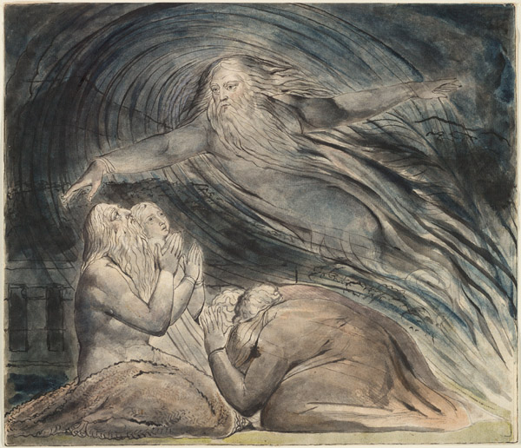
God answers Job from a whirlwind.
Watercolor by William Blake

Slide 213
The Voice of God
At long last, Job hears the voice of God for which he has been desperately longing (cf. 9:35; 13:22; 23:3-7; 31:35-37).
As with the other voices in the story, the reader must decide what tone is to be heard in the divine voice.
  Sometimes there are clues in language that might swing the reader in one direction or another, but the reader can hardly remain neutral.
  God will pose some very pointed questions to Job: the issue is whether these are to be heard as coming from a friend or an enemy.
Those readers who consider Job to be cynical and antagonistic toward God read the divine questions as thrusts aimed at crushing Job in humiliation.
Such an assumption is unnecessary, in my view, and it seems better, especially since God will say that Job had spoken what was right (cf. 42:7b.), to view these questions are treated as coming from a friend to a friend.

Slide 214
The Nature of God’s Revelation to Job
In one sense, the divine speeches are surprising.
Job had asked for specific charges (cf. 31:35), or at least, a verdict of exoneration (cf. 13:18; 23:3-7, 10-12).
Neither of these are forthcoming.
Conspicuous by its absence is a list of Job’s offenses causing his downfall or any explanation as to why it all happened.
Rather, God voices a series of questions that invite Job to observe the world, and in doing so, he will implicitly discover God within the world.
This, then, is the central point of the book: Job can find resolution to his suffering without ever knowing the complete back story.

Slide 215
In the end, Job does not see it all; rather, he sees God, and this makes all the difference!
  Job had felt abandoned by God.
  The divine voice indicated that God was not aloof, and more to the point, Job could experience the presence of God even in the midst of suffering.

Slide 216
THE FIRST SPEECH (38-39)
The opening question, “Who is this darkening counsel in speech without knowledge?” is a wry reference to Elihu’s castigation of Job (cf. 38:1-2; cf. 35:16).
Job is now invited to face God, the very thing he has repeatedly requested (cf. 38:3; cf. 13:222; 31:35).
The divine questions fall into two large blocks, the mysteries of the created world (38:4-38) and the mysteries of the animal kingdom (38:39—39:30).

Slide 217
The Purpose of the Divine Questions
These questions are rhetorical and educational. The intent is not to humiliate Job (contrary to some interpreters), but to reinforce to him that there were huge areas of knowledge that were simply beyond him.
By analogy, Job should see his own suffering in the same light—something he experiences but may not fully understand.
Because God speaks to Job directly, he confers upon him the highest dignity. Job had invited God to call and believed he would answer (cf. 13:22), and now the thing he desperately desired was actually happening!

Slide 218
Mysteries of the Created World
The initial series of questions concern the origins of the universe.
Though humans were not there to see it, the angels (sons of God) were there, and they watched with admiration, amazement, and spontaneous song (38:1-7).
The origins of the oceans are described by the metaphor of child-birth (38:8-11).
The questioning continues regarding the demarcation of night and day (38:12-13) and the coming of light that brings into sharp relief the profile of the wicked (38:12-15).

Slide 219
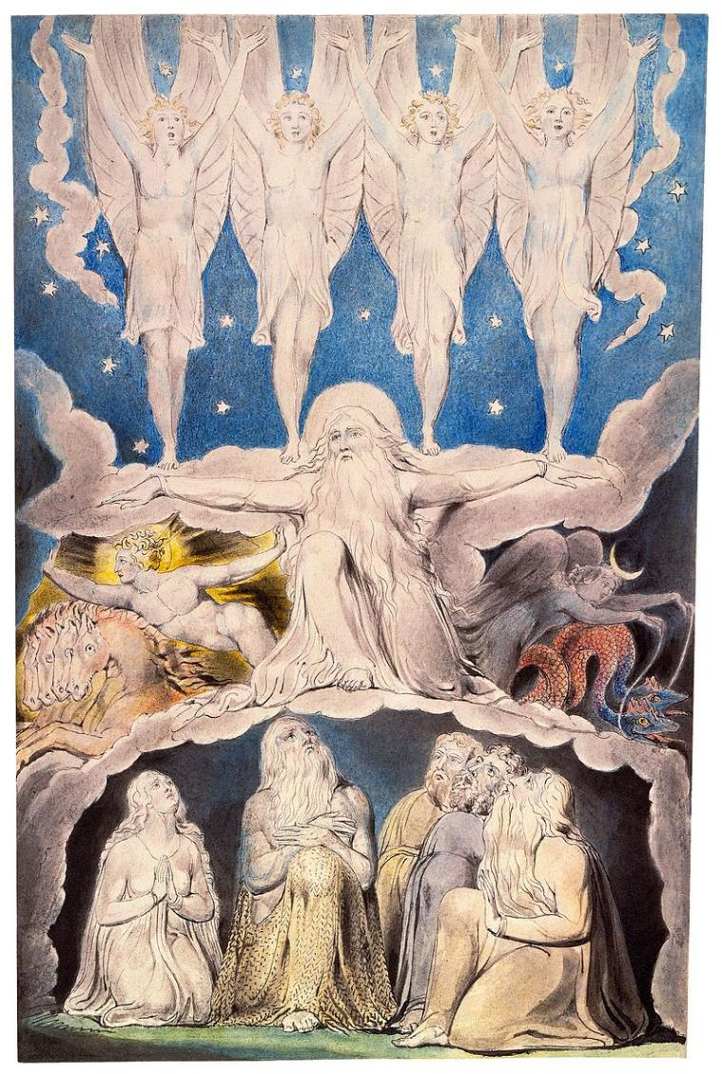
When the morning stars sang together and the sons of God shouted for joy…
Watercolor by William Blake

Slide 220
The Subterranean World
God returns to the sea, this time to its subterranean depths.
In Hebrew poetry, the sea is often a symbol of death (e.g., Ps. 69:2, 14; Jonah 2:3).
Here, the sea is linked to the “gates of death,” the entry into the place of the dead (38:17).

Slide 221
Other Places Job has Never Been
Just as Job has never explored such unreachable places in the sea, so he has never explored the expanse of even the visible land (38:18).
He’s never been to the horizon, where light and darkness begin and end (38:19-20). We should think of Job’s world-view as phenomenological; Job (nor the Bible) is not offering any sort of scientific view.
God even uses some gentle sarcasm, “surely you know,” probably a play on Eliphaz’ jibe (38:21; cf. 15:7).
Job has never seen the origins of snow or hail, “weapons” that God sometimes uses (38:22-23; cf. Ex. 9:22; Jos. 10:11; 1 Sa. 7:10; Eze. 13:13), nor has he seen the sources of lightning or the east wind (38:24).

Slide 222
The Mysteries of Weather and the Heavens
Continuing with more rhetorical questions, God asls whether Job knows about rain in uninhabited places that carve channels for irrigation (38:25-27).
What could he know about the origins of rain, dew, ice, and frost (38:28-30)?
Moving to the heavens (38:31-33; cf. 9:9), there are the mysteries of the constellations. (Pleiades and Orion are well-known, but Mazzaroth and the Bear with Cubs are not, though some have suggested the Bear might possibly refer to Ursa Major).
The movements of cloud, lightning, rain, and flood are totally out of Job’s realm of control (38:34-38).
The “water skins of the skies,” of course, is a metaphor for the heavenly reservoirs of water (38:37).

Slide 223
The Mysteries of the Animal World
In a series of vignettes, God now invites Job to explore the animal world. (The chapter division between 38:38 and 38:39 is unfortunate.)
Could Job conduct a hunt to provide meat for a pride of lions (38:39-40)?
Could he provide for the chicks of the desert raven (38:41)?
What does he know about the birthing patterns of the ibex (39:1-4)?
What about wild asses that freely roam the steppes (39:5-8) or the wild ox (39:9-12), a creature of great strength but impossible to domesticate?

Slide 224
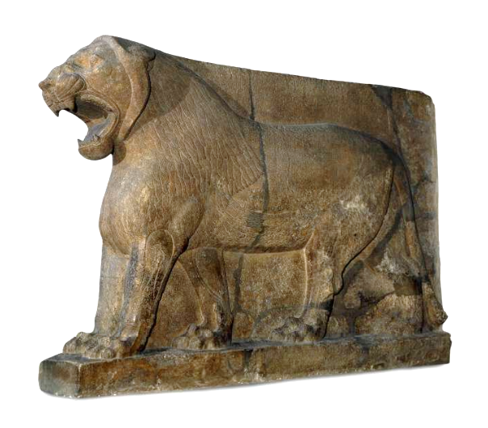
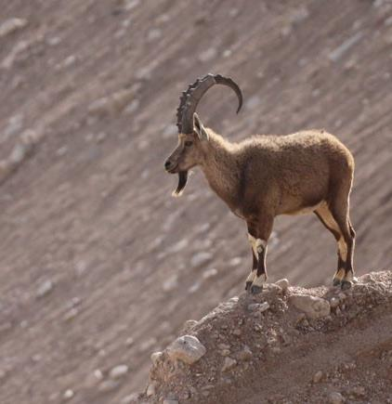
The Asian Lion
The Ibex
British Museum, London

Slide 225
From Questions to Descriptions
Even though some of these descriptions are not in a question format, they still are implicit questions.
Ostriches are comical creatures with feathers useless for flying but running faster than a horse, while leaving their eggs exposed (39:13-18)? (The identity of this creature is a contextual guess, since the Hebrew noun is a hapax legomenon. A stork is another possibility.)
The horse, famous for its courage in battle, is the only domesticated animal in the series (39:19-25). (At this point in history, horses were primarily used for chariotry rather than cavalry.)
The soaring flight of hawks and vultures are equally beyond Job’s ken (39:26-30).

Slide 226
The Divine Challenge (40:1-5)
After this lengthy series of unanswerable rhetorical questions, God now challenges Job to respond (40:1-2).
Once again, there is the language of the law court (40:2; cf. 9:3).
In his final appeal, Job had bluntly said that if God would provide him an audience, he would approach God “like a prince” (cf. 31:35-37).
Now, God has answered, and Job, too, must answer!
Job, suitably chastened, concedes that before God he is very small indeed, and he lapses into awed silence (40:4-5).

Slide 227
THE SECOND SPEECH (40:6—41:34)
In the first speech, God addressed Job’s penchant for wanting to know about things that were unfathomable. In the second speech, God addresses Job’s complaint that life is not fair and that God seems unreachable.
Job’s final challenge had been his insistent plea that God would put an indictment in writing (cf. 31:35).
God offers Job no such indictment, but in this second speech he demonstrates that Job’s attitude needs adjustment.
Just as Job was completely unable to understand the incomprehensible features of the natural world, he was equally incapable of directing the incomprehensible features of the moral world.

Slide 228
The Issue of Moral Justice
As in the first speech, God confronts Job out of the whirlwind (40:6-7).
The first question concerns moral justice (40:8-9).
Was Job so insistent on his innocence that he would impugn God?
What follows is a challenge for Job to consider how he might govern the moral world if he had the opportunity (40:10-13).
If Job could achieve justice in such a way, only then would God concede that Job was capable of vindicating himself (40:14).
THE POINT, OF COURSE, IS THAT JOB WAS QUITE UNEQUAL TO SUCH A TASK, AND CONSEQUENTLY, HE NEEDED TO RETHINK HIS MINDSET.

Slide 229
Two Additional Awesome Creatures
Both these creatures are prime examples of power and pride.
Was Job, wearing the robes of God as judge, able to bring them down?
Did he have an “arm” like God or a “hand” like God that could bring to heel these two terrible and incredible creatures called Behemoth and Leviathan (40:9, 14)?
Leviathan, especially, is regarded as “the king of the sons of pride” (41:33-34).

Slide 230
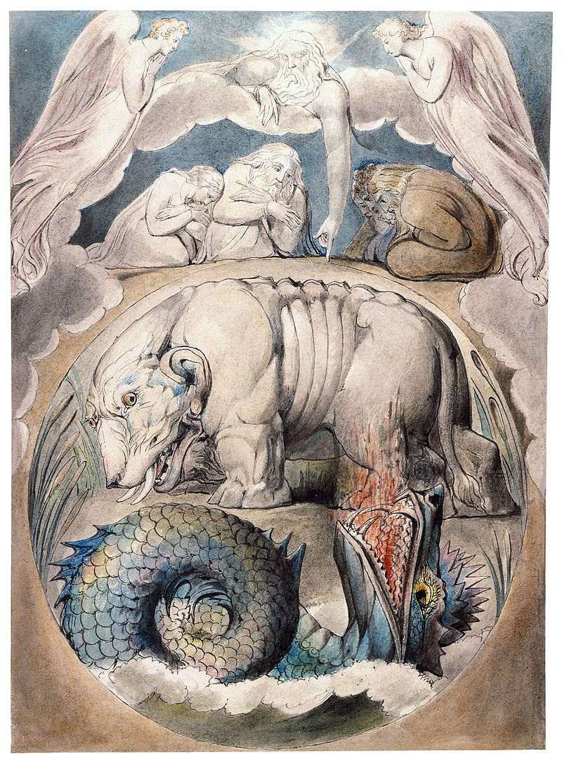
Behemoth and Leviathan
Watercolor by William Blake

Slide 231
So, who are these creatures?
Translators have transliterated their names.
The names are proper, since they appear in the Hebrew text without definite articles.
One of them, Leviathan, has been mentioned earlier (3:8), and both names are known from other ancient Near Eastern literature, where they seem to refer to supernatural creatures.
Isaiah depicts Leviathan as the “twisting serpent” and the “dragon from the sea” that God will ultimately slay (Is. 27:1).

Slide 232
Behemoth
Behemoth eats grass (40:15), but he also is called “the first of the works of God,” which is to say, the first created creature (40:19a).
The Hebrew word “behemoth” can be used of beasts in general (12:7; Dt. 32:24; Ps. 8:7; 50:10, etc.), but since this is a proper name, it is not “beast,” but “Beast.”
In later Jewish writings, Behemoth (a male monster) is depicted as a primeval creature of the land (1 Enoch 60:7-9).

Slide 233
Leviathan
Leviathan seems to live in the water (41:1), yet out of his nostrils comes smoke and fire (41:19-21).
In the ancient Near East, Leviathan is generally described as a sea monster with seven heads: Ugaritic texts describe him as the “twisting serpent” and “the tyrant with seven heads.”
In later Jewish literature, Leviathan (a female monster) is the symbol of chaos from the abyss (1 Enoch 60:7-9).

Slide 234
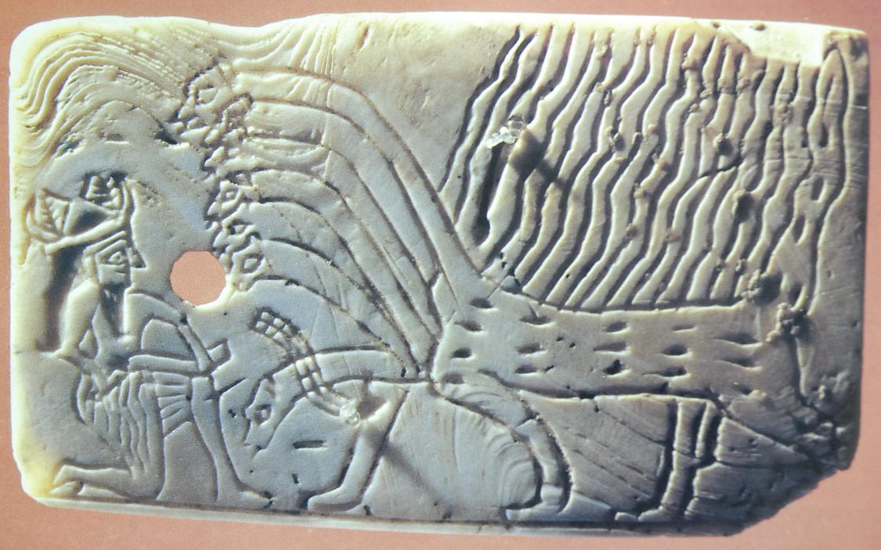
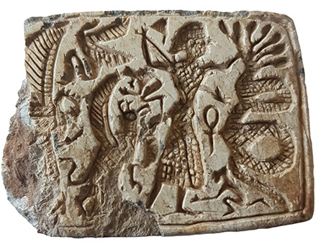
Imagery of Leviathan
Various passages, both in the Bible (Isa. 27:1) and other ancient Near Eastern literature, use stock imagery to depict a dragon-like, threatening creature with seven heads.
STOCK NAMES
Leviathan
Rahab
Tannin
Yam
Nahar
Nahash
In this incised Sumerian shell from ca. 2600 BC, a seven-headed monster confronts a god or hero who already has wounded one of its heads.
A stamp seal excavated in 2022 in northern Israel and dating to the 8th century BC depicts a seven-headed serpent held at bay by a hero who with one hand grasps one of its necks while brandishing a speak in his other hand.

Slide 235
Interpreting the Two Monsters
Since the 17th century, Behemoth has traditionally been identified with the hippopotamus, while Leviathan has been thought to be a crocodile.
With the discovery of both ancient Near Eastern texts and artifacts depicting these creatures as mythological, many scholars are doubtful that they represent ordinary animals.
If they are taken to represent spiritual powers, which Paul would much later describe as the “stoicheia,” i.e., the rulers, authorities, powers, and dominions (Ep. 1:21; 3:10; 6:12; Col. 2:8, 20), then they are malevolent creatures opposing God, like the beast from the sea and the beast from the land in the Revelation of John (Rv. 13:1, 11).

Slide 236
The Main Point
Regardless of their precise identity, one thing is clear: these creatures, whatever they are, were created by God and live under God’s dominion (40:15, 19; cf. Ps. 104:26; Col. 1:16).
Job would never be able to control them or bring them under submission!

Slide 237
Behemoth (40:15-24)
Behemoth is a created being, just as Job (40:15).
The description of his diet of grass (40:15b), his great midbody (40:16), powerful legs and bone (40:17b-18), and his home in the reeds and marshes (40:21-22), makes it understandable why some interpreters thought him to be a hippopotamus.
Other features, however, are not much like a hippo, including:
  His tail like a cedar (40:17a)
  His foraging on the mountains (40:20)
  His home in the Jordan River (40:23)
While the Hebrew text of 40:19a is a challenge to translate, the basic idea seems to be that no one except God is sufficiently powerful to slay this fearsome creature—certainly not Job!

Slide 238
Leviathan (41)
In a much longer description, Leviathan is depicted with powerful limbs, hide, teeth, back, scales, flesh, neck, and underbelly (41:12-13, 14-17, 22-23, 30).
This description makes understandable why some interpreters have identified him as a crocodile.
However, his depiction as a fire-breathing dragon sneezing flashes of light with red eyeballs before whom the “gods” recoil does not fit quite so well (41:18-21, 25).

Slide 239
Could Job Capture or Kill Such a Creature?
The initial series of questions make clear that this creature is untamable.
It would be sheer madness to stand against it (41:10).
Anyone who came near such a ferocious creature and lived to tell it would never do so again (41:8)!
The meaning of 41:11a is not immediately clear, and translators have struggled to make sense of it, offering a wide variety of renderings, some literal (KJV, RV, RSV, JPS, NAB, NASB, ESV, NET, NLT) and some dynamic equivalencies (NIV, NIB, NJB, NRSV).

Slide 240
Again, the Main Point
Leviathan represents the unfathomable, a creature of God’s making that defies explanation.
By analogy, Job himself must be content without knowing.
There is mystery in the Almighty’s creation that cannot be explained by limited humans, and they must admit these limitations.
What is true of God and the created world is equally true in terms of moral and ethical categories.
Job must trust in God whether or not he fully understands why things happen as they do. God is not obligated to explain himself. Rather, he invites Job to trust in his divine power and character.

Slide 241
If These Creatures Are Supernatural Entities…
If the interpreter is willing to see in Behemoth and Leviathan the embodiment of the powers of evil, creatures that can be taken down by God alone (Is. 27:1; Ps. 74:14; Rv. 12:10; 19:19-20; 20:10), then they take on a deeper significance.
Here, God is sovereign over even the invisible spiritual powers that intrude into the fractured world of humans.
There is no explanation as to why God allows such powers to continue, but again, the principal lesson is one of trust in God without full comprehension.

Slide 242
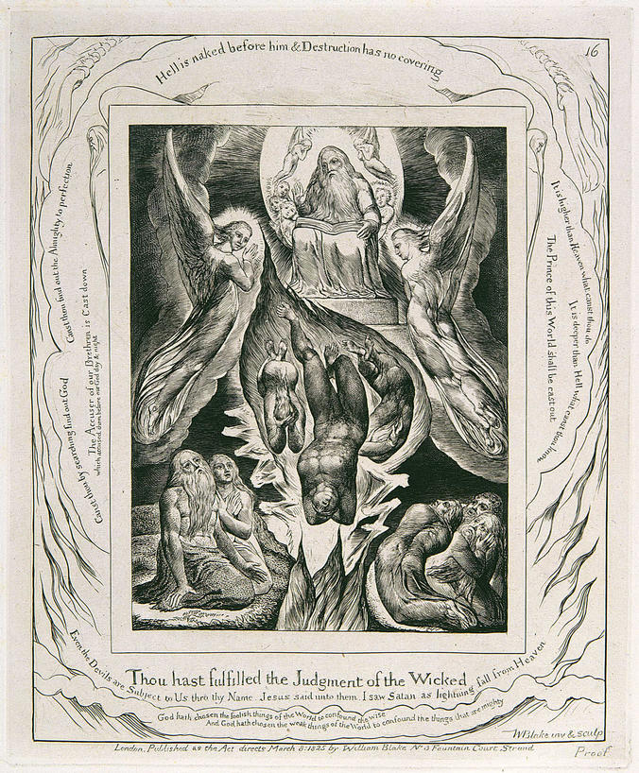
The Fall of the Satan
Watercolor by William Blake

Slide 243
Only God can turn the power of evil upon itself, changing “ashes into beauty” (cf. Is. 61:3).
Does Leviathan represent the satan? God does not say.
More importantly, it was a wonderful thing for Job to be able to commit into the hands of an Almighty God the things he could not understand and could not change.
Job was not able to manage the universe, but God could!

Slide 244
The denouement
42

Slide 245
Job’s Final Response (42:1-6)
After his tour of the unfathomable world, Job now understands all too clearly that as a limited, finite human he could never govern the universe.
God alone can do this.
Humans must be content to leave this governance in the hands of God, who is both all-powerful and all-wise.
Job also realizes that God is transcendent, and as a finite human, it is not his place to unpack the mystery of God.
While Job does not discover the back story of his tragedy, he has discovered something much more satisfying—God himself!

Slide 246
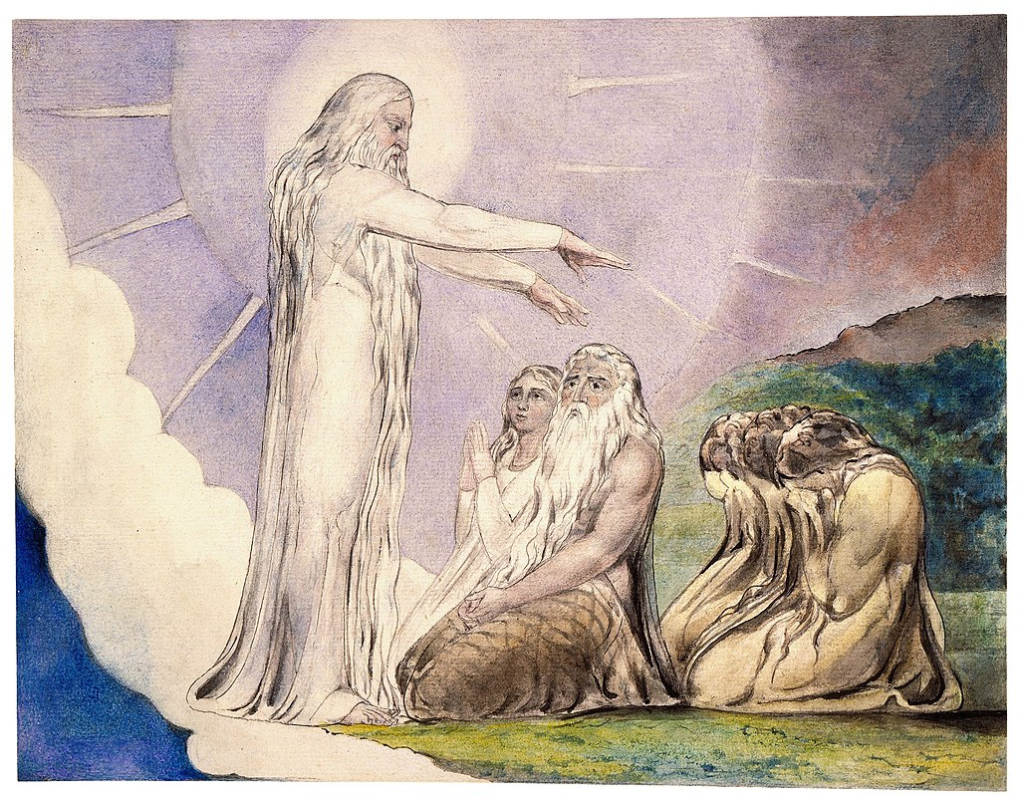
The Vision of Christ: but now my eye seeth Thee.
Watercolor by William Blake

Slide 247
Job’s Confession
“I know you are able [to do] everything, and no purpose of yours can be restrained.”
“Therefore, I declared [what] I did not discern, [things] too wonderful for me, which I did not know”
Job 42:1-3

Slide 248
Resolution
Job has now been set free from the narrow confines of his former world-view.
The satan’s slanderous prediction that Job would curse God to his face has been proved absolutely false.
Now, Job is free to speak, for he realizes that his former knowledge of God was only comparable to a dim rumor; now, he has heard from God himself (42:5).
He retracts his former doubtful ruminations and bows in deep reverence while gratefully accepting the comfort brought to him by the voice of God (42:6).

Slide 249
The Meaning of MHn
The Niphal form of the verb MHn (= to be sorry) is commonly translated as “repent.”
However, this word can also mean “to be consoled” or “to find comfort,” depending on context, and this seems to be a good choice here.
Job is not confessing sin; rather, he is frankly and fully recognizing his limitations as a man of “dust and ashes,” an idiom for human mortality.

Slide 250
God’s Rebuke of Job’s Friends
In neither of God’s long speeches did he refer to any of the arguments of Job’s friends, but now he does so.
Addressing Eliphaz, presumably the oldest and representing the others, he bluntly assesses their contributions as failures (42:7).
The irony is that all of Job’s friends condemned him, implying that his suffering was a result of God being angry with him, and now, at the end, it is Yahweh who is angry at his friends.
It was not that his friends did not say many things that were true (or for that matter, that Job always said what was correct), but their overall conclusion that sin is immediately punished while righteousness is immediately rewarded was absolutely wrong.

Slide 251
The Final Assessment
Job’s friends had argued that Job brought this tragedy on himself, and this was certainly not the case.
Indeed, Job had spoken what was “right” about God, and whatever else this might mean, it must surely include his unwavering trust in a Redeemer who would someday “stand upon the earth” and right the wrongs of the world (cf. 19:25-27).

Slide 252
The Final Irony
The deepest irony is that God now demanded of Job’s friends that they suffer the ultimate ignominy—going to Job so that he might offer a sacrifice and prayer in their behalf for their folly (42:8-9).
The large size of their sacrifice suggests the enormity of their error.
No mention is made of Elihu. Given his pomposity and verbose exuberance, it may be that he experiences the ultimate dismissal as a theological fly-weight.

Slide 253
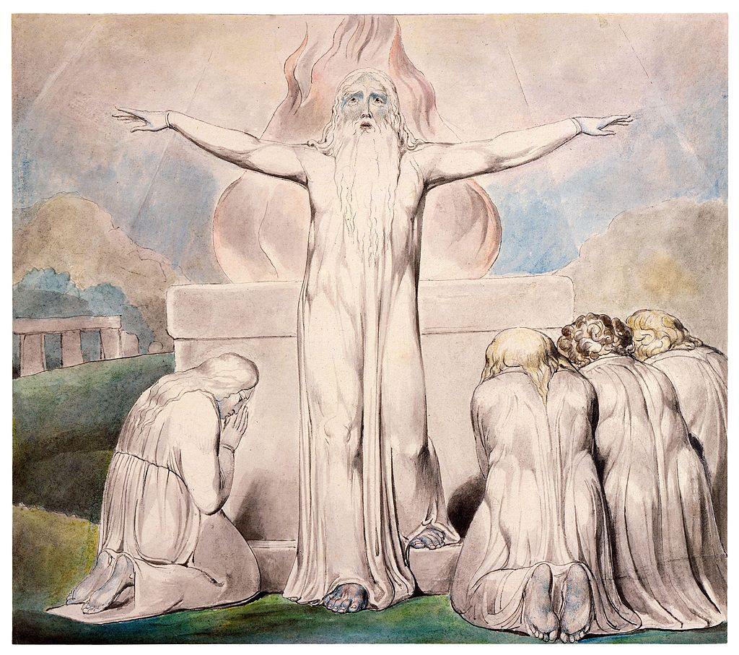
Job sacrifices and prays for his friends.
Watercolor by William Blake

Slide 254
Restoration
After his generous prayer, God turned about Job’s ordeal (42:10).
His relatives and acquaintances now came to offer gifts and condolences (42:11).
The numbers of his livestock doubled (42:12; cf. 1:3).
His additional three daughters, Dove, Cinnamon and Mascara Bottle, are singled out because of their beauty (42:13-15).
Job lived out his life to the age of 140, double the normal lifespan (cf. Ps. 90:10).

Slide 255
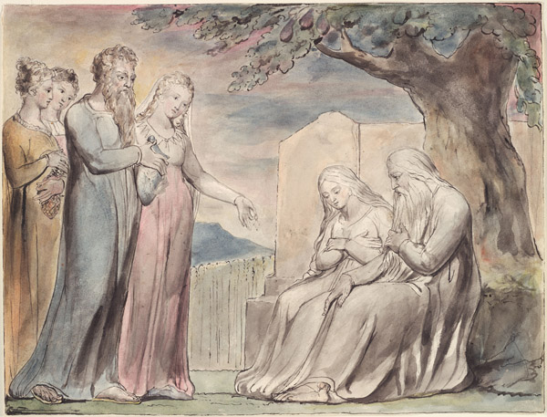
Everyone gave him a piece of money.
Watercolor by William Blake

Slide 256
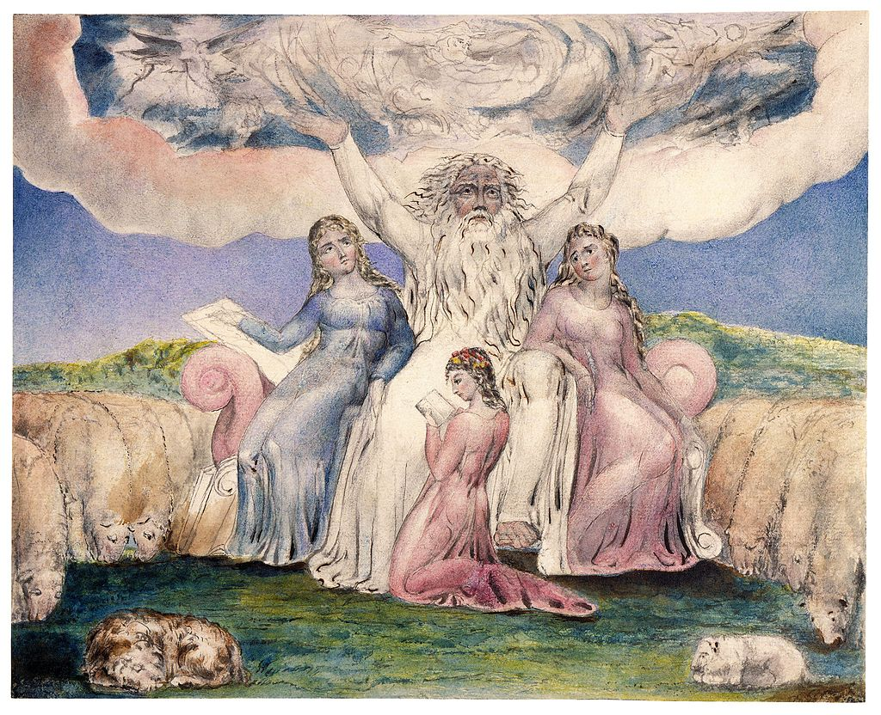
Job and his daughters
Watercolor by William Blake

Slide 257

Job restored to prosperity
Watercolor by William Blake

Slide 258
The Septuagint Addendum
The LXX offers five additional verses that are absent from the Masoretic Text.
The addendum begins with the line: “It is written, however, that he [Job] will rise again with those whom the Lord raises up.”
It also identifies Job as a descendant of Esau, locates him in Edom, offers a brief pedigree, names his wife as an Arabian, and describes Job as an Edomite king.

Slide 259
The Answers of Jesus to Job
Job’s penetrating questions are timeless, and though Job could not have known it, they would be answered in the incarnation of God’s Son.
Does God understand human suffering (6:2-3)? Jesus was made like his human fellows in every respect; he suffered and was tested to the limit (He. 2:17-18).
Could humans be righteous before an infinitely holy God (9:2, 14-20)? Since they have been justified by faith, they now have peace with God through the Lord Jesus Christ (Ro. 5:1). They are given the gift of righteousness (Ro. 5:15-17).
Is there a mediator who can fully relate to both God and human life (9:32-35)? There is one mediator between God and humans, the man Jesus Christ (1 Ti. 2:5).

Slide 260
Does God somehow perversely enjoy human suffering (10:3-4)? Certainly not! The person of faith may confidently cast all his/her cares upon Jesus, for he cares for them (1 Pe. 5:7).
Would God cover over human sin so that he might enjoy relationship with his creatures (14:16-17)? Humans have been given the opportunity of true fellowship, for the blood of Jesus cleanses them from all sin (1 Jn. 1:7).
Will there be justice in the end (24:1)? When Christ comes, he will bring to light the things now hidden in darkness and will disclose the purposes of the heart. Then each one will receive his commendation from God (1 Co. 4:5).
Why is God silent? Will he ever speak (23:3-9; 30:20)? In these last days, God has spoke to us by his Son (He. 1:2). He is able to sympathize with humans in their weakness, inviting them near to the throne of grace, where they will find mercy in their time of need (He. 4:15-16).

Slide 261
The Son of God suffered unto death, not that men might not suffer, but that their sufferings might be like his.
George MacDonald

