Slide 1
The Bible and the Artefacts of the DIA
how archaeology can enhance your appreciation of the history, culture and narratives of the Bible

Slide 2
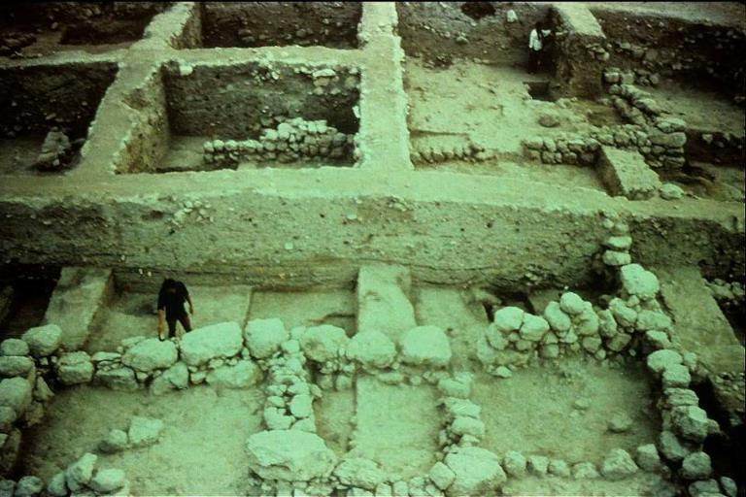
Archaeological Praxis
brief comments on how archaeologists do their work
The first reality of archaeology is that excavation is inevitably the destruction of the site. Hence, excavation is painstaking, slow, and must be properly recorded. Archaeologists unpack a dig site by dividing it into five-meter excavation grids, called balks.

Slide 3
Since many ancient sites consist of historical layers of occupation (called stratigraphy), these layers are carefully labeled and analyzed.
Here is a balk showing stratigraphy. Numbered tags identify strata (layers). Each layer is given is own “locus” (identification number) for careful recording.

Slide 4
Small hand picks and trowels are used to “trim” the balk. The upper horizontal line and the vertical plumb-line maintain the accuracy of the excavation.

Slide 5
Careful measuring and recording, using a centimeter tape alongside a plumb bob, preserve the context in written form.

Slide 6
Fragile materials require delicate tools, such as, dental picks and a soft brush.

Slide 7
Context
LITERARY CONTEXT
HISTORICAL CONTEXT
CULTURAL CONTEXT
1
2
3
Artefacts from the material past often fit into one or more important contexts. This is no less true of artefacts that are linked to the Bible.

Slide 8
For an ancient text, one needs to know not only the immediate literary context, but also, the context of other similar texts from the same period.
If a tool, weapon or utensil, one must know something of the surrounding cultural context to properly appreciate its use in the ancient world.
If an artefact relates to a person, one must attempt to discover the culture, ethnicity, government, historical period, and geographical location.
Artefacts do not stand alone. They reflect civilizations from identifiable periods of time, distinct ethnicities, unique cultures, and particular geographical locations.

Slide 9
Three Galleries in the DIA feature artefacts that assist in our understanding of the Bible
EGYPTIAN
1st Floor
Though the influence of Egypt upon ancient Israel was limited, the earliest Israelites had contact with Egyptian culture through Abraham, Jacob and their descendants.
ANCIENT MIDDLE EAST
1st Floor
The greatest influence upon ancient Israel was through Canaanite and Mesopotamian cultures.
Indeed, the very language of Hebrew is cognate with several other northwest Semitic languages.
GRECO-ROMAN
Atrium
The Christian New Testament was written against the prevailing backgrounds of both 2nd Temple Jewish and Greco-Roman cultures.

Slide 10
The Period of the Patriarchs
ca. 2000 BC

Slide 11
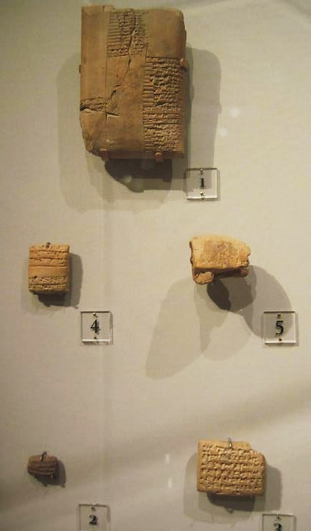
Development of Writing
The invention of writing marks the transition between the Pre-historic Period and the Historic Period. The earliest writing comes from Sumer in about 3400 BC (cuneiform), with Egypt being a close second (hieroglyphics). It first consisted of pictographs (pictorial symbols), later of graphemes (representation of spoken sounds). The earlier graphemes were syllabic, but eventually, alphabetic.
The examples here show the cuneiform style, which consisted of wedge shaped marks in soft clay.
1st Floor, Ancient Middle East

Slide 12
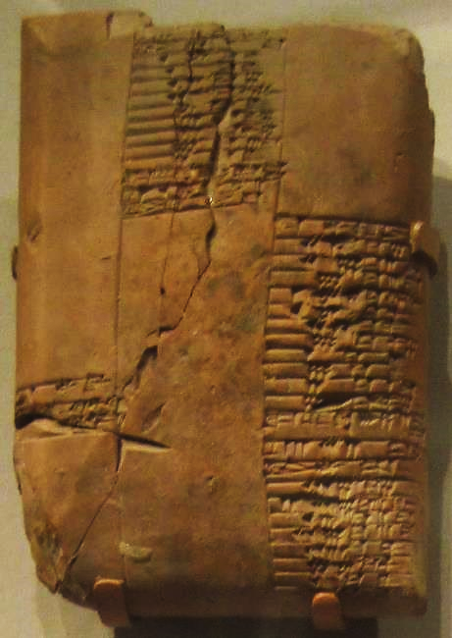
From Cuneiform to Alphabets
Cuneiform dominated Mesopotamia for several centuries, but about 2000 BC, the invention of alphabets reduced the number of written signs from about 1000 to about 30. Hebrew, the language of the Old Testament, developed from the Phoenician alphabet along with several other Northwest Semitic languages.
None of the Bible is written in cuneiform. However, some early sources used by biblical writers might have existed in cuneiform. A number of biblical names have been found in cuneiform texts, such as, Omri, Ahab, Jehu, Menahem, Pekah, Hoshea, Hezekiah and Manasseh.
1st Floor, Ancient Middle East

Slide 13
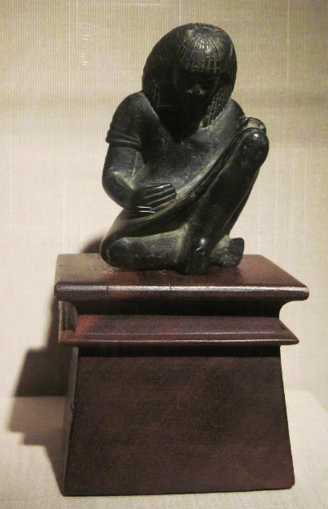
Scribes
Ancient writing initially was the province of royal courts, and it was primarily used for record keeping. While most people were illiterate, a special class of experts in writing, called scribes, served their royal superiors.
Here, an Egyptian scribe from the reign of Amenhotep III (1391-1353 BC) is shown seated with his writing implements in hand.
In the Bible, it was King David who first began using a scribe as a constituent member of his administration (2 Samuel 8:16; 1 Chronicles 24:6; cf. 2:55).
1st Floor, Ancient Middle East

Slide 14
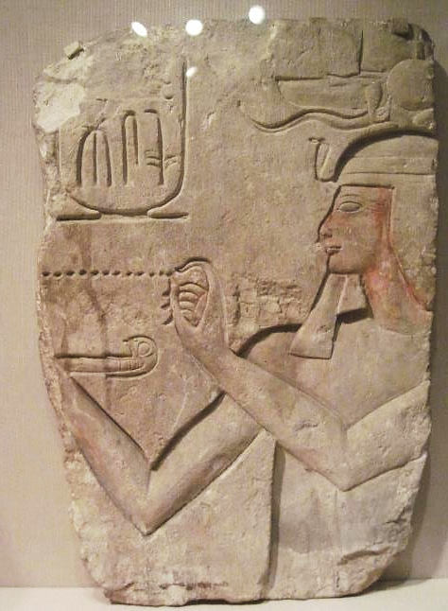

Slide 15
Wooden Coffin Wall
Egyptian burial practices varied according to the price paid by the family, and coffins varied accordingly, including a wooden sarcophagus and a wooden coffin. The Book of Genesis specifically says that Joseph was interred in a coffin (Genesis 50:26), and the Hebrew term used here is the same as the word “ark”, though the precise style of coffin is unknown.
1st Floor, Egyptian

Slide 16
Egyptian Canopic Jars
EGYPTIAN CANOPIC JARS The Egyptian process of embalming included the removal of internal organs, which then were deposited in special jars, each jar reserved for a specific organ, the stomach, intestines, lungs and liver. The four jars in this display are typical, each representing one of the four sons of the Egyptian god Horus. The Israelites, of course, did not practice embalming, but two very important Israelites were embalmedJacob, the father of all Israelites, and Joseph, the oldest son of Rachel, who when he died was embalmed and placed in a wooden coffin (Genesis 50:2-3, 26).
Whether or not Jacob’s or Joseph’s internal organs were deposited in canopic jars is unknown, but presumably they were. Subsequent to his embalming, Jacob was removed from Egypt and carried back to Canaan, where he was buried in the cave originally purchased by Abraham for the interment of Sarah (Ge. 50:4-14). The remains of Joseph himself were later removed from Egypt and carried to Canaan in the exodus (Exodus 13:19; Acts 7:15-16).
1st Floor, Egyptian

Slide 17
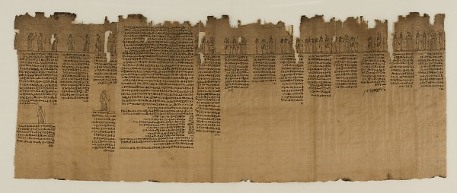
Book of the Dead
The Book of the Dead is an ancient Egyptian funerary text intended to assist deceased persons as they journey through the underworld in the afterlife. The ancient Israelites, of course, had no such text, but they did envision a Book of Life, a heavenly record of the righteous (Exodus 32:32; Psalm 69:28; Philippians 4:3; Revelation 3:5; 13:8; 17:8; 21:27).
1st Floor Egyptian

Slide 18
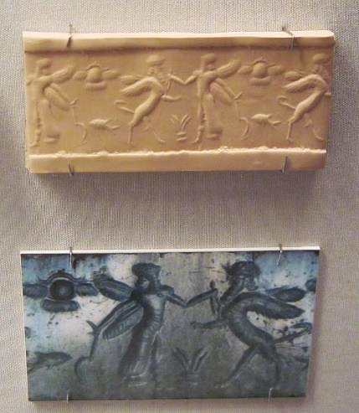
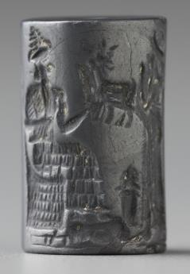
Cylinder Seals
Invented around 3500 BC, cylinder seals were created from hardstones, bored through the center (for hanging around one’s neck), and engraved with figures or characters. These seals served as personal signatures. They could be rolled into wet clay, producing a reverse image of the engraving.
Just such a cylinder seal saved the life of Tamar, the widowed daughter-in-law of Judah, one of the ancestors of Jesus (Matthew 1:3). She was discovered to be pregnant and sentenced to death for immorality, but when she produced the cylinder seal of the father, it was the signature of Judah himself (Genesis 38:25-26)!
1st Floor, Ancient Middle East

Slide 19
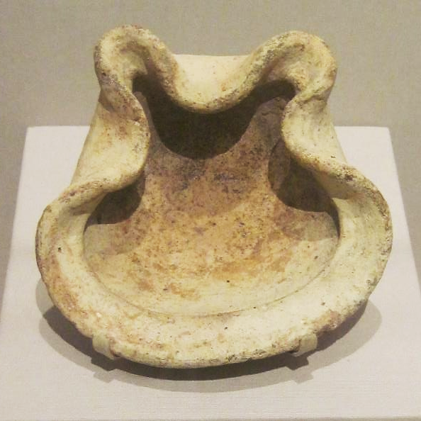
Oil Lamps
Oil lamps were used throughout antiquity for light. Early lamps were hand-formed, and by the Middle Bronze Age they were fashioned as saucers by pinching the sides to form corners for wicks. Gradually, these corners developed into spouts, which were useful for pouring out unused oil and water. Eventually, lamps were formed on a wheel. The form of this particular lamp suggests it comes from the Iron Age. In a vision, Daniel saw a heavenly figure whose eyes were like flaming lamps (Daniel 10:6).
Olive oil was the standard fuel, and it floated upon the surface of an underlying layer of water. Water sealed the porous clay of the lamp, while a wick was inserted and salt could be used for a brighter flame.
1st Floor, Ancient Middle East

Slide 20
The Period of the Tribal League
ca. 1200-1000 BC

Slide 21
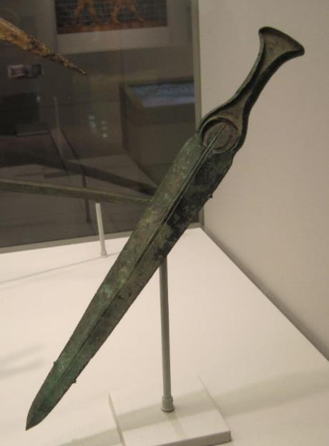
Bronze Sword
Weapons and tools made from bronze, an alloy of tin and copper, characterize the Bronze Age. The Israelites were late in making the transition from bronze implements to iron ones, since the Philistines held a monopoly on emerging iron technology (1 Sa. 13:19-21). During the tribal confederacy, the Israelites were held under tribute to Eglon, the Moabite king from the Transjordan. A left-handed Benjamite named Ehud was chosen to carry tribute money to Eglon, but after he delivered the tribute, he assassinated the pagan ruler in his own royal privy (Judges 3:12-27). He had concealed a short sword—much like the one here—along his right thigh under his clothing. Since most people in the ancient world were right-handed, the king did not see Ehud draw the sword with his left hand.
1st Floor, Ancient Middle East

Slide 22
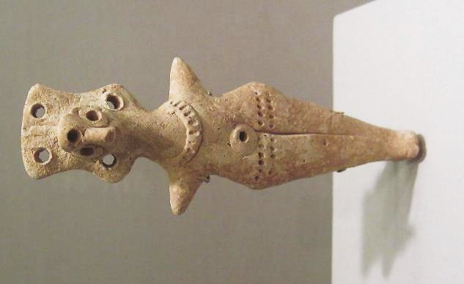
Fertility Figurine
This goddess figurine with what many scholars believe to be a bird face probably depicts Asherah or Astarte (ca. 14th - 13th century BC), one of the female deities of the Canaanite pantheon (Judges 3:7, etc.). Canaanite religion was a type of fertility cult featuring the mating of Ba’al and his consort, and religious rituals may have included sacred prostitution. The female deity usually is portrayed nude and adorned with necklaces or other jewelry. The terephim of Laban may have looked similar to this (Genesis 31:19, 30-35).
1st Floor, Ancient Middle East

Slide 23
The Period of the Monarchy
ca. 1000 BC and later

Slide 24
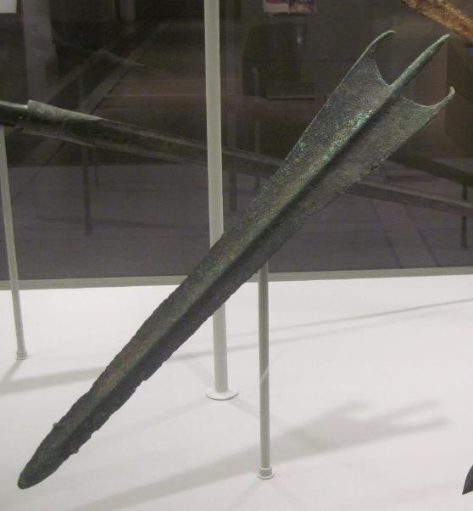
Bronze Javelin Head
Bronze was the metal of choice during the Bronze Age for tools and weapons, largely due to it’s relatively low melting temperature. It was much harder and durable than copper and was a distinct technological advantage over stone tools or weapons. Fortunately for archaeologists, bronze implements survive reasonably well over the centuries, since unlike iron, bronze does not deteriorate so rapidly.
Saul, Israel’s first king, used a javelin with a head probably similar to this one, and twice he attempted to murder David with it (1 Samuel 18:10-11; 19:9-10).
1st Floor, Ancient Middle East

Slide 25
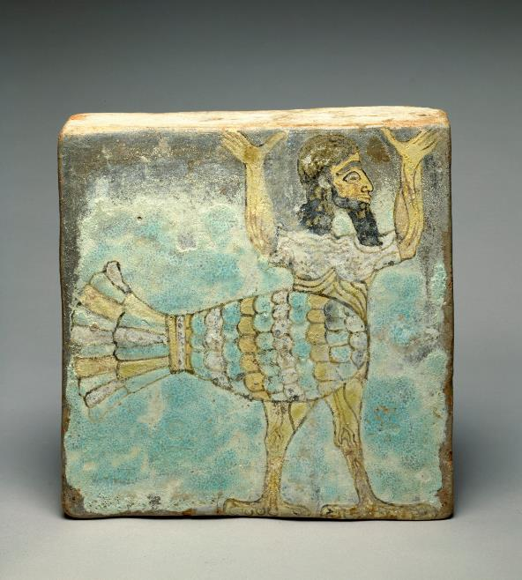
Assyrian Magical Bird Man
The walls of Assyrian temples and palaces sometimes were decorated with adornments such as this glazed brick Bird-Man, ca. 13th century BC.
This creature is a composite, part bird and part human, a typical feature of Assyrian iconography, which brings together multiple attributes into a single creature. It is depicted with arms upraised, presumably in deference to a deity.
The Israelites were strictly forbidden to depict such images in the 2nd of the 10 commandments (Exodus 20:4; Deuteronomy 5:8).
1st Floor, Ancient Middle East

Slide 26
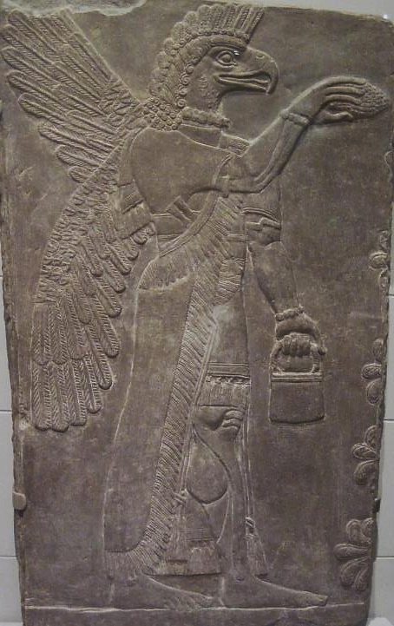
Protective Figure
Mesopotamian iconography depicted deities and spirits as animals or half-human and half-animal. This bas-relief of an Assyrian protective spirit, shown with a human body, wings and an eagle’s head, is depicted as fertilizing the sacred date palm tree. In Ezekiel’s temple vision (Ezekiel 8:9-13), where he was shown several forms of idolatry being carried on in the very precincts of the Jerusalem temple, one type of figure he saw was of “detestable animals” engraved on the wall. This image is likely the sort of thing that Ezekiel saw. The Israelites had become fascinated with Mesopotamian religion, and they were importing it wholesale into Israel, a violation so egregious that Yahweh determined to abandon the temple and allow its destruction.
1st Floor, Ancient Middle East

Slide 27
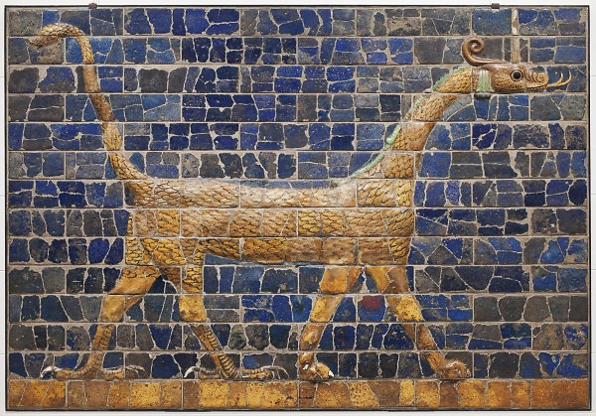
Dragon of Marduk
Marduk, a primary deity of Babylon, is also depicted as a composite animal, having the head of a serpent with viper’s horns, a body covered by scales, the front feet of a lion, the hind feet of an eagle and a scorpion’s tail. This iconography, which symbolized the attributes of power, intelligence and speed, would later be utilized by the biblical Daniel to describe the powerful empire-builders of the ancient world (Daniel 7). The glazed brick image here was part of the Ishtar Gate, the climax of the Processional Way constructed by Nebuchadnezzar II (604-562 BC). This Babylonian king would destroy Jerusalem and its temple (2 Kings 24-25), and the exiles of Judah would have passed through this gate as trophies of war while viewing this image of the god of their enemies.
1st Floor, Ancient Middle East

Slide 28
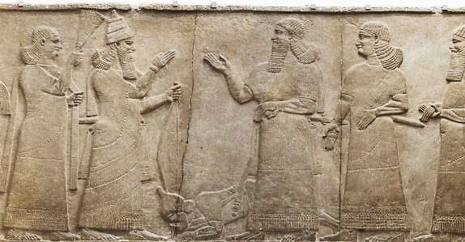
Tiglath-Pileser III
Known as Pul in the Bible (2 Kings 15:19, KJV), this Assyrian Emperor (745-727 BC) began an aggressive western campaign against nations in the Levant, of which the northern kingdom of Israel was one. Menahem, one of the Israelite kings, was forced to become a vassal (2 Kings 15:17-22), and Menahem is
named in Assyrian texts as a tributary. When Ahaz of Judah invited Tiglath-pileser to defend him (2 Kings 16:7-9), it was the beginning of the end for the northern kingdom of Israel. With terrific force, the Assyrians invaded both Aram and Israel, deporting more than 13,000 Israelites from their homeland and placing Hoshea as a puppet-king over Israel. Here, Tiglath-pileser, who is named in the cuneiform script, receives homage from a tributary, while surrounded by his eunuch asn military officers.
1st Floor, Ancient Middle East

Slide 29
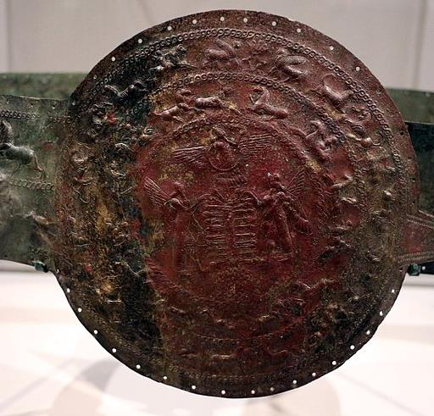
Assyrian Ceremonial Belt
This bronze ornamental belt with perforations for attaching leather or cloth linings is made of hammered sheet metal with engravings. It dates to ca. 850-650 BC. In the center, it features two winged guardians ceremonially fertilizing the sacred date palm. Above them is the winged sun-disk of Shamash, the sun god.
Isaiah used the imagery of a belt to describe the character of the Messiah in which “righteousness shall be the belt of his waist” (Isaiah 11:5).
1st Floor, Ancient Middle East

Slide 30
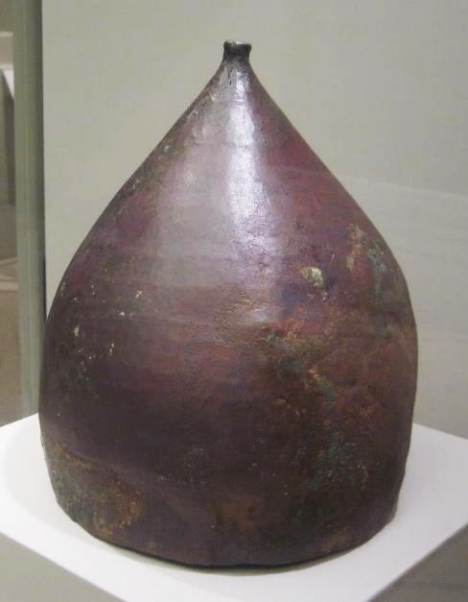
Assyrian Helmut
Assyria was the first big superpower that ancient Israel faced. Beginning with Ahab, who joined a coalition of small states, the Israelites would confront the Assyrian threat again and again, until finally, it would be the Assyrians who would bring the northern kingdom of Israel to an end.
Assyrian soldiers wore pointed bronze or iron helmets, hammered from a single piece of metal, which deflected blows or missiles. King Uzziah of Judah outfitted his soldiers with various implements, including helmets similar to this one (2 Chronicles 26:14). Isaiah was the first biblical writer to speak of the helmet metaphorically as a symbol of salvation (Isaiah 59:17).
1st Floor, Ancient Middle East

Slide 31
The Period of the Exile and Post-exile
ca. 600 BC and later

Slide 32
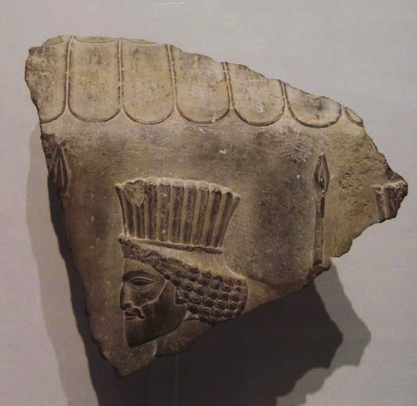
Persian Imperial Guard
Persian imperial guard holding a spear
Persepolis???
Capital of the Achaemenid Empire
Line of soldiers (see spear tip and edge of headdress)
Major building projects by Darius the Great, Xerxes Artaxerxes I, Artaxerxes III
Largest empire so far in history, from the Indus River to Libya and Egypt, and the northern coast of the Aegean Sea

Slide 33
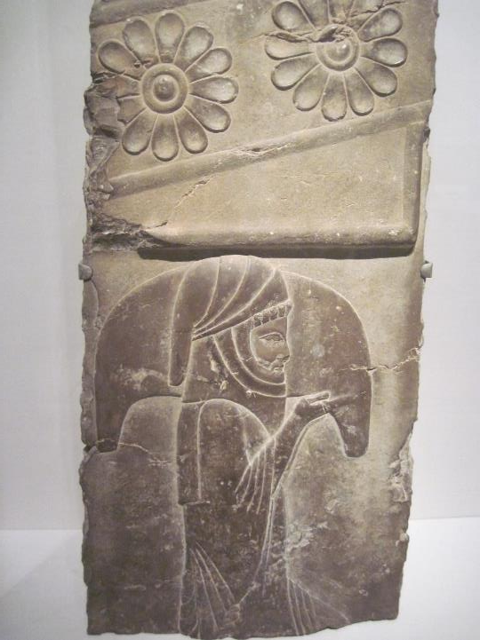

Slide 34
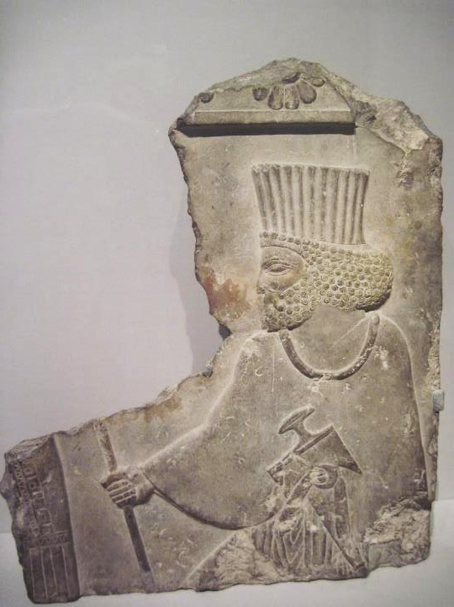

Slide 35
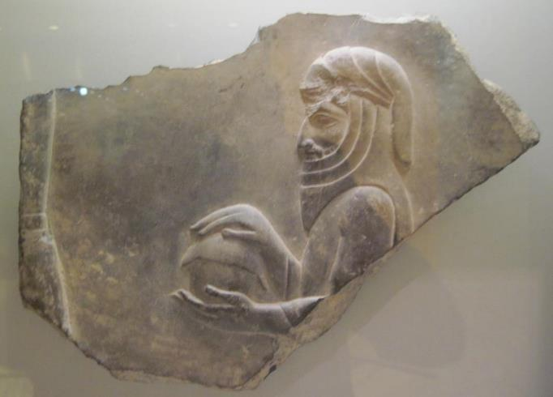
Courtier with a covered bowl
Persepolis

Slide 36
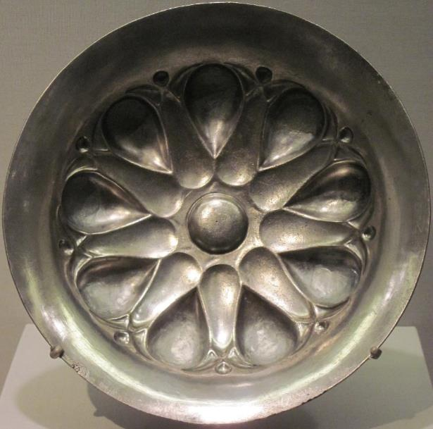
Persian Drinking Bowl
Silver drinking bowls such as this one are excellent examples of the high level of metallurgy and artistic design in the Persian Period (539-331 BC). One important biblical character, Nehemiah, served as the cupbearer to Artaxerxes I (Nehemiah 1:11b; 2:1), and almost certainly he used silver drinking bowls like this one to wait upon the emperor. The position of cupbearer to the emperor was much more important than might be supposed at first glance, since this was a highly trusted position. Ancient kings were well-protected from assassination by armed palace guards, but there was always the danger of poison. Indeed, we know of several ancient kings who died in just this way. The cupbearer to the emperor, then, must be a man completely trustworthy, since the life of the emperor might quite literally be in his hands.
1st Floor, Ancient Middle East Gallery

Slide 37
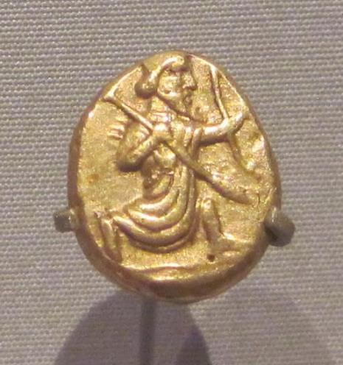
Gold Daric
A daric is a Persian gold coin bearing the image of Darius I Hystaspes (ca. 500 BC). The coin weighs 0.3 ounce, and coins like this one were brought by the Jewish exiles from Babylon/Persia when they were allowed to return to Jerusalem under the edict of Cyrus the Great (Ezra 2:69; Nehemiah 7:70-72). Coins were introduced to Persia from Lydia, which the Persians conquered in 546 BC. Prior to coinage as a medium of exchange, precious metals like gold and silver were weighed on a balance scale.
1st Floor, Ancient Middle East

Slide 38
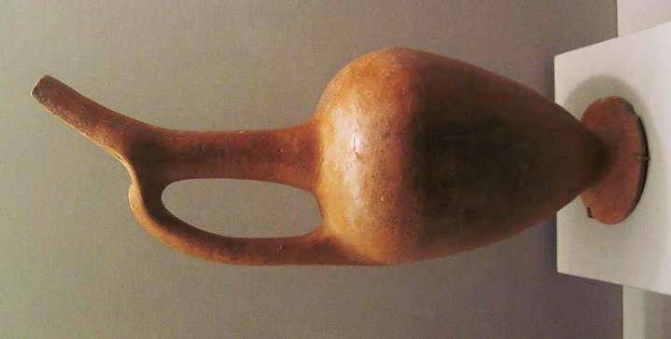

Slide 39
The Period of the Early Christianity
ca. 4BC to 100 AD

Slide 40
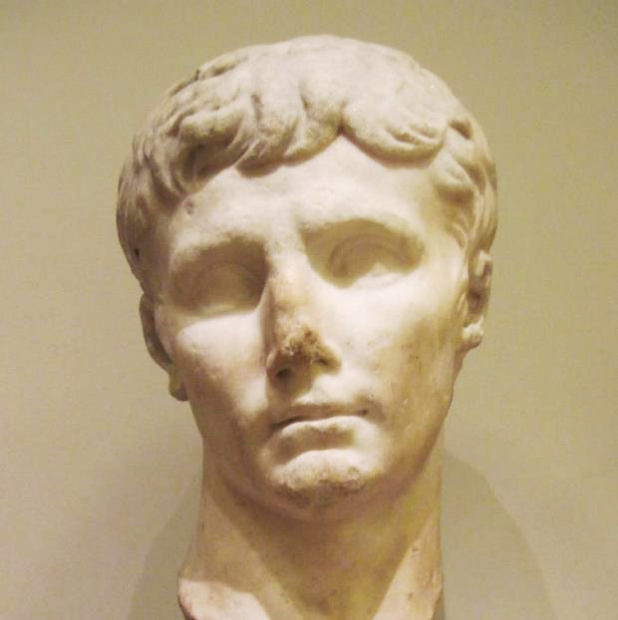
Caesar Augustus
Augustus (ruled 27 BC – AD 14) was the emperor of Rome at the time of Jesus’ birth (Luke 2:1). Three important Greek words in the New Testament are linked with him. First is SOTER (= Savior, Benefactor), one of the titles for the Emperor, which is contrasted with the birth of Christ as the true Savior (Luke 2:11). Second is KYRIOS (= Lord), and the common patriotic acclamation for Roman subjects was “Caesar is Lord”. By contrast, the Christian confession was “Jesus is Lord” (Romans 10:9). The third word is EUANGELION (= good news, gospel). Augustus’ birthday was announced to the empire as “good news”, but for Christians, the good news was about Jesus, not Caesar (Mark 1:1).
2nd Floor, Atrium

Slide 41
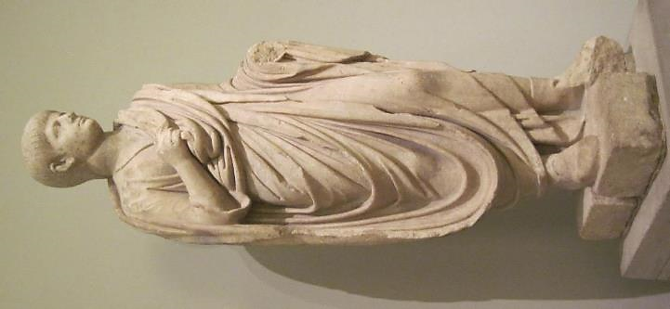
Caesar Nero
This youthful version of Nero (ruled AD 54-68) was produced after he was named successor to Emperor Claudius. When in power, Nero blamed the great fire in Rome in AD 64 on the Christians, according to the Roman historian Tacitus. It was to this Caesar that St. Paul appealed after his arrest in Jerusalem and two year incarceration in Caesarea. Paul was incarcerated in Rome another two years. However, the New Testament does not describe the outcome of his imperial hearing. Later Christian historians indicate that Paul was executed by beheading under Nero, probably in AD 64. Probably in AD 65, the other great leader of the Christians, St. Peter, was also martyred in Rome under Nero, who according to early witnesses was crucified upside down, because he felt unworthy to be crucified in the same manner as his Lord.
2nd Floor, Atrium

Slide 42
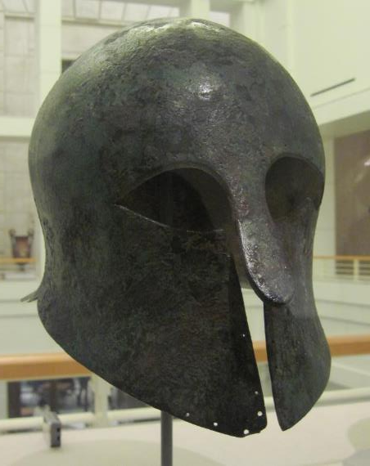
Hoplite Helmut
Hoplites were citizen-soldiers of the ancient Greek city-states who wore special bronze armor. Hoplite armor and weaponry consisted of a helmet, breastplate, greaves, a concave shield and a short sword, among other pieces. St. Paul used the hoplite armor and weaponry as metaphors for the Christian’s warfare against spiritual enemies. He speaks of the “full armor of God”, which includes the “helmet of salvation”, the “breastplate of righteousness”, the “shield of faith” and the “sword of the Spirit” (Ephesians 6:11-17). In yet another letter, he speaks of the “breastplate of faith and love” as well as the “helmet of the hope of salvation” (1 Thessalonians 5:8).
2nd Floor, Atrium

Slide 43
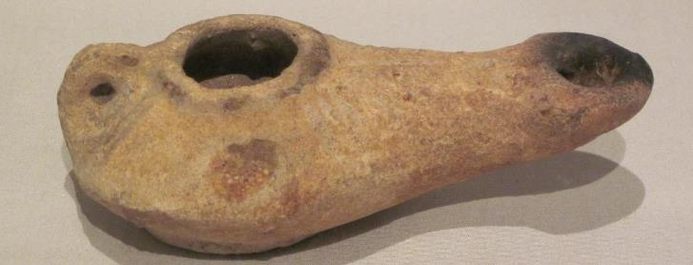
Oil Lamp
This ancient lamp, probably dating to the Hellenistic Period or later, has a central upper opening for pouring in oil and a small spout with a hole for the wick. Such lamps are featured in several New Testament stories, including the lamps in Jesus’ parable of the ten wedding attendants (Mt. 25:1-13), the parable of the woman who lost a valuable coin and used a lamp to search out the dark corners of her home (Luke 25:8), Jesus’ humorous comment that no one lights a lamp and puts it under a mattress (Luke 8:16) and Paul’s midnight sermon in an upstairs room lit by “many lamps” (Acts 20:8).
1st Floor, Ancient Middle East

Slide 44
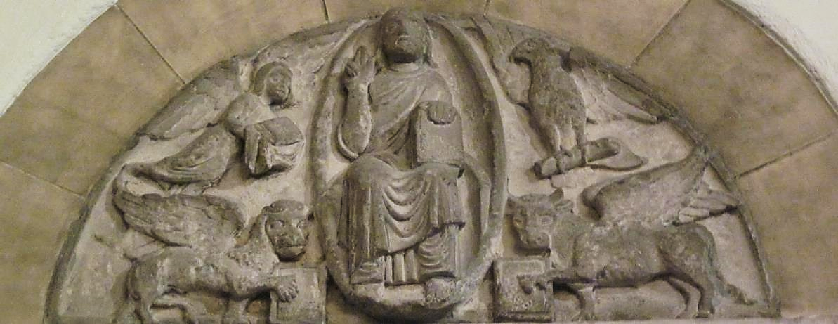
Symbols of the Four Gospels
Two places in the Bible describe four heavenly creatures, the cherubim of Ezekiel 1, 10 and the four living creatures in Revelation 4:6b-8. These creatures are depicted as a lion, an ox, a human and an eagle. Early Christians associated these four creatures with the four gospels, the human symbolizing Matthew, the lion symbolizing Mark, the ox symbolizing Luke and the eagle symbolizing John.
2nd Floor, Medieval

