Slide 1
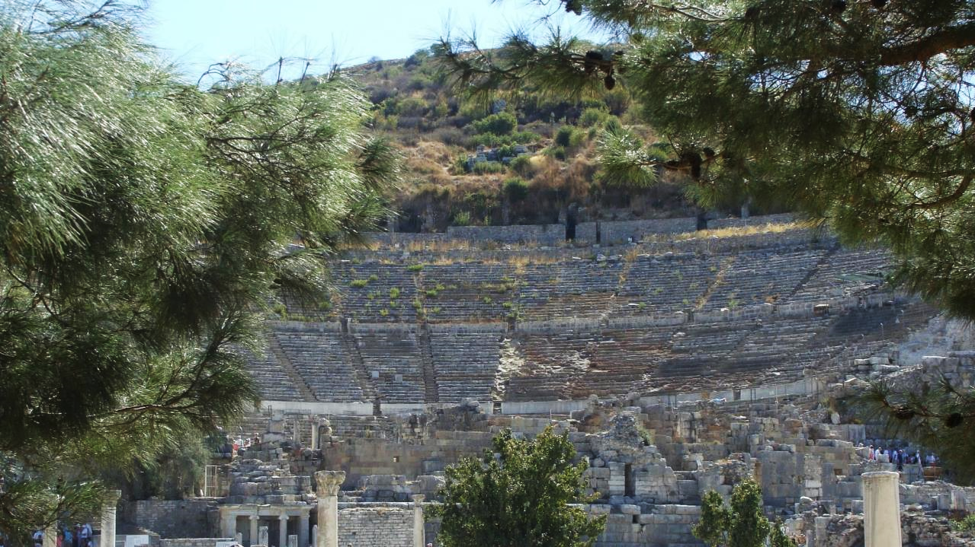
NT ARCHAEOLOGY
NT ARCHAEOLOGY
Early Christianity after the New Testament
Lesson 13
Lesson 1
Introduction

Slide 2
BIRKAT HA-MINIM
(curse upon the heretics)
“For the apostates let there be no hope, and let the arrogant government (i.e., Rome) be speedily uprooted in our days. Let the Nazarenes (i.e., Christians, cf. Acts 24:5) and the heretics be destroyed in a moment, and let them be blotted out of the book of life and not be inscribed together with the righteous. Blessed art thou, O Lord, who humblest the arrogant.”
(from the 18 benedictions, the synagogue liturgy of the late 1st century)

Slide 3
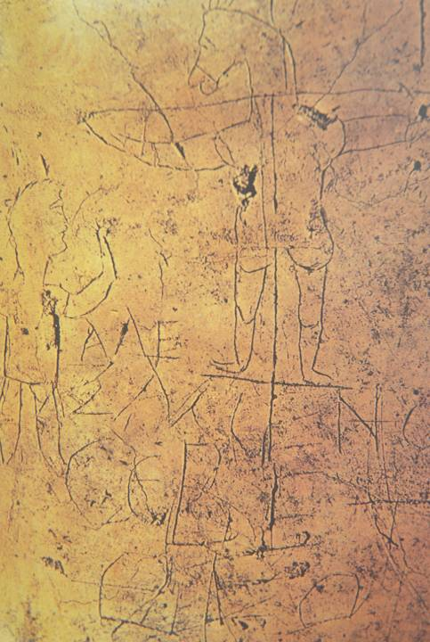
Early graffito mocking Christians, Palatine Hill, Rome
Alecamenoj sebete qeon
(Alexamenos prays to [his] god)

Slide 4
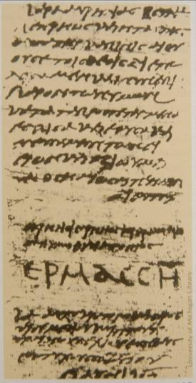
LIBELLUS: certificate proving that one had sacrificed to the Roman gods
Found in Egypt
One of 43, all dated between June 12th and July 14th, AD 250.
Hermas, the recipient, signed his name in large capital letters.
University of Michigan

Slide 5
Talking Points
Religious persecution has a long history, not only non-Christians against Christians (Rome, Islam), but also Christians against non-Christians (Crusades) and Christians against other Christians (Post-Reformation Period). Why do you think Christians themselves have engaged in such religious persecution?
How has this affected their Christian testimony?

Slide 6

Staurograms
The earliest depictions of the cross occur in New Testament texts in which the letters tau (t) and rho (r) from the Greek words “cross” (stauroj) and “crucify” (staurow) appear superimposed on each other, looking something like this:
Beginning in NT texts from about AD 200, staurograms are the earliest visual depictions of Christ crucified.

Slide 7
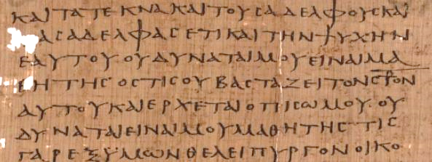
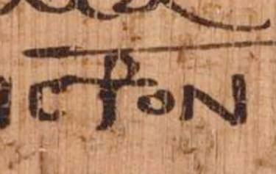
Early text of Luke 14:27 p75 Bodmer Papyri XIV (ca. AD 200-225)
Vatican Library, Rome

Slide 8
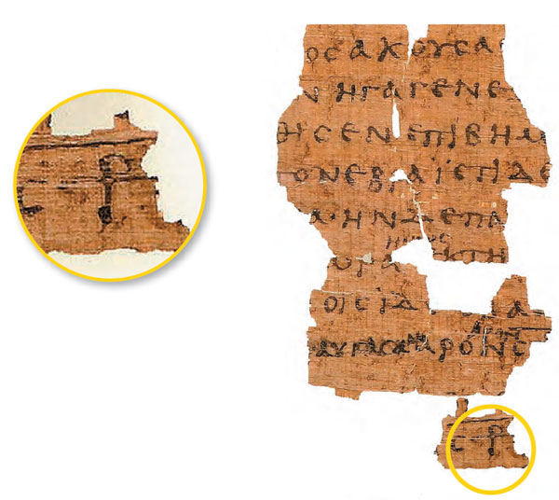
Early Text of John 19:13ff. p66
Bodmer Papyri II
(ca. AD 200)
Staurograms appears in John 19:6, 15, 16, 18, 19, 25, 31.
The superimposed letters look like a human figure hanging on a cross.

Slide 9
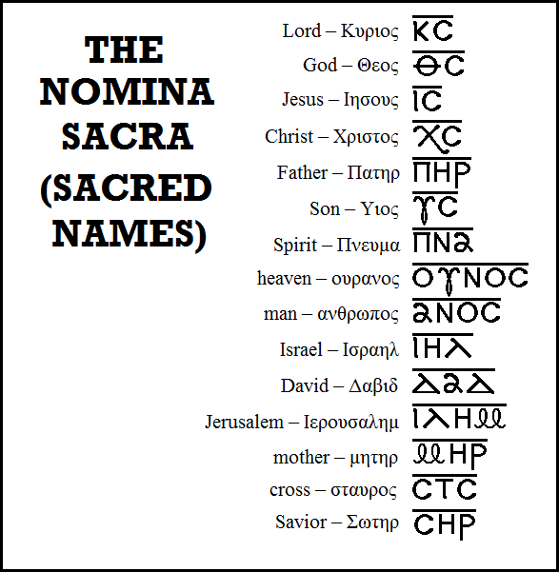
Typical Nomina Sacra found in early New Testament manuscripts.
All these abbreviations are found in Greek manuscripts of the 3rd century and earlier except “mother,” which begins to appear in the 4th century.
Bruce Metzger,
Princeton University

Slide 10
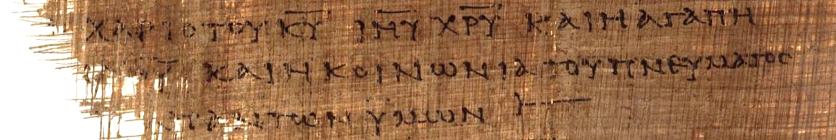
2 Corinthians 13:13 (p46)
“[The] grace of the Lord Jesus Christ and the love of [God] and the fellowship of the Holy Spirit [be] with you all.”
Here, the sacred names “Lord,” “Jesus,” and “Christ” have all been abbreviated with a line drawn over them.
KURIOU = KU = Lord
IHSOU = IHU = Jesus
XRISTOU = XRU = Christ

Slide 11

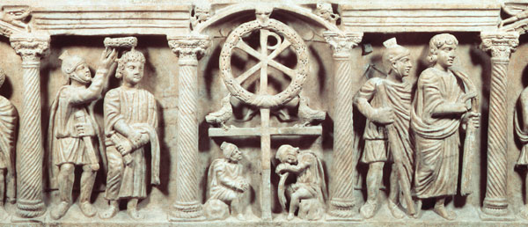
Christograms
Other early similar literary combinations include the chi-rho, looking something like this:
Ca. AD 340
These are the first two letters in the name “Christ” superimposed over each other.

Slide 12
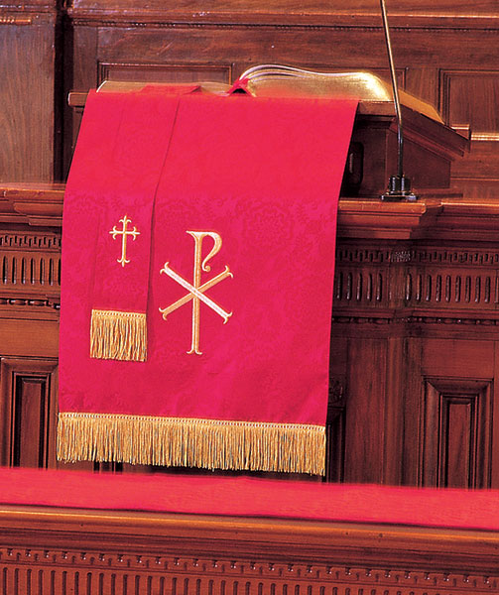
Even in the 21st century, liturgical churches continue to use these ancient symbols, such as the chi-rho.

Slide 13
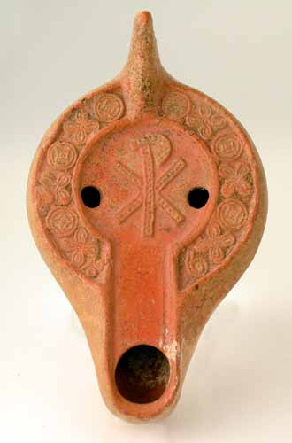
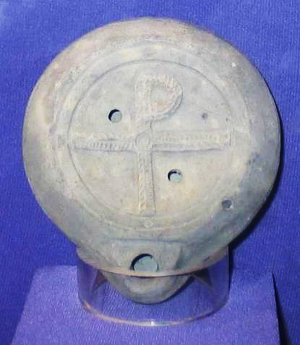
Lamps with Christian Reliefs
Christian oil lamp from the late Roman Period with Chi-Rho
Recovered from Caesarea Maritima, 4th century with Tau-Rho

Slide 14
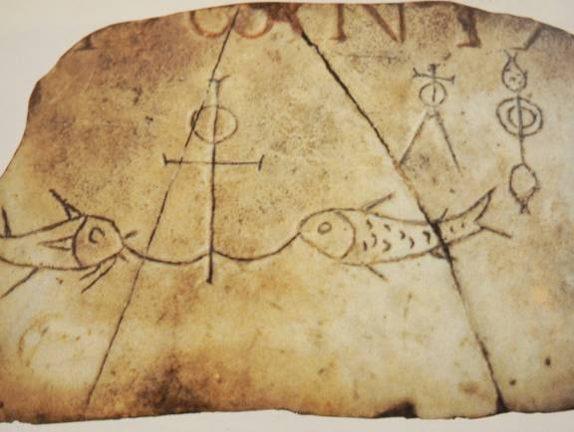
THREE SYMBOLS
ANCHOR
Symbol of hope and steadfastness
CROSS
Symbol of the sacrifice of Jesus
i]xquj (= fish acronym)
i]hsouj = Jesus
xristoj = Christ
qeoj = God
u[ioj = Son
swthr = Savior

Slide 15
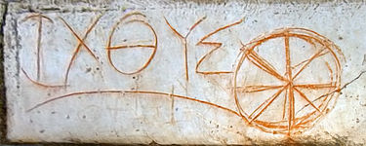
Early circular fish symbol created from Greek Letters IXQUS/ICHTHUS discovered at Ephesus

Slide 16
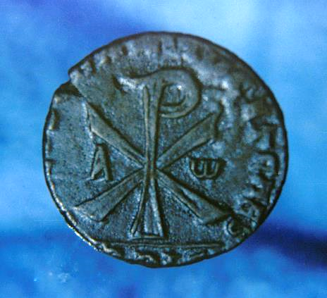
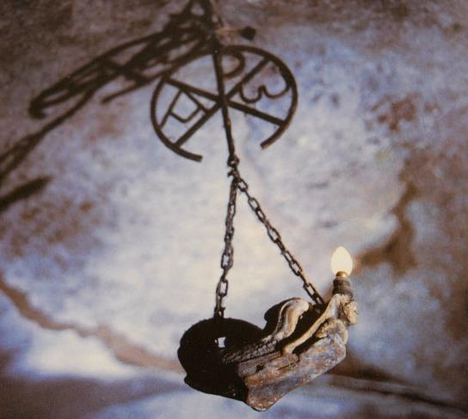
Early Christian
Chi-Rho Symbols
…with the alpha and omega

Slide 17
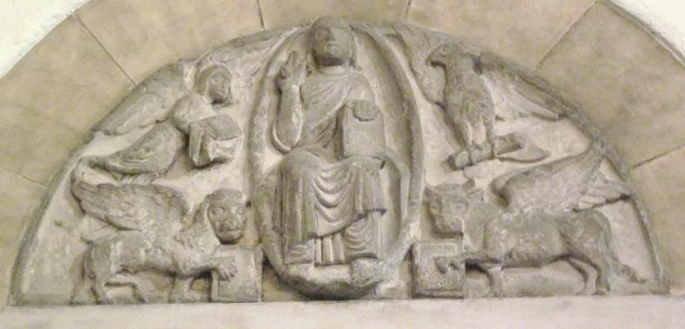
ANCIENT CHRISTIAN SYMBOLS OF THE FOUR GOSPELS Early Christians, beginning at least as far back as St. Jerome, began to associate the four creatures in Ezekiel and Revelation as representing the four canonical gospels, with the winged human symbolizing Matthew, the winged lion symbolizing Mark, the winged ox symbolizing Luke and the eagle symbolizing John. The majestic figure of Christ, enthroned as the ruler of the world, is usually depicted along with these four witnesses to his incarnation, kingship, sacrifice and heavenly character. These symbols were common motifs in church portals, apses and other locations.
Detroit Institute of Arts

Slide 18
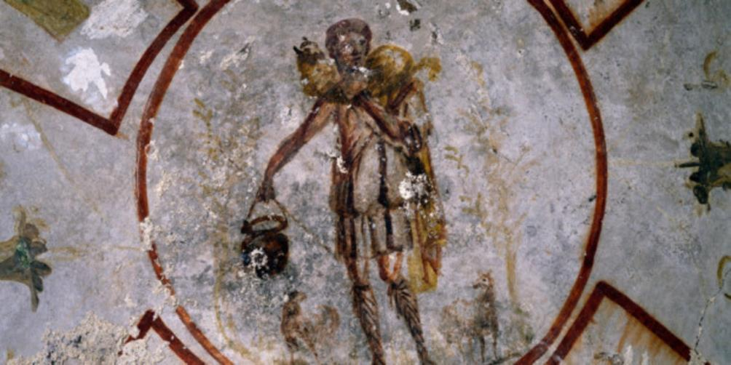
Christ, the Good Shepherd, carries a lamb on his shoulders.
Painted on the walls of the St. Callisto catacomb in Rome (mid-3rd century).

Slide 19
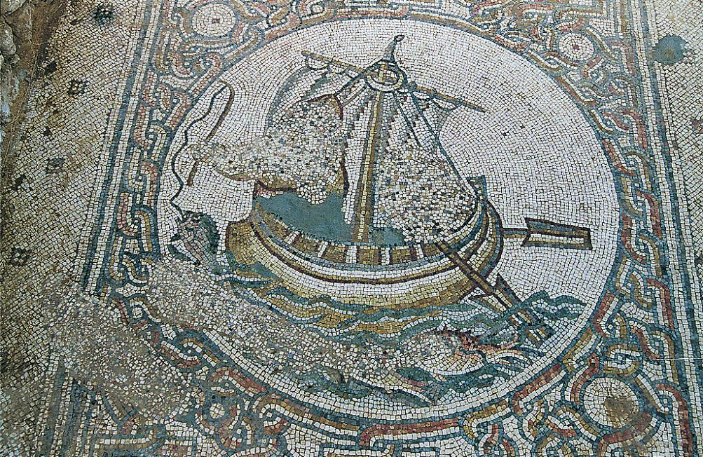
Floor mosaic in the 6th century church at Horvat Beit Loya in central Israel.
Although the figures have been defaced (by Muslim edict), they probably depicted Jesus and his disciples.

Slide 20
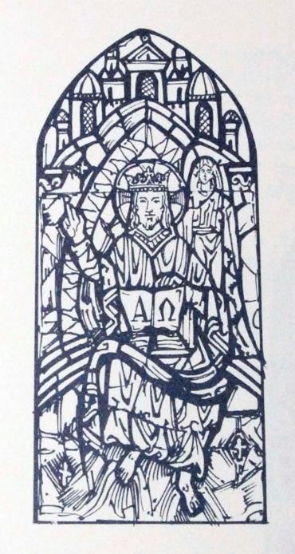
A and W
The prologue concludes with a cryptic description of God’s sovereignty over history using the first and last letters of the Greek alphabet.
The Alpha and Omega are featured in the second Narthex window of Mariners’ Church

Slide 21
Talking Points
Are there limits to the use of Christian art, and if so, what might they be?
How have Christians of different persuasions answered this question?

Slide 22
NT ARCHAEOLOGY
NT ARCHAEOLOGY
New Testament Texts
Lesson 14
Lesson 1
Introduction

Slide 23
The Papyri of the New Testament
All extant texts of the New Testament were written on papyrus sheets and bound in a codex.
Papyrus was an inexpensive “paper” made from crushed reed stems, and the process of writing is what John calls “papyrus and ink” (2 Jn. 12) or “ink and reed” (3 Jn. 13).
Early Christian texts, unlike traditional Jewish texts which were written on scrolls, were bound in a codex (indeed, Christians are credited with popularizing, perhaps even inventing, the codex form).
Unlike a bundle of scrolls, the codex, by necessity, necessitates a fixed order, and this fixed order was applied to both the LXX and the Christian texts.

Slide 24
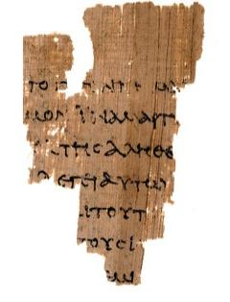
p52 verso side (back) John 18:37-38 the earliest fragment of the NT yet discovered
TOU]TO G[E]GENNHM[AI
e]gw> eij tou?]to g[e]ge<nnh[mai kai>
“…I for this have been born and…”
EIC TON KOC]MON INA MART[URHCW
ei]j to>n ko<s]mon i!na mart[urh<sw
“…into the wor]ld that I might wit[ness…”
EK] THC ALHQE[IAC
pa?j o[ w}n e]k] th?j a]lhqe[i<j a]kou<ei mou
“…everyone who being] of the tru[th hears of me.”
L]EGEI AUGW [---
th?j fwnh?j. l]e<gei au]t&? [o[ Pila?toj ti<
“…the voice. S]ays to him, [Pilate: ‘What…”
KA]I TOUT[O
e]stin a]lh<qia; ka]i> tou?t[o ei]pw>n pa<lin
“…is truth? An]d thi[s having said again…”
T]OUC I[OUDAIOUC
e]ch?lqen pro>j t]ou>j ]I[oudiai<ouj
“…he went out t]o the J[ews…”
OUD]EM[IAN
e]gw> ou]d]em[i<an eu[ri<skw e]n au]t& ai]ti<an
“…I n]o[ find in him crime…”
University of Manchester, England

Slide 25
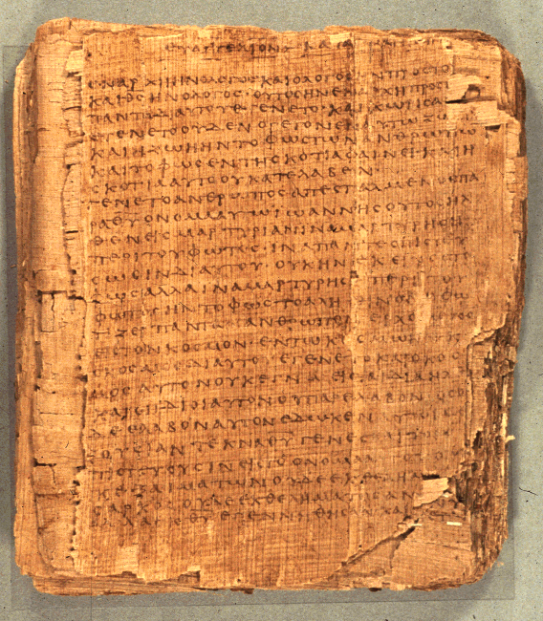
p66
Bodmer Papyrus II
Gospel of John
75 leaves and 39 fragments
6.4 inches x 5.6 inches
14-25 lines per page
ca. AD 200
Words for “God”, “Jesus”, “Lord,” and “Christ” are always abbreviated
Bodmer Library of World Literature, Geneva

Slide 26
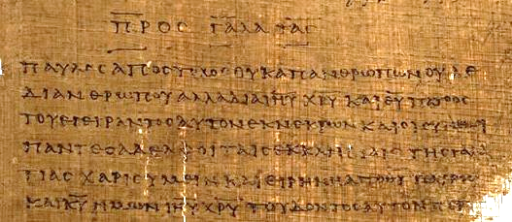
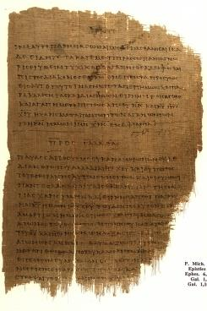
p46
End of Ephesians and beginning of Galatians
ca. AD 200
University of Michigan

Slide 27
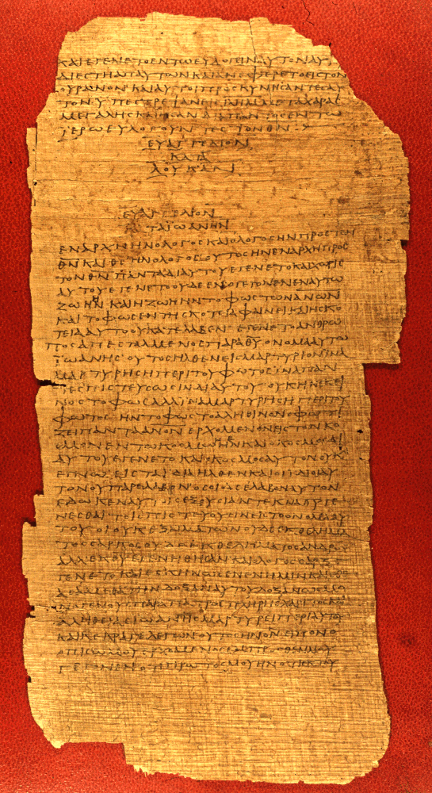
p75
End of Luke, beginning of John
Vatican Library, Rome
AD 175-225

Slide 28
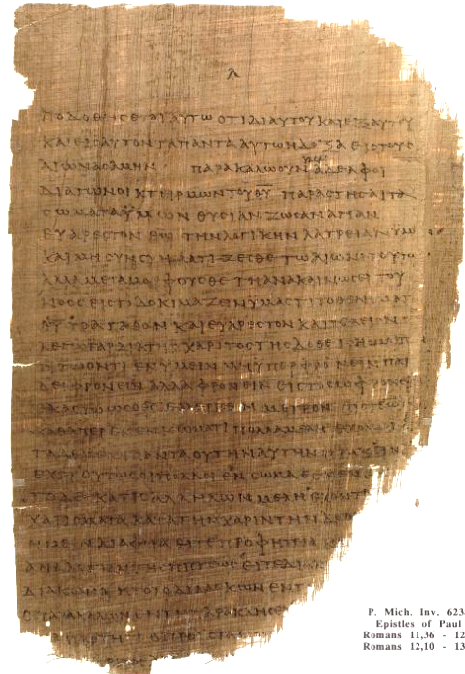

p46
Romans 11:36ff. ca. AD 200
University of Michigan

Slide 29
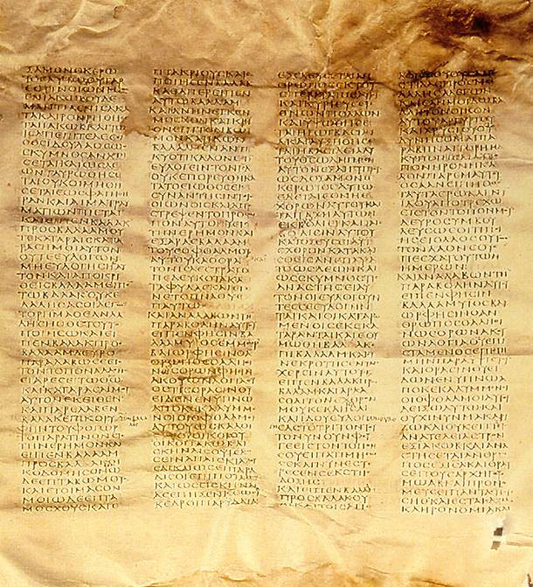
x
Codex Sinaiticus
4th century
Oldest “complete” Christian Bible
Complete New Testament and most of the Old Testament (LXX)
Leaves 14” x 15”
48 lines per column
British Library, London

Slide 30
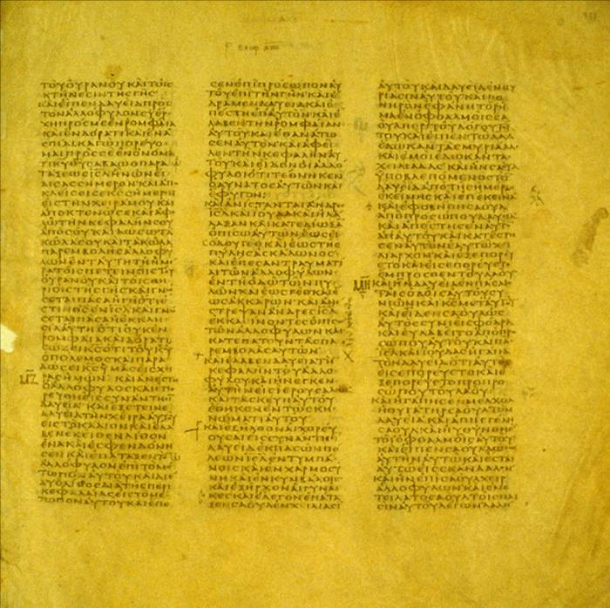
B
Codex Vaticanus
4th century
617 leaves
Originally a full Bible (LXX)
10.8” x 10.8” per leaf
40 to 44 lines per column
Vatican Library, Rome

Slide 31
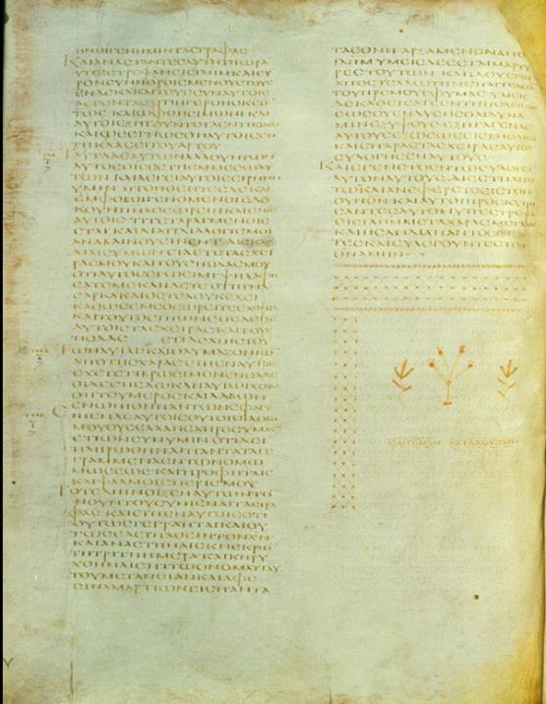
A
Codex Alexandrinus
5th century
Full Bible
773 leaves
12.6” x 10.4” per leaf
46 to 52 lines per column
British Library, London

Slide 32
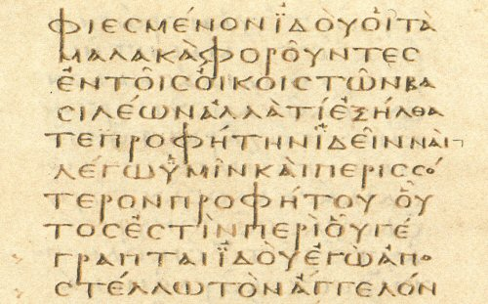
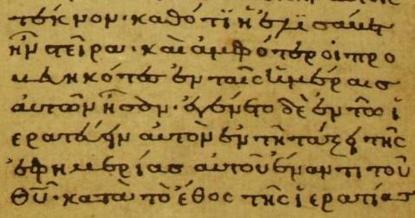
Script comparison between an Uncial (left) and a Minuscule (right)

Slide 33
Fixed Order
The fixed order of a codex affected both the Old and New Testaments.
The order of books in the LXX was somewhat different than the ordering of books in the Hebrew tradition.
  For instance, in the LXX the prophetic books are generally placed last, whereas in the Hebrew tradition they fall in the middle section (Nebiim) of the Hebrew Bible.
  Ruth is placed next to Judges in the LXX, but in the Hebrew Bible it belongs to the Megilloth near the end.
Very early, the four gospels gained a fixed order which we retain today: Matthew, Mark, Luke and John.
Paul’s letters in the various early Christian lists have a varied order, though eventually it became fixed by about the 4th century.
The so-called “general epistles” also had a varied order which eventually became fixed.

Slide 34
Talking Points
How did technology affect the availability of the Bible to Christians?
Why is it important to recognize that the texts of the New Testament were written in common Greek?
How did the early Christian community affect the way the New Testament comes to us today?
Does a fixed order of books in the New Testament affect the way we read them?

Slide 35
AUTOGRAPHxxxxxxxxxxxxxxxxxxxxxxxxxxxx
1st Century
2nd Century
3rd Century
4th Century
5th Century
EGYPT
COPY
xxxxxxxxxxxxxxxxxxxxxxxxxxxx
ITALY
COPY
xxxxxxxxxxxxxxxxxxxxxxxxxxxx
PALESTINE
COPY
xxxxxxxxxxxxxxxxxxxxxxxxxxxx
COPY
xxxxxxxxxxxxxxxxxxxxxxxxxxxx
COPY
xxxxxxxxxxxxxxxxxxxxxxxxxxxx
COPY
xxxxxxxxxxxxxxxxxxxxxxxxxxxx
COPY
xxxxxxxxxxxxxxxxxxxxxxxxxxxx
COPY E
xxxxxxxxxxxxxxxxxxxxxxxxxxxx
COPY F
xxxxxxxxxxxxxxxxxxxxxxxxxxx
COPY A
xxxxxxxxxxxxxxxxxxxxxxxxxxxx
COPY B
xxxxxxxxxxxxxxxxxxxxxxxxxxx
COPY C
xxxxxxxxxxxxxxxxxxxxxxxxxxxx
COPY D
xxxxxxxxxxxxxxxxxxxxxxxxxxxx
COPY G
xxxxxxxxxxxxxxxxxxxxxxxxxxxx
Slight variations get passed down through subsequent copies as texts are copied and shared.

Slide 36
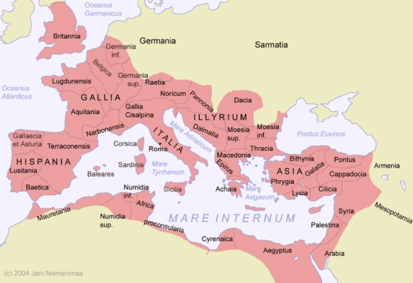
GEOGRAPHICAL TEXTUAL FAMILIES
Western Text
Byzantine Text
Alexandrian Text
Caesarean Text

Slide 37
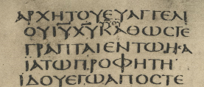
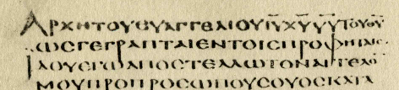
AN EXAMPLE OF A TEXTUAL VARIATION
The problem, of course, is that the passages quoted come from Malachi 3:1 as well as Isaiah 40:3.
Mark1:2
…e]n t&? [Hsai~% t&? profh<t^. (= “…in Isaiah the prophet.”)
…e]n toi?j profh<taij. (= “…in the prophets.”)
__________
___________________
_________________
X CODEX SINAITICUS (4th century)
A CODEX ALEXANDRINUS (5th century)
Followed by all modern versions
Followed by the KJV

Slide 38
The Selected Readings
The early churches varied in their choice of selected readings.
Some churches read from Sunday to Sunday until a particular book was finished (and this seemed to have been the general practice).
In other areas (Spain and France), short selections from various parts of Scripture were pieced together.
Some churches used harmonies of the gospels and read them in parallel.
By the 4th century, fixed readings were associated with Advent and Pentecost, and eventually, Lent, Good Friday, Easter, etc.

Slide 39
The Lectionary
In AD 471 (or earlier), a lectionary was produced, the Comes Hieronymi (Lectionary from Jerome), and it became the standard order of readings for the Western Church.
It assigned readings for Advent, Christmas, Lent, and Easter.
The rest of the year was covered by optional texts and could be adjusted by the local bishop or pastor.
Three centuries later, Charlemagne standardized liturgical practices in his domain along with a revision of the lectionary, and this, in turn, meant that everyone in the west was reading the same passages on the same Sundays.

Slide 40
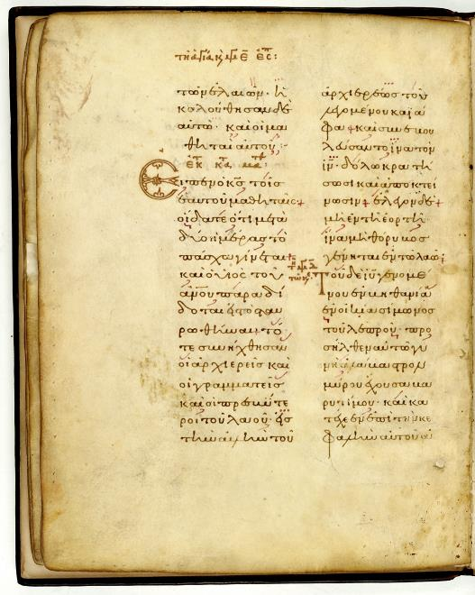
Greek Lectionary of the Gospels
The Readings for Easter Week from the Gospel of Matthew, along with readings for the stations of the cross.
The Greek lectionaries become an important witness to the Greek text of the New Testament.

Slide 41
Talking Points
Christians preserve as many ancient texts as possible, including texts that have variants. Muslims, on the other hand, long ago destroyed the texts of the Qur’an that had variants (and now claim to have an unvarying perfect text). Which approach is better?
Due to textual variants in the ancient manuscripts, our English Versions of the Bible also vary to some degree from translation to translation. How much of a problem is this?
What are the advantages or disadvantages of every Christian having a personal copy of the Bible?

Slide 42
Early Translations
As early as the 2nd century, the texts of the New Testament began being translated into vernacular languages.
Christian missionaries translated biblical texts into local languages wherever Greek would not serve the needs of the people.
These early translations include:
  Old Latin (predating Jerome’s Latin Vulgate)
  Syriac (Peshitta)
  Coptic
  Armenian
  Georgian
  Ethiopic
  Arabic
  Gothic

Slide 43
An Early Christian Description
“On the day called Sunday, all who live in the cities or in the country gather together in one place, and the memoirs of the Apostles or the writings of the prophets are read, as long as time permits…”
Justin Martyr (d. 166)

