Slide 1
The Emergence of Israel in Canaan

Slide 2
The Emergence of Israel
Given the rather mixed results of literary theories and archaeological reassessments, by the late 20th century modern scholars now struggle to find a model for the emergence of Israel that correlated with all these factors.
The Bible, of course, describes the emergence of Israel through the narratives of the exodus and Joshua’s invasion of the land of Canaan.
Historical-critical scholars were quite willing to adjust or even reject the biblical story in light of the various scientific approaches.

Slide 3
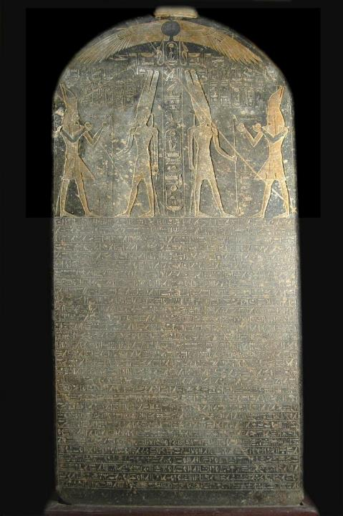
There is a terminus ad quem (i.e., a limiting point in time) for Israel’s appearance in Canaan.
Composed in Egyptian hieroglyphics, this hymn of victory boasts that Pharaoh Merneptah triumphed over Israel (ca. 1210 BC) during a military campaign into Canaan. The stela was installed in Merneptah’s funerary shrine in Thebes and discovered by Sir Flinders Petrie in 1896.
Cairo Museum, Cairo, Egypt

Slide 4
Models for Israel’s Origins
Since there was an identifiable group called “Israel” in Canaan by 1210 BC, but also since there was a lack of clear archaeological evidence of Israel’s exodus from Egypt and a 40-year sojourn in the Sinai Peninsula, four paradigms have been developed by scholars for how Israel emerged as a people in Canaan.
Some of these models were quite incompatible with the Bible’s record, others more compatible.

Slide 5
The Conquest Model
William Albright; G. Ernest Wright
This model, patterned after the Book of Joshua, attempted to preserve the Bible’s story for the most part.
Based on the destruction layers of some Canaanite cities at approximately the “right” time period (Late Bronze Age), it suggested that the Israelites came from the outside and conquered Canaan by a military invasion.
However, the archaeological record worked better for some Canaanite cities than for others, and the evidence yielded mixed results. Hazor was clearly burned, but the excavations at Jericho raised more questions than they answered.

Slide 6
The Immigration Model
Albrecht Alt; Martin Noth
This model proposed that the Israelites came from the outside, possibly Egypt, and first occupied the highlands of Canaan but only gradually extended their control to the plains.
Here, the rise of Israel was not by outright conquest but by a gradually attained superiority over many years.
This model follows the pattern in the Book of Judges while at the same time questioning the conquest narratives in the Book of Joshua.

Slide 7
The Revolt Model
George Mendenhall; Norman Gottwald
This model held that the Israelites were lower class Canaanites who rebelled against their overlords, eventually forming an identifiable group later called “Israel.”
Hence, they did not come from the outside at all, and they certainly did not arrive via any “exodus” from Egypt.
Their emergence was more along the lines of the Marxist theories of a revolt against the bourgeoisie, an internal uprising against Canaanite feudalism.

Slide 8
Gradual Emergence Model
21st Century Consensus among Critical Scholars
By the turn of the millennium, most historical-critical scholars had reached the conclusion that any reconciliation between the Book of Joshua and the archaeological record was impossible.
Hence, some form of gradual emergence must be adopted.
The Israelites were insider Canaanites who gradually developed a separate identity, migrated from the highlands to the lowlands, and eventually gained dominance.
…the external evidence supports almost nothing of the biblical account of a large-scale, concerted Israelite military invasion of Canaan… William Dever (University of Arizona)

Slide 9
Where do we go from here?
In the first place, biblical Christians share the conviction that the Bible is trustworthy and that God’s revelation in Scripture cannot contradict his revelation in the concrete world of experience.
At the same time, they also know that God is sovereign and that truth has time on its side.
While history is very important, even history is not, in itself, the center of faith: the center is the conviction of sin and the acceptance of the gospel. Historical questions must be worked out from that center.
Biblical Christians have long survived as a minority with respect to cultural trends and opinions, but what they must not do is abandon the field.

Slide 10
The issues concerning the Book of Joshua are part of a larger picture.
In our post-modern world, there is a decided trend toward revisionist history.
Much of history is currently being rewritten by deconstructionist literary theorists and political activists. To assume that biblical studies will be exempt from the influences of this trend is naïve.
Postmodernism is the handmaiden of this trend with its rejection of the notion of historical objectivity and its concerted attack upon written texts as untrustworthy.

Slide 11
At the same time, it must be remembered that BOTH archaeology AND the Bible are interpreted sources of information.
ARCHAEOLOGY
Over-confidence in the archaeological enterprise that claims “assured results” often is undermined by further investigation.
Only a fraction of the archaeological sites in Israel have been excavated.
THE BIBLE
Christians also must be careful in their biblical interpretation so that they do not force the Bible to say what it, in fact, does not say.
Some interpreters have reached unwarranted conclusions about what the Bible actually says.

Slide 12
A case in point…
Language must be given enough flexibility so that phrases like “the entire land” (Jos. 11:23) and “all the land” (Jos. 21:43) should be qualified by parallel statements in the biblical text.
“…there are still very large areas of land to be taken over” (Jos. 13:1)
“Judah could not dislodge the Jebusites…” (Jos. 15:63)
“They did not dislodge the Canaanites living in Gezer…” (Jos. 16:10)
“…the Manassites were not able to occupy these towns…” (Jos. 17:12)

Slide 13
Invasion is not the same as occupation. At the very least, the Book of Joshua does not describe a total occupation.
When Christians conclude (wrongly) that it does, they open themselves to criticisms that are unnecessary.
Even the Deuteronomic promise did not include total occupation immediately: “Yahweh your God will drive out those nations…little by little. You will not be allowed to eliminate them all at once…” (Dt. 7:22).
The Book of Joshua describes disabling raids, not territorial occupation. After their various raids in the center, the south, and the north, the Israelites simply returned to their base camp at Gilgal (Jos. 10:15, 43; 14:6).

Slide 14
An interpretive approach is required that takes into consideration all these factors as opposed to a selective approach that singles out and isolates some passages without giving due consideration to others.

Slide 15
The common interpretation of a sweeping conquest with nearly immediate occupation of the whole land is not what the Book of Joshua actually describes. To expect archaeology to demonstrate such a conclusion is deeply flawed!

Slide 16
The Moral Problem of War Against the Canaanites

Slide 17
The Moral Problem of War
Canaan was not open, available land to the Israelites. Rather, it was widely populated by various Canaanite groups.
The wars were wars of extermination commanded by Yahweh (Jos. 6:17, 24; 8:24, 29; 10:40; 11:12; Dt. 7:1-2, 16, 24; 13:12-16; 20:16-18).
The Hebrew term MrH (= banned, utterly destroyed) describes the mass killing of the Canaanites.
Such wars have caused considerable distress for modern sensitivities, particularly in light of the message of peace through Christ.
Hence, some modern interpreters reject the Book of Joshua as fundamentally incompatible with Christianity.

Slide 18
“Much about the Book of Joshua is repulsive, starting with ethnic cleansing, the savage dispossession and genocide of native peoples, and the massacre of women and children—all not simply condoned but ordered by God. These features are worse than abhorrent; they are far beyond the pale…”
Robert Coote
New Interpreters Bible (1998)

Slide 19
“This is a case where biblical authority is a dangerous and misleading concept. The aura of biblical authority must not be allowed to mask the utter barbarity of the conduct.” John Collins
Introduction to the Hebrew Bible (2004)
“The God of the Old Testament is arguably the most unpleasant character in all fiction; jealous and proud of it; a petty, unjust, unforgiving control-freak; a vindictive, bloodthirsty ethnic cleanser…
Richard Dawkins
The God Delusion (2006)

Slide 20
Can the wars against the Canaanites be correlated with the calling of Israel to be a blessing to the nations, a kingdom of priests among the nations of the world?

Slide 21
BASIC MORAL ASSUMPTIONS
Conservative interpreters generally work within the parameters of what are considered to be moral constants:
God is always good and compassionate.
The OT is a faithful record of God’s dealings with humans.
The OT describes events that are similar to genocide and/or ethnic cleansing.
Mass killings are evil.
The problem is that these moral constants collide in the wars of Israel against the Canaanites.

Slide 22
DIFFERENT APPROACHES interpreters have offered multiple solutions
The OT Text is Not Faithful
Events Less Violent Than They Seem
The Destruction was Justifiable
Here, it is argued that the destruction of the Canaanites never happened.
The texts were written much later (in the time of Josiah), long after the Canaanites had disappeared.
They were written in the interests of Josiah’s reform movement as a stimulant to remove the remnants of Canaanite religion.
Here, it is argued that the events are not as violent as they appear.
The herem texts are treated as non-lethal, either as a destruction of Canaanite religious paraphernalia or a metaphor for religious fidelity.
What was called for was expulsion, not extermination.
It was a destruction of Canaanite identity, not the Canaanite people.
God’s judgments are righteous, but sometimes they are mysterious and incomprehensible to humans.
The Canaanites were utterly wicked, deserving to be destroyed (Ge. 15:16; Lv. 18:24-25; Dt. 9:4-5; 2 Chr. 28:3.
God was gracious to the Canaanites, giving them many centuries to repent.

Slide 23
The Ethics of Yahweh War
The wars of Israel against the Canaanites were not merely wars of conquest.
As early as Abraham, Yahweh anticipated that these wars would be wars of judgment (Ge. 15:16).
The Canaanites’ immoral lifestyles were so vile that the land would “vomit out its inhabitants” (Lv. 18:24-27).
Such immorality was abhorrent to God himself (Lv. 20:22-23).
Hence, the wars of Joshua were to be waged “on account of the wickedness of these nations” (Dt. 9:5; 18:9, 12).
They were analogous to the plagues of Egypt, where “Yahweh brought judgment upon their gods” (cf. Nu. 33:4b).

Slide 24
“…the sin of the Amorites…”
(Ge. 15:16; Dt. 7:25-26; 12:31; 18:9-12; 20:18)
Idolatry
Child sacrifice
Divination and sorcery
Omens
Witchcraft and spells
Consulting the dead

