Slide 1
Early writing prophets

Slide 2
PROPHETS IN THE
ANCIENT NEAR EAST
Widespread phenomenon (Canaan, Syria, Anatolia, Mesopotamia and Egypt)
Balaam ben Beor, a biblical example
    Agreed to prophecy for a “fee” (Nu. 22:7, 16)
    Resorted to sorcery (Nu. 24:1)
Prophets of Ba’al, other examples
    Raving and self-mutilation (1 Kg. 18:29)
ANE prophecies often took the form of transcendental ecstasy
    Fits or violent trances
    Leaping, wild dancing
    Contortions, constriction of muscles
    Unintelligible utterances

Slide 3
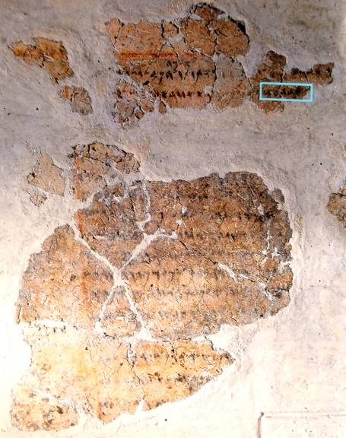
Balaam Inscription
A reference to “Balaam, son of Beor” was discovered at Deir Alla (biblical Succoth) in the transjordan in 1967 (probably from the mid-8th century BC). It appears on a plastered wall and reads in part:
“Inscription of [Ba]laam [son of Beo]r, the man who was a seer of the gods. Lo, the gods came to him at night and [spoke to] him.
“…And the Mighties [Shaddayin, plural of Shadday] have fixed a date, and they said to Sha[ma]sh [the sun]: Sew shut the skies with your cloud! There, let there be darkness and no shining…”

Slide 4
UNIQUENESS OF ISRAEL’S PROPHETS
Prophetic revelations typically were given as sermons, not visionary ecstasies
The content was primary, not the psychic state of mind (the standard formula = “The word of Yahweh came to ________”
The tests of legitimate prophecy were:
    Fidelity to the Torah, not signs and wonders (Dt. 13:1-11)
    Accuracy of prediction (Dt. 18:20-22; 1 Kg. 22:28)
    Privileged inclusion in Yahweh’s heavenly council in order to speak his word (Je. 23:16-18, 21-22, 25-32; Eze. 13:2-7, 17)
Israel’s prophets consciously distinguished themselves from the non-cognitive ANE style (Am. 7:14; Is. 28:7-10; Je. 23:9-40; Eze. 13:1-13)

Slide 5
THE HEBREW BIBLE
Three Collections
hrvt Myxybn Mybvtk
(Torah) (Nebiim) (Kethubim)
Genesis Former Prophets Psalms
Exodus Joshua Proverbs
Leviticus Judges Job
Numbers Samuel Megilloth (five rolls)
Deuteronomy Kings Song of Songs
Latter Prophets Ruth
Isaiah Lamentations
Jeremiah Esther
Ezekiel Ecclesiastes
The Twelve Daniel
Ezra-Nehemiah
Chronicles

Slide 6
The Writing Prophets
Prophets who did not date their oracles
Prophets who dated their oracles
8th Century
North (Israel)
Amos
Hosea
South (Judah)
Isaiah
Micah
7th Century
Judah only
Zephaniah
Jeremiah
6th Century
Among the Exiles
Ezekiel
Probable Dates
Judah only
Jonah (8th)
Joel (8th)
Nahum (7th)
Habakkuk (7th)
Obadiah (6th)

Slide 7
8th Century Prophets
ISRAEL
Jeroboam II
AMOS
HOSEA
800 790 780 770 760 750 740 730 720 710 700 690 680 670 660 B.C.
MICAH
ISAIAH
Uzziah/Azariah
Jotham
Ahaz
Hezekiah
JUDAH

Slide 8
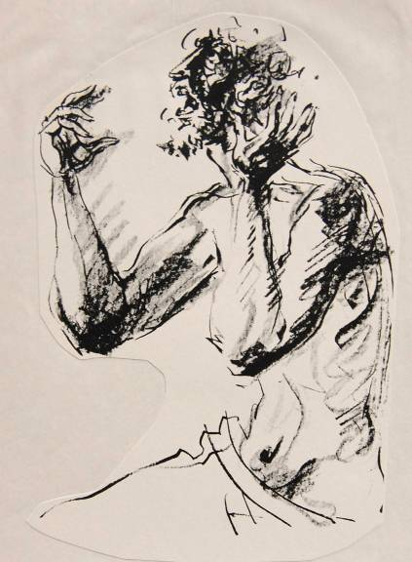
Pathos of the Prophets
The trials and trauma of the prophets reflected the pathos of God. They experienced:
    Abandonment
    Ostracism
    Ridicule
    Loss of love ones
    Depression
    Divorce
    Threats
    Persecution
    Torture
    Death

Slide 9
amos

Slide 10
Jeroboam II of Israel (2 Kg. 14:23-29)
Jeroboam II enjoyed a long and relatively stable reign in the north, the longest of any of the northern kings (41 years).
He reclaimed his northern border to Damascus, as predicted by the prophet Jonah (2 Kg. 14:25), and his southern border in the Transjordan to the Dead Sea.
His military extensions brought increased prosperity to his capital for which he was severely castigated by Amos (Am. 3:15; 6:1, 4-6, 11).
The Israelite social injustice and unfaithfulness to Yahweh during his reign was challenged by Hosea as well (Ho. 1:1).

Slide 11
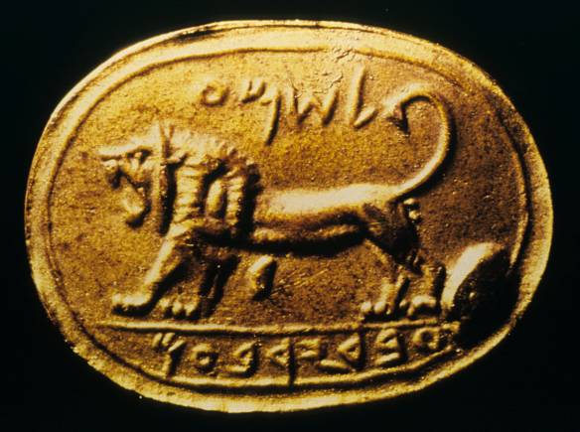
The Shema Seal Impression
Jeroboam II’s name is preserved on this seal impression, which is inscribed with the words “[belonging] to Shema, servant of Jeroboam”. The expression “servant of the king” is known from other seals to refer to high ranking officials (cf. 2 Kg. 22:12).
Excavated at Megiddo in 1904, the original seal was carved in jasper. Rockefeller Museum, Jerusalem

Slide 12
Huge Ideological Differences
Abijah, the son of Rehoboam, capsulized the huge ideological differences between north and south (2 Chr. 13). These included:
God’s covenant with David
Divine approval of the dynasty of David
Legitimacy of Solomon’s temple
Illegitimacy of the shrines at Bethel and Dan
Illegitimacy of the northern priesthood

Slide 13
Covenant Loyalties
ISRAEL
Covenants with Abraham and Moses were primary
Covenant with Moses and its threats of exile were subordinated to the perceived inviolability of the covenant with Abraham
JUDAH
Covenant with David was primary
Covenant with Moses and its threats of exile were subordinated to the perceived inviolability of the covenants with David and Abraham

Slide 14
In spite of the north’s secession, however, Amos does not castigate the northerners for political reasons, but rather, for their violation of the covenant with Moses—the very covenant they championed!
Amos would certainly have agreed with St. Paul, when he wrote: “For it is not those who hear the law who are righteous in God’s sight, but it is those who obey the law who will be declared righteous” (Ro. 2:13)

Slide 15
The Humanitarian Law of Moses
In particular, Amos concentrates on the aspects of social justice embedded in the law of Moses.
Justice in business practices (Dt. 25:13-16)
Justice in the courts (Dt. 16:18-20)
Justice for those who were economically disadvantaged (Dt. 23:19, 24-25; 24:10-13, 17-18)
Justice toward workers (Dt. 24:14-15)

Slide 16
Covenant Failure at Social Justice
Though Jeroboam II’s kingdom was awash in prosperity—at least for the upper classes—the poor were still severely oppressed by:
Foreclosures (5:11; 8:4)
Lawsuits (5:10, 12b)
Dishonest business practices (8:5-6)
Unreasonable collateral (2:8; 4:1)
Bribery (2:6b; 5:12a)
Intimidation (5:7; 8:6)
Usury (3:10)
Taxation (7:1)

Slide 17
Ahijah
Jehu
Elijah
Micaiah
Elisha
Jonah
Amos
Hosea
Amos stands in the sequence of prophets to the northern kingdom of Israel:
What is unique about Amos as opposed to his predecessors is that he began to write down his oracles.
Prior to the spread of literacy in the 8th century, earlier prophets only gave their oracles verbally, but in the 8th century, literacy became much more widespread.
From this time onward, the prophets would record their sermons in texts.

Slide 18
Amos, the Farmer
Amos describes himself as a herdsman and dresser of sycamore fruit (1:1; 7:14-15).
The Hebrew terms for herdsman indicate that he shepherded sheep and goats along with cattle.
Sycamore fig trees are similar to other fig trees but grow to a greater height (up to 60’). The fruit is not as sweet as the true fig, and it had to be pricked at just the right stage to make it edible.
Amos’ home was in Tekoa a few miles south of Bethlehem.

Slide 19
Amos, the Prophet
As a prophet, Amos intentionally distanced himself from court prophets and the Near
Eastern tradition of ecstatic prophets (7:14a).
His diatribe against Jeroboam II was delivered at the Bethel shrine (7:10ff.) from which he was expelled.
Other sermons may have been delivered at the northern capital of Samaria (cf. 3:9; 4:1; 6:1).

Slide 20
Structure of the Book the material in Amos falls into four blocks
1st Division
Amos 1-2
God’s coming judgment on the nations
First, toward Israel’s neighbors; then, toward Israel herself
2nd Division
Amos 3-6
Sermons of judgment on the northern nation Israel
Yahweh is the divine lion; Israel is his prey
3rd Division
Amos 7:1—9:10
Series of parabolic visions: locusts, fire, plumb-line, fruit basket, execution
Amos & Amaziah
4th Division
Amos 9:11-15
Restoration of the fallen family of David
Restoration of Israel in the last days

Slide 21
The Divine Lion
The metaphor of Yahweh as a divine lion on the attack is a reoccurring metaphor in Amos, beginning with the “roar” in 1:2 (cf. 3:4, 8).
Lions in ancient Palestine were a subspecies of the lions generally in the ancient Near East.
The fiercest of predators, Yahweh, the Divine Lion, was on the attack, his roar shattering the complacency of the northern nation of Israel.
That he roars “from Zion” and “Jerusalem” heralds to the northern nation its tragic error in renouncing the temple and following the sin of Jeroboam I.

Slide 22
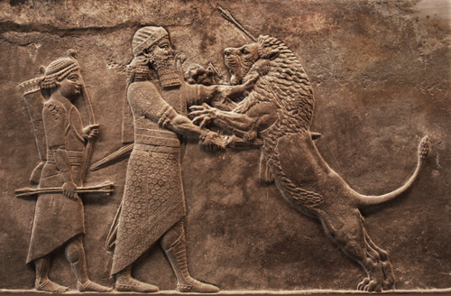
Here, a lion attacks the Assyrian king. In Amos, Yahweh is the divine lion and he attacks the nations because of their war crimes.
British Museum, London

Slide 23
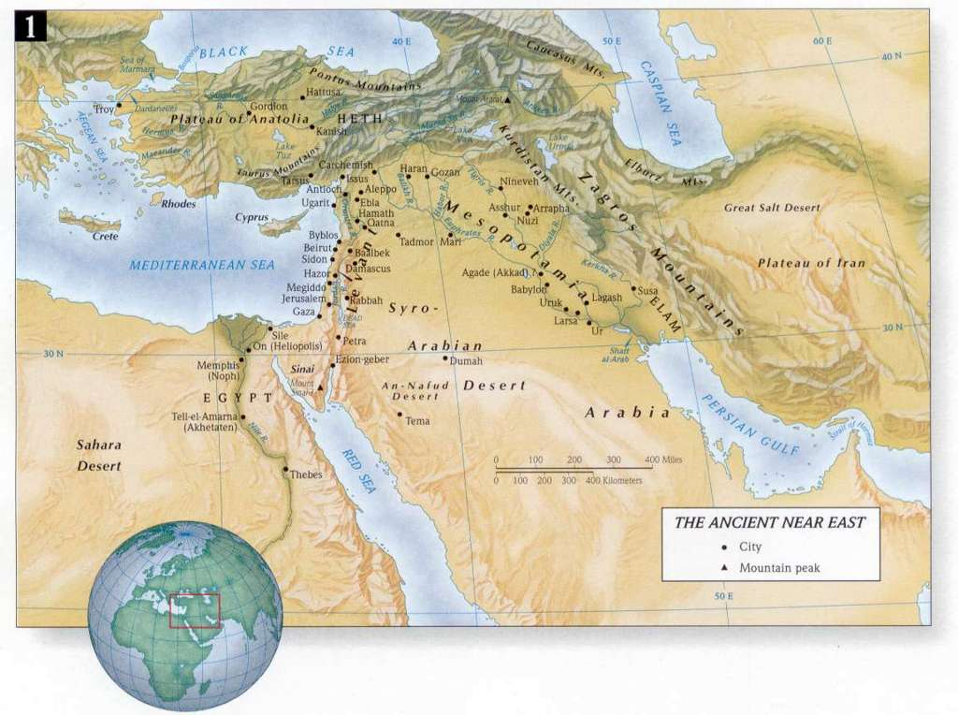
TYRE
DAMASCUS
AMMON
GAZA
MOAB
EDOM
FOREIGN NATIONS INDICTED BY AMOS

Slide 24
“For Three Sins…even for Four” (1:3, 6, 9, 11, 13; 2:1, 4, 6)
This phrase, which prefaces the oracles to individual nations, is a graduated numerical sequence typical in Hebrew wisdom literature.
Sometimes it appears in a two-three pattern, sometimes a three-four pattern, and sometimes in other patterns (Ps. 62:11-12; Pro. 30:15b, 18, 21, 29; Job 5:19; Pro. 6:16).
Obviously, this idiom is more a symbolic than a mathematical use of numbers. It means God has reached the limit of his patience.

Slide 25
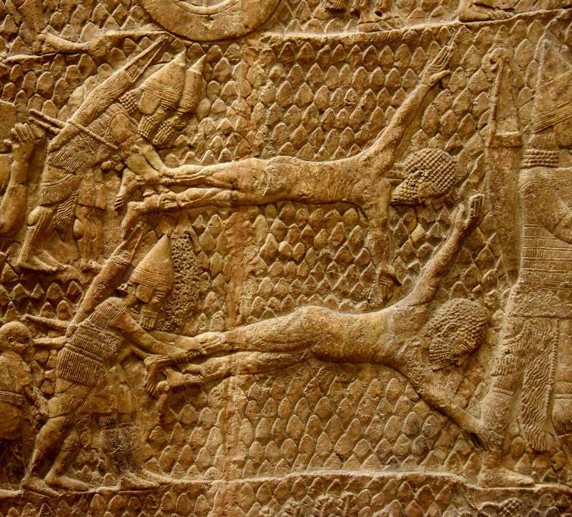
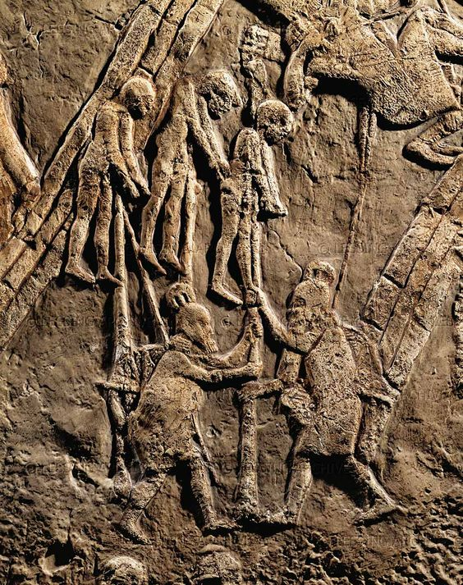
Assyrian Bas-reliefs Detail Various Atrocities
Assyrian soldiers impaling victims on poles
Assyrian soldiers flaying Nubian prisoners of war

Slide 26
The Sins of Judah (2:4-5)
Amos’ oracle of judgment toward Judah may have been a surprise.
It is likely that his oracles of judgment against foreigners was received with approval.
However, the people of Judah were Israelites, also, and to hear that they were under divine scrutiny with the same rubric—“for three sins, even for four”—must have caused some discomfort.

Slide 27
Rejection of the Torah (2:4)
Whereas the foreign nations had been indicted for social crimes against humanity, Judah is indicted for abandoning God’s decrees.
The character of this charge is religious.
The people of Judah had begun to flirt with paganism.
The term bzK (2:4), which means “liars,” indicates that the people were being led astray, either by false gods or false prophets or both.

Slide 28
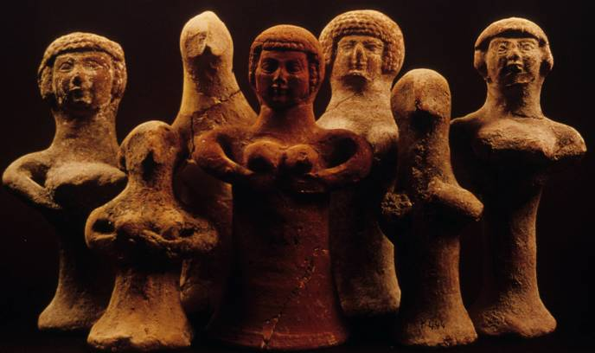
Fertility Figurines
Some 3000 of these terra cotta (clay) statuettes representing the goddess Asherah have been excavated from the towns of Judah’s pre-exilic period (Iron Age II), most often from private houses but occasionally in tombs.
These pillar figurines testify to the attraction of the fertility cult to the citizens of the southern nation.

Slide 29
The Sins of Israel (2:6-16)
If the Israelites were in any doubt, it would now be clear that divine judgment was due them, also.
“For three sins, even for four” applied to the northern tribes who had violated the very Torah they claimed to support.
In particular, it was the violation of the Torah concerning social justice that was the most egregious moral failure.

Slide 30
Selling the Righteous and the Needy (2:6b)
Clearly, Amos’ language points toward the abuse of the innocent.
The righteous were sold out, either by unscrupulous judges who were taking kick-backs or the sale of debtors into debt slavery for some trifling liability.
The phrase about sandals was probably an idiom referring to land transfers (cf. 8:6; Ru. 4:7).
The poor man who is “sold for a pair of sandals” has been unjustly dispossessed of his property.

Slide 31
Injustice (2:7)
Descriptions about “the poor” and “the oppressed” are against the legal background of the humanitarian laws in the Torah.
When a woman was sold into debt slavery, the Torah forbade that she become the concubine of both the father and his son (Ex. 21:7-11; Dt. 22:30).
Though she was in debt slavery, she still retained her rights—the right to food, clothing and marriage.
Failure to maintain these rights meant that the woman was to be set free and her debt cancelled.

Slide 32
The Profane Use of Power
Three examples are provided showing the abuse of power by the elite (2:8).
Father and son use the same girl
Forcing the girl to be a concubine of both father and son directly violated Dt. 22:30.
It deprived her of the right of marriage (Ex. 21:7-11).
Garments taken in pledge
If a garment was used as security for a debt, it must be returned by sunset (Ex. 22:26-27).
To make it particularly heinous, the rich were using such collateral in the service of their religion!
Drinking wine taken as fines
Wine gained from fines refers to payment or interest exacted from debtors.
This, too, was being used in the service of religion!

Slide 33
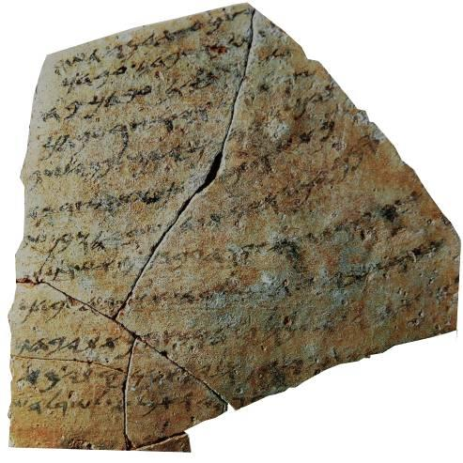
Translation
“…your servant was at Ha-saar-Asam (when the following incident occurred). …when your servant had finished (his) reaping and had stored it a few days ago, Hoshayahu ben Shabay came and took your servant’s garment. …all of my companions will vouch for me…(that) I am guiltless of any in[fraction]. [(So) please return] my garment. If the official does not consider it an obligation to return [your servant’s garment, then have] pity upon him [and return] your servant’s [garment] from that motivation. You must not remain silent [when your servant is without his garment].”
This 7th century BC ostracon from the Israelite coast specifically mentions the dg,b,, the “garment” which functioned as a cloak by day and a blanket by night (2:8; cf. Dt. 24:12-13).

Slide 34
“Hear this word…”
The oracles of judgment in the second part of the book are characterized by an introductory formulae: “Hear this word…” (3:1, 13; 4:1; 5:1, 3, 4, 16; 6:8).
Since Israel had been “chosen” (3:2), judgment must begin with them.
God’s choice of Israel as his special people did not exempt them from discipline; indeed, it presupposed that they were accountable to the terms of the covenant.

Slide 35
Rhetorical Questions
Rhetorical questions, by definition, anticipate an obvious answer. Here, Amos’ series of questions aim at pointing out the obvious to the citizens of Israel (3:2-6).
Do two walk together unless they have an appointment? Israel has an appointment with God!
Does the lion roar when he has no prey? Israel is now the prey of Almighty God!
Does a bird fall into a snare when there is no trap? Israel is now in God’s trap!
Don’t people tremble when they hear the warning trumpet? God’s prophets are his trumpets sounding the alarm!

Slide 36
A Reckoning: A Judgment within History
Because the elite of Samaria were so consumed by materialism, even at the expense of the poor, God would send them an enemy.
Israel was now a kingdom under judgment (3:9-11)!
The Torah required a shepherd to produce evidence that a sheep had been scavenged in order to alleviate any suspicion of theft (Ex. 22:10-13).
The elite of Samaria would now be ripped as though by a predator—and nothing would be left but the smallest fragments (3:12).
Though they might dawdle on their couches, judgment was coming!

Slide 37
Ivory Decorations
Amos’ castigation of ivory decorated homes in Samaria (3:15) was no exaggeration.
Excavated from Samaria by the Harvard Expedition in the early 1900s, many ivory objects along with hundreds of ivory fragments from the northern capital demonstrate the luxury against which Amos preached.
Though the dating of the various artifacts varies, most of them span the time between Ahab and Jeroboam II (9th and 8th centuries BC).

Slide 38
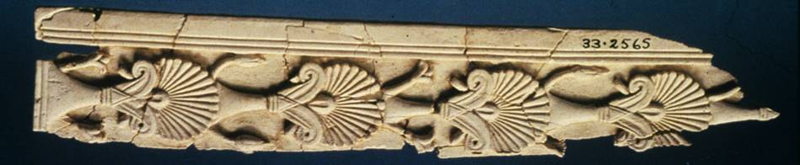
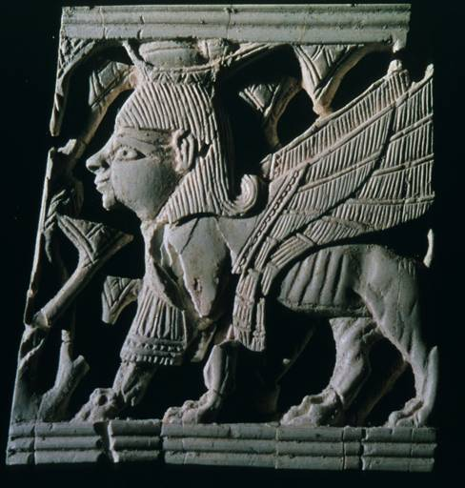
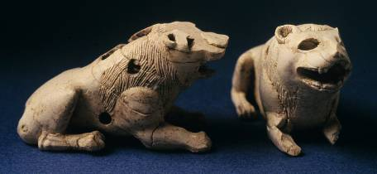
Ivory artifacts excavated in Samaria from the time of Jeroboam II testify to the luxury of the court, which could afford such imported artistic decorations.

Slide 39
Callousness (4:1)
The moral problem of Israel’s elite was not merely wealth, but that their wealth had been amassed by ruthless exploitation.
Callous attitudes toward the disadvantaged was completely foreign to the spirit of the law of Moses, which urged humanitarianism.
The rich women of Samaria, who incited their husbands to further crush the powerless, epitomized this callousness.
Judgment was coming in the form of exile (4:2-3)!

Slide 40
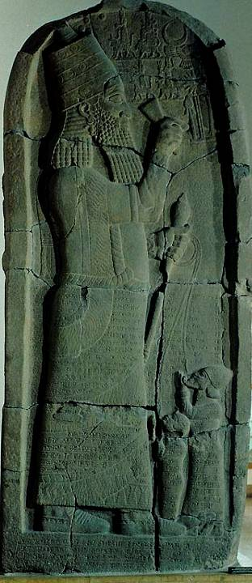
“…the last of you with fishhooks”
The reference to fishhooks is not purely metaphorical. The Assyrians were known for leading captives with hooks through their mouths (2 Chr. 3:11; cf. Eze. 19:4, 9; 29:4; 38:4).
Here, two prisoner kings are depicted with ropes through their lips.
Staatlich Museen zu Berlin

Slide 41
Sinful Worship (4:4-5)
“Go to Bethel and sin” is a biting sarcasm.
Bethel and Gilgal were ancient sacred places associated with Jacob’s dream and Joshua’s invasion of Canaan.
Both sites were sacred places where the northern citizens practiced tithing, sacrifice and freewill offerings.
The ritual of the Torah, however, was meaningless without the spirit of the Torah.

Slide 42
bv0w (4:6b, 8b, 9b, 10b, 11b)
Nuances of the verb “shuv” (= to turn) in the prophets
“They turn…”
(Israel turns from Yahweh)
“Turn…”
(Yahweh’s call to repent)
“They will not turn…”
(the people’s stubbornness)
“I will not turn…”
(Yahweh’s anger will not hold back)
“They will return…”
(Israel will go back to slavery and exile)
“They will turn…”
(in exile the people will repent)
“I will turn…”
(Yahweh will forgive their sins)
“They will return…”
(they will be restored from exile)

Slide 43
Meeting God (4:12)
The phrase “prepare to meet your God” is one of the most ominous in the book.
If the nation would not turn to God whose mercy and forgiveness was freely offered, then they would meet him nonetheless (but as the divine lion seeking prey).
The God they claimed to worship, who created all things, would now face them in judgment.

Slide 44
Pilgrimages (5:4-5)
The practice of worship included pilgrimages, where the Israelites recalled the divine encounters in the past.
Bethel (the location of one of the shrines of Jeroboam II) was the site where their ancestor Jacob dreamed of a ladder reaching into the heavens, and he named it “house of God” = Bethel (Ge. 28:11-22).
Gilgal was where the ancient tribes entered the land with Joshua and set up a memorial cairn of stones (Jos. 3:19-24).
Beersheba was where Yahweh appeared to Isaac (Ge. 26:23-25) and Jacob (Ge. 46:1-4).

Slide 45
The Purpose of Worship (5:6)
Though the Israelites still made pilgrimages to celebrate the past, there was no true relationship with God himself.
“Seek me and live,” was what Yahweh asked.
Rituals of worship without a true relationship with God were empty expressions.
Hence, the sites of the ancient pilgrimages would not be protected—they, too, were destined for fire and exile.

Slide 46
The Day of the Lord (5:18-20)
Earlier, Amos spoke of “that day” (2:16; 3:14). Now he uses the fuller expression “the day of the LORD.”
The way he cites the phrase implies that it already was in usage by the Israelites—probably heralding a day when God would bring blessing, prosperity and well-being.
Amos stands the expression on its head, preaching that the Day of the LORD would be a day of reckoning.
In vivid metaphors, he likens the Day of the LORD to doomsday.

Slide 47
When God Hates the Worship Service (5:21-26)
God’s assessment of Israel’s worship was stark and to the point: he hated it!
The fundamental issue, surprisingly, was not merely the abandonment of Zion but the flood of injustice that nullified all their religious festivals and sacrificial offerings.
God loathed their music, because it was a false front!
What God required was not more “religion” per se, but hearts that earnestly sought him!

Slide 48
Look Around! (6:2)
The antidote to false optimism was a serious look at the fall of neighboring cities.
Calneh and Hamath were city-states to Israel’s north, once prosperous, but now fallen.
Gath, one of the five Philistine cities, also was now gone. Earlier, when Amos spoke of the Philistine cities, he mentions all but Gath (1:6-8), presumably because of its earlier demise.

Slide 49
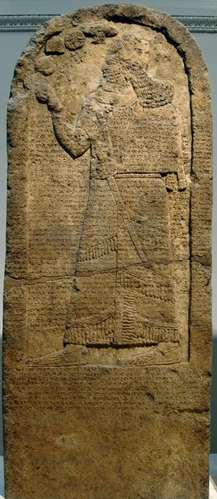
Kurkh Stele
Years earlier, the Hittite city-state of Hamath had joined a coalition at Qarqar on the Orontes River in 853 BC to successfully oppose the Assyrian campaigner Shalmaneser III, contributing 700 chariots, 700 cavalrymen and 10,000 infantry. (Though not recorded in the Bible, Ahab of Israel joined this same coalition of a dozen kings fielding 2,000 chariots and 10,000 soldiers.)
By 738 BC, however, Hamath had been forced to surrender 19 provinces to the Assyrians, and soon all resistance ceased when the whole territory was absorbed into the Assyrian Empire.
British Museum, London

Slide 50
The Party Is Over! (6:8-11)
Taking oath on himself, Yahweh declared that a reckoning was coming (6:8-11).
The same God who “swore by himself” to bless the descendants of Abraham and give them the territories of their enemies (Ge. 22:16-17) now swore by himself that the cities of Israel would fall.
God hated their arrogance, and masses of the population would be destroyed.
So dreadful would be the calamity that people would not dare use the name of Yahweh for fear of reviving his divine curse upon them.
Houses great and small would be decimated!

Slide 51
The Prophets and Visions
A characteristic of the writing prophets was their experience of parabolic visions, that is, revelations from Yahweh that gave graphic metaphorical depictions of their message.
Here, Amos depicts the coming divine judgment against the background of the nation’s spiritual bankruptcy.
He offers four vision reports, each beginning with the introductory formula, “This is what Adonay Yahweh showed me” (7:1; 7:4; 7:7; 8:1).

Slide 52
1 - The Locust Swarm (7:1-3)
Similar to Joel (cf. Jl. 1:4), Amos saw a vision of a locust plague arising between the first and second harvests (the former and latter rains).
“After the king’s share” refers to the tax levied on the farmers from the first harvest.
When the locusts had stripped the land bare, the prophet became an intercessor for God’s mercy so that a remnant might survive, and Yahweh relented his judgment.

Slide 53
2 - Judgment by Fire (7:4-6)
In Amos second vision, he saw a raging fire that ravaged the land and was so severe it dried up the subterranean waters.
As before (and like Moses, cf. Ex. Ex. 32:9-14, 30-32), Amos interceded for the people.
Again, God relented and postponed judgment.
As is clear from these passages, prophets are not only preachers, but also intercessors, praying for forgiveness and standing between the holy wrath of God and the culpability of sinful people. In this sense, they prefigure Christ, the greatest intercessor of all.

Slide 54
3 - The Plumb Line (7:7-9)
In the third vision, Amos saw the Lord standing with a plumb line by a wall built true to plumb. .
The symbolic meaning of the vision, when explained, was that Israel, originally constructed true to vertical, had now shifted until the nation was severely out of plumb.
God determined to destroy the nation, and this time, no reprieve is mentioned.

Slide 55
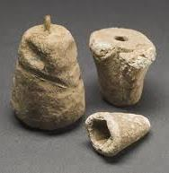
Ancient Plummets
The ancient use of plumb bob technology for building straight walls is at least as old as the building of the pyramids.
A plummet or plumb bob—a weight of metal, clay or stone—was attached to a cord, which then gave the builder a true vertical for wall construction.

Slide 56
4 - The Fruit Basket (8:1-3)
Puns or plays on words, which are a phonetic device sometimes used by the writing prophets, require explanation when one moves the text into a second language.
Here, the word-play is on two near homonyms:
  Cyiq! (qayits = summer fruit)
  Cq02ha (haqqets = the end)
The NIV attempts to capture this pun by translating the Hebrew phrase “The end has come” as “the time is ripe.”
Though Yahweh’s patience was vast, it was not unlimited.

Slide 57
Amos and Amaziah (7:10-17)
Amos’ sermons of judgment were promptly reported by Amaziah, the priest at Bethel, to Jeroboam II, the king.
Like the court prophets, Amaziah’s primary allegiance was to the royal family.
He indicted Amos for insurrection because he had predicted the exile of the northern nation.
He demanded that Amos vacate the premises and return to Judah.
Amos, for his part, immediately disclaimed any continuity with the general class of ancient Near Eastern prophets.

Slide 58
Oracle of Hope (9:11-15)
Amos’ final oracle returns to the expression “in that day,” i.e., the Day of the Lord.
Though “that day” would be a day of darkness and judgment (3:14; 5:18, 20; 8:3, 9, 13), it also would be a day of restoration.
The irony (at least for those in the northern kingdom) is that the restoration would not be the kingdom of Jeroboam, but the kingdom of David—the united tribes under a single ruler.

Slide 59
hosea

Slide 60
Hosea’s Marriage
The Hebrew expression Myn9v0nz4 tw,xe (= wife of adulteries) refers to a professional prostitute who takes payment for her services (1:2). Gomer may have been a cult prostitute, though this is not stated.
Possibly, Gomer bat Diblaim was a prostitute before she married Hosea, though again, this is debated.
This marriage was intended to symbolize the “vilest adultery in departing from the LORD”.

Slide 61
The Three Children
The names of the children become religious symbolisms.
Jezeel (1:3-5)
(probably Hosea’s)
Means “God plants”
City of the Omride kings’ winter palace
Recalls the bloody purge of Jehu
Anticipates God’s judgment on Jehu’s dynasty
Anticipates God’s judgment on Israel
Lo-Ruhamah (1:6-7)
(illegitimate, cf. 2:5)
Means “not loved”
Anticipates the withdrawal of Yahweh’s love from Israel
Judah would be spared by divine grace (temporarily) because of its spiritual reforms
Lo-Ammi (1:8-9)
(illegitimate, cf. 2:5)
Means “not my people”
The northern Israelites, who were called to be God’s people, were by their own behavior removing themselves from his family.

Slide 62
The Wonder of Hope
Immediately following the warnings of impending judgment, God offers the promise of future redemption (1:10—2:1).
A remnant of faith would survive and multiply so that God’s promises to Abraham and Jacob would be fulfilled: Israel would be like sand on the seashore (1:10a; cf. Ge. 13:1; 22:17;32:12).
The children once rejected as “not loved” and “not mine” would become the sons of God—God’s people whom he loves (1:10b; 2:1)!
The disaster of Jezreel would be turned to joy, and the clans of Israel would be reunited (1:11).

Slide 63
Words to the Children
The form of writing now shifts from prose to poetry. The name-meanings of the children now become reprimands to the unfaithful mother and wife.
Lo-Ammi (= not my people) now symbolizes the wayward woman who is “not my wife” (2:2).
Lo-Ruhammah (= not loved) now symbolizes the dire consequences of illegitimacy, when the father says, “I will not show my love to her children” (2:4).
Jezreel (= God plants) now symbolizes the fact that Israel has not acknowledged the true lord of harvest but instead has given the credit to Ba’al (2:8).

Slide 64
Severe Rebuke and Warning
Because the parents are now separated (2:7), the husband is obliged to address the mother through the children.
If she does not turn away from her adulterous unfaithfulness, she will be publicly stripped and shamed (2:3a).
The land will be devastated by drought (2:3b).
The Deuteronomic Curse
Reprisals for covenant unfaithfulness were severe, including scorching heat, drought, blight and mildew (Dt. 28:20, 22-24).

Slide 65
Courting Again!
Yahweh determined to “court” Israel again, just as he once courted her in the Sinai desert (2:14-16).
Valley of Achor (= Valley of Disaster)
Where Achan was stoned to death because he violated the ban at Jericho (Jos. 7:26)
Now, Achor would become a door of hope!
Language of “Husband” and “Master” (2:16)
“…you will call me ywiyxi“ (my ‘Ish = my husband, my man)
“…you will no longer call me ylif;Ba (my Ba’al = my lord, my husband)

Slide 66
A Future Marriage Covenant
“In that day” (2:18) is eschatological language for the future.
In the “new” covenant of marriage, Yahweh would abolish all war and violence (2:18).
All false worship would be removed (2:17).
God’s people would be betrothed to him in true fidelity (2:19-20).
The whole heavens and earth will revel in this divine blessing of the union of God and his bride (2:21-22a).
The tragic name-meanings of Jezreel, Lo-Ammi and Lo-Ruhammah would be reversed (2:22b-23).

Slide 67
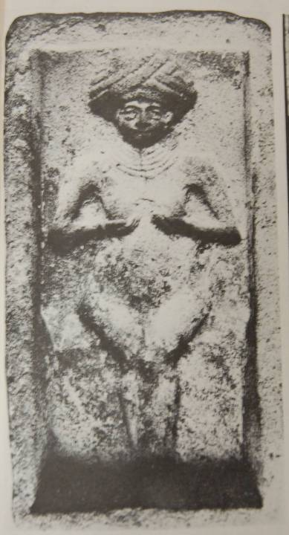
Sacred Raisin Cakes (3:1b)
Cake mold from the palace kitchen of Mari, Mesopotamia.
Used for making cakes in the form of the love-goddess, Ishtar, the Queen of Heaven.
Ishtar, the “Queen of Heaven”, was the Mesopotamian fertility goddess as well as the goddess of war. She was believed to contain the inseparable powers of life and death.

Slide 68
Redeeming Love!
Shifting back to prose, the text describes Hosea’s purchase of his wayward wife at Yahweh’s command (3:1-2).
That he “purchased” her presumes that she now had been reduced to slavery.
Hosea’s redemption of his wife mirrors God’s redemption of his people, even though they were unfaithful. Such redemption was wholly at God’s initiative, since a slave had no options for freedom.

Slide 69
Old Habits Die Hard!
To break Gomer of her old habits of promiscuity, Hosea suspended conjugal relations for an extended period (3:3).
This forced abstinence symbolized the coming exile of Israel, when the citizens of the northern kingdom would be deported to Assyria (3:4).
After living a long time without the familiar structures of royalty or religion, they would reverse their rejection of David (cf. 1 Kg. 12:16) and return to Yahweh as his chastened people (3:5).

Slide 70
Israel’s Day in Court!
Yahweh indicts the Israelites at every level.
Citizen (4:1-4)
Faithless
Loveless
No knowledge of God
There was no dependability, steadfast loyalty or intimate knowledge of Yahweh.
Priest/Prophet (4:5-10)
Rejects knowledge
Ignores Torah
Spiritual leaders were driven by the values of their audience rather than by the Word of God.
Cult (4:11-14)
Consults a wooden idol
Pop-worship at pop shrines
Religious forms were wholly taken over by the Canaanite fertility cult.
Royalty (5:1b-2, 10, 13b)
Changes laws for self gain
Seeks help from Assyria
Political leaders were willingly corrupt in order to maintain their own power.

Slide 71
The ancient sacred places to which the northern Israelites made pilgrimages were linked to the covenant promises of land made to the patriarchs.
Bethel/Beth Aven (Ho. 4:15b; 10:5; cf. Am. 4:4a; 5:5a)
Where God promised Jacob, “To you and your descendants I will give the land on which you are lying” (Ge. 28:13-15)
Gilgal (Ho. 4:15b; 12:11; cf. Am. 4:4b; 5:5b)
Where the tribes initially convened for the conquest of Canaan (Jos. 4:20-24; 5:9-12)

Slide 72
Metaphors metaphors become powerful rhetorical tools for the prophets to communicate not merely facts but passion
Character of Metaphorical Language:
Increases memorability
Incredible capacity for conveying abstract ideas
Offers intense visual capacity
Increases persuasive power
More ambiguous than literal descriptions
Often not intended to be taken too literally
Metaphors for Israel:
Stubborn heifer (4:16)
Prostitute (5:3-4, 7)
Metaphors for Moral Collapse:
Sickness (5:13)
Sores (5:13)
Metaphors for Judgment:
Whirlwind (4:19)
Flood (5:10b)

Slide 73

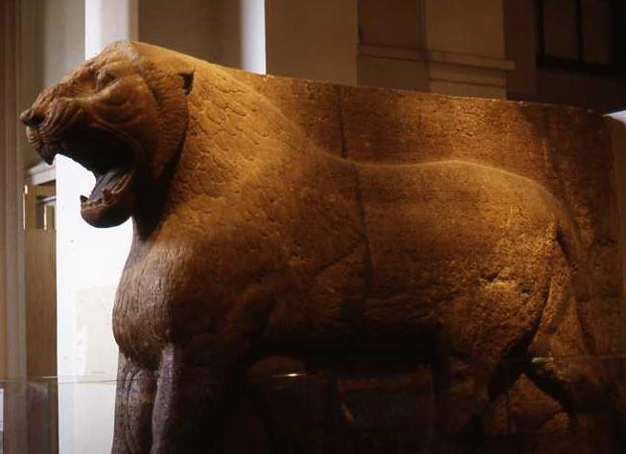
Metaphors for God
“I am like a moth” (5:12a)
“[I am] like rot” (5:12b)
“I will be like a lion” (5:14; cf. 6:1; 13:7-8)
The Palestinian Tineola biselliela lays it eggs in wool or furs, upon which the larvae feed, causing irreparable damage (cf. Ps. 39:11; Is. 50:9; 51:8)
The Asian lion, symbol of Yahweh’s attack upon Judah (5:14; cf. Am. 3:8; Is. 38:13; Je. 25:38; )

Slide 74
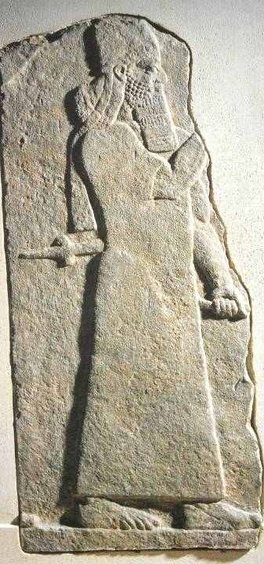
Turning to Assyria
5:13; cf. 2 Kg. 15:19-20, 29-30
“As for Menahem I overwhelmed him like a snowstorm and he…fled like a bird, alone, and bowed to my feet. I returned him to his place and imposed tribute upon him: gold, silver, linen garments with multi-colored trimmings.”
“Israel…overthrew their king Pekah, and I placed Hoshea as king over them. I received from them 10 talents of gold, 1000 talents of silver as their tribute…”
Assyrian Inscription
Annals of Tiglath-Pileser III (Pul)
British Museum, London

Slide 75
Waiting for a Response
The withdrawal of Yahweh after the discipline of judgment is an invitation to repentance (5:15-15).
God’s wrath was not merely punitive, but remedial.
It seeks reconciliation, not destruction.
God is not merely a lion dragging his prey to his lair to be eaten up; rather, he leaves the scene of attack and “goes to his own place” to await Israel’s repentance.

Slide 76
The Dialogue
Since ancient Hebrew has no punctuation, dialogues must be determined by context.
Observe that the NIV puts quotation marks around 6:1-3, denoting that this part of the dialogue is put into the mouth of the Israelite citizens (so also RSV, NASB, NRSV, ESV, NAB).
They talk about repentance after the divine discipline described in 5:14.
They anticipate that their repentance will result in restoration.

Slide 77
The Fundamental Question
Is this overture of repentance sincere?
On the surface, their words sound appropriate, and surely God’s faithfulness to forgive was a certainty.
However, the metaphors of God coming to them “like the winter rains” and “like the spring rains” suggest that their real interest is in fertility and prosperity, not relationship with Yahweh.
Later, God will directly accuse them of insincerity.
They do not cry out to me from their hearts but wail upon their beds. (7:14a)

Slide 78
Yahweh’s Response
The second part of the dialogue demonstrates Yahweh’s frustration with Israel’s half-hearted repentance.
The question, “What can I do with you?” (6:4a) is surely a question every parent has asked a stubborn child!
The metaphors describe Israel’s fickleness (6:4b). The people could not match their best intentions with enduring faithfulness.

Slide 79
What Yahweh Wants!
ds,H, = loyalty, faithfulness, steadfast love
Hosea 6:6 is the epitome of the message of the book, and Jesus quoted it twice.
Matthew 9:13
When the Pharisees criticized Jesus for eating with tax collectors and sinners, he said God came to call sinners, not the righteous, to repentance—then quoted this verse.
Matthew 12:7
When the Pharisees criticized Jesus’ disciples for violating the oral law by picking grain and eating it on the Sabbath, Jesus cited two OT examples of mercy before quoting this verse.

Slide 80
Metaphors Merge with Reality
Covenant-breakers
(6:7)
The Hebrew Mdx can mean:
Adam (so NIV, ESV, NASB)
Men (so KJV, NAB)
A city in the transjordan (so RSV, NEB)
Murderers
(6:8; cf. 12:11a)
Gileadites who have tracked through the blood of their victims
Bandits
(6:9)
Priests who ambush travelers on the road to Shechem, a sacred site
Prostitutes
(6:10)
Ephraimites who defile themselves by whoring
Reapers
(6:11)
Judah would not escape the harvest of its sin.
These descriptions may be metaphors, but they may describe actual incidents!

Slide 81
The Frustration of Fickleness
“Whenever I would restore…whenever I would heal…their sins and crimes are exposed” (6:11b-7:1a)
Rampant Social Sins
General dishonesty (7:1b)
Burglary and muggings (7:1c)
Political corruption (7:3)
Plots to overthrow the government while celebrating the king’s coronation—possibly referring to the series of assassinations (7:5).
Metaphors
Israel is like an old man who is unaware of his age (7:9)
Israel is like a silly dove, easily confused (7:11)
Israel is like a faulty bow that cannot shoot straight (7:16a)

Slide 82
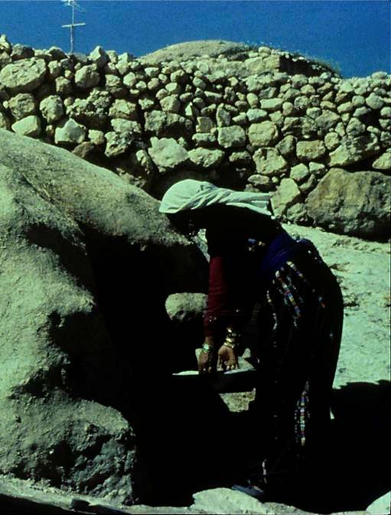
Cooking Metaphors
The characteristic oven excavated from the biblical period was a domed cavity made from mud and fueled with dung or brush.
Burning like a baker’s oven (7:4)
Self-perpetuating fire (7:6)
Flat cake not turned—burnt on one side and raw on the other (7:8)

Slide 83
God’s Pathos and Israel’s Oblivion
In a series of anguished phrases, God describes the broken relationship between himself and Israel.
“…they do not realize that I remember all their evil” (7:2)
“…their sins…are always before me” (7:2b)
“Foreigners sap his strength, but he does not realize it.” (7:9a)
“…he does not return to Yahweh his God or search for him” (7:10)
“They do not cry out to me from their hearts” (7:14a)
“They…turn away from me” (7:14b)
“…they plot evil against me” (7:15)
“They do not turn to the Most High” (7:16a)

Slide 84
Reluctant Judgment
God’s judgment of Israel was far from what he wanted to do!
On the one hand, God moaned, “I long to redeem them….” (7:13b; cf. 6:11b-7:1a)
On the other hand, judgment was what God was compelled to do because of his covenant word.
THE JUDGMENT
Israel would be like birds caught in God’s net of judgment (7:12-13a)
Leaders would fall by the sword (7:16b).
They would be ridiculed in Egypt (7:16c)

Slide 85
Cutthroat Politics
Baasha assassinated Nadab (1 Kg. 15:27-28)
Zimri assassinated Elah (1 Kg. 16:9-10)
Omri attacked Zimri, forcing his death (1 Kg. 16:15-16)
Jehu assassinated Joram and slaughtered his whole family (2 Kg. 9:14-24; 10:1-8, 17)
Shallum assassinated Zechariah (2 Kg. 15:10)
Menahem assassinated Shallum (2 Kg. 15:14)
Pekah assassinated Pekahiah (2 Kg. 15:25)
Hoshea assassinated Pekah (2 Kg. 15:30)
The coup d’etats in Israel were symptomatic of the internal rottenness of the nation (7:5-7).
“Princes become inflamed with wine…”
“They devour all their rulers.”
“All their kings fall…”

Slide 86
Back to Egypt!
Because of covenant unfaithfulness, the God who delivered Israel from Egypt would now send the nation back into bondage (cf. Dt. 28:68).
Their religious ritual had simply become institutionalized sin (8:11).
Though any “strange god” and cult should have been alien to Israel, now Yahweh and his law had become alien (8:12).
Religious ritual continued, but the people were more interested in the meal than atonement (8:13).
“Back to Egypt” meant exile to Assyria (8:13b-14; 9:3a, 6a).
In a pagan land they would eat unclean food in an unclean land, making them unclean themselves (9:3b).

Slide 87
The People and the Prophets
The Israelites’ optimism led them to ridicule and reject their prophets.
The prophets were mocked as fools and maniacs (9:7b).
Though the prophets were spiritual watchmen, Israel was like a city that attacked its own sentries (9:8).
“Yahweh warned Israel…through all his prophets… ‘Turn from your evil ways… Observe my commands…that I delivered to you through my servants the prophets.’ But they would not listen” (2 Kg. 17:13-14)

Slide 88
Metaphors of Disaster
“Samaria and its king will float away like a twig…” (10:7)
“Ephraim is a trained heifer that loves to thresh…so I will put a yoke on her fair neck” (10:11a)
“I will drive Ephraim, Judah must plow, and Jacob must break up the ground” (10:11b)
If Israel won’t plow up the fallow field of her heart in repentance, then she must plow in the despair of judgment for the King of Assyria (10:12-15)!

Slide 89
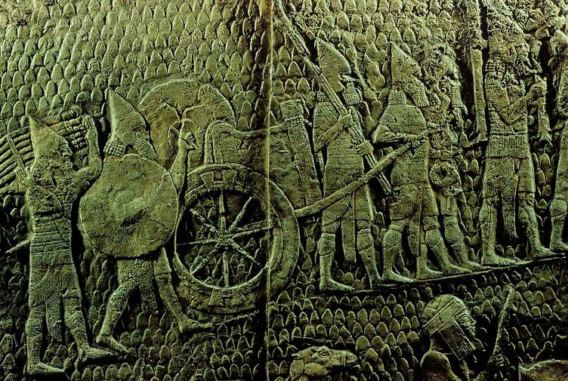
The Wealth of the Land is Only Booty for the Great King of Assyria
“The calf-idol of Bethel (Beth Aven = ‘house of wickedness’) will be taken as tribute” (10:5-6a).
The Assyrians take the booty of the Israelites to present to Sennacherib, the “great king” of Assyria.
(from the palace reliefs at Nineveh, British Museum, London)

Slide 90
Israel’s Childhood
Israel and God is the Old Testament story of the prodigal son.
God’s “son” was called out of Egypt in the exodus (11:1; cf. Ex. 4:22-23).
As a gentle father, God reared Israel with kindness and affection (11:3-4).
In spite of God’s father-love, Israel was determined to go his own way (11:2, 7).
Therefore, the judgment of exile was unavoidable (11:5-6).
Beyond the discipline of exile, however, God’s compassion prevented total rejection. There still was hope! (11:8-11)

Slide 91
The Things that Cannot Save!
“Where is your king?” (13:10)
“Where are your rulers?” (13:10b)
“Assyria cannot save!” (14:3a)
Israel’s chariot corps cannot save! (14:3b)
The gods of the pagans cannot save! (14:3c)
The only one who can save is the God who has compassion on orphans! (14:3d)

Slide 92
Redemption Hope!
I will ransom them from the power of the grave; I will redeem them from death. 13:14a
The book closes with call to repentance (14:1-3) and a promise of restoration (14:4-8).
Healing was coming—the healing of the wounds of sin (14:4a)
Yahweh would be like life-giving dew to Israel who would flourish like a healthy tree.

Slide 93
How it all ended:
As Assyria turned its attention westward, the strategy seems to have been a step-by-step conquest.
First, a vassal relationship was established with a small western state, and tribute was demanded.
As the years passed, the demand for tribute increased and intensified.
At the first sign of dissatisfaction or rebellion, Assyria conducted a military takeover of the small western state.
Menahem’s vassalship to Tiglath-pileser III was the first step in this process for the northern nation Israel.

Slide 94
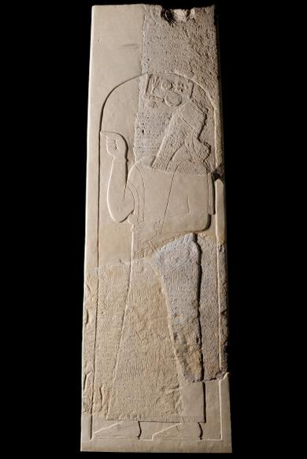
Iran Stele
On this monumental stele of Tiglath-pileser III appears a list of kings who paid tribute to Assyria.
Among them are “…Rezin of Damascus and Menahem of Samaria…”
Menahem, the usurper who assassinated his predecessor, courted Assyrian favor, paying 1000 talents to Tiglath-pileser III (2 Kg. 15:19-20).
Israel Museum, Jerusalem

Slide 95
Hoshea’s Revolt
When Tiglath-pileser III died, Hoshea, the Assyrian puppet king, seized the opportunity to break his vassalship to Assyria (2 Kg. 17:3-6).
Hoping for support from Egypt, Hoshea withheld tribute.
Egyptian support was a vain hope, and Shalmaneser V, Tiglath-pileser III’s successor, invaded Samaria, putting it to a three year siege.
When the city fell, he put Hoshea in prison. Sargon II, Shalmaneser’s successor, deported large portions of the population to outlying regions of the empire.

Slide 96
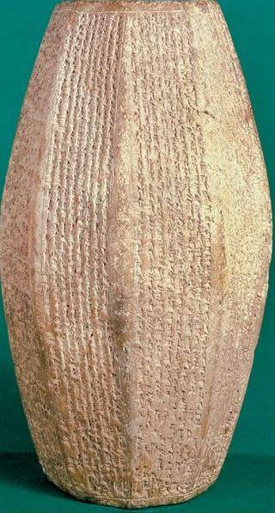
Nimrud Prism
Commemorating Sargon II’s rule, this prism boasts how he deported and resettled the Israelites in “the midst of Assyria”. He claimed to have deported 27,280 people.
“…I repopulated Samerina (Samaria) more than before. I brought into it people from countries conquered by my hands. I appointed my eunuch as governor over them. And I counted them as Assyrians.”

Slide 97
ISAIAH
The Tested Stone

Slide 98
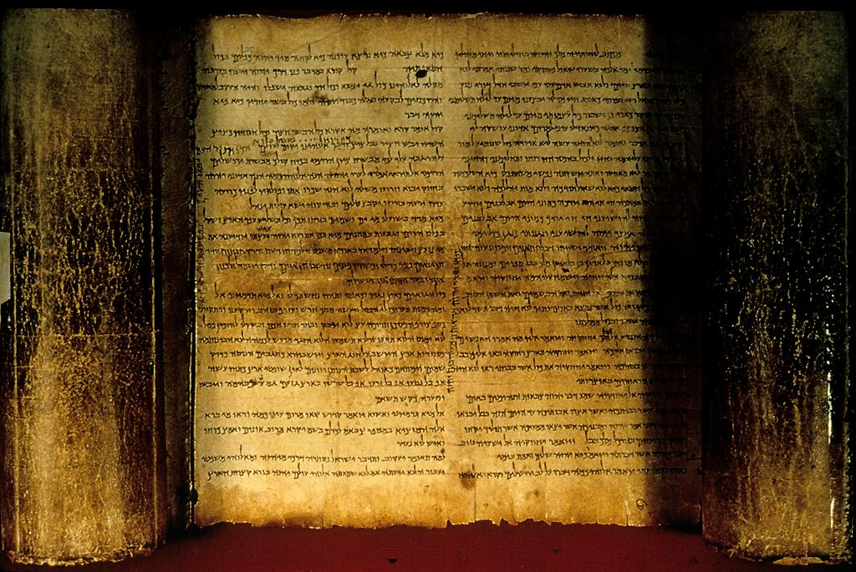
The Isaiah Scroll (Dead Sea Scrolls, 1QIsaª) the oldest existing copy

Slide 99
Uzziah and Ahaz of Judah
(792-740 BC and 735-715 BC; cf. 2 Kg. 15:1-7; 16)
Uzziah/Azariah’s reign in Judah was long and stable (52 years).
Isaiah’s call came in the year of Uzziah’s death (Is. 6:1).
Ahaz, Uzziah’s grandson, revived the fertility cult in Judah and sacrificed his own son.
When Rezin of Aram and Pekah of Israel tried to force him to join an anti-Assyrian coalition, he invited Tiglath-pileser III to defend him (Is. 7).

Slide 100
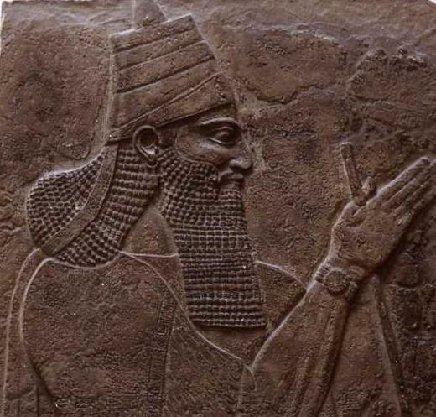
Tiglath-pileser III (744-727 BC)
British Museum, London
“I laid siege to and conquered…Rezon of Damascus… 592 towns…of the 16 districts of the country of Damascus I destroyed like hills of the flood.”
“They [the Israelites] overthrew their king Pekah and I placed Hoshea as king over them.”
(Annalistic Records, ANET, p. 284)

Slide 101
The Effect of Israel’s Exile on Judah
The fall of the north could only have been a severe shock to the citizens of Judah.
The northern Israelites were also the descendants of the patriarchs to whom the land had been promised “forever”.
Earlier, both Israel and Aram had been buffer states between Judah and Assyria. Now, both were gone.
A very real fear must have been that what had happened in the north might happen in the south also.
It is hardly to be doubted that the exile of the northern nation was a powerful incentive for reform by Hezekiah (2 Kg. 18-19; 2 Chr. 29-32; Is. 36-39).

Slide 102
Isaiah ben Amoz
Other than his father’s name, Amoz, we know nothing of Isaiah’s ancestry.
Jewish tradition has it that he was a cousin of Uzziah.
He seems to have lived exclusively in Jerusalem, and his oracles contain many urban metaphors as well as images of rural life.
He was married and fathered children (7:3; 8:3):
  Shear-yashuv (= A Remnant Will Return)
  Maher-Shalal-Hash-Baz (= Speed-Plunder-Haste-Booty)
His call to prophethood was in 740 BC, the year of Uzziah’s death (6:1).
The last biblical mention of him is in 701 BC (Is. 36-37).
The Ascension of Isaiah in the Pseudepigrapha indicates that he was executed by Manasseh, who had him sawed in half with a wood saw, a tradition later reflected in the New Testament (cf. Heb. 11:37).

Slide 103
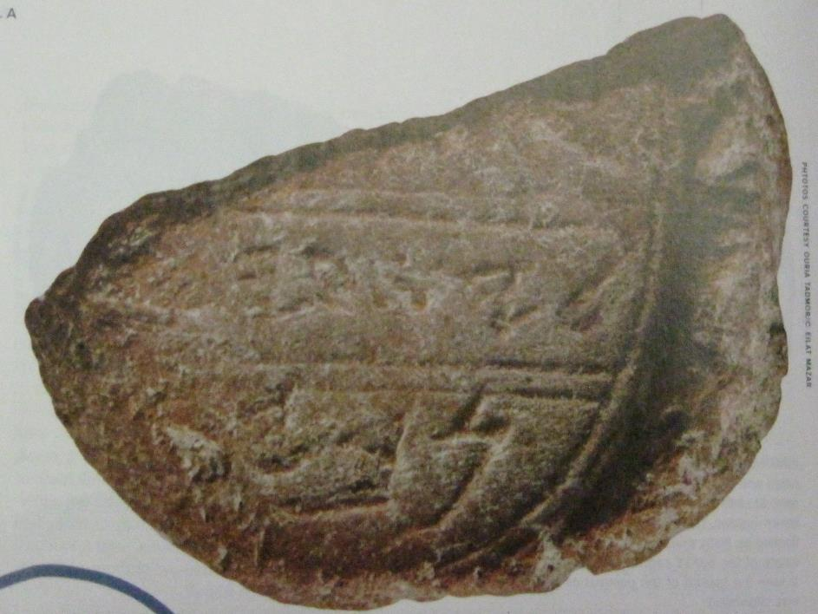
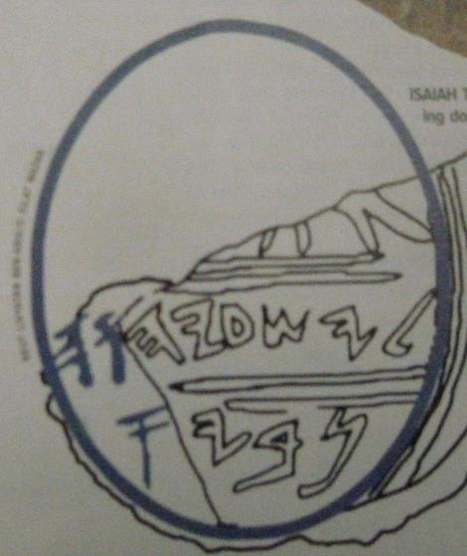




Isaiah’s “Signature”?
In 2009, archaeologist Eilat Mazar discovered this bulla on the Ophel in her excavations of 8th century BC Jerusalem. The middle register contains the name “Isaia[h]”, and the bottom register the title “proph[et]”.

Slide 104
Authorship
Historical-critical scholars have divided the Book of Isaiah into two (sometimes three) major sections/authors.
Isaiah 1-39 is credited to Isaiah of Jerusalem in the 8th century BC.
Isaiah 40-66, often called “Second Isaiah,” is credited to an unnamed prophet during the 6th century Babylonian exile.
Still others divide the last section into Chapters 40-55 (Deutero- Isaiah) and Chapters 56-66 (Trito-Isaiah).
Conservative scholars are more doubtful about this theory of multiple authorship and eventual redaction.

Slide 105
The Call of Isaiah (6)
Isaiah’s vision and calling describe his privileged position as a true prophet who has stood in the council of the exalted God (cf. Je. 23:18).
The setting for this vision is a deliberate interplay between the earthly temple of Solomon and the heavenly temple, where God is enthroned and surrounded by angelic hosts.
The death of Uzziah after his lengthy reign underscored the theological truth that the true King of Israel was Yahweh himself, whose glory filled the earth (6:3, 5).

Slide 106
The Commissioning (6:8-13)
Standing within heaven’s council, Isaiah overheard deliberations and the question as to what messenger could be sent (6:8a).
Immediately, he offered himself and was commissioned as a prophet (6:8b-9a).
He was warned in advance that he would face a recalcitrant and unresponsive audience, much as would be true for other prophets (6:9b-10; cf. Je. 1:17-19; Eze. 2:3-8).
This hardening of hearts would continue until the “forest” of Judah (a metaphor for the nation) would be cut down (6:11-13).

Slide 107
The Summary (1)
The initial chapter in Isaiah serves as a summary of his entire ministry (1:1).
It commences with the original covenant witnesses of heaven and earth (1:2; cf. Dt. 4:26; 30:19; 31:28; 32:1).
Hence, the opening lines are an indictment against Israel, who has been unfaithful to the covenant.
Like Hosea, his contemporary in the north, Isaiah employs the metaphor of Israel as rebellious children (1:2b-6; cf. Ho. 11:1ff.).
Anticipating the ravages of the Assyrian scourge, Isaiah describes Judah as stripped bare (1:7-9).

Slide 108
The Last Days (2)
The Day of Yahweh would be both a day of Yahweh’s peace but also his judgment.
The vision of peace (2:2-5) is virtually identical to Micah 4:1-5, and some literary dependence must be assumed, though which is earlier is a moot question.
Three times Isaiah repeats the phrase that the people of Judah would run to the caves in fear of the coming judgment (2:10, 19, 21).

Slide 109
The Branch (4)
The metaphor of the Branch depends in turn upon the metaphor of the deforestation of Judah, where the people would be left as a stump in the land (cf. 6:13).
If the stump represents the coming disaster and the survivors who remain, the Branch represents the blessing and restoration of this remnant.
Later, the Branch will point toward the Messiah, the son of David (cf. 11:1ff.).
The same metaphor will be used by later prophets to speak of the same messianic future (cf. Je. 23:5; 33:15; Zec. 3:8; 6:12).

Slide 110
Song of the Vineyard (5)
While the title might suggest that this is a love song, the rhythm is for a funeral song.
The qinah meter (3 + 2 stressed syllable) is the rhythm of a dirge.
Hence, the listeners would immediately notice the discord.
This vineyard, far from producing the “bright-reds” appropriate for wine-making, produced only the small, hard sour grapes that were useless.
Because the vineyard produced only bad fruit, the owner intended to desert it.

Slide 111
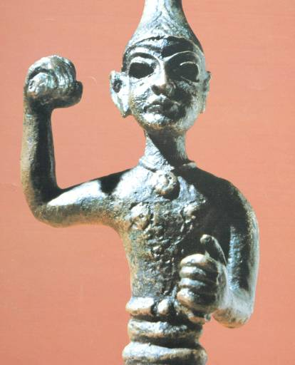
Image of the Upraised Hand
The imagery of an upraised hand was a widely recognized symbol in Canaanite culture of a deity’s power to strike his enemies.
This image of Ba’al Hadad is typical.
For Judah, Yahweh would discipline the nation with upraised hand, and his rod of discipline would be the Assyrian army (cf. Is. 10:5).
(Isa. 5:25b; 9:12b, 17b, 21b; 10:4b)

Slide 112
Syro-Ephraimite Alliance (7)
Pekah’s assassination of Pekahiah, Menahem’s son, could be expected to result in Assyrian reprisals, since Pekahiah was an Assyrian vassal (2 Kg. 15:29).
In response to this threat, Israel (Ephraim) and Aram (Syria) formed a political alliance.
Pekah and Rezin, their respective kings, intended to force Ahaz of Judah to join them (2 Kg. 15:37; 16:5).
They devastated many towns, even putting Jerusalem to siege (7:1; 2 Chr. 28:5-8).
They threatened to depose Ahaz and install a puppet king of their own, a certain Ben Tabe’el (7:2, 5-6).

Slide 113
Isaiah’s Word to Ahaz (7:3-9)
When Ahaz went to check the city’s water supply in view of this threat, Yahweh instructed Isaiah to confront him, taking with him his son Shear-Yashuv.
The presence of Isaiah’s son, whose name was at once a prediction of doom and a ray of hope, was an implicit rebuke to Ahaz, who already had burned his own son to a pagan deity (cf. 2 Kg. 16:3).
His message was formed in a play on words: “If your faith is not sure (ta-aminu), you will not be secure (te’amenu)” (7:9b).

Slide 114
The Immanuel Sign (7:10-17)
Yahweh invited Ahaz to ask for a sign to confirm God’s promise of security, but Ahaz, in a gesture of pseudo-humility, refused.
God gave him a sign anyway: a virgin would give birth to a son, naming him Immanuel (= God with us).
Before the child would be old enough to make his own moral decisions, the lands of Aram and Israel would be wiped out.
The name “God with us” was a reflection of God’s promise to protect Judah if Ahaz would only trust him.
However, God’s presence would be there not only to protect, but also to judge (7:17), and that judgment would come from the king of Assyria (7:18-25).

Slide 115
The “Virgin” (7:14)
Because this passage is quoted in the New Testament (Mt. 1:23), considerable discussion has arisen over the translation of the word hmAl;fa(= young woman).
Most Old Testament occurrences of the word seem to refer to an unmarried young woman with the strong presumption that she was a virgin at the time she was described. The LXX made this explicit in its translation of Is. 7:14 by using the term parqe<noj (= virgin).
Some translations render it “virgin” out of deference to the New Testament citation based on the LXX (so KJV, ASV, NIV, NAB, NASB, ESV, CEV, etc.).
Other translations render it more directly by its basic Hebrew meaning as “young woman” (so RSV, NRSV, NEB).

Slide 116
The Sign-Child Name (8:1-4)
Already, two children’s names have served as signs of the future: Shear-yashuv (= a remnant will return) and Immanuel (= God is with us).
Now, Yahweh reveals a third name, Maher-Shalal-Hash-Baz (= quick to the plunder, swift to the spoil).
This child was to be born to Isaiah and his wife, but before the child was old enough to talk, Damascus and Samaria, the capitals of Aram and Israel, would have fallen.
These children all served as signs of the future (8:18).

Slide 117
The Future Promise (9:1-7)
Judgment would not be Yahweh’s final word, however.
Though Galilee might suffer under the invasion of the Assyrians in the near future, the same region would be honored in the distant future (9:1).
The darkness of Assyrian conquest would be ameliorated by a new and joyful day through the coming of a child in David’s family line (9:6ff.)—foreshadowed by the Immanuel child.
This Coming One would reign forever, bringing peace and justice.
Matthew was not slow in seeing this promise fulfilled in Jesus’ Galilean ministry (Mt. 4:13-16).

Slide 118
The Stump of Jesse (11:1-9)
Isaiah’s metaphor of deforestation (cf. 2:12-13; 5:5; 6:13b; 7:2; 10:33-34) now becomes the background for one of Isaiah’s most important messianic prophecies.
From the stump of Jesse, a Branch would flourish (11:1; cf. 4:2), a child to be born to rule on David’s throne (cf. 9:6-7).
The “fruit” of this Branch would be true justice and international peace, for the child to be born would be the bearer of Yahweh’s Spirit.
Amazingly, the Branch of Jesse would also be the Root of Jesse (11:10), one who was both David’s Son and David’s Lord (cf. Mt. 22:43-45; Rv. 22:16, etc.).

Slide 119
The Remnant (11:10-16)
A remnant of Israel, foreshadowed by the name of Isaiah’s son, would be regathered from the whole world (11:12).
In the New Testament, this concept of the remnant of faith would be enlarged to include the preaching of the gospel to the nations (cf. Ro. 15:8-12).
In the near future, the return of the remnant refers to the return of the exiles from Mesopotamia on a “highway…from Assyria” (11:16; cf. Zec. 8:6, 11-12). In the far future, it refers to those who accept the message of Christ (cf. Ac. 15:15-18; Ro. 9:27-29).

Slide 120
Oracles to Non-Israelites (13-23)
In the ancient Near East, provincial deities were the norm. Yahweh, by contrast, ruled over all (cf. Ps. 103:19).
It was God’s ultimate purpose to bring blessing to the nations through Abraham and his posterity (Ge. 12:3; 18:18; 22:18; 26:4).
Israel was chosen to be a “kingdom of priests”, presumably priests to the other nations of the world (Ex. 19:5b-6).
Thus, the nations are part of God’s overarching concern, but they are equally accountable to him and will be judged by him.
Israel’s prophets had substantial sections addressing other nations, and Isaiah is no exception.

Slide 121
Taunt Song (14:3-21)
The oracle against Babylon includes a taunt against the ruler of Babylon.
A taunt is a literary form in Hebrew poetry that addresses an opponent, ridicules his pretensions and scoffs at his destruction. (There is a similar taunt against Ithobal II of Tyre in Ezekiel 28.)
Here, the king of Babylon descends to Sheol, the place of the dead, where his lofty claims are derided while maggots eat his body (14:11): he is a human of no greater importance than anyone else in the world (14:9-10, 15-17)!
His corpse is left unburied amidst other corpses from his final battle (14:19-20).

Slide 122
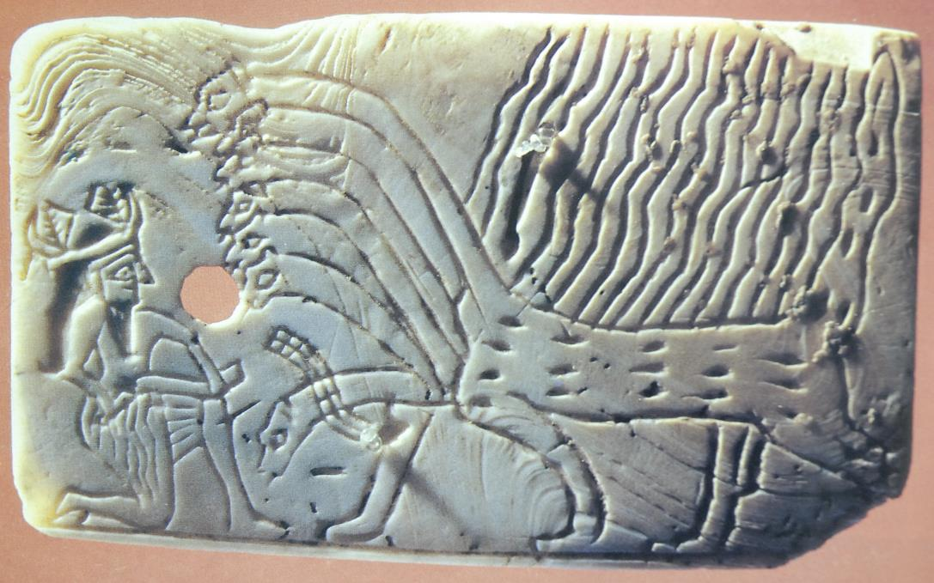
Leviathan and the Use of Ancient Mythology
The imagery of Yahweh in conflict with a dragon-like creature appears in various places in the Old Testament (e.g., Job 9:13; 26:12-13; Ps. 74:13-14; 89:10; Is. 27:1). It seems to have been a stock image, for it is found in the various literature of Sumer, Babylon, Phoenicia, Canaan and Egypt. In the New Testament, this same image appears in Revelation 13:1ff.
In this incised Sumerian shell from ca. 2600 BC, a seven-headed monster confronts a god who already has wounded one of its heads.
STOCK NAMES
Leviathan
Behemoth
Rahab
Tannin
Yam
Nahar
Nahash

Slide 123
The Fall of Lucifer? (14:12-15)
Many interpreters have understood the overthrow of the king of Babylon to be a metaphor for Satan’s downfall.
The title “Daystar” (lleyhe = “Lucifer,” KJV via the Latin Vulgate) has become a popular title for Satan, though this is the only passage in the Bible that contains the name (14:12).
In this reading, the attempt to usurp God’s throne (14:13-14) is not only a description of the earthly Babylonian king’s pretensions, it mirrors the dark spiritual power that lies behind him, Satan himself.
Usually, this reading is coupled with a similar reading of Ezekiel 28.

Slide 124
The Restoration (27)
“In that day” (The Day of Yahweh), God will destroy Leviathan, the sea monster (whom John later will call “that old serpent, the devil,” 27:1; Re. 12:9).
Israel, the vineyard of the Lord (27:3-4; cf. 5:1ff.), will finally fulfill its destiny to bring blessing to the nations, filling the world with bounty (27:6)!
Before blessing, however, will come judgment, war and exile (27:7-11).
Finally, at the divine trumpet, the exiles would regather to worship on Mt. Zion (27:13; cf. Mt. 24:31).

Slide 125
“Woe!”
God’s judgment against Israel and Judah is punctuated by a repetitious “woe!”
“Woe” to Ephraim/Israel (28:1)
“Woe” to Jerusalem/Ariel (29:1)
“Woe” to God’s stubborn children (30:1)
“Woe” to those who seek help from Egypt (31:1)
“Woe” to the Assyrian destroyer (33:1)
Each nation would suffer judgment, but judgment was not God’s final word. Beyond judgment there was hope for each. Judgment was God’s “strange work” before salvation (28:21).

Slide 126
The Stone in Zion (28:14-29)
In view of the coming judgment and the efforts of Israel to fortify its future by political schemes, Yahweh announced the laying of a cornerstone (28:14-16).
Israel’s self-made security would be swept away (28:17-19)!
Israel was now in God’s process—his strange therapy—which was as much a divine process as a farmer’s various tasks of plowing, sowing and threshing (28:21-29).
Of course, it was a deep irony that the promise of security in the Zion stone would be given to the northern nation which had rejected Zion altogether!

Slide 127
The Zion Stone and the Messiah
Embedded in the prediction of the Zion Stone was hope for the future. What was this stone in Zion? New Testament writers were in no doubt—it was the Messiah, Jesus Christ.
UNBELIEVERS
BELIEVERS
COMMUNITY
They stumbled over the stumbling stone… (Ro. 9:32)
Everyone who trusts in him will never be put to shame (Ro. 10:11)
As you come to him, the living stone…you are built into a spiritual house (1 Pe. 4:4-6)
THE STONE
OF STUMBLING
(Is. 8:14-15)
THE STONE
OF SECURITY
(Is. 28:16b)
THE CHURCH’S FOUNDATION
(Is. 28:16a)

Slide 128
Hezekiah and Assyria
In the early years of his reign, Hezekiah was by default under suzerainty to Assyria as established by his father Ahaz.
Hence, when Assyria brought the northern nation of Israel to an end and penetrated Palestine as far as Ashdod, Judah was left unscathed.
When Sargon II died (705 BC), however, Hezekiah saw his opportunity to break his vassalship to Assyria.
The citizens of Ekron and other local states joined this rebellion and deposed Padi, their pro-Assyrian king, delivering him over to Hezekiah for imprisonment.

Slide 129
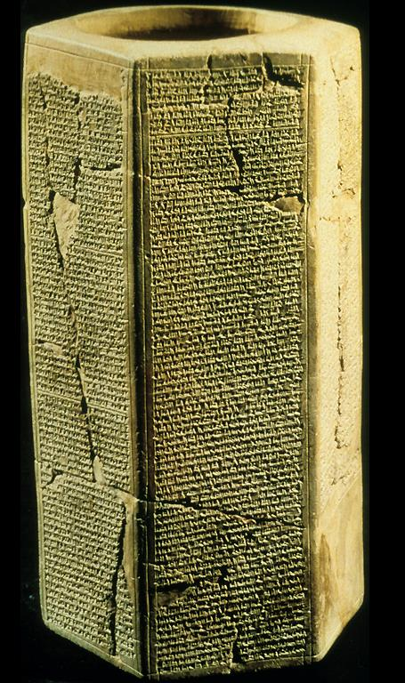
Taylor Prism
Sennacherib’s invasion of Judah is particularly well documented in Assyrian texts, bas-reliefs and excavation.
The Taylor Prism, like the Oriental Institute Prism, details his conquest of 46 of Judah’s walled cities and “countless villages”. He also claimed to deport 200,150 people.
“Hezekiah I made a prisoner in Jerusalem, his royal residence, like a bird in a cage.”
British Museum, London

Slide 130
Sennacherib’s Threat (37)
The irony of Sennacherib’s threat is that it was delivered at the same place that Hezekiah’s father, Ahaz, had been urged by Isaiah to stand firm in his faith (36:2-3; cf. 7:3).
Ahaz had ignored Isaiah, but Hezekiah would listen.
In spite of his threats, Sennacherib did not breach Jerusalem’s walls nor conquer the city.
Hearing a report that Tirhakah of Egypt was mobilizing, and after losing troops in a plague, Sennacherib withdrew (37:36-37).

Slide 131
The Scholarly Controversy
In the past two centuries, historical-critical scholars have concluded that Isaiah 40-66 was not written by Isaiah of Jerusalem.
Typically dubbed “Deutero-Isaiah,” this latter section is believed to have been composed by one or more anonymous authors about two centuries after Isaiah 1-39.
Some scholars also argue for “Trito-Isaiah,” chapters 56-66, which are believed to have been composed by yet a different author.

Slide 132
What is at Issue
Historical-Critical Scholars
The literary style in chapters 40-66 is quite different than in chapters 1-39.
The context is post-exilic, two centuries later than Isaiah.
Several other OT scrolls are composites (e.g., 1 & 2 Kings, 1 & 2 Chronicles, The Twelve).
NT citations from this section of Isaiah simply use conventional language in referencing Isaiah.
Conservative Scholars
There is no textual evidence for two or more sources.
If Isaiah was a true prophet, a different context is immaterial.
The OT books that are composites clearly say so—and the Book of Isaiah does not.
If Jesus said Isaiah said it, then he said it, conventional language notwithstanding.
However the question of authorship is to be decided, scholars agree that Isaiah 40-66 presupposes the Babylonian exile.

Slide 133
The New Historical Situation
Beginning in Isaiah 40:1, the oracles implicitly assume that the exile has occurred and is now nearly over.
In chapters 1-39 the enemy is clearly Assyria, while Jerusalem and Judah are still surviving politically and the kings of David’s family still reign.
In chapters 40 and following, Jerusalem is in ruins (40:1-2; 44:26-28; 49:14-23; 64:10). The temple has been destroyed (63:18; 64:11). The only references to David now seem to be in the distant future (55:3-5).
Some oracles seem to be direct responses to statements and complaints by the exiles themselves (40:27; 45:9-13; 49:14).
A third world power, Persia, is anticipated. It’s leader is already identifiable as Cyrus, the Great (44:28; 45:1, 13).
Hence, the exile is not something that is going to happen; it is something that has already happened.

Slide 134
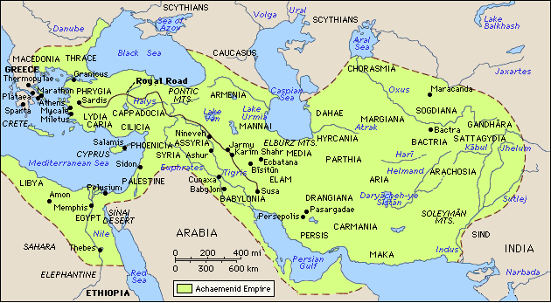
The Jews in the Babylonian/Persian Empires
Jewish settlements (ca. 539 BC)

Slide 135
Comfort to the Exiles (40:1-2)
God’s message of comfort was directed toward the last vestiges of Jewish national life, the desolated Jerusalem now in ruins.
All the towns of Judah had been crushed by the Babylonian war machine, but Jerusalem had been particularly hard hit with the burning of every major building, including Solomon’s temple, as well as the deportation of most of its citizens (cf. 2 Kg. 25:8-11).
This horrific judgment was now at an end.
The Deuteronomic penalty for Jerusalem’s sin had been discharged (cf. Dt. 28:64-68).
Now, there was hope for restoration (cf. Dt. 30:1-10; cf. 2 Chr. 6:36-39).

Slide 136
The Voice in the Desert (40:3-5)
A voice was now calling from the great desert that separated Babylon from Jerusalem.
A returning highway would be built so that once more God could inhabit his holy city.
No doubt this “highway” recalled the exodus from Egypt, but it also may allude to the Persian Royal Highway built from Susa to Sardis.
Yahweh’s glory, which had abandoned the temple prior to its destruction (cf. Eze. 10), now would return and be revealed to the nations.

Slide 137
The Second Voice (40:6-8)
A second voice now sharply contrasts the transitory nature of human life with the enduring Word of God.
If the nation of Judah had wilted like grass before the divine breath of judgment, the promises of God stand without wavering!
Only God’s faithful promises could stand firm through the ravages of history.

Slide 138
Good News from the Mountain (40:9-11)
The good news (gospel) of God was to be shouted to the towns of Judah and the city of Jerusalem!
God was coming!
Previously, he had come against Jerusalem as a Man of War; now he would come as a tender Shepherd and Savior!

Slide 139
The Incomparable Greatness of Yahweh (40:12-26)
The opening consolation is followed by an extended description of Yahweh’s sovereignty.
A series of rhetorical questions, reminiscent of the questions God asked Job, emphasize the mind and craftsmanship of God as the Creator of the universe.
The nations are no more than dust upon the balance scales.

Slide 140
Who is Truly God?
Central to all these oracles is the fundamental question, “Who is really God?”
All war in the ancient Near East was religious war, and when a nation conquered another nation, their boast was that their patron gods were more powerful than those of the defeated enemy.
How would the people of Judah respond to this claim, since Yahweh’s temple had been burned to the ground and his people deported to Babylon?
In Babylon, they would encounter the sophisticated mythologies and religions of Mesopotamia, and by comparison, Yahweh and his ruined temple must have seemed provincial and weak.

Slide 141
Holy Sarcasm
In Babylonian temples, it was believed that the gods were present in the form of images.
The idols were dressed, served food twice a day, their mouths were washed and a curtain was drawn in front of the image while he “ate.”
Though people were conscious that images were humanly constructed, they believed that at night these idols became the instruments of the deities.
With biting sarcasm, Isaiah contrasts these pagan idols with Yahweh who reigns supreme over the whole universe. Even the heavenly bodies, which the Babylonians conceived as gods, were nothing more than part of the created order.

Slide 142
The Inquiry (41:2-4)
God’s interrogation of the nations concerns whether or not they can fathom his future purposes.
The next significant event would be someone from the east to whom God would hand over the nations of the Babylonian world (41:2b-3).
Though presently he is unnamed (he will be named in 45:1), God will stir him up and call him into divine service (41:2a, 25).
No one—certainly not the Babylonians—could have foreseen the rise of Cyrus, the Persian!
Only Yahweh, who controls all things from beginning to end, could know the full range of future events (41:4)!

Slide 143
The First Evidence (41:5-7)
The initial evidence that Cyrus was coming already had occurred in his advance to the Anatolian coast in the winter of 547 BC.
Those in the Aegean Islands had seen him and were banding together for defense (41:5-6).
Frantically, they were multiplying their pagan idols in the hopes of warding off Cyrus’ encroaching military threat (41:7).

Slide 144
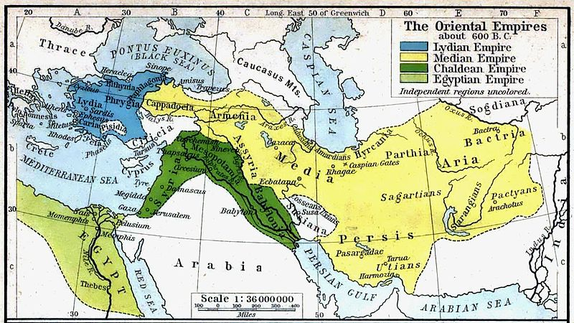
CYRUS’ ADVANCES
Against the Medes (550 BC) Northeast Iran (546-540 BC)
Against Lydia (547 BC) Against Babylon (539 BC)

Slide 145
Israel, Yahweh’s Servant (41:8-20)
Yahweh’s deeper purpose in history would now become clear.
Exile was not God’s final word for Israel.
Israel remained the chosen people of Yahweh, the descendants of Abraham, and God had chosen Israel from the ends of the earth to be his servant—to serve his profound divine purpose (cf. Ge. 12:3; 26:2-5; Ex. 19:3-6).

Slide 146
The Metaphor of the Servant
The acclamation, “Israel, my servant” (41:8) is very much like the ancient acclamation, “Israel is my firstborn son” (Ex. 4:22-23).
Such expressions are collective metaphors, a Hebraic figure of corporate personality in which “the one” can represent “the many.”
Later, the metaphor will be reversed in which “the many” can be represented by “the one,” and the figure of Yahweh’s Servant will refer to an individual who represents the whole, even to the point of turning the Israelites back to God and becoming a light for the nations of the whole world (cf. 49:5-6; 52:13-15).
Both the metaphors of “the son” and the “the servant” come to be embodied in God’s perfect Son and Servant, Jesus Christ!

Slide 147
The Songs of the Servant
Beginning in 42:1, the reader encounters the first of what has come to be called the four Servant Songs, poetic declarations about Yahweh’s special purpose for his servant.
Mission
42:1-4
Justice to the nations
Endowed with the Spirit
Gracious to the weak
Determined to succeed
Call
49:1-6
Chosen before birth
Hidden in God’s purpose
Destined for glory
A light for the nations
Humiliation
52:13—53:12
Despised and rejected
Suffers innocently & vicariously
Bears the sin of many
Victorious!
Submission
50:4-9
Completely faithful
Willing to suffer
Determined to endure
Vindicated at last by Yahweh

Slide 148
Who is Yahweh`s Servant?
As the servant metaphor fluctuates between a collective figure for the nation of Israel and an individual figure with a mission both to the nation of Israel and to the nations of the world, the intriguing question arises, which was so eloquently voiced by the Ethiopian eunuch in the New Testament: “Who is the prophet talking about” (Ac. 8:34a)?
Christians have never been in doubt! Philip opened his mouth, and beginning with this Scripture he told him the good news about Jesus (Ac. 8:35)!

Slide 149
The Mission of the Servant (42:1-8)
The task of Yahweh’s servant had been clearly set forth.
As the bearer of the Spirit, the Ebed-Yahweh (= Servant of the Lord) was destined to bring justice to the nations (42:1-4).
He was called to rescue those perishing in darkness (42:5-8).
The description of this mission links God’s promise to Abraham—that his posterity would bless the nations (Ge. 12:3; cf. 26:2-5)—with the commission of Israel to be a kingdom of priests, ostensibly to the world (Ex. 19:5-6).
Because of repeated covenant violation, the ideal embodied in this mission had never been realized.

Slide 150
The Failed Servant (42:18-25)
As the servant who failed in God’s mission, Israel’s national life ended in exile.
Blind to God’s larger purpose, both northern and southern Israel failed terribly (2 Kg. 17:7-23; Eze. 24:1-14).
The exile came as a judgment from God himself, when Israel simply refused to hear his longsuffering call.

Slide 151
The Creator-Savior (43:1-13)
Israel’s failure, however, did not mean the failure of God.
A remnant had been promised the hope of return (cf. 10:20-21).
The present holocaust of suffering was not final, for Yahweh had created, redeemed, named and accepted Israel as his own.
In the end, he would regather the exiles from all directions, even in their spiritual blindness, to be court witnesses of Yahweh’s sovereignty, glory and grace.

Slide 152
The Promise of the Spirit (44:1-5)
Though Israel, Yahweh’s servant, had failed terribly, God promised to blot out her sins. This was the first step in the “new thing” God would do.
This promise of the life-giving Spirit must be viewed against the background of its removal from the temple (cf. Eze. 10).
If the Spirit had departed, it also would return (cf. Eze. 11:18-20; 36:24-28; 37:14; 39:29), like water on parched soil!
The root of Israel was not dead, and the refreshing rain of the Spirit would revive the people again!

Slide 153
The Servant Redeemed (44:21-23)
In the midst of pagan Babylon, Israel must continually bear in mind that she is remembered by Yahweh!
As one created to be his servant, she would be redeemed and forgiven, even though she had failed.
Jeremiah had predicted that God would forgive Israel’s sins (cf. Je. 31:34), and he would do this very thing!
Indeed, Yahweh would not wait for Israel’s initiative to repent, for he had himself created conditions whereby she could repent.

Slide 154
Messianic Allusions
The messianic overtones of Isaiah are clearly echoed and quoted in New Testament passages about the coming of Christ
40:1 Comfort, my people…
40:3 Prepare the way for the LORD…
40:11 He tends his flock like a shepherd…
41:4 I am…the first and…the last (cf. 44:6)
42:1-4 Here is my servant…
42:6 A light for the Gentiles…
43:21 That they may proclaim my praise.
Waiting for the consolation… (Lk. 2:25)
Prepare the way for the Lord… (Mt. 3:3)
I am the Good Shepherd… (Jn. 10:11)
I am the First and the Last (Rv. 1:17)
Here is my servant… (Mt. 12:18-22)
A light for the Gentiles… (Lk. 2:32)
That you may declare his praises (1 Pe. 2:9)

Slide 155
Cyrus and the Remnant (44:24-28)
Earlier, Isaiah had predicted that “one from the north…from the rising sun” would be Yahweh’s chosen instrument (cf. 41:25).
Now, this chosen instrument will be precisely identified as Cyrus of Persia.
Cyrus would allow the Israelites to fulfill God’s plan of rebuilding Jerusalem and its temple.
Versions of Cyrus’ repatriation edict can be found in the Bible at various places (e.g., 2 Chr. 36:22-23; Ezr. 1:1-4; 6:1-5).

Slide 156
From Babylon to Persia
As described in Daniel 5, the changeover from Babylon to Persia occurred in a single night.
Babylon was seized on October 12, 539 BC, and Cyrus was welcomed into the city as a liberator.
In the first year after Babylon’s conquest, Cyrus issued an edict of repatriation allowing displaced peoples in his regime to return to their homelands in order to rebuild their sacred temples—a form of enlightened self-interest.
This edict was a direct fulfillment of Jeremiah’s prophetic oracles (1:1; cf. Je 25:12-13; 29:10-14; 32:13-15, 42-44).
Cyrus, of course, is directly referenced here in the Book of Isaiah as God’s “anointed one” to make possible the Jews return to Jerusalem (Is. 44:28; 45:1).

Slide 157
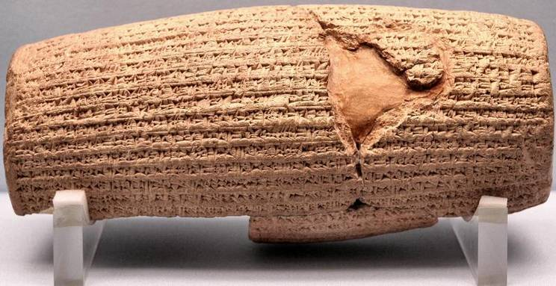
Cyrus Cylinder
“I returned to these sacred cities on the other side of the Tigris, the sanctuaries of which have been in ruins for a long time, the images which used to live therein and established for them permanent sanctuaries. I also gathered all their former inhabitants and returned to them their habitations.”
British Museum, London

Slide 158
The Servant Who Was, and the Servant Who Would Be
The fluidity of the servant metaphor between the many and the one is particularly evident in this section.
Jacob, the failed servant (the Israelites), would be redeemed from Babylonian bondage (48:20), but it is to the point that Jacob could not redeem himself.
  He was obstinate (48:4), prone to idolatry (48:5) and a rebel from birth (48:8).
  In his redemption, all glory must go to Yahweh alone (48:11).
The redeemer of Jacob, therefore, could never be Jacob himself—the redeemer would be a perfect Servant, called from the womb to turn Jacob back to Yahweh (49:1, 5), and beyond that, to call the nations to himself so they might be saved (49:6).

Slide 159
Yahweh’s Perfect Servant (49:1-6)
If the initial servant song envisioned God’s purpose to bring justice to the nations (42:1-4), this second song explains how God commissioned his Servant from before his birth.
Yahweh’s Servant would be a powerful spokesman, hidden in God’s eternal purpose until the time of his revealing (cf. Ro. 16:25-26).
This chosen one would be “Israel” (49:3), yet at the same time he is commissioned to restore Israel (49:5) as well as bring salvation to the ends of the earth (49:6)!

Slide 160
The “true Israel”—the “true Servant”—is Christ Jesus!
It was faithful to the intent of this passage that Paul and Barnabas quoted Isaiah 49:6, applying it directly to the non-Jews in Pisidian Antioch (cf. Ac. 13:46-38).
“For so the Lord has commanded us, saying, ‘I have made you a light for the Gentiles, that you may bring salvation to the ends of the earth.’”

Slide 161
The Listening Servant (50:4-9)
Whereas Israel, the collective servant, had been blind, deaf, rebellious and unresponsive (42:19; 48:4, 8; 50:2a), in this third Servant Song the coming individual Servant would be submissive, receptive and obedient.
In striking contrast to ancient Israel, he would faithfully listen to Yahweh.
He also would experience great suffering and abuse (cf. 49:7a).
At last, however, Yahweh would vindicate him completely!

Slide 162
The Suffering Servant (52:13—53:12)
This fourth Servant Song brings the reader to the climax of the mission of Yahweh’s Perfect Servant.
For many, this has become the single most important messianic passage in the Old Testament.
Earlier, the Perfect Servant is regarded as a figure of suffering (cf. 49:7a; 50:6); here, that suffering is described in vivid and moving detail.
If centuries later an Ethiopian proselyte would ask of this very passage, “Who is the prophet talking about?” Philip’s answer has remained the Christian constant: “He began with that very passage and told him the good news about Jesus” (Ac. 8:34-35).

Slide 163
Sprinkling Many Nations (52:13-15)
In public opinion, the Servant would seem to fail.
His ministry would incite both admiration and horror (cf. Ro. 15:21).
As a priestly figure, the Servant would “sprinkle” many nations, an allusion to the high priestly ritual of purification, either through the sprinkling of water or blood. (Some English translations follow a lesser meaning “amazed” based on the LXX, but in the larger context of the Fourth Servant Song, the priestly nuance seems best.)
As before (cf. 42:1; 49:6; 51:4-5; 52:10), the Perfect Servant’s ministry to those beyond the traditional lines of Jewish ethnicity is apparent.

Slide 164
The Despised Servant (53:1-9)
The Servant’s mission would be so unusual that it would strain credulity in all who saw him.
Even his own people would find him unattractive (cf. Jn. 12:37-38; Ro. 10:16).
His outward appearance was not inspiring.
However, he would so fully empathize with the sorrow of his people that he would vicariously suffer for their sins.
In spite of torture and abuse, he would suffer silently, even to death (cf. Mk. 9:12; Jn. 1:29; Mt. 27:12, 14; Lk. 24:25-26, 46; 1 Co. 5:7; Rv. 5:6, 12; 1 Pe. 1:11; 2:22-25).
Incongruously, he would be buried with the rich (cf. Jn. 19:38-42).

Slide 165
Yahweh’s Will (53:10-12)
This vicarious suffering for the sins of others was at the very center of God’s will.
The Servant’s death would serve as an atonement for others.
Though cut off from any natural descendents by death, paradoxically he would be given spiritual posterity through God’s divine will, and God would grant him prolonged life (cf. Ro. 5:19).
Still, in his death he would be in the company of transgressors, bearing the sin of many and offering intercession for them (cf. Mk. 15:17mg; Lk. 22:37; 23:34).

Slide 166
Thirst for Righteousness (55:1-13)
Building on the reconciling mission of the Perfect Servant, an open invitation is now offered to all who are spiritually hungry.
The substance of this invitation is very much along the lines of “man does not live by bread alone” (cf. Dt. 8:3; Mt. 5:6).
The invitation to come “that your soul may live” emphasizes that the entire person stands in need. The wpn (= soul) in Hebrew thought refers to the whole person.
Hence, the imperative is to “seek Yahweh…while he is near.”

Slide 167
Yahweh’s Unfailing Kindnesses to David
In the past, the citizens of Judah had thought they were politically secure because of Yahweh’s covenant with David (2 Sa. 7:8-16; 22:51; 23:5a; Is. 37:35; Ps. 46; 48; 89:20, 26-37; Mic. 2:6-7; 3:11; 4:11-13; Zep. 1:12; Je. 5:12-13; 6:14; 7:4, 9-10; 8:11; 22:21).
The Babylonian exile dispelled this notion forever.
From 2 Sa. 22:51, the prophet draws the phrase “the unfailing kindnesses to David” but projects a fulfillment into the future.
God’s promises to David had not fallen, but their fulfillment was not confined to the political vicissitudes of ancient Judah.
In the New Testament, St. Paul sees these same promises fulfilled in the resurrection of Christ (Ac. 13:34).

Slide 168
Salvation to the Nations (56:1-8)
The salvation Yahweh planned had a much greater scope than just the repatriation of exiles to Jerusalem.
Earlier, the mission of Yahweh’s Perfect Servant was to the nations, and here that vision is reaffirmed to include both foreigners and eunuchs.
  Both had been excluded from certain levels of worship (Ex. 12:43; Lv. 21:16-23; Dt. 23:1-6).
  Now, no one would be excluded, for the temple would indeed be a house of prayer for all nations (cf. Mk. 11:17).
The climactic phrase, “I will gather still others,” includes non-Israelites!

Slide 169
Healing for the Contrite (57:14-21)
To those who would turn to Yahweh in true repentance, he offers healing and restoration.
The real issue was not simply “back to Jerusalem,” but back to God!
The true road of return would be found by the poor in spirit and pure in heart—those who realized they were spiritually bankrupt before God (cf. Ps. 24:3-6).
Isaiah 57:15, 18-19 may well be part of the background for Jesus’ teaching in the Sermon on the Mount (Mt. 5:3, 8).

Slide 170
Salvation by Grace (59:15b-21)
The only solution to this moral depravity would be an act of divine grace.
Humans were powerless to help themselves, so in the absence of help, Yahweh would set them right himself!
Not only did he demand righteousness, he would bring righteousness and salvation by his own arm!
Alluding to this passage, St. Paul encourages the Ephesians to imitate God in their approach to the world (Ep. 6:13-17).

Slide 171
Salvation by Grace (65:1-16)
God’s grace especially was revealed to Israel who did not even seek him (cf. Ro. 10:21)!
Though Yahweh’s overtures to Israel repeatedly had been rebuffed and though his covenant demanded he repay Israel for her flagrant violations, he still saw that among this nation of rebels there was a remnant of faith.
The promise of blessing would be fulfilled to this remnant.
In the end, the promises of blessing would be fulfilled, but only to the remnant of faith!

Slide 172
A New Heavens & Earth (65:17-25)
To this remnant of faith would be given a new and breath-taking creation.
A new Jerusalem would be created where longevity of life would be the norm, peace would prevail and the downfall of the treacherous serpent would finally come to pass (cf. Ge. 3:14-15).
The vision of peace announced as coming through the messianic branch of Jesse (cf. 11:6-9) would be accomplished at last!

Slide 173
MicAH

Slide 174
Micah’s Historical Context (1:1)
A contemporary of Isaiah, Micah’s ministry occurred during the regnal years of Jotham (ascension c. 750), Ahaz (ascension c. 735), and Hezekiah (ascension c. 715).
Unlike Isaiah, however, whose ministry was in Jerusalem, Micah was a rural prophet from the border country of Moresheth-Gath (1:14), a locale with a history of turbulence and political fragility.
  The village name immediately suggests its proximity to the Philistine city of Gath.
  Immediately prior to Micah’s career, Uzziah of Judah had raided the area, rebuilding some of the local towns (2 Chr. 26:6-7), possibly including Moresheth.
  During Micah’s lifetime, the Philistines raided Judah’s occupied cities in the area (2 Chr. 28:18; cf. Is. 9:12).
Later, the Assyrian Tiglath-pileser III attacked Gath in 734 BC for disloyalty, and still later, Hezekiah would war with the Philistines (2 Kg. 18:8).

Slide 175
The Social Background
The halcyon years of Uzziah’s reign, which was largely due to a power vacuum with no serious outside threat, brought an increase in trade and commerce, elevating the wealthy class in Jerusalem with the finery of sophistication and culture (Is. 3:16-23; 5:11-12).
This amassed wealth, however, often came at the expense of the poor, whose fortunes were decided by dishonest magistrates in cahoots with thieves (Is. 1:21-23; 3:13-15; 5:23; 10:1-2).
Dirt farmers were losing their land (Is. 5:8).

Slide 176
The Assyrian Threat
Rising in the east, the Assyrian war machine was on the move, and the kingdoms of Aram and Israel formed a coalition to defend against it, attempting to force Jotham to join them (2 Kg. 15:36-37).
When Jotham died, his son Ahaz was left to deal with the extortion (Is. 7).
Ahaz directly appealed to the Assyrian Tiglath-pileser III, offering himself as an Assyrian vassal (2 Kg. 16:7-10).
This vassalship would last until the death of Tiglath-pileser III, when Hezekiah would withhold tribute and break the Assyrian suzerainty-treaty (2 Kg. 18:7), though later he would be forced to accept vassalship once again (2 Kg. 18:13-16).

Slide 177
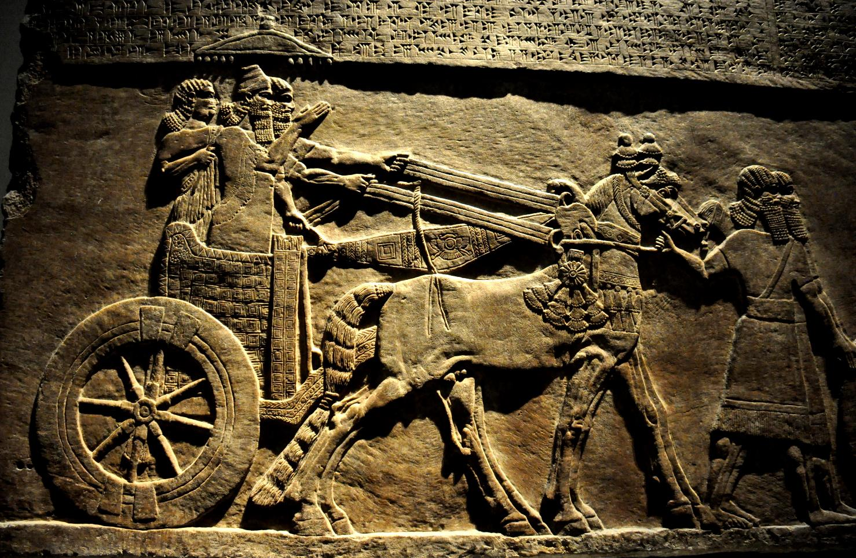
Tiglath-pileser III (744-727 BC)
British Museum, London

Slide 178
Micah, the Man
The book offers little in the way of personal information other than his name, which means, “Who is like Yahweh?”
Like Amos, he distanced himself from the court prophets who supported the status quo (3:5-8; cf. Am. 7:14).
Nothing in the book suggests that any of Judah’s kings ever consulted him as was the case for Isaiah (though many years later, his oracles were certainly known in Jerusalem, cf. Je. 26:18).
Whether or not he was himself a farmer, he certainly championed the property rights of the small farmers who were threatened by the encroachment of the wealthy (2:2; 3:1-3).

Slide 179
Date and Structure
Given the opening (1:1), the date of Micah’s ministry is not in doubt.
His ministry begins prior to the fall of the northern nation Israel and extends for another three decades or so into the period of Hezekiah.
Structurally, the oracles of Micah alternate between doom and hope and are demarcated by the imperative form of the Hebrew verb fmawA (= Listen!) in 1:2, 3:1 and 6:1.
  Oracles Against Israel and Judah (1-2)
  Oracles of Judgment and Restoration (3-5)
  Oracles about Crime, Punishment and Mercy (6-7)

Slide 180
The First Oracle: the Covenant Lawsuit (1-2)
The ancient Near Eastern suzerainty treaty offered a powerful image used by several prophets, the image of the courtroom (Is. 3:13-14; Je. 2:9; Ho. 4:1; Am. 3:13; Mic. 6:1-2; Eze. 20:4).
These indictments, in turn, derived from the ancient suzerainty treaty between Yahweh and Israel, where the heavens and earth stand as witnesses to the covenant terms (Dt. 4:26; 30:19; 31:28; 32:1).
Micah now describes Yahweh as prosecuting a case against the capital cities of the northern and southern nations, Samaria and Jerusalem (1:2-5), and he issues a summons to the whole world to these assizes.
The charge is covenant unfaithfulness, and both capitals have invited the sworn covenantal judgments of Yahweh (cf. Lv. 26:14, 30-33; Dt. 28:15, 42-52, 64-68).

Slide 181
USE OF COURTROOM LANGUAGE IN THE PROPHETS
“Will you judge them?” (Eze. 20:4)
bYR9 (R’iv = lawsuit)
Domestic (civil case)
Suzerainty-Vassal (international)
Covenant (human-divine)
TYPICAL ELEMENTS:
Appeal to witnesses
Interrogation & accusation
Review of past benefits
Warning about disloyalty
Declaration of guilt & punishment
Byr9 (r’iv = lawsuit)
FpawA (shaphat = to settle a case)
tOmcuf3 (‘etsumoth = arguments)
hHAk;v0An9 (niwwakeha = summons)

Slide 182
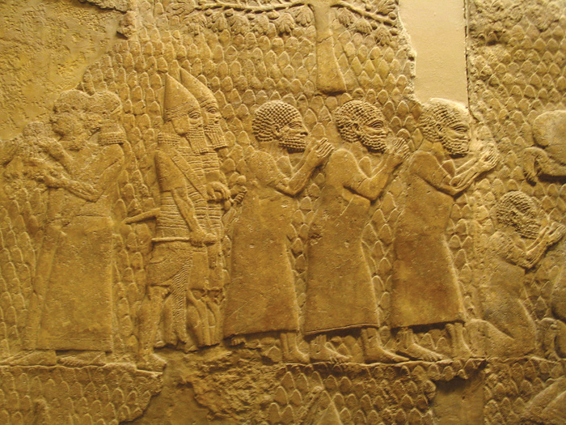
Living Parables (1:6-9)
Several prophets acted out living parables of their messages, and Micah is one of them, parading himself either as a refugee, a potent symbol of the coming exile, or someone mourning for the dead.
Prisoners of war being deported by the Assyrians from Ashtaroth.
British Museum, London

Slide 183
Puns (1:10-15)
  Gath (tGa) creates assonance with dgan!, meaning to report or to announce [i.e., disaster].
  Beth Ophrah (hr!p;fa tyBe) means “house of dust”, and its citizens are sentenced to rolling in the dust as an expression of lament.
  Shaphir (rypiwA), meaning “pleasant”, sounds like rpAOw), the war trumpet; the town’s pleasantness would be brutally reversed by a coming invasion.
  Tsaanan (Nn!xEca) creates assonance with the verb hxAc;y!, meaning “to come out”. The citizens will refuse to engage in battle because it will be hopeless.
  Beth Etsel (lcAxe tyBe) sounds similar to the verb lcaxA, meaning “to take away”. The city’s protection would vanish.
  Maroth (tOrmA) sounds like rma, which means “bitter,” and the bitterness of disaster would reach as far as the gates of the city of peace (Jerusalem).
  Lachish (wykilA) sounds like the word wk,r@, which refers to a team of horses [i.e., chariot horses].
  Moresheth (tw,r@Om) sounds like hwAr!Om, meaning “possession”, the very thing the citizens would give up when invaded.
  Aczib (byz9k;xa) sounds like bz!k;xa, meaning “deceitful.”
  Mareshah (hwAr2mA) sounds like wr1y!, meaning “to dispossess.”
Puns, where the sounds of two words are similar, are largely untranslatable. In an oral culture, however, they become powerful rhetorical devices to assist in memory and vivid imagery. Micah has a whole series of them in the latter half of chapter 1.

Slide 184
Exploitation and Deception (2:1-13)
Society had disintegrated at every level:
Powerful landowners aimed to drive out the small farmers through an unjust court system by which they could manipulate foreclosures and evictions (2:1-5).
The prophetic guild supported the status quo and were eager to silence Micah’s denunciations, arguing that sermons must only be positive, not negative (2:6-11).
Hence, judgment was coming! Still, as was true for all the prophets, judgment was not God’s final word. The final word was hope for a remnant surviving on the far side of judgment (2:12-13).

Slide 185
The Second Oracle (3-5)
The second oracle paralleled the first, and later, it would be recalled in the lifetime of Jeremiah (cf. Je. 26:17-19).
Dirty politics characterized Judah’s leaders, who treated their subjects like carcasses to be butchered (3:1-4).
Prophets, who should have been a voice for justice, were in cahoots with the crooked politicians (3:5-8).
Hence, judgment was surely coming, and the climax of this judgment would be the destruction of the temple on Mt Zion (3:9-12).
Micah, therefore, becomes the first prophet to directly predict the destruction of the 1st temple (3:12).

Slide 186
The Message of Hope (4:1-5)
Earlier, Micah offered a small glimpse of the future on the other side of judgment with a future king (2:13); now he expands on that theme, predicting that Zion, after its destruction, would become the center of worship for the whole world (4:1-5).
Obviously, there is a literary relationship between this passage in Micah and Isaiah 2:2-5, since the larger portion of the two passages are word-for-word in the Hebrew text.
Micah uses the stock phrases “in the last days” and “in that day” to refer to the cessation of war and the universal worship of Yahweh.

Slide 187
Isaiah 2:2-4 (My Translation)
Micah 4:1-3 (My Translation)
(Is. 2:2) In the last days, the mountain of the LORD’s house will be established as the most important of the mountains, being lifted up more than the hills, and all the nations will stream to it.
(Is. 2:3) Many peoples will come and say, “Come, let us go up to the mountain of the LORD to the house of the God of Jacob, so that he will teach us his ways and so that we may walk in his paths.” For the law will go forth from Zion, and the word of the LORD from Jerusalem.
(Is. 2:4) He will judge between the nations and will arbitrate for many peoples; and they will hammer their swords into plowshares and their spears into pruning hooks. Nation will not raise sword against nation, nor will they again learn war.
(Mic. 4:1) In the last days, the mountain of the LORD’s house will be established as the most important of the mountains. It will be lifted up more than the hills, and the peoples will stream on it.
(Mic. 4:2) Many nations will come and say, “Come, let us go up to the mountain of the LORD and to the house of the God of Jacob, so that he will teach us his ways and so that we may walk in his paths.” For the law will go forth from Zion, and the word of the LORD from Jerusalem.
(Mic. 4:3) He will judge between many peoples and will arbitrate for vast nations far away; and they will hammer their swords into plowshares and their spears into pruning hooks. Nation will not raise sword against nation, nor will they again learn war.

Slide 188
The Day of Yahweh in the Prophets
NEAR FUTURE
Judgment by exile on the unfaithful nations of Israel and Judah
Judgments in history on the nations surrounding Israel and Judah
FAR FUTURE
Judgment on a blasphemous world by universal cataclysm
Disintegration of the universe
Salvation of God’s people
Victory of God’s armies
Universal peace

Slide 189
Yahweh’s Glorious Plan (4:6—5:1)
For those who would survive exile, hope remained, since the royal dominion would be restored.
The Hebrew text of 4:8 uses the term “Ophel” or “hill” ( lp,f*), the name of the ancient ridge that David fortified as his capital (2 Sa. 5:9), to describe the place of this restored kingship.
In the meantime, however, there would be a period without a king, since the nation of Judah would be deported to Babylon.
From Babylon, the remnant eventually would be rescued, but first Jerusalem would be put to siege by “many nations”, and her leader would be “struck on the cheek”. This may refer to the invasion of Sennacherib in the period of Hezekiah.

Slide 190
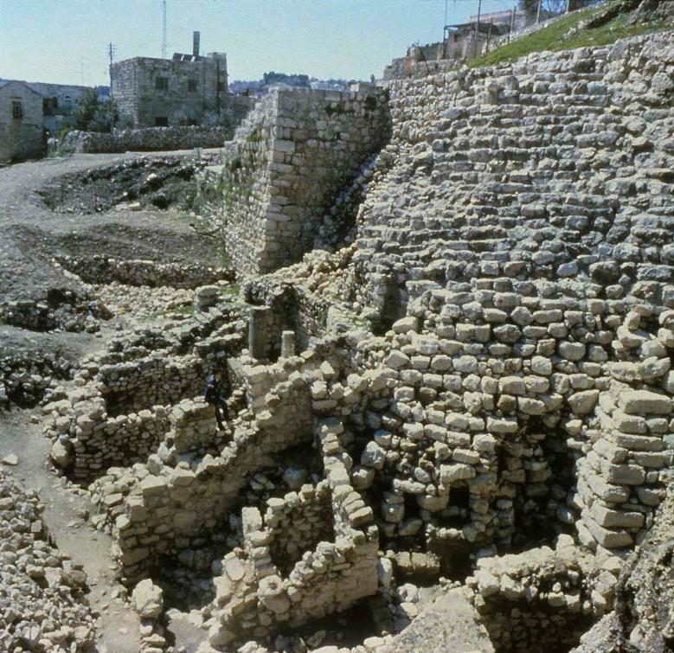
The Stepped Stone Structure
On the east side of the Hill of Ophel (City of David), archaeologists have excavated a stepped stone structure. It appears to date from pre-Davidic Jerusalem, but was reused by both David and Solomon as a high standing buttress upholding a platform for a state building.
Possibly, this structure is the famous “Millo” (= filling) described in 2 Sa. 5:9; 1 Chr. 11:8.

Slide 191
Taylor Prism
Sennacherib’s invasion of Judah is particularly well documented in Assyrian texts, bas-reliefs and excavation.
The Taylor Prism, like the Oriental Institute Prism, details his conquest of 46 of Judah’s walled cities and “countless villages”. He also claimed to deport 200,150 people.
“Hezekiah I made a prisoner in Jerusalem, his royal residence, like a bird in a cage.”
Sennacherib may indeed have “struck the judge of Israel on the cheek” (5:1).
British Museum, London

Slide 192
The Coming King (5:2-5a)
The loss of the house of David, whose kingdom was never to have ended (cf. 2 Sa. 7:13, 16; 22:51b; 23:5a), would be a formidable theological problem for the people of Judah.
Many thought that the kingdom of David had divinely guaranteed longevity, and Micah’s break with this popular ideal was decidedly unpopular (cf. 2:6-7; 3:11b).
However, the divine promise to David’s house would not fail, for a king yet to be born would come, arising from Bethlehem, the ancient village of David.
Between the time of Babylonian exile and the birth of the coming king, the people of Judah would suffer abandonment, waiting like a pregnant woman for the time of delivery.
When this king came, he would tend the flock of Israel like a good shepherd.

Slide 193
The New Kingdom (5:5b-15)
The remainder of Micah’s second oracle describes the prominence of God’s people under the reign of the coming king.
The aggression of Assyria and Babylon (land of Nimrod) would not last indefinitely (5:5b-6).
The remnant would distil among the nations as mysterious as dew (5:7-8).
At last, the many covenant violations would cease, and God would purge from his people all vestiges of false religion (5:10-14).

Slide 194
The Third Oracle: the Covenant Lawsuit Resumes (6-7)
The third oracle returns to the image of the court scene, where Yahweh presses his case against Judah (6:1-2).
The summon to the mountains and hills as ancient witnesses to the covenant are consonant with the heavens and earth, the original witnesses (cf. Dt. 32:1).
Now, God cross-examines his people (6:3). That Israel had broken covenant implied that she was the aggrieved party, but given all that Yahweh had done for Israel since the exodus from Egypt, how could they contend that he had not fulfilled his covenant obligations (6:3-5)?
For too many, it was the external form of the covenant that counted most, but what Yahweh required was the inward character of righteousness (6:6-8)!

Slide 195
THE ESSENCE OF TRUE RELIGION
FPAwmi (mishpat = justice, upholding what is right)
ds,H, (hesed = mercy, loyal love)
fn1cA (tsana’ = to live modestly) implies humility, not so much in terms of self-effacement as by considered attention to others

Slide 196
Crime and Punishment (6:9-16)
Israel’s covenant violations could only result in deserved reprisals:
Judgment would begin with the city, where so much dishonesty and exploitation had been perpetrated.
It would climax with the sword of invasion.
Judah had been infiltrated with the deadly religious syncretism of the Ba’al cult so vigorously pursued by the Omri dynasty in Samaria, and now a judgment within history was at hand.

Slide 197
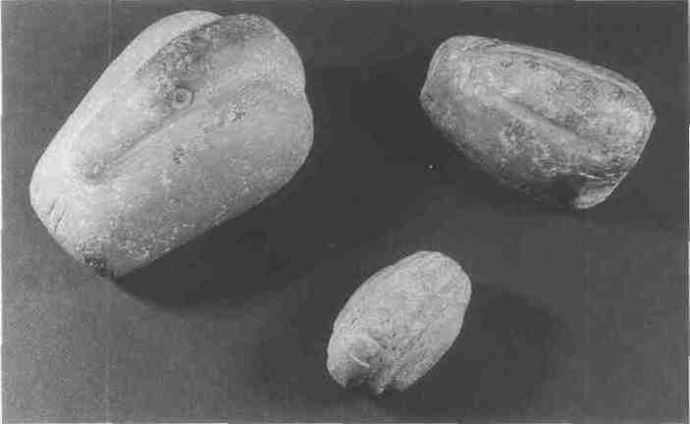
Weights and Measures
Metrology in the ANE, going back as far as 3000 BC or earlier, primarily consisted of standardized lengths (e.g., cubit, etc.), capacities (e.g., ephah, etc.) and weights (e.g., shekel, etc.).
Dishonest merchants would deliberately deceive a buyer by using different weights, one heavy for purchasing, one light for selling (6:11).
Semitic Museum, Harvard University
These stone weights, excavated at Nuzi (1600-1400 BC), represent 20 shekels (smallest), 1 mina and 2 minas (largest). They are marked with incisions to denote their values.

Slide 198
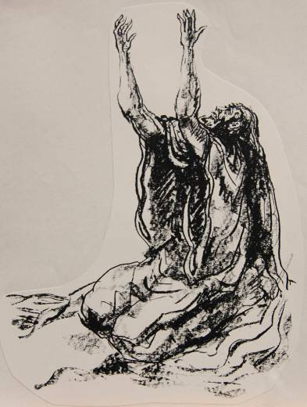
The Anguish of the Prophet
Micah’s moan, “What misery is mine!” expresses his deep grief over the godlessness of his own people. He laments:
Their rapacious greed and corruption.
Their lust for advantage.
Their faithlessness, contempt and disloyalty.

Slide 199
Waiting for Justice (7:7-20)
As did other prophets, Micah determined that he could only wait for God’s justice (7:7; cf. Hab. 2:1, 4b, etc.).
Still, the hope of Israel would rise from the ashes, and the fallen Zion would be rebuilt!
In the end, the nations would make pilgrimage to Jerusalem.
Micah closes with a prayer to Yahweh as the true Shepherd of Israel, whose defining characteristic is not wrath but mercy.

Slide 200
Joel

Slide 201
Author and Date
Little is known about Joel other than his name (which means “Yah is God”):
He seems to have lived either in or near Jerusalem, since he was aware of details about temple life (1:9, 13: 2:17).
The date of composition is widely debated, since there are no clear historical links. Two dates, a late and an early one, have been proposed:
  The late date depends upon internal references to the Greeks (3:6), which if referring to the expansions of Alexander the Great, might put it in the 4th century BC.
  The early date depends upon internal references to Judah’s enemies of the Philistines, Edomites, Egyptians and Phoenicians (3:4, 19), which fits best with the kingdom period prior to the exile and puts the book in the 8th or 7th century BC, more or less. The reference to Greeks is understood to refer to Greek slave-trading, not Alexander.
However one dates the book, in turn, drives how one interprets Joel’s references to invasion, whether Assyrian, Babylonia or Hellenistic.

Slide 202
The Locust Plague (1:1-12)
The opening describes the horrors of a locust invasion, an image also employed by Amos (7:1-3) and Jeremiah (51:14, 27).
Locust plagues may have been one of the “pestilences” for covenant violation (cf. Lv. 26:14ff; Dt. 28:15ff.), since locusts devastate local vegetation, stripping the entire landscape.
Additionally, if Joel is using the locust plague as a metaphor for foreign invasion, which some interpreters suggest, then words like “nation” (1:6) and “army” (2:4-5, 20), not to mention siege terminology (2:7-9), may actually refer to the advance of the enemy (and any proposed date for the book would specify which enemy).
Still, the description of the locust plagues may very well have referred to an actual agrarian disaster.

Slide 203
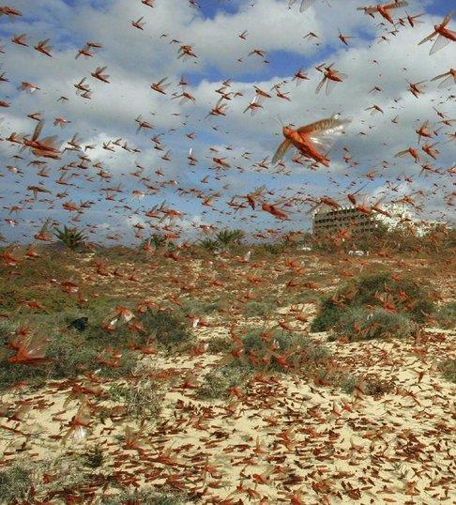
Locust plagues were one of the great natural disasters in the ancient world.
The native region of the locust is the Sudan, but at times the insects exhibit a strong, massive wandering instinct, crossing rivers and consuming all fresh vegetation they encounter.

Slide 204
Call to Repentance (1:13-20)
In view of the locust plague, Joel urges the apathetic citizens of Judah to repent!
The solution to the curses of covenant judgment is always repentance (Lv. 26:40-42; Dt. 30:1-10).
True national repentance should be led by the priests, ministers and elders.
Like Amos and Isaiah, Joel uses the term “Day of the LORD” to refer to the economic disaster.

Slide 205
Yahweh’s Army of Judgment (2:1-11)
What the nation had experienced in the locust invasion was only a harbinger of worse things to come!
The war trumpet, the shophar, was the signal for alarm and invasion.
To be sure, Joel’s language is hyperbolic (chariots leaping over mountains; the darkening of sun and moon), but the anguish of people in siege warfare is certainly real enough, with enemy soldiers scaling the fortification walls, fire devouring the cities, and soldiers charging into homes and looting the contents.
God was coming, not to deliver his people, but to judge them by invasion! Like Amos’ “prepare to meet your God”, Joel’s “the Day of the LORD is great…who can survive?” is a blunt warning!

Slide 206
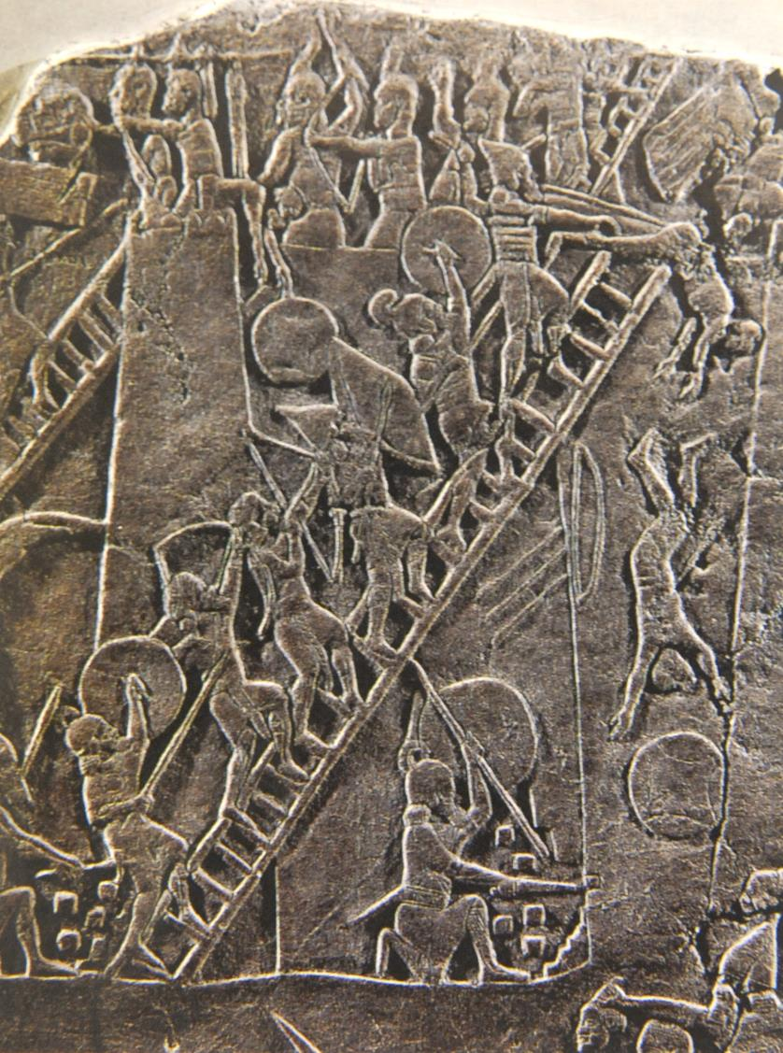
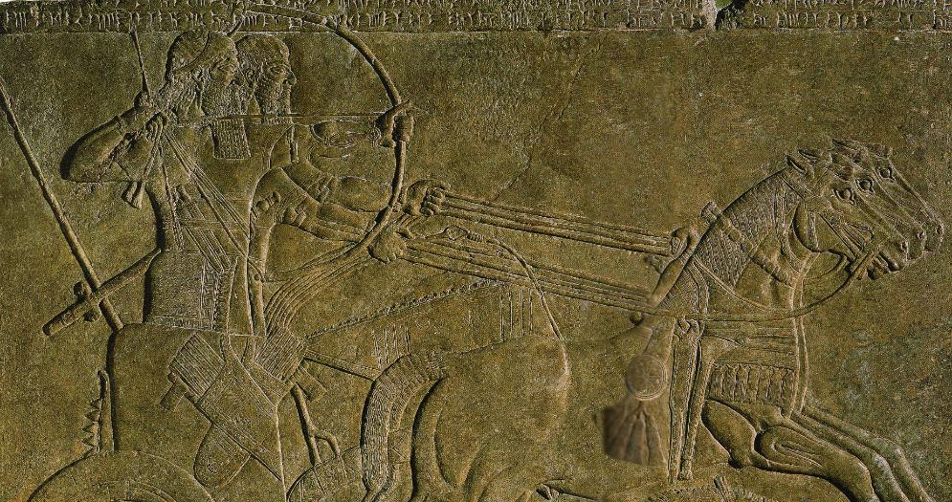
Assyrian Warfare
British Museum, London

Slide 207
Returning to Yahweh (2:12-17)
Like Amos (4:6b), Joel uses the verb bUw (shuv = to turn, return) to call Judah back to God with heart-searching repentance—rending their hearts, not merely their garments!
He quotes the language of Sinai that Yahweh is “compassionate and gracious, slow to anger, abounding in love” (Ex. 34:6-7).
The affirmation that Yahweh may announce disaster and then withhold it in view of repentance is not unique to Joel (cf. Je. 18:7-10), and it is cogently expressed in the Book of Common Prayer as: it is “God’s property always to have mercy”.
Intercession “between the porch and the altar” refers to the area between the vestibule of the temple, a roof over the entrance supported by two huge columns (cf. 1 Kg. 6:3; 7:21-22; 2 Chr. 3:15-17), and the altar for burnt offerings just outside the Holy Place. Here, the priests must represent the nation in prayer.

Slide 208
The Restoration (2:18-27)
If the Day of the LORD was an acronym for doomsday, it also was a bright promise of hope after judgment.
The blessings that had been withheld in judgment would be restored.
The northern invader would be vanquished, and the land would once more produce it proper crops.
In this restoration (2:23b), Yahweh would give the nation a “hr@Om (moreh) of righteousness”, a word that has two meanings: 1) teacher, and 2) early rain. This word has become an interpretive crux. Is it:
  A play on words, first meaning “teacher” and later meaning “early rain” (here, the moreh of righteousness would have a messianic connotation)
  A repeating element, both times meaning “early rain” as an indication of righteous blessing (most English Versions adopt this reading for contextual reasons)

Slide 209
Jewish Months
Nisan
Iyyar
Sivan
Tammuz
Ab
Elul
Tishri
Marchesvan
Chislev
Tebeth
Shebat
Adar
English Months
Mar-Apr
Apr-May
May-Jun
Jun-July
July-Aug
Aug-Sept
Sept-Oct
Oct-Nov
Nov-Dec
Dec-Jan
Jan-Feb
Feb-Mar
Seasons
Flax harvest
Spring rains
Barley Harvest
Dry season starts
Early figs ripen
Grape harvest
Early olives
Summer wheat
Dates
Summer figs
Early rain
Late olives
Winter figs
Plowing
Sowing
Latter rain/snow
Almond blossom
Citrus fruit
Festivals
Passover
Unleavened Bread
First fruits
Weeks (Pentecost)
Trumpets (Rosh Hashanah)
Atonement (Yom Kippur)
Booths (Succoth)
Dedication (Hanukkah)

Slide 210
The Gift of the Spirit (2:28-32)
Whatever the moreh of righteousness means, “after this” would come the blessing of the gift of the Spirit.
All people, both men and women, young and old, would be given the Spirit; hence, the Spirit would not simply be for a few chosen individuals, it would be for all God’s people (implicitly answering Moses’ desire, cf. Nu. 11:29).
The greatest blessing of all would be that “everyone who calls on the name of the LORD shall be saved”, a passage that many centuries later would carry great meaning for Peter at Pentecost, who would directly quote this passage from Joel (Ac. 2:16-21, 33).

Slide 211
Judgment and Salvation (3:1-16)
Alongside the blessing of the Spirit would come Yahweh’s judgment of the nations.
He would assemble them to a great assizes in the “Valley of Jehoshaphat” (not a known location in Israel but used here because of the meaning of the name, which is, “”Yahweh judges”).
The charge against the nations would be their treatment of the people of Judah by sending them into exile and engaging in slave-trading.
Pay-back was coming, and the nations may as well prepare for war.
To Yahweh, the assembly of defiant nations would be like a vineyard ready for harvest, the grapes ripe for crushing (cf. Is. 63:1-6)!

Slide 212
The Blessing of Salvation (3:17-21)
The people of Judah and Zion will be blessed with peace, while their perennial enemies, Egypt and Edom, will be deserted.
Again using hyperbolic language, Joel predicts that the mountains will “drip sweet wine” and the hills “overflow with milk”.
The theme of God’s dwelling-place in Zion, the ancient site of the temple, is reaffirmed in the final line of the book: “the LORD dwells in Zion!”
It is the same language used by John in the Revelation: “the dwelling of God is with men, and he will live with them. They will be his people, and God himself will be with them and be their God” (Rv. 21:3).

Slide 213
jonah

Slide 214
Background
Outside the book that bears his name, the only mention of Jonah ben Amittay (or John, meaning “dove”) is 2 Kings 14:25, which puts him in the reign of Jeroboam II (c. 793-753 BC).
He came from a border town in Zebulun (cf. Jos. 19:13) about three miles north of Nazareth. (This, in turn, means the Pharisees were wrong when they said no prophet ever came from Galilee, cf. Jn. 7:52.)
Unlike the other 8th century prophets, Jonah’s oracles do not address the sins of either Israel or Judah. Rather, the book describes a missionary trip to Nineveh, one of the principle cities of the Assyrian Empire.
Further, unlike any other prophetic book, this one is not a collection of oracles, but rather, a narrative.

Slide 215
Two Critical Questions
Was Jonah a Real Person?
Given the uniqueness of this book, the question is raised as to whether the story is parabolic or historical.
There is no external account of Nineveh’s conversion to Hebrew monotheism.
Is the Story Credible?
Here, one question concerns the probability of a man being swallowed by a fish and surviving.
A second question concerns the size of Nineveh as described in the book—120,00 citizens taking a 3-day journey to traverse it (4:11; 3:3).
Some interpreters have opted for an parabolic approach, saying the book intended to emphasize the point that God was not confined to the Israelites, but his mercy extended even to Israel’s enemies.

Slide 216
How plausible is the parabolic approach?
While the main point of the parabolic approach is surely true enough, there are some difficulties with it.
It seems unlikely that a Jewish writer from Judah would choose such an obscure figure as Jonah as a nom de plume for his fiction.
Jesus seems to have considered the story of Jonah to have been a real occurrence (Mt. 12:39-41//Lk. 11:29-30, 32).
If the parabolic approach is adopted merely to avoid the supernatural (which in some interpretations seems to be the case), then this approach says more about the interpreter than it does about the story itself.
Hence, it seems better to allow the story to stand within the historical framework of the 8th century BC.

Slide 217
The Reluctant Prophet (1-2)
Jonah’s decision to run from God’s calling resulted in a downward spiral.
He went down to Joppa (1:3), down below the deck (1:5), down into the water, down into the fish, and down to the bottom of the sea (2:6).
There is pronounced irony in that the pagan sailors prayed while Jonah, a true prophet, slept.
A double irony is that Jonah, who would have preferred to drown rather than preach to the hated Ninevites, was prevented from downing by the great fish. (Incidentally, the Hebrew expression “great fish” was not necessarily a whale, as translated in the KJV.)
Jonah’s prayer in the belly of the fish takes the form of a poem in which he experienced a living death described as the depths of Sheol (2:2b).

Slide 218
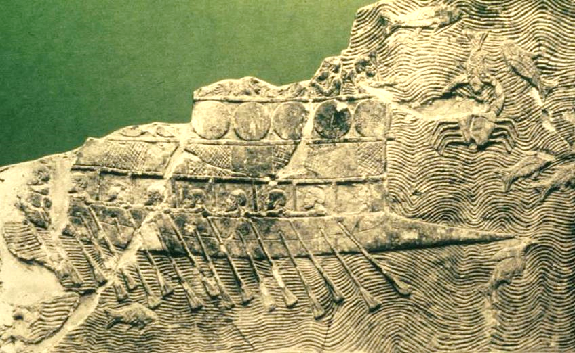
Phoenician vessel depicted on an Assyrian bas-relief from about 700 BC. The ship which carried Jonah was likely similar.
(British Museum, London)

Slide 219
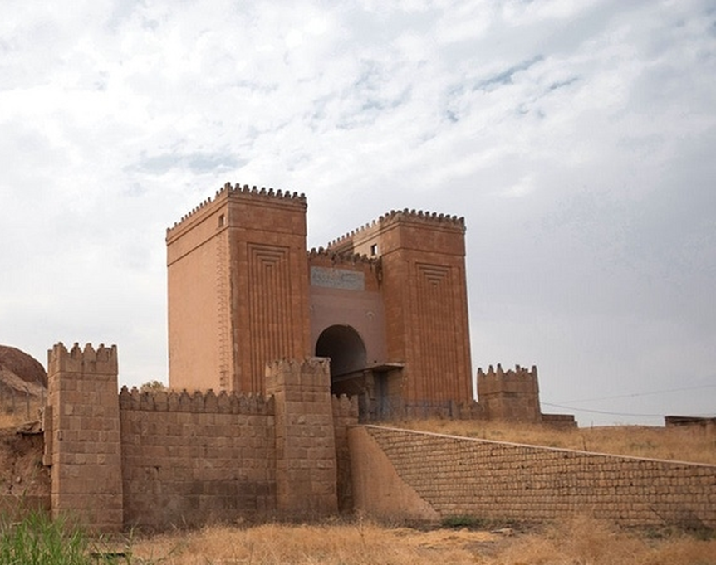
The excavated ruins of Nineveh, one of the oldest cities in antiquity and populated from about 6000 BC, are located near the modern city of Mosul, Iraq on the east bank of the Tigris River. With an estimated population in excess of about 100,000, it served as the capital for the Neo-Assyrian Empire. This Mashki Gate, which was reconstructed by archaeologists in the late 20th century, was significantly damaged by ISIS in 2010, and the ruins of Nineveh remain one of the most endangered archaeological sites in the world.

Slide 220
Jonah’s Second Commission (3-4)
God’s commission to Jonah did not change. After the great fish vomited him up, God again instructed Jonah to go to Nineveh.
His misplaced patriotism did not allow him to escape the long reach of God.
Jonah then preached a message that destruction would come in 40 days, and the Ninevites repented so that God spared them.
Jonah, however, was chagrined at God’s mercy, and there were yet lessons for him to learn:
  He was petulant about God being merciful to those whom the Israelites hated.
  So God, who had prepared the great fish, now prepared a castor-oil plant to shade Jonah’s bald head from the blazing sun.
  Then, God prepared a worm to kill the plant and a scorching wind to blow hot air at Jonah.
  God’s final question to Jonah concerned his divine right to care for what he had created, both human and even animal.

Slide 221
Nahum

Slide 222
Historical Background
The history of Assyrian decline lies behind the little work of Nahum.
Assyria reached the height of its imperial power under Ashurbanipal (668-631 BC), but his reign was followed by a series of weak leaders who suffered crippling defeats from the Babylonians.
When the Assyrian refugee government was backed up in northwest Mesopotamia, and the Egyptians, Assyrian’s allies, were marching northward for support, Josiah, the king of Judah, interposed his army, confronting Pharaoh-Neco II at Megiddo in 609 BC.
Though Josiah died in this confrontation, he stalled the Egyptian advance just long enough to leave the Assyrians unaided.

Slide 223
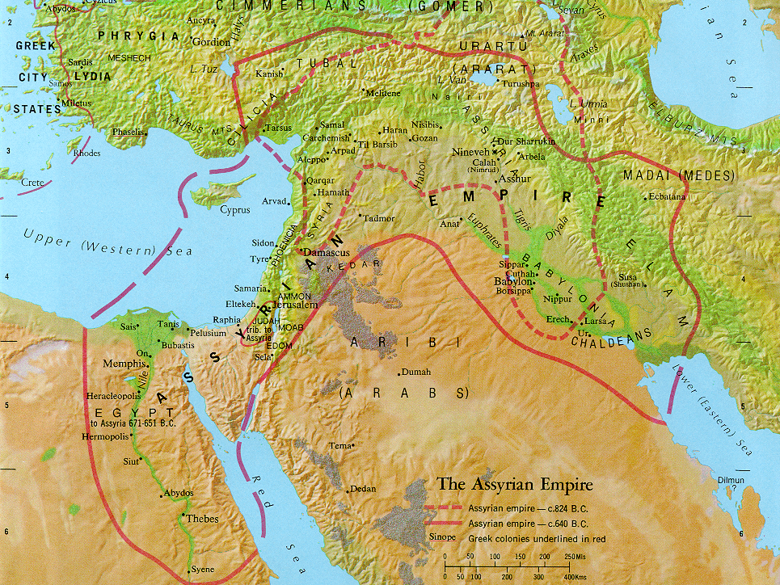
Carchemish
Nineveh
Haran
Asshur
Babylon
Judah
Egypt

Slide 224
DECLINE OF ASSYRIA/RISE OF BABYLON
626-620 BC Defeat at Babylon (Assyrians
driven from Babylon)
614 BC Fall of Ashur (loss of
southern capital)
612 BC Fall of Nineveh (loss of
northern capital)
609 BC Defeat at Haran (loss of
government in exile)
605 BC Battle of Carchemish (loss of last
significant ally, Egypt)

Slide 225
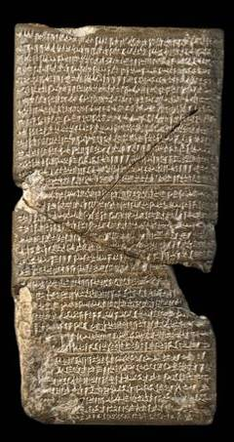
The fall of Assyria was predicted by the prophet Nahum.
The attack upon Nineveh by the Medes and Babylonians, which was successfully conducted in 614 BC, left Assyria’s northern capital in shambles (Na. 2:3-13).
This tablet from the Babylonian Chronicle describes the fall of Nineveh and the collapse of the Assyrian Empire.
British Museum, London

Slide 226
Structure
The structure of the book falls into three sections roughly corresponding to the chapter divisions.
1 - Opening psalm extolls the warlike Yahweh who comes to judge his enemies. (Verses 1:2-9 follow a partial acrostic pattern for the letters x through n, though 1:2b is misplaced.)
2 – The siege and sack of Nineveh
3 – Woe oracle on Nineveh, comparing it to the earlier fall of Thebes (since Thebes was sacked by Ashurbanipal in 663 BC, Nahum must be dated after this known historical event)

Slide 227
Yahweh, the Man of War (1:2—2:2)
Nahum depicts God descending on the world in the awe-inspiring form of theophany—a warrior who executes judgment on his enemies.
As in the theophany at Mt. Sinai, Yahweh is “slow to anger…but not leaving the guilty unpunished” (1:3; cf. Ex. 34:6-7).
The language of theophany shows the world in recoil before the wrath of God, who comes like a desert sirocco, drying up water courses, withering the plateaus and sweeping away the mountains.
Still, his basic relationship toward those who trust him is to provide refuge (1:7).
Judgment is reserved for unbelievers, but for the faithful, there is “good news on the mountains” (1:15; cf. Is. 52:7).

Slide 228
The Fall of Nineveh (2:2-13)
Nahum’s vivid description of the storming and capture of Nineveh contains powerful poetic lines.
The Assyrian chariots would race through the streets to shore up the city’s defenses, but it would be too little, too late.
The Babylonian attackers would dam the river in order to send a hurtling flood of water toward the city, and Nineveh would be left in a pool of receding water, while the enemy looted the town.
Once the home of royal game preserves, where lions were kept for the royal hunts, Nineveh and her royal sport would now be devastated. The empire that once was itself a preying lion would become the victim of the hunt.

Slide 229
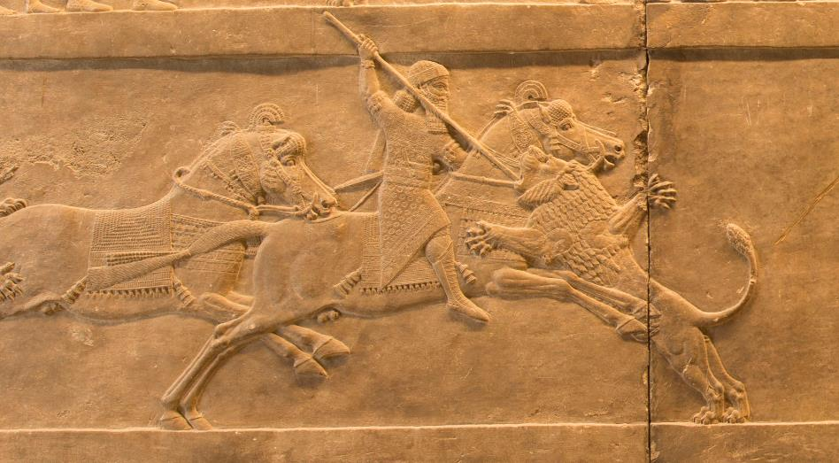
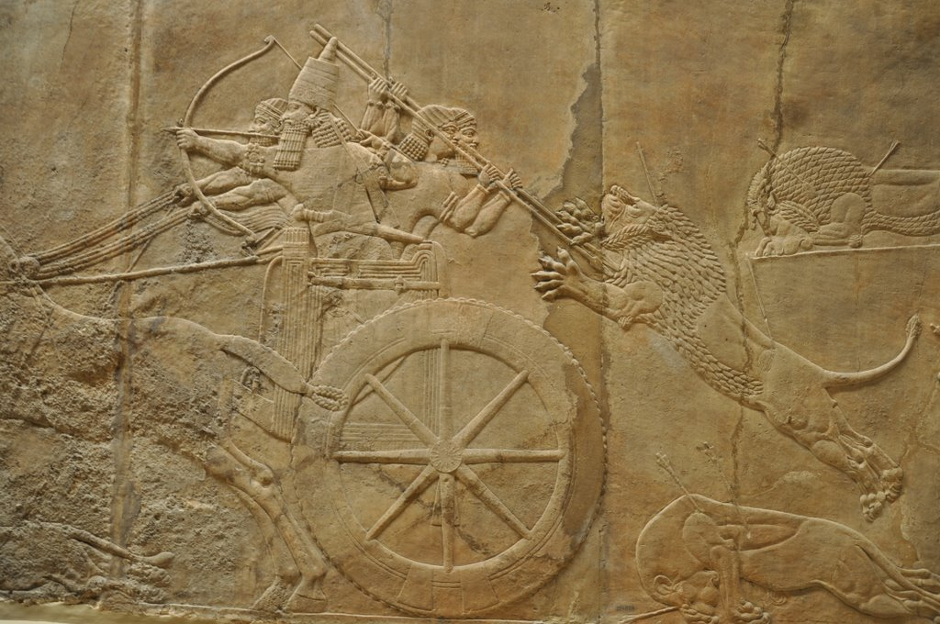
The Royal Assyrian Lion Hunt the symbol of Assyrian dominance over the Mesopotamian world
British Museum, London

Slide 230
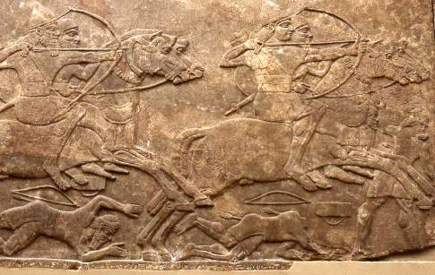
Nineveh, the City of Blood (3)
ASSYRIAN TERRORS (3:1-7)
Nineveh’s wealth had been built upon the blood of its victims.
Like the metaphor of the great whore in the Book of Revelation, Assyria was an international whore destined to be exposed in public disgrace and reduced to ruins.
British Museum, London

Slide 231
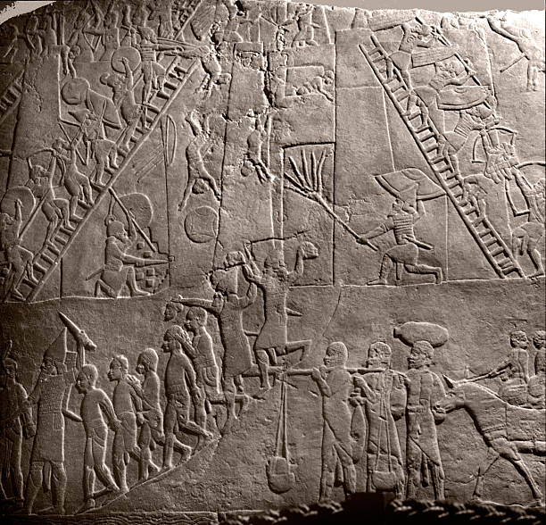
Bas-relief of the attack on Thebes from the palace of Ashurbanipal in Nineveh
THE FALL OF THEBES (3:8-19)
Nineveh’s fall is compared to Ashurbanipal’s destruction of Thebes in 663 BC.
As the Assyrians did to Thebes, so Babylon would do to Assyria.
The Assyrian armies might be multiplied like locusts, but before the Babylonians, they would be like cold-blooded creatures clinging to the walls on a cold day.

Slide 232
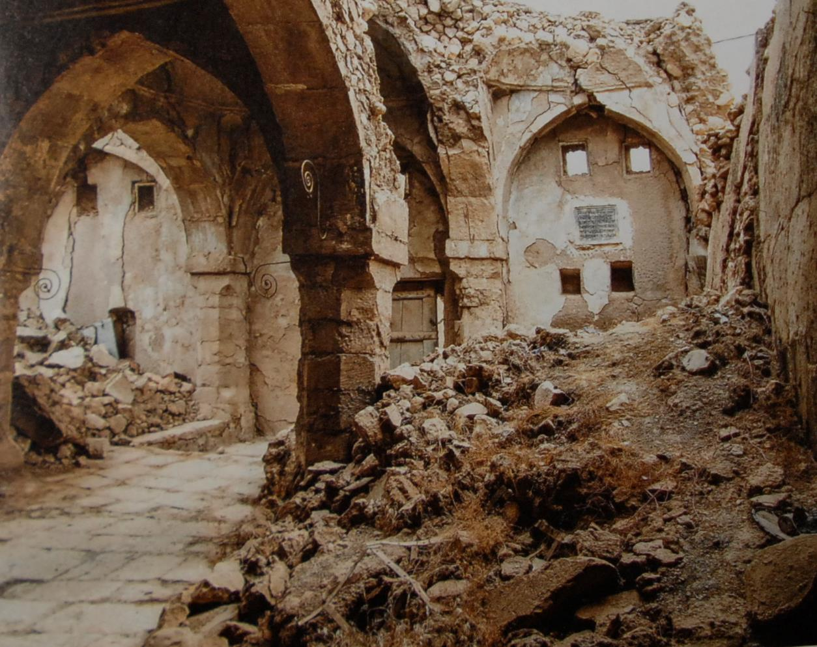
Located in al-Qosh, some 30 miles northeast of Mosul, Iraq, this synagogue, now damaged by war, is believed to house the tomb of Nahum. The shrine was once a site for pilgrimage, but in a war-torn area it now is slowly being reduced to rubble, though recent steps have been taken to stop the deterioration (as of 2017).
POSSIBLE BURIAL SITE OF NAHUM

