Slide 1

-----KINGS AND PROPHETS-----
(Week 2)

Slide 2
Ancient Biblical Texts and Literacy

Slide 3
THE HEBREW BIBLE (Old Testament)
Three Collections
תורה נביאים כתובים
(Torah) (Nebiim) (Kethubim)
Genesis Former Prophets Psalms
Exodus Joshua Proverbs
Leviticus Judges Job
Numbers Samuel Megilloth (five rolls)
Deuteronomy Kings Song of Songs
Latter Prophets Ruth
Isaiah Lamentations
Jeremiah Esther
Ezekiel Ecclesiastes
The Twelve Daniel
Ezra-Nehemiah
Chronicles
KINGS AND PROPHETS
These 24 books are the same as the 39 in the English Old Testament.

Slide 4
The Text of the Hebrew Bible
Our primary text of the Old Testament is the Leningrad Codex.
Known as the Masoretic Text (after the Jewish family of scribes called the Masoretes in the Middle Ages), this text dates to 1008-1009 AD.
Most earlier Hebrew Texts were buried reverently after they were well-worn, and subsequent copies were then made.
The Dead Sea Scrolls are a millennium older, but they are fragmented. They are helpful but not complete.
Hence, the Masoretic Text is the starting place for all Old Testament translation.

Slide 5
The Form of Hebrew Writing
The typical form of Hebrew writing became the scroll, long sheets of parchment (leather) stitched together and attached to a spindle for rolling up.
Usually, writing would be on only one side of the parchment surface.
The codex form (book form bound on one edge) would not be developed until the Christian era.
The reader was obliged to provide things like the division of words, vowels, punctuation, and paragraphing. There were no chapter or verse divisions.

Slide 6
Supplements to the Masoretic Text
Several important supplements to the Masoretic Text assist in the task of Bible translation. These include:
Dead Sea Scrolls (fragmented texts from Qumran dating to before the time of Jesus, ca. 200 BC)
Septuagint (translation of the Hebrew Bible into Greek from about 250 BC)
Targums (Aramaic paraphrases and translations of the Hebrew Bible for the synagogue from about the time of Jesus)

Slide 7
TEXTS and TRANSLATIONS (NRSV notes)
5 HEBREW/ARAMAIC 5 TRANSLATIONS
Dead Sea Scrolls (Q Ms)
Aramaic(Tg) Latin (Vg)
Syriac (Syr) Pointed Hebrew (MT)
Septuagint (LXX) Theodotion (Gk)* Unpointed Hebrew (Heb)
2nd Century Birth 9th Century
BC of Christ AD
*Theodotion was a Jewish convert to Christianity near the close of the 2nd century. He did not offer a new version of the LXX, but he did revise an existing Greek version following the Hebrew and Aramaic texts.

Slide 8
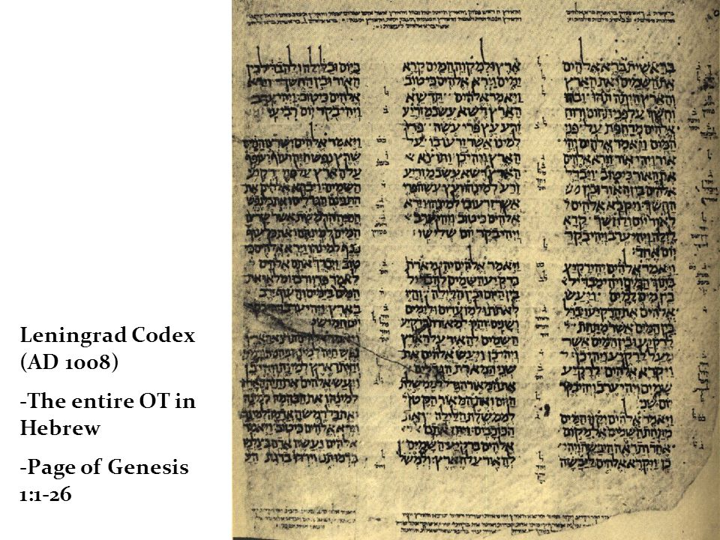
Leningrad Codex (AD 1008)
Entire OT in Hebrew
Page 1 of Genesis (1:1-26)
National Library of Russia
(St. Petersburg)

Slide 9
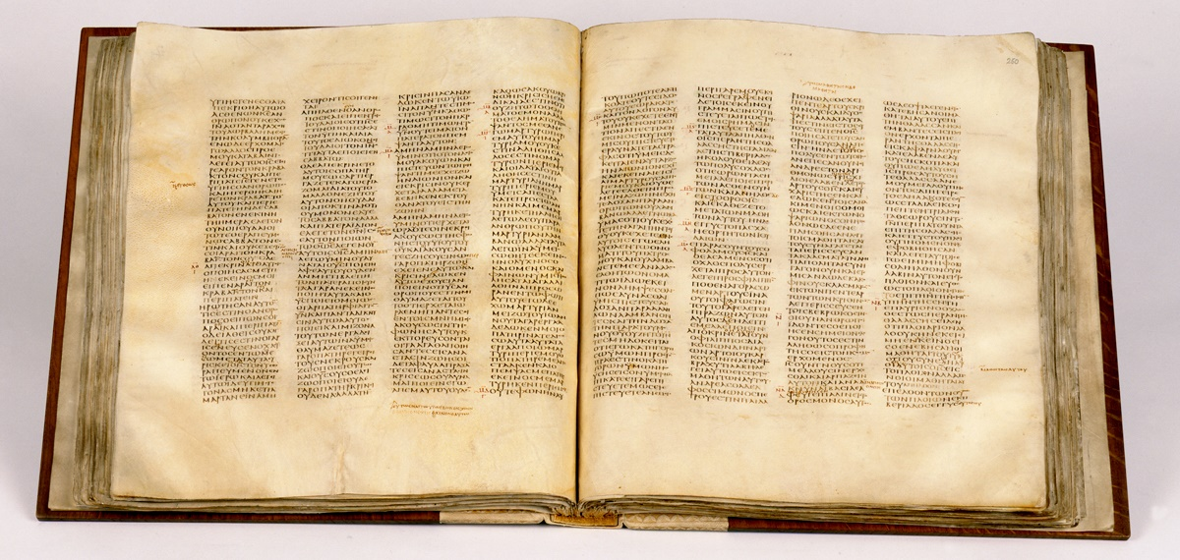
Codex Sinaiticus, 4th century Septuagint and New Testament
(British Library, London)

Slide 10
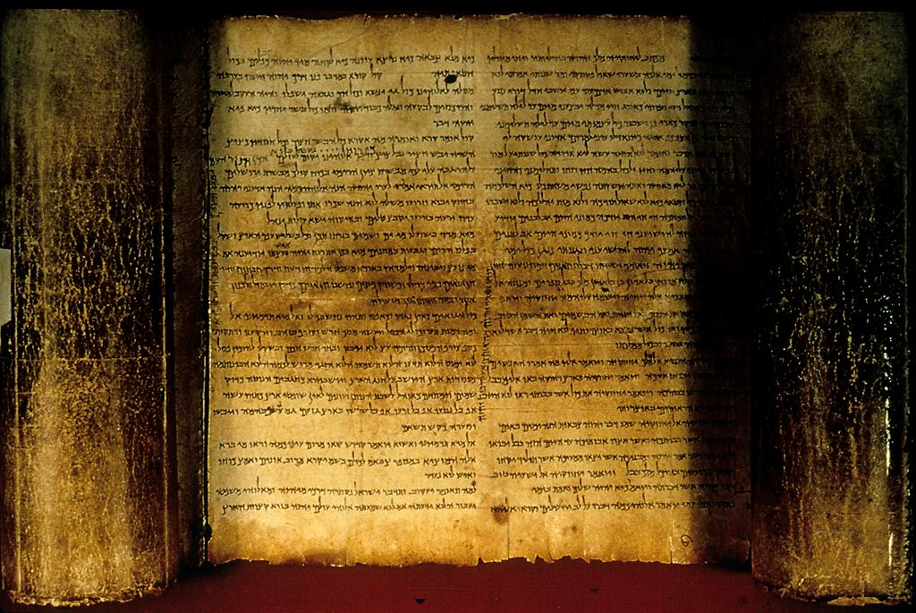
The Isaiah Scroll (Dead Sea Scrolls, 1QIsaª)

Slide 11
DEVELOPMENT OF LITERACY
Writing is known from about 3200 BC.
Most early writing was the provenance of specialists (scribes) supported by the state.
Public written documents were not for general reading but were displays of royal power and authority.
Israelite society was essentially an oral society.
In about the 12th century BC, the Semitic alphabet was standardized to 22 consonants, written horizontally from right to left.
From about the 10th century BC, Hebrew was written in paleo-Hebrew script.
Widespread literacy occurred in about the 8th century BC, due largely to urbanization and Assyrian bureaucracy.
It was during this increase of literacy that the 8th century prophets began recording their oracles in writing.

Slide 12
Archival Sources for 1 & 2 Kings
While the books of 1 & 2 Kings are formally anonymous, they seem to have been composed using pre-existing sources that have not survived, some of which are named:
Book of the Song (1 Kg. 8:12-13, LXX)
Book of the Acts of Solomon (1 Kg. 11:41)
Book of the Annals of the Kings of Israel (mentioned 18 times)
Book of the Annals of the Kings of Judah (mentioned 15 times)
See also, Isaiah 36-39, which parallels 2 Kings 18-20

Slide 13
Archival Sources for 1 & 2 Chronicles
The primary sources appear to have been 1 & 2 Samuel and 1 & 2 Kings.
These sources were supplemented with other literary traditions, including:
  Tribal genealogical records (1 Chr. 4:33b; 5:17; 7:40; 9:1, 22; 2 Chr. 12:15)
  Records of David and his associates (1 Chr. 23:27; 35:4, 15)
  Archives of the Kings of Israel and Judah (2 Chr. 16:11; 24:27; 25:26; 28:26; 32:32b; 27:7; 33:18; 35:27; 36:8)
  Records of Samuel, Nathan and Gad (cf. 1 Chr. 29:29-30; Chr. 9:29a)
  Oracles of Ahijah and Iddo (2 Chr. 9:29b; 12:15b; 13:22)
  Records of Shemaiah (2 Chr. 12:15a)
  Annals of Jehu (2 Chr. 20:34)
  Letter of Elijah (2 Chr. 21:12ff.)
  Records of Isaiah (2 Chr. 26:22; 32:32)
  Records of the seers (2 Chr. 33:19)

Slide 14
Post-exilic Language Shift
After the return from exile, there would be some language adjustments for the post-exilic community. When Ezra came to read the Torah, some of the younger people could no longer understand Hebrew (Ezra 8:1ff.).
For those who could not understand (i.e., the Aramaic speaking community), the Levites assisted with explanations, either by “translating” (so JB, GNB) or “giving the sense” (ESV, RSV, NIV, NASB). This is the first biblical description of Scripture translation.
Some parts of later Old Testament books (Daniel and Ezra) would have sections in them in the Aramaic language.
  Daniel 2:4b—7:28
  Ezra 4:7—6:18; 7:12-16

Slide 15
The Davidic Covenant

Slide 16
The Davidic Covenant (2 Sa. 7:4-29)
The covenant Yahweh made with David is the third major covenant, added to the covenant with Abraham and the covenant through Moses.
God’s covenant promise guaranteed David’s dynastic future, a promise that would link with the other two covenants in the messianic hope (cf. Ge. 12:1-3; Dt. 18:15, 18-19; 34:10).
This covenant was framed in the language of an eternal promise (23:5; cf. Ps. 89:19-37; 132:11-18).

Slide 17
God’s Covenant with David
2 Sa. 7:5-16; Ps. 89:19-37; 132:11-18
A PROMISED DYNASTY
The Davidic lineage from which Yahweh would
never retract his favor
A PROMISED LAND
An undisturbed home for Israel and rest from all enemies
A PROMISED KINGDOM
A rule that would endure forever

Slide 18
Covenant Tensions
The Promise Seems Secure Forever
Is not my house right with God? Has he not made with me an everlasting covenant, arranged and secure in every part? (2 Sa. 23:5)
I will maintain my love to him forever, and my covenant with him will never fail. I will establish his line forever, his throne as long as the heavens endure. (Ps. 89:28-29)
The Promise Seems Conditional
…observe what Yahweh your God requires…so that you may prosper…and so that Yahweh may keep his promise… (1 Kg. 2:2-4)
Yahweh swore an oath to David…that he will not revoke…if your sons keep covenant and the statutes I teach them, then their sons will sit on your throne forever and ever. (Ps. 132:11-12)

Slide 19
The Royal Theology based on the Davidic Covenant
The Royal Assumptions
David had been guaranteed a perpetual dynasty (2 Sa. 7:11b-16; 22:51b; 23:5a).
The Davidic covenant was firmly linked with the temple on Mt. Zion (Ps. 2:6-9; 78:65-72; 132:11-18).
The city of Jerusalem and Mt. Zion were impregnable, their security eternally guaranteed by Yahweh (Ps. 46; 125:1-2; 146:10).
The Perspective of the Prophets
Earlier prophets warned that the Davidic covenant must not be viewed as an unconditional guarantee of political security (Am. 2:4-5; 6:1a; Mic. 3:10, 12).
Jeremiah warned that Yahweh had rejected Jehoiakim’s family (Je. 36:30-31; cf. 22:18-19).
Yahweh was now against the kings in David’s line (Je. 21:11-14; 23:1-2).

Slide 20
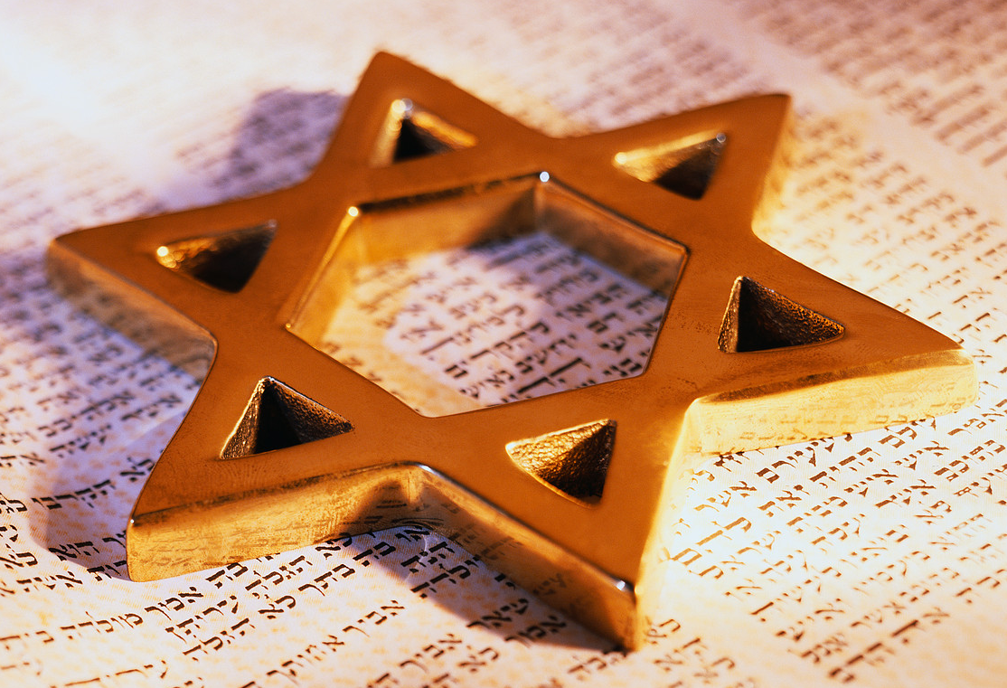
The Future of David’s Dynasty
In spite of the coming exile, Yahweh still promised a future for David’s dynasty.
Yahweh would regather the people of Judah and establish them in
safety (Je. 23:3-4).
Using Isaiah’s metaphor (cf. Is. 11:1ff.), a righteous “Branch” would
arise from David’s family (Je. 23:5-6).
In a second exodus, the scattered remnant would be brought back
to their own land (Je. 23:7-8).

Slide 21
The Messianic Overtones in David’s Covenant
The Davidic Covenant was guaranteed forever, despite temporary restrictions on David’s sons.
It would be this eternal character of the Davidic covenant that would capture the spiritual imagination of the prophets who, despite the end of temporal power for David’s dynasty, held forth a future hope.
Solomon, David’s son, would indeed build the temple.
However, a greater son than Solomon would someday appear (Is. 9:1-7; 11:1-9).

Slide 22
The Narratives of Israel’s National Life

Slide 23
After Moses and the exodus from Egypt, the Old Testament narratives concern the working out of the covenantal land promises in Israel’s national history. This history falls into four large blocks:
Conquest &
Settlement
United
Monarchy
Divided
Monarchy
Exile &
Return
12
Tribes
12
Tribes
Israel (10 tribes)
Judah (2 tribes)
Judah
1200 1100 1000 900 800 700 600 500 400 BC

Slide 24
Why was Kings written?
At the theological center is the covenant of Moses, especially as expressed in Deuteronomy.
The central feature of the covenant is the Shema (“Yahweh our God is one”, cf. Dt. 6:4), and this declaration is epitomized in the 1st temple as the only legitimate place for worship.
Equally central are the consequences for obedience and disobedience, the covenant blessings and curses (Dt.28-29).
The Kings narratives begin with the building of the 1st temple and end with its destruction.
They seek to show how covenant unfaithfulness led to the loss of the temple, the land, and the kingship.
It’s initial audience was the people who went into exile, both Israel in the north (2 Kg. 17) and Judah in the south (2 Kg. 24).

Slide 25
Two histories are embedded in the record of the Hebrew Bible
Deuteronomistic History
Chroniclers History
Joshua
Judges
Samuel
Kings
Conquest
Tribal League
United Monarchy
Divided Monarchy
Exile of Israel
Exile of Judah
Chronicles
Ezra-
Nehemiah
Genealogies
David
Solomon
History of Judah
Rebuilding the Temple
Rebuilding Jerusalem

Slide 26
The Stereotypical Pattern
Kings of Israel
In the ____year of so-and-so, king of Judah, so-and-so, king of Israel, began to reign.
Regnal years, location of capital
Theological evaluation
Sources
Death and succession
Kings of Judah
In the ____year of so-and-so, king of Israel, so-and-so, king of Judah, began to reign.
Ascension age, regnal years, queen mother
Theological evaluation
Sources
Death and succession

Slide 27
Historical Structure
Historically, the material falls into three large chronological blocks:
Kingship of Solomon (1 Kg. 1-11)
Kings of the Divided Monarchy (1 Kg. 12—2 Kg. 17)
Last Kings of Judah (2 Kg. 18-25)

Slide 28
Theological Themes
Solomon’s reign becomes paradigmatic for the whole nation:
His reign began in obedience and blessing
It ended in disobedience and dissolution
Each successive king is evaluated with respect to covenant faithfulness:
Without exception, the northern kings were judged as covenant violators and thoroughly evil.
In the south, two kings were given unqualified commendation, several were partially commended, and the rest were judged as thoroughly evil.

Slide 29
The Temple
The Deuteronomic code (Dt. 12) specified a single place for temple worship.
This single place was not chosen until the time of David and Solomon (1 Chr. 22:1; Ps. 78:67-69; 132:13-18).
Prior to David and Solomon, the various shrines and high places of Canaan still were used for worship (1 Kg. 3:2).
The construction of the 1st temple anticipated a shift from multiple sites to a single site.
Faithfulness to this ideal became a central criteria for judging the covenant fidelity of the kings of Israel and Judah.

Slide 30
Violation in the North
Solomon became the first to violate the expectation that worship was to be conducted exclusively at the Jerusalem temple (1 Kg. 3:3; 11:7-8).
His lead was followed by Jeroboam I, who rejected the temple outright (1 Kg. 12:16, 26-33). This rejection of the temple was unforgiveable (1 Kg. 12:30; 13:1-5, 32-34).
Every king in the north was denounced for “walking in the way of Jeroboam.”

Slide 31
Violation in the South
The southern kings remained faithful to Jerusalem’s temple and were somewhat better than the northern kings, but they, also, were not completely faithful.
Only two kings, Hezekiah and Josiah, were given unqualified commendation based on exclusive temple worship and whole-hearted devotion to Yahweh (cf. 2 Kg. 18:4, 22; 23:4-15, 19-20).
The other southern kings were less than faithful, and their neglect led to the temple’s destruction (2 Kg. 23:27; 25:8-9, 13-17).

Slide 32
A Prophetic History
The entire history is punctuated with the powerful voices of prophets calling the Israelites back to covenant and announcing disaster if they refused.
The two most important are Elijah and Elisha.
In addition, however, there are several named and unnamed prophets whose voices make this a prophetic history—a history repeatedly assessed by God’s spokespersons.
Eventually, beginning with Amos, there would be writing prophets whose oracles are collected in the books by their names.

Slide 33
Dating
Our dating largely is based both on Assyrian records, which have archives of 261 continuous years with names, dates of kings and important events, as well as Egyptian records.
The Assyrians recorded important events, including solar and lunar eclipses, and these can be traced accurately by astronomers.
For instance, the Assyrians recorded a solar eclipse during the reign of Assur-dan III, and this can be calculated precisely to the year 763 BC.
With this “peg” fixed within the larger record of 261 continuous years, we can fix the dates of Assyrian kings from 910 BC to 649 BC.

Slide 34
Assyrian, Egyptian and Israelite
Cross-Referencing
Several Israelite kings are directly mentioned in Assyrian records, the two most important being:
Jehu of Israel (Obelisk of Shalmaneser III), 841-840 BC
Ahab of Israel (Annals of Shalmaneser III), 853-852 BC
In addition, two important events are directly recorded in Egyptian records that also are mentioned in the Bible:
Shoshenq’s (biblical Shishak) triumphal relief at Karnak (925 BC) and the stela at Silisila (924 BC) , both commemorating his campaign in Judah and Israel, cf. 1 Kg. 14:25-26//2 Chr. 12:1-9.
Siamun’s triumphal relief commemorating his campaign against the Philistines (c. 970-960 BC), cf. 1 Kg. 9:16.

Slide 35
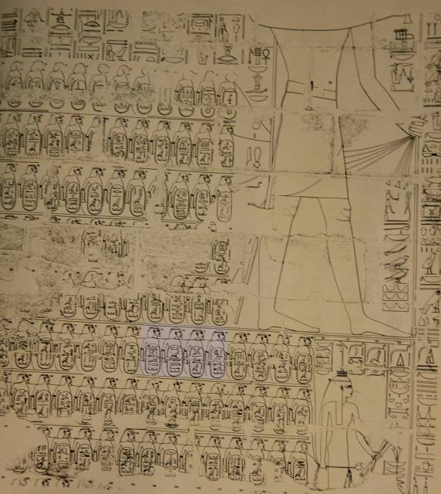
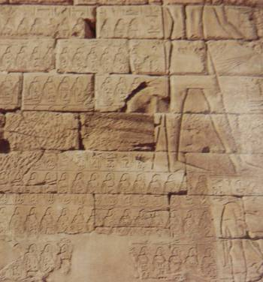
The four highlighted cartouches contain place names in Judah of cities captured by Sheshonq I (biblical Shishak).
Altogether, he decimated some 180 towns.
Sheshonq’s triumphal relief at Karnak

Slide 36
Counting Backward
These fixed points in Assyrian and Egyptian records can be correlated with biblical references to the regnal years of Israelite kings.
Jehu 818-841 BC
Joram 841-852 BC
Ahaziah 852-853 BC
Ahab 853-872 BC
Omri 872-883 BC
Zimri 883 BC
Elah 883-884 BC
Baasha 884-907 BC
Nadab 907-908 BC
Jeroboam 908-930 BC
Solomon 930-970 BC
David 970-1001/1009 BC
Saul 1009-1030 BC
To be sure, there are some complicating factors, such as, differences between the way ascension years were calculated in Assyria as opposed to Egypt, but these factors can be taken into account and our dates for these anchor points are accurate within a year or so.

Slide 37
Special Dating Challenges
Enormous challenges make a precise chronology difficult.
Divergent numbers between the Masoretic Text, the LXX and Josephus
Practice of co-regencies between a king and his son
Two systems for calculating an ascension year:
  Mesopotamian (postdating): Counts the first full calendar year after the year of ascension (used in the kingdom of Judah)
  Egyptian (antedating): Counts as a full year the year when the ascension took place (used in the kingdom of Israel)
Two ANE annual calendars with two New Years (Spring &
Fall)

Slide 38
Deciphering Regnal Years
Several factors must be coordinated in seeking to determine the chronology of the kings of Israel and Judah.
The ascension year of one king (north/south) is synchronized with the regnal year of another contemporary king (south/north).
Length of reign is given (but co-regencies may begin before the death of the father)
Major historical events or persons are to be coordinated with extra-biblical texts (i.e., 1 Kg. 14:25; 2 Kg. 15:19-20; 16:5-9; 17:6; 18:9-11; 23:29)
Various Hebrew kings are listed in extra-biblical texts (Ahab, Jehu, Jehoash, Menahem, Pekah, Hezekiah, Manasseh, Jehoiakim, Jehoiachin, Zekekiah)

Slide 39
Solomon and Division

Slide 40
David’s Dying Testament (1 Kg. 2)
David’s last words to Solomon were intended to set the kingdom on solid footing.
Covenant faithfulness was paramount, and David expressed Yahweh’s dynastic promises in “if/then” conditional terms (1 Kg. 2:2-4).
While the larger promise to David’s house was inviolable (cf. 2 Sa. 7:11b-16; Ps. 89:3-4, 27-37), this larger promise was not an unconditional guarantee for individual kings.

Slide 41
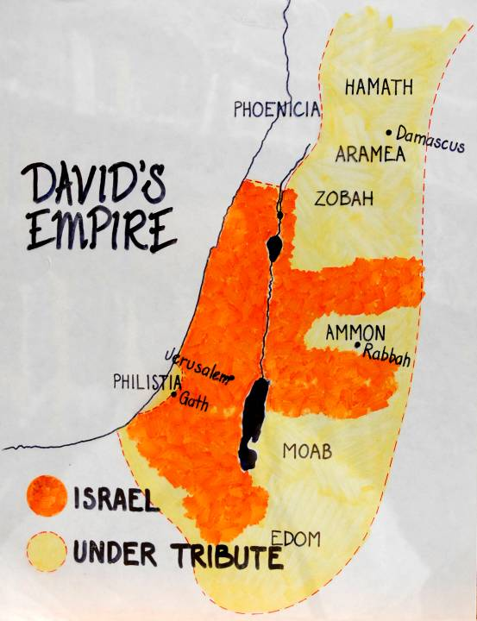
The heartland of David’s mini-empire and his tributaries inherited by Solomon

Slide 42
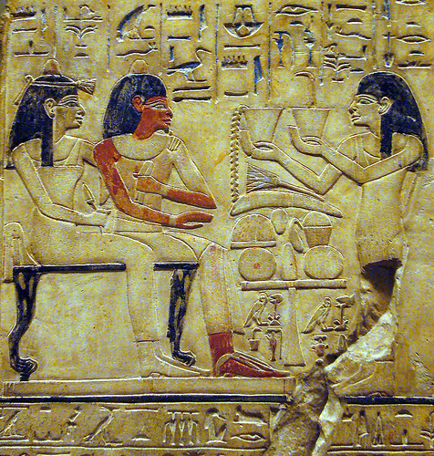
Solomon’s marriage to an Egyptian princess—an example of ANE political wisdom (1 Kg. 3:1)
The Pharaoh in this early peace treaty is unnamed, but assuming the marriage was early in Solomon’s reign (Solomon ruled 970-930 BC), the best candidate is Siamun (978-959 BC), the 6th Pharaoh of the 21st dynasty.
  That Siamun captured Gezer and used it as a dowry for his daughter indicates the exalted status of Solomon (1 Kg. 9:16).
  Such marriages were primarily diplomatic and intended to seal an alliance between two kingdoms.
The Metropolitan Museum of Art, New York

Slide 43
Taxation
Solomon’s form of state taxation required each of twelve Tax Districts to support the royal court one month per year.
The sacred tribal number “12” was retained.
The Tax District governors were appointed by the king, two of which were the king’s sons-in-law (4:1, 15).
Such a system strengthened the central government, while it diminished individual tribal loyalties.

Slide 44
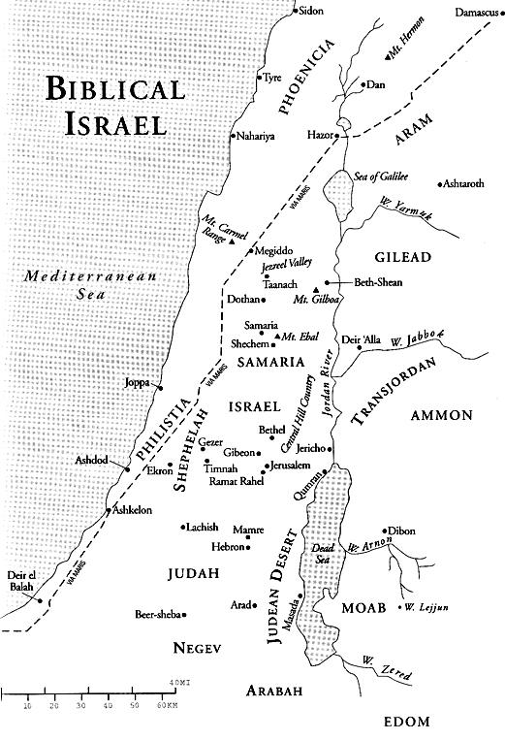
The Tax Districts
The fact that Judah was exempt showed favored status.
Later, however, this favoritism would contribute toward a wedge between north and south.
9
8
10
4
6
5
3
7
1
2
11
12

Slide 45
An Ominous Note!
The king…
…must not acquire great numbers of horses…
Dt. 17:16
Solomon had…
…12,000 horses!
1 Kg. 4:26
Horses at this early period were not used for cavalry, but rather, for chariotry. Chariot horses worked in teams of three.

Slide 46
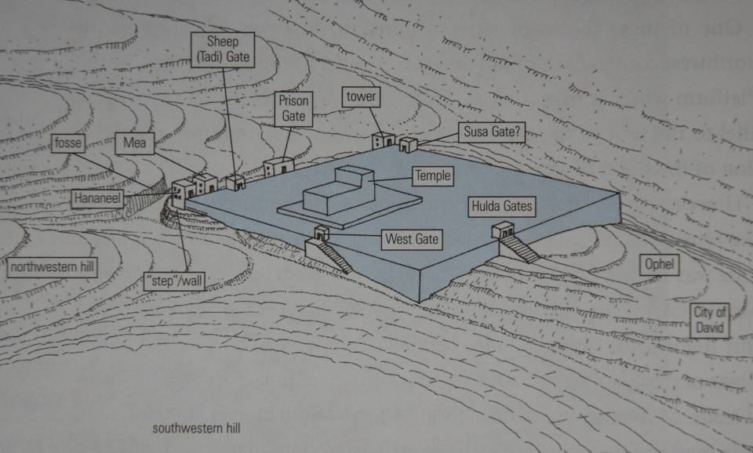
The temple mount was essentially a square, probably with short retaining walls to create a flat surface.
N

Slide 47
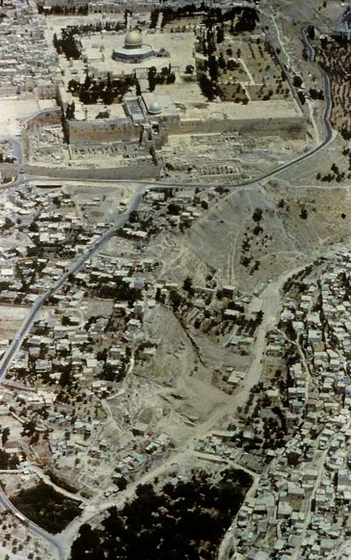
Mt. Zion and the City of David
The original square of the temple mount was much smaller than is present today. The current surface of the temple mount was greatly enlarged by Herod the Great, and that surface remains, even though crowned by the Dome of the Rock.

Slide 48
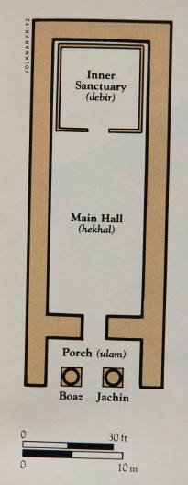
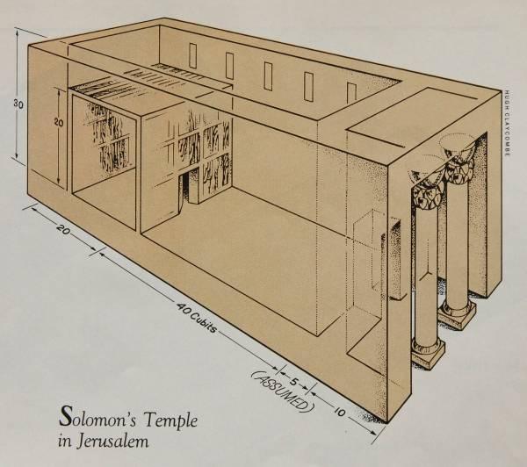
First Temple (basic configuration)
Solomon built the first temple (1 Kg. 6). The temple, like the kingship, was anticipated in the Torah (Dt. 12).

Slide 49
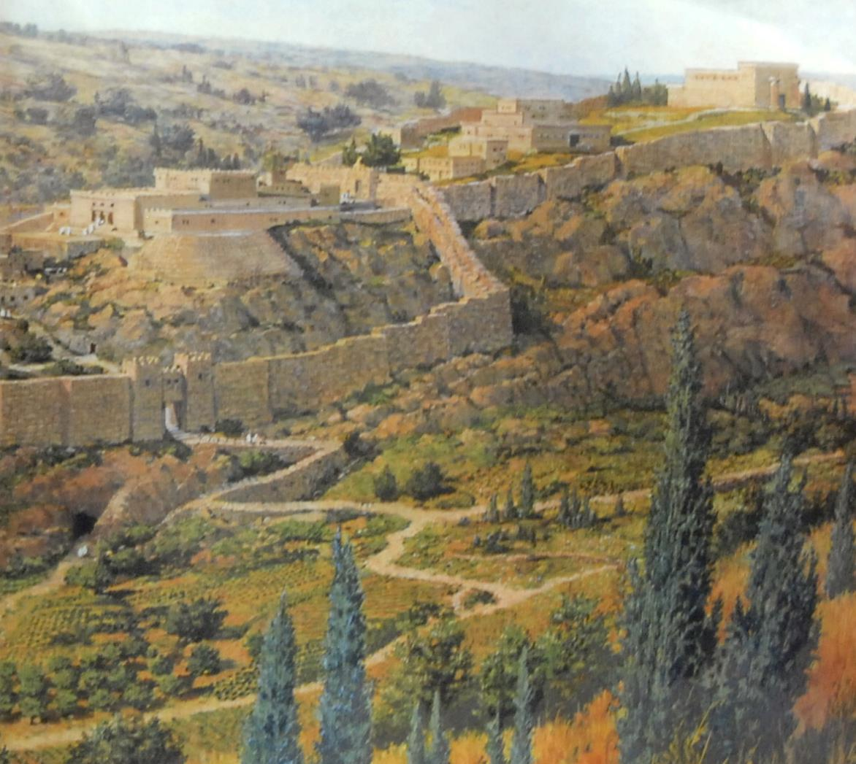
Mt. Zion
Artist’s conception of the royal palace and temple mount based on archaeological data.

Slide 50
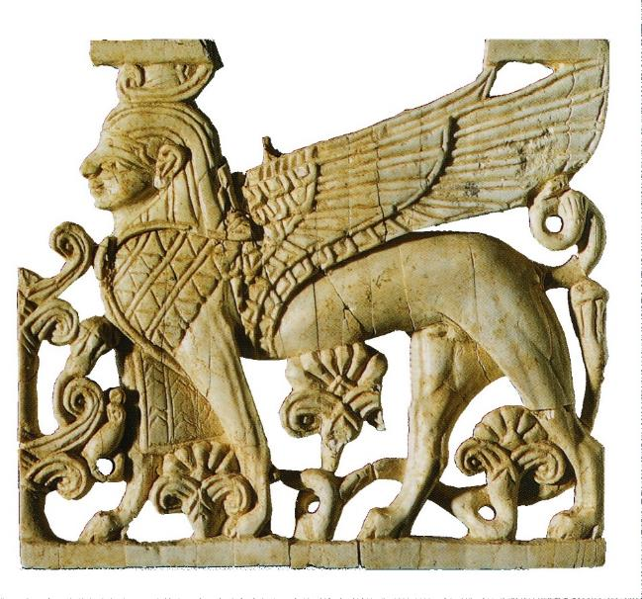
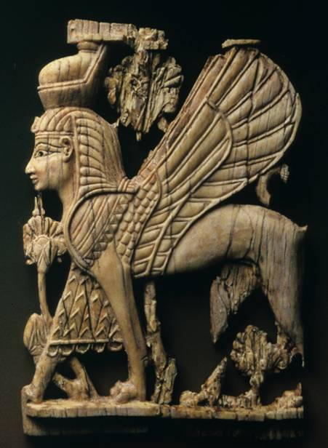
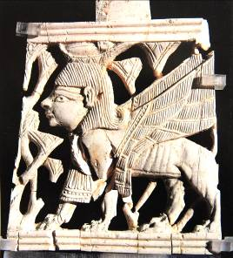
Cherubim
Guardian sphinxes also known as griffins
From Arslan Tash, Syria
Assyrian
Israelite from Samaria

Slide 51
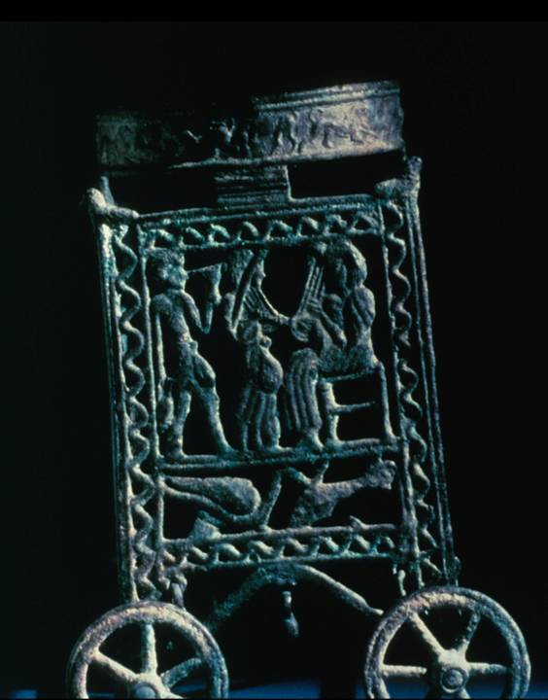
Phoenician bronze-wheeled laver stand
In Solomon’s temple, ten bronze-wheeled laver stands were positioned, five on the north and five on the south of the temple court (cf. 1 Kg. 7:27-39).

Slide 52
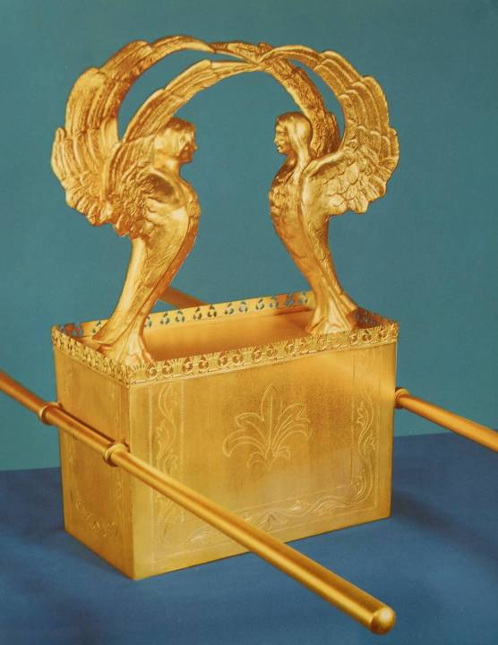
The Ark as a Throne
The ark of the covenant, symbolizing Israel’s binding agreement with God and containing the Ten Commandments, was the very center of the Israelite nation.
Here the glory of God rested between two huge cherubim constructed to virtually fill the whole room.

Slide 53
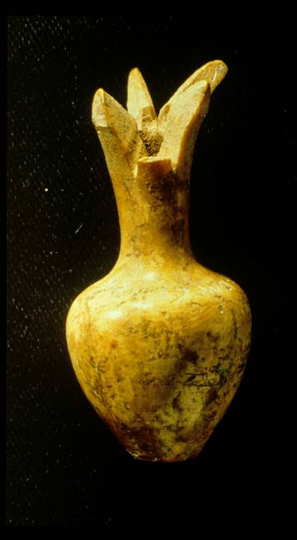
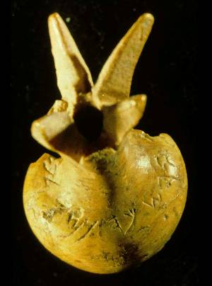
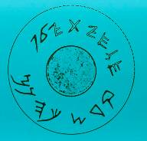
This ivory pomegranate scepter head is perhaps the only surviving relic from Solomon’s temple. The artifact surfaced on the antiquities market and was subsequently purchased by the Israel Museum. Though its authenticity has been questioned, the consensus at present is that it is authentic.
It has an inscription reading, “Belonging to the temple of Yahweh, holy to the priests.”

Slide 54
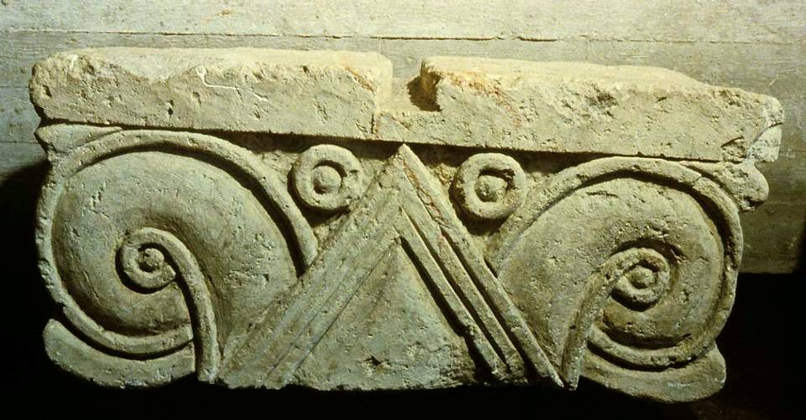
Proto-aeolic capital from the 10th century BC royal construction in Jerusalem. In a style borrowed from Phoenicia, this capital may once have stood atop a pillar in one of Solomon’s state buildings. Several capitals of this style have now been recovered from Jerusalem.

Slide 55
The Glory (8:10-11)
The term כבוד (= glory, weight) derives from the notion of heaviness.
Yahweh’s glory appeared in the cloud in the wilderness (Ex. 16:7, 10), at Mt. Sinai (Ex. 24:16-17), and eventually took up residence in the Tent of Meeting (Ex. 29:42-43; 40:34-35).
The association of Yahweh’s glory with the cloud suggests that the glory was visible and that God, in the mystery of his Being, was within the cloud.
The essence of God’s glory is his goodness, mercy and compassion (Ex. 33:18-23).

Slide 56
Moses and Solomon
At the dedication of the Tent of Meeting:
When the ancient Tent had been erected, Yahweh’s glory filled it (Ex. 40:34).
God’s presence was so intense that Moses could not enter the tent (Ex. 40:35).
At the dedication of the 1st Temple:
When Solomon’s temple was completed and the ark of the covenant was installed, the cloud of glory filled it, also (1 Kg. 8:10).
As with the Tent of Meeting, the priests could not minister because of the intensity of Yahweh’s presence (1 Kg. 8:11).
The Lord has come from Sinai into his sanctuary (Psa. 68:17).

Slide 57
The Possibility of Exile
But if you or your sons turn away…
…then I will cut off Israel from the land I have given them and will reject this temple!
1 Kg. 9:6-7
If you do not carefully follow all the words of this law…
…Then Yahweh will scatter you among all nations, from one end of the earth to the other.
Dt. 28:58, 64

Slide 58
Solomon’s Glory (1 Kg. 9:10—10:29)
Solomon’s grand plans for the state outstripped his available resources.
The enormous cost of constructing the temple and palaces force him to cede 20 cities in Galilee to Hiram of Phoenicia to pay his debts (cf. 9:10-14).
To provide the necessary manpower for his state projects, Solomon extended forced labor to Israelite citizens (9:15; cf. 5:13-18).
He also heavily increased taxation.

Slide 59
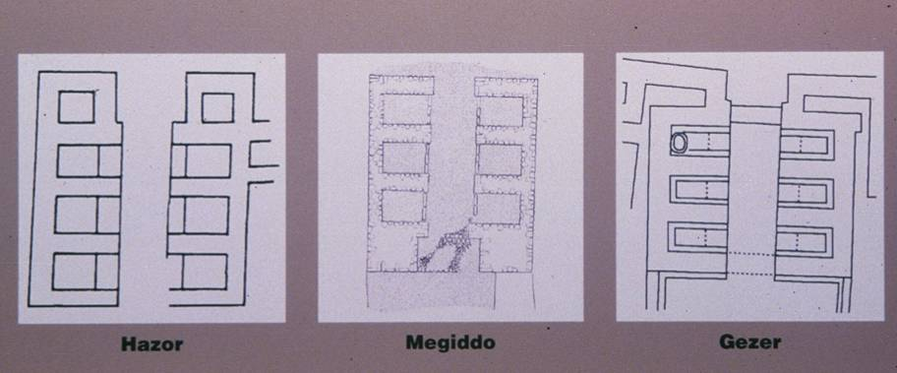
Solomon used innovative gate technology to fortify cities. By creating gates with narrow entrances and alcoves, the chances of an enemy penetrating the gate with foot soldiers was greatly reduced.

Slide 60
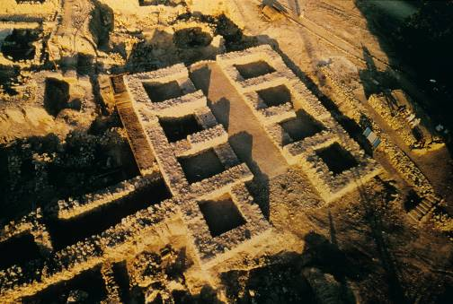
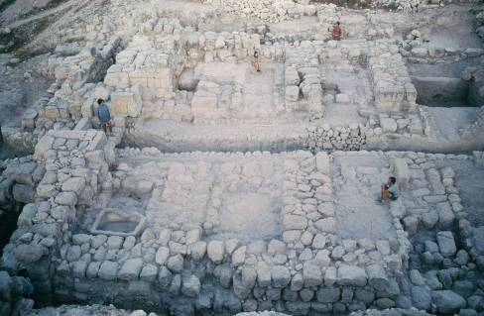
Solomonic gates at Hazor and Gezer
By filling the alcoves with soldiers, any attempt to pass through the narrow opening would be met with withering defensive fire (1 Kg. 9:15; cf. Eze. 40:10).
These gate structures are dated to the mid-10th century BC, the time of Solomon’s rule.

Slide 61
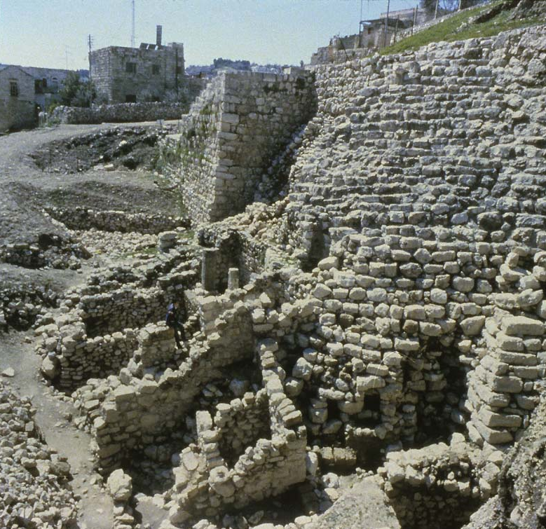
The Stepped Stone Structure
On the east side of the Hill of Ophel (City of David), archaeologists have excavated a stepped stone structure. It appears to date from pre-Davidic Jerusalem, but was reused by both David and Solomon as a high standing buttress upholding a platform for a state building.
Possibly, this structure is the famous “Millo” (= filling) described in 1 Kg. 9:15, 24.

Slide 62
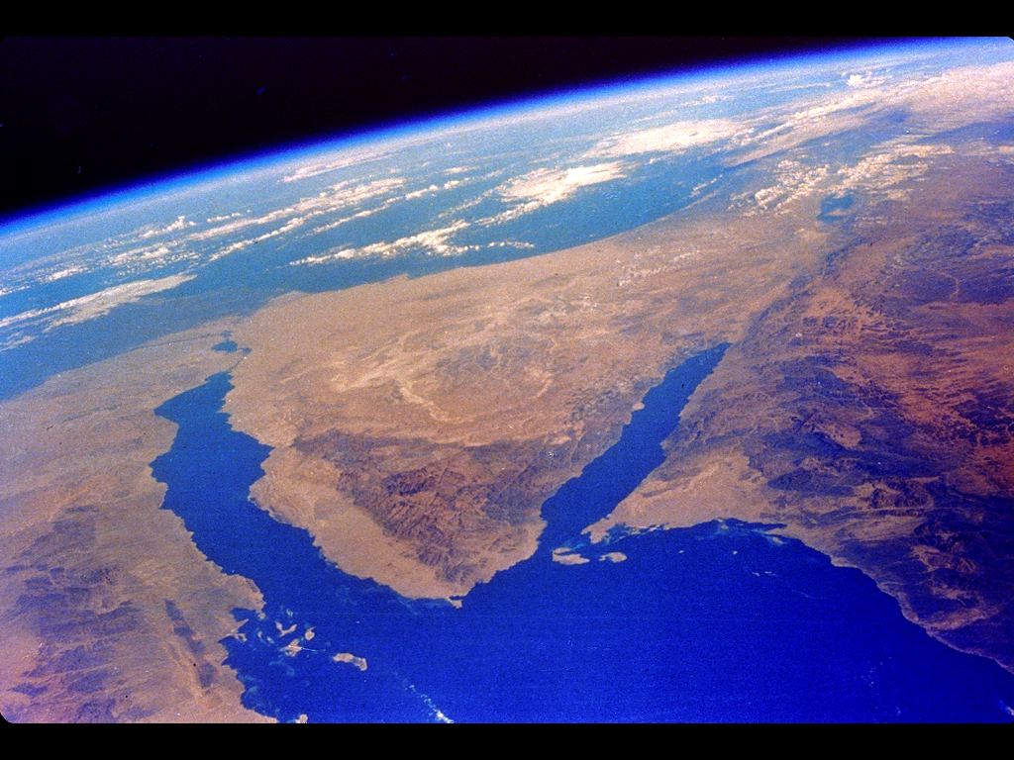
Jerusalem
Ezion-Geber
Solomon constructed a merchant navy at Ezion-Geber for trading southward via the Red Sea (1 Kg. 9:26), bringing in revenues of gold, silver, ivory and exotic animals (1 Kg. 10:22).

Slide 63
Solomon’s Wealth
State revenues into Solomon’s treasury were huge.
Annual revenues in gold alone were about 25 tons (10:14).
His state buildings in Jerusalem, not to mention his place, were ornate and richly decorated (10:16-21).
Exotic animals, probably from Africa, testified to his extravagance (10:22).
He built a large chariot corps with imported horses and chariots as well as engaged in international chariot trade (10:26-29).

Slide 64
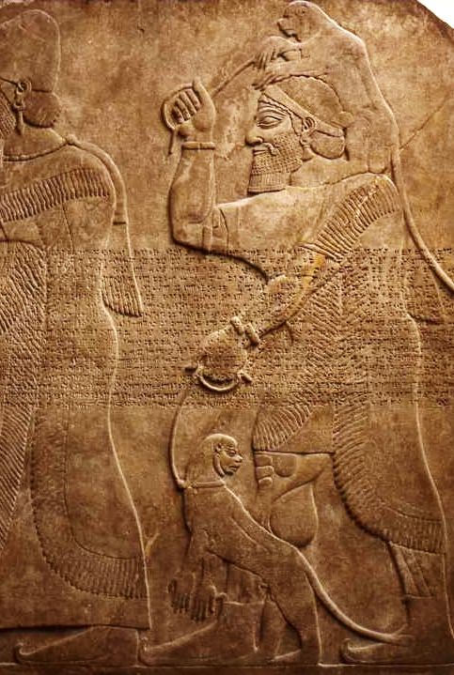
The importation of exotic animals was a sign of sophistication and an expression of power for ancient monarchs.
Here, exotic animals are being brought to the Assyrian king for his amusement. In fact, the Assyrians even began to create zoos for such animals.

Slide 65
Solomon’s Dissolution
In spite of his wisdom and wealth, Solomon’s later years were characterized by Torah disobedience (cf. Dt. 17:16-17; 7:3-4).
He accumulated horses and chariots (1 Kg. 9:22; 10:25-26, 28-29).
His royal coffers swelled with gold and silver (1 Kg. 9:11, 28; 10:14-15, 21-22, 25, 27).
He married a large harem of foreign and domestic wives (1 Kg. 11:1-4).
He practiced pagan worship, building shrines to various foreign deities (11:4-8).

Slide 66
Rehoboam’s Ascension (1 Kg. 12:1-19)
Upon Solomon’s death, Rehoboam traveled to Shechem for acclamation as the new king.
The fact that he traveled to this ancient northern shrine suggests that already there was a north-south mentality among the tribes, possibly a residual from the civil war between the houses of Saul and David.
Jeroboam, the corvee leader in Egyptian exile, returned to represent the northern clans.
The primary plea of the citizens was for tax relief and exemption from forced labor in the state projects.

Slide 67
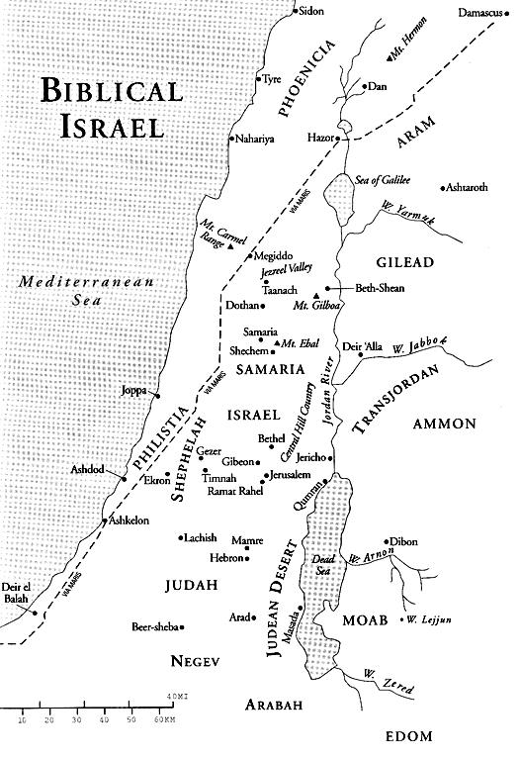
Shechem, the holy site in the north where the tribes had renewed the covenant under Joshua (Josh. 24), held long-standing prominence.
After three days reflection and consultation, Rehoboam chose to insult the northern clans, resulting in their abrupt secession from the kingdom and rejection of the “house of David” (12:16).
SHECHEM
JERUSALEM

Slide 68
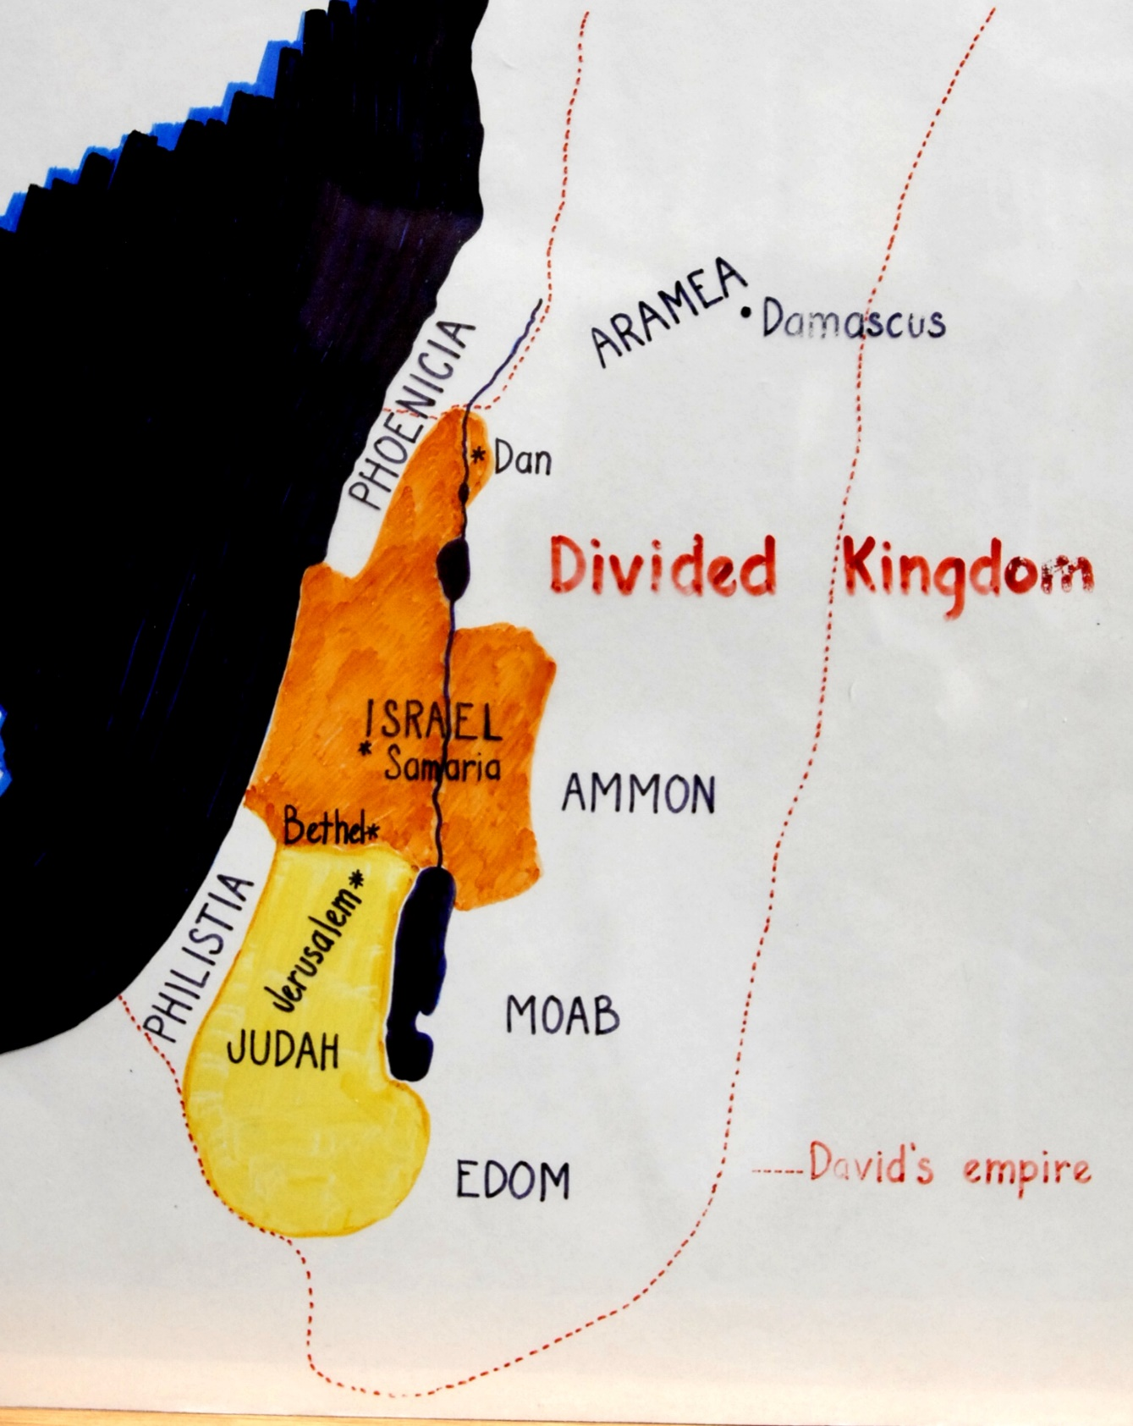
The divided kingdom was considerably smaller than the mini-empire of David.
While Shechem became the initial capital of the north, it later was moved to Tirzah and then to Samaria.

Slide 69
Anomalies in the “12” Tribes
The sacrosanct number “12” continued, even though compromised (1 Kg. 11:30-32, 35-36).
The Simeon Tribe
Originally to the south of Judah, the Simeon tribe either was assimilated into Judah or else migrated northward, as did the Danites (cf. Jg. 18).
The “10” Tribes in the North
If the Simeon tribe was assimilated into Judah, then the “10” tribes in the north counts Manasseh twice or else includes the Levites.
The “One” Tribe in the South
The “one” tribe is probably one in addition to Judah (i.e., Benjamin). The LXX reads “two tribes” in the south (11:32, 36).

Slide 70
Implications of secession
Capital
What city would replace Jerusalem?
Throne Succession
Would leadership transitions be dynastic or charismatic?
Place of Worship
What site would replace Mt. Zion?
Form of Worship
Could the worship required in the Torah be changed?
Liturgical Calendar
Would festivals in the south compete with those in the north?
Priesthood
How were priests to be chosen?
Covenant
How was the covenant with David to be regarded in the north?
Political relationship to Judah
Was Judah an enemy or a friend?

Slide 71
Kings of the Divided Monarchy
Israel (9 dynasties)
Categorically condemned by the biblical historians—they all continued the sins of Jeroboam I, blending the worship of Yahweh with the worship of the Canaanite gods and goddesses.
Judah (1 dynasty)
Some good kings attempted reforms, most notably Hezekiah and Josiah. Other kings, like those of the north, lapsed into syncretism.

Slide 72
The Shrines at Bethel and Dan
The immediate threat to Jeroboam was any remaining loyalty to the new temple in Jerusalem.
Ostensibly, the bull calves at the two new shrines were intended as symbols of Yahweh, possibly based on the fact that the ancient title “Mighty One of Jacob” is the same as the “Bull of Jacob” (Ge. 49:24).
However, the bull calves also recalled the idolatry of the golden calf cast by Aaron (cf. Ex. 32), and certainly the bulls violated the second commandment (cf. Ex. 20:4; Dt. 5:8).

Slide 73
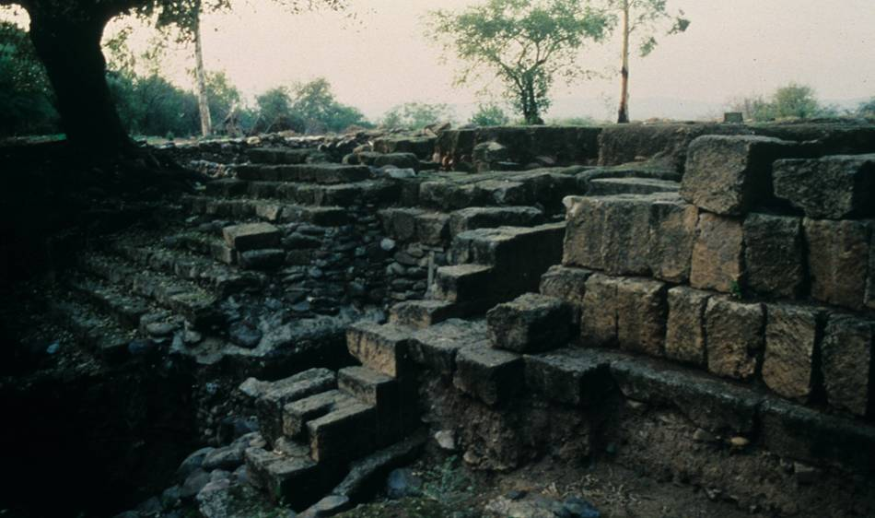
Excavated by Abraham Biran, this ancient shrine at Dan was the one constructed by Jeroboam I on the site of the even more ancient shrine built by the Danites (cf. Jg. 18:30).

Slide 74
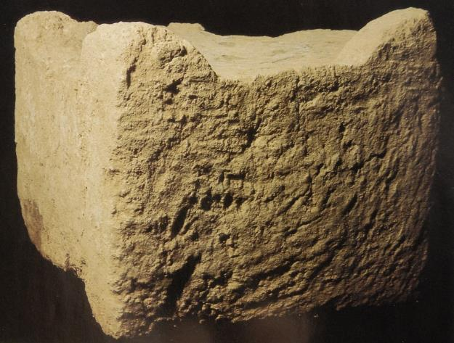
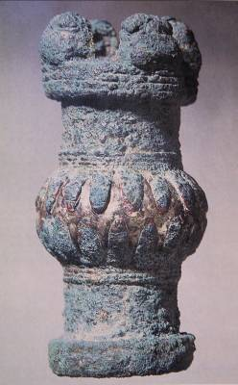
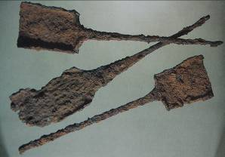
Implements from Tel Dan
This scepter head discovered hidden beneath a stone altar may have belonged to either a priest or the northern king.
This horned altar is nearly perfectly preserved. Burn marks on the top are clear evidence of its sacrificial use.
Iron incense shovels, the earliest of their kind ever discovered

Slide 75
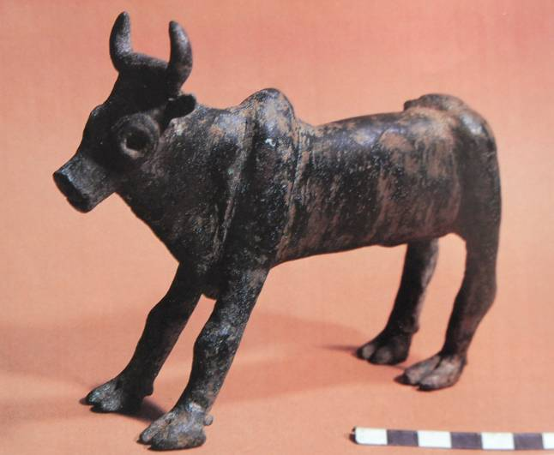
Shrine Calves at Bethel & Dan
Discovered by Ofer Broshi, an officer in the Israeli army, at an ancient “high place” in the territory of Manasseh; the cult site was probably built by the tribe of Manasseh.
The calves at Bethel and Dan may have been similar.

Slide 76
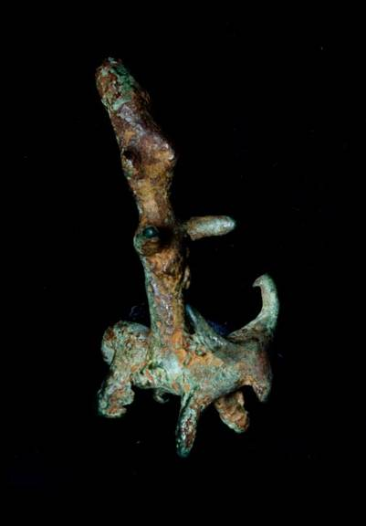
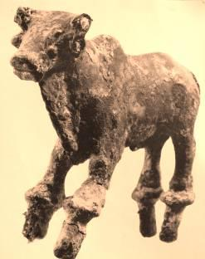
ANE Deities/Ba’al
This small bronze figurine (ca. 1500 BC) depicts a deity sitting on a bull. Ba’al, the storm god of the Canaanite pantheon, was believed to ride on the back of a bull. Sometimes bulls were represented without a deity, though often an invisible deity was implied.
(West Semitic Research Project)
This 3” bronze bull was excavated in Hazor and dates to the Late Bronze Age (1550-1200 BC).

Slide 77
Rehoboam of Judah (1 Kg. 14:21-31)
Rehoboam, half-Israelite and half-Ammonite, was Judah’s first king.
In his 5th regnal year, Judah was invaded by Sheshonq I of Egypt—a Deuteronomic judgment (cf. Dt. 28:25, 49-52).
This invasion is corroborated by the Karnak relief of Sheshonq I in the year 925 BC.
Rehoboam paid to Sheshonq I a huge indemnity to preserve his independence.

Slide 78
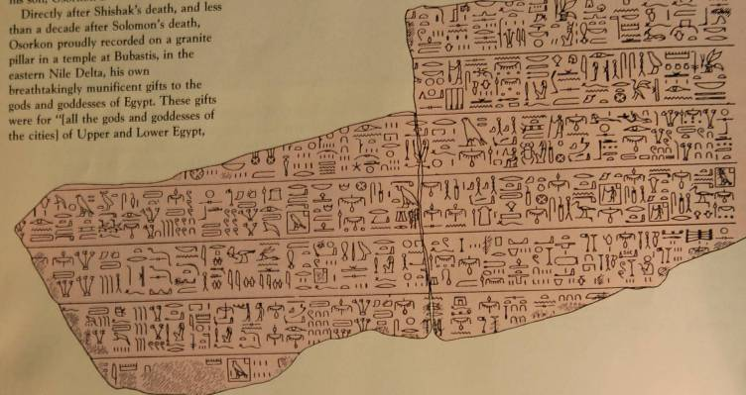
Where did Solomon’s wealth go?
Much of Solomon’s wealth went to Egypt during the invasion of Sheshonq I (1 Kg. 14:25-26). Though Sheshonq died the year after he invaded Palestine, his son Osorkon I recorded huge gifts to the deities of Egypt—383 tons of gold and silver! Where could Osorkon have obtained such immense wealth early in his reign? Almost certainly from the booty his father took from Judah.
This drawing of fragments from a pillar at Bubastis shows itemized lists of gifts given by Osorkon I to each god and goddess of Egypt.

Slide 79
Clearly, the temple and its worship was central for the southern nation.
Perhaps the fullest expression of this centrality is in Abijah’s speech (2 Chr. 13:10-12), where he chastises the northern Israelites for forsaking the temple.
The relationship of the Davidic king to the temple is therefore central as well, and figures like David, Solomon, Asa, Jehoshaphat, Joash, Hezekiah and Josiah are models of the ideal.
By the same token, figures like Jehoram, Ahaziah, Athaliah, Ahaz and Manasseh are negative examples of rulers reverting to paganism.

Slide 80
Covenant Loyalties
ISRAEL
Covenant with Abraham and the patriarchs was primary
Covenant with Moses and its threats of exile were subordinated to the perceived inviolability of the Abrahamic covenant
JUDAH
Covenant with David was primary
Covenant with Abraham was embraced, also
Covenant with Moses and its threats of exile were subordinated to the perceived inviolability of the former two covenants

Slide 81
Northern Kings & the Omri Dynasty

Slide 82
The Reign of Omri (1 Kg. 16:21-28)
After a brief rivalry with another claimant to the throne (Tibni), Omri emerged as the popular king of Israel.
Omri purchased the hill of Samaria and moved the capital once again.
He continued the paganizing trend of his predecessors (1 Kg. 16:25-26).
Omri’s name appears in both Assyrian records as well as on the famous Moabite Stone.
When he died, his son Ahab succeeded him.

Slide 83
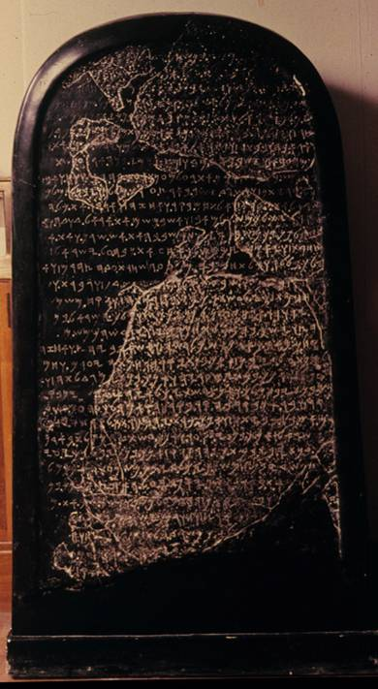
THE MOABITE STONE
“…and Omri had taken possession of the land of Medeba. And he dwelt in it in his days and the sum of the days of his sons: 40 years; but Chemosh restored it in my days. …and the men of Gad had dwelt in the land of Atarot from of old, and the king of Israel built Atarot for himself; but I fought against the town and took it, and I slew all the people: the town belonged to Chemosh and Moab. …and Chemosh said to me: ‘Go! Take Nebo against Israel.’ And I went by night and fought against it until from break of dawn till noon. …and I took thence the altar hearths of Yahweh, and I dragged them before Chemosh.”
The Louvre, Paris

Slide 84
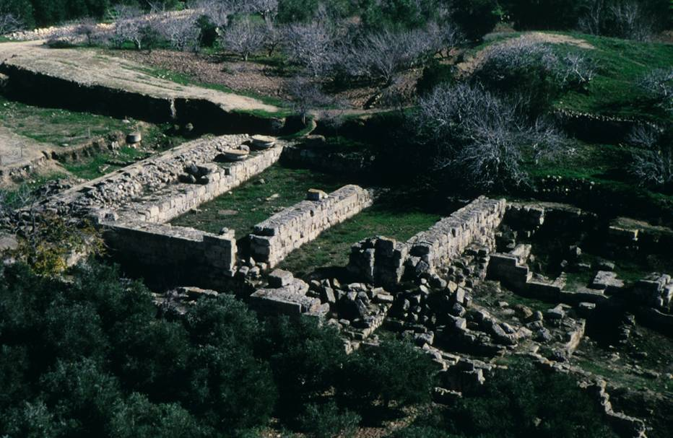
Harvard University excavations of the palace of Omri and Ahab in Samaria; the style of masonry derives from Phoenicia, the home of Ahab’s wife.

Slide 85
The Contest Between Yahweh & Ba’al
The alternative worship shrines at Bethel and Dan left the northern kingdom wide open to the Ba’al fertility cult.
The golden calves were easily confused with the pedestal of Ba’al, the storm god who stood on the back of a bull.
Ahab was brazen enough to build a temple to Ba’al in Samaria, the new capital (1 Kg. 16:32).

Slide 86
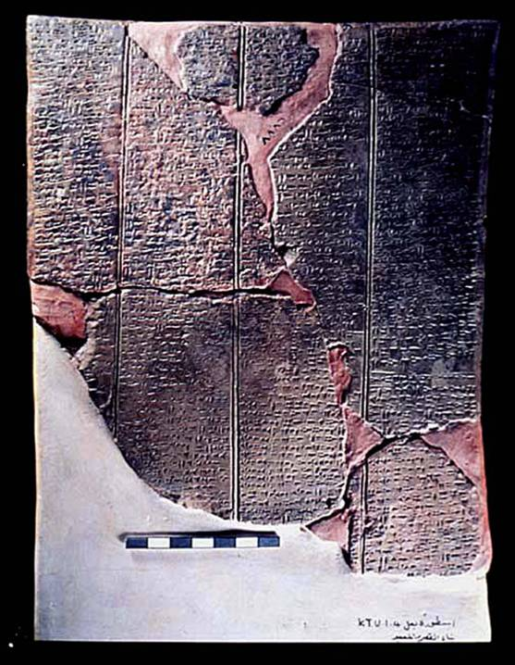
Ba’al Epic
Discovered in Ugarit (Ras Shamra, Syria), this text describes the myth of Ba’al and his role as “Lord of the Earth” (responsible for fertility). The text describes the construction of Ba’al’s palace on Mt.
Zaphon after he defeated Yamm, god of the sea, as well as his return from the underworld after being imprisoned by Mot, god of death.

Slide 87
Canaanite Religion
The religions of the Canaanite nations were fertility cults using imitative magic to induce fertility in the land, livestock and people.
  The deities were both male and female.
  In Canaanite mythology, Ba’al (god of rain, lightning and storm) was killed each fall and imprisoned by Mot (god of death), causing the dry season.
  In the spring, Ashtaroth (goddess of sex and war) rescued Ba’al from the power of Mot, enabling Ba’al and Ashtaroth to mate.
  The mating of the deities was believed to cause fertility in soil, animals and humans.
  To induce the mating of Ba’al and Ashtaroth, humans participated in sacred prostitution at the high places as a form of imitative magic—”on every high hill and under every green tree”.
  Both male and female sacred prostitutes (qedeshim and qedeshot) served the public in Canaanite temples and open air sacred sites on the mountains.

Slide 88
Canaanite Pantheon
אל (El) אשרת (Asherat)
father of the pantheon mother of the gods
אלים (Elim)
70 gods and goddesses
Symbols and sacred places:
מצבות (matstsebot = phallic pillars, male symbols)
אשרה (asherah = sacred tree, female symbol)
במות (bamoth = high places)

Slide 89
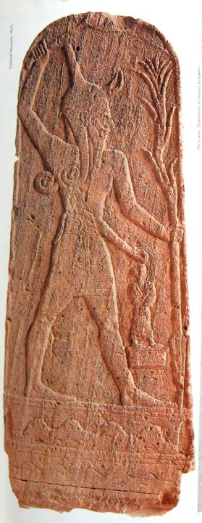
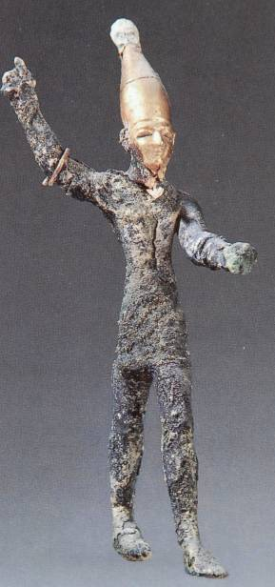
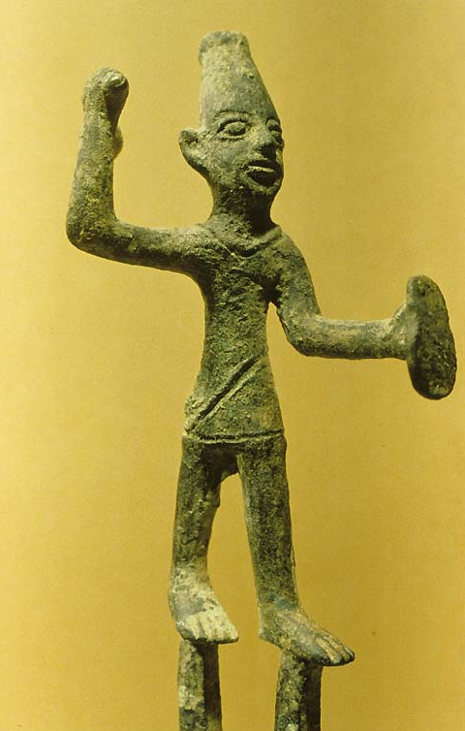
Ba’al
Ba’al, the Canaanite god of storm, was usually depicted with a conical hat and often with an upraised “smiting” hand.

Slide 90
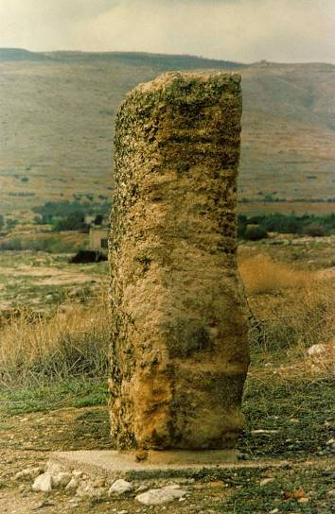
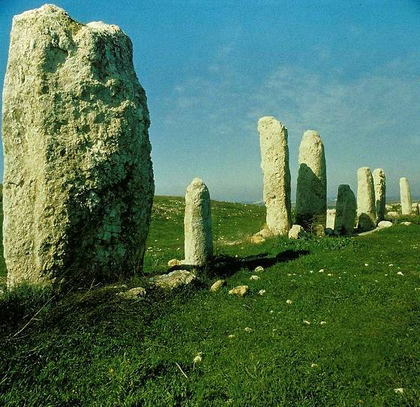
Standing Stones (matstsebot) were often phallic symbols for the Ba’al cult
Pillar excavated at Tirzah (condemned in Dt. 12:1-3; Mic. 5:13-14)
Standing stones, the two largest more than 10’ tall, were excavated at the Gezer high place.

Slide 91
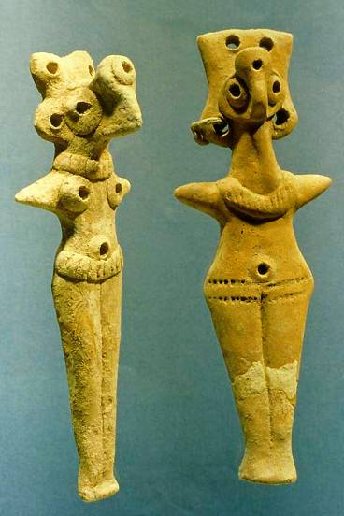
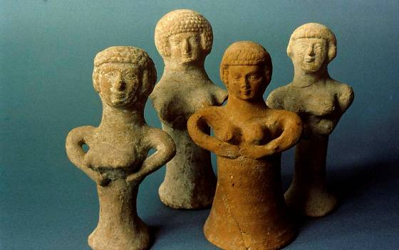
Fertility Worship and the Period of Israel
Late Bronze Age Canaanite female deity figurines
Asherah figurines from Israel’s Iron Age

Slide 92
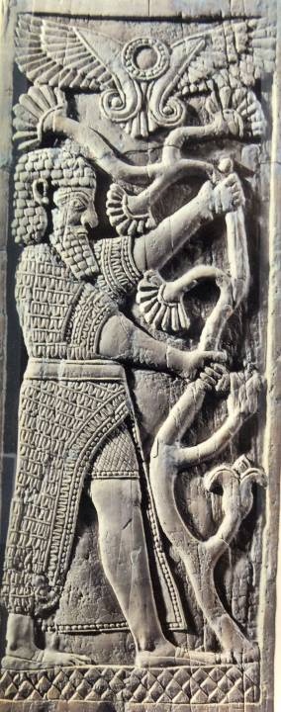
Asherah Tree
אשרה (asherah = sacred tree, female symbol)
Sacred trees (asheroth) were associated with cult places throughout the ancient Near East. They represented the female element in the fertility cults. Sometimes the sacred trees were ceremonially “grasped,” as in this ivory plaque from the 8th century BC (Nimrud).
British Museum, London

Slide 93
The Kings During the Omri Dynasty
(dates are based on the chronology of Edwin Thiele)
ISRAEL
*Omri 885-874 BC
Ahab 874-853 BC
Ahaziah 853-852 BC
Jehoram 852-841 BC
* = dynastic change
JUDAH
**Jehoshaphat 872-848 BC
**Jehoram 853-841 BC
Ahaziah 841 BC
** = co-regency

Slide 94
The Reign of Ahab (= father’s brother)
Ahab justifiably earns the worst marks for any northern king.
He continued the shrines of Jeroboam I (1 Kg. 16:31a; cf. 12:26-33).
He married a pagan princess, daughter of Ethbaal of Phoenicia (1 Kg. 16:31b; cf. Dt. 7:3-4).
He plunged into Canaanite paganism (1 Kg. 16:31c-33; cf. Ex. 20:4).
He authorized the rebuilding of Jericho (1 Kg. 16:34; cf. Jos. 6:21, 24, 26).

Slide 95

Kurkh Stele
Though not recorded in the Bible, Ahab joined a coalition of a dozen kings to confront Shalmaneser III of Assyria at Qarqar on the Orontes River in 853 BC.
According to this Assyrian stele, Ahab fielded 2,000 chariots and 10,000 soldiers.
British Museum, London

Slide 96

Jezebel’s seal
Israel Museum
This seal has been identified by scholar Marjo Korpel, University of Utrecht, as belonging to the wife of Ahab.
Not all the inscription is legible, due to the chip at the top, but the missing two letters can be feasibly reconstructed.
איזבל (= Jezebel)
יזבל (the letters visible on the seal)
יזבל[לא] (reconstruction with an additional two letters = “to Jezebel”

Slide 97

Seal Impression
(with reconstructed letters)
The seal measures about 1.25 inches (top to bottom).
It is filled with common Egyptian symbols popular in Phoenicia.
The winged sphinx has an Isis/Hathor crown.
Below the sphinx is a winged sun-disk.
On either side of the falcon are cobras facing outward, commonly used on headdresses of royalty.

Slide 98
Political Maneuvering
The Omri Dynasty sought to create political alliances for commercial advantage and border security.
Omri sealed an alliance with Ethba’al of Tyre by marrying his son to Jezebel, the Phoenician princess.
Israel’s suzerainty over Moab in the Transjordan (attested on the Moabite Stone) secured his eastern border.
Ahab and Jezebel married their daughter Athaliah to Jehoram, the son of Judah’s king, thus securing their southern border.
The primary remaining threat was now Aram to the northeast.

Slide 99
A true family resemblance…
But Omri did evil in the eyes of Yahweh and sinned more than all those before him.
1 Kings 16:25
Ahab son of Omri did more evil in the eyes of Yahweh than any of those before him.
1 Kings 16:30
There was never a man like Ahab, who sold himself to do evil in the eyes of Yahweh, urged on by Jezebel his wife. He behaved in the vilest manner by going after idols, like the Amorites Yahweh drove out before Israel.
1 Kings 21:25-26

Slide 100
The Fight for Israel’s Religious Soul
The Faith of Yahweh
The prophets of God
The religion of life
Yahweh, the true Sovereign over the earth
The Religion of Ba’al
The prophets of Ba’al
The religion of death
Ba’al, the one who claims to control the weather
VS
THE ISSUE: Who is truly God?

Slide 101
The Elijah Cycle

Slide 102
Elijah is the paradigm and epitome of true prophethood
His name, “My God [is] Yah[weh],” stands in sharp contrast to the Ba’al cult.
Elijah is the voice of Yahweh, the One “before whom I stand” (1 Kg. 17:1; 18:15; cf. Je. 23:18, 22).
He is unrestricted in time and space, appearing and disappearing mysteriously (1 Kg. 18:12; 2 Kg. 2).
He is a man of mountains, first Carmel, then Horeb, then an unnamed mountain (1 Kg. 18:19; 19:8; 2 Kg. 1:9).
He is the moral balance of power against Ahab and Jezebel, who were not just pagans, but killers.

Slide 103

Elijah’s Attack on the Ba’al Cult
Elijah’s announcement of drought was a direct attack upon Ba’al, the lord of rain & fertility (1 Kg. 17:1).
The fundamental question: “Who really has the power over the skies? Who really is God?”
Ba’al Hadad (= Lord Thunderer)

Slide 104
Elijah’s Challenge (1 Kg. 18:16-19)
Ahab’s greeting mirrored the conclusion of his wife—the drought was Elijah’s fault!
Though Ahab called Elijah the “troubler of Israel,” Elijah turned the jibe back on Ahab’s head.
Elijah challenged Ahab to a divine duel—Elijah would confront 450 prophets of Ba’al and 400 prophets of Asherah at Mt. Carmel on the border between Israel and Phoenicia.
That Elijah chose this mountain was nothing less than an “in your face” gauntlet dropped before Jezebel’s deity!

Slide 105



Mt. Carmel
Southern end of Mt. Carmel (facing north).
Satellite photo of Israel (taken from the Challenger Space Shuttle, 1984)
Approximate site of Elijah’s contest
Mt. Carmel, on the border of Israel and Phoenicia

Slide 106
“How long will you hobble on two crutches?” (1 Kg. 18:20-21)
To invite the respective deities to light the altar fires was especially apt, since Ba’al was purported to be the god of lightning.
The Ba’al devotees spent the day in orgiastic ritual, including self-mutilation.
Despite their fanaticism, there was “no voice, no answerer, no attention”.

Slide 107
Elijah’s Taunts (1 Kg. 18:27)
In the afternoon, Elijah flung sarcastic jibes at the pagan prophets.
“Shout louder! Surely he is a god!”
“Maybe he’s in deep thought!”
“Perhaps he’s busy!” (a euphemism for relieving himself which is reflected in the Aramaic Targums)
“Possibly he’s on a journey!”
“Maybe he’s asleep!”

Slide 108
Elijah’s Offering (18:30-38)
Elijah’s altar of 12 stones symbolized the unity of the clans, the two nations notwithstanding.
His act of drenching the altar made the final effect even more dramatic!
His prayer “at the time of the evening oblation” would link his sacrifice with the Jerusalem temple.
His short prayer (34 words in Hebrew) brought the lightning (fire) that Ba’al was unable to produce, consuming the sacrifice, the wood, the altar stones, the soil and the water in the trench.

Slide 109
Prayer and Response (1 Kg. 18:37, 39)
“Answer me, O Yahweh, so these people will know that you, O Yahweh, are God, and that you are turning their hearts back again!”
When all the people saw this, they fell prostrate and cried, “Yahweh is God! Yahweh is God!”

Slide 110
Yahweh, the True God Who Brings Rain
In accord with the Deuteronomic code, the prophets of Ba’al were executed (1 Kg. 18:40; Dt. 13).
Elijah now announced that rain was coming!
He sent his servant to look seaward, while he crouched with his head between his knees, presumably in prayer.
When after seven times the servant finally said he saw a small cloud, Elijah told Ahab to hurry home.
The prophet, under the power of Yahweh, ran ahead of Ahab’s chariot some 17 miles to Jezreel!

Slide 111

Looking seaward from the top of Mt. Carmel.

Slide 112
The Flight to Mt. Horeb (1 Kg. 19)
Though Elijah faced down 850 pagan prophets, he ran for his life from one woman, Jezebel!
Elijah as so discouraged he sat under a broom tree and prayed to die (but, of course, had he really wanted to die he could simply have stayed home, where Jezebel was trying to kill him).
At Horeb (an alternative name for Mt. Sinai), the ancient mountain where Moses received the Torah, Elijah sought the roots of his faith: Was the covenant still intact? Would Jezebel win in her mad attempt to expunge the faith of Israel?

Slide 113
Elijah’s flight from Mt. Carmel to Mt. Horeb (approx. 320 miles)

Slide 114

Chapel on the summit of Jebel Musa (6th century AD)
A cave near the chapel is traditionally associated with the cave in which Moses was hidden and covered by God’s hand (cf. Ex. 33:22).
Presumably, it would have been the same cave in which Elijah spent the night (1 Kg. 19:9).

Slide 115
Moses and Elijah at Horeb
Moses
40 days on Mt. Horeb
Sustained with bread & water (Ex. 16:4; 17:5-6)
Sheltered in a rocky cleft (Ex. 33:22)
Stood on the rock (Ex. 33:21)
Cloud, earthquake and fire (Ex. 19:16, 18; Dt. 4:11-12)
Prevented from seeing God’s face (Ex. 33:20, 22)
Elijah
40 day trip to Mt. Horeb
Sustained with bread & water (1 Kg. 19:6-8)
Sheltered in a cave (1 Kg. 19:9)
Stood at the cave’s mouth (1 Kg. 9:11a, 13)
Cloud, earthquake and fire (1 Kg. 19:11b-12a)
Prevented from seeing God’s face (1 Kg. 19:13)

Slide 116
“Why are you here?” (1 Kg. 19:9)
Yahweh’s question to Elijah and Elijah’s response suggest that the prophet’s deep-seated depression concerned the survival of the covenant faith, which was given to Moses at Mt. Horeb.
This mountain was the site at the very roots of the covenant faith.
Would Jezebel succeed in her mad attempt to exterminate the covenant faith of Yahweh?

Slide 117
The Remarkable Difference!
For Moses, God appeared in the cloud, earthquake and fire (Ex. 19:18; Dt. 4:12; 5:23-24).
For Elijah, God was NOT in the cloud, earthquake and fire (1 Kg. 19:11b-12a). Rather, he was in “the sound of silence” (קול דממה דקה).
This difference underscored the contrast between Yahweh and Ba`al. Ba`al (Lord Thunder) must never be confused with the mystery of Yahweh, who could speak as the sovereign God even in the sound of silence.

Slide 118
Elijah’s New Commission (1 Kg. 19:15-18)
Elijah’s commission sent him back northward, where he was to…
…anoint Hazael as the King of Aram
  Hazael was to be Yahweh’s instrument of discipline for wayward Israel
  This anointing later would be fulfilled in the office of Elisha (cf. 2 Kg. 8)
…anoint Jehu as the King of Israel
  Jehu would exterminate the family of Ahab (cf. 2 Kg. 9-10)
…anoint Elisha, his prophetic successor
  Between Hazael, Jehu and Elisha, the family of Ahab and Jezebel would be wiped out completely!

Slide 119
The Depressed Prophet and God
“I am the only one left, and now they are trying to kill me, too!”
1 Kg. 19:14
“Yet I reserve seven thousand in Israel—all whose knees have not bowed down to Ba’al and all whose mouths have not kissed him.”
1 Kg. 19:18

Slide 120
Israelite Property Laws
The land of Israel belonged to Yahweh. The Israelites were his tenants (Lv. 25:23).
Land inside a walled city could be sold permanently under the proviso that the sale was not final for a year after the original purchase agreement (Lv. 25:29-30).
Land outside walled cities, i.e., arable land, could NOT be sold permanently (Lv. 25:25-28, 31).
  It could be leased temporarily on the basis of a land contract.
  It could be redeemed by the original owner or his family.
  At the Jubilee, which came every 50 years, the land would revert automatically to the original owner.

Slide 121
The Murder of Naboth (1 Kg. 21)
Jezreel, the site of Ahab’s winter palace, was also home to Naboth, a vineyard farmer.
As a Torah-observant Israelite, Naboth refused to sell his vineyard to Ahab.
Jezebel conspired to have him murdered so that his property could be seized by the crown.
Elijah pronounced a grim judgment on both Ahab and Jezebel for their Torah violations.

Slide 122
Elijah’s Death Sentence to Ahab
Already, an unnamed prophet had sentenced Ahab to death for sparing the king of Aram in holy war (20:41-42).
Now, because of the Naboth incident, Elijah confronted Ahab with a scorching denunciation and an even more specific death sentence, both for him and his wife as well as his whole family (21:17-24).
All these death sentences would be carried out in the remaining years of Elijah’s ministry or in the ministry of Elisha, his successor.

Slide 123
“…like the Amorites…” (2 Kg. 21:26)
That Ahab’s behavior was “like the Amorites” recalls the original divine sentence of judgment upon the Amorites and Canaanites (cf. Ge. 15:16; Lv. 18:24-27; Lv. 20:22-23; Dt. 7:25-26; 9:5; 12:31; 18:9-12; 20:17-18).
Ostensibly, two people groups figured in the early history of Israel in the land, the Canaanites and the Amorites, but the Bible uses such terms almost interchangeably (e.g., Ge. 36:2-3).
The Canaanites established themselves in Canaan by about the end of the 4th millennium BC, largely living in the city-states of the plains.
The Amorites, with roots in Syria, migrated into Canaan also, but lived primarily in the hill country.
There is little to distinguish between them ethnically, and the two terms are likely to be more of a geographical distinction.

Slide 124
The Prophetic Conflict
As the phenomenon of court prophets grew, the conflict between Yahweh’s true spokesmen and the current king’s prophetic coterie of supporters begins to emerge.
Prophet Against King
Samuel vs. Saul
Nathan vs. David
Gad vs.David
Ahijah vs. Jeroboam I
Shemaiah vs. Rehoboam
Jehu vs. Baasha
Elijah vs. Ahab
Prophet Against Prophet
Old prophet vs. the unnamed prophet of Judah
Elijah vs. prophets of Ba’al
Micaiah vs. Ahab’s court prophets
Eventually, Jeremiah and Ezekiel against other prophets

Slide 125

Ahab was buried in Samaria (22:37), somewhere near here, the excavated remains of the Samaria palace (Harvard University).
Norma Franklin from Tel Aviv University believes she may have found the actual tomb of Ahab, but her case has been disputed by other scholars.

Slide 126
From Elijah to the Exile of Israel

Slide 127
Family Names and Family Ties
Ahab’s Family (Israel)
Ahaziah ben Ahab
Jehoram ben Ahab
  Translated Joram (NIV, NAB, CEV)
  Translated Jehoram (RSV, NRSV, KJV, ESV, NASB)
Jehoshaphat’s Family (Judah)
Jehoram ben Jehoshaphat
  Translated Jehoram (NIV, NAB, CEV, RSV, NRSV, KJV, ESV, NASB)
Ahaziah ben Jehoram
The marriage of Ahab’s daughter, Athaliah, to Jehoshaphat’s son, Jehoram, established a firm link between the Omrides and the Davidic family—and also became the avenue for the Ba’al cult to infiltrate Judah (cf. 2 Kg. 8:18).

Slide 128
Yahweh and the Davidic Covenant
“Nevertheless, for the sake of his servant David, Yahweh was not willing to destroy Judah. He had promised to maintain a lamp for David and his descendants forever.” (2 Kg. 8:19)
In spite of Athaliah’s influence for bad, Yahweh had not yet given up on Judah.
Only time would tell whether his divine longsuffering would yield a turn of heart in the south.

Slide 129
The Anointing of Jehu (2 Kg. 9:1-13)
Though Ahab was now dead, his family still remained in power despite Elijah’s prediction of the Omride downfall.
Jezebel, the queen mother, and Jehoram, her son, ruled in the north.
Athaliah, Jezebel’s daughter, who had married into the Davidic dynasty of Judah, extended Omride influence into the south.
Divine judgment upon the Omride family began with the anointing of Jehu, who was commissioned to exterminate Ahab’s family.

Slide 130

Jehu’s Anointing (9:1-6)
The anointing of Jehu by Elisha’s colleague may have been with an implement similar to this horn excavated at Megiddo (northern Israel) from the 15th century BC. This horn of elephant ivory has gold bands and originally was used for perfume. The people of Israel, of course, used such horns for anointing oil. High priests were anointed for office, and kings were anointed to rule.
Anointing with oil symbolized consecration for service. The anointing oil was composed according to a special recipe (cf. Ex. 30:22ff.).

Slide 131
Jehu’s Purge (2 Kg. 9:14-29)
Jehu, an Israelite officer, began the purge by executing both Jehoram of Israel and Ahaziah of Judah at the vineyard that once belonged to Naboth in Jezreel.
Riding to Jezreel, where Jehoram of Israel was resting after being wounded in combat, Jehu shot him through the heart.
They dumped his corpse in Naboth’s field where Jehu once had heard Elijah pronounce the death sentence upon Ahab’s family (cf. 1 Kg. 21:17-19).
Ahaziah of Judah, who was visiting the wounded Israelite king, was assassinated also.

Slide 132

Tel Dan Inscription
The Tel Dan inscription mentions both the kings executed by Jehu: “[Jeho]ram, son of [Ahab] king of Israel,” and “[Ahaz]iah son of [Jehoram ki]ng of the house of David”. Though the text is fragmented, scholars speculate that it may have alluded to the death of one or both of these kings (cf. 2 Kg. 8:28-29; 9:24, 27).

Slide 133
The Purge Continues (9:30—10:27)
Jehu’s zeal in exterminating Ahab’s family continued unabated.
In Jezreel, he rode down Jezebel in the street, and as Elijah had predicted, the dogs ate her (2 Kg. 9:30-37; cf. 1 Kg. 21:23).
In Samaria, the capital, Jehu executed the entire royal family with a severed head count (2 Kg. 10:1-11, 15-17).
He also executed Ahaziah’s relatives from Judah (2 Kg. 10:12-14).
Finally, he executed the entire company of Ba’al ministers (2 Kg. 10:18-27).

Slide 134

Head counts of severed heads (2 Kg. 10:6-8) was a common way of numbering executed victims in the ancient Near East.
British Museum, London

Slide 135
Jehu’s Shortfall (10:28-31)
Though Jehu exterminated the Omride Dynasty once and for all, he did not wholly follow Yahweh.
He was commended for his zeal in destroying Ba’al worship (10:28), and he was promised a dynasty which was to last four generations (10:30).
However, his refusal to dismantle the shrines at Bethel and Dan and his carelessness about keeping the Torah became his downfall (10:29, 31).

Slide 136
Deuteronomic Judgments (10:32-36)
The inexorable curses for covenant failure materialized in a weak administration.
Yahweh allowed Hazael of Aram to encroach upon the three Transjordan tribes, and the entire land east of the Jordan was claimed by Aram (10:32).
Though the Bible does not mention it, Jehu also was forced to pay tribute to Shalmaneser III of Assyria as recorded on the Black Obelisk, where Jehu is depicted as bowing before the Assyrian king while offering tribute of gold, silver and various other implements.

Slide 137



Shows Jehu of Israel bringing tribute to the Assyrian king.
Shows Israelites bringing tribute.
Black Obelisk of Shamaneser III
British Museum, London

Slide 138
Athaliah Seizes Judah’s Throne
(2 Kg. 11:1-3)
When Jehoram was killed by Jehu, Athaliah, the queen mother, slaughtered Judah’s royal family in order to prevent conservative elements in the south from dethroning her and elevating another son to the throne.
Unknown to Athaliah, one son survived, who was hidden with a priestly family in the temple.
Athaliah’s usurpation now became a threat to the Davidic dynasty altogether as well as the covenant promise!
She held power for six years.

Slide 139
THREATS TO GOD’S PROMISES
Throughout biblical history, there have been various threats to God’s covenantal promises.
Abraham’s and Sarah’s sterility and Pharaoh’s attempt to take Sarah into his harem (Genesis)
Athaliah’s attempt to wipe out the family of David (2 Kings)
Haman’s attempt to wipe out the Jews (Esther)
Herod’s attempt to murder the Christ-child (Matthew)

Slide 140
The Overthrow of Athaliah (2 Kg. 11:4-11)
In the seventh year of Athaliah’s usurpation, conservative elements under Jehoiada, the priest, staged the surviving royal son’s coronation.
Athaliah’s dethronement began with Jehoida’s revelation to the army commanders that there was a living, royal son of David’s family.
On a Sabbath at the changing of the temple guard, when there would be no suspicions about troop movements, Jehoiada put the army officers under oath so that all the army units would remain on site to protect the newly crowned boy king.

Slide 141
The Coronation of Joash (2 Kg. 11:12-21)
By one of the pillars of Solomon’s temple and with the support of the army, Joash was crowned King of Judah at the age of seven.
Hearing the commotion, Athaliah rushed out of the palace screaming, “Treason!”
She was summarily arrested and executed, the last member of Ahab’s family to perish under judgment.
Jehoiada then renewed Yahweh’s covenant with the citizens of Judah, purging the country of the Canaanite fertility cult and the idols of Ba’al.

Slide 142

Tel al Rimah Stele
Discovered in 1967, this inscription contains the boast of Adad-nirari III that he conquered “the entire lands of Amurri (Syria) and Hatti (Israel)”, imposing tax and tribute. Jehoash of Israel is named in the list of tributaries: “He (Adad-nirari III) received the tribute of Joash [Iu’asu] of Samaria.”
Iraq Museum, Bagdad

Slide 143
Jeroboam II of Israel (2 Kg. 14:23-29)
Jeroboam II enjoyed a long and relatively stable reign in the north, the longest of any of the northern kings (41 years).
He reasserted his northern border to Damascus, as predicted by the prophet Jonah (2 Kg. 14:25), and his southern border in the Transjordan to the Dead Sea.
His military extensions brought increased prosperity to his capital for which he was severely castigated by Amos (Am. 3:15; 6:1, 4-6, 11).
The social injustice and unfaithfulness to Yahweh during his reign was challenged by Hosea (Ho. 1:1).

Slide 144

The Shema Seal
Jeroboam II’s name is preserved on this seal impression, which is inscribed with the words “[belonging] to Shema, servant of Jeroboam”. The expression “servant of the king” is known from other seals to refer to high ranking officials (cf. 2 Kg. 22:12).
Excavated at Megiddo in 1904, the original seal was carved in jasper. Rockefeller Museum, Jerusalem

Slide 145



Ivory artifacts excavated in Samaria from the time of Jeroboam II testify to the luxury of the court, which could afford such imported artistic decorations.

Slide 146

Amos castigated the extravagance of Jeroboam II’s cultural elite for their “ivory beds” (Am. 6:4). Many of the ivory fragments excavated at Samaria were used as inlays for furniture, such as, this reconstructed bed from a tomb in Salamis (Cyprus).

Slide 147
Hosea and Amos stand in the sequence of prophets to the northern kingdom of Israel:
What is unique about them as opposed to their predecessors is that they began to write down their oracles.
Prior to the spread of literacy in the 8th century, earlier prophets only gave their oracles verbally.
From this time onward, the prophets would record their sermons in texts.
Ahijah
Jehu
Elijah
Micaiah
Elisha
Jonah
Amos
Hosea

Slide 148
The Rise and Westward Expansion of Assyria
By 1300 BC, Assyrian individual city-states in central Mesopotamia had united under strong central control.
In the Neo-Assyrian Period (900-612 BC), central Mesopotamia was consolidated, preparing the way for a major expedition into Syria by Ashurnasirpal (877 BC).
Shalmaneser III (859-824 BC) expanded the empire’s borders both eastward (to the Persian Gulf) and westward (to Cilicia and Palestine).
Tiglath-pileser III (745-727 BC) began an aggressive campaign toward Aram and Israel.

Slide 149

ARAM
ISRAEL
JUDAH

Slide 150
Two Assassinations in Israel (2 Kg. 15:8-16)
Jehu’s dynasty was predicted to last four generations (cf. 2 Kg. 10:30).
Zechariah, the 5th king in Jehu’s dynasty, was publicly killed as predicted by Amos (cf. Am. 7:9, 11). He was succeeded by Shallum, his assassin (2 Kg. 15:8-12).
Shallum’s reign lasted only a month, when he, too, was assassinated (2 Kg. 15:13-16). Menahem, his assassin, succeeded him.

Slide 151
Menahem and Pekahiah
Assyrian interference escalates.
Menahem was forced to pay a huge tribute to Tiglath-pileser III (Pul) to maintain his throne (2 Kg. 15:17-22).
After a short reign, Pekahiah ben Menahem was assassinated by Pekah, one of his officers (2 Kg. 15:23-26).

Slide 152
Assyrian Strategy
As Assyria turned its attention westward, the strategy seems to have been a step-by-step conquest.
First, a vassal relationship was established with a small western state, and tribute was demanded.
As the years passed, the demand for tribute increased and intensified.
At the first sign of dissatisfaction or rebellion, Assyria conducted a military takeover of the small western state.
Menahem’s vassalship to Tiglath-pileser III was the first step in this process.

Slide 153

Iran Stele
On this monumental stele of Tiglath-pileser III appear a list of kings who paid tribute.
Among them are “…Rezin of Damascus and Menahem of Samaria…”
Menahem, the usurper who assassinated his predecessor, courted Assyrian favor, paying 1000 talents to Tiglath-pileser III (2 Kg. 15:19-20).
Israel Museum, Jerusalem

Slide 154

Assyria & Israel
“As for Menahem I overwhelmed him like a snowstorm and he…fled like a bird, alone, and bowed to my feet. I returned him to his place and imposed tribute upon him: gold, silver, linen garments with multi-colored trimmings.”
Assyrian Inscription
Annals of Tiglath-Pileser III (Pul)
Bas-relief of Tiglath-pileser III
British Museum, London

Slide 155
Pekah’s Rebellion Against Assyria
Pekah’s assassination of Pekahiah, who was an Assyrian vassal, could be expected to result in Assyrian reprisals.
Pekah joined Aram to form an anti-Assyrian alliance, and they pressured Ahaz of Judah to join them (Is. 7:2).
Against Isaiah’s advice (Is. 7:3-9), Ahaz of Judah directly appealed to Tiglath-pileser III for help (2 Kg. 16:7-9).
Tiglath-pileser III then attacked Aram and Israel, resulting in the assassination of Pekah by the pro-Assyrian Hoshea and the first deportation of Israelites to Assyria (2 Kg. 15:27-31).

Slide 156

Bas-relief of Tiglath-Pileser III from the royal palace at Nimrud
Detroit Institute of Arts, Detroit, Michigan
By the end of Pekah’s reign, Israel had lost the Transjordan and Galilee to Tiglath-pileser III, and according to Assyrian records, 13,520 citizens were deported.
“Israel…overthrew their king Pekah, and I placed Hoshea as king over them. I received from them 10 talents of gold, 1000 talents of silver as their tribute…”
Assyrian Inscription, Annals of Tiglath-Pileser III (Pul)

Slide 157
Ahaz of Judah (2 Kg. 16)
Ahaz revived the fertility cult in Judah and sacrificed his own son.
When Rezin of Aram and Pekah of Israel tried to force him to join the anti-Assyrian coalition, he invited Tiglath-pileser III to defend him, submitting to Assyrian suzerainty by sending a large gift stripped from the temple and repudiating the advice of Isaiah (Is. 7).
The Assyrians then attacked Damascus of Aram and deported its citizens.
Ahaz subsequently set up a new altar in the Jerusalem temple precincts along with other changes to show his vassal loyalty to Assyria.

Slide 158
ISAIAH AND AHAZ
Early in his ministry, Isaiah confronted Ahaz directly about the crisis looming in the north (Is. 7:1-3).
The Aram-Ephraim alliance urged Judah to join them in facing down the Assyrians, even threatening to depose Ahaz and replace him with their own puppet king (Is. 7:4-6).
Isaiah’s word was to ignore the threat, but to stand firm, trusting in Yahweh (Is. 7:7-9).
Ahaz refused Isaiah’s advice, preferring instead to offer himself as a vassal to Tiglath-pileser III (2 Kg. 16:7-9).

Slide 159

Seal Impression of Ahaz
Bearing the inscription “belonging to Ahaz (son of) Yehotam”, this bulla features a discernible fingerprint on the left edge.
The bulla was used to seal a papyrus document, and the impression of some fibers remain on the back. There also are impressions of the double string with which the document was tied.

Slide 160

Kalhu Palace Summary Inscription
Within the 86 lines of text on this inscription of Tiglath-pileser III are the words:
“In all the countries which… [I received] the tribute of…Jehoahaz (Ia-u- ha-zi)* of Judah (Ia-u-da-a-a)…(consisting of) gold, silver, tin, iron, antimony, linen garments with multicolored trimmings…” (Summary Inscription No. 7)
* The name Ahaz is written out fully as Jehoahaz
British Museum, London

Slide 161
The Beginning of the North’s Collapse
Ahaz’ invitation to Tiglath-pileser III proved fatal to both Aram and Israel.
Rezin of Damascus was deposed, and Aram was annexed by the Assyrian Empire.
Pekah was assassinated by Hoshea, who ostensibly was pro-Assyrian, and now Israel once again became an Assyrian vassal state.
Tiglath-pileser III claimed to have established Hoshea as his vassal ruler.

Slide 162

Tiglath-pileser III (744-727 BC)
British Museum, London
“I laid siege to and conquered…Rezon of Damascus… 592 towns…of the 16 districts of the country of Damascus I destroyed like hills of the flood.”
“They [the Israelites] overthrew their king Pekah and I placed Hoshea as king over them.”
(Annalistic Records, ANET, p. 284)

Slide 163

Royal signet belonging to Hoshea’s minister
The name of Israel’s final king is inscribed on this chalcedony seal. The inscription reads:
“belonging to Abdi servant of Hoshea”
From the private collection of Shlomo Moussaieff, London

Slide 164
Hoshea’s Revolt (2 Kg. 17:3-6)
When Tiglath-pileser III died, Hoshea seized the opportunity to break his vassalship to Assyria.
Hoping for support from Egypt, Hoshea withheld tribute.
Egyptian support was a vain hope, and Shalmaneser V, Tiglath-pileser III’s successor, invaded Samaria, putting it to a three year siege.
When the city fell, he put Hoshea in prison. Sargon II, Shalmaneser’s successor, deported large portions of the population to outlying regions of the empire.

Slide 165


Sargon II and his Tartan
(721-705 BC)
Louvre, Paris
Clay prism recording the capture and deportation of the northern kingdom in 722/1 BC.
British Museum, London

Slide 166

Nimrud Prism
Commemorating Sargon II’s rule, this prism boasts how he deported and resettled the Israelites in “the midst of Assyria”. He deported 27,280 people.
“…I repopulated Samerina (Samaria) more than before. I brought into it people from countries conquered by my hands. I appointed my eunuch as governor over them. And I counted them as Assyrians.”

Slide 167

This alabaster relief from the palace of Tiglath-pileser III in Nimrud shows prisoners of war going into exile from Astartu (usually identified as Ashtaroth, a town north of the Sea of Galilee). The refugees carry sacks of their possessions.
The British Museum, London

Slide 168
EXILE OF THE NORTH
Israel (Ephraim)
Tribute under Menahem to Tiglath-pilseser III (745-738 BC) 2 Kings 15:19-20
Early deportation under Pekah by Tiglath-pileser III (733 BC) 2 Kings 15:29
Fall of Samaria and deportation under Hoshea by Shalmaneser V and Sargon II (722-721 BC) 2 Kings 17

Slide 169
“I counted them as Assyrians…”
This phrase of Tiglath-pileser III suggests that the deported Israelites were treated as Assyrian subjects.
Names with Hebrew suffixes (Yau, referring to Yahweh) begin appearing in Assyrian texts, such as:
  Nadbi-Yau (a chariot driver)
  Azri-Yau (a bodyguard)
  Ahi-Yau (an archer)
  Neri-Yau (an accountant)
  Palti-Yau (an advisor)
  Iadi-Yau (a director of public works)
Sargon II used Israelites as workers on his capital in Khorsabad.

Slide 170
Judah Alone

Slide 171
The Effect of Israel’s Exile on Judah
The fall of the north could only have been a severe shock to the citizens of Judah.
The northern Israelites were also the descendants of the patriarchs to whom the land had been promised “forever”.
Earlier, both Israel and Aram had been buffer states between Judah and Assyria. Now, both were gone.
A very real fear must have been that what had happened in the north might happen in the south, also.

Slide 172
Implications for the Text of the Bible
Refugees from the north now flooded south to Jerusalem.
Certainly some northern texts now became accessible to those in the south if they had not been accessible previously.
  The archives of the kings of Israel (mentioned 18 times in 1 & 2 Kings)
  The written oracles of Amos and Hosea
These texts now became part of the sacred history of God’s people and were added to texts from the south.

Slide 173



The Shifting Size of the City of Jerusalem
10th century – 8th century BC

Slide 174
FALSE SECURITY IN JUDAH
The fall of the north did not entirely shake the confidence of those in the south.
Zep. 1:12
Je. 22:21; 6:13-14; 8:10-11; 7:1-4, 9-10
They believed their defining national symbols remained intact because of their loyalty to David’s family and Mt. Zion:
Covenant (especially the Davidic covenant)
Ps. 89:19-37
Kingship (loyalty to the family of David)
2 Sa. 22:50-51
Temple (loyalty to God’s choice of Zion)
Ps.125:1-2; 48:12-14; 46:1-7
The land was inviolably theirs forever.
Je. 26:7-11

Slide 175
An Ominous Voice in Judah
Her leaders teach for a bribe, her priests teach for a price, and her prophets tell fortunes for money.
Yet they lean upon Yahweh and say, ‘Is not Yahweh among us? No disaster will come upon us.’
Therefore, because of you, Zion will be plowed like a field, Jerusalem will become a heap of rubble, the temple hill a mound overgrown with thickets.
Micah 3:11-12

Slide 176
The Kings During the Last Years of Judah
(dates are based on the chronology of Edwin Thiele)
ISRAEL
After the fall of Samaria, the northern nation of Israel was absorbed into the Assyrian Empire.
Later, when Assyria fell to Babylon, the northern lands of Israel became part of the Babylonian Empire.
JUDAH
Hezekiah 715-686 BC
**Manasseh 697-642 BC
Amon 642-640 BC
Josiah 640-609 BC
Jehoahaz 609 BC
Jehoiakim 609-598 BC
Jehoiachin 598-597 BC
Zedekiah 597-586 BC
** = co-regency

Slide 177
The Two Reform Movements
If what happened in the north was to be avoided in the south, serious reforms were in order.
Two reform attempts dominate the final history of Judah, those of Hezekiah and Josiah.
It is hardly to be doubted that these reforms were in part driven by the collapse of the north.
Nevertheless, there also was considerable false optimism in Judah based on the perceived inviolability of David’s dynasty and the 1st temple.
To exacerbate this false optimism, court prophets and even priests from the south repeatedly urged that there was nothing to fear.

Slide 178
Hezekiah ben Ahaz (2 Kg. 18-19)
Hezekiah’s reign was characterized by one of the two most important reform movements in the south (cf. 2 Chr. 29-32; Is. 36-39).
He removed all vestiges of the Canaanite fertility cult—the high places, the pillars, the Asherahs and the bronze snake.
Upon the death of Sargon II, he led a rebellion of nearby states against Assyrian suzerainty (Ekron, Ashkelon, Sidon, Ammon, Moab and Edom), though he paid dearly in Assyrian reprisals.

Slide 179
The Deuteronomic Evaluation
There was no one like him among all the kings of Judah, either before him or after him. He held fast to Yahweh and did not cease to follow him; he kept the commands Yahweh had given Moses.
2 Kings 18:5b-6

Slide 180
2 Kings and the Book of Isaiah
2 Kings 18-20 is to a large degree a duplication of Isaiah 36-39.
So close is the language in the Hebrew text that virtually all scholars agree that there must be a literary dependency between them.
What is more debatable is which document is the earliest. Some scholars argue that Kings is earlier and Isaiah is dependent upon Kings, but other scholars argue the reverse.

Slide 181


Hezekiah’s Portrait?
Discovered at Ramat Rahel between Jerusalem and Bethlehem in the excavation of the royal buildings of the kings of Judah, this shard, painted with a figure seated on a throne, suggests that the portrait is a king of Judah, probably Hezekiah.
pottery shard
artist’s drawing
Israel Antiquities Authority

Slide 182

The Seal Impression of Hezekiah
Several seal impressions have been discovered bearing parts or all of the following inscription:
לחזקיהו אחז מלך יהדח
[belonging] to Hezekiah [son of] ‘Ahaz, king of Judah
The seals feature the Egyptian scarab (winged beetle), a widely recognized symbol of authority and rulership.

Slide 183
Hezekiah and Assyria (2 Kg. 18:7)
In the early years of his reign, Hezekiah was by default under suzerainty to Assyria as established by his father Ahaz.
Hence, when Assyria brought the northern nation of Israel to an end and penetrated Palestine as far as Ashdod, Judah was left unscathed.
When Sargon II died (705 BC), however, Hezekiah saw his opportunity to break his vassalship to Assyria.
The citizens of Ekron and other local states joined this rebellion and deposed Padi, their pro-Assyrian king, delivering him over to Hezekiah for imprisonment.

Slide 184


Though the Bible does not record it, Assyrian records detail the revolt against Padi and his imprisonment by Hezekiah.
Inscription excavated at Ekron naming Padi and his son, Achish
The Oriental Institute Prism of Sennacherib (University of Chicago) describing the revolt against Padi and his imprisonment by Hezekiah

Slide 185
Hezekiah’s Defense Preparations
Breaking his suzerainty to Assyria could only mean Assyrian reprisals. Consequently, Hezekiah made extensive defense improvements. These included:
Construction of the so-called “broad wall” (Is. 22:9-11; 2 Chr. 32:5).
Construction of the tunnel between the Gihon Spring and the Pool (2 Kg. 20:20).

Slide 186

The Broad Wall during the 1970 excavations.

Slide 187

Hezekiah’s Tunnel
The most ambitious water tunnel prior to the Roman Period was constructed by Hezekiah to bring water from the Gihon Spring on the east side of the Hill of Ophel to a pool on the southwestern side of the slope.
The tunnel is 1750’ long bored through solid rock.

Slide 188



The Tunnel Bore
The tunnel slopes slightly downward from the underground spring in a double-curve. It was dug from both ends, and the meeting place in the middle features several “jogs” where the tunnelers sought to meet each other.
The shaft
The Gihon Spring
The “Jogs” in the middle

Slide 189

The Siloam Inscription
Istanbul Archaeological Museum
Discovered in 1880 near the southern end of the tunnel, this inscription, incised in paleo-Hebrew, describes the tunneling process. The tunnel was completed shortly before 701 BC.

Slide 190
Sennacherib’s Attack (2 Kg. 18:7—19:37)
As Hezekiah expected, Sargon II’s successor, Sennacherib, savagely attacked Judah because of its rebellion.
Assyrian records confirm that Sennacherib invaded the rebel coalition in 701 BC, first Sidon, then Ashkelon, then Ekron and finally Judah.
Padi was released and reinstated in Ekron.

Slide 191

Taylor Prism
Sennacherib’s invasion of Judah is particularly well documented in Assyrian texts, bas-reliefs and excavation.
The Taylor Prism, like the Oriental Institute Prism, details his conquest of 46 of Judah’s walled cities and “countless villages”. He also claimed to deport 200,150 people.
“Hezekiah I made a prisoner in Jerusalem, his royal residence, like a bird in a cage.”
British Museum, London

Slide 192

Sennacherib’s battering rams on a siege ramp attempt to penetrate Lachish’s walls. Defenders throw down rubble and firebrands, hoping to set the siege machine on fire. Water is poured over the machine to preserve it. Prisoners of war with packs on their backs head for deportation. Archers on both sides send a withering fire of attack and defense.
British Museum, London

Slide 193

Sennacherib receives his general (Assyrian turtanu), called the Tartan (2 Kg. 18:17). Eunuchs are behind him in front of his tent wielding fly whisks.
The cuneiform at the top reads: “Sennacherib, king of the world, king of Assyria, sat on a throne; the booty from Lachish was paraded before him.”
British Museum, London

Slide 194

Helmeted Assyrian soldiers carry off the booty from Lachish to present to Sennacherib.
British Museum, London

Slide 195

Judean prisoners of war are deported to Assyria. Sennacherib claimed to have deported more than 200,000 people and animals from the 46 cities he crushed.
British Museum, London

Slide 196
Sennacherib’s Threat (2 Kg. 18:17-37)
The irony of Sennacherib’s threat is that it was delivered at the same place that Hezekiah’s father, Ahaz, had been urged by Isaiah to stand firm in his faith (2 Kg. 18:17; cf. Is. 7:3).
Ahaz had ignored Isaiah, but now Hezekiah would listen (2 Kg. 19:5ff.).
In spite of his threats, Sennacherib did not breach Jerusalem’s walls nor conquer the city.
Hearing a report that Tirhakah of Egypt was mobilizing, and after losing troops in a plague, Sennacherib withdrew (2 Kg. 19:9, 35-36).

Slide 197
Vassalship to Assyria
Manasseh reestablished Judah’s vassalship to Assyria that had been resisted in the reign of his father.
The Chronicler indicates that Manasseh suffered a temporary deportation to Assyria (2 Chr. 33:10-13).
Assyrian texts indicate that Manasseh supplied building materials for Nineveh under Esarhaddon and stooped to “kiss the feet” of Ashurbanipal.
When Manasseh died, Amon, his son, made no effort to reverse the paganizing trend. He was assassinated after a short reign (2 Kg. 21:23-24).

Slide 198
Josiah’s Reign (2 Kg. 22:1—23:30)
After the assassination of his father, Josiah ascended the throne at the tender age of eight.
His ascension year can be fixed at 640 BC based on a correlation with the Babylonian Chronicle.
While there is no information about the early years of his reign, it is likely that he was under the tutelage of court officials or perhaps even a priest.
His initial reforms began when he was a teenager (2 Chr. 34:3-7), but in his 18th regnal year he began renovating the temple.

Slide 199
Josiah’s Evaluation
Josiah was the only king of Judah other than Hezekiah to receive full commendation.
He did what was right in the eyes of Yahweh and walked in all the ways of his father David, not turning aside to the right or to the left (2 Kg. 22:2).
Neither before nor after Josiah was there a king like him who turned to Yahweh as he did—with all his heart and with all his soul and with all his strength, in accordance with all the Law of Moses (2 Kg. 23:25).

Slide 200
The Discovery of the Torah Scroll
During temple repairs, Hilkiah, the high priest, reported the discovery of a Torah scroll.
The distressed reaction of Josiah when it was read suggests that it may have been the scroll of Deuteronomy with its searing curses for covenant disobedience (2 Kg. 22:11; cf. Dt. 28).
The scroll was then sent to Huldah, the prophetess, and she confirmed that the disaster predicted because of covenant unfaithfulness would surely happen (2 Kg. 22:14-20).

Slide 201


Hilkiah’s name surfaces on a sealing ring
The three-line inscription…
“[belonging] to Hanan, son [of] Hilqiyahu”
…may indicate that this ring belonged to the son of the priest who discovered the Torah scroll.

Slide 202

Another Biblical Signature
The seal impression of Azariah ben Hilkiah also names the high priest who found the Torah scroll.
Azariah served in the office of his father during the last days of Judah (cf. 1 Chr. 6:13, 9:11). He was the grandfather of Ezra (cf. Ezr. 7:1).

Slide 203
Historical-Critical Scholarship and the “Discovered” Torah Scroll
Historical-critical scholars have speculated considerably about the discovered Torah scroll.
First, they conclude that the so-called “Books of Moses” either were not in their final form from the time of Moses and/or were edited or composed much later than Moses.
Second, the full Torah (five books) existed on five separate scrolls, so whatever was discovered could not have been the whole Torah, but only one scroll of the Torah at most.
The tendency has been to consider this Torah scroll (Deuteronomy) a fresh composition, and the account of its “discovery” is thought to be an artifice to gain its acceptance.

Slide 204
Conservative Scholarship
Conservative scholars are doubtful about this theory of late composition and/or editing of the Book of Deuteronomy.
Allowing for some later revisions and/or additions (e.g., the account of Moses’ death, cf. Dt. 34), they still give the lion’s share of credit to Moses himself.
Rather than a fresh composition, they suggest that the Torah scroll may have been suppressed during the dark regime of Manasseh. Indeed, the Chronicler’s record indicates that it was known during the reign of Jehoshaphat (cf. 2 Chr. 17:9). Hence, it’s discovery was not an artifice, but a genuine recovery of something that had been lost.

Slide 205
Josiah’s Reform (2 Kg. 23:1-30)
Josiah’s reform began with a public reading of the recovered Torah scroll.
The temple was purged of pagan elements.
Pagan priests were deposed.
The bamoth in both Judah and the former land of Israel were cleansed of pagan accretions.
All pagan implements dating to former kings—some as far back as Solomon—were purged.
The burning of human bones on Jeroboam’s altar at Bethel fulfilled a prophetic prediction made three centuries earlier (1 Kg. 13:2).

Slide 206
Calendar of Judah’s Political Death the death of the kingdom of Judah would occur less than a quarter century after Josiah’s death
609 BC Pharaoh Neco II kills Josiah and soon deposes his son, Jehoahaz, replacing him with Jehoiakim.
605 BC Nebuchadnezzar of Babylon defeats Neco II at Carchemish.
603 BC Judah surrenders to Nebuchadnezzar, and Jehoiakim is forced to change fealty to Babylon.
601/600 BC Babylon invades Egypt but is repulsed, and Jehoiakim reverses his fealty back to Egypt.
598 BC Nebuchadnezzar attacks Jerusalem and Jehoiakim dies during the siege.
597 BC Jerusalem surrenders to Nebuchadnezzar, who deports Jehoiachin and installs Zedekiah as king.

Slide 207
Too Little, Too Late
In spite of Josiah’s reforms, the course of Judah’s national future was set inexorably for exile.
Nevertheless, Yahweh did not turn away from the heat of his fierce anger, which burned against Judah because of all Manasseh had done to provoke him to anger. So Yahweh said, “I will remove Judah also from my presence as I removed Israel, and I will reject Jerusalem, the city I chose, and this temple, about which I said, ‘There shall my Name be.’”
(2 Kg. 23:26-27)

Slide 208
DECLINE OF ASSYRIA/RISE OF BABYLON
626-620 BC Defeat at Babylon (Assyrians driven from Babylon)
614 BC Fall of Ashur (loss of southern capital)
612 BC Fall of Nineveh (loss of northern capital)
609 BC Defeat at Haran (loss of government in exile)
605 BC Battle of Carchemish (loss of last significant ally, Egypt)

Slide 209
Haran
Nineveh
Ashur-uballit II
Asshur
Nebopolasar
Megiddo
Babylon
Judah
Necho II
Egypt

Slide 210

The fall of Assyria was predicted by the prophet Nahum.
The attack upon Nineveh by the Medes and Babylonians, which was successfully conducted in 614 BC, left Assyria’s northern capital in shambles (Na. 2:3-13).
This tablet from the Babylonian Chronicle describes the fall of Nineveh and the collapse of the Assyrian Empire.
British Museum, London

Slide 211
Jehoiakim’s Reign (2 Kg. 23:36—24:7)
Though Jehoiakim began his reign as a vassal to Egypt, Nebuchadnezzar’s defeat of Neco II in 605 BC left Judah as a pawn between superpowers.
When Nebuchadnezzar invaded Judah in 603 BC, Jehoiakim was forced to become a vassal to Babylon.
However, when the Babylonians were repulsed by the Egyptian army in 601/600 BC, Jehoiakim (who ostensibly was pro-Egyptian) once more reversed his fealty back to Neco II.
This reversal guaranteed Babylonian reprisals, and Jerusalem was invaded again, at which time Jehoiakim died (2 Chr. 36:6; Je. 22:18-19).

Slide 212
Jehoiachin’s Reign (2 Kg. 24:8-17)
As a teenager, Jehoiachin’s reign lasted only until his surrender to Nebuchadnezzar.
He, along with his mother, his harem, his officials and 10,000 citizens (including Ezekiel) were deported to Babylon.
The temple was stripped for booty.
Zedekiah (Mattaniah), Jehoiachin’s uncle, was installed as a vassal king.
According to Ezekiel, Jehoiachin was the last legitimate king of David’s line (implied, since even in exile he still calls Jehoiachin “the king”, cf. 1:2, etc.).

Slide 213


Babylonian Chronicle 5
The record of Nebuchadnezzar II’s early years appear on Chronicle 5 of the Babylonian Chronicle texts. They describe his defeat of Neco II at Carchemish (obverse side), his own severe losses when he invaded Egypt and his siege of Jerusalem (reverse side).
“In the seventh year: In the month Kislev the king of Akkad [Nebuchadnezzar] mustered his army and marched to Hattu [Palestine]. He encamped against the city of Judah [Jerusalem] and on the second day of the month Adar he captured the city (and) seized (its) king. A king of his own choice he appointed in the city (and) taking the vast tribute he brought it to Babylon.”

Slide 214
Zedekiah’s Reign (2 Kg. 24:18—25:7)
Zedekiah’s eleven years as a Babylonian vassal ended in disaster.
In his fourth regnal year (594 BC), he traveled to Babylon, probably to pay tribute, and he took with him a letter from Jeremiah announcing judgment on Babylon (Je. 51:59-64).
Zedekiah’s reign was marked by a vacillating hope that Judah would survive, but both Jeremiah and Ezekiel regarded such hopes as utterly in vain.
In the end, Zedekiah rebelled against Babylon, precipitating the siege that ended Judah’s national life.

Slide 215
Siege of Jerusalem ( 2 Kg. 25:1-7; Je. 39, 52)
The siege began in Zedekiah’s 9th regnal year and lasted nearly two years.
Starvation was rampant (2 Kg. 25:3), and some of the besieged resorted to cannibalism (cf. La. 4:10).
Possibly acting on Jeremiah’s suggestion (Je. 38:14-28), some citizens slipped out and gave themselves up to the Babylonians (Je. 38:19).
Ezekiel in Babylon predicted that Zedekiah would attempt to flee the city (Eze. 12:12-14; 17:19-21). This, in fact, happened, but he was caught, just as Ezekiel predicted (2 Kg. 25:4-7).

Slide 216
SUMMARY OF THE EXILE OF JUDAH
Deportation and release of Manasseh by Ashurbanipal of Assyria (ca. 648 BC)
Vassalship of Jehoiakim to Pharaoh Neco of Egypt (609-605 BC)
Vassalship of Jehoiakim to Nebuchadnezzar of Babylon (605-598 BC)
Includes the deportation of Daniel and the Three
Rebellion of Jehoiakim and execution by Nebuchadnezzar of Babylon (598 BC)
Deportation of Jehoiachin by Nebuchadnezzar (598-597 BC, called “the 1st Deportation”)
Includes the deportation of Ezekiel
Destruction of Jerusalem under Zedekiah and deportation by Nebuchadnezzar (587-586 BC, called “the 2nd Deportation”)
Final deportation (582 BC, cf. Je. 52:28-30)

Slide 217

Neo-Babylonian Chronicle
This 3” tall cuneiform fragment is one of four tablets mentioning Jehoiachin of Judah.
This tablet describes monthly rations for the exiled king and his five sons to be allotted to “Jehoiachin, king of the land of Judah”.

Slide 218
“Pick your way through these everlasting ruins, all this destruction the enemy has brought on the sanctuary. Your foes roared in the place where you met with us; they set up standards as signs. They behaved like men wielding axes and hatchets. They burned your sanctuary to the ground; they defiled the dwelling place of your Name.”
(Psalm 74:3-7)
“How deserted lies the city, once so full of people! How like a widow she is, who once was great among the nations! She who was queen among the provinces has now become a slave.”
(Lamentations 1:1)

Slide 219
Why would the Chronicler want to write another history of Israel?
There are special features of the Chronicler’s Record that indicate his central concerns.
The covenant with David is foundational, which would explain why he did not cover the history of the northern kingdom.
The focus of the Davidic covenant is on the temple, its services and liturgy as well as the role of the priests and Levites.
When faithfulness was maintained with a full heart, Yahweh blessed the nation. When God’s law was compromised by disobedience, the nation suffered under divine retribution.

Slide 220
This history of David and his sons is especially marked by spiritual and moral lessons.
Given the loss of the temple, the exiled people of God had to take seriously both the positive and negative role-players in their ancestral history, for the past illustrated the present while offering perspective toward the future.
Such examples say both how to live and how not to live.
If the exiled people of God were to survive their displacement and beleaguered return to the land, they needed to know Yahweh’s requirements.

Slide 221
What the Chronicler Left Out
From the period of David, the Chronicler omitted three main blocks of material:
David’s youth and outlaw period (1 Sa. 15-31)
The civil war between David and the house of Saul (2 Sa. 1-4)
David’s great sin with Bathsheba and the later turbulent court history (2 Sa. 11—1 Kings 2)

Slide 222
What the Chronicler Left Out
From the period of Solomon, the Chronicler omitted two main blocks of material:
The struggle for throne succession between Solomon and Adonijah and the following purge (1 Kg. 1-2)
Solomon’s foreign harem, resultant idolatry and divine judgment (1 Kg. 11)

Slide 223
What the Chronicler Left Out
From the period of the divided kingdom, the Chronicler omitted all the narrative history about the northern kingdom:
He only touches on the northern kingdom as it came into contact with Judah.
Hence, there is no history of Elijah and Elisha and their struggle with the Ba’al cult in the north.

Slide 224
Decree of Cyrus
2 Chronicles closes with a postscript that becomes the transition to Ezra-Nehemiah.
Cyrus the Persian allows the exiled Jews to return to Jerusalem to build a 2nd temple (2 Chr. 36:2-23).
This postscript is virtually identical in wording to the opening verses of Ezra 1:1-3a.

Slide 225

Cyrus Cylinder 539-8 BC
“I returned to these sacred cities on the other side of the Tigris, the sanctuaries of which have been in ruins for a long time, the images which used to live therein and established for them permanent sanctuaries. I also gathered all their former inhabitants and returned to them their habitations.”
British Museum, London

