Slide 1
Joel

Slide 2
Author and Date
Little is known about Joel other than his name (which means “Yah is God”):
He seems to have lived either in or near Jerusalem, since he was aware of details about temple life (1:9, 13: 2:17).
The date of composition is widely debated, since there are no clear historical links. Two dates, a late and an early one, have been proposed:
  The late date depends upon internal references to the Greeks (3:6), which if referring to the expansions of Alexander the Great, might put it in the 4th century BC.
  The early date depends upon internal references to Judah’s enemies of the Philistines, Edomites, Egyptians and Phoenicians (3:4, 19), which fits best with the kingdom period prior to the exile and puts the book in the 8th or 7th century BC, more or less. The reference to Greeks is understood to refer to Greek slave-trading, not Alexander.
However one dates the book, in turn, drives how one interprets Joel’s references to invasion, whether Assyrian, Babylonia or Hellenistic.

Slide 3
The Locust Plague (1:1-12)
The opening describes the horrors of a locust invasion, an image also employed by Amos (7:1-3) and Jeremiah (51:14, 27).
Locust plagues may have been one of the “pestilences” for covenant violation (cf. Lv. 26:14ff; Dt. 28:15ff.), since locusts devastate local vegetation, stripping the entire landscape.
Additionally, if Joel is using the locust plague as a metaphor for foreign invasion, which some interpreters suggest, then words like “nation” (1:6) and “army” (2:4-5, 20), not to mention siege terminology (2:7-9), may actually refer to the advance of the enemy (and any proposed date for the book would specify which enemy).
Still, the description of the locust plagues may very well have referred to an actual agrarian disaster.

Slide 4
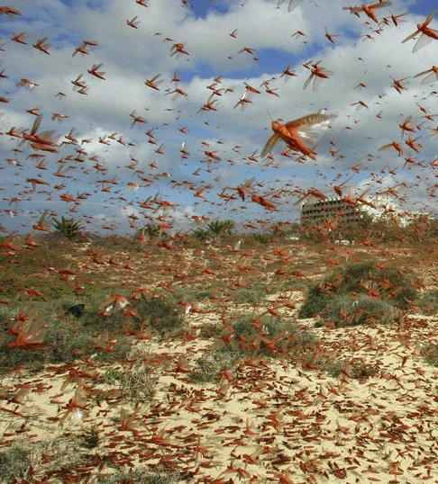
Locust plagues were one of the great natural disasters in the ancient world.
The native region of the locust is the Sudan, but at times the insects exhibit a strong, massive wandering instinct, crossing rivers and consuming all fresh vegetation they encounter.

Slide 5
Call to Repentance (1:13-20)
In view of the locust plague, Joel urges the apathetic citizens of Judah to repent!
The solution to the curses of covenant judgment is always repentance (Lv. 26:40-42; Dt. 30:1-10).
True national repentance should be led by the priests, ministers and elders.
Like Amos and Isaiah, Joel uses the term “Day of the LORD” to refer to the economic disaster.

Slide 6
Yahweh’s Army of Judgment (2:1-11)
What the nation had experienced in the locust invasion was only a harbinger of worse things to come!
The war trumpet, the shophar, was the signal for alarm and invasion.
To be sure, Joel’s language is hyperbolic (chariots leaping over mountains; the darkening of sun and moon), but the anguish of people in siege warfare is certainly real enough, with enemy soldiers scaling the fortification walls, fire devouring the cities, and soldiers charging into homes and looting the contents.
God was coming, not to deliver his people, but to judge them by invasion! Like Amos’ “prepare to meet your God”, Joel’s “the Day of the LORD is great…who can survive?” is a blunt warning!

Slide 7
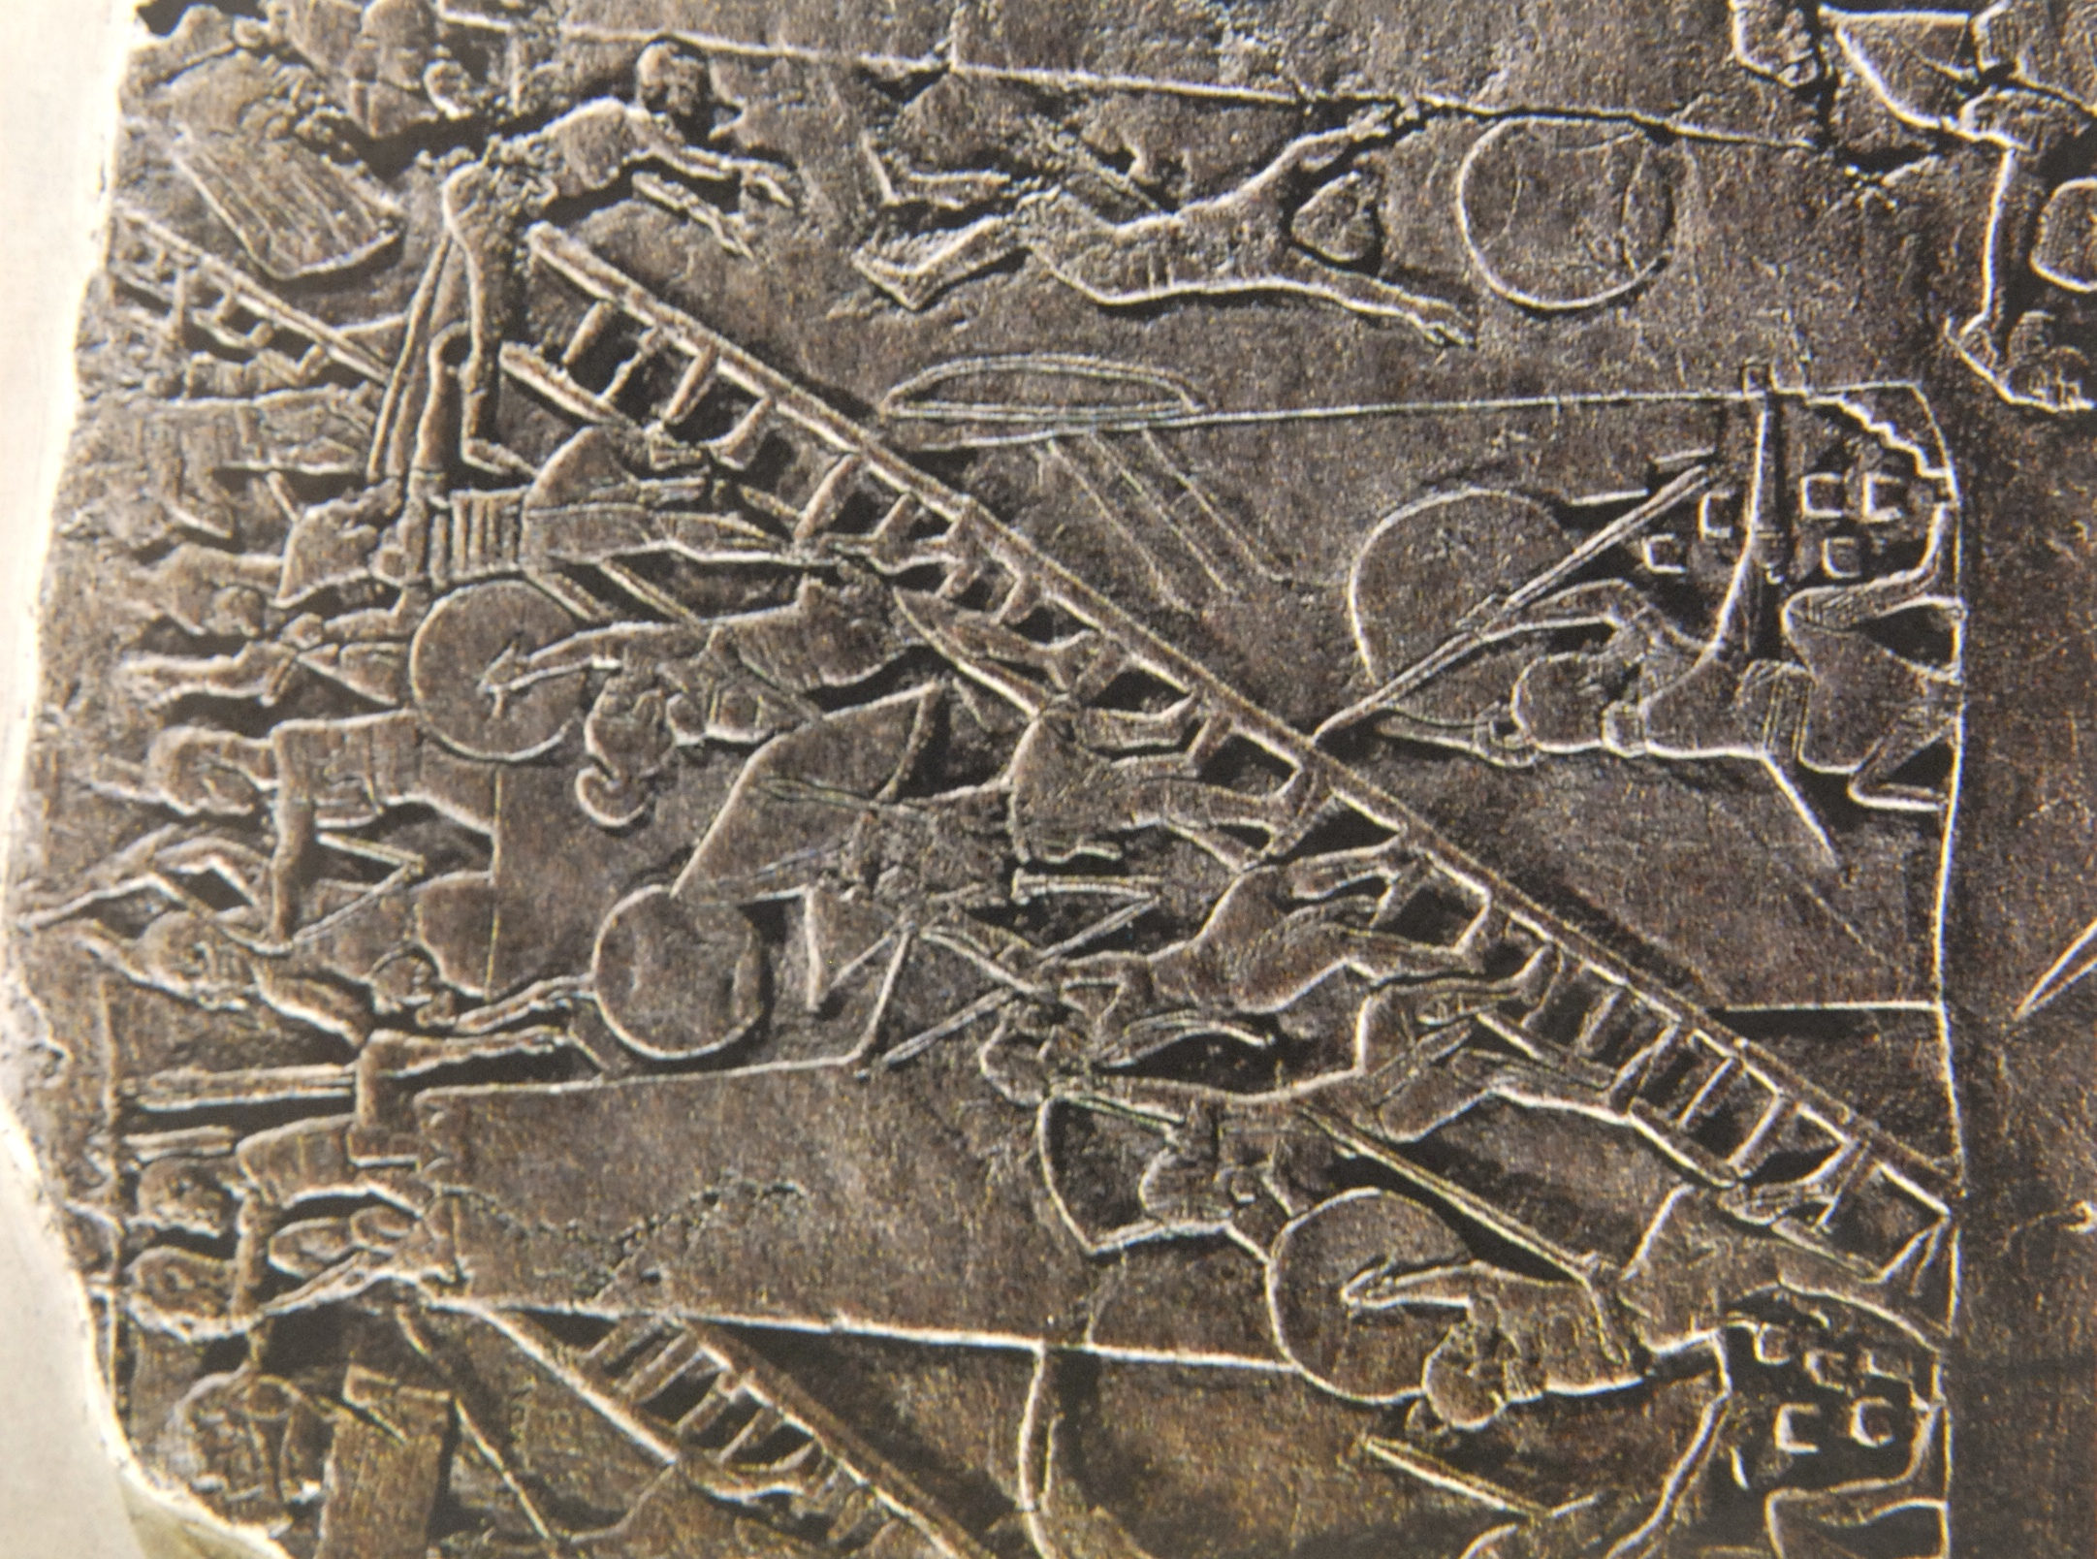
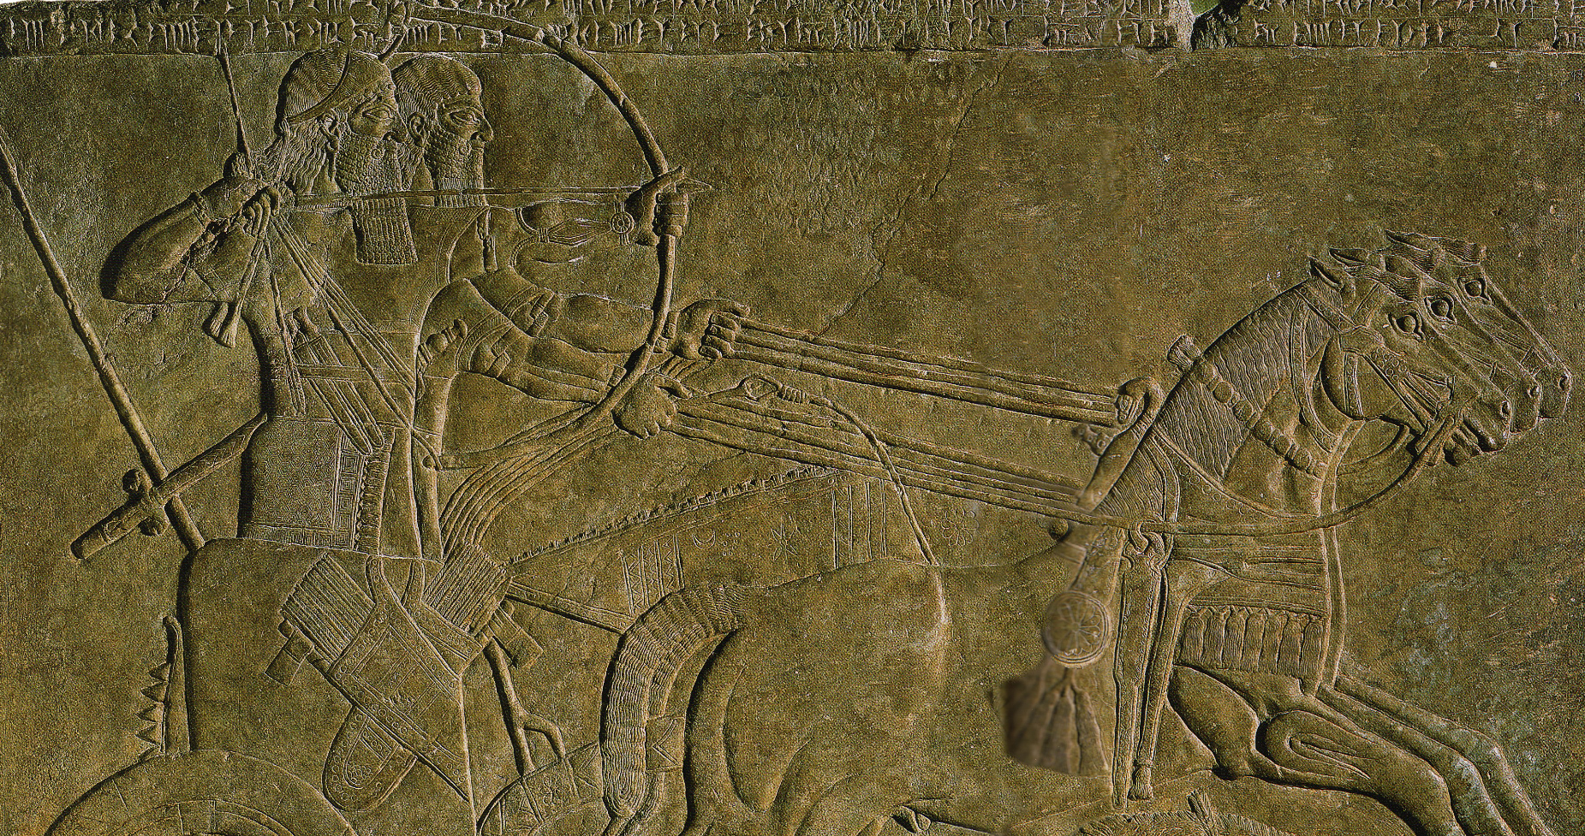
Assyrian Warfare
British Museum, London

Slide 8
Returning to Yahweh (2:12-17)
Like Amos (4:6b), Joel uses the verb bUw (shuv = to turn, return) to call Judah back to God with heart-searching repentance—rending their hearts, not merely their garments!
He quotes the language of Sinai that Yahweh is “compassionate and gracious, slow to anger, abounding in love” (Ex. 34:6-7).
The affirmation that Yahweh may announce disaster and then withhold it in view of repentance is not unique to Joel (cf. Je. 18:7-10), and it is cogently expressed in the Book of Common Prayer as: it is “God’s property always to have mercy”.
Intercession “between the porch and the altar” refers to the area between the vestibule of the temple, a roof over the entrance supported by two huge columns (cf. 1 Kg. 6:3; 7:21-22; 2 Chr. 3:15-17), and the altar for burnt offerings just outside the Holy Place. Here, the priests must represent the nation in prayer.

Slide 9
The Restoration (2:18-27)
If the Day of the LORD was an acronym for doomsday, it also was a bright promise of hope after judgment.
The blessings that had been withheld in judgment would be restored.
The northern invader would be vanquished, and the land would once more produce it proper crops.
In this restoration (2:23b), Yahweh would give the nation a “hr@Om (moreh) of righteousness”, a word that has two meanings: 1) teacher, and 2) early rain. This word has become an interpretive crux. Is it:
  A play on words, first meaning “teacher” and later meaning “early rain” (here, the moreh of righteousness would have a messianic connotation)
  A repeating element, both times meaning “early rain” as an indication of righteous blessing (most English Versions adopt this reading for contextual reasons)

Slide 10
Jewish Months
Nisan
Iyyar
Sivan
Tammuz
Ab
Elul
Tishri
Marchesvan
Chislev
Tebeth
Shebat
Adar
English Months
Mar-Apr
Apr-May
May-Jun
Jun-July
July-Aug
Aug-Sept
Sept-Oct
Oct-Nov
Nov-Dec
Dec-Jan
Jan-Feb
Feb-Mar
Seasons
Flax harvest
Spring rains
Barley Harvest
Dry season starts
Early figs ripen
Grape harvest
Early olives
Summer wheat
Dates
Summer figs
Early rain
Late olives
Winter figs
Plowing
Sowing
Latter rain/snow
Almond blossom
Citrus fruit
Festivals
Passover
Unleavened Bread
First fruits
Weeks (Pentecost)
Trumpets (Rosh Hashanah)
Atonement (Yom Kippur)
Booths (Succoth)
Dedication (Hanukkah)

Slide 11
The Gift of the Spirit (2:28-32)
Whatever the moreh of righteousness means, “after this” would come the blessing of the gift of the Spirit.
All people, both men and women, young and old, would be given the Spirit; hence, the Spirit would not simply be for a few chosen individuals, it would be for all God’s people (implicitly answering Moses’ desire, cf. Nu. 11:29).
The greatest blessing of all would be that “everyone who calls on the name of the LORD shall be saved”, a passage that many centuries later would carry great meaning for Peter at Pentecost, who would directly quote this passage from Joel (Ac. 2:16-21, 33).

Slide 12
Judgment and Salvation (3:1-16)
Alongside the blessing of the Spirit would come Yahweh’s judgment of the nations.
He would assemble them to a great assizes in the “Valley of Jehoshaphat” (not a known location in Israel but used here because of the meaning of the name, which is, “”Yahweh judges”).
The charge against the nations would be their treatment of the people of Judah by sending them into exile and engaging in slave-trading.
Pay-back was coming, and the nations may as well prepare for war.
To Yahweh, the assembly of defiant nations would be like a vineyard ready for harvest, the grapes ripe for crushing (cf. Is. 63:1-6)!

Slide 13
The Blessing of Salvation (3:17-21)
The people of Judah and Zion will be blessed with peace, while their perennial enemies, Egypt and Edom, will be deserted.
Again using hyperbolic language, Joel predicts that the mountains will “drip sweet wine” and the hills “overflow with milk”.
The theme of God’s dwelling-place in Zion, the ancient site of the temple, is reaffirmed in the final line of the book: “the LORD dwells in Zion!”
It is the same language used by John in the Revelation: “the dwelling of God is with men, and he will live with them. They will be his people, and God himself will be with them and be their God” (Rv. 21:3).

