Slide 1
POST-EXILIC WEEK
Ezra, Nehemiah, esther, haggai, zechariah, malachi, intertestament

Slide 2
A Remnant Will Survive
8th Century Prophets
SOUTHERN NATION
“I will surely gather all of you…the remnant of Israel” (Mic. 2:12a)
“’In that day,’ declares Yahweh, ‘I will assemble the exiles…’ Yahweh will rule over them in Mount Zion from that day and forever.” (Mic. 4:6-7)
“In that day Yahweh Tsabaoth will be a glorious crown…for the remnant of his people” (Is. 28:5)
“In that day Adonay will reach out his hand a second time to reclaim the remnant… He will assemble the scattered people of Judah from the four quarters of the earth.” (Is. 11:11-12)
NORTHERN NATION
“I will bring back my exiled people Israel…” (Am. 9:14a)
“I will plant Israel in their own land never again to be uprooted from the land…” (Am. 9:15)
“The Israelites will live many days without king or prince…afterward they will return…” (Ho. 3:4-5)
“I will plant her for myself in the land… (Ho. 2:23)

Slide 3
I Will Bring You Back
7th and 6th Century Prophets
I will…gather those who have been scattered. At that time I will gather you; at that time I will bring you home. (Zep. 3:19-20)
I myself will gather the remnant of my flock out of all the countries where I have driven them… (Je. 23:3)
I will forgive the remnant I spare. (Je. 50:20)
When seventy years are completed… I will…bring you back to the place from which I carried you into exile. (Je. 29:10-14)
I will gather you from the nations…where you have been scattered, and I will give you back the land of Israel again. (Eze. 11:17)
In the first year of Darius…I, Daniel, understood from the Scriptures…that the desolation of Jerusalem would last seventy years. (Da. 9:1-3)

Slide 4
From Babylon to Persia
While Nabonidus was conducting campaigns in Arabia and his son Belshazzar was overseeing the capital, the Persian army under Cyrus was annexing Babylonian cities in the east.
Babylon itself was seized on October 12, 539 BC, and Cyrus was welcomed into the city as a liberator.
In the first year after Babylon’s conquest, Cyrus issued an edict of repatriation allowing displaced peoples in his regime to return to their homelands in order to rebuild their sacred temples—a form of enlightened self-interest.
This edict was a direct fulfillment of Jeremiah’s prophetic oracles (1:1; cf. Je 25:12-13; 29:10-14; 32:13-15, 42-44).
Cyrus also was directly referenced by name in the Book of Isaiah (Is. 44:28; 45:1).

Slide 5
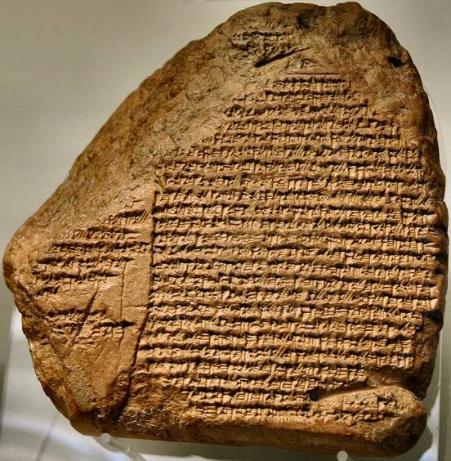
Nabonidus Chronicle
(British Museum, London)
“The 14th day, Sippar (city to the northwest of Babylon) was seized without battle. Nabonidus fled. The 16th day…the army of Cyrus entered Babylon without battle. Afterwards Nabonidus was arrested in
Babylon when he returned [there]. …in the month of Arahshamnu, the 3rd day, Cyrus entered Babylon, green twigs were spread in front of him—the state of ‘Peace’ was imposed upon the city. Cyrus sent greetings to all Babylon.”

Slide 6
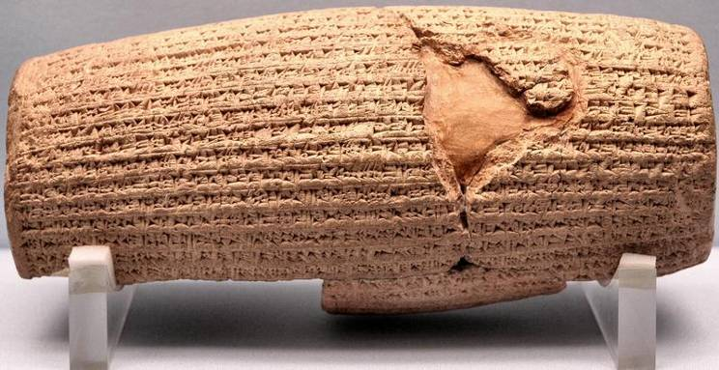
Cyrus Cylinder 539-8 BC
“I returned to these sacred cities on the other side of the Tigris, the sanctuaries of which have been in ruins for a long time, the images which used to live therein and established for them permanent sanctuaries. I also gathered all their former inhabitants and returned to them their habitations.”
British Museum, London

Slide 7
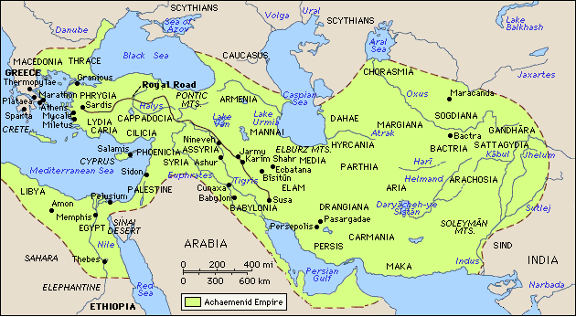
The Archaemenid Empire (Persia) at its greatest extent under Darius III.

Slide 8
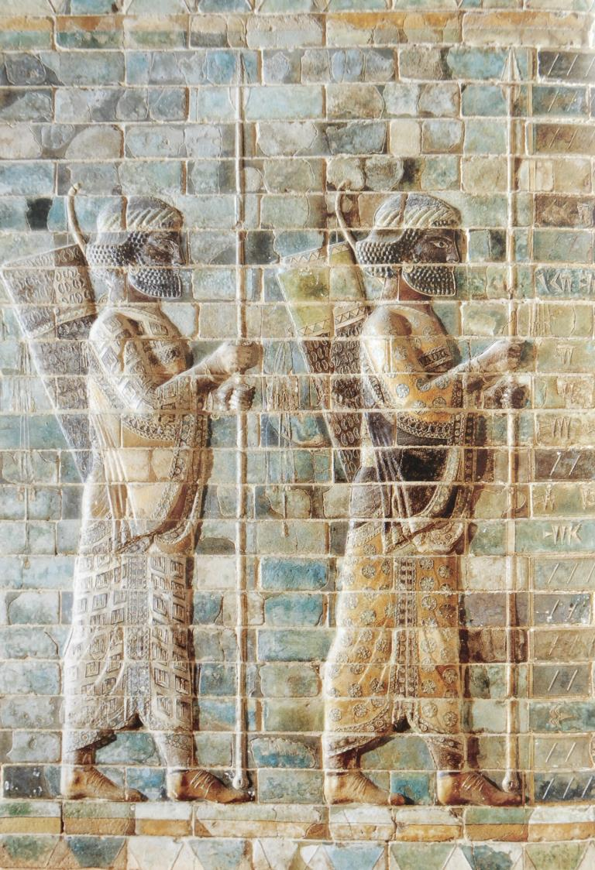
Ezra
The Road Home
Persian archers
Achaemenid Dynasty, Susa
Louvre, Paris

Slide 9
Biblical Languages
The original text of Ezra-Nehemiah comes to us in two ancient languages:
Hebrew
(language of ancient Israel)
All except the small sections in Aramaic
Aramaic
(international language of the ancient Near East)
The sections of Ezra 4:7—6:18; 7:12-16
The Aramaic sections are largely official correspondences between provincial officials and the Persian government as well as between the Persian government and the returned exiles. Aramaic had become the official language of trade and diplomacy.

Slide 10
Ezra-Nehemiah completes the history begun in 1 & 2 Chronicles.
It details the return of the exiles to Jerusalem.
It narrates their efforts to build the second temple.
It describes their renewal of the Mosaic covenant.
It tells of the reconstruction of Jerusalem’s walls.
In particular, the Ezra-Nehemiah books describe the theological restoration of the nation after exile. The national center would no longer be the monarchy, but the temple and the Torah.

Slide 11
Structure
EZRA NEHEMIAH
Return of exiles with Sheshbazzar and Zerubbabel (1-2)
Restoration of worship and the building of the second temple (3-6)
  Building the great altar and laying the temple foundation (3:1-13)
  Opposition to the temple (4:1-24)
  The temple is completed (5:1—6:22)
Return of exiles with Ezra (7-10)
  Ezra’s commission (7:1-26)
  Ezra’s Memoirs (7:27—9:15)
  The end of mixed marriages (10:1-44)
Restoration of the walls (1-7)
  Coming of Nehemiah (1-2)
  Rebuilding begins in the midst of opposition (3-4)
  The wall is completed (5-7)
Final Reforms (8-13)
  The assembly in the 7th month (8-10)
  Repopulating Jerusalem (11:1—12:26)
  Nehemiah’s Memoirs (12:27—13:31)
    Wall dedication (12:27-43)
    Final reforms (12:44-13:31)

Slide 12
THE GLORY (dObKA) TO RETURN
THE GLORY OF YAHWEH VACATED THE TEMPLE PRIOR TO ITS DESTRUCTION.
(Eze. 10:3-5, 18-19; 11:22-24)
YAHWEH PROMISED TO RETURN TO DWELL AMONG HIS PEOPLE FOREVER IN A NEW TEMPLE.
He ordained that the new temple would be “the place of my throne and the place for the soles of my feet. This is where I will live among the Israelites forever.” (Eze. 43:6-7) The final word of Ezekiel was that “Yahweh was there! (48:35).

Slide 13
Those who returned with Sheshbazzar would have done so with this vision in mind!
Ezekiel’s prediction of a new temple was recorded precisely so that a future generation might “be faithful to its design and follow all its regulations” (Eze. 43:11-12).
During his prophetic ministry, Ezekiel was well-known among the exiles in Babylon, so it is hardly to be doubted that those who returned with the permission of Cyrus believed their mission had a spiritual mandate.
Hence, the list of the initial returning party was of “everyone whose heart God had moved…to go up to build the house of the LORD in Jerusalem” (Ezra 1:5b).

Slide 14
Cyrus’ Edict appears in Ezra in two forms.
The Hebrew form is probably the one heralded within the Jewish communities (Ezra 1:2-4).
The Aramaic form is probably the official statement as recorded in the Persian archives (Ezra 6:3-5).
Cyrus also consigned to the Jews the temple vessels that had been plundered by Nebuchadnezzar (1:7-11; cf. 2 Kg. 25:13-14//2 Chr. 36:1) and desecrated by Belshazzar (Da. 5:2-4).
As had happened long ago in Egypt, the Jews also were assisted by all sorts of gifts from the natives of Babylon (1:6; cf. Ex. 11:2-3; 12:35-36).

Slide 15
Leaders of the Returning Jews
Sheshbazzar (governor) initial return
Zerubbabel (governor)
Joshua (priest)
Haggai (prophet)
Zechariah (prophet)
Ezra (priest & scribe) spiritual reform
Nehemiah (governor) rebuilding walls
Rebuilding the temple

Slide 16
The Registration List
The Leaders:
To the eleven names in Ezra should be added the name Nahamani, who is listed in Nehemiah 7:7 and 1 Esdras 5:8.
Together, these twelve leaders probably symbolized the traditional number of the clans of Israel.
The names Nehemiah and Mordecai are unlikely to refer to either Nehemiah the governor, who would come later, or the uncle of Esther.

Slide 17
The Registration List cont.--
The Pure Israelites:
Those with verifiable genealogies (2:3-20)
Those with clear ancestral roots in an Israelite town (2:21-35)
Those with a clear connection to the first temple (i.e., priests, Levites, singers, gatekeepers or temple servants, 2:36-58).
Those With Unclear Status: These claimants were not excluded outright, but they were given probationary acceptance until their claim could be validated by the use of Urim and Thummim.
Those with unsubstantiated genealogical claims (2:59-60)
Those with unvalidated claims of priesthood (2:61-63)

Slide 18
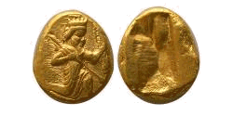
Gifts for the Temple
The gifts for the temple (2:69) were offered in both coins (Persian Darics), weights (minas) and garments.
This is the earliest biblical reference to coinage, which became a medium of exchange beginning in about the mid-6th century BC by King Croesus of Sardis, Asia Minor. The Persians learned about coinage and adopted the practice during the spread of their empire into Asia Minor, which is why some of the returning exiles paid their gifts in coins.
Golden Daric introduced in Persia by Darius I (522-486 BC)

Slide 19
“When the LORD brought back those who returned to Zion, we were like those who dream. Then our mouth was filled with laughter, and our tongues with shouts of joy.”
Psalm 126:1-2a
In all, about 50,000 people returned from Babylon to Jerusalem (2:64-65).
The numerical tally in Ezra differs from the one in Nehemiah 7:8-65. Presumably, these discrepancies are due to scribal transmission errors.
The wealthy (and since slaves numbered about one out of every six, many families apparently were wealthy indeed!) gave substantial gifts for the rebuilding project (2:68-69).

Slide 20
Discussion Questions:
Why do you think that God allowed the ark of the covenant to disappear altogether?
How was the return from Babylon like a second exodus?

Slide 21
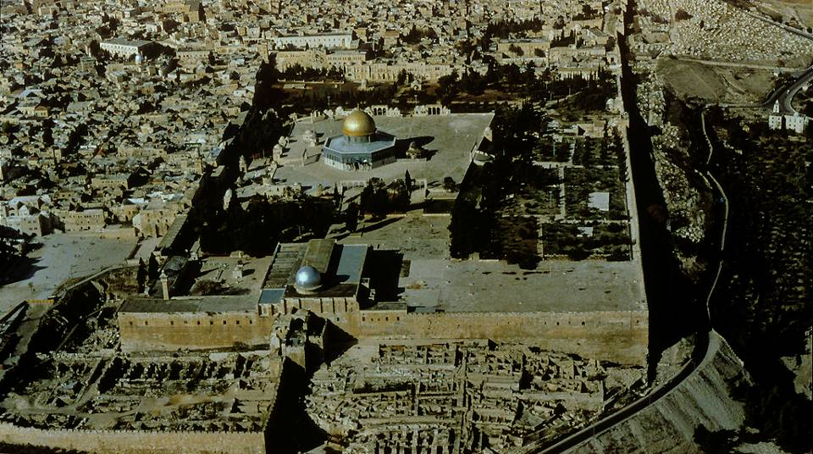
The Temple Mount (facing northward)
The site for the second temple was the same as for the first temple. Mt. Zion (also called Mt. Moriah, cf. 2 Chr. 3:1) was the site David purchased for the first temple (1 Chr. 21-22).
Approximate location of the 1st and 2nd temples
73

Slide 22
The Project Begins (3)
Reconstruction began during the festivals of the 7th month:
Ritual blowing of trumpets (Lv. 23:24-25; Nu. 29:1-6); later, Rosh ha-shanah (the New Year) would also fall on this date.
Day of Atonement (Lv. 23:26-32; Nu. 29:7-11)
Feast of Tabernacles (Lv. 23:33-36; Nu. 29:12-40)
If Rosh ha-Shanah was being celebrated as the New Year by this time (which is debated), then the project began in the same month (though not the same year) that Ezekiel saw his vision of the new temple (Eze. 40:1).

Slide 23
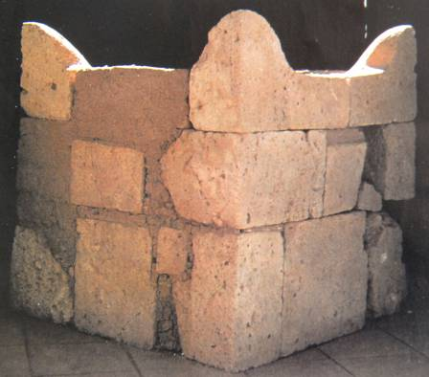
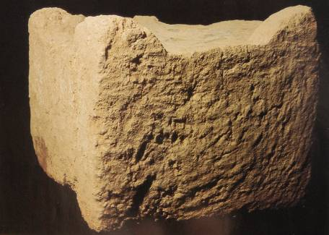
Construction of the Great Altar while the details of the great altar are unknown to us, presumably it looked similar to other altars that have been excavated in Israel
Four horned altar excavated at Dan, ca. 9th century BC
Four horned altar excavated at Beersheba, ca. 8th century BC

Slide 24
The Sacrificial System Resumes
The reinstatement of the Tami’d (daily sacrifice) would have reestablished continuity with the past (3:3; cf. Ex. 29:38-46).
The sacrifices associated with the annual festivals as well as the new moons would have reinforced this historical link (3:4-6).
Materials for the temple construction were stockpiled (3:7).
The foundation for the second temple was laid in the second year (i.e., 536 BC) of their return (3:8-9).
At its completion, a grand celebration was staged with priests, choirs and orchestras, just as David had prescribed for the first temple (3:10-11; 1 Chr. 16, 23-26; 2 Chr. 5:13).
The laying of the foundation was cause for both joy and disappointment (3:12-13; cf. Hg. 2:3).

Slide 25
Structure of Ezra 4
Parenthetical summary of later oppositions*
Accusation to Xerxes (4:6)
486 BC
--------------------------
Stop Order from Artaxerxes (4:7-23)
464-445 BC
4:1-5
Initial Resistance (work suspended)
536 BC
4:24—5:1
Work on the temple resumes
520 BC
* It is critically important for the reader to realize that the narrative about the temple’s reconstruction moves directly from 4:5 to 4:24. One should NOT read 4:24 as though it were linked to what is described in 4:23!

Slide 26
Chronology
539 BC (Cyrus’ Edict of Repatriation)
538 BC (Jews return to Jerusalem)
537 BC (Great altar is constructed)
536 BC (Temple work begins, cf. Ezra 3:8)
----------------------------------------------------
Work Suspended (Ezra 4:24a)
550-529 BC (Reign of Cyrus)
529-523 BC (Reign of Cambyses)
522-486 BC (Reign of Darius I)
---------------------------------------------------
520 BC (Work resumed, cf. Ezra 4:24b;
Hg. 1:1)

Slide 27
Discouragement and Malaise
The sixteen year hiatus between 4:5 and 4:24 was brutal:
Series of drought and crop failures (cf. Hg. 1:6, 9-11; 2:15-17, 19)
A “day of small things” (cf. Zec. 4:10)
A time of disillusionment (cf. Hg. 1:1)
Continuous antagonism from local opposition (Ezra 4:4-5)

Slide 28
Discussion Questions:
How is discouragement a spiritual battle?
Discouragement can be paralyzing. How can one win the spiritual battle against discouragement?
What can one do to help someone else who is discouraged?

Slide 29
The Work is Resumed
With the support of Haggai and Zechariah, Zerubbabel, Joshua and the people resumed the work in the 2nd regnal year of Darius I (4:24—5:2).
They still contended with opposition (5:3—6:5), and an archival search of Cyrus’ permission document had to be found to validate the work (the name of Sheshbazzar was critical for this search, since his name would have appeared on the original list as the leader).
When a record of the original decree of Cyrus was discovered in
Ecbatana (where Cyrus spent his first regnal year), Darius not only forbade interference with the work (6:6-7), he also ordered the governor of the Trans-Euphrates Province to pay for construction expenses as well as provide sacrificial animals (6:8-12).

Slide 30
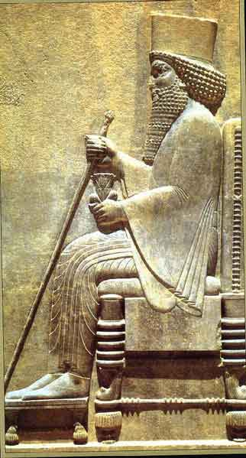
Darius I (the Great)
522-486 BC
In his second regnal year, he researched the royal archives for Cyrus’ decree, and when it was discovered, he authorized the returning Jews to continue their work of rebuilding the second temple.
86

Slide 31
Completion!
The work continued steadily until the second temple was completed in 516 BC (6:14-15):
The new edifice was dedicated, and the priests were installed in office for temple service (6:16-18).
The offering of the 12 male goats “according to the tribes of Israel” indicates the people’s desire to maintain continuity with their covenant history, even though the northern nation was gone forever (6:17).
It had been 70 years (586 BC to 516 BC) since the destruction of the first temple, the exact time specified by Jeremiah (25:12-13; 29:10-14).
The project was completed in Adar, the last month of the year, and the Passover was celebrated in the first month of 515 BC (6:19-22).

Slide 32
Half a Century Later
The words “after this” (7:1a) belie the fact that more than half a century had passed since the completion of the temple.
The temple was completed in 516 BC.
The seventh regnal year of Artaxerxes I Longimanus (464-424 BC) takes the reader down to 458 BC (7:8).
The early leaders, Zerubbabel and Joshua, plus the prophets Haggai and Zechariah, were now gone, presumably by death.
If the oracles of Malachi are any indication (usually taken to be about 450 BC), then the community had fallen into a state of spiritual malaise, disillusionment, cynicism and hostility toward God (Mal. 1:2, 6-7, 13-14; 2:11, 13-14, 17; 3:5, 8-9, 13-14).

Slide 33
Ezra Comes to Jerusalem
Ezra, a priest with an impeccable pedigree (7:1-5), gained permission to lead another group from Babylon on the four month trek to Jerusalem (7:6-9).
Ezra exemplified the ideal of the teaching priest (7:6, 9b-11; cf. Lv. 10:11; Dt. 33:8-10; 2 Chr. 15:3; 31:4; Mal. 2:7).
Ezra was armed with an official letter of authority (in Aramaic) from Artaxerxes that stipulated:
  Permission to go with as many as wanted to accompany him (7:13)
  A state grant for sacrifices (7:15-17; 8:24-30)
  A writ to the governor of the Trans-Euphrates Province for supplies (7:21-23)
  An exemption from taxes (7:24)
  Authority to set up a judicial system and to appoint civil magistrates for enforcement (7:25-26)

Slide 34
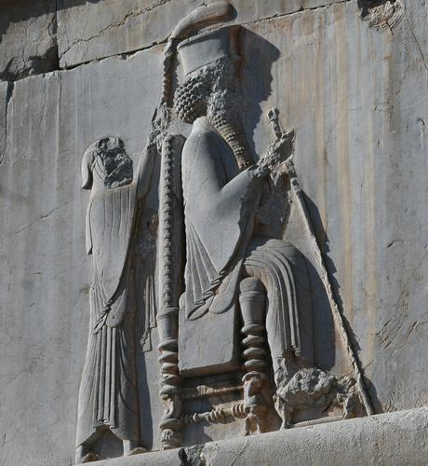
Artaxerxes I
Persepolis from the Hall of 100 Columns showing the king with a servant behind him wielding a fly whisk

Slide 35
The repeating refrain…
“…the gracious hand of our God was upon us!”
(7:6, 9, 28; 8:18, 22, 31)

Slide 36
Organizing the Returning Group
The register of families in Ezra’s group must have been closely connected with families who already had gone to Jerusalem, since the family names are nearly identical (8:1-14; cf. 2:3-15; 1 Esdras 8:28-40).
While checking the list of expedition members, Ezra discovered there were no Levites present (8:15).
Hence, Ezra took the extra time to recruit Levites, and more than 200 volunteers responded (8:16-20).
As a sign of trust in God, Ezra did not ask for a military escort (8:21-23).
After a successful trip, they offered sacrifices of thanksgiving to God in Jerusalem (8:31-36).

Slide 37
The Scandal of Mixed Marriages
Ezra’s mission was to teach the Torah (7:10), and soon his teaching ministry began to produce a deep moral response.
At issue was the Torah’s requirement for racial purity in marriage (Ex. 34:11-16; Dt.7:1-6).
The issue was not purely ethnic, but religious (proselyte marriage was acceptable, e.g. Ruth).
The initial response came from the community leaders, who reported that the people, priests and Levites all had participated in the sin of intermarriage (9:1-2).
If Malachi’s oracles addressing the situation are relevant (and presumably they are), then some Jewish men had divorced their Jewish wives in order to marry non-Jewish women (Mal. 2:11-16).

Slide 38
Ezra accepted solidarity with his own people, publicly confessing their covenant violations (note the first person plurals in his prayer, 9:6-15).
This violation endangered the entire remnant community (9:14-15).
Ezra’s public confession drew a crowd, and one of the family leaders who had returned with Ezra (10:2; 8:5, 7) encouraged Ezra to take leadership in making amends (10:1-4).
A solemn public gathering was mandated in front of the recently completed temple. Even though it was raining (10:9), at Ezra’s prompting they agreed to divorce their foreign wives and offer sacrifices for their sins (10:9-44), which would have included writing certificates of divorce (cf. Dt. 24:1-4).

Slide 39
Nehemiah
The Road Home
Persian archers
Achaemenid Dynasty, Susa
Louvre, Paris

Slide 40
The Prelude
The renewal precipitated by the coming of Ezra carries on into the Book of Nehemiah.
Though the neighboring peoples had been compelled to allow the temple reconstruction, they continued in their attempts to harass the Jews.
Around the time of the Ezra’s arrival, the Jews had begun to rebuild Jerusalem’s walls (Ezr. 4:12).
Due to a letter of protest from the locals to Artaxerxes (Ezr. 4:8-16), all work on the walls was forced to stop (Ezr. 4:17-23).
Hanani, a Jew who traveled from Jerusalem to Persia, reported to Nehemiah that the walls still were broken down and the gates had been burned (Ne 1:3). This description may well refer not merely to what the Babylonians had done in 587-6 BC, but what the local officials had done in their zeal to enforce Artaxerxes’ stop order.
This report came in about 445 BC (Artaxerxes 20th regnal year, cf. Ne. 2:1).

Slide 41
The Jews & the Rulers of Persia
Decree to Return
539 BC
550-529 BC (Reign of Cyrus)
529-523 BC (Reign of Cambyses)
522-486 BC (Reign of Darius I)
486-465 BC (Reign of Xerxes)
465-425 BC (Reign of Artaxerxes I)
423-404 BC (Reign of Darius II)
404-359 BC (Reign of Artaxerxes II)
359-338 BC (Reign of Artaxerxes III)
336-330 BC (Reign of Darius III)
Temple is Completed
516 BC
Ezra Returns
458 BC
Nehemiah Returns
445 BC

Slide 42
Nehemiah, the Man
Nehemiah was deeply distressed at the report:
With a prayer of confession and a plea for God’s help, he determined he should do something (1:4-11).
His occupation was that of a trusted officer of high rank—a cupbearer to Artaxerxes himself (1:11b). (His duties would have consisted of tasting and serving wine to the king, and due to the possibility of plots against the king’s life, especially by poison, he necessarily had to be completely trustworthy.)
Four months later, he had opportunity to express his concerns to his master (2:1).

Slide 43
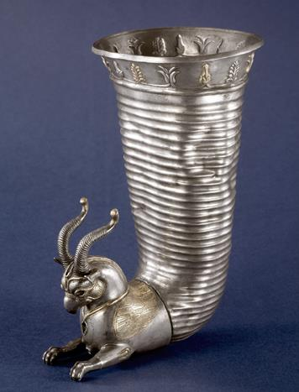
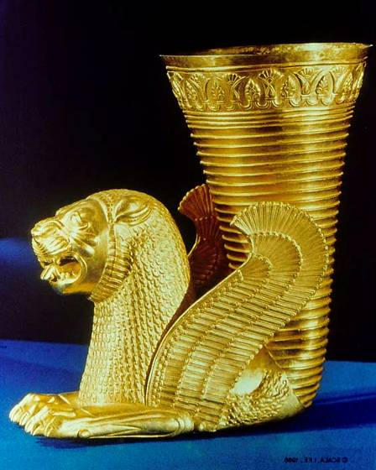
Silver and gold Persian Rhytons (drinking vessels) from the 5th-4th centuries demonstrate the luxury of ancient Persia
British Museum Tehran National Museum
106

Slide 44
Nehemiah is Permitted to Return
Personal feelings were usually shielded from high officials (cf. Pr. 16:14), but Nehemiah was unable to restrain his depression (2:1-2).
He was courageous enough to request a reversal of the stop order against reconstruction, and he offered to oversee the project himself to allay any suspicion (2:3-5).
Artaxerxes’ trust in Nehemiah was evident in that he agreed to reverse the stop order and issued official documents authorizing Nehemiah to return under army security (2:6-7) and to cut timber for gate reconstruction (2:8).
Not surprisingly, the Trans-Euphrates officials were chagrined at this turn of events (2:9-10).

Slide 45
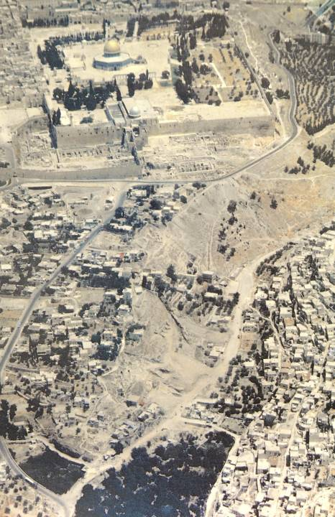
If the conjectures by archaeologists Aharoni and Avi-Yonah in the preceding map are correct, then some of Nehemiah’s locations can be approximated.
Valley Gate (if for the Tyropoeon Valley)
Dung Gate
Fountain Gate
King’s Pool (if Siloam; if otherwise, location is unknown)
The Valley (if the Kidron Valley)

Slide 46
Nehemiah Confronts the Post-exilic Community (2:17-20)
After his inspection tour by horse and by foot, Nehemiah confronted the officials of Jerusalem about their dilemma:
He challenged them to begin reconstruction of the city walls.
He explained to them his authorization from Artaxerxes.
The rebuilding intentions immediately were opposed by the Trans-Euphrates officials to the north, east and south. Jerusalem, clearly, was surrounded by hostile parties.

Slide 47
Discussion Questions:
What lessons are to be learned from Nehemiah’s response to the disturbing news from Jerusalem and how he addressed it?
What is the significance of Nehemiah’s prayer? What did he include in his prayer, and how might this be helpful for the way we pray?
The Bible is clear that Nehemiah was “very much afraid” (2:2b). How should believers conquer their own fears?
What wisdom do you see in how Nehemiah approached the remnant in Jerusalem about their dilemma?

Slide 48
The Wall-Building Begins
(3:1—4:23)
Reconstruction of Jerusalem’s gates and walls are narrated in a counter-clockwise circuit, various families signing on for the adjoining sections (3:1, 32).
Gates controlled traffic in and out of a fortified city. Usually, they were flanked by towers so defenders could use archers to protect against any attempt to breach the gates in time of war.
While the Trans-Euphrates officials could hardly oppose Nehemiah with force, since he had authorization from Artaxerxes plus was backed by a detachment of the army (cf. 2:9), they set about to discourage the reconstruction through ridicule and intimidation (4:1-3).

Slide 49
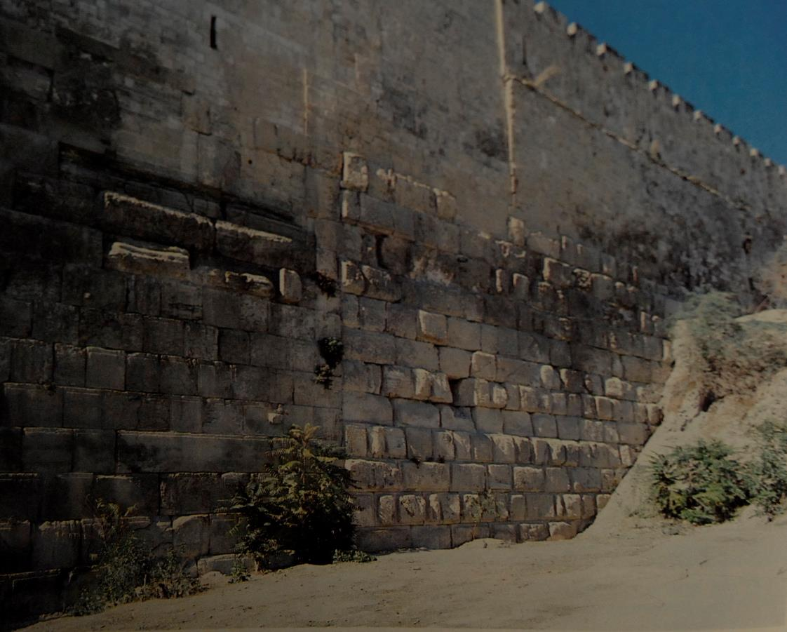
Straight joint in Jerusalem’s eastern wall about 105’ north of the southern end of the wall.
This vertical seam with differing masonry on each side probably depicts two different eras. To the left of the seam is clearly Herodian masonry. To the right of the seam is masonry from an earlier period, possibly Nehemiah’s time, according to Kathleen Kenyon.

Slide 50
Daniel’s vision that the city would be “rebuilt…in times of trouble” certainly proved accurate!
(4:7-8, 11-12; cf. Da. 9:25)
The work continued, fortified by prayer (4:4-5, 9a).
In addition, Nehemiah posted guards (4:9b, 13, 16-18, 22-23).
Trumpeters with signals were stationed to sound the alarm if attacked (4:18b-20).
Everyone worked with his weapon at his side (4:16-18).

Slide 51
The Internal Problem (5)
The daily toil on the walls meant that the normal activities of farming and trade were suspended.
This redirection of labor took its toll in loss of income and basic staples (5:1-2).
Some families were obliged to use their farms as security for loans (5:3), and the threat of foreclosure and the requirement to pay Persian taxes (5:4) put whole families at risk.
Some, in dire straits, already had sold their children into debt slavery (5:5; cf. Ex. 21:1-11; Lv. 25:39-43; Dt. 15:12-18).

Slide 52
Nehemiah’s solution was that the more wealthy should take the lead in relieving this distress.
In a general meeting (5:5-6), he chastised the wealthy, since they were taking advantage of their fellow Jews, just like the pagans did, by negotiating harsh terms of repayment (5:7-8). (The 100th part in 5:11 possibly refers to monthly interest, hence, 12% annually.)
Nehemiah demanded that interest and foreclosure be suspended, which was no more than the Torah required (5:9-11; cf. Ex. 22:25; Lv. 25:35-38; Dt. 23:19-20).
On oath, the leaders agreed to follow this course of action, and Nehemiah conferred a curse on any violators (5:12-13).

Slide 53
Nehemiah’s leadership is evident in that he refused to accept the allotment of food and taxes the Persian government permitted him to levy (5:14-16).
Unlike the prior governors, he suspended this levy for a dozen years, even though it meant that his personal expenses to support his staff were enormous (5:17-19)!
He resolutely refused to engage in mortgage foreclosures (5:16b).

Slide 54
Completion of the Wall (6)
By now the gaps in the wall had been closed, though the gates were not yet installed (6:1).
In yet another effort to retard their efforts, the leaders from the Samaritan, Ammonite and Arab communities repeatedly invited Nehemiah to meet with them at an outside location (6:1-4). The danger, of course, was assassination!
When Nehemiah refused, they threatened a report to Artaxerxes that Nehemiah was planning a revolt (6:5-7). The fact that this “rumor” was sent in an unsealed letter meant that the contents would then be generally known, and presumably, reported to Artaxerxes.
Nehemiah refused to be intimidated (6:8-9), even though they hired a false prophet to discourage him with threats on his life (6:10-13).

Slide 55
Nehemiah’s Prayers
Short versions of Nehemiah’s prayers yield insight into his struggles to complete the wall:
Repentance in behalf of his people (1:5-11)
Petition for success in approaching Artaxerxes (2:4b)
Imprecatory curse upon Sanballat and Tobiah for their insults and discouragement (4:4-5)
Prayer when posting the guards (4:9)
Plea for God to remember his generosity to the people (5:19)
Plea for strength to finish the work (6:9b)
Prayer against his intimidators (6:14)

Slide 56
The wall finally was completed at the end of 52 days (6:15-16).
The work had gone on despite continual harassment from local antagonists who attempted to foil the progress through contacts even within the Jewish community (6:17-19).
The term “oath” (6:18) probably refers to trade agreements, and on the basis of such trade agreements as well as intermarriage between children of Jewish nobility and children of (non-Jewish) locals, the intimidation had continued without reprieve.

Slide 57
Hanging of the Gates (7:1-4)
When the gates were set in place, gatekeepers were appointed and a schedule was set for opening and closing them.
Jerusalem was now secure!
Most Jews, however, lived outside the city walls, since prior to the gate reconstruction there would have been little advantage in rebuilding within the city proper, plus they would have been at a distance from their farming plots.
Hence, the city was large, but the population sparse (7:4).

Slide 58
The Registration (7:4-73)
If Jerusalem was to be populated by Jews, as had been the concern all along, it was important for residents to be able to prove that they were properly Jewish.
The registration was based on the genealogical records of the returning remnant (7:5-7).
Though now almost a hundred years old, the record listed here (7:7-63) is nearly identical to the one given earlier (Ezra 2:2-70). Minor differences are usually believed to be transcription problems.

Slide 59
Discussion Questions:
The rebuilding of the walls was an exercise in community cooperation. What factors brought the community together?
Nehemiah led the more affluent in relieving the distress of those less advantaged. Is there a counterpart for Christians?

Slide 60
The Festivals of the Seventh Month
Memorial Blowing of Trumpets (Lv. 23:23-25; Nu. 29:1-6)
A Sabbath and solemn assembly
Beginning of the Jewish civil year (Rosh Hashanah)
Public reading of the Torah (in the post-exilic period)
Yom Kippur (Ex. 30:9-10; Lv. 16:1-34; 23:26-32; Nu. 29:7-11)
National atonement for the people of Israel
High priest enters the Most Holy Place three times (to offer incense, to offer blood for himself, to offer blood for the people)
Goat for Azazel ritual
Feast of Succoth/Booths (Ex. 23:16-17; Lv. 23:33-44; Dt. 16:13-17)
An eight-day celebration of the wilderness sojourn and survival
Regular daily offerings
Completion of the harvest season

Slide 61
Ezra Reads the Torah (8:1-8)
The text from 8:1—12:26 shifts from the 1st person to the 3rd person
The public reading was for “those who could understand” (i.e., the reading was in Hebrew, but not everyone could understand Hebrew):
For those who could not understand (i.e., the Aramaic speaking community), the Levites assisted with explanations, either by “translating” (so JB, GNB) or “giving the sense” (ESV, RSV, NIV, NASB). This is the first biblical description of Scripture translation.
The public reading was conducted from a Cfe-lDag;mi (= tower of wood), which probably refers to either a pulpit (so KJV, RSV, NASB, ASV) or a platform (so NIV, NEB, ESV, NAB).

Slide 62
Celebrating the Festival of Booths (8:9-18)
The second day’s reading brought them to one of the passages about the Festival of Booths (presumably Lv. 23:40-43):
Initially, the Torah reading created agitation, probably because the people realized for the first time how much they had violated the covenant (cf. 9:1-2).
Nehemiah, Ezra and the Levites encouraged the people not to grieve, but to rejoice and celebrate.
They built booths, as the Torah stipulated, and rejoiced for the seven days of the festival.
Each day, Ezra continued to publicly read from the Torah.

Slide 63
The Confession of Sin (9:1-37)
After the Festival of Booths, the assembly began to formally express their penitence for their national sins.
They divided the day, listening to readings from the Torah for the first half of daylight hours and confessing their sins and worshipping for the second half.
Two groups of Levites assisted the assembly in congregational responses, one group leading in confessions and the other in praises—reminiscent of the ancient ceremony of blessings and curses (cf. Dt. 27:12-14; Jos. 8:30-35).

Slide 64
Covenant Renewal
(9:38—10:39)
The climax was a binding covenant-renewal ceremony in which the leaders, priests and Levites fixed their seals to a written document.
They put themselves under oath to obey the Torah (10:28-29).
They promised to be racially pure (10:30).
They promised to keep the Sabbath (10:31).
They promised to provide gifts for the temple (10:32-33).
They promised to bring wood for sacrificial fires (10:34).
They promised to fulfill their obligation for first-fruit offerings (10:35).
They promised to dedicate their first born (10:36).
They promised to pay tithes (10:37-39).

Slide 65
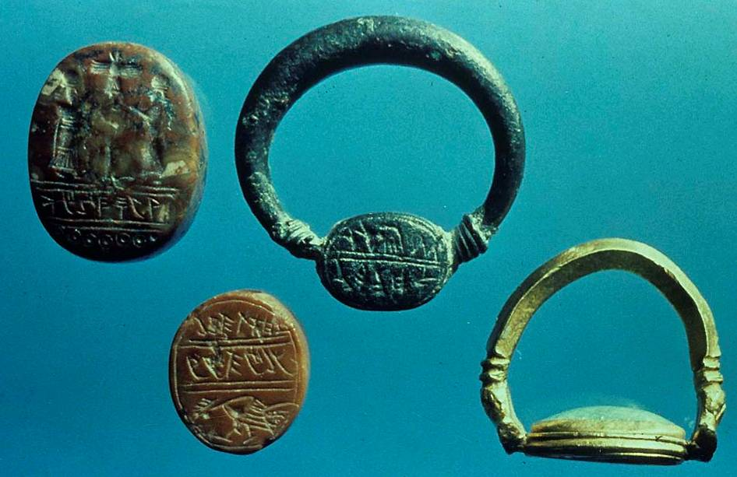
These personal seals are typical. All are preserved in the Israel Museum, Jerusalem.

Slide 66
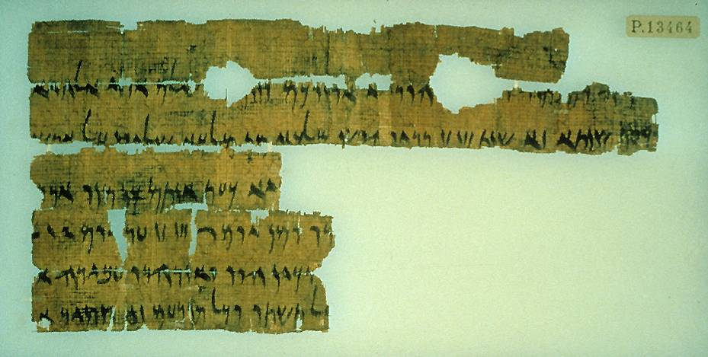
Dated to the 5th year of Darius II (419 BC), this letter from a Hananiah in Jerusalem exhorts the Jews in Elephantine, Egypt to celebrate the Passover. Hananiah identifies himself as “the brother,” and quite possibly he was the brother of Nehemiah (cf. Ne. 1:2), whom Nehemiah placed in charge of Jerusalem (cf. Ne. 7:2).
The letter evidently was written in the atmosphere of reform that prevailed in the aftermath of Nehemiah’s mission and Ezra’s public reading of the Torah.
Staatliche Museen zu Berlin
Passover Letter

Slide 67
Repopulating the City
(11:1—12:26)
Since the enclosure of Jerusalem was now large, but the population small (cf. 7:4), it was decided that a tithe of people would be chosen by lot to move within the walls (11:1-2).
The bulk of the community was now from three tribes—Judah, Benjamin and Levi (11:3-36).
However, there were representatives from the northern clans as well (cf. 1 Chr. 9:1b-3).
Priests and Levites were listed by pedigree (12:1-26).
The traditional performance of antiphonal choirs was reinstated (12:24; cf. 1 Chr. 25).

Slide 68
The Wall Dedication (12:27-43)
Once more, the narrative resumes in the 1st person.
Ceremonies of purification were conducted for the people, the walls, and the gates, presumably with sprinkled blood and/or water (cf. Nu. 19:18; Lv. 14:5-7; Eze. 36:25; He. 9:21-22).
Twin processionals of choirs and musicians, one accompanied by Ezra and the other by Nehemiah, encircled the city on the top of the walls. Both processions, marching in opposite directions, met again at the temple for worship and celebration.

Slide 69
Final Reforms (12:44—13:31)
The close of the Book of Nehemiah consists of several final measures to bring the community into alignment with the Torah.
Supervisors were appointed to manage the various offerings for the support of the priests, Levites, choirs and other temple staff (12:44-47).
During the public reading of the Torah, the people discovered that foreigners were forbidden any place in the worshipping assembly, so foreigners were expelled (13:1-3; cf. Dt. 23:3-6).
After Nehemiah was recalled by Artaxerxes back to Mesopotamia, one of the priests had allowed an Ammonite official the use of a temple storage room. This violation was rectified upon Nehemiah’s return (13:4-9).

Slide 70
On his return, Nehemiah also discovered that the leaders had neglected to provide for the Levites, who were forced to go back to farming in order to survive. This lapse, also, was rectified (13:10-14; cf. Mal. 3:6-12).
Phoenician merchants had been allowed to set up booths on the Sabbath, and Jerusalem merchants, not to be outdone, followed suite. This violation also was corrected (13:15-18). When Nehemiah closed the city gates for the Sabbath, the merchants tried to circumvent him by setting up just outside, so Nehemiah threatened to arrest them and stationed guards to prevent Sabbath violations (13:19-22).
The intermarriage of Israelites with non-Israelites was a perennial threat (13:23; cf. Ezr. 9-10; Mal. 2:11-16). Nehemiah exploded, cursing them, punching them, and pulling out their hair. He compelled them to swear an oath to suspend this racial compromise (13:24-28).
He purified the priesthood of everything foreign (13:30).

Slide 71
Discussion Questions:
Because the law of Moses was not available to the people apart from public reading, how difficult was it for them to know its content?
How do the traditions of worship in the OT set patterns that might be reproduced in the Christian community with respect to:
  A liturgical year
  Translation of the Scriptures
  Architecture (e.g., a pulpit or platform)
  Public reading of Scripture
  Public prayers
  Antiphonal choirs
  Tithing
  Dedication of building projects
  Sabbath observance

Slide 72
THE BOOK OF ESTHER
the first pogrom

Slide 73
The Persian Monarchs
Sheshbazzar 539
Zerubbabel & Joshua 538-516
Haggai & Zechariah 520-516
Esther 479
Ezra 458 Malachi 450 Nehemiah 445
550-529 Cyrus the Great
529-523 Cambyses
522-486 Darius I (the Great)
486-465 Xerxes I
464-424 Artaxerxes I Longimanus
423-404 Darius II
404-359 Artaxerxes II
359-338 Artaxerxes III
336-330 Darius III

Slide 74
The Early Reign of Xerxes (486-465)
If one takes an historical approach to the book, then the events of Esther must be coordinated with the known history of Xerxes’ reign, the major events of which are:
486 Suppression of an Egyptian revolt
484 Abolition of the kingdom of Babel
483 Demotion of Vashti (Est. 1:3ff.)*
483 Beginning of the campaign against the Greeks
480 Defeat at Thermopylae & Salamis
479 Marriage of Esther (Est. 2:16)*
* Events unrecorded in secular history
Little is known about the later years of Xerxes’ reign. He was murdered by his vizier in 465 BC, who elevated Artaxerxes I to the throne.

Slide 75
Discussion:
How difficult would it be to experience an arranged marriage, especially to someone from a different culture?
How might this affect the expression of your faith?

Slide 76
The Hidden Hand
Some rabbinical interpreters have suggested that Yahweh’s divine hand is hidden in the book.
Normal Spelling
The normal spelling for the Hebrew word “the Jews” is:
Mydvhyh
(appears 32 times in the book)
Abnormal Spelling
An abnormal spelling contains an extra letter “yod.”
Myydvhyh
(appears 6 times in the book)
y = yod or yad (= hand) represents six times God’s hand intervened to save the Jews (4:7; 8:1, 7, 13; 9:15, 18)

Slide 77
Discussion:
There are no mentions of God in the Book of Esther: why do you think this may be?
How important is it to know that God is providentially at work, even though there may not be obvious signs?

Slide 78
The Setting
Set in the Persian Period during the reign of Xerxes I (486-465 BC), the story of Esther takes place less than a century after many Jews returned to Jerusalem.
Xerxes I is Ahasurerus in the Hebrew Bible (Chshayarsha in Old Persian).
The Jewish community in Persia consisted of those who elected to stay in the heartland of the new Persian Empire rather than return to Judah after the edict of Cyrus the Great.
The provinces (1:3b) were possibly subdivisions of the larger satrapies, the districts of the empire.

Slide 79
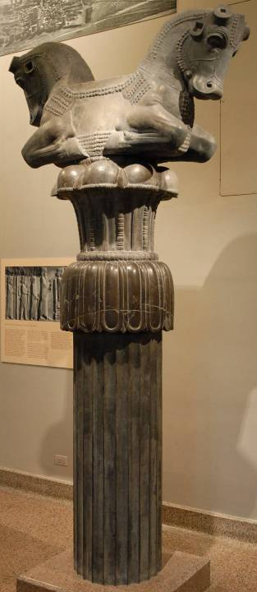
The roof of the Apadana (audience hall) at Susa was supported by thirty-six stone columns, each surmounted by a capital formed by the forequarters of two bulls joined at the middle. The roof beams rested between the bulls almost 65’ above the pavement.
Oriental Institute,
University of Chicago

Slide 80
Vashti is Deposed
In his third regnal year, Xerxes staged a six-month celebration in Susa for Persian nobility.
Susa, the ancient capital of Elam, was the winter residence of the emperor and one of the Persian administrative centers.
The site was identified in the mid-1800s and excavated by the French.
The end of the celebration climaxed with a week’s party, at which time Xerxes sent for Vashti, his queen. At her refusal to come, he deposed her for insubordination.

Slide 81
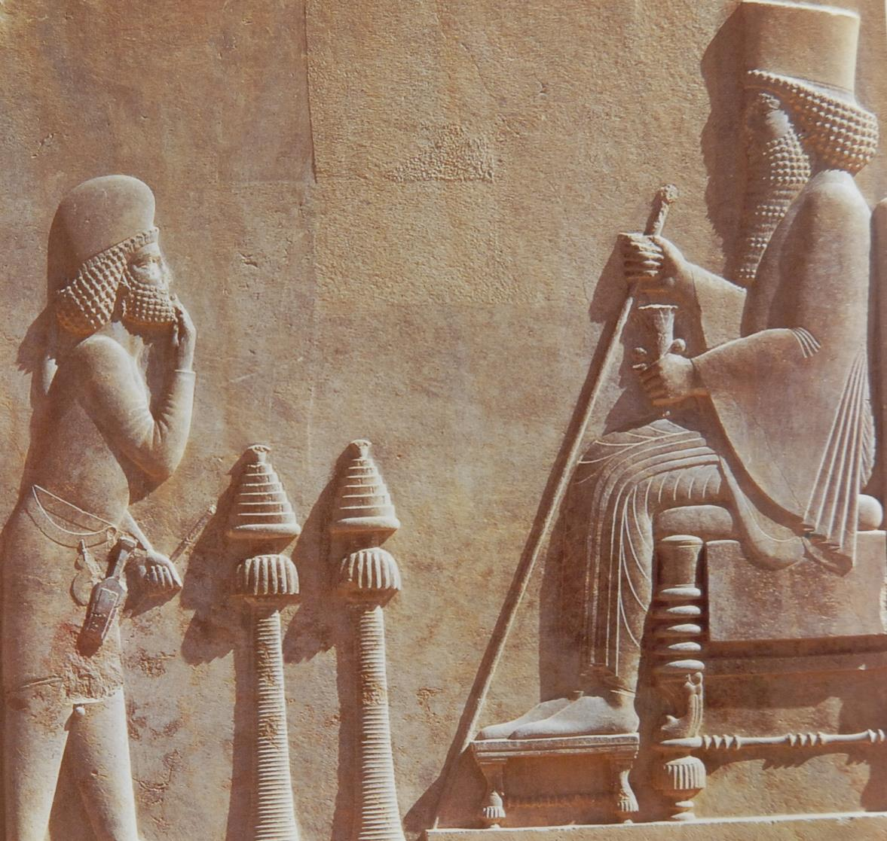
Xerxes I
Persepolis
Tehran Museum, Iran

Slide 82
The Campaign Against Greece
Vasti was deposed in Xerxes 3rd regnal year, and he did not remarry until his 7th regnal year (1:3; 2:16).
Between these two dates, he conducted a disastrous war with the Greeks.
With a huge land force reinforced by ships, he crossed the Hellespont but suffered defeat at Salamis. His land army was defeated at Plataea, and his fleet was defeated at Mycale.
He finally withdrew to Persepolis and Susa.

Slide 83
The Search for a New Queen
It was apparently after his return that the search was conducted for a new queen.
A Jew named Mordecai offered his adopted daughter Hadassah (Esther) as a candidate.
Josephus preserves a tradition that there were 400 candidates (Antiquities, XI.6.2).
Esther apparently had no compunctions about dietary laws, but at Mordecai’s insistence, she still refused to reveal that she was Jewish.
Esther won Xerxes’ favor, and he accepted her as his new queen, marking the date as a holiday.

Slide 84
Mordecai Saves Xerxes’ Life
Palace intrigues were common enough (and indeed, Xerxes later would die by assassination in 465 BC).
On this occasion, while Mordecai was serving in some official capacity, he discovered a plot on the king’s life.
  The “king’s gate” (2:19), where Mordecai sat, was the management center for the whole palace administration, as indicated by both Xenophon and Herodotus.
  Through Esther, the king was informed and the plot thwarted.
The perpetrators were hanged, and the incident was recorded in the daily record of court affairs.

Slide 85
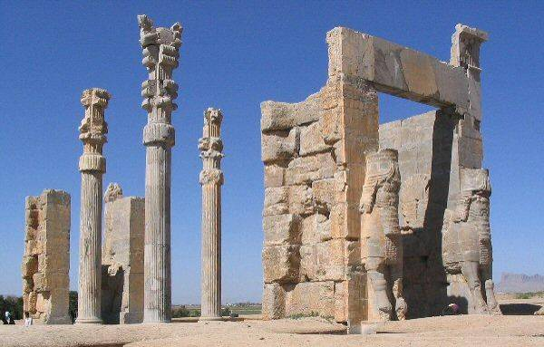
While the gate at Susa is unavailable to us, the “Gate of All Nations” in Persepolis has been reconstructed by archaeologists.

Slide 86
Haman is Elevated and Insulted
A descendent of Agag, the Amalekite from the period of Samuel and Saul, had been elevated to the role of Prime Minister.
Mordecai, however, refused to bow before him.
If Mordecai had been awarded the title “Orosanges” (= Benefactor to the King) for his service in saving Xerxes’ life (which is not unlikely), he would not have been required to prostrate himself before anyone but Xerxes himself.
Still, his refusal to bow to Haman stimulated the plot to kill all Jews in the empire.

Slide 87
The Pur is Cast
The Pur (a Mesopotamian method of casting lots) was cast to determine the day of the pogrom, less than a year away.
Haman succeeded in convincing Xerxes to give his consent and seal the order with the royal signet ring.
Conveniently, Haman did not mention Mordecai.
Scribes published the order, and dispatches were sent with copies throughout the empire.

Slide 88
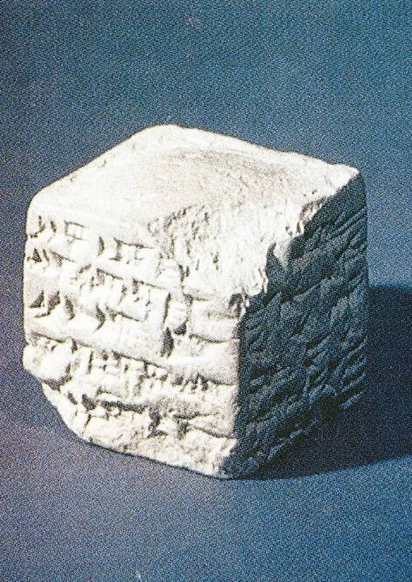
Numerous devices were used in the ancient Near East to help determine the course of an action. This one inch cube is a replica of a 9th century BC Assyrian clay lot, known as a pur. The Persian pur was likely similar.

Slide 89
Mordecai’s Instructions (4)
Both Mordecai and the Jews in the empire were devastated by the edict.
Esther’s attempts to console her uncle failed, and only through using a eunuch as an intermediary was she able to discover the full intent of the edict.
Mordecai urged Esther to approach Xerxes in behalf of her people.
The risk would be high, however, because anyone who approached the king uninvited faced the possibility of immediate execution.

Slide 90
“for such a time as this”
Mordecai’s response to Esther was one of the great commitment challenges in the Bible.
She must realize that she was not exempt, even though she was the queen!
Esther 4:14 is the closest one comes in the book to an affirmation of divine providence.
Esther accepted the challenge, calling on her people to fast in her behalf before she approached the king, and as she said, “If I perish, I perish!”

Slide 91
The First Banquet (5:1-8)
On the third day, Esther entered the throne room.
To her relief, Xerxes extended his scepter, thus sparing her life.
However, instead of immediately broaching her request, she invited the king and his prime minister Haman to a banquet.
There, over wine, the king again pressed Esther as to the cause of her boldness.
Esther, however, deferred her answer to yet another day and a second banquet.
Haman, for his part, was entranced to be invited to two private banquets with king and queen!

Slide 92
The Gallows (5:9-14)
In spite of his ebullience about attending the private banquets, Haman still was chagrined over his continual snub by Mordecai.
At the suggestion of his friends and family, Haman had a huge gallows constructed especially in anticipation of the execution of Mordecai.
He determined to ask Xerxes for permission to have Mordecai hanged.
The LXX translates the instrument of execution as an impaling stake rather than a gibbet (but the Mishnah describes a gibbet).

Slide 93
The Deep Irony (6)
Haman’s diabolical plans were foiled that very night.
During a sleepless night, Xerxes called for a reading of the Persian daily court record, only to discover the account of Mordecai’s intervention to save his life.
Finding that Mordecai had received no special honors for his service, Xerxes asked the advice of Haman (but without mentioning Mordecai’s name).
Thinking the king meant to elevate him, Haman described several ostentatious honors, and to his chagrin, he then was ordered to bestow these very honors on Mordecai!

Slide 94
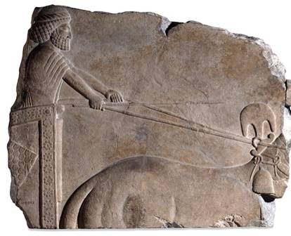
This relief from the Archaemenid court at Persepolis was excavated in 1811 by Robert Gordon. It originally decorated a staircase in the Apadana (audience hall) built by Darius I, Xerxes I and Artaxerxes I.
The royal crest on the neck of the horse shows the type described in Esther 6:8.
Horse with Royal Crest
British Museum, London

Slide 95
The Second Banquet (7:1-6)
Hardly had Haman completed his odious task of honoring Mordecai, when he was summoned to join the king and queen for the second banquet.
On this occasion, Esther pled for the life of her people and herself, explaining the plot against them.
When Xerxes asked who had designed such a plot, Esther fingered Haman.

Slide 96
Haman’s End (7:7-10)
While the king stormed out in rage, Haman fell on the couch, begging Esther to spare his life.
Returning, Xerxes saw Haman prostrated on the couch and concluded that he was trying to molest the queen (an Aramaic Targum says that an angel pushed Haman on the couch).
Servants immediately covered Haman’s face as a man condemned.
He was summarily hanged on his own gibbet!

Slide 97
The Immutable Persian Law
The immediate problem was that Persian law was irrevocable; it could not be countermanded, even by the king.
A similar circumstance is recorded in Daniel 6:8, 15.
In later Persian history, Darius III executed a man he knew to be innocent because of this immutable standard.
Hence, the only alternative was to neutralize the law.

Slide 98
The New Edict (8)
To neutralize the pogrom, a second decree was drawn up authorizing the Jews to defend themselves.
This decree also was composed in several languages and distributed in advance of the pogrom date, making clear that the pogrom was under official displeasure.
So great was the favor shown toward the Jews in the empire that many pagans accepted the faith of Judaism (the LXX adds that many Gentiles became circumcised).

Slide 99
The Pogrom Date (9:1-17)
When the pogrom date was reached, the 13th of Adar, the Jews clearly had the upper hand.
Not only were they able to defend themselves, they lashed out at their anti-Semitic enemies, killing 75,000 in all.
Haman’s sons were impaled and their corpses publicly exposed.

Slide 100
Purim (9:18—10:3)
The Jews began an annual festival to celebrate their near escape.
The name of the festival was drawn from Haman’s casting of the pur to decide the date (cf. 3:7).
Xerxes imposed an empire-wide tribute: the reason for this levy is not stated, but perhaps it was initiated to compensate Xerxes for his loss of the 10,000 talents promised by Haman (cf. 3:9).
The book ends with an acclamation of Mordecai as the new prime minister.

Slide 101
Haggai
Reviving the Work

Slide 102
The Historical Context of Haggai’s and Zechariah’s Ministry (Ezra 5:1; 6:14a)
Now the prophets, Haggai and Zechariah son of Iddo, prophesied to the Jews in Judah and Jerusalem in the name of the God of Israel, who was over them.
So the elders of the Jews continued to build and prosper under the preaching of Haggai and Zechariah son of Iddo.

Slide 103
Haggai, the Man
Little is known about the prophet’s personal life, other than he was a contemporary of Zechariah (cf. Ezr. 5:1; 6:14).
In the Septuagint, Syriac and Vulgate, he, along with Zechariah, is credited with the authorship of Psalms 138, 146-149.
Jerome, in the Christian era, maintained that Haggai was of priestly descent.

Slide 104
Haggai’s First Oracle (1:1-15)
General disillusionment with the temple building project left the people with the sentiment that it was not time to build (1:2).
Yahweh’s word was a challenge to their priorities—they were preoccupied with their own lifestyles (1:3-4).
Their bad crops, drought, and deprivation were results of their neglect of God’s house (1:5-11; cf. Dt. 28:15-19).

Slide 105
Disillusionment!
“Many of the older priests and Levites and family heads, who had seen the former temple, wept aloud when they saw the foundation of this temple being laid…”
Ezra 3:12
“You expected much, but see, it turned out to be little!”
Haggai 1:9
“How does it look to you now? Does it not seem to you like nothing?”
Haggai 2:3
“Who despises the day of small things?”
Zechariah 4:10a

Slide 106
Response!
The response of the leaders and people to Haggai’s preaching was immediate.
They resumed the work in godly fear (1:12).
Because they obeyed, Yahweh’s word was clear: “I am with you” (1:13)!
Zerubbabel and Joshua were deeply stirred along with the people, and the work resumed on the 24th day of the 6th month in Darius the Great’s 2nd regnal year (1:14).

Slide 107
Discussion:
What is the controlling theological norm for the discipline of economic deprivation?
Should Haggai’s interpretive principle be applied to Christians in economic distress?

Slide 108
The Central Theological Question
Why was it so important that the temple be reconstructed? Why not be happy with a synagogue?
Important factors are:
God’s choice of Zion
Centrality of temple worship (until the Messiah)
Jerusalem still remained the symbolic center of the nation
A new temple would be the first step toward Ezekiel’s eschatology

Slide 109
Haggai’s Second Oracle (2:1-9)
If Haggai’s first oracle stimulated action, his second one assured them of the worthiness of the project.
The 7th month would have delayed the work temporarily because of the festivals:
  Feast of Trumpets (1st day of Tishri)
  Yom Kippur (10th day of Tishri)
  Succoth (15th-21st day of Tishri)
Hence, Haggai addressed the leaders again at the end of the Feast of Booths (21st day of Tishri).

Slide 110
Second Oracle cont.--
Haggai encouraged them along five lines:
God reaffirmed that he was with them (2:4).
He reminded them that the covenant was not destroyed in spite of the recent exile (2:5).
He urged them that in the building project they had a stake in the eschatological future—and hence, they needed to work in light of that future (2:6)!
That future included the “desire of the nations” and would fulfill Ezekiel’s prediction that the glory of Yahweh would return (2:7-8; cf. Eze. 43:1-5; 44:4).
The splendor of the 2nd temple would be greater than the splendor of the 1st one (2:9).

Slide 111
Discussion:
Why do you think God gave glimpses into the eschatological future far removed from 520 BC?
In what sense was the 2nd temple more glorious than the 1st one?

Slide 112
Haggai’s Third Oracle (2:10-19)
After two more months, Haggai again addressed the community by using a defilement ruling as an illustration of human attitudes.
The Torah’s purity laws indicated that contagion spreads from unclean things, not clean things (2:10-13).
  Holiness cannot be transmitted by secondary contact.
  Defilement, on the other hand, does transmit by secondary contract.
By analogy, apathy and disillusionment are contagious, but dedication and commitment are not (2:14)!

Slide 113
Third Oracle cont.--
Because what had been spreading for 16 years was indifference, not holiness, the community needed a line of demarcation between the old period of inactivity and the new period of resuming the work.
The previous judgments upon grain and wine had been blight (disease and/or insects), mildew (spoilage in storage) and hail (destruction by weather). The law of mildew (Lv. 14) regulated spoilage.
With their renewed dedication, the future would be marked by blessing (2:19b).

Slide 114
The New Date!
On the 24th day of the 9th month (December 18, 520 BC), the past and the future would be separated (2:18)!
Seed for the next harvest already had been taken from the grain pits and sown. (Fields were plowed and seed sown in late fall for the next season.)
Thus, the question, “Is there any grain left in the barn?” is to be answered, “No”! All seed had been sown in the fields already, and they could expect an excellent harvest (cf. Zec. 8:12)!

Slide 115
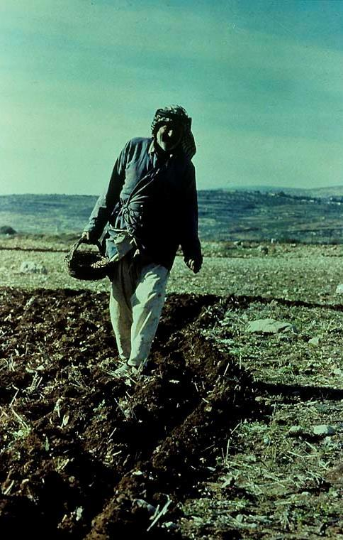
Sowing and plowing in the fall
In some regions, sowing actually precedes plowing, and in general, sowing is done in the fall, allowing the seed to remain in the ground until spring. This seems to have been the case for Haggai’s people (Hg. 2:19).

Slide 116
Haggai’s Fourth Oracle (2:20-23)
Haggai’s final word came later on the same day as his 3rd oracle (2:20).
He reiterated the prediction of the shaking of the nations (cf. 2:6).
He predicted that “on that day” Zerubbabel would be established as God’s chosen executive, making Zerubbabel like his divine signet ring.

Slide 117
A Typological Approach
In typology, an Old Testament person prefigures a New Testament reality.
In the pedigree of Christ, Matthew divides Jesus’ ancestors into three blocks (Mt. 1:1-17):
  Abraham to David (promise = all nations blessed)
  David to Jehoiachin (promise = David’s son will reign)
  Jehoiachin to Jesus (promise = Zerubbabel, a type of God’s signet, and also, the Branch, cf. Zec. 6:12-13).
Typologically, then, Christ is Abraham’s seed, David’s Son and Zerubbabel’s authority.
In Jeremiah, the metaphor of the signet was used to symbolize Jehoiachin’s rejection (cf. Je. 22:24). Now, in Zerubbabel, this judgment was reversed (Hg. 2:23).

Slide 118
Zechariah
Reinforcing the Spiritual Renewal

Slide 119
Zechariah, the Man
In his genealogy as given in Ezra 5:1 and 6:14, the “son of Iddo” should be taken in the sense of “descendant” or “grandson” (Zec. 1:1, 7).
His name means “Yahweh has remembered.”
The word rfan1 in 2:4 (= “young man”) suggests that he was relatively young, since that term usually refers to a young single man of marriageable age.
While the name Zechariah was a popular one (there are no less than 31 people in the Hebrew Bible with that name), it is possible that Zechariah, like Jeremiah and Ezekiel, was both a priest as well as a prophet (cf. Ne. 12:4a, 16).

Slide 120
Dated Oracles
Undated Oracles
Reflection on the Covenant (1:1-6)
Eight Night Visions:
Four horsemen (1:7-17)
Four Horns & Smiths (1:18-21)
Surveyor (2)
Joshua, the Priest (3)
Lampstand & olive trees (4)
Flying scroll (5:1-4)
Woman in the basket (5:5-11)
Four chariots (6:1-8)
Joshua’s crown (6:9-15)
True fasting (7)
Final promises (8)
1st Oracle of Judgment and Salvation, War and Victory (9:1—11:17)
Arrival of the King
Shepherds are rejected
2nd Oracle of War and Victory (12:1—14:21)
Yahweh’s representative
is pierced
The Shepherd is struck
down

Slide 121
Reflection on the Covenant
(1:1-6)
Zechariah’s preaching began with a rehearsal of Yahweh’s anger that resulted in exile.
While Yahweh is “slow to anger” (Ex. 34:6), the exile had been inevitable if the nation did not turn from faithless rebellion.
The verb bvw (= turn, return) was a primary expression of the earlier prophets urging repentance (cf. Ho. 5:4; 7:10, 16; 11:5; 12:6; 14:1-2; Am. 4:6b, 8b, 9b, 10b, 11b; Is. 6:10; 9:13; 31:6-7).
Now, Zechariah’s call for the remnant community was to “turn” (1:3).

Slide 122
The Four Horsemen
(1:7-17)
The riders (probably depicting angelic beings) are modeled after the Persian dispatches, well-known throughout the empire (cf. Est. 1:22; 3:13, 15; 8:10, 14).
They reported to the Mal’ak Yahweh that political and military conflict had subsided.
However, this state of peace had not resulted in the restoration of Jerusalem and Judah.
Nevertheless, Yahweh’s passion was deeply stirred, both in anger at the nations for their treatment of his people and in eagerness for the holy city and temple to be rebuilt.
Yahweh had once chosen Mt. Zion in the time of David (Ps. 68:15-18; 78:67-72; 132:13-18).
Now, he would chose it again (1:17)!
If God’s passion was so aroused, how could the passion of the remnant be any less?

Slide 123
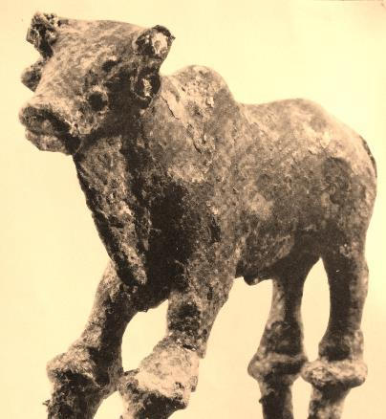
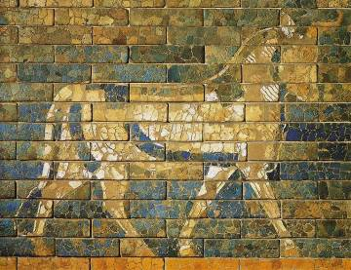
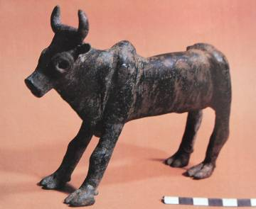
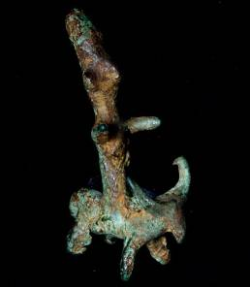
Four Horns and Four Smiths
(1:18-21)
Babylonian
Canaanite
Bull horns were a common symbol of power in the ancient Near East, either the power of a political entity or the power of the patron god of a city or state (cf. Da. 7:24; Ps. 132:17).
Israelite
Canaanite

Slide 124
The four horns symbolize the nations that exiled Israel. If the four smiths symbolize the nations that conquered the horns (nations), the possible interpretations are:
Symbolic Israel & Judah Judah only As in Daniel
Oppressors
Assyria & Babylon
Conquered by
Babylon & Persia and their cohorts
(here the number “4” simply means “all”)
Oppressors
Assyria (Israel)
Egypt (Jehoahaz)
Babylon (Jehoiachin)
Persia (pogrom)
Conquered by
Babylon
Persia
Greece
Rome
Oppressors
Babylon
Persia
Greece
Rome
Conquered by
Persia
Greece
Rome
Kingdom of God
Oppressors
Babylon
Persia
Greece
Rome
Conquered by
Messianic kingdom

Slide 125
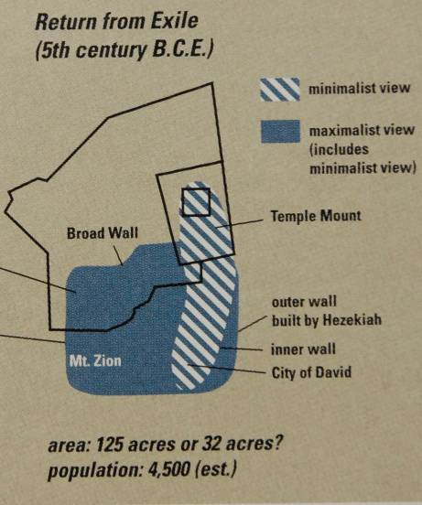
The man with the measuring cord (2:1-2), like the man with the measuring rod in Ezekiel’s vision (Eze. 40:3), presumably intends to survey the city so that the work of rebuilding may resume.
THE MESSAGE:
Jerusalem would be so heavily populated that it could have no walls. It would be protected by a “wall of fire,” as in the exodus (Ex. 13:21-22; 40:38), and God’s glory would be within it.
Hence, rebuilding the 2nd Temple was part of a much grander future in God’s larger purpose.

Slide 126
Discussion:
How should interpreters understand the prediction of Jerusalem without walls, especially in light of Nehemiah’s wall-repair project?
Is this prediction symbolic? Is it messianic? Is it unfulfilled?

Slide 127
Jerusalem’s Future Included the Nations (2:6-13)
In an oracle, the Jews remaining in Babylon and Persia are urged to “come out” (2:6).
The lands of Babylon and Persia were now under judgment, for Zechariah had been commissioned to preach judgment against the nations plundering Jerusalem (2:7-9)
In the end, Yahweh himself promised to come and live among them (2:10).
Many from among the nations would also be joined to the remnant of Israel so that together they will be his people (2:11-12).
The rebuilding of the temple was part of this international future!

Slide 128
The Heavenly Court Scene (3:1-5)
The accused, Joshua, the High Priest
As the High Priest, Joshua stood as the representative of the remnant community.
His filthy robes symbolized the sins of the nation, and as their representative, he bore the uncleanness of the people.
The prosecutor, NFAWAha (= Satan, the Accuser)
As in the Book of Job, the name “satan” is not used here as a proper name (i.e., it has a definite article in the Hebrew text)
The defense, the hvAhy4 j`xal;ma (= Messenger of Yahweh)
The Mal’ak Yahweh speaks both as Yahweh’s representative and as Yahweh himself.
The rebuke, “Yahweh rebuke you”, parallels the rebuke of Michael (Jude 9).

Slide 129
The New Commission (3:6-10)
After the celestial Judge exonerated Joshua and cleansed him by a divine act (3:3-5), he was commissioned anew.
He was charged to keep the Torah, and when he did, he would be given immediate access to God like the angels (i.e., he would be “among those who stand here”, that is, the heavenly beings).
Joshua and his fellow priests were symbols of things to come, one of which was the advent of God’s servant “the Branch” (cf. Is. 4:2-6; 11:1ff.; Je. 23:5-6; 33:15-16).
The stone with its seven facets (possibly the diadem in the priest’s turban) symbolized the cleansing of guilt from the land in a single day.
The rebuilding of the temple was linked to this messianic future!

Slide 130
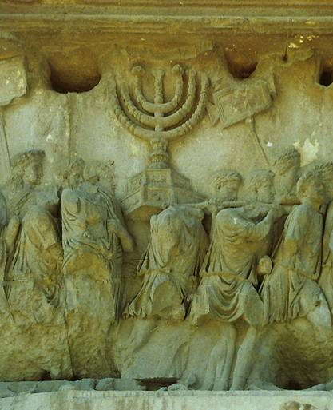
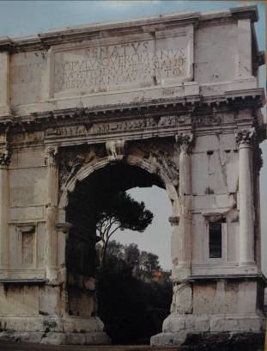
In Zechariah’s vision (4:2), he saw a solid gold lampstand (menorah). Whether or not the lampstand depicted in the Arch of Titus is as old as the construction of the 2nd temple in the period of Zerubbabel is unknown, but the similarity of description is close.
The interior detail of the Arch of Titus, erected to commemorate the destruction of Jerusalem in AD 70, offers an ancient relief sculpture of the temple menorah, which the Romans carried off.

Slide 131
The Meaning of the Lampstand and Olive Trees (4:1-5, 11-14)
The question about the meaning of the vision is not answered until after the oracles to Zerubbabel.
The seven lights in the lamp represent the seven eyes of Yahweh, which in turn are symbols of the divine omniscience (4:2, 10b).
The two olive trees supply oil for the lamps through two “pipes” (this word is a hapax legomenon, so translation is only a guess), and the two trees in turn symbolize the two primary leaders, Zerubbabel and Joshua (4:13-14).
  Zerubbabel was from the line of David, the royal family
  Joshua was from the line of Aaron, the priestly family.
  Together, they were the channels by which the Spirit would supply for God the temple he had commissioned.

Slide 132
Discussion:
Who does Joshua symbolize for the future (3:8)?
What is the cleansing of Israel in a single day (3:9)?
What is the meaning of “that day” (3:10)?

Slide 133
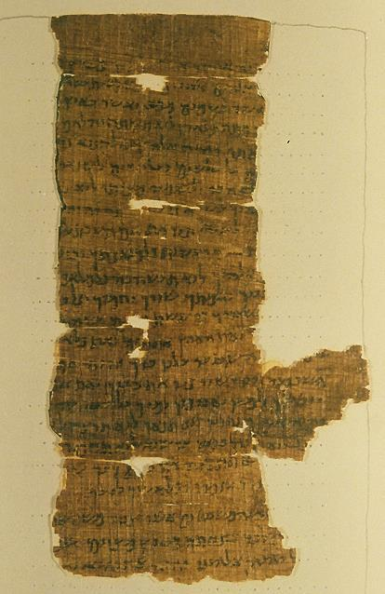
The Flying Scroll (5:1-4)
Typically, scrolls are only inscribed on a single side. This one was open and had inscriptions of curses on both sides.
On one side was a curse for violating the third commandment (Ex. 20:7; Dt. 5:11)
On the other was a curse for violating the eight commandment (Ex. 20:15; Dt. 5:19).
Nash Papyrus containing the Ten Commandments.
Cambridge University Library
Clearly, God expected his ancient laws to prevail!

Slide 134
The Ephah Barrel (5:5-11)
The ephah barrel with the lead cover symbolized the moral deterioration of the people in the land (5:6b).
The woman represented the power of evil (5:7), and since she was to have a “house” in Babylon (a shrine or temple?), she probably represents a goddess figure, possibly Ishtar.
Just as God had removed the remnant from Babylon so they could build Yahweh’s house in Jerusalem, so now the vestiges of Babylon are removed from the land of Israel and sent back to “Shinar” (the Hebrew text reads “Shinar” rather than Babylon, possibly to link it with the great rebellion associated with Shinar in Gen. 11).

Slide 135
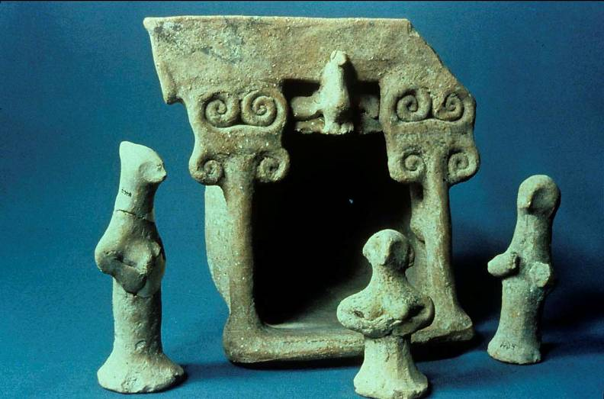
Rockefeller Museum, Jerusalem
This cult house and its figurines decorated with Persian designs and discovered near Amman, Jordan probably represent a personal shrine to the goddess.

Slide 136
The Four Chariots (6:1-8)
Like the earlier four horsemen, the four chariots also are patterned after the Persian imperial couriers, and also as before they represent Yahweh’s storm troopers sweeping throughout the world.
They have accomplished Yahweh’s purpose by securing peace; now that the Babylonian-Persian wars were over, this peace enabled the exiles to return to Judah to rebuild their temple.
Hence, if God had ordered history so as to permit the rebuilding, then the returned exiles should return to the work with all their hearts.

Slide 137
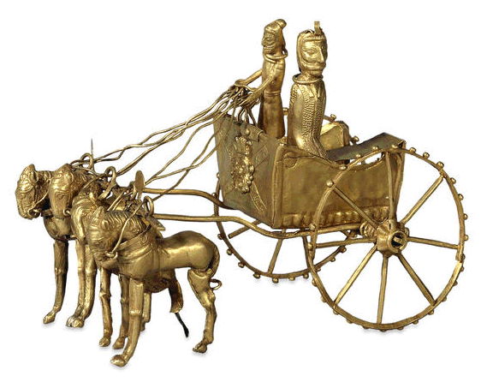
Persian gold model of a chariot, 5th-4th century BC. Discovered in Afghanistan.
British Museum, London

Slide 138
Oracle About Joshua’s Crown (6:9-15)
Using precious metals brought as gifts by recently returned exiles, Zechariah was instructed to make a crown of honor for Joshua.
The crown was to be set on the head of Joshua, the high priest (6:11).
The announcement, “Here is the man whose name is Branch…” (6:12), presumably was directed to Zerubbabel (rather than Joshua), since he was the one who was to build the temple of Yahweh (6:12; cf. 4:9).

Slide 139
The Messianic Symbolism of the Branch
The meaning of “the Branch” begins with Isaiah’s metaphor of the deforestation of Israel, when the people would be cut down leaving only stumps (Is. 6:13).
From the remaining stumps of Israel, a “branch” would survive from the stump of Jesse (Is. 11:1), a branch that would be the pride and glory of the survivors (Is. 4:2).
A century later, Jeremiah picks up the same metaphor to describe the messianic “Branch” from
David’s family (Je. 23:5-6; 3:15-16).
Zechariah now draws upon this same metaphor to describe Zerubbabel (Zec. 6:12; cf. 3:8).

Slide 140
Oracle About True Fasting
(7:1-14)
THE RITUAL FASTS RECALLING THE EXILE OF JUDAH:
Fast of the 10th month
Remembering the beginning of the siege against Jerusalem (2 Kg. 25:1; Zec. 8:19)
Fast of the 4th month
Remembering the breaching of Jerusalem’s wall (Je. 52:6-11; Zec. 8:19)
Fast of the 5th month
Remembering the destruction of the temple (2 Kg. 25:8-11; Zec. 7:3)
Fast of the 7th month
Remembering the assassination of Gedaliah (Je. 41:1-3; Zec. 7:5)
Nearly two years later, Zechariah’s next oracle addressed a question about ritual fasts.
Since the new temple was being built, was it any longer appropriate to continue the fasts commemorating the first temple’s fall?
Zechariah’s immediate response was about the more fundamental issue of the nature of true fasting.

Slide 141
True Fasting
Was fasting truly out of respect for Yahweh, or was it merely the expression of regret for what had happened (7:4-7; cf. Is. 58:3-9a)?
In true fasting there is a component of social justice—the intent to show mercy and compassion for the powerless and disadvantaged (7:9b-10; cf. Am. 5:21-24; Ho. 6:6; Is. 1:12-17; Mic. 6:6-8).
By ignoring such mandates from earlier prophets, the Israelites had incited God’s anger against themselves (7:11-12), and this in turn led to the exile (7:13-14).
The answer to the question about fasting would not be given until the third oracle (cf. 8:18-19).

Slide 142
Discussion:
Does this oracle about fasting have anything to say about the modern practice of fasting?
Why do modern Christians fast, and how does their fasting compare with this word from Zechariah?

Slide 143
Summary Oracle (8:1-23)
No.1 Yahweh once more had chosen Jerusalem and Mt. Zion. His zeal was burning hot! (8:1-2)
No.2 As the City of Truth and the Holy Mountain, Jerusalem and Mt. Zion would be reclaimed from their former faithless-ness and defilement. (8:3)
No.3 The future would be characterized by the peacefulness of the aged and the joyfulness of the young. (8:4-5)
The third oracle is composed of ten divine promises describing the blessedness of restoration. Each promise begins with the formula, “Thus says Yahweh Tsabaoth…”

Slide 144
No.4 Like the question, “Is anything to hard for the Lord,” the question “Will it seem impossible to me?” affirms that however extravagant God’s promises might seem, they are not too hard for him to fulfill. (8:6)
No.5 The regathering of
God’s elect was directly linked to his dwelling among them as their God. (8:7-8)
No. 6 Past times had been difficult, but opposition and deprivation would now be reversed. Therefore, boldness and courage for completing the work were in order! (8:9-13)
No.7 The terrible judgment of exile was now reversed. The remnant must respond to this divine grace by living according to covenant morality. (8:14-17)

Slide 145
No.8 As for the question about the ritual fasts, they could be continued, but now they should become occasions for celebration, not mourning. (8:18-19)
No.9 The new temple would be linked to God’s ideal for all nations to come and worship him. (8:20-22)
No.10 God’s ancient promise to Abraham that the nations would be blessed through his seed would now be fulfilled. (8:23)
These ten promises point to the great redemptive work that Yahweh intended for the earth.
In rebuilding the Temple, the remnant community had a crucial role to play in this redemptive future!
The implications stretch all the way to the messianic age.

Slide 146
Zechariah’s Focus on Haggai’s Eschatological Vision
If Haggai’s preaching anticipated a “shaking of the nations” (Hg. 2:6, 21-22), it remained for Zechariah to provide a vision of this shaking.
His two apocalyptic oracles resonate with themes of God’s warlike advance against the nations.
Intertwined with this invasion are images of salvation, restoration and the mission of the Messiah.

Slide 147
1st Oracle of Judgment and Salvation, War and Victory
(9:1—11:17)
One of the immediate differences between the first and second sections of Zechariah is that while the first section has a sense of immediacy with respect to rebuilding the 2nd Temple, the second section seems more applicable to a remote future.
The second section contains two lengthy oracles (9:1—11:17 and 12:1—14:21).
Each begins with the heading xW0Ama (= burden).
The genre is apocalyptic and poetic with extensive use of imagery and symbolism.

Slide 148
Judgment on Neighboring Peoples (9:1-8)
The vision begins with a description of a northern invasion as Yahweh conquers every city on his way to Jerusalem.
Hadrach (northern Syria)
Damascus (capital of Syria)
Hamath (on the Orontes River)
Tyre and Sidon (coastal cities in Phoenicia)
Ashkelon, Gaza, Ekron and Ashdod (Philistine cities on the south coastal plain of Israel)
THE SURPRISE ELEMENT: The Philistines will be converted, embracing the dietary laws of Israel and becoming part of God’s faithful remnant (9:7). During all this war, Yahweh will protect his temple and his people.

Slide 149
The Arrival of the King
(9:9-10)
The invasion is linked to the arrival of a new king to Jerusalem.
He would come as a righteous, gentle king, riding on a donkey, the symbol of peace (recalls the ancient prophecy of Jacob, cf. Ge. 49:10-11).
The implements of war would be cleansed from both the north (Ephraim) and the south (Jerusalem), and universal peace would be established for the nations.

Slide 150
The Deliverance of Israel
(9:11—10:1)
Once again, the vision returns to war.
In covenant faithfulness, Yahweh will rescue his prisoners of war, empowering both the north and the south against the Aegeans ( Nv!y! = Greece and the other nations in the Aegean).
In a striking theophany, Yahweh appears in order to defend his people, saving his flock and restoring them with full blessings.

Slide 151
Victory in Spite of False Shepherds
(10:2—11:3)
A perennial problem for Israel had been false shepherds, kings, priests and prophets who led the people astray.
Lacking sound leaders, the Israelites had fallen into idolatry and pagan spirituality, but Yahweh himself would become a Good Shepherd to the flock (10:2-3), much like the vision of Ezekiel (cf. Eze. 34:11-16).
He would empower both north and south, regathering them from Egypt, Assyria and the nations, multiplying them and leading them in a second exodus (10:4-12).
As at the Red Sea, God’s victory in this second exodus ends with a taunt song directed at the enemy (11:1-3).

Slide 152
The Flock and the Shepherds
(11:4-17)
The final section shifts from poetry to prose (except for the final stanza in 11:17).
The flock is Israel, and the shepherds are Israel’s leaders.
In the first movement, Yahweh calls upon the prophet to act out the role of a good shepherd to a flock ravaged by poor leadership (11:4-6).
In doing so, the good shepherd’s primary tools were his shepherd’s staves called “Favor” and “Unity,” symbols of his gracious care (11:7). He dismissed three shepherds who were unworthy of the name (11:8).

Slide 153
The Flock and the Shepherds cont.--
(11:4-17)
In the second movement of the narrative, the flock rejected the good shepherd, so he in turn rejected them (11:10-11).
He broke his shepherd’s staff called “Favor” (11:10-11).
He asked for his wages and was paid the price of a slave (11:12; cf. Ex. 21:32).
With a sarcastic jibe (“this lordly price”), he threw the money to the temple potter (11:13).
Then, he broke his shepherd’s staff called “Union” (11:14).

Slide 154
In the third movement of the narrative, the prophet was instructed to play the role of a worthless shepherd (11:15).
This role symbolized what would happen to the flock after they had rejected the good shepherd (11:16).
The narrative ends with a poetic stanza pronouncing a curse upon the worthless shepherd.

Slide 155
Interpreting the Oracle three general approaches
HISTORICAL
Here, the attempt is to locate the meaning in Israel’s history leading to the exile or in the post-exilic period up through the Maccabean revolt.
FUTURISTIC
This approach locates the meaning in the life and ministry of Jesus or else in the events at the end of the age (or both).
SPIRITUAL
If the wars are treated as symbols, then the visions might anticipate the missionary spread of Christianity.

Slide 156
NT References to the 1st Oracle
The Flock Scattered
The aimlessness of the flock without a shepherd (Zec 10:2) is referenced ny Jesus in the gospels (Mk. 6:34).
Jesus’ Triumphant Entry
Both Matthew and John link Jesus’ entry into Jerusalem on Palm Sunday with Zec. 9:9 (cf. Mt. 21:4-5; Jn. 12:14-16).
Jesus’ Betrayal by Judas
John’s Gospel presents Jesus as the Good Shepherd (Jn. 10).
Matthew links the insulting wages of the Good Shepherd with the thirty pieces of silver paid to Judas (Zec. 11:8b-12; Mt. 26:14-16).
Matthew later describes Judas’ blood money used to purchase the potter’s field (Mt. 27:5-10; cf. Ac. 1:18-19).

Slide 157
2nd Oracle of War, Victory and Restoration
(12:1—14:21)
The second oracle continues many of the themes of the previous oracle.
It also begins with the title xWAma (= burden).
Whereas the former oracle began in poetry and ended in prose, this one is largely prose and contains only a short poetic section.
The city of Jerusalem is the central focus.

Slide 158
War and Victory (12:1-9)
This war scene is international (12:1). In two striking metaphors, Yahweh describes Jerusalem under siege.
Jerusalem is an intoxicating cup of wine (12:2).
Jerusalem is an immovable rock lacerating anyone who tries to dislodge it (12:3).
Under Yahweh’s watchful eye, Judah’s leaders will be like a consuming fire to their enemies. Yahweh will fight on the side of his people, and the weakest among them will be as strong as David, while the house of David will be like the heavenly Man of War, the Mal’ak Yahweh (12:4-9; cf. Ex. 15:3).

Slide 159
Mourning for the Pierced One (12:11—13:1)
The people’s mourning would be so intense that it would be comparable to grief for the death of a firstborn son or the pagan ritual mourning for the fertility deities.
Each Israelite clan would mourn separately (12:11-14).
A cleansing fountain for purification from sin would be opened to the family of David and all Jerusalem (13:1).

Slide 160
Suppression of Idols and False Prophets (13:2-6)
In this purification, all traces of idolatry would be removed and false prophecy would be condemned.
Parents would not hesitate to obey the Deuteronomic injunction for execution—even if the false prophet were their own child (cf. Dt. 13:1-11; 18:20).
The traditional prophetic garb—the garment of hair (cf. 2 Kg. 1:8)—would be discarded as worthless.
The very title “prophet” would be disclaimed, and any marks that might be suspected of being self-inflicted wounds induced in a prophetic ecstasy would be passed off as wounds from a friendly scuffle. (Though some have thought that 13:6 might be interpreted messianically, the context is against it.)

Slide 161
Song of the Sword (13:7-9)
This poetic interjection resumes the theme of the shepherd from the 1st oracle.
The Good Shepherd is one who stands as Yahweh’s associate.
The sword of execution is called forth, and the Good Shepherd is struck down, scattering the flock.
Most of the flock will perish, though a third will survive by passing through the fires of purification and refinement.
In the end, this remnant would become the covenant people of God. (The words “you are my people” and “I am your God” is the basic covenant formulary.)

Slide 162
War and Victory (14:1-15)
The battle for Jerusalem is described as the “Day of Yahweh” in which all the nations will put the city to siege while committing all the atrocities of war (14:1-2).
Yahweh will himself intervene to save the city, appearing on the Mt. of Olives with the angelic armies (14:3, 5b).
In the midst of a great earthquake, life-giving water will flow from the Mediterranean to the Dead Sea (14:4-5a, 8).
Jerusalem will be secure forever, her enemies will be destroyed, the terrain and seasons will be affected, and Yahweh will reign as King over the whole world (14:6-15).

Slide 163
Judgment and Salvation of the Nations (14:16-21)
Survivors from the nations will be compelled to come to Jerusalem to worship Yahweh Tsabaoth, celebrating Succoth (14:16-19).
Every item in the city will be consecrated as holy.
No longer will there be any distinction between the holy and profane, for everything will be holy from the horses’ bells to the cooking pots.
Racketeers (Canaanites) will be banned from the temple.

Slide 164
Interpreting the Song of the Sword
HISTORICAL
If the Song of the Sword is interpreted in the context of the OT, then the attack upon the shepherd is the downfall of the dynasty of David. The scattering of the flock is the exile.
FUTURISTIC
If it is interpreted in the context of the NT, then the shepherd is Christ and the scattering is the flight of his disciples.

Slide 165
Two NT Passages clearly quote from the 2nd oracle
The pierced one (12:10b)
John’s Gospel links the pierced one to the soldier’s action of piercing Jesus’ side with the spear at his crucifixion (Jn. 19:33-37).
In the Revelation, it is not only Israel who views the pierced messiah and mourns, but all the peoples of the earth (Rv. 1:7).
The shepherd who is struck down (13:7b)
Jesus himself quoted the Song of the Sword with reference to his own death (Mt. 26:31//Mk. 14:27; cf. Jn. 10:11-12; 16:32a).
The striking down of the flock might refer to the Jewish wars in the first and/or second Jewish revolts (60s AD and 130s AD), or if taken in a Christian sense, it might refer to persecutions in the apostolic era.

Slide 166
Malachi
Yahweh’s Messenger

Slide 167
The Date
Since the circumstances in Malachi seem so similar to the those described in Nehemiah, most interpreters place Malachi at about the same time.
Malachi makes no references to Nehemiah’s reforms, so perhaps his ministry was slightly earlier than Nehemiah.
If Nehemiah appeared in Jerusalem in about 445 BC, a general date of about 450 BC can be assigned to Malachi.

Slide 168
Closing Prophetic Voice
While Malachi appears in the middle collection of the Hebrew Bible (Nebiim), it still has a closing function.
Its closing passages are messianic (3:1ff; 4:5-6).
Jewish theologians considered Malachi to be the last authentic prophetic voice (1 Maccabees 4:46; 9:27; 14:41).
With this last voice, the prophets were now “sleeping” (2 Baruch 85:3; cf. Josephus in Against Apion 1:8).

Slide 169
1 Dialogue About Election Love (1:2-5)
Yahweh had chosen them out of his election-love (bhaxA), Jacob instead of Esau, that Israel might serve his divine purpose.
The names Jacob and Esau should be understood corporately, not as individuals.
Edom had not been allowed to rebuild, but Judah had been allowed to do so!
“I have loved you!”
“How have you loved us?”
By implication, the covenant required reciprocal love and faithfulness.

Slide 170
2 Dialogue About Honorable Sacrifices (1:6—2:9)
“If I am a father, where is the honor due me? If I am a master, where is the respect due me? It is you, O priests, who despise my name!”
“How have we despised your name?”
Contempt for Yahweh was apparent in the offering of ritually unclean sacrifices.
The people were treating God with less honor than they would even the secular governor!
Better to close the temple doors and not even light the altar fires!

Slide 171
Contempt for God`s Universal Purpose
“I am a great King,” says Yahweh Sabaoth, “and my name is to be feared among the nations!”
By insulting Yahweh’s kingship in bringing diseased or crippled animals, they also were demeaning God’s greater purpose that his name should be honored among the nations (cf. Hg. 2:6-9; Zec. 2:11; 8:20-23; 14:16).
God’s warning was that the offal of the sacrifices (which were unclean and were to be burned outside the camp) would be smeared on the priest’s faces, rendering them unclean!

Slide 172
3 Warning About Broken Marriage Covenants (2:10-16)
“Have we not one father? Did not one God create us? Why do we profane the covenant by breaking faith with one another?”
Yahweh no longer pays attention… You ask, “Why?”
It is unclear whether the term “father” refers to God, Abraham or Jacob.
Regardless, the problem of broken marriages and mixed marriages was rampant (cf. Ezr. 9-10; Ne. 13:23-24).
Yahweh himself was the faithful witness of the marriage covenant—and he hates divorce, since divorce is a kind of covenant unfaithfulness!

Slide 173
Discussion:
Do the warnings of Malachi about sacrifices and priests have anything to say to modern Christians or modern church leaders?
What about Yahweh’s assessment that divorce is a type of covenant unfaithfulness?

Slide 174
4 Dialogue About Justice (2:17—3:5)
“You have wearied Yahweh with your words.”
“How have we wearied him?”
The problem was that those who lived for evil seemed to be prosperous, causing others to become cynical toward God.
This cynicism was exacerbated by the fact that the promised glory had not returned to the 2nd temple.
In the end, Yahweh would come—but would they be ready for him, for he would come to judge?

Slide 175
The Forerunner
Before the coming of the Day of Yahweh, a forerunner would be sent to announce the coming of the Lord to the temple.
The title “messenger of the covenant” probably refers to the one who would come to establish the new covenant promised by Jeremiah (cf. Je. 31:31-34).
The promise that Yahweh would come to the 2nd temple was still firm.
However, the question of final justice must be associated with the Lord’s coming, not some intermediate resolution.

Slide 176
5 Dialogue About Tithing (3:6-12)
“Will a man rob God? Yet you rob me!”
“How do we rob you?”
The only reason the remnant was not destroyed was because of Yahweh’s faithfulness.
Malachi’s message was the same as Zechariah’s —”return to God, and he will return to you” (cf. Zec. 1:3).
In returning, they must be faithful in their tithes and offerings if they expected God to give them temporal blessing.

Slide 177
The Agrarian Tithing Cycle rWef3m0aha (= the tithe, the tenth)
YEAR 1
Celebration Tithe
Dt. 12:5b-19; 14:22-27
Levites, aliens, orphans & widows were invited to share the bounty of the Israelite families.
Celebration was held at the pilgrim festivals.
YEAR 2
Celebration Tithe
Dt. 12:5b-19; 14:22-27
Levites, aliens, orphans & widows were invited to share the bounty of the Israelite families.
Celebration was held at the pilgrim festivals.
YEAR 3
Charitable Tithe
Lv. 27:26-34; Dt. 14:28-29; 26:12-15
The tithe was given outright to the Levites, aliens, orphans & widows.
The tithe was collected in a town storehouse.

Slide 178
Discussion:
What might this dialogue about tithing have to say to modern Christians?
Can this passage in Malachi be used by Christians to support mandatory tithing?
Should the social component of tithing somehow have a Christian counterpart?

Slide 179
6 Dialogue About the Fear of God (3:13—4:3)
“You have said harsh things against me!”
“What have we said against you?”
The complaint of the people was that it was useless to serve God, especially since evildoers seemed to prosper.
Again, their question was about temporal justice in history.
Those who maintained their faith promised to fear the Lord.
The heavenly “scroll of remembrance” was a surety that when judgment fell in the end, those who had been faithful would be spared.

Slide 180
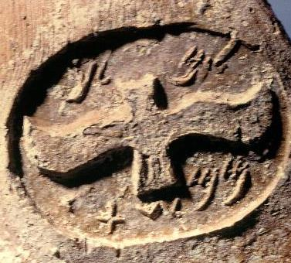
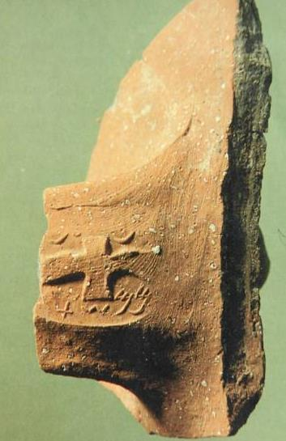
“the sun of righteousness will arise with healing in its wings”
(the winged sun-disk, symbol of royalty)
l’melekh jar handles from the period of Hezekiah bear the inscription “belonging to the king.” This symbol was used in Israel, Mesopotamia,Phoenicia and Egypt.
To date, more than 1200 of these winged sun-disk symbols on jar handles have been excavated.

Slide 181
Conclusion (4:4-6)
Malachi closes by anticipating the coming messianic kingdom and Elijah the prophet as the advance messenger.
An angel announced that John the Baptist would come in the “spirit and power of Elijah” (Lk. 1:17), and Jesus indicated that John fulfilled this prediction by Malachi (Mt. 11:13-14; 17:10-13).
John himself may not have understood his role (Jn. 1:21, 25).

Slide 182
Return of Yahweh to the Second Temple
PROMISE POSTPONEMENT
HAGGAI & ZECHARIAH
“’…I will fill this house with glory,’ says Yahweh Tsabaoth. ‘The glory of this present house will be greater than the glory of the former house…” (Hg. 2:7b, 9a)
“…Yahweh will again comfort Zion and choose Jerusalem.” (Zec. 1:17b)
“This is what Yahweh says: ‘I will return to Zion and dwell in Jerusalem.’” (Zec. 8:3)
MALACHI
“’See, I will send my messenger, who will prepare the way before me. Then suddenly the Lord you are seeking will come to his temple…” (Mal. 3:1a)
“See, I will send you Elijah the prophet before that great and dreadful day of the LORD comes.” (Mal. 4:5)

Slide 183
At the close of the Old Testament…
What had happened…
Temple rebuilt
Priesthood installed
Temple sacrifice resumed
What had not happened yet…
No new Davidic king
No new covenant established
No reunion with the northern tribes
No establishment of Mt. Zion as a place of international worship
No outpouring of the Spirit
No return of Yahweh’s glory

Slide 184
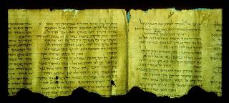
BETWEEN THE TESTAMENTS
DSS Commentary on Habakkuk

Slide 185
The Silent Years
The term “silent years” refers to the period between the Old and New Testaments.
It derives from the idea that after the last of the writing prophets (Malachi), no inspired prophetic voice was forthcoming (Josephus) until the ministry of John.
The expression “silent years” can be seriously misleading, however, in that it might suggest that nothing of importance happened in the four centuries between Malachi and the birth of Christ.
Most Christians have only a vague knowledge of what happened in this period.

Slide 186
History

Slide 187
The Historical Periods for the Jews
Persian (Archaemenid) Empire
539-331 BC
Grecian (Hellenistic) Empire
331-164 BC
Hasmoneans
164-63 BC
Romans
63 BC
500 400 300 200 100 0
331
Alexander the Great defeats Darius III
63
Pompey takes Palestine for Rome
450?
Malachi
168
Maccabean Revolt
4
Birth of Christ

Slide 188
The Diaspora
Following the exile and return, the Jews existed in three geographically separated communities (though there is evidence of communication between them).
EGYPT: Refugees from the Babylonian invasion established a community in Egypt (cf. Je. 42-44).
BABYLON: Many Jews in Babylon did not return to Judah but remained in the new communities they established in Mesopotamia (cf. Esther, Tobit).
JUDAH: Those who returned to Jerusalem established themselves around the 2nd temple (cf. Ezra, Nehemiah, 1 Esdras).

Slide 189
Key Historical Events in the Persian Period
Our knowledge of the Jews during the Persian Period after the close of the Old Testament is limited.
In 419, the so-called Passover Letter was sent to the Jewish community at Elephantine, Egypt ordering the Jews there to observe the Feast of Unleavened Bread.
The Samaritans became a distinct branch of Yahweh worshippers similar to but not the same as Judaism, building a rival temple on Mt. Gerizim (5th century BC).
Aramaic, which was the language of the Jews’ immediate neighbors, gradually was adopted by the Jews (though Hebrew was maintained for religious discourse).

Slide 190
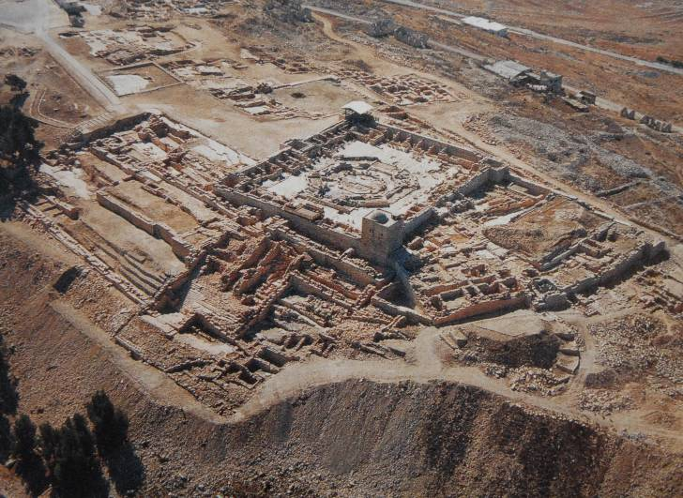
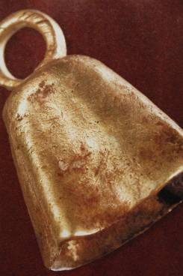
Archaeological excavations at Mt. Gerizim have not yet uncovered remains of the original Gerizim temple, but inscriptions in Aramaic as well as a bell of gold (appropriate for a priest, cf. Ex. 28:33-35) testify to its presence.

Slide 191
Key Historical Events in the Grecian Period
The Hellenistic Period began when Alexander the Great conquered Darius III of Persia in 331 BC (cf. Da. 8:1-7):
When Alexander died at the age of 33, his empire fragmented among his generals (cf. Da. 8:8).
Of these, Ptolemy seized control of Egypt and made Alexandria his capital.
Seleucus seized Babylon, extending his power westward into Syria.
Both rivals coveted Palestine and Phoenicia.

Slide 192
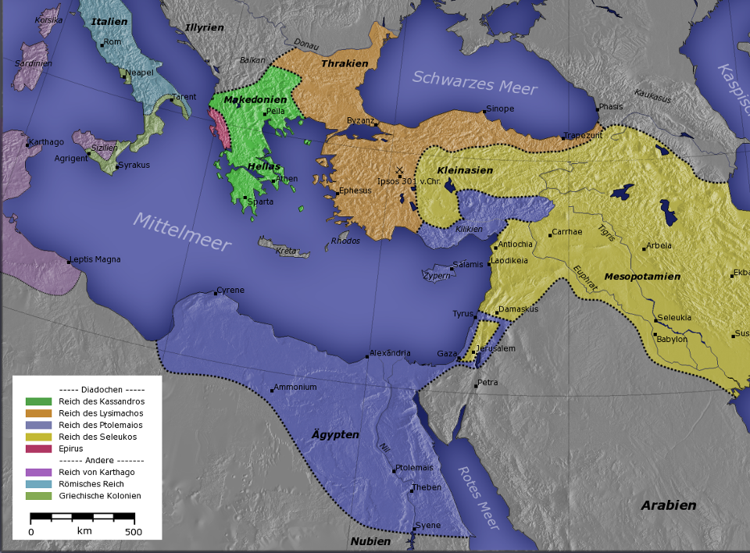
The Seleucid Empire
The Ptolemaic Empire
BREAKUP OF ALEXANDER’S EMPIRE

Slide 193
Grecian Period cont.--
Hellenism spread rapidly, and Greek became the primary language of the civilized world.
Little is known of the Jews in Palestine during the first century of the Hellenistic Period other than that they were under the jurisdiction of Ptolemy of Egypt.
The population of Jews in Egypt, however, increased sharply due to migration and prisoners of war.
The Jews in Egypt quickly adopted Greek as their language and by the close of the 3rd century BC had translated their Scriptures into Greek (the Septuagint).
Eventually, the Seleucids gained control of Palestine by the early 2nd century BC.

Slide 194
The Maccabean Revolt
One particular Seleucid ruler, Antiochus IV Epiphanes, began a concentrated enforcement of Greek culture upon the Jews in Palestine and a suppression of the Jewish faith.
In 168 BC he invaded Jerusalem.
He forbade the practice of Judaism, burning Torah scrolls and forcing Jews to eat swine flesh.
He erected a shrine to Zeus in the temple and offered swine flesh upon the altar, what Daniel would call “the abomination of desolation” (Da. 11:31; cf. 1 Maccabees 1:54).
This outrage precipitated a successful Jewish revolt for independence led by the Jewish family of the Maccabees.

Slide 195
Key Historical Events in the Hasmonean Period
In later Jewish literature, the family name “Hasmon” came to be used of the descendants of the Maccabees.
For the better part of a century the Hasmonean family experienced a period of independent rule over Judah.
John Hyrcanus (ruled 134-104 BC) seized the Samaritan territory and destroyed their rival temple.
A growing breach in Judaism began to emerge with two religious parties, the Pharisees and the Sadducees.
Due to political turbulence in Judah, Rome determined to interfere, and in 63 BC Pompey conquered Jerusalem.

Slide 196
Key Events in the Roman Period
Herod the Great traveled to Rome, where he was appointed king in 40 BC by Anthony.
It still remained for him to establish his kingship, since Antigonus, a Hasmonean, had taken control of Judah.
Herod returned to Palestine, put Jerusalem to siege, and with Roman help emerged the victor.
He ruled Palestine from 37-4 BC.
Beginning in 20 BC, he rebuilt the temple mount in Jerusalem.
He abolished the hereditary and life-time tenure of the Jerusalem High Priests, appointing priests as he saw fit.
In addition to the temple, his extensive building projects included several fortresses as well as Caesarea Maritima, which would become the administrative capital.

Slide 197
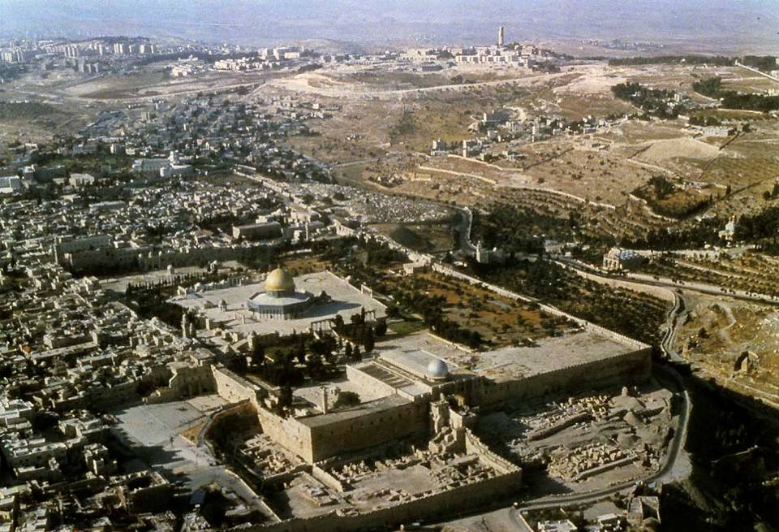
Herod’s Temple Mount enlargement

Slide 198
Institutions

Slide 199
Second Temple Judaism
The Judaism that developed during the Intertestamenal Period was diverse.
There was a gradual shift in the balance between temple and Torah so that the Torah carried more and more weight in Jewish life and religion.
No doubt, this was augmented by the heavy-handed leadership of John Hyrcanus and others as well as by the eventual appointment of the High Priests by Herod the Great.
It also was augmented by the development of the synagogues, the local centers for Torah teaching (though not for sacrifice).

Slide 200
The Temple
Despite the development of the synagogue, the temple continued as a spiritual center.
While there was dissatisfaction over the appointment of High Priests by Herod, the daily temple rituals and annual festivals, which were centered in the temple, continued to hold high value.
Only the Qumran Community maintained that the temple was altogether corrupt and to be rejected outright.

Slide 201
The Synagogues
Synagogues (= “assemblies”) were local places for Jewish prayer and worship.
Though their origin is obscure, they seem to have developed among the Diaspora, the earliest example discovered to date being in Egypt during the reign of Ptolemy III Euergetes (246-221 BC).
According to the Talmud, there were 80 synagogues in Jerusalem alone prior to AD 70.

Slide 202
The Sanhedrin
The Jerusalem Sanhedrin was patterned after the 70 elders in the time of Moses (Ex. 24:1; Dt. 27:1), the community headed by the priestly nobility in the time of Ezra and Nehemiah (cf. Ne. 2:16; 5:7) and the various Councils of Elders among the Diaspora.
It was permitted during the relative freedom of the Hellenistic Period.
Its power increased during the Hasmonean Period.
In 47 BC, it was assigned responsibility for the whole nation by Julius Caesar.
Under the Roman Procurators (AD 6-41), its power increased so that it became the supreme court of justice.

Slide 203
The Major Jewish Sects described by Flavius Josephus
Pharisees
Middle-class separatists
Lay theologians
Upheld both oral and written Torah
Closely allied with scribes (copyists)
Linked with the synagogues
Essenes
Ascetics with a high value on apocalyptic literature
Held that the priesthood was fully corrupt and saw themselves as the true Israel in exile
Qumran was possibly Essene
Sadducees
Upper-class, mostly priests
Upheld the supremacy of the written Torah
Primary influence in the Sanhedrin and Second Temple
Rejected resurrection & angels
Zealots
Patriotic freedom-fighters
Upheld Maccabean idealism
Opposition to Rome was an expression of zeal for the Torah
Central to the 1st and 2nd Jewish Revolts

Slide 204
The ‘Am Ha-aretz
Crxh mf
The “people of the land” were generally the poor, the peasants as opposed to the wealthy (there was no effective middle class).
These included small landowners who lived marginally, tenant farmers, hired laborers and beggars with a hand-to-mouth existence.
Mixed among them were various trades, such as, fishermen, carpenters and masons, as well as those with despised trades, such as, shepherds, dung-collectors, tanners, butchers, tax-collectors, etc.
Most lived in villages rather than urban areas.
Frequently, the ‘am ha-aretz were regarded as careless about scrupulous Torah observance, and therefore, “sinners.”

Slide 205
Texts

Slide 206
THE HEBREW BIBLE (Old Testament)
Three Collections (24 books total)
hrvt Myxybn Mybvtk
(Torah) (Nebiim) (Kethubim)
Genesis Former Prophets Psalms
Exodus Joshua Proverbs
Leviticus Judges Job
Numbers Samuel* Megilloth (five rolls)
Deuteronomy Kings* Song of Songs
Latter Prophets Ruth
Isaiah Lamentations
Jeremiah Esther
Ezekiel Ecclesiastes
The Twelve* Daniel
Ezra-Nehemiah*
Chronicles*
These 24 books are the same as the 39 in the English Old Testament.
* Originally appearing in single scrolls

Slide 207
TRANSLATIONS
Two important translations of the Hebrew
Scriptures enabled the Jews to hear their Bible in the vernacular.
The Septuagint (LXX), translated in Alexandria, Egypt ca. 250 BC, became the primary Bible of the Diaspora Jews, since Greek was the international language of the Hellenistic world.
The Targums, translated in Palestine, became the standard text of Aramaic-speaking synagogues.

Slide 208
ADDITIONAL WRITINGS
In addition to the three collections that became the Hebrew canon of Scripture, the Jews produced other important writings. These largely fall into two collections:
The Apocrypha
The Pseudepigrapha

Slide 209
THE DEAD SEA SCROLLS
Written between ca. 200 BC and 68 AD, a desert community at Qumran produced texts that subsequently were stored in clay jars and hidden in caves near the Dead Sea.
The Qumran scrolls were discovered in the late 1940s, and the texts were committed to various international scholars for translation and publication.
The full range of DSS texts only became generally available in the 1990s.

Slide 210
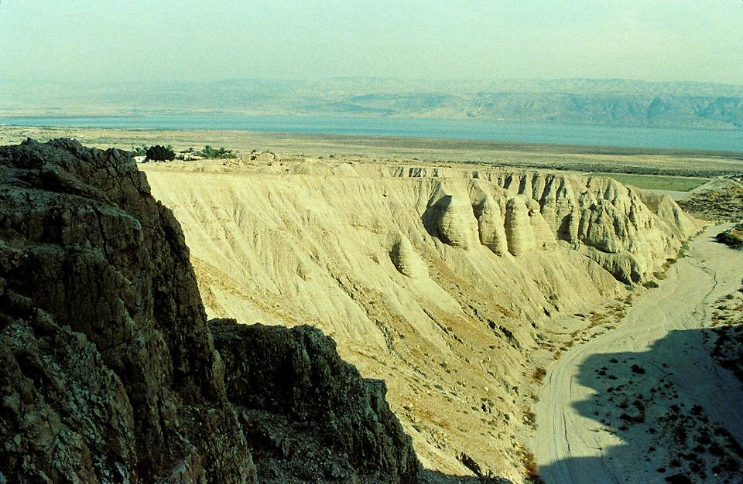
Qumran settlement (upper left) looking eastward toward the Dead Sea.

Slide 211
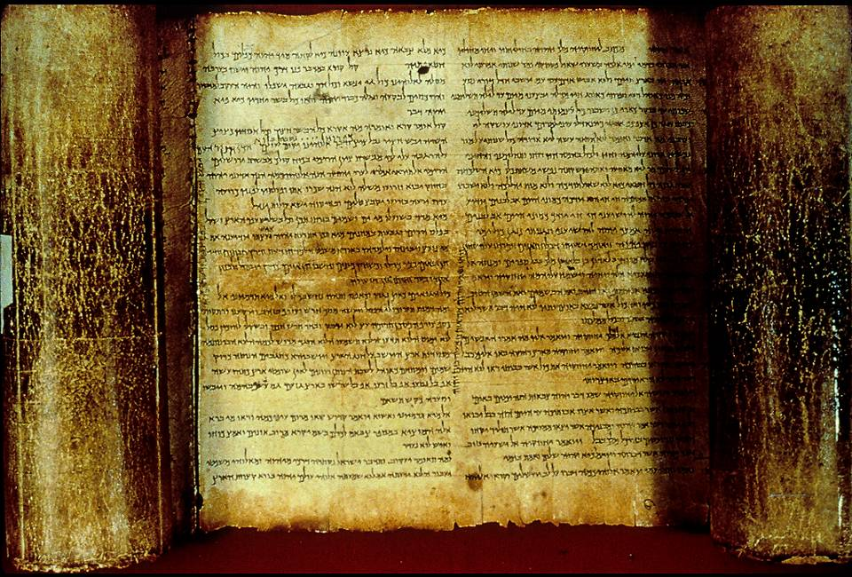
The Isaiah Scroll from Cave 1 contains all 66 chapters of Isaiah.

Slide 212
Oral Tradition
Though obviously not a physical text, the “Oral Torah” (oral tradition) eventually was codified and preserved as the Jewish Mishnah (2nd century AD) and finally incorporated into the Talmud (4th century).
This “tradition of the elders” was a mass of interpretation subsequent to the time of Ezra (cf. Mk. 7:3).
Some of these traditions aimed at forming a “fence” around the written Torah, strict cautionary rules by which a person would find himself halted before he was within striking distance of breaching the written Torah.
According to the Pharisees, the oral Torah was of equal authority to the written Torah and was believed to have been handed down through the generations since Moses.

Slide 213
Theology

Slide 214
MESSIANIC CONSCIOUSNESS
The Jewish messianic hope was shaped in the context of exile and restoration.
To be sure, there were early hints about a Coming One (cf. Ge. 3:15; 12:3; 49:10; Nu. 24:17; Dt. 18:18).
However, between Moses and the monarchy, there was virtually nothing directly contributing to this idea.
It was during the monarchy that the term Messiah (= the anointed one) came to be a common reference to the Israelite king (cf. 1 Sa. 12:3, 5; 16:6; 24:6, 10; 26:9, 11, 16, 23; 2 Sa. 1:14, 16).

Slide 215
The Ebed-Yahweh hvhy dbf
In the midst of the hope for restoration, several oracles appear describing a Coming One in new language—the language of Yahweh’s Servant.
In a preliminary sense, this “servant” was a collective figure for the whole nation which had terribly failed in its mission (Is. 41:8-10; 42:18-22, 25).
Nevertheless, Yahweh intended to blot out the nation’s transgressions and redeem it (Is. 43:1-7, 14-21, 25; 44:22-23).
The most remarkable aspect of this promise was the coming of a future Servant, an individual commissioned by Yahweh as his special representative (Is. 49:5).

Slide 216
The Mission of Yahweh’s Servant
This coming Servant of the Lord not only would bring Israel back to God, he would redeem the nations as well (Is. 49:6).
Though collectively the Israelite nation had failed as God’s servant, the coming Servant would never falter (Is. 42:1-7).
Though Israel had been stubborn and disobedient, the coming Servant would be obedient even to the point of vicarious suffering and death (Is. 50:4-9; 52:13—53:12).
Though the coming Servant is never titled “the messiah,” his mission would bring about the rebirth of the nation and the fulfillment of God’s unfailing promises to David (Is. 54:1-8; 55:3-5).

Slide 217
THE EXILE IS NOT OVER
With the Jewish community now scattered between Mesopotamia, Egypt, the Mediterranean and Judah, there was a sense that the exile was not over.
The northern tribes, for the most part, had disappeared, assimilated into Assyrian culture.
Even for those who returned to Jerusalem, the fact remained that they still were under Persian rule (cf. Ne. 9:36-37).
Daniel recast the 70 years of exile as 490 years—seventy “sevens” of exile (Da. 9:2, 24).

Slide 218
The Yoke of Heathen Rule
For most of the centuries succeeding the exile, the Jews remained under the hegemony of foreign rulers.
Under the empires of Persia, the Greek Ptolemies and Seleucids, and finally the Romans, the Jews were left with the bitter taste of subservience to pagans.
The century of independence under the Hasmoneans, even though it was an attempt to recapture the ancient ideal of the kingdom, fell far short.

Slide 219
Thy Kingdom Come
1st Century AD responses to the messianic vision of the prophets was varied:
The Herodians and Sadducees deemed collaboration with the Roman occupation a temporary, but necessary, expedient.
The Pharisees urged intensifying devotion to the Torah as the way to usher in God’s kingdom.
The Essenes and the Qumran Community withdrew into the desert to await an apocalyptic divine intervention.
Zealots urged that only immediate armed resistance to Rome was acceptable.
All sects still embraced the memories of the Maccabean success.

Slide 220
Waiting for the Consolation
It is therefore not surprising to hear Simeon, the old man in the temple, described as one “waiting for the consolation of Israel” (Lk. 2:25).
Mary’s Song celebrates the downfall of pagan rulers and God’s help for his servant Israel (Lk. 1:51-55).
The Song of Zechariah echoes this same hope for deliverance “from the hand of all who hate us” (Lk. 1:71-74).

Slide 221
…a man sent from God whose name was John…
When the Baptist came preaching in the desert of Judea that “the kingdom of God is near,” no one doubted what he was talking about.
Small wonder that everyone went out to the Jordan to hear him.
John’s consistent witness was that the Coming One would soon appear—and he soon would baptize with the fire of judgment!

Slide 222
The Jewish Revolts
Following the Maccabean ideal and concluding that Jesus was a failed messiah, the voices of armed rebellion eventually won out among the Palestinian Jews, leading to two revolts against Rome.
In AD 66-73, the Jews expelled the Romans from Palestine, but later succumbed to Vespasian and Titus.
  Jerusalem was retaken by the Romans and the temple destroyed in AD 70.
  The final resistance force at the Masada fortress by the Dead Sea committed mass suicide in AD 73.
In AD 132-135, Simeon bar Kosiba led a second revolt against Rome resulting in death, defeat and thousands of Jews sold into slavery. Jerusalem was destroyed, and in its place, the Romans built Aelia Capitolina, a Roman city.

Slide 223
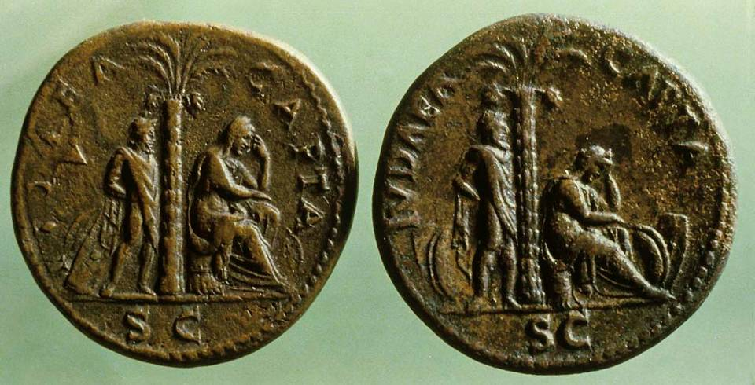
Coins, minted and distributed throughout all the Roman provinces after AD 70 with the text “Judaea Capta,” depicted a bound Jewish captive and a mourning woman. This series of coins was larger than any other minted by the Romans in celebrating a victory.

Slide 224
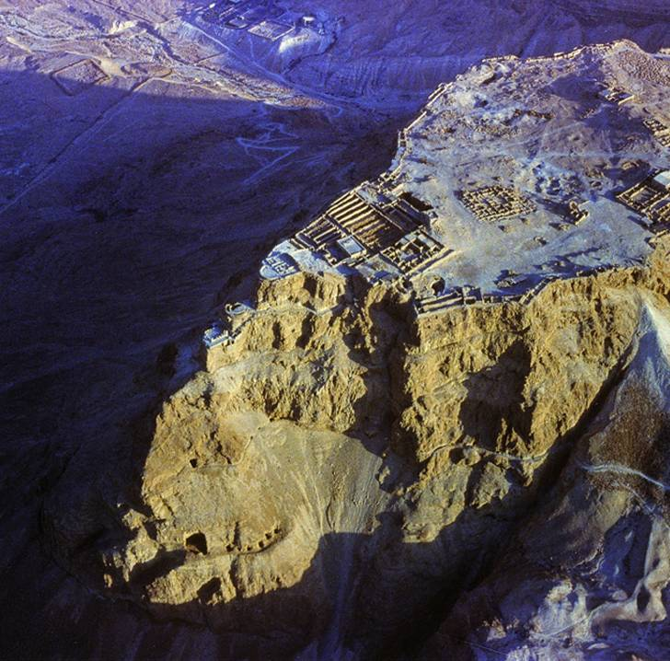
Masada
This 400’ high rocky escarpment near the Dead Sea was the last holdout for Jews in the 1st revolt. Originally constructed by Herod the Great, the nearly impregnable fortress enabled the last of Jewish resistance to hold out against the Romans for three years. When the Romans finally breached the stronghold, the Jewish rebels all had committed suicide.

Slide 225
Two Paths into the Future without temple, land or Jewish sovereignty
Jesus
Prediction: the temple will be destroyed!
The body of Christians become the temple of the Holy Spirit.
Worship and good deeds become the daily sacrifice.
Every believer is a priest before God.
Atonement for sin has been completed once, for all, on the cross.
Judaism
The reality: the temple WAS destroyed!
The synagogue succeeds the temple.
Daily prayer replaces the daily sacrifice.
The rabbis inherit the authority of the priests.
Altar of atonement is replaced by the family table.

