Slide 1
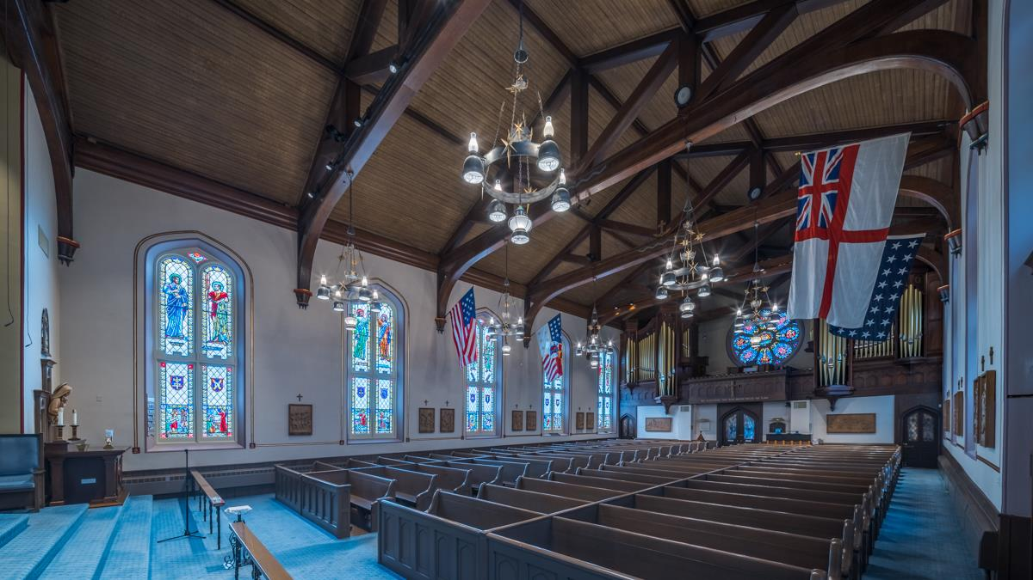
Christ in the Old Testament

Slide 2
“You are not yet fifty years old,” the Jews said to him, “and you have seen Abraham?”
“Amen, amen, I tell you,” Jesus answered, “before Abraham was, I am!”
Jn. 8:57-58

Slide 3
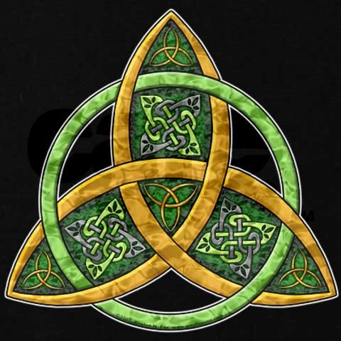
The Trinity in the old testament
The word “Trinity” as used to describe the triune God emerges in the late 2nd Century.
Tertullian coined the phrase “three persons in one substance,” which became the standard language for describing the Trinity.
God is one with respect to his nature; he is three with respect to his inner Being, Father, Son, and Holy Spirit.
It is because God is Trinity that we can expect to find Christ in the Old Testament.
Irish Celtic symbol of the Trinity

Slide 4
THERE IS BUT ONE GOD
Israel’s basic confession of faith (the Shema) was that God is one. There are several possible translations of the Hebrew sentence in Deut. 6:4, but all point to the basic idea that God is one.
dHAx, hv!hy4 Unhelox$ hvAhy4
Yahweh our God, Yahweh is one! (NIV)
Yahweh our God is one Yahweh! (RSV)
Yahweh is our God, Yahweh alone! (NAB)
Yahweh is our God, one Yahweh! (NEB)
Yahweh is our God, Yahweh is one! (NASB)

Slide 5
GOD IS A COMPLEX ONE
The word “one” in Hebrew is not merely mathematical, but it is also used to describe a unity, which is to say, a complex “one.”
It is the word used to speak of marriage in which the man and the woman are united into one flesh (Gen. 2:24).
It is the word used to describe all the manufactured pieces of the Tabernacle so that when it was set up, it is stated, “The Tabernacle is one.”

Slide 6
ELOHIM
This complex “one” is especially to be seen in the most common word for “God” in the Hebrew Bible.
The word “Elohim” is a plural, but when it is used to refer to Yahweh God, it takes a singular verb. (Only when it refers to pagan gods does it have a plural verb form.)
Hence, the Jewish people, and later Christians, always have understood this to be a plurality of majesty, i.e., the God who possesses every conceivable attribute of authority and power.

Slide 7
PLURAL PRONOUNS
At various times, plural pronouns are used, which also points to a complex “one.”
“Let us make man in our likeness…” (Gen. 1:26)
“The human has become like one of us, knowing good and evil” (Gen. 3:22).
“Come, let us go down and confuse their language…” (Gen. 11:7).
“Whom shall I send? Who will go for us?” (Isa. 6:8)
IT IS BECAUSE GOD IS A COMPLEX “ONE” THAT WE ARE ABLE TO FIND CHRIST IN THE OLD TESTAMENT.

Slide 8
Discussion
How does the capacity of God as the “three-in-one” help us to understand the concept of love?
On the night before his death, Jesus prayed, “Father…you loved me before the creation of the world” (Jn. 17:24b). What does this prayer say about the Son and the Father?

Slide 9
“And God said, ‘Let there be…’” Gen. 1:3
“In the beginning was the Word, and the Word was with God, and the Word was God.”
Jn. 1:1

Slide 10
The agent of creation
The confession of New Testament writers is that the entire creation was accomplished through Christ, the Son.
“All things were made by him, and apart from him was not anything made that was made” (Jn. 1:3).
“By him all things were created: things in heaven and on earth” (Col. 1:15).
“The Son…laid the foundations of the earth, and the heavens are the work of you [his] hands” (Psa. 102:25-27; Heb. 1:10-12).

Slide 11
WISDOM, THE CRAFTSMAN AT GOD’S SIDE
Wisdom, which we normally think of as an attribute, is personified as the craftsman at God’s side (Pro. 8:30). Wisdom is “Someone.”
“Yahweh possessed me at the beginning of his work…” (Pro. 8:22).
“I was appointed from eternity…before the world began” (Pro. 8:23).
“I was there when he set the heavens in place…” (Pro. 8:27).
“I was the craftsman at his side…” (Prov. 8:30).
“CHRIST THE POWER OF GOD AND THE WISDOM OF GOD” (1 Cor. 1:24b)

Slide 12
GOD SPEAKS TO GOD
At various times, one finds the Persons of the Trinity in dialogue.
“Yahweh says to Adonay, ‘Sit at my right hand until I make your enemies a footstool for your feet”” (Psa. 110:1).
“Your throne, O God, will last forever and ever…therefore God, your God, has set you above your companions…” (Psa. 45:6-7). The Book of Hebrews says that this passage was “about the Son” (Heb. 1:8).
BECAUSE THERE IS ONLY ONE GOD, WE MUST UNDERSTAND SUCH DIALOGUE BETWEEN THE FATHER AND THE SON TO BE WITHIN GOD’S INNER BEING.

Slide 13
THE ANGEL OF THE LORD
By far, the most extensive appearances of Christ in the Old Testament are as the Angel of the LORD.
Three terms are used for this figure:
  Mal’ak Yahweh (The Angel of the LORD)
  Mal’ak ha-Elohim (The Angel of God)
  Mal’ak Panim (The Angel of the Face)
This Angel is a Theophany who appears to perpetuate God’s covenant and to protect his people.

Slide 14
Theophanies
…Yahweh appeared to Abram…so he built an altar there… (12:7)
A theophany (= God shining, God appearing) bridges the gap between YHWH as invisible Spirit and YHWH as one who reveals himself.
DEFINING NORMS:
YHWH cannot be seen by humans (Ex. 19:21; 33:20).
He takes the initiative to reveal himself in temporary self-disclosures as
the Mal’ak Yahweh (Angel of the LORD) and other forms.

Slide 15
THE BURNING BUSH
The Angel speaks as God to Moses from the burning bush.
God’s call to Moses, when he revealed himself as the great “I AM” (Ex. 3:14), came in the form of the Angel of the LORD (Ex. 3:2).
When the Angel spoke, he said, “I am the God of your father, the God of Abraham, the God of Isaac, and the God of Jacob” (Ex. 3:6). As Yahweh, he continued to speak to Moses (Ex. 3:7).
This fluidity between the Angel and God himself, as later worded in the Nicene Creed, is “God of God…very God of very God.”

Slide 16
THE ANGEL WHO SPEAKS FOR GOD AND AS GOD
The interchangeability between the Angel and God—the movement between the 1st person and 3rd person—suggests that when one has seen the Angel, in some sense, he/she has seen God.
The Angel can say to Hagar, “Yahweh had heard of your misery…” (Gen. 16:11), but she would later say, “You are the God who sees me,” and she named the place Beer Lahai Roi (= the well of the Living One who sees me).
Jacob, also, wrestled with a “man” (whom later the prophet Hosea would described as the “Angel,” Ho. 12:4), but he later would say, “I saw God face to face” and would name the place Peniel (= face of God).
To Gideon, the Angel can speak both “for” God (Jg. 6:12) but also “as” God (Jg. 6:14).

Slide 17
THE CHURCH FATHERS REGULARLY UNDERSTOOD THE ANGEL OF YAHWEH TO BE christ, THE SECOND PERSON OF THE TRINITY.
This is the One who shepherded Jacob all his life (Gen. 48:15-16), who in apposition is called both “Elohim” but also “the Angel” (Gen. 48:15).
The Angel of his Face led the Israelites out of Egypt, redeeming them in mercy and love (Isa. 63:9).
He would lead them all the way to the land of Canaan (E.x. 23:20, 23).
He would rescue Hezekiah and Jerusalem from Sennacherib (Isa. 37:36).
He would intercede for Israel (Zec. 1:12-13).

Slide 18
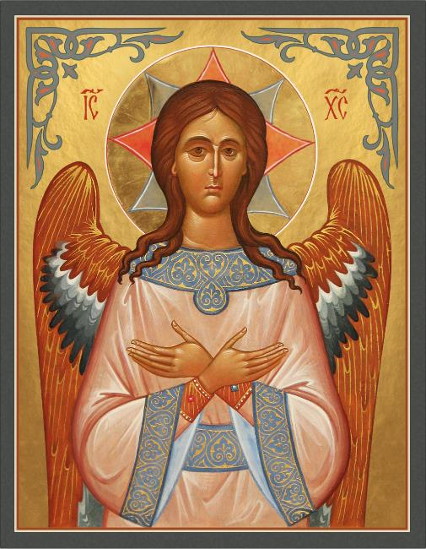
RUSSIAN ORTHODOX ICON OF THE ANGEL OF THE LORD AS CHRIST
The wings denote the Angel.
The Greek Letters IC and XC are common abbreviations for “Jesus” and “Christ” in the early Greek manuscripts of the New Testament; later, they are used in Christian art.

Slide 19
Jacob’s ladder
When Jacob fled northward, he slept and dreamed of a stairway between heaven and earth (Gen. 28).
Yahweh stood above the stairway, and angels ascended and descended between heaven and earth.
What is especially important is that Jesus emphatically identified himself as the ladder between heaven and earth (Jn. 1:50-51). As such, he is the gate of heaven and the mediator between humans and God.

Slide 20
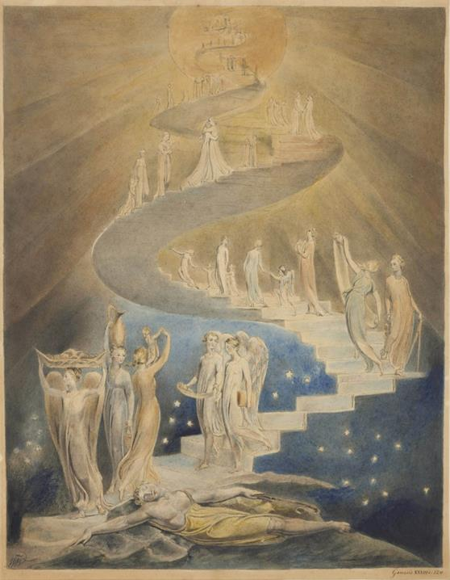
INK and WATERCOLOR BY WILLIAM BLAKE, ENGLISH POET AND ARTIST (ca. 1800)
British Museum, London

Slide 21
The rock was christ
When the Israelites had no water, Moses was instructed by God to take his staff and walk forward until he found a rock (Ex. 17:1-6).
He would see Yahweh standing on this rock.
He was to strike the rock, and water would gush out to sustain the people.
Obviously, some kind of theophany is intended, but what is most fascinating is St. Paul’s explanation: “They all…drank from the same spiritual drink; for they drank from the spiritual rock that accompanied them, and that rock was Christ” (1 Co. 10:3-4).

Slide 22
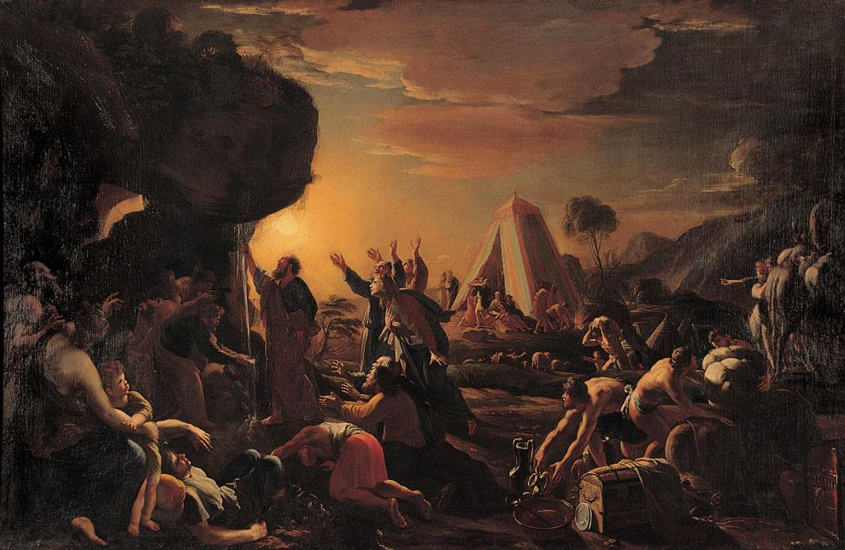
French artist Francois Perrier (painted in 1642)

