Slide 1
POETRY AND WISDOM
Hebrew Poetry, Wisdom Literature

Slide 2
The English Old Testament
Prophecy
Isaiah
Jeremiah
Lamentations
Ezekiel
Daniel
Hosea
Joel
Amos
Obadiah
Jonah
Micah
Nahum
Habakkuk
Zephaniah
Haggai
Zechariah
Malachi
Pentateuch
Genesis
Exodus
Leviticus
Numbers
Deuteronomy
History
Joshua
Judges
Ruth
1 & 2 Samuel
1 & 2 Kings
1 & 2 Chronicles
Ezra
Nehemiah
Esther
Poetry
Job
Psalms
Proverbs
Ecclesiastes
Song of Songs

Slide 3
THE HEBREW BIBLE (Old Testament)
Three Collections
These 24 books are the same as the 39 in the English Old Testament.
hrvt Myxybn Mybvtk
(Torah) (Nebiim) (Kethubim)
Genesis Former Prophets Psalms*
Exodus Joshua Proverbs*
Leviticus Judges Job*
Numbers Samuel Megilloth (five rolls)
Deuteronomy Kings Song of Songs*
Latter Prophets Ruth
Isaiah* Lamentations*
Jeremiah* Esther
Ezekiel* Ecclesiastes*
The Twelve* Daniel
Ezra-Nehemiah
Chronicles
* Substantial amounts of poetry

Slide 4
Biblical Poetic Books
While it is customary to categorize several books as “poetical” (Job, Psalms, Proverbs, Ecclesiastes and the Song), it should be noted that poetry is not confined to these books.
Much of the literature in the Prophets is poetic, also.
Various smaller units in the Law of Moses and even other biblical books contain poetry as well.

Slide 5
It usually is assumed that the three collections in the Hebrew Bible reflect successive stages in the growth of the Hebrew Scriptures and the order in which they came to be recognized as sacred and authoritative.
Even if this assumption is correct, it should be noted that the Psalms may contain material that is older even than other sections of the Hebrew Bible that are theoretically earlier.
In the Greek and Latin versions of the Hebrew Bible, the division between the Prophets and the Writings has disappeared, while the various books have been rearranged along topical and/or chronological lines.

Slide 6
Written Oracles
Development of Literacy in the Ancient Near East
Writing is known from about 3000 BC.
Most early writing was the provenance of specialists (scribes) supported by the state.
Public written documents were not for general reading but were displays of royal power and authority.
Israelite society, like most others, was essentially an oral society.
In about the 12th century BC, the Semitic alphabet was standardized to 22 letters, written horizontally from right to left.
From about the 10th century BC, Hebrew was written in paleo-Hebrew script.
Widespread literacy occurred in about the 8th century BC, largely due to urbanization and Assyrian bureaucracy.

Slide 7
Period of Hezekiah
(8th century BC)
Explosion of written texts in the historical and archaeological record
Collections of proverbs (Pro. 25:1), a pattern that probably was repeated for the Psalms (cf. 2 Chr. 29:30).
Refugees swelled Jerusalem after the exile of the north.
Writing appears on ostraca, tombs and pots; graffiti appears.
Official communications were issued by royal letter to outlying towns (2 Chr. 30:1).
Libraries were built in all Assyrian provinces
Rediscovery of an important Torah text (2 Kg. 22; 2 Chr. 34)

Slide 8
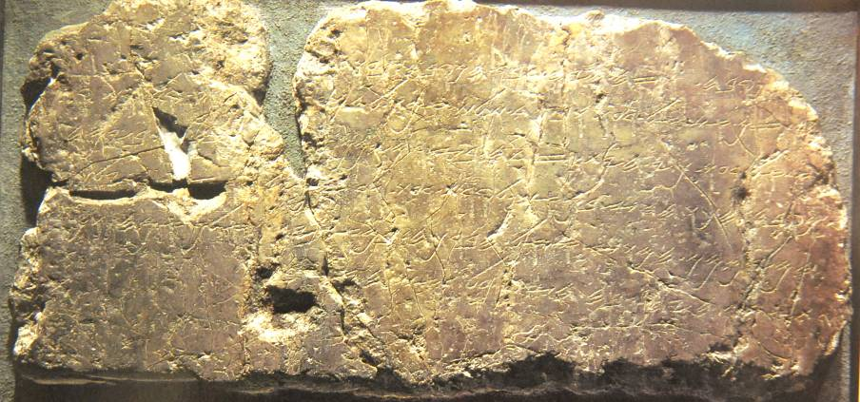
Siloam Inscription describes the building of a water tunnel under Jerusalem between the Gihon Spring on the east and the Pool of Siloam on the west (ca. 701 BC)
Imperial Museum, Istanbul

Slide 9
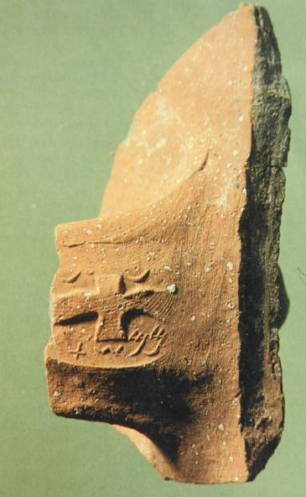
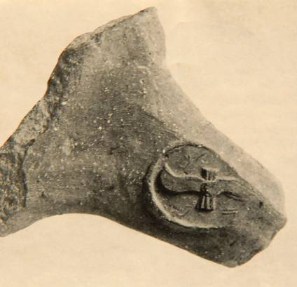
Lamelek Jars
Jar handles (8th century BC, probably during the reign of Hezekiah) stamped with royal insignia (winged sun disk) and the words “belonging to the king”
Nearly 1000 have been excavated to date
Presumes a growing literacy

Slide 10
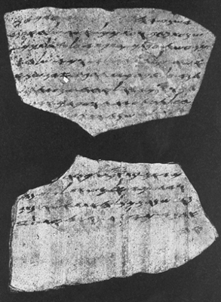
Lachish Letter
One of twenty-two inscribed ostraca dating to the final days of Judah’s monarchy, several written by the same hand
Letter No. 4 describes both Azekah and Lachish (cf. Je. 34:6-7) as the only remaining fortresses protecting Jerusalem from the Babylonian armies.
Israel Department of Antiquities and Museums

Slide 11
A little exercise in consonantal text…
Standard Hebrew square text without vowel points (written right to left with word spacing)
rsHx xl yfr hvhy
Ynlhny tvHnm ym-lf yncyBry xwD tvxnB

Slide 12
English consonantal text without vowels or word spacing (written right to left)
tnwtnllhsdrhphsmsdrlht
srtspnrgnnwdltmhtkmh
srtwlltshtdsbmhtdlh
English consonantal text without vowels or word spacing (written left to right)
thlrdsmshphrdshllntwnt
hmkthmtldwnngrnpstrs
hldthmbsdthstllwtrs

Slide 13
English consonantal text with word spacing but no vowels (written left to right)
Th lrd s m shphrd shll nt wnt
H mkth m t l dwn n grn pstrs
H ldth m bsd th stll wtrs
English consonantal text with word spacing and vowel subscripts (written left to right)
Th_{e} l_{o}rd _{i}s m_{y} sh_{e}ph_{e}rd; _{I} sh_{a}ll n_{o}t w_{a}nt.
H_{e} m_{a}k_{e}th m_{e} t_{o} l_{ie} d_{o}wn _{i}n gr_{ee}n p_{a}st_{u}r_{e}s
H_{e} l_{ea}d_{e}th m_{e} b_{e}s_{i}d_{e} th_{e} st_{i}ll w_{a}t_{e}rs

Slide 14
Hebrew Poetry
Poetry is literature written in meter. General characteristics of Hebrew poetry include:
Rhythm (accented language)
Meter (patterns of verse)
Rhyme (repetitive elements)
Lyrical style (expression of deep personal feelings and emotion)
Metaphorical language (words become symbols of other entities)

Slide 15
Why poetry?
In an oral society, poetry, due to its repetitive features in rhythm, rhyme and meter, is more easily memorized than prose.
Poets are linguistic artists who, in addition to the mechanical features of their craft, draw for their listeners striking word pictures.
They offer analogies, insights and reflections that we might not otherwise notice.
They call upon the listener to think more deeply about life and reality.

Slide 16
Some features of Hebrew poetry are nearly impossible to reproduce in a second language.
Insofar as poetical structures depend upon phonetic devices, such as, puns, assonance, rhyme, alliteration, onomatopoeia, and the like, a second language is largely incapable of reproducing such elements from the donor language.
However, because Hebrew poetry emphasizes the “rhyming” or relationship of ideas (as opposed merely to the rhyming of sounds), such elements are capable of being understood in a second language.
This “rhyming” of ideas is called parallelism, and it is the most distinctive feature of biblical Hebrew poetry. Several types are observable.

Slide 17
Synonymous or Congruent Parallelism (symmetrical)
(A₁, A₂ // A₁, A₂, etc.)
Come let us sing for joy to Yahweh;
Let us shout aloud to the Rock of our salvation.
Psalm 95:1
God presides in the great assembly;
He gives judgment among the “gods”.
Psalm 82:1

Slide 18
Antithetic Parallelism (Assymetrical)
(A₁, A₂// -A₁, -A₂, etc.)
For Yahweh watches over the way of the righteous,
But the way of the wicked will perish.
Psalm 1:6
They provoked Yahweh to anger by their wicked deeds,
and a plague broke out among them.
But Phinehas stood up and intervened,
and the plague was checked.
Psalm 106:29-30

Slide 19
Staircase Parallelism (the sentence is started, then interrupted, then started again)
(A_{b}A)
When the waters saw you, God,
The waters saw you and writhed;
Psalm 77:16
The seas have lifted up, O LORD,
the seas have lifted up their voice;
the seas have lifted up their pounding waves.
Psalm 93:3

Slide 20
Chiasm (inverted)
(ABA, ABBA, ABCBA, ABCDEDCBA, etc.)
Yahweh’s right hand has done mighty things!
Yahweh’s right hand is lifted high;
Yahweh’s right hand has done mighty things!
Psalm 118:15b-16
His mischief returns upon his own head,
and on his own pate his violence descends.
Psalm 7:16 (RSV)
(some translations either miss or ignore the chiasmus in the Hebrew text, (e.g. NIV)

Slide 21
Acrostics (cola begin with the letters of the alphabet in order)
x b g d h v z H F y k l m n s f p c q r w t
Psalm 111
bbAle-lkAB; Hv!hy4 hd@Ox
:hdAfev4 Myr9wy4 dOsB;
hv!hy4 yWef3ma MylidoG;
Mh,ycep;H,-lkAl; Mywiv0rD;
Olf#PA rdAhAv4-dOh
dfalA td@m,fo Otq!d4civ4
vytAxol;p;nil; hWAfA rk,ze
etc.
I will extol Yahweh with all my heart
In the council of the upright and in the assembly.
Great are the works of Yahweh,
They are pondered by all who delight in them.
Glorious and majestic are his deeds,
And his righteousness endures forever.
He has caused his wonders to be remembered;

Slide 22
Metaphorical Language
Metaphors must be understood in the context of the original language. Such language invites refection in order to perceive why an analogy is being made. The analogy may not be obvious.
American Examples
to bend over backwards (= to try very hard)
to talk turkey (= to get to the heart of a matter)
to have a screw loose (= to think or behave irrationally)
French Examples
je ne peux pas le sentir ( = I can’t smell him, i.e., he annoys me)
il est un bouseux (= he is cow dung, i.e., he is uncultured)
il a les chevilles enflees (= he has swollen ankles, i.e., he is proud)

Slide 23
Hebrew Metaphors
Yahweh is my shepherd. (Psa. 23:1; cf. 80:1)
“Shepherd” is a metaphor for leadership, especially kingship, in the ANE.
The metaphor speaks of leadership and protection.
I am a worm and not a man. (Psa. 22:6)
Worms were perceived as the lowest of living creatures, generally helpless against all other things (cf. Job 25:6).
Worms were associated with the grave and the dead (Job 17:13-14).
I sink in the miry depths, where there is no foothold. I have come into the deep waters; the floods engulf me. (Psa. 69:2, 14)
Drowning is a common symbol of overwhelming trouble and the threat of death (cf. Psa. 18:16; 124:3-5; 144:7).
Water also was commonly associated with the underworld in the ANE, so “the waters” symbolize the very clutch of the realm of the dead.

Slide 24
Other Figures of Speech
Simile (analogy using “as” or “like”):
“I eat ashes like bread” (Ps. 102:9).
“As the eyes of slaves look to the hand of their master…so our eyes look to Yahweh our God” (Ps. 123:2).
“As for man, his days are like grass” (Ps. 103:15a).
“Your righteousness is like the mighty mountains…” (Ps. 36:6a)
Some similes are extended:
“He is like a tree planted by streams of water…” (Ps. 1:3)
“…unity…is like precious oil poured on the head, running down on the beard, running down on Aaron’s robes” (Ps. 133:2).

Slide 25
Personification (attributing living expressions to inanimate objects)
“…the mountains skipped like rams, the hills like lambs” (Ps. 114:4, 6).
“Praise him, sun and moon, praise him, all you shining stars” (Ps. 148:3)
Irony/Sarcasm (expressing one thing when the opposite is expected or intended)
“…’You are gods’…but you will die like mere men” (Ps. 82:6-7)
“Why do you boast of evil, you mighty man?” (Ps. 52:1)
Metonomy/Synecdoche (using an associated word to represent the object intended; using a part to signify the whole or vice versa)
“I will make…your throne firm” [throne = dynasty] (Ps. 89:4b)
“Your face, Yahweh, I will seek!” [face = God] (Ps. 27:8)

Slide 26
Apostrophe (an address to a person or a thing regarded as a person)
“Why are you downcast, O my soul?” (Ps. 42:11)
“O Daughter of Babylon, doomed to destruction…” (Ps. 137:8)
Hyperbole (intentional overstatement in order to add emphasis)
“He rained meat down on them like dust…” (Ps.78:27)
“They have poured out blood like water…” (Ps. 79:3)
Merismus (where a totality is expressed in abbreviated form)
“The sea…the dry land…” [= whole universe] (Ps. 95:5).
“…cattle on a thousand hills…” [= all the cattle in the world] (Ps. 50:10b)

Slide 27
Hendiadys (two substantives joined by a conjunction intended to express a single but complex idea)
“Trembling and fear came upon me.” (Ps. 55:5)
“When can I go and meet the face of God?” (Ps. 42:2)
Rhetorical Questions (posing a question that requires an obvious answer)
“Does he who implanted the ear not hear?” Ps. 94:9)
“Why was it, O sea, that you fled…?” (Ps. 114:5)

Slide 28
Other Poetic Devices
Inclusio (marking off a section by a common element at the beginning and end)
“O Yahweh, our Adonay, how majestic is your name in all the earth” (Ps. 8:1, 9).
“Give thanks to Yahweh, for he is good…” (Ps. 118:1, 29).
Key Word Repetition
The noun “voice” (lOq) in Psalm 29
The verb “watch” (rmawA) in Psalm 121
Refrain (repeating element within the poem)
“May the peoples praise you, O God…” (Ps. 67:3, 5).
“Restore us, O God; make your face shine upon us” (Ps. 80:3, 7, 19).
“Then they cried out to the LORD in their trouble…” (107:6, 13, 19, 28); “Let them give thanks…” (107:8, 15, 21, 31).

Slide 29
WISDOM LITERATURE
Wisdom in the ancient Near East was the practical art of being skillful and successful in life.
Wise persons, the MkAHA (both men and women, cf. 2 Sa. 14:2; 20:16), are listed alongside prophets and priests as prominent resources for practical and spiritual guidance (cf. Je. 18:18).
The Proverbs, for instance, are the collected wisdom of Israel’s wise persons, including Solomon (1:1), Agur (30:1), Lemuel (31:1) and others (22:17; 24:23).
Ecclesiastes, on the other hand, aims at a more philosophical analysis of what it would mean to live as a practical atheist.
The Book of Job is concerned with the problem of innocent suffering in the world.
The Song is a celebration of marriage and conjugal love.

Slide 30
Sapiential works
Following are those works in Hebrew literature belonging to the genre of “Wisdom Literature”
IN THE HEBREW BIBLE
Job
Psalms
Proverbs
Song of Songs
Ecclesiastes
IN THE SEPTUAGINT
Sirach
Wisdom of Solomon
Those in the Hebrew Bible are canonical for all Christians. In addition, those in the Septuagint are canonical for Roman Catholics and the Eastern Orthodox.

Slide 31
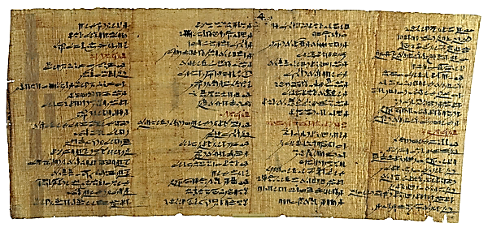
Ancient Wisdom
Instruction of Amenemope, ca. 1000 BC, more or less the time of Solomon; contains various proverbs and wisdom in the form of advice for successful living from a father to a son.
Collected wisdom was known throughout the ancient Near East.
Such wisdom generally carried common themes.
The “Instruction of Amenemope” (Egyptian) has striking parallels with several proverbs from the Bible.

Slide 32
Similar lines
“Have I not written for you thirty sayings of counsel and knowledge?” (Pro. 22:20)
“Look to these thirty chapters; they inform, they educate.” (Amenenope, Chapter 30, line 539)
”Incline thine ear, and hear the words of the wise, And apply thine heart to my doctrine; For it is pleasant if thou keep them in thy belly, that they may be established together upon thy lips.“ (Pro. 22:17-18)
”Give thine ear, and hear what I say, And apply thine heart to apprehend; It is good for thee to place them in thine heart, let them rest in the casket of thy belly; That they may act as a peg upon thy tongue.” (Amenenope, Chaper 1)
Enough such parallels exist between Proverbs and Amenenope to cause scholars to speculate on some amount of literary relationship between them.

Slide 33
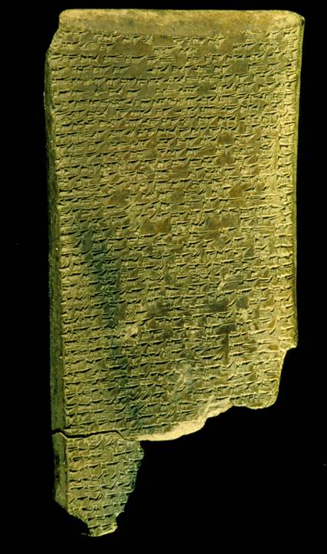
This lengthy Babylonian poem describes the plight of a righteous sufferer and the eventual restoration of his fortunes. The composition has the form of an extended monologue uttered by an aristocratic devotee of Marduk, the god of Babylon. The opening line, from which the poem took its ancient name, is addressed to Marduk: Ludlul bel nemeqi, "Let me praise the lord of wisdom!"
BABYLONIAN JOB TABLET
the plight of an innocent sufferer
The British Museum, London

Slide 34
Babylonian Job Tablet
In Tablet II (the tablet previously shown) the sufferer complains that his situation is like that of someone who has behaved impiously or irreligiously, whereas he has lived as a model of piety and reverence. This leads him to wonder if this way of life is really the behavior the gods want, and he contemplates, in Job-like fashion, the incomprehensibility of the divine will:
  ”I wish I knew that these things are pleasing to a god!”
  “What seems good to oneself may be a sin to a god.”
  “What in one's own heart seems objectionable may be good to a god.”
  “Who can comprehend the purpose of the gods in the sky?”
  “Who can fathom the plan of the gods of the underworld?”
  “Where have the masses ever understood the way of a god?”
This tablet testifies to the widespread genre of wisdom literature seeking to answer philosophical and existential questions. Biblical books like Job and Ecclesiastes fall into this larger genre of literature as well.

Slide 35
Structure
Works of Hebrew wisdom may or may not have a literary structure.
The Book of Proverbs comes from various authors and periods (1:1; 22:17; 24:23; 30:1; 31:1) and does not have a narrative structure, though there is one editorial note to indicate when one section was first collected (25:1).
Job, on the other hand, has a clear structure of cyclical conversations, and while the short opening and epilogue are narratives, the large central part is poetic.
Structure is more debatable in the Song and Ecclesiastes, some scholars arguing for structure and others doubtful.

Slide 36
Character of Hebrew wisdom
Hebrew wisdom is essential practical—wisdom for how to live successfully in life—and it should not be confused with the New Testament spiritual gift of wisdom.
Proverbs, for instance, are short, pithy sayings that invite meditation: most are 25 words or less.
Typically, they express a general truth that will be applicable most of the time; however, proverbs are not the same as promises nor are they the same as law.
Often, proverbs have implied applications (i.e., what is true in one situation is likely to be true in others).

Slide 37
Distinguishing Between Law, Promise & Proverb
Everyone who calls on the name of the Lord will be saved (Ro. 10:13). Promise
From evil doers come evil deeds (1 Sa. 24:13). Proverb
Do not repay anyone evil for evil (Ro. 12:17). Law
The fathers eat sour grapes, and the children’s teeth are set on edge (Eze. 18:2). Proverb
Physician, heal yourself (Lk. 4:23)! Proverb
If a man is found sleeping with another man’s wife…both shall die (Dt. 22:22). Law
Yahweh your God will never leave you nor forsake you (Dt. 31:6). Promise
Bad company corrupts good character (1 Co. 15:33). Proverb

Slide 38
Word Groups
Word groups evoke comparisons and contrasts, such as:
Wisdom/understanding/training/instruction/learning
Fool/folly/the simple
Mocker/the proud
Friend/neighbor/brother
Father/mother/son/child/ parent
Words/tongue/slander/truthful/gossip/falsehood/honest
Correction/rebuke
Life/death

Slide 39
Purpose & Perspective
PERSPECTIVES
Students:
…for acquiring a disciplined and prudent life, doing what is right and just and fair (Pro. 1:3)
Teachers:
…for giving prudence to the simple, knowledge and discretion to the young (Pro. 1:4)
The Wise:
…let the wise listen and add to their learning (Pro. 1:5)
PURPOSE
Moral:
…for attaining wisdom and discipline (Pro.1:2a)
Mental:
…for understanding words of insight (Pro. 1:2b)

Slide 40
Moral and Mental
Which of the following proverbs work toward moral development, and which work toward skills of discernment?
As iron sharpens iron, so one man sharpens another (Pro. 27:17). Discernment
Do not exploit the poor…for Yahweh will take up their cause (Pro. 22:22-23). Moral Development
A truthful witness does not deceive, but a false witness pours out lies (Pro. 14:5). Discernment
One man pretends to be rich, yet has nothing; another pretends to be poor, yet has great wealth (Pro. 13:7). Discernment
The eyes of Yahweh are everywhere, keeping watch on the wicked and the good (Pro. 15:3). Moral Development

Slide 41
Above All
The fear of the LORD…
...is the beginning of wisdom (Pro. 1:7; 9:10)

