Slide 1

THE CHRISTIAN CHURCH
Its peoples, theologies, and practices
A Short History
PART 1: From the Apostles to the Renaissance

Slide 2
INDEX (2-3)
The Apostolic Period (4-5)
The New Israel (6-7)
Crossing Barriers (8-18)
The Pauline Churches in the Roman World (19)
The Church and the Churches (20)
The AnteNicene Church (21)
Transition from apostolic to post-apostolic (22-24)
The Separation from Judaism (25-30)
The Apostolic Fathers (Clement, Ignatius, Polycarp) (31-34)
Early Christian Worship (35-43)
Developments and Variations (44-46)
Defining Orthodoxy (47-49)
Scriptural Texts, Readers, and Canon (50-72)
The Apologists (Justin Martyr, Irenaeus) (73)
The Ante-Nicene Fathers (Irenaeus, Tertullian, Hippolytus, Cyprian, etc.) (74)
The Early Heresies (Ebionites, Gnostics, Marcionites, Montanists, Modalists, Novatianists, Manichaeans) (75-94)
The Apostle’s Creed (Rule of Faith) (95-108)
Persecution and martyrdom (109-120)
Donatism (121)
The Edict of Milan (conversion of Constantine) (122-124)
The Post-Nicene Church and the Fall of Rome (125)
Arianism, the Trinity, and the Nicene Creed (126-132)
The Ecumenical Councils (1st, 2nd, 3rd, 4th, 5th, 6th, 7th) (133-134)
The Post-Nicene Fathers (Athanasius, Eusebius, Chrysostom, Jerome, Augustine) (135)
Later Heresies: Pelagianism, Nestorianism, Monophysitism, Monothelitism (136-147)
The Development of Church Hierarchy: bishops, elders, deacons, monarchical bishops, metropolitan bishops, bishop of Rome, first among equals, Pope (148-152)
Early Christian Art (153-166)
Early Christian Architecture (167-174)

Slide 3
The Continuing Development of Worship: Christian year, service of word/eucharist, liturgy, instrumental music (175-177)
The Development of Roman Christianity (178)
The Fall of Rome: Effect on Christianity (179-180)
St. Augustine’s “The City of God” (181)
The Medieval Church (182)
The Medieval Period (183)
Asceticism (184-188)
Rome and Constantinople (189)
The Elevation of the Pope (190)
Eastern Orthodoxy (191)
Gregory I (192-197)
Monks and Monasteries (198-201)
The Struggle Against Islam (202-205)
Charlemagne and the Holy Roman Empire (206-209)
The Medieval Theologians: Anselm, Bernard, Abelard, Francis, and Aquinas (210-211)
Medieval Life (212-213)
Veneration of Icons (214)
The Division of the East and the West (215-216)
The Norman Conquest (217)
The Cathedral Churches (218-222)
The Black Death (223)
The Late Medieval Church (224-225)
The Renaissance (226)
The Rediscovery of Classical Thought (227-230)
The Copernican Revolution (231-232)
The Renaissance and the Church (233)
The Wyclif Bible (234-237)
Jan Hus (238-241)
Technological Advances (242-244)
Standardized Language (245)
Constitutions of Oxford (246)
Hebrew and Greek (247-248)
Erasmus of Rotterdam (249)
The Fall of Constantinople (250)

Slide 4

1 - THE APOSTOLIC PERIOD
Jesus and the Apostles, the Foundation

Slide 5
So then you are…fellow citizens with the saints and members of the household of God, built on the foundation of the apostles and prophets, Christ Jesus himself being the cornerstone…
Ephesians 2:19-20

Slide 6
The new israel
Without equivocation, Jesus clearly based his mission and ministry on the Hebrew Bible (Old Testament).
He said he did not come to abolish the law and the prophets (Mt. 5:17).
He based the authority of his ministry on the Old Testament, frequently using the phrase, “It is written…”
At the same time, he anticipated a New Israel.
He chose 12 apostles to be his emissaries, the ancient number of the 12 tribes (Lk. 6:13-16).
He sent out 70 disciples into Galilee, the ancient number of the Israelites who descended into Egypt (Ex. 1:5).
He began redefining the boundary of Israel, reaching out to non-Jews and delivering a final commission to the nations (Mt. 28:19).

Slide 7
“Go therefore and make disciples of all nations, baptizing them in the name of the Father, and of the Son, and of the Holy Spirit.
Matthew 28:19

Slide 8
CROSSING BOUNDARIES
The first barrier was the equalization of the Hebrew-speaking Christians with the Greek-speaking Christians.
While the church was concerned to minister to the disadvantaged, such as widows, an implicit favoritism was shown toward the Hebrew-speaking contingency (Ac. 6:1).
The apostles appointed seven overseers (the first example of deacons) to ensure equality, and it is to the point that all seven had Greek names, suggesting that they were from the neglected group (Ac. 6:2-6). One of them was a proselyte (Ac. 6:5).
Despite Jesus’ great commission to go to the nations, the earliest Christians were reluctant to cross ethnic barriers.
Those who traveled northward from Jerusalem eagerly shared the story of Jesus—but only with other Jews (Ac. 11:19).
Only through a series of graduated steps did they finally become an international multi-ethnic community.

Slide 9
THE SAMARITAN MISSION (Ac. 8:4-25)
Stephen’s martyrdom became a watershed for the Jerusalem church, since it forced the Jewish Christians out of their local environment.
Philip, one of the new deacons, would test the boundaries by preaching about Jesus in Samaria. Samaritans, though Yahweh worshippers, were at odds with Torah-observant Jews, and both claimed to be the true Israel.
Many believed Philip’s word and were baptized (Ac. 8).
The news of what was happening in Samaria made it back to Jerusalem, and the apostles felt it necessary to send a delegation to investigate. Peter and John were sent, and they confirmed that this outreach was legitimate and approved by God.

Slide 10
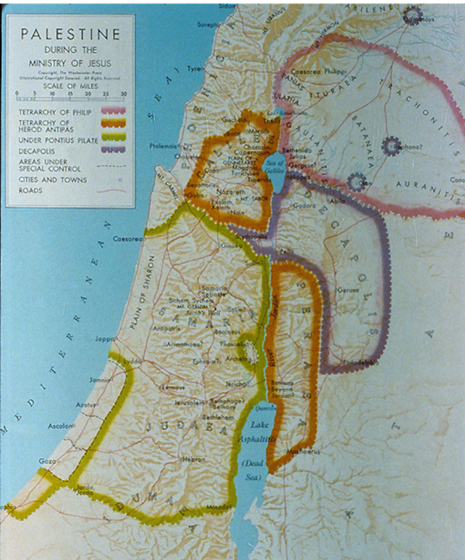
Samaria lay between Galilee and Judea, and due to mutual hostilities, it was generally avoided by Jews traveling north to south or vice versa on the grounds of ritual impurity or outright danger.
Samaritans had their own version of the Pentateuch and had rejected the temple in Jerusalem.
Samaritans did not use the term “messiah,” but they did believe in the Taheeb, a coming Savior and prophet like Moses.

Slide 11
The New Horizon
The Samaritan episode changed the entire outlook of the Jerusalem church.
Now, not only proselytes and Hellenistic Jews could be included, but also Samaritans.
Peter and John, thoroughly convinced that this new direction had divine sanction, continued to preach the message of Jesus in many Samaritan villages (Ac. 8:25).
The programmatic geographical/ethnic directive of the risen Christ, “You will be my witnesses in Jerusalem, in all Judea and Samaria…” (1:8), had begun to materialize.

Slide 12
THE CONVERSION OF A GENTILE GOD-FEARER (Ac. 10:1-48)
Peter’s residence with a tanner, a Jew of a despised trade, became the scene for crossing the next great ethnic barrier.
The story begins with a God-fearer, a Roman centurion in the administrative city of Caesarea about 30 miles north of Joppa, who was instructed by an angel to send for Peter.
The next day, while Peter was on the rooftop of Simon’s house (possibly to escape some of the foul odors), he had a vision of non-kosher animals (Lv. 11) and a heavenly voice that told him to “slay and eat,” with the follow-up that he should not regard anything as unclean that God had cleansed. This scenario was repeated twice.
At the same time, the ambassadors from Caesarea arrived.

Slide 13
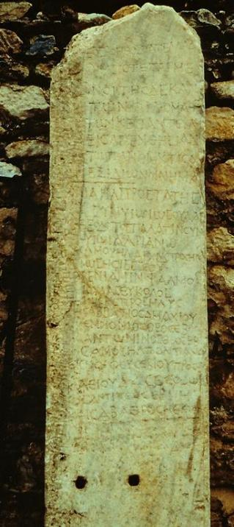
“God-fearers” (Ac. 10:2, 22) This “roster” of God-fearers from Aphrodisias (southwestern Turkey) is one of various references in inscriptions and texts to pious Gentiles who were sympathetic to Jewish religion, even though they had not themselves become proselyte Jews. Hence, they stood somewhere between full Jewishness and paganism. This list names 54 Gentiles who, alongside Jews from the local synagogue, contributed to relief efforts as well as construction of a place for worship. The Gentile part of the register is headed by the words “those who are God-fearers.”

Slide 14
At Cornelius’ Home
Peter took with him half a dozen Christian brothers when he departed for Caesarea (cf. 10:23; 11:12).
This may have been the first time in his life that Peter had entered a Gentile home—an entry that would immediately have defiled him, a fact that Peter frankly asserted to the whole group when he arrived.
But Peter was quick to acknowledge that God had changed the rules (Ac. 10:28)!
Before Peter had finished speaking, the Holy Spirit fell on Cornelius, his family and his gathered friends, a clear confirmation that God had fully accepted them.

Slide 15
THE JERUSALEM CHURCH AFFIRMATION (Ac. 11:1-18)
Earlier, the Jerusalem church had sent investigative representatives to Samaria to investigate Philip’s crossing an ethnic barrier. Now, they thoroughly examined Peter!
In the first place, Peter’s entrance into a Gentile residence sent shock waves through the Jewish Christian community, and the fact that he even ate there suggested he may have violated the Torah’s kosher laws (Ac. 11:3).
The Jewish believers were scandalized, and the entire incident threated to divide the community.

Slide 16
Peter’s Explanation
Peter rehearsed his story beginning with the rooftop vision, the angelic message to Cornelius, and the outpouring of the Spirit as had happened at Pentecost (Ac. 11:4-17).
The six Jews who had accompanied him now were highly important for corroborating Peter’s account.
Peter then recalled the words of John the Baptist, suggesting that what had happened at Pentecost had now happened to Gentiles.
The bold conclusion: “So then, God has even granted the Gentiles repentance unto life!” (Ac. 11:18)

Slide 17
THE GREEK CHURCH IN ANTIOCH (Ac. 11:19-30)
If Peter’s trip to Caesarea opened the door to Gentile God-fearers, what happened in Antioch only solidified the bold conclusion.
Some of the Christians who now were fleeing persecution in Jerusalem went there, and some of the Cypriot and African Jewish Christians began to tell the story of Jesus to Greeks.
Many Greeks now became believers, and when the Jerusalem church heard about it, they did what they had done before—they sent an investigative and trusted representative, this time Barnabas of Cyprus, who confirmed that all was well!
The Antioch church would become the first sending church for Christian missionaries, and the mission trips of Paul to the larger Roman world occupy the last half of the Book of Acts.

Slide 18
STAGES BETWEEN JEW & GENTILE
Hebraistic Jews (ε[βραιος)
Jews attending a Hebrew-speaking synagogue
Hellenistic Jews (ε[λληνιστης)
Jews attending a Greek-speaking synagogue
Proselytes (προσηλυτοι)
Gentiles who accepted circumcision
Samaritans (Σαμαριτοι)
Yahweh worshippers who rejected the Jerusalem temple
God-fearers (φοβουμενοι)
Gentiles attracted to the Jewish view of God (but remaining uncircumcised)
Pagans (ε]θνοι)
Worshipers of the Greco-Roman pantheon

Slide 19
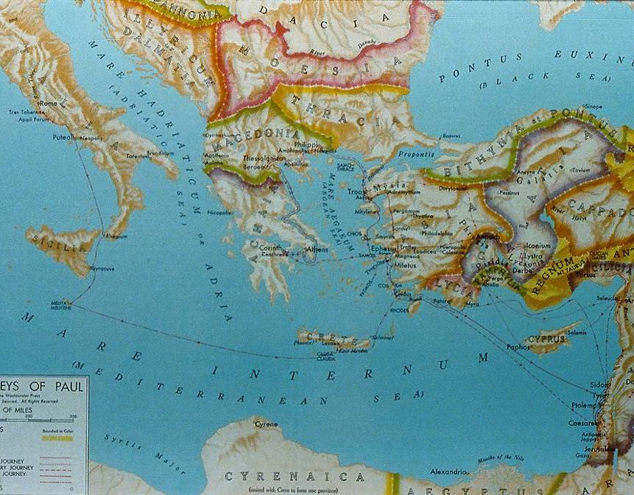
The Roman World and the Pauline Churches

Slide 20
THE CHURCH AND THE CHURCHES
The New Testament uses the word “church” (ε]κκλησια) in two basic ways.
First, it is used of local congregations in the various towns and cities where Christians gathered (Ac. 13:1; 18:22; 1 Cor. 16:19b, etc.).
Second, it is used of the entire Christian movement (1 Cor. 10:32; 12:28; 15:9; Eph 1:22; 3:21, etc.).
The Church Catholic
This broader reference to the church as the growing world-wide body of Christians eventually gave rise to the term “catholic church” (Greek: καθολικος; Latin: catholicus).
The earliest usage of the term “the catholic church” (or universal church) is in St. Ignatius’ letter to the Smyrnaeans (ca. AD 110).

Slide 21
THE ANTENICENE CHURCH
Before the Council of Nicaea when Christianity Was An Illegal Religion

Slide 22
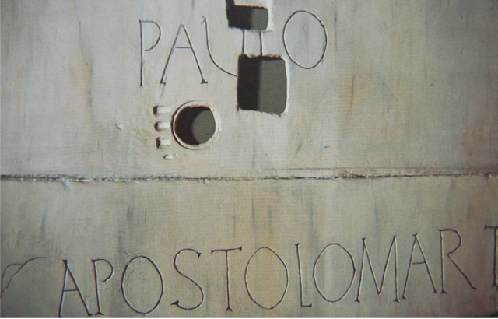
The churches the apostles left behind
Jerusalem (James)
Asia Minor & Greece (Paul)
Cyprus (Barnabas)
Rome (Paul, Peter and others)
Crete (Titus)
Ephesus (Timothy, John)
Antioch (Matthew?)
Erected above Paul’s tomb, Church of St. Paul Outside the Walls, Rome

Slide 23
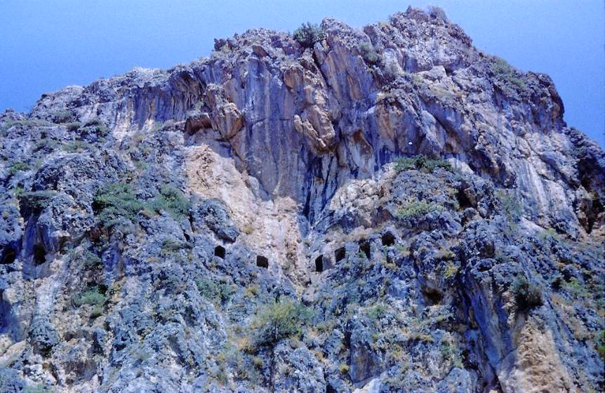
Church at Antioch, Syria (modern Antakya, Turkey)
ancient church in a cave above the city
Peter is believed to have preached here.

Slide 24
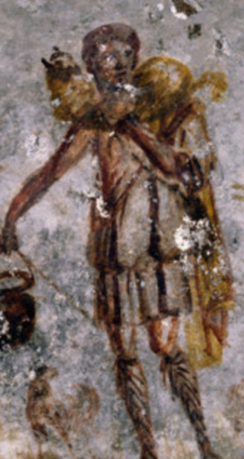
TRANSITION QUESTIONS Apostolic To Post-apostolic
What is the relationship between Judaism & Christianity?
What forms of worship can be used?
What are the authoritative Scriptures?
How should leadership & succession work?
How should we treat opposing religious ideas?
What church administration is necessary?
What is the relationship between Christianity & Rome
Christ, the Good Shepherd, St. Callisto Catacomb, Rome

Slide 25
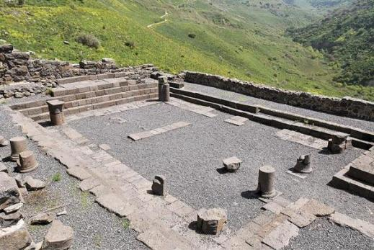
Separation from Judaism
Jesus, the apostles, and the earliest Christians were all Jewish.
The temple and the synagogue continued to be revered as sacred space with Christians meeting in the temple (Ac. 2:46; 3:11; 5:12, 21, 42) and Paul visiting synagogues throughout the Roman world (Ac. 13:14; 14:1; 17:1-2, 10, 17; 18:4, 19; 19:8).
When Christian Jews spread out from Jerusalem, they only shared the message of Jesus with other Jews (Ac. 11:19).
James could address Christians and write, “For if a man enters into your synagogue…” (Ja. 2:2, Greek).
Excavated remains of the Gamla synagogue in northern Galilee

Slide 26
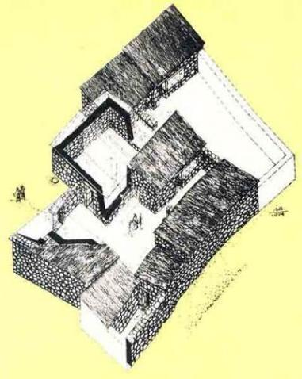
The Tensions begin
Jesus warned that his followers would be expelled from the synagogues (Jn. 16:1-4).
Stephen was accused of speaking against the temple and the Torah (Ac. 7:11, 13-14).
Paul was expelled from the synagogues (Ac. 13:50; 18:6-8; 19:8-9).
The anonymous author of Hebrews wrote an entire NT document dedicated to the thesis that the old system of temple and sacrifice was now obsolete (He. 8:13; 10:8-9).
House churches apart from the synagogue began being used for Christian assembly on the Lord’s Day (Ac. 12:12; Ro. 16:5; 1 Co. 16:19; Col. 4:15).
By the end of the 1st century, John began to speak of “those who say they are Jews and are not, but are a synagogue of Satan” (Rv. 2:9; 3:9).
Archaeologist’s sketch of a 1st century house in Capernaum used as a house church. Graffiti on the carefully plastered walls (more than 100 in Greek, Latin, Aramaic, Syriac, and Hebrew) inscribe sayings such as, “Lord Jesus Christ help your servant…” and “Lord have mercy.”

Slide 27
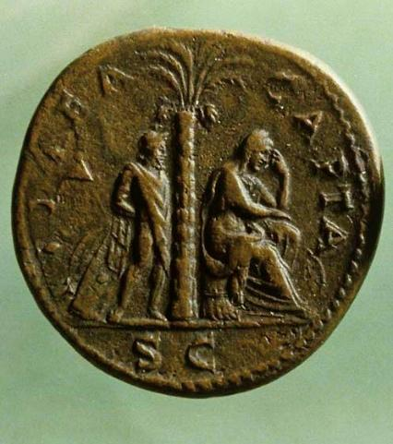
The Jewish revolt
Led by Simon bar-Giora, the Jews in Jerusalem revolted against the Romans in AD 66.
According to the early church historian, Eusebius, the Christians acted upon Jesus’ warnings in Matthew 24 and Luke 21 and did not join in this revolt, but rather, escaped the city and moved to the Transjordan town of Pella for the duration (Church History 3, 5, 3).
There were two significant outcomes: first, it drove a further wedge between the Jews and the Christians, and second, it made clear to the Romans that Christianity was not a subset of Judaism, and therefore, its legal status was questionable since it was not protected under the umbrella of Judaism.
The inclusion of the birkat ha-minim in synagogue liturgies effectively forced Jewish Christians out of the synagogues.
Thousands of Judaea Capta coins, like this bronze sesterce, were struck in Rome in AD 71. This coin was the largest series minted in Roman history. The bound captive and weeping woman symbolize the disaster.

Slide 28
BIRKAT HA-MINIM (curse upon the heretics)
“For the apostates let there be no hope, and let the arrogant government (i.e., Rome) be speedily uprooted in our days. Let the Nazarenes (i.e., Christians, cf. Acts 24:5) and the heretics be destroyed in a moment, and let them be blotted out of the book of life and not be inscribed together with the righteous. Blessed art thou, O Lord, who humblest the arrogant.”
(from the 18 benedictions, the standard synagogue liturgy of the late 1st century)

Slide 29
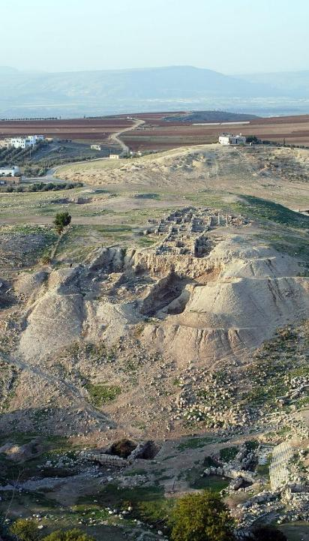
Saturday to sunday
In the apostolic period, Christians already were meeting on “the Lord’s Day,” presumably an idiom for Sunday, the day of Jesus’ resurrection (Ac. 20:7; 1 Co. 16:2; Rv. 1:10).
This did not preclude their attending a synagogue on Saturday.
However, there was no “weekend” in the Roman Empire, and every day, including Sunday, was a work-day. (The Jews had special permission from the Roman Senate to observe the Sabbath, but Christians did not have Sunday free. Hence, any Christian assembly was either early in the morning or late at night, cf. Ac. 20:7-8, 11.)
By the early 2nd century, several early Christian writers recognize the Lord’s Day as a replacement of the Jewish Sabbath.
Remains of Pella in the Transjordan, where Christians escaped during the Jewish Revolt against Rome

Slide 30
THE LORD’S DAY
“Assemble on the Lord’s Day, and break bread and offer the Eucharist…”
Didache 14 (c. AD 95)
“We keep the eighth day [Sunday] with joyfulness, the day also on which Jesus rose again from the dead...” Epistle of Barnabas (c. AD 100)
“They [Jewish Christians] have given up keeping the Sabbath, and now order their lives by the Lord’s Day instead (the day when life first dawned for us…) …to profess Jesus Christ while continuing to follow Jewish customs is an absurdity…” Ignatius, Magnesians 9 and 10 (c. AD 135)
“And on the day called Sunday, all who live in cities or in the country gather together to one place, and the memoirs of the apostles or the writings of the prophets are read…”
Justin Martyr, First Apology 67 (c. AD 155)
“On the first day of the week let there be service, and the reading of the holy scriptures, and the oblation [Eucharist], because on the first day of the week [i.e., Sunday] our Lord rose from the place of the dead…” Didascalia 2 (c. AD 255)

Slide 31
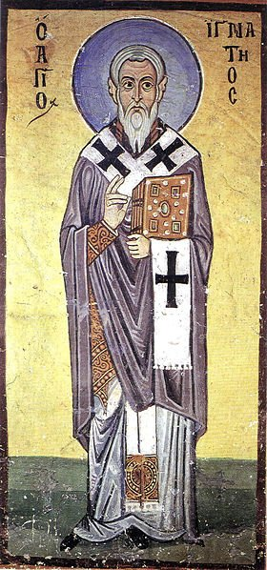
The apostolic fathers
The title “Apostolic Fathers” refers to the writings of those Christian leaders who had known the apostles and were faithful to their teachings.
Though some of these texts are anonymous, at least four writers are directly linked to apostles:
Clement (ordained by Peter according to Tertullian) c. AD 35-99
Ignatius (a disciple of John, Bishop of Antioch) c. AD 35-110
Polycarp (a disciple of John, Bishop of Smyrna) c. AD 69-155
Papias (knew John, Bishop of Hierapolis) c. AD 60-130
These texts, widely circulated among the early Christians, were: Didache, 1 Clement, Seven Letters of Ignatius, Epistle of Polycarp, Martyrdom of Polycarp, Epistle of Barnabas, Epistle to Diognetus, Shepherd of Hermas, and Fragments of Papias.
Fresco of Ignatius, Hosios Loukas Monastery, Greece

Slide 32
The apostolic fathers
DIDACHE (c. AD 95) | 1 CLEMENT (c. AD 96) | 7 LETTERS OF IGNATIUS (c. AD 135)
The Two Ways | Letter to the Corinthians | Wrote letters while being transported to Rome for execution
Instructions for Baptism and Eucharist | Addresses congregational repentance and restoration of unjustly deposed elders | Six letters were to churches; one letter was to Polycarp.
Instructions about itinerant apostles and prophets | Included in some early Bibles (Codex Alexandrinus) | Stresses the value of the Eucharist, replacing the Sabbath with the Lord’s Day, and loyalty to a single bishop in each city.

Slide 33
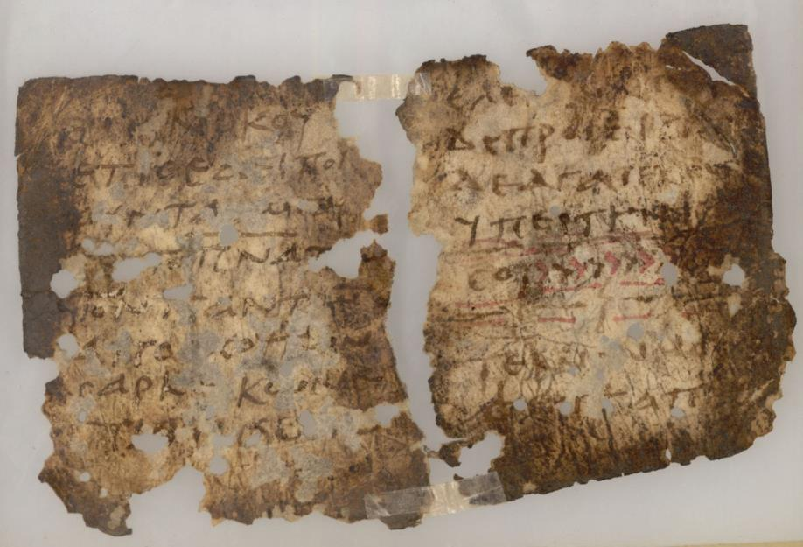
Ancient copy of the Didache, in which appears the baptismal formula of “in the name of the Father, the Son, and the Holy Spirit” in about AD 95.

Slide 34
Excerpts from the didache
The procedure for baptism is as follows: After repeating all that has been said, immerse in running water “In the name of the Father, and of the Son, and of the Holy Ghost.” If no running water is available, immerse in ordinary water. This should be cold if possible; otherwise, warm. If neither is practicable, then pour water three times on the head “in the name of the Father, and of the Son, and of the Holy Ghost.”
At the Eucharist, offer the eucharistic prayer in this way: Begin with the chalice: “We give thanks to thee, our Father, for the holy Vine of thy servant David, which thou has made known to us through thy servant Jesus. Glory be to thee, world without end.”
Then over the broken bread: “We give thanks to thee, our Father, for the life and knowledge thou has made known to us through thy servant Jesus. Glory be to thee, world without end.”
As regards apostles and prophets… Every apostle who comes to you should be welcomed as the Lord, but he is not to stay more than a day, or two days if it is really necessary. If he stays for three days, he is a false prophet… If he asks for money, he is a false prophet.

Slide 35
EARLY CHRISTIAN WORSHIP
Christ Jesus did not leave his disciples with a form for Christian worship. Hence, it is not too surprising that for the most part early Christians drew from the pattern of the synagogue with which they were familiar.
Jesus himself had been comfortable in the synagogue (Lk. 4:16-21), so this pattern prevailed.
He also promised that the Holy Spirit would guide his followers, teaching and reminding them of his life and instruction (Jn. 16:13a; 14:26; 15:26; cf. 4:21-24).
Jesus did leave two sacraments (rituals in which the outward form expresses an inward reality): baptism (Mt. 28:19; Mk. 16:16) and Eucharist (Lk. 22:19b; 1 Co. 11:24b).
Both rituals had precedents in Judaism, miqvah immersion as a ritual of purification and a Passover seder meal in memory of the exodus using unleavened bread and wine.
Both rituals were transformed, baptism as an initiation ritual signifying faith in Christ and Eucharist as a weekly memory of Jesus’ death.

Slide 36
The two sacraments
BAPTISM
As a ritual of initiation, baptism is mentioned frequently in the New Testament (Ac. 2:4; 8:12-13, 36-39; 9:18; 10:47-48; 16:14-15, 33; 18:8; 22:16; 19:3-5; 1 Co. 1:13-16; Ro. 6:3-4; Ga. 3:27).
EUCHARIST
Luke’s phrase “breaking bread” (Ac. 2:42, 46; 20:7, 11) probably refers to the celebration of the Lord’s Table as do Paul’s instructions about Communion (1 Co. 10:16-17, 21; 11:17-34).
By the end of the 1st century, instructions for water baptism and the ongoing practice of the Eucharistic meal is attested widely (Didache VII, IX and X; Ignatius, Philadelphians IV; Justin Martyr, 1st Apology LXV-LXVI; Irenaeus, Against Heresies V.ii.2-3, etc.).

Slide 37
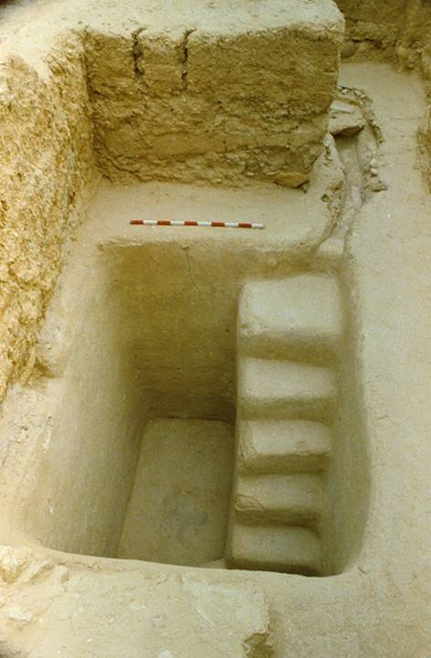
A 2nd temple mikveh (purification pool) excavated near the stairway at the southern wall of the temple mount.
It would have been in use during the time of Jesus
It is not unlikely that such mikva’ot were used for the 3000 baptisms on the Day of Pentecost (Ac. 2:41).

Slide 38
Worship in the New Testament There are hints about the form of Christian worship in the New Testament:
Described Elements
Eucharist (Ac. 20:7; 1 Co. 11:17-34)
Baptisms (Ac. 2:41, etc.)
Community Prayer (Ac. 4:24; 12:12)
Jewish Prayer Hours (Ac. 3:1)
Free Participation in hymn, instruction, revelation, tongue/interpretation (1 Co. 14:26) – tongues were restricted to two or at the most three occasions per service and forbidden outright if not translated (1 Co. 14:27-28)
Public Scripture Reading (1 Ti. 4:13; Col. 4:16; 1 Th. 5:17; Rv. 1:3)
Confessions of Faith (Ro. 10:”8-9; 1 Co. 12:3; 15:1-4; 1 Ti. 6:12)
Preaching & Teaching (1 Ti. 5:17, etc.)
Collection of Gifts (Ro. 15:25-27; 1 Co.. 16:1-4; 2 Co. 8-9; Phil. 4:15-19; 1 Ti. 5:17-18)
“Maranatha” (1 Co. 16:22) in Aramaic
“Abba” (Ro. 8:15; Ga. 4:6)
Doxologies (Ro. 16:27; Ga. 1:5; 1 Ti. 1:17; 6:16; 1 Pe. 5:11; Jude 25; Rv. 1:6; 7:12; 19:1)
Psalms, Hymns, Songs (Ep. 5:14, 19; Phil 2:6-11; Col. 3:16; 1 Ti. 1:17; 3:16; 6:15-16; 2 Ti. 2:11-13)
Liturgical Elements
“The Thanksgiving” (1 Co. 14:16)
“The Amen” (1 Co. 14:16; 2 Co. 1:20) in Hebrew

Slide 39
EARLY INSTRUCTIONS FOR CHRISTIAN WORSHIP
“And on the Lord’s own day gather yourselves together and break bread and give thanks, first confessing your transgressions, that your sacrifice may be pure. And let no man, having his dispute with his fellow, join your assembly until they have been reconciled, that your sacrifice may not be defiled; for this sacrifice it is that was spoken of by the Lord: ‘In every place and at every time offer me a pure sacrifice; for I am a great king, says the Lord, and my name is wonderful among the nations.’”
Didache 14 (c. AD 95)

Slide 40
EARLY EUCHARISTIC PRAYER
“We give you thanks, O our Father, for your holy vine of your son David, which you made known unto us through your Son Jesus; Yours is the glory forever and ever. We give you thanks, O our Father, for the life and knowledge which you made known unto us through your Son Jesus; Yours is the glory forever and ever. As this broken bread was scattered upon the mountains and being gathered together became one, so may your church be gathered together from the ends of the earth into your kingdom; for yours is the glory and the power through Jesus Christ forever and ever.’”
Didache 9 (c. AD 95)

Slide 41
EARLY EUCHARISTIC THANKSGIVING
“We give you thanks, Holy Father, for your holy name, which you have made to tabernacle in our hearts, and for the knowledge and faith and immortality, which you made known unto us through your Son, Jesus; yours is the glory forever and ever. You, Almighty Master, created all things for your name’s sake, and gave food and drink unto men for enjoyment, that they might render thanks to you; but you bestowed upon us spiritual food and drink and eternal life through your Son. Before all things we give you thanks that you are powerful; yours is the glory forever and ever. Remember, Lord, your church to deliver it from all evil and to perfect it in your love; and gather it together from the four winds—even the church which has been sanctified—into your kingdom which you have prepared for it; for yours is the power and the glory forever and ever. May grace come and may this world pass away. Hosanna to the God of David. If any man is holy, let him come; if any man is not, let him repent. Maranatha. Amen!”
Didache 10 (c. AD 95)

Slide 42
EARLY DESCRIPTION OF CHRISTIAN WORSHIP BY AN OUTSIDER
“They were in the habit of meeting on a fixed day before it was light, when they sang an anthem to Christ as God, and bound themselves by a solemn oath not to commit any wicked deed, but to abstain from all fraud, theft and adultery, never to break their word, or deny a trust when called upon to honor it; after which it was their custom to separate, and then meet again to partake of food, but food of an ordinary and innocent kind.”
Pliny, Letters x.96 (c. AD 110)
(Pliny was the Governor of Bithynia, and he was writing to Emperor Trajan about how to treat the Christians in his province)

Slide 43
2nd CENTURY DESCRIPTION OF CHRISTIAN WORSHIP
And on the day called Sunday, all who live in cities or in the country gather together to one place, and the memoirs of the apostles or the writings of the prophets are read, as long as time permits; then, when the reader has ceased, the president verbally instructs and exhorts to the imitation of these good things. Then we all rise together and pray, and, as we before said, when our prayer is ended, bread and wine and water are brought, and the president in like manner offers prayers and thanksgivings, according to his ability, and the people assent, saying, “Amen”; and there is a distribution to each, and a participation of that over which thanks have been given, and to those who are absent a portion is sent by the deacons. And they who are well to do, and willing, give what each thinks fit; and what is collected is deposited with the one who presides, who succors the orphans and widows, and those who, through sickness or any other cause, are in want, and those who are in bonds, and the strangers sojourning among us, and in a word takes care of all who are in need. But Sunday is the day on which we all hold our common assembly, because it is the first day on which God, having wrought a change in darkness and matter, made the world; and Jesus Christ our Savior on the same day rose from the dead. For he was crucified on the day before that of Saturn [i.e., Friday]; and on the day after that of Saturn, which is the day of the Sun [Sunday], having appeared to his apostles and disciples, he taught them these things, which we have submitted to you also for your consideration.
Justin Martyr, 1st Apology 68 (c. AD 155)

Slide 44
DEVELOPMENTS and variations
As the decades rolled by, Christians continued the apostolic practices, but sometimes with developments and variations.
Eschatology: The dominant view was what today we called historic premillennialism, i.e., the belief that the church would face the anti-Christ and the great tribulation (Papias, Lactantius, Theophilus, Tertullian, Hippolytus or Rome).
Infant Baptism: Four occasions in the NT describe household baptisms (Ac. 10:24, 47-48; 16:15, 32: 1 Co. 1:16). These likely included children. By the early 200s, infant baptism was widely practiced. In the Apostolic Tradition (Hippolytus of Rome), collected in ca. 215 from earlier works, it says, “Baptize first the children and if they can speak for themselves, let them do so. Otherwise, let their parents or other relatives speak for them.”
The Holy Kiss: Based on NT references, the exchange of peace with a kiss appears to be a Christian innovation with no examples from the Roman or Jewish cultures. Tertullian wrote that before leaving a house, Christians are to give the Holy Kiss and say “peace to this house.” It was also viewed as an essential part of preparing to participate in the Eucharist.

Slide 45
Real Presence: Early Christian writers referred to the Eucharistic bread and wine as Jesus’ “body and blood,” following the language of Jesus at the last supper. The Eucharist was reserved for baptized Christians (Didache). Various leaders speak of what we call the “real presence” of Christ in the Eucharist, including Ignatius (ca. AD 106), Justin Martyr (ca. AD 150), Tertullian (ca. AD 200), Ambrose (ca. AD a397), etc.
Foot-washing: Tertullian (ca. AD 200) wrote that foot-washing was a regular part of early Christian worship, using a basin of water and a linen towel.
Morning and Evening Prayer: Hippolytus instructed Christians to pray privately seven times a day, upon rising, at bed-time, at midnight, and at the 3rd, 6th, and 9th hours of the day. These various times are associated with Christ’s Passion. Throughout the week, Christians assembled each day for morning prayer (known as lauds) and evening prayer (known as vespers).
Monasticism: Monastics began to appear in the deserts of Egypt by the 3rd century as a kind of living martyrdom. Anthony (AD 251-356) gradually gained followers who lived as hermits. Monasticism spread to Palestine, Syria, Asia Minor, and beyond, and the sayings and writings of the monastics came to be circulated as the Desert Fathers.

Slide 46
A BASIC QUESTION: What was/is the relationship of the developing church to the primitive church?
Is it imitating what the early church did?
Fosters a “back to the early church” search, typical of restorationist Protestantism. Tends to reject much of the tradition and long history of the church while (ironically) favoring innovation and new, emerging styles which they seek to read back into the Bible.
Is it following the trajectory that the early church set?
Embraces the belief that the church has legitimately recognized and followed the Spirit’s ongoing direction through the centuries. Places a high value on tradition and seeks to preserve the patterns that have developed over the church’s long history.

Slide 47
Passing on Important Truths, Values, and Traditions
ORAL TRADITION
…what I received I passed on to you as of first importance (1 Co. 15:3a; 2 Ti. 1:13)
TRUSTED SUCCESSORS
…the things you have heard me say in the presence of many witnesses entrust to reliable men who will also be qualified to teach others (2 Ti. 2:2)
RITUALS
…For I received from the Lord what I also passed on to you: The Lord Jesus, on the night he was betrayed, took bread… (1 Co. 11:23)
WRITTEN DOCUMENTS
…after this letter has been read to you, see that it is also read in the church of the Laodecians and that you in turn read the letter from Laodecia. (Col.4:16)

Slide 48
Balancing Orthodoxy o]rqo<j = right; do<ca = glory three spheres of authority must be kept in balance to preserve orthodox Christianity
Scripture: Canon of the Old and New Testaments
CHALLENGE: Proper interpretation
Tradition: Rituals, practices, and oral transmissions of the church
CHALLENGE: Rigidity
Holy Spirit: Ongoing direct guidance by God
CHALLENGE: Subjectivism

Slide 49
THE Quod ubique CENTRAL quod semper THEOLOGICAL quod ab omnibus CORE creditum est
“…that which has been believed everywhere, always, by all.”
Vincent of Lerins
ca. AD 450

Slide 50
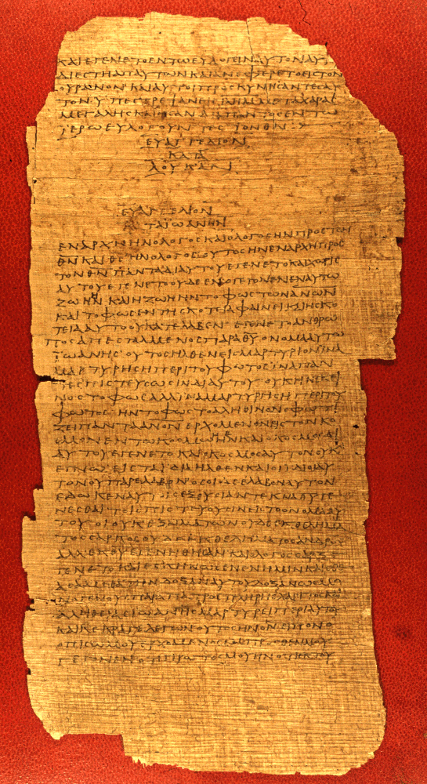
CHRISTIANS AND THE NEW TESTAMENT
The extent of literacy in the Greco-Roman world of the 1st century (the ability to read and write) was generally about 10% of the population and at no time larger than 15-20%.
Literacy was thus the privilege of a minority, and it existed alongside an oral culture.
Familiarity with the Scriptures did not depend upon an individual’s capability of reading them.
Hence, the ability to read and interpret belonged to a relatively small number of Christians in any given congregation.
A primary exception was the Jewish community, where Jewish children were taught to read in the synagogues (Josephus, Antiquities 4.211).
P75 end of Luke, beginning of John, Vatican Library, Rome AD 175-225

Slide 51
Public Reading
An essential part of early Christian worship was the public reading of Scripture.
Paul instructs Timothy: “…devote yourself to the public reading of Scripture…” (1 Ti. 4:13a).
Naturally, those able to publicly read texts were held in high esteem by the congregations, often rising to become leaders.
Apollos, for instance, is described as someone “skilled in the Scriptures” (Ac. 18:24).
Paul’s literary skills were instrumental in his missionary work.

Slide 52
In a society where the ownership of texts was economically prohibitive, the familiarity of Christians with the Bible depended upon hearing the texts read publicly.
In the synagogue tradition, two Scripture readings were appointed for each service, one from the Torah and one from the Prophets, and these were arranged in a three-year cycle. (Jesus gave the “Prophets” reading in his hometown of Nazareth, cf. Lk. 4:16ff.).
These readings in turn became the “text” for the sermons of the rabbis.
Christians followed the same pattern (1 Ti. 4:13). Indeed, some suggest that the nuance of the passage about the public reading of Scripture is, “…give attention to the selected reading of the day…”

Slide 53
The Codex
A major development in early Christianity was the change from a scroll to a codex.
The standard form had been the scroll rolled on a spindle and containing writing on only one side.
The codex, the earliest Christian texts, were individual sheets bound together on one edge and written on both sides.
Paul can speak of both the bibli<a and the membra<naj (2 Ti. 4:13). The first refers to scrolls and the second to parchment codices.

Slide 54
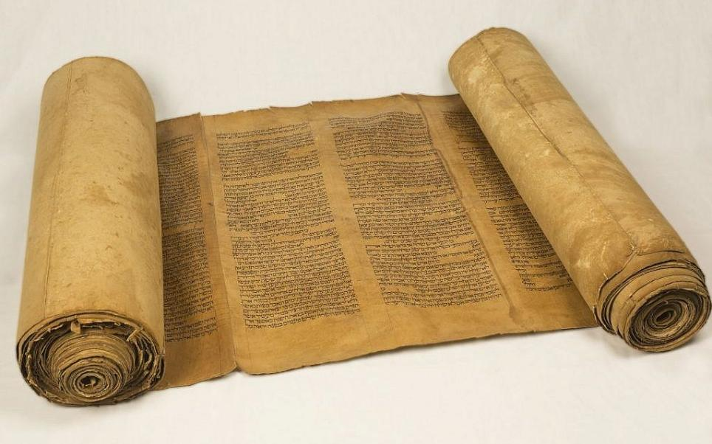
The Hebrew scroll was made of individual sheets of papyrus or leather glued or sewn together. Writing was from right to left in columns. Typical scroll length was 3.5 meters.

Slide 55
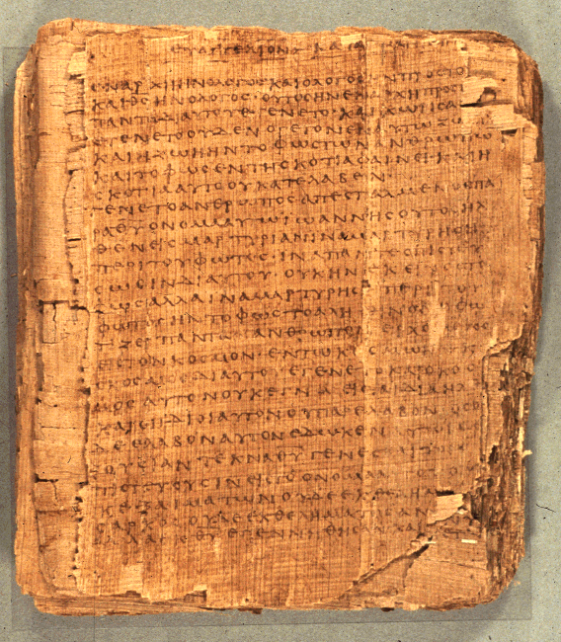
Christian texts were composed as codices, such as, p66
Bodmer Papyrus II
Opening of the Gospel of John
75 leaves and 39 fragments
6.4 inches x 5.6 inches
14-25 lines per page
The codex was more economical (about 25% less expensive than a scroll).
It also was more compact and less bulky.

Slide 56
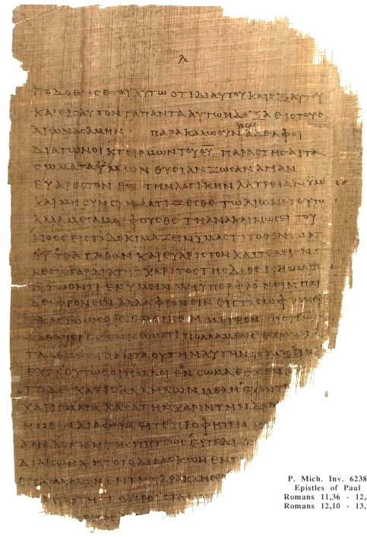
Codex page of Romans 11:36—12:8
Chester Beatty Papyri p⁴⁶
University of Michigan
ca. AD 200

Slide 57
The LXX became the “Bible” of the earliest Christians.
Few people outside Palestine would have been conversant in Biblical Hebrew.
Hence, the writers of the New Testament, when quoting from the Old Testament, frequently do so from the LXX.
Paul quotes from both the LXX as well as the Hebrew Bible (but, of course, he writes in Greek).
Luke and the author of Hebrews quote exclusively from the LXX.

Slide 58
The Apocrypha (Deutero-Canonical)
Besides the Old Testament, Jewish authors composed a number of works about Jewish history, legends, wisdom, and expansions to canonical books (notably Daniel and Esther).
Some are historical, some fictional, and some theological.
Though not part of the law, prophets, and writings, they were included in the LXX, and subsequently, they were read by Jews and Christians in the Greek-speaking world. St. Jerome included them in the Latin Vulgate.
Much later, in the Protestant Reformation, they were rejected as non-canonical (but translated and read in the churches as edifying). They were included in the KJV for the first century of its printing.
At the Roman Catholic Council of Trent (1545-1563), they were officially recognized as canonical for the Roman Church. They are also canonical in Eastern Orthodoxy.

Slide 59
The Apocryphal Books
1 Esdras
2 Esdras
Tobit
Judith
Prayer of Azariah
Song of the Three Young Men
Susanna
Bel and the Dragon
Additions to Esther
Prayer of Manasseh
Letter of Jeremiah
Baruch
Sirach (Ecclesiasticus)
Wisdom of Solomon
1 Maccabees
2 Maccabees
3 Maccabees
4 Maccabees
Psalm 151
In keeping with other Protestants, Anglicans do not recognize the Apocrypha as canonical. However, following St. Jerome, they approve of them for “examples of life and instructions of manners.” It only restricts their use for the establishment of Christian doctrine.
39 Articles, Article VI

Slide 60
The Texts of the New Testament
As the apostles and those close to them began to compose Christian texts, they naturally did so in Greek.
Paul typically used an amanuensis, like Tertius, Sosthenes or Timothy (Ro. 16:22; 1 Co. 1:1; 2 Co. 1:1; Phil. 1:1; Col. 1:1; 1 Th. 1:1; 2 Th. 1:1; Phlm 1), though he made it a practice to sign off with his own signature (1 Co. 16:21; Ga. 6:11; 2 Th. 3:17).
We know considerably less about the process of writing lying behind the four Gospels, but early Christian testimony (Papias) indicates that Mark, at least, was a collector of the personal memories about Jesus by Simon Peter.
One fascinating feature of early Christian texts was their tendency to abbreviate sacred names with a line over the abbreviation. Presumably, this practice was to mark the sacredness of the divine name.

Slide 61
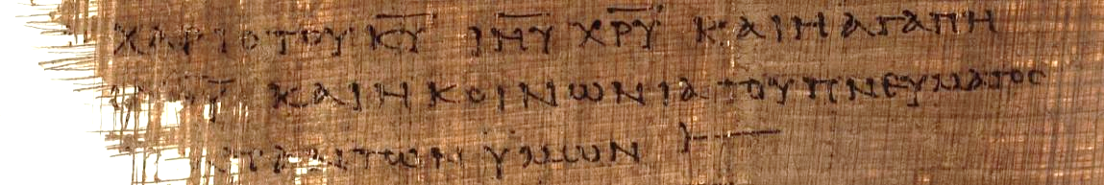
2 Corinthians 13:13 (p46) “[The] grace of the Lord Jesus Christ and the love of [God] and the fellowship of the Holy Spirit [be] with you all.” Here, the sacred names “Lord,” “Jesus,” and “Christ” have all been abbreviated with a line drawn over them. KURIOU = KU = Lord IHSOU = IHU = Jesus XRISTOU = XRU = Christ

Slide 62
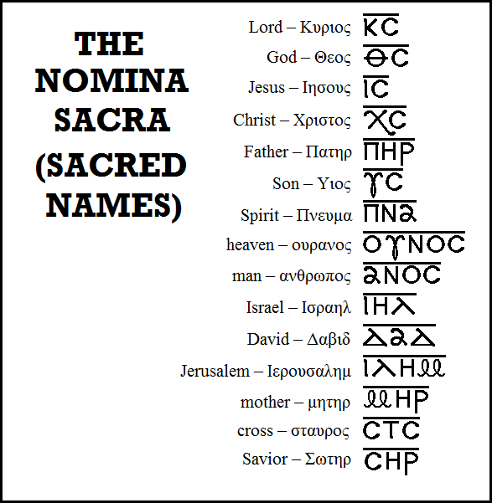
Typical Nomina Sacra found in early New Testament manuscripts. All these abbreviations are found in Greek manuscripts of the 3rd century and earlier except “mother,” which begins to appear in the 4th century.
Bruce Metzger,
Princeton University

Slide 63
Fixed Order
The fixed order of a codex affected both the Old and New Testaments.
The order of books in the LXX was somewhat different than the ordering of books in the Hebrew tradition.
For instance, in the LXX the prophetic books are generally placed last, whereas in the Hebrew tradition they fall in the middle of the Hebrew Bible.
Ruth is placed next to Judges in the LXX, but in the Hebrew Bible it belongs to the Megilloth near the end.
Very early, the four gospels gained a fixed order which we retain today: Matthew, Mark, Luke, and John.
Paul’s letters in the early Christian lists have a varied order, though eventually they became fixed by about the 4th century (long to short, but not chronological).
The so-called “general epistles” also had a varied order which eventually became fixed.

Slide 64
Factors for Circulation
Texts were circulated between congregations more often than between individuals.
Christian groups had different language bases, Greek, Latin, Aramaic, Syriac, and Coptic, among others, so translation work began quite early.
Some texts were intended for more than a single audience, such as, “all [the house churches] in Rome” (Ro. 1:7), the “churches of Galatia” (Ga. 1:2), possibly Ephesians (Ep. 1:1, some early manuscripts do not say “in Ephesus” leading to the theory of a circular letter), the “twelve tribes scattered among the nations” (Ja. 1:1), God’s “scattered elect” (1 Pe. 1:1), and the “seven churches of Asia” (Rev. 1:4, 11).
Multiple recipients would require multiple copies, and the couriers might well have been responsible for such copies.

Slide 65
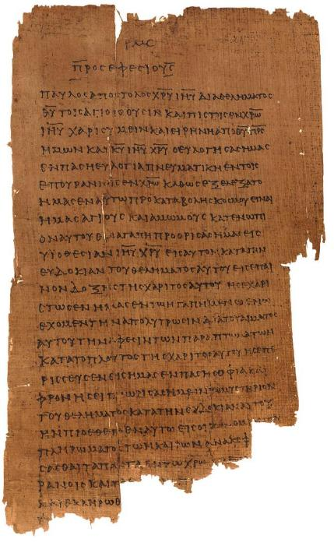
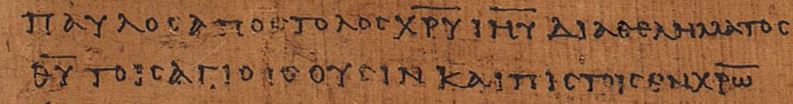
Ephesians 1:1 p46 Chester Beatty Papyri ca. AD 200 earliest copy of the Ephesian letter (University of Michigan, Hatcher Library)
“Paul, an apostle of Christ Jesus through [the] will of God to the holy ones who are also faithful in Christ…” (1:1)

Slide 66
Early Translations
As early as the 2nd century, the texts of the New Testament began being translated into vernacular languages.
Christian missionaries translated biblical texts into local languages wherever Greek would not serve the needs of the people.
These early translations include:
Coptic – 3rd Century
Syriac – 3rd and 4th Centuries
Old Latin (predating Jerome’s Latin Vulgate) – 4th Century
Armenian – 5th Century
Georgian – 5th Century
Ethiopic – 5th Century

Slide 67
A Religion Oriented Toward Texts
Unlike all other religions in the Roman world save Judaism, Christianity was oriented toward texts.
Not all Christians could read, of course, but in public reading, all Christians could listen.
Texts, therefore, were essential to the life of a Christian congregation.

Slide 68
The Fixing of the NT Canon
The New Testament canon was fixed gradually during the early centuries of Christianity.
The earliest canon lists and translated codices are not uniform:
Marcion’s canon (consists of Luke and ten letters of Paul)
Muratorian fragment (omits Hebrews, James and 1 & 2 Peter)
Old Syriac (omits 2 Peter, 2 & 3 John, Jude and Revelation)
Old Latin (omits Hebrews, James and 1 & 2 Peter)
Codex Sinaiticus (includes the Letter of Barnabas and the Shepherd of Hermas)

Slide 69
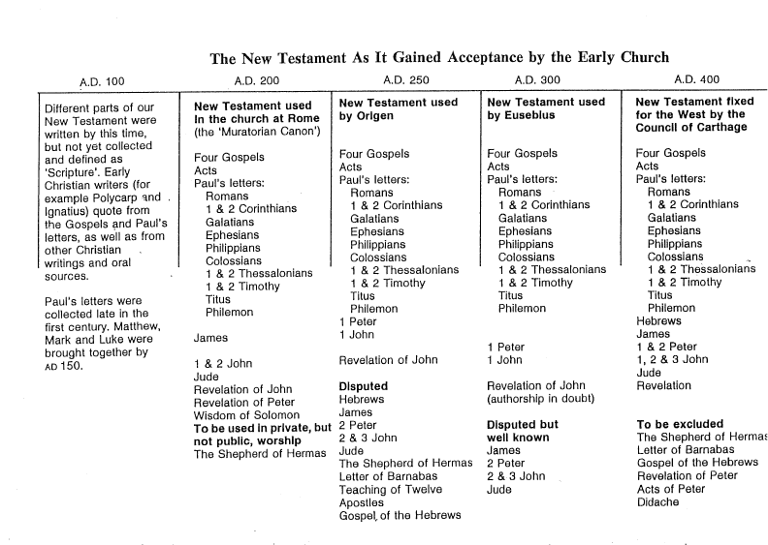

Slide 70
Criteria for Canon kanw<n (canon = rule, standard)
INSPIRATION
In the use and testimony of the church from earliest times, was the document accepted as inspired by God?
APOSTOLICITY
Did the testimony of the church credit the document to an apostle or someone close who carried the authority of an apostle?
TRADITION
In the succession of bishops, did the early church use these texts as Scripture (urged by Irenaeus)?

Slide 71
The Categories of Eusebius By the 4th century, Eusebius divides the Christians’ writings into three classes (Ecclesiastical History III.25)
Known to be Canonical
Four Gospels
Acts
Pauline Letters
Hebrews
1 John
1 Peter
Revelation
Widely accepted as canonical though disputed by some
James
Jude
2 Peter
2 & 3 John
Specified as Not Canonical
Acts of Paul
Shepherd of Hermas
Apocalypse of Peter
Epistle of Barnabas
Didache

Slide 72
Athanasius’ 39th Easter Letter
The earliest full canon listing of New Testament books as we know them today was made by Athanasius in AD 367.
Contains the full 27 books of the New Testament
Augustine supported this canon list
Jerome’s Vulgate also supported this canon list

Slide 73
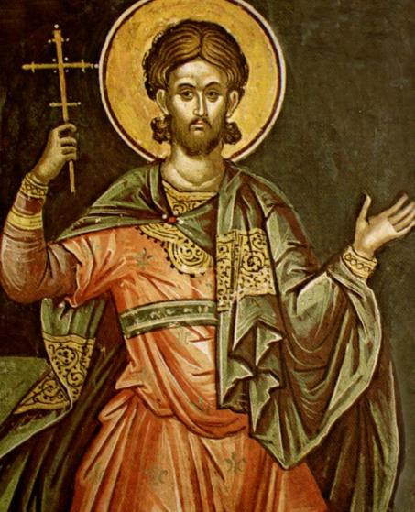
THE APOLOGISTS
The Apologists were early Christian leaders who wrote treatises defending Christianity against critics, whether pagans or Jews.
Prominent apologists include Justin Martyr, Tatian, Origen, Athenagoras of Athens, and others.
Addressed to the Roman emperor Antoninus Pius, Justin’s First Apology defends the morality of the Christian life.
His Dialogue with Trypho interacts with a learned Jew, Trypho, and attempts to show how Christianity supersedes the old covenant.
The first comprehensive attack upon Christianity came from the Greek philosopher Celsus (ca. AD 175), and Origen’s Against Celsus became one of the most important early apologetic works.
While most of Justin Martyr’s works are lost, two apologies and a dialogue survive. He is revered as a saint by the Roman Catholic, Anglican, and Eastern Orthodox churches.

Slide 74
THE ante-nicene fathers These prominent Christian leaders in the Ante-Nicene Period wrote in two languages, Greek and Latin.
The Greek Fathers:
Irenaeus of Lyons (c.130--c.202): A disciple of Polycarp, his most well-known work is Against Heresies, emphasizing that Christian unity must derive from uniform Christian theology.
Clement of Alexandria (c.150--c.215): He is most well-known for developing a type of Christian Platonism.
Origen (184-253): Probably the most scholarly of the early Christian leaders, he wrote commentaries on all the books of the Bible.
Hippolytus of Rome (c.170-235): One of the most prolific writers, he was a disciple of Irenaeus.
The Latin Fathers:
Tertullian (c. 155--c. 240): He is famous for describing God as “three Persons, one Substance” and the question, “What has Athens to do with Jerusalem?”
Cyprian (200-258): Bishop of Carthage, he eventually died as a martyr.
Their writings are translated into English and available in various published formats.

Slide 75
THE EARLY HERESIES
A heresy is a teaching that the Christian church at large considers to be erroneous or dangerous to the faith.
In addressing heresies, it should be kept in mind that there were various disagreements in the early church which did NOT threaten the core of the Christian faith.
For instance, Jerome, in the Latin Vulgate, translated the plant that grew up over Jonah’s head was a “gourd.” Earlier translations had rendered this Hebrew word as “ivy,” and there was heated debate in North Africa over which was correct. Still, neither the “gourdists” nor the “ivyists” were treated as heretics, since this issue was not central to the gospel.
The rise of heresies forced the early Christians to better define themselves, and at least in this sense, the heretics provided the incentive. Heretics were not necessarily bad or evil people; however, they arrived at answers to theological questions that, in the end, did not win the day.
The result of these debates and the decisions reached is now what we consider orthodox Christianity.

Slide 76
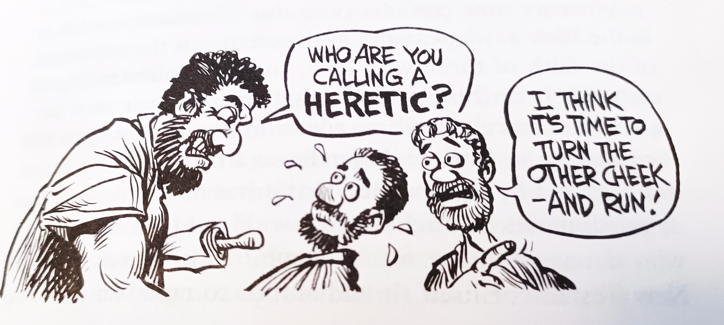
Ron Hill

Slide 77
The ebionites
One of the earliest issues concerned a group self-designated as Ebionites (an Aramaic word the “the poor”).
This group developed among Jewish Christians, and many scholars think their background might be the Essenes, who also referred to themselves as “the poor.”
They required Torah observance, but they believed traditional Judaism had radically misinterpreted the books of Moses regarding sacrifices.
After the episode of the golden calf, they taught that God gave the sacrificial system as a temporary expedient.
Jesus came to correct that and institute the true worship of God.
They used some form of the Gospel of Matthew, though they omitted some of it, especially Matthew’s description of the virgin birth of Jesus. They emphatically did not like the writings of Paul.
They accepted the idea that Jesus ended the OT sacrificial system, but they rejected the idea that Jesus’ death was itself a sacrifice. They believed Jesus was only a human endowed with special powers.
They also held that in the creation there was both a good, masculine power alongside an evil, feminine power. John the Baptist rerpresented the evil power, and Jesus the good one. Jesus was primarily a teacher, not a redeemer.

Slide 78
The gnostics
Gnosticism was a collection of religious ideas flourishing in the mid-2nd century among some Christians. Rather than focusing on sin and repentance, as was true of the apostles, the Gnostics focused on concepts of enlightenment. The goal was to escape the physical world through special knowledge, and salvation was being liberated from the prison of the body.
Gnostics especially emphasized personal spiritual knowledge, and their name derives from the Greek word gnwsij (= knowledge).
They wrote their own versions of gospels about Jesus (and these versions were many decades later than the canonical gospels and not within the era of any eyewitnesses).
They held that their writings contained the only true version of Jesus.
They objected to the Eucharist, since how could a physical meal of bread and wine have anything to do with pure spiritual truth?

Slide 79
Gnosticism and Early Christianity
Gnostic Concepts
Universe created by a demiurge
Salvation is by knowing secrets of the universe
The spiritual person is free from moral law
The redeemer is a demi-god, wholly a spirit-being
Christian Beliefs
Universe created by God through Christ
Salvation is by believing in God’s Son
The spiritual person lives by light and truth, not darkness
The redeemer is God’s Son incarnate, both human and divine.

Slide 80
GNOSTIC IDEAS the merging of Christianity and Greek dualism
SPIRIT
all good
MATTER
all evil
IMPLICATION…the incarnation of Jesus is impossible.
GOAL…to attain secret knowledge by which one can escape the material prison of the body and achieve an elevated spiritual existence in heaven.

Slide 81
GNOSTIC SOLUTIONS TO THE INCARNATION
DOCETISM
Christ only seemed to be a real human. His apparent body was really an illusion.
CERINTHIANISM
Christ and Jesus were two separate beings: Christ was divine and Jesus was human. Their union was only temporary.
THE PLEROMA
Jesus was a demi-god, the last of a series of intermediate beings between the Father and the world of humans.

