Slide 1
THE BOOK OF ACTS
History of the Earliest Christians

Slide 2
Introduction

Slide 3
AUTHOR
Our earliest references cite Luke as the author, and this opinion directly links up with the introduction to the Gospel of Luke (1:1-2; cf. Lk. 1:1-4).
Irenaeus (AD 180) cites Luke as the author (Against Heresies III.14.1).
The title in the earliest extant Greek copy cites Luke as the author (p75, c. AD 200).
Louka?j apparently was himself a Greek, a physician by profession and the fellow-worker of Paul (Col. 4:14; 2 Ti. 4:11; Phlmn 24).
He seems to have accompanied Paul during those missionary narratives written in the first person plural (the “we” sections of Acts), beginning in 16:10 (cf. 20:6; 21:1; 27:1).

Slide 4
DATE
Since the book closes with Paul’s incarceration in Rome as he awaited his hearing before Caesar Nero, the book could not have been composed any earlier than about AD 60.
Also, since it references the Gospel of Luke in the first line, it must postdate this document also. Most scholars date Luke at about AD 80-85 (though this dating is an educated guess, has no hard evidence to support it and may well be too late).
Since Acts contains no references to the Neronian persecution in AD 64 or the fall of Jerusalem in AD 70, some think it likely to have composed before either of these events, though again, there is no hard data.

Slide 5
TITLE & SCOPE
The title “Acts of the Apostles”, which goes back to the earliest manuscripts, can be misleading.
It does not cover the careers of the apostles in general, but rather, two apostles in particular, Peter and Paul.
The book functions as Part 2 of Luke’s two-part history:
  PART 1: The Gospel of Luke (the birth and ministry of Jesus the Messiah)
  PART 2: The history of the earliest Christians
Theophilus, likely a wealthy patron who underwrote the production of both Luke and Acts, is otherwise unknown (however, it was customary to dedicate literary works to such patrons).

Slide 6
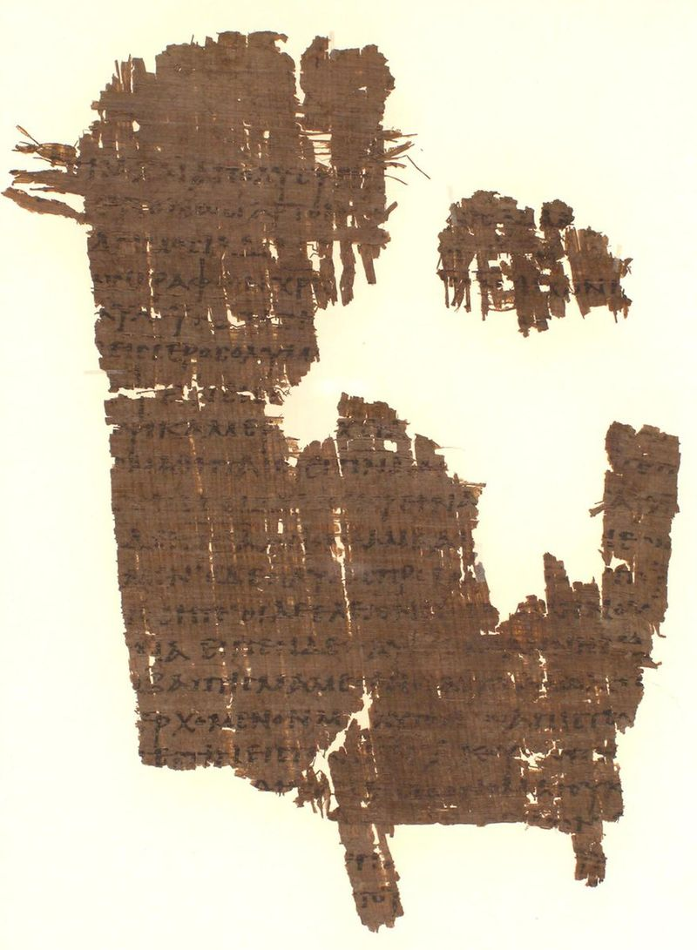
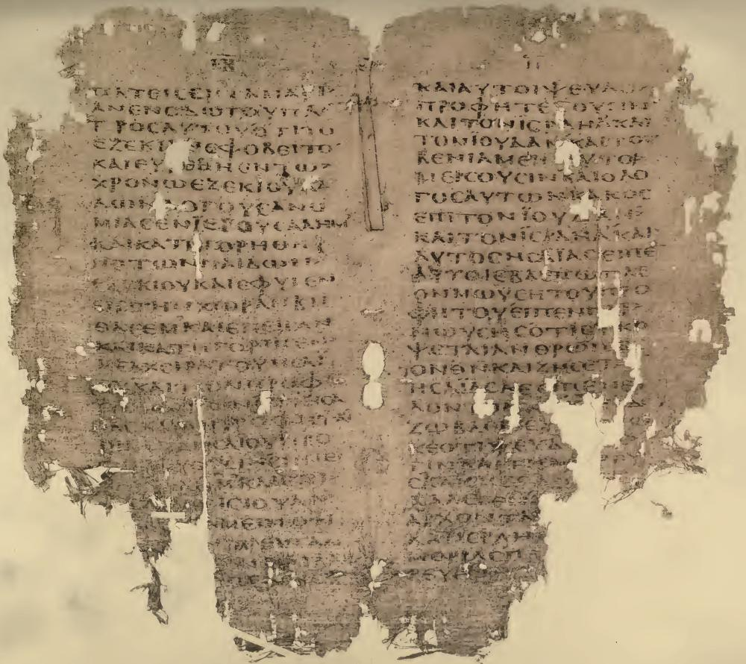
TEXT
Two early manuscripts from Acts
Hatcher Library, University of Michigan
Pierpont Morgan Library, New York, New York
p38 (left)
Acts 18:27—19:6, 12-16
ca. AD 300
076 (right)
Acts 2:11-22
5th/6th century AD

Slide 7
STYLE
Luke-Acts is written in very excellent Greek, ranging from the formal rhetoric of his prologues to the standard style in the body of the two works. His style follows the ancient practice of prosopopoeia (fitting his style to the occasion).
His “Bible” of choice seems to have been the Septuagint, from which he regularly quotes (cf. Ac. 2:16ff.; 7:42-43; 28:26-27, etc.).
His concern for accurate historicity shows a remarkable knowledge of Roman culture, practices and legal procedures.
“…it is a perpetual puzzle to me how New Testament Greek got the reputation of being easy. …St. Luke I find particularly difficult.” C. S. Lewis

Slide 8
LINGUISTIC PRECISION
Luke begins his gospel by stating that he was concerned to write an orderly account (Lk. 1:3).
In Acts, his precision in accurately describing various government structures and provincial titles for officials follows in kind. He accurately describes:
  Sergius Paulus as a Proconsul (a]nqu<patoj, 13:7)
  Philippi as a Roman colony (kolwni<a) governed by civil magistrates (strathgoi?j, 16:12, 20)
  Politarchs (polita<rxaj) as the city leaders in Thessalonica (17:6, 8)
  Asiarchs (a]siarxw?n) in Ephesus (19:31)
  The ruler of Malta as the “First Citizen” (prw<t&, 28:7)
He could have used more general titles, but he uses those titles that are precisely specific in the Roman world.

Slide 9
PURPOSE
Luke intends to tell the story of Christian origins with particular goals in mind.
As both a theologian and an historian, his primary goal is to show how the good news about Christ became international as a fulfillment of God’s purpose.
The opening language in the gospel about the “[things] having been fully carried out” (Lk. 1:1) was according to God’s “fixed counsel and foreknowledge” (Ac. 2:23).
What Jesus “began to do and teach” is carried on by the apostles as directed by the Holy Spirit (1:1-2).

Slide 10
THE PROBLEM
Luke addresses a profound problem, the problem of how God, who chose Israel to be his special people and gave them profound promises, had fulfilled those promises not only to Jews but to those who were not from the Jewish community.
Luke shows that a complex of fulfillments had happened:
  The opposition to Christ Jesus (4:27-29)
  The outpouring of the Spirit (2:16-17
  The mission to the Gentiles (13:47)
  The inclusion of non-Jews in God’s people (15:13-19)
  The general refusal of the Jewish community to accept the message (28:25-28)
Luke follows the same trajectory as Paul, “to the Jew first, then the Greek” (Ro. 1:16:b; Ac. 3:25-26; 28:25-29).

Slide 11
THE PROGRAMMATIC PATTERN
At the beginning, Luke offers a pattern for how the message of Jesus would spill over beyond the Jewish circle.
“But you will receive power when the Holy Spirit comes on you; and you will be my witnesses in Jerusalem, and in all Judea and Samaria, and to the ends of the earth.” (1:8)
At the end, he shows how from Rome itself this goal was attained in the missionary work of Paul.
“…God’s salvation has been sent to the Gentiles, and they will listen! …boldly and without hindrance, he preached the kingdom of God and taught about the Lord Jesus Christ.” (28:30-31)

Slide 12
GEOGRAPHICAL CHIASMUS
LUKE
ACTS
GALILEE A
SAMARIA/JUDEA B
JERUSALEM C
A’ NATIONS
B’ JUDEA/SAMARIA
C’ JERUSALEM
D
ASCENSION

Slide 13
CONTINUITY
The transition between Judaism and Christianity was neither immediate nor sharp.
Christians continued to use the same basic biblical texts (whether in Hebrew or Greek).
Basic structures seemed to retain their value for the earliest Christians, especially covenant, ethnicity and temple.
  Israel was the heir to the covenants made with the ancestors (3:24-25).
  The earliest Christian community was thoroughly Jewish (6:7; 11:19).
  They continued to use the temple as sacred space, meeting there (2:46; 3:1; 5:12, 20-21, 42a; 21:20-26).
  They continued to attend synagogue worship (6:9ff.; 9:20; 13:14; 14:1; 17:2; 18:4, 19, 26; 19:8).

Slide 14
DISCONTINUITY
Initial continuity notwithstanding, there was discontinuity as well.
Jews who remained opposed to Jesus were regarded as rejecting God’s messiah (3:22-23; 4:8-12; 13:46; 18:6; 28:25-28).
The message to Israel was to repent and be baptized in the name of Jesus Christ, for only in him was there true forgiveness (2:38; 5:30-31).
Such teaching was bound to bring these earliest Christians into sharp conflict with the Sanhedrin and the Temple, who easily cast the followers of Jesus as anti-Torah and anti-temple—and this is precisely what happened (6:11-14; 7:48-53).

Slide 15
THE TEMPLE SACRIFICIAL SYSTEM
It should be remembered that all sacrifice was not in the interest of the expiation of sin—but of course, some sacrifices were specifically for this reason.
Christians believed that the death of Jesus was the once-for-all sacrifice for the sins of the world (Mt. 26:28; Jn. 6:51; He. 9:26-28; 1 Pe. 3:18; 1 Jn. 2:2).
To turn back to the temple in this regard would be futile (He. 10:1-2, 18, 26-31).
On the other hand, Paul, the missionary, would complete a Nazirite vow, offering the appropriate sacrifices at the temple (21:20-26).

Slide 16
Discussion Questions
Why do you think it was so difficult for the early Jewish Christians to cross ethnic boundaries with the gospel, and what parts of the teachings of Jesus may have played a role in this challenge?
Did Jesus cross ethnic boundaries?
Why do you think the earliest Christians had difficulty understanding the international implications of the “great commission”?

Slide 17
EXPANDING THE BOUNDARIES
In time, the new Christian movement found itself to be international in scope, but this transition was not smooth but tension-filled.
The first hint of reordering was the appointment of seven deacons to assist in food distribution to widows (6:5). Since all the names of these leaders are Greek, it is to be presumed that they were all Hellenistic Jews.
After the martyrdom of one of these deacons and intense persecution, the followers of Jesus spread into the outlying areas of Judea and Samaria, but only sharing the message of Jesus with other Jews (11:19).

Slide 18
EXPANDING THE BOUNDARIES cont.--
Four events now follow in succession, each of them critical junctures in the expanding Christian mission.
Philip, another of the seven deacons, preached the message of Christ to some Samaritans (8:5, 12).
Philip also baptized an African proselyte (8:36-38), who returned to Ethiopia.
Saul, the inquisitor for the Sanhedrin against Christians, was confronted by direct encounter with the risen Christ and told that he would be a “chosen instrument to carry my name to the Gentiles” (9:15; 22:21; 26:17-18).
Peter was constrained by God to preach the gospel to a God-fearer Roman officer’s family at Caesarea, and he baptized them (10:47-48).

Slide 19
EXPANDING THE BOUNDARIES cont.--
A hugely important event happened at Antioch, Syria, when some traveling Diaspora Jewish Christians began to preach to pagan Greeks (11:19-21).
Previously, no one had yet preached to outright pagans.
A great number of converts became the nucleus of what would become one of the most important churches in the Roman Empire and the first church to actively sponsor missionary outreach abroad.

Slide 20
THE MOTHER CHURCH INVESTIGATES
When ethnic boundaries were crossed, the Jerusalem church sent investigative representatives to assess what had happened before accepting such non-Jewish converts.
To Samaria, they sent Peter and John (8:14-17), who not only confirmed the authenticity of the converts, but also preached in other Samaritan villages themselves (8:25).
Concerning the God-fearing Roman at Caesarea, they examined Peter, who was compelled to defend his actions (11:1-3, 18).
To Antioch, they sent Barnabas to investigate, who confirmed the legitimacy of this Greek outreach.

Slide 21
THE INTERRACIAL MISSIONARY CHURCH
Antioch would become the sending congregation for the mission trips of Paul, who was brought from Tarsus to Antioch by Barnabas (11:25-26; 13:1-3).
The remainder of the Book of Acts details Paul’s travels, which eventually took him to Rome itself, the capital of the empire.
The Greek text of the book closes with the final words meta> pa<shj parrhsi<aj a]kwlu<twj (= “with all boldness unhindered”), Luke’s artful suggestion that the evangelistic effort of Paul and the church would be ongoing.

Slide 22
Discussion Questions
How difficult is it to overcome ethnic prejudice?
Does it surprise you that God used persecution and martyrdom to “push” the early Christians beyond their comfort level?

Slide 23
The Birth of the Church
1-2

Slide 24
JESUS’ ASCENSION AND COMMISSION
If the purpose of the Book of Acts is to show how the Christian movement became international, the opening is paradigmatic for the whole book.
Luke makes the transition from the story of Jesus to the story of the church.
Most importantly, he will show how the story of Jesus continues in the story of the church.
He intends to show that the motivation for the church toward internationalism was in the commission of the risen Christ.

Slide 25
The Prologue (1:1-5)
This second volume of his two-volume work commences with a reference back to the first volume (the Gospel of Luke).
Both were written under the patronage of Theophilus, an otherwise unknown figure but probably a well-to-do Christian. Such dedications in literary works usually referred to real persons.
The suggestive phrase, “…all that Jesus began to do and teach…” implies that Jesus’ work would continue in the life of the church.
For 40 days after his ascension, Jesus demonstrated that he was truly alive and instructed his followers about the reign of God, telling them to wait in Jerusalem for the outpouring of the messianic Spirit.

Slide 26
Final Instructions (1:6-11)
Central to Jesus’ instructions to his apostles was the clarification that the restoration of Israel’s autonomy must give way to the coming Holy Spirit.
The apostles were to be witnesses of the risen Christ, beginning in Jerusalem and extending to the ends of the earth.
After a final ascension into the heavens, two angelic figures instructed them that the Jesus who had now disappeared would appear again in the same way.

Slide 27
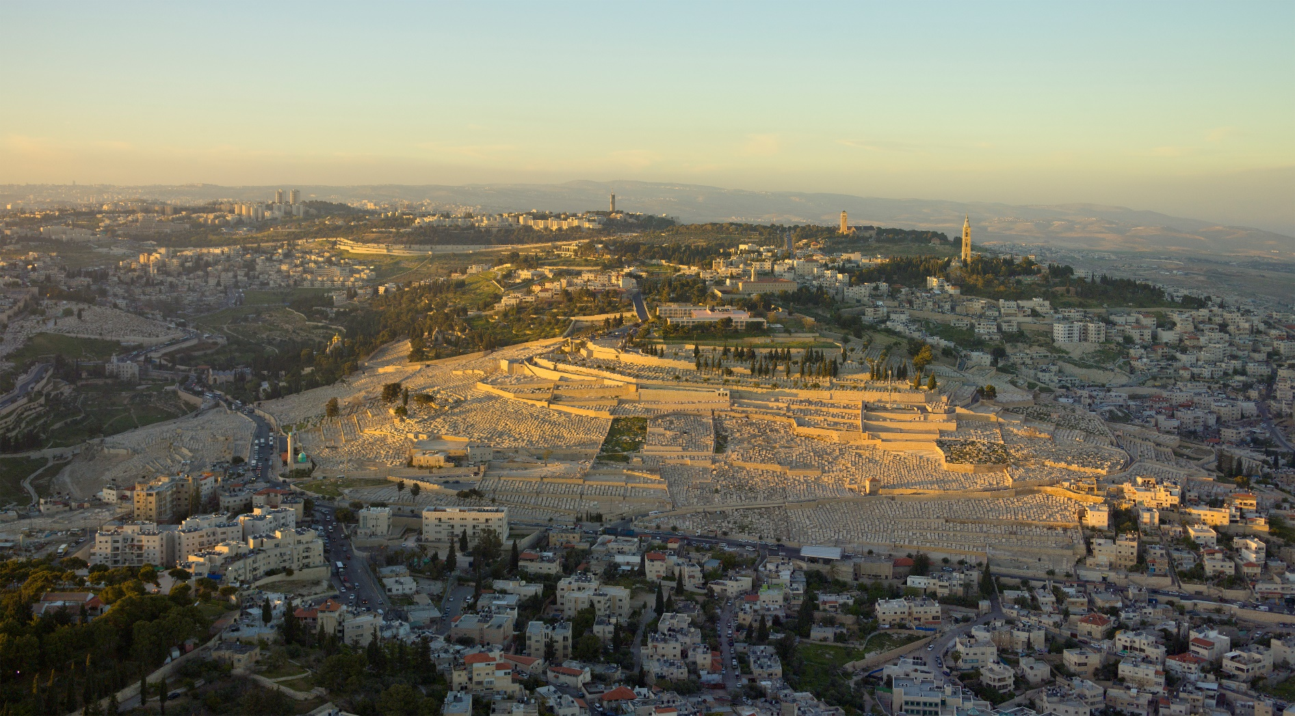
Mt. of Olives

Slide 28
THE NEW ISRAEL (1:12-26)
The story of Jesus concludes with the disciples returning to the Jerusalem temple (cf. Lk. 24:53).
They were joined by the faithful women who had followed Jesus along with Jesus’ mother and brothers and some others (about 120 in all), and they spent the nights in an upper room, though they spent the daytime hours in the temple courts in prayer (1:13; cf. Lk. 24:53).
Peter led them in installing a replacement for the defected and dead Judas Iscariot, indicating that this would “fulfill” an ancient text (cf. Ps. 69:25; 109:8).
This deep reverence for the sacred number “12” shows that they considered themselves to be a reconstitution of a new Israel.

Slide 29
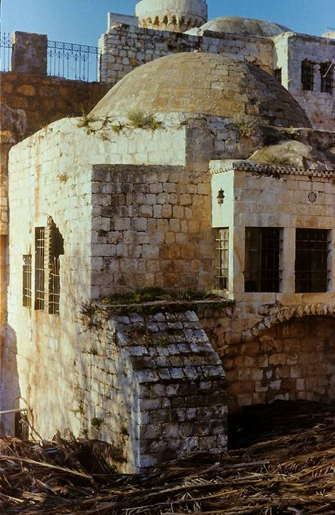
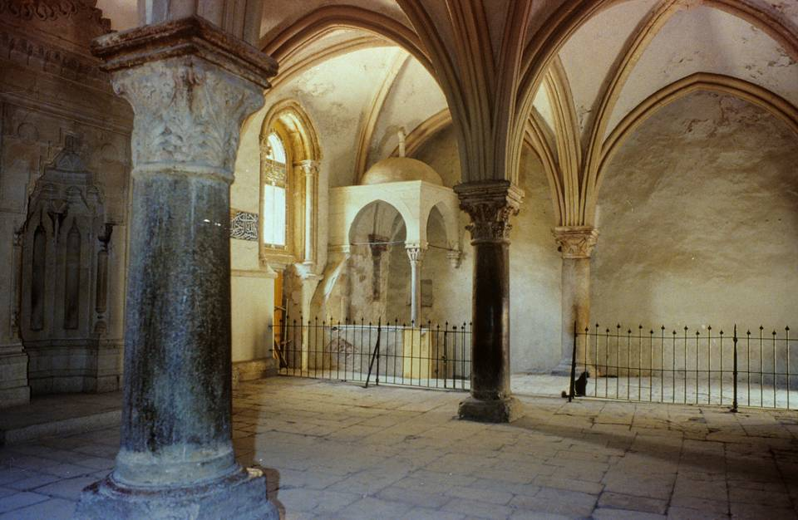
Though the present structure only dates to the Crusader Period, foundations beneath it may go back as far as the time of Jesus. This is the traditional site of the Last Supper and the upper room, called the Cenacle (from Jerome’s Latin Vulgate). Its earliest foundation seems to be from either an ancient synagogue or church that may have existed prior to the destruction of the 2nd temple. The columns of the structure’s interior go back to an early Byzantine church, while the vaulted ceiling was constructed by the Crusaders.
Traditional site of the Upper Room

Slide 30
The New Testament Concept of Fulfillment
Because the gospel writers so frequently appeal to the Hebrew Scriptures as “fulfilled”, some appreciation of the range of meanings is important. The verb “fulfil” (plhro<w) means “to make full”, and this was conceived in more than a single way.
Prediction/Verification
This type of fulfillment is announced in advance and fulfilled when the event takes place.
Recapitulation
This type of fulfillment features a sort of “history repeats itself” motif. An event that happens in ancient times has a striking parallel in later times, so striking that the past event seems to foreshadow the future event.
Clarification
This type of fulfillment begins with an ancient ambiguity, yet in the New Testament the writer sees that this ambiguity is resolved by later events.
The One/the Many
This type of fulfillment is based upon the Hebrew concept that a single individual could represent a group and vice versa. The fluidity between the one and the many links Jesus to the ancient nation Israel.

Slide 31
Can Judas Iscariot be Reclaimed?
Various efforts, especially by those advocating the legitimacy of Gnostic literature, have been undertaken to reclaim Judas:
Some are based on psychological arguments that Judas was actually supportive of Jesus and only wished to be a catalyst for him to reveal his messiahship
Some advocate collusion between Jesus and Judas so that Judas’ “betrayal” was really at Jesus’ request so that Judas ends up being a hero.
All such attempts conflict with the record of the New Testament, where Jesus says that Judas was the “son of damnation” (Jn. 17:12) and Peter says after his suicide he “went to his own place” (Ac. 1:25).

Slide 32
Was Matthias the Right Choice?
Other attempts have been made to discredit the appointment of Matthias, either on the grounds that the decision was made before the outpouring of the Spirit or that Paul was really the 12th apostle.
All such attempts fail. Luke expresses no such doubt, and he speaks of the “Twelve” (minus Judas) even before Paul’s conversion (6:2).
Paul, on the other hand, distinguishes himself from the Twelve (1 Co. 15:5). He speaks of the apostles who traveled with Jesus “from Galilee to Jerusalem”, and he makes no attempt to include himself in this number (Ac. 13:30-31). Paul could never have satisfied the basic criteria as a witness of the living Jesus from the time of John the Baptist (Ac. 1:21-22; 3:15; 10:39, 41).

Slide 33
Discussion Questions
Why do you think Peter emerged as the leader among the disciples?
What were the requirements for being an “apostle”, and should we recognize apostles today?

Slide 34
THE MESSIANIC GIFT OF THE SPIRIT (2:1-13)
Luke heralded the return of the quenched Spirit in his gospel (Lk. 1:15, 35, 41, 67; 2:26-27), and Jesus was the bearer of the Messianic Spirit (Lk. 3:22: 4:1, 14, 18).
At Pentecost he describes the outpouring of the Messianic Spirit upon the disciples, which John the Baptist had predicted (Lk. 3:15-16) and Jesus had promised before his ascension.
This would be the only occasion where disciples would wait for the Spirit. On all other occasions, the Spirit came without prior instruction and without forewarning.
The apostles may well have been infilled with the Spirit earlier (cf. Jn. 20:22), but Pentecost was a more general outpouring, presumably including Jesus’ mother, brothers and the others with them.

Slide 35
Pentecost
The Greek term “Pentecost” (= 50th) corresponds with the Old Testament Festival of Weeks, seven weeks plus one day after Passover (Lv. 23:15-16; Nu. 28:26-31; Dt. 16:9-12).
The languages spoken were “dialects” from around the Roman Empire, now heard by Diaspora Jews who had traveled to Jerusalem.
Theologically, the event at Pentecost was a reversal of Babel (Ge. 11), where the human race was divided by languages, and it hinted at what would come later—the gospel to the nations.

Slide 36
Did the Holy Spirit Descend in the Upper Room?
In Acts 2:2, Luke speaks of a house (oi#koj), but in his gospel, he speaks of the temple (24:53).
The place of the outpouring is not otherwise described.
Traditionally, the “house” has been supposed to be the upper room mentioned earlier (1:13), but it may have been some structure within or adjacent to the temple.
Wherever it was, it must have been sizeable in order to accommodate 120 people. Perhaps it was in the temple itself.
Furthermore, the large crowd present and the events that followed seem more appropriate to the temple courts.

Slide 37
To whom was the Spirit given?
Some have suggested that only the Twelve received this outpouring, but the Greek grammar discourages such a view.
The pronoun “they” implicit in the verb e]plh<sqhsan of 2:4 (= they were filled) goes back to a series of preceding “theys”, which in turn go back to “the brothers” in 1:15 (a group numbering about a hundred and twenty”).
When the text says “all” (pa?j) were filled (2:1-2), it implies all those who made up the “they” mentioned earlier.
Hence, the most natural reading of the Greek text is that the Holy Spirit descended upon the full group of 120, not just the Twelve.

Slide 38
PETER’S SERMON (2:14-36)
Peter, as spokesman, announced that what had happened was a fulfillment of Joel’s prediction that the Holy Spirit would be poured out on all flesh (cf. Joel 2:28-32).
With the coming of the Messiah and the outpouring of the Holy Spirit, the “last days” had arrived.
Most important, all who called on the Lord’s name would be saved.
Peter immediately began to proclaim the messiahship of Jesus of Nazareth, who in his life, death and resurrection fulfilled the ancient predictions.
This Jesus, crucified and risen, was now Messiah and Lord.

Slide 39
The Apostolic Preaching of the Gospel
Peter’s sermon at Pentecost is the first of four extended accounts in the Book of Acts describing the preaching of the gospel. These four sermons have striking similarities and epitomize the message that was proclaimed, both among the Jews and later among the non-Jews.
Acts 2:14-36
The prophecies are fulfilled.
God has acted in the life, death and resurrection of Jesus.
These events are attested by eyewitnesses.
Jesus is exalted as Lord over all!
Acts 3:13-26
The prophecies are fulfilled.
Eyewitnesses attest to what God has done in Jesus’ death and resurrection.
These events are attested by Scripture.
Jesus is the exalted Messiah!
Acts 10:34-43
God has acted in the life of Jesus.
Jesus’ life, death and resurrection is attested by eyewitnesses.
Jesus has been exalted as Judge of the living and dead.
This was predicted by the prophets.
Acts 13:16-41
The promises have been fulfilled.
The message of salvation is in Jesus’ death and resurrection.
Jesus’ resurrection was attested by eyewitnesses.
The appropriate response is faith.

Slide 40
THE APPEAL (2:37-41)
Peter’s words struck home, and the Jewish listeners, deeply convicted of their compliance in the death of God’s Messiah, asked, “What shall we do?”
This question, in such a Jewish context, is not quite the same as the later question of the Philippian jailor, “What must I do to be saved?” It probably would not have occurred to these Jews that they were anything other than part of God’s chosen family.
Rather, they wanted to know what they could do to rectify their egregious error in committing God’s Messiah to death.
The right course of action was to repent (= change their mind) and be baptized, showing their new allegiance to Jesus.

Slide 41
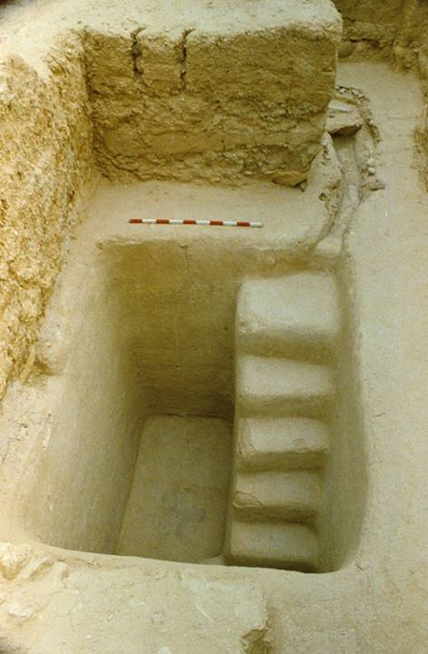
BAPTIZING 3000 CONVERTS
Luke doesn’t say where the apostles baptized this large number of Jewish converts, but there are two reasonable possibilities:
…one of the large pools in Jerusalem (e.g., Siloam, Bethesda, etc.).
…the various mikva’ot (pools for Jewish ritual baptism) near the temple precincts. So far, about 40 have been excavated by archaeologists.
Second temple mikveh (baptismal pool) excavated near the stairway at the southern wall of the temple mount.
It would have been in use during the time of Jesus.

Slide 42
The Baptismal Words
While there is no reason to assume that precision of wording is the primary issue, it is at least worth noting that the baptismal words in Acts are different than in Matthew. Luke tends to use a shorter former (2:38; 8:16; 10:49; 19:5), while the wording commanded by Jesus in Matthew are longer (Mt. 28:19).
It may have been that the shorter formula was more important for Jewish converts, who already believed in God, the Father, and in the Holy Spirit.
The longer formula may have been more appropriate for pagans, who would need to reject the pantheon of Greco-Roman deities for the one true God—Father, Son and Holy Spirit.

Slide 43
THE NEW COMMUNITY (2:42-47)
Luke summarizes the character and practice of the new community.
Four key features are enumerated:
  The teaching of the apostles was central.
  Continued fellowship included communal meals and prayer, the meals probably including the Eucharist. (Luke seems to use the expression “breaking of bread” to refer to the Eucharistic meal, cf. 20:7.)
  The same authority to perform miraculous signs Jesus had given to the apostles during his Galilean ministry now continued to extend into the period of the church.
  They practiced the common life, pooling their resources.
The temple continued to serve as a sacred place for meeting (cf. 5:12).

Slide 44
Discussion Questions
At various times in Christian history, groups of Christians have become preoccupied with precise wording and/or precise actions in conducting baptism. How important are such issues, and should they divide Christians from each other?
If the “breaking of bread” refers to communion, which the earliest Christians began to observe immediately after Pentecost, how important do think this observance is in the modern church?

Slide 45
The Jewish Church
3-5

Slide 46
THE JEWISH CHURCH IN THE CONTEXT OF JUDAISM
Accepting Jesus as the Messiah did not constitute a alienation from either the Jewish community or Judaism.
When Luke says they enjoyed the favor of all the people (2:47a), he surely means the Jewish community, many of whom, no doubt, had seen and heard Jesus.
Continuing to meet in the temple, they presumably continued in temple worship, such as, the daily burnt offering and the morning and evening incense.
They also continued to observe the tefillah (the two periods of daily prayer, morning and afternoon).

Slide 47
THE HEALING OF A CRIPPLED MAN (3:1-11)
It was when Peter and John were going to the temple for the afternoon tefillah (about 3:00 PM), offered at the time of the whole burnt offering, that they encountered the crippled beggar.
The exact location can only be conjectured; Luke’s description of “the beautiful gate” is not otherwise attested in ancient Jewish literature.
Instead of alms, Peter commanded the man to stand upright, and the crippled man was healed, walking and leaping in the temple courts.

Slide 48
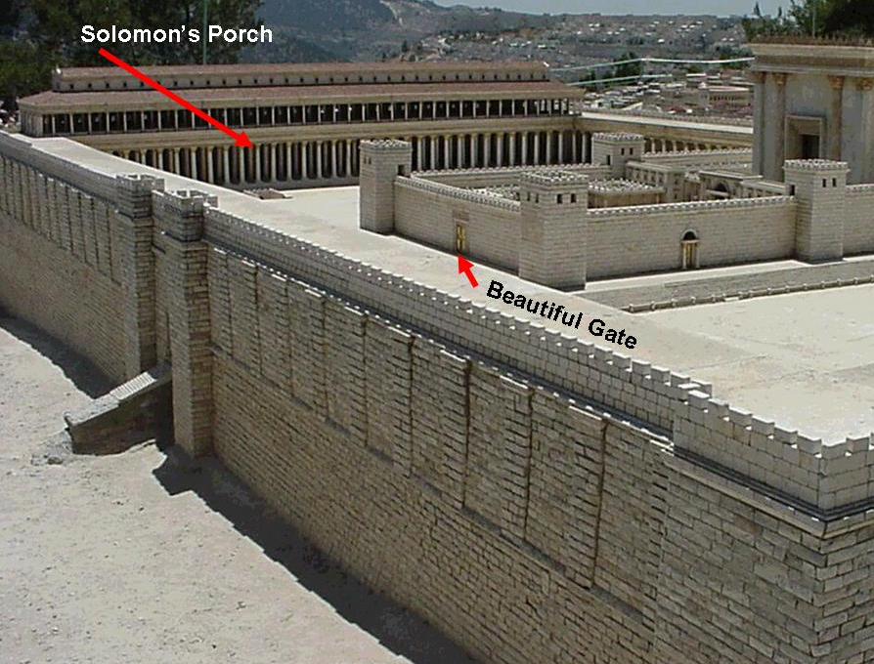
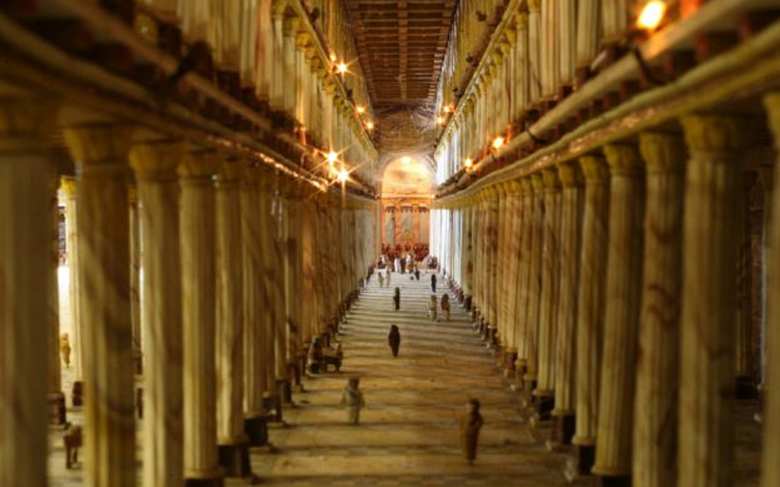
Solomon’s Colonade was also where Jesus was nearly stoned at the Feast of Hanukkah (Jn. 10:22ff.).

Slide 49
PETER’S SERMON (3:12-26)
Luke now offers a sketch of Peter’s second great sermon.
For the apostles, a miracle was not an end in itself, but a bridge toward the gospel.
As at Pentecost, and particularly relevant to his Jewish audience, Peter’s sermon focused on the fulfillment of prophecy.
  This time he identified Jesus as Isaiah’s “the Servant of Yahweh” (3:13), the one who would herald God’s knowledge to the ends of the earth (cf. Is. 42:1-4; 49:1-6; 50:4-9; 52:13—53:12).
  Jesus, the suffering Servant, had indeed suffered to the death! But God raised him from the dead (3:26)!

Slide 50
The Striking Parallel with the Septuagint
o[ pai?j mou…decasqh<setai (Isaiah 53:13, LXX)
“My Child-Servant…will be glorified…”
o[ qeo>j…e]docasen to>n pai?da au]tou? (Acts. 3:13)
“God…has glorified his Child-Servant…”
What God had promised for his faithful Servant, he had fulfilled in Jesus of Nazareth!

Slide 51
Who Is Jesus?
Peter’s sermon concentrates on the true identity of Jesus of Nazareth.
If Jesus is Isaiah’s “Servant of Yahweh”, he also is no less than the “Prophet like Moses” (Dt. 18:15, 18-19; cf. 34:10-12), the one foretold by all the prophets.
Peter’s titles for Jesus are exalted and vivid:
  The Holy and Righteous One (3:14)
  The Author of Life (3:15)
  The Christ (3:18, 20)

Slide 52
Discussion Questions
Since the crippled man whom Peter and John healed had been at this temple gate every day for a long time, do you think Jesus may ever have passed him?
In none of the sermons by Peter or others to unbelievers is there any anecdotal personal stories. Rather, they seemed to concentrate on the fulfillment of Scripture and the events of Jesus’ life, death and resurrection. How does this compare with gospel presentations today?

Slide 53
CONFRONTATION (4:1-22)
The Sadducees interrupted Peter’s sermon, apparently incensed over the proclamation of resurrection in Jesus (whom they had helped execute).
They jailed Peter and John for the night, bringing them in the next morning for examination.
Though the temple rulers made no attempt to deny the miracle, they focused on the authority by which it was performed.
“Filled with the Spirit”, Peter explained that their authority came from Jesus, whom the temple authorities had rejected and crucified. Jesus was the rejected cornerstone (cf. Ps. 118:22), and he was the only source of true salvation!

Slide 54
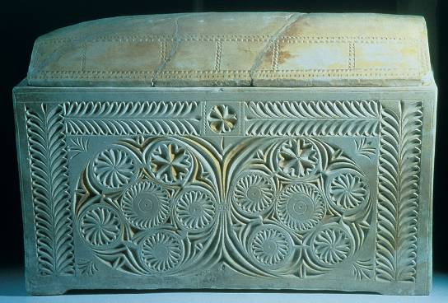
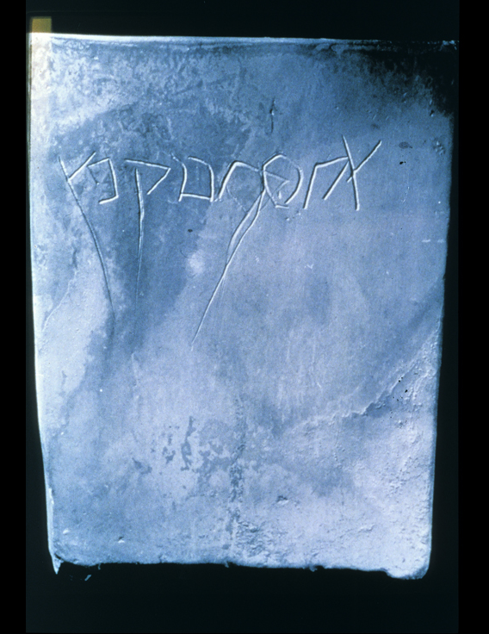
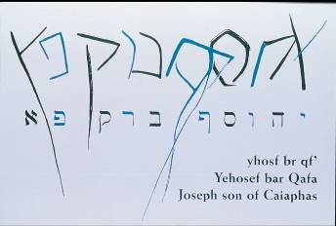
In 1990 an ancient tomb chamber was discovered containing several ossuaries (bone boxes for second burial). Among them was an ossuary inscribed with the name “Joseph bar Caiaphas”, almost certainly the same Caiaphas in the gospels and here in Acts 4:6 whom Josephus calls “Joseph Caiaphas”.

Slide 55
THE COMMISSION RENEWED (4:23-31)
After hearing the parting warning of the Temple authorities, Peter and John returned to their new community and reported what had happened.
The whole community joined in prayer, citing the royal Psalm 2 celebrating the victory of God’s Anointed One over the rulers of the earth.
What had happened in the death of Jesus was no more than what had been foreordained by God himself.
Now, they prayed for courage to continue to preach about Jesus, after which they were again “filled with the Holy Spirit”.

Slide 56
THE COMMON LIFE (4:32—5:11)
Earlier, Luke briefly alluded to the common life of this early community (cf. 2:44-45). Now, he offers some fascinating details:
In the first place, contributing to the common fund was voluntary, not obligatory, and one notable example was the sizeable contribution of a Levite from Cyprus, Joseph Barnabas (who later would be linked to Saul of Tarsus).
A second incident, involving dishonesty on the part of a man and his wife, ended with a summary judgment of death for both!
Deep awe filled the “church” (and this is Luke’s first occasion to use the term e]kklhsi<a to describe the new community).

Slide 57
MIRACLES AND PERSECUTION (5:12-42)
After the interlude regarding the common life, Luke returns to the outcome of the community prayer following the arrest of Peter and John.
The apostles continued to perform miracles, but while many more people accepted the messiahship of Jesus, many others rejected their message.
A popular belief was that the shadow of a holy man could cure the sick, and many people attempted to position their sick loved ones so that Peter’s shadow would pass over them. Luke is ambiguous as to whether this was actually successful, but for those who brought their sick to Peter directly, they were all healed.

Slide 58
The Second Interrogation
Once more the apostles were arrested—all of them—after they refused to heed the warning at the first arrest.
The Sanhedrin, under the direction of the Sadducees, must have been chagrined to find the apostles free the next morning and teaching in the temple courts about Jesus. (And it must have been especially galling when it was reported they had been released by an angel, since Sadducees did not believe in angels.)
A second order for arrest was given, this time carefully so as not to arouse the people.
Peter boldly indicted the leaders again for their role in killing Jesus.

Slide 59
The Major Jewish Sects described by Flavius Josephus
Pharisees
Middle-class separatists
Lay theologians
Upheld both oral and written Torah
Closely allied with scribes (copyists)
Linked with the synagogues
Essenes
Ascetics with a high value on apocalyptic literature
Held that the priesthood was corrupt and saw themselves as the true Israel in exile
Qumran was possibly Essene
Sadducees
Upper-class, mostly priests
Upheld the supremacy of the written Torah
Primary influence in the Sanhedrin and Second Temple
Rejected resurrection & angels
Zealots
Patriotic freedom-fighters
Upheld Maccabean idealism
Opposition to Rome was an expression of zeal for the Torah
Central to the 1st and 2nd Jewish Revolts

Slide 60
The Advice of Gamaliel
Contemplating a death penalty for the apostles, the Sanhedrin was finally persuaded toward a more reasoned response by Rabbi Gamaliel.
Gamaliel is justly famous for two reasons:
  He was the tutor of Saul of Tarsus (22:3).
  He was of such revered status that the Talmud says when he died, “…the glory of the law ceased and purity and abstinence died” (Sota 9:15).
Other zealot uprisings had come and gone, and if this one was merely humanly contrived, it would fall also.
Hence, they only flogged the apostles with the 39 stripes (cf. Dt. 25:3), and the apostles continued to preach and teach about Jesus.

Slide 61
Discussion Questions
Several times, Luke uses the phrase, “…filled with the Spirit” (2:4; 4:8, 31), and in his gospel, he also uses this same kind of language (Lk. 1:15, 35, 41, 67; 2:25, 27; 4:1, 14). What do you think Luke means by this phrase?
Some Christians have taken the early disciples’ practice of the common life to be an implicit mandate for all Christians. What do you think?

Slide 62
Crossing the First Ethnic Barriers
6:1—8:40

Slide 63
THE JEWSHNESS OF THE CHURCH
To this point, Luke has described an exclusively Jewish community of believers in Jesus.
All the converts had been Jews within Judaism.
Peter’s sermons had addressed them as such (“fellow Jews”, “men of Israel” and “brothers”, 2:14, 22; 3:17).
Peter seemed convinced that the message of Jesus must necessarily go “first” to Israel if not exclusively to Israel (3:26; 5:31).
Earlier, Luke said the believers were “together” with “one heart and one mind” (2:44; 4:32). Now, their unity would suffer its first setback, when their common life was disrupted by a cultural dispute.

Slide 64
THE ETHNIC DISPUTE (6:1-7)
Tension developed between the Greek-speaking Jews and the Aramaic-speaking Jews over the distribution of assistance to widows from the common fund.
Probably, each Christian faction attended a different synagogue, the Greek-speaking Hellenists (likely immigrants from elsewhere in the empire) both linguistically and culturally at a distance from their Aramaic-speaking counterparts.
Favoritism was shown toward the Aramaic-speaking part of the community, which seemed to assume an attitude of superiority, and in the common meetings in Solomon’s portico, the language difference would have been immediately apparent.

Slide 65
The Seven
To remedy this problem, the Twelve now appointed a second group of leaders, the Seven (cf. 21:8), probably the forerunners of what later would be called deacons.
Their credentials were based on their spirituality and character, and it is likely significant that all seven had Greek names, which suggests that they may have been selected from the Greek-speaking contingency.
At least one was a proselyte (Nicolas of Antioch), a non-Jew who had embraced the Jewish faith, and he now becomes the first non-Jew to embrace the Christian faith (but via Judaism).

Slide 66
“DEACONS” IN THE EARLY CHURCH
While there is no systematic explanation of how the office of “deacon” (dia<konoj = “servant”) developed, the choosing of the Seven seems to have been the first step.
The order of “deacons” seems to have been something new, since there was no counterpart in either the synagogue or other Jewish community structures. No doubt the title itself derives from Jesus’ teachings about servant-leadership.
The imposition of hands can be traced to antiquity, when someone was commissioned to leadership (cf. Nu. 27:22-23).
In time, the leadership roles of “overseers and deacons” seem to have existed side-by-side (cf. Phil. 1:1; Ro. 16:1; 1 Ti. 3:1-13).

Slide 67
THE FIRST MARTYRDOM (6:8—8:3)
The amount of space Luke devotes to this incident suggests how important he considered it to be.
Stephen, one of the Seven, gives the longest single speech in the book, longer even than Peter’s sermon at Pentecost.
It climaxes with the conclusion that the temple is no longer the center of Israel’s faith, a clear watershed in the history of the Jerusalem church.
It climaxes with the martyrdom of Stephen virtually at the feet of a young rabbi named Saul.

Slide 68
Stephen’s Ministry
As is apparent, Stephen’s ministry went a good way beyond managing the daily food distribution for the common life.
While he is never accorded the title “apostle”, the miracles attending his ministry were very near that of others in this exalted position.
In his evangelism, he was confronted by members of a Diaspora synagogue made up of Jews from northern Africa and southern Asia Minor.
Presumably these Diaspora Jews were Hellenists, and in all likelihood, Stephen was himself a member of the same synagogue.

Slide 69
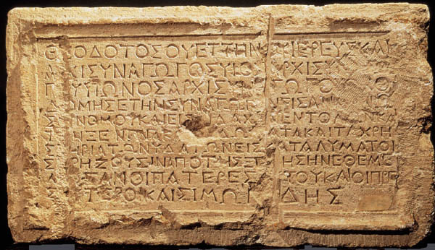
Theodotus Inscription
Many synagogues stood in ancient Jerusalem prior to AD 70, and in one of them hung the following Greek inscription, “Theodotus…rebuilt this synagogue for the reading of the Torah and the teaching of the commandments, and the hostelry, rooms and baths, for the lodging of those who have need from abroad.” The fact that the language of the inscription is Greek, not Hebrew, and its allusion to “those who have need from abroad,” suggest that this synagogue was used by Jews from the Diaspora. Some scholars have identified it with the Synagogue of the Freedmen (former slaves in the Roman Empire), mentioned in Acts 6:9. It is possible that Saul of Tarsus in Cilicia may even have been a member also (21:39), since many other members were from Cilicia (6:9).
Israel Museum

Slide 70
The Accusation
Stephen and the synagogue members debated vigorously, though Stephen seems to have had the better of it.
At issue, as seems clear from a later reference (7:47-50), was the role of the temple in Judaism.
His opponents accused him, because he supposedly spoke “words of blasphemy against Moses and against God” (6:11), and further, that he railed “against the holy place and against the Torah” (6:13) and sought to “change the customs Moses handed down” (6:14b).
Stephen, for his part, seems to have drawn his argument directly from Jesus concerning the fall of the temple (6:14a; cf. Mt. 24:2//Mk. 13:2//Lk. 21:6; cf. Jn. 2:19).

Slide 71
Stephen’s Defense to the Sanhedrin
Arraigned before the Sanhedrin, Stephen’s hearing began with the interrogative, “Are these charges true?”
Instead of defending himself outright, Stephen launched into a sweeping history of Israel, including the stories of Abraham, Joseph, Moses and the construction of the 1st temple.
These examples were hardly chosen randomly, for they converged in a radical conclusion—one that no Christian so far had voiced—that God could not be confined to any humanly constructed temple!

Slide 72
Themes Woven into Stephen’s Speech
GOD’S PRESENCE HAS NEVER BEEN CONFINED TO ONE PLACE OR ONE COUNTRY.
Abraham in Mesopotamia
Abraham in Haran
Joseph in Egypt
Moses in the Sinai
Solomon in the Holy Land
THE PEOPLE OF ISRAEL HAD BEEN REBELLIOUS ALMOST FROM THE BEGINNING.
Sold Joseph as a slave
Rejected Moses
Worshipped pagan gods.
Persecuted the prophets.
Murdered the Messiah.
EVEN THOUGH THE FORMS OF WORSHIP BEGINNING WITH ABRAHAM WERE APPROPRIATE, THEY WERE NOT ENDS IN THEMSELVES
The tabernacle was replaced by the temple.
The temple, however, could not contain God.

Slide 73
The Broad Implications
God’s promise to David that he would have a son who would build a house was by no means exhausted in Solomon’s construction of the 1st temple.
All ancient forms of worship pointed beyond themselves to the coming of the Messiah!
Just as Moses was rejected and the people’s worship became blasphemous, so now God’s Messiah had been rejected and temple worship had become blasphemous!
Hence, for Stephen to announce the supersession of the temple was hardly blasphemous: God was independent of any temple!

Slide 74
Stephen’s Indictment
Stephen’s speech ended with a blistering indictment of the Sanhedrin!
The present leaders were just like their ancestors—”uncircumcised in hearts and ears”!
Stephen could hardly have chosen more inflammatory language! The rejection of Joseph, Moses and the prophets had culminated in the rejection and murder of God’s Messiah.
At the end of his speech, Stephen had a vision of the risen Christ, standing at God’s right hand with all power and authority, a final vindication that the true glory of the true temple was in the heavens, not on earthly Mt. Zion.

Slide 75
Stephen’s Martyrdom
In an uncontrollable rage, the Sanhedrin members dragged Stephen outside the city and stoned him.
Stoning was the Mosaic penalty for blasphemy (Lv. 24:11-16, 23).
Those stoning Stephen deposited their cloaks at the feet of a young Pharisee, Saul of Tarsus, who was in Jerusalem studying under the Great Rabban Gamaliel (cf. 22:3).
Stephen died as did his Lord, praying for the forgiveness of those killing him.

Slide 76
Discussion Questions
Why do you think Stephen’s vision of the risen Christ was so important in this first martyrdom?
Stephen said that his accusers were “uncircumcised in hearts and ears”. What do you think he meant by this phrase?

Slide 77
The New Inquisitor
Now the fledgling community of Christians would face the terrorizing tactics of a new champion for the Torah, the young Rabbi, Saul of Tarsus.
Under his energetic guidance, a severe persecution against Christians began in deadly earnest as Saul began to destroy them, imprisoning them, beating them and giving his testimony against them to the death (cf. 22:19-20; 26:9-11; 1 Co. 15:9; Gal. 1:13; Phil. 3:6; 1 Ti. 1:13).
This outbreak of opposition was so harsh and so brutal that many Christians began to flee the city for the outlying regions of Judea and Samaria. (The apostles apparently stayed in Jerusalem, presumably in hiding.)

Slide 78
THE SAMARITAN MISSION (8:4-25)
Stephen’s martyrdom became a watershed for the Jerusalem church, since it forced the Jewish Christians out of their local environment.
Already, the new Christian community had stretched to include proselyte and Hellenistic leaders from within the larger Jewish community.
All this was in Judea, however, and all concerned Torah-observant people.
Now, an outreach to Samaria would test the boundaries, for Samaritans were theologically distant from Torah-observant Jews.

Slide 79
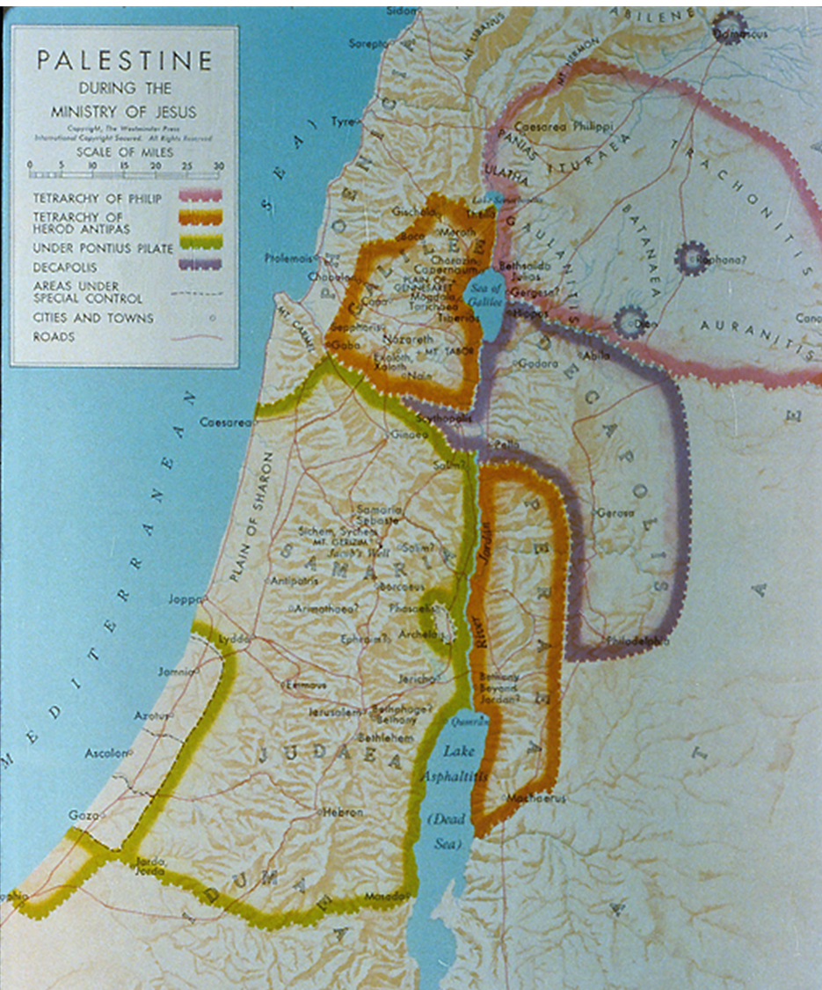
Samaria lay between Galilee and Judea, and due to mutual hostilities, it was generally avoided by Jews traveling north to south or vice versa on the grounds of ritual impurity or outright danger.
If traveling southward to Judea, Jews from Galilee typically would ford the Jordan River in the north near the southern end of the Sea of Galilee, travel down the eastern side of the river, and then ford it again at Jericho.

Slide 80
The Longstanding Dispute
Jewish and Samaritan relationships were deeply strained.
ETHNICALLY
Samaritans claimed to be descendants of Israelites in the time of Eli, when the tabernacle was moved from Shechem (its rightful place) to Shiloh.
The Jews claimed they were an impure breed resulting from intermarriage with pagans after the fall of the northern kingdom.
THEOLOGICALLY
The Samaritans championed their own version of the Torah (Samaritan Pentateuch), which specified the building of an altar on Mt. Gerizim (an insertion following Ex. 20:17 and implied in various other places).
The Jews, of course, rejected this Torah.
HISTORICALLY
In 128 BC, John Hyrcanus, one of the Jewish Hasmonean priest-kings, destroyed the Samaritan sanctuary on Mt. Gerizim.
A century later, some Samaritans slipped into the Jerusalem temple at Passover and defiled it with human bones in the middle of the night.

Slide 81
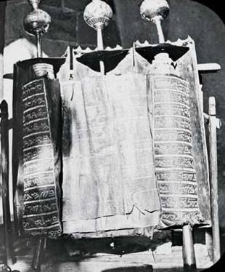
The Later Debate
While the traditional Torah contains no indication of the site for the central shrine, the Samaritan Pentateuch specifically commanded a sanctuary on Mt. Gerizim. Hence, the debate in the second temple period.

Slide 82
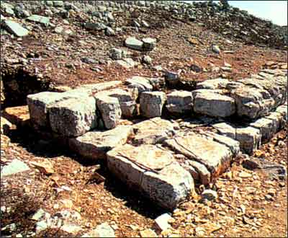
Based on archaeological excavations, the first phase of the temple on Mt. Gerizim was erected in the 5th century BC. In the 2nd century BC, a larger edifice was constructed, but John Hycanus of Jerusalem, razed it to the ground in the late 2nd century BC. Hostilities continued into the time of Jesus.
Archaeological remains of the Samaritan temple on Mt. Gerizim. Excavations began in 1982 and have continued uninterrupted ever since.

Slide 83
Jesus and the Samaritans
Jesus, however, had spent two entire days in Samaria after his encounter with a Samaritan woman at Jacob’s well (Jn. 4:4-42). Once he had healed a Samaritan leper (Lk. 17:15-16).
From this incident of the woman at the well, many Samaritans had come to believe in Jesus (Jn. 4:39, 41), the coming Taheb (Savior) who would end their period of divine disfavor.
It is hardly to be doubted that Jesus’ brief contact with these Samaritans paved the way for some of the fleeing disciples to go in this direction (Ac. 8:1)

Slide 84
Philip’s Preaching
Among those Christians who fled Jerusalem to Samaria was Philip, one of the Seven.
Without hesitation, he preached that Jesus was the Messiah, performing miraculous healings and exorcisms, so that joyful attention was focused on what he said.
Many believed Philip’s word and were baptized, including one man in particular, a certain Simon who had practiced sorcery and was amazed by the signs he saw Philip do.

Slide 85
The Jerusalem Investigation
The news of what was happening in Samaria made it back to Jerusalem, and the apostles felt it necessary to send a delegation to investigate.
If what was happening in Samaria was genuine, then the circle of Christians must be expanded beyond the traditional boundaries of Jewishness.
Peter and John were sent, therefore, to observe and report back.
When they arrived in Samaria, they prayed that the Samaritans might receive the Spirit, and their prayers were answered.
The gift of the Holy Spirit to the Samaritans was the decisive proof that God had accepted them.

Slide 86
The Pattern of Conversion-Initiation
The typical pattern of conversion-initiation in the New Testament is that those who come to faith are immediately blessed with the gift of the Holy Spirit (Ac. 10:44; Ga. 3:2, 5, 14; 4:6; Ep. 1:13; Ro. 8:15-16).
Why, then, was this not the case for the Samaritans?
They “believed” (8:12) Philip’s preaching of the gospel, but they did not receive the gift of the Spirit until the arrival of Peter and John some days later (8:15-17).
There is no hint in the New Testament of two bodies of people, one with the Spirit and the other without, for the very essence of the church’s unity is based upon the fact that “all were given one Spirit to drink” (1 Co. 12:13).

Slide 87
The Pattern of Conversion-Initiation
This separation of faith from the gift of the Spirit has engendered considerable discussion, and while some Christians demarcate between them as baptism and confirmation, mostly they are explained along one of three lines.
Pentecostal
Pentecostals separate the act of faith from the baptism in the Holy Spirit, treating the latter as a post-conversion work of grace.
The baptism of the Spirit is perceived as a blessing of empowerment, rather than a constituent part of salvation itself, and usually, they believe it should be accompanied by glossolalia.
Inferior Faith
Based on linguistic issues (that the verb pisteu<w, when used with the dative case, means intellectual assent, not full commitment), the early “belief” of the Samaritans was not yet genuinely Christian faith.
Only when Peter and John came did they fully believe and receive the Spirit.
Exceptional Situation
Here, while the Spirit normally is given in the act of faith, it was divinely withheld on this occasion so that Peter and John could witness it.
Only in this way could they report back to the Jerusalem church that the Samaritans’ faith was genuine.

Slide 88
Simon the Sensationalist
The act of the imposition of hands and the gift of the Spirit was especially impressive to Simon, and though earlier he is said to have “believed”, now his true colors become evident.
He offered to buy their “secret”.
Peter was incensed at this obvious display of duplicity, and he clearly judged that Simon’s “faith” was seriously defective.
A century later, Justin Martyr, one of the apostolic fathers and himself a Samaritan, would described Simon’s teaching as “the wicked and deceitful doctrine of Simon of my own nation” (2nd Apology xv).

Slide 89
The New Horizon
The Samaritan episode changed the entire outlook of the Jerusalem church.
Now, not only proselytes and Hellenists could be included, but also Samaritans.
Peter and John, thoroughly convinced that this new direction had divine sanction, continued to preach the message of Jesus in many Samaritan villages.
Hence, the programmatic geographical/ethnic directive of the risen Christ, “You will be my witnesses in Jerusalem, in all Judea and Samaria…” (1:8), had begun to materialize.

Slide 90
CONVERSION OF AN ETHIOPIAN (8:26-40)
In a continuing description of Philip’s ministry, Luke now describes his encounter with an Ethiopian near Gaza.
Luke does not tell us whether or not the man was a proselyte or an outright Gentile.
  That he was a eunuch complicates the matter (cf. Dt. 23:1), and Josephus indicates that eunuchs were to be driven out (Antiquities 4.8.40).
  Still, he had been to Jerusalem and was now reading the Torah, presumably the LXX, so at the very least he had broad sympathies toward Judaism.
  Luke’s interest in him almost certainly derives from the fact that Ethiopia was popularly considered to be at the “ends of the earth”.
Very much to the point, the Ethiopian was reading the scroll of Isaiah, and not very far from 56:3-8, where in the messianic age eunuchs would be accepted by God.

Slide 91
The Suffering Servant
Urged by the Spirit, Philip approached the man to discover him reading from Isaiah 53:7-8, the passage about the suffering Servant of Yahweh.
From this passage, Philip told him that the suffering of the Servant referred to the sufferings of Jesus of Nazareth.
In the conversation, Philip must have said something about baptism, for the man asked why he might not be baptized, and coming to a suitable place (possibly Ein Yael), Philip baptized him.
According to later tradition, the Ethiopian returned to his home country and preached Christ there (Irenaeus, Against Heresies, 3.12.8).

Slide 92
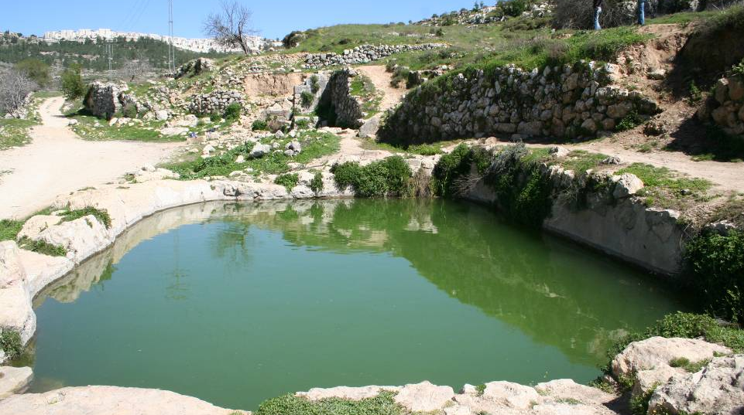
That there was sufficient water for a traditional baptism is evident in these 2nd-3rd century AD remains of a Roman bathhouse from Ein Yael on the Roman road from Jerusalem to Gaza. The road was paved, hence suitable for chariot travel.

Slide 93
Discussion Questions
Why was it important for the Jerusalem church to send representatives to “investigate” the crossing of new ethnic boundaries, such as the outreach in Samaria by Philip?
Given that the Ethiopian was returning to his own country, where there would be no Christian community, how would his new faith be nurtured in this far-off land?

Slide 94
Breaking the Gentile Barrier
9:1—12:25

Slide 95
Of Jews and Gentiles
From a social point of view, the whole community of Judaism in the 1st century was dominated by the fundamental idea of maintaining racial purity.
Various stages of less-than-perfect ancestry were demarcated by the rabbis, and at the very bottom were Gentiles, as far from the Jewish center as could be imagined.
Outside the Holy Land, all was darkness and death.
The very dust of a pagan country was defiling as the grave.
Pagans, because of their idolatry and immorality, were justly deserving of divine judgment.
Hence, to say that carrying the gospel to the Gentiles was to cross the final ethnic barrier is not an overstatement!

Slide 96
THE CONVERSION OF SAUL (9:1-31)
Saul of Tarsus, Cilicia, was the young rabbi who participated in the martyrdom of Stephen and headed the severe persecution of the Jerusalem church.
A Diaspora Jew (21:39), he had relatives in Jerusalem (23:16) and had moved there at an early age to study under Rabban Gamaliel (22:3; cf. Ga. 1:14).
As the arch inquisitor for the Sanhedrin, he extradited Christians from far-flung synagogues, bringing them to heresy trials (22:4-5; 26:9-11).
With extradition letters from the high priest in hand, he was on his way to Damascus, Syria when he was struck to the ground amidst a blinding light and a heavenly voice.

Slide 97
Saul is Baptized a Christian!
He could not have been more shocked than when the answer to his question, “Who are you, Lord,” was the heavenly voice saying, “I am Jesus!”
Later, Saul would recount more fully what the voice said, that he was chosen as a witness of Jesus to the Gentiles so they might be forgiven and included in God’s holy people (cf. Ac. 26:15-18).
Led into Damascus blind, he was eventually healed and baptized by a reluctant Ananias in the home of a Christian named Judas.
To Ananias, God revealed that Saul would be an instrument of profound suffering as well as outreach to the Gentiles.

Slide 98
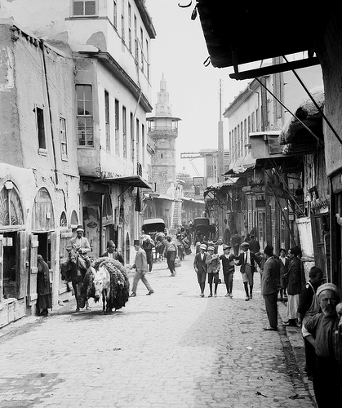
Straight Street
The “Street Called Straight” is the Roman street (Decumanus Maximus) which runs from east to west in the old city of Damascus, Syria.
During the Greek period in Damascus, the city was re-designed by Hippodamus, who gave the city a grid structure. The longest of these streets, 1,500 metres in length across the city, was called Straight Street.
It still is there today, one of the oldest streets in the world.

Slide 99
The Inquisitor Turned Evangelist
The newly converted Saul did visit the synagogues in Damascus, not to serve extradition papers, but to preach Jesus as the Christ.
Ripples of shock, surprise and suspicion filtered through the whole Jewish community.
Eventually, some of the Jews decided he must be silenced by death, but the Christians secretly slipped Paul over the city wall in a basket, an event Paul would later refer to as a irony to the Roman accolade for soldiers who first made it over the wall.

Slide 100
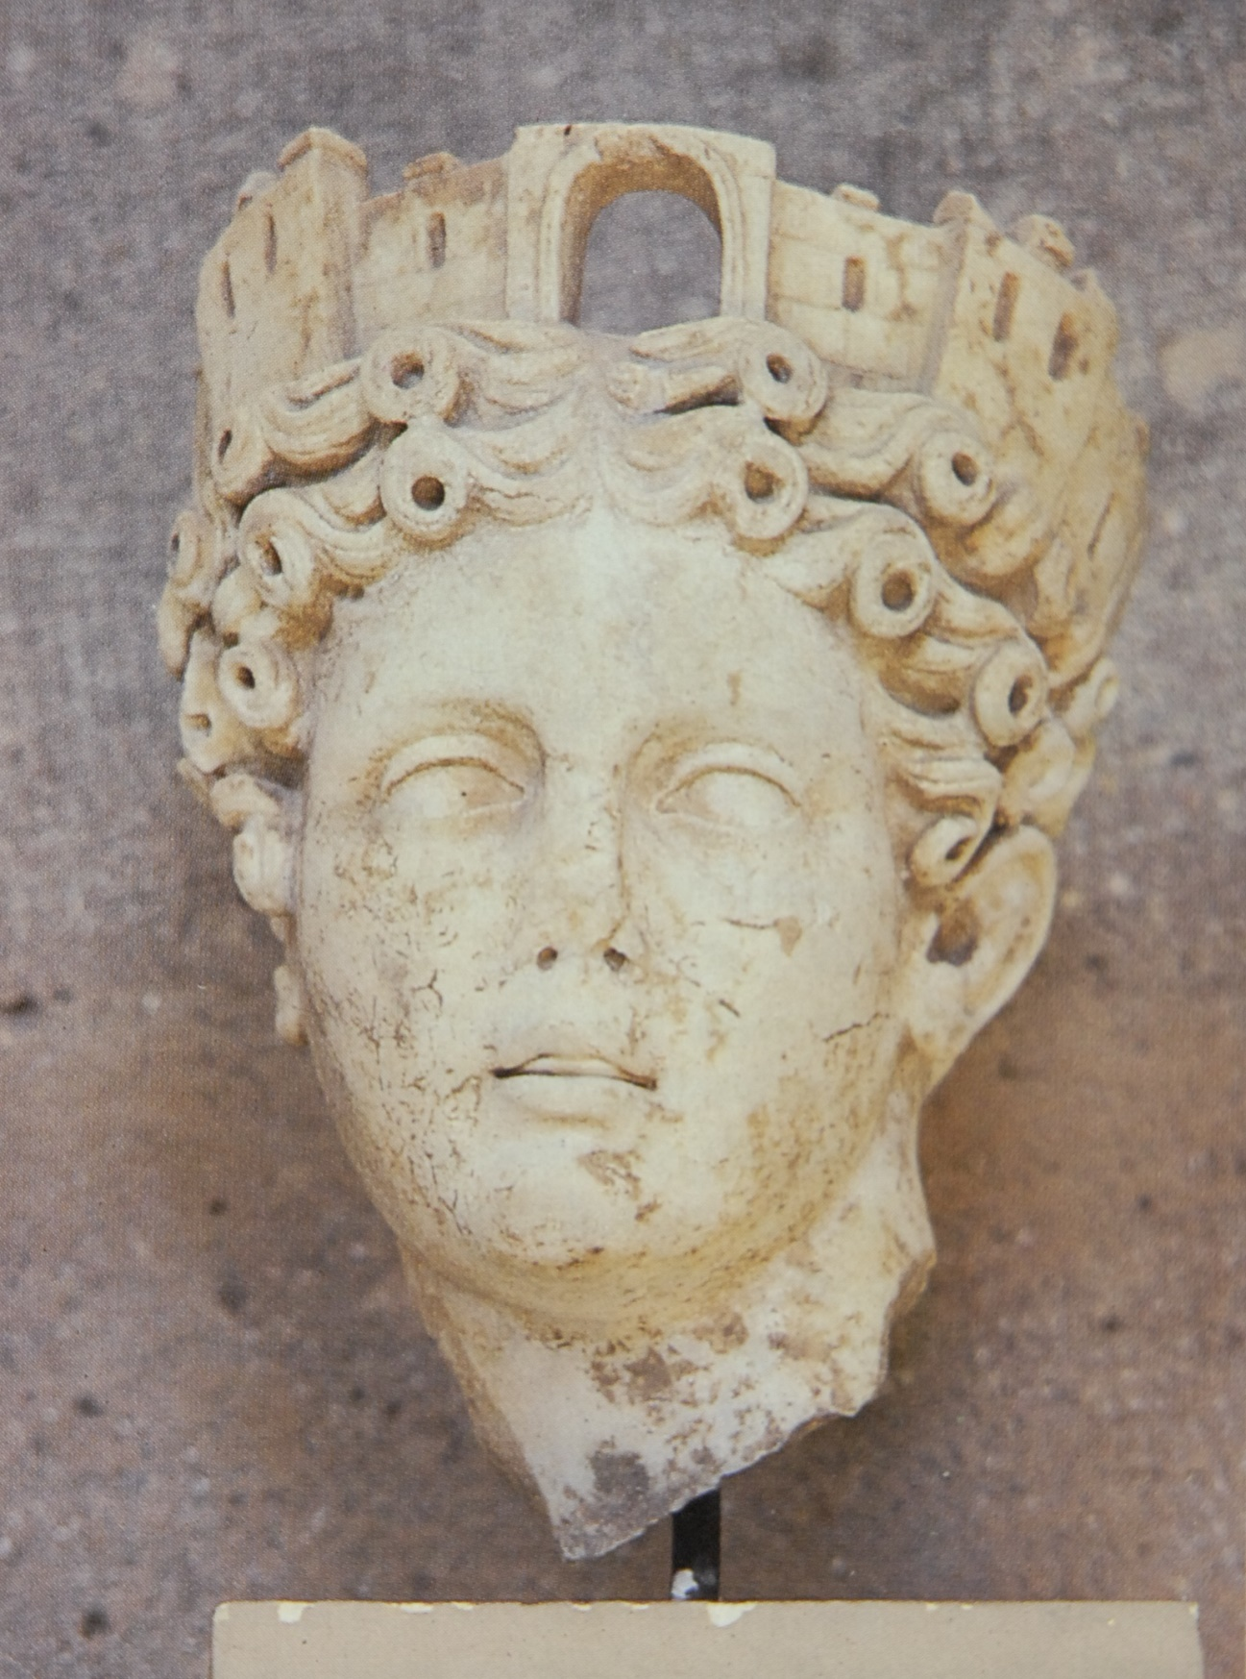
Wall Crown
The corona muralis was a standard adornment of Fortuna, goddess of cities.
Such a crown was bestowed by the emperor on the first soldier who was able to make it safely over the wall into an enemy city.
Paul possibly alludes to this in an irony, when he claimed that he, also, once went “over the wall”—in a basket to escape the clutches of Aretas of Damascus (2 Co. 11:32-33).

Slide 101
Saul in Arabia and Jerusalem
In his Galatian letter, Saul (Paul) adds details that Luke omits.
After his conversion, he immediately went into Arabia, the Nabataen kingdom ruled by Aretas IV (9 BC – AD 40). Presumably this interlude took about three years (Ga. 1:18a).
The trip to Jerusalem that Luke describes in Acts 9 would have been after the time in Arabia. In Jerusalem, Barnabas introduced him to Peter and James (Ga. 1:18b-19).
While in Jerusalem, he saw none of the other apostles (Ga. 1:19). The other Christians were understandably reluctant to accept him at first.
During this short stay, Saul debated with the Hellenistic Jews who now were so angered they attempted to kill him, but once more the Christians secreted him out of the city and sent him home to Tarsus.

Slide 102
Paul, the Man
Saoul
Jewish name
Paullus
Roman name (cognomen)
Roman Citizen from Tarsus
Acts 16:37; 21:39; 22:26-28
Hebraistic Jew
Philippians 3:6 (Hebrew speaking)
Tribe of Benjamin
Romans 11:1
Pharisee
Acts 23:6; 26:5
Disciple of Rab Gamaliel
Acts 22:3
Tentmaker Trade
Acts 18:3
Unmarried
1 Corinthians 7:7a; 9:5

Slide 103
Discussion Questions
Why do you think the leaders of the Jerusalem church did not do more to facilitate a wider acceptance of Saul (Paul) in the Jerusalem community?
In these early accounts of Saul’s life, both before and after he became a believer, what do we discover about his personality?

Slide 104
Peter Travels Up the Palestinian Coast
After Saul was hustled off to Cilicia, Peter now left Jerusalem, traveling northward along the Mediterranean coast where Philip had preached earlier (cf. 8:40).
Two notable miracles occurred on this trip, the healing of a paralyzed man in Lydda and the raising from the dead of a woman in Joppa.
What is particularly surprising is that Peter lodged with a tanner, a Jew of a despised trade dealing in corpses and blood—which would have made him perpetually unclean!
For Peter to stay there meant that already he had come a fair distance in his understanding that God’s acceptance trumped all other considerations! If Simon was a believer, then God had accepted him! At this tanner’s house, Peter soon would understand this even better!

Slide 105
THE CONVERSION OF A GENTILE GOD-FEARER (10:1-48)
Peter’s residence with the tanner, a Jew of a despised trade, became the scene for crossing the next great ethnic barrier.
The story begins with a God-fearer, a Roman centurion in the administrative city of Caesarea about 30 miles north of Joppa, who was instructed by an angel to send for Peter.
The next day while Peter was on the rooftop of Simon’s house (possibly to escape some of the foul odors), he had a vision of non-kosher animals (Lv. 11) and a heavenly voice that told him to eat one, with the follow-up that he should not regard anything as unclean that God had cleansed. This scenario was repeated twice more.
At the same time, the ambassadors from Caesarea arrived.

Slide 106
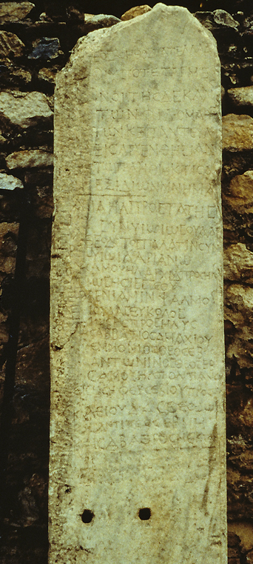
“God-fearers” (Ac. 10:2, 22)
This “roster” of God-fearers from Aphrodisias (southwestern Turkey) is one of various references in inscriptions and texts to pious Gentiles who were sympathetic to Jewish religion, even though they had not themselves become proselyte Jews. Hence, they stood somewhere between full Jewishness and paganism.
This list names 54 Gentiles who, alongside Jews from the local synagogue, contributed to relief efforts as well as construction of a place for worship. The Gentile part of the register is headed by the words “those who are God-fearers”.

Slide 107
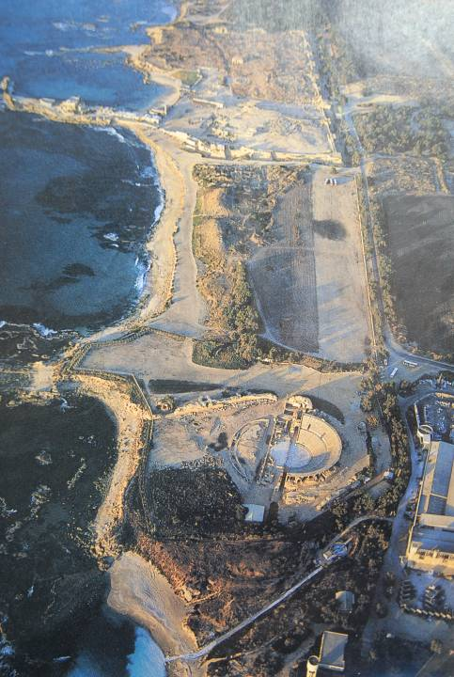
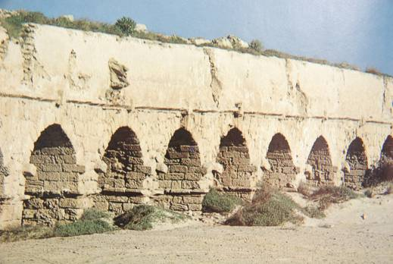
Caesarea Maritima was the government seat for the Roman jurisdiction of Palestine.
Cornelius was a Roman officer stationed there, but he also was a “God-fearer”, i.e., one sympathetic to the Jewish faith.

Slide 108
At Cornelius’ Home
Peter took with him half a dozen Christian brothers when he departed for Caesarea (cf. 11:12).
This may have been the first time in his life that Peter had entered a Gentile home—an entry that would immediately have defiled him, a fact that Peter frankly asserted to the whole group when he arrived.
But Peter was quick to acknowledge that God had changed the rules!
Peter’s sermon immediately showed how far he had come: he began by asserting that God does not show favoritism!
As a God-fearer, Cornelius must have had considerable knowledge of the Hebrew Scriptures, but Peter also assumes he knew something of the story of Jesus.

Slide 109
The Gentile Pentecost
Peter rehearsed the story of Jesus, climaxing with his death and resurrection.
Before Peter had finished speaking, the Holy Spirit fell on Cornelius, his family and his gathered friends.
What happened at Pentecost now happened to these Gentiles: they all spoke in other languages and praised God, a clear confirmation that God had fully accepted them.
This was the first description of the phenomenon of other languages since the Day of Pentecost, and it amazed the six Jewish Christians just as Peter had been shocked on the tanner’s rooftop.
Baptism was then enjoined, for no one could deny what had happened.

Slide 110
A Related Theological Issue
The separation of water baptism from the gift of the Spirit on this occasion has led some to argue for a two-step theology, but such a conclusion is unnecessary.
This occasion reflects the unusual, not the usual.
The fundamental point was that God “showed he accepted them by giving the Holy Spirit to them just as he did to us” (15:8), and he did so just as he did for the others “at the beginning”, i.e., the Day of Pentecost (11:15).
Had it not happened in this way, it is unlikely that the Jews accompanying Peter would have accepted them as full believers.

Slide 111
Another Related Theological Question
Who was included in the company of those baptized? The household of Cornelius is one of several household baptisms described in the New Testament (cf. 16:15, 33; 18:8; 1 Co. 1:16).
Based on the fact that a 1st century oi]konomi<a (= household) presumes a large, inclusive body of several families along with friends and clients, the probability of there being small children present, even infants, is high. In some of the occasions the word “all” is used, implying that every person in the group was baptized.
This becomes the biblical case for the baptism of infants., though it must be conceded that Peter also required faith (10:43; cf. 16:31; 18:8).

Slide 112
THE JERUSALEM CHURCH AFFIRMATION (11:1-18)
Earlier, the Jerusalem church sent investigative representatives to Samaria to investigate Philip’s crossing an ethnic barrier. Now, they thoroughly examined Peter!
In the first place, Peter’s entrance into a Gentile residence sent shock waves through the Jewish Christian community, and the fact that he even ate there suggested he had violated the Torah’s kosher laws.
The Jewish believers were scandalized, and the entire incident threated to divide the community.

Slide 113
Peter’s Explanation
Peter rehearsed his story beginning with the rooftop vision, the angelic message to Cornelius and the outpouring of the Spirit as had happened at Pentecost.
The six Jews who had accompanied him now were critical for corroborating Peter’s account.
Peter then recalled the words of John the Baptist, suggesting that what had happened at Pentecost had now happened to Gentiles.
The bold conclusion: “So then, God has even granted the Gentiles repentance unto life!”

Slide 114
THE GREEK CHURCH IN ANTIOCH (11:19-30)
If Peter’s trip to Caesarea opened the door to Gentiles, what happened in Antioch only solidified their bold conclusion.
Antioch, Syria, the third largest city in the Roman Empire, was the home of Nicolas, one of the Seven.
Some of the Jewish Christians who now were fleeing persecution in Jerusalem went there, and some of the Cypriot and African Jewish Christians began to tell the story of Jesus to Greeks.
Many Greeks now became believers, and when the Jerusalem church heard about it, they did what they had done in Samaria—they sent an investigative representative, Barnabas of Cyprus, who confirmed that all as well!

Slide 115
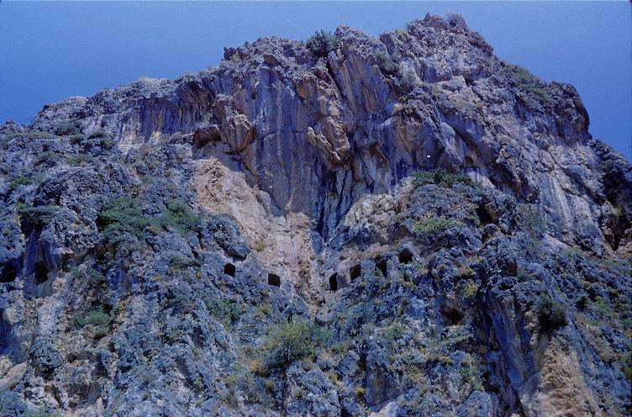
Ancient Church at Antioch, Syria in a mountain cave (modern Antakya, Turkey)
The Antioch church came to be called “the center and eye of Christianity” in the early centuries of the church. Here, Christians were first called “Christians”.

Slide 116
Discussion Questions
What might be gleaned from the fact that in these various investigative missions and reports back to the Jerusalem church, the conclusions they reached seem to have been group decisions by the apostles and elders rather than ones handed down unilaterally by a single individual?
What role did the Holy Spirit play in all these stories where outsiders continually were coming to faith?

Slide 117
Barnabas Brings Saul to Antioch
Barnabas, knowing of Paul’s skill in debating Hellenistic Jews, considered him to be a prime candidate for reaching out to Greeks.
Traveling to Tarsus, Cilicia, he found Paul and brought him to Antioch.
Here, the believers were first dubbed with the Latin coinage “Christians”, though earlier they were simply known as “followers of the Way” (9:2; cf. 19:9, 23; 22:4; 24:14, 22).

Slide 118
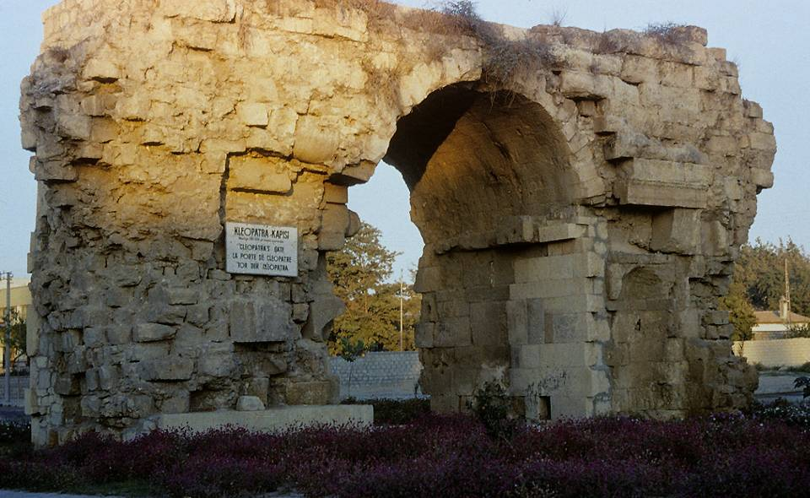
Cleopatra’s gate in Tarsus is the only one of three Roman gates that have survived the centuries in Saul’s home city.

Slide 119
STAGES BETWEEN JEW & GENTILE
Hebraistic Jew (e[brai?oj)
Jew attending a Hebrew-speaking synagogue
Hellenistic Jew (e[llhnisth<j)
Jew attending a Greek-speaking synagogue
Proselyte (prosh<lutoj)
Gentile who has accepted circumcision
God-fearer (fobou?menoj)
Gentile attracted to the Jewish view of God (but remaining uncircumcised)
Pagan (e@qnoj)
Worshiper of the Greco-Roman pantheon

Slide 120
The Prophets from Jerusalem
An important incident occurred when some prophets from Jerusalem came north to Antioch.
This is Luke’s first mention of such a Christian ministry, though he would use the same language later (13:1; 15:32; 21:9, 10).
One of them, Agabus, predicted the coming of a severe famine over the entire Roman world, a famine that actually happened during the reign of Claudius Caesar (ruled AD 41-54). Josephus records a severe famine in Judea in about AD 46 in which many people died (Antiquities 3:15.3; 20.2.5).
In anticipation of this hardship, the new Greek Christians began collecting funds to send to their Jewish brothers and sisters in Judea, sending Barnabas and Saul to Jerusalem with the gift.

Slide 121
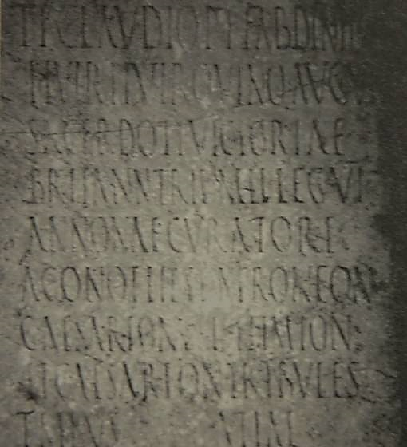
Inscription of Tiberius Claudius Dinippus, the curator annonae in charge of the grain supply at Corinth for famine relief on three separate occasions.
Famine primarily denotes a grain shortage for the many communities that were in areas where the surrounding agriculture could not support them. Grain ships plied the Mediterranean regularly from Egypt to Greece and Italy. Such a grain shortage would produce immediate, if temporary, stress for all believers in all circumstances.
American School of Archaeology in Corinth

Slide 122
THE CHURCH AND HEROD (12:1-25)
Sandwiched between the relief mission of Barnabas and Saul to Jerusalem (11:30) and their return to Antioch (12:25), Luke inserts a parenthetical account of how Herod Agrippa I tried to silence the church.
While there had been a brief respite in persecution from the Sanhedrin (9:31a), now it reemerged from Herod Agrippa I, the grandson of Herod the Great, who had assisted Claudius in his rise to power and was awarded jurisdiction over Judea.
Herod’s opposition to the Christians was likely politically expedient, an effort to curry favor with the temple authorities.
He arrested some and had James bar Zebedee summarily executed.

Slide 123
Peter’s Imprisonment
Since the Jewish opponents of Christianity seemed pleased by the execution of James, Herod now arrested Peter during Passover.
Before he could be executed, however, an angel released him from the prison.
When joining the believers at the home of Mary, John Mark’s mother, the group at first found it hard to believe that it was really Peter, thinking perhaps it was his “angel”.
Peter quickly left Jerusalem, and we hear of him no more in Luke’s account. (Roman Catholics are convinced he went to Rome almost immediately, though this is unclear.)

Slide 124
Peter’s “Angel” (a@ggeloj)
The oblique reference to Peter’s “angel” has occasioned several interpretive options:
The Christians may have thought it was Peter’s “guardian angel”.
They may have thought it was Peter’s ghost, assuming he had been executed.
Some Jews had adopted a Persian notion that all good persons had pre-existent souls that could assume the bodily appearance of the person they protected.
The least sensational interpretation is that they thought Peter had sent a messenger from the prison to speak to them.

Slide 125
Herod Agrippa I’s Death
Luke now offers a description of Herod’s death because he would not honor God.
His account is corroborated by Josephus, who also recounts that the “flatterers” cried out that he was a god. Immediately, accordingly to Josephus, he was seized by a severe pain in the belly, carried out and succumbed five days later at the age of 54 (Antiquities 19.8.2).
Luke’s final comment, that Barnabas and Saul returned to Antioch after their relief mission taking with them John Mark, prepares the way for their first great missionary tour.

Slide 126
Discussion Questions
Sometimes it has been urged that Peter’s release from prison was the result of heroic faith on the part of the church praying for him. Is this the best way to understand this story?
Do you think angels still execute people who do not give glory to God? How do you think the early church knew that Herod Agrippa I’s death was a judgment from God?

Slide 127
The First Great Tour
13-14

Slide 128
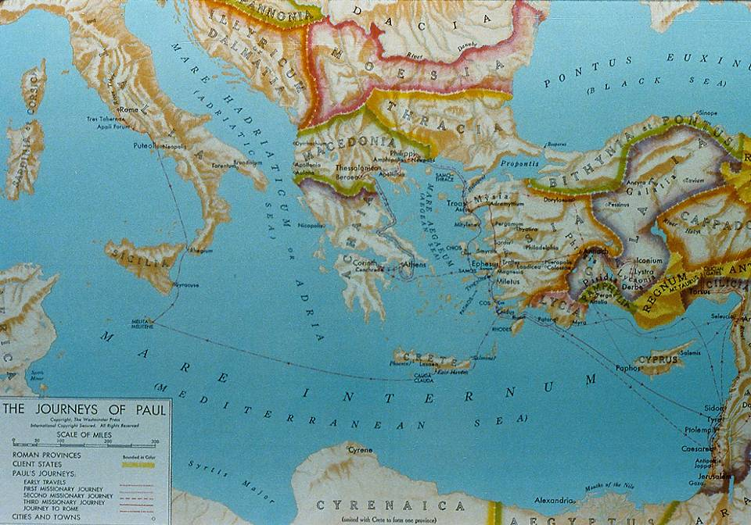
The Roman World and the Gospel

Slide 129
Christians in the Gentile World
There may have been a few scattered Christians in the larger Roman world, presumably Jews, though no formal outreach had been conducted.
That there were Christians in Rome during the reign of Claudius (AD 41-54) is apparent, since the emperor expelled the Jews from the city over rioting connected with the “instigation of Chrestus”. Scholars generally agree that “Chrestus” is a misspelling of “Christus”, the Latin word for Christ, and the demonstrations probably were protests from the Jews against the Christian message.
It would now be Saul and Barnabas who would deliberately reach out into this larger Gentile world with the gospel.

Slide 130
Antioch, the First Missionary Church
Antioch, Syria became the first “sending” church for Christian missions.
The leadership of the Antioch church was multi-ethnic and multi-national:
  Barnabas, a Diaspora Levite from Cyprus
  Simeon “the Black”, probably an African
  Lucius of Cyrene, probably either a Hellenistic Jew or an African proselyte
  Manaen, a Palestinian aristocrat
  Saul, a Christian Pharisee
At the direction of the Holy Spirit, the church commissioned its first missionary team of Barnabas, Saul and John Mark.

Slide 131
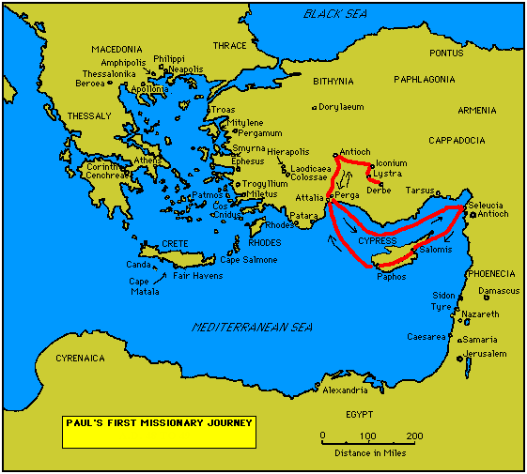
Four Important Churches
Antioch (Pisidia)
Iconium
Lystra
Derbe
Probable recipients of the Galatian Letter

Slide 132
Luke’s Ordering of Names
Luke’s use of names is significant.
In the first place, he lists Barnabas first in the early missions narratives (13:2, 7; 14:14), suggesting that Barnabas was the more prominent figure initially.
This distinction will be apparent later, when in 14:12 Barnabas will be confused with Zeus (the main deity) and Paul with Hermes (the messenger of Zeus).
The order would change shortly, with Paul listed first, denoting that he had now become the more prominent leader.
Also, as the team moved into Gentile areas, Saul (his Hebrew name) will be called Paul (his Greek name), beginning in 13:9.

Slide 133
AT CYPRUS (13:4-12)
The first leg of their trip brought them from Seleucia near Antioch to Salamis, a Greek settlement on the island of Cyprus but with a sizeable Jewish community.
Here, they began preaching in the synagogues, though Luke does not record any immediate response.
From Salamis they traveled overland to Paphos on the western coast, where they encountered a sorcerer named Elymas who had attached himself to the proconsul.
Vexed with the opposition of Elymas, Paul rebuked him resulting in a judgment of temporary blindness, which in turn caused the Roman proconsul to become a believer.

Slide 134
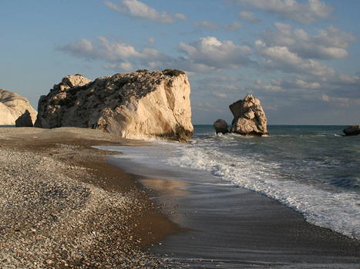
According to Greek legend, Aphrodite was born from the waves off the coast of Cyprus. The soft breezes of the Zephers then carried her ashore on a shell. She emerged from the sea foam at Aphrodite's Rock (left), spawning a wave of cult worship from neighboring countries that lasted several centuries

Slide 135
The Ancient Synagogue Service
(according to the Mishnah)
The ancient synagogue service consisted of two primary activities, prayer and the study of Scripture:
Opening benedictions (call to “bless” the Lord)
Recitation of the Shema (Deut. 6:4-9; 11:13-21; Num. 15:37-41)
Prayer (from the lectern)
The Eighteen Benedictions (from before the Torah ark) to which the congregation responded, “Amen.”
Public reading of the Torah
Public reading of the Prophets
Sermon (exposition of Scripture)
Concluding benediction

Slide 136
“He believed…”
Luke’s description of the proconsul in 13:12, “…he believed…” is his standard verbal expression describing the acceptance of the Christian faith (4:4; 5:14; 8:12; 9:42; 10:43; 11:21; 13:39, 48; 14:1; 15:7; 16:15, 31, 34; 17:12, 34; 18:27; 19:18; 21:20).
OTHER SIMILAR EXPRESSIONS
“…became obedient to the faith” (6:7)
“…turned to the Lord” (19:35; 11:21)
“…honored the Word of the Lord” (13:48)
“…put their trust in the Lord” (14:23)
“…were persuaded” (17:4)
“…were convinced” (28:24)
The critical element in all these descriptions is faith in Christ.

Slide 137
ON TO PISIDIAN ANTIOCH (4:13-52)
From Paphos, the group sailed to the port of Perga, Pamphylia, where John Mark left them to return to Jerusalem.
Paul is now clearly the leader, for Luke’s verbiage is “the ones around Paul” (13:13) rather than “Barnabas and Saul”.
John Mark’s decision to go home seems sudden and the reason unclear, especially since the trip from Cyprus to Pamphylia was in the opposite direction of Jerusalem. What is clear is that Paul was deeply vexed by it, as would become apparent later (cf. 15:37-39).
Why they bypassed Perga and pressed inland to Pisidian Antioch is also unclear (they would preach there later, cf. 14:25), though Paul’s statement that he first preached in Galatia due to an illness may bear upon the question (cf. Ga. 4:13).

Slide 138
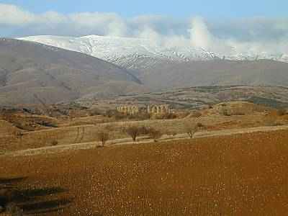
Pisidian Antioch, not to be confused with Syrian Antioch, was founded in the 3rd century BC by Antiochus I or II but gained prominence after its refounding as a Roman colony in 25 BC. Members of the imperial family served as honorary magistrates.

Slide 139
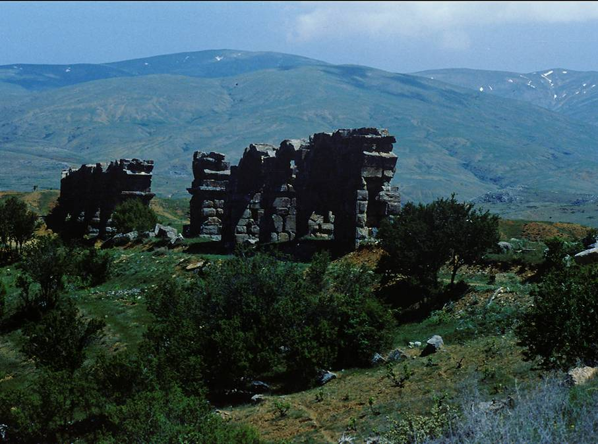
By the time of Paul, Antioch, Pisidia had become the governing and military seat for the southern half of a large area known as Galatia.
Here are remains (right) of the Roman aqueduct serving Pisidian Antioch.

Slide 140
In the Antioch Synagogue
As was their custom, they began teaching in the local synagogue. The synagogue service would have included:
Recitation of the Shema
The Eighteen Benedictions
A reading from the Torah
A reading from the Prophets
A sermon and a Benediction
Synagogue rulers presided over the service and designated persons to fulfill the various functions. Visitors such as Paul (who was himself a visiting teacher with impeccable credentials) were sometimes invited to give the sermon.

Slide 141
Paul’s Sermon
Luke offers two abstracts of Paul’s missionary sermons (13, 17), and this is the longest of the two.
In it, Paul addressed both Jews and God-fearers, beginning with a historical recitation of Israel’s early history (which probably functioned much like a confession of faith).
When he came to David, it was a natural bridge toward the genealogy of Jesus, the ministry of John the Baptist and the fulfillment of the promises to David in Jesus.
The climax was the fulfillment of prophecy in the death and resurrection of Jesus, who was now the Savior and the true source of forgiveness and justification.

Slide 142
The Aftermath
Paul’s sermon was unlike anything they had ever before heard, and they invited him back to speak on the next Sabbath.
Word had gotten out, and the next Sabbath the synagogue was jammed with people.
The popularity of Paul and his company created jealousy on the part of some synagogue members, and Paul and Barnabas only exacerbated the situation by telling them that if they rejected God’s Word, the missionaries had scriptural authority in Isaiah’s second Song of the Servant (Is. 49:6) to turn to the pagans!
Though many believed, the opponents to the missionaries, through their connections with civic leaders, expelled them.

Slide 143
Discussion Questions
Given that Paul and his team always seemed to begin at the synagogue, how do you think they regarded their Jewish compatriots, and for that matter, themselves as members of the Jewish community?
In some of the towns, they seemed only to be there for a few days (sometimes not by their own choice, of course). None the less, how would these new converts “survive” without any established community and leadership?

Slide 144
ON TO ICONIUM (14:1-7)
About 90 miles eastward and slightly to the south was Iconium near the border of Phrygia and Lycaonia.
The native worship of Lycaonia was directed toward Cybele, the fertility deity who drove her consort to emasculation by killing his lover nymph. Hence, castration was required for all priests of Cybele.
The religion gained official acceptance during the reign of Claudius about the time Paul was there.
The city had been honored in AD 41 and given the imperial name Claudiconium.

Slide 145
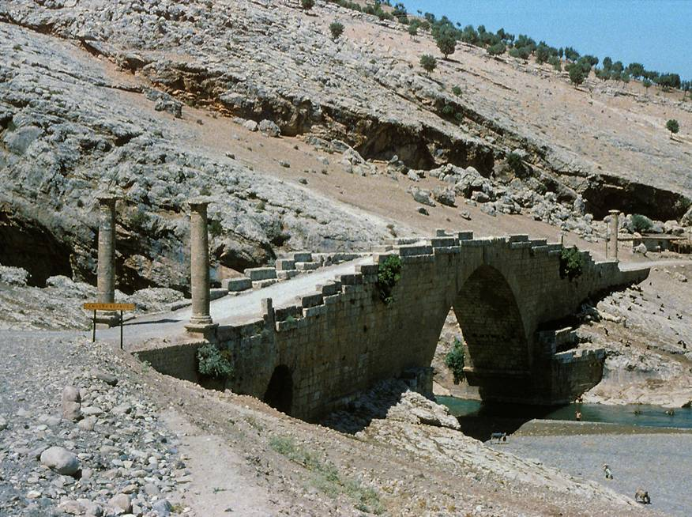
After the expulsion from Antioch, Paul and his company went eastward toward the Lycaonian Plain, traveling over Roman roads and bridges similar to this one still remaining at Cendere (though this bridge is about a century later than Paul).

Slide 146
In the Iconium Synagogue
As before, Paul and Barnabas attended the synagogue service.
Though Luke does not detail any sermon, he clearly indicates that a large number of both Jews and Gentiles accepted the Christian message.
The apostles also were able to perform certain miracles so that the people were divided, some for them some against them.
In the end, opposition was sufficient that their very lives were in danger, and they fled to the neighboring cities of Lystra and Derbe.

Slide 147
Thecla
“And he (Onesiphorus) saw Paul coming, a man small in size, bald-headed, bandy-legged, well-built [i.e., healthy], with eyebrows meeting, rather long-nosed, full of grace. For sometimes he seemed like a man, and sometimes he had the countenance of an angel.”
In the 2nd century (c. AD 160-180), a work would be composed titled “The Acts of Paul and Thecla,” an account of a young woman in Iconium who heard Paul preach and was converted, herself later becoming a preacher and eventually a martyr.
This work contains the only ancient physical description of Paul.

Slide 148
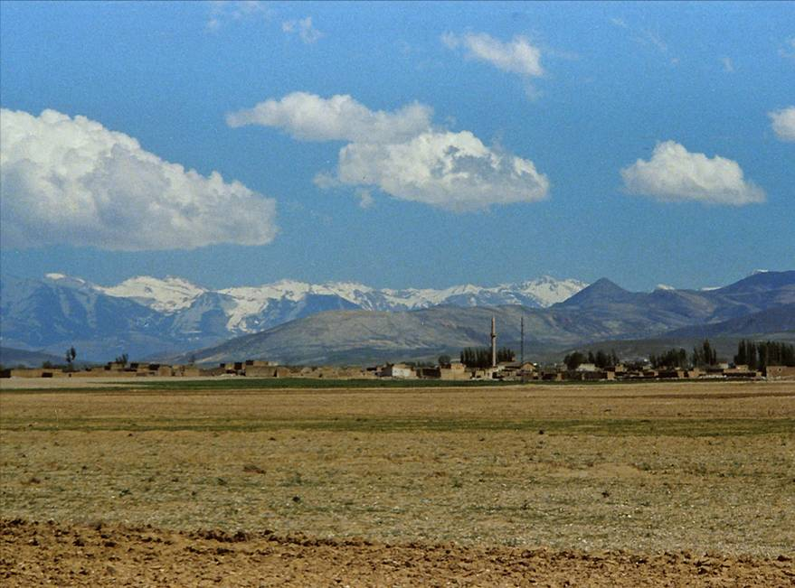
The Lycaonian Plain was home to the cities of Iconium, Lystra and Derbe. The mountains in the background are the Taurus Range, behind which lay Paul’s home city of Tarsus.

Slide 149
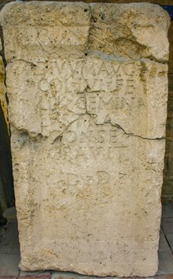
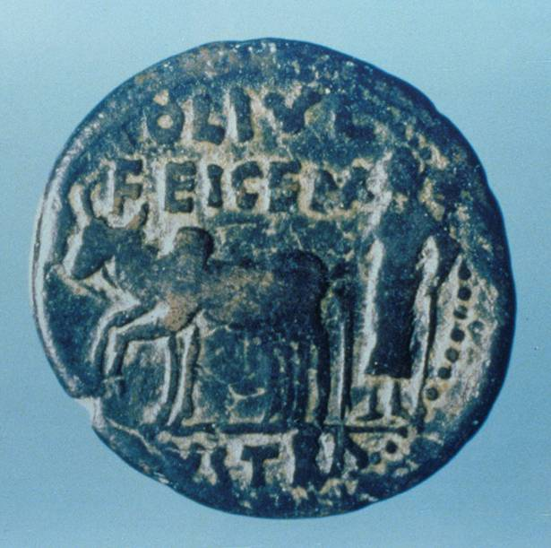
Roman coin from Lystra, minted about 6 BC. It shows an episode from the local legend of the city’s founding, when the city boundaries were marked off by a plow drawn by a bull and a cow.
1st century Latin inscription naming the city Lystra.
Archaeological Museum, Konya (biblical Iconium)

Slide 150
IN BI-LINGUAL LYSTRA (14:8-20)
Like Antioch and Iconium, Lystra and Derbe were in southern Galatia, Lystra being at the end of the Imperial Road from Antioch.
Here, Paul and his company encountered a congenitally crippled man whom God healed through Paul.
The bystanders who saw it immediately decided that Paul and Barnabas must be gods, specifically Hermes and Zeus.
However, their excited shouting was in the language of the Lycaonians, a language with which Paul was unfamiliar, and it wasn’t until the priest of Zeus from the nearby temple was preparing a sacrifice to honor them that Paul realized what they were thinking.

Slide 151
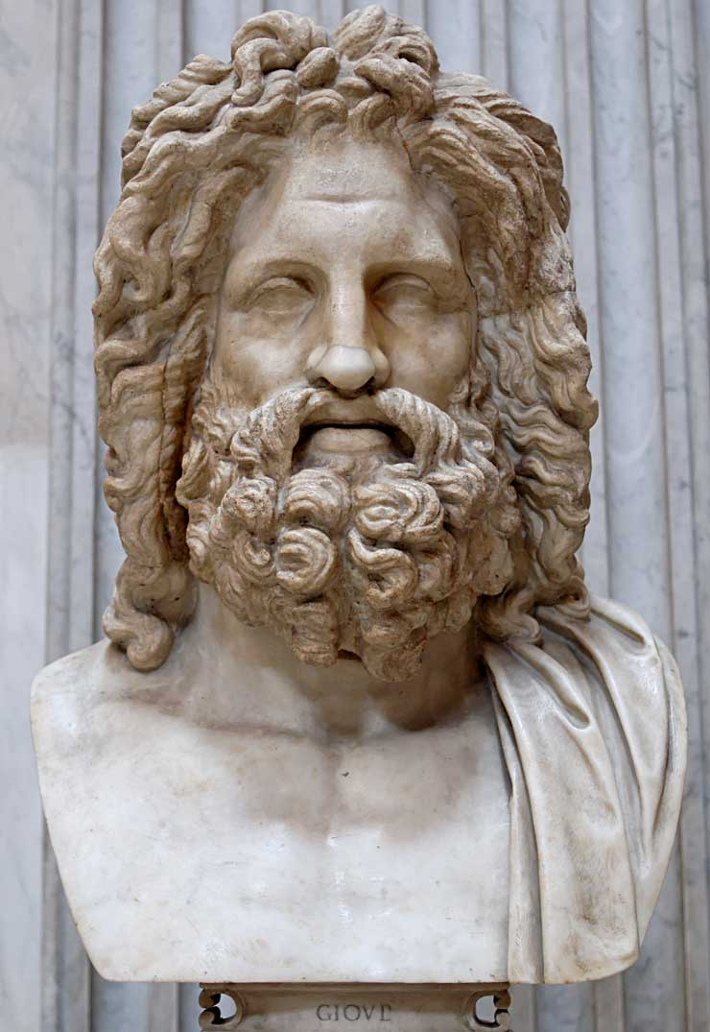
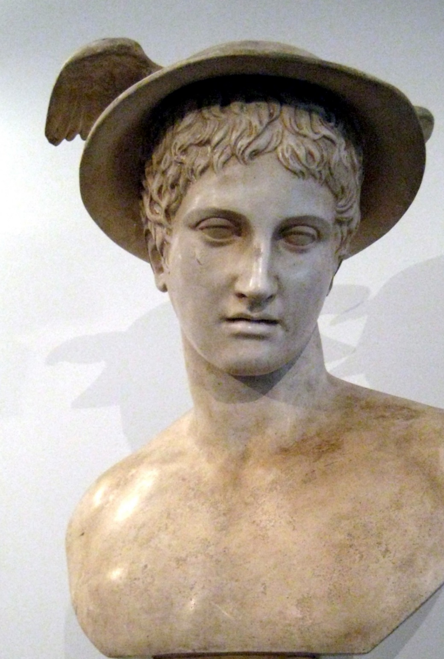
Zeus (Jupiter), the leader of the gods who lived on Mt. Olympus: perhaps Barnabas was thought to be Zeus because he was older.
Hermes (Mercury), the messenger of the gods: the Lycaonians thought Paul was Hermes because he was the main speaker.

Slide 152
Paul’s Sermon to Pagans
Luke now records Paul’s first sermon directly to pagans. Previously, all his encounters with non-Jews had been within the wing of the Jewish community.
Paul sought to turn his listeners toward the God of the Hebrew Scriptures, the Creator and Sustainer of life. The story of Jesus presumably would have come later.
However, some Jews from Antioch and Iconium arrived, stirring up such violent opposition that Paul was dragged from the city, stoned and left for dead (cf. 2 Co. 11:25b).
Nevertheless, Paul revived, and he and Barnabas left quickly for Derbe.

Slide 153
AT DERBE AND BACK TO SYRIA (14:21-28)
At Derbe, many believed their message.
Leaving Derbe, they retraced their steps, visiting the new Christians in each city and encouraging them in their faith, especially in the face of persecution.
In each city, they appointed (elected?) elders (presbu<teroi) to oversee the congregations. (The Greek verb xairotone<w means to appoint or to choose by raising hands.)
Returning by sea voyage to Antioch, Syria, their sending church, they reported on their travels and missions efforts.

Slide 154
Discussion Questions
On several occasions, the ministry of the apostles included miracles. What seems to have been the purpose of such miracles?
Not only in Jerusalem, but also in the towns of this first missions trip, there were several incidents of persecution. What role does persecution play in missions, and how should believers regard persecution in their own lives?

Slide 155
The First Ecumenical Council
15:1-35

Slide 156
The Gentile Question
The acceptance of the Christian message by pagans in Asia Minor raised a critical question: Did Gentiles need to become Jews in order to become Christians?
Circumcision was the religious symbol of accepting the Jewish faith, since the uncircumcised were not numbered among God’s people.
A strong party in Jerusalem advocated that circumcision and Torah observance were necessary and carried this message to Antioch, Syria.
Paul and his party countered that this was not necessary, and he and Barnabas were sent to the Jerusalem apostles for a decision.
In Jerusalem, they encountered strong opposition from Christian Pharisees.

Slide 157
The Galatian Letter
There is scholarly debate about whether the Galatia to whom Paul wrote was northern Galatian (ethnic) or southern Galatia (provincial).
If the latter (the position followed here), then it would include the churches Paul and his company started on their 1st missions tour into Asia Minor (i.e., Antioch, Iconium, Lystra and Derbe).
Since the Galatian letter addresses the problem of the Judaizers, why did Paul not appeal to the Jerusalem Council in the letter? The best answer is that Paul wrote the Galatian letter before the Jerusalem Council, perhaps as early as AD 49.

Slide 158
Presentation of Cases
In Jerusalem, the apostles and elders listened to both sides. In the end, two voices served to swing the decision to the side of Paul and Barnabas.
Peter recounted the events at the home of Cornelius in Caesarea, emphasizing that God showed his acceptance of Gentiles by giving them the Holy Spirit. Cornelius had not submitted to circumcision. His inclusion in God’s people was on the basis of grace and faith.
Barnabas and Paul (note the reversal of the names, since Barnabas was above suspicion in Jerusalem whereas Paul was not) then recounted their Gentile mission and its attendant miracles, clear signs of God’s approval.

Slide 159
The Summary of James
James, the Lord’s brother, then summed up the case, citing the prophet Amos (Am. 9:11-12), whom he quoted from the LXX.
The inclusion of Gentiles in the circle of God’s people had been part of God’s ancient purpose.
The restoration of David’s dynasty (and all its attendant promises) had been fulfilled in Jesus.
The whole human race was now privileged to seek salvation in him without requiring the full range of Jewish legalism.

Slide 160
The Encyclical Letter
James then advised a letter to the new Gentile congregations, urging them to show respect to four particularly sensitive Jewish issues, since they would be living side-by-side with Jews.
Food dedicated to pagan deities: it was common practice in Greco-Roman cities to eat food that had been dedicated at pagan temples.
Incestuous marriages: probably, the prohibition against pornei<a (= unchastity, fornication) is especially directed toward the Gentile practice of marrying close relatives or else mixed marriages between Christians and pagans.
The meat of strangled animals (cf. Lv. 17:13-14)
Eating blood (cf. Lv. 17:10-12)

Slide 161
Sending Letters in Imperial Rome
While there was an imperial postal service (cursus publicus), it was not available for private mail.
Hence, private correspondence necessarily had to be sent by private courier.
The letter from the Jerusalem church was duly composed and ordered to be carried by Barnabas and Paul, along with two other representatives of the Jerusalem church, Judas and Silvanus (Silas), who would validate the letter by personal testimony.
The four of them then were sent to Antioch, where they delivered the letter to the church.

Slide 162
Discussion Questions
Why might some Christian Jews have thought it was necessary to become Jewish before becoming Christian?
The circular letter required that pagan converts abstain from food dedicated to pagan deities, from blood, from the meat of strangled animals, and from sexual immorality—all derived from the law of Moses. Why do you think these things were singled out?
Does it surprise you that James seems to be the senior leader in Jerusalem, not one of the Twelve apostles?

Slide 163
The Second Great Tour
15:36—18:22

Slide 164
A Christian Disagreement (15:36-41)
The 2nd mission tour also began at Antioch, but this time the leaders were Paul and Silas.
Paul and Barnabas disagreed about the usefulness of John Mark, so Barnabas took Mark and went to Cyprus.
Paul chose Silas and traveled throughout the congregations in Syria and Cilicia, traveling overland this time while passing through the Cilician Gates and over the Taurus mountains in order to visit the churches they initially established in Galatia.
Silas was an admirable choice for Paul: he was a Roman citizen (cf. 16:37) and one of the guarantors of the Jerusalem Council’s letter (15:22).

Slide 165
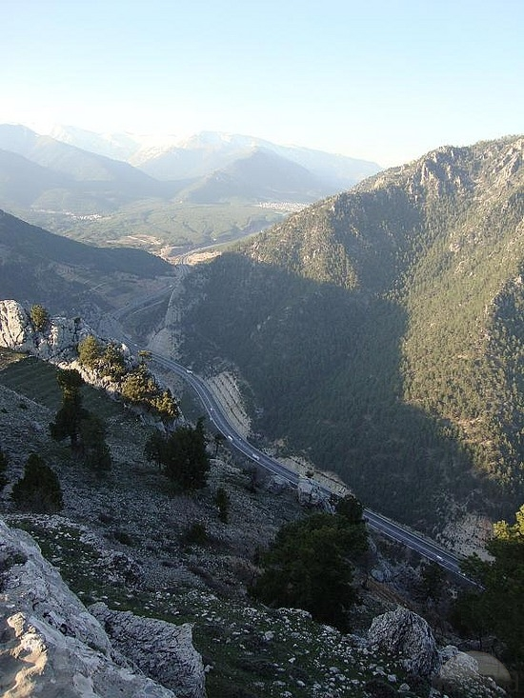
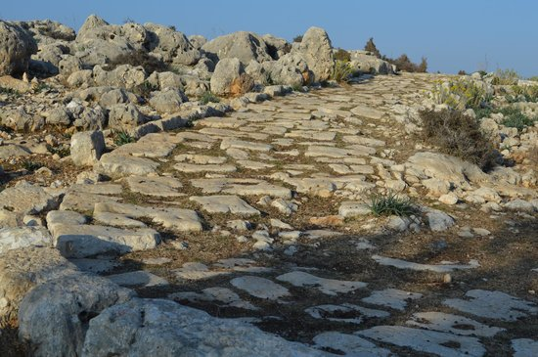
The Roman Road out of Tarsus
The Cilician Gates from above

Slide 166

Five Important New Churches
Philippi
Thessalonica
Beroea
Athens
Corinth
Paul would write letters to three of them

Slide 167
1st Century Travel by Land and by Sea
The Route of Paul’s 2nd Missions Tour (2 Co. 11:23-27)
Jerusalem to Antioch (Ac. 15:30) = 375 miles By land
Antioch to Cilicia (Ac. 15:41) = 140 miles By land
Cilicia to Phrygia & Galatia (Ac. 16:6) = 495 miles By land
Phrygia & Galatia to Troas (Ac. 16:8) = 500 miles By land
Troas to Neapolis (Ac. 16:11) = 140 miles By sea
Neapolis to Philippi (Ac. 16:12) = 15 miles By land
Philippi to Thessalonica (Ac. 17:1) = 85 miles By land
Thessalonica to Berea (Ac. 17:10) = 45 miles By land
Berea to Athens (Ac. 17:15) = 310 miles By sea
Athens to Corinth (Ac. 18:1) = 50 miles By land
Corinth to Ephesus (Ac. 18:18-19) = 250 miles By sea
Ephesus to Caesarea and Antioch (Ac. 18:22) = 620 miles By sea and land

Slide 168
Revisiting Lystra, Derbe and Iconium
In Lystra, Paul encountered Timothy, a young man who was one of his earlier converts and who was an ardent student of the Hebrew Scriptures (cf. 2 Ti. 1:5; 3:15).
Paul invited him to join the missionary team, though he required him to be circumcised because of his Jewish heritage on his mother’s side.
Timothy was duly ordained for Christian service (cf. 1 Ti. 4:14).
Traveling through the congregations established earlier, Paul delivered to them the encyclical letter composed by the Jerusalem church.

Slide 169
Crossing the Aegean
When the missionaries tried to turn eastward, they were directed away from Asia and Bithynia by the Holy Spirit and ended up at Troas on the coast of the Aegean Sea near the ancient site of Troy.
Here, Paul had a vision of a Macedonian man calling for help.
Taking this as direction from God, they booked passage across the Aegean (probably on a commercial vessel), and landed at the port city of Neapolis near Philippi.
In 16:10, Luke begins using the 1st person pronouns “we” and “us”, implying that at this point he also had joined the missionary team. This will continue to 16:17 and resume again in 20:5.

Slide 170
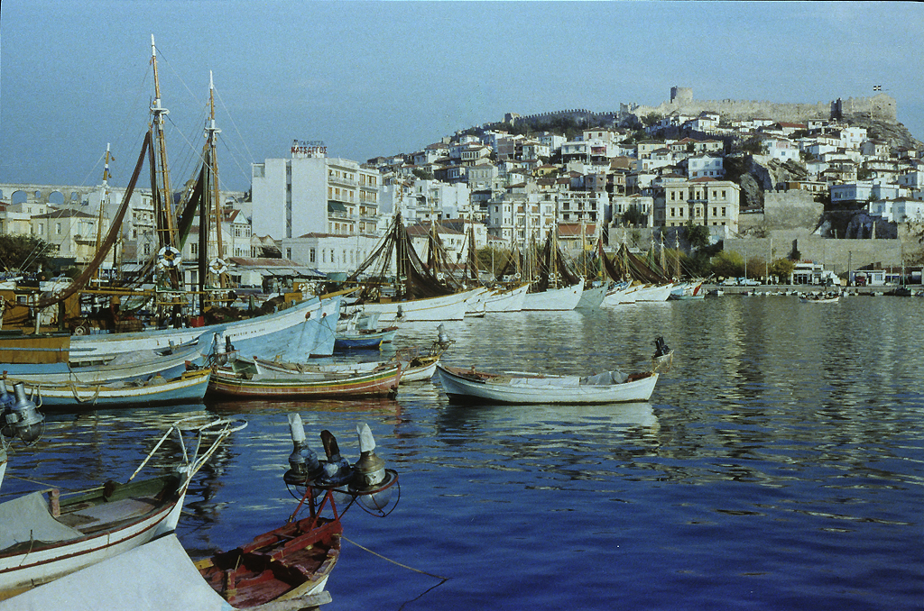
Kavalla Harbor, Roman Neapolis

Slide 171
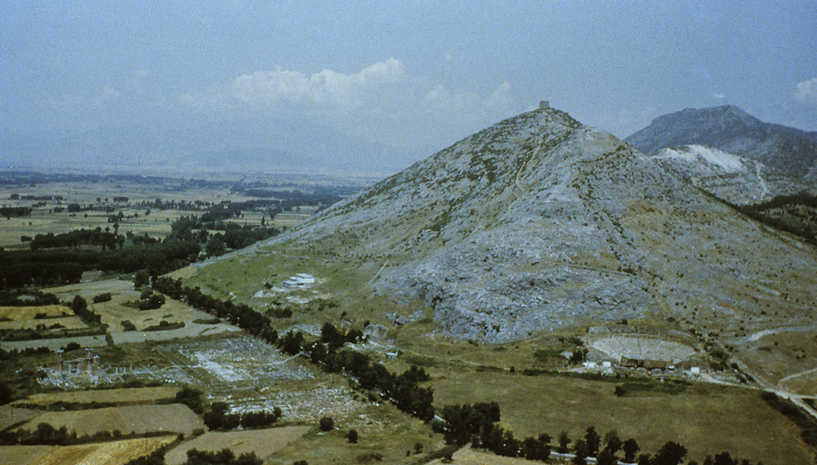
Philippi

Slide 172
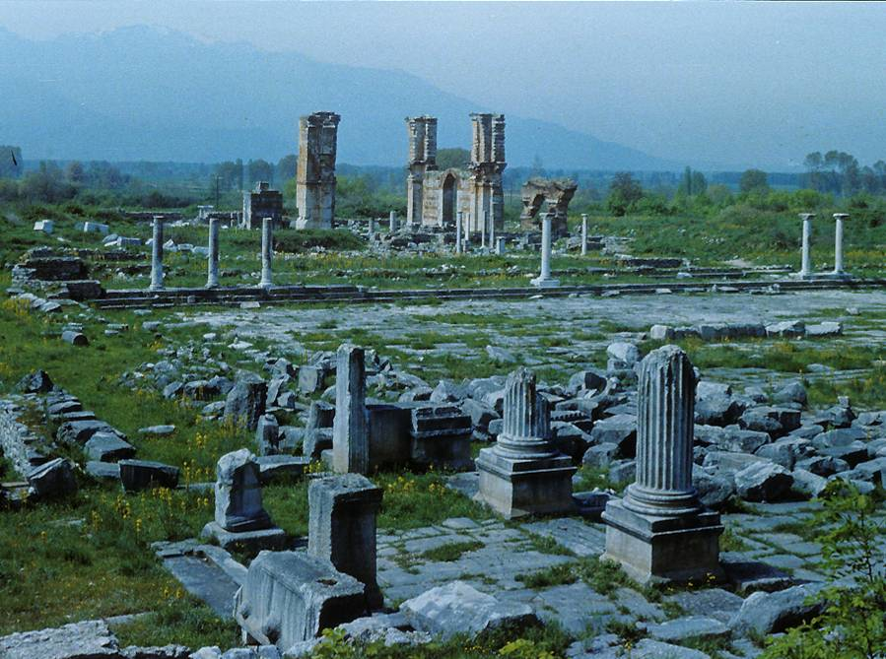
Excavations of the Roman colony at Philippi began with the French in 1914. The Agora, the administrative center, was constructed around an open square.
The Via Egnatia, the Roman Road, bisected the city as it ran the nearly 500 miles from the west coast to the east coast of Macedonia.
Ruins of the forum at Philippi

Slide 173
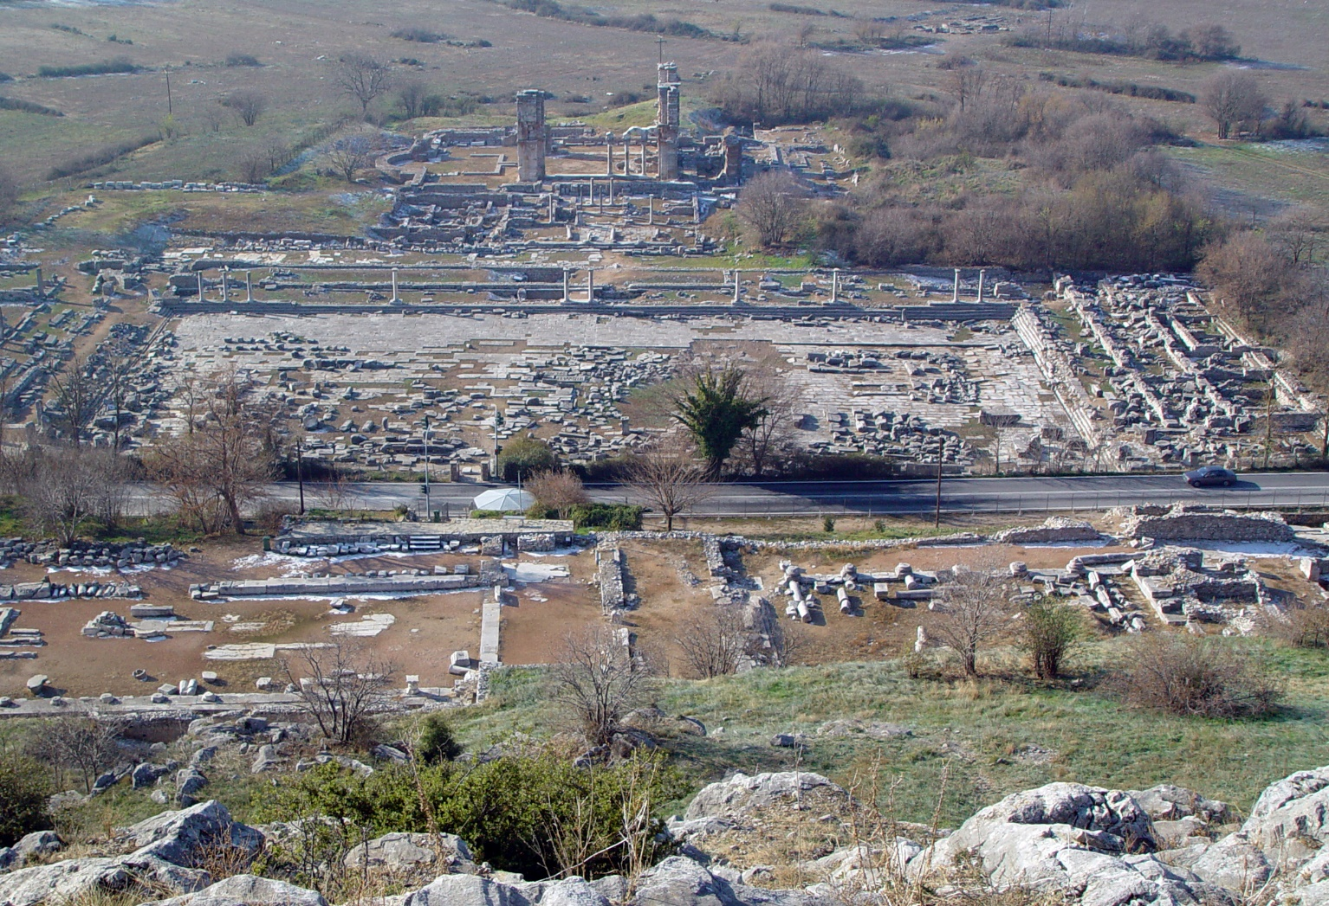
The people of Philippi were largely Greeks and Romans.
The Jewish community seems to have been small, since there was no synagogue (10 males were required), and Jewish prayer was held outside the city.

Slide 174
IN PHILIPPI (16:13-40)
Though Luke indicates they only stayed a few days, the stay in Philippi would be eventful!
Joining a Sabbath prayer group of Jewish women, they encountered Lydia, a merchant from Thyatira in Asia Minor, either a Jewish proselyte or a God-fearer. She accepted Paul’s message, and she and her household were baptized.
On one Sabbath, they were confronted by a slave spiritualist whom Luke describes as “having the spirit of a python” (Greek text).
When Paul addressed the spirit and exorcised it, her owners were furious and dragged Paul and Silas into the Agora before the magistrates.

Slide 175
The Greco-Roman oi]ko<j or oi]konomi<a
The Greco-Roman “household” was a large, inclusive and socially cohesive unit, often composed of several families bound together under the authority of the principle family.
It might consist of relatives, friends, workers, slaves and even clients valuable to the household and its business function.
When Paul began a Christian community in Lydia’s “household”, he entered a social institution especially favorable to minority groups, such as slaves and women, who then could fully participate in religious activities (whereas in other social venues they may have been excluded).
Traditionally, the religious affiliation of the household leader held for all those belonging to the household.

Slide 176
Paul and Silas, Flogged and Imprisoned
The magistrates peremptorily arrested Paul and Silas, flogging them and jailing them under guard in stocks.
Roman flogging varied with the status of the prisoner, slaves whipped and freemen beaten with rods of elm or birch. Paul would experience this three times in his missionary career (cf. 2 Co. 11:25).
In the night, Paul and Silas consoled themselves by praying and singing while the other prisoners listened.
Abruptly, an earthquake shook the jail so violently that the anchors for the prisoners’ chains were loosened from the walls and the prison doors were jarred open.

Slide 177
Another Conversion
Failure to keep prisoners for trial was punishable by execution, and the Philippian jailor, seeing the open doors, feared the worst.
He was on the verge of killing himself, when Paul stopped him.
Consequently, Paul explained their Christian message, and the jailor and his household accepted the new faith and were baptized.
When the magistrates sent officers to the jail to release Paul and Silas, Paul revealed that both he and Silas were Roman citizens who had been arrested and punished without a formal hearing and sentence, a grave violation of Roman law.

Slide 178
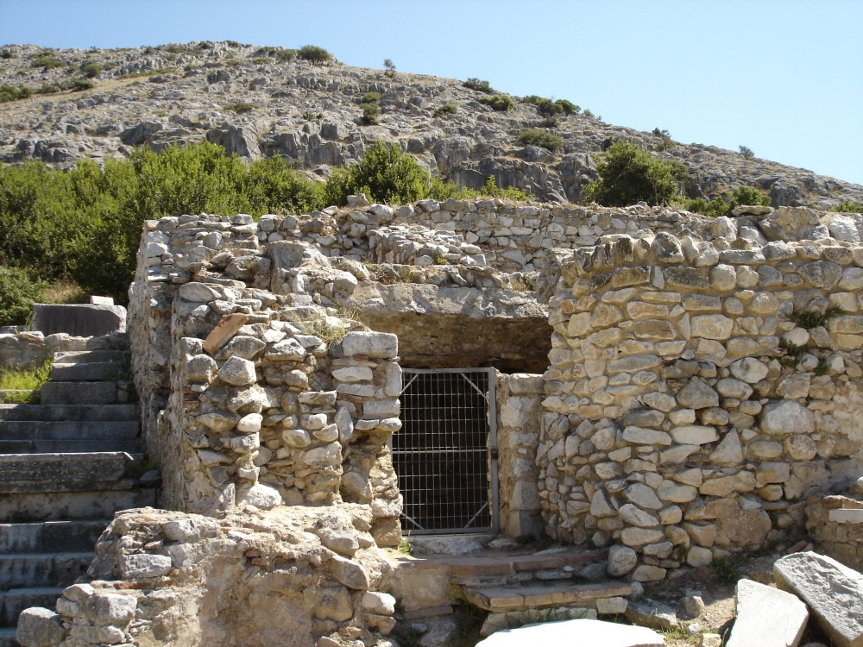
Here is the traditional site where Paul and Silas were imprisoned.
This site was actually a cistern for storing water during the 1st century, but it was later transformed into a small church whose walls were covered in paintings of Paul’s arrest, his miraculous liberation and the baptism of the jailor’s family.

Slide 179
Discussion Questions
Do you think that Timothy fulfilled the role that Paul may once have designed for John Mark, who left the group, and might this have a bearing on why Paul was so set against John Mark rejoining the team?
How different would the history of the world have been had Paul gone to the East, where he originally intended, instead of West to Greece?

Slide 180
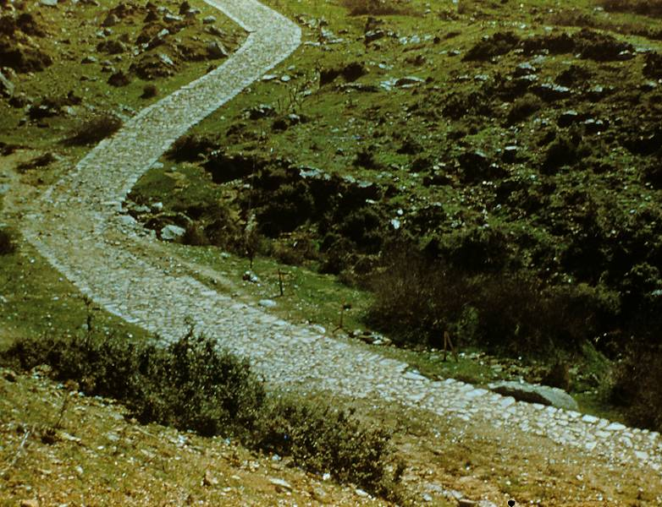
The officials in Philippi were alarmed when they discovered their beach of Roman law, and they personally escorted Paul and Silas out of the city.
Luke seems to have stayed in Philippi, since the “we” sections now cease until 20:5.
The Via Egnatia, the Roman road over which Paul and his party traveled from Philippi westward.

Slide 181
Paul’s Church Planting Strategy
It is apparent that Paul did not preach in every town through which he passed. On the way from Philippi to Thessalonica, for instance, he passed through two major cities, Amphipolis and Apollonia, without stopping.
Luke offers no direct explanation, but he does indicate that Paul was sensitive to the Holy Spirit about where he should preach (16:6-7, 9-10; cf. 1 Co. 16:7-9; 2 Co. 2:12-13; Col. 4:3-4; Ep. 6:19-20).
Paul seems to have focused on strategic provincial footholds from which the message might be spread by others in adjacent territories (2 Co. 10:15-16; 1 Th. 1:8; Col. 1:6-8).
All the places Paul preached were centers of Roman administration, Greek civilization, Jewish influence and commercial importance.

Slide 182
IN THESSALONICA (17:1-9)
Thessalonica, the capital of Macedonia’s Second District and its largest city, was a free city with its own democratic assembly working under the jurisdiction of the Roman Senate.
The city was a center for poets, philosophers and rhetoricians, and the leading families were educated and affluent.
Beginning in the synagogue as usual, Paul preached the message of Jesus’ passion and resurrection. Luke uses no less than five distinct verbs to describe Paul’s presentation:
  Diale<gomai (= to discuss, lecture)
  Dianoi<gw (= to open up, explain)
  Parati<qhmi (= to demonstrate, point out, prove)
  Katagge<lw (= to proclaim, announce)
  Pei<qw (= to persuade, convince)

Slide 183
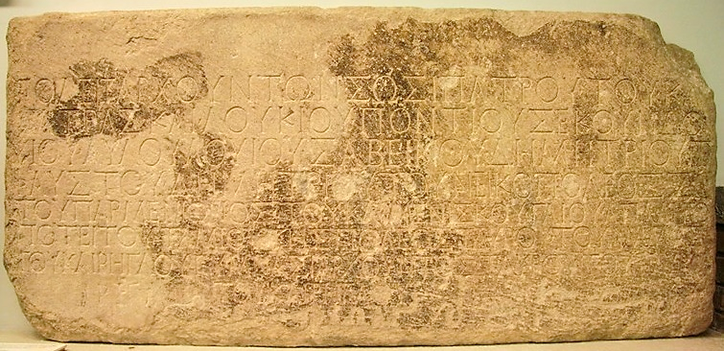
Politarchs were elected governors of Macedonian cities in the Roman era. This inscription excavated from the Vardar Arch of Thessalonica lists six politarchs in the city. (British Museum, London)

Slide 184
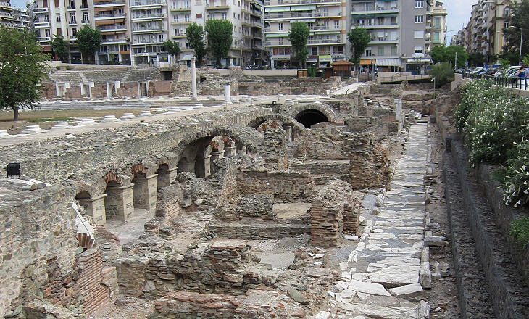
1st century Roman Market at Thessalonica

Slide 185
A Mixed Response
As in the Galatian cities on the 1st tour, some Jews, God-fearers and prominent women accepted Paul’s message, but the larger body of synagogue members were inflamed, inciting riots and breaking into one of the convert’s homes, searching for Paul and Silas.
They dragged some of these new believers before the politarchs, accusing them of insurrection against Caesar.
This was a particularly sensitive charge, since Emperor Claudius had expelled the Jews from Rome in AD 49 and forbade Jews from Palestine to enter Alexandria, Egypt, since they were “fomenting a general plague throughout the whole world”.

Slide 186
IN BEROEA (17:10-15)
To spare the new converts any more distress, Paul and his party left that very night for Beroea, a city not on the Via Egnatia (cf. 1 Th. 2:1-2, 14, 17).
Once again, they began at the synagogue, though here the response was more positive.
Eventually, however, Jews from Thessalonica showed up in Beroea, and once more Paul was forced to leave, though he left Timothy and Silas behind to consolidate the new converts.
Paul now sailed for Athens, just north of the Peloponnesus.

Slide 187
IN ATHENS (17:16-34)
With Luke at Philippi and Silas and Timothy at Beroea, Paul reached Athens alone.
While there, he was troubled by the rampant idolatry of the Athenians, though he expressed himself in the local synagogue and agora concerning Jesus and the resurrection.
After debating the Stoics and Epicureans, he was invited to address the Areopagus, the council that supervised education and visiting lecturers in Athens.

Slide 188
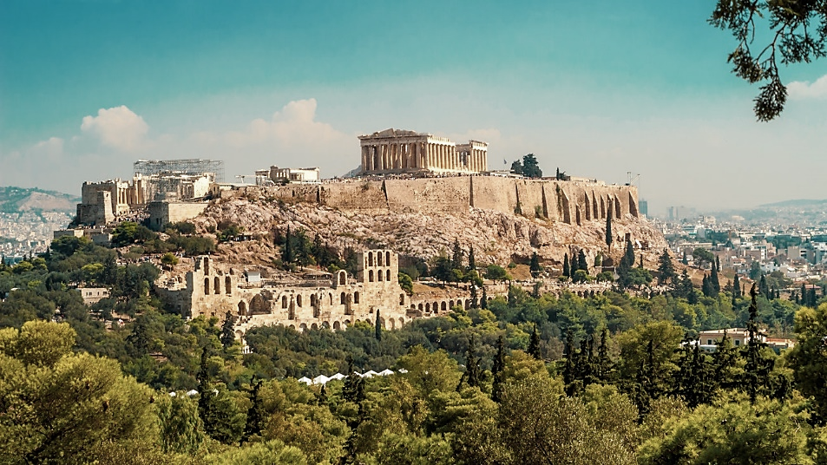
Athens was (and still is) dominated by the Parthenon, accessible by a marble stairway constructed by Claudius in AD 42. ,

Slide 189
Stoicism and Epicureanism had long histories, both beginning in Athens about 300 BC. Both had a penchant for individualism, a lack of concern about societal welfare and categorically denied spiritual substances (even the gods and the soul were believed to be material).
STOICISM
Zeno, founder of the Stoics, taught that the cosmos is an ordered whole in which all contradictions are resolved for ultimate good.
Evil is relative, and evil things are just necessary incidents on the way to perfection.
Fate ruled all, however, and humans were free only in the sense that they could accept their fate or resent it.
The highest good was serenity of mind, while duty and self-discipline were the highest values.
Stoicism was characterized by egalitarianism, pacifism and humanitarianism.
EPICUREANISM
Epicurus, founder of Epicureanism, accepted the atomic theory of Democritus (all things are composed of invisible atoms).
Unlike the Stoics, Epicureans affirmed human freedom.
The greatest good was pleasure (not merely self-indulgence, but serenity of soul, absence of pain and elimination of fear).
Virtue was not good in and of itself, but only insofar as it brought happiness.
The gods were remote and took little interest in the world, since they were preoccupied with their own happiness.

Slide 190
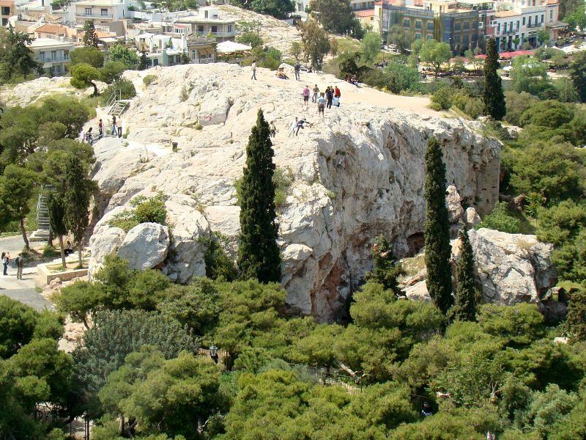
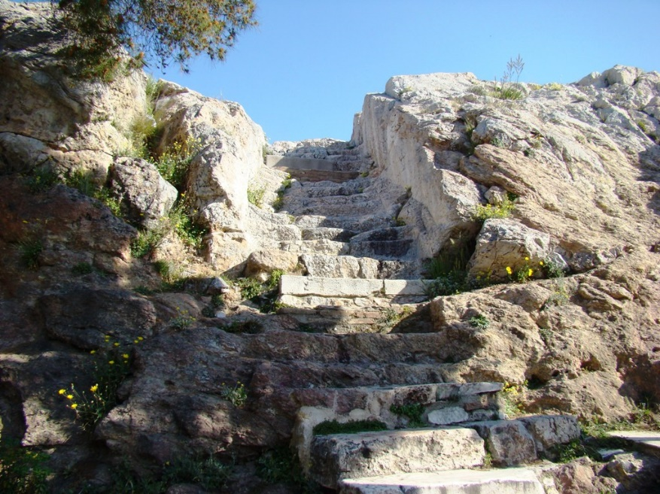
While in Athens, Paul spoke at the Areopagus (right), where he explained his “new teaching”.
Steps leading to the Areopagus (inset).

Slide 191
Paul’s Address to the Areopagus
Paul began his speech with a reference to an altar inscription in Athens, “To an Unknown God”. His discourse followed three main lines of thought:
God created the universe. (His consistent use of the singular would have been striking in the Athenian context of polytheism.) He is self-sufficient, doesn’t live in temples, and doesn’t need humans to justify his existence.
All humans are related and are descended from the one primordial human. God’s purpose all along was for humans to seek him. He quoted both Epimenides and Aratus for support.
Human accountability follows the first two premises. God will judge the world by the resurrected Christ.

Slide 192
Paul’s Approach to Pagans
There are striking parallels between Paul’s sermon at Iconium (1st Tour) and his discourse at Athens (2nd Tour)
ICONIUM
God made heaven and earth and the sea and everything in them (14:15).
In the past, he allowed all nations to go their own way (14:16).
He has showed kindness by giving rain for crops, providing food and giving capacity for joy (14:17).
ATHENS
God made the world and everything in it (17:24).
In the past, God overlooked human ignorance (17:30).
He himself gives all people life and breath and everything else (17:25).

Slide 193
QUOTING GREEK POETS
That Paul quotes pagan poets, eliciting their support for his ideas, seems to show that he sought points of contact with his audience.
Epimenides
In the fourth quatrain of the “Hymn to Zeus”, the poet rebukes the impiety of the Cretans for building a tomb for Zeus.
Paul quotes the line, “But you [Zeus] are not dead: for in you we live and move and have our being.”
Aratus
In the poem “Natural Phenomena,” the Cretan poet Aratus extolls Zeus by saying, “Let us begin with Zeus…for we are also his offspring.”
Elsewhere, Paul will again quote Epimenides (Tit. 1:12) as well as Menander (1 Co. 15:33).

Slide 194
The Response
Paul’s reference to “a resurrection of dead men” was jeered. Earlier they had called him a sperma<logoj (= seed-picker), and now they lampooned his radical claim about resurrection.
At the institution of the Areopagus many years earlier, Aeschylus depicts the god Apollo as saying, “When the dust has soaked up a man’s blood, once he is dead there is no resurrection.”
At least one member of the Areopagus accepted Paul’s message along with a few other Athenians. However, so far as we know, no Christian congregation was started in Athens. (Later, Paul would say that the Corinthians were the “first-fruits” of Achaia, cf. 1 Co. 16:15).

Slide 195
Discussion Questions
Some interpreters have regarded Paul’s evangelistic approach in Athens (where he quotes pagans) to be a mistake, while others champion his approach as entirely appropriate in the interest of outreach. Luke offers no value judgment, one way or another, but what do you think?
Is there truth in other religious systems? What do you make of the saying, “All truth is God’s truth?”

Slide 196
IN CORINTH (18:1-17)
Since neither Luke nor Silas nor Timothy arrived in Athens to rejoin Paul, he continued southward to Corinth.
Corinth, the “master of two harbors” (Strabo), was a city on the rise. It had been rebuilt by Julius Caesar in 44 BC, and Paul arrived in about AD 50.
Lying on the narrow isthmus between the Saronic Guilf and the Gulf of Corinth, Corinth featured the Diolkos, a 3.5 mile roadway connecting the two ports, which enabled cargo to be trundled across this shorter route rather than by sea voyage around the Peloponnesus.
Corinth was the home of the biennial Isthmian Games, and Paul would have been there in AD 51 when the games were held, since he stayed there a year and a half.

Slide 197
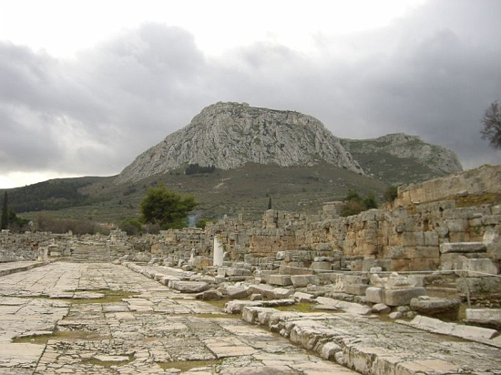
Lechaeum Road of Corinth with the Acrocorinth in the background, the view that would have greeted Paul when he entered the city.

Slide 198
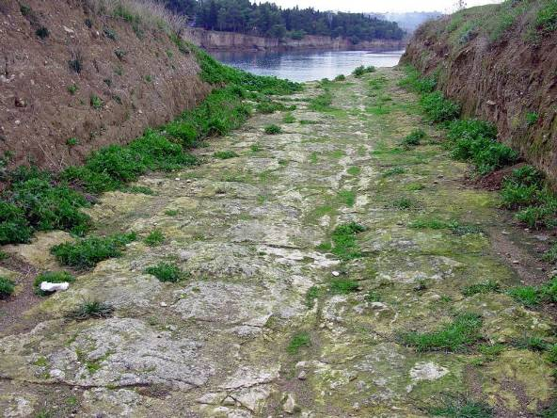
Ongoing excavations of ancient Corinth have been conducted since 1886.
The Diolkos, a paved sledging road between the two harbors, provided a means for transporting cargo between the Saronic Gulf (Aegean Sea) and the Gulf of Corinth (Adriatic Sea).

Slide 199


Small wonder that Paul speaks of “many gods and many lords” (1 Co. 8:5).
Temple of Apollo
Temple of Octavia
Corinth was home to many shrines and temples, including sites for Tyche, Hera, Poseiden, Aphrodite, Demeter, Kore and Asclepius, in addition to the two here.

Slide 200

An excavated medical complex dedicated to Asclepius, the god of healing, produced a range of terra-cotta body parts, symbols of claims for successful cures.

Slide 201
Paul in Corinth
By his own testimony, Paul entered Corinth “in weakness, fear and much trembling” (1 Co. 2:3).
Here, he encountered a Jewish couple, Prisca and Aquila, recently arrived from Rome due to Claudius’ expulsion of all Jews from the city (Suetonius, Lives of he Caesars, 25.4).
Because their trade, like his own, was tent-making, he joined them, working during the week and reasoning in the synagogues on the Sabbath.
Once Silas and Timothy arrived (presumably with some financial support from the Macedonians, cf. 2 Co. 11:8-9; Phil. 4:15), Paul was able to devote his full time to preaching the Christian message.

Slide 202
Opposition Once Again
When Jewish antagonism became severe, Paul left the synagogue and relocated next door in the home of a God-fearer (the synagogue ruler and his family had become believers, along with many Corinthians).
One of his converts was Erastus, the City Director for Public Works (cf. Ro. 16:23), whose name has surfaced on an inscription from Corinth.
Due to a night vision, Paul remained in Corinth a year and a half, preaching the crucified Christ (cf. 1 Co. 2:3).
When he was arraigned by the Jews on a charge of promoting an illegal religion, Gallio, the new Proconsul (who took office in AD 51), threw the case out of court.

Slide 203

One of Paul’s converts was Erastus, the Aedile of Corinth (= administrator of financial matters concerning streets, markets, games and public buildings). This pavement in his honor was laid in about AD 50, about the time Paul arrived (cf. Ro. 16:23). It reads, “Erastus, in return for his aedileship laid [this pavement] at his own expense.”

Slide 204


The so-called “Gallio Inscription” from Delphi names Gallio as Proconsul, and the Greek form of his name (GALLIW) can be clearly seen. This inscription puts his tenure in the 26th acclamation year of Claudius Caesar, which can be cross-referenced with other Roman sources, giving us a firm date of AD 51.
The Corinthian Bema
Lucius Junius Gallio, a brother of the famous Seneca, took office on July 1, AD 51 as the Proconsul of Corinth. He heard the case against Paul at the above tribunal platform (18:12-13), concluding that Christians were simply a sect of Judaism and not under the jurisdiction of his court.

Slide 205
BACK HOME TO ANTIOCH (18:18-22)
After his lengthy stay at Corinth, by far the most lengthy stay in any city up to this point, Paul then sailed for Antioch with Prisca and Aquila.
Before leaving, he took a Nazirite vow at the Corinthian port city of Cenchrea.
Passing through Ephesus on the coast of Asia Minor, he spoke briefly in the synagogue, promising to return. He left Prisca and Aquila at Ephesus.
After landing at Caesarea, he “went up and greeted the church”, presumably the Jerusalem church, and then traveled back to Antioch, his sending church.

Slide 206
Nazirites
The Nazirite vow was a special commitment to Yahweh for a designated period of time (Nu. 6). During the time of the vow, a Nazirite:
Could not cut his hair; presumably the head was shaved at the commencement of the vow
Could not drink wine.
Could not come into contact with the dead, even a family member.
Nazirite vows were normally for a specified period, but they could be for life as well.
Several biblical figures were life-Nazirites, including:
Samson
Samuel
John the Baptist
The most notable example of a temporary Nazirite vow was the one taken by St. Paul at the end of his 2nd missions tour (18:18). Completion of this vow required sacrifices at the temple, and Paul complied (21:23-26).

Slide 207
PAUL’S THIRTEEN LETTERS
While Luke does not describe the writing of Paul’s letters, a reasonable chronology can be ascertained from internal references in the letters themselves.
2ND TOUR LETTERS
Galatians (date is debated between 2nd and 3rd tour)
1 Thessalonians
2 Thessalonians
3RD TOUR LETTERS
1 Corinthians
2 Corinthians
Romans
PRISON LETTERS
Colossians
Philemon
Ephesians
Philippians
PASTORAL LETTERS
1 Timothy
2 Timothy
Titus

Slide 208
Discussion Questions
Paul was almost certainly in Corinth for the Isthmian Games in AD 52. In some of his letters, he uses athletic training and events to illustrate the Christian life. In addition to the athletic events, the Isthmian Games would have included much debauchery and sexual promiscuity. Do you think Paul would have attended the games?
Luke does not mention any of Paul’s letter-writing during his missionary travels, but Paul certainly wrote these letters while traveling. Why do you think Luke does not mention them?
What do you make of the fact that Paul took a Jewish vow—and what do you suppose he took a vow about?

Slide 209
The Third Great Tour
18:23—21:17

Slide 210
BACK TO GALATIA AND PHRYGIA (18:28)
After a brief stay in Antioch, Syria, Paul once more set out to visit the congregations he had started.
Traveling overland, he visited the churches in Phrygia and Galatia.
At this point Luke inserts an interlude concerning a traveling Diaspora Jew from Alexandria named Apollos, a skilled exegete of the Septuagint, familiar with the baptism of John and somewhat knowledgeable about the life of Jesus.
At Ephesus, Apollos encountered Prisca and Aquila, Paul’s converts whom he had left in Ephesus when returning to Caesarea and Antioch.
Prisca and Aquila filled in Apollos’ knowledge of Jesus, and the Christian brothers sent him to Achaia with a letter of introduction, where he excelled in preaching the Christian message in Corinth.

Slide 211

On his 3rd journey, Paul wrote three large letters:
He wrote two letters to the Corinthians and one to the Romans.

Slide 212
IN EPHESUS (19:1-41)
Still traveling inland by foot, Paul journeyed westward until he reached Ephesus, fulfilling his promise to return (cf. 18:21).
Here, he encountered some disciples similar to Apollos, who knew about John the Baptist but were imperfectly informed about the fulfillment of John’s prediction concerning the messianic gift of the Spirit.
Paul now informed them more fully of the coming of the Holy Spirit, and these disciples, twelve in all, were baptized and filled with the Spirit.

Slide 213
A Debated Theological Question
Who were these “disciples” in Acts 19?
Sub-standard Christian Disciples
This interpretation usually is adopted by Pentecostal Christians in order to show that the gift of the Spirit is a post-salvational work of grace.
Here, the “disciples” are considered to have been Christians already, but they had not yet been “baptized” with the Spirit.
The phenomenon of speaking in tongues was necessary to validate their Spirit-baptism.
Disciples of John the Baptist
This interpretation usually is adopted by non-Pentecostal Christians.
They consider these “certain disciples” to be non-Christians, which is why they were baptized and filled with the Spirit at this time.
There is evidence of John the Baptist sects as late as the early 3rd century AD.
Some of them claimed John was the Messiah, not Jesus (Recognitions of Clement, 1.LIV).
Notes:
IV

Slide 214
In the Synagogue and Beyond
Paul spent three months in the Ephesian synagogue, urging the Christian message.
His response was mixed, and his opponents forced him out.
Moving, he spent two years preaching in a lecture hall, effectively reaching both Jews and Greeks throughout the Province of Asia (probably including the Colossian church to whom Paul would later write).
Unusual miracles also occurred during this time when sweat-rags and work aprons that Paul had used (simiki<nqion) were then taken to sick people, who were cured or delivered from demons.

Slide 215
Other Remarkable Events
In addition to the healings, Luke describes two other unusual events attending Paul’s ministry in Ephesus.
One concerned some Jewish exorcists who began using the name of Jesus to address demons, and one priestly family of this kind was attacked and injured by a demonized man.
The other event concerned the public burning of sorcery scrolls by converts to Paul’s ministry.
Near the end of his three years in Ephesus (cf. 20:31), Paul decided to return to Jerusalem by way of Macedonia and Achaia on the Grecian peninsula, presumably to complete the collection of funds for the impoverished Christians in Jerusalem and to complete his Nazirite vow (cf. 18:18).

Slide 216
The Riot in Ephesus
Too many converts to Christianity meant a loss of business to the artisans who sold silver images of the patron goddess Artemis, whose image was displayed in the local temple, one of the seven wonders of the ancient world.
Under the leadership of a local silversmith, who incited a hostile crowd, two of Paul’s traveling companions were hauled into the theater.
Paul was warned not to attempt to enter the theater to address this mob, and the town clerk finally managed to restore some order, warning that their rash conduct might have Roman reprisals.
After this near escape, Paul deemed it best to leave Ephesus (20:1).

Slide 217

Though only sculptural fragments and foundations stones remain, the Temple of Artemis was named by Antipas of Sidon as one of the seven wonders of the ancient world.
Though destroyed in the late Roman Period, it’s ruins were rediscovered by scholars from the British Museum in 1869.
Model of the Temple of Artemis

Slide 218

STATUE OF ARTEMIS FROM EPHESUS
Worshipped as the goddess of the hunt and protectress of women in childbirth
Identified with Cybele, the Asian mother-goddess of fertility

Slide 219

The amphitheater in Ephesus, where Paul was nearly lynched, lies at the end of the Arcadian Way.
While at Ephesus, Paul made a firm decision to revisit Jerusalem after which he hoped to reach further west by going to Rome (Ac. 19:21; cf. Ro. 1:11-13; 15:23-24, 31-32).

Slide 220
ON TO GREECE, BACK TO ASIA, ON TO JERUSALEM (20:1-38)
From Ephesus, Paul crossed the Aegean continuing north-westward to Macedonia and then southward to Achaia.
We can reasonably assume he reached Corinth, since he almost certainly composed the Roman letter during the three months he was there.
In it he mentions Phoebe of Cenchrea (the port city of Corinth) and Gaius and Erastus, both members of the Corinthian church (Ro. 16:1, 23; cf. 1 Co. 1:14).
His collection of funds was now nearly complete (Ro. 15:25-28).

Slide 221
Retracing His Steps
Paul’s three months in Corinth ended with yet one more plot against him by antagonistic Jews.
Though Paul intended to embark for Jerusalem by setting sail for Syria, he changed his plans at the last, probably because many Jews would be headed toward Jerusalem for the Festival of Pentecost, and being confined on a boat with hostile enemies was hardly attractive.
Instead, he returned to the mainland of Asia by way of Macedonia, sending ahead of him church representatives from Beroea, Thessalonica, Derbe and Lystra, as well as some from Asia, who waited for him at Troas. These, likely, were the representatives he mentioned in 2 Corinthians 8:18-24, who would carry the gifts from the Greek Christians to the Jewish ones.

Slide 222
Asia Once More
From Philippi, Paul, once more accompanied by Luke (the “we” sections resume again), sailed eastward across the Aegean, joining his company at Troas where he stayed a week.
On Sunday, as Paul was speaking to the Christians there, he continued on late into the night.
One of their members fell from an upper story window and died. Presumably the service had begun at sundown (Sunday was a normal workday in the Roman world).
Paul quickly went down, hugged the boy, and he revived.

Slide 223
Breaking Bread on the First Day of the Week
Luke’s language in 20:7 is the first occasion of describing a Sunday service
First Day of the Week
Breaking Bread
Sunday was the day of the Lord’s resurrection, so it may have been natural to choose it for Christian worship.
By the post-apostolic church, it seems to have become the standard Christian holy day, though services would have been before daylight or after sundown, since Sunday was regular work day.
Most scholar understand the expression “breaking bread” to refer to the Eucharist, which at this early period also seems to have included a full meal (2:42; cf. 1 Co. 10:16; 11:23ff.)

Slide 224
The Trip Back Toward Palestine
For reasons unknown, Paul took a day’s walk to the south, rejoining his companions at Assos who sailed there by ship.
Since the group was likely traveling on a commercial vessel, they put in at several ports, finally ending up at Miletus, about 30 miles south of Ephesus.
The Ephesian elders traveled to Miletus to meet with Paul, where he delivered to them a parting speech about his integrity in ministry.
This is our only record of a speech given to Christians, and it is a combination of autobiography, exhortation, apologetic and warning, delivered with pastoral love, humility and vision for the future.

Slide 225
The Prophetic Warnings
Paul’s return trip to Jerusalem was punctuated with prophetic messages that when he arrived he would face bondage (Ac. 20:22-24; 21:4, 10-11; cf. Ro. 15:30-31).
In spite of these warnings, Paul was determined to go, for as he himself put it, he felt “compelled by the Spirit” (Ac. 20:22, 24; 21:12-15).
Though he did not know what would happen in Jerusalem, these warnings clearly seemed to anticipate imprisonment and hardship for him, perhaps even death (20:23; 21:13).
Paul seemed not to construe these messages as forbidding his trip, but rather, as confirming what he should expect.
In the end, it was his own sense of the Spirit’s direction, not someone else’s, that was determinative.

Slide 226
On to Jerusalem
From Miletus, they touched at several islands and ports, changing vessels on one occasion (which was not unusual, since travelers using commercial vessels often were obliged to go to destinations other than where one wanted to go).
They stayed for a week at Tyre, where once again he was warned not to go to Jerusalem.
Eventually, they reached Caesarea, where they stayed with Philip, one of “the Seven” (cf. 6:5).
Here, Paul once more was warned about Jerusalem, but he was determined to go, and the brothers escorted him to the city.

Slide 227
Discussion Questions
Why do you think Paul was so determined to go to Jerusalem, even though he was warned against it by prophetic messages? Mght this have had something to do with the vow he took in Cenchrea?
Paul obviously did not think he needed to take the prophetic warnings as “directive”, which is to say, that he must now avoid Jerusalem. Indeed, prophetic warnings notwithstanding, he was all the more determined to go. What, then, might this say about the character of New Testament prophecy?

Slide 228
The Arrest in Jerusalem
21:18—26:32

Slide 229
ARRIVAL IN JERUSALEM (21:18-39)
Upon his arrival in Jerusalem, Paul immediately faced a delicate situation.
After reporting on his missions work, he was apprised that his reputation had preceded him, a distorted picture that he was urging Diaspora Jews to abandon the Torah. This may not have been true, but perception counted nonetheless.
Since all the Jewish Christians in Jerusalem were Torah-observant, it was decided that Paul should accompany some brothers to the temple, who, like Paul, were completing a Nazirite vow (cf. 18:18).
This temple ritual, involving the offering of four offerings (Nu. 6:13-21), hopefully would defuse the nasty rumors.

Slide 230
The Temple Riot
Entry into the temple precincts required purification, since Paul had been traveling among Gentiles.
Such defilement would have prevented Paul from passing beyond the Court of the Nations.
Some Asian Jews, probably from Ephesus, saw Paul there and seized him, charging that he not only opposed the Torah but had brought a Greek beyond the barrier. (Earlier, they had seen Paul in company with the Greek Christian Trophimus.)
Paul was dragged from the temple, and had it not been for an alert Roman officer who saw the commotion from the Antonia Fortress, Paul likely would have been summarily lynched.

Slide 231

Paul was initially incarcerated in the Antonio Fortress, built by Herod the Great in honor of Mark Anthony. It’s towers overlooked the temple courtyard so soldiers could see where Jewish religious unrest was most likely to break out.

Slide 232

This excavated fragment is one of several of the “keep out” inscriptions surrounding the 2nd temple in the 1st century. The penalty for violation was “death”, and the Greek word “death” can be clearly made out in the final line:
[Q]ANATO[S]
The notices were written in Greek and Latin. This one is in Greek.

Slide 233
Paul’s Arrest
The commanding Roman Tribune immediately entered the temple’s Court of the Nations with soldiers, arresting Paul and shackling him with chains.
This defused the lynch mob, but there was so much confusion the officer could not even elicit a cognitive charge, so he brought him into the barracks.
As he was being carried inside, Paul spoke to the Tribune in Greek, surprising him, for by this time the officer had assumed Paul to be an Egyptian rebel, a known messianic pretender who had caused trouble before.
Paul requested that he be allowed to speak to the crowd, and since he claimed to be a Roman Citizen, the Tribune gave his consent.

Slide 234
Discussion Questions
What do you make of Paul and the other Jewish Christians offering sacrifices at the temple, even though they were believers in Jesus?

Slide 235
Paul’s Five Defenses
Over the next several chapters, Paul will offer five defenses of himself and his ministry.
To the Jews
To the Sanhedrin
To Felix
To Festus
To Agrippa
This speech was made from the steps of the Antonia Fortress to the Jews in the Court of the Nations (Ac. 22).
This speech was given to the assembled Sanhedrin by order of the Roman Tribune (Ac. 23).
This speech was given to the Roman Procurator, Antonius Felix (Ac. 24).
This speech was given to the incoming governor who would replace Felix (Ac. 25).
This speech was given to Herod Agrippa II, the provincial king from Caesarea Philippi (Ac. 26).
In the accounts of these five defenses, Luke provides an extended apologetic for the Christian movement, both to Romans and to Jews.

Slide 236
PAUL’S FIRST DEFENSE (21:40—22:29)
To the Jews…
Here, Paul addressed the crowd in Aramaic from the steps of the Antonio Fortress.
He recounted his studies under Gamaliel, his role as an inquisitor, his conversion, and his divine commission to the nations.
Because Paul addressed them in Aramaic, he immediately grabbed their attention.
After reciting his Jewish pedigree, he detailed his Damascus Road experience and his baptism by Ananias, a Torah-observant Jew.
However, when he described his temple vision and commission to the Gentiles, his listeners erupted once again, which forced the Tribune to remove him.

Slide 237
Paul’s Roman Citizenship
Once again, as in Philippi (16:37-39), Paul’s Roman citizenship becomes an important factor, here saving him from corporeal punishment. His citizenship will loom large in all the narratives that follow.
The term po<lithj (= citizen) probably means that his name was on the roll of Roman citizens in Tarsus.
If, as he claimed, Paul was a citizen by birth, this in turn meant that his father was a citizen before him, though how we are not told.
In any case, it was illegal to punish a Roman citizen without a formal hearing and sentence.
Citizens also had the right to appeal directly to the Caesar.

Slide 238
PAUL’S SECOND DEFENSE (22:30—23:35)
To the Sanhedrin…
Probably the membership of the Sanhedrin had changed over the years, so Paul was not personally acquainted with many of them.
Paul threw the body into confusion by claiming to be a Pharisee who believed in bodily resurrection (Ac 23:6).
Since Paul’s accusers were Jewish, and the issue concerned Jewish law, the Tribune called for an assembly of the Sanhedrin.
Paul’s retort after being insulted by a back-handed blow essentially implied the High Priest was a false prophet, like the imposters of Ezekiel’s day (cf. Eze. 13:10-16).
Paul’s sudden announcement that he was a Pharisee and the whole accusation was based on his allegiance to resurrection threw the group into a polarized turmoil.

Slide 239
Pharisees and Sadducees
Pharisees
Middle-class separatists
Lay theologians
Upheld both oral and written Torah
Closely allied with scribes (copyists)
Linked with the synagogues
Sadducees
Upper-class, mostly priests
Upheld the supremacy of the written Torah
Primary influence in the Sanhedrin and Second Temple
Rejected resurrection & angels

Slide 240
The Plot Against Paul
Once more, the Tribune was forced to rescue Paul from the violent reaction in the Sanhedrin.
At night, Paul had a vision of Christ encouraging him that he would eventually testify in Rome itself, the very place where he had long felt God would take him (19:21; cf. 1:13, 15; 15:23-24, 28, 31-32).
Meanwhile, a plot to assassinate Paul was afoot among his Jewish enemies, and it was only through a warning from his nephew that the ambush was avoided.

Slide 241
Transferred to Caesarea
When the plot was reported to the Tribune, the officer immediately made plans to remove Paul to the Roman provincial government seat to the north.
Under heavily armed guard, Paul was taken by night to be arraigned before Felix, the Governor.
The Tribune wrote an accompanying letter to explain the circumstances, and Paul was duly delivered and kept under guard to await his accusers.
This move accomplished several things:
  As a Roman citizen, Paul would be safe and the assassins stymied.
  Also, the change in venue put the onus of responsibility squarely on the Sanhedrin to show up and make a formal charge.

Slide 242

Caesarea Maritima
The city was built by Herod the Great and became the military and civilian capital of the Judean Province. It included:
A palace (where Paul was held temporarily)
Sebastos Harbor, the largest artificial harbor in the ancient world with cement breakwaters poured on the bottom of the seabed.
An amphitheater
A cardo
An aqueduct

Slide 243
Discussion Questions
What do you make of Paul’s claim to be a Pharisee, even though he was already a Christian? Compare this with Ac. 15:5.
What does Paul’s retort, “God will smack you, you whitewashed wall,” tell us about Paul’s temperament? How about his quick apology when he realized he was talking to the high priest?

Slide 244
PAUL’S THIRD DEFENSE (24:1-27)
To Felix…
At the capital, Paul appeared before Antonius Felix, the Roman Procurator from AD 52—58/59.
Paul said he had come to Jerusalem to worship and to give gifts to his people (the relief offering).
It took the Sanhedrin five days to make the trip and present their case against Paul.
The charge that Paul had incited world-wide riots and committed temple desecration were both capital offenses.
As was customary for citizens, Paul was given the opportunity to respond to the charge. He urged that the charge was without proof, but he did acknowledge that he was a follower of Christ, a believer in the Torah and the Prophets and one who hoped in a final resurrection.

Slide 245
A Long Incarceration
After explaining that his trip to Jerusalem was charitable and that he had committed no desecration, Paul urged that the only sustainable charge against him was that he had shouted in the assembly of the Sanhedrin that he was a believer in the resurrection of the dead.
Felix then deferred anything farther until he had a chance to interview the Tribune who had arrested Paul.
Later, Felix again interviewed Paul in the presence of his Jewish wife.
Paul courageously spoke about Christ, righteousness and the final judgment, and an uneasy Felix allowed him to languish in prison for two years, hoping for a bribe.

Slide 246
PAUL’S FOURTH DEFENSE (25:1-12)
To Festus…
Since Paul was in Caesarea until the change in office (Felix was recalled by Nero in probably AD 58 or 59), he now appeared before the incoming governor.
When confronted with the possibility of moving his trial site back to Jerusalem, Paul appealed directly to Caesar, which was his right as a Roman citizen (Ac. 25:10-12).
Porcius Festus, the new governor, began his tenure with an official visit to Jerusalem, where the Sanhedrin again raised their charges against Paul, requesting that the venue be moved back to Jerusalem (and privately, hoping once more to assassinate him).
Festus declined, but when he was back in Caesarea, the case continued much as before.
At this point, Festus directly asked Paul if he would be willing that the venue should be changed to Jerusalem. Paul, rather than go to Jerusalem, claimed his right to appeal directly to Caesar.

Slide 247
PAUL’S FIFTH DEFENSE (25:13—26:32)
Festus was pleased to discuss Paul’s case with Agrippa, since the charges seemed to be religious, not political, and he had no clear sense of how the case should be described in his missive to Caesar Nero.
Paul once more rehearsed his basic defense—he was on trial for no other reason than that he believed in the resurrection of the dead based on the Torah, the prophets and the resurrection of Jesus Christ.
The dignitaries all agreed that had Paul not appealed to Caesar, he might have been set free.
To Agrippa…
When Herod Agrippa II, the provincial king from Caesarea Philippi, came to pay his respects to the new incoming governor, Paul was brought before him as well.
Once more, he rehearsed his early life as a Pharisee, his persecution of Christians, his conversion, and his call to international ministry.

Slide 248
Discussion Questions
In Paul’s retelling of his Damascus Road experience, which Luke describes in chapter 9 and Paul retells in chapters 22 and 26, what details does Paul add that Luke does not include in his original description?

Slide 249
The Voyage to Rome
27-28

Slide 250
SETTING SAIL FOR ITALY (27:1-26)
After a two-year incarceration at Caesarea, Festus extradited Paul to Rome.
Responsibility for Paul and some other prisoners was assigned to Julius, a Roman centurion.
They boarded a coastal vessel bound for the northwest shore of Mysia (by the 1st person pronouns, it appears that Luke was allowed to accompany Paul on this voyage).
Battling prevailing winds that were against them, they changed ships from a coaster to probably a grain vessel (cf. 27:38).
Paul warned against proceeding, but the centurion and the pilot were determined to reach a better winter harbor.

Slide 251

Fair Havens in Crete was where Paul recommended wintering. (Winter travel generally halted on the Mediterranean due to adverse weather.)

Slide 252


Slide 253
THE SHIPWRECK (27:27-44)
Though the crew had pitched overboard both cargo and tackle and had given up on surviving, Paul told them he had been visited by an angel, and they all would be saved, though they would run aground.
For 14 days the ship was driven relentlessly, but when soundings showed they were near some shore, Paul urged them all to eat to keep up their strength. None would be lost if they stayed with the ship.
When the ship ran aground, it began to break apart, and either swimming or clinging to flotsam, all 276 made it safely to shore.

Slide 254
ON TO ROME (28:1-16)
Surviving the shipwreck, Paul and the others discovered they were on the island of Malta.
It would be another three months before their party could safely put out again to sea, since they were now forced to await the new shipping season.
Here, Paul experienced a miracle by being saved from a viper bite, causing some to think he was a divine figure.
While at Malta, Paul prayed for the healing of the chief official’s father.
Finally able to travel again, they put in at Syracuse, Sicily, reached the “boot” toe of Italy at Rhegium, and finally landed at Puteoli, at the northern end of the Gulf of Naples, where the rest of the trip was overland.

Slide 255

This relief of a Roman commercial vessel (excavated from Pompeii) shows a typical merchant ship in the Mediterranean fleet. In this ship, the figurehead of a female adorns the bow. In Paul’s final ship, the figurehead was the twin gods Castor and Pollux (Ac. 28:11).

Slide 256

The final leg of the journey to Rome was on the Via Appia, a well-laid stone pavement from southern Italy to Rome dating to 312 BC. The ruts in this pavement show the wear from generations of chariot travel.

Slide 257
IN ROME (28:17-31)
Upon reaching Rome, Paul was put under house arrest to await his hearing before Caesar Nero.
Though he would not have been allowed to attend the local synagogue, he did request an audience with its members, where he shared with them his gospel to the nations.
Though some believed his message, others turned away.

Slide 258
They Will Listen!
Of the Jews who rejected the message of Jesus, Paul countered their disenchantment by quoting Isaiah’s words about the closed ears and calloused hearts of the ancient Israelites (cf. Is. 6:9-10).
He was confident that the Gentiles would hear and believe!
Paul would stay in Rome under house arrest for another two years until his hearing.

Slide 259
The Final Verse
…khru<sswn th>n basilei<an tou? qeou? kai> dida<skwn ta> peri> tou? kuri<ou ]Ihsou? Xristou? meta> pa<shj parrhsi<aj a]kwlu<twj.
…proclaiming the kingdom of God and teaching the things concerning the Lord Jesus Christ with all boldness—unhindered!

Slide 260
Hope for Acquittal
The Philippian Letter, one Paul probably composed while incarcerated (Phil. 1:7, 12-14), seems to reflect on his hopes of acquittal before Caesar.
Paul clearly expected the outcome to be life or death (Phil. 1:20; 2:17).
He seems to have had hopes of acquittal (Phil. 1:19, 25; 2:24), though nothing was certain (Phil. 2:23).

Slide 261

Caesar Nero ruled Rome (AD 54-68), and according to 5th century church tradition, he released Paul after his first imprisonment, after which Paul went to Spain.
Later, Paul is said to have been arrested a second time, and this time Nero had him executed by beheading.
However, there are competing factors that make the closing years of Paul’s life uncertain.

Slide 262

The Mamertine Prison, the state dungeon in Rome, where Paul was believed to be incarcerated after his second arrest and until his second hearing before Nero.

Slide 263

Erected above the traditional site of Paul’s tomb, Church of St. Paul Outside the Walls, Rome.

