Slide 1
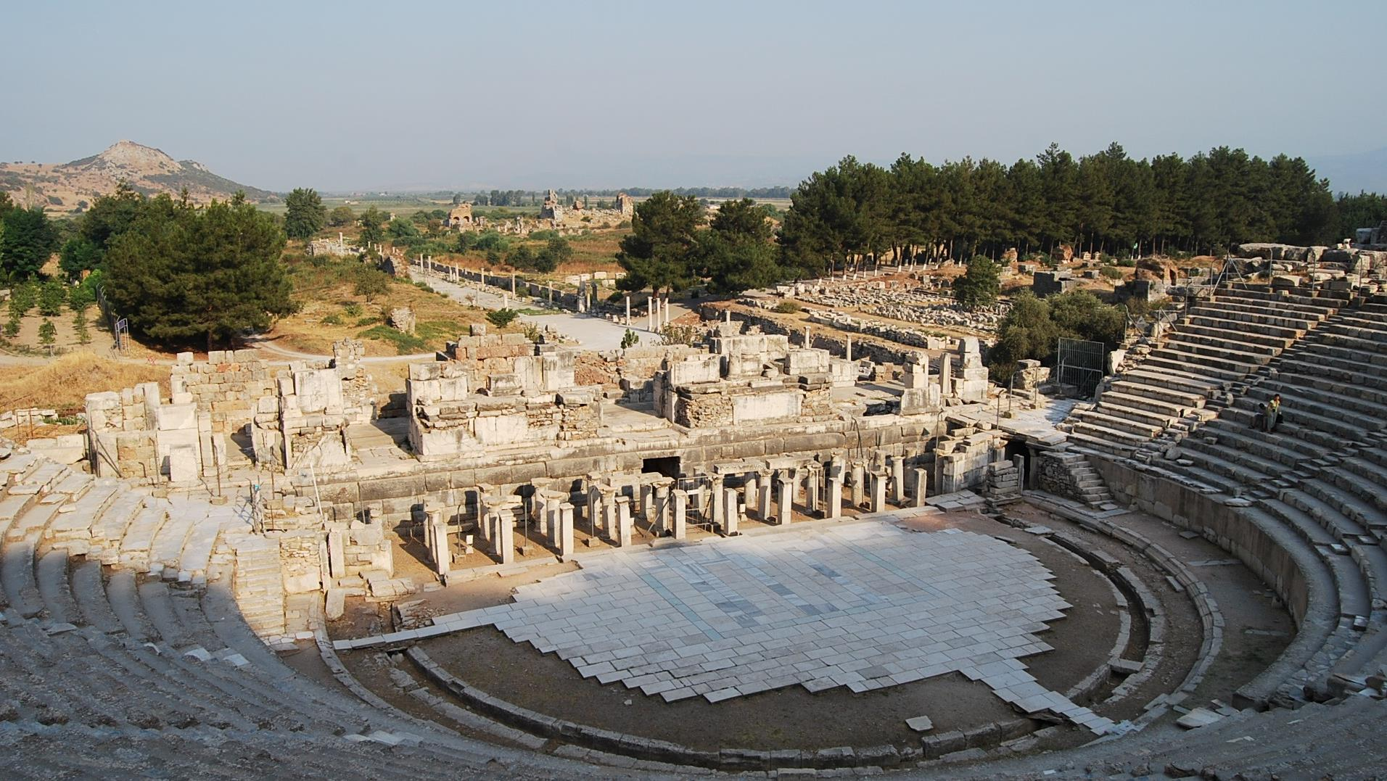
The Ephesian Letter
This Photo by Unknown Author is licensed under CC BY-NC-ND

Slide 2
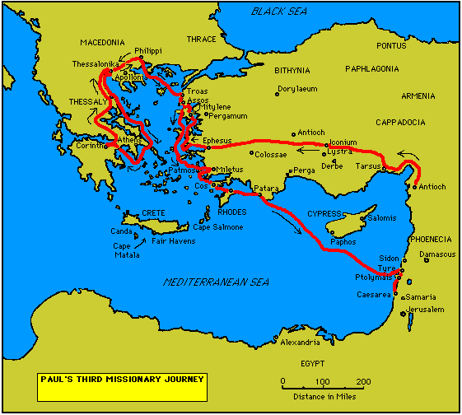
On his 3rd journey, Paul established the Ephesian church:
He had visited the city briefly on his 2nd mission tour, promising to return (Ac. 18:19-21).
Paul made good on this promise, arriving once more at Ephesus on his 3rd mission tour (Ac. 19:1ff).

Slide 3
In the Synagogue and Beyond
Paul spent three months in the Ephesian synagogue, urging the Christian message.
His response was mixed, and his opponents forced him out.
Moving, he spent two years preaching in a lecture hall, effectively reaching both Jews and Greeks throughout the Province of Asia (probably including the Colossian church to whom Paul would also write).
Near the end of his three years in Ephesus (cf. 20:31), Paul was involved in a riot incited by the silversmiths in devotion to Artemis, the patron goddess of the city (Ac. 19:21ff.). He was nearly lynched and decided it was best to now depart (20:1).

Slide 4
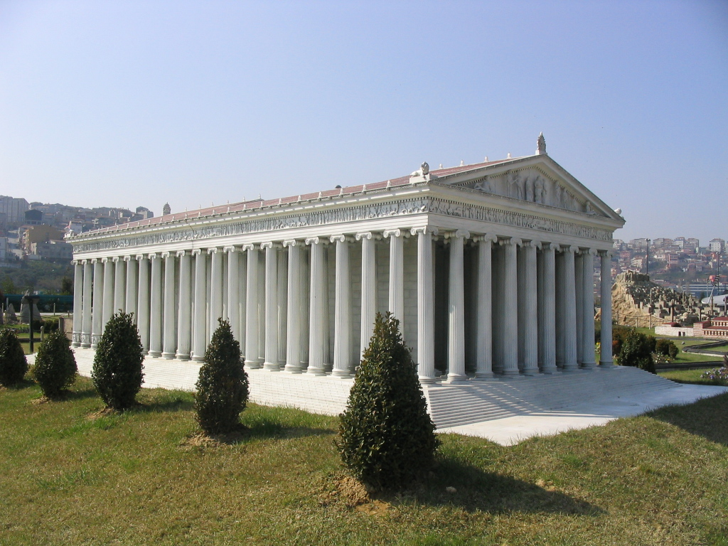
Though only sculptural fragments and foundations stones remain, the Temple of Artemis was named by Antipas of Sidon as one of the seven wonders of the ancient world.
Though destroyed in the late Roman Period, it’s ruins were rediscovered by scholars from the British Museum in 1869.
Model of the Temple of Artemis

Slide 5
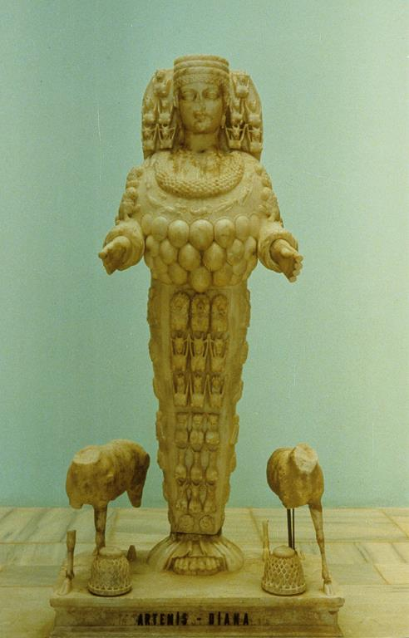
STATUE OF ARTEMIS FROM EPHESUS
Worshipped as the goddess of the hunt and protectress of women in childbirth
Identified with Cybele, the Asian mother-goddess of fertility

Slide 6
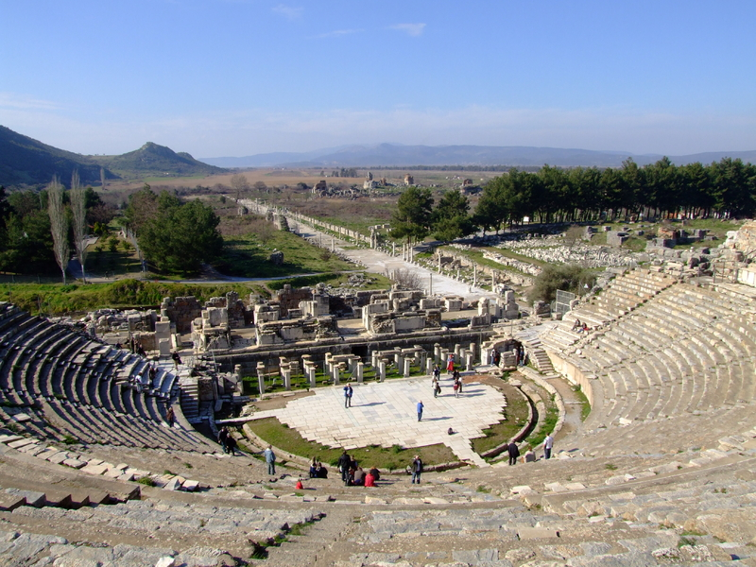
The amphitheater in Ephesus, where Paul was nearly lynched, lies at the end of the Arcadian Way.
While at Ephesus, Paul made a firm decision to revisit Jerusalem after which he hoped to reach further west by going to Rome (Ac. 19:21; cf. Ro. 1:11-13; 15:23-24, 31-32).

Slide 7
Authorship
Some scholars argue that the Ephesian letter is post-Pauline.
The letter seems to regard the apostles as a closed group (2:20; 3:5), and the developed sense of church offices seems too late for Paul (4:11).
There are many striking parallels between Ephesians and Colossians, which might be the result of a literary dependency (1:4//Col. 1:22; 1:15//Col. 1:4; 2:13//Col. 1:20; 4:2-3//Col. 3:12-13; 6:21-22//Col. 4:7-8).
The term “church” in Ephesians is more of a cosmic concept, whereas in Paul’s other letters, it refers to a local congregation.
STILL, THE FOLLOWING QUESTION IS WORTH REPEATING: “Which is more likely—that an imitator of Paul in the first century composed a writing ninety or ninety-five percent in accordance with Paul’s style, or that Paul himself wrote a letter diverging five or ten percent from his usual style?” (H. J. Cadbury)

Slide 8
Theme
PAUL WROTE TO THE EPHESIANS WHILE INCARCERATED (cf. 3:1; 4:1).
More than any other of his letters, Ephesians addresses the nature and character of the Christian church.
The church was planned by God before the creation of the universe, established through the death and resurrection of Christ, and is being brought to unity and maturity through the ongoing work of the Spirit.
This church is God’s temple (2:21), a counterpart to the Ephesian Temple of Artemis.
Unlike some of his letters, this one does not combat a heresy; rather, it displays the church as combatting the powers of evil in the world while serving as the showpiece of God’s wisdom to the whole universe (3:10-11).

Slide 9
Audience
Ephesians is less personal than Paul’s other letters. Indeed, other than Paul himself, the only other name in the letter is Tychicus (6:21), the same courier as for the Colossian letter (cf. Col. 4:7-9).
One possible reason for this generality may be that the letter was intended for multiple recipients, possibly all of them in Asia and probably only one of them the Ephesians.
This speculation derives from the fact that in some of the earliest manuscripts, the words “in Ephesus” are missing from the introduction (1:1).

Slide 10
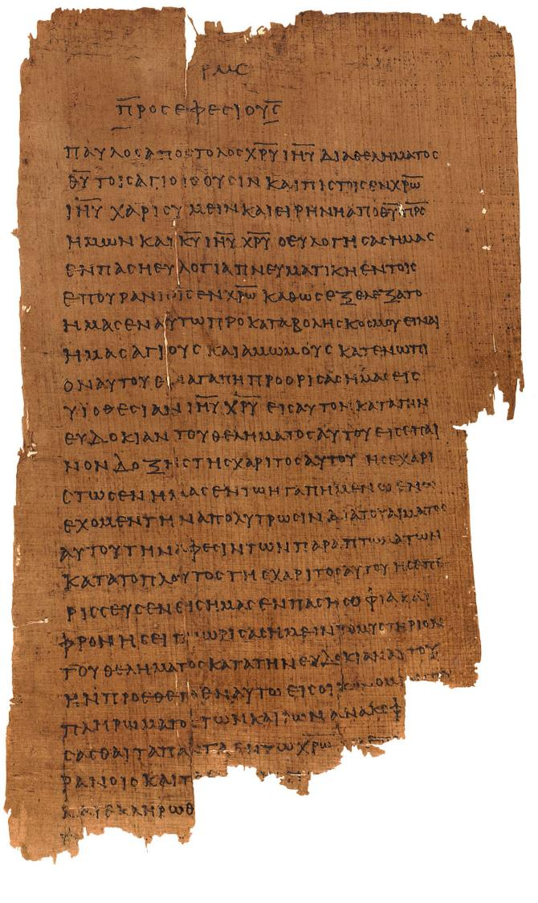
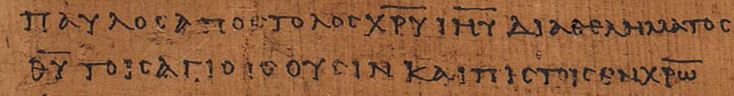
Ephesians 1:1 p46
Chester Beatty Papyri ca. AD 200 earliest copy of the Ephesian letter
(University of Michigan, Hatcher Library)
“Paul, an apostle of Christ Jesus through [the] will of God to the holy ones who are also faithful in Christ…” (1:1)

Slide 11
The Argument
The church is the climax of God’s eternal purpose (1):
Before the creation of the universe, the Father planned to have a body of people adopted as his children.
He provided redemption and forgiveness through his Son, working everything out according to his sovereign will.
Through the Holy Spirit, he guaranteed the final outcome of this blessing.
The Ephesians themselves were examples of this mystical “body”, over whom is Christ the “head”.
Grace and unity are the enduring qualities of God’s redemptive work (2):
Believers are saved by grace through faith.
Unity between Jews and Gentiles in a single body through the cross has resulted in a holy temple where God lives by his Spirit.

Slide 12
The Argument
Paul was himself a servant of this gospel (3):
This eternal purpose of God—the “mystery”—was kept hidden for long ages, but now God has made it known.
It was Paul’s privilege and burden to be the bearer of this good news to Gentiles.
His continual prayer was that the Ephesians would be able to fully grasp Christ’s immeasurable love.
The practical implications of this universal gospel aimed toward unity and spiritual maturity (4:1—5:20):
Since God has now united both Jew and Gentile, Christians must live in unity with each other, using the gifts God has given for the spiritual growth of the body.
As God’s children, they must be characterized by moral behavior.

Slide 13
The Argument
Family life must be follow the lead of Christ as the “husband” of the church, his “bride” (5:21—6:9).
This meant sacrifice and submission between husbands and wives.
It also meant respectful obedience on the part of children.
It meant that Christians who were slaves and Christians who were masters must see themselves as serving Christ, not the expectations of the surrounding culture.
The church faces an intractable and threatening world (6:10-24):
Still, though the church engages in warfare, its warfare is not conducted with physical violence, but rather, spiritual weaponry.
Prayers for Paul as Christ’s ambassador were in order, and peace, love and grace were the enduring virtues of God’s new society, the church.

Slide 14
God’s eternal purpose
Ephesians 1

Slide 15
The Triadic Blessing (1:3-14)
Paul is both consciously and unconsciously trinitarian, here structuring the opening blessing in terms of the Father, the Son, and the Holy Spirit.
This blessing is the single longest sentence in Paul’s letters, a total of 258 words (English Versions break up this long sentence)!
The blessing also resembles the Jewish berakah, sharing its threefold structure in which God is blessed, the reason for this blessing is recounted, and a response of praise is offered.

Slide 16
The Father’s Plan (1:3-6)
The blessing begins by praising the Father’s gracious choice of the community of faith as his own children.
This chosen body is now seated with Christ in the heavenly realms and privileged to share the blessings of this exalted position.
The designation “in the heavenlies” (e]n toi?j e]pourani<oij), which Paul will use several more times in this letter (cf. 1:3, 20; 2:6; 3:10; 6:12), refers to an invisible, spiritual realm which exists alongside the visible, natural realm.
This invisible realm means that in some sense believers already participate in the Age to Come while still living in the Present Age.

Slide 17
THE DIVINE CHOICE
Paul describes the divine choice in five stages:
Ro. 8:28-29
Ep 1:3-14
2 Th. 2:13-17
ELECTION
CALLING
SALVATION
PERSEVERANCE
GLORIFICATION
Foreknowledge and Predestination
Called according to God’s purpose
Justification
Inseparable from Christ’s love
Glorification
Chosen and predestined to be sons
His will revealed in the word of truth
Redemption and forgiveness through Christ’s blood
The Spirit is a deposit guaranteeing our inheritance
Final redemption of believers who are God’s possession
Chosen from the beginning
Called through the gospel
Sanctification by the Spirit and belief in the truth
Believers must stand firm and hold to the teachings
All will share in the glory of the Lord

Slide 18
From Paul’s language, the long-standing debate continues over divine sovereignty and human freedom.
CALVINISM
ARMINIANISM
Here, the focus is upon the individual whom God chose.
God acts alone in saving the individual based upon his sovereign choice before the universe began.
The Ephesians passage is read in the sense “God chose me”.
Here, the focus is upon the community which God chose.
Before the universe began, God determined that he would have an international, multi-ethnic church.
The Ephesians passage is read in the sense “God chose us”.

Slide 19
The Son’s Redemptive Work (1:7-12)
If it was the father’s purpose to choose the church, it was the Son’s role to effect this redemption in history.
This plan was formed in love and its benefits freely given in the One beloved by the Father.
It was accomplished “in him” (1:7), the Father’s good purpose and will was “in Christ” (1:9), and “in him” we were chosen (1:11) and included (1:13).
THE CENTER OF THE CHRISTIAN GOOD NEWS IS THE CROSS AND EXALTATION OF JESUS. THE KEY REALITIES ARE DIVINE GRACE AND THE RESPONSE OF FAITH.

Slide 20

Critical Vocabulary
…to decide in advance
proari<zw
Predestine
a]polu<trwsij
Redemption
…to buy back, set free
ui[oqesi<a
Adoption
…to accept as a legitimate child

Slide 21
The Mystery (1:9)
Paul calls the Christ event a “mystery” (musth<rion), a term he will use several more times in this letter (cf. 3:3-4, 9; 5:32; 6:19).
This term refers not to a puzzle, but rather, to the unveiling of something previously hidden or obscure.
From before the creation, the hidden redemptive purpose of God lay behind the movements of history, and it has come to fruition in Christ, in whom will be reconciled all things in heaven and on earth—the same goal expressed in the Lord’s Prayer: “…thy kingdom come, thy will be done, on earth as in heaven.”
Ultimately, all things will be headed up under the lordship of Christ.

Slide 22
The Spirit’s Seal (1:13-14)
The consequence of hearing and believing is the seal of the Spirit given to all who believe.
This gift of the Spirit is given at the time of faith (the translation in the KJV, which says “after ye believed, ye were sealed”, can be misleading if it is taken to mean subsequently; rather, the Greek temporal participle expresses coincident action, so the modern versions are better in saying “when you believed you were sealed).
The seal of the Spirit guarantees the final redemption at the end.

Slide 23
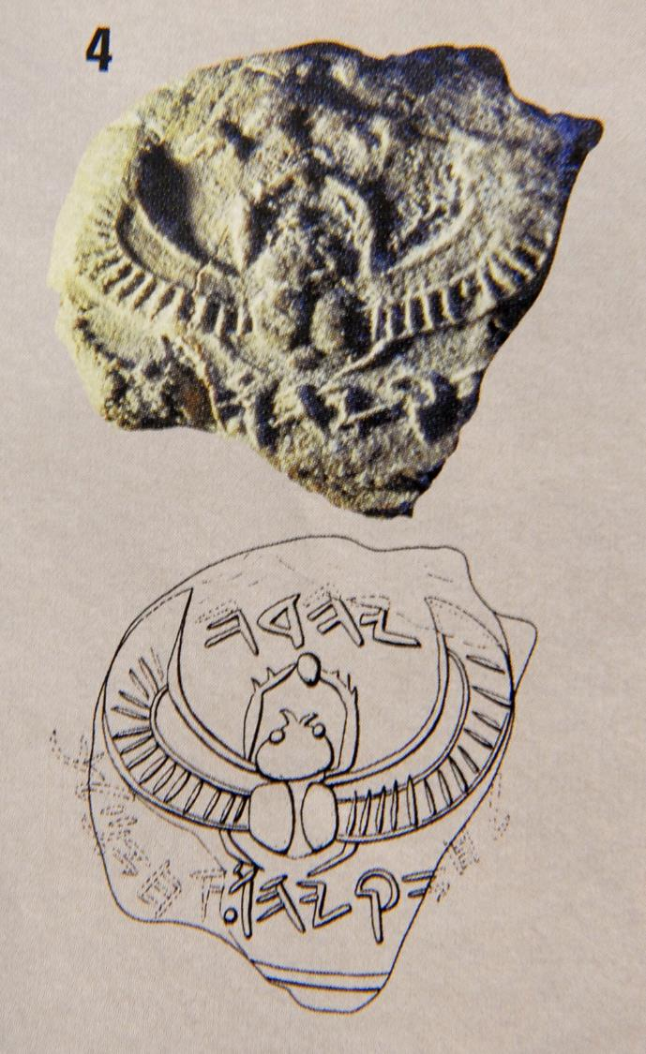
Fixing a Seal
Seal Impression of King Hezekiah of Judah
“Belonging to Hezekiah [son of] Ahaz, King of Judah”
Such seals were in use in the ancient world from antiquity right up into the Roman Period.
To be sealed with the Holy Spirit means to be marked as God’s own.

Slide 24
Thanksgiving and Prayer (1:15-23)
Unlike typical prayers for health, emotional well-being and economic security, Paul’s prayers were deep with theological content and supplication that believers might come to know the spiritual truths of the gospel.
The trilogy of faith, hope and love are central (cf. 1 Co. 13:13).
He describes the power of God in four important categories:
  Christ’s resurrection from the dead
  His enthronement at the Father’s right hand
  His lordship over the whole world and its powers
  His headship over all things for the church
Th church is Christ’s mystical body on earth, and as the head of the church, Christ gives to it his life and power.

Slide 25
Grace and unity
Ephesians 2

Slide 26
The Kingdom of Death (2:1-3)
The background for salvation is the kingdom of death.
The metaphor of death suggests the complete incapability of anyone coming to God on his/her own merit or ability.
Rather, all humans were trapped under the dominion of Satan (the “prince of the power of the air”), living their lives in accord with the “rulers, authorities, powers and lordships”, the entities over which Christ triumphed in his exaltation (cf. 1:21).
All men and women behaved in the “passions of their flesh”.
Because of disobedience, all were destined for divine wrath.

Slide 27
sarc (the sphere of “the flesh”)
The Flesh
The sphere of human weakness
Mind controlled by what the flesh desires
Mind of the flesh is death
Hostile to God, refusing to submit to his Torah
Subject to the parasite of sin
Paul often describes the sphere of human weakness as “the flesh”.
Before coming to Christ, our sinful passions were aroused, leading to death (Ro. 7:5).
The behaviors of the flesh are degenerative (Ro 8:5-8; Ga. 5:19-21).

Slide 28
o]rgh< (Wrath)
The Semitism “children of wrath” denotes that all humans were under condemnation for their rebellion against God.
Unlike some post-modern theologians who wish to eliminate from the NT the reality of divine wrath (e.g., Rob Bell), Paul is clear that this is the destiny of all who refuse to put their faith in Christ (Ro. 5:9).
Divine wrath is the counterpart to divine mercy: the one without the other becomes meaningless.

Slide 29
Alive with Christ (2:4-7)
If the metaphor of death describes the former life, the metaphor of being resurrected with Christ describes the present state.
Redemption comes from the divine initiative: humans, being “dead”, could not respond to God’s mercy on their own.
However, in love and mercy God “made them alive together” (suzwopoie<w), and through his grace, he rescued them.
Now, believers have been privileged not only to be resurrected with Christ, but also to be enthroned with him in the heavenlies (cf. 1:3).

Slide 30
xa<rij ( grace)
Paul uses the word “grace” more than all other NT writers combined.
Grace is God’s unmerited initiative to provide humans with salvation (Ro. 11:6).
Grace stands in polar opposition to salvation by wages (Ro. 4:4), obedience to law (Ro. 3:28; 4:14; 6:14; Ga. 1:6ff; 2:19-21; 5:4) or religious works (Ro. 11:6; Ep. 2:9; 2 Ti. 2:9).

Slide 31
The Already-Not Yet Tension
The Christian lives within an inaugurated eschatology, which is to say, he/she participates in both the present and the future.
ALREADY
…we are seated in the heavenly places in Christ Jesus (Ep. 1:3; 2:6)
…our citizenship is in heaven (Phil. 3:20a)
…we have been transferred over into the kingdom of God’s Son (Col. 1:13)
…we have been saved and justified by faith (Ro. 5:1; Ep. 2:5)
NOT YET
…we presently live in an earthly home while awaiting a heavenly home (2 Co. 5:1)
…we await the transformation of our bodies (Phil. 3:20b-21)
…we await being brought safely into Christ’s heavenly kingdom (2 Ti. 4:18)
…we shall be saved in the day of the Lord Jesus (Ro. 5:9b; 10:9; 1 Co. 1:8; 5:5; Ep. 4:30)

Slide 32
Grace and Faith (2:8-10)
Salvation is not an achievement by righteous men and women nor the culmination of the human quest for God.
Rather, salvation is an act of God on behalf of the sinner (cf. Ro. 9:16; 11:6).
Grace describes the divine initiative; faith is the human response to divine grace by which the sinner accepts God’s free gift.
Still, faith is not itself a human-generated response: the entire process of salvation, faith included, is God’s gift (cf. Phi. 1:29).

Slide 33
Salvation in Two Directions
Believers are saved “from” something, but they also are saved “to” something.
DEATH
the flesh
dominion of Satan
divine wrath
GRACE
the gift of faith
a new creation
to do good works
From To
Salvation is not only an escape but also a calling (cf. Eph. 2:10; 2 Ti. 1:9).

Slide 34
The Church Catholic (2:11-22)
Paul now begins to develop the theme toward which he has been building since the opening—the church catholic.
If the church was chosen in Christ before the creation… (1:4, 11)
If this church was predestined to be God’s intimate family… (1:5)
If God’s eternal purpose is to unite under Christ’s lordship every entity in heaven and earth… (1:9-10)
If Christ has been resurrected and exalted in the heavenlies … (1:22-23)
If every believer has been saved by grace through faith… (2:8-10)
…THEN, the church can be nothing less than catholic. Artificial divisions can no longer be maintained!

Slide 35
What You Once Were (2:11-12)
The creation accounts depict God as the maker of all humans, not just Israel.
Hence, God’s ultimate purpose in choosing Abraham was that in his progeny all nations would be blessed (Ge. 12:1-3).
In spite of this universal purpose, the division between Israel and the nations had been a sharp, impassable rift—a division marked by circumcision or the lack of it.
Israel’s ancient holiness code separated them from false religion, and the covenant of Moses left Gentiles in a state of total alienation from God.

Slide 36
What You Now Are (2:13-16)
This former alienation was abolished in the death of Jesus.
Such alienation was graphically symbolized by the temple barrier that separated the Court of the Nations from the inner courts available only to Jews.
  Fastened to this barrier were inscribed notices prohibiting Gentiles.
  Hence, Gentiles could not “come near” on pain of death.
In Christ, this barrier has been abolished. Through the blood of Christ, Gentiles have been “brought near”.
Instead of there being two, a Jewish person and a Gentile person, there is now one new person—the Christian!

Slide 37
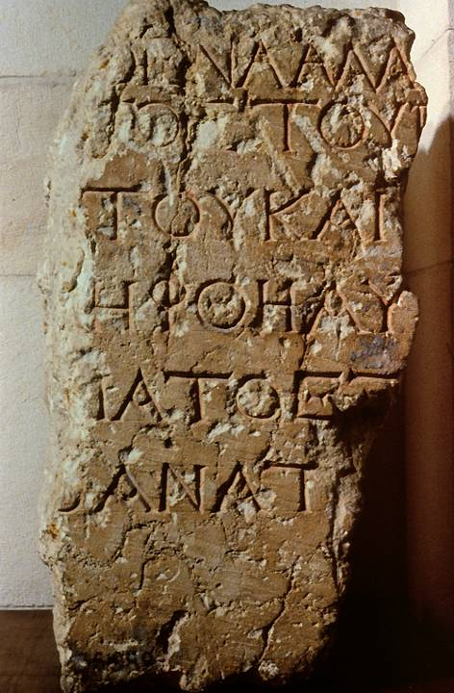
This excavated fragment is one of several of the “keep out” inscriptions surrounding the 2nd temple in the 1st century. The penalty for violation was “death”, and the Greek word “death” can be clearly made out in the final line:
[Q]ANATO[S]
The notices were written in Greek and Latin. This one is in Greek.

Slide 38
A United Household (2:17-22)
This single entity—the church catholic—is now God’s new community.
This divine purpose was no more than what had been predicted in the Book of Isaiah with its language of peace to those “near” and “far” (cf. Is. 52:7; 57:19).
Now, both Jew and Gentile have access to the Father by one Spirit.
Believers have now become a new citizenship, a new household, and a new temple.

Slide 39
The Three Metaphors
Paul’s uses three powerful metaphors to describe this unity in Christ.
nao<j
The dwelling-place of God
(Christ, the temple cornerstone)
oi]konomi<a
the household
(inclusive unit of several families)
politei<a
the city-community
(Greek city-state)

Slide 40
Paul’s unique role
Ephesians 3

Slide 41
Paul, a Servant of the Gospel (3:1-13)
In view of this one, holy, catholic and apostolic church, Paul now proceeds to explain his own unique role in God’s eternal purpose.
In doing so, he will offer a lengthy interlude in which he breaks off his sentence at the end of 3:1 before taking it up again in 3:14.
He also will once more employ the term “mystery” (cf. 1:9) to describe God’s hidden purpose in history.
He writes as a “prisoner” of Christ, presumably referring to his incarceration after visiting Jerusalem (3:1; cf. 4:1; Ac. 21ff.)

Slide 42
The Mystery Revealed (3:2-7)
The hidden purpose of God for the whole universe begins with the church.
Paul’s role was to be a missionary to testify to this mystery—hidden in past ages, but now revealed through the apostles and prophets of the church.
His “stewardship” (a term describing the manager a large estate) was that of a minister of God’s grace to preach the gospel.
After his arrest in Jerusalem, Paul experienced a trance in the Jerusalem temple, and in a vision, Christ promised to send him to the Gentiles (cf. Ac. 22:21).

Slide 43
The Gentile Missionary (3:8-13)
Despite his earlier career as an inquisitor for the Sanhedrin to arrest Christians, something for which Paul experienced continuing regret (cf. Ac. 7:58; 8:3; 9:1-2; 22:4-5; 26:9-11; 1 Co. 15:9; Ga. 1:13; 1 Ti. 1:15-16), he now had been divinely appointed to preach “the mystery”.
In this proclamation, all humans, regardless of race or heritage, could be saved through faith in Christ.
What God intended to do in the whole universe he now had accomplished in his church, a demonstration of the mystery revealed.

Slide 44
The Prayer for Fulness (3:14-21)
Picking up the broken sentence from 3:1, Paul describes his continuing prayer that the Ephesians would fully understand the scope of this mystery.
As is invariably the case, Paul’s prayers are addressed to the Father (the NT typically does not have prayers addressed directly to Christ or the Holy Spirit—rather, one prays to the Father through the Son).
Paul’s intercession was that the Ephesians would be powerfully enabled through the Spirit to comprehend Christ’s love, thus being filled with God’s own fullness.
He closes with a doxology, which in turn makes way for a shift in focus from the theological to the practical.

Slide 45
Practical advice
Ephesians 4:1-16

Slide 46
The Goal of Unity (4:1-16)
The Letter to the Ephesians can be rather evenly divided between the theological and the practical.
Chapters 1-3 are theological, while chapters 4-6 are practical.
As is customary in Paul’s letters, the theological is addressed first with the practical implications built on the theology.
Here, as in others letters, he uses the verb parakale<w (= to exhort, to urge) to introduce the practical section (4:1; cf. Ro. 12:1).

Slide 47
Christian Life in Community (4:1-3)
If the church is one, holy, catholic and apostolic body established through the death of Jesus, uniting both Jew and Gentile into a single body, then this truth has wide-ranging implications for how believers should live in this new community.
Twice Paul will use the key term e[no<thj (= unity), in 4:3 and 4:13, which form an inclusio that the Ephesians are to “keep the unity of the Spirit” until they “attain the unity of the faith and of the Son of God”.
They are to live in a manner appropriate to their high calling, a life of humility, gentleness, longsuffering, and forbearance.

Slide 48
The Basis of Unity (4:4-6)
Paul summarizes the basis for unity in the core of seven common beliefs, experiences and realities, each prefaced by the word “one”.
One body (the church, cf. 1:22-23)
One Spirit (indwelling the community of faith, cf. 2:22)
One Hope (expectation of eternal life, cf. 1:9-10, 18)
One Lord (Christ raised from the dead and exalted, cf. 1:20-21)
One Faith (the gospel of grace, cf. 2:8)
One Baptism (the gift of the Spirit outwardly expressed in the water ritual, cf. 1:13-14)
One Father (God over all, through all, and in all cf. 1:13; 3:14-15).

Slide 49
Diversity in Ministry (4:7-13)
The unity of the church is a unity in diversity, not a monolithic conformity. Hence, Christ apportions diverse spiritual gifts as he so chooses (cf. Ro. 12:3-6a).
In his resurrection, Christ was like a conquering general over all spiritual enemies (cf. 1:20-21; 3:10; 6:12; Ps. 68:18; Col. 2:15).
In his exaltation and ascension “higher than the heavens”, he not only fills the universe with his presence, but he also gives gifts of ministry to his church.
These ministry gifts aim at bringing the church to maturity in the fullness of Christ.

Slide 50
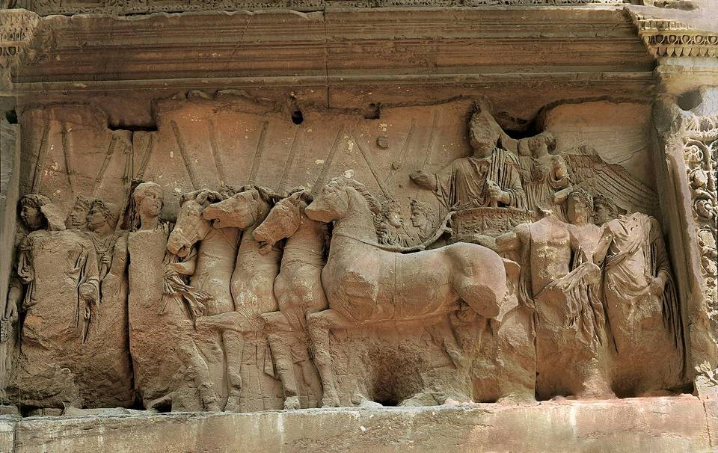
The Triumph
In referencing Psalm 68, Paul recalls the triumph of David, when he brought the ark to Jerusalem (cf. 2 Sa. 6:17-19). The idea of a triumphal procession also would immediately recall the image of the Roman Triumph, here depicted in the Arch of Titus.

Slide 51
The Harrowing of Hell?
Christ’s descent to the “lower parts of the earth” was interpreted by many early church fathers to refer to Christ’s descent to the place of the dead between his crucifixion and resurrection.
This passage in Ephesians was linked to Ac. 2:25-35; Ro. 10:6-7; 1 Pe. 3:18-20; 4:6 and Mt. 12:40, and together, these passages lie behind the phrase in the Apostles’ Creed “he descended into hell”.
However, some interpreters understand the “lower parts of the earth” to refer, not to the underworld, but rather, to Christ’s incarnation in coming from heaven to earth.

Slide 52
The Ministry Gifts
As is his custom, Paul offers a selective list of gifts, one among several such gift-lists in the NT (cf. Ro. 12:6-8; 1 Co. 7:7; 12:8-10, 28-30; 13:1-3, 8; 14:6, 26).
APOSTLES
PROPHETS
EVANGELISTS
PASTORS-TEACHERS
Primary church leaders, either eyewitnesses of Jesus ministry (cf. Mk. 3:14; Ac. 1:21-22) or specially chosen missionaries (cf. Ac. 14:4;1 Co. 9:1)
Spokespersons for preaching, prediction and edification (cf. 1 Co. 14:3, 22, 30-31; Ac. 11:27-28; Ac. 15:32), including both men and women (Ac. 21:9)
A proclaimer of the gospel (Ac. 21:8; 2 Ti. 4:5).
Teaching shepherds of congregations, also called “elders” and “overseers” (Ac. 20:17, 28; 1 Pe. 5:1-2). A single definite article in Greek governs “pastors” and “teachers”, indicating a single category.

Slide 53
The Maturing Community (4:14-16)
Christians grow from spiritual infancy toward the full image of Christ.
In doing so, they learn to avoid vacillating religious fads that blow through, growing up into Christ, who is the church’s head and source of life and character.
Every member contributes to the health of the whole body through the exercise of love.

Slide 54
The imperatives
Ephesians 4:17—5:20

Slide 55
Two Verbal Moods in Paul`s Letters Describe both Process and Result
INDICATIVE MOOD
(the fact of what now is)
“God…has raised us up with Christ…in the heavenlies…” (Ep. 2:6)!
“For by grace you have been saved through faith…” (Ep. 2:8-9).
IMPERATIVE MOOD
(the demand for what should be)
“I urge you to walk in a manner worthy of your calling…” (Ep. 4:1)!
“You must no longer walk as the Gentiles do…” (Ep.. 4:17)
This is what Christ has done! It is accomplished—finished—in Him alone!
This is what we are called to do by the power of the Spirit.

Slide 56
The Old and the New (4:17-24)
Paul now contrasts the former lifestyle of the Ephesian Christians with their new life in Christ, which parallels his earlier description comparing the kingdom of death with new life in the heavenlies (cf. 2:1-7).
Before, they lived as pagans, ignorant, morally insensitive, and given over to sensuality and impurity.
Now, they have discarded their old self like an abandoned garment, and have clothed themselves with a new self made in God’s own image.

Slide 57
Putting Off and Putting On
The metaphorical language of “putting off” and “putting on” derives from the language of changing clothes.
This metaphor might possibly reflect on the change of clothes necessary in Christian baptism.
Still, Paul is not talking about mere appearances, but a new kind of life altogether (cf. Col. 3:9-10).

Slide 58
Concrete Behavioral Norms (4:25—5:7)
The new life in Christ affects attitudes toward truthfulness, material property, emotional expression, daily conversation and interpersonal relationships.
Deceit is particularly odious, since Christians are fellow-members of one body.
Anger must be put away in order to prevent a foothold for Satan.
Wealth must be used as a resource to help others.
Speech patterns, also, must change.
While sexual license was common in Greco-Roman society, Christians must completely eliminate all deviant sexual behavior.

Slide 59
Vices and Virtues
Paul offers suggestive lists demarcating the old and the new life
(4:19—5:21).
VICES
pikri<a (bitterness)
qumo<<j (rage)
o]rgh< (anger)
kraugh< (clamor)
blashmi<a (slander)
pa<s^ kaki<% (all malice)
porhei<a (fornication)
ai]sxro<thj (obscenity)
mwrologi<a (silly talk)
eu]trapeli<a (crude jesting)
a]palge<w (to become callous)
a]selgei<a (debauchery)
a]kaqarsi<a (uncleanness)
pleoneci<a (coveteousness)
e]piqumi<a th?j a]pa<thj (deceitful passions)
yeu?doj (falsehood)
o]rgi<zomai (to become angry)
kle<ptw ( to steal)
lo<goj sapro>j (foul speech)

Slide 60
VIRTUES
a]naneou?sqai t&? pneu<mati tou? noo>j (to
renew in the spirit of the mind)
dikaiosu<nh (righteousness)
o[sio<thti th?j a]lhqei<aj (true piety)
a]lh<qeia (truth)
e]rgazo<menoj tai?j xersi>n to> a]gaqo<n
(working honestly with his hands
metadido<nai t&? xrei<an e@xonti (giving to
those having a need)
lo<goj…a]gaqo>j pro>j oi]kodomh>n (speech
good for edification)
xrhsto<j (kind)
eu@splagxnoj (tenderhearted)
Xari<zomai (to forgive)
mimhtai> tou? qeou? (imitators of God)
peripatei?te e]n a]gap^ (walking in love)
eu]xaristi<a (thanksgiving)

Slide 61
Living as Children of Light (5:8-20)
The primary goal of the believer in the new life is to please the Lord.
This new life is characterized by light, which is a metaphor for moral rectitude.
While darkness conceals, the light reveals.
Paul introduces the quotation in 5:14 in the same way he usually cites passages from the Hebrew Bible, yet this saying is not in the Hebrew Bible. Possibly, Paul is quoting from a Christian hymn.
The opposite of being filled with “spirits” (intoxicating beverages) is to be filled with the Holy Spirit.

Slide 62
Paul’s Metaphors for the Old and New Life
2:1-6
2:12-19
4:22-24
5:8-14
Death and Resurrection
Formerly, we were dead in sin; now, we are alive together with Christ.
Alienation and Citizenship
Formerly, we were outside the commonwealth of Israel; now, we are fellow-citizens.
Old Clothes and New Clothes
Formerly, we were dressed in the garments of the “old self”; now, we are dressed in the garments of the “new self”.
Darkness and Light
Formerly, we lived in moral darkness; now, we live in the moral light of Christ.

Slide 63
Christian Hymnody
yalmo<j
u!mnoj
&]dai?j pneumatikai?j
PSALMS
The Book of Psalms; also, as a verb, this term means to pluck a stringed instrument
HYMNS
This term might refer to Christian compositions.
SPIRITUAL SONGS
This term might refer to adaptations of Greco-Roman celebration songs.
The clearest of these terms is “psalms”; the precise meaning of the other two can only be guessed at, given our current understanding of the language.

Slide 64
The household code
Ephesians 5:21—6:9

Slide 65
The Household Codes
Ethical lists were common in the 1st Century
JEWISH (Mishnah, other writings)
Husband, wife, sons, daughters, daughters-in-law, mother-in-law, parents
Slaves, friends, domestic animals
The Lord, the priests, the poor, the dead, the sick
GRECO-ROMAN
(the moralists)
Parents, children, relatives, marriage partners
The deities, the heroes, teachers, guardians, citizens, rulers
Domestic servants
The law
CHRISTIANS (New Testament)
Husbands and wives, children and parents
Slaves and masters
Citizens and the state
Younger people, older people

Slide 66
Household Codes in the NT
When members of a pagan household community became Christian, it mean an upsetting of the basic household structure.
“Households” (oi]konomi<a) were large inclusive units composed of multiple families bound together under the authority of the senior male of the primary family.
It included friends, clients, relatives, slaves and others with mixed social positions.
Wives and slaves were expected to follow the religion of their husbands and masters and to preserve religious ancestral customs.
Abandonment of expected social structures was perceived as rebellion against society and even the state.

Slide 67
Adaptation
By adopting and adapting such household codes, the apostles aimed at establishing social stability.
Sometimes these adaptations seem to be an accommodation ethic that falls short of the full implications of the gospel (e.g., submission of slaves, etc.).
What saves Paul from being unprincipled is that his overriding concern is that the gospel not be hindered, even if it meant yielding ground temporarily in other areas.
PAUL’S OVERRIDING ETHIC: “Though I am free…I make myself a slave to everyone, to win as many as possible. I do this for the sake of the gospel.” (1 Corinthians 9:19, 23)

Slide 68
The Transition (5:21)
Here, I follow the exegetical conclusion that 5:21 belongs with what follows rather than with what precedes (so RSV, NRSV, NEB, NJB, TEV).
This seems warranted, since to do otherwise leaves 5:22 without a verb (and in the phrase “wives [submiting] to your own husbands”, the verb “submit” must be drawn from the participle in 5:21).
The English Versions that render 5:21 as linked with what precedes conclude that the participle “submitting” in 5:21 should be linked to the main verb in 5:18.
In either case, 5:21 serves as a transition between what goes before and what follows. The NIV opts to make 5:21 a paragraph in itself.

Slide 69
Deference to Each Other (5:21-33)
If 5:21 prefaces the section following, then what Paul urges for spouses is mutual submission.
The verb u[pota<ssw, which mean “to submit” (5:21, 24), appears in both occasions in the middle voice (“submit yourselves”). Middle voice, in turn, suggests that wives are to voluntarily submit (i.e., it is not the husband’s right to dominate, but the wife’s responsibility to submit out of freedom rather than because of compulsion).
Had Paul intended submission out of compulsion, he probably would have used either u[pakou<w or peiqarxe<w (= to obey), such as he does for children to parents (cf. 6:1) and slaves to masters (cf. 6:5).
Later, he will instruct husbands to “give themselves up” for their wives (5:25), which is an act of sacrificial love. In this way, the ideal of mutual submission of 5:21 is maintained.

Slide 70
The Meaning of Headship (5:23-24)
Paul uses the metaphor of headship (kefalh<) in more than one way in his letters.
Besides the direct relationship of husbands and wives, Paul also uses this metaphor for the relationship between God, Christ, the man, and the woman (cf. 1 Co. 11:3).
While much scholarly discussion has attended the metaphor, research seems to indicate that in the 1st century the meaning of headship is more along the lines of “source” or “sustainer” (think of the head of a river) rather than the modern neurological understanding of headship as “ruler” or “authority over” (F. F. Bruce).
Paul, for instance, does not use the word a]rxh< (= ruler, authority over).
Against this, Wayne Grudem has argued that the metaphor of headship does mean “authority over”, thus supporting a hierarchical relationship.

Slide 71
Sacrificial Love (5:23, 25)
Whatever the lexical conclusion about the metaphor of headship, contextually it seems evident that Paul intends the husband’s headship to be an expression of sacrificial love.
The metaphor of headship may imply leadership, but it is hard to see how it can mean authoritarianism.
John Stott is probably closer to the mark when he says that it is more about care than control and more about responsibility than authority.
The pattern is the sacrifice of Christ, who gave himself up for his “bride”.

Slide 72
BRIDE
BODY
CITIZENS
TEMPLE
PAUL’S CORPORATE METAPHORS FOR THE CHURCH
THE BODY OF CHRIST
Ep. 2:14-16, 5:29-30; Ro. 12:4-5; 1 Co. 12:12-27; Col. 1:24, 2:19
THE TEMPLE OF GOD
Ep. 2:20-22; 1 Co. 3:10-11, 16-17; 2 Co. 6:16;
THE BRIDE OF CHRIST
Ep. 5:23-24, 32; 2 Co. 11:2
CITIZENS OF THE CITY
Ep. 2:19a; Phil. 3:20
THE HOUSEHOLD OF GOD
Ep. 2:19b
HOUSEHOLD

Slide 73
Children (6:1-4)
The second station in the household code concerns children and parents.
Paul follows the injunction of the 5th commandment that children should obey and honor their parents (cf. Ex. 20:12; Dt. 5:16).
However, he also includes a special notation for fathers that they should not discipline their children in such a way as to cause resentment, which stands in sharp contrast to the typical patria potestas (= the father’s power), which was so absolute in Greco-Roman society that a father could even sell a child into slavery, abandon it after birth, or inflict on it the death penalty.

Slide 74
Slaves and Masters (6:5-9)
The third station Paul addresses concerned slaves, those considered to be “living property”.
They had no legal rights under Roman law, but Paul was clear that in Christ their relationship should be different.
Slaves should be obedient as though they were serving Christ himself, but at the same time, masters were obligated to treat slaves fairly, remembering that with God there was no favoritism—and he was the Master of all!
While in the modern world Paul’s advice to slaves and masters might seem irrelevant, his principles should also apply to employers and employees. Both serve Christ in view of eternity, and God is the one who will pass final judgment on each.

Slide 75
Spiritual warfare
Ephesians 6:10-20

Slide 76
The Christian’s Armor
Paul’s imagery for spiritual warfare was based on the armor of the soldier, since Christians are “soldiers” in God’s army (cf. 2 Ti. 2:3; Phil. 2:25; Phlm 2).
The first order in this war is that the Christian’s strength lies in the Lord’s mighty power, not his/her own ability.
He urges believers to arm themselves with every piece of God’s spiritual armor so as to protect themselves from the devil’s schemes.

Slide 77
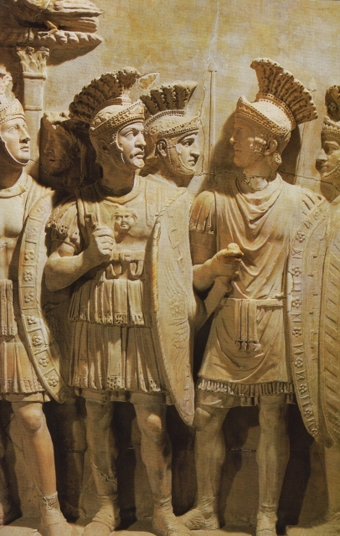
Roman Armor
Cingulum (the belt which held the sword and identified the soldier as “on duty”)
Lorica (the breastplate protecting the neck and torso)
Caliga (half-boot necessary for lightness of foot)
Scutum (metal-sheathed body shield)
Galea (helmet, protecting the head)
Gladius (short-sword)

Slide 78
The Armor Analogy
Paul compares these six pieces of armor/weaponry to the spiritual resources of the believer.
Some of these analogies have precedents in the Book of Isaiah (Is. 11:5; 59:17).
The most important protective piece is the helmet, the assurance of salvation.
The most important weapon is Holy Scripture, wielded by the Spirit.
The protective pieces are: truth, righteousness, the gospel, and faith.
Enemies are not physical foes but spiritual ones.

Slide 79
closing
Ephesians 6:21-24

Slide 80
Sending Letters in the Roman World
Since no postal system was available to the public (there was an official postal system, the cursus publicus, but it was unavailable to private citizens), letters were carried by private courier, in this case Tychicus (cf. Col. 4:7-8; Ro. 16:1-2).
Letters typically had internal references to the courier as a confirmation of his/her trustworthiness.
As the writer’s personal representative, the courier would read the letter publicly, explaining any difficult parts and generally sharing news of the sender.

