Slide 1
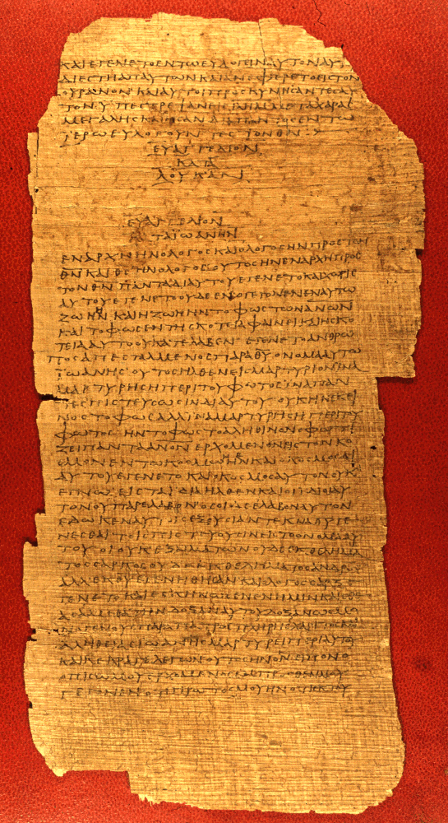
Texts and Readers in Early Christianity
p75
End of Luke, beginning of John
Vatican Library, Rome
AD 175-225

Slide 2
What We’ll Cover
Literacy
Physical form of early Christian texts
Texts of the Old Testament
Texts of the New Testament
Transcription
Publication
Circulation
The Libraries
Reading and Readers

Slide 3
Literacy

Slide 4
Literacy
The extent of literacy in the Greco-Roman world of the 1st century (the ability to read and write) was generally about 10% of the population and at no time larger than 15-20%.
Literacy was thus the privilege of a minority, and it existed alongside an oral culture.
Familiarity with the Scriptures did not depend upon an individual’s capability of reading them.
Hence, the ability to read, critique, and interpret belonged to a relatively small number of Christians in any given congregation.
A primary exception was the Jewish community, where Jewish children were taught to read in the synagogues (Josephus, Antiquities 4.211).

Slide 5
Public Reading
An essential part of early Christian worship was the public reading of Scripture.
Paul instructs Timothy: “…devote yourself to the public reading of Scripture…” (1 Ti. 4:13a).
Naturally, those able to publicly read texts were held in high esteem by the congregations, often rising to become leaders.
Apollos, for instance, is described as someone “skilled in the Scriptures” (Ac. 18:24).
Paul’s literary skills were instrumental in his missionary work.

Slide 6
In a society where the ownership of texts was economically prohibitive, the familiarity of Christians with the Bible depended upon hearing the texts read publicly.
In the synagogue tradition, two Scripture readings were appointed for each service, one from the Torah and one from the Prophets, and these were arranged in a three-year cycle. (Jesus gave the “Prophets” reading in his hometown of Nazareth, cf. Lk. 4:16ff.).
These readings in turn became the “text” for the sermons of the rabbis.
Christians followed the same pattern (1 Ti. 4:13). Indeed, some suggest that the nuance of the passage about the public reading of Scripture is, “…give attention to the selected reading of the day…”

Slide 7
An Early Christian Description
“On the day called Sunday, all who live in the cities or in the country gather together in one place, and the memoirs of the Apostles or the writings of the prophets are read, as long as time permits…”
Justin Martyr (d. 166)
Apology 1.67
Mid-2nd Century

Slide 8
The Selected Readings
The early churches varied in their choice of selected readings.
Some churches read from Sunday to Sunday until a particular book was finished (and this seemed to have been the general practice).
In other areas (Spain and France), short selections from various parts of Scripture were pieced together.
Some churches used harmonies of the gospels and read them in parallel.
By the 4th century, fixed readings were associated with Advent and Pentecost, and eventually, Lent, Good Friday, Easter, etc.

Slide 9
The Lectionary
In AD 471 (or earlier), a lectionary was produced, the Comes Hieronymi (Lectionary from Jerome), and it became the standard order of readings for the Western Church.
It assigned readings for Advent, Christmas, Lent, and Easter.
The rest of the year was covered by optional texts and could be adjusted by the local bishop or pastor.
Three centuries later, Charlemagne (768-814) standardized liturgical practices in his domain along with a revision of the lectionary, and this, in turn, meant that everyone in the west was reading the same passages on the same Sundays.

Slide 10
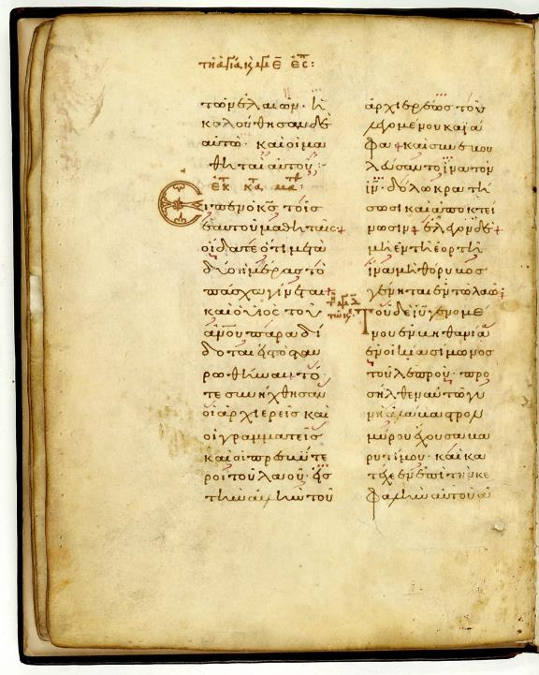
Greek Lectionary of the Gospels
The Readings for Easter Week from the Gospel of Matthew, along with readings for the stations of the cross.
The Greek lectionaries become an important witness to the Greek text of the New Testament.

Slide 11
Physical Form

Slide 12
Writing Materials
The primary writing surfaces were papyrus or leather sheets.
Papyrus was a tall reed widely found in shallow lakes and marshes.
  Sections of the stalk were either sliced or peeled, laid side-by-side on a hard smooth surface, and overlaid with other stalk sections at right angles.
  The two layers were then pressed to break down the cellular structure and release the juice of the pith, which served as a glue, bonding the two layers together. Each page was approximately 10” high x 8” wide.
The pages were pasted together with a flour paste to form a roll of about 20 sheets, more or less.

Slide 13
Leather was more durable than papyrus, but also more expensive.
Parchment was made from animal skins (primarily goats and sheep)
  Parchment was not tanned. The flayed animal skins were soaked in lime solution, scraped, washed, and stretched for drying.
  Parchment is thinner, softer, and whiter than ordinary leather.
Vellum was a finer parchment made of calf’s skin or kid’s skin.
Rolls were inscribed on one side only with relatively wide margins, no punctuation or accents, no paragraphing, and usually without word-spacing (scriptio continua).
Generally, papyrus was more widely used than parchment. It was easier to obtain and less expensive.

Slide 14
The Codex
A major development in early Christianity was the change from a scroll to a codex.
The standard form had been the scroll rolled on a spindle and containing writing on only one side.
The codex, the earliest Christian texts, were individual sheets bound together on one edge and written on both sides.
Paul can speak of both the bibli<a and the membra<naj (2 Ti. 4:13). The first refers to scrolls and the second to parchment codices.

Slide 15
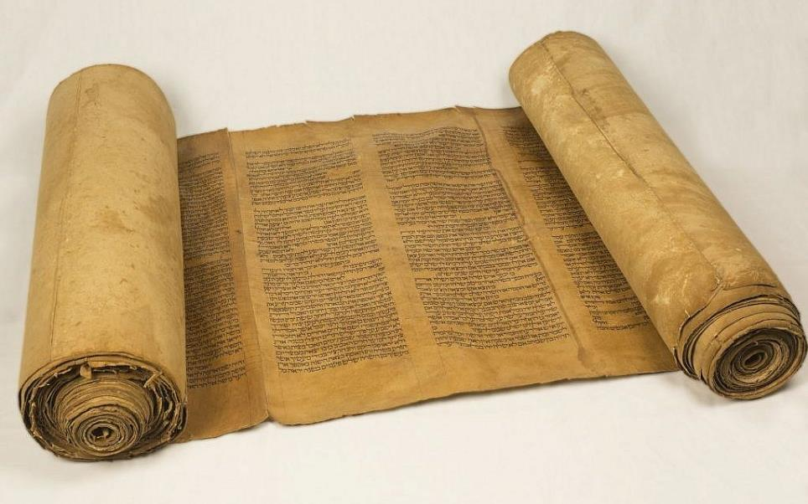
The Hebrew scroll was made of individual sheets of papyrus or leather glued or sewn together.
Writing was from right to left in columns.
Typical scroll length was 3.5 meters.

Slide 16
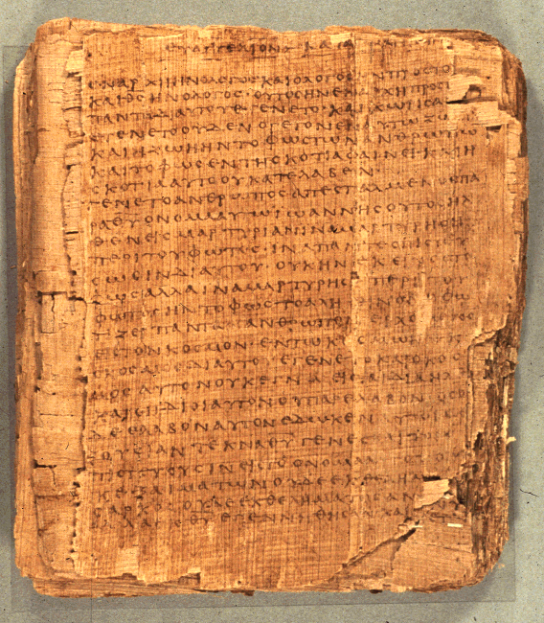
Christian texts were composed as codices, such as, p66
Bodmer Papyrus II
Opening of the Gospel of John
75 leaves and 39 fragments
6.4 inches x 5.6 inches
14-25 lines per page
The codex was more economical (about 25% less expensive than a scroll).
It also was more compact and less bulky.

Slide 17
St. Paul and the Codex
While we have no autographs of any biblical authors, the earliest collections of Christian writings were Paul’s letters which were in the form of codices.
Paul’s letters are the earliest Christian writings, the earliest to be copied and circulated, and the earliest to be collected (early collections were in groups of either seven or ten letters by the early 2nd century, the oldest extent collection being p46).
The fact that they are ordered from the longest to the shortest suggests a codex not a scroll (a scroll containing seven letters would reach about 80’, more than double the maximum length of Greek scrolls and three times the normal length of typical Greek scrolls).
Hence, it is possible that the widespread use of the codex in Christian circles derives from Paul himself.

Slide 18
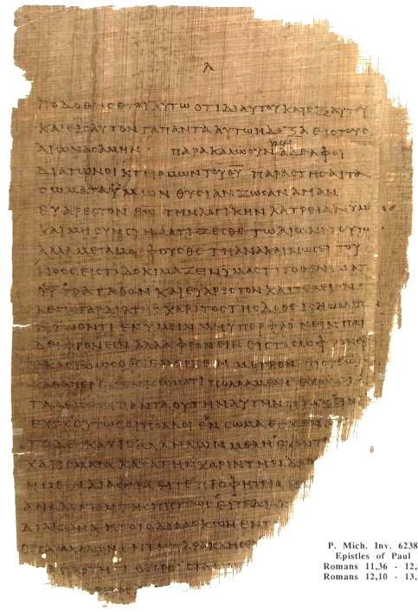
Codex page of Romans 11:36—12:8
Chester Beatty Papyri p⁴⁶
University of Michigan
ca. AD 200

Slide 19
Codex Construction
The size of early biblical codices was approximately 8-10” in height and 4-6” in breadth.
Most were constructed of a single quire (i.e., one set of sheets stacked and folded vertically at the center) and stitched along the fold. About 50 sheets per codex were the practical upper limit, which when folded and written on both sides, produced a document of about 200 pages.
Some were constructed using multiple quires (i.e., 4-12 sheets per quire stacked, folded, and stitched).
  p46 (Paul’s Letters) – 208 pages (single quire)
  p47 (Revelation) – 46 pages (single quire)
  p52 (Gospel of John) – 130 pages (single quire)
  p66 (Gospel of John) – 156 pages (multiple quire)
  p75 (John and Luke) – 144 pages (single quire)

Slide 20
Covers and Columns
None of the codices discovered from the first three centuries have been preserved with covers.
However, the discovered Nag Hammadi codices (Gnostic literature) have some eleven covers intact, suggesting that covers, usually leather, were used.
Thongs were used to tie the codex shut.
The columns of writing in a codex were usually one wide column per page (as opposed to the relatively narrow columns in a scroll.

Slide 21
Texts of the Old Testament

Slide 22
Old Testament
The Old Testament (Hebrew Bible) for the early Christians was available in both Hebrew and Greek and had been since well before the time of Jesus.
After the Hebrew Bible was fixed in its three ancient languages (Hebrew, Aramaic and Greek), translations began even before the time of Jesus.
However, after the missionary travels of Paul in the Greek-speaking world, the Greek translation (LXX) would be the one generally used, especially among non-Jews, but also among Jews of the Diaspora.

Slide 23
THE HEBREW BIBLE (Old Testament)
Three Collections
hrvt Myxybn Mybvtk
(Torah) (Nebiim) (Kethubim)
Genesis Former Prophets Psalms
Exodus Joshua Proverbs
Leviticus Judges Job
Numbers Samuel Megilloth (five rolls)
Deuteronomy Kings Song of Songs
Latter Prophets Ruth
Isaiah Lamentations
Jeremiah Esther
Ezekiel Ecclesiastes
The Twelve Daniel
Ezra-Nehemiah
Chronicles
These 24 books are the same as the 39 in the English Old Testament.

Slide 24
TEXTS of the OT (NRSV footnotes)
5 HEBREW 5 TRANSLATIONS
Dead Sea Scrolls (Q Ms)
Aramaic Targums (Tg)
Aramaic (Aram)
Latin (Vg) Pointed Hebrew (MT)
Septuagint (Gk, LXX) Syriac (Syr) Unpointed Hebrew (Heb)
2nd Century Birth 9th Century
BC of Christ AD

Slide 25
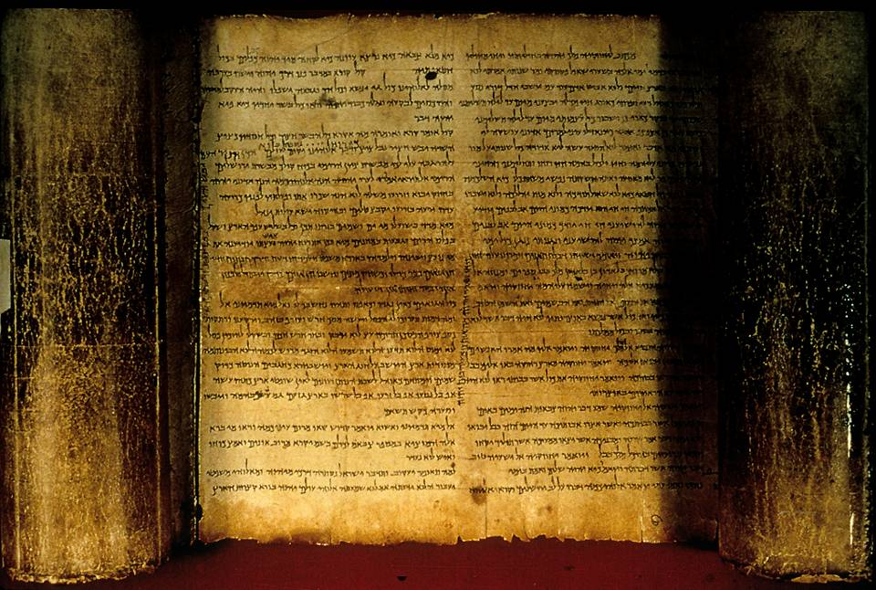
The Isaiah Scroll (Dead Sea Scrolls, 1QIsaª)

Slide 26
The Septuagint
Alexander the Great initiated the spread of Greek culture throughout the ancient world.
This included the Greek language (koine = common Greek), which by the time of early Christianity was the international language of the Roman Empire.
In approximately 250 BC, Jews in Alexandria, Egypt began translating the Hebrew Bible into Greek for inclusion in the Great Library at Alexandria, and this Bible, the Septuagint (LXX), became the “go to” version for Diaspora Jews around the world.
When James remarked, “…in every city [Moses] is read every Sabbath in the synagogues,” he was surely speaking of the Septuagint (Ac. 15:21).

Slide 27
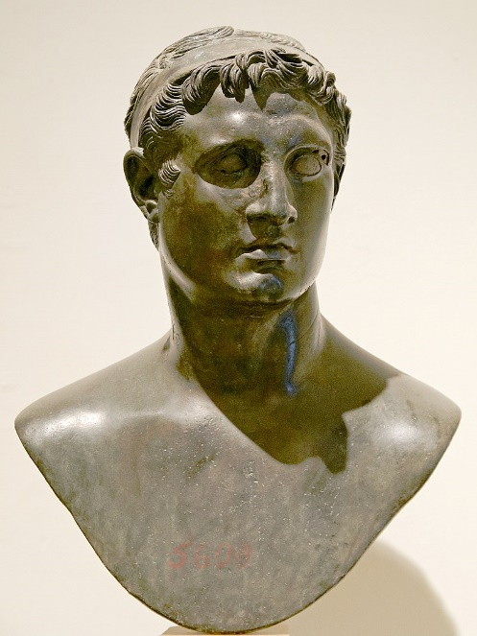
Ptolemy II Philadelphus (285-246 BC) brought to fruition the dream of his father to build a Great Library of all the most important literary works of the ancient world.
This collection would include the Hebrew Bible translated into Greek, what we now call the Septuagint (LXX).

Slide 28
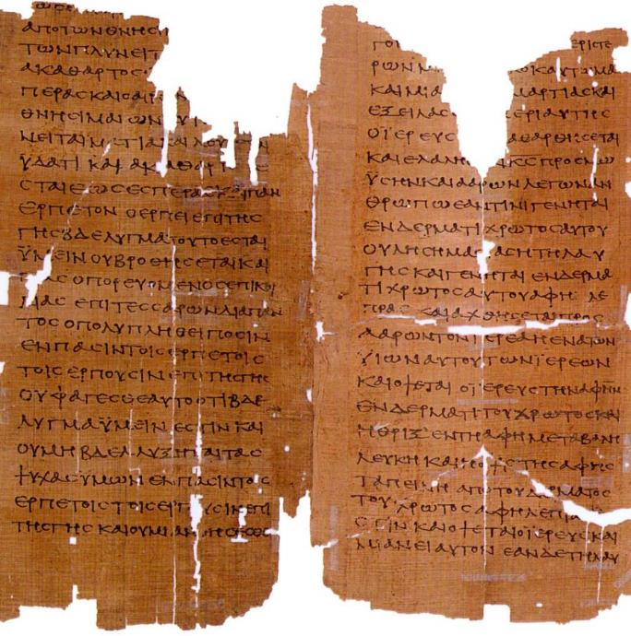
MS2649
From the LXX, Pages from Leviticus, late 2nd century AD, the oldest manuscript of this part of the Bible
(the Schoyen Collection)

Slide 29
The Apocrypha (Deutero-Canonical)
Besides the Old Testament, Jewish authors composed a number of works about Jewish history, legends, wisdom, and expansions to canonical books (notably Daniel and Esther).
Some are historical, some fictional, and some theological.
Though never considered canonical by the Jews, they were included in the LXX, and subsequently, they were read by early Christians in the Greek-speaking world. St. Jerome included them in the Latin Vulgate.
In the Protestant Reformation, they were rejected as canonical (but translated and read in the churches as edifying). They were included in the KJV for the first century of its printing.
At the Roman Catholic Council of Trent (1545-1563), they were officially recognized as canonical for the Roman Church. They are also canonical in Eastern Orthodoxy.

Slide 30
The Apocryphal Books
1 Esdras
2 Esdras
Tobit
Judith
Prayer of Azariah
Song of the Three Young Men
Susanna
Bel and the Dragon
Additions to Esther
Prayer of Manasseh
Letter of Jeremiah
Baruch
Sirach (Ecclesiasticus)
Wisdom of Solomon
1 Maccabees
2 Maccabees
3 Maccabees
4 Maccabees
Psalm 151
In keeping with other Protestants, Anglicans do not recognize the Apocrypha as canonical. However, following St. Jerome, they approve of them for “examples of life and instructions of manners.” It only restricts their use for the establishment of Christian doctrine.
39 Articles, Article VI

Slide 31
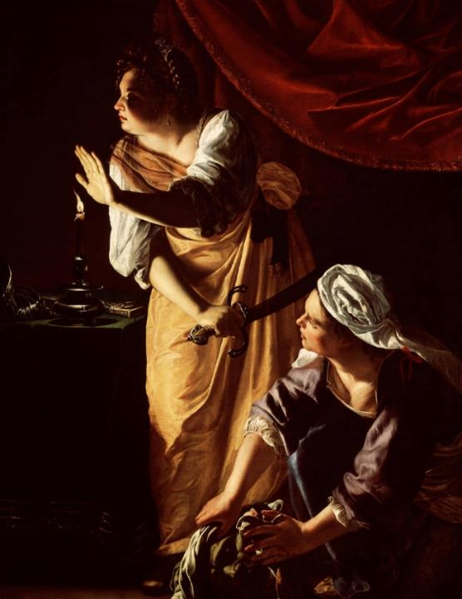
The story of Judith, as one example, is written against the background of a siege upon the Israelite city Bethulia.
To rescue her people, Judith, a beautiful widow, prayed for God’s help and boldly walked into the enemy camp with her maid.
Holofernes, the enemy general, attempted to seduce her, but when he was drunk, Judith took his sword and hacked off his head, putting it in a bag and taking it with her back into the city, where it was exposed on the city wall.
Judith and Her Maidservant with the Head of Holofernes by Artemisia Gentilechi (1593-1643), Detroit Institute of Arts

Slide 32
Some NT Allusions to the Apocrypha
For by the greatness and beauty of the creatures proportionably the Maker of them is seen (Wisdom 5:5)
But miserable are they, and in dead things is their hope, who called them gods, which are the works of men’s hands, gold and silver, to show art in, and resemblances of beasts, or a stone good for nothing… (Wisdom 5:10).
Be quick to hear, and be deliberate in answering (Sirach 5:11)
…what may be known about God is plain to them, because God has made it plain to them (Rom. 1:19).
Although they claimed to be wise, they became fools and exchanged the glory of the immortal God for images made to look like mortal man and birds and animals and reptiles (Rom. 1:22-23).
Everyone should be quick to listen, slow to speak… (Ja. 1:19)

Slide 33
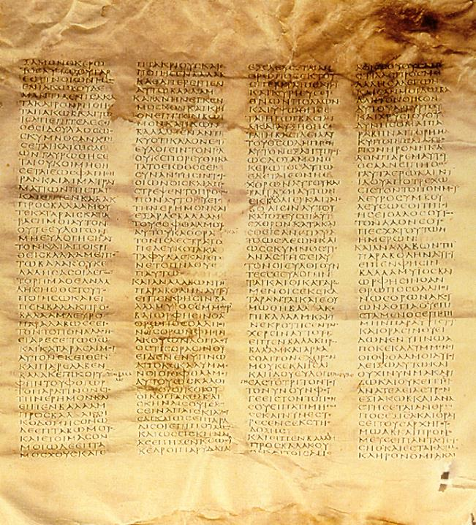
x
Codex Sinaiticus
4th century
Complete New Testament and most of the Old Testament (LXX)
Leaves 14” x 15”
48 lines per column
British Library, London

Slide 34
The LXX thus became the “Bible” of the earliest Christians.
Few people outside Palestine would have been conversant in Biblical Hebrew.
Hence, the writers of the New Testament, when quoting from the Old Testament, frequently do so from the LXX.
Paul quotes from both the LXX as well as the Hebrew Bible (but, of course, he writes in Greek).
Luke and the author of Hebrews quote exclusively from the LXX.

Slide 35
Texts of the New Testament

Slide 36
The Texts of the New Testament
As the apostles and those close to them began to compose Christian texts, they naturally did so in Greek.
Paul typically used an amanuensis, like Tertius, Sosthenes or Timothy (Ro. 16:22; 1 Co. 1:1; 2 Co. 1:1; Phil. 1:1; Col. 1:1; 1 Th. 1:1; 2 Th. 1:1; Phlm 1), though he made it a practice to sign off with his own signature (1 Co. 16:21; Ga. 6:11; 2 Th. 3:17).
We know considerably less about the process of writing lying behind the four Gospels, but early Christian testimony (Papias) indicates that Mark, at least, was a collector of the personal memories about Jesus by Simon Peter.
One fascinating feature of early Christian texts was their tendency to abbreviate sacred names with a line over the abbreviation. Presumably, this practice was to mark the sacredness of the divine name.

Slide 37
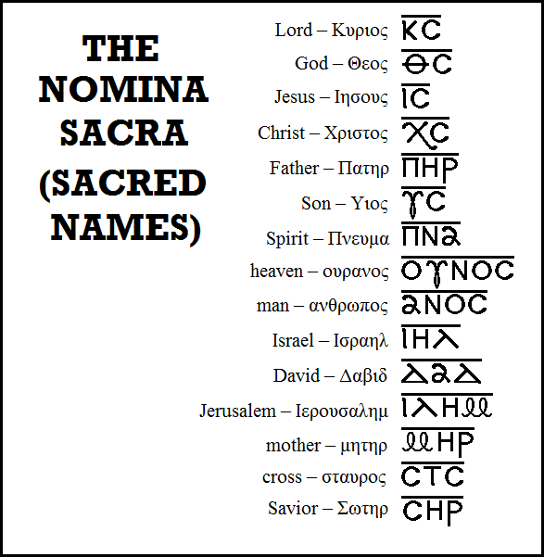
Typical Nomina Sacra found in early New Testament manuscripts.
All these abbreviations are found in Greek manuscripts of the 3rd century and earlier except “mother,” which begins to appear in the 4th century.
Bruce Metzger,
Princeton University

Slide 38
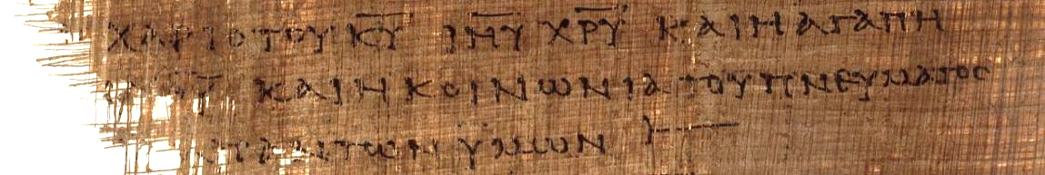
2 Corinthians 13:13 (p46)
“[The] grace of the Lord Jesus Christ and the love of [God] and the fellowship of the Holy Spirit [be] with you all.”
Here, the sacred names “Lord,” “Jesus,” and “Christ” have all been abbreviated with a line drawn over them.
KURIOU = KU = Lord
IHSOU = IHU = Jesus
XRISTOU = XRU = Christ

Slide 39

Staurograms
The earliest depictions of the cross occur in New Testament texts in which the letters tau (t) and rho (r) from the Greek words “cross” (stauroj) and “crucify” (staurow) appear superimposed on each other, looking something like this:
Beginning in NT texts from about AD 200, staurograms are the earliest visual depictions of Christ crucified.

Slide 40
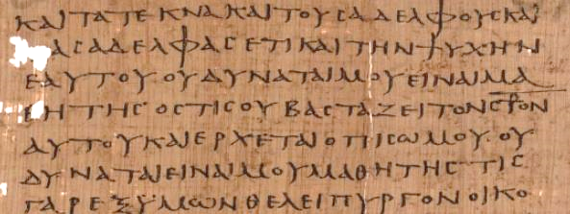
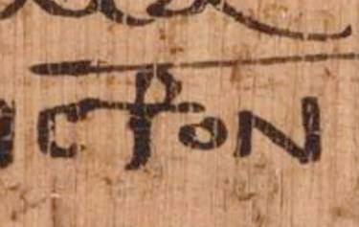
Early text of Luke 14:27 p75 Bodmer Papyri XIV (ca. AD 200-225)
Vatican Library, Rome

Slide 41
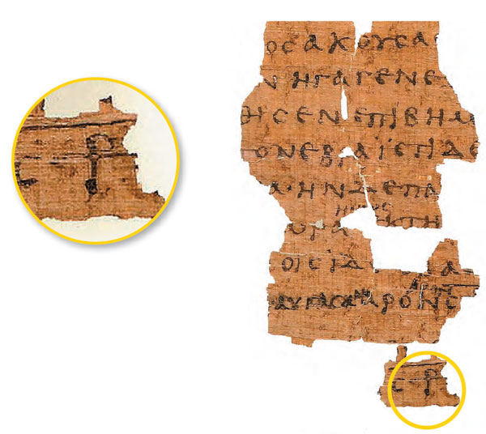
Early Text of John 19:13ff. p66
Bodmer Papyri II
(ca. AD 200)
Staurograms appears in John 19:6, 15, 16, 18, 19, 25, 31.
The superimposed letters look like a human figure hanging on a cross.

Slide 42
The Papyri of the New Testament
All extant texts of the New Testament were written on papyrus sheets and bound in a codex.
Papyrus, the inexpensive “paper” made from crushed reed stems, was typically used for writing, what John calls “papyrus and ink” (2 Jn. 12) or “ink and reed” (3 Jn. 13).
Early Christians, who bound their texts in codices, are credited with popularizing, perhaps even inventing, the codex form.
Unlike a bundle of scrolls, the codex, by necessity, necessitates a fixed order, and this fixed order was applied to both the LXX and the Christian texts.

Slide 43
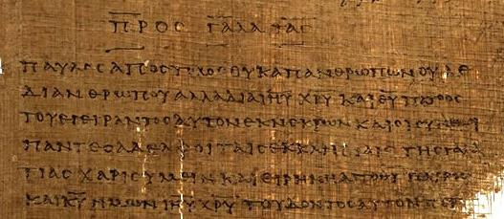
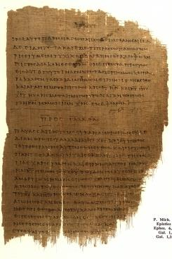
Beginning of Galatians, p46
ca. AD 200
Written on papyrus, bound in a codex
University of Michigan

Slide 44
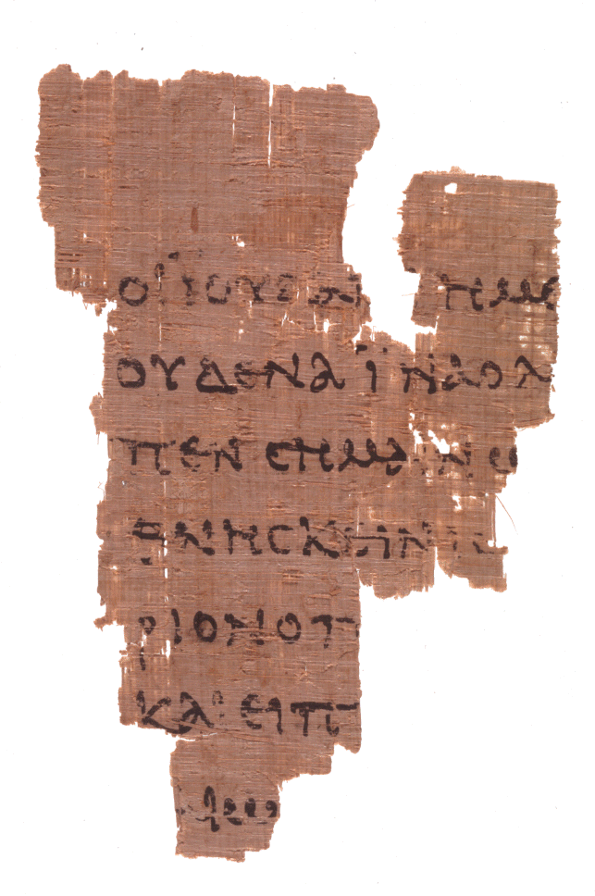
P52
John Rylands Fragment
Earliest fragment of any part of the New Testament
c. AD 125
John 18:31-33
University of Manchester

Slide 45
Fixed Order
The fixed order of a codex affected both the Old and New Testaments.
The order of books in the LXX was somewhat different than the ordering of books in the Hebrew tradition.
  For instance, in the LXX the prophetic books are generally placed last, whereas in the Hebrew tradition they fall in the middle of the Hebrew Bible.
  Ruth is placed next to Judges in the LXX, but in the Hebrew Bible it belongs to the Megilloth near the end.
Very early, the four gospels gained a fixed order which we retain today: Matthew, Mark, Luke, and John.
Paul’s letters in the early Christian lists have a varied order, though eventually they became fixed by about the 4th century.
The so-called “general epistles” also had a varied order which eventually became fixed.

Slide 46
Transcription

Slide 47
The Gentile Question Prompted One of the Earliest Christian Letters
The acceptance of the Christian message by pagans in Asia Minor raised a critical question: Did Gentiles need to become Jews in order to become Christians?
Circumcision was the religious symbol of accepting the Jewish faith, since the uncircumcised were not numbered among God’s people (Ge. 17:14).
A strong party in Jerusalem advocated that circumcision and Torah observance were necessary, and they carried this message to Antioch, Syria (Ac. 15:1, 5).
Paul and his party countered that this badge of Jewish identity was unnecessary, and he and Barnabas were sent to Jerusalem for a decision (Ac. 15:2).

Slide 48
Presentation of Cases
In Jerusalem, the apostles and elders listened to both sides.
James, the Lord’s brother, then summed up the case, citing the prophet Amos (Am. 9:11-12), whom he quoted from the LXX.
He then advised a letter to the new Gentile congregations, urging them to show respect to four particularly sensitive Jewish issues, since they would be living side-by-side with Jews (Ac. 15:19-20).
Paul and three others were appointed as couriers for the copies of this letter (Ac. 15:22-31; 16:4-5).

Slide 49
Sending Letters in Imperial Rome
While there was an imperial postal service (cursus publicus), it was not available for private mail.
Hence, private correspondence necessarily had to be sent by private courier.
The letter from the Jerusalem church was duly composed and commissioned to be carried by Barnabas and Paul, along with two other representatives of the Jerusalem church, Judas and Silvanus (Silas), who would validate the letter by personal testimony.
The four of them then were sent to Antioch, where they delivered the letter to the church.

Slide 50
Production of Paul’s Letters
Composition & Inscription
Amanuenses:
  Tertius (Rom. 16:22)
  Sosthenes (1 Cor. 1:1)
  Timothy (2 Cor. 1:1; Phil. 1:1; Col. 1:1; 1 Thess. 1:1; 2 Thess. 1:1; Phlm. 1)
Personal Signature (1 Cor. 16:21; Gal. 6:11; 2 Thess. 3:17)
Delivery & Public Reading
Personal Couriers:
  Phoebe (Rom. 16:1-2)
  Titus (2 Cor. 8:17-18; 12:18)
  Tychicus (Eph. 6:21-22; Col. 4:7-8)
Public Reading (Eph. 6:21-22; Col. 4:16; 1 Thess. 5:27)

Slide 51
Using an Amanuensis
It seems that Paul’s co-workers sometimes had a hand in the composition of his letters, since he names them as co-senders (1 Co. 1:1; 2 Co. 1:1; Phi. 1:1; Col. 1:1; Phlm 1; 1 Th. 1:1; 2 Th. 1:1).
While the mention of these co-senders is sometimes taken to be a mere formality, it seems more likely that they may have been involved in at least the conception of the letters if not their actual composition.
Similarly, the excellent Greek style in the composition of 1 Peter may be credited to Silas, who was Peter’s amanuensis (1 Pe. 5:12).

Slide 52
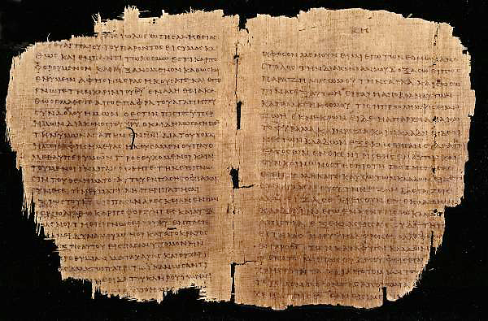
What Paul’s Letters May Have Looked Like p46 (Chester Beatty Papyri Collection, Dublin): Romans 11: 13-22 and Colossians 1: 5-12, c.AD 200

Slide 53
Paul’s Epistolary
Style
THE PAULINE PATTERN
Opening
Paul, an apostle…to the saints…
Thanksgiving
Greeting…grace and peace
(xai<rein changed to xa<rij)
Body
Central concern and communication
Paraenesis
Indicative and imperative moods (you are…so behave in this way)
Closing
Benediction
Letter-writing in the Greco-Roman world followed stylistic conventions.
Handbooks on letter theory were available as guides to differentiate between business letters, official letters, public letters and discursive letters.
Paul’s letters follow to a large degree the conventions of the times, but he also freely adapted those conventions to suit his own purposes.

Slide 54
Making Copies
To share letters or to exchange letters entailed making copies.
It would be normal for the writer to preserve copies for himself.
It is reasonable to assume that Paul’s collection of his own letters became the impetus for the copying of his letters into early collections of seven, ten, and thirteen letters, as we find them in early Christianity.
As such, the reference to “all Paul’s letters” (2 Pe. 3:15-16) demonstrates that his correspondence was known and collected at a very early period.
By the mid-2nd century, Marcion attests to the collected letters of Paul.

Slide 55
The Gospels
While the four gospels were composed later than the life of Paul and copies of them somewhat later still, at least some information is available.
Papias (ca. AD 110) writes that Mark’s Gospel was composed from the memories of Simon Peter. He also is familiar with Matthew.
Luke mentions some early compositions concerning the life of Jesus but now no longer extant (Lk. 1:1).
Most scholars conclude that Matthew and Luke used Mark’s Gospel as a basic source due to the large blocks of material that are in the same order and in many cases nearly verbatim.
This all presupposes the existence of copies of texts being widely circulated among the early Christians, and indeed, by the early 2nd century, were known to non-Christians as well (cf. Trypho, etc.).

Slide 56
Publication

Slide 57
Factors for Publication
In antiquity, different factors lay behind the publication of texts as compared with the modern world.
All texts were handwritten.
Relatively few people were literate.
Financial incentives were largely absent.
Production and use of literature were largely private.
There was nothing resembling the modern copyright.

Slide 58
Making a Work Public
Several ways lay open to authors who wished to make their work public.
Groups could be assembled for a public reading: texts were made public, not merely by distributing copies, but by oral performance.
Several copies could be made at the author’s own expense (or at the expense of a patron, cf. Lk. 1:1-4; Ac. 1:1-2) and then distributed to friends.
Once copies were made under the author’s immediate supervision, further personal control over the text was now surrendered (though the author might keep an exemplar for personal reference).

Slide 59
Paul’s Instructions
“After this letter has been read to you, see that it is also read in the church of the Laodiceans and that you in turn read the letter from Laodicea.”
St. Paul, Colossians 4:16
Mid-1st Century
“I charge you before the Lord to have this letter read to all the brothers.”
St. Paul, 1 Thessalonians 5:27
Mid-1st Century

Slide 60
Making Copies
Each handmade copy was unique.
All reading, public or private, as done aloud in antiquity. A copyist visually copying a text would do so by reading it aloud to himself (cf. Ac. 8:30).
In principle, copies became public property and disseminated without regulation through an informal network of interested people.
Hence, texts made their way into general circulation gradually, slowly, and somewhat haphazardly.
On occasion, some texts might be forgeries to which a genuine author would be at some pains to correct.
Paul made it his practice, even though he used an amanuensis, to sign off in his own hand.

Slide 61
Paul and Forgeries
“…we ask you, brothers, not to become easily unsettled or alarmed by some prophecy, report or letter supposed to have come from us...”
St. Paul, 2 Thessalonians 2:1b-2a
Mid-1st Century
“I, Paul, write this greeting in my own hand.”
St. Paul, 1 Corinthians 16:21
Mid-1st Century
(cf. Ga. 6:11; 2 Th. 3:17)

Slide 62
Textual Variants
Even with the greatest care, mistakes in transcription are inevitable in any hand-copied text.
Most variants occurred unintentionally, and almost all of them were the same kinds of mistakes for the same reasons: errors of hearing, inadvertent omissions or additions, transpositions, and misspellings.
Occasionally, scribes made intentional changes to improve the language, clarify the sense, create harmony with other passages, or alter a text for theological reasons, usually with the assumption that they were rectifying the error of a previous scribe.

Slide 63
Mistakes During Dictation
Multiple copies could be made by dictation if enough copyists were available.
Such a practice explains what appear to be errors of hearing in some of the Greek manuscripts of the New Testament.
Especially when two words sound alike, when read orally the copyist was vulnerable to phonetic errors.

Slide 64
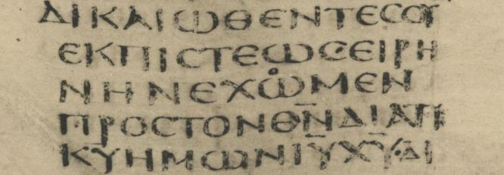
Mistake of Hearing
Romans 5:1
Codex Sinaiticus
Romans 5:1
Two words, e@xwmen (subjunctive) and e@xomen (indicative) are easily confused orally, since the difference in pronunciation between w and o was almost non-existent.
The Greek manuscripts of the New Testament have both readings, though most scholars opt for e@xomen.
If e@xwmen, then it reads “Let us have peace…”
If e@xomen, then it reads, “We have peace…”
Codex Sinaiticus originally had e@xwmen but a later scribe corrected it by adding a small “o” over the w.
The difference is probably an error of hearing during dictation.

Slide 65

Mistake In Word Division
__________________________
1 Timothy 3:16
o[mologoumenwjmega
Two word divisions are possible:
o[mologou?men w[j me<ga (= “we acknowledge how great…”)
D CODEX Claromontanus (4th century)
o[mologoume<nwj me<ga (= “confessedly great…”)
X CODEX SINAITICUS (4th century)
______________________

Slide 66
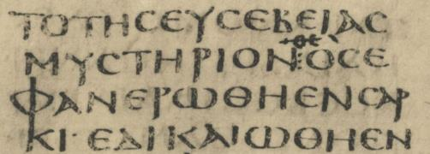
Confusion of Letters
1 Timothy 3:16
QC (abbreviation for qeo<j) e]fanerw<qh e]n sarki<… (“…God was manifested in flesh…”
OC e]fanerw<qh e]n sarki<… (= “…who was manifested in flesh…”)
A corrector has written in QC over the original text OC.
X CODEX SINAITICUS (4th century)

Slide 67
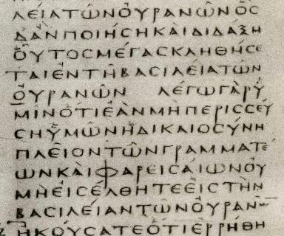
Similar Endings
______________________
Matthew 5:19b-20
The scribe’s eye moves from one group of letters in the exemplar to a later similar group of letters while inadvertently skipping a section in the middle.
__________________
B CODEX VATICANUS (4th century)

Slide 68
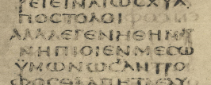
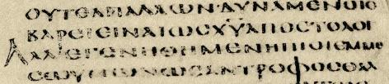
Inadvertently Dropping A Letter
1 Thessalonians 2:7
…e]genh<qhmen nh<ptioi… (= “…we became infants…”)
…e]genh<qhmen h@ptioi... (= “…we became gentle…”)
The problem, of course, is that the ending letter of the previous word and the beginning letter of the succeeding word are the same.
_______
X CODEX SINAITICUS (4th century)
______
A CODEX ALEXANDRINUS (5th century)

Slide 69

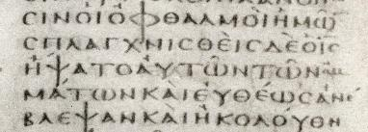
Error of Memory
Matthew 20:34
… ]Ihsou?j h!yato tw?n o]fqalmw?n au[tw?n. (“…Jesus touched their eyes.”)
…’Ihsou?j h!yato tw?n o]mma<twn au]tw?n. (“…Jesus touched their eyes.”)
Here, the problem is synonyms. Both words mean “eyes,” but they are different words.
__
_______________
__
X CODEX SINAITICUS (4th century)
__________
B CODEX VATICANUS (4th century)

Slide 70
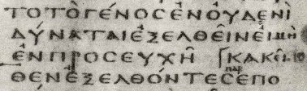

Additions
Mark 9:29
…proseux^?. (= “…prayer.”)
…proseux^? kai> nhstei<%. (= “…prayer and fasting.”)
________________
B CODEX VATICANUS (4th century)
_______________
__________________
A CODEX ALEXANDRINUS (5th century)

Slide 71
AUTOGRAPHxxxxxxxxxxxxxxxxxxxxxxxxxxxx
1st Century
2nd Century
3rd Century
4th Century
5th Century
EGYPT
COPY
xxxxxxxxxxxxxxxxxxxxxxxxxxxx
ITALY
COPY
xxxxxxxxxxxxxxxxxxxxxxxxxxxx
PALESTINE
COPY
xxxxxxxxxxxxxxxxxxxxxxxxxxxx
COPY
xxxxxxxxxxxxxxxxxxxxxxxxxxxx
COPY
xxxxxxxxxxxxxxxxxxxxxxxxxxxx
COPY
xxxxxxxxxxxxxxxxxxxxxxxxxxxx
COPY
xxxxxxxxxxxxxxxxxxxxxxxxxxxx
COPY E
xxxxxxxxxxxxxxxxxxxxxxxxxxxx
COPY F
xxxxxxxxxxxxxxxxxxxxxxxxxxx
COPY A
xxxxxxxxxxxxxxxxxxxxxxxxxxxx
COPY B
xxxxxxxxxxxxxxxxxxxxxxxxxxx
COPY C
xxxxxxxxxxxxxxxxxxxxxxxxxxxx
COPY D
xxxxxxxxxxxxxxxxxxxxxxxxxxxx
COPY G
xxxxxxxxxxxxxxxxxxxxxxxxxxxx
Slight variations get passed down through subsequent copies as texts are copied and shared.

Slide 72
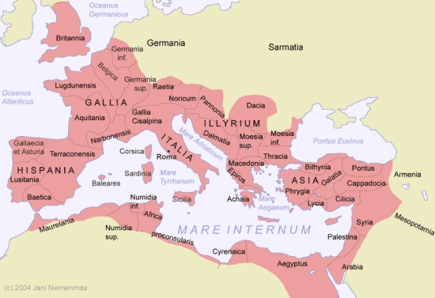
GEOGRAPHICAL TEXTUAL FAMILIES
Western Text
Byzantine Text
Alexandrian Text
Caesarean Text

Slide 73
Circulation

Slide 74
Factors for Circulation
Texts were circulated between congregations more often than between individuals.
Christian groups had different language bases, Greek, Latin, Aramaic, Syriac, and Coptic, among others, so translation work began quite early.
Some texts were intended for more than a single audience, such as, “all [the house churches] in Rome” (Ro. 1:7), the “churches of Galatia” (Ga. 1:2), possibly Ephesians (Ep. 1:1, some early manuscripts do not say “in Ephesus” leading to the theory of a circular letter), the “twelve tribes scattered among the nations” (Ja. 1:1), God’s “scattered” elect (1 Pe. 1:1), and the “seven churches of Asia” (Rev. 1:4, 11).
Multiple recipients would require multiple copies, and the couriers might well have been responsible for such copies.

Slide 75
Early Translations
As early as the 2nd century, the texts of the New Testament began being translated into vernacular languages.
Christian missionaries translated biblical texts into local languages wherever Greek would not serve the needs of the people.
These early translations include:
  Old Latin (predating Jerome’s Latin Vulgate) – 4th Century
  Syriac – 3rd and 4th Centuries
  Coptic – 3rd Century
  Armenian – 5th Century
  Georgian – 5th Century
  Ethiopic – 5th Century

Slide 76
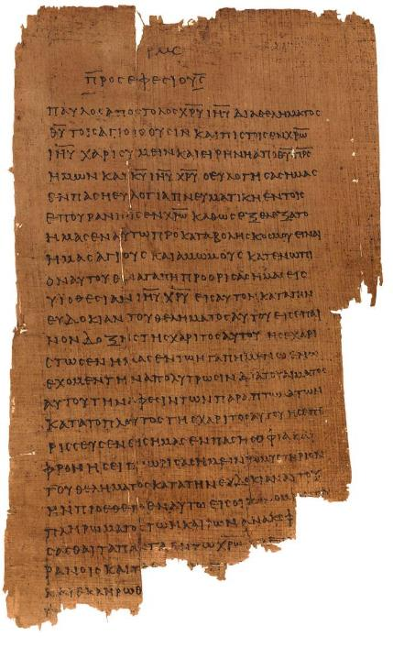
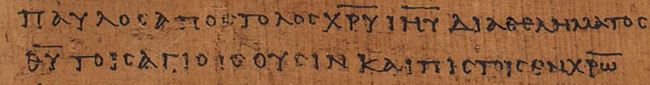
Ephesians 1:1 p46
Chester Beatty Papyri ca. AD 200 earliest copy of the Ephesian letter
(University of Michigan, Hatcher Library)
“Paul, an apostle of Christ Jesus through [the] will of God to the holy ones who are also faithful in Christ…” (1:1)

Slide 77
Sending Letters
Colleagues like Tychicus, Phoebe, and Titus, among others, were commissioned by Paul to carry his letters. This accounts for his recommendations (e.g., Col. 4:7-8; Eph. 6:21; Rom. 16:1-2).
Letters typically had internal references to the courier as a confirmation of his/her trustworthiness.
As the writer’s personal representative, the courier would read the letter publicly, explain any difficult parts. and share news of the sender (Ep. 6:21-22; Col. 4:16; 1 Th. 5:27; cf. Re. 1:3, 9; 22:7, 18-19).
Paul also began the process of sharing his letters among other congregations (Col. 4:16).
There was no public postal system in the Roman Empire nor were there commercial passenger vessels, so sending letters required a personal courier, the purchase of a booking on a commercial vessel, and the responsibility for travel expenses of food and lodging.

Slide 78
The Importance of Broad Circulation
In the absence of controlled transmission, an ancient text acquired stability by the broad circulation of enough copies to establish a consistent textual tradition.
For some Christians, the many manuscripts of the Greek New Testament (with some variants) seems threatening.
Actually, the reverse should be true. The many manuscripts of the Greek New Testament (even though with some variants) point to a broad textual tradition that was considered trustworthy in all parts of the Roman world.

Slide 79
A Religion Oriented Toward Texts
Unlike all other religions in the Roman world save Judaism, Christianity was oriented toward texts.
Not all Christians could read, of course, but in public reading, all Christians could listen.
Texts, therefore, were essential to the life of a Christian congregation.

Slide 80
The “Ecclesia Katholike”
The geographic dispersion of Christian communities and their close relationship with each other created a network which was ideally suited for the dissemination of texts.
Very early, the “church catholic” was now to be found across Syria, Asia Minor, Greece, and Italy in most major urban cities.
By the 2nd century, it had begun to penetrate Egypt, Gaul, and North Africa.
Though the circulation of texts was slow by modern standards, it was quite rapid by ancient ones.

Slide 81
Early Canon Lists
The impetus for establishing a New Testament canon of Scripture was initiated by the heretic Marcion in Rome (c. AD 144), who eliminated the Old Testament entirely and much of the New Testament, retaining only part of Luke and ten letters of Paul.
After Marcion’s heresy, several canon lists begin to appear by various church leaders. Indeed, the initial nuance of the word “canon” was list.
While most of the lists contained most of the documents of the New Testament, and all were widely read, a handful of books were disputed in some regions: Jude, 2 Peter, 2 and 3 John, Revelation, Hebrews.

Slide 82
Early Christian Libraries

Slide 83
Churches and Synagogues
The collection of sacred books by Christians for public reading can hardly be understood outside the liturgical practice of the synagogues.
Synagogues had a receptacle or “chest of books” (tebah shel sepharim) where sacred texts were stored, and these texts were read publicly as part of the synagogue service (cf. Lk. 4:16-17).
2nd Temple sources speak of a “house of the book” (bet sepher) or “house of study” (bet midrash) in connection with synagogues.
Similarly, Cave 4 at Qumran is thought by some scholars to be the main library of the community, not merely a hiding place.
If Christians followed this pattern, and presumably they did, then congregational “libraries” would have been widespread from a very early period.

Slide 84
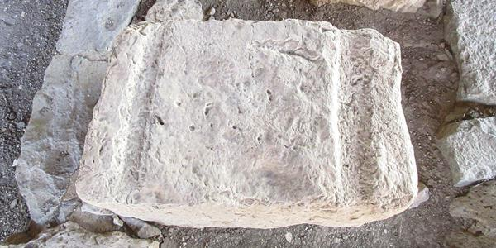
One of two limestone blocks with grooves discovered in one of two synagogues discovered at Magdala: the grooved stones may have been used as reading surfaces for the scrolls, and the grooves may have held wooden dowels used as rollers on either end of the scroll.

Slide 85
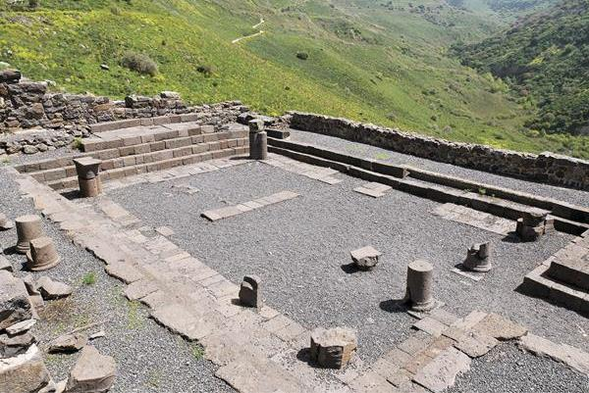
The excavated remains of the synagogue in Gamla show the basic layout with stepped benches on four sides of the assembly hall and columns supporting a clerestory ceiling.
The receptacle for texts would have been placed on a wall facing Jerusalem.

Slide 86
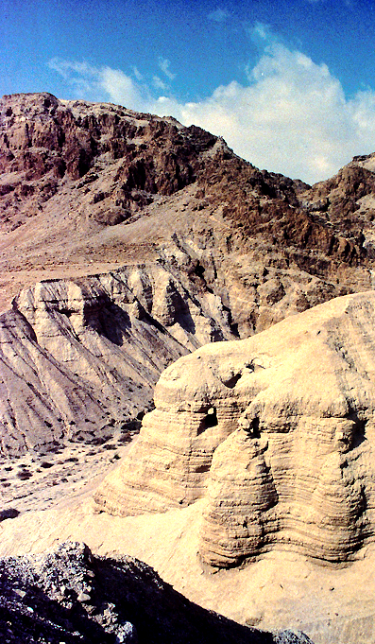
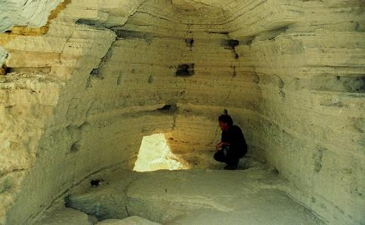
Cave 4 at Qumran
Viewed from the terrace directly south of the Qumran buildings (right) and from inside the cave (above), the entrance to Cave 4 can be seen on the side of the marl rib of the terrace wall jutting out to the south over the wadi floor below. While debatable, the reasons as to why this might have been the main library, as opposed to just a hiding place, are:
Cave 4 is the one closest to the buildings and settlement area.
It is the only cave among all the others to house a large number of manuscripts, many more than any other cave.
On the walls of the cave are man-made holes that would serve to anchor wood shelving.
No jars were found in this cave.

Slide 87
Receptacle for Texts
An early reference (ca. 180) refers to a Christian with a “book bucket” (Greek teuchos) made of wood or canvas for portability.
It contained the “books and letters of Paul.”
Other references in the late 2nd century speak of collections of books.
This sounds very similar to synagogue practice.

Slide 88

Titles
It is likely that titles, such as, titles for the four gospels, came into being in connection with congregational collections; such titles start to appear in the early 2nd century.
Originally, the gospels had no titles, but adding titles would then distinguish one gospel from another.
The typical form of the title was “the gospel according to…”
The manuscript of p75 (ca. 200) contains the title “[the] gospel according to John.”

Slide 89
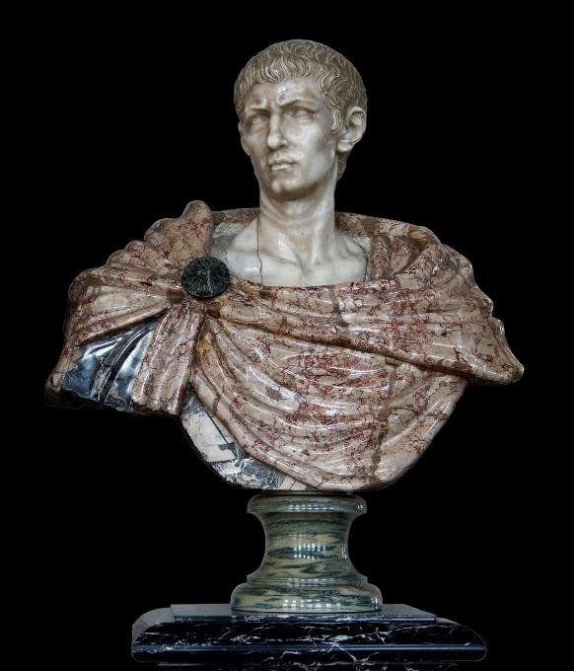
Congregational Libraries
Over time, congregations accumulated various texts that eventually would make up the New Testament.
These “libraries” are directly described in connection to the persecutions of Emperor Diocletian (303-312), who ordered that all Christian texts be confiscated and burned.
Such texts included codices and parchments and a “Great Book” (probably the four gospels).

Slide 90
Emperor Diocletian’s purge suggests some important aspects about Christian texts.
He took it for granted that such texts were essential to Christianity’s viability.
Hence, he sought the most direct means for undermining Christianity by aiming his edict at destroying their texts.
He could assume that every Christian community had a collection, and his purge aimed at wiping it out.
The Donatists (a Christian sect in North Africa) regarded handing over Christian texts to the authorities as a repudiation of the faith, and those who did so were branded as “surrenderers” (traditores) and stripped of their ecclesiastical authority.

Slide 91
Reading and Readers

Slide 92
Reading Aloud
As mentioned earlier, all reading in the ancient world was done aloud, whether publicly or privately (cf. Ac. 8:26-31).
This means that New Testament texts were written as much for the ear as for the eye.
Since the texts were written with no word divisions, sentences, paragraphs, or punctuation (scriptio continua), the reader was obliged to deconstruct the text into these basic literary units, much the same way that listeners must deconstruct spoken language when they hear it.
Out of this there developed a tradition for deconstruction, which in turn led to the eventual written word divisions, paragraphing, punctuation, and so forth to which we are now accustomed.

Slide 93
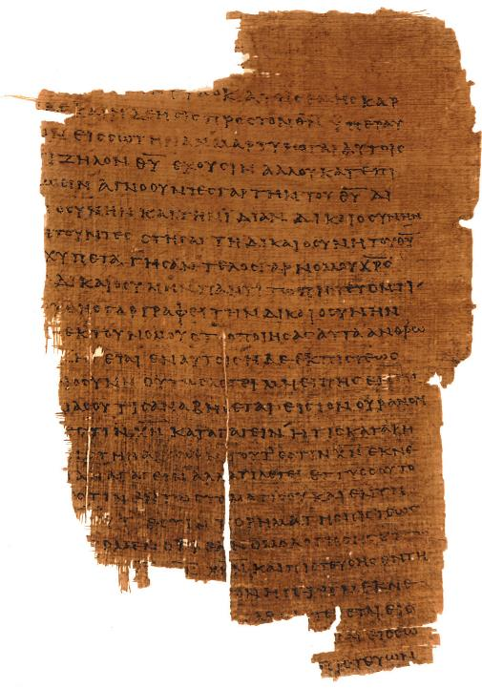
scriptio continua
A good example of scriptio continua, this page from p46 (Ro. 10:1-11) would require the readers to decipher:
Word divisions
Sentence structure and punctuation
Paragraphing

Slide 94
The Task of the Reader
Several factors affected the reading of Scripture:
By the late 2nd century, a specific title emerged for the readers (anagnostes or lector). Functionally, this became a lower church office.
Good public reading required familiarity with the text in order to avoid halting, tentative, or misleading readings.
It is likely that readers would rehearse their readings privately (aloud) in advance of a public reading. Hence, lectors often kept the texts in their homes, as indicated in the Diocletian purge.
Public readings of Scripture then held a central place in the Christian worship service.

Slide 95
What Was Read
There seem to have been regional variations in the choice of readings in Christian worship.
Justin Martyr (early 2nd century) speaks of two lessons, “…the memoirs of the apostles” and “the writings of the prophets.”
By the 4th century, the Antiochene church took two lessons from the Old Testament (law and prophets), and two from Christian Scripture (Acts/epistles and Gospels).
Western liturgies had one lesson from the Old Testament and two from the New.
In Rome, there were two lessons, both from the New Testament (epistles and Gospels).
In all cases, the gospel readings were the climax and reserved as last.

Slide 96
Manner of Reading
Certain protocols became the norm for public reading in the Christian worship service.
Following Jewish precedent, the reading was conducted from a raised platform (pulpitum), and the reader stood facing the congregation (cf. Ne. 8:3-4).
In time, the podium for reading was situated off-center.
Often, the reading would have a singing quality or chant, which amplified the voice while producing a solemnity of style.
A gradual development during the 2nd and 3rd centuries was to read the Psalms in musical form, and by the 4th century the singing of psalms was an established element in Christian worship.

Slide 97
Irenaeus (AD 130-202) on the reading of 2 Th. 2:8
“If then one does not attend to the [proper] reading [of the text] and if he does not exhibit the intervals of breathing as they occur, there will be not only incongruities but he will utter blasphemies when reading, as if the advent of the Lord could take place according to the working of Satan.”

Slide 98
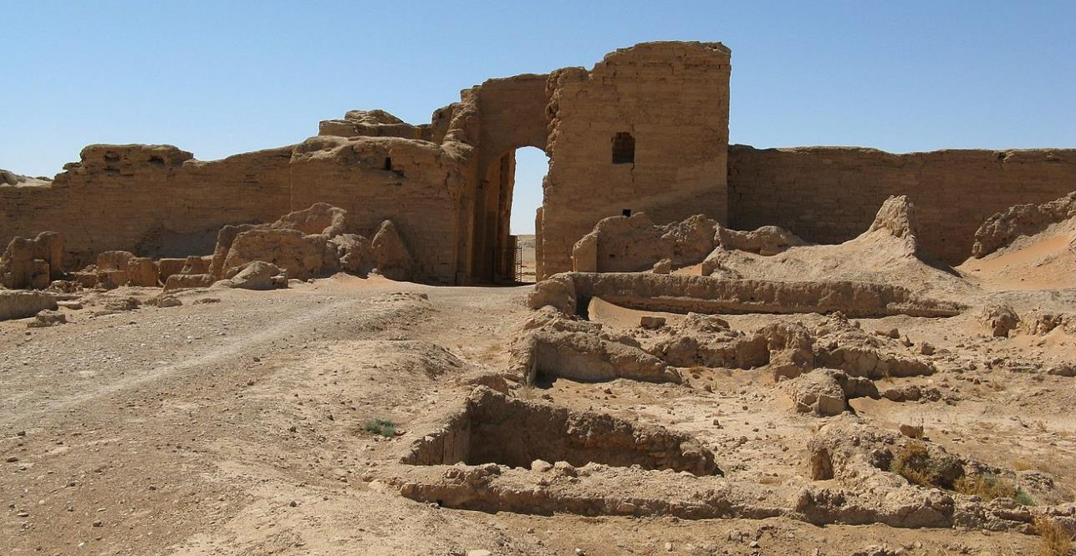
Dura Europos House Church

Slide 99
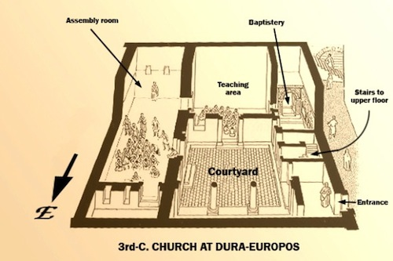
Dura Europos House Church
(ca. AD 241)
Built on a high cliff above the Euphrates River at a crossroads between Damascus and Baghdad, this is the earliest Christian church discovered to date (discovered in 1920). It was converted from a private house to a church.
Notice the raised platform area for reading and teaching. It also contains a baptistery, assembly room, and courtyard.

Slide 100
Parallel Readings
Some early manuscripts feature columns in Greek and parallel columns in Latin (or another language). Sometimes the two languages were written on facing pages.
This suggests a double reading, first in its original language and then in its translation.
This double reading would be similar to synagogue readings, where the Torah was read first in Hebrew followed by a reading from an Aramaic targum of the same passage.

Slide 101
Discussion:
Is the public reading of Scripture as important today as in ancient times?
What might be the advantage of using a lectionary for public reading?
Does it surprise you that the earliest canon list for the New Testament, exactly as we have it today, comes as late as AD 367 (Athanasius’ Paschal Letter)?

Slide 102
Discussion:
Jesus never wrote texts nor did he instruct his followers to do so. Why do you think they began this writing process?
What are the implications of Peter’s words about Paul’s letters in 2 Peter 3:15-16?
Given the hazards of travel in the ancient world, what challenges might face a courier carrying a letter?

Slide 103
Discussion:
How might a fixed order of the Old Testament books affect the way they are understood?
What about the fixed order of the New Testament?

