Slide 1
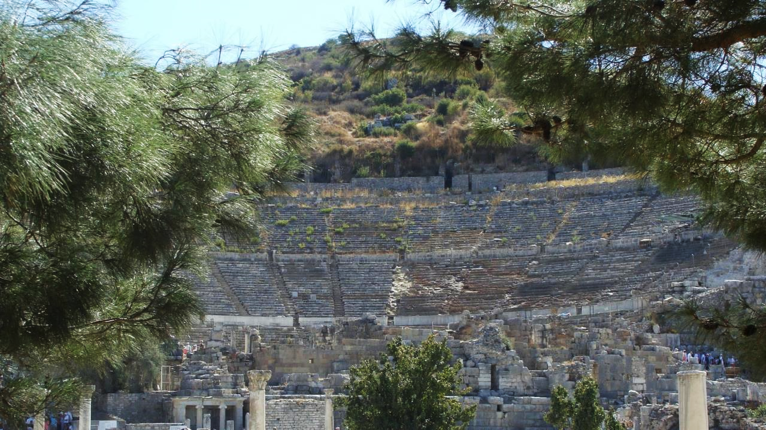
NT ARCHAEOLOGY
NT ARCHAEOLOGY
THE PASSION
Lesson 7
Lesson 1
Introduction

Slide 2
The Trial of Jesus Proceeded in Two Stages with Different Indictments
The Jewish Stage
Preliminary examination before Annas (John)
Appearance before Caiaphas (all four gospels)
Condemnation by the Sanhedrin (Synoptics)
Indictment
Blasphemy
The Roman Stage
First appearance before Pontius Pilate (all four gospels)
Appearance before Herod Antipas (Luke)
Final appearance before Pilate (all four gospels)
Indictment
Treason

Slide 3
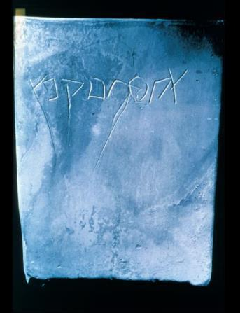
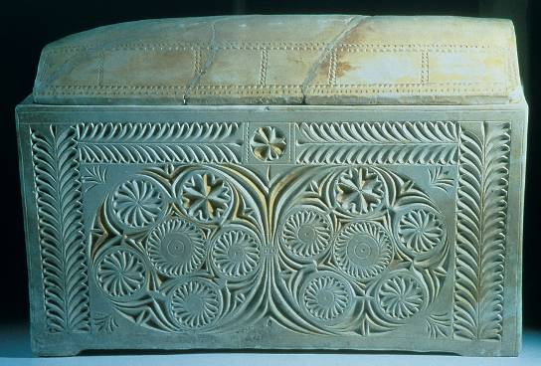
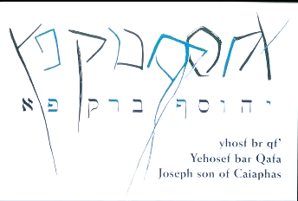
THE CAIAPHAS OSSUARY
In 1990 an ancient tomb chamber was discovered containing several ossuaries (bone boxes for second burial). Among them was an ossuary inscribed with the name “Joseph bar Caiaphas,” almost certainly the same Caiaphas in the gospels whom Josephus calls “Joseph Caiaphas.”

Slide 4
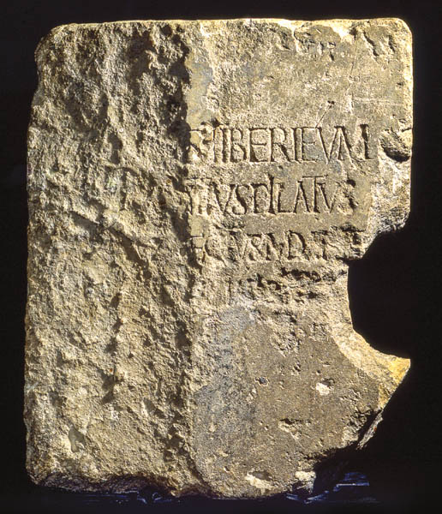
Found in the 1st century theater at Caesarea Maritima in excavations in the early 1960s, this inscription block had been used as a step in the theater during repairs in the Roman Period. Originally, however, it had been part of a dedicatory plaque for a Tiberium, a temple erected in honor of Emperor Tiberius, who ruled Rome from 14-37 AD.
The reconstructed inscription reads: “Pontius Pilate, the Prefect of Judea, has dedicated to the people of Caesarea a temple in honor of Tiberius.” On this portion of the plaque one can see in the top line the word [T]IBERIUM, in the second line [ ]IUS PILATUS, and in the third line CA[E]SAR[EA].

Slide 5
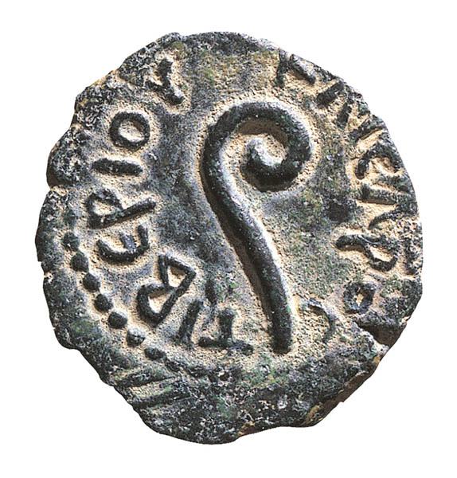
This coin minted in Jerusalem by Pontius Pilate bears the curved wand, a ritual instrument associated with the Roman imperial cult. The name “Tiberiou” (= of Tiberius) can be seen on the lefthand side.
This overt reference to Tiberius suggests Pilate’s dedication to promoting Roman religion in Judea, and if so, it explains the sting in the accusation made by the Sanhedrin, “If you let this man go, you are not Caesar’s friend” (Jn. 19:12).

Slide 6
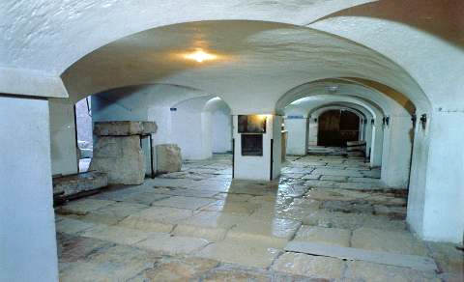
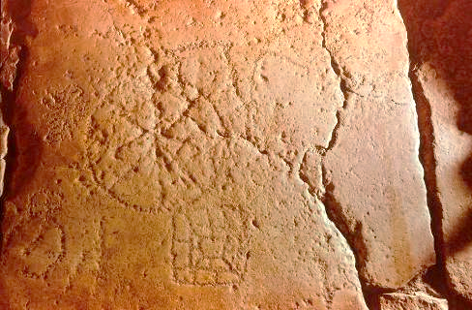
The game Basilikos (= the king) consisted of a square box formed by a spiraling string of smaller boxes. The opponents’ markers are advanced by the throw of dice in a race to storm the king’s tower at the center.
It has been suggested that the mocking of Jesus included using him as a human game piece. Just such a game was found etched into an early pavement beneath the Sisters of Zion Convent, though most archaeologists now believe the pavement dates to the time of Hadrian, a century or so later, and if so, would not be directly connected to Jesus’ trial.
Dice game etched into the pavement beneath the Sisters of Zion Convent

Slide 7
Then the Jews led Jesus from Caiaphas to the palace of the Roman Governor. By now it was early morning, and to avoid ceremonial uncleanness the Jews did not enter the palace… So, Pilate came out to them…
John 18:28-20
Pilate then went back inside… (18:33)
With this, he went out again… (18:38)
Once more Pilate came out… (19:4)
And he went back inside… (19:9)
When Pilate heard this, he brought Jesus out… (19:13)

Slide 8
The Hearing Before Pilate (Jn. 18:28—19:16a)
The Roman Prefect had the final decision in matters of execution (18:31b; 19:10), and this policy is corroborated by Flavius Josephus (Antiquities xviii.1.1).
Because it was the day before Passover, the Sanhedrin representatives could not enter a gentile’s residence without ceremonial defilement: hence, John describes the “back and forth” movements of Pilate to speak with them (18:29, 33, 38; 19:4-5, 9, 13).
Pilate seemed to suspect that this issue was more religious than political, which explains his reluctance to give an execution order. Jesus might be a religious eccentric, but he was no threat to Rome, and Pilate knew it.

Slide 9
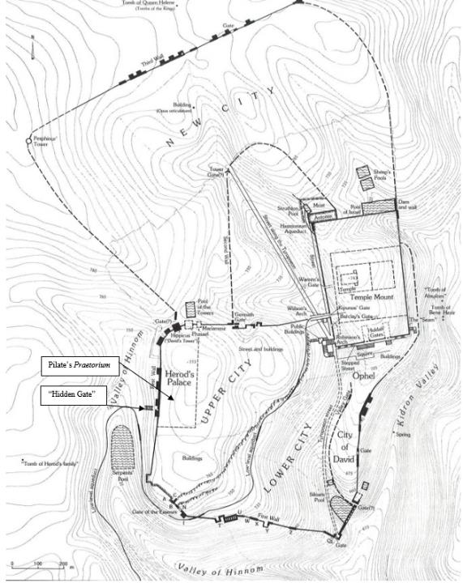
After the Sanhedrin had reached a guilty verdict, the members had to go to Pilate for an execution order, hence, the second stage of Jesus’ trial.
This hearing, early on Friday morning, was held on the day the lambs were to be slaughtered (Jn. 18:28), and the members of the High Priest’s coalition would not enter the praetorium, where normally Pilate would preside, at the risk of ceremonial uncleanness. Hence, some way of arguing their case had to be found that permitted access to Pilate without actually entering his residence. A small, hidden courtyard answered their needs perfectly.

Slide 10
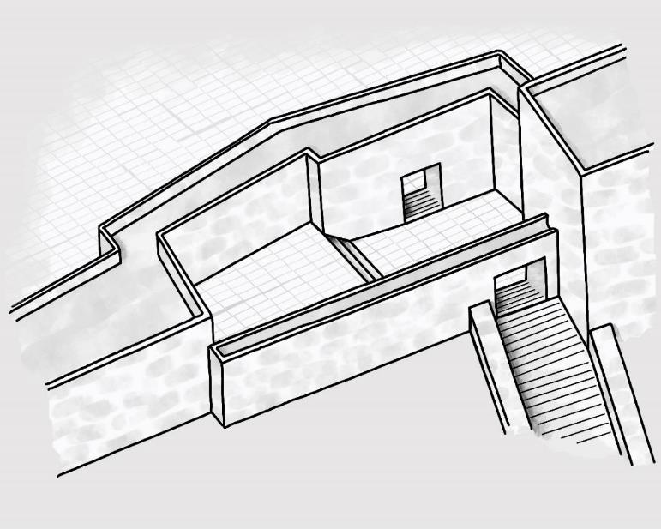
RECONSTRUCTION OF THE HIDDEN (ESSENE) GATE
Scholars today believe they have found the location of Pilate’s interaction with the High Priestly faction. John’s Gospel clearly describes the “in” and “out” movements of Pilate from the praetorium and back into it (allowing him to converse with the priests without them risking defilement by entering a Gentile residence).
If so, his interaction with the priests would have occurred in the small courtyard between an inner and outer gate.

Slide 11
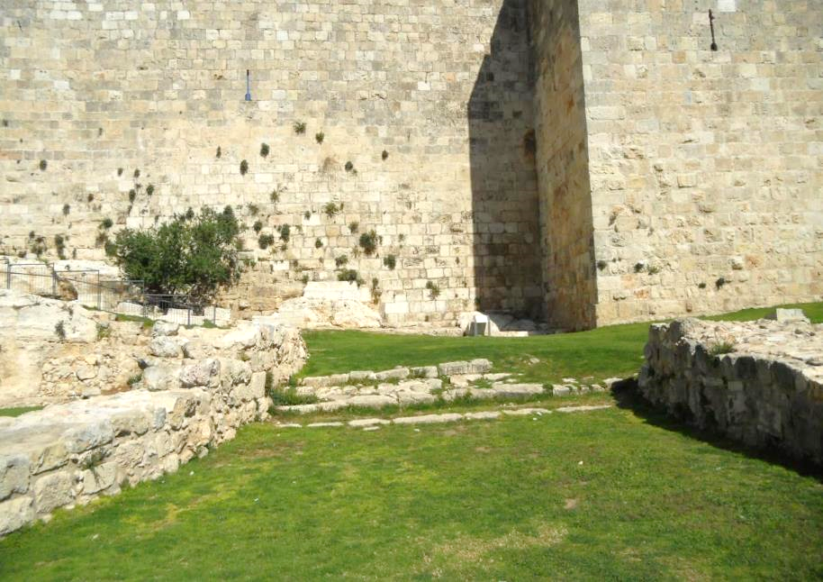
Pilate would have placed his sella curula (official seat of judgment) at the top of the stairs leading to the inner door.
The priests would have assembled in the courtyard.
Jesus would have been held just inside the threshold of the inner door.
Inner Staircase
Courtyard
Outer Staircase
Mark Smith photo

Slide 12
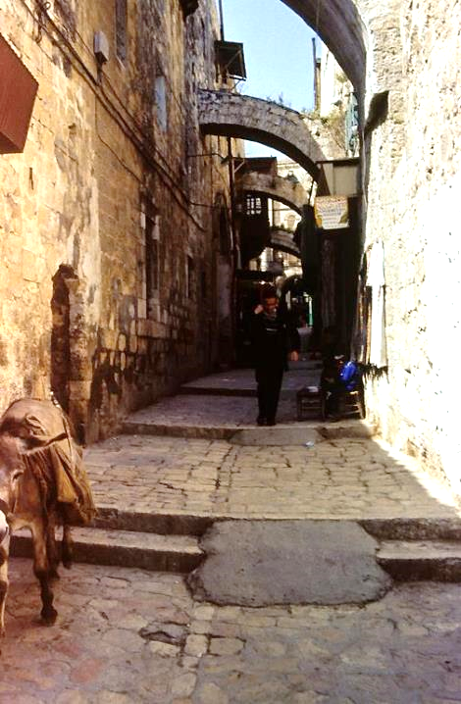
The Via Dolorosa (way of suffering)
This is the traditional route of Jesus’ painful procession to Calvary, following the 14 Stations of the Cross and ending at the Church of the Holy Sepulcher.
Much of Jerusalem has changed after the destruction of the city by the Romans in AD 70 and AD 134 and the Muslim occupation since the 7th century. The present street, even if correct, is several feet higher than the ancient street in the 2nd Temple Period.

Slide 13
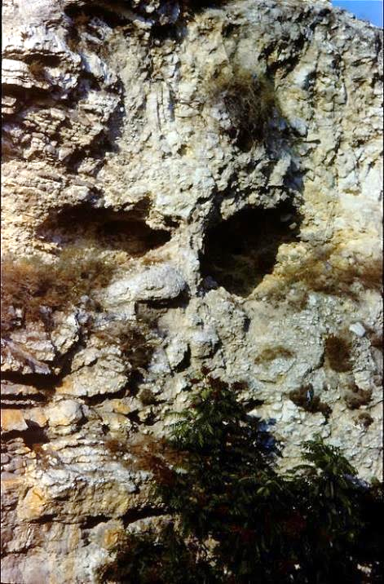
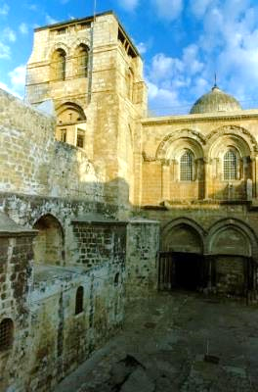
Locating Calvary
The exact site of the crucifixion has been elusive, exacerbated by the destruction of the city in AD 70 and its rebuilding by Hadrian in the 2nd century. Two primary sites have been defended (as well as several that are less popular), Gordon’s Calvary and the Church of the Holy Sepulcher. The only clear identity marker in the gospels is that it was outside the city wall (Mt. 19:20; cf. He. 13:12-13).
Gordon’s Calvary (left) was identified by British General Charles Gordon for mystical reasons. The shape of the hill somewhat resembles a skull.
The Church of the Holy Sepulcher (right) has the best attestation in antiquity (Eusebius and Jerome). In general, the question is still open.

Slide 14
The Crucifixion
Roman crucifixions generally consisted of three parts:
Scourging (there was no limit to Roman flogging as there was in Judaism)
Carrying the patibulum (cross-piece) to the site of execution, usually with the titulus (inscription with charges) hung about the victim’s neck
Nailing (or tying) and lifting: crosses could be T-shaped (crux commissa) or dagger shaped (crux immissa). Also, crosses typically had a sharp projection that fit beneath the pelvis and helped suspend the weight of the body (sedile). Sometimes they also had a foot support (suppedaneum)
Death was by shock or gradual asphyxiation as the lungs collapsed and the victim could no longer raise himself in order to breath. Breaking the legs of the victims would hasten asphyxiation. For more clinical-medical details on crucifixion, see W. Edwards, W. Gabel and F. Hosmer, Journal of the American Medical Association (March 21, 1986), pp 1455-1463.

Slide 15
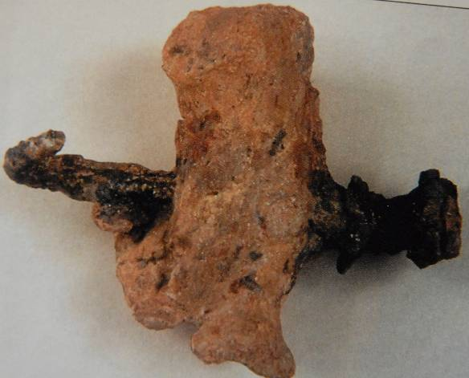
Although thousands of prisoners and slaves were crucified in antiquity, the remains of only one victim so far have been discovered in Israel, a Jewish male from about the mid-1st century AD.
Excavated in 1986 in Jerusalem, the remains of this man of about 24-28 years old were found in an ossuary that named him as Yehohanan.
His heel bone was transfixed sideways by a single spike, which had sunk deep into a knot so that the only way to remove the body from the cross was to amputate the feet.

Slide 16
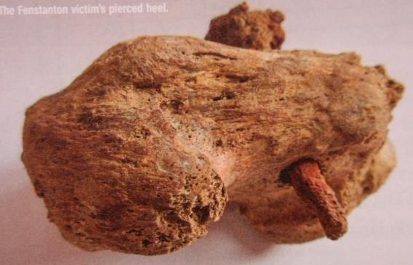
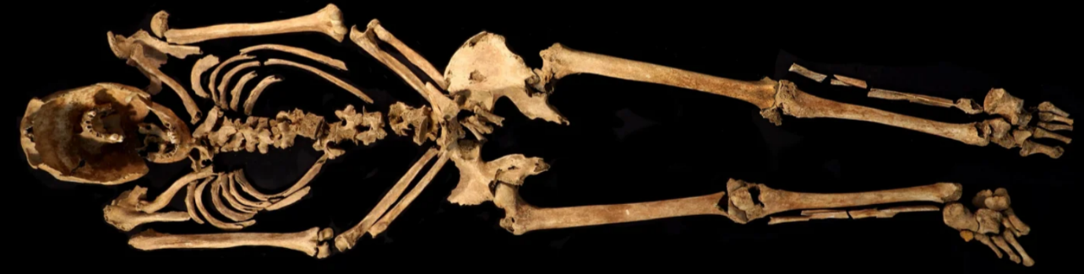
Another artifact from Roman crucifixion, discovered in 2017 and this time in Roman Britannia from about the 2nd century, shows the spike also driven through the heel from the side. The remains of Skeleton 4926, radiocarbon dated to AD 130-360, was surrounded by several iron nails, one of which pierced the victim’s heelbone.
University of Cambridge

Slide 17
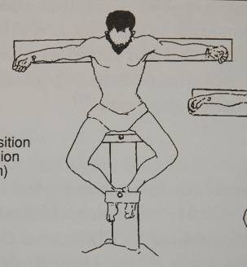
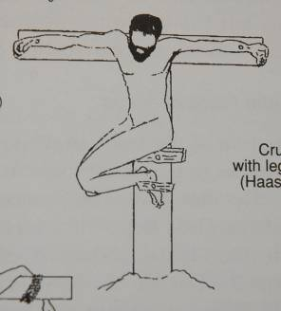
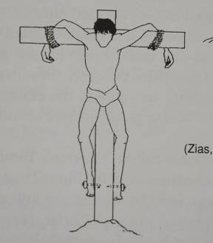
Possible Positions of Crucifixion
Based on the remains of Jehohanan, archaeologists have theorized about his position on the cross, given that his heels were nailed with a single spike
It remains an open question as to whether or not the crucifixion of Jesus may have been similar.

Slide 18
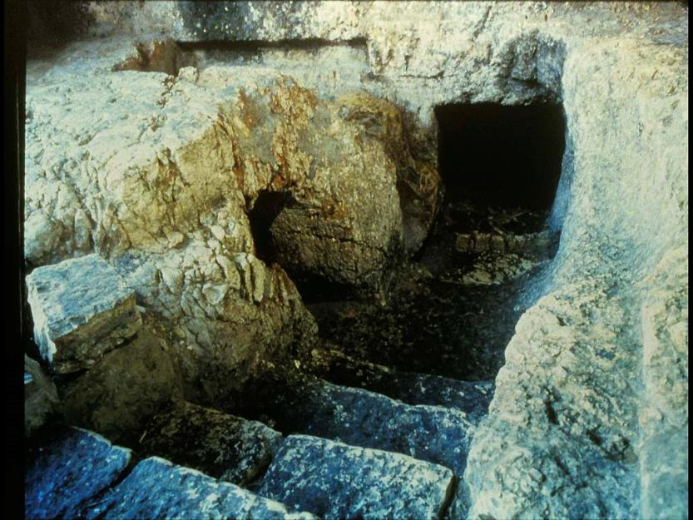
This 1st century rock cut tomb shows the typical entrance with the floor of the channel sloping upward away from the opening.
At the foot of the steps is a channel cut at right angles to the door opening, and a heavy cylindrical stone is just visible in the channel to the left of the doorway. When rolled in front of the doorway, it effectively sealed the tomb.
Rolling Stone

Slide 19
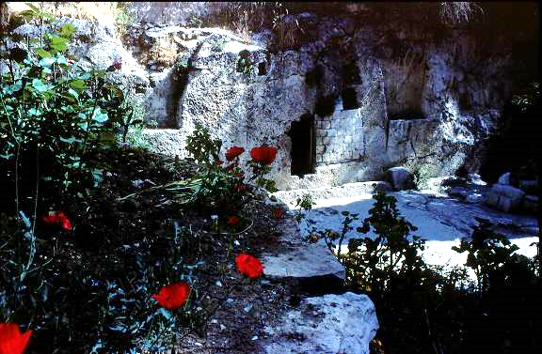
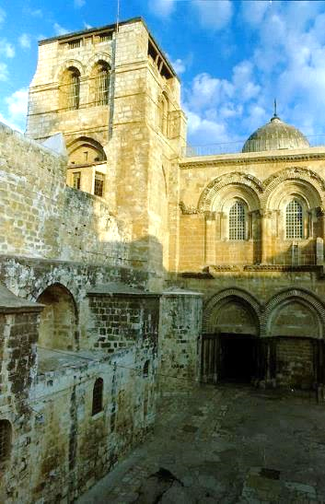
Here are the two most popular sites for the location of Jesus’ burial, which was “at the place” of crucifixion (Jn. 19:41).
The Garden Tomb was located by Protestant missionaries. However, archaeologists believe this tomb to be too old (8th-6th centuries BC) to be the tomb of Jesus.
The Church of the Holy Sepulcher has been revered as Jesus’ burial place since the early 4th century AD.

Slide 20
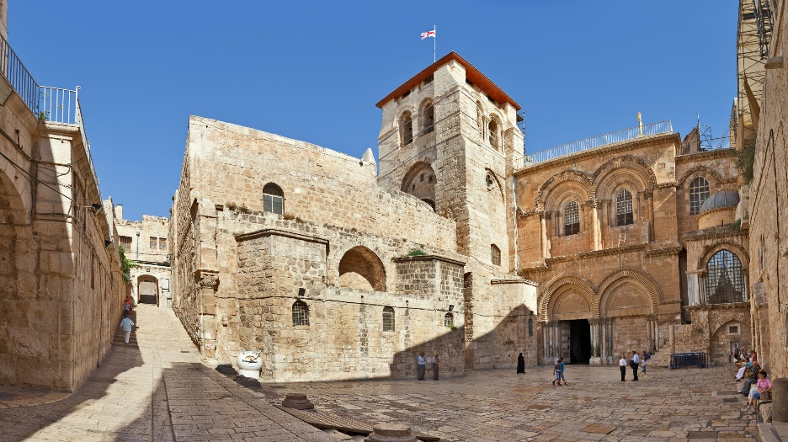
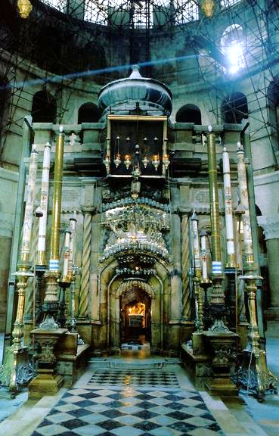
Both Eusebius and Jerome, both from the 4th century, identified this site as the place of Jesus’ crucifixion and burial. It is the oldest of the traditions.

Slide 21
NT ARCHAEOLOGY
NT ARCHAEOLOGY
THE EARLIEST CHRISTIANS
Lesson 8
Lesson 1
Introduction

Slide 22
In the first book, O Theophilus, I have dealt with all that Jesus began to do and teach, until the day when he was taken up…
Acts 1:1-2a
He [Jesus] said to them…you will be my witnesses in Jerusalem and in all Judea and Samaria and to the end of the earth.
Acts 1:7a, 8b
…proclaiming the kingdom of God and teaching about the Lord Jesus Christ with all boldness and without hindrance.
Acts 28:31
The final word in the Book of Acts is akwlu<twj, which means “unhindered.”

Slide 23
GEOGRAPHICAL CHIASMUS
LUKE
ACTS
GALILEE A
SAMARIA/JUDEA B
JERUSALEM C
A’ NATIONS
B’ JUDEA/SAMARIA
C’ JERUSALEM
D
ASCENSION

Slide 24
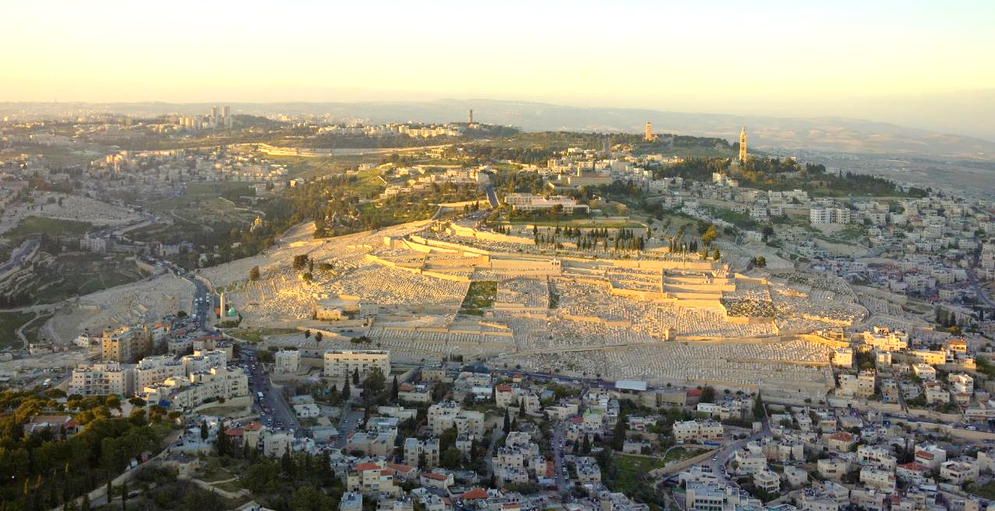
Mt. of Olives from which Jesus ascended into the heavens

Slide 25
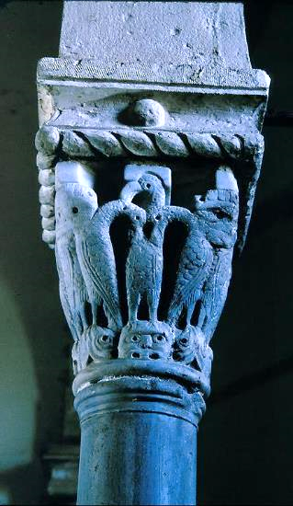
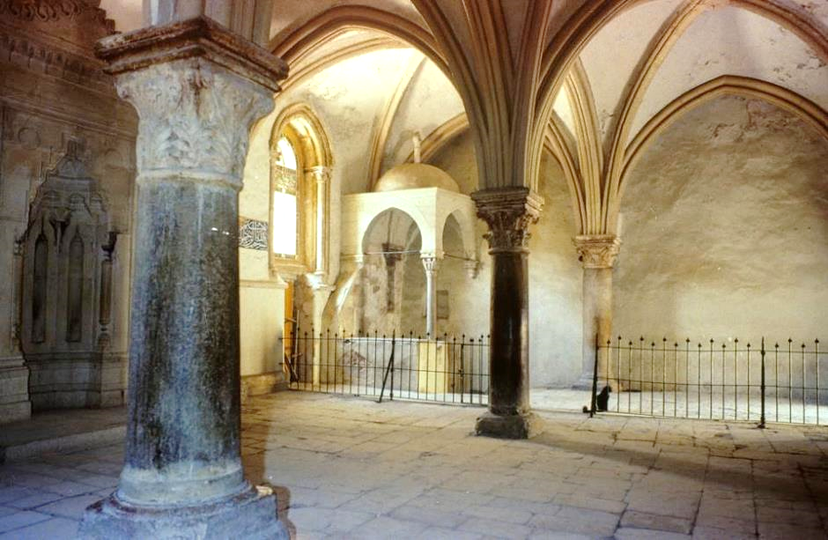
Traditional site of the Upper Room
This is the traditional site of the upper room. Its earliest foundation seems to be from either an ancient synagogue or church that may have existed prior to the destruction of the 2nd temple. The columns of the structure’s interior go back to an early Byzantine church, while the vaulted ceiling was constructed by the Crusaders.
The use of the iconic pelican as an early Christian symbol is based on the belief that pelicans will feed their young with their own blood in times of emergency.

Slide 26
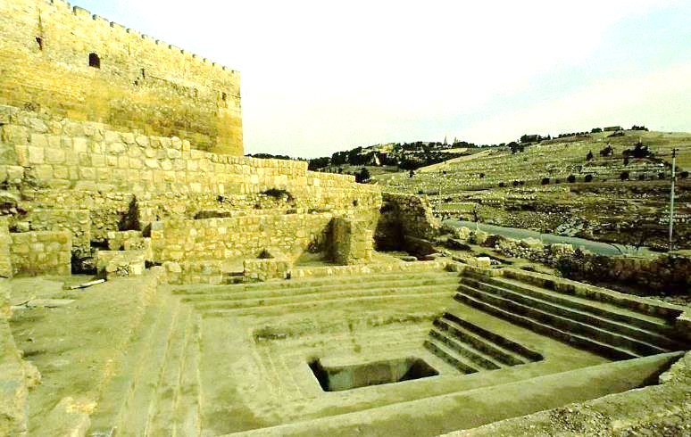
BAPTIZING 3000 CONVERTS
Luke doesn’t say where the apostles baptized the large number of Jewish converts, but there are two reasonable possibilities:
…the various mikva’ot (pools for Jewish ritual baptism) near the temple precincts. So far, about 40 have been excavated by archaeologists.
…one of the large pools in Jerusalem (e.g., Siloam, Bethesda, etc.).
2nd Temple mikveh excavated near the stairway at the southern wall of the Temple Mount. It would have been in use during the time of the early church..

Slide 27
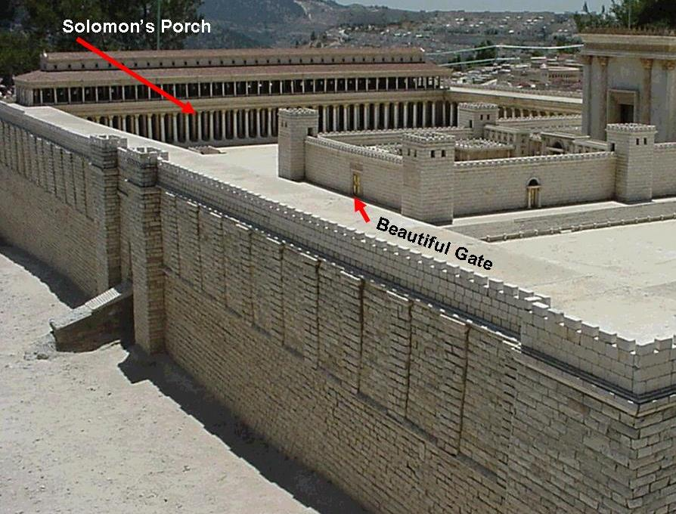
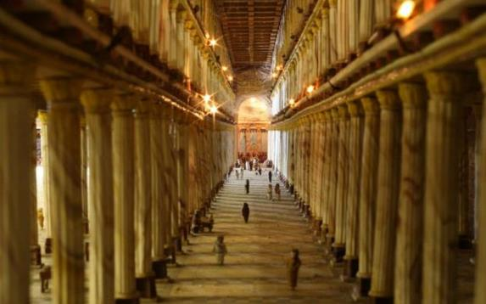
Solomon’s Colonade was where the early Christians met (Ac. 5:12). This model, based on ancient texts and archaeological data, show how it may have looked.

Slide 28
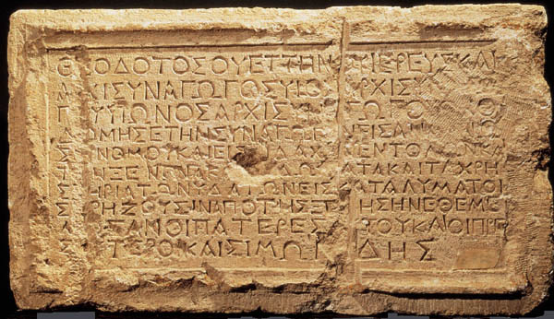
Theodotus Inscription
Many synagogues stood in ancient Jerusalem prior to AD 70, and in one of them hung the following Greek inscription, “Theodotus…rebuilt this synagogue for the reading of the Torah and the teaching of the commandments, and the hostelry, rooms and baths, for the lodging of those who have need from abroad.”
The fact that the language of the inscription is Greek, not Hebrew, and its allusion to “those who have need from abroad,” suggest that this synagogue was used by Jews from the Diaspora. Discovered in 1914, some scholars have identified it with the Synagogue of the Freedmen (former slaves in the Roman Empire), mentioned in Acts 6:9. It is possible that Saul of Tarsus in Cilicia may even have been a member also (21:39), since many other members were from Cilicia (6:9).
Rockefeller Museum, Jerusalem

Slide 29
Now those who were scattered because of the persecution that arose over Stephen traveled as far as Phoenicia and Cyprus and Antioch, speaking the word to no one except Jews.
Acts 11:19

Slide 30
STAGES BETWEEN JEW & GENTILE
Hebraistic Jew (e[brai?oj)
Jew attending a Hebrew-speaking synagogue
Hellenistic Jew (e[llhnisth<j)
Jew attending a Greek-speaking synagogue
Proselyte (prosh<lutoj)
Gentile who has accepted circumcision
God-fearer (fobou?menoj)
Gentile attracted to the Jewish view of God (but remaining uncircumcised)
Pagan (e@qnoj)
Worshiper of the Greco-Roman pantheon

Slide 31
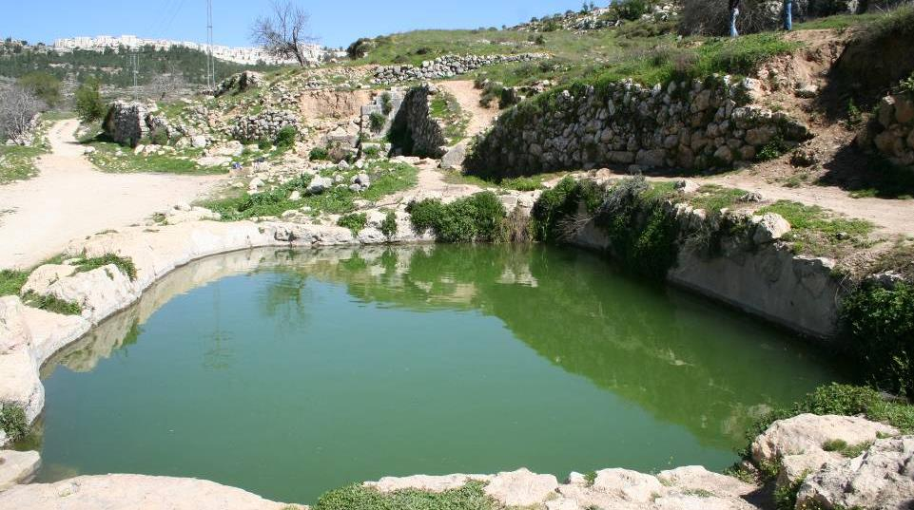
That there was sufficient water for a traditional baptism is evident in these 2nd-3rd century AD remains of a Roman bathhouse from Ein Yael on the Roman road from Jerusalem to Gaza. The road was paved, hence suitable for chariot travel.

Slide 32
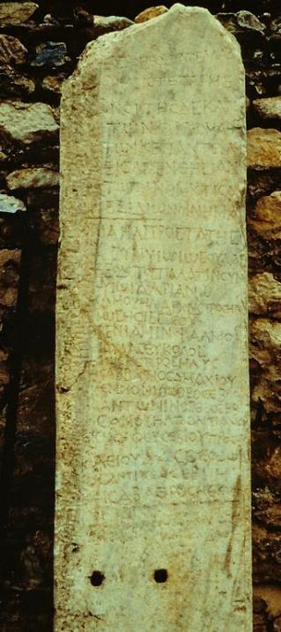
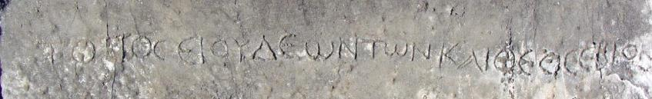
“God-fearers” (Ac. 10:2, 22)
This “roster” of God-fearers from Aphrodisias (southwestern Turkey) is one of various references in inscriptions and texts to pious Gentiles who were sympathetic to Jewish religion, even though they had not themselves become proselyte Jews. Hence, they stood somewhere between full Jewishness and paganism.
This list names 54 Gentiles, alongside Jews from the local synagogue, contributed to relief efforts as well as construction of a place for worship. The Gentile part of the register is headed by the words “those who are God-fearers.”
This inscription from the theater in Miletus designates seating for “Jews” and “God-worshipers.”

Slide 33
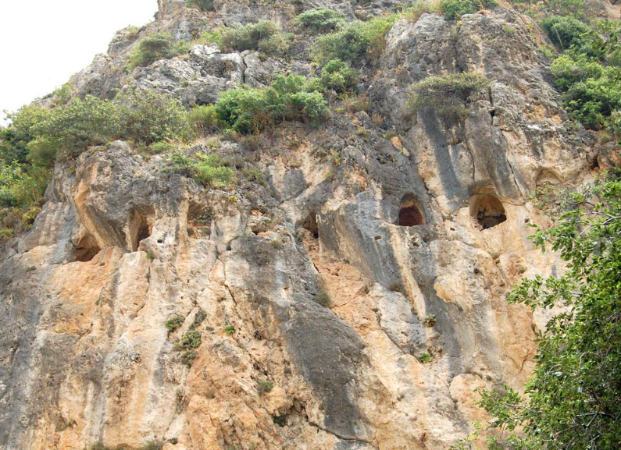
Ancient Church at Antioch, Syria in a mountain cave (modern Antakya, Turkey)
The Antioch church came to be called “the center and eye of Christianity” in the early centuries of the church. Here, Christians were first called “Christians.”
This ancient cave church, measuring 31’ wide x 42’ long x 23’ high has been designated by UNESCO as the world’s first cathedral.

Slide 34
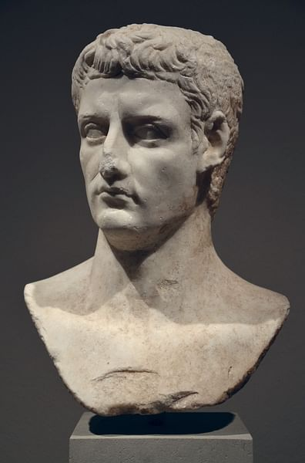
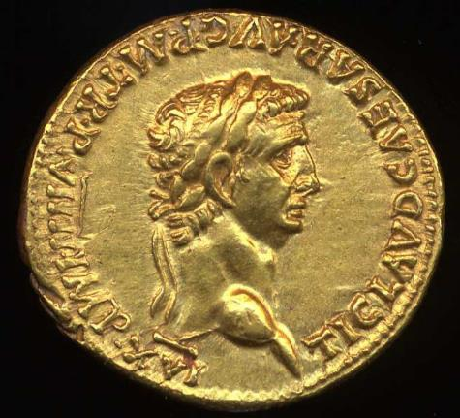
Coin and bust of Claudius Caesar (Ruled from 41-54 AD): the prediction by Agabus of a severe famine was fulfilled during his tenure (Ac. 11:27-30), prompting the Antioch church to send a relief gift to the Christians in Jerusalem.

Slide 35
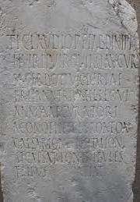
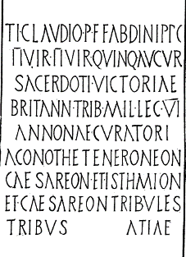
A number of grain shortages occurred in the Mediterranean world during the Claudian Period. Remains of at least 20 Latin and six Greek inscriptions, including this one from Corinth, attest to the municipal office of the “curator of the grain supply” (curator annonae), an office that likely was only functional during times of threatened or actual food shortage.
American School of Archaeology in Corinth

Slide 36
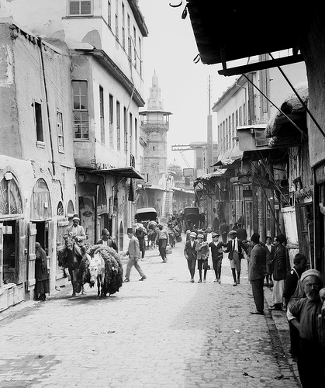
Straight Street
The “Street Called Straight” (Ac. 9:11) is the Roman street (Decumanus Maximus) which runs from east to west in the old city of Damascus, Syria.
During the Greek period in Damascus, the city was re-designed by Hippodamus, who gave the city a grid structure. The longest of these streets, 1,500 meters long, was called Straight Street.
It still is there today, one of the oldest streets in the world.

Slide 37
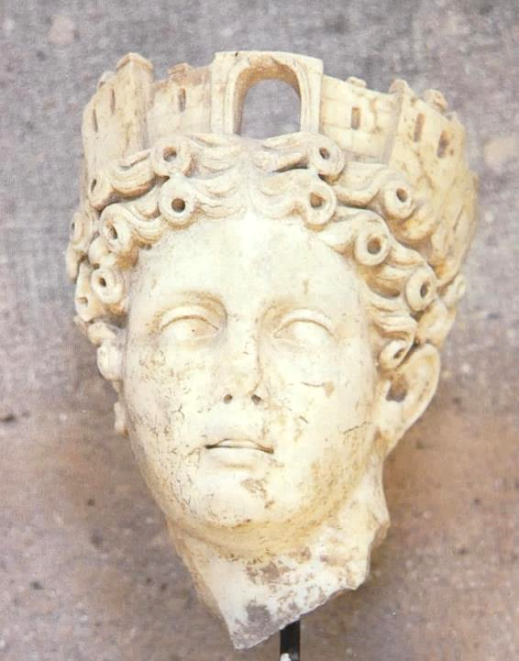
Wall Crown
The corona muralis was a standard adornment of Fortuna, goddess of cities.
Such a crown was bestowed by the emperor on the first soldier who was able to make it safely over the wall into an enemy city.
Paul alludes to this in an irony, when he claimed that he, also, once went “over the wall”—in a basket to escape the clutches of Aretas of Damascus (2 Co. 11:32-33).

Slide 38
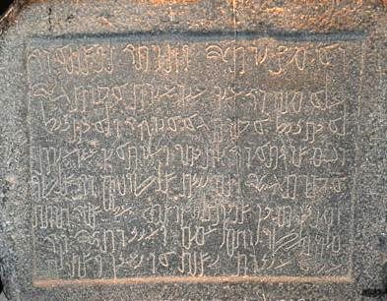
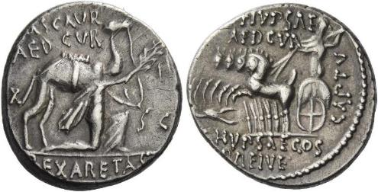
Historical References to Aretas IV, Ethnarch of the Nabataen kingdom, from whom Saul escaped by “going over the wall” in a basket
Coin of Aretas IV. On the obverse side, it shows the ethnarch kneeling and holding the reins of a camel while holding an olive branch. On the reverse side is an image of Jupiter hurling a thunderbolt from his chariot.
Ancient inscription naming Aretas IV
Vatican Museum, Rome

Slide 39
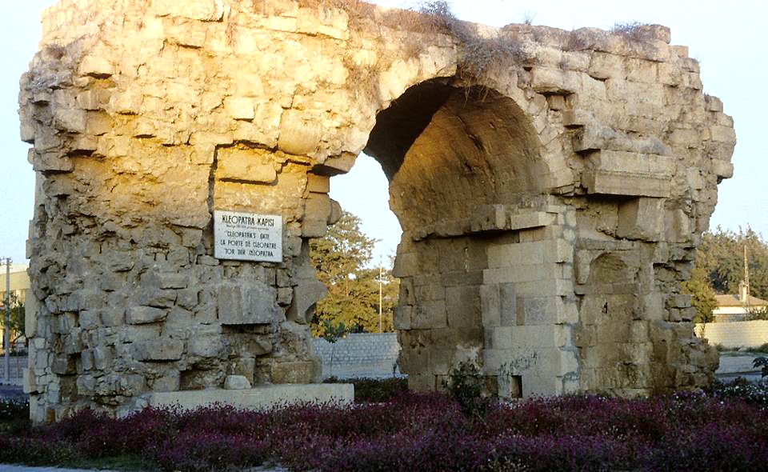
Cleopatra’s gate in Tarsus is the only one of three Roman gates that have survived the centuries in Saul’s home city.

