Slide 1

3 – DEVELOPMENTS
The Church Continues to Develop

Slide 2
Passing on Important Truths, Values, and Traditions
ORAL TRADITION
…what I received I passed on to you as of first importance (1 Co. 15:3a; 2 Ti. 1:13)
TRUSTED SUCCESSORS
…the things you have heard me say in the presence of many witnesses entrust to reliable men who will also be qualified to teach others (2 Ti. 2:2)
RITUALS
…For I received from the Lord what I also passed on to you: The Lord Jesus, on the night he was betrayed, took bread… (1 Co. 11:23)
WRITTEN DOCUMENTS
…after this letter has been read to you, see that it is also read in the church of the Laodecians and that you in turn read the letter from Laodecia. (Col.4:16)

Slide 3
A BASIC QUESTION: What was/is the relationship of the developing church to the primitive church?
Is it imitating what the early church did?
Is it following the trajectory the early church set?

Slide 4
Balancing Orthodoxy o]rqo<j = right; do<ca = glory three spheres of authority must be kept in balance to preserve classical Christianity
Scripture: Canon of the Old and New Testaments
CHALLENGE: Proper interpretation
Tradition: Rituals, practices, and oral transmissions of the church
CHALLENGE: Rigidity
Holy Spirit: Ongoing direct guidance by God
CHALLENGE: Subjectivism

Slide 5
DEVELOPMENTS and variations
As the decades rolled by, Christians continued the apostolic practices, but sometimes with developments and variations.
Infant Baptism: Four occasions in the NT describe household baptisms (Ac. 10:24, 47-48; 16:15, 32: 1 Co. 1:16). These likely included children. By the early 200s, infant baptism was widely practiced. In the Apostolic Tradition (Hippolytus), collected in ca. 215 from earlier works, it says, “Baptize first the children, and if they can speak for themselves, let them do so. Otherwise, let their parents or other relatives speak for them.”
The Holy Kiss: Based on NT references, the exchange of peace with a kiss appears to be a Christian innovation, since there are no examples from the culture at large. Tertullian wrote that before leaving a house, Christians are to give the Holy Kiss and say “peace to this house.” It was also viewed as an essential part of preparing to participate in the Eucharist.
Foot-washing: Tertullian (ca. AD 200) wrote that foot-washing was a regular part of early Christian worship, using a basin of water and a linen towel.

Slide 6
Real Presence: Early Christian writers referred to the Eucharistic bread and wine as Jesus’ body and blood, following the language of Jesus at the last supper. The Eucharist was reserved for baptized Christians (Didache). Various leaders spoke of what today we call the “real presence” of Christ in the Eucharist, including Ignatius (ca. AD 106), Justin Martyr (ca. AD 150), Tertullian (ca. AD 200), Ambrose (ca. AD 397), etc.
Morning and Evening Prayer: Hippolytus instructed Christians to pray privately seven times a day, upon rising, at bed-time, at midnight, and at the 3rd, 6th, and 9th hours of the day (these various times are associated with Christ’s Passion). Throughout the week, Christians assembled each day for morning prayer (known as lauds) and evening prayer (known as vespers).
Eschatology: The dominant view about the end of the age was what today we called historic premillennialism, i.e., the belief that the church would face the great tribulation and the anti-Christ some time in the future (Papias, Lactantius, Theophilus, Tertullian, Hippolytus).
Monasticism: Monastics began to appear in the deserts of Egypt by the 3rd century as a kind of living martyrdom. Anthony (AD 251-356) gradually gained followers who lived as hermits. Monasticism spread to Palestine, Syria, Asia Minor and beyond, and the sayings and writings of the monastics came to be circulated as the Desert Fathers.

Slide 7
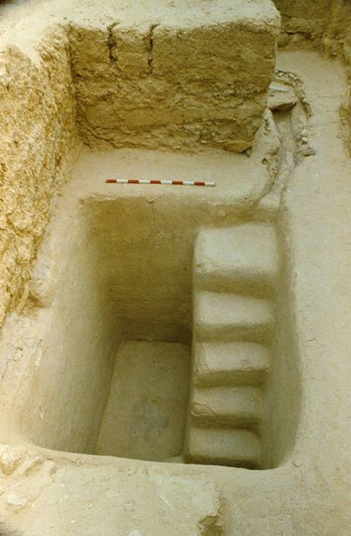
A 2nd temple mikveh (purification pool) excavated near the stairway at the southern wall of the temple mount.
It would have been in use during the time of Jesus
It is not unlikely that such mikva’ot were used for the 3000 baptisms on the Day of Pentecost (Ac. 2:41).
Because such elaborate structures would not be tolerated by the Romans for Christians, this situation probably encouraged baptism by pouring, as mentioned in the Didache, when a river or pond was unavailable.

Slide 8
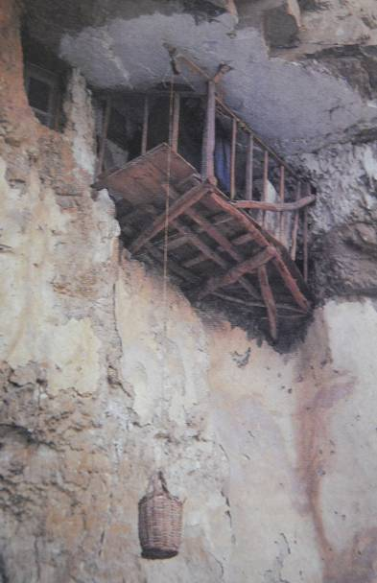
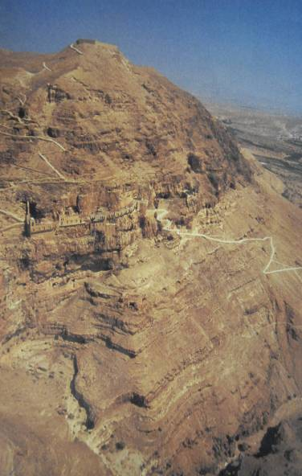
Believed to be the site of Jesus’ temptations, the monastery of Douka was established in AD 340.
Isolated monks would pull up food and necessary items in a basket

Slide 9
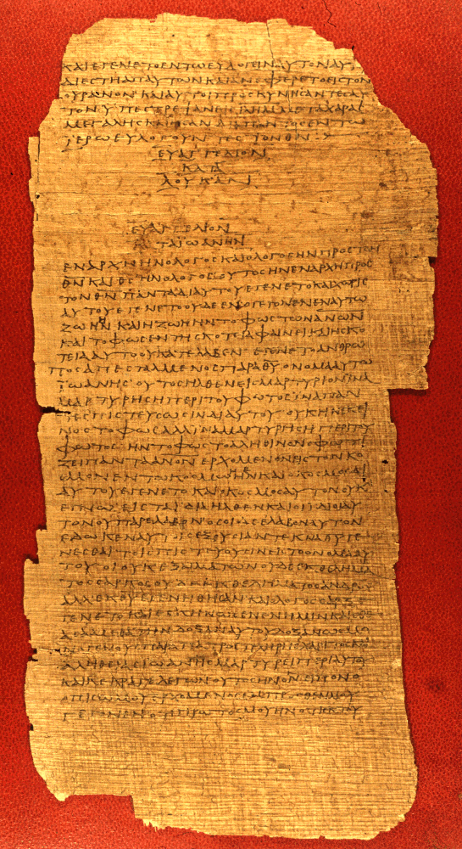
CHRISTIANS AND TEXTS
The extent of literacy in the Greco-Roman world of the 1st century (the ability to read and write) was generally about 10% of the population and at no time larger than 15-20%.
Literacy was thus the privilege of a minority, and it existed alongside an oral culture.
Familiarity with the Scriptures, therefore, did not depend upon an individual’s capability of reading them, since most Christians did not read.
Hence, the ability to read, critique, and interpret belonged to a relatively small number of Christians in any given congregation.
P75 end of Luke, beginning of John, Vatican Library, Rome AD 175-225

Slide 10
Christians and the Synagogue
In a society where the ownership of texts was economically prohibitive as well, the familiarity of Christians with the Bible depended upon hearing the texts read publicly.
In the synagogue tradition, two Scripture readings were appointed for each service, one from the Torah and one from the Prophets, and these were arranged in a three-year cycle. (Jesus gave the “Prophets” reading in his hometown of Nazareth, cf. Lk. 4:16ff.).
These readings in turn became the “text” for the sermons of the rabbis.
Christians followed the same pattern (1 Ti. 4:13).

Slide 11
Public Reading
Hence, an essential part of early Christian worship was the public reading of Scripture.
Paul instructs Timothy: “…devote yourself to the public reading of Scripture…” (1 Ti. 4:13a).
Naturally, those able to read texts publicly were held in high esteem by the congregations, often rising to become leaders.
Apollos, for instance, is described as someone “skilled in the Scriptures” (Ac. 18:24).
Paul’s literary skills were instrumental in his missionary work.

Slide 12
The Septuagint (LXX) was the Bible of Diaspora Jews, and it became the “Bible” of Gentile Christians.
Few people outside Palestine would have been conversant in Biblical Hebrew.
Christian public readings, especially as Christianity moved into the Greco-Roman world, were from the LXX (the Greek translation of the Hebrew Bible).
It is to the point that when Paul or Luke or others quote from parts of the New Testament, they often did so from the LXX.
The books in the Apocrypha were also read, since they were included in the LXX, and sometimes such works are referenced in the New Testament.

Slide 13
The Apocryphal Books
1 Esdras
2 Esdras
Tobit
Judith
Prayer of Azariah
Song of the Three Young Men
Susanna
Bel and the Dragon
Additions to Esther
Prayer of Manasseh
Letter of Jeremiah
Baruch
Sirach (Ecclesiasticus)
Wisdom of Solomon
1 Maccabees
2 Maccabees
3 Maccabees
4 Maccabees
Psalm 151
In keeping with other Protestants, Anglicans do not recognize the Apocrypha as canonical. However, following St. Jerome, they approve of them for “examples of life and instructions of manners.” The 39 Articles only restrict their use for the establishment of Christian doctrine. They continue to be read publicly in the services.
39 Articles, Article VI

Slide 14
DISCUSSION
Today, it is the liturgical church which reads lengthy passages from the Bible publicly. What is the value of this? Is there a downside?
What do you make of the Anglican approach to the Apocrypha? How is this different from both Roman Catholic and Orthodox Christians? How is it different from other Protestants?

Slide 15
The Texts of the New Testament
As the apostles and those close to them began to compose Christian texts, they naturally did so in Greek, the international language of the day.
Paul typically used an amanuensis, like Tertius, Sosthenes, or Timothy (Ro. 16:22; 1 Co. 1:1; 2 Co. 1:1; Phil. 1:1; Col. 1:1; 1 Th. 1:1; 2 Th. 1:1; Phlm 1), though he made it a practice to sign off with his own signature (1 Co. 16:21; Ga. 6:11; 2 Th. 3:17).
We know considerably less about the writing process behind the four Gospels, but early Christian testimony (Papias) indicates that Mark, at least, was a collector of the personal memories about Jesus by Simon Peter. Luke seems to have done his own research (Lk. 1:1-4).
One fascinating feature of early Christian texts was their tendency to abbreviate sacred names with a line over the abbreviation. Presumably, this practice was to mark the sacred character of the divine name.

Slide 16
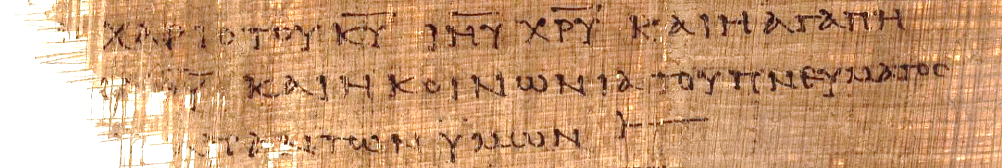
2 Corinthians 13:13 (p46) “[The] grace of the Lord Jesus Christ and the love of [God] and the fellowship of the Holy Spirit [be] with you all.” Here, the sacred names “Lord,” “Jesus,” and “Christ” have all been abbreviated with a line drawn over them. KURIOU = KU = Lord IHSOU = IHU = Jesus XRISTOU = XRU = Christ

Slide 17
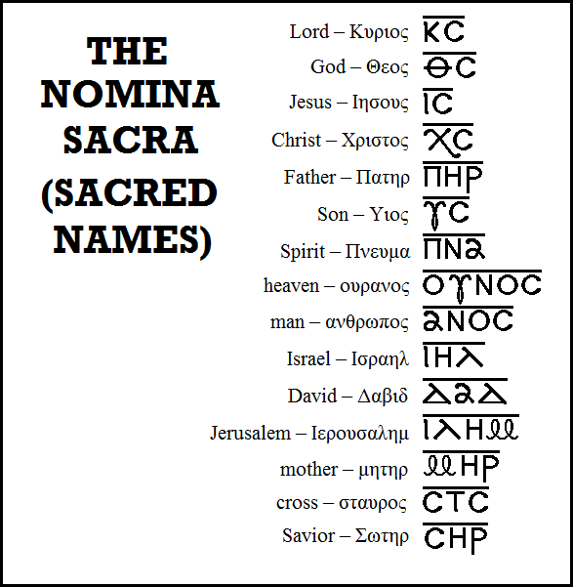
Typical Nomina Sacra found in early New Testament manuscripts. All these abbreviations are found in Greek manuscripts of the 3rd century and earlier except “mother,” which begins to appear in the 4th century.
Bruce Metzger,
Princeton University

Slide 18
Fixed Order
The fixed order of a codex, which Christians regularly used, affected both the Old and New Testaments.
The order of books in the LXX was somewhat different than the ordering of books in the Hebrew tradition. We follow this order today.
For instance, in the LXX the prophetic books are generally placed last, whereas in the Hebrew tradition they fall in the middle of the Hebrew Bible.
Ruth is placed next to Judges in the LXX, but in the Hebrew Bible it belongs to the Megilloth near the end.
Very early, the four gospels gained a fixed order which we retain today: Matthew, Mark, Luke, and John.
While an attempt was made to combine the four gospels into a single narrative by a theologian named Tatian (called the Diatessaron), in the end the church retained the four gospels in their original form.
Paul’s letters in the early Christian lists have a varied order, though eventually they became fixed by about the 4th century.
The so-called “general epistles” also had a varied order which eventually became fixed.

Slide 19
Early Translations
As early as the 2nd century, the texts of the New Testament began being translated into vernacular languages.
Christian missionaries translated biblical texts into local languages wherever Greek would not serve the needs of the people.
These early translations include:
Coptic – 3rd Century
Syriac – 3rd and 4th Centuries
Old Latin (predating Jerome’s Latin Vulgate) – 4th Century
Armenian – 5th Century
Georgian – 5th Century
Ethiopic – 5th Century

Slide 20
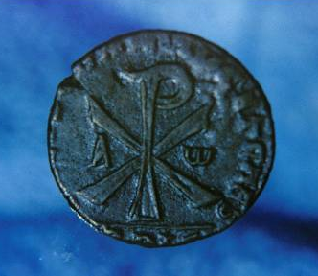
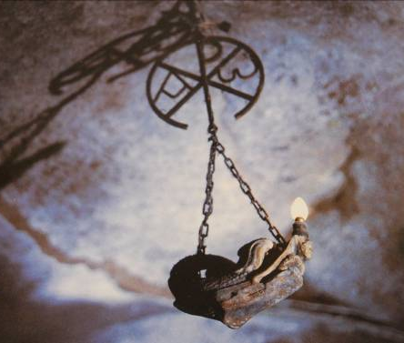
Early Christian Alphabetic Symbols (XP = initial Greek letters of “Christ”; A and w = Greek letters Alpha and Omega, the first and last letters of the alphabet (Rev. 1:8; 21:6; 22:13).

Slide 21
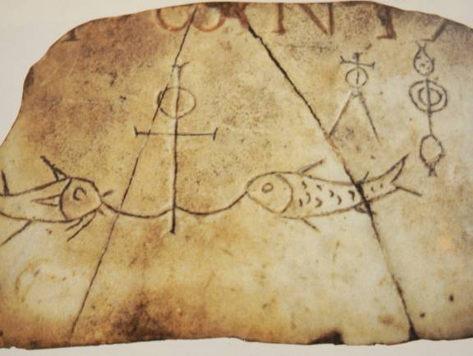
THREE SYMBOLS
ANCHOR
Symbol of hope and steadfastness
CROSS
Symbol of the sacrifice of Jesus
i]xquj (= fish acronym)
i]hsouj = Jesus
xristoj = Christ
qeoj = God
u[ioj = Son
swthr = Savior

Slide 22
DISCUSSION
What do you think about Tatian’s attempt to combine the four gospels into a single gospel?
Some Christians argue that there is only one legitimate translation, the King James Version. What do you make of this point of view?
How important is Christian art? Are there dangers? Should there be limitations?

