Slide 1

Myhlx
lx
yndx
hxry-hvhy
hvhy
abba
qeoj
kurioj
-----------THE DIVINE NAMES: Part 1-----------
Nvylx-lx
Ydw-lx
Xpr-hvhy

Slide 2
There he [Jacob] built an altar, and he called the place El Bethel, because it was there that God revealed himself to him…
Genesis 35:7

Slide 3
THE BASIC IDEA OF DIVINE REVELATION
Crucial to the development of the Hebrew faith is the belief that God took the initiative to reveal himself.
Atheism was not a philosophical option in the ancient world.
The question was not so much, “Is there a God?” but rather, “Who is God?” or “What is his name?”
For Israel, there was only one God, but while he is called “God” by the terms widely used in the ancient Near East, he was also called by names that were unique to him alone.

Slide 4
GOD AND THE GODS
The basic name for God in the languages of the ancient Near East was ‘El (lxe).
This was true for the Israelites, but it was equally true for Israel’s neighbors.
Derived from this basic word ‘El is the most widely used name for God in the Hebrew Bible, ‘Elohim (Myhilox$), which is a plural form.
In Israel, this plural form was taken to indicate a plurality of majesty—the one God who had many attributes.

Slide 5
Singulars, plurals, and verbs…
…a little venture into Hebrew grammar
In Hebrew syntax, verbs drive the sentences, often appearing as the first word in a sentence.
When ‘Elohim, which is a plural form, refers to the one true God, the verb will be singular, and we translate it as “God.”
  Ge. 1:1: “In the beginning ‘Elohim [plural noun] created [singular verb] the heavens and the earth.” (Here we translate ‘Elohim as “God.”)
When ‘Elohim refers to the pagan pantheon of deities, the verb will be plural, and we translate it as “gods.”
  1 Kg. 19:2: “May the ‘Elohim [plural noun] do [plural verb] to me and more also, if I do not make your life as the life of one of them by this time tomorrow.” (Here, we translate ‘Elohim as “gods.”)

Slide 6
When Abram was ninety-nine years old, Yahweh appeared to him and said, “I am ‘El Shaddai…”
Genesis 17:1
God also said to Moses, “Say to the Israelites, ‘Yahweh, the God of your fathers…has sent me to you. This is my name forever, the name by which I am to be remembered from generation to generation.’” Exodus 3:14-15
God also said to Moses, “I am Yahweh…but by my name Yahweh I did not make myself known to them.” Exodus 6:2-3

Slide 7
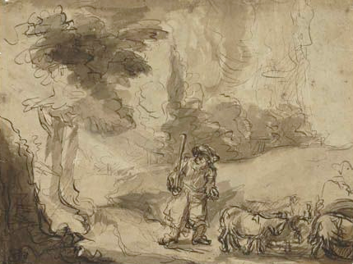
MOSES AT THE BURNING BUSH (Ex. 3)
Here, God revealed to Moses his personal name, “Yahweh” (hv!hy4).
This name was unknown to the patriarchs, who knew God as ‘El Shaddai (Ex. 6:2-3; cf. Ge. 17:1; 35:11).
This raises the question of why the name Yahweh is so frequently used in the Book of Genesis.
  Is the name retrojected back into the Genesis stories by the later author?
  Does the name Yahweh now have new content unknown previously?
Moses and the Burning Bush
Brown ink and wash
Rembrandt van Rijn (1606-1669)

Slide 8
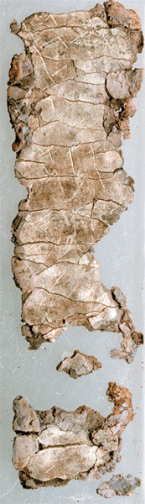
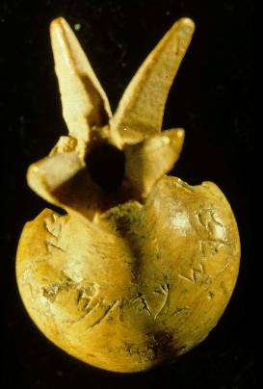
TWO ANCIENT INSCRIPTIONS OF THE NAME YAHWEH
This ivory pomegranate scepter head is perhaps the only surviving relic from Solomon’s temple. The artifact surfaced on the antiquities market and was subsequently purchased by the Israel Museum. The incised inscription reads, “Belonging to the Temple of Yahweh, holy to the priests.”
Discovered in 1980 in a tomb dating to the end of the Judean monarchy, this 1” long roll of silver foil, when unrolled, revealed an inscription of the ancient priestly blessing in Nu. 6:
“May Yahweh bless you and watch over you. May Yahweh make his face shine upon you and grant you peace.”

Slide 9
Discussion
Names seemed to have been very important to ancient peoples. Is it the same today?
In the Ten Commandments, it says that one must not misuse the name of God. What do you think this prohibition means, and how would someone misuse God’s name?

Slide 10
ADON (NOdx3) and ADONAI (yn!Odx3)
Like ‘El and ‘Elohim, the names ‘Adon and ‘Adonai are singular and plural respectively.
At a human level, this title is used to address a superior, i.e., “my lord” or “sir.”
As a divine name, it is frequently used in apposition to the name Yahweh or God, i.e., “Lord God.”
Once again, the verb drives the syntax, so when ‘Adonai refers to Yahweh God, it takes a singular verb (e.g., Ps. 51:17), but when it refers to multiple superiors, it takes a plural verb (e.g., Ge. 19:2).

Slide 11
YAHWEH TSABAOTH (tOxbAc; hv!hy4)
The name Yahweh Tsabaoth means LORD of Armies (or Hosts).
It is not used in the Torah, but it is increasingly used in the historical books, the Psalms, and the prophets.
Depending on context, the “armies” could refer either to the armies of the Israelites, or more often, to the heavenly armies of angels.
A MIGHTY FORTRESS IS OUR GOD
Luther’s famous hymn uses this name: “…Lord Tsabaoth his name, from age to age the same, and he must win the battle.”

Slide 12
English Translations of the Divine Names
KJV RSV NIV ESV NJB
‘El G/god G/god G/god G/god El
‘Elohim G/god G/god G/god G/god G/god
Shaddai Almighty Almighty Almighty Almighty Shaddai
Yahweh LORD LORD LORD LORD Yahweh
‘Adon L/lord L/lord L/lord L/lord L/lord
‘Adonai L/lord L/lord L/lord/sir L/lord L/lord
Tsabaoth Hosts Hosts Almighty Hosts Sabaoth

Slide 13
THE SEPTUAGINT (LXX) AND DIVINE NAMES
When the Hebrew Bible was translated into Greek (ca. 250 BC), the translators had decisions to make concerning translating the divine names.
They chose to translate both Yahweh and Adonai by the same Greek name “Lord” (ku<rioj).
This became the “go to” Bible for Diaspora Jews, and later, for Greek-speaking Christians.
It comes as no surprise, then, that the New Testament documents, which were written in Greek, followed in kind. Both Old and New Testaments in the LXX use “Lord” to refer to Yahweh.

Slide 14
“You have forgotten God your Savior; you have not remembered the Rock, your fortress.”
Isaiah 17:10
“Jeshurun (meaning Upright One, a special name of Israel)…rejected the Rock his Savior.”
Deuteronomy 32:15

Slide 15
Myhlx
lx
yndx
hxry-hvhy
hvhy
abba
qeoj
kurioj
-----------THE DIVINE NAMES: Part 2-----------
Nvylx-lx
Ydw-lx
Xpr-hvhy

Slide 16
DESCRIPTIVE NAMES
Especially in Hebrew poetry, various metaphorical names for God appear from time to time, including:
“Rock” (Dt. 32:4; Is. 17:10; Hab. 1:12, etc.)
“Holy One” (Is. 57:15; Ho. 11:9; Je. 15:29, etc.)
“King” (Nu. 23:21; Ps. 5:2; Is. 6:5, etc.)
“Shepherd” (Ps. 23:1; 80:1)
“Spring of Living Water” (Je. 17:13).
“Savior” (Ps. 25:5; Is. 45:15; Mic. 7:7, etc.)

Slide 17
Discussion
Some English Versions do not translate divine names, but rather, offer transliterations (as in the New Jerusalem Bible). What might be advantages or disadvantages in this approach?
Since the name “Lord” can refer both to a human who is superior or to God who is divine, how is one to tell the difference?

Slide 18
PRONOUNCING THE NAME YAHWEH
Today, we no longer know for sure how to pronounce the name “Yahweh.”
Many Jews vocalize the Hebrew letter “v” as ”vuv,” while scholars usually pronounce it as “waw.” As applied to the divine name, then it is either “Yahveh” or “Yahweh.”
Both approaches are based upon oral tradition, which is undependable, since from about the 3rd century BC, the Jews ceased vocalizing the name at all, considering it too sacred to be pronounced.
Written vowels were not added to the Hebrew text until ca. 10th century AD.

Slide 19
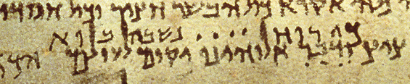
In the great Isaiah scroll from the Dead Sea Scrolls (1QIsaª), the four letters in the name Yahweh are represented by four dots, signifying its sanctity.

Slide 20
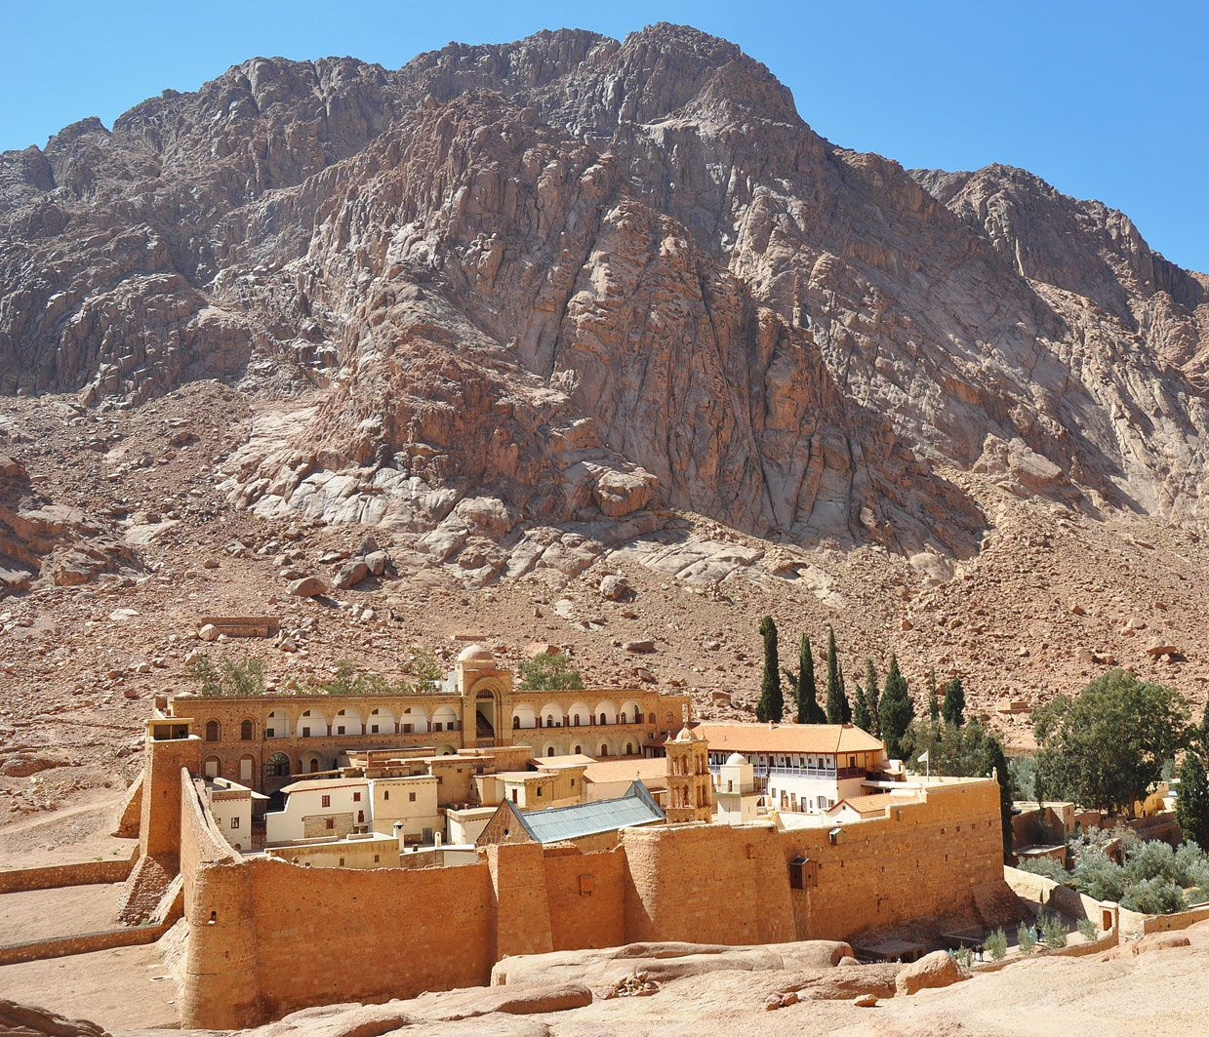
And the LORD said, “I will cause all my goodness to pass in front of you, and I will proclaim my name, Yahweh, in your presence.”
Exodus 33:19
The traditional Mt. Sinai and St. Catherine’s monastery

Slide 21
THE DIVINE NAME AND THE GLORY
On Mt. Sinai, Moses requested that God show him the divine glory. Yahweh said, “I will cause all my goodness to pass in front of you, and I will proclaim my name, Yahweh…” (Ex. 33:18-20).
In this proclamation, the holy name of God is bound up with the holy character of God, and the essential character of God is his goodness.
What God gave to Moses was not a visible representation, but rather, a description of his divine character—not how God looks but how he is.

Slide 22
WHAT’S IN A NAME?
In Hebrew thought, a person’s name was inextricably bound up with his/her existence, personality, and reputation.
It is out of this understanding that one finds compound names for God.
These come in two primary forms:
  ‘El compounds (already we have seen this in ‘El Shaddai)
  Yahweh compounds

Slide 23
THE ‘EL-COMPOUNDS
We encounter the first of these compounds, ‘El ‘Elyon, in the Abraham stories, when Abram returned after rescuing his nephew Lot from eastern marauders.
At pre-Israelite Salem (Jerusalem), Abram encountered Melchizedek, a priest-king of ‘El Elyon (= God Most High), and paid to him a tithe of the spoils of war.
Thereafter, this name appears a number of times, sometimes without the addition of ‘El (e.g., Nu. 24:16; Ps. 46:4) and sometimes linked to the name ‘Elohim (e.g., Ps. 57:2; 78:56).
In Ps. 91:1-2, the names ‘Elyon, Shaddai, Yahweh, and ‘Elohim appear in a single expression.

Slide 24
“The one dwelling in the hiding place of ‘Elyon will abide in the shadow of Shaddai. I will say to Yahweh, “My refuge and my stronghold [is] ‘Elohim, and I will trust in him.”
Psalm 91:1-2
(my translation)

Slide 25
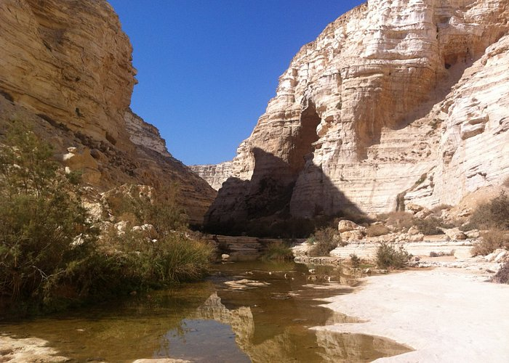
‘El ‘Olam (= God eternal)
It was first invoked by Abraham when establishing a treaty over water rights at Beersheba (Ge. 21:33).
Thereafter, it appears as a divine attribute, attached to God’s mercy, love, glory, and faithfulness, all of which are eternal, just as God is eternal.
Beersheba

Slide 26
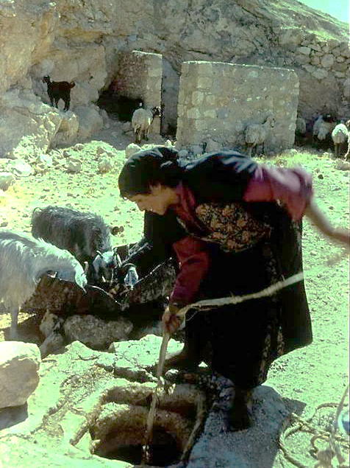
‘El Ro’ i (= the God who sees)
This name was spoken by Hagar, when she found sustenance at Beer-lahai-roi (Ge. 16:13).
After her pregnancy, she had fled into the desert and found a spring.
She said, “You are a God of seeing, for truly I have seen him who looks after me.”

Slide 27
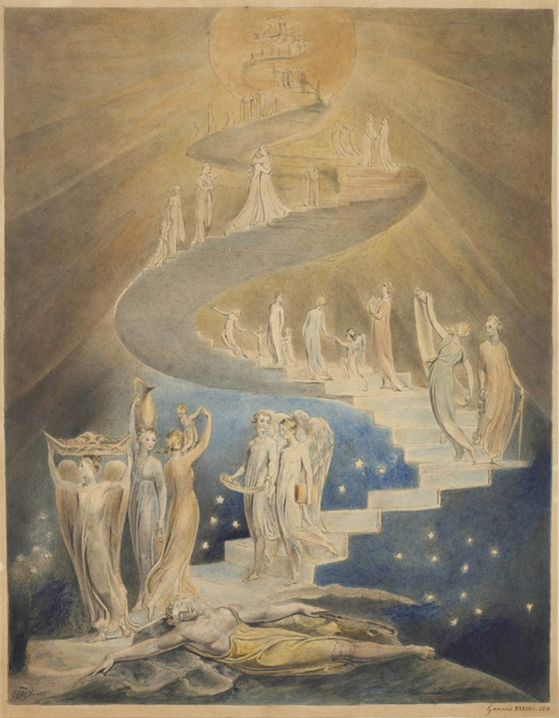
‘El Bethel (= God of the House of God)
God identified himself by this name when Jacob built an altar at Bethel (Ge. 31:13; 35:7).
It recalls Jacob’s dream of a ladder reaching from heaven to earth, a place Jacob named Bethel (= house of God, cf. Ge. 28:19).
“Jacob’s Ladder” by William Blake (ca. 1799-1806)
British Museum, London

Slide 28
Discussion
How do the compound names for God enrich our understanding of God’s relationship to his people?
Can you find the “‘El” element in the following personal names in the Bible?
  Samuel (= name of God)
  Nathanael (= gift of God)
  Gabriel (= God is my warrior)
  Michael (= who is like God?)
  Immanuel (= God with us)
  Daniel (= God is my judge)

Slide 29
THE YAHWEH-COMPOUNDS
Similar to the ‘El-compounds, the Yahweh-compounds offer additional descriptive terms illuminating God’s character attributes.
Often, such names arise out of specific historical circumstances or personal encounters with God.
It became quite common to add a “Yah” element to personal names (called theophoric names). In most of these cases, the “y” sound has been spelled in English with a “J”, i.e., Jehoshaphat (= Yahweh judges), Jeremiah (= Yahweh establishes), Joel (= Yahweh is God), etc.

Slide 30
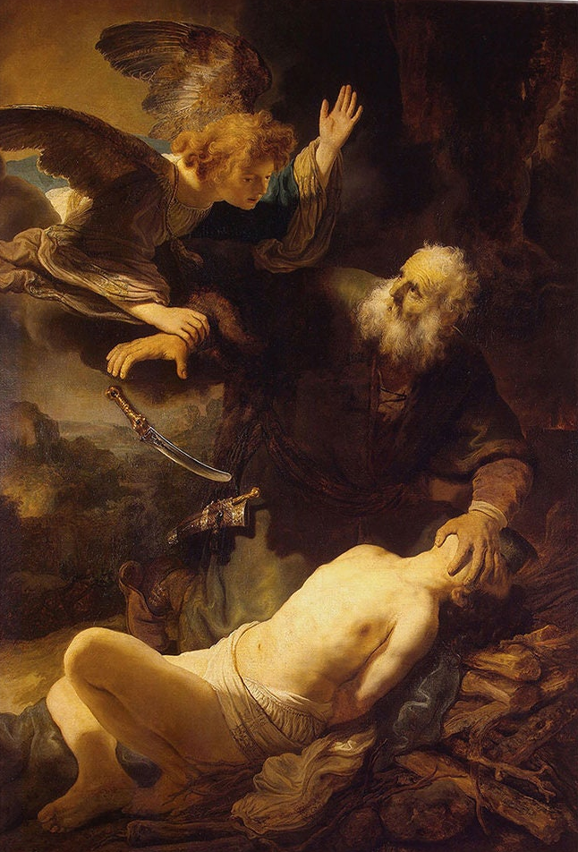
Yahweh Yir’eh (= the LORD will see/provide)
This compound arises in the story that in Jewish tradition is called “the binding of Isaac.”
After the life of his son was spared with a ram substitute, Abraham named the place: “The LORD will see/provide” (Ge. 22:14).
Rembrandt van Rijn
1635
The Hermitage
St. Petersburg, Russia

Slide 31
Yahweh Roph’eka (= the LORD who heals you)
When Israel escaped from Egypt, at the Marah oasis, God sweetened the bitter water (Ex. 15:26).
He also promised that none of the
diseases of Egypt would strike the Israelites.
Yahweh Shalom (= the LORD is peace)
When rescued from Midianite invaders, Gideon built an altar, naming it Yahweh Shalom (Jg. 6:24).
Yahweh Tsidkenu (= the LORD our Righteousness)
God’s word to Jeremiah was that a righteous King would be born from the family of David (Je. 23:6).
This Coming One would be called Yahweh Tsidkenu.

Slide 32
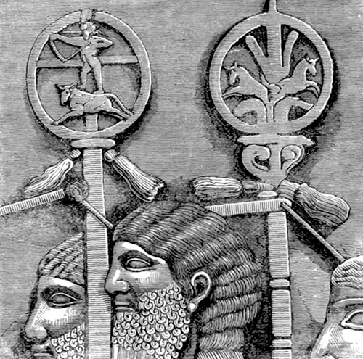
Yahweh Nissiy (= the LORD is my Banner)
When the Amalekites attacked the Israelites in the wilderness, Aaron and Hur assisted Moses by holding up his arms for the duration of the battle.
He then built an altar, naming it after a battle emblem, Yahweh is my banner.
Assyrian Battle Emblems or Banners (we have no imagery of Israelite banners, though surely they once existed, cf. Nu. 2:2)

Slide 33
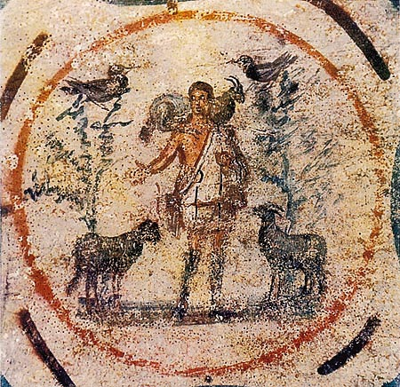
Yahweh Ro’iy (= the LORD is my Shepherd)
David, the great psalm-writer, grew up herding his father’s sheep near Bethlehem.
The most famous of all his psalms begins with the line, “Yahweh [is] my Shepherd” (Ps. 23:1).
A depiction of Christ, the Good Shepherd, from the Priscilla Catacomb in Rome, ca. 3rd century. Jesus’ claim to being the Good Shepherd was no less than a claim to be God.

Slide 34
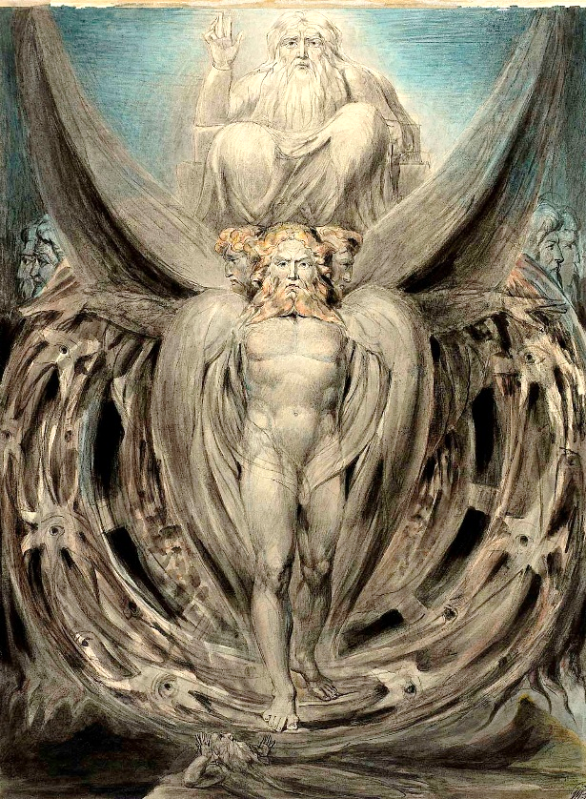
Yahweh Shammah (= the LORD is there)
Ezekiel depicted Yahweh abandoning Solomon’s Temple because of Israel’s idolatry and desecration.
Later, however, he depicted Yahweh’s return to a new temple, and the final word in his book is “Yahweh is There” (Eze. 48:35).
William Blake’s water color depicts the divine glory and the four living creatures surrounding Yahweh’s chariot throne. Yahweh had now abandoned the temple and accompanied the exiles into Babylon.

Slide 35
Discussion
The name “Jesus” is a Greek form.
Underlying it, however, are the combined Hebrew forms “Yah” (the short form of the name Yahweh) and “Hoshea” (the noun for “salvation”), making this a theophoric name.
This is the name the angel charged both Mary and Joseph to give to the child born in Bethlehem (Lk. 1:31; Mt.1:21).
What do you think this name means, and why is this significant?

Slide 36
NEW TESTAMENT DIVINE NAMES
Written in Greek, the New Testament derives its basic divine names from the Septuagint, which had been translated more than two centuries earlier.
The basic word for “God” is the same as used throughout the Greco-Roman world, the name Theos (qe<oj).
In most cases, it corresponds to the Hebrew name ‘Elohim.
On occasion, it can directly refer to Jesus Christ (Jn. 1:1, 18; 20:28; Ro. 9:5; Tit. 2:13).
Depending on context, it can also refer to pagan deities, where we do not capitalize it (e.g., Ac. 28:6; 1 Co. 8:5).

Slide 37
THE NAME “LORD”
Both the names Yahweh and ‘Adon are rendered by the Greek name Kyrios.
On most occasions in the New Testament, this name is used for Jesus, and effectively it becomes a compound name, Jesus Christ (Kyrios Christos) or Jesus the Messiah.
When used as a vocative, the name Kyrie is most familiar in Christian liturgy in the prayer “Lord, have mercy.”
At the climax of the age, all entities in heaven, earth, and under the earth will bow their knees to acknowledge Jesus Christ as “Lord” (Phil. 2:11), and in light of Is. 45:23, this means they will acknowledge him as Yahweh.

Slide 38
FATHER/ABBA
It is a measure of the deep reverence early Christians had for the precise words of Jesus that they continued to address God using the Aramaic word “Abba” (= father), even in language groups outside Jewry (Ga. 4:6).
This is the word Jesus used in prayer to address the Father (Mk. 14:36). It was almost certainly a coinage of Jesus, since it appears in no other Jewish literature of the 1 ^{st} century.
Paul could write to a church whom he had never visited, yet comfortably use this term, assuming without hesitation that his readers would clearly understand it (Ro. 8:15).

Slide 39
OTHER NEW TESTAMENT NAMES
Soter
(= Savior)
This name was counter-cultural, since Caesar was proclaimed to be the “savior” or benefactor of the world.
Pantokrator (= Almighty)
Appearing some ten times in the NT, this name is the equivalent of Yahweh Tsabaoth in the OT.
Despotes
(= Master)
Also translated as “Lord,” this name denotes the owner of a slave.
Basileus
(= King)
Commonly used of earthly potentates, this name is used both of God and also of Christ.

Slide 40
Discussion
What is your favorite of the divine names and why?

