Slide 1
ZEPHANIAH
The Purifying Anger of Yahweh

Slide 2
The prophet zephaniah
The opening line of the book locates Zephaniah during the reign of Josiah of Judah (640-609 BC).
Following the long but disastrous reign of Manasseh (686-642 BC) and the assassination of Amon by his own officials (642-640), the young Josiah came to the throne at the tender age of eight (2 Kg. 22:1; 2 Chr. 34:1).
By the time Josiah was in his mid-teens, he had begun a serious turning toward the faith of Yahweh, and by the age of 20 he began sweeping religious reforms to purge the capital and the nation of the paganizing syncretism of his predecessors.

Slide 3
The Kings During the Last Years of Judah
(dates are based on the chronology of Edwin Thiele)
ISRAEL
After the fall of Samaria, the northern nation of Israel was absorbed into the Assyrian Empire.
Later, when Assyria fell to Babylon, the northern lands of Israel would become part of the Babylonian Empire.
JUDAH
Hezekiah 715-686 BC
**Manasseh 697-642 BC
Amon 642-640 BC
Josiah 640-609 BC
Jehoahaz 609 BC
Jehoiakim 609-598 BC
Jehoiachin 598-597 BC
Zedekiah 597-586 BC
** = co-regency

Slide 4
The josianic reform
Two things in particular seem especially significant as spurring on Josiah’s reform movement.
The discovery of a “lost” Torah scroll:
  During a restoration project in the temple, a Torah scroll was discovered, in all probability, the Scroll of Deuteronomy (2 Kg. 22:8-10; 2 Chr. 34:14-18).
  The sworn curses for covenant disobedience (Dt. 28) produced a horrified reaction from the king, and Josiah initiated a renewal of the ancient covenant.
The preaching of Zephaniah:
  The incentive for covenant renewal was probably not due to the rediscovered Torah scroll alone, however.
  Alongside it were the blistering oracles of Zephaniah about the anger of Yahweh for Judah’s covenant failure.

Slide 5
Zephaniah, the man
Zephaniah’s lineage can be traced backward to Hezekiah (1:1), which puts him in the royal family of Judah.
As a resident of Jerusalem, he no doubt was only too familiar with the rash paganizing tendencies of Manasseh.
His descriptions of the shocking idolatrous practices in Jerusalem and Judah suggest that his life experience precedes the great reforms of Josiah.
His name means “Yah has treasured”.

Slide 6
Manasseh (2 Kg. 21:1-18)
At the age of 12, Manasseh, Hezekiah’s son, began a co-regency with his father.
When Hezekiah died, Manasseh deliberately turned to the Canaanite fertility cult, reinstating the high places, erecting shrines to Ba’al and Asherah, and participating in the astral religions of Mesopotamia.
Like Ahaz, his grandfather (cf. 2 Kg. 16:3), he sacrificed his own son.
He placed an Asherah pole in the temple.

Slide 7
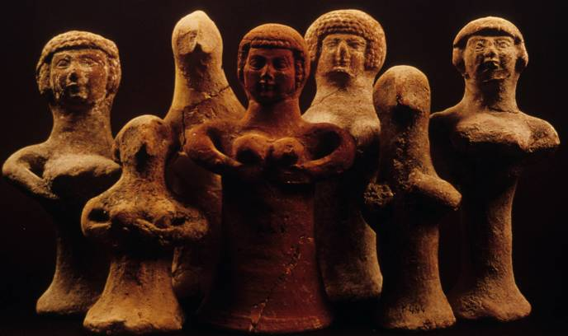
Fertility Figurines
Some 3000 of these terra cotta (clay) statuettes representing the goddess Asherah have been excavated from the towns of Judah’s pre-exilic period (Iron Age II), most often from private houses but occasionally in tombs.
These pillar figurines testify to the attraction of the fertility cult to the citizens of the southern nation.

Slide 8
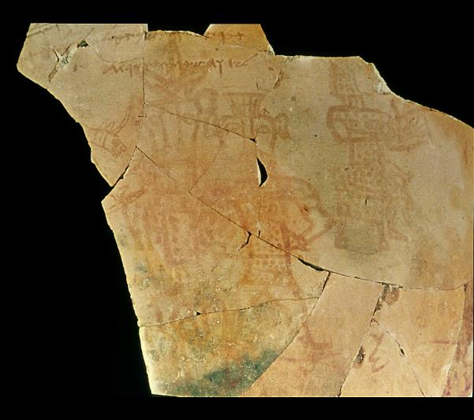
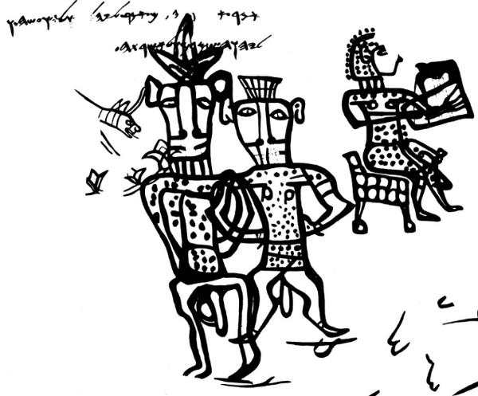
Syncretism in Judah
The mixing of Yahweh worship with the Canaanite fertility cult so typical of Manasseh’s reign is verified by this drawing from a large vessel excavated at Kuntillet Ajrud in southern Judah. The crude pictures show androgynous figures of gods/goddesses, the larger one with the face of a bull and his consort with the face of a cow plus a musician. It bears an inscribed blessing:
“I bless you by Yahweh of Samaria and by his Asherah”

Slide 9
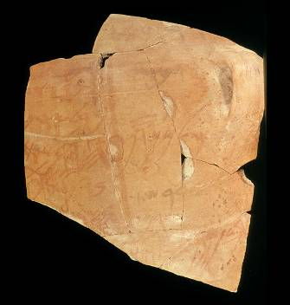
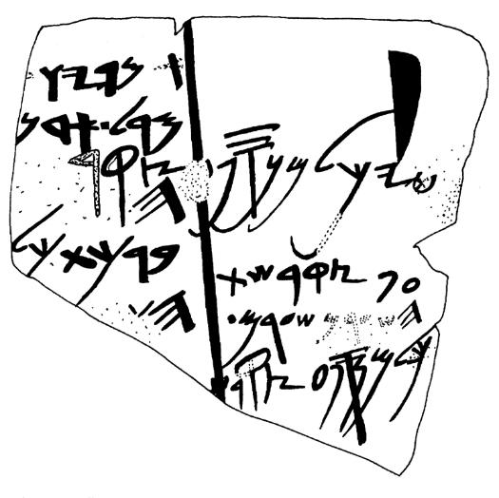
Syncretism cont.--
Also excavated at Kuntillet Arjrud, the wording on this sherd is:
“Message of […] so[n of] Amaryaw: Speak to my lord… ‘I bless you by Yahweh of Teman and by his Asherah…’”
This blending of Yahweh worship and the female consort of Ba’al testifies to the religious confusion of the times.

Slide 10
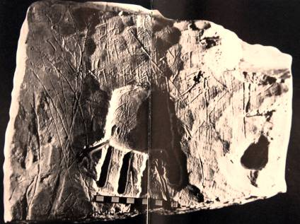
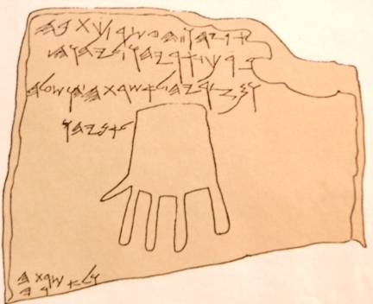
Syncretism cont.--
This Hebrew blessing on the wall of a tomb near Hebron also contains the phrase:
“Blessed by Yahweh and by his Asherah”
While this inscription and the preceding ones may be earlier than the time of Manasseh (probably 8th century BC), they demonstrate Judah’s tendency toward syncretistic religion.

Slide 11
Vassalship to Assyria
Manasseh reestablished Judah’s vassalship to Assyria that had been resisted in the reign of his father.
The Chronicler indicates that Manasseh suffered a temporary deportation to Assyria (2 Chr. 33:10-13).
Assyrian texts indicate that Manasseh supplied building materials for Nineveh under Esarhaddon and stooped to “kiss the feet” of Ashurbanipal.
When Manasseh died, Amon, his son, made no effort to reverse the paganizing trend. He was assassinated after a short reign (2 Kg. 21:23-24).

Slide 12
Points to ponder
How many generations does it take to turn from faithfulness to unfaithfulness?
Can the process work in reverse?
What can you take away from the fact that Josiah’s spiritual turning toward God began when he was a teenager?

Slide 13
The day of yahweh
1:1—2:3

Slide 14
Vision of the day of Yahweh (1:2-3)
Zephaniah’s initial oracle focuses upon “the Day of Yahweh” (1:7), a designation used by other prophets as well (cf. Am. 5:18; Is. 2:12; 13:9ff.; Joel 2:1, 31).
The term “day of Yahweh” more or less approximates what we mean when we speak of doomsday.
It would be a cataclysm as devastating as Noah’s flood, wiping out the earth’s human population and destroying animal, fish and fowl.

Slide 15
The Eschatological Language of the Prophets
hv!hy; MOy (= Day of Yahweh)
Mymiy0!ha tyr9H3xaB; (= in days to come, in the last days)
Xv0hha MOy0B;(= in that day)
All these expressions are fluid and have a semantic range that includes the near future as well as the indeterminate future.

Slide 16
Day of Yahweh
NEAR FUTURE
Judgment by exile on the unfaithful nations of Israel and Judah
Judgments in history on the nations surrounding Israel and Judah
FAR FUTURE
Judgment on a blasphemous world by universal cataclysm
Disintegration of the universe
Salvation of God’s people
Victory of God’s armies
Universal peace

Slide 17
Jerusalem and Judah (1:4-6)
Zephaniah’s primary concern was with the city and the nation Yahweh had chosen to bear his name.
Her citizens had turned away from the pure faith of Yahweh to follow the Ba’al fertility cult.
They were bowing before the astral deities of the Mesopotamians, where the heavenly bodies were believed to be gods, especially Ishtar, the Queen of heaven, who was linked to the planet Venus.
They were participating in the bloodthirsty offerings of Moloch, whose devotees offered propitiatory child sacrifices, pronouncing oaths in the name of Yahweh and in the name of Moloch as well.

Slide 18
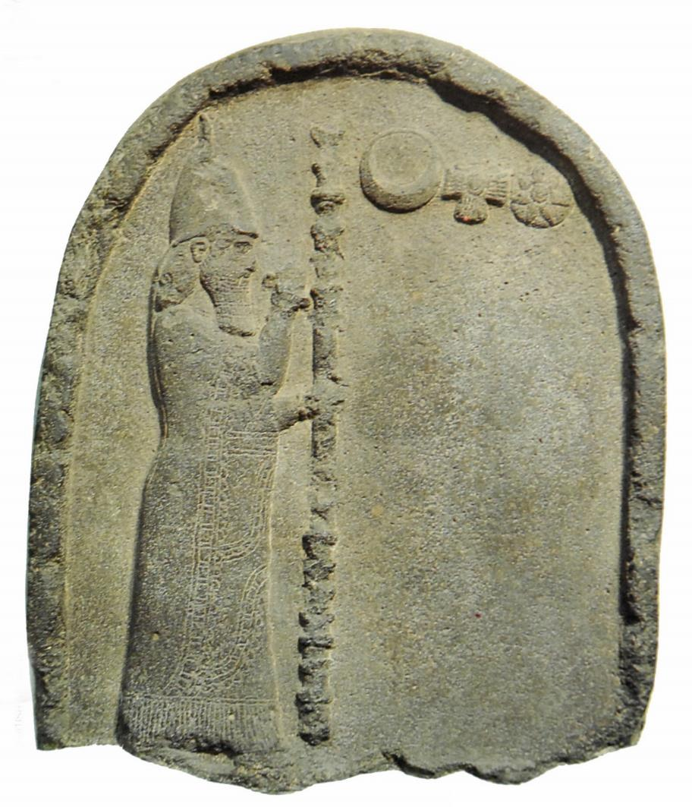
Nabonidus Stele
Nabonidus, king of Babylon (556-539 BC), holds a staff topped with a divine emblem in his left hand, while he raises his right hand toward three symbols of the gods, Sin, the crescent moon deity, Shamash, the sun god represented by the winged sun-disk, and Ishtar, the planet Venus symbolized by the star.
(British Museum, London)

Slide 19
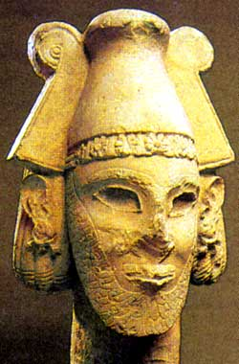
Ammonite deity
Discovered at Ramat Ammon, dating to the 8th-7th centuries BC
The worship of Moloch (the name is based on the ANE word jlm = “king”) is probably to be linked to the OT language about making children “pass through the fire” (Dt. 18:10; 2 Kg. 21:6; Eze. 20:26, 31; 23:37).
Israel Museum, Jerusalem

Slide 20
Other paganizing trends (1:7-9)
In addition to the basic offense of idolatry, the citizens of Jerusalem had adopted…
…the clothing styles of the foreigners, probably neglecting the special clothing stipulated in the Torah (Nu. 15:38-42; Dt. 22:11-12).
  The “tallith” was a garment with specially knotted fringes (“tzitzits”) with blue thread at the four corners, eventually evolving into the post-biblical prayer shawl of Jewish tradition.
  The purpose of the fringes was a reminder to observe the commandments of Yahweh.
…pagan superstitions, such as, “stepping over the threshold”, an obscure custom associated with the Philistines (1 Sa. 5:5). Apparently, it was believed that household demons lay beneath the thresholds of doorways, and stepping on the threshold might anger them.

Slide 21
Coming judgment (1:10-13)
As an act of judgment, Yahweh had determined to allow an enemy to invade from the north.
While the enemy is not named, all the districts under attack are on the northern side of Jerusalem, the “Fish Gate” (probably in the northern wall), the “Second Quarter” (Mishneh) and the “Mortar” (Maktesh). This was the area of the city most vulnerable to assault.
Whether the enemy would be Assyria or Babylon was unclear, but what was clear is that all commerce would be wiped out.
In particular, those who relegated Yahweh to being a “do-nothing” deity would be rudely awakened by his divine wrath!

Slide 22
FALSE SECURITY IN JUDAH
The fall of the northern kingdom apparently did not shake the confidence of those in the south.
Mic. 2:6-7; 3:11-12
Zep. 1:12
Je. 22:21; 6:14; 8:11; 7:4, 9-10
They believed their defining national symbols remained intact because of their loyalty to David’s family and Mt. Zion:
Covenant (especially the Davidic covenant, cf. Ps. 89:19-37)
Kingship (loyalty to the family of David, cf. 2 Sa. 22:50-51)
Temple (loyalty to God’s choice of Zion, cf. Ps.125:1-2; 48:12-14; 46:1-7
Land (believed to be inviolably theirs forever, cf. Je. 26:7-11

Slide 23
The day of Yahweh (1:14—2:3)
Doomsday was near and coming fast!
Like Amos (5:18-20), Zephaniah describes it as a day of darkness, sweeping the whole land.
Indeed, as is common among the prophets, the coming judgement of God on Judah would broaden out until it included the whole world. God’s judgment against Jerusalem was only a microcosm of his coming judgment on all nations.
This dire prediction was tempered with a call to repentance. Perhaps it was not too late, or perhaps at least those who maintained their covenant faith might seek the LORD and be hidden from this devastating stroke of judgment.

Slide 24
Points to ponder
Are there dangers of religious syncretism for modern believers, and if so, what form might such syncretism take?
What do you make of the indictment for pagan clothing styles? Is this at all relevant for contemporary Christians?
What about superstitions? What superstitions might Christians adopt that are inappropriate?
The citizens of ancient Judah were naively secure because of a distorted theological emphasis. Do you think this may be possible for modern Christians as well, and if so, how?

Slide 25
Yahweh and the nations
2:4-15

Slide 26
Yahweh, The international god (2:4-15)
Like all the prophets, Zephaniah’s preaching contained oracles to other nations, too.
Neighboring nations, also, would be called to account on the Day of Yahweh.
Zephaniah spells out only the sins of the Moabites, but it can be assumed that the others were apparent.
The oracles to the nations demonstrated that Yahweh was not merely a provincial deity. He was Lord of all nations, not merely Judah.

Slide 27
NATIONS FROM THE FOUR DIRECTIONS
PHILISTIA
The Philistine cities were marked for destruction.
The name Kerethites (= Cretan, cf. Eze. 25:16) alludes to the Philistine origins in the Aegean islands (cf. Dt. 2:23; Je. 47:4; Am. 9:7).
Their lands would e annexed by the people of Judah and turned into pasture.
MOAB & AMMON
The Moabites and Ammonites had long threatened the people of Judah.
Yahweh had heard their mockery and now took oath that Moab and Ammon would be destroyed as thoroughly as Sodom and Gomorrah.
Their peoples and all nations would bow before Yahweh.
CUSH
Cush, the region usually identified with Nubia and/or Ethiopia in Africa, would also face judgment.
Possibly Cush was chosen because it was to the south and fills out a listing of nations in all four directions.
ASSYRIA
Assyria and Nineveh, where Jonah preached, would become a wasteland, fit only for wild animals.
The boast of being a self-sufficient city free from care and fear would end.
Nineveh would fall in 612 BC to the Babylonians.

Slide 28
Woes & blessings of Jerusalem
3:1-20

Slide 29
The fate of Jerusalem (3:1-8)
The capital of Judah, a city of oppressors and rebels, was polluted just like the surrounding nations.
It’s citizens refused to trust in Yahweh, neither obeying nor accepting correction.
Her political leaders were predators, gnawing the bones of the people; her prophets and priests were treacherous and defiled.
Still, Yahweh was within the city, dispensing true justice daily, bringing down nations in the hopes that Jerusalem might take warning, but to no avail.
Nothing was left but to await doomsday.

Slide 30
The restoration (3:9-20)
If woe was in the near future, blessing would come in the distant future. Judgment was not Yahweh’s final word.
Then, Judah’s citizens would be purified, standing shoulder to shoulder to serve the LORD in unity.
God’s scattered people, even those from Africa, would bring offerings to Yahweh.
The meek would inherit the earth!
The people of Israel now would celebrate their gift of forgiveness and freedom, and God would live among them.
Yahweh would sing lullabies over Jerusalem, the festivals would be restored and the city’s shame would be exchanged for honor.

Slide 31
Points to ponder
In the context of the ancient Near East, why was it important to understand that Yahweh was the God of all nations?
Judah’s spiritual leaders were hypocrites, both prophets and priests. How might this speak to the character of spiritual leaders today?
Do you think Zep. 3:11-12 could have been behind Jesus’ statement in Mt. 5:5 in the Sermon on the Mount?
Do you think the gathering of God’s scattered people from Africa informs the NT mission to the non-Jews?

