Slide 1

4A – APOLOGISTS AND HERETICS
The Early Christians Wrestle with Issues

Slide 2
THREE MYTHS FROM MY PAST: all inadequate
Christian history is a great wasteland: nothing important happened between the end of the 1st century and the beginning of the 20th.
There is only one right pattern for worship—and we have it! The NT paradigm for all Christian worship is that of Corinth.
Religious tradition is always bad and to be avoided.

Slide 3
Two Concerns for Early Christians
The Evangelical Concern
Here, the concern is the gospel. There is only one gospel, and anyone who advances any other gospel or “another Jesus” (2 Co. 11:4) is under a curse (Ga. 1:8-9).
The Catholic Concern
Here, the concern is the unity of the church. There is only one church, and all who are baptized into Christ are part of that same body (1 Co. 12:12-13). The prayer of Jesus on the night before his death was that his followers would be one (Jn. 17:20-23).

Slide 4
DISTINGUISHING BETWEEN CENTRAL AND SECONDARY ISSUES
The visible church is composed of humans who produce different interpretations of the Bible. The invisible church is the one seen by God alone, who only can read the human heart. Here, then, are the questions early Christians had to ask:
Want constitutes a true church?
Can a candlestick be removed?
What theological issues become deal-breakers?
What moral issues become deal-breakers?
What belongs in the center?
What should be left in the periphery?
THESE SAME QUESTION MUST BE ADDRESSED BY EVERY CHURCH IN EVERY GENERATION!

Slide 5
THE Quod ubique CENTRAL quod semper THEOLOGICAL quod ab omnibus CORE creditum est
“…that which has been believed everywhere, always, by all.”
Vincent of Lerins
ca. AD 450

Slide 6
DISCUSSION
If there is a central core of Christian thought, which distinguishes between primary and secondary issues, what belongs in this core?
What might be secondary issues that do not belong in this central core.

Slide 7
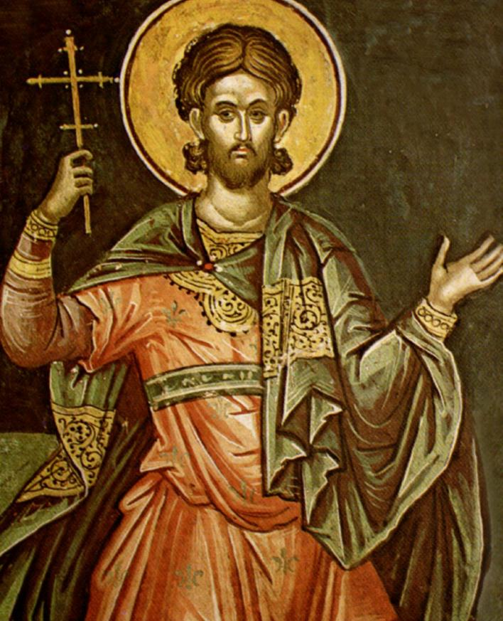
THE APOLOGISTS
The Apologists were early Christian leaders who wrote treatises defending Christianity against critics.
Prominent apologists included Justin Martyr, Tatian, Origen, Athenagoras of Athens, and others.
Addressed to the Roman emperor Antoninus Pius, Justin’s First Apology defended the morality of the Christian life.
His Dialogue with Trypho interacted with a learned Jew, Trypho, and attempted to show how Christianity superseded the old covenant.
The first comprehensive attack upon Christianity came from the Greek philosopher Celsus (ca. AD 175), and Origen’s Against Celsus became one of the most important early apologetic works.
While most of Justin Martyr’s works are lost, two apologies and a dialogue survive. He is revered as a saint by the Roman Catholic, Anglican, and Eastern Orthodox churches.

Slide 8
THE ante-nicene fathers These prominent Christian leaders in the Ante-Nicene Period wrote in two languages, Greek and Latin.
The Greek Fathers:
Irenaeus of Lyons (c.130-c.202): A disciple of Polycarp, his most well-known work is Against Heresies, emphasizing that Christian unity must derive from uniform Christian theology.
Clement of Alexandria (c.150-c.215): He is most well-known for developing a type of Christian Platonism.
Origen (184-253): Probably the most scholarly of the early Christian leaders, he wrote commentaries on all the books of the Bible.
Hippolytus of Rome (c.170-235): One of the most prolific writers, he was a disciple of Irenaeus.
The Latin Fathers:
Tertullian (c. 155-c. 240): He is famous for describing God as “three Persons, one Substance.”
Cyprian (200-258): Bishop of Carthage, he eventually died as a martyr.
Their writings are translated into English and available in various published formats.

Slide 9
THE EARLY HERESIES
A heresy is a teaching that the Christian church at large considers to be erroneous or dangerous to the faith.
In addressing heresies, it should be kept in mind that there were various disagreements in the early church which did NOT threaten the core of the Christian faith.
The rise of heresies forced the early Christians to better define themselves, and at least in this sense, the heretics provided an important incentive. Heretics were not necessarily bad or evil people; however, they arrived at answers to theological questions that, in the end, did not win the day.
The result of these debates and the decisions reached is now what we consider orthodox Christianity.

Slide 10
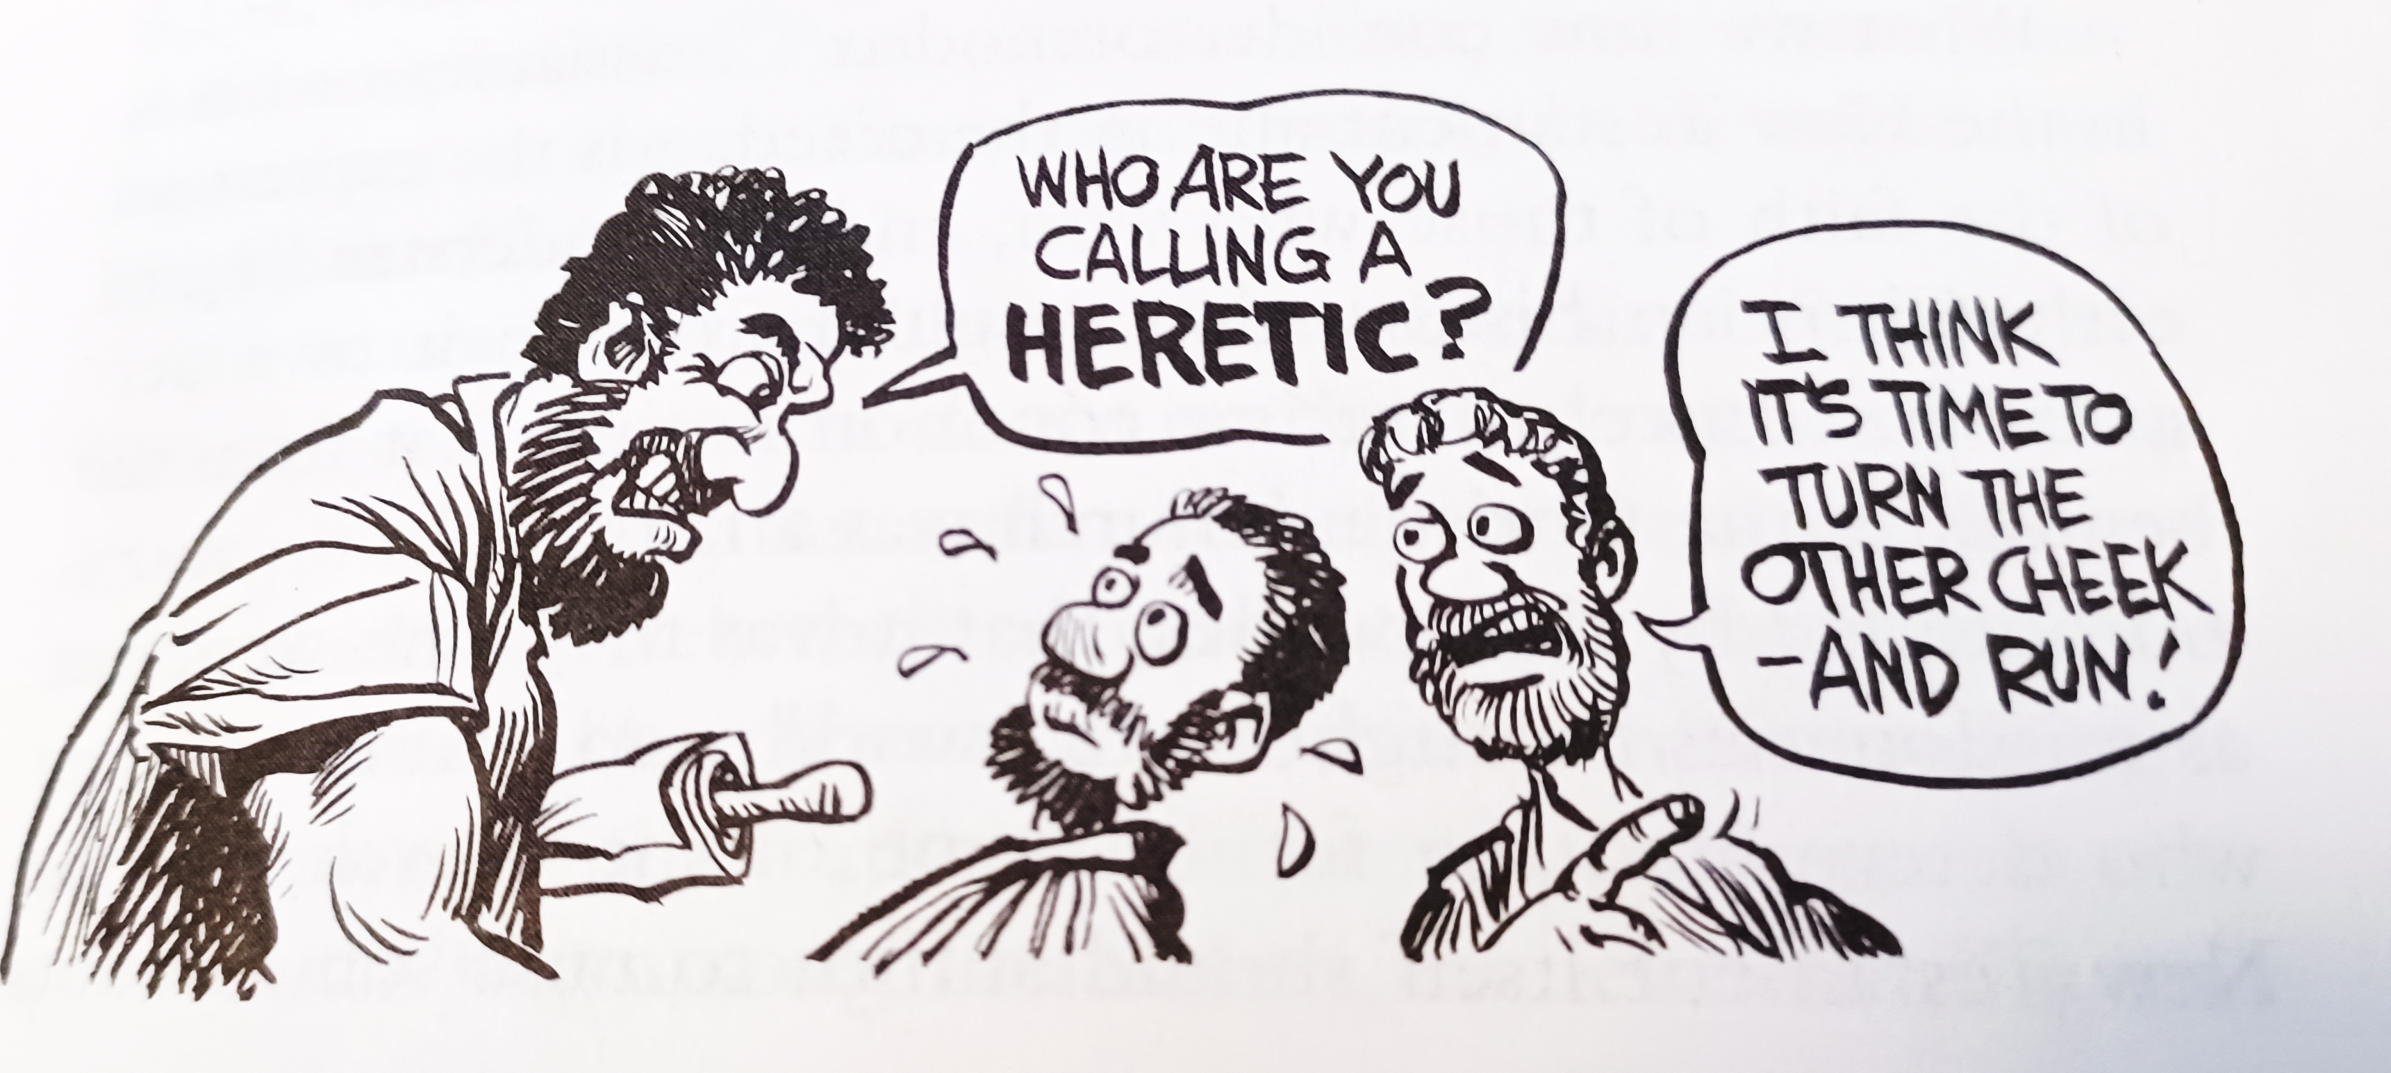
Ron Hill

Slide 11
The ebionites
One of the earliest issues concerned a group self-designated as Ebionites (an Aramaic word the “the poor”).
This group developed among Jewish Christians, and many scholars think their background might be the Essenes, who also referred to themselves as “the poor.”
They required Torah observance, but they believed traditional Judaism had radically misinterpreted the books of Moses regarding sacrifices.
After the episode of the golden calf, they taught that God gave the sacrificial system as a temporary expedient.
Jesus came to correct that and institute the true worship of God.
They used some form of the Gospel of Matthew, though they omitted some of it, especially Matthew’s description of the virgin birth of Jesus. They emphatically did not like the writings of Paul.
They accepted the idea that Jesus ended the OT sacrificial system, but they rejected the idea that Jesus’ death was itself a sacrifice. They believed Jesus was only a human endowed with special powers.

Slide 12
The gnostics
Gnosticism was a collection of religious ideas flourishing in the mid-2nd century among some Christians. Rather than focusing on sin and repentance, as was true of the apostles, the Gnostics focused on concepts of illusion and enlightenment. The goal was to escape the physical world, while salvation was to be liberated from the prison of the body.
Gnostics especially emphasized personal spiritual knowledge, and their name derives from the Greek word gnwsij (= knowledge).
They wrote their own versions of gospels about Jesus (and these versions were many decades later than the canonical gospels and not within the era of any eyewitnesses).
They held that their writings contained the only true version of Jesus.
They objected to the Eucharist, since how could a physical meal of bread and wine have anything to do with pure spiritual truth?

Slide 13
Gnosticism and Early Christianity
Gnostic Concepts
Universe created by a demiurge
Salvation is by knowing secrets of the universe
The spiritual person is free from moral law
The redeemer is a demi-god, wholly a spirit-being
Mainstream Christian Beliefs
Universe created by God through Christ
Salvation is by believing in God’s Son
The spiritual person lives by light and truth, not darkness
The Redeemer is God’s Son incarnate, both human and divine.

Slide 14
GNOSTIC IDEAS the merging of Christianity and Greek dualism
SPIRIT
all good
MATTER
all evil
IMPLICATION…the incarnation of Jesus is impossible; Jesus’ bodily resurrection is impossible.
GOAL…to attain secret knowledge by which one can escape the material prison of the body and achieve an elevated spiritual existence in heaven.

Slide 15
GNOSTIC SOLUTIONS TO THE INCARNATION
DOCETISM
Christ only seemed to be a real human. His apparent body was really an illusion.
CERINTHIANISM
Christ and Jesus were two separate beings: Christ was divine and Jesus was human. Their union was only temporary.
THE PLEROMA
Jesus was a demi-god, the last of a series of intermediate beings between the Father and the world of humans.

