Slide 1

THE CHRISTIAN CHURCH 2
Its peoples, theologies, and practices
A Short History
PART 1: From the Apostles to the Renaissance

Slide 2
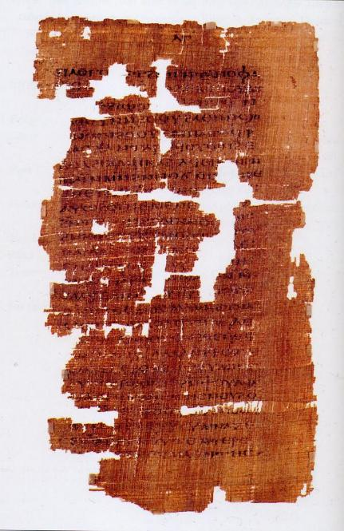
REJECTION OF GNOSTICISM
The early church fathers denounced Gnosticism as heresy and destroyed Gnostic texts.
Our knowledge of Gnostic ideas only derived from secondary sources until the middle of the 20th century.
With the discovery of the Nag Hammadi texts in Egypt in 1945, we gained first-hand access to actual Gnostic writings, which contain several additional gospels and other writings.
Page from the Gospel of Judas

Slide 3
COPTIC GOSPELOF THOMAS
The earliest Gnostic gospel consisting of 114 “sayings” of Jesus without narratives
SOME SAYINGS ARE VERY SIMILAR TO THE CANONICAL GOSPELS
Jesus said, “If a blind man leads a blind man, both of them fall into a pit.”
Jesus said, “It is not possible for one to enter the house of the strong [man] and take him by force unless he binds his hands; then will he ransack his house.”
Logia 34-35
OTHER SAYINGS ARE STRANGE AND ESOTERIC
His disciples said, “When will you be revealed to us and when will we see you?”
Jesus said, “When you take off your clothing without being ashamed, and take your clothes and put them under your feet as the little children and tread on them, then [you shall behold] the Son of the Living One and you shall not fear.”
Logion 37

Slide 4
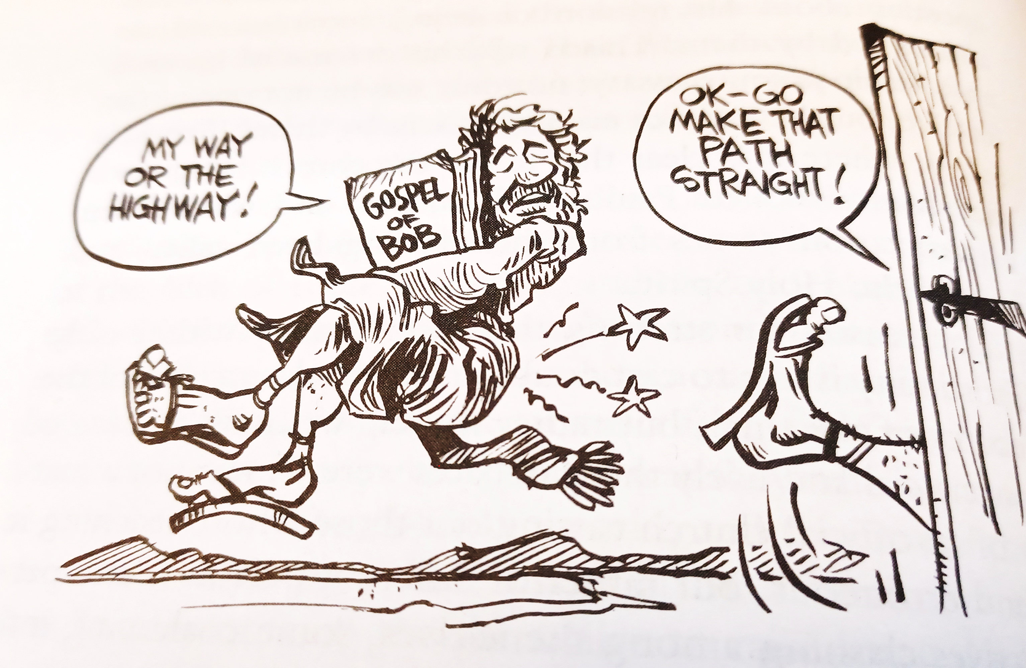
Ron Hill

Slide 5
marcion
Marcion, a teacher in Rome (c. AD 144), determined to sever Christianity from Judaism as much as possible.
Like Gnostics, he did not believe that Jesus was born or had a true human body.
He also held that Jesus came from a superior God, a God of love (good God), who had nothing to do with the God of Israel, who was a God of laws (bad God).
He believed that the Old Testament should be rejected outright, along with any New Testament books that seemed to conflict with his ideas. Hence, he created his own canon of Scripture, which included 10 letters of Paul and the Gospel of Luke.
In his “two-God-theology,” Marcion held that Jesus’ death was a payment from the God of love to the God of Israel to set humans free.
Due to Marcion’s abbreviated canon, the early church was now compelled to wrestle with the task of deciding which Christian writings ought to belong to the canon, so indirectly, Marcion did the church a favor. In addition, the early church would embrace the Hebrew Bible as belonging to the true canon of Scripture.

Slide 6
The montanists
Montanus, a teacher from Phrygia (near the Black Sea) and a convert from paganism, announced that the age of the Father was past, the age of the Son was past, and now the new age of the Holy Spirit had begun. He claimed that he was himself indwelt bodily by the Spirit to announce the new age.
He also announced that the end of the world was at hand, and the New Jerusalem would soon descend from heaven upon the village of Pepuza, Phrygia.
Alongside Montanus and supporting him were his two female prophets, Maximilla and Priscilla.
Some Montanists were martyred, and some even volunteered and sought out martyrdom.
Because he was the embodiment of the Holy Spirit, Montanus supported an open canon of Scripture, while the larger church held that such new revelation had ended with Jesus and the apostles.

Slide 7

Ron Hill

Slide 8
The triadic language
It is probably fair to say that in view of the triadic language in the NT of Father, Son, and Holy Spirit, worship preceded doctrine.
The language of Father, Son, and Spirit was widely used in the New Testament, both in concise sentences (Mt. 28:19; Ro. 15:30; 2 Co. 13:14; Ep. 2:18) as well as in longer constructions (1 Co. 12:4-6; Ga. 4:4-6; Ep. 1:3, 11, 13; 4:4-6; Tit. 4:4-6; Jude 20-21).
The Father was worshipped as God, the Son as God, and the Holy Spirit as God.
Still, while Jesus can be called God (e.g., Jn. 1:18; 1 Jn. 5:20), the Son is never addressed as the Father nor the Father as the Son.
Prayer, invariably, is directed to the Father in the name of the Son and through the Spirit (Jn. 16:23-24; Ro. 8:15b; 15:6; 2 Co. 11:31; Ga. 4:6; Ep. 2:18; 3:14; 5:20; Col. 1:3, 12; 3:17).
At the same time, the monotheism of the OT is clearly upheld by the writers of the NT (Ro. 3:30; 1 Co. 8:4, 6; Ga. 3:20; Ep. 4:6; 1 Ti. 2:5; cf. Ja. 2:19).

Slide 9
The POST-APOSTOLIC CHURCH
This triadic language continued in the writings of the leaders in the post-apostolic church:
"Baptize in the name of the Father, and of the Son, and of the Holy Spirit....“ (Didache 7:1, 3) c. AD 95
"....as God lives, and the Lord Jesus Christ, and the Holy Spirit…” (1 Clement 58:2) c. AD 96
“…in the Son and in the Father and in the Spirit…” (Ignatius, Magnesians 13) c. AD 114
…gives praise and glory to the Father of the universe, through the name of the Son and of the Holy Spirit....“ (Justin Martyr, 1st Apology 65) c. AD 140
“…walk according to the doctrine of the gospel of Jesus Christ; with whom be glory to God, the Father, and the Holy Spirit…” (Polycarp, Martyrdom of Polycarp 22) c. AD 155
"We acknowledge a God, and a Son His Logos, and a Holy Spirit united in power...” (Athenagoras, Plea for the Christians 24) c. AD 177

Slide 10
Early heresies about the godhead
The paradoxical Divine Nature was that there is one God who is Father, Son, and Holy Spirit, but the names Father, Son, and Spirit are not synonyms. Some of the early heresies departed from these fundamental confessions in significant ways:
The Ebionites refused to recognize the deity of Christ altogether.
The Gnostics could not accept the idea of the incarnation.
The Marcionites embraced a two-God theology and pitted one against the other.

Slide 11
The modalists
Toward the end of the 2nd century, some Christians began to explore this triadic language in a deeper, theological way.
Following the teachings of Praxeas and Sabellius, some decided that the Father, Son, and Spirit should be understood as phrases or modes through which God passed: he was the Father in creation and in the Old Testament, he was the Son in the New Testament, and he became the Spirit in the life of the church.
There were some acute problems with this view, however:
  It directly cut across the NT affirmation that God created all things through the Son (Jn. 1:3, 10; Col. 1:15-17; He. 1:2)
  It failed to account for the many passages that showed a distinction between the Father and the Son (Jn. 1:1-2; 8:18; the repeating salutations in Paul’s letters acknowledging both the Father and the Son)
  It seemed in direct conflict with the NT affirmation that the Father sent the Son into the world, and the Son returned where he was before (Jn. 3:34; 4:34; 5:23-24, 30; 5:36-38; 6:29, 38-39, 44, 57; 7:16, 28-29, 33, etc. and Jn. 6:62; 17:5).
  It implied that the Father died on the cross (called Patripassionism).

Slide 12
Two Views
MODALISM
God is a simple “one.”
The Son is God only in a particular time and space. Sonship is only a temporary mask.
Father, Son, and Spirit are not the essence of God, only modes.
The Spirit tends to be impersonal.
TRINITARIANISM
God is a complex “one.”
Jesus is God the Son incarnate. He is the Son eternally, and this is part of his essential nature.
God is one Substance in three Persons. This IS the essence of God.
The Holy Spirit is personal.
The earliest written appearance of the word “Trinity” to describe God (triaj in Greek) comes in the writings of Theophilus of Antioch (c. AD 180). Slightly later, Tertullian (c. AD 155-220) uses the term (trinitas in Latin) as well.

Slide 13
The NOVATIaNISTS
The Novatianists split from the church in Rome in the mid-3rd century after Novatian was defeated in the election of bishop. The name by which they called themselves was “the Purists.”
  Novatian fostered a rigorist position that anyone who denied the faith under persecution could never be reinstated. It was an unpardonable sin.
  All major sins (i.e., murder, adultery, blasphemy, etc.) after baptism were unforgiveable.
  Any who came into the Novatianist congregations from the wider church were required to be re-baptized.
  Novatianists created a separate church that survived up into the 7th century.

Slide 14
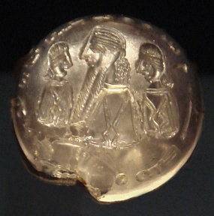
The manichaeans
Mani, a Persian of the 3rd century, claimed to have received the final, universal revelation.
  Reality consisted of two independent and eternal principles, a view similar to Gnosticism:
    Light/God
    Darkness/Matter
  Jesus, along with Zoroaster, Buddha, and others, had come so that the “souls of light” could be released from the material prison of the body. As with Marcionism, Jesus never experienced human birth. His death was in appearance only.
  Manichaeism combined features of Zoroastrianism and Indian thought with Christianity, including the idea of reincarnation.
  It several ways it was similar to Gnosticism.
  Manichaeism survived into the Middle Ages.
Seal of Mani with the inscription “Mani, Messenger of the Messiah”

Slide 15

The Apostles’ Creed

Slide 16
Credo
“I believe…”
The term “creed” comes from the Latin “credo,” which means “I believe…” or “I rely upon…”
It is similar to the modern “Statement of Faith” that many churches publish, which are themselves creedal in nature.

Slide 17
The Apostles’ Creed
The Apostles’ Creed is the oldest and most generally accepted statement of faith in Christendom (Roman Catholic, Eastern Orthodox, Anglican, Lutheran, Presbyterian, and most evangelical denominations).
Since it is largely a collage of NT Scripture phrases, there is little room for objection.
At the same time, it serves to focus on the core of what Christians have always held central.

Slide 18
Development of the Creed
Various segments of it can be found in Christian writings as early as the 2nd century in what is called “the Rule of Faith.”
In the earliest period of the church, simple versions functioned as confessions of faith for those who were to be baptized.
It also provided a benchmark for distinguishing the true faith over against heresies and distortions.

Slide 19
As a baptismal confession…
“Do you believe in God, the Father Almighty?”
“Do you believe in Christ Jesus, the Son of God, who was born by the Holy Spirit of the Virgin Mary, and was crucified under Pontius Pilate, and was dead and buried, and rose again the third day, alive from the dead, and ascended into heaven, and sat down at the right hand of the Father, and will come to judge the living and the dead?”
“Do you believe in the Holy Spirit, in the holy church, and the resurrection of the body?”
Hippolytus (early 3rd century)

Slide 20
The Rule ofFaith
ORTHODOXY
God is the Father Almighty.
He is the Creator of heaven and earth.
HERESY
Creation is by an inferior deity (Gnosticism).
Creation is by a vengeful god who was not the father of the Lord Jesus (Marcionism).

Slide 21
Rule ofFaith cont.-
ORTHODOXY
Christ Jesus is the eternal Son of the Most High God.
He came from heaven.
He was born of the Holy Spirit through the virgin Mary.
He took upon himself flesh in the incarnation.
HERESY
Christ Jesus was the son of a lower Aeon in the pleroma (Gnosticism).
He was born naturally (Ebionites).
He was not born at all (Marcion).

Slide 22
Rule ofFaith cont.-
ORTHODOXY
Jesus Christ was pierced, dead, and buried.
He ascended into heaven to the right hand of the Father.
He will judge the living and the dead.
HERESY
Jesus Christ did not truly die (Gnosticism).
He was not truly resurrected (Gnosticism).
Mani, not Jesus, is the final revelation (Manichaeism).

Slide 23
Rule ofFaith cont.-
ORTHODOXY
The Holy Spirit belongs to the Godhead.
The church is catholic (universal).
The bodies of believers will be resurrected.
HERESY
Mani is the Paraclete (Manichaeism).
Church schisms are to be tolerated (Novatianists).
Matter is evil; there can be no resurrection of the body (Gnosticism).

Slide 24
The Apostles’ Creed
I believe in God, the Father Almighty, Maker of heaven and earth.
And in Jesus Christ, his only Son, our Lord; who was conceived by the Holy Spirit, born of the virgin Mary, suffered under Pontius Pilate, was crucified, dead and buried; he descended into hell; the third day he rose again from the dead; he ascended into heaven and sitteth on the right hand of God, the Father Almighty, from thence he shall come to judge the quick and the dead.
I believe in the Holy Spirit, the holy catholic church, the communion of saints, the forgiveness of sins, the resurrection of the body, and the life everlasting. Amen.

Slide 25
“he descended into hell”
This phrase is based upon several passages that seem to describe the interval between Jesus’ death and resurrection.
Christ “preached to the dead” (1 Pe. 4:6).
He descended to the “lower parts of the earth” (Ep. 4:9; Mt. 12:40).
He was not “abandoned to hell” (Ac. 2:25ff.)
He was in “the Abyss” prior to his resurrection (Ro. 10:6-7).
The ante-Nicene fathers took these passages to mean that Christ descended into Hades, either to proclaim the gospel or to announce his victory over Satan and death.

Slide 26
At the very least, the phrase “he descended into hell” means that Christ’s death was real.
Hence, some versions of the creed use the expression “he descended to the dead” rather than “he descended into hell.”
Most Protestants are uncomfortable with the idea that Christ may have offered a second chance for salvation to those already in hell.
This clause is the most controversial, because alternative interpretations of the key passages have offered equally alternative meanings for the whole.

Slide 27
“the catholic church”
The Greek term katholikos in the creed means “through the whole”.
Referring to the universal church, this word has been used by Christians since the early 100s AD to describe the whole church in the whole world.
It also is used to describe the orthodoxy of the church in the face of heresies—the church whose faith is “that which has been believed everywhere, always, and by all.”
The word “catholic” should be distinguished from the expression “Roman Catholic.”

Slide 28
“the communion of saints”
Since all Christians, living or dead, are “in Christ,” all believers belong to a single body, the church.
Those who are living are alive “in Christ” (Ro. 6:11; Ep. 2:4-5); those who are deceased are dead “in Christ” (1 Th. 4:14, 16).
Hence, Christ is Lord of both the dead and the living (Ro. 14:9).
At the end, both the living and dead in Christ will be caught up to meet the Lord at his return as a single group (1 Th. 4:15-17).

Slide 29
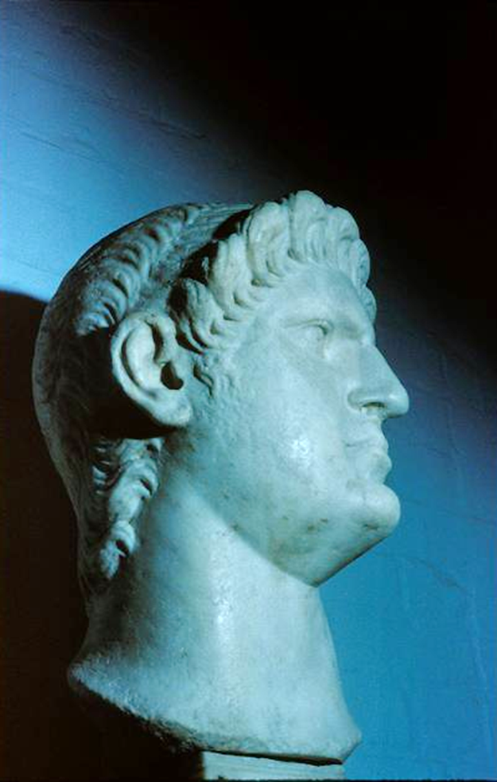
EARLY PERSECUTIONS
FROM SOME WITHIN THE JEWISH COMMUNITY
Sanhedrin in Jerusalem (Ac. 8:1; 9:1-2)
Jewish communities in Asia Minor and Greece (Ac. 13:50; 14:4-5, 19; 17:5-9, 13; 18:12-17)
FROM THE ROMAN GOVERNMENT
Tacitus, the Roman historian, wrote that Caesar Nero blamed the great fire in Rome upon the Christians (AD 64).
The legality of Christianity, after its alienation from Judaism, became ambiguous (post-AD 70).
By the time of Domitian (AD 81-96), emperor worship became the primary point of contention.
CAESAR NERO

Slide 30
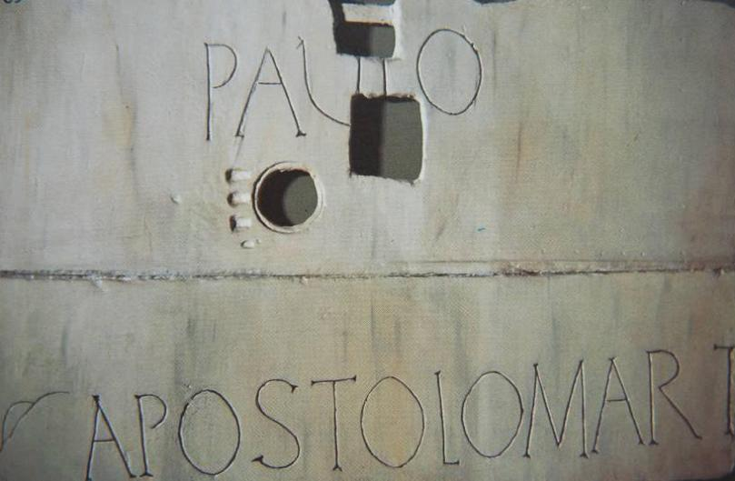
Paul and Peter, the two most important leaders in early Christianity, were both executed in Rome by the mid-60s.
Erected above Paul’s tomb, Church of St. Paul Outside the Walls, Rome
In 2009, the Pope gave permission for the bone fragments in the tomb to be carbon-dated, and indeed they date to the 1st century.

Slide 31
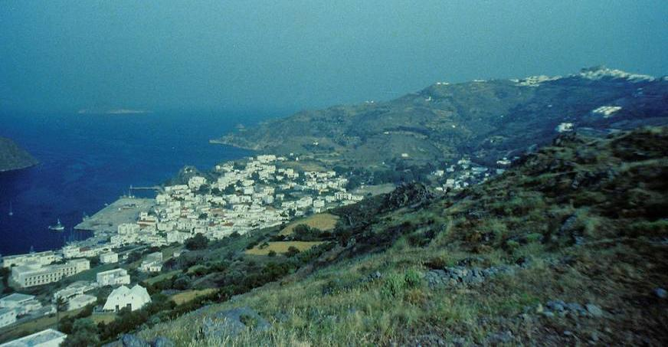
“I, John, your brother and companion in the sufferings and kingdom and patient endurance that are ours in Jesus, was on the island of Patmos because of the word of God and the testimony of Jesus.”
The Island of Patmos, where John was exiled.

Slide 32
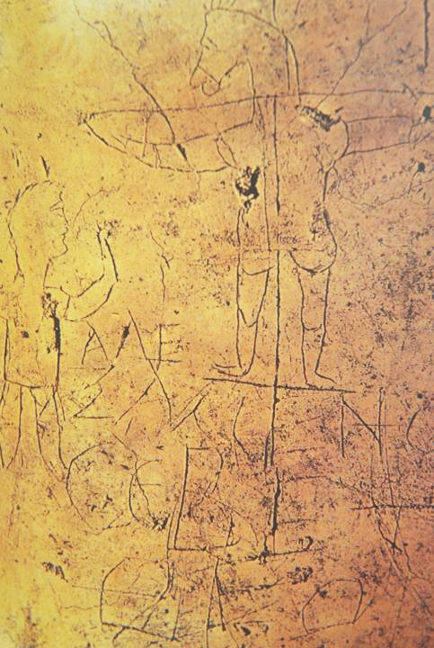
Grafitto mocking Christians,
Palatine Hill, Rome
Alecamenoj sebete qeon
(“Alexamenos prays to [his] god”)

Slide 33
Pagan Diatribe against Christians…
“Excuse me for expressing my intense feelings so freely, but I think it is deplorable that attacks should be made upon the gods, by a gang, yes I mean a gang, of discredited and proscribed desperadoes. This gang [the Christians] has been gathered from the lowest dregs of the population. They are ignorant men and women—and we all know women are naturally unstable. They are a rabble of impious conspirators. At their night-time meetings, solemn fasts, and barbarous meals, their bond of union is not a sacred rite, but crime. They are a secret tribe that lurks in the darkness and shuts out the light. They are silent in public but chatter in the corners.
These conspirators must be utterly destroyed and cursed!”
From Minucius Felix (d. 250)

Slide 34
Roman Accusations Against Christians
Christians were “anti-social”
Christians were “atheists”
Christians were “haters of mankind”
Christians were “cannibals”
Christians promoted “incest”
“The blood of the martyrs is seed…”
Tertullian (early 3rd century)

Slide 35
Excerpts from the Martyrdom of Polycarp
“…Polycarp entered into the stadium… When he was brought up, there was a great tumult, for they heard that Polycarp had been apprehended.
“…the Proconsul [urged], ‘Swear by the genius of Caesar; repent, and say, Away with the atheists.’ Polycarp…looked upon the whole multitude of lawless heathen…and waved his hand to them; and groaning and looking up to heaven he said, ‘Away with the atheists.’
“They did not nail him, but tied him. …looking up to heaven [he] said, ‘O Lord God Almighty…may I be received in your presence this day…’ When he had offered up the ‘Amen’ and finished his prayer, the firemen lighted the fire.
Martyrdom of Polycarp 9-15

Slide 36
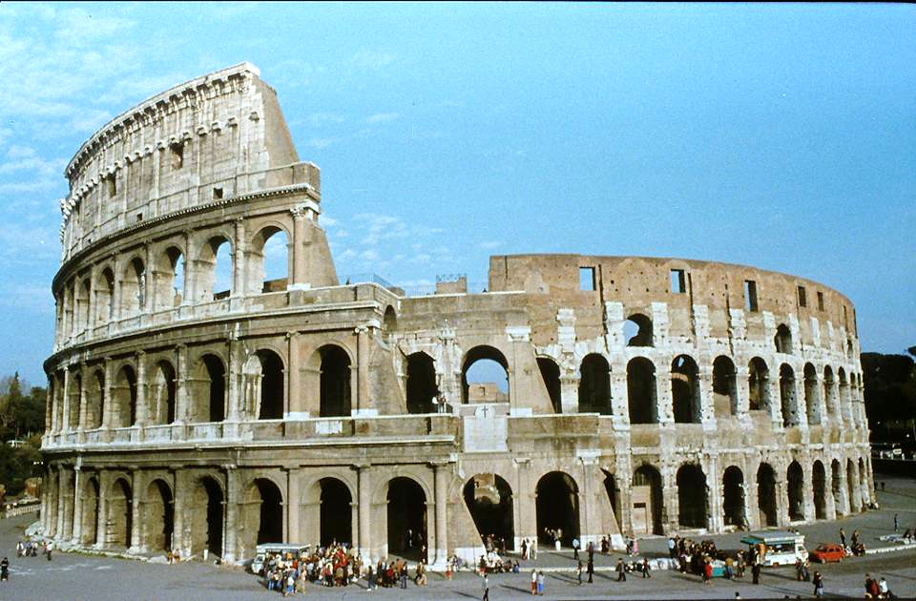
The Colosseum in Rome was completed in AD 80. Ignatius may have been the first Christian martyred here, since he expected to be “thrown to the beasts” when he arrived in Rome.

Slide 37
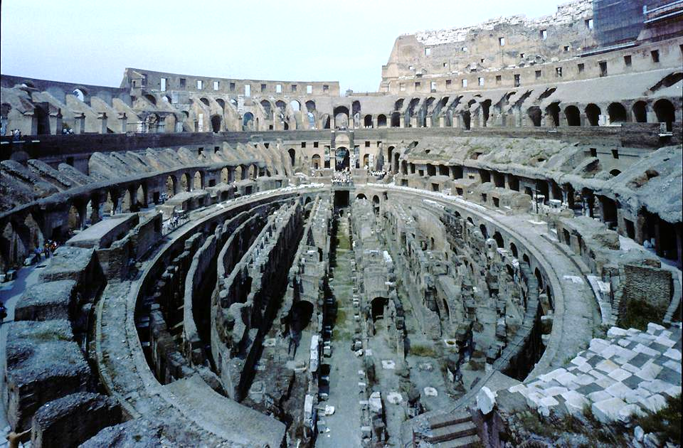
Colosseum Floor, where prisoners and wild animals were kept in preparation for the spectacles in the arena.

Slide 38
SPORADIC PERSECUTION
Emperor Trajan’s policy toward Christians was that they should be punished only if they refused to worship the emperor and the gods, but they were not to be sought out.
According to Irenaeus, there was a mass-slaughter of Christians thrown to wild beasts in Lyon.
In the 2nd century, Justin Martyr wrote that Christians were punished if they did not deny and blaspheme Christ.
In the 3rd century, Maximinus Thrax ordered leaders of the Christian churches to be put to death.
Emperor Decius (249-251) initiated the first empire-wide persecution to be enforced by a libellus, a certificate verifying that the recipient had sacrificed to the Roman gods. Failure to do so resulted in arrest, imprisonment, torture, and execution.

Slide 39
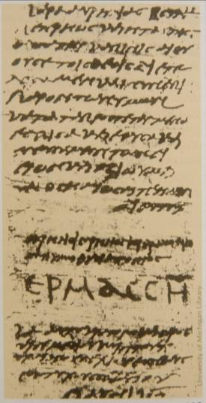
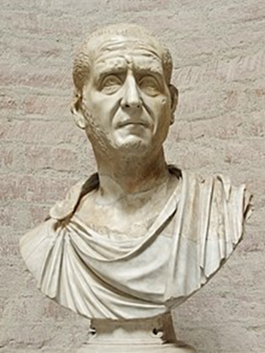
LIBELLUS: certificate proving that one had sacrificed to the Roman gods
Found in Egypt,
one of 43, all dated between June 12th and July 14th, AD 250.
Hermas, the recipient, signed his name in large capital letters.
University of Michigan, Hatcher Library
Emperor Decius

Slide 40
THE GREAT PERSECUTION
Emperor Diocletian began an intensive persecution on February 23, 303.
Churches were destroyed, Scriptures confiscated and burned, and Christians imprisoned and forced to perform sacrifices to the gods.
The emergence of Constantine as emperor brought an end to the state persecutions.

Slide 41
THE DONATIST CONTROVERSY
After each of the major persecutions, the church had to decide what to do with Christians who had succumbed to the demand to deny Christ, worship Caesar, and/or surrender their Scriptures to the authorities.
Some leaders held that after a period of penance, such persons could be readmitted.
Others considered this blasphemy, and such people could never again be part of the church.
The issue came to a head after the Diocletian persecution, when it became known that the Bishop of Carthage had turned over Christian Scriptures to the Roman soldiers.
  Donatus led the faction demanding that any church recognizing the bishop was a false church, and in the end, claimed that the Donatist churches were the only true church.
  Constantine, the new emperor, became involved, and Augustine provided the definitive theological response to the Donatists, which allowed lapsed Christians to be reconciled to the church.

Slide 42
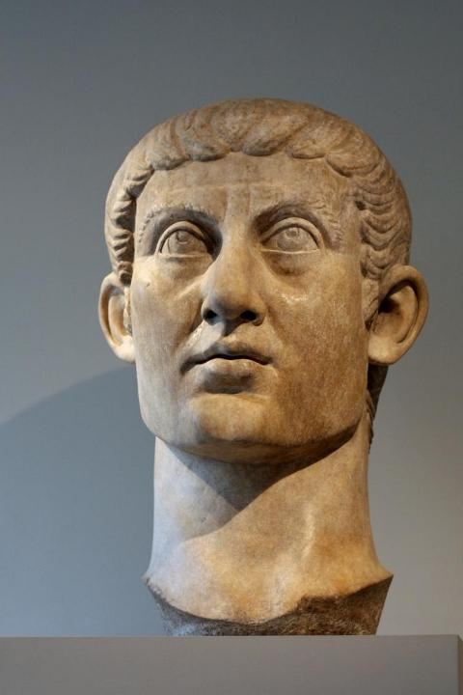
EDICT OF MILAN
Constantine, the Roman Emperor (AD 306-337) who, after claiming to have seen a vision of the cross in the Battle of the Milvian Bridge, converted to Christianity in AD 312.
  In AD 313 he issued the Edict of Milan, which announced tolerance for the Christian religion. This edict effectively ended the persecution of Christians by the state.
  While he clearly seemed to wish all his subjects would become Christians, he did not believe that genuine faith could be imposed.
  Rather, in his best moments he worked from the viewpoint of toleration, respect, bridge-building, and persuasion.
  He would not receive Christian baptism, however, until just before his death.
  Marble bust of Constantine (c. 325-370), Metropolitan Museum of Art, New York

Slide 43
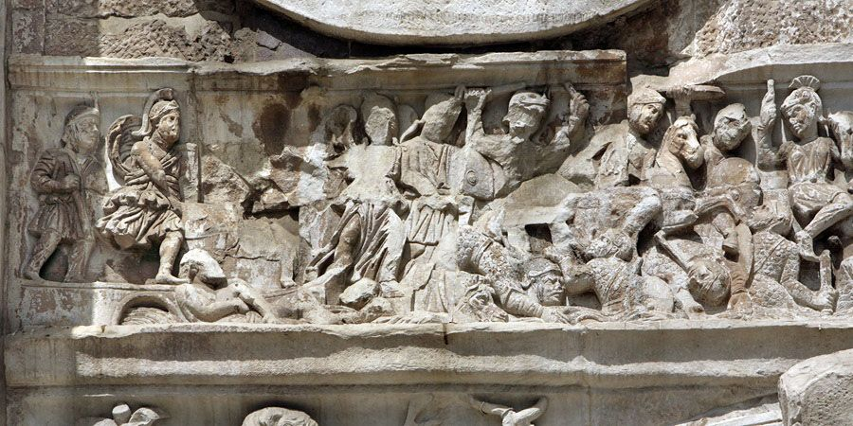
Battle Of The Milvian Bridge: Relief From The Arch Of Constantine

Slide 44
CONSTANTINE and CHRISTIANITY
Constantine was pivotal in transforming Christianity from a persecuted faith to the dominant religion in the empire.
He constructed new churches, especially in Bethlehem, Jerusalem, Rome, and Constantinople, and he commissioned the copying of 50 new large format Bibles.
Still, despite favoring Christianity, he also permitted the traditional pagan religions to continue, sometime patronizing them and allowing their images to appear on imperial coinage. This, in turn, raised questions about the authenticity of his conversion.
Was he a genuine Christian or a political mastermind who used Christianity to foster political unity? (The debate continues.)
Many citizens now converted to Christianity, but their motives might well have been social advantage as much as faith (nominal Christianity).

Slide 45

THE POST-NICENE CHURCH
When Christianity Became a Legal Religion

Slide 46
The doctrine of the trinity comes of age
Already, the term “Trinity” had been employed as a description of the Three-in-One God for well over a century, first used by Theophilus of Antioch and Tertullian in the late 2nd century.
Tertullian also had coined the language “three persons, one substance” to express the three-ness and one-ness of the Father, Son, and Holy Spirit.
After rejecting the various early heresies of the Ebionites, the Gnostics, the Marcionites, and the Modalists about the nature of God, the church would now encounter the most serious threat to its understanding of the godhead in the rise of Arianism.
The struggle with Arianism, in turn, would lead to a more nuanced definition of the Trinity expressed in the Nicene Creed.

Slide 47
The arians
In the 4th century, not long after Constantine’s rise, a popular preacher name Arius contended that the Son was not eternal but was the first created Being, hence, a creature less than God.
Arius’ followers took up the chant into the streets, “There was a time when he was not!”
The problem with Arianism, like Modalism, is that it cut directly across plain statements in the New Testament:
  At the beginning of time, the Son (Logos) already was “with” God (Jn. 1:1, 3).
  If only God the Father was eternal and absolute, then the Logos was a sort of intermediate Being, neither fully divine nor fully a creature.
  If the Son was a created Being, how could he have been “before all things” (Col. 1:17) and how could the Father have loved him “before the world’s creation” (Jn. 17:5, 24)?
  Most important, if the Son was not fully divine, then the Christian church since its inception had been worshipping a creature, which is the essence of idolatry.

Slide 48
The nicene council
The theological dispute also had political implications, so Emperor Constantine called for a council of all the bishops world-wide to convene at Nicaea, Bithynia to resolve the dispute.
According to Athanasius, some 318 bishops attended from all over the Roman Empire (and a few outside it as well).
They met from May until the end of July AD 325.
A statement of faith (Creed of Nicaea) was drafted based on the Apostles’ Creed, and all but two bishops subscribed to its final form. (This creed would later be slightly amended in AD 381, with some expansions concerning the Holy Spirit and the Church, in what we now call the Nicene Creed.)
This council was the first of its kind to attain Christian theological consensus, and subsequent councils would follow, called the first seven ecumenical councils in Christian history.

Slide 49
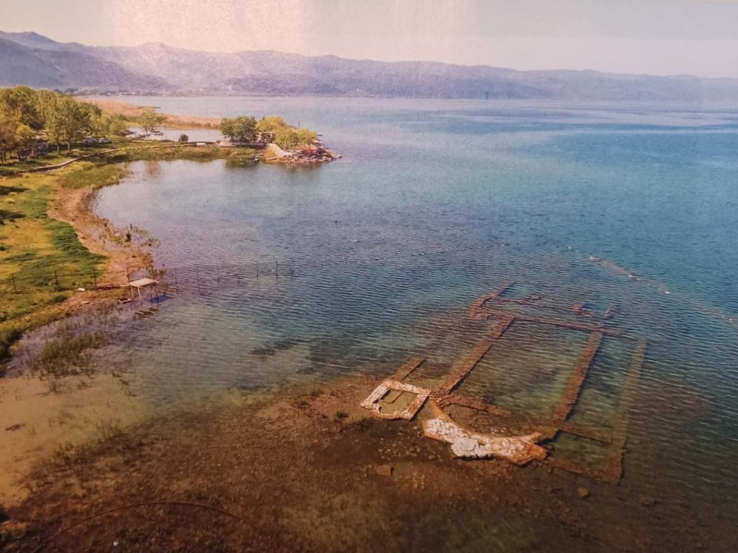
In 2015 near modern Iznik (ancient Nicaea), an early basilica was discovered lying submerged in 6-10’ of water about 165’ offshore. The church is divided into three aisles with an apse on the eastern end. Likely it was built on the site where the Council of Nicaea convened in AD 325.

Slide 50
The Nicene Creed from AD 325 and AD 381
We believe in one God, the Father Almighty, maker of all things visible and invisible;
And in one Lord, Jesus Christ, the Son of God, begotten from the Father, only-begotten, that is, from the substance of the Father, God from God, light from light, true God from true God, begotten not made, of one substance with the Father, through Whom all things came into being, things in heaven and things on earth,
Who because of us men and because of our salvation came down,
and became incarnate and became man, and suffered,
and rose again on the third day, and ascended to the heavens,
and will come to judge the living and dead,
And in the Holy Spirit.
But as for those who say, “There was [at time] when He was not,” and, “Before being born He was not,” and that “He came into existence out of nothing,” or who assert that the Son of God is of a different hypostasis or substance, or created, or is subject to alteration or change–these the Catholic and apostolic Church anathematizes.
The areas highlighted in yellow were especially directed toward the Arian controversy, both as positive statements regarding Christ Jesus as well as anathemas at the end directed toward the Arians.

Slide 51
Two Competing Views
ARIANISM
God is a simple “one.”
The Son is less than God. He was the first created Being, hence not fully God.
The Son is inferior to the Father.
The Holy Spirit is impersonal.
TRINITARIANISM
God is a complex “one.”
Jesus is God the Son incarnate. He is the Son eternally, and this is part of his essential nature.
God is one Substance in three Persons.
The Holy Spirit is personal.

Slide 52
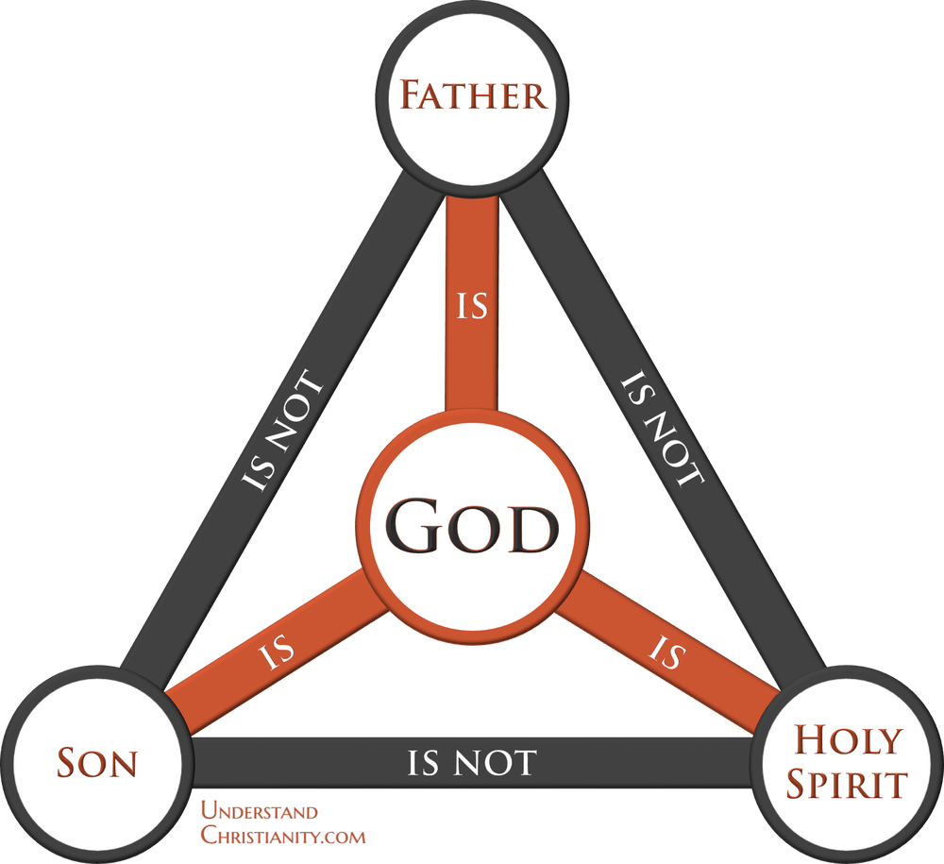
“How much more, then, will the blood of Christ [the Son], who through the eternal Spirit [the Holy Spirit] offered himself unblemished to God [the Father], cleanse our consciences from acts that lead to death so that we may serve the living God?”
He. 9:14
“Father, I want those you have given me to be with me where I am, and to see my glory, the glory you have given me because you loved me before the creation of the world.”
Jn. 17:24

Slide 53
The FIRST seven ecumenical councils
Periodically, the emperors called councils in the attempt to reach an orthodox consensus to unite Christendom.
Their decisions were intended to be binding upon the whole church. The word “ecumenical” derives from the Greek word oikoumenikos, meaning “from the whole world.”
The first four of them are generally accepted by Lutherans, Anglicans, and Reformed Churches, though generally Protestants do not hold their decrees in the same regard as do Catholics. For Protestants, any decrees by councils are subordinate to Holy Scripture.
All of the first seven are accepted by the Eastern Orthodox Churches.
The Roman Catholic Church accepts 21 councils altogether, the final being the Second Vatican Council (1962-1965). However, since many of them were only attended by Roman Catholic bishops, they were hardly ecumenical in the plain sense of the word.

Slide 54
1st COUNCIL OF NICAEA
(AD 325)
Affirmed the deity of Christ
Condemned Arianism
Christ is of the same substance as the Father
The date of Easter was fixed
1st COUNCIL OF CONSTANTINOPLE (AD 381)
Clarified the nature of the Holy Spirit
Condemned Arianism
Christ is “begotten of the Father before all time”
COUNCIL OF EPHESUS
(AD 431)
Clarified the nature of Christ’s personhood
Condemned Nestorianism
Proclaimed Mary as the Theotokos (= God-bearer)
Condemned Pelagianism
COUNCIL OF CALCEDON
(AD 451)
Clarified the nature and person of Christ as fully God and fully human
Condemned the Monophysites
2nd COUNCIL OF CONSTANTINOPLE (AD 553)
Confirmed the conclusions of the first four councils
3rd COUNCIL OF CONSTANTINOPLE (AD 680-681)
Clarified the nature of Christ’s will
Condemned Monothelitism
2nd COUNCIL OF NICAEA
(AD 787)
Established guidelines for veneration of icons
Condemned iconoclasm

Slide 55
THE POST-NICENE FATHERS
The Post-Nicene fathers are those church leaders who came during and after the Council of Nicaea in AD 325. The most important of them were:
ATHANASIUS
(c. 296-373)
The primary proponent of Nicene trinitarianism against the Arians. He was the first to list the 27 NT books as canon. Because of his struggle with several Roman emperors, he was known as “Athanasius Against the World.”
EUSEBIUS
(c. AD 260-340)
Known as the father of church history, he was the first to write a comprehensive history of the early church, Ecclesiastical History, using extensive quotations and references from primary sources.
CHRYSOSTOM
(c. AD 347-407)
Archbishop of Constantinople, he was famed because of his excellent skills in elocution and dubbed the “golden-mouthed.” He was banished by the empress Eudoxia and died in exile.
JEROME
(c. AD 345- 420) Translated the Latin Vulgate from the Hebrew Bible and the Greek New Testament. This translation would serve the western church for a full millennium and remains the official Latin Bible for Roman Catholics.
AUGUSTINE
(c. AD 354-430)
Converted in AD 387, he became the Bishop of Hippo, Africa. He is best known for his Confessions (personal memoirs) and The City of God (composed after the sack of Rome by the Visigoths).

