Slide 1

LISTENING TO JEREMIAH
1

Slide 2
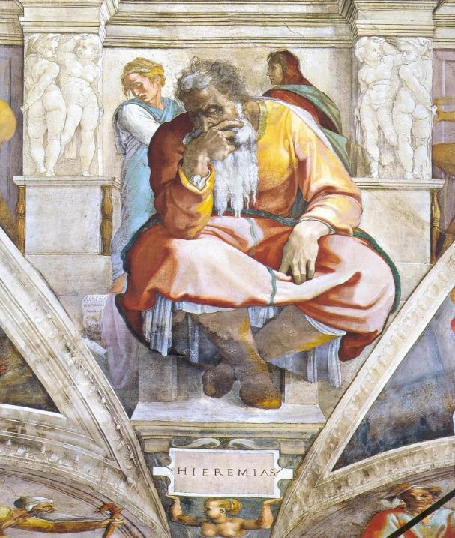
Michelangelo’s depiction of the aged Jeremiah shows one of the most crushing images of melancholy and desolation every painted. It is no accident that people sometimes wondered if Jesus were Jeremiah (Mt. 16:14), and it is fair to say that Jeremiah experienced his own version of the Passion: he was derided, imprisoned, and beaten.
Beside him, Michelangelo painted a small scroll with the word ‘aleph, the first letter of the Hebrew alphabet symbolizing the Book of Lamentations, where each of the four acrostic poems begins with this letter.
The two women, whose faces are averted, probably symbolize Israel and Judah, both of which were sent into exile.

Slide 3
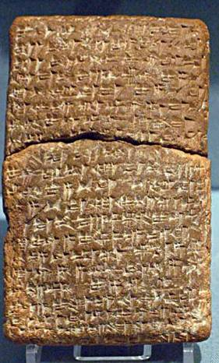
Hittite Suzerainty Treaty
(15th century BC)
The form of this treaty parallels the form of the Book of Deuteronomy:
  Preamble
  Historical prologue
  Stipulations
  Deposit of the covenant document
  Witnesses
  Blessings and curses
British Museum, London

Slide 4
TALKING POINTS
Does it surprise you that God would use the ancient Near Eastern form of covenant as a basis for relationship with his people Israel?
How would defining Israel as a covenant people help shape their identity for the future?
How is the idea of covenant important for Christians beyond the ancient world of the Israelites?

Slide 5
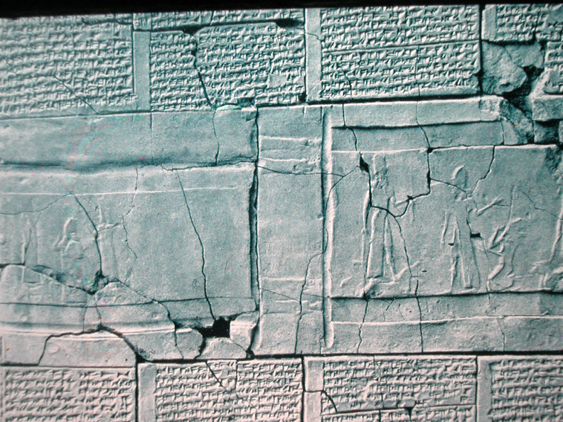
Vassal Treaty of Esarhaddon II
Especially striking are the list of curses, which describe the same sort of disasters found in Deuteronomy and in the same order.
This has led many scholars to conclude that such curses were stereotypical for suzerainty treaties.
7th century BC
University of Pennsylvania

Slide 6
Curses from Dt. 28
Yahweh will plague you with diseases…
At midday you’ll grope about like a blind man...
Your carcasses will be food for the birds and the beasts…
You will be pledged to be married…but another will take and ravish her…
Curses from Esarhaddon
May Sin…clothe you with leprosy…
May Shamash…take away your eyesight…
May Ninurta…give your flesh to eagles and vultures…
May Venus…let your wives lie in the embrace of your enemies…

Slide 7
Blessings for Obedience (Dt. 28:1-14)
Blessings and curses were a constituent part of ancient Near Eastern Suzerainty treaties.
The blessings for obedience included both farmers and city-dwellers.
Families, fields, and livestock would be fertile.
Victory over enemies was assured.
As promised, the people of Israel would become Yahweh’s holy nation (cf. Dt. 26:18; 27:9).

Slide 8
Curses for Disobedience (Dt. 28:15-68)
Detailed descriptions of escalating disasters are offered.
The pattern of these curses are consistent with other known vassal treaties from the ancient Near East.
The first section of curses begins with an “if” clause; the following sections have no stated conditions, but they assume covenant violation.
The curses climax with the threat of exile.
There were only two ways open, obedience or rebellion.

Slide 9
This is the word that came to Jeremiah from Yahweh: “Listen to the terms of this covenant and tell them to the people…this is what Yahweh says, “Cursed is the man who does not obey the terms of this covenant.” I said, “Obey me and do everything I command you, and you will be my people, and I will be your God.” …but they did not listen or pay attention; instead, they followed the stubbornness of their evil hearts. Therefore, this is what Yahweh says, “I will bring on them a disaster they cannot escape” (Jer. 11:1-13).

Slide 10
TALKING POINTS
How difficult would it be to convince people of something they didn’t want to believe?
What might the experience of ancient Israel have to say to modern Christians who, while not in quite the same situation as ancient Israel, still are reminded that “these things happened to them as examples for us, on whom the fulfillment of the ages has come” (1 Co. 10:11)?

Slide 11
LISTENING TO JEREMIAH
2

Slide 12
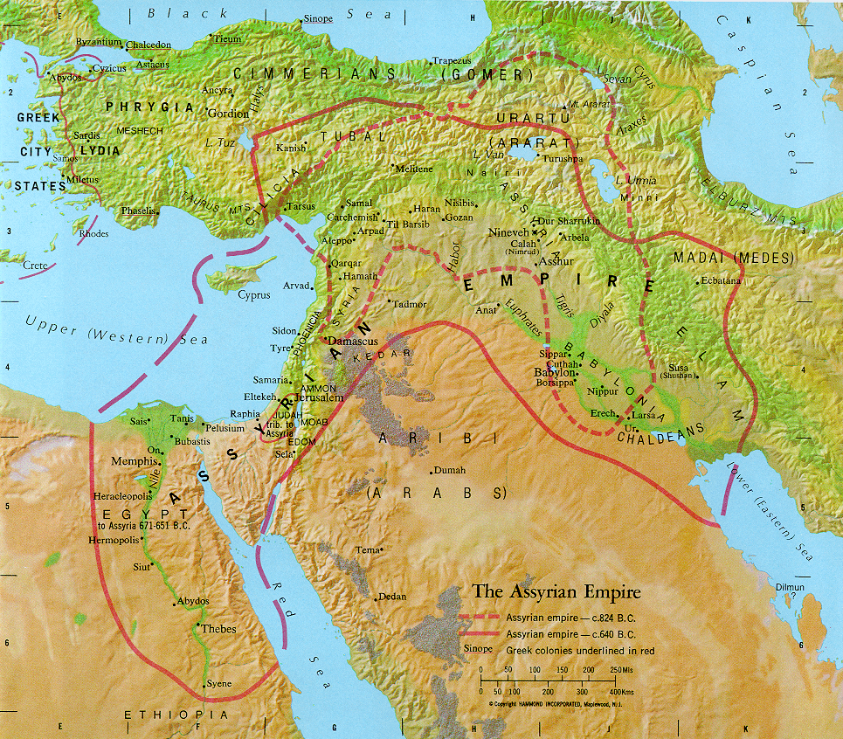
ARAM
ISRAEL
JUDAH

Slide 13
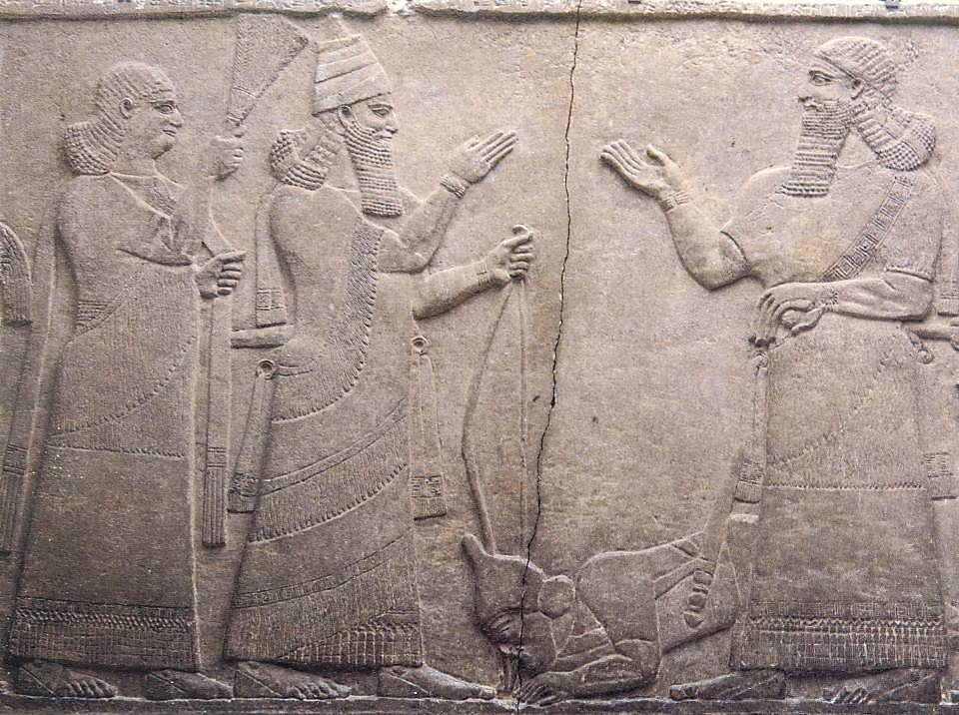
Bas-relief of Tiglath-Pileser III from the royal palace at Nimrud,Detroit Institute of Arts, Detroit, Michigan
By the end of Pekah’s reign, Israel had lost the Transjordan and Galilee to Tiglath-pileser III, and according to Assyrian records, 13,520 citizens were deported.
“Israel…overthrew their king Pekah, and I placed Hoshea as king over them. I received from them 10 talents of gold, 1000 talents of silver as their tribute…”
Assyrian Inscription, Annals of Tiglath-Pileser III (Pul)

Slide 14
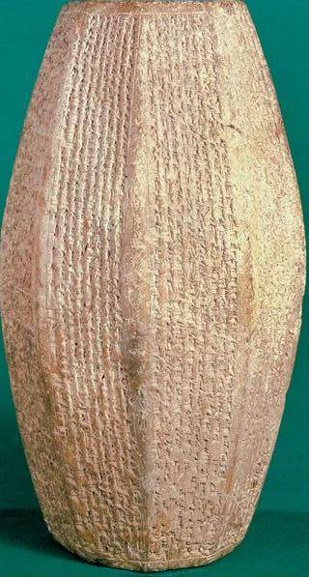
Nimrud Prism
Commemorating Sargon II’s rule, this prism boasts how he deported and resettled the Israelites in “the midst of Assyria.” He deported 27,280 people.
“…I repopulated Samerina (Samaria) more than before. I brought into it people from countries conquered by my hands. I appointed my eunuch as governor over them. And I counted them as Assyrians.”

Slide 15
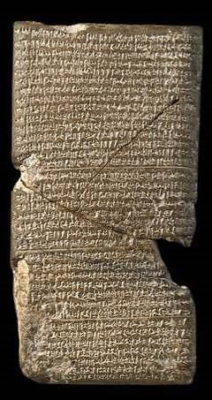
The fall of Assyria was predicted by the prophet Nahum.
The attack upon Nineveh by the Medes and Babylonians, which was successfully conducted in 614 BC, left Assyria’s northern capital in shambles (Nah. 2:3-13).
This tablet from the Babylonian Chronicle describes the fall of Nineveh and the collapse of the Assyrian Empire.
British Museum, London

Slide 16
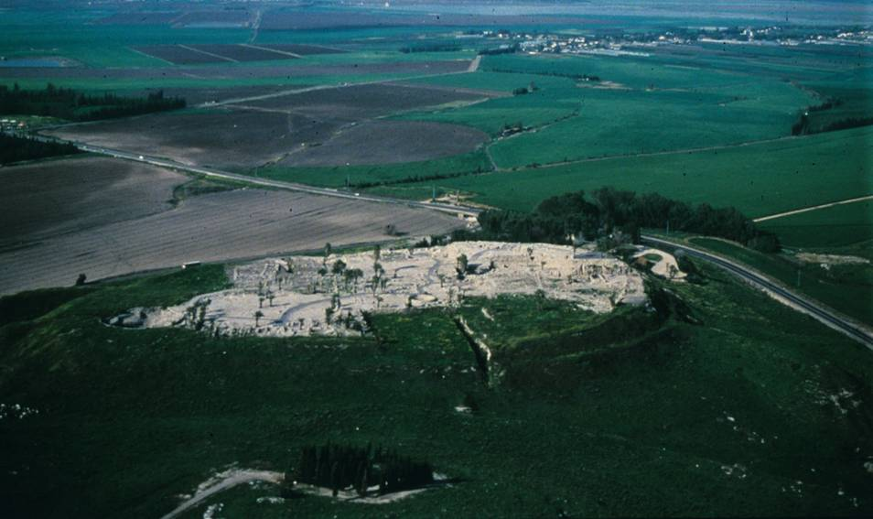
The ruins of the Megiddo Fortress near where Josiah was shot and killed. The Megiddo mound rises 100’ above the plain, where it guards the northern end of a pass through the mountains of Manasseh.

Slide 17
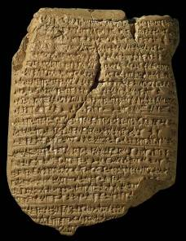
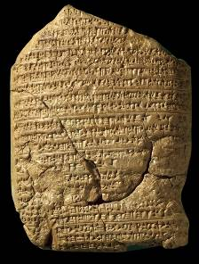
Babylonian Chronicle 5
The record of Nebuchadnezzar II’s early years appear on Chronicle 5 of the Babylonian Chronicle texts. They describe his defeat of Neco II at Carchemish (obverse side), his own severe losses when he invaded Egypt and his siege of Jerusalem (reverse side).
“In the seventh year: In the month Kislev the king of Akkad [Nebuchadnezzar] mustered his army and marched to Hattu [Palestine]. He encamped against the city of Judah [Jerusalem] and on the second day of the month Adar he captured the city (and) seized (its) king. A king of his own choice he appointed in the city (and) taking the vast tribute he brought it to Babylon.”

Slide 18
The Kings During the Last Years of Judah
(dates are based on the chronology of Edwin Thiele)
ISRAEL
After the fall of Samaria, the northern nation of Israel was absorbed into the Assyrian Empire.
When Assyria fell to Babylon, the northern lands of Israel became part of the Babylonian Empire.
JUDAH
Josiah 640-609 BC
Jehoahaz 609 BC
Jehoiakim 609-598 BC
Jehoiachin 598-597 BC
Zedekiah 597-586 BC
The ministry of Jeremiah

Slide 19
TALKING POINTS
Isaiah describes the Assyrians as “Yahweh’s war club” (Is. 10:5), used to discipline his unfaithful people (Is. 10:5)? Do you think God disciplines his people in the modern world also?
The young Jeremiah witnessed the loss of his beloved King Josiah and composed funeral dirges for him (2 Chr. 35:25), yet he says nothing about Josiah’s reforms? Why might this be?
How were the exiles of both Israel and Judah to be understood as acts of God, and why was it important to see these tragedies in this light?

Slide 20
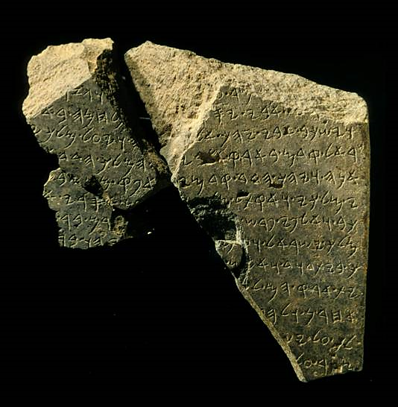
Tel Dan Inscription
This artifact, part of a stela erected by the king of Aram to commemorate a war effort, contains the earliest known reference to the “house of David” outside the Bible. It was discovered at Tel Dan in 1993 by Israeli archaeologist Avraham Biran. The enhanced line in the square contains the phrase “house of David.”

Slide 21
TALKING POINTS
How would you define false security, and do you think this can be a problem for modern people of faith?
Jeremiah not only contended with an audience who didn’t want to hear what he had to say, he also contended with false prophets within the community of Israel. What might be false voices today within the church with which God’s people must contend?

Slide 22
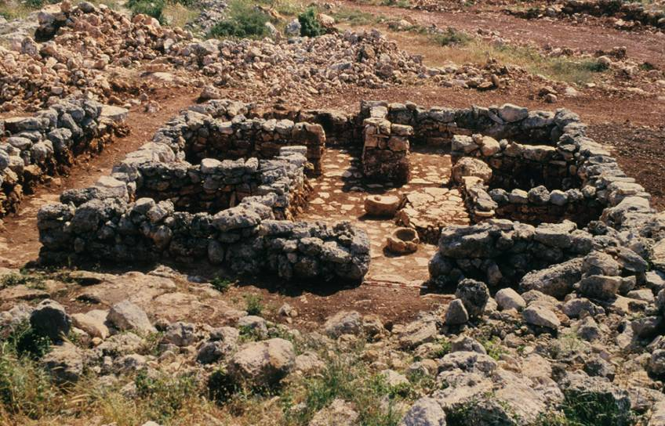
Israelite Four-Room House
The Israelite “four-room house” was unique, consisting of three parallel long rooms plus a broad room across one end.

Slide 23
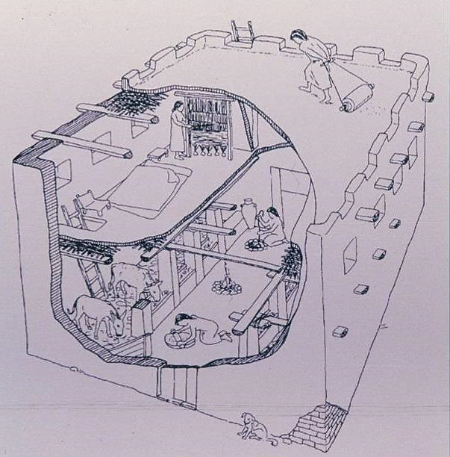
Reconstruction of the Israelite four-room house based on excavated sites. An “upper room” would have been in a second story or on the roof.

Slide 24
LISTENING TO JEREMIAH
3

Slide 25
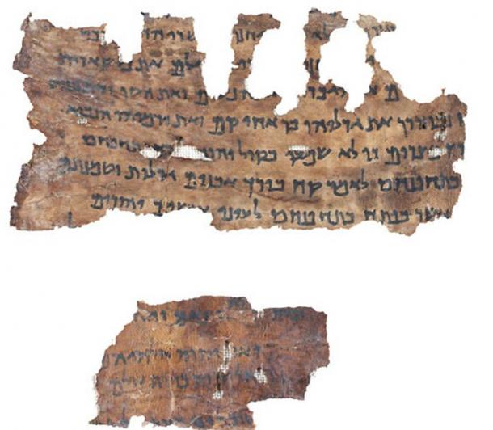
Fragment of Jeremiah from the Dead Sea Scrolls
Israel Antiquities Authority

Slide 26
In the fourth year of Jehoiakim ben Josiah, king of Judah, this word came to Jeremiah from Yahweh. “Take a scroll and write on it all the words that I have spoken to you against Israel and Judah and all the nations, from the day I spoke to you, from the days of Josiah until today. It may be that the house of Judah will hear all the disaster I intend to do to them, so that every one may turn from his evil way, and that I may forgive their iniquity and their sin.”
Jer. 36:1-3

Slide 27
As Jehudi read three or four columns, the king would cut them off with a knife and throw them into the fire in the firepot, until the entire scroll was consumed in the fire that was in the firepot.
Jer. 36:23
Now after the king had burned the scroll with the words that Baruch wrote at Jeremiah’s dictation, the word of Yahweh came to Jeremiah: “Take another scroll and write on it all the former words that were in the first scroll, which Jehoiakim the king of Judah has burned.” Then Jeremiah took another scroll and gave it to Baruch ben Neriah, the scribe, who wrote on it at the dictation of Jeremiah all the words of the scroll that Jehoiakim king of Judah had burned in the fire. And many similar words were added to them.
Jer. 36:27-28, 32

Slide 28
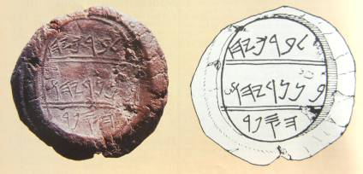
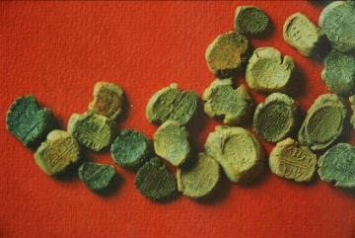
Bulla of Jeremiah’s Scribe
In 1975, a hoard of more than 250 bullae (lumps of clay impressed with a seal) were discovered, one of them containing the name of Baruch ben Neriah (cf. Je. 36:4).
“Belonging to Berekhyahu
ben Neriyahu
The scribe”
The hoard was discovered in October 1975 in the shop of an Arab antiquities dealer in East Jerusalem. Each bulla was about 1” across. Such seals were used to secure important documents. They were baked hard in the fire that destroyed Jerusalem, 587-6 BC.

Slide 29
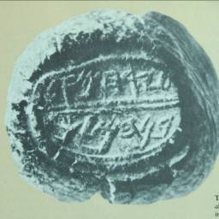
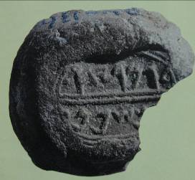
Two Biblical Signatures
“Belonging to Yerahme’el, son of the king”
“Belonging to Gemaryahu, son of Shaphan”
Seal impression of Yerahme’el, a member of the arresting party sent to arrest Jeremiah (cf. Je. 36:26). Discovered in the same hoard of bullae as the seal impression of Baruch.
Seal impression of Gemaryahu, son of Shaphan, the secretary in whose room the codified oracles of Jeremiah first were read (cf. Je. 36:10). Discovered by Yigal Shiloh among a hoard of 51 bullae.

Slide 30
Now the word of Yahweh came to me, saying,
“Before I formed you in the womb I knew you,
and before you were born, I consecrated you;
I appointed you a prophet to the nations.”
Jer. 1:4-5
Then Yahweh put out his hand and touched my mouth. And Yahweh said to me, “Behold, I have put my words in your mouth. See, I have set you this day over nations and over kingdoms, to pluck up and to break down, to destroy and to overthrow, to build and to plant.”
Jer. 1:9-10

Slide 31
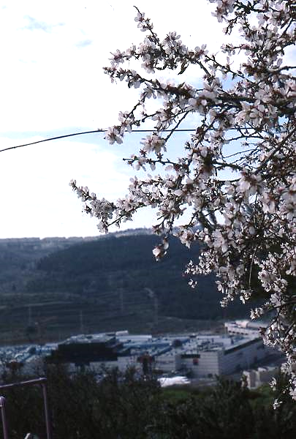
The Almond Tree Branch
Based on a pun in Hebrew
(1:11-12):
dq2wa (shaqed = almond tree)
dq2wo (shoqed = watching)
Yahweh was “watching” to see that his Deuteronomic word was carried out.
Almond blossoms in Jerusalem
Notes:
Almond Blossoms: Recalls the word-play in Jeremiah 1:12, where the Hebrew shaqed (= almond) is a pun on the word shoqed (= watching) [II2-21]

Slide 32
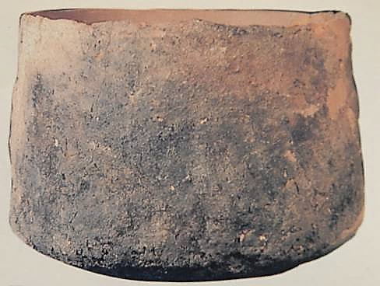
The Boiling Krater
The southward tilt (1:13-14) implies that the enemy is from the north (cf. 4:6; 6:1, 2; 10:22; 13:20; 25:9, etc.).
Cooking krater, Negbite pottery (handmade without a potter’s wheel)

Slide 33
“Behold, I am bringing against you a nation from afar, O house of Israel,” declares Yahweh.
“It is an enduring nation;
It is an ancient nation,
a nation whose language you do not know,
nor can you understand what they say.
Their quiver is like an open tomb;
they are all mighty warriors.”
Jer. 5:15-16
“They lay hold on bow and javelin;
they are cruel and have no mercy;
The sound of them is like the roaring sea;
they ride on horses, set in array as a man for battle,
against you, O daughter of Zion!”
Jer. 6:23

Slide 34
TALKING POINTS
What might God’s calling of Jeremiah, even before he was born, have to say about the value of prenatal life?
Jesus was considered by some to be a return of the prophet Jeremiah (Mt.16:14). What was there about him and his message that may have reminded them of this ancient prophet?

Slide 35
COURTROOM LANGUAGE IN THE PROPHETS—THE COVENANT LAWSUIT
“Yahweh takes his place in court” (Is. 3:13ff.; Ho. 4:1; Mic. 6:1-2; Je. 2:9; Eze. 20:4)
bYR9 (R’iv = lawsuit)
Domestic (civil case)
Suzerainty-Vassal (international)
Covenant (human-divine)
FORM:
Appeal to witnesses
Interrogation & accusation
Review of past benefits
Warning about disloyalty
Declaration of guilt & punishment
byr9 (r’iv = lawsuit)
FpawA (shaphat = to settle a case)
tOmcuf3 (‘etsumoth = arguments)
hHAk;v0An9 (niwwakeha = subpoena)

Slide 36
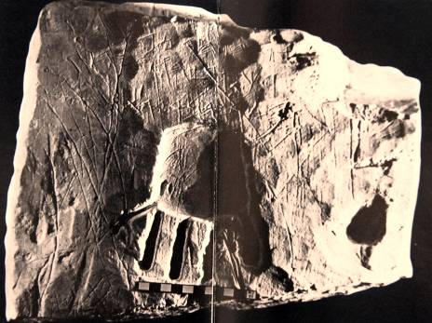
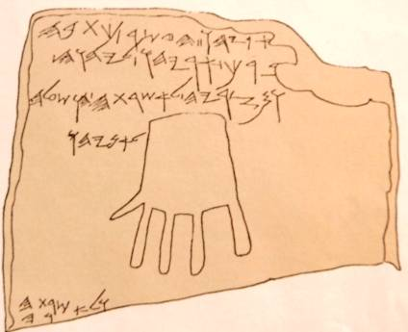
YHWH and his Asherah
Discovered on the wall of a tomb near Hebron, this inscription reads: “Blessed by Yahweh and by his asherah.”
Both Scripture and archaeological evidence demonstrate that religious syncretism was a widespread phenomenon in Judah.

Slide 37
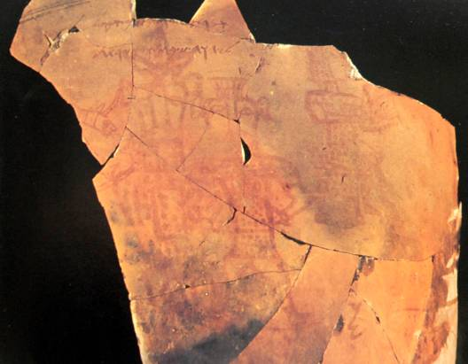
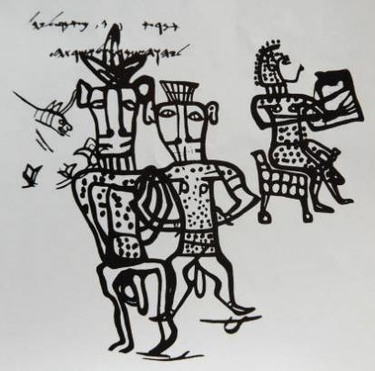
YHWH and his Asherah
Fragments from a broken pithos (large pottery jar) excavated about 40 miles south of Kadesh reveal an enigmatic drawing showing a seated female musician accompanied by two figures, one apparently male and the other androgynous. The inscription across the top of the drawing reads: “I bless you by Yahweh of Samaria and by his asherah,” a further testimony to religious syncretism in Israel.

Slide 38
Divorce Court
Yahweh said to me in the days of king Josiah: “Have you seen what she did, that faithless one, Israel, how she went up on every high hill and under every green tree, and there played the whore? And I thought, ‘After she has done all this she will return to me,’ but she did not return, and her treacherous sister Judah saw it. She saw that for all the adulteries of that faithless one, Israel, I had sent her away with a decree of divorce. Yet her treacherous sister Judah did not fear, but she too went and played the whore.”
Jer. 3:6-8

Slide 39
Vivid metaphors of adultery are given against the background of the Canaanite fertility cult
Judah was like a faithless wife, brazen and unashamed (3:2-5, 20).
Israel and Judah were like two adulterous sisters (3:6-10).
Yahweh divorced Israel, the northern nation, sending her into exile (3:8).
Judah, because of her adultery, had no right to expect Yahweh to take her back (3:1; cf. Dt. 24:1-4).
In spite of the Deuteronomic code, Yahweh invited his unfaithful wife to return to him (3:12, 14, 22).
However, this return was to be only on his terms (3:13; 4:1-4).

Slide 40
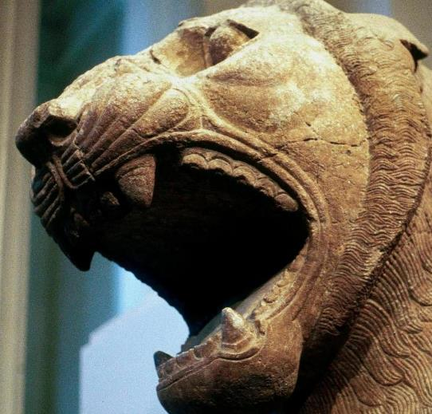
False Optimism in Judah
“They have lied about Yahweh; they said, ‘He will do nothing! No harm will come to us; we will never see sword or famine.”
(Je. 5:12)
“Prophets and priests alike, all practice deceit. They dress the wound of my people as though it were not serious. ‘Peace, peace,’ they say, when there is no peace.”
(Je.6:13b-14;
cf. 8:10b-11)
[But] A lion has come out of his lair… (Je. 4:7a)
Mesopotamian Lion, British Museum

Slide 41
TALKING POINTS
Why do you think Jeremiah used metaphors like the lawsuit and the divorce laws in the Torah to present his message to the people of Judah?
Can religious syncretism be a threat to genuine faith in modern times?

Slide 42
LISTENING TO JEREMIAH
4

Slide 43
Haran
Nineveh
Ashur-uballit II
Asshur
Nebopolasar
Megiddo
Babylon
Judah
Necho II
Egypt

Slide 44
For thus says Yahweh concerning Shallum (Jehoahaz) ben Josiah, king of Judah, who reigned instead of Josiah his father, and who went away from this place. “He shall return here no more, but in the place here they have carried him captive, there shall he die, and he shall never see this land again.”
Jer. 22:11-12

Slide 45
Why do you look…at the mount that God desired for his abode, yes, where Yahweh will dwell forever? The chariots of God are twice ten thousand, thousands upon thousands; the Lord is among them; Sinai is now in the sanctuary.
Psa. 68:16-17
He chose the tribe of Judah, Mount Zion, which he loves. He built his sanctuary like the high heavens, like the earth, which he has founded forever.
Psa. 78:68-69

Slide 46
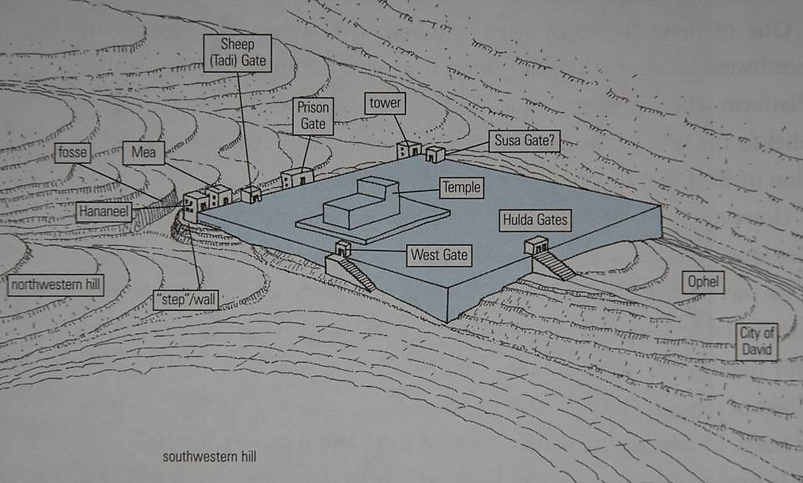
The temple mount was essentially a square, probably with short retaining walls to create a flat surface.
N

Slide 47
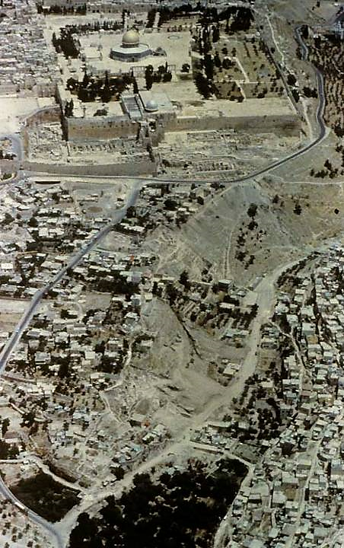
Mt. Zion and the City of David
The original square of the temple mount was much smaller than is present today. The current surface of the temple mount was greatly enlarged by Herod the Great, and that surface remains, even though crowned by the Dome of the Rock.

Slide 48
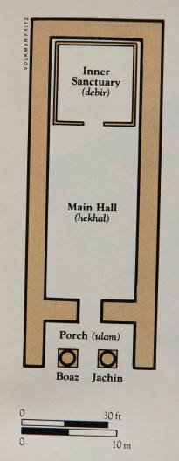
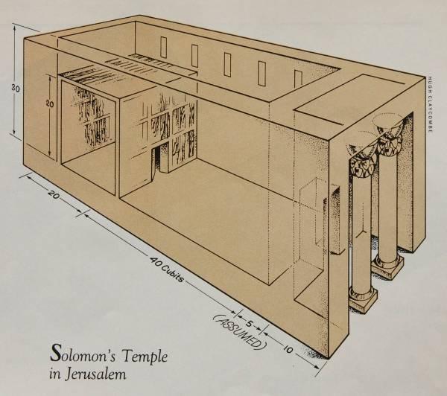
First Temple (basic configuration)
Solomon built the first temple (1 Kg. 6). The temple, like the kingship, was anticipated in the Torah (Dt. 12).

Slide 49
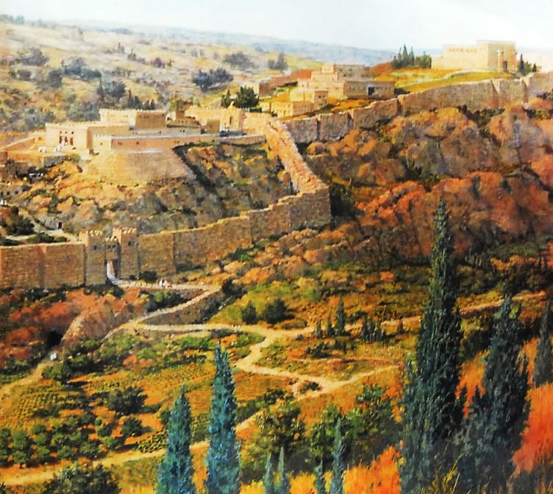
Mt. Zion
Artist’s conception of Solomon’s royal palace and the temple mount based on archaeological data.

Slide 50
Do not trust in these deceptive words, “This is the temple of Yahweh, the temple of Yahweh, the temple of Yahweh.” Will you steal, murder, commit adultery, swear falsely, make offerings to Ba’al, and go after other gods…and then come and stand before me in this house, which is called by my name, and say, “We are safe!” —only to go on doing these abominations?
…go now to my place that was in Shiloh, where I made my name dwell at first, and see what I did to it because of the evil of my people Israel.
Jer. 7:4, 9-10, 12

Slide 51
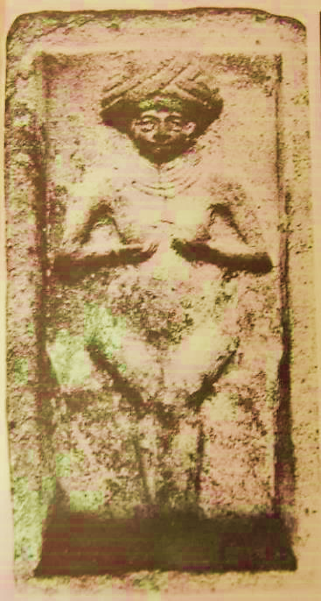
Je. 7:18
Cake mold from the palace kitchen of Mari, Mesopotamia
Used for making cakes in the form of the love-goddess, Ishtar, the Queen of Heaven
Ishtar, the “Queen of Heaven”, was the Babylonian fertility goddess as well as the goddess of war. She was believed to embody the inseparable powers of life and death.

Slide 52
…the women knead dough, to make cakes for the queen of heaven. And they pour out drink offerings to other gods…
Jer. 7:18
They have set their detestable things in the house that is called by my name, to defile it. And they have built the high places of Topheth, which is in the Valley of the Son of Hinnom, to burn their sons and their daughters in the fire.
Jer. 7:30b-31

Slide 53
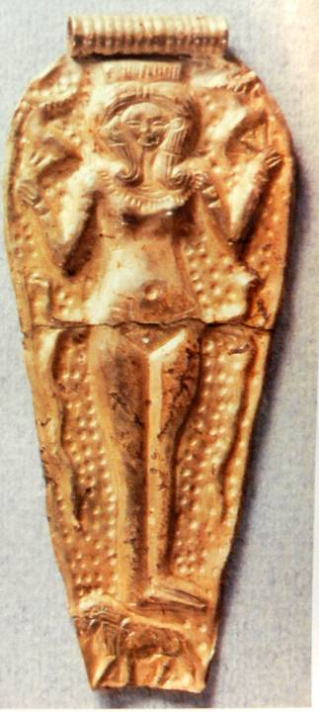
Image of Astarte gold pendant excavated in Ugarit
Ezekiel’s description of the “idol of jealousy” (Eze. 8) is sufficiently ambiguous to prohibit any firm conclusions as to its precise appearance. However, many scholars suspect that it was a pillar image of the goddess Asherah or Astarte or an Asherah tree, such as the one Manasseh once installed in the temple (cf. 2 Kg. 21:7).

Slide 54
TALKING POINTS
Why do you think the king and the people of Judah were so fascinated by the fertility cults of the ancient Near East?
What is the danger of religious superficiality for modern Christians that might be similar to what was true for ancient Israel?
Yahweh told Jeremiah it was no use to even pray for the nation (7:16). How is this similar to John’s statement about not praying for the “sin unto death” (1 Jn. 5:16)? Is there some spiritual “point of no return?”

Slide 55
Is there no balm in Gilead? Is there no physician there?
Je. 8:22a
My joy is gone; grief is upon me; my heart is sick within me. Oh that my head were waters, and my eyes a fountain of tears, that I might weep day and night for the slain of the daughter of my people! Jer. 8:18; 9:1
…from the least to the greatest everyone is greedy for unjust gain; from prophet to priest everyone deals falsely. Jer. 8:10b

Slide 56
Thus says Yahweh, “Let not the wise man boast in his wisdom, let not the mighty man boast in his might, let not the rich man boast in his riches, but let him who boasts boast of this, that he understands and knows me, that I am Yahweh who practices faithful love, justice, and righteousness in the earth. For in these things I delight, declares Yahweh.”
Jer. 9:23-24

Slide 57
TALKING POINTS
How important is moral integrity and theological faithfulness for modern Christian leaders? What have we tended to substitute for these values?
Modern westerners do not practice idolatry, at least not in the ancient sense, but what expressions of replacing God with other things might be modern forms of idolatry?
The outward trappings of religion became an instrument of self-deception for the ancient Israelites. Why do you think this was so?
How were Jesus’ words about “discerning the times” (Mt. 16:2-3) similar to the message of Jeremiah (8:7)? How was Jeremiah’s culture in ancient Judah similar to our own?

Slide 58
LISTENING TO JEREMIAH
5

Slide 59
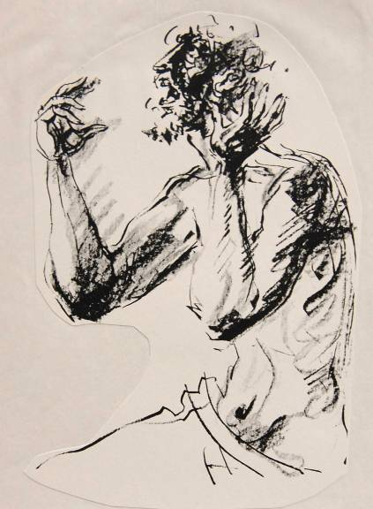
Pathos of the Prophets
The trials and trauma of the prophets reflected the pathos of God. They experienced:
    Abandonment
    Ostracism
    Ridicule
    Loss of love ones
    Depression
    Divorce
    Threats
    Persecution
    Torture
    Death

Slide 60
Ah, sinful nation, a people loaded with guilt,
a brood of evildoers, children given to corruption.
They have forsaken the LORD;
they have spurned the Holy One of Israel and turned their backs on him.
Isa. 1:4
…the sins of Ephraim are exposed and the crimes of Samaria revealed.
They practice deceit, thieves break into houses, bandits rob in the
streets;
but they do not realize that I remember their evil deeds.
Their sins engulf them; they are always before me.
Hos. 7:1-2

Slide 61
“My people, what have I done to you?
How have I burdened you? Answer me!”
Mic. 6:3
“Why should I forgive you?
Your children have forsaken me
and sworn by gods that are not gods.
I supplied all their needs,
yet they committed adultery
and thronged to the houses of prostitution.
They are well-fed lusty stallions,
each neighing for another man’s wife.
Should I not punish them for this?” declared Yahweh.
Jer. 5:7-9

Slide 62
Metaphors
Must be understood in the context of their original language
American Examples
to bend over backwards (= to try very hard)
to talk turkey (= to get to the heart of a matter)
to have a screw loose (= to think or behave irrationally)
French Examples
je ne peux pas le sentir ( = I can’t smell him, i.e., he annoys me)
il est un bouseux (= he is cow dung, i.e., he is uncultured)
il a les chevilles enflees (= he has swollen ankles, i.e., he is proud)

Slide 63
Hebrew Metaphors
The house of Israel has become dross to me; all of them are copper, tin, iron and lead left inside a furnace. (Eze. 22:18)
Circumcise yourselves to the LORD; remove the foreskin of your heart. (Je. 4:4)
I will rebuke your offspring and spread dung on your faces, and I will put you out of my presence. (Mal. 2:3)
You will drink the milk of nations and be nursed at royal breasts. (Is. 60:16)

Slide 64
I reared up children and brought them up,
but they have rebelled against me.
The ox knows his master, the donkey his owner’s manger,
but Israel does not know, my people do not understand. Isa. 1:2b-3
Will you steal and murder, commit adultery and perjury, burn incense to Baal and follow other gods you have not known, and then come and stand before me in this house, which bears my Name, and say, ‘We are safe’—safe to do all these detestable things? Has this house, which bears my Name, become a den of robbers to you? But I have been watching! declares the LORD.
Jer. 7:9-11

Slide 65
When Israel was a child, I love him, and out of Egypt I called my son.
But the more I called Israel, the further they went from me.
…It was I who taught Ephraim to walk, taking them by the arms;
But they did not realize it as I who healed them. Hos. 11:1-3
Then I passed by and saw you kicking about in your blood, and as you lay there in your blood I said to you, “Live!” I bathed you with water and washed the blood from you and put ointment on you. But you trusted in your beauty and used your fame to become a prostitute. You lavished your favors on anyone who passed by and your beauty became his. Eze. 16:6, 9, 15

Slide 66
TALKING POINTS
Do you think God feels emotion? Some theologians speak of the “impassibility of God,” by which it is meant that God does not experience involuntary changes of state. Other theologians argue that this can be taken to an extreme whereby God is distant and unconcerned.
How would you compare the metaphors of the prophets with the preaching of Jesus?

Slide 67
THE ROLE OF THE PROPHET
Provenance of Israel’s Spiritual Leaders
(Je. 18:18; cf. Eze. 7:26)
PRIESTS (teachers of the Torah, the codified word of Yahweh)
WISE PERSONS or ELDERS (insight or practical counsel based on experience and observation)
PROPHETS (the immediate word of Yahweh)

Slide 68
Kings, Priests, Prophets
BALANCE OF MORAL POWER
Prophet against King
(Elijah vs. Ahab, 1 Kg. 17-19, 21)
Prophet against Priest
(Samuel vs. Eli, 1 Sa. 3)
Prophet against Prophet
(Jeremiah vs. Hananiah, Je. 28)

Slide 69
The prophets prophesy lies,
the priests rule by their own authority,
And my people love it this way
But what will you do in the end? Jer. 5:31
Woe to me because of my injury!
My wound is incurable!
Yet I said to myself, “This is my sickness, and I must endure it.
My tent is destroyed; all its ropes are snapped.
My sons are gone from me and are no more.
No one is left now to pitch my tent or set up my shelter.”
Jer. 10:19-20

Slide 70
I will show my love to the one I called, ‘Not my loved one.’
I will say to those called ‘Not my people,’ ‘You are my people’;
and they will say, ‘You are my God.’
Hos. 2:23
I will sprinkle clean water on you, and you will be clean; I will cleanse you from all your impurities and from all your idols. I will give you a new heart and put a new spirit in you; I will remove from you your heart of stone and give you a heart of flesh. And I will put my Spirit in you and move you to follow my decrees and be careful to keep my laws.
Eze. 36:25-27

Slide 71
TALKING POINTS
Is there a place for prophets in the church today, which is to say, voices that call God’s people back to himself?
What is your own response to the prophets’ powerful images of betrayal, marital unfaithfulness, divorce court, and prodigal children?
How is similar imagery present in Jesus’ parables of the tenant farmers (Mt. 21:33-44) and the prodigal son (Lk. 15:11-32)?

Slide 72
LISTENING TO JEREMIAH
6

Slide 73
Protocols of the Israelite King (Dt. 17:14-20)
The idea of Israelite kingship is as old as God’s promises to Abraham (Ge. 17:6, 16).
Though attempted during the period of the judges (cf. Jg. 9), kingship was not successfully instituted before the time of Samuel (cf. 1 Sa. 8-10).
The primary criterion for Israel’s kings was not popularity but divine approval.
Kings were restricted from building a large chariot corps, a large harem or a large treasury, which were the usual hallmarks of royal power in the ancient Near East.
The king must wholeheartedly follow the Torah, regularly reading it to refresh his memory as to its requirements.

Slide 74
Covenant Loyalties
NATION OF JUDAH
Covenant with David was primary
Covenant with Abraham was embraced, also
Covenant with Moses with its threats of exile was subordinated to the perceived inviolability of the former two covenants

Slide 75
The Royal Theology based on the Davidic Covenant
The Royal Assumptions
David had been guaranteed a perpetual dynasty (2 Sa. 7:11b-16; 22:51b; 23:5a).
The Davidic covenant was firmly linked with the temple on Mt. Zion (Ps. 2:6-9; 78:65-72; 132:11-18).
The city of Jerusalem and Mt. Zion were impregnable, their security eternally guaranteed by Yahweh (Ps. 46; 125:1-2; 146:10).
The Perspective of the Prophets
Earlier prophets warned that the Davidic covenant must not be viewed as an unconditional guarantee of political security (Am. 2:4-5; 6:1a; Mic. 3:10, 12).
Jeremiah warned that Yahweh had rejected Jehoiakim’s family (Je. 36:30-31; cf. 22:18-19).
Yahweh was now against the kings in David’s line (Je. 21:11-14; 23:1-2).

Slide 76
The Promises to David’s Family
“I will provide a place for my people Israel and will plant them so that they can have a home of their own and no longer be disturbed. …and I will also give you rest from all your enemies. Your house and your kingdom will endure forever before me; your throne wll be established forever.” 2 Sam. 7:10-11, 16
“Yahweh swore an oath to David, a sure oath that he will not revoke: ‘One of your own descendants I will place on your throne—if your sons keep my covenant and the statutes I teach them, then their sons will sit on your throne forever and ever.’”
Psa. 132:11-12
“Those who trust in Yahweh are like Mt. Zion, which cannot be shaken but endures forever.” Psa. 25:1

Slide 77
The Popular View
“…they lean upon Yahweh and say, ‘Is not Yahweh among us? No disaster will come upon us.’”
Mic. 3:11b
“At that time I will search Jerusalem with lamps and punish those who are complacent, who are like wine left on its dregs, and who think, ‘Yahweh will do nothing, either good or bad.’”
Zeph. 1:12

Slide 78
TALKING POINTS
Who was the first of Israel’s kings to egregiously violate the protocols for kingship?
Why would God restrict Israel’s kings from horses, a large harem, and a burgeoning treasury?
If Israel’s prophets were a kind of “balance of power,” is there anything comparable in the modern church world?

Slide 79
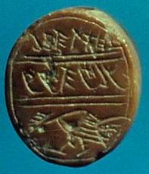
Possible seal of Jehoahaz
This red jasper seal bearing the image of a fighting cock and the inscription “[belonging] to Jehoahaz, son of the king” may have belonged to the short-tenured King of Judah by that name.
Israel Museum, Jerusalem

Slide 80
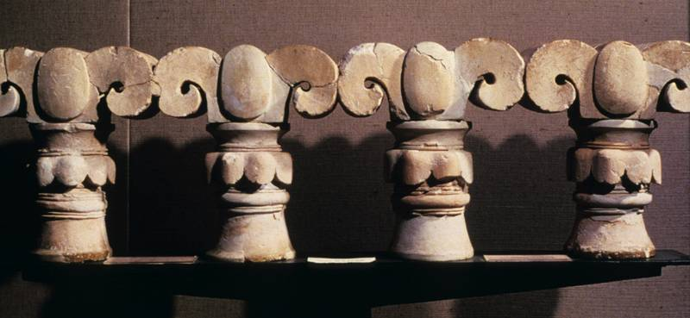
Jehoiakim’s Ornate Windows
Jeremiah’s diatribe against Jehoiakim’s palace-building project at the expense of the poor (Je. 22:13-17) likely refers to construction at Ramat Rahel, the royal citadel just south of Jerusalem. Jeremiah especially singled out the ornate windows.
This limestone window balustrade was excavated at Ramat Rahel, and the capitals probably imitate the stylized palm trees in Egyptian architecture.

Slide 81
Jeremiah Predicts the Fall of David’s Dynasty
“Do not weep for the dead king [i.e., Josiah] or mourn his loss;
Rather, weep bitterly for him who is exiled [i.e., Jehoahaz],
Because he will never return nor see his native land again.”
Jer. 22:10
“Therefore, this is what Yahweh says about Jehoiakim son of Josiah king of Judah: ‘They will not mourn for him ‘Alas, my master! Alas, his splendor!’ He will have the burial of donkey, dragged away and thrown outside the gates of Jerusalem.”
Jer. 22:18-19
“’As surely as I live,’ declares Yahweh, ‘even if you, Jehoiachin son of Jehoiakim king of Judah, were a signet ring on my right hand, I would still pull you off. I will hand you over to those who seek your life, those you fear—to Nebuchadnezzar king of Babylon and to the Babylonians. I will hurl you and the mother who gave you birth into another country, where neither of you were born, and there you both will die. You will never come back…’”
Jer. 22:24-27

Slide 82
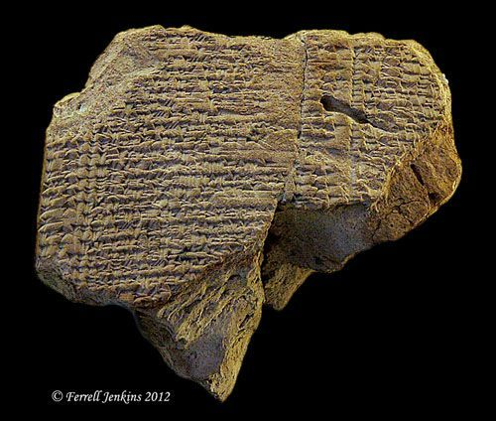
Neo-Babylonian Chronicle
This 3” tall cuneiform fragment is one of four tablets mentioning Jehoiachin of Judah.
This tablet describes monthly rations for the exiled king and his five sons to be allotted to “Jehoiachin, king of the land of Judah”.

Slide 83
The Decline of the Davidic Royal Family
Jehoahaz (Shallum)
Deposed and exiled by the Egyptians, never to return (Je. 22:10-17; cf. 2 Kg. 23:30b-33)
Jehoiakim
Executed by Nebuchadnezzar of Babylon (Je. 22:18-19; cf. 2 Chr. 36:6)
Jehoiachin
Deposed and exiled by Nebuchadnezzar of Babylon, never to return (Je. 22:24-30; 2 Kg. 24:6-17)
Zedekiah
Hoped for a last minute reprieve (Je. 21:1-2); Jeremiah scorned his hope, advising him simply to surrender to Nebuchadnezzar (Je. 21:3-10).

Slide 84
TALKING POINTS
How dangerous would it have been in the ancient world to speak publicly (or even privately) against the reigning king?
Can you see why Jeremiah was considered by many of his contemporaries to be a traitor?

Slide 85
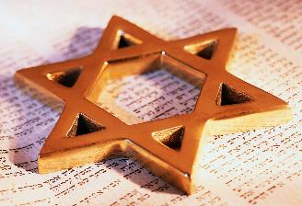
The Future of David’s Dynasty
In spite of the coming judgment, Yahweh still promised a future for David’s dynasty.
Yahweh would regather the people of Judah and establish them in safety (Je. 23:3-4).
Using Isaiah’s metaphor (cf. Is. 11:1ff.), a righteous “Branch” would arise from David’s family (Je. 23:5-6).
In a second exodus, the scattered remnant would be brought back to their own land (Je. 23:7-8).

Slide 86
A Future Hope for David’s Dynasty
“’The days are coming,’ declares Yahweh, ‘when I will raise up to David a righteous branch, a King who will reign wisely and do what is just and right in the land. In his days Judah will be saved and Israel will dwell in safety. This is the name by which he will be called: Yahweh-Tsidkenu [i.e., The LORD our righteousness].’”
Jer. 23:5-6

Slide 87

The Paths into the Future vis-à-vis the son of David
Christianity
“Jesus Christ, raised from the dead, descended from David!” (2 Ti. 2:8)
The genealogical record (Mt.1; Lk. 3)
The apostolic preaching (Ac. 2:24-35; 13:32-38)
The gospel to the nations (Ac. 15:15-18; Ro. 1:2-4)
The eschatological hope (Rv. 3:7; 5:5; 22:16)
Judaism
The reality: no descendant of David ruled after the Babylonian exile
The rabbis who compiled the Mishnah did not appeal to the Davidic promises or eschatology in any form.
The later Talmud anticipates when Israel fully accepts God’s rule, the messiah will come.
The ideal of the messiah is elevated above time and history or ignored altogether.

Slide 88
TALKING POINTS
Can you see how the exile of Judah and the promises of restoration lay the foundation for the messianic hope?
Can you also see why the New Testament begins with the genealogy of Jesus, the son of David (Mt. 1:1)?

Slide 89
LISTENING TO JEREMIAH
7

Slide 90
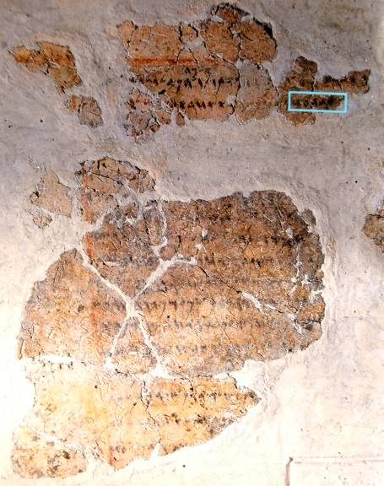
Balaam Inscription
A reference to “Balaam, son of Beor” was discovered at Deir Alla (biblical Succoth) in the transjordan in 1967 (probably from the mid-8th century BC). It appears on a plastered wall and reads in part:
“Inscription of [Ba]laam [son of Beo]r, the man who was a seer of the gods. Lo, the gods came to him at night and [spoke to] him.
“…And the Mighties [Shaddayin, plural of Shadday] have fixed a date, and they said to Sha[ma]sh [the sun]: Sew shut the skies with your cloud! There, let there be darkness and no shining…”

Slide 91
“These are the terms of the covenant… Make sure there is no man or woman among you today whose heart turns away from Yahweh your God to go and worship the gods of those nations…
When such a person hears the words of this oath, he invokes a blessing on himself and therefore thinks, ‘I will be safe, even though I persist in going my own way.’ This will bring disaster on the watered land as well as the dry…
The whole land will be a burning waste of salt and sulfur—nothing planted, nothing sprouting, no vegetation growing on it.
All the nations will ask: ‘Why has Yahweh done this to this land? Why this fierce, burning anger?’ And the answer will be: ‘It is because this people abandoned the covenant of Yahweh… Therefore Yahweh’s anger burned against this land…’”
Deut. 29:1, 18, 23-27

Slide 92
“Judah mourns,
her cities languish;
They wail for the land,
and a cry goes up from Jerusalem.
The nobles send their servants for water;
they go to the cisterns but find no water.
They return with their jars unfilled,
dismayed and despairing, they cover their heads;
The ground is cracked,
because there is no rain in the land;
The farmers are dismayed and cover their heads.”
Jer. 14:2-4

Slide 93
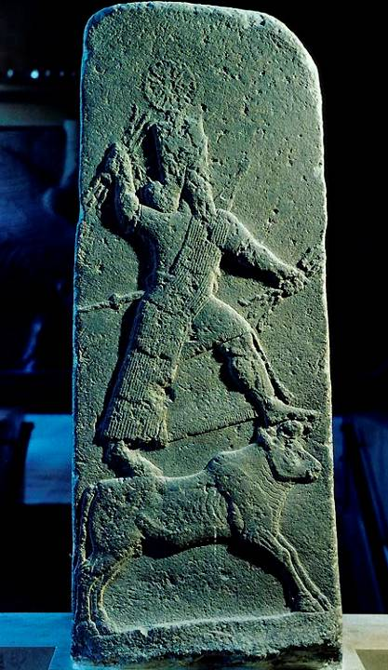
Bull-riding Deity
This 4.5’ bas-relief of an ancient deity strikes the pose of the bull-rider, a stereotypical icon of the gods from the Hittites to the Mesopotamians to the Canaanites. He brandishes thunderbolts in his right hand, a symbol of his control over the sky and rain.
As Ba’al (= Master), he is the chief god in the Canaanite fertility cult.
The Louvre, Paris

Slide 94
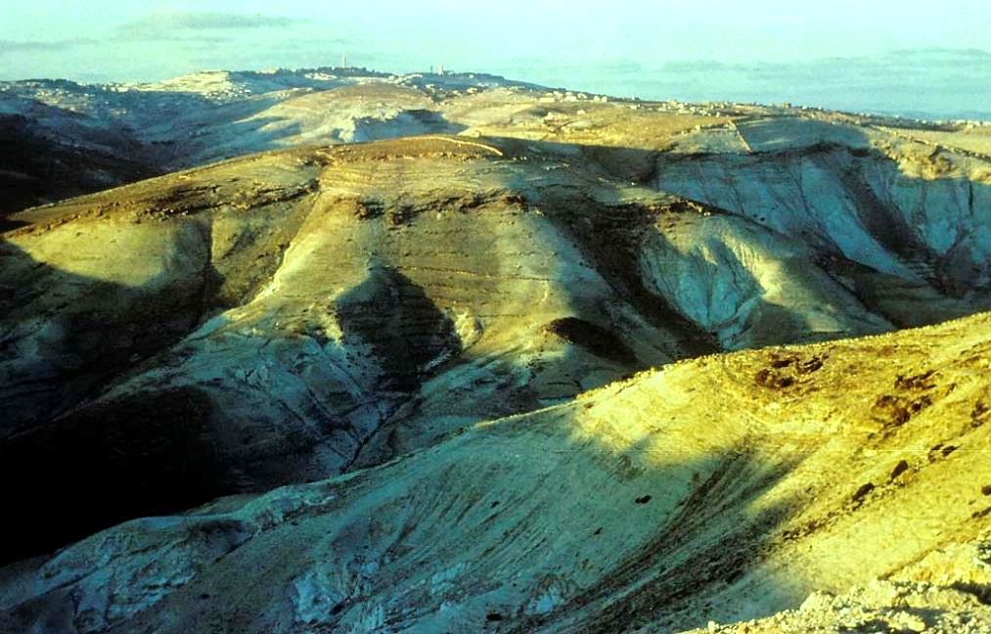
Jerusalem from the southeast, over 2600’ above sea level. The region’s relative barrenness results from the combination of a sharp drop in rainfall east of the central hill range and the nature of the bedrock. Drought was a constant threat to farming.

Slide 95
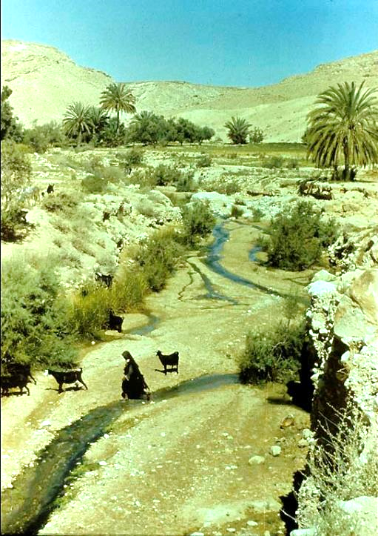
The wilderness of Judah is slashed by wadis (deep ravines or arroyos), which become temporary stream beds after the brief winter rains. Vegetation clusters along the wadi banks. The Bedouin come here to find water and forage for their flocks.
Scenes such as this are characteristic of the wilderness regions along the east and west sides of the Jordan Valley and the Dead Sea.

Slide 96
The Third Commandment
The 3rd commandment bans the abuse of God’s sacred name.
Ancient people considered a name to bear the nature or function of the one named.
Primary abuses concern oath-taking (“As Yahweh lives…”) and prophecy (“Thus says Yahweh…”), both of which were attempts to presume on God’s power.

Slide 97
“Therefore, this is what Yahweh Tsabaoth says concerning the prophets… ‘Do not listen to what the prophets are prophesying to you; they fill you with false hopes. They speak visions from their own minds, not from the mouth of Yahweh. They keep saying to those who despise me, ‘Yahweh says: You will have peace.’ And to all who follow the stubbornness of their hearts they say, ‘No harm will come to you.’”
“I did not send these prophets, yet they run with their message;
I did not speak to them, yet they have prophesied.”
“I have heard what the prophets say who prophesy lies in my name. They say, ‘I had a dream! I had a dream!’ How long will this continue in the hearts of these lying prophets, who prophesy the delusions of their own minds?”
“I am against the prophets who wag their own tongues and yet declare, ‘Yahweh declares.’”
Jer. 23:15-17, 21, 25, 31

Slide 98
TALKING POINTS
In biblical times, do think there were more false prophets than true prophets?
How about in modern times?

Slide 99
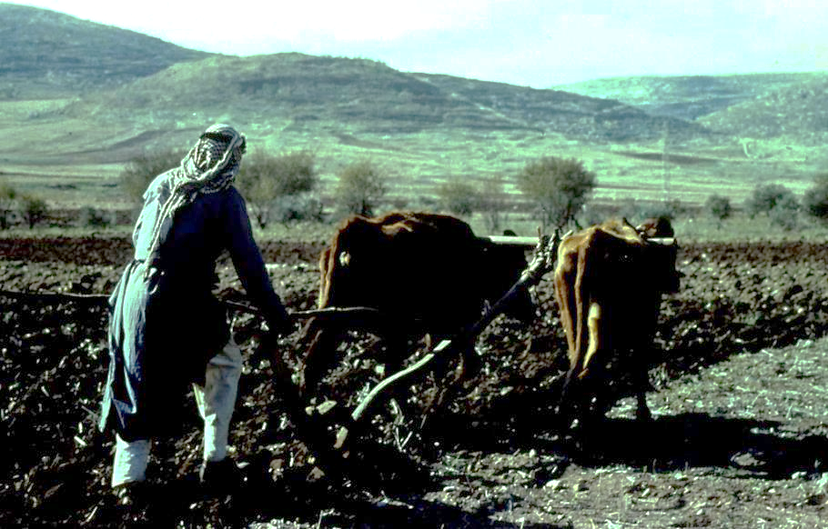
This ox-pulled plow is not much different from those used by the Israelites from the beginning of the Iron Age.
The iron plowpoint may have been introduced in the 12th century BC by the Philistines, who, according to 1 Samuel 13:19ff, maintained a monopoly over iron-smithing technology.
Pulled by oxen or asses, these plows helped the Israelites plant in the sparse soil of the hill regions.

Slide 100
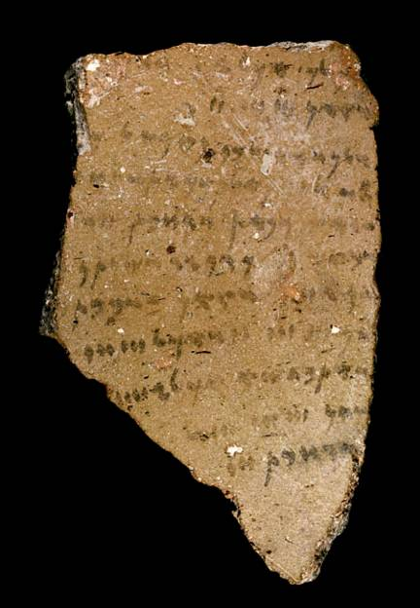
The Form of Jeremiah’s Letter is Unknown
The letter could have been written on a potsherd, such as this Heshbon ostracon dating to the 7th/6th century BC.
Alternatively, it might have been written on a scroll.
West Semitic Research Project, University of Southern California

Slide 101
TALKING POINTS
How difficult or how easy would it be to tell whether a prophet was genuine? What sorts of criteria might one use?
How does this relate to St. Paul’s statement in the New Testament, when he says, “Let two or three prophets speak, and let the others weigh what is said?” (1 Cor. 14:29)

Slide 102
LISTENING TO JEREMIAH
8

Slide 103
The Linen Loincloth
13:1-11
Prophetic Action
Jeremiah bought and wore a linen loincloth, the innermost piece of clothing
He was forbidden to launder it.
He hid the loincloth in a cleft of rock near the Euphrates River.
After a long time, he retrieved the loincloth, only to find that it was now rotted beyond usage.
Prophetic Meaning
The loincloth symbolized the intimacy of God’s relationship with his people.
Hiding the loincloth near the Euphrates River symbolized the coming exile to Mesopotamia, where the nation would become spoiled and useless.

Slide 104
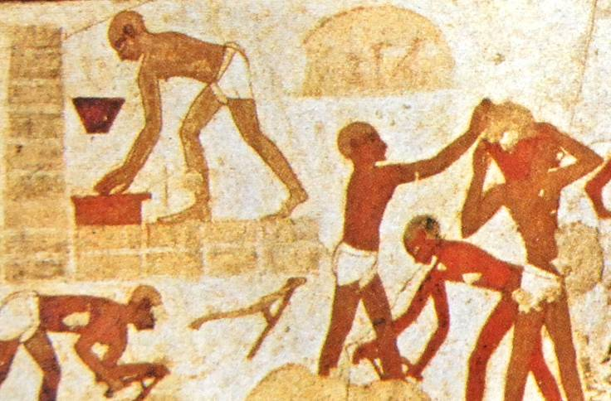
slaves wearing only loincloths while making bricks from an Egyptian wall painting, Thebes (15th century BC)

Slide 105
The Smashed Wine Jars
13:12-27
Prophetic Meaning
The smashing of the wine jars symbolized the downfall of the dynasty of David and the city of Jerusalem.
Both were under the sentence of death, not merely from Babylon, but from Yahweh.
Both king and queen mother were doomed.
Judah would be like a prostitute, publicly exposed for shame.
Prophetic Action
Jeremiah collected every available wine jar, filling them with wine.
He then smashed the wine jars, spilling all the wine.

Slide 106
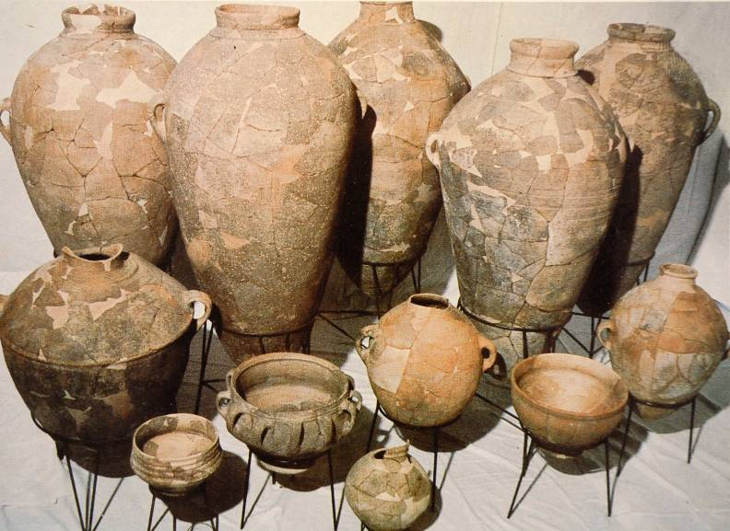
Iron Age Storage Vessels
Excavated at Shiloh

Slide 107
“Then the word of Yahweh came to me: ‘You must not marry and have sons or daughters in this place…’”
“For this is what Yahweh says, ‘Do not enter a house where there is a funeral meal; do not go to mourn or show sympathy, because I have withdrawn my blessing, my love and my pity from this people.’”
“And do not enter a house where there is feasting and sit down to eat and drink. For this is what Yahweh Tsabaoth, the God of Israel, says: ‘Before your eyes and in your days I will bring an end to the sounds of joy and gladness and to the voices of bride and bridegroom in this place.’”
Jer. 16:1, 5, 8

Slide 108
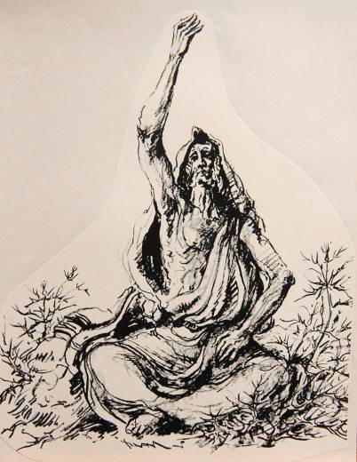
Emotionless Stoicism
16
Prophetic Action
Yahweh forbade Jeremiah to marry or have children.
He forbade him to attend funerals, feasts or weddings.
Prophetic Meaning
By showing neither pity, sympathy nor joy, Jeremiah’s life was a stark sign pointing to the coming disaster.

Slide 109
The Potter’s House
18
Prophetic Meaning
Though the potter is in control, the condition of the clay is also critical.
Israel is like clay in the potter’s hand.
Because of covenant violation, Yahweh intended to destroy Judah.
Yet, he also stood ready to act in news ways if Judah would respond with new behavior.
Yet, Judah was hardened beyond recovery.
Prophetic Action
Yahweh instructed Jeremiah to visit a local potter.
He watched the potter make a vessel that was marred.
Then the potter made another vessel, this time an acceptable one, from the same clay.

Slide 110
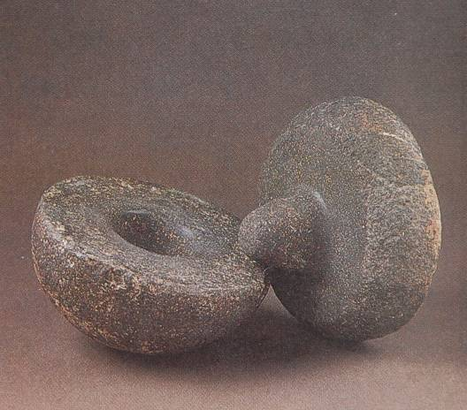
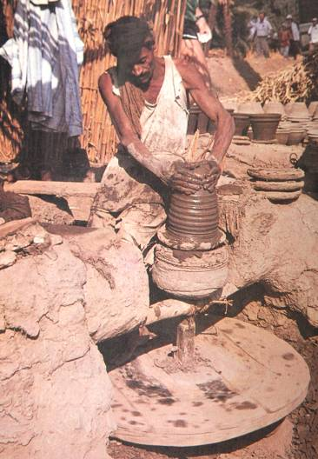
The Potter’s Wheel
The double wheel (right) was not invented until the Hellenistic Period. Hence, pottery in Jeremiah’s day was made on a hand-operated wheel, such as the one below (left) excavated at Hazor.
Upper stone fits into the base stone, then turned by hand

Slide 111
The Smashed Clay Jar
19
Prophetic Action
Jeremiah bought a clay jar from a potter.
He took some elders and priests to the Valley of Ben Hinnom (where ritual child sacrifice was conducted).
They exited the city through the potsherd gate, where potters dumped their wasted vessels.
While they watched, Jeremiah smashed the jar.
Prophetic Meaning
While clay is soft, it is suitable for reshaping.
When it becomes hardened, it is fit only for smashing.
Judah was now hardened in its sin.
The Valley of Ben Hinnom (Topheth) would become the scene of slaughter—not child sacrifice, but the slaughter of the citizens of Judah during the Babylonian siege.

Slide 112
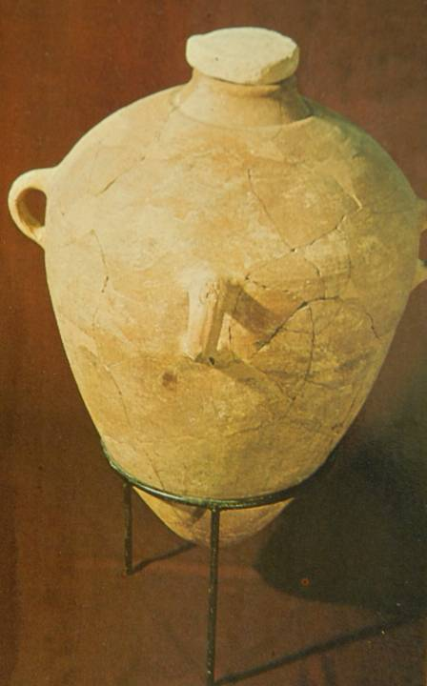
Large storage jar excavated from Level III, Lachish, and reconstructed.
Bears the l’melekh symbol (i.e., “belong to the king”) on one of the handles and the place name Hebron. At Lachish, more than 300 l’melekh handles have been found.

Slide 113
TALKING POINTS
How would the “parables” of Jeremiah reinforce his message of coming disaster to people in a largely oral society?
Given Jeremiah’s parable at the potter’s house, how does this story emphasize both the sovereignty of God as well as the freedom he gives to humans?
Do you think there is any significance in the fact that Judas Iscariot’s suicide ended with his betrayal money used to purchase the potters’ field (Mt. 27:3-10)? Matthew seems to bring together the predictions of Zechariah about the 30 pieces of silver (Zech. 11:13) and link them with Jeremiah’s reference to the Valley of Slaughter (Jer. 19:6), which is more or less equivalent to the “field of blood.”

Slide 114
The Cup of Wine
25
Prophetic Action
In a vision, Yahweh handed Jeremiah a cup of wine.
He was commanded to make the nations drink from the cup, including the citizens of Jerusalem and Judah.
Yahweh’s word to the nations was to drink until they vomited.
Prophetic Meaning
The cup of wine symbolized the wrath of Yahweh.
Judah and the other nations of the Levant would be devastated by the Babylonian war machine.
Yahweh would shout like those treading grapes in a winepress.
He would attack like a lion leaving its lair.

Slide 115
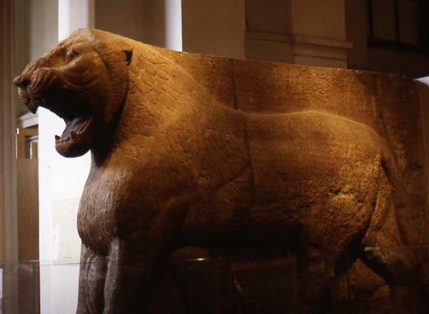

Two Divine Metaphors
Cup of intoxicating wine, symbol of Yahweh’s wrath.
Negbite (handmade) cups or bowls.
The Asian lion, symbol of Yahweh’s attack upon Judah (Je. 25:38; cf. 4:7a)
British Museum, London

Slide 116
The Recabites
35
Prophetic Action
The Recabites were a semi-nomadic Kenite clan that refused to participate in the sedentary life of the city.
Viticulture was unknown to them.
They only had come within the protection of Jerusalem after the land had been invaded.
Jeremiah offered them wine in the temple, knowing they would refuse.
Prophetic Meaning
Their refusal to drink wine, following a tradition of two centuries of loyalty to their ancestor, Jonadab ben Recab, contrasted sharply with Judah’s wanton disloyalty to Yahweh.

Slide 117

Semi-nomadic Tent-dwellers
(Modern Bedouin, Sinai Peninsula)
Photo by Dan Lewis

Slide 118
The Two Baskets of Figs
24
Prophetic Action
Yahweh called Jeremiah’s attention to two baskets of figs in front of the temple.
One basket had very good figs.
The other had poor figs, so poor they could not be eaten.
Prophetic Meaning
The good figs represented those already exiled to Babylon with Jehoiachin; these figs Yahweh would save as a remnant.
The bad figs represented Zedekiah and the citizens of Jerusalem—figs fit only for destruction.

Slide 119
The Field in Anathoth
32
Prophetic Action
During the final siege of Jerusalem, Yahweh instructed Jeremiah to redeem a field in Anathoth from his cousin.
Jeremiah purchased the land, arranging for deeds to be drawn up.
Prophetic Meaning
Jeremiah’s purchase was a sign pointing toward the restoration of Jerusalem.
In the future, fields, houses and vineyards once again would be occupied in the land.

Slide 120


Scrolls normally have writing only on a single side. So-called “Double Deeds” had both a sealed text (permanent legal description) and an open text (abstract available for inspection).
Brooklyn Museum, Brooklyn, New York
Double Deeds
Je. 32:10-15

Slide 121
TALKING POINTS
Do you think the metaphor of the cup, symbolizing God’s wrath, has any overtones in the language of Jesus in his final prayer in Gethsemane?
How does the language of redemption in Jeremiah’s purchase of property help us understand the spiritual idea of redemption in the cross of Christ?

Slide 122
LISTENING TO JEREMIAH
9

Slide 123
OLD TESTAMENT IMPRECATORY PRAYERS
Imprecatory prayers are found in various places in the Old Testament, notably the Psalms, but also within the prophets.
Often, the poetic form of these prayers are in the qinah meter, a poetic rhythm employing five stressed syllables in a 3 + 2 meter, similar to English iambic pentameter (of course, this rhythm is only accessible in the original language; one translated, the rhythm disappears).
hAyr,Ug htAB;r9 Myr,piK; j`OtB; hcAbAr! (from Ezekiel 19:2b)
In-the-midst of-lions she-crouched, rearing her-whelps.
The qinah meter is the rhythm of a dirge or funeral song, and it would be immediately recognizable by the ancient hearer.

Slide 124
CRIES FOR VENGEANCE
The so-called imprecatory Psalms, which call for divine vengeance against enemies and wickedness, strike Christians as discordant:
“Break the teeth in their mouths, O God…” (58:6a)
“…consume them in wrath, consume them till they are no more.” (59:13a)
“…happy is he who repays you…who seizes your infants and dashes them against the rocks.” (137:8-9)
Such expressions, composed before there was any gospel or clear expectation of justice in the after-life, are not so much a call for personal retribution as a plea for God to vindicate himself by establishing justice.

Slide 125

The “confessions” or “complaints” of Jeremiah are a series of candid, direct and intimate prayers composed after the pattern of laments in the Psalms. Jeremiah gives full vent to his anguish, questioning God and cursing his enemies.
11:18-23
12:1-6
15:10-21
17:14-18
18:18-23
20:7-13
20:14-18

Slide 126
“I had been like a gentle lamb led to the slaughter; I did not realize that they had plotted against me, saying,
‘Let us destroy the tree and its fruit;
Let us cut him off from the land of the living,
That his name be remembered no more.’
But, O Yahweh Tsabaoth, you who judge righteously
and test the heart and mind,
Let me see your vengeance upon them,
for to you I have committed my cause.”
Jer. 11:19-20

Slide 127
A Gentile Lamb Led to Slaughter
11:18-23
Jeremiah was severely opposed by members of his home town, Anathoth, who plotted to kill him.
He prayed for divine vengeance against them.
Imprecatory prayers and/or curses are a feature of many psalms (e.g., 35, 59, 69, 109, etc.).
Occasionally, such sentiments are to be found in the NT as well (e.g., 1 Co. 16:22; Ga. 1:8-9; Jude 11).
At the very least, such prayers are pleas for God’s final justice.
They may express outrage as much as spell out intended penalties.

Slide 128
JEREMIAH
“You are always righteous, O Yahweh,
When I bring a case before you.
Yet I would speak with you about your justice:
Why does the way of the wicked prosper?
Why do all the faithless live at ease?”
Jer. 12:1
GOD
“If you have raced with men on foot and they have worn you out,
How can you compete with horses?
If you stumble in safe country,
How will you manage in the thickets by the Jordan?”
Jer. 12:5

Slide 129
The Prosperity of the Wicked
12:1-6
The classical statement of the problem of evil indicts God:
If God is all good, then he must not be all powerful, else he would eliminate evil.
If God is all powerful, he must not be all good, else he would eliminate evil.
Biblical people also struggled with this same challenge—how to reconcile God’s power and goodness in the presence of evil.
Similar to Job (9:1-20) and Habakkuk (1:2-4, 13), Jeremiah questioned God’s justice.
Why do wicked people do so well? As before, he prayed for their destruction.
Yahweh’s answer was a shock: things would get much worse!

Slide 130
TALKING POINTS
How much identity do you find with Jeremiah’s frustrations in ministry?
What similarities or contrasts do you see between Jeremiah and Jesus?

Slide 131
“Alas, my mother, that you gave me birth,
A man with whom the whole land strives and contends!
I have neither lent nor borrowed,
Yet everyone curses me.”
“You understand, O Yahweh;
Remember me and care for me.
Avenge me on my persecutors.
You are long-suffering—do not take me away;
Think how I suffer reproach for your sake.”
“Will you be to me like a deceptive brook,
Like a spring that fails?”
Jer. 15:10, 15

Slide 132
The Suffering Prophet
15:10-21
In an outburst of emotion, Jeremiah lamented his ministry. He was:
  Antagonized (15:10)
  Ostracized (15:15)
  Lonely (15:17)
  His anguish seemed interminable (15:18a)
He even questioned God’s reliability (15:18b)!
Yahweh rebuked his impertinent prophet for such accusations:
Jeremiah had told the nation to repent; now Yahweh tells Jeremiah to repent (15:19).
He must remain resolute and not be shaped by his audience (15:19b-20).

Slide 133
“Heal me, O Yahweh, and I will be healed;
Save me, and I will be saved,
For you are the one I praise.
They keep saying to me,
‘Where is the word of Yahweh?
Let it now be fulfilled!’”
“Let my persecutors be put to shame,
But keep me from shame.
Let them be terrified,
But keep me from terror.
Bring on them the day of disaster;
Destroy them with double destruction.”
Jer. 17:14-15, 18

Slide 134
Vindication
17:14-18
Because Jeremiah did not give a date for Jerusalem’s destruction, and because his ministry was lengthy, he was susceptible to the charge of unfulfilled prophecy.
Ezekiel, similarly, was taunted with the cliché “the days go by and every vision comes to nothing” (Eze. 12:22, 27).
When Jeremiah asked for “healing” (17:14a), he prayed for his predictions to come to pass. His “healing” would occur only when Yahweh fulfilled the promise of judgment.
Jeremiah reminded God that he had been faithful to his prophetic commission (17:16).
Once more, he prayed for his enemies to be shamed and destroyed (17:18).

Slide 135
“They said, ‘Come, let’s make plans against Jeremiah…let’s attack him with our tongues and pay no attention to anything he says.’
“Listen to me, O Yahweh; hear what my accusers are saying!
Should good be repaid with evil? Yet they have dug a pit for me.
Remember that I stood before you and spoke in their behalf to turn your wrath
away from them.
So give their children over to famine;
Hand them over to the power of the sword.
Let their wives be made childless and widows;
Let their men be put to death, their young men slain by the sword in battle.”
“Do not forgive their crimes or blot out their sins from your sight.”
Jer. 18:18-21, 23b

Slide 136
Vengeance and Retribution
18:18-23
When his opponents designed a campaign to slander him, Jeremiah prayed for the devastation of their homes and families.
He prayed that God would not forgive their crimes!
A contemporary description of three recognized mediums of divine communication (18:18; cf. Eze. 7:26):
Priests, who teach the Torah
Wise men, who give counsel
Prophets, who speak the direct Word of Yahweh

Slide 137
“O Yahweh, you deceived me, and I was deceived;
You overpowered me and prevailed.
I am ridiculed all day long
Everyone mocks me.”
“I hear many whispering,
‘Terror on every side!
Report him! Let’s report him!’”
Jer. 20:7, 10a

Slide 138
The No-Win Prophet
20:7-13
Jeremiah’s blunt preaching cost him dearly:
Pashur, a priest and temple officer, arrested him, had him flogged and put in stocks (Je. 20:1-2).
In turn, Jeremiah predicted that Pashur would personally see the fall of Jerusalem.
He renamed him Magor-Missabib (= Terror on Every Side).
Jeremiah’s retort to Pashur was turned against him:
  He was taunted with his own words when his enemies nicknamed him “The Terror” (20:10).
  Jeremiah complained that Yahweh had tricked him by forcing him to prophecy things that did not come to pass (20:7a).

Slide 139
“Cursed be the day I was born!
May the day my mother bore me not be blessed!
Cursed be the man who brought my father the news,
Who made him very glad, saying, ‘A child is born to you—a son!’
Why did I ever come out of the womb to see trouble and sorrow
And to end my days in shame?”
Jer. 20:14-15, 18

Slide 140
“I Wish I Had Never Been Born”
20:14-18
Jeremiah cursed his birth day.
He cursed the man who brought the news of his birth to his father.
He cursed the fact that he was not aborted before birth.
This final confession, the most bitter of all, closes without resolution. Final resolution would not come until Christ:
Jesus also was like a lamb to be butchered.
He faced a bleak and bitter death.
But, unlike Jeremiah, he prayed for forgiveness for his enemies’ crimes.

Slide 141
TALKING POINTS
Is there a place for moral outrage in our contemporary world?
How are Christians to pray in the face of overwhelming injustice, and how might their prayers be like (or, unlike) the prayers of Jeremiah?
In the NT, Paul speaks of “wrestling in prayer” (Col. 4:12). How might the prayers of Jeremiah contribute to our understanding of this metaphor?

Slide 142
LISTENING TO JEREMIAH
10

Slide 143

The Scroll
The “book” (30:2) almost certainly refers to a scroll.
The “book” of consolation collects Jeremiah’s oracles of restoration.
In particular, he anticipated a future on the far side of exile with respect to land, covenant, and king.
It is likely that these oracles were interspersed throughout his ministry.

Slide 144
The Land
The central message of the Book of Consolation: Yahweh intends to bring Israel back to the land (30:3; 31:17; 33:7).
The exile is the “time of Jacob’s trouble” (30:7).
The ghostly figure of Rachel weeps for her exiled children, Benjamin in the south and Ephraim (Joseph) in the north (31:15).
Ephraim/Israel is a prodigal son under discipline (31:18-20).
Hope remained, however, on the far side of exile, a hope expressed in vivid metaphors (30:10-11):
The incurable wound would be healed (30:12-15, 17; 33:6; cf. 8:22; 10:19).
The fallen tent would be pitched again (30:18).
The purchase of the field in Anathoth was a sign for the future (32:1-15).

Slide 145
Jeremiah’s Message in Context
SOUTHERN NATION
“I will surely gather all of you…the remnant of Israel” (Mic. 2:12a)
“’In that day,’ declares Yahweh, ‘I will assemble the exiles…’ Yahweh will rule over them in Mount Zion from that day and forever.” (Mic. 4:6-)
“In that day Yahweh Tsabaoth will be a glorious crown…for the remnant of his people” (Is. 28:5)
“In that day Adonay will reach out his hand a second time to reclaim the remnant… He will assemble the scattered people of Judah from the four quarters of the earth.” (Is. 11:11-12)
8th Century Prophets
NORTHERN NATION
“I will bring back my exiled people Israel…” (Am. 9:14a)
“I will plant Israel in their own land never again to be uprooted from the land…” (Am. 9:15)
“The Israelites will live many days without king or prince…afterward they will return…” (Ho. 3:4-5)
“I will plant her for myself in the land… (Ho. 2:23)

Slide 146
I Will Bring You Back
7th and 6th Century Prophets
I will…gather those who have been scattered. At that time I will gather you; at that time I will bring you home. (Zep. 3:19-20)
I myself will gather the remnant of my flock out of all the countries where I have driven them… (Je. 23:3)
I will forgive the remnant I spare. (Je. 50:20)
When seventy years are completed… I will…bring you back to the place from which I carried you into exile. (Je. 29:10-14)
I will gather you from the nations…where you have been scattered, and I will give you back the land of Israel again. (Eze. 11:17)
In the first year of Darius…I, Daniel, understood from the Scriptures…that the desolation of Jerusalem would last seventy years. (Da. 9:1-3)

Slide 147
“The days are coming,” declares Yahweh, “when I will plant the house of Israel and the House of Judah… Just as I watched over them to uproot and tear down, and to overthrow, destroy and bring disaster, so I will watch over them to build and to plant,” declares Yahweh.
Jer. 31:27-28
“The days are coming” declares Yahweh, “when I will fulfill the gracious promise I made to the house of Israel and to the house Judah. In those days and at that time I will make a righteous Branch sprout from David’s line; he will do what is just and right in the land…” For this is what Yahweh says, “David will never fail to have a man to sit on the throne of Israel…”
Jer. 33:14-17
This is what Yahweh says, ”If you can break my covenant with the day and my covenant with the night, so that day and night no longer come at their appointed time, then my covenant with David my servant…can be broken…”
Jer. 33:20-21
Jer. 18:18-21, 23b

Slide 148

Cyrus Cylinder 539-8 BC
“I returned to these sacred cities on the other side of the Tigris, the sanctuaries of which have been in ruins for a long time, the images which used to live therein and established for them permanent sanctuaries. I also gathered all their former inhabitants and returned to them their habitations.”
British Museum, London

Slide 149
TALKING POINTS
While the Jews’ return from exile and the building of a 2nd Temple is established historical fact, one of the perennial questions is how to interpret those promised features that that were not realized (e.g., the king from David’s line, the freedom from foreign oppression, the return of divine glory to the 2nd temple, and so forth). How would you respond to such questions?

Slide 150
The Covenant
Jeremiah’s original commission had a dual orientation: Yahweh was “watching” to…
…uproot, tear down, destroy and overthrow (1:10a)
…but also to build and to plant (1:10b)
In the Book of Consolation, the positive side of this polarity comes to the forefront: Yahweh still is watching…
…but this time, to build and to plant (31:27-28)

Slide 151
THE PROBLEM
Corporate Retributive Justice
Torah declared that Yahweh inflicted the penalty for covenant disobedience upon succeeding generations (Ex. 20:5; 34:7; Nu. 14:18; Dt. 5:9)
This, in turn, gave rise to the popular proverb, “The fathers eat sour grapes, and the children’s teeth are set on edge” (Je. 31:29; cf. Eze. 18:1-2).
Consequently, those who suffered discipline were apt to blame their punishment on their ancestors (cf. Eze. 18:3-32).
Both Jeremiah and Ezekiel rejected this interpretation, declaring that each one would be punished for his own sin (Je. 31:30; Eze. 18:4-29).

Slide 152
The New Covenant
Nevertheless, a New Covenant was coming!
It was to be established with the remnant from both the northern and southern nations (31:31).
Whereas the Mosaic covenant was contained in external codes, the New Covenant would be deeply internalized (31:33-34a).
Whereas the Mosaic covenant was based on obedience-reward and disobedience-punishment—retributive justice—the New Covenant would be grounded in forgiveness (31:34b).
Whereas the Mosaic covenant could end in a divine rejection of Israel for disobedience, the New Covenant was guaranteed forever (31:35-37; 32:40).

Slide 153
The New Covenant Cont.--
Jeremiah
“The time is coming,” declares Yahweh, “when I will make a new covenant…
“It will not be like the covenant I made with their forefathers…
“I will put my law in their minds and write it on their hearts…
“I will forgive their wickedness and will remember their sins no more…
Jeremiah 31:31-34
Ezekiel
“I will make a covenant of peace with them…
“There will be showers of blessing…
“I will establish an everlasting covenant with you. Then…I will make atonement for you for all you have done…
“I will give them an undivided heart and put a new Spirit in them…
Ezekiel 34:25-31; 16:60-63; 11:1-20

Slide 154
The King
Central to this new covenant was a revival of the Dynasty of David!
Earlier, Jeremiah had used Isaiah’s “Branch” metaphor to describe the restoration of David’s family (Je. 23:5-6; cf. Is. 11:1).
In the time of restoration, the ancient promise to David’s family would be fulfilled (Je. 33:14-26; cf. 2 Sa. 7:16; 23:5; Ps. 89:35-37).

Slide 155
The Prophets and the Link with David
In that day I will restore David’s fallen tent… (Am. 9:11)
Afterward, the Israelites will seek…David their king. (Ho. 3:5)
In love a throne will be established; in faithfulness a man will sit on it—one from the house of David… (Is. 16:5)
I will raise up to David a righteous branch, a King who will reign wisely… (Je. 23:5)
I will place over them one shepherd, my servant David… (Eze. 34:23)

Slide 156
The Spiritual Character of Restoration
Afterward, the Israelites will…come trembling to Yahweh and to his blessings… (Ho. 3:5b)
I will heal their waywardness and love them freely… (Ho. 14:4)
Those who are left in Zion…will be called holy… (Is. 4:3)
And a highway will be there; it will be called the Way of Holiness. The unclean will not journey on it…only the redeemed will walk there. (Is. 35:8-9)
But I will leave within you the meek and humble, who trust in the name of the LORD. The remnant of Israel will do no wrong; they will speak no lies… (Zep. 3:12-13)
I will give them a heart to know me, that I am Yahweh. They will be my people, and I will be their God, for they will return to me with all their heart. (Je. 24:7)
I will cleanse them from all the sin they have committed against me and will forgive all their sins… (Je. 33:8)
I will sprinkle clean water upon you, and you will be clean… (Eze. 36:25)

Slide 157
“A record of the genealogy of Jesus Christ the son of David…
Matt. 1:1
In the same way, after the supper he took the cup, saying, “This cup is the new covenant in my blood, which is poured out for you.”
Luke 22:20
He has made us competent as ministers of a new covenant—not of the letter but of the Spirit…
2 Cor. 3:6a
By calling this covenant “new,” he has made the first one obsolete; and what is obsolete and aging will soon disappear.
Heb. 8:13
For this reason, Christ is the mediator of a new covenant, that those who are called may received the promised eternal inheritance—now that he has died as a ransom to set them free from the sins committed under the first covenant.
Heb. 9:15

Slide 158
TALKING POINTS
What do you make of this superimposing of ancient promises so that some refer to the near future and some to the distant future?
Can you begin to see why Luke says that “beginning with Moses and all the Prophets, he [Jesus] explained to them what was said in all the Scriptures concerning himself” (Lk. 24:27)?

Slide 159
LISTENING TO JEREMIAH
11

Slide 160
“Then Jeremiah the prophet told all this to Zedekiah king of Judah, in Jerusalem, while the army of the king of Babylon was fighting against Jerusalem and the other cities of Judah that were still holding out—Lachish and Azekah. These were the only fortified cities left in Judah.”
Jer. 34:6-7

Slide 161
Nebuchadnezzar’s strategy was similar to Sennacherib’s a century earlier (the attack on Jerusalem began with the fortress cities guarding the pass into the central mountains).
Jeremiah predicted that the Babylonian attack on the defense cities of Lachish and Azekah was the beginning of the end (34:1-3).
Lachish had been rebuilt after its destruction by Sennacherib in 701 BC.
At the time of Jeremiah’s oracle, the only two defense cities remaining were Lachish and Azekah (34:6-7).
In 1935 and 1938, ostraca were discovered in the ruins of Lachish containing letters between Jewish military personnel who, during Nebuchadnezzar’s attack on Judah, communicated about…
…urgent orders calling for special
arrangements of signal fires
…sending to Egypt for military support
…inspection of the guards
Several names known to us from the Book of Jeremiah appear in these letters, such as, Gemariah, Jaazaniah and Neriah.

Slide 162

Lachish Letter III
“…And it has been reported to your servant, saying, ‘The commander of the host, Coniah son of Elnathan, has come down in order to go into Egypt; and unto Hodaviah son of Ahijah and his men has he sent to obtain […] from him.’ And as for the letter of Tobiah, servant of the king, which came to Shallum son of Jaddua through the prophet, saying, ‘Beware!’, your servant has sent it to my lord.”

Slide 163

Lachish Letter IV
“…And let (my lord) know that we are watching for the signal (fires) of Lachish, according to all the indications which my lord has given, for we cannot see Azekah.”
These two fortress cities are the very ones directly mentioned in Jer. 34:6-7.

Slide 164

Lachish Letter VI
“…Who is your servant (but) a dog that my lord should have sent (him) the king’s letter and those of the officials asking me to read them? The words of the p[rophet]* are not good—(they are of a kind) to slacken your courage and to weaken that of the men […]”
*restoration by Parker (other restorations read “officials” or “princes” instead of “prophet”)
Could the references to a prophet in Letters III and VI refer to Jeremiah? (cf. Je. 38:1-4)

Slide 165

Judah’s Penchant for Looking to Egypt
The perennial challenge to the Mesopotamian superpowers’ campaigns in Palestine was Egypt (cf. 2 Kg. 18:21; 24:7).
After Jehoahaz’ deportation to Egypt, Jehoiakim was established as a puppet king by Pharaoh-Neco II (2 Kg. 23:33-35).
Judah’s temptation was to depend upon Egypt for military assistance (Eze. 17:15; 29:6-7).

Slide 166
Temporary Withdrawal
During the siege on Jerusalem, the Babylonian armies withdrew due to a report that the Egyptians were mobilizing in the south (Je. 37:5).
Jeremiah’s oracle to Zedekiah was that the Egyptian threat was temporary, and Nebuchadnezzar still would return to destroy Jerusalem (Je. 37:6-10).
When Jeremiah attempted to return to Anathoth (possibly in connection with the purchase of the field), he was apprehended, accused of defection, flogged, and imprisoned (Je. 37:13-16).
After a long incarceration, Zedekiah again called for Jeremiah, but the prophet’s message was the same: the city would surely fall (Je. 37:17).
At Jeremiah’s request, Zedekiah allowed him to remain under courtyard arrest (Je. 37:18-21).

Slide 167

King Zedekiah sent Jehucal ben Shelemiah to ask Jeremiah to pray for the city after the Babylonian withdrawal. Jeremiah’s response was that the withdrawal was temporary, and Nebuchadnezzar would return to capture and burn Jerusalem (37:3-10).
Hebrew University, Jerusalem
SEAL IMPRESSION OF JEHUCAL
This bulla was excavated by archaeologist Yoav Farhi in Jerusalem (2005). It reads:
Ybwnb vhymlwn blkvhyl
“Belonging to Yehucal ben Shelemiyahu ben Shovi”
Jehucal also was witness to Jeremiah’s oracle that those who surrendered to the Babylonians would be spared (cf. 38:1-3).

Slide 168
The Release of the Slaves
Zedekiah’s release of the slaves was a misdirected overture toward Yahweh:
Probably he hoped that this act might induce Yahweh to lift the blockade (Je. 34:8-10).
The insincerity of this action became evident when the Babylonians withdrew; the emancipated slaves once more were stripped of their freedom (Je. 34:11, 16).
Deuteronomic Code
While debt slavery was tolerated in the Torah, slaves were to be released on sabbatical years.
When released, they were to be treated generously.
Deuteronomy 15:12-15
Jeremiah 34:12-15
JEREMIAH’S ORACLE: Judah was now “free” to be destroyed (Je. 34:17-22).

Slide 169
TALKING POINTS
In the modern world, we have little conception of the horrors of siege warfare which could last for months or even years. How might ancient cities have prepared themselves to withstand siege warfare?
The release of the slaves was essentially an attempt to manipulate God. How might this compare with Christians who try to manipulate God?
The release of the slaves was a bit like what sometimes is dubbed “foxhole repentance.” Do you think God accepts such repentance in the midst of a life-threatening crisis?

Slide 170

In July 2008, another bulla was discovered in situ by archaeologist Eilat Mazar about 600 feet south of the temple mount.
The seal impression was of Gedaliah ben Pashur, who accompanied Jehucal ben Shelemiah to arrest Jeremiah (Je. 38:1).
Gabri Laron/Hebrew University/Dr. Eilat Mazar

Slide 171

In the Cistern
38:1-13
Jeremiah’s advice that the citizens of Jerusalem should surrender to the Babylonians was taken to be a traitorous act.
Jeremiah was lowered into a cistern into the mud.
With permission from Zedekiah, Ebed-Melech rescued Jeremiah so that he remained under courtyard arrest.
Unlike this cistern excavated at Gibeon, Jeremiah’s place of punishment presumably had no stairway.

Slide 172
”Then King Zedekiah sent for Jeremiah the prophet and had him brought to the third entrance to the temple of Yahweh. ‘I am going to ask you something,’ the king said to Jeremiah. ‘Do not hide anything from me.’
Jeremiah said to Zedekiah, ‘If I give you an answer, will you not kill me? Even if I did give you counsel, you would not listen to me.’
But King Zedekiah swore this oath secretly to Jeremiah: ‘As surely as Yahweh lives, who has given us breath, I will neither kill you nor hand you over to those who want to kill you.’”

Slide 173
Then Jeremiah said to Zedekiah, "This is what the Yahweh Tsabaoth, the God of Israel, says: 'If you surrender to the officers of the king of Babylon, your life will be spared and this city will not be burned down; you and your family will live. But if you will not surrender to the officers of the king of Babylon, this city will be given into the hands of the Babylonians and they will burn it down; you yourself will not escape from them.’"
Jer. 38:14-18

Slide 174
Private Oracle to Zedekiah
38:14-28
So, once more, Zedekiah called for Jeremiah’s counsel:
Jeremiah’s response was chilling: the king’s only chance for survival was surrender.
Zedekiah, for his part, was afraid that if he surrendered he would be abused by Jews who already had defected.
Indecisive to the end, Zedekiah seemed paralyzed to act.
He only asked that Jeremiah not reveal their private conversation.

Slide 175

Casemate Wall
Construction of two parallel walls about 5’ to 7’ apart, the outer wall being the thickest, and joined together at intervals by cross sections creating a series of casemates or chambers.
Casemates usually were filled with rubble for added mass, but sometimes casemates were used for storage rooms.

Slide 176

Inset/Offset Walls and Towers (Arad, Judah) offsets in wall construction offered a field of fire down the wall line without the defenders exposing themselves
Excavations at Arad

Slide 177


Gate Technology
Gates were constructed with alcoves that could be manned during a siege, making it difficult for enemy invaders to breach this, the weakest part of the fortification. Some gates were constructed with a bent-axis, making it nearly impossible to use a battering ram because of the angled entrance.
Excavated Solomonic gate at Gezer

Slide 178

Glacis and Revetment Wall
GLACIS = steep inclined approach to the primary wall base
REVETMENT WALL = outer retaining wall at the foot of the glacis

Slide 179

SCALING LADDERS
With upraised shields for protection and probably under a covering fire by supporting archers, soldiers scale an enemy city wall using ladders.
British Museum, London

Slide 180

SIEGE RAMPS AND SIEGE MACHINES
Impaling POWs was an intimidation technique.
British Museum, London
Notes:
Siege at Lachish (slab 3): Assyrians attack Lachish’s central sector with battering rams under a hail of stones, arrows and fire-torches. Corpses are stripped and impaled on stakes. Captives are sent off into exile with their packs on their backs. [AI-20]

Slide 181
The Fall of Jerusalem, 587-6 BC
Jeremiah 39, 52
Famine within (52:6; cf. 2 Kg. 25:1-2; La. 4:7-10)
Exhaustion with defending against the siege works (39:1; 52:4-5; cf. 2 Kg. 25:1-2)
Wall breached (39:2-4; 52:7-8; cf. 2 Kg. 25:4)
The king and the remains of the army attempted escape, unsuccessfully (39:3-7; 52:7-11; cf. 2 Kg. 25:4-7; Eze. 12:12-13; La. 4:19-20)
The Babylonians sacked the city, torched the temple, broke down the walls, and burned to the ground every important building (39:8; 52:12-16; cf. 2 Kg. 25:8-10; 2 Chr. 36:19).
The valuables from the temple were salvaged as plunder and carried to Babylon along with the deportation of the most important citizens (39:9-10; 52:17-30; cf. 27:16-22; 2 Kg. 25:11-21; 2 Chr. 36:18, 20).

Slide 182

The name of Nebuchadnezzar’s chief eunuch, Nebo-Sarsekim, is discovered among the Babylonian tablets (cf. Je. 39:3).
On July 12, 2007, Dr. Michael Jursa, an Assyriologist and professor from Vienna, was searching for ancient financial accounts among the British Museum’s 130,000 cuneiform tablets.
Among them, he discovered a small tablet that served as a receipt for payment of 0.75 kilogram of gold to a temple in Babylon by Nabu-sharrussu-ukin.
“[Regarding] 1.5 minas (0.75 kg) of gold, the property of Nabu-sharrussu-ukin, the chief eunuch, which he sent via Arad-Banitu the eunuch to [the temple] Esangila… Month XI, day 18, year 10 [of] Nebuchadnezzar, king of Babylon.”

Slide 183

Jeremiah’s Near
Escape
Prisoners of war prepared for deportation
British Museum, London
CHAINED FOR DEPORTATION
At first, Jeremiah was prepared for deportation with all the others, in spite of an order for his freedom (40:1; cf. 39:11-12).
When the commander of the guard discovered Jeremiah chained, he released him, giving him the option of staying in Jerusalem or going to Babylon (40:2-6).

Slide 184
TALKING POINTS
How does Psalm 74:3-8 reflect upon the fall of Jerusalem?
How about the opening poem in Lamentations?

Slide 185
“Pick your way through these everlasting ruins, all the destruction the enemy has brought on the sanctuary. Your foes roared in the place where you met with us; they set up their standards as signs. They behaved like men wielding axes to cut through a thicket of trees. They smashed all the carved paneling with their axes and hatchets. They burned your sanctuary to the ground; they defiled the dwelling place of your Name. They said in their hearts, ‘We will crush them completely!’ They burned every place where God was worshipped in the land.”
Psa. 74:3-8
“How deserted lies the city, once so full of people! How like a widow she is, who once was great among the nations! She who was queen among the provinces has now become a slave. Bitterly she weeps at night, tears are upon her cheeks. Among all her lovers there is none to comfort her. All her friends have betrayed her; they have become her enemies.
After affliction and harsh labor, Judah has gone into exile.”
Lam. 1:1-3a

Slide 186
LISTENING TO JEREMIAH
12

Slide 187

GEDALIAH’S ASSASSINATION
40:7—41:15
Gedaliah, a Jewish noble, was appointed governor by Nebuchadnezzar (2 Kg. 25:22).
At the instigation of Baalis of Ammon, Gedaliah was assassinated by Jewish patriots in a plot headed by Ishmael, another Jewish prince.
The vigilante force also slaughtered Gedaliah’s attendants, some Babylonian soldiers, and some pilgrims.
BROWN AGATE SEAL READING: “[belonging to] Baalis [‘] king of B[nei Ammo]n”

Slide 188

The Pool of Gibeon, excavated in the late 1950s and early 1960s by James Pritchard of the University of Pennsylvania, is where Gedaliah’s officers caught up with Ishmael, the assassin. Ishmael and eight of his men escaped.

Slide 189

Flight to Egypt
41:16—43:13
Gedaliah’s assassination created panic
Would the Babylonians seek reprisals?
Against Jeremiah’s advice, they determined to flee to Egypt.
The Jewish military officers distrusted Jeremiah, accusing him of being manipulated by Baruch, his scribe.
They took both Jeremiah and Baruch with them in the flight to Tahpenes in the northeast Delta (cf. 2 Kg. 25:26).
Jeremiah buried stones in a brick pavement as a sign of Nebuchadnezzar’s coming attack upon Egypt.

Slide 190

Oracle to the Exiles in Egypt
THE LION, SYMBOL OF ISHTAR
From the Ishtar Gate, Babylon
Royal Ontario Museum, Toronto, Canada
The Jewish refugees in Egypt continued worshipping Ishtar, the Queen of Heaven (Je. 44).
They argued that Jerusalem fell because they had left off worshipping her.
Jeremiah declared that Yahweh still was watching; he still would judge them!

Slide 191

Goddess Ishtar
“Cakes of bread for the Queen of Heaven” (Je. 44:17; cf. 7:18) refer to cakes bearing the image of Ishtar (Je. 44:19).
Ishtar, the “Queen of Heaven,” was the Babylonian fertility goddess as well as the goddess of war. She was believed to contain the inseparable powers of life and death.
(Louvre, Paris)

Slide 192
The word that came to Jeremiah… “Thus says Yahweh Tsabaoth, the God of Israel, ‘You have seen all the disaster that I brought upon Jerusalem and upon all the cities of Judah… I persistently sent to you my servants the prophets, saying, ‘Oh, do not do this abomination that I hate… Have you forgotten the evil of your fathers, the evil of the kings of Judah, the evil of their wives, [and] your own evil?’”
Jer. 44:1-10
“But the men…and all the women who stood by…answered Jeremiah, ‘We will not listen to you. We will do everything that we have vowed, make offerings to the Queen of Heaven, and pour out drink offerings to her, as we did, both we and our fathers… For then we had plenty of food, and prospered, and saw no disaster. But since we left off making offerings to the Queen of Heaven and pouring out drink offerings to her, we have lacked everything, and have been consumed by the sword and by famine.’”
Jer. 44:15-19

Slide 193
TALKING POINTS
Why do you think that the community of Jews remaining in Jerusalem still refused to listen to Jeremiah?
Does it surprise you that after all the devastation, which Jeremiah directly attributed to idolatry and covenant violation, the refugees who escaped to Egypt still resorted to worshipping the Queen of Heaven?

Slide 194
PROPHETIC ORACLES TO THE NATIONS
Substantial sections of the prophetic literature consist of oracles about nations other than Israel and Judah
Amos 1-2 Zephaniah 2
Isaiah 13-21, 23-24, 34, 47 Jeremiah 46-51
Micah 4 Ezekiel 25-32, 35
Joel 3 Daniel 2, 7, 8, 10-12
At the beginning of his ministry, Jeremiah was appointed as a prophet “to the nations” (1:5b). Yahweh was Lord of the nations, not merely of Israel and Judah.

Slide 195
Oracles about the Nations
PRIMARY THEME IS WAR:
Yahweh directs the wars against the nations (46:10; 47:6-7; 48:10; 49:2, 8, 20, 27, 32b, 35; 50:15, 21, 25; 51:1).
The nations serve as Yahweh’s war club with which he shatters kingdoms under judgment (51:20-23).
Geographical Order
South (Egypt)
West (Philistia)
East (Moab, Ammon and Edom)
North (Damascus, Kedar and Hazor)
Farther North and East (Elam and Babylon)

Slide 196

Damascus
JUDAH
Ammon
BABYLON
Moab
Elam
Philistia
Edom
EGYPT

Slide 197
Notations…
Pharaoh Neco II’s defeat is verified by the Babylonian Chronicles:
“He [Nebuchadnezzar] crossed the river [Euphrates] to go against the Egyptian army which lay in Carchemish. The armies fought with each other and the Egyptian army withdrew before him. He accomplished their defeat and beat them to nonexistence. As for the rest of the Egyptian army which had escaped from the defeat so quickly that no weapon had reached them, the Babylonians overtook and defeated them in the district of Hamath so that not a single man escaped to his own country. At that time Nebuchadnezzar conquered the whole of Hatti-land.”
Translated by D. J. Wiseman
EGYPT (46:1-12)
This oracle is dated to 605 BC, the year of Pharaoh Neco II’s confrontation with Nebuchadnezzar at the Battle of Carchemish (2 Kg. 24:7).
At that time, Jehoiakim had been forced to change fealty from Egypt to Babylon (cf. 2 Kg. 24:1; cf. Da. 1:1-2).
This prediction earlier in Jeremiah’s ministry about Egypt’s defeat, which certainly happened, should have established him as a true prophet (cf. Dt. 18:21-22).

Slide 198

Babylonian Chronicles
Collection of tablets from Sargon of Akkad (ca. 2350 BC) to the advent of the Persian Empire (6th century BC).
Compiled to inform the Achaemenid kings (Persia) of the prior history of Babylon following the Persian conquest in 539 BC.
Texts are of various types and writing styles
Tablet ABC 05 (left) recounts the defeat of Pharaoh Neco II at Carchemish in 605 BC by the Babylonians.
Nebuchadnezzar Chronicle
British Museum, London

Slide 199
Notations…
EGYPT (46:13-28)
The second oracle about Egypt is undated, but it describes Nebuchadnezzar’s advance toward Egypt following the Battle of Carchemish, probably about 604 BC.
Observe the sarcastic labeling of Pharaoh as an empty braggart (various renderings):
“Why has Apis fled?” (LXX)*
“Crash” (S. R. Driver)
“Loudmouth” (R. K. Harrison)
“Much-noise-but-he-lets-the-
chance-slip-by” (JB)
Attached to the oracles about Egypt is a reaffirmation of Judah’s discipline in exile and later restoration.
Je. 46:27-28
Nearly verbatim
Je. 30:10-11
*Apis = bull-deity of the god Osirus

Slide 200
Notations…
BABYLON (50-51)
Marduk, also called Bel (50:2), the Babylonian king of the gods.
The enemy from farther north that would attack Babylon (50;3, 9, 41; 51:48) would be Media (51:11).
After the fall of Babylon, the Jews would be allowed to return to Judah (50:4-7, 16b, 19, 33-34; 51:5-6, 10, 45).
Babylon had destroyed Yahweh’s temple; now Yahweh would destroy Babylon (50:28; 51:11, 24, 50-51).
For Babylon there would be no restoration (50:39-40; 51:26, 39, 57, 62).

Slide 201

A Sign for the Future
51:59-64
The entire text of the oracle against Babylon was recorded on a scroll and given to Baruch’s brother, Seraiah ben Neriah, so that it might be publicly read in Babylon, ca. 594 BC.
After the reading, it was to be tied to a stone and thrown into the Euphrates River, signifying the eternal sinking of Babylon.
The oracle against Babylon concludes the collection of Jeremiah’s sermons (51:64b).
SEAL OF SERAIAH from a private collection:
“Belonging to Seriahu / Neriyahu”

Slide 202
“So will Babylon sink to rise no more because of the disaster I will bring on her. And her people will fall.”
The words of Jeremiah end here.
Jer. 51:64

Slide 203
TALKING POINTS
In the Old Testament, God seems to hold the nations accountable in space-time history; in the New Testament, a final judgment of the nations is heralded at the end of history. Why do you think this difference exists?
What is your final take away from the life and ministry of Jeremiah?

