Slide 1

POOJITHA GIRLS’ Jr. COLLEGE
B.N.KANDRIGA
Established: 2018
College code: 09113
RC No: 1350724
Website: www.svredu.in Phone no: 9000487879
Email : poojithagirlscollege@gmail.com 9440494894

Slide 2
About our College:
Private unaided jr. college for girls
Established in 2018 in B.N.Kandriga, a mandal head quarter (rural)
With an aim to encourage Girl child education in rural areas
At an affordable fee structure
By experienced lecturers
Providing competitive examinations coaching like EAPCET, NEET, ICAR
Focusing on health and wellness by conducting YOGA classes
A wonderful study atmosphere
Total facility under CCTV surveillance

Slide 3
Besides and Beyond Marks & Ranks
Traditional support: Conducting classes on chanting slokas and encourage their thoughts to be fearless
Motivational support: Motivating students to approach Lecturers for better understanding of lessons and concepts
Sharing & Caring: Knowledge shared among students and encourage each other in all aspects
Conceptual track: Following Yoga and Meditation and helping students to understand the concepts
Health is wealth: Encouraging students to follow good eating habits to prevent falling sick

Slide 4
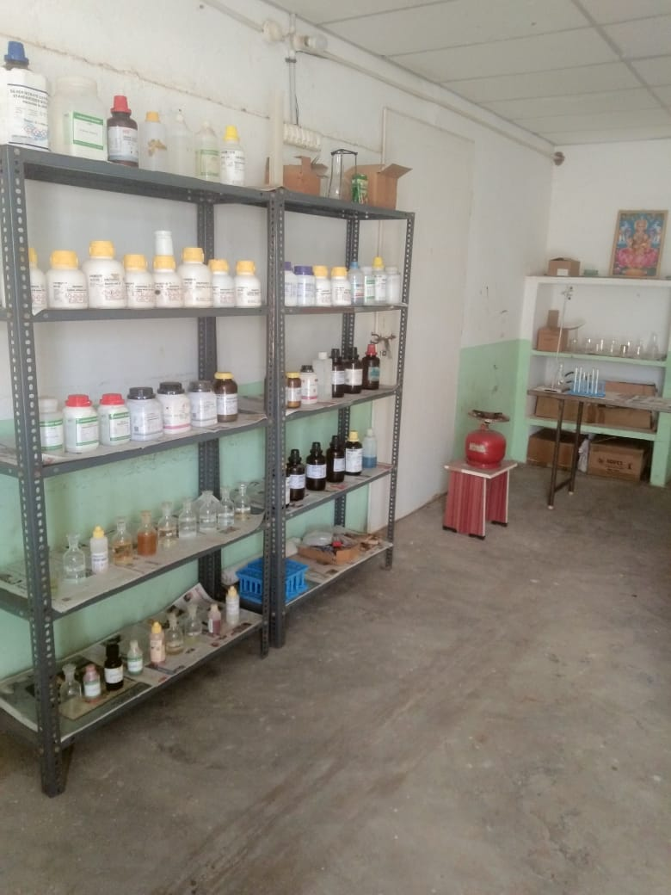
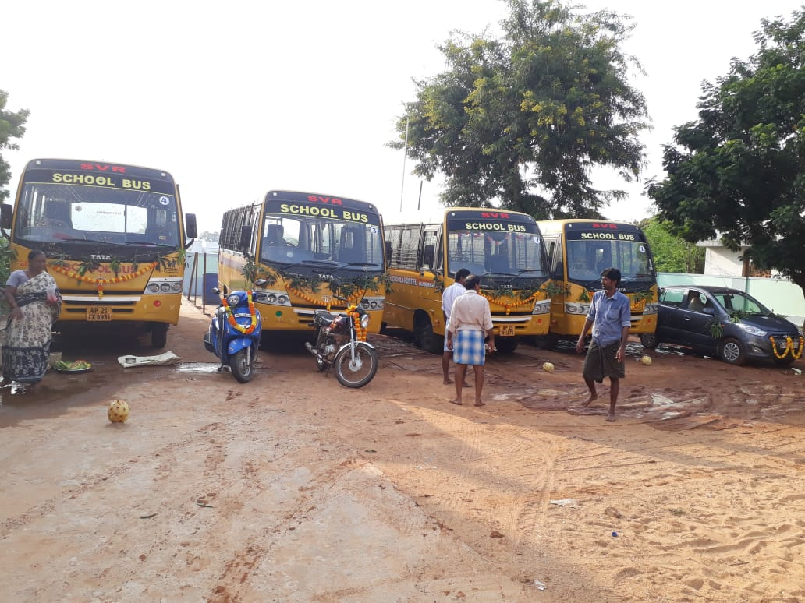
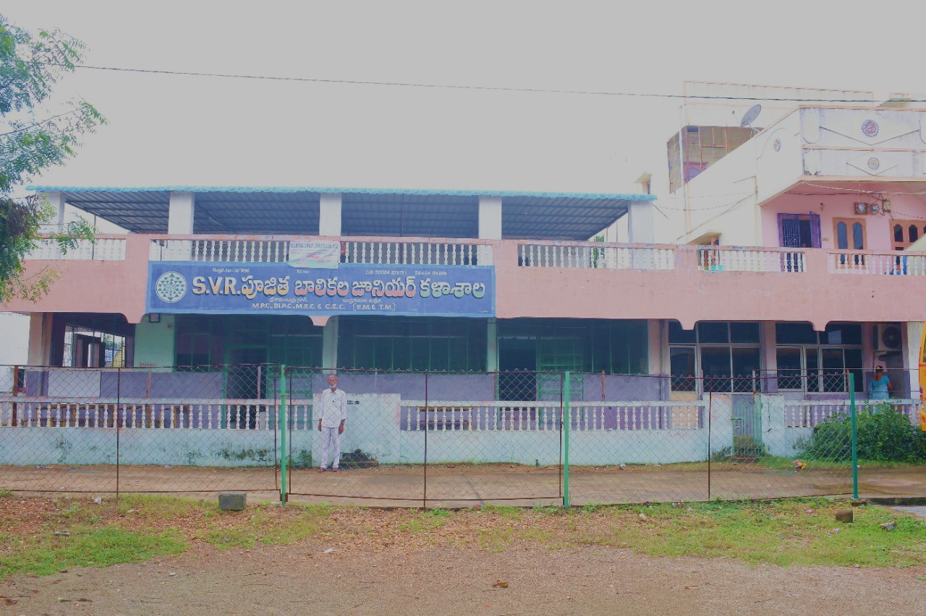
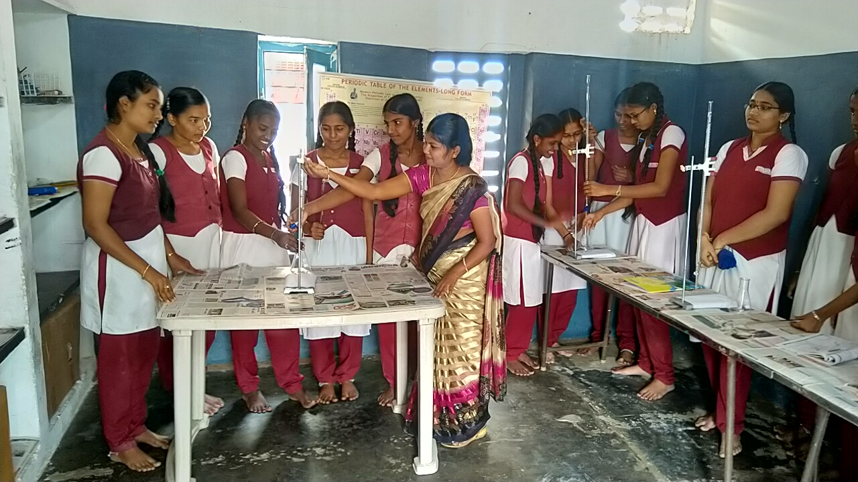
FACILITIES:

Slide 5
Courses taught:
Groups (E.M. & T.M.):
M.P.C.
Bi.P.C.
C.E.C.
M.E.C.
H.E.C.
Coaching is provided for:
ECET
NEET
JEE Mains
C.A.-C.P.T.
ICAR

Slide 6
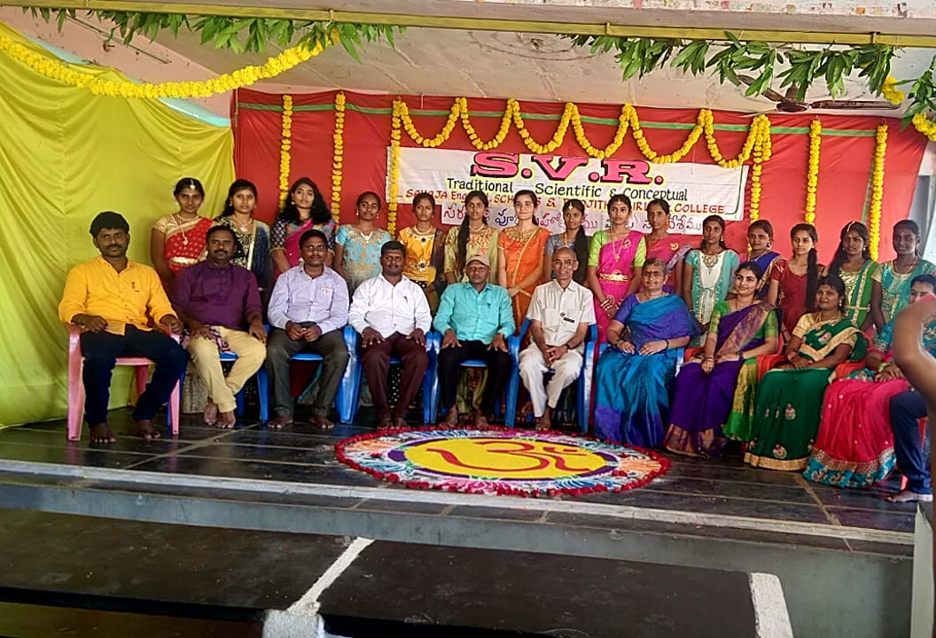
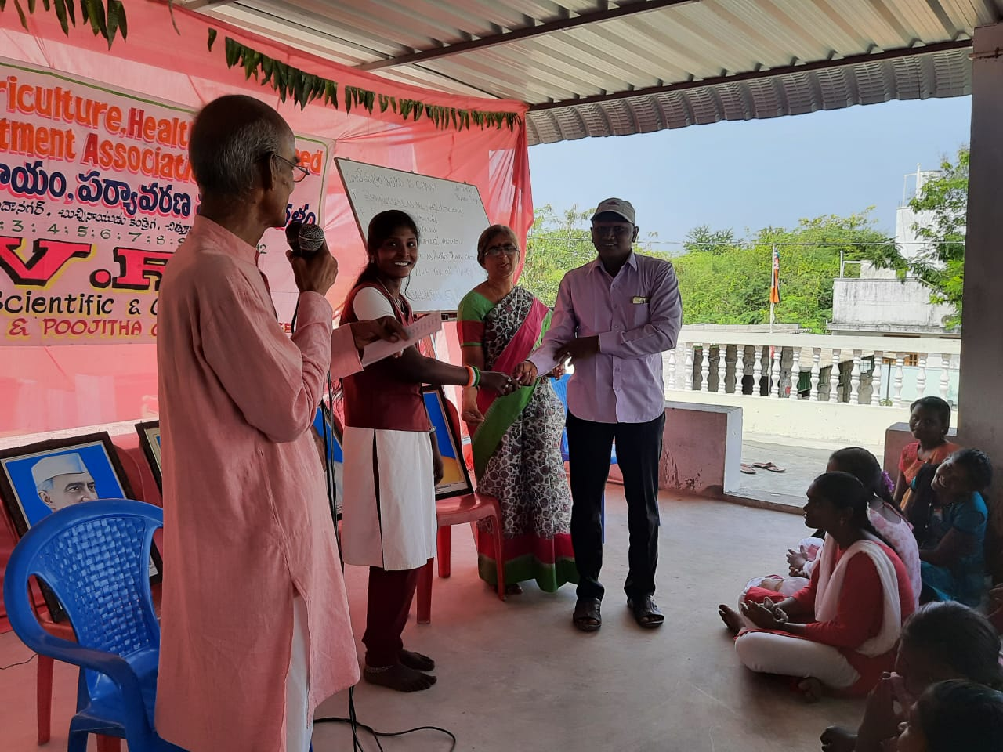
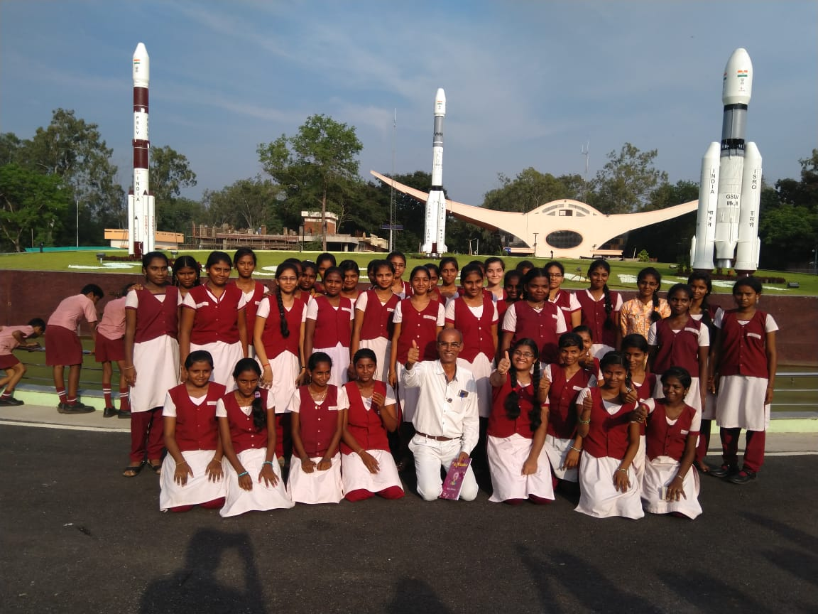
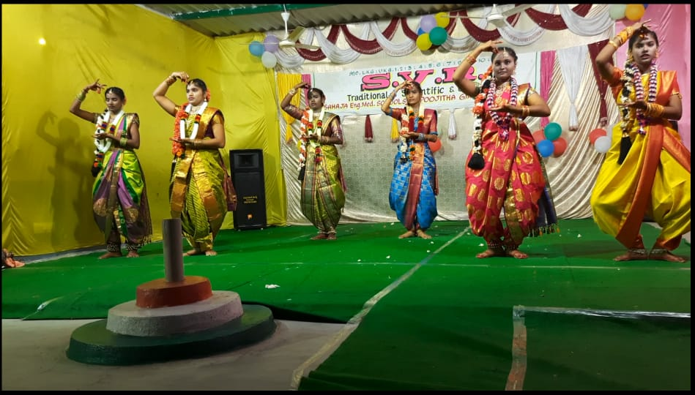
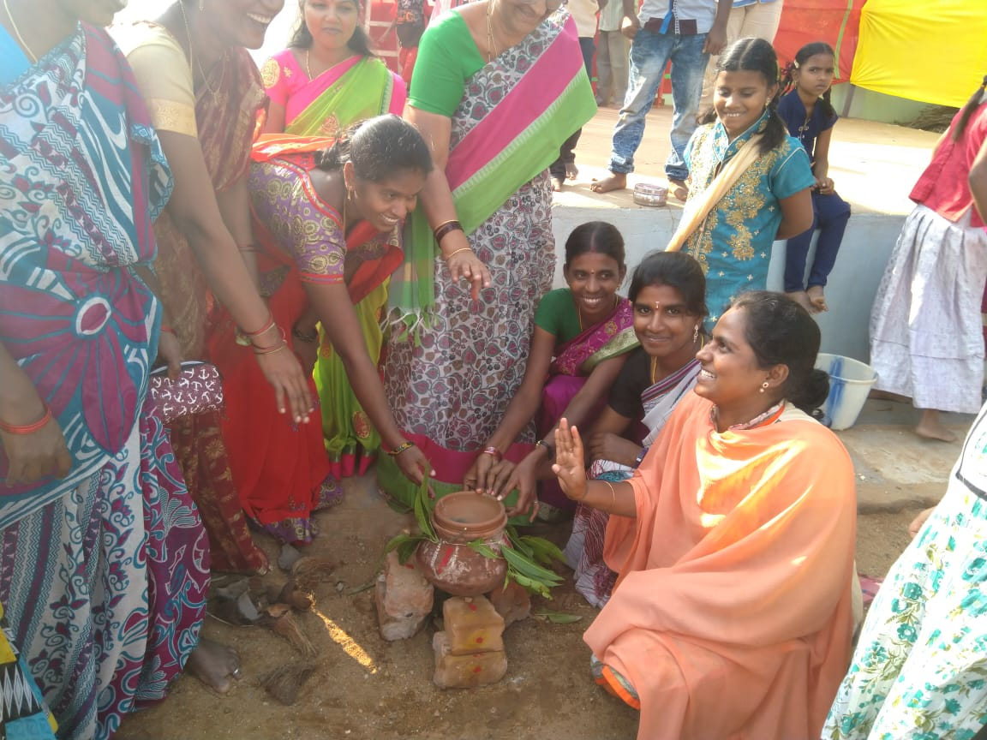
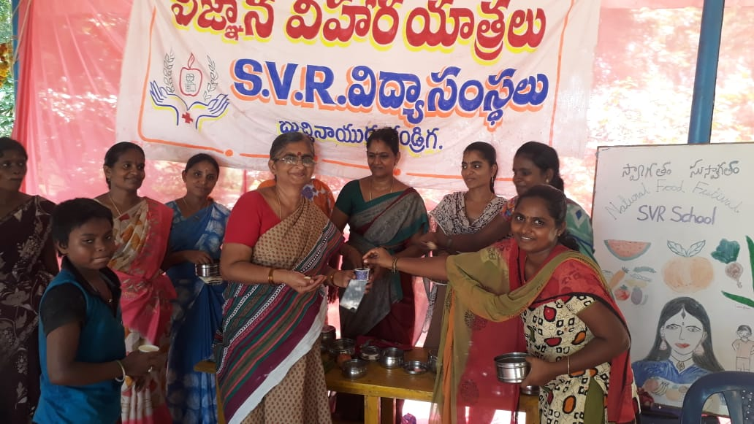
EXTRA-CURRICULAR ACTIVITIES

Slide 7
Hostel facility highlights:
Secured and spacious hostel rooms
Under supervision of a woman warden
Conducting study hours at morning and evening
Conducting yoga and pranayama classes in early morning
Helping students to improve concentration and memory by providing safe, nutritious and wholesome food.
Having Mineral drinking water and hot water facility
Dedicated mini theatre for entertainment and dedicated hours for sports and games

Slide 8
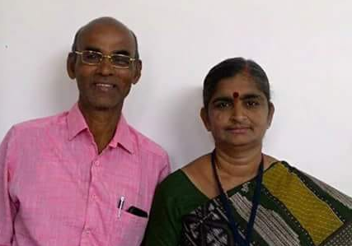
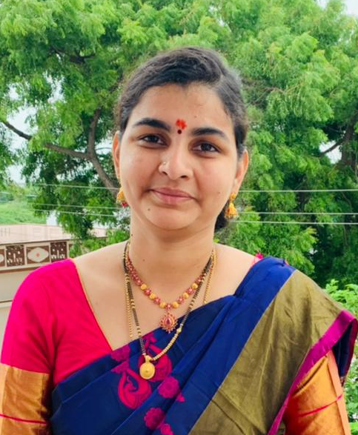
MANAGEMENT
Observing the difficulty for girl child education after completing SSC in rural areas, it took me to follow the foot-steps of my parents to provide them Quality education at affordable and safest place.
Treating all our students as a family gives us a boost to provide them the best possible education and facilities.
Pochineni Sahaja B.Tech, M.Sc (Food Tech)
Correspondent
Over past 30 years, we could provide stressless and quality education to many students in rural areas of B.N.Kandriga, Varadaiahpalem, Damanellore. Being well-wishers to all your children like ours, we could gain all your support and bleesings.
- Smt. & Sri Pochineni Renuka & Suresh Naidu
Strength for our campus:
M. Hameed, M.A., B.Ed., Campus Principal
N. Deenaiah, M.Sc., B.Ed., Academic Principal

