Slide 1
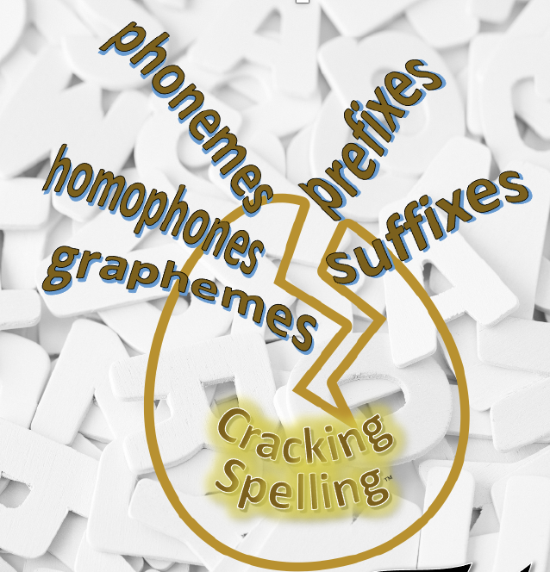
Cracking Spelling™© 2024 D Stinson Education Limited

Slide 2
The Cracking Spelling programme is designed to support and guide staff in delivering the spelling expectations from the National Curriculum through years 1 - 6. It is a prescriptive programme that focuses on ensuring children develop an investigative approach to spelling. All the Cracking Spelling programmes align with the expectations outlined in the DFE Writing framework, ensuring it develops children's understanding of words through phonemic awareness, orthographical understanding, morphology and, where appropriate, the etymology of words, providing children with a deeper understanding of word structures.
Within the programme, there is also the focus on the grammar understanding of the words that are the focus of the sessions.
Each year group is provided with a downloadable teacher's guide and 6 half-termly activity books.
Cracking Spelling™© 2024 D Stinson Education Limited

Slide 3
To understand how to spell, we need to understand the English language.
Alphabetic system
      26 letters creating 44 phonemes in 144 combinations to form about half a million words in current use
      21 consonants; spoken English uses 24 consonant sounds – generally predictable
      20 spoken vowel sounds but only 5 vowel letters
History
      Germanic – Anglo Saxons, over ½ our words
      Romance – French, Spanish and Portuguese
      Classical – Greek and Latin
85% of English spelling system is predictable
Cracking Spelling™© 2024 D Stinson Education Limited

Slide 4
Cracking Spelling
This spelling programme is designed to support and guide teachers in delivering the spelling expectations from the National Curriculum.
It is a prescriptive programme that focuses on ensuring children develop an investigative approach to spelling.
It builds on the children’s understanding of the key principles – phonemic knowledge, orthography, morphemic knowledge and etymological knowledge.
Cracking Spelling™© 2024 D Stinson Education Limited

Slide 5
To support children in spelling, a spelling programme needs to include:
Phonemic knowledge:
Phonics as a start and continues throughout
Homophones – word understanding – in context of a sentence structure to clarify
Orthography:
Spelling patterns and conventions
Letter patterns – e.g. ck never starts a word – k or ck at the end – lists of words to identify this
Morphological knowledge:
Units of meaning in words
Root words
Suffixes
Prefixes
Compound words
Etymological knowledge:
Word derivations - etymology – origins of words – if this supports the understanding of the words
Cracking Spelling™© 2024 D Stinson Education Limited

Slide 6
Cracking Spelling
Throughout the programme, it supports children:
in being able to recognise how phonology, orthgography, morphology and etymology apply to each word, in order to learn to spell words.
by providing activities to practise and explore spelling conventions to their new learning.
in assessing their spelling through dictation and spelling tests that prompt them to recall previously taught spellings.
in building their spelling vocabulary.
in developing their grammar understanding of the words in context.
learning the common exception words and statutory word lists in context.
Cracking Spelling™© 2024 D Stinson Education Limited

Slide 7
Cracking Spelling
Within the programme, there is also the focus on the grammar understanding of the words that are the focus of the sessions. Therefore, the words have been colour coded in the sessions to show their function in sentences (see 8-word class sheet). In Key Stage 2, if a word can function in a variety of ways, it has been left without colour to indicate so.
Cracking Spelling™© 2024 D Stinson Education Limited

Slide 8
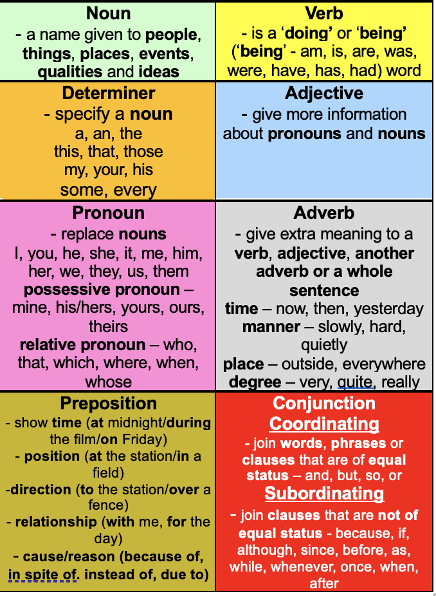
Cracking Spelling™© 2024 D Stinson Education Limited

Slide 9
Cracking Spelling - Key stage 1
Rather than children learning the common exception words out of context, these have been included throughout the sessions. In the dictated sentences that have been provided as examples, the Year 1 common exception words have been highlighted and the Year 2 common exception words have been highlighted to indicate their use – there should be an expectation throughout the year that the children should be spelling these correctly.
Cracking Spelling™© 2024 D Stinson Education Limited

Slide 10
Cracking Spelling - Key stage 2
Rather than children learning the statutory word lists out of context, these have been included throughout the sessions. In the dictated sentences that have been provided as examples, the year 3/4 statutory words have been highlighted and year 5/6 statutory words highlighted to indicate their use – there should be an expectation throughout the year that the children should be spelling these correctly.
Cracking Spelling™© 2024 D Stinson Education Limited

Slide 11
Cracking Spelling
The programme is sequenced using a progressive teaching sequence.
The teaching sequence
This sequence comprises of three short sessions (approximately 15 minutes) every week. The sequence is designed to be used flexibly; the number of sessions spent on each part of the sequence will vary according to the needs and ability of the children.
The programme and activities are designed to build the children’s spelling vocabulary by introducing new words and giving continual practice of words already introduced.
A detailed teaching approach is outlined in each session, indicating what the teaching practitioner should say highlighted in grey and the expected response from the pupils in yellow.
Cracking Spelling™© 2024 D Stinson Education Limited

Slide 12
Cracking Spelling
Revise
The approaches described in the first part of the sequence are activities with two purposes: to revise and secure prior learning and to introduce and explain new learning. These revise sessions are designed to consolidate and deepen earlier learning from the previous year group or previous key stage. They can also be a good source for identifying any previous misconceptions.
Teach
This second part of the sequence introduces the new learning, using teacher modelling and involving the children in the new learning. These teach sessions are designed to promote discussion around the new learning and ensure pronunciation of new vocabulary is modelled correctly.
Cracking Spelling™© 2024 D Stinson Education Limited

Slide 13
Cracking Spelling
Practise
This part of the sequence provides the children with the opportunity to explore and investigate independently, in pairs or in small groups, using strategies to practise and consolidate the new learning. These practise sessions are designed to develop children as investigative spellers – detecting and understanding patterns and rules rather than just learning rules.
Apply
This final part of the sequence gives children the opportunity to apply their learning in writing, both through a short, dictated piece, by composing their own sentence or spelling tests.
The key principle is that the children are learning about words rather than given words to learn.
The aim of each unit is that the children understand the patterns and structures of words and can apply their learning to their writing.
Cracking Spelling™© 2024 D Stinson Education Limited

Slide 14
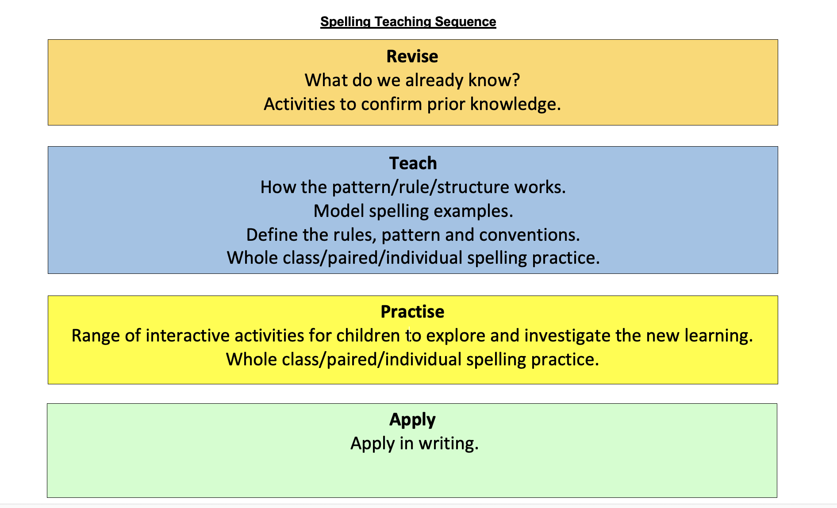
Cracking Spelling
Cracking Spelling™© 2024 D Stinson Education Limited

Slide 15
Cracking Spelling
Yearly Overviews
Every year group has been mapped out using the National Curriculum appendix 1 programmes of study throughout the year.
Cracking Spelling™© 2024 D Stinson Education Limited

Slide 16
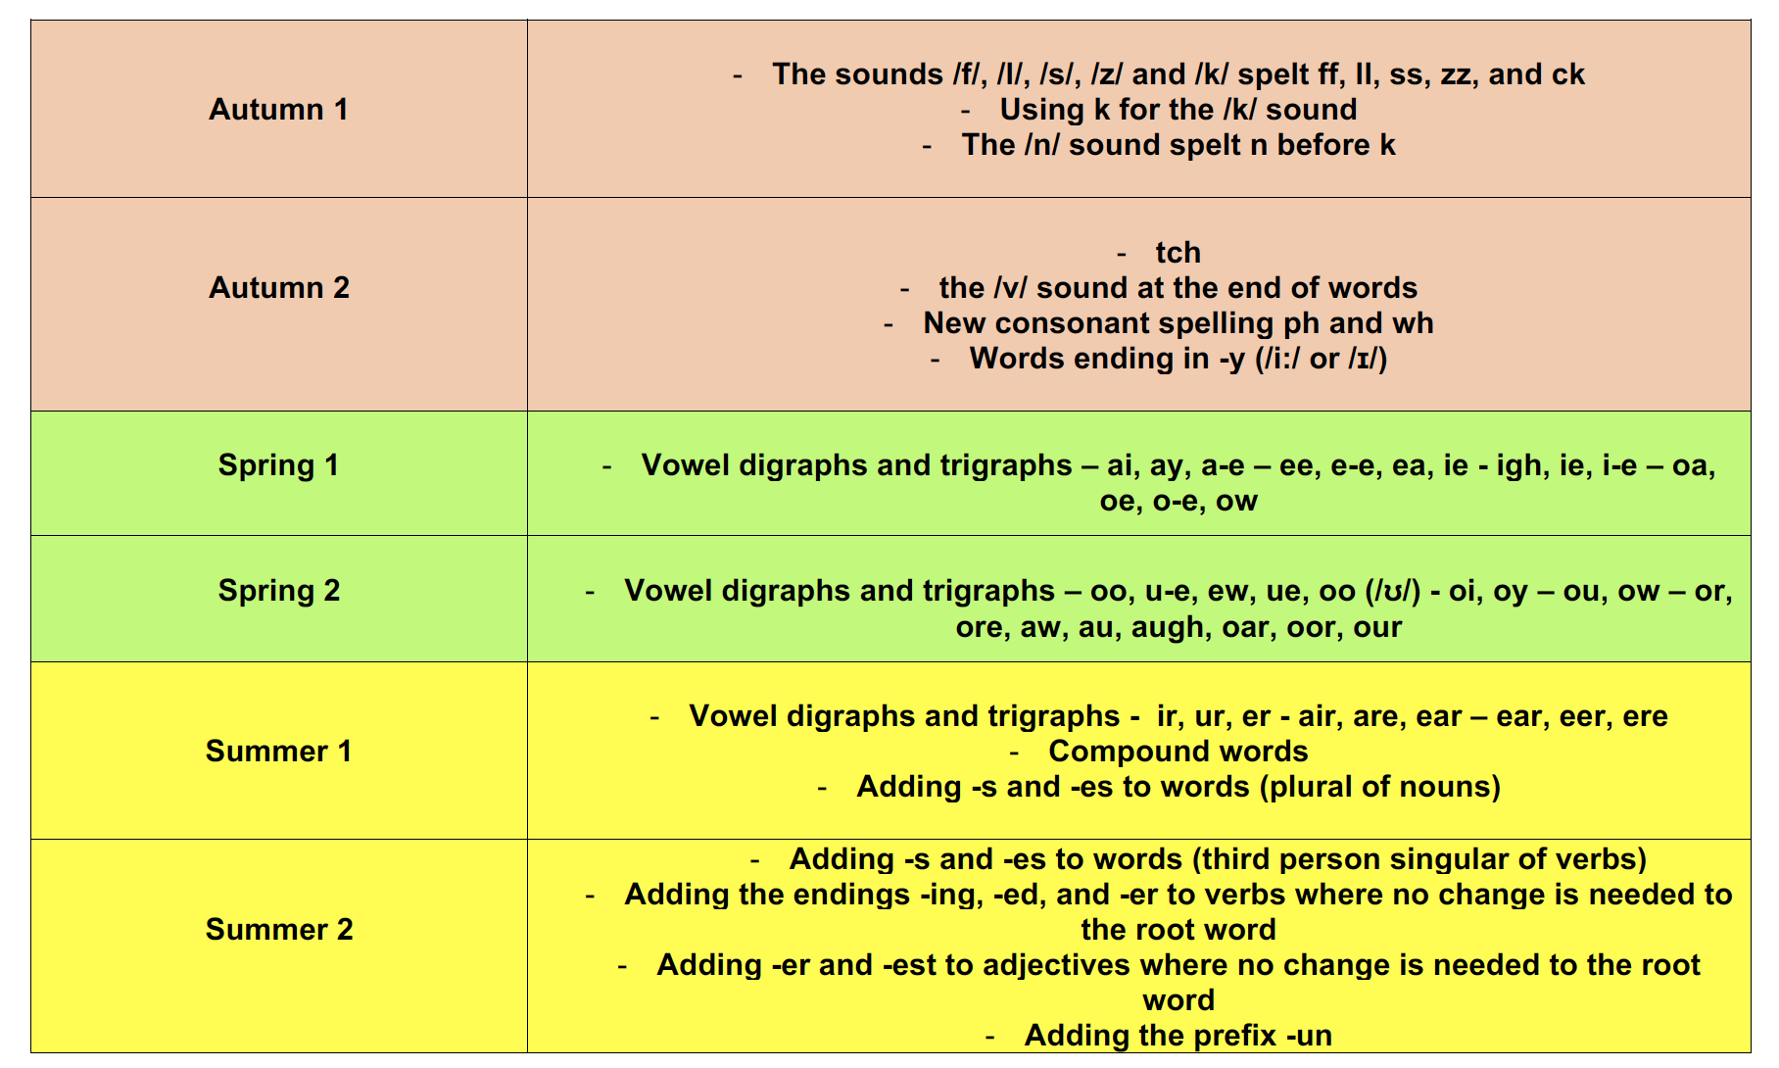
Cracking Spelling
Year 1
Cracking Spelling™© 2024 D Stinson Education Limited

Slide 17
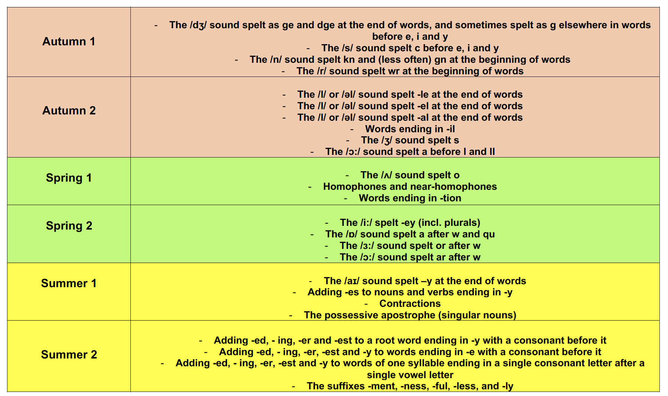
Cracking Spelling
Year 2
Cracking Spelling™© 2024 D Stinson Education Limited

Slide 18
Cracking Spelling
Year 3
Autumn 1 | The suffix – ly More prefixes
Autumn 2 | The /u/ sound spelt ou The /i/ sound spelt y elsewhere than at the end of words Words with the /k/ sound spelt ch (Greek in origin) Words with the /sh/ sound spelt ch (mostly French in origin) Words with the /ae/ sound spelt as ei, eigh or ey
Spring 1 | Homophones and near-homophones The suffix – ation The suffix – ous
Spring 2 | Endings which sound like /zhun/ Words with endings sounding like /zhure/ and /chure/
Summer 1 | Endings which sound like /shun/ spelt – tion, -ssion
Summer 2 | Endings which sound like /shun/ spelt -sion, - -cian Words ending with the /g/ sound spelt –gue and the /k/ sound spelt -que (French in origin) Words with the /s/ sound spelt sc (Latin in origin)
Cracking Spelling™© 2024 D Stinson Education Limited

Slide 19
Cracking Spelling
Year 4
Autumn 1 | Adding suffixes beginning with vowel letters to words of more than one syllable More prefixes
Autumn 2 | The /u/ sound spelt ou The /i/ sound spelt y elsewhere than at the end of words Words with the /k/ sound spelt ch (Greek in origin) Words with the /sh/ sound spelt ch (mostly French in origin) Words with the /ae/ sound spelt as ei, eigh or ey
Spring 1 | Homophones and near-homophones The suffix – ation The suffix – ous
Spring 2 | Endings which sound like /zhun/ Words with endings sounding like /zhure/ and /chure/ Possessive apostrophe with plural words
Summer 1 | Endings which sound like /shun/ spelt – tion, -sion, -ssion
Summer 2 | Endings which sound like /shun/ spelt –-cian Words ending with the /g/ sound spelt –gue and the /k/ sound spelt -que (French in origin) Words with the /s/ sound spelt sc (Latin in origin)
Cracking Spelling™© 2024 D Stinson Education Limited

Slide 20
Cracking Spelling
Year 5
Autumn 1 | From Appendix 2 More prefixes – verb prefixes Converting nouns or adjectives into verbs using suffixes – -ate, -ify, -ise
Autumn 2 | Words with /ee/ sound spelt ei after c Words containing the letter-string ough Endings which sound like /shus/ spelt -cious or -tious
Spring 1 | Endings which sound like /shul/ Homophones and other words that are often confused
Spring 2 | Words ending in -ant, -ance/-ancy Words ending in -ent, -ence/-ency
Summer 1 | Words ending in -able and -ible Words ending in -ably and -ibly
Summer 2 | Adding suffixes beginning with vowel letters to words ending in -fer Words with ‘silent’ letters
Cracking Spelling™© 2024 D Stinson Education Limited

Slide 21
Cracking Spelling
Year 6
Autumn 1 | More prefixes – verb prefixes Endings which sound like /shus/ spelt -cious or -tious Use of the hyphen
Autumn 2 | Words with /ee/ sound spelt ei after c Words containing the letter-string ough
Spring 1 | Endings which sound like /shul/ Homophones and other words that are often confused
Spring 2 | Words ending in -ant, -ance/-ancy Words ending in -ent, -ence/-ency Words ending in -able and -ible Words ending in -ably and -ibly
Summer 1 | Adding suffixes beginning with vowel letters to words ending in -fer Words with ‘silent’ letters
Summer 2 | From Appendix 2 Converting nouns or adjectives into verbs using suffixes – -ate, -ify, -ise
Cracking Spelling™© 2024 D Stinson Education Limited

Slide 22
Cracking Spelling
The Teaching Sequence
Every half term has an overview of the sequence week by week.
The sessions are colour-coded to match the part of the teaching sequence that they are.
Autumn 1
Week 1 | Revise – prefixes – revisit prefixes from Year 3 and 4 – in, il, im,ir | Revise – prefixes – revisit prefixes from Year 3 and 4 – dis, re, pre, mis | Revise – prefixes Prefix grid
Week 2 | Teach – verb prefixes dis, mis, re further understanding of the meaning of these prefixes | Teach – verb prefixes de, over, under | Practise – verb prefixes Prefix grid – how many verbs? dis-, re-, mis-
Week 3 | Practise – verb prefixes Prefix grid – how many verbs? de-, under-, over- | Practise – verb prefixes Find the definition | Practise – verb prefixes Sentence challenge
Week 4 | Apply – verb prefixes Dictation | Apply – verb prefixes Spelling test | Revise – suffixes Suffix grid
Week 5 | Teach – converting nouns into verbs using suffixes – -ate, -en, -ise, -ify | Teach – converting adjectives into verbs using suffixes – -ate, -en, -ise, -ify | Practise – converting nouns into verbs using suffixes – -ate, -en, -ise, -ify Suffix grid
Week 6 | Practise – converting adjectives into verbs using suffixes – -ate, -en, -ise, -ify Suffix grid | Apply - converting nouns and adjectives into verbs using suffixes Spelling test | Apply - converting nouns and adjectives into verbs using suffixes Spelling test
Cracking Spelling™© 2024 D Stinson Education Limited

Slide 23
Cracking Spelling
The Activity Packs
Every year group has 6 activity packs for each half term.
These are referenced in the teachers’ guide.
These contain all the resources needed for all the sessions.
Incorporated in the activities, there are also teacher completed versions of any activities to support teachers when reviewing the activities with the children.
Cracking Spelling™© 2024 D Stinson Education Limited

Slide 24
Cracking Spelling
The programme can also be used as intervention, where needed.
For example:
If children are not secure in the choice of vowel digraph representations, then Year 1 Spring units have activities to support this.
Similarly, if children struggle with adding suffixes in Key Stage 2, Year 2 Summer or Year 3 Autumn Revise activities can be used to consolidate the basics before investigating more complex word structures.
Where children have a misconception with the use of the apostrophe with s and are adding to most words ending in s, revisiting singular and plural adding s and es in Year 1 Summer 1 would be beneficial.
Cracking Spelling™© 2024 D Stinson Education Limited

Slide 25
Cracking Spelling in Year 6
Included in the Year 6 programme is a table showing previous year group units that can be used to address any particular spelling weaknesses or revise content domains assessed in the end of key stage 2 spelling test.
National Curriculum content domain and PoS | Units in ‘Cracking Spelling’
S38 - adding suffixes beginning with vowel letters to words of more than one syllable | Year 4 Autumn 1 – weeks 1-3
S39 - the /i/ sound spelt y other than at the end of words | Year 4 Autumn 2 – Weeks 2-3
S40 - the /u/ sound spelt ou | Year 4 Autumn 2 – Weeks 1-2
S41 – prefixes | Year 4 Autumn1 – Weeks 3-6
S42 – the suffix -ation | Year 4 Spring 1 – Weeks 4-5
S43 - the suffix -ly | Year 3 Autumn 1 – Weeks 2-4
S44 – words with ending /zhure/ and /chure/ | Year 4 Spring 2 – Weeks 1-4
S45 – endings which sound like /zhun/ | Year 4 Spring 2 – Weeks 1-2
S46 – the suffix – ous | Year 4 Spring 1 – Weeks 5-6
S47 - endings which sound like /ʃən/, spelt –tion, –sion, –ssion, –cian | Year 4 Summer 1 – Weeks 1-3
S48 - words with the /k/ sound spelt ch | Year 4 Autumn 2 – Weeks 3-5
S49 – words with the /sh/ sound spelt ch | Year 4 Autumn 2 – Weeks 3-5
S50 - Words ending with the /g/ sound spelt –gue and the /k/ sound spelt -que | Year 4 Summer 2 – Weeks 2-5
S51 – words with the /s/ sound spelt sc | Year 4 Summer 2 – Weeks 5-6
S52 – words with the /ae/ sound spelt as ei, eigh or ey | Year 4 Summer 2 – Weeks 2-5
S54 - homophones and near homophones (Year 3 and 4) | Year 4 Spring 1 – Weeks 1-3
Cracking Spelling™© 2024 D Stinson Education Limited

