Slide 1
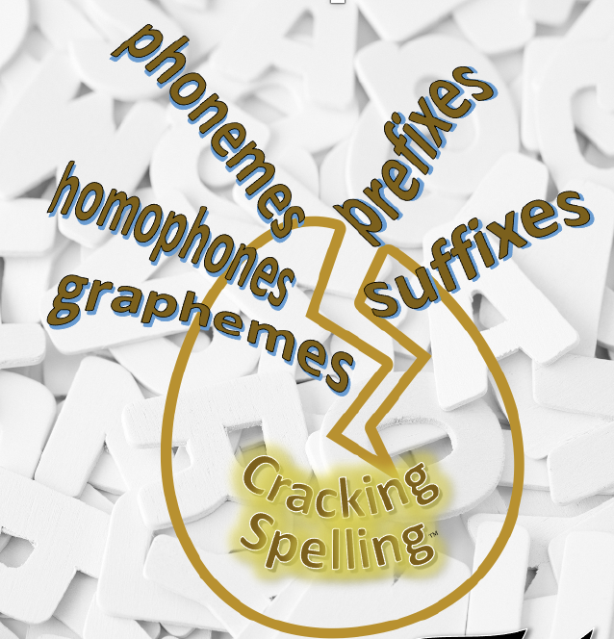
Cracking Spelling™© 2024 D Stinson Education Limited

Slide 2
English Language
Alphabetic system
      26 letters creating 44 phonemes in 144 combinations to form about half a million words in current use
      21 consonants; spoken English uses 24 consonant sounds – generally predictable
      20 spoken vowel sounds but only 5 vowel letters
History
      Germanic – Anglo Saxons, over ½ our words
      Romance – French, Spanish and Portuguese
      Classical – Greek and Latin
85% of English spelling system is predictable
Cracking Spelling™© 2024 D Stinson Education Limited

Slide 3
Cracking Spelling in Key Stage 2
This spelling programme is designed to support and guide teachers in delivering the spelling expectations from the National Curriculum.
It is a prescriptive programme that focuses on ensuring children develop an investigative approach to spelling.
It builds on the children’s understanding of the key principles – phonemic knowledge, morphemic knowledge and etymological knowledge.
Cracking Spelling™© 2024 D Stinson Education Limited

Slide 4
Cracking Spelling in Key Stage 2
Phonemic knowledge:
Phonics
Spelling patterns and conventions
Homophones
Phonological knowledge
Morphological knowledge:
Root words
Compound words
Suffixes
Prefixes
Etymological knowledge:
Word derivations
Cracking Spelling™© 2024 D Stinson Education Limited

Slide 5
Cracking Spelling in Key Stage 2
Throughout the programme, it supports children:
in being able to recognise how these apply to each word, in order to learn to spell words.
by providing activities to practise and assess their spelling.
in building their spelling vocabulary.
in developing their grammar understanding of the words in context.
learning the statutory word lists in context.
Cracking Spelling™© 2024 D Stinson Education Limited

Slide 6
Cracking Spelling in Key Stage 2
Within the programme, there is also the focus on the grammar understanding of the words that are the focus of the sessions. Therefore, the words have been colour coded in the sessions to show their function in sentences (see 8-word class sheet). If a word can function in a variety of ways, it has been left without colour to indicate so.
Cracking Spelling™© 2024 D Stinson Education Limited

Slide 7
Noun - a name given to people, places, things, events, qualities and ideas | Verb - is a ‘doing’ or ‘being’ word
Determiner - specify a noun a, an, the this, that, those my, your, his some, every | Adjective - give more information about pronouns and nouns
Pronoun - replace nouns I, you, he, she, it, me, him, her, we, they, us, them possessive pronoun – mine, his/hers, yours, ours, theirs relative pronoun – who, that, which, where, when, whose | Adverb - give extra meaning to a verb, adjective, another adverb or a whole sentence time – now, then, yesterday manner – slowly, hard, quietly place – outside, everywhere degree – very, quite, really
Preposition - show time (at midnight/during the film/on Friday) - position (at the station/in a field) -direction (to the station/over a fence) - relationship (with me, for the day) - cause/reason(because of, in spite of. instead of, due to) | Conjunction Coordinating - join words, phrases or clauses that are of equal status – and, but, so, or Subordinating - join clauses that are not of equal status - because, if, although, since, before, as, while, whenever, once, when, after
Cracking Spelling™© 2024 D Stinson Education Limited

Slide 8
Cracking Spelling in Key Stage 2
Rather than children learning the statutory word lists out of context, these have been included throughout the sessions. In the dictated sentences that have been provided as examples, the year 3/4 statutory words have been highlighted and year 5/6 statutory words highlighted to indicate their use – there should be an expectation throughout the year that the children should be spelling these correctly.
Cracking Spelling™© 2024 D Stinson Education Limited

Slide 9
Cracking Spelling in Key Stage 2
accident(ally) actual(ly) address answer appear arrive believe bicycle breath breathe build busy/business calendar caught centre century certain circle complete consider continue decide describe different difficult disappear | early earth eight/eighth enough exercise experience experiment extreme famous favourite February forward(s) fruit grammar group guard guide heard heart height history imagine increase important interest island | knowledge learn length library material medicine mention minute natural naughty notice occasion(ally) often opposite ordinary particular peculiar perhaps popular position possess(ion) possible potatoes pressure probably promise | purpose quarter question recent regular reign remember sentence separate special straight strange strength suppose surprise therefore though/although thought through various weight woman/women
accommodate accompany according achieve aggressive amateur ancient apparent appreciate attached available average awkward bargain bruise category cemetery committee communicate community competition conscience* conscious* controversy convenience correspond | criticise (critic + ise) curiosity definite desperate determined develop dictionary disastrous embarrass environment equip (–ped, –ment) especially exaggerate excellent existence explanation familiar foreign forty frequently government guarantee harass hindrance identity immediate(ly) | individual interfere interrupt language leisure lightning marvellous mischievous muscle necessary neighbour nuisance occupy occur opportunity parliament persuade physical prejudice privilege profession programme pronunciation queue recognise recommend | relevant restaurant rhyme rhythm sacrifice secretary shoulder signature sincere(ly) soldier stomach sufficient suggest symbol system temperature thorough twelfth variety vegetable vehicle yacht
Cracking Spelling™© 2024 D Stinson Education Limited

Slide 10
Cracking Spelling in Key Stage 2
The programme is sequenced using a progressive teaching sequence.
The teaching sequence
This sequence comprises of three short sessions (approximately 15 minutes) every week. The sequence is designed to be used flexibly; the number of sessions spent on each part of the sequence will vary according to the needs and ability of the children.
The programme and activities are designed to build the children’s spelling vocabulary by introducing new words and giving continual practice of words already introduced.
A detailed teaching approach is outlined in each session, indicating what the teaching practitioner should say highlighted in grey and the expected response from the pupils in yellow.
Cracking Spelling™© 2024 D Stinson Education Limited

Slide 11
Cracking Spelling in Key Stage 2
Revise
The approaches described in the first part of the sequence are activities with two purposes: to revise and secure prior learning and to introduce and explain new learning. These revise sessions are designed to consolidate and deepen earlier learning from the previous year group or previous key stage. They can also be a good source for identifying any previous misconceptions.
Teach
This second part of the sequence introduces the new learning, using teacher modelling and involving the children in the new learning. These teach sessions are designed to promote discussion around the new learning and ensure pronunciation of new vocabulary is modelled correctly.
Cracking Spelling™© 2024 D Stinson Education Limited

Slide 12
Cracking Spelling in Key Stage 2
Practise
This part of the sequence provides the children with the opportunity to explore and investigate independently, in pairs or in small groups, using strategies to practise and consolidate the new learning. These practise sessions are designed to develop children as investigative spellers – detecting and understanding patterns and rules rather than just learning rules.
Apply
This final part of the sequence gives children the opportunity to apply their learning in writing, both through a short, dictated piece, by composing their own sentence or spelling tests (set out like end of key stage tests).
The key principle is that the children are learning about words rather than given words to learn.
The aim of each unit is that the children understand the patterns and structures of words and can apply their learning to their writing.
Cracking Spelling™© 2024 D Stinson Education Limited

Slide 13
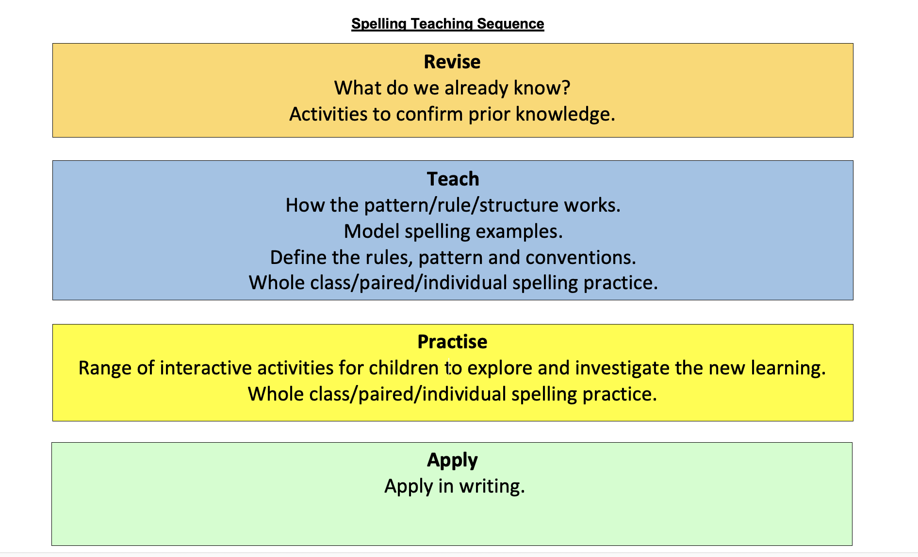
Cracking Spelling in Key Stage 2
Cracking Spelling™© 2024 D Stinson Education Limited

Slide 14
Cracking Spelling in Key Stage 2
The Teaching Sequence
Every year group has been mapped out using the National Curriculum appendix 1 programmes of study throughout the year.
Cracking Spelling™© 2024 D Stinson Education Limited

Slide 15
Cracking Spelling in Key Stage 2
Year 3
Autumn 1 | The suffix – ly More prefixes
Autumn 2 | The /u/ sound spelt ou The /i/ sound spelt y elsewhere than at the end of words Words with the /k/ sound spelt ch (Greek in origin) Words with the /sh/ sound spelt ch (mostly French in origin) Words with the /ae/ sound spelt as ei, eigh or ey
Spring 1 | Homophones and near-homophones The suffix – ation The suffix – ous
Spring 2 | Endings which sound like /zhun/ Words with endings sounding like /zhure/ and /chure/
Summer 1 | Endings which sound like /shun/ spelt – tion, -ssion
Summer 2 | Endings which sound like /shun/ spelt -sion, - -cian Words ending with the /g/ sound spelt –gue and the /k/ sound spelt -que (French in origin) Words with the /s/ sound spelt sc (Latin in origin)
Cracking Spelling™© 2024 D Stinson Education Limited

Slide 16
Cracking Spelling in Key Stage 2
Year 4
Autumn 1 | Adding suffixes beginning with vowel letters to words of more than one syllable More prefixes
Autumn 2 | The /u/ sound spelt ou The /i/ sound spelt y elsewhere than at the end of words Words with the /k/ sound spelt ch (Greek in origin) Words with the /sh/ sound spelt ch (mostly French in origin) Words with the /ae/ sound spelt as ei, eigh or ey
Spring 1 | Homophones and near-homophones The suffix – ation The suffix – ous
Spring 2 | Endings which sound like /zhun/ Words with endings sounding like /zhure/ and /chure/ Possessive apostrophe with plural words
Summer 1 | Endings which sound like /shun/ spelt – tion, -sion, -ssion
Summer 2 | Endings which sound like /shun/ spelt –-cian Words ending with the /g/ sound spelt –gue and the /k/ sound spelt -que (French in origin) Words with the /s/ sound spelt sc (Latin in origin)
Cracking Spelling™© 2024 D Stinson Education Limited

Slide 17
Cracking Spelling in Key Stage 2
Year 5
Autumn 1 | From Appendix 2 More prefixes – verb prefixes Converting nouns or adjectives into verbs using suffixes – -ate, -ify, -ise
Autumn 2 | Words with /ee/ sound spelt ei after c Words containing the letter-string ough Endings which sound like /shus/ spelt -cious or -tious
Spring 1 | Endings which sound like /shul/ Homophones and other words that are often confused
Spring 2 | Words ending in -ant, -ance/-ancy Words ending in -ent, -ence/-ency
Summer 1 | Words ending in -able and -ible Words ending in -ably and -ibly
Summer 2 | Adding suffixes beginning with vowel letters to words ending in -fer Words with ‘silent’ letters
Cracking Spelling™© 2024 D Stinson Education Limited

Slide 18
Cracking Spelling in Key Stage 2
Year 6
Autumn 1 | More prefixes – verb prefixes Endings which sound like /shus/ spelt -cious or -tious Use of the hyphen
Autumn 2 | Words with /ee/ sound spelt ei after c Words containing the letter-string ough
Spring 1 | Endings which sound like /shul/ Homophones and other words that are often confused
Spring 2 | Words ending in -ant, -ance/-ancy Words ending in -ent, -ence/-ency Words ending in -able and -ible Words ending in -ably and -ibly
Summer 1 | Adding suffixes beginning with vowel letters to words ending in -fer Words with ‘silent’ letters
Summer 2 | From Appendix 2 Converting nouns or adjectives into verbs using suffixes – -ate, -ify, -ise
Cracking Spelling™© 2024 D Stinson Education Limited

Slide 19
Cracking Spelling in Key Stage 2
The Teaching Sequence
Every half term has an overview of the sequence week by week.
The sessions are colour-coded to match the part of the teaching sequence that they are.
Autumn 1
Week 1 | Revise – prefixes – revisit prefixes from Year 3 and 4 – in, il, im,ir | Revise – prefixes – revisit prefixes from Year 3 and 4 – dis, re, pre, mis | Revise – prefixes Prefix grid
Week 2 | Teach – verb prefixes dis, mis, re further understanding of the meaning of these prefixes | Teach – verb prefixes de, over, under | Practise – verb prefixes Prefix grid – how many verbs? dis-, re-, mis-
Week 3 | Practise – verb prefixes Prefix grid – how many verbs? de-, under-, over- | Practise – verb prefixes Find the definition | Practise – verb prefixes Sentence challenge
Week 4 | Apply – verb prefixes Dictation | Apply – verb prefixes Spelling test | Revise – suffixes Suffix grid
Week 5 | Teach – converting nouns into verbs using suffixes – -ate, -en, -ise, -ify | Teach – converting adjectives into verbs using suffixes – -ate, -en, -ise, -ify | Practise – converting nouns into verbs using suffixes – -ate, -en, -ise, -ify Suffix grid
Week 6 | Practise – converting adjectives into verbs using suffixes – -ate, -en, -ise, -ify Suffix grid | Apply - converting nouns and adjectives into verbs using suffixes Spelling test | Apply - converting nouns and adjectives into verbs using suffixes Spelling test
Cracking Spelling™© 2024 D Stinson Education Limited

Slide 20
Cracking Spelling in Key Stage 2
The Activity Packs
Every year group has 6 activity packs for each half term.
These are referenced in the teachers’ guide.
These contain all the resources needed for all the sessions.
Incorporated in the activities, there are also teacher completed versions of any activities to support teachers when reviewing the activities with the children.
Cracking Spelling™© 2024 D Stinson Education Limited

Slide 21
Cracking Spelling in Year 6
Included in the Year 6 programme is a table showing previous year group units that can be used to address any particular spelling weaknesses or revise content domains assessed in the end of key stage 2 spelling test.
National Curriculum content domain and PoS | Units in ‘Cracking Spelling’
S38 - adding suffixes beginning with vowel letters to words of more than one syllable | Year 4 Autumn 1 – weeks 1-3
S39 - the /i/ sound spelt y other than at the end of words | Year 4 Autumn 2 – Weeks 2-3
S40 - the /u/ sound spelt ou | Year 4 Autumn 2 – Weeks 1-2
S41 – prefixes | Year 4 Autumn1 – Weeks 3-6
S42 – the suffix -ation | Year 4 Spring 1 – Weeks 4-5
S43 - the suffix -ly | Year 3 Autumn 1 – Weeks 2-4
S44 – words with ending /zhure/ and /chure/ | Year 4 Spring 2 – Weeks 1-4
S45 – endings which sound like /zhun/ | Year 4 Spring 2 – Weeks 1-2
S46 – the suffix – ous | Year 4 Spring 1 – Weeks 5-6
S47 - endings which sound like /ʃən/, spelt –tion, –sion, –ssion, –cian | Year 4 Summer 1 – Weeks 1-3
S48 - words with the /k/ sound spelt ch | Year 4 Autumn 2 – Weeks 3-5
S49 – words with the /sh/ sound spelt ch | Year 4 Autumn 2 – Weeks 3-5
S50 - Words ending with the /g/ sound spelt –gue and the /k/ sound spelt -que | Year 4 Summer 2 – Weeks 2-5
S51 – words with the /s/ sound spelt sc | Year 4 Summer 2 – Weeks 5-6
S52 – words with the /ae/ sound spelt as ei, eigh or ey | Year 4 Summer 2 – Weeks 2-5
S54 - homophones and near homophones (Year 3 and 4) | Year 4 Spring 1 – Weeks 1-3
Cracking Spelling™© 2024 D Stinson Education Limited

