Slide 1
The Passover
Proclaims Christ
Part 2
By Brian White

Slide 2
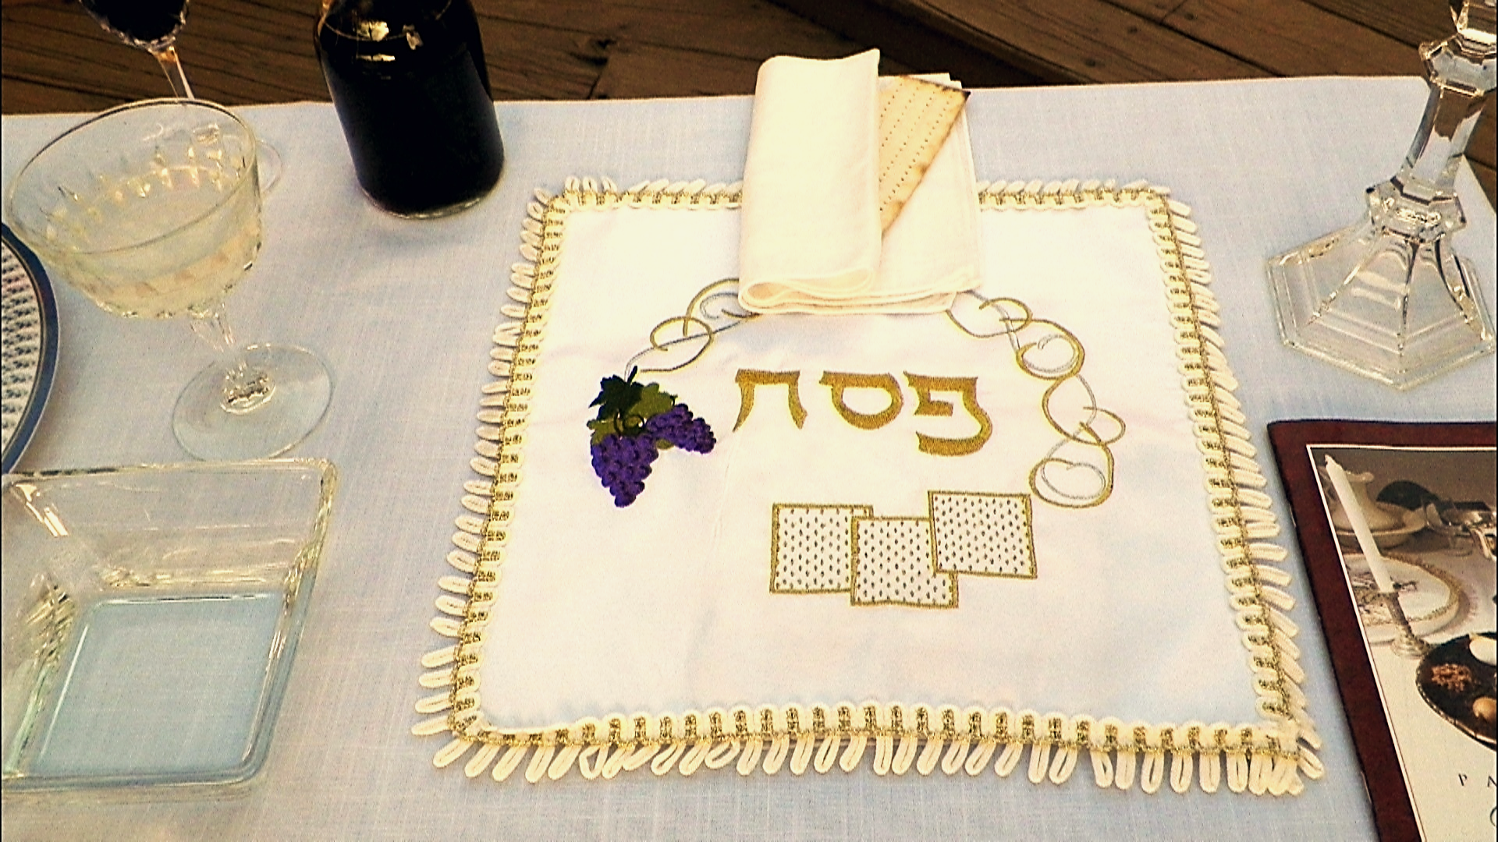

Slide 3
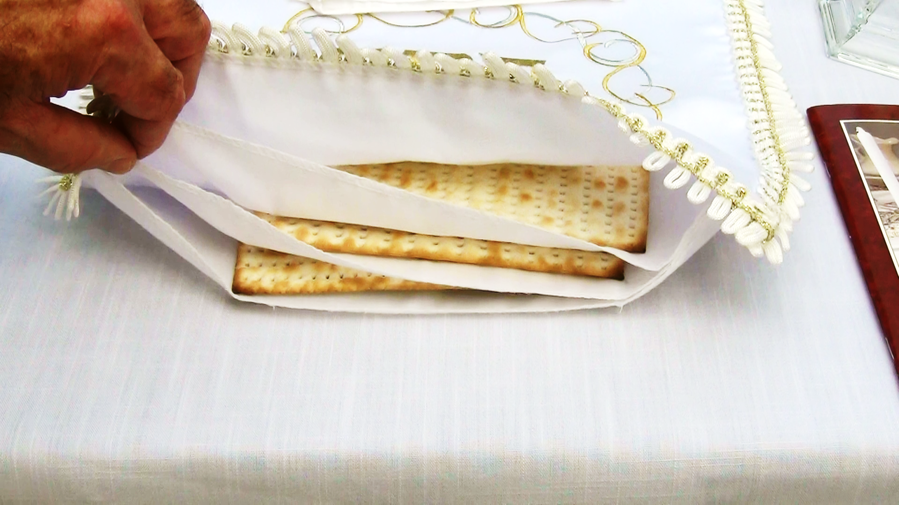

Slide 4
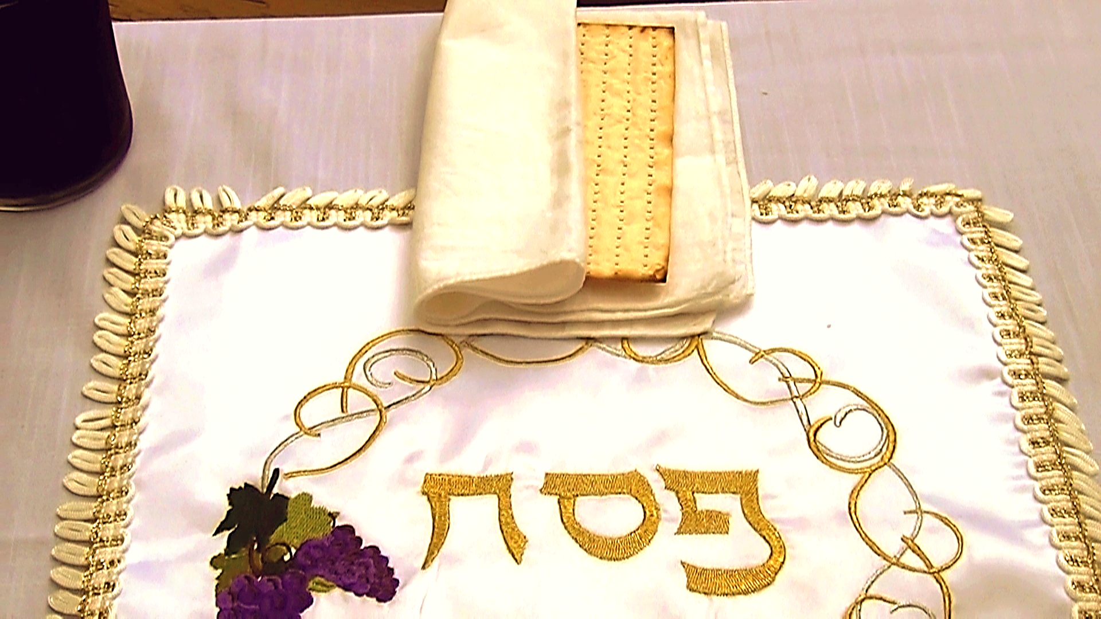

Slide 5
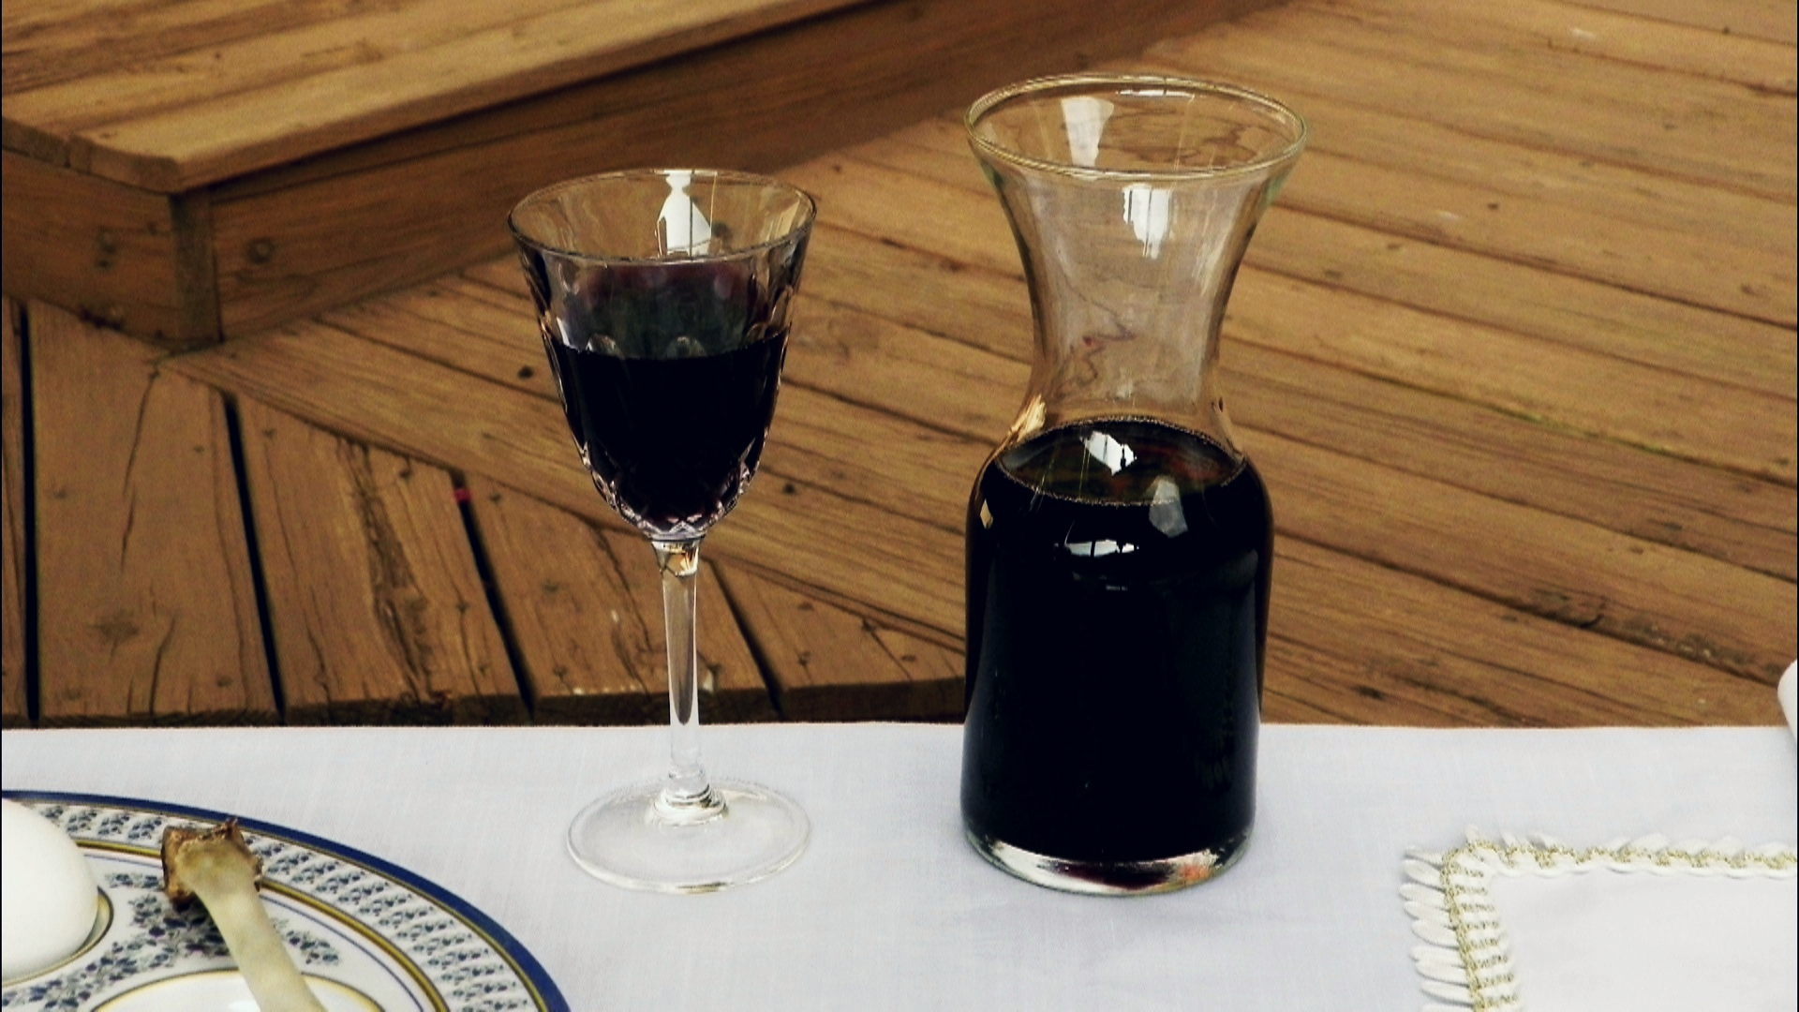

Slide 6
