Slide 1
Vaccine Hesitancy Comparative Study:
A Summary of Key Findings
01 Feb. 2021
University of Buckingham Medical students:
Amirmohammad Heidari
Dekshaa Bidlan
Iheanyichukwu Chukwujindu
Maureen Cheruiyot
Shreya Srikumar
Victoria Khaukha
Hania Sohawon
In collaboration with Public Health, Bedford Borough, Central Bedfordshire and Milton Keynes Council

Slide 2
Methodology
13 Articles relating to Vaccine hesitancy were reviewed including the most recent studies from Luton, Bradford and Hertfordshire Local Authorities

Slide 3
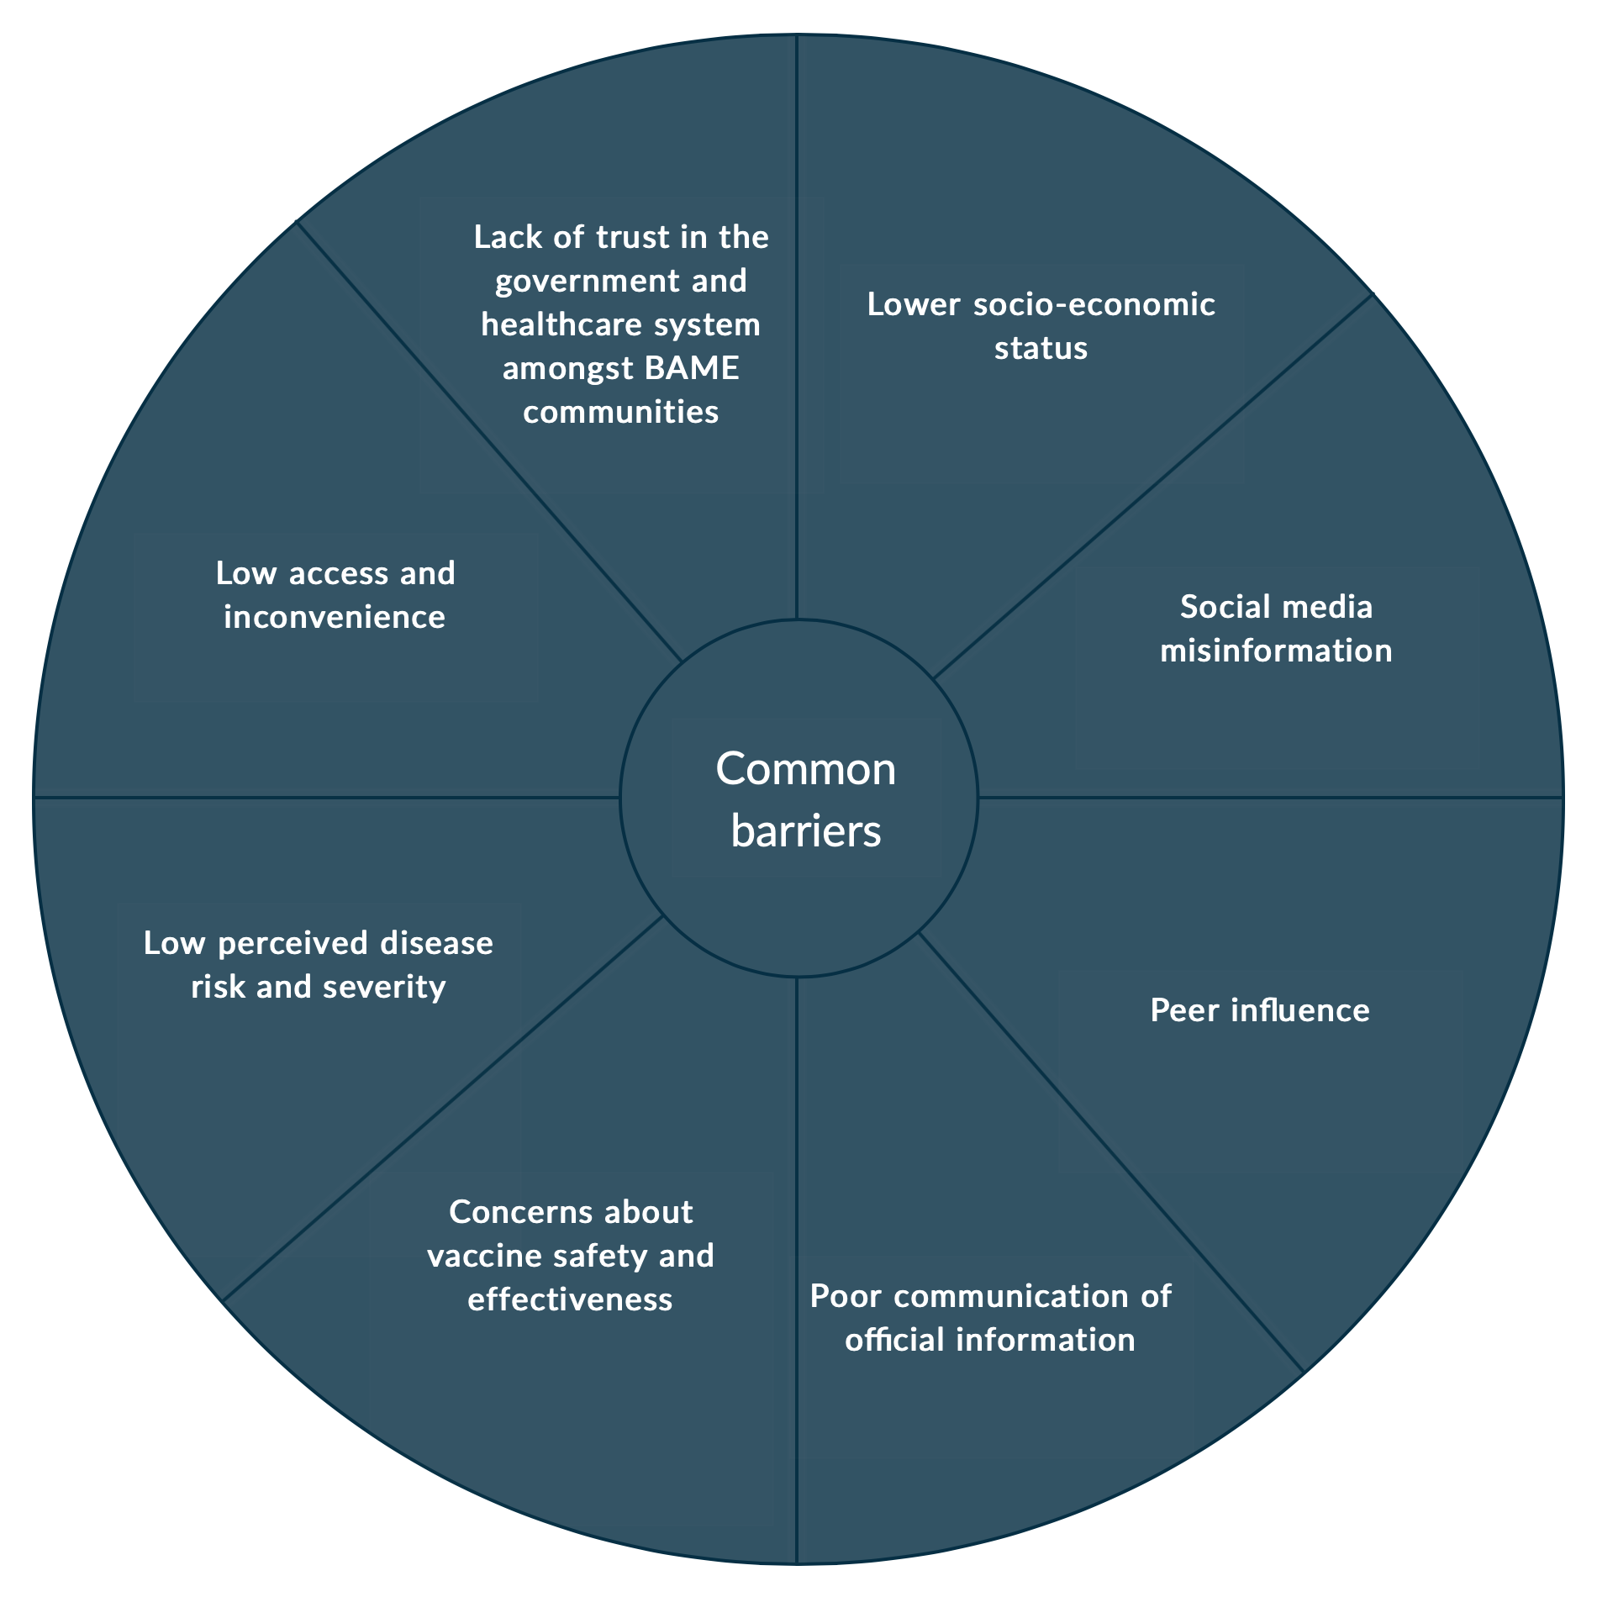
Common barriers found in COVID-19 vaccine studies, but also similar themes seen in other vaccine studies
and conspiracy theories
Lack of endorsement by trusted community leaders

Slide 4
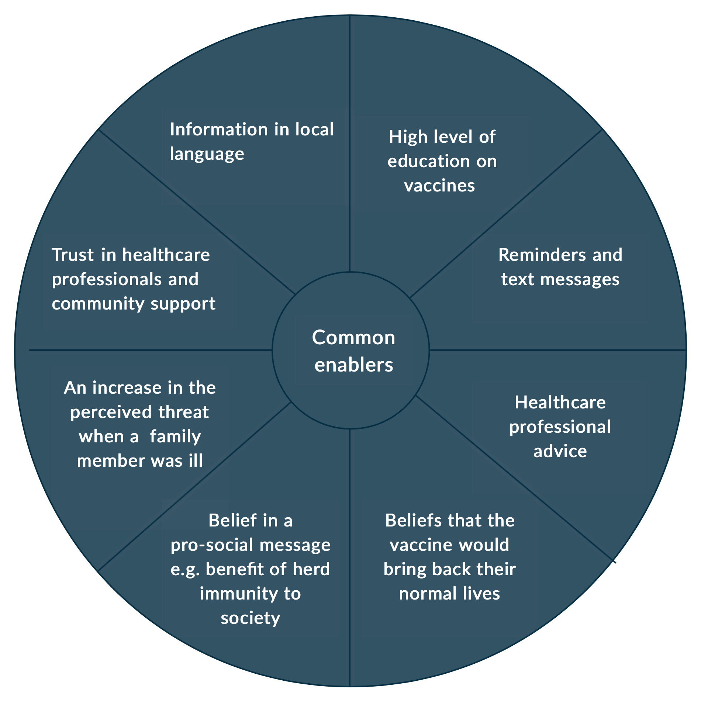
Common enablers very specific to the COVID-19 vaccine

Slide 5
Common misinformation/conspiracy theories
Beliefs of harmful side effects, e.g. During pregnancy teratogenic contents
Microchips to track individuals
The Pandemic not as serious
'Man-made virus' theories reinforcing confusion and hesitancy
The belief that certain ethnic groups were targeted
Leaders, social media and anti-vaccination activists dissuading groups of people from taking vaccination.

Slide 6
Key points for particular communities
  Pregnant women (not a COVID-19 study)
    The single most important factor in maternal vaccination uptake is healthcare professional recommendation
    Beliefs that vaccine could cause birth defects or general harm in pregnancy
  Black British groups, followed by Pakistani/Bangladeshi groups
    Beliefs that certain ethnic communities were targeted by the vaccine
    Not clear if truly associated:
      Perception of risk
      Low confidence in vaccines
      Distrust
      Access barriers
      Lack of communication from trusted providers and community leaders

Slide 7
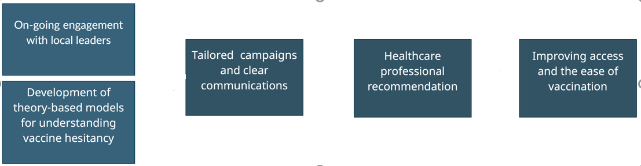
Common recommendations

Slide 8
COVID-19 specific recommendations
Tailored communication: Multilingual and supported by sources trusted by the communities
  Specific concerns of communities such as dietary practices or ethics should be addressed
Community engagement using trusted individuals from the community
Regular reporting on the vaccination including minority groups
Increasing accessibility and safety of vaccination sites

Slide 9
References
Bateman, W., Deo, R., Nocco, L., Constable, M. and Chadwick, P. (2020). COVID-19 Vaccination: Reducing vaccine hesitancy Review & Recommendations.
Bromley, J. (2020). Luton Vaccine Study: Primary Research into Vaccine Hesitancy.
Freeman, Daniel, et al. “COVID-19 Vaccine Hesitancy in the UK: The Oxford Coronavirus Explanations, Attitudes, and Narratives Survey (OCEANS) II.” Psychological Medicine, 11 Dec. 2020, pp. 1–34, www.cambridge.org/core/journals/psychological-medicine/article/covid19-vaccine-hesitancy-in-the-uk-the-oxford-coronavirus-explanations-attitudes-and-narratives-survey-oceans-ii/C30FDB5C3D87123F28E351FDAAD5351A, 10.1017/S0033291720005188.
Karafillakis, E. and Larson, H.J. (2017). The benefit of the doubt or doubts over benefits? A systematic literature review of perceived risks of vaccines in European populations. Vaccine, [online] 35(37), pp.4840–4850. Available at: https://www.sciencedirect.com/science/article/pii/S0264410X17309696.
Kilich, E., Dada, S., Francis, M.R., Tazare, J., Chico, R.M., Paterson, P. and Larson, H.J. (2020). Factors that influence vaccination decision-making among pregnant women: A systematic review and meta-analysis. PLoS ONE, [online] 15(7). Available at: https://www.ncbi.nlm.nih.gov/pmc/articles/PMC7347125/ [Accessed 31 Jan. 2021].
Lawes-Wickwar, S., Ghio, D., Tang, M.Y., Keyworth, C., Stanescu, S., Westbrook, J., Jenkinson, E., Kassianos, A.P., Scanlan, D., Garnett, N., Laidlaw, L., Howlett, N., Carr, N., Stanulewicz, N., Guest, E., Watson, D., Sutherland, L., Byrne-Davis, L., Chater, A. and Hart, J. (2021). A Rapid Systematic Review of Public Responses to Health Messages Encouraging Vaccination against Infectious Diseases in a Pandemic or Epidemic. Vaccines, 9(2), p.72.
Lewandowsky, S. (2021). The COVID-19 Vaccine Communication Handbook. [online] HackMD. Available at: https://hackmd.io/@scibehC19vax/home [Accessed 31 Jan. 2021].
Lockyer, B., Islam, S., Rahman, A. and Dickerson, J. (2020). Understanding Covid-19 misinformation and vaccine hesitancy in context: Findings from a qualitative study involving citizens in Bradford, UK. [online] medrxiv.org. Available at: https://www.medrxiv.org/content/10.1101/2020.12.22.20248259v1 [Accessed 31 Jan. 2021].
Royal Society for Public Health (2019). MOVING THE NEEDLE: Promoting vaccination uptake across the life course.
Schmid, P., Rauber, D., Betsch, C., Lidolt, G. and Denker, M.-L. (2017). Barriers of Influenza Vaccination Intention and Behavior – A Systematic Review of Influenza Vaccine Hesitancy, 2005 – 2016. PLOS ONE, [online] 12(1), p.e0170550. Available at: https://journals.plos.org/plosone/article?id=10.1371/journal.pone.0170550.
Scientific Advisory Group for Emergencies (2020). Factors influencing COVID-19 vaccine uptake among minority ethnic groups, 17 December 2020. [online] GOV.UK. Available at: https://www.gov.uk/government/publications/factors-influencing-covid-19-vaccine-uptake-among-minority-ethnic-groups-17-december-2020.
Williams, Lynn, et al. “Social Patterning and Stability of Intention to Accept a COVID-19 Vaccine in Scotland: Will Those Most at Risk Accept a Vaccine?” Vaccines, vol. 9, no. 1, 4 Jan. 2021, pubmed.ncbi.nlm.nih.gov/33406762/, 10.3390/vaccines9010017.
Wilson, K., Nguyen, Holdt Henningsen, Brehaut and Hoe (2011). Acceptance of a pandemic influenza vaccine: a systematic review of surveys of the general public. Infection and Drug Resistance, p.197.

