Slide 1
Waste Collection Information Session
October 2020

Slide 2
Welcome
Councillor Emily Darlington

Slide 3
Pilot Overview
Housing Types
Round 17 covers all of the 8 of the criteria
Almost 3000 properties will be covered.
Social Housing
Rural Area
Edwardian / Victorian Housing
Post Edwardian: 1950’s -1960’s
Early MK (Before 1990)
Modern MK (1990 – 2015)
New MK: 2015+
PILOT STARTING DATE :
26th October - February 2021

Slide 4
Communication
Advance letters have been sent to households included within pilot area
Leaflets are to go on bins/boxes when delivered – including calendar
Continued promotion for residents to sign-up for pilot alerts
Updates to website
Post cards for feed back
Satisfaction
Video/audio

Slide 5
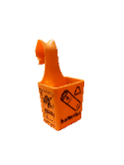
Residual Weekly Split Weekly Recycling Mixed Food and Garden Waste
Week 1
Week 2
180L
180L
REFUSE
180L
180L
RECYCLING
Containers
Paper
140L
FOOD & GARDEN
140L

Slide 6
Special Kerbside Properties
Week 1
Week 2
REFUSE
RECYCLING
140L
FOOD & GARDEN
140L
Food
Food
Food
Food
Garden
or
Garden
or

Slide 7
Why are we using 3 new bins?
MKC currently has a contamination rate of around 25%.
Residents have let us know that having sufficient recycling volume is important. More bins provides greater volume.
Separating recycling means we will be able to improve quality and therefore have access to local markets in the UK.
Separating paper and card from other waste types makes it easier to recover dry good quality paper.
The Resources and Waste Strategy for England is promoting segregation of recyclable streams where it is technically, environmentally and economically practicable.

Slide 8
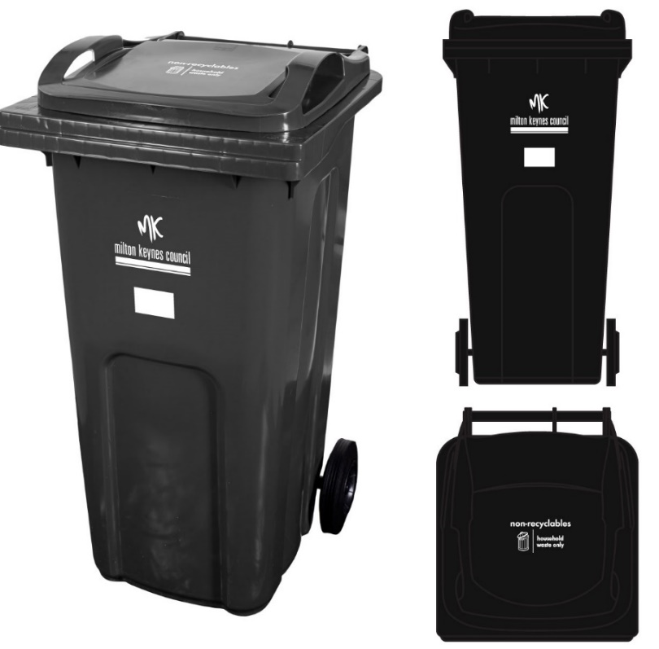
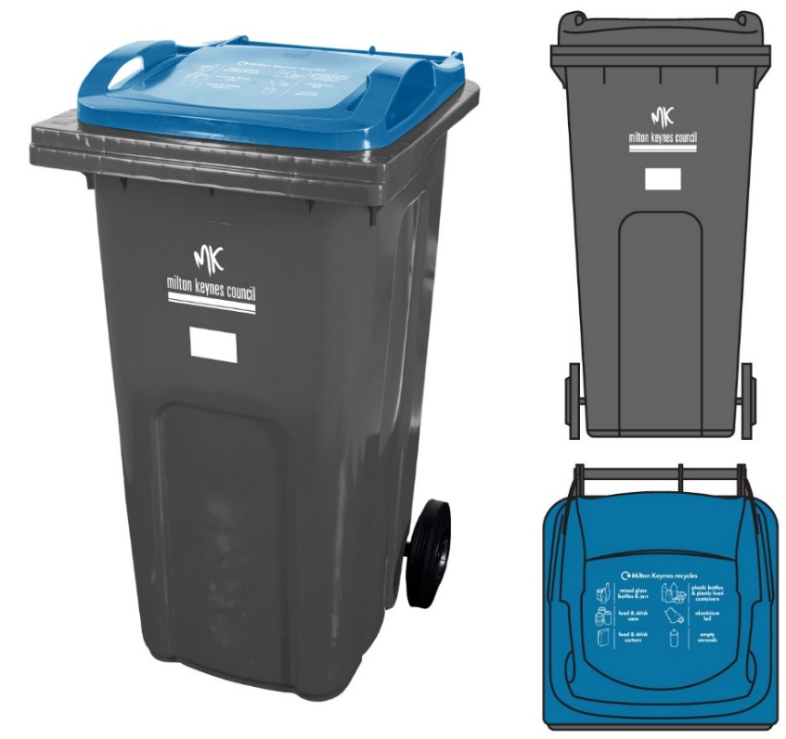

Slide 9
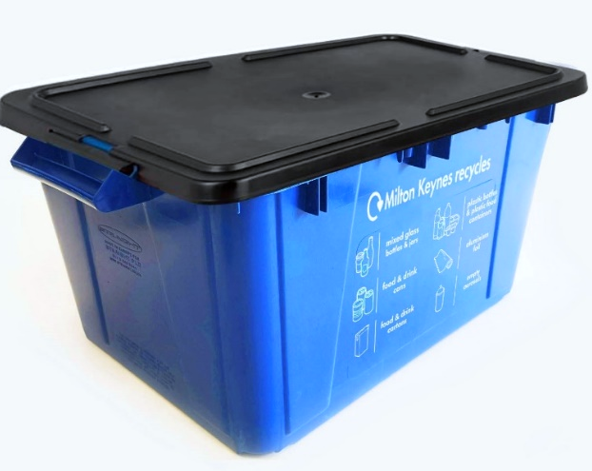
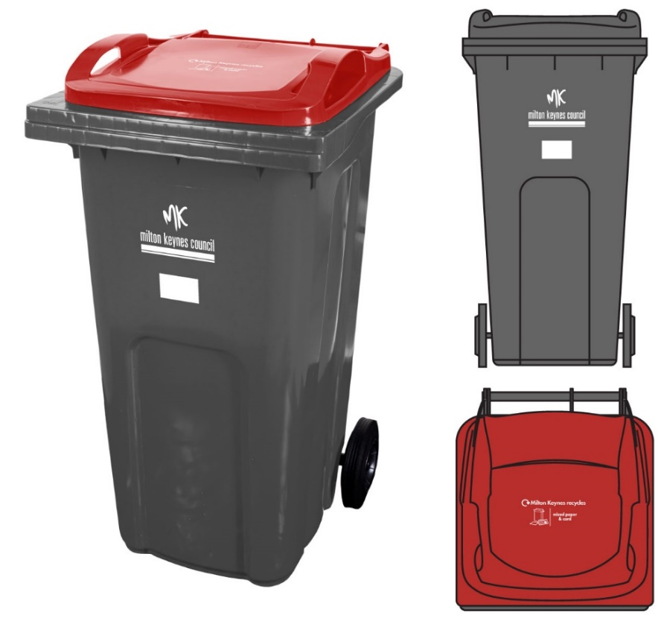
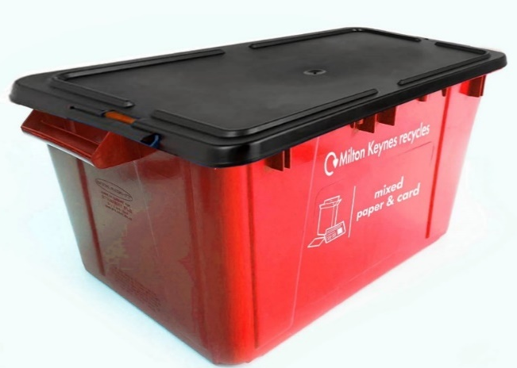

Slide 10
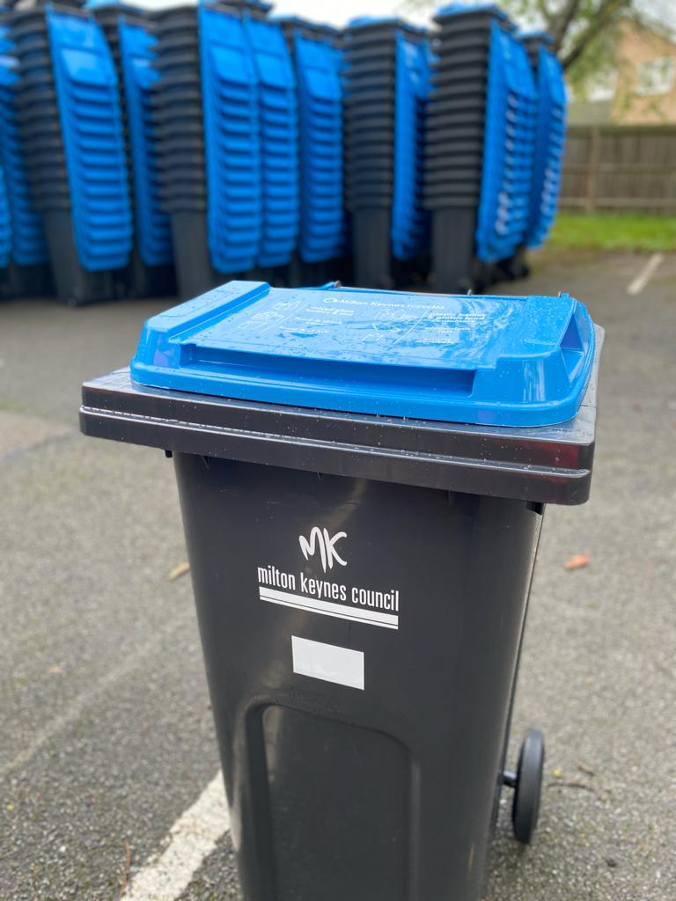
New bins start to arrive

Slide 11
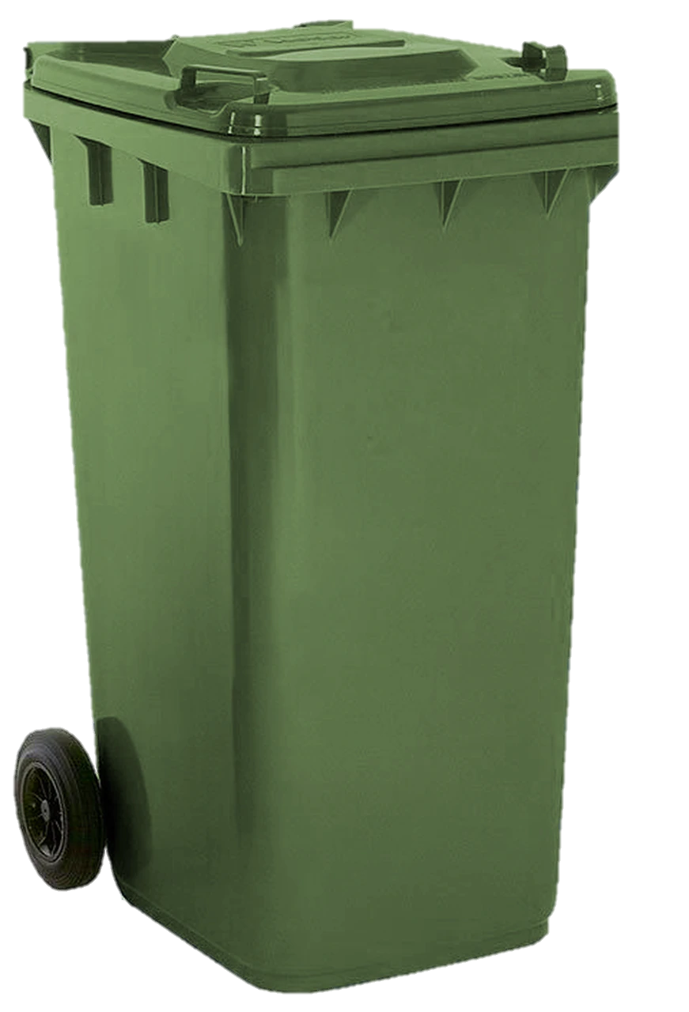
Non- recyclables
waste
Recyclables :
Glass, cans, plastic
Recyclables :
Cardboard, Paper
Food &
Garden Waste

Slide 12
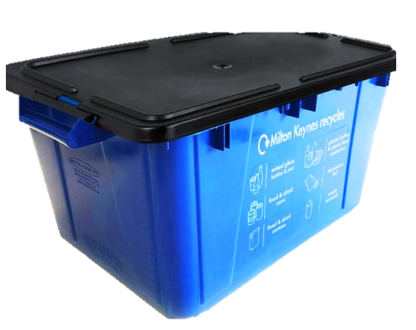
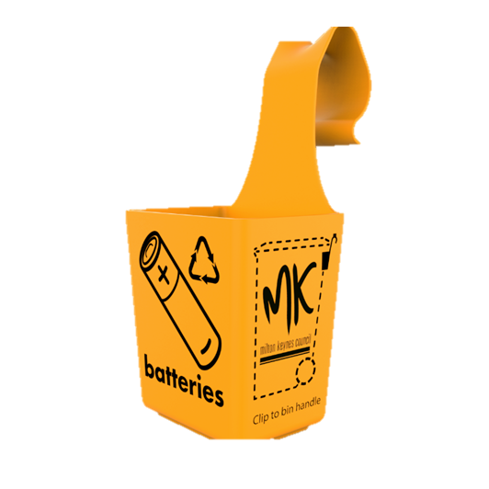
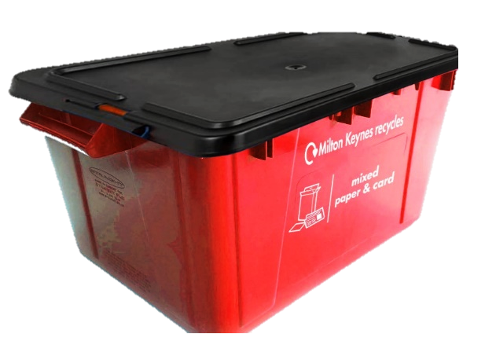
Pilot Overview
Cans, glass, plastic
Batteries
Recyclables :
Card/Paper

Slide 13
Pilot Monitoring
Pre Pilot
Contamination
Volumes (per HH and by material type)
Composition
Recycling Rate
Participation
Set-out
Productivity – time and motion
Loose waste
Bin returning
Spillage / Litter
Local Environmental Quality Surveys (LEQ)
During Pilot
Contamination
Volumes (per HH)
Composition
Recycling Rate
Participation
Set-out
Productivity
Side Waste
Loose waste / sacks out
Bin clustering
Bin returning
Spillage / Litter
LEQs
Post (start during) Pilot
Satisfaction – Ease of Use
Satisfaction – Service delivery
Satisfaction – Cleanliness Perception

Slide 14
Thank you
Contact & information
Email: recycling-pilot@milton-keynes.gov.uk
Telephone: 01908 253334
Alerts: www.milton-keynes.gov.uk/wheelie-bin-pilot-updates
Website: www.milton-keynes.gov.uk/wheeliebinpilot

Slide 15
Questions

