Slide 1

VFW Auxiliary
LOCAL AUXILIARY TREASURERS
Unwavering Support for Uncommon Heroes ^{tm}

Slide 2


VFW Auxiliary
New Auxiliary Treasurer (Notifying the IRS)
  Need to notify IRS of change in responsible party
  File form 8822‐B with the IRS within 60 days of election
  Ensures IRS correspondence goes to the new Treasurer
  Form can be found on‐line at www.irs.gov
Notes:
New Auxiliary Treasurer
Need to notify IRS of change in responsible party, this is done by filing form 8822‐B with the IRS within 60 days of election (Ensures IRS correspondence goes to the new Treasurer)
Go to bank and get setup on Auxiliary Bank account along with the current or incoming President (will need copy of April’s auxiliary minutes showing election results)

Slide 3
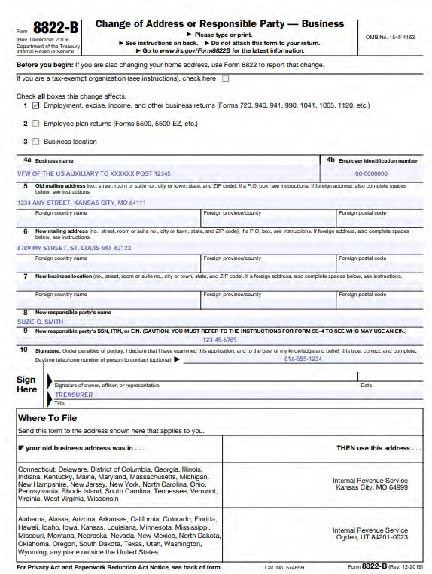
VFW Auxiliary
Notes:
Form can be found on‐line at www.irs.gov

Slide 4
VFW Auxiliary
President & Treasurer Bonds
After the Installation Report is input into MALTA, a bond may be purchased by the Treasurer on 7/1
If an Installation Report is never input, a bond cannot be purchased by the Auxiliary officers
The bond runs from September 1 thru August 31 each year, and the premium is due in advance prior to September 1st
Notes:
After the Installation Report is input into MALTA, a bond may be purchased by the Treasurer on 7/1.
The bond runs from September 1 thru August 31 each year, and the premium is due in advance prior to September 1^{st.}

Slide 5
VFW Auxiliary
President & Treasurer Bonds
Upon receipt of payment, a bond certificate will be available to the officers of the Auxiliary once the pending clearance time frame as passed
The President shall retain the Bond
The bond bonds the “offices” of the President & Treasurer It does not bond the “individuals” holding the offices
If there is a change of President or Treasurer during the term of the bond, the new President or Treasurer is bonded without further action
Notes:
Once you’ve received a receipt of the payment, a bond certificate will be available to the officers of the Auxiliary once the pending clearance time frame as passed.
The President shall retain the Bond. (As Treasurer, I would print a copy and place it in my minutes book so that the Trustees can see it was purchased).
The bond bonds the “offices” of the President & Treasurer. It does not bond the “individuals” holding the offices. If there is a change of President or Treasurer during the term of the bond, the new President or Treasurer is bonded without further action.

Slide 6
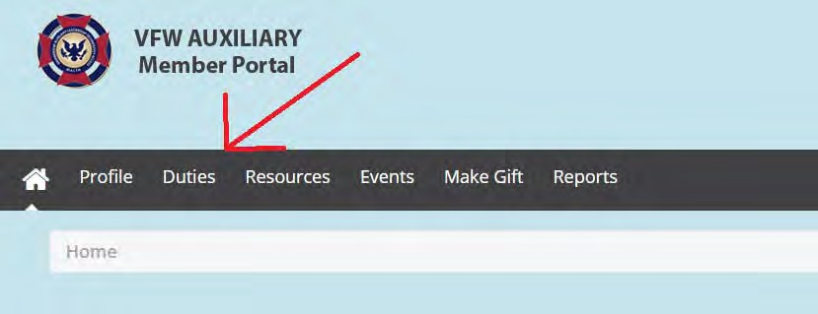
VFW Auxiliary
President & Treasurer Bonds

Slide 7
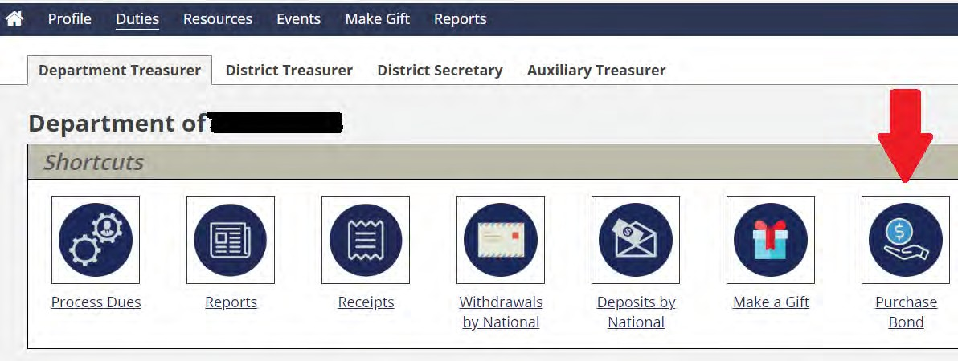
VFW Auxiliary
President & Treasurer Bonds

Slide 8
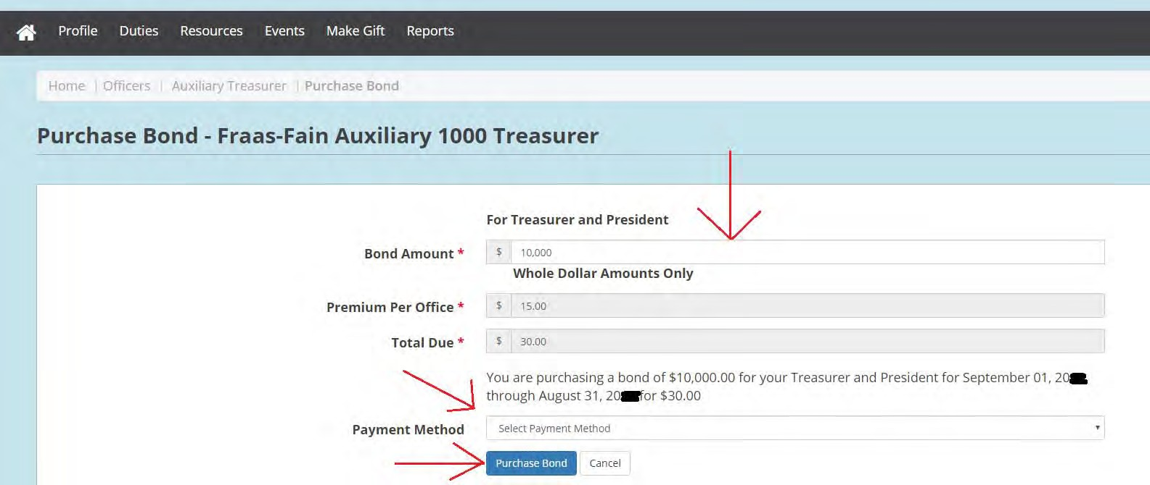
VFW Auxiliary
President & Treasurer Bonds

Slide 9
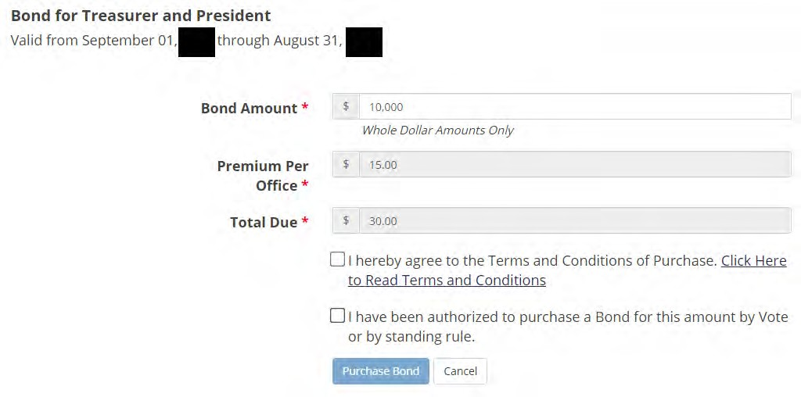
VFW Auxiliary
President & Treasurer Bonds

Slide 10
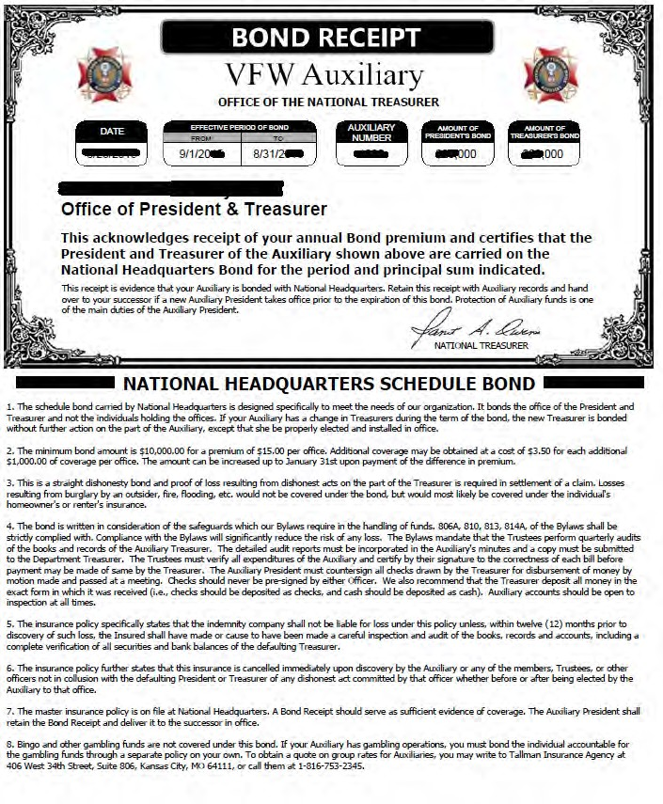
VFW Auxiliary

Slide 11

VFW Auxiliary
Annual Membership Cards
Annual membership cards will be sent directly to the member approximately two weeks after the payment has been processed in MALTA.
Temporary membership cards can be accessed in MALTA while waiting for membership card to arrive.
** If not received in 2 months by member – notify HQ. If 4 months elapses, must pay $5 for new card
Notes:
A few pieces of information you need to know regarding new membership cards…
Annual membership cards will be sent directly to the member approximately two weeks after the payment has been processed in MALTA.
Treasurers can also print temporary membership cards from MALTA while waiting for membership card to arrive.

Slide 12

VFW Auxiliary
Life Membership Cards
A new card is issued free of charge when life membership is purchased
If not received in 2 months by member – notify HQ. If 4 months elapses, must pay $10 for new card
New life card issued free if transferring Auxiliaries
No card will automatically be issued for transfer to at large or transfer back to an Auxiliary where previously a member
$10 fee for replacement for:
Name change
Damaged / Lost / Stolen
Notes:
Life Membership Cards are issued free of charge when life membership is purchased or a member transfers into your auxiliary.
If not received in 2 months by member – notify HQ.
If 4 months elapses, must pay $10 for new card.
No card will automatically be issued for transfer to at large or transfer back to an Auxiliary where previously a member.
A $10 fee will be charged for replacement card for a Name change, Damaged, Lost, or Stolen cards.

Slide 13
VFW Auxiliary
Life Membership Per Capita
Life member per capita payout – 2x per year
    January – All life members as of December 31st
  August – Life memberships that were processed between January 1st and June 30th

Slide 14
VFW Auxiliary
Deposits from National
All funds from National to Auxiliaries for Life member per capita payouts will be sent via Electrionic Funds Transfer (EFT) (aka ACH/Direct Deposit) from National Headquarters
The Treasurer will be notified by e-mail that a deposit has been made into the auxiliary bank account
National will NOT withdraw funds from the auxiliary bank account without the knowledge of the Treasurer
MALTA must be updated, or a new ACH Authorization form must be sent to National Headquarters, anytime the auxiliary changes banks, or for any changes are made to the accounts or bank information (i.e., bank changes names)

Slide 15

VFW Auxiliary
Auxiliary Treasurer’s Report
At each Auxiliary meeting, the Treasurer shall make a report following the reading of the minutes
  The Auxiliary Treasurer’s Report shall contain:
  Balance on hand as of the last report (Beginning Balance)
  Amount of funds received from all sources since the last report
  Amount expended since last report
  Balance on hand (Ending Balance)
  The report must show all receipts and disbursements in detail, including the name of the person or organization to whom the check is issued and stating for what purpose
Notes:
At each Auxiliary meeting, the Treasurer shall make a report following the reading of the minutes.
The Auxiliary Treasurer’s Report shall contain:
Balance on hand as of the last report (Beginning Balance); Amount of funds received from all sources since the last report;
Amount expended since last report; Balance on hand (Ending Balance);
The report must show all receipts and disbursements in detail, including the name of the person or organization to whom the check is issued and stating for what purpose.

Slide 16
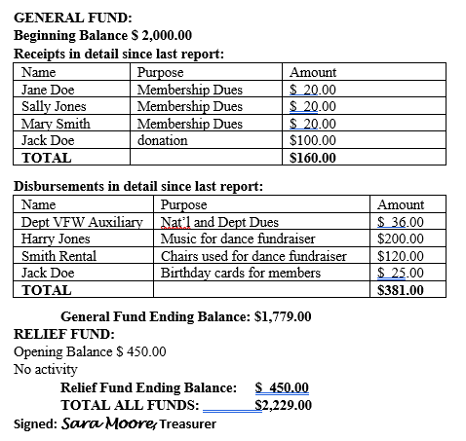
VFW Auxiliary
Auxiliary Treasurer’s Report
Notes:
At each Auxiliary meeting, the Treasurer shall make a report following the reading of the minutes.
The Auxiliary Treasurer’s Report shall contain:
Balance on hand as of the last report (Beginning Balance); Amount of funds received from all sources since the last report;
Amount expended since last report; Balance on hand (Ending Balance);
The report must show all receipts and disbursements in detail, including the name of the person or organization to whom the check is issued and stating for what purpose.

Slide 17
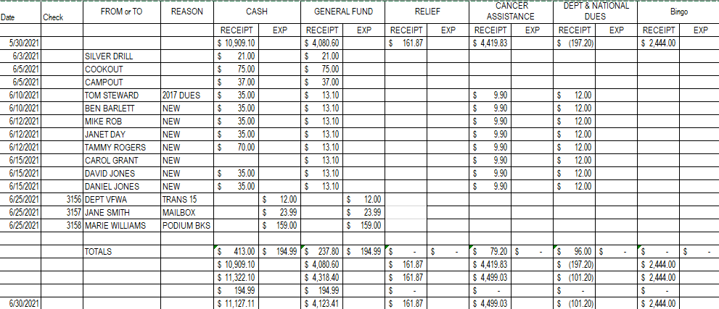
VFW Auxiliary
Auxiliary Treasurer’s Report
Notes:
At each Auxiliary meeting, the Treasurer shall make a report following the reading of the minutes.
The Auxiliary Treasurer’s Report shall contain:
Balance on hand as of the last report (Beginning Balance); Amount of funds received from all sources since the last report;
Amount expended since last report; Balance on hand (Ending Balance);
The report must show all receipts and disbursements in detail, including the name of the person or organization to whom the check is issued and stating for what purpose.

Slide 18

VFW Auxiliary
Auxiliary Treasurer’s Report
A copy of the Treasurer’s Report goes to the Secretary to be included in the minutes
As per the Auxiliary Order of Business, after the Treasurer’s report it is customary for the Presentation of Bills to be approved to be paid

Slide 19

VFW Auxiliary
990‐N ePostcard
Due within 4 ½ months after the end of the organization’s fiscal year
Section 920 of Bylaws the Fiscal Year End is June 30th
990‐N ePostcard is due by November 15th each year
Information needed to complete the 990‐N ePostcard:
Your organization's Employer Identification Number (EIN)
Your organization's legal name
Any other names your organization uses to do business (DBA name)
Able to answer the following questions:
◉ Are the gross receipts normally $50,000 or less?
◉ The organization's mailing address, city, state and zip code
◉ The organization's website address (if it has one)
◉ The name and address of one of your organization’s principal officer
◉ 990‐N ePostcard user guide at https://www.irs.gov/pub/irs‐pdf/p5248.pdf

Slide 20

VFW Auxiliary
990‐N ePostcard
To file a 990‐N ePostcard
Register with the IRS website
Respond to the activation email sent during the registration process
Complete and submit the 990‐N ePostcard for an exempt organization
990‐N ePostcard must be filed electronically on the website https://sa.www4.irs.gov/epostcard/

Slide 21
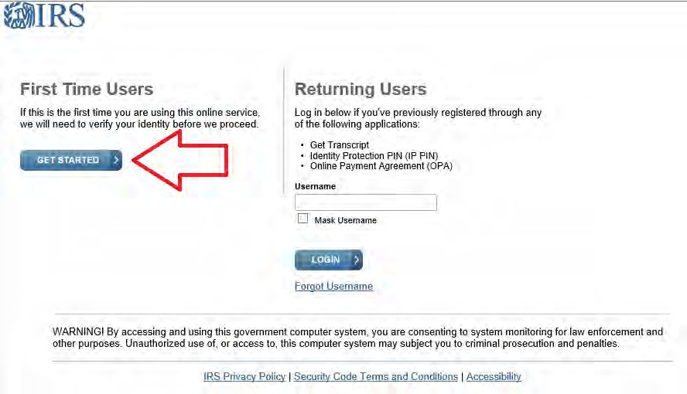
VFW Auxiliary

Slide 22
VFW Auxiliary
990‐N ePostcard Issues
Has the 990‐N ePostcard been filed in past?
Look on IRS website for Exempt Organization Select Check at http://apps.irs.gov/app/eos
Please note that the VFW Auxiliary National Headquarters has found that this website might not be up to date.

Slide 23

VFW Auxiliary
A local Auxiliary has the right to possess a credit card acceptance machine. This is by vote of the local Auxiliary and with the understanding that the Auxiliary will assume all risk and fees associated with the credit card acceptance machine.
Unwavering Support for Uncommon Heroes ^{tm}

Slide 24

VFW Auxiliary
Retention of Auxiliary Records
Most accounting records = 6 years
Accounts Receivables
Accounts Payables
Canceled Checks
Bank Statements
Great resource
Booklet of Instructions in Bylaws (yellow pages)
Paper vs. electronic file keeping

