Slide 1



Welcome To
HolyGrounds
CoffeeHouse
Happy Father’s Day!
Welcome VBS!
First Presbyterian Church
www.fpcmesa.org

Slide 2


Slide 3
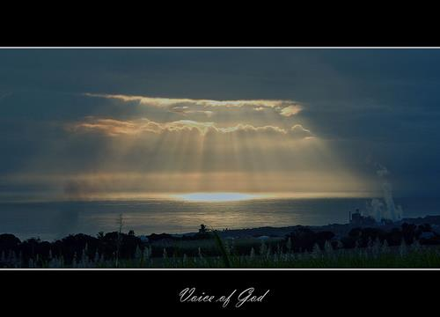
For Such a Time as This
- Wayne Watson
Now all I have is now
To be faithful to be holy and to shine
Lighting up the darkness
Right now I really have no choice
But to voice the truth to the nations
A generation looking for God

Slide 4
For such a time as this
I was placed upon the earth
To hear the voice of God
And do His will whatever it is
For such a time as this
For now and all the days He gives
I am here I am here and I am His
For such a time as this

Slide 5
You do you ever wonder why
Seems like the grass is always greener
Under ev'rybody else's sky
But right here right here for this time and place You can live a mirror of His mercy
A forgiven image of grace

Slide 6
For such a time as this
I was placed upon the earth
To hear the voice of God
And do His will whatever it is
For such a time as this
For now and all the days He gives
I am here I am here and I am His
For such a time as this

Slide 7
Can't change what's happened till now
But we can change what will be
By living in holiness
That the world will see Jesus

Slide 8
For such a time as this
I was placed upon the earth
To hear the voice of God
And do His will whatever it is
For such a time as this
For now and all the days He gives
I am here I am here and I am His
For such a time as this
© 1998 Material Music; CCLI #844038

Slide 9
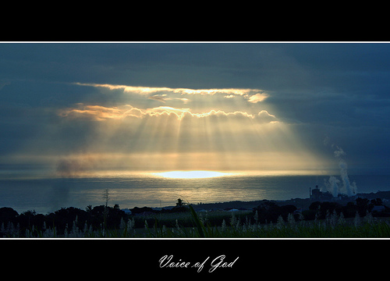

Slide 10
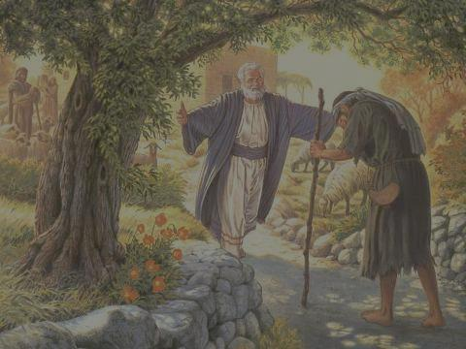
When God Ran
– Benny Hester/John Parenti
Almighty God the great I Am,
Immovable Rock, Omnipotent Powerful
Awesome Lord, Victorious Warrior, Commanding King of kings,
Mighty Conqueror, and the only time,
The only time I ever saw Him run

Slide 11
(Was) when He ran to me, took me in His arms,
Held my head to His chest said My son's come home again,
Lifted my face, wiped the tears from my eyes,
With forgiveness in His voice, He said,
"Son do you know I still love you?"
He caught me by surprise (He brought me to my knees). When God ran.

Slide 12
After I left home, I knew I'd broken His heart.
I wondered then if things would ever be the same,
But one night, I remembered His love for me,
And down that dusty road ahead I could see,
It's the only time, the only time I ever saw Him run.

Slide 13
(Was) when He ran to me, took me in His arms,
Held my head to His chest said My son's come home again,
Lifted my face, wiped the tears from my eyes,
With forgiveness in His voice, He said,
"Son do you know I still love you?"
He caught me by surprise (He brought me to my knees). When God ran.

Slide 14
I saw Him run to me, and then I ran to Him.
I was so ashamed, all alone and far away,
But now I know, He's been waiting for this day.

Slide 15
(And then) He ran to me, took me in His arms,
Held my head to His chest, said My son's come home again,
Lifted my face, wiped the tears from my eyes,
With forgiveness in His voice (I felt His love call me again).

Slide 16
He said "Son", He said "Son, My son,
do you know I still love you?"
He ran to me, when God ran.
©1985 Word Music, CCLI License 844038

Slide 17
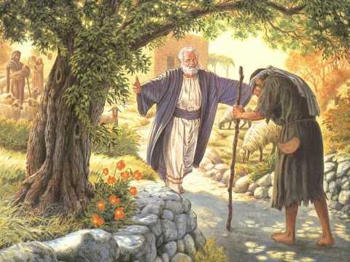

Slide 18
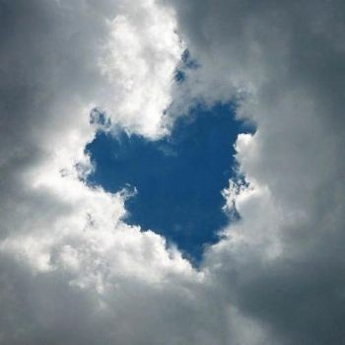
Where We Belong
- Joel Davies / Reuben Morgan
There is no height or depth
Neither life nor death
Can take me from all that I find
Here now in Your glory Lord

Slide 19
No other pow'rs or love
The things of now or to come
There's nothing on earth in this life
That could ever separate us Lord

Slide 20
Your love is never ending to Your hands we surrender
Where all our sins are washed away
Your grace beyond reason has paid for our freedom
We're made alive in You

Slide 21
We run to Your throne where we belong
Every heart will sing that Jesus is Lord
Casting all else aside for the joy of our Christ
Let Your glory fall our hearts are filled with Your fire

Slide 22
No other pow'rs or love
The things of now or to come
There's nothing on earth in this life
That could ever separate us Lord

Slide 23
Your love is never ending to Your hands we surrender
Where all our sins are washed away
Your grace beyond reason has paid for our freedom
We're made alive in You

Slide 24
We run to Your throne where we belong
Every heart will sing that Jesus is Lord
Casting all else aside for the joy of our Christ
Let Your glory fall our hearts are filled with Your fire

Slide 25
Your love is never ending to Your hands we surrender
Where all our sins are washed away
Your grace beyond reason has paid for our freedom
We're made alive in You

Slide 26
We run to Your throne where we belong
Every heart will sing that Jesus is Lord
Casting all else aside for the joy of our Christ
Let Your glory fall our hearts are filled with Your fire

Slide 27
We run to Your throne where we belong
Every heart will sing that Jesus is Lord
Casting all else aside for the joy of our Christ
Let Your glory fall our hearts are filled with Your fire
© 2008 Hillsong Publishing; CCLI #844038

Slide 29
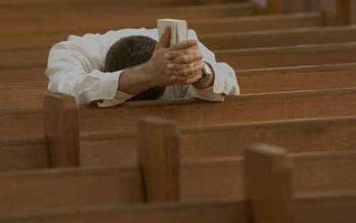
Surrender
- Marc James
I'm giving you my heart, and all that is within
I lay it all down for the sake of you my King
I'm giving you my dreams, I'm laying down my rights
I'm giving up my pride for the promise of new life

Slide 30
And I surrender all to you, all to you
And I surrender all to you, all to you

Slide 31
I'm singing You this song, I'm waiting at the cross
And all the world holds dear, I count it all as loss
For the sake of knowing You for the glory of Your name
To know the lasting joy, even sharing in Your pain

Slide 32
And I surrender all to you, all to you
And I surrender all to you, all to you
***

Slide 33
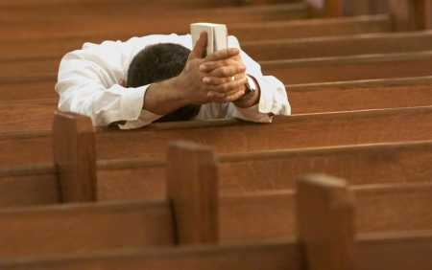

Slide 34

Scripture
Bible Point: When you’re lonely…Jesus rescues!
The Lord will hold me close. – Psalm 27:10
Bible Point: When you worry…Jesus rescues!
The Lord comes to the rescue each time. –
Psalm 34:19

Slide 35
Bible Point: When you struggle…Jesus rescues!
Be still, and know that I am God! –
Psalm 46:10
Bible Point: When you do wrong…
Jesus rescues!
Here on earth you will have many trials and sorrows. But take heart, because I have overcome the world. – John 16:33

Slide 36
Bible Point: When you’re powerless…
Jesus rescues!
This is the same mighty power that raised Christ from the dead. – Ephesians 1:19-20

Slide 38
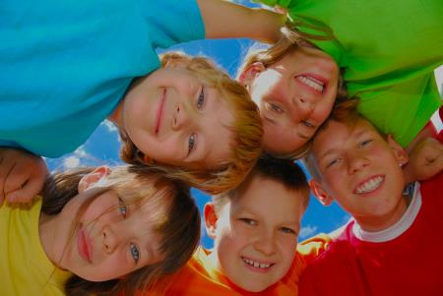
MOMENT WITH YOUNG DISCIPLES
VBS Songs

Slide 39
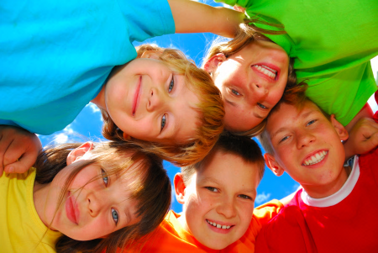

Slide 40
Sermon
Jesus Rescues
Rev. Ann Conklin

Slide 42
Pastoral Prayer

Slide 43
The Lord’s Prayer
Our Father, who art in heaven, hallowed be Thy name. Thy kingdom come, Thy will be done on earth as it is in heaven. Give us this day our daily bread; and forgive us our debts, as we forgive our debtors; and lead us not into temptation but deliver us from evil. For Thine is the kingdom and the power, and the glory, forever. Amen.

Slide 45
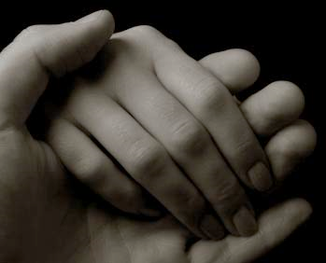
Here I Am, Lord - Daniel Schutte
Cortney Bever, Solo

Slide 46
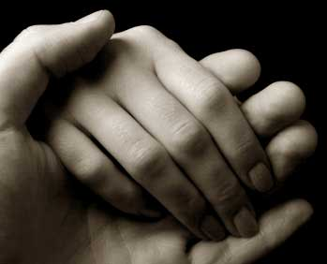

Slide 47
Call to Offering
Do good and share what you have, for such sacrifices are pleasing to God. The ushers will receive the morning offering.

Slide 48
ANNOUNCEMENTS

Slide 50
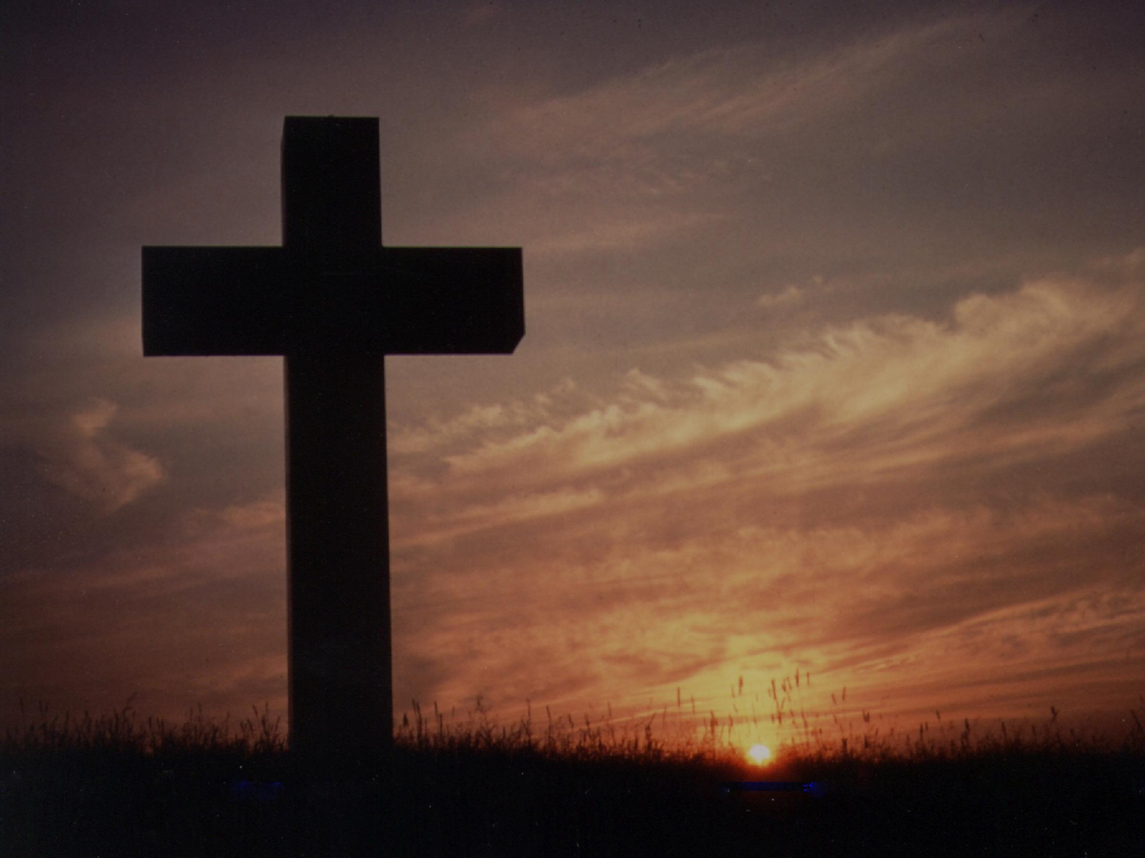
Courageous
- Mark Hall / Matthew West
We were made to be courageous
We were made to lead the way
We could be the generation
That fin'lly breaks the chains
We were made to be courageous
We were made to be courageous

Slide 51
We were warriors on the frontline Standing unafraid
But now we're watchers on the sidelines
While our fam'lies slip away
Where are you men of courage
You were made for so much more
Let the pounding of our hearts cry
We will serve the Lord

Slide 52
We were made to be courageous
And we're taking back the way
We were made to be courageous
And it starts with us today
The only way we'll ever stand
Is on our knees with lifted hands
Make us courageous
Lord make us courageous

Slide 53
This is our resolution
Our answer to the call
We will love our wives and children
We refuse to let them fall
We will reignite the passion
That we buried deep inside
May the watchers become warriors
Let the men of God arise

Slide 54
We were made to be courageous
And we're taking back the way
We were made to be courageous
And it starts with us today
The only way we'll ever stand
Is on our knees with lifted hands
Make us courageous
Lord make us courageous

Slide 55
Seek justice love mercy
Walk humbly with your God
Seek justice love mercy
(Walk humbly with Your God)
(REPEAT 3X)

Slide 56
We were made to be courageous
And we're taking back the way
We were made to be courageous
And it starts with us today
The only way we'll ever stand
Is on our knees with lifted hands
Make us courageous
Lord make us courageous

Slide 57
We were made to be courageous
Lord make us courageous
We were made to be courageous
Lord make us courageous
© 2011 My Refuge Music; CCLI #844038

Slide 58
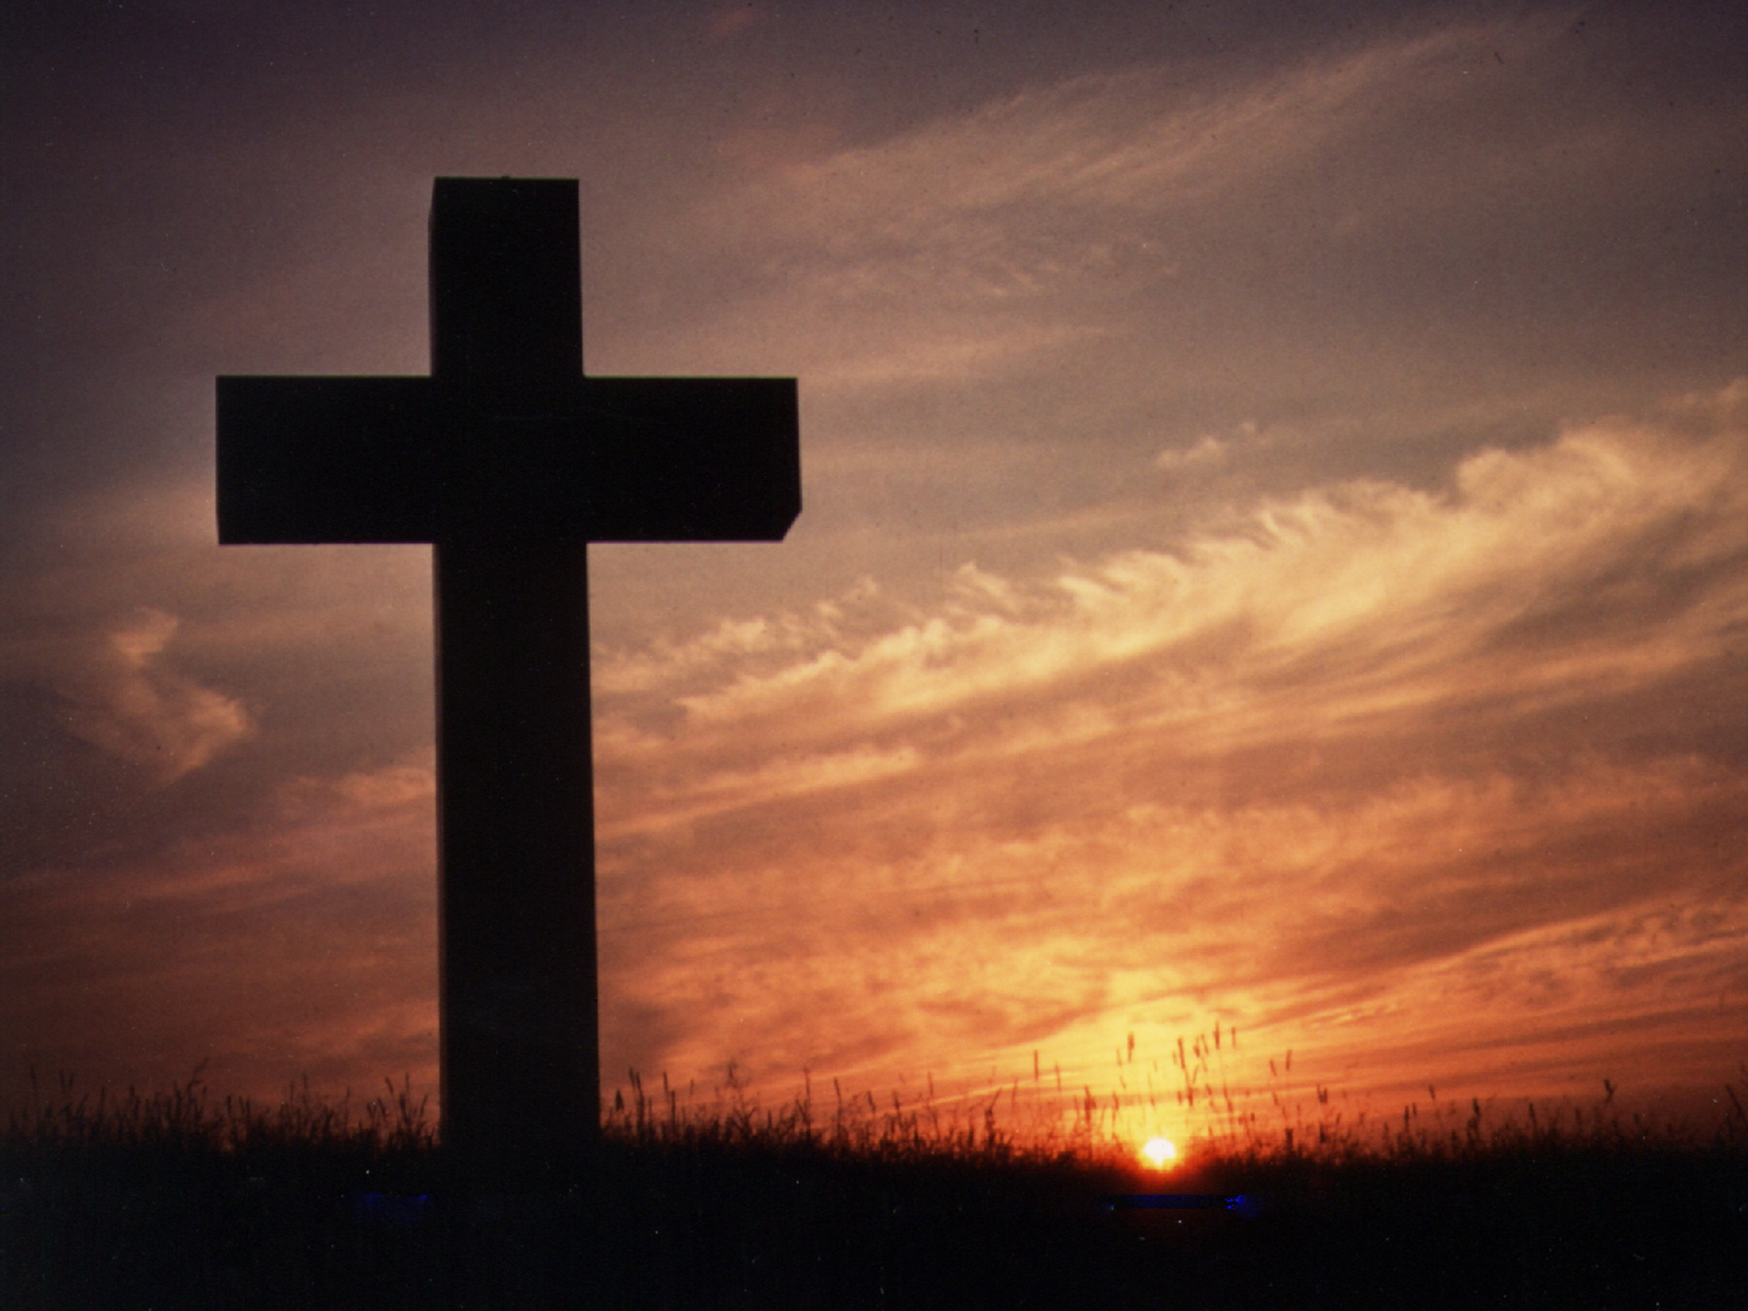

Slide 59
Benediction

Slide 61
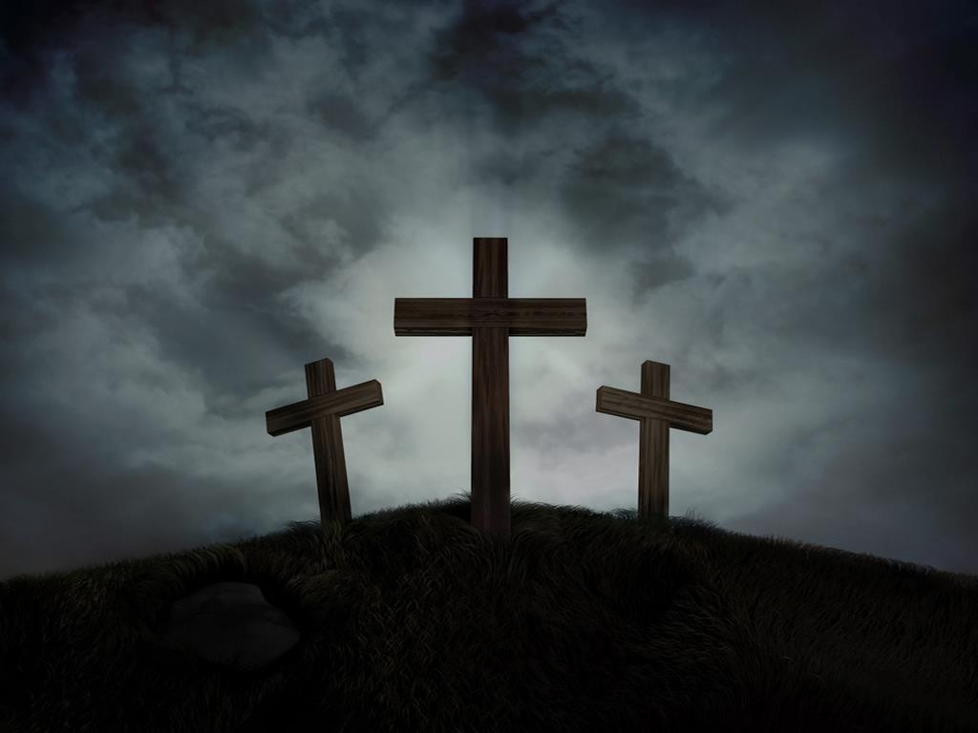
There is Power in the Blood
- Lewis E. Jones
Would you be free from the burden of sin?
There's pow'r in the blood, pow'r in the blood;
Would you o'er evil a victory win?
There's wonderful pow'r in the blood.

Slide 62
Chorus: There is pow'r, pow'r, wonderworking pow'r
In the blood of the lamb;
There is pow'r, pow'r, wonderworking pow'r
In the precious blood of the Lamb.

Slide 63
Would you do service for Jesus your King?
There's pow'r in the blood, pow'r in the blood;
Would you live daily His praises to sing?
There's wonderful pow'r in the blood.

Slide 64
Chorus: There is pow'r, pow'r, wonderworking pow'r
In the blood of the lamb;
There is pow'r, pow'r, wonderworking pow'r
In the precious blood of the Lamb.
Words & Music: Lewis E. Jones, 1899

Slide 65
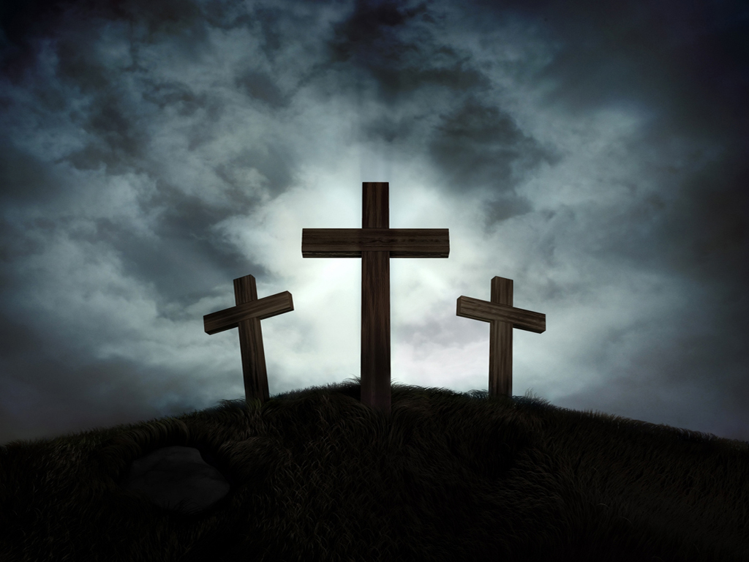

Slide 66
Thanks for attending
HolyGrounds
CoffeeHouse
First Presbyterian Church
www.fpcmesa.org

