Slide 1
Apple-House Halloween Competition 2021
WINNERS

Slide 2
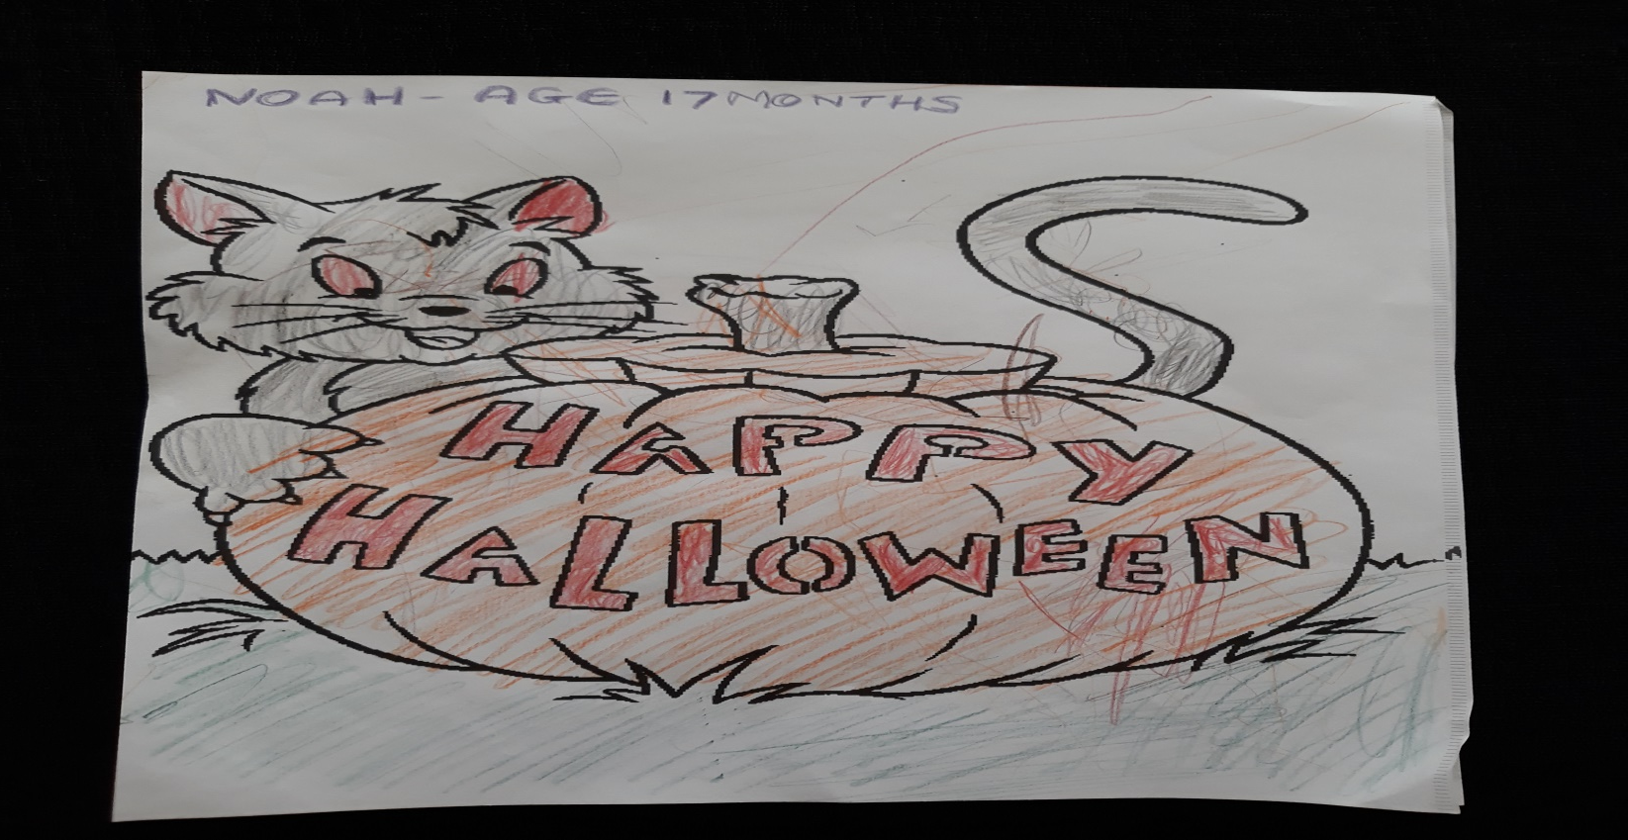
Winner of Age Group 0-2 Years
NOAH - 1 Years

Slide 3
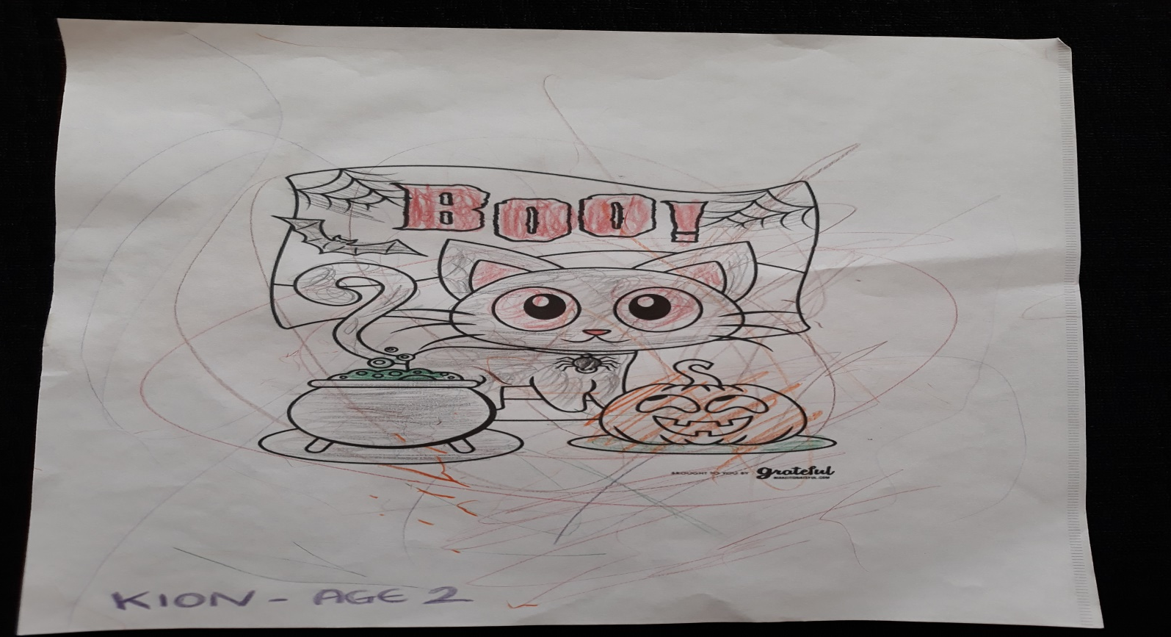
Winner of Age Group 2-3 Years
KION - 2 Years

Slide 4
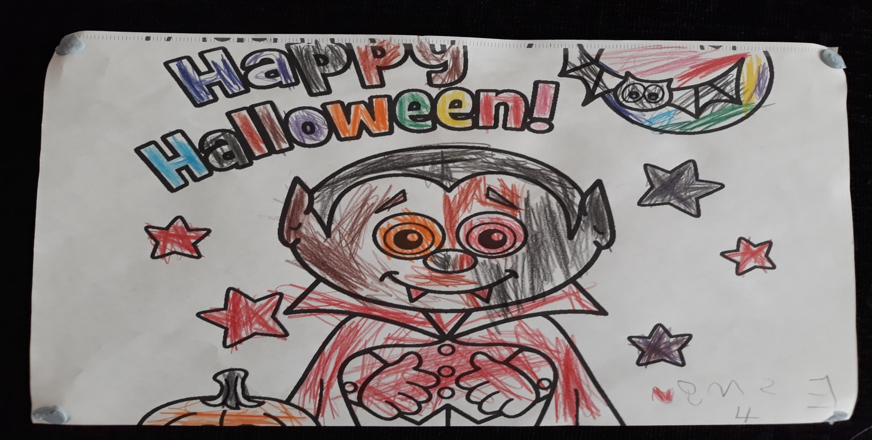
Winner of Age Group 4-5 Years
ESME – 4 Years

Slide 5
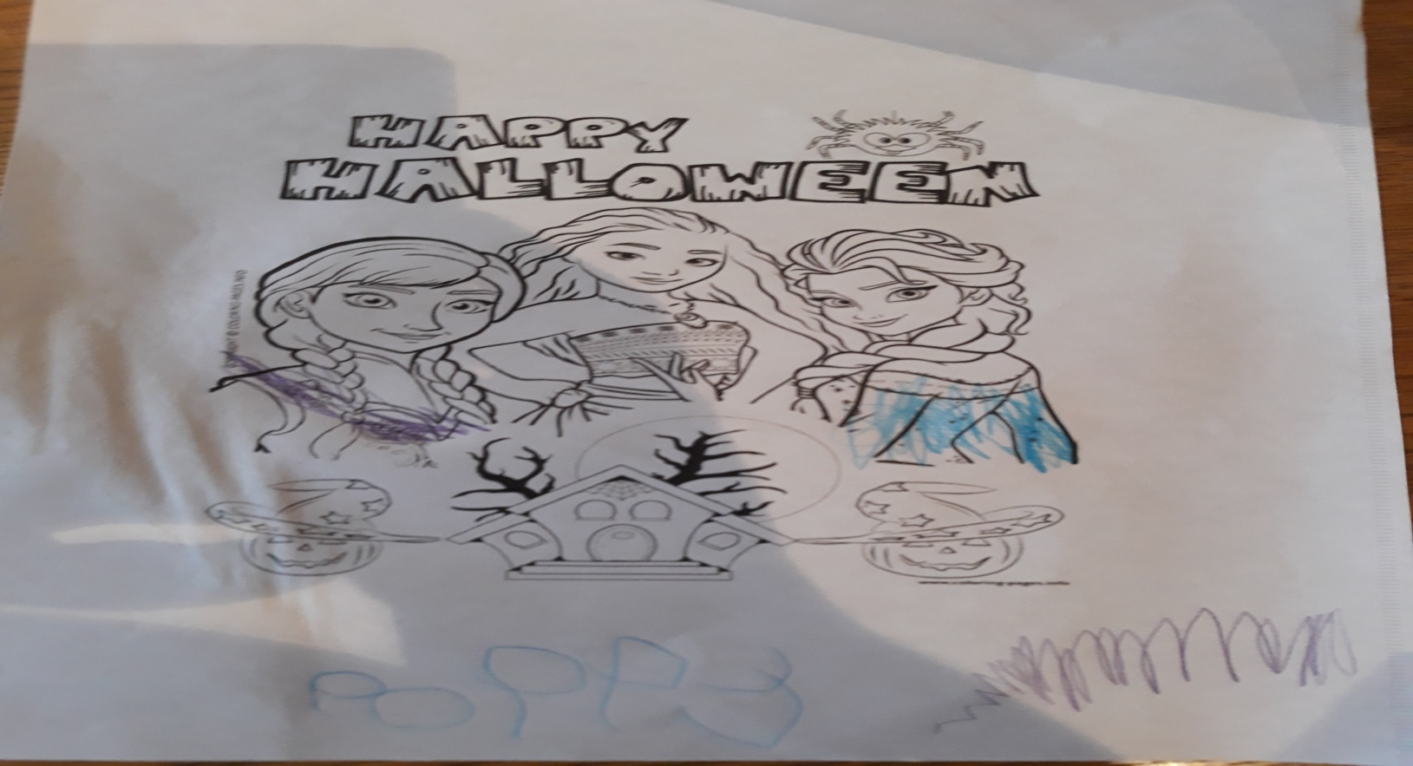
Winner of Age Group 5-6 Years
POPPY – 5 Years

Slide 6
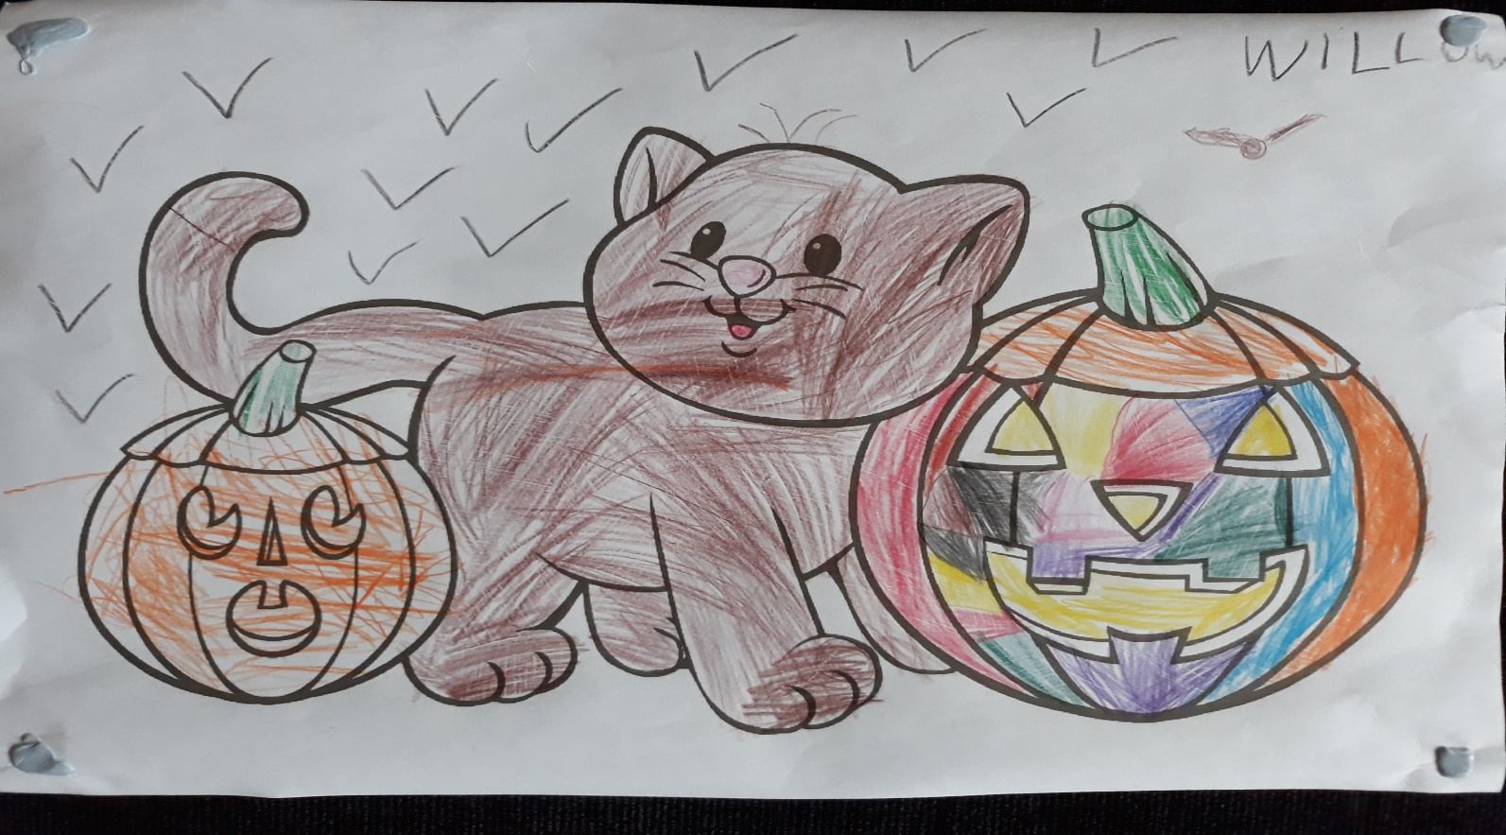
Winner of Age Group 6-7 Years
WILLOW – 6 Years

Slide 7
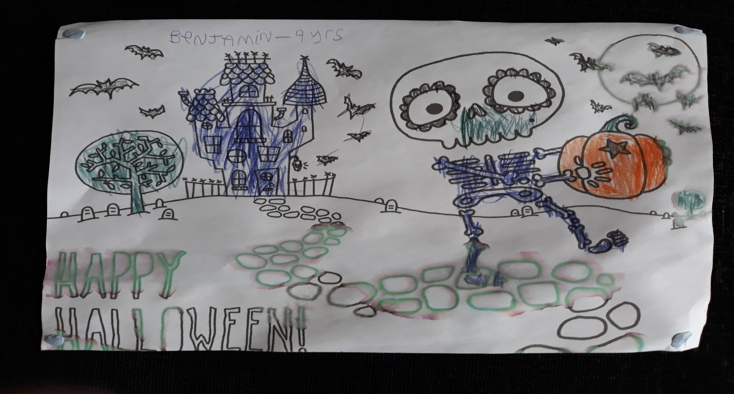
Winner of Age Group 8-9 Years
BENJAMIN – 9 Years

Slide 8
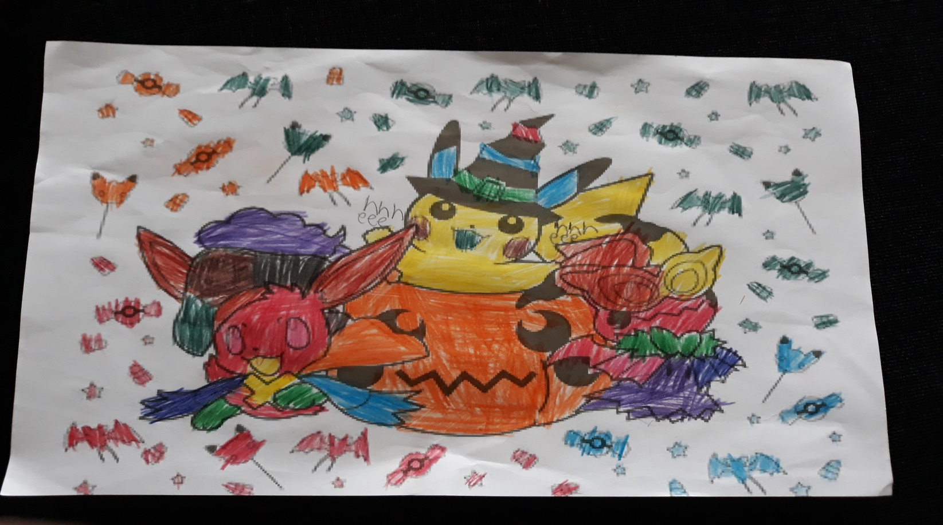
Winner of Age Group 9-10 Years
MCKENZIE – 9 Years

Slide 9
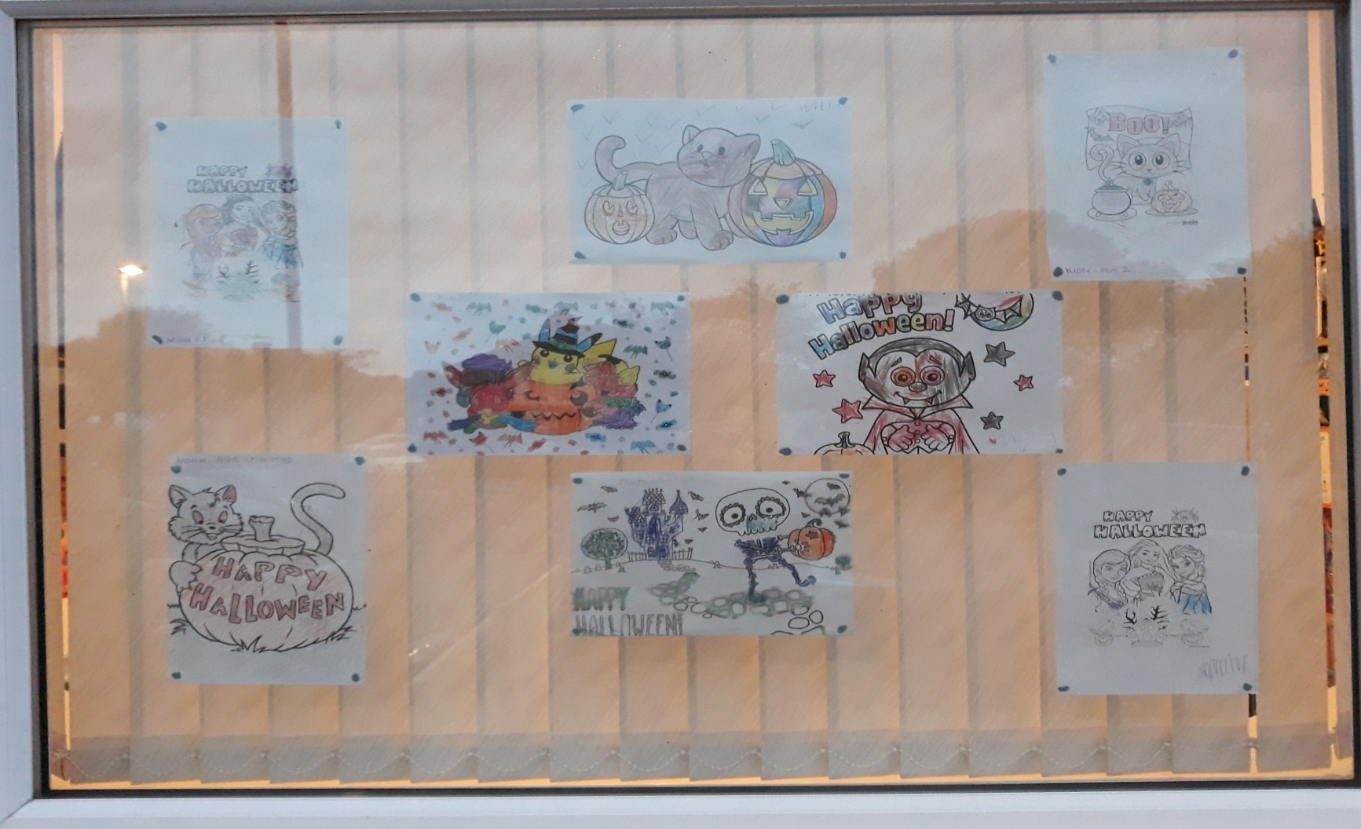
Our Window Display 2021

