Slide 1


NGENX Energy
Modular energy Solutions
04-23-2020

Slide 2
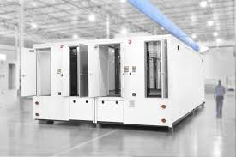
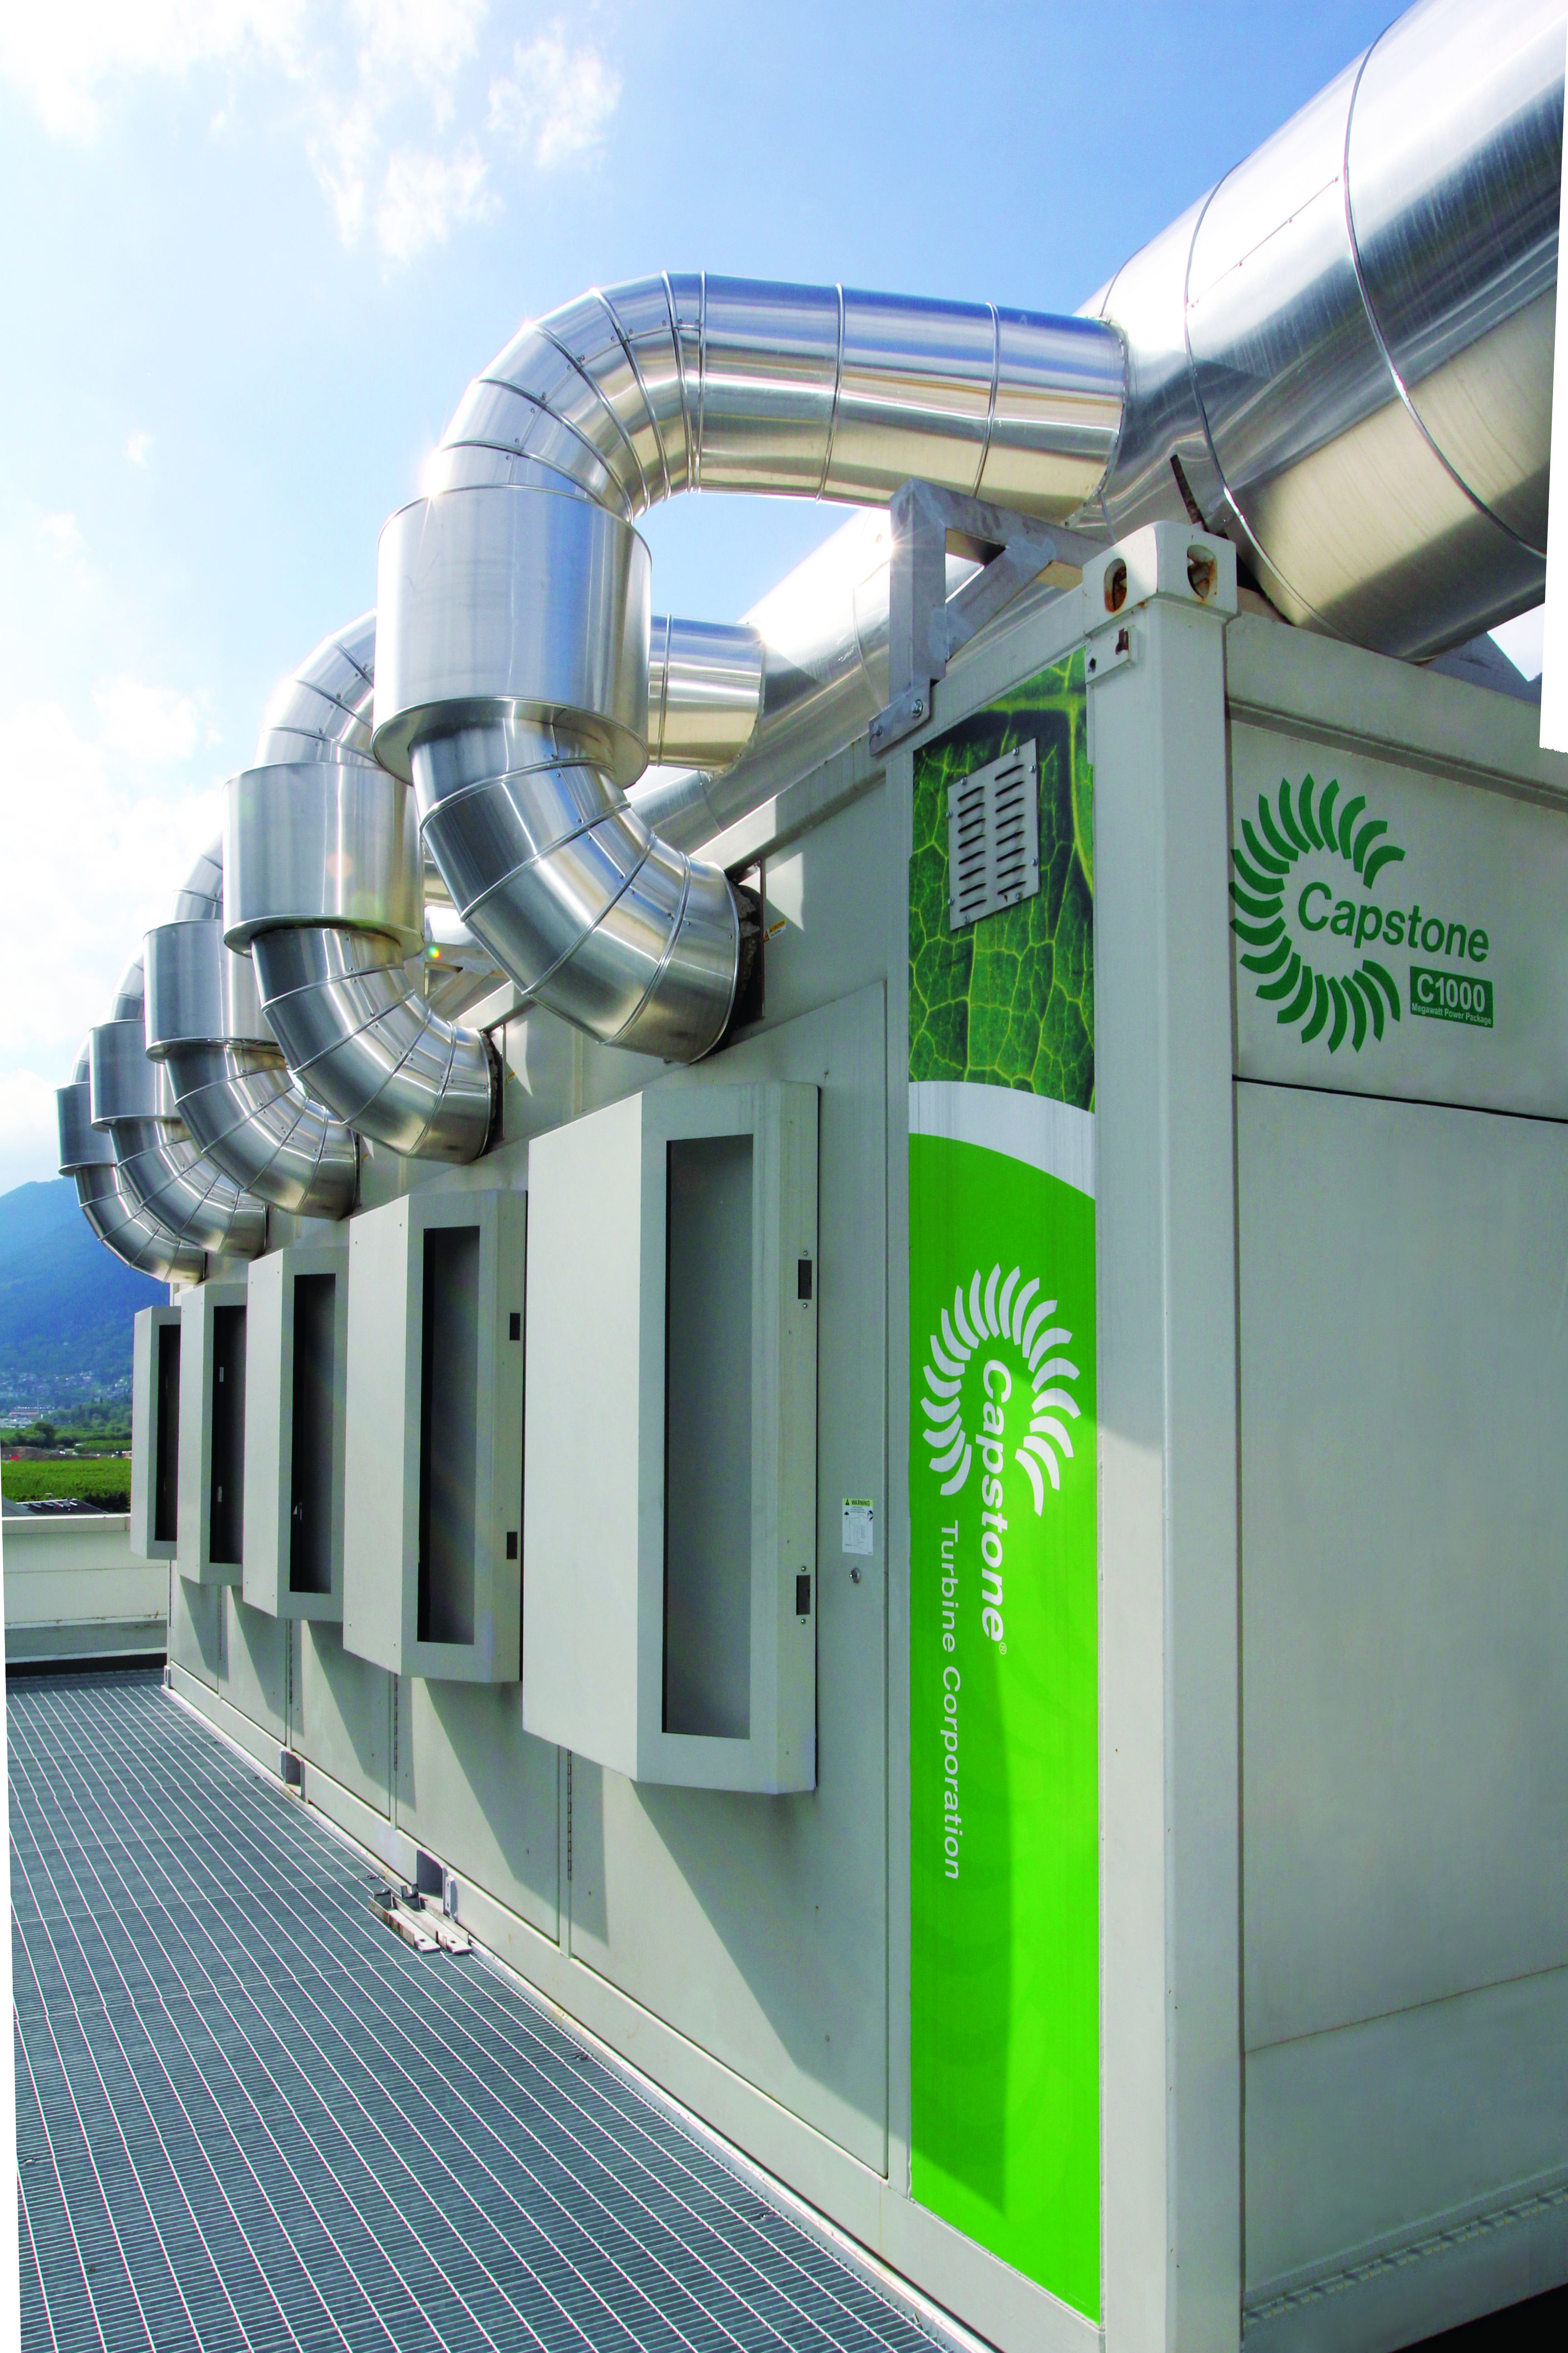
NGENX Energy has coupled marquee technology providers into a unique application for data center solutions
Scalable from 65Kw to up to 3WM our solutions provide primary power and cooling with inherent redundancy
Power and Cooling availability assured with N+1+1 reliability
Solutions custom designed for power, cooling and resiliency requirements to meet specific data center objectives
Modular scalable approach

Slide 3
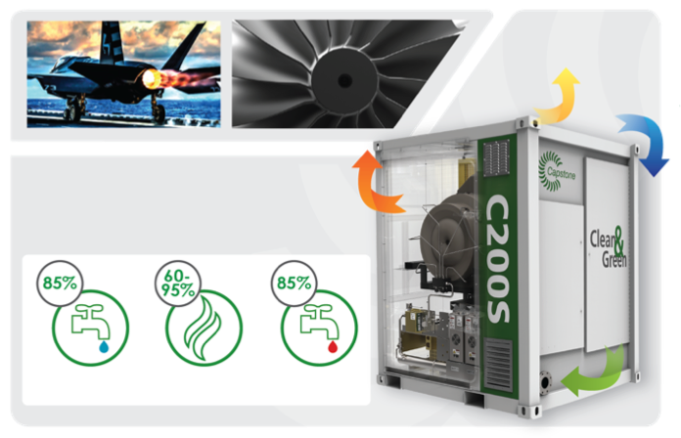
Microturbine Power and Cooling
HEAT OUT
AIR IN
POWER OUT
ENERGY EFFICIENCY
Overall ELECTRIC EFFICIENCY of 33%
COLD WATER
STEAM
HOT WATER
FUEL IN

Slide 4
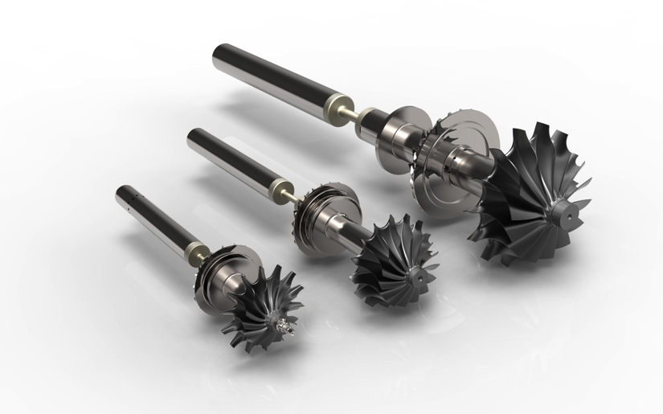
Rotor Shaft
C200
61,000 RPM
C65
96,000 RPM
C30
96,000 RPM
Notes:
Add video of air bearing

Slide 5

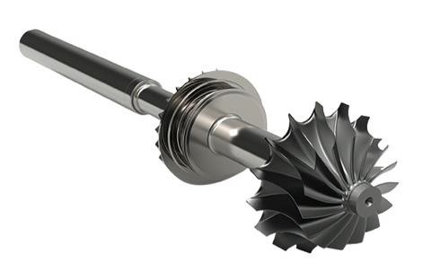
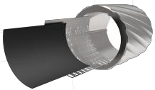
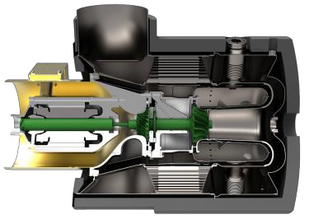
Microturbine Generation
Air Foil
Rotor Group
Single stage design
Recuperated
Single moving part
Air lubricated
Air cooled
Low emissions < 9 ppm NOx

Slide 6









Power Electronics
BCM 1
BCM 2
BATTERY 1
BATTERY 2
Inverter-based technology
Superior turndown ability
Batteries utilized to support step loading, Black Start and Island Mode
Power Electronics are UL1741 Listed and IEEE 1547 Compliant
No Synchronization Equipment Required.

Slide 7
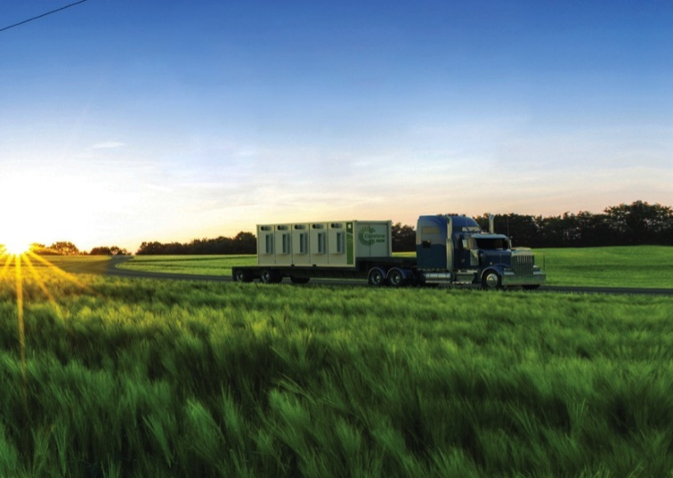
DG & CHP with Ultra Low Emissions
Natural Gas Microturbines:
  40 PPM CO
  9PPM NOx
  7 PPM VOC
Optional LE Design
Ultra-low NO_{X}
  Less than 5ppm
No additional catalyst requirement
Considered an insignificant source of emissions in all 50 stares
Notes:
Capstone is one of two companies which has implemented air-bearings in commercial applications
Air bearings eliminate the need for conventional oil lubrication of any kind
avoiding oil changes and reducing maintenance costs
One moving part vs. 150 in reciprocating engines dramatically reduces maintenance and replacement costs
The technology provides very clean emissions with less than 9 ppm of NOX while burning natural gas – which is extremely low
All of this is controlled by our patented digital power controller

Slide 8
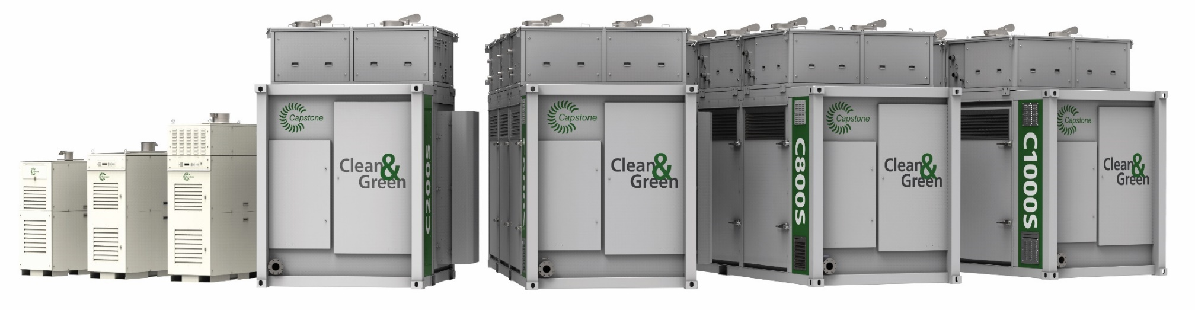
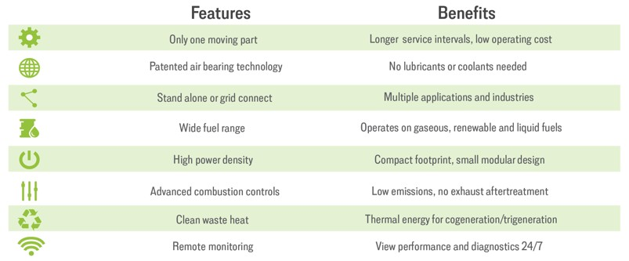
Broad Product Offering

Slide 9
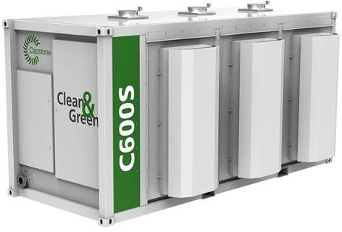
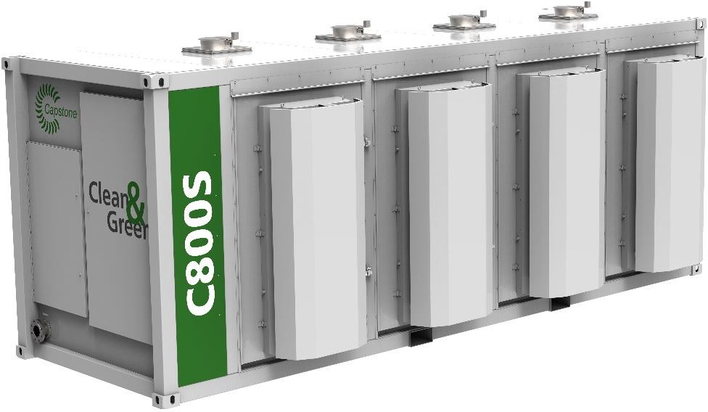
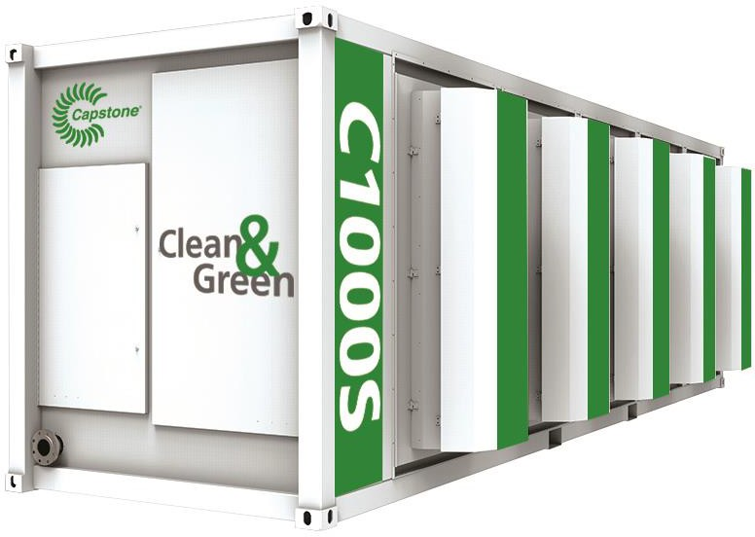

C1000S Series Turbine

Slide 10
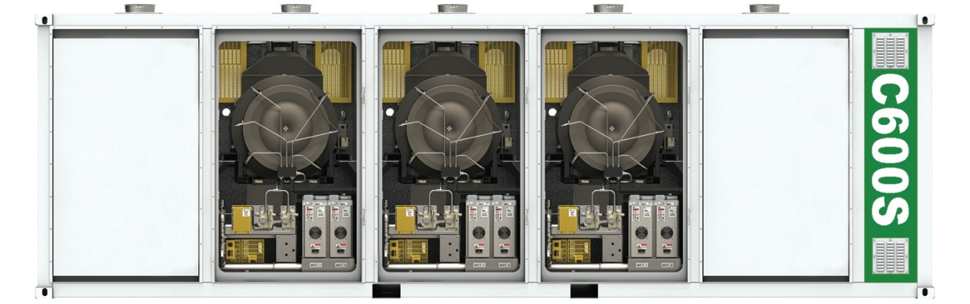
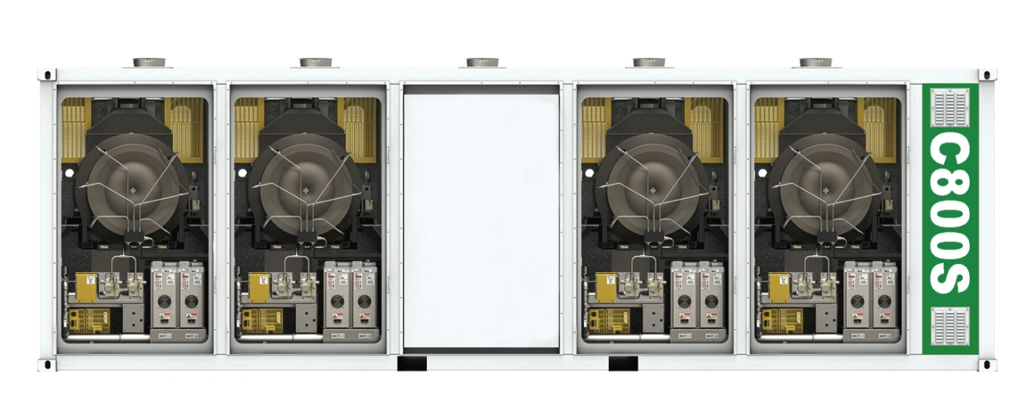
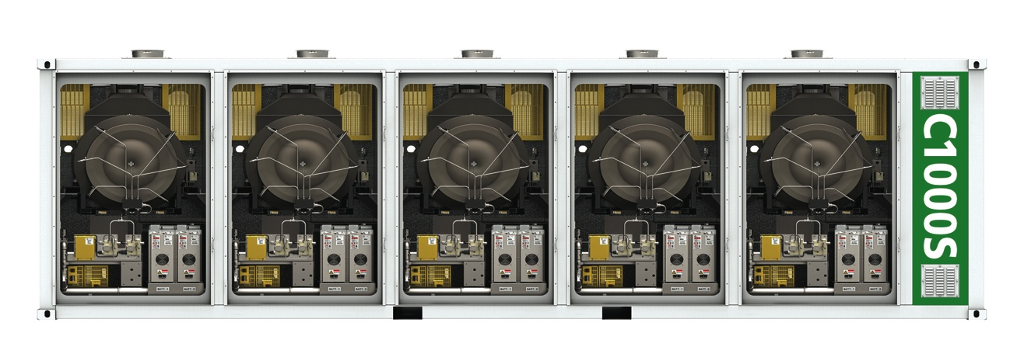
Resiliency (N+ Redundancy)
C600 Power Package
C800 Power Package
C1000 Power Package
Notes:
N+ redundancy is the cornerstone of resiliency
Backbone of a great microgrid – full system resiliency. Multiple prime movers gives further redundancy to the system.

Slide 11
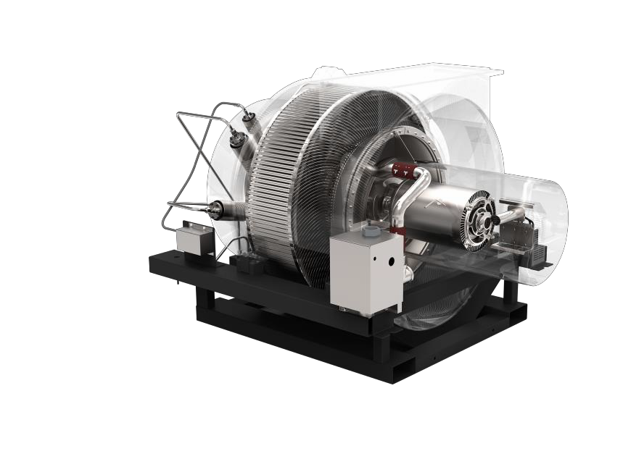
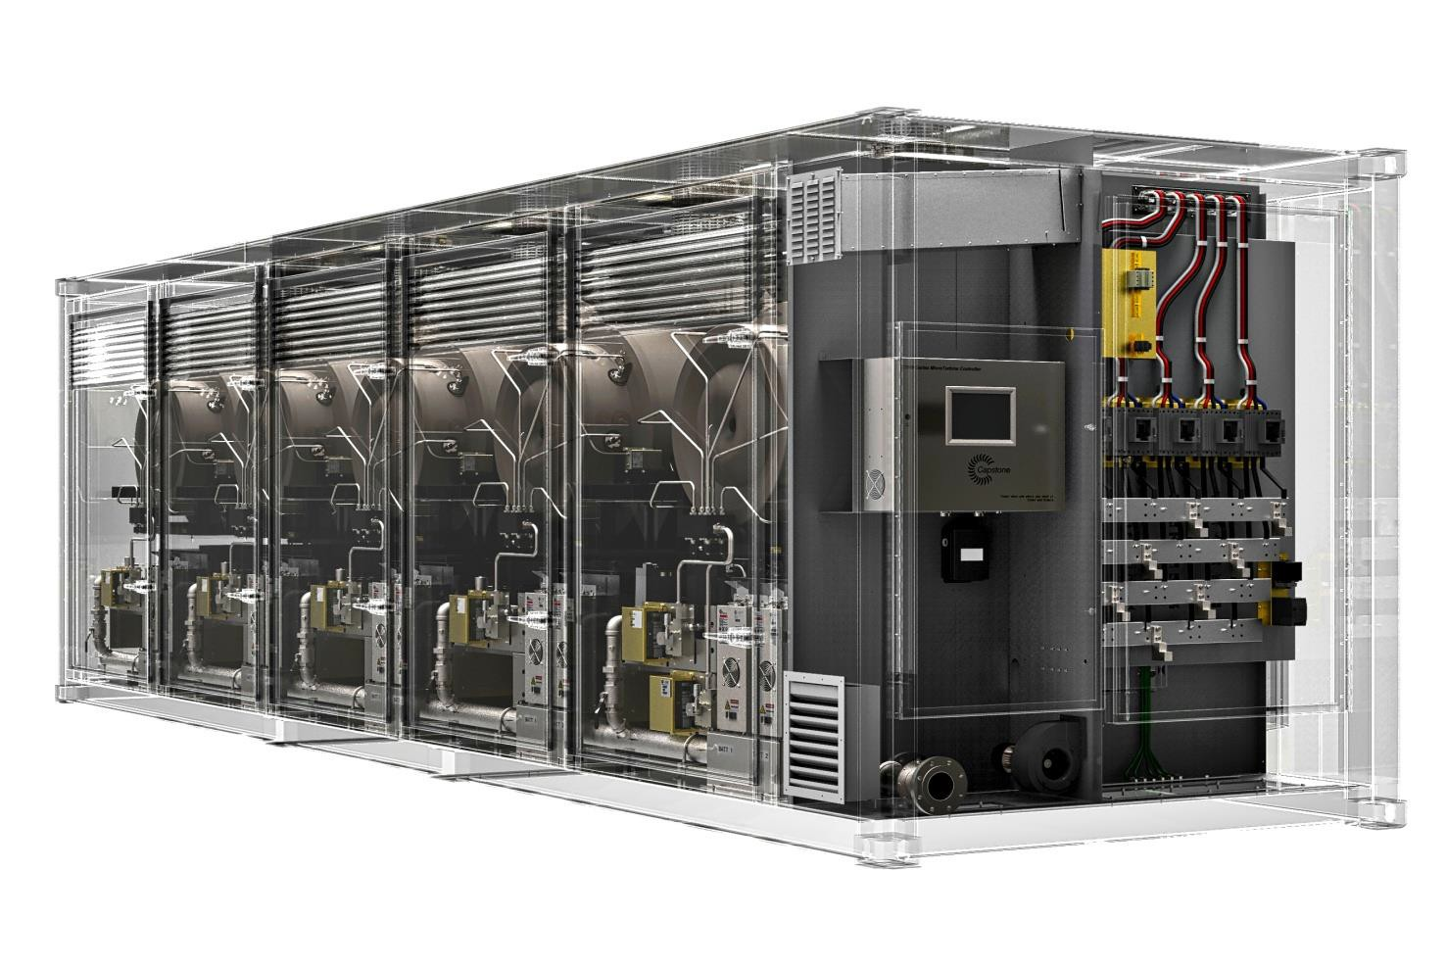
C1000S Series
C600 to C1000 Series
Operates as a single scalable genset
Stable combustion from idle to 100% load
Catastrophic failure is limited to a 200kW engine
All Capstone Microturbines are UL2200 Listed

Slide 12
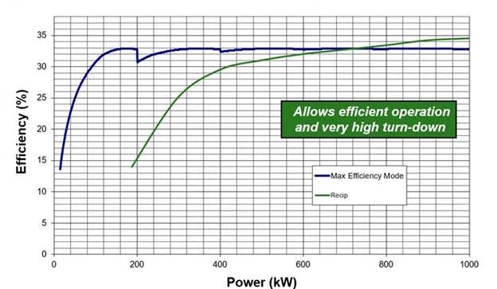
Part Load Efficiency

Slide 13
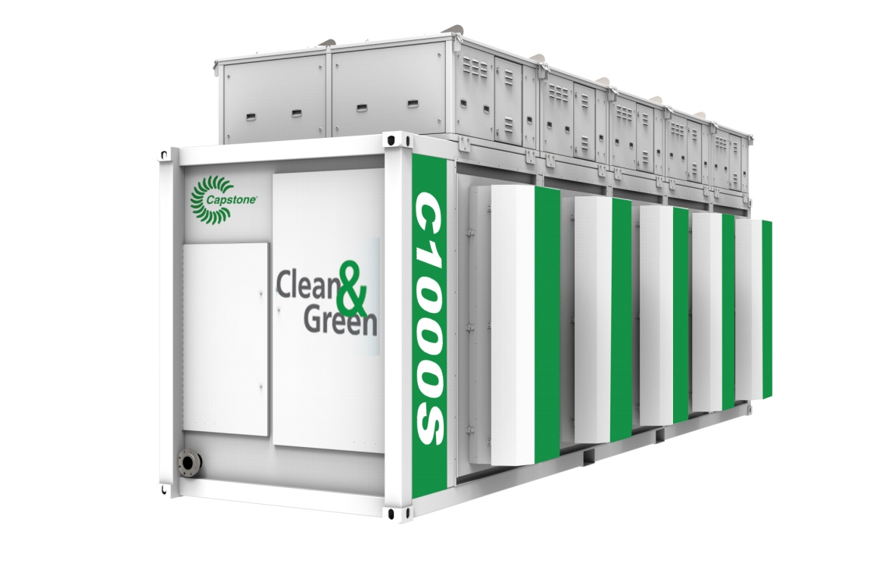
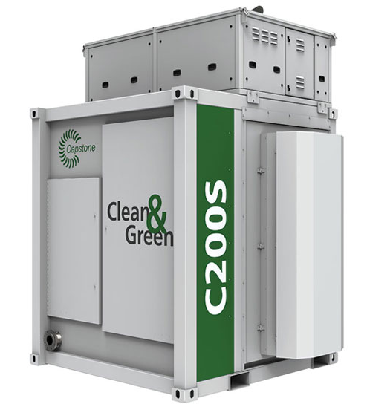
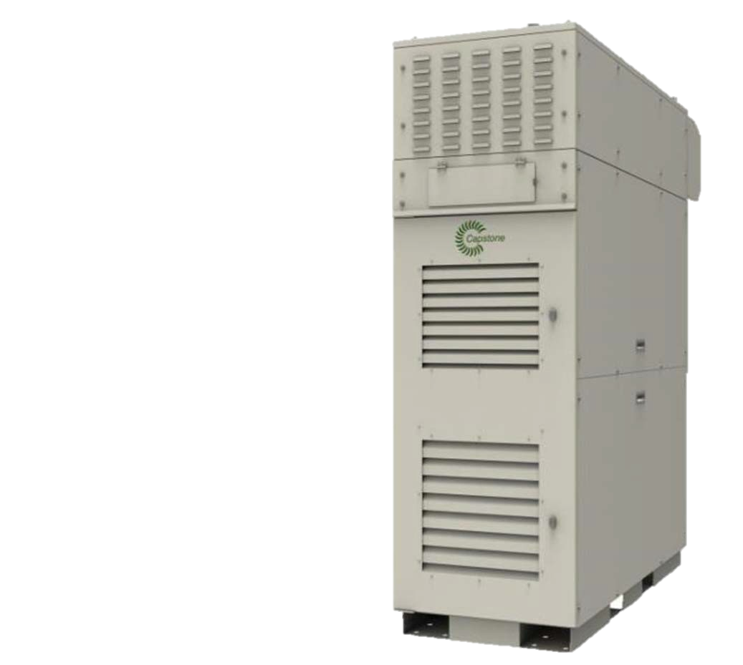
Hot Water
Hot water heat exchanger integrated for all turbines
Up to 210 ºF hot water
External heat recovery available for higher temperatures/efficiencies
Hot Water @100F
 | C65 | C200 | (2)C200 | C600 | C800 | C1000
Hot Water Output (Btu/hr) | 420,000 | 1,000,000 | 2,000,000 | 3,000,000 | 4,000,000 | 5,000,000
C65 ICHP
C200 ICHP
C1000 Series ICHP

Slide 14
Steam Production
Heat recovery steam generators
3 to 500 psig
Integrated duct burners
Efficiencies of up to 90%
Skid mounted
Steam @15 psig
 | C65 | C200 |  | C600 | C800 | C1000
Steam Capacity with Duct Burner (lbs/hr) | 450 | 6,650 |  | 19,675 | 25,950 | 32,000
Steam Capacity Unfired (lbs/hr) | 300 | 795 |  | 2,365 | 3,120 | 3,870

Slide 15
Chilled Water
Absorption Chiller
 | C65 | C200 | (2)C200 | C600 | C800 | C1000
Tons of Chilled Water | 25 | 65 | 130 | 195 | 260 | 325
20 to 400 tons
Single to triple effect
Hot water, steam, and exhaust driven
COP 0.7 to 2.5
Indoor and outdoor rated

Slide 16
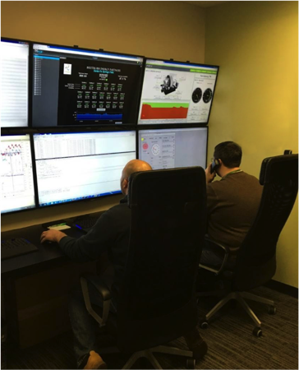
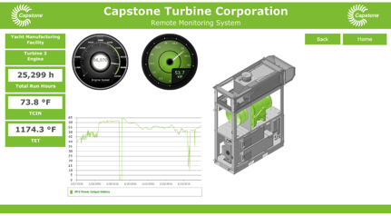
Remote Monitoring
Web access to sites
Data logging
Alarming
Remote trouble shooting
Less down time

Slide 18
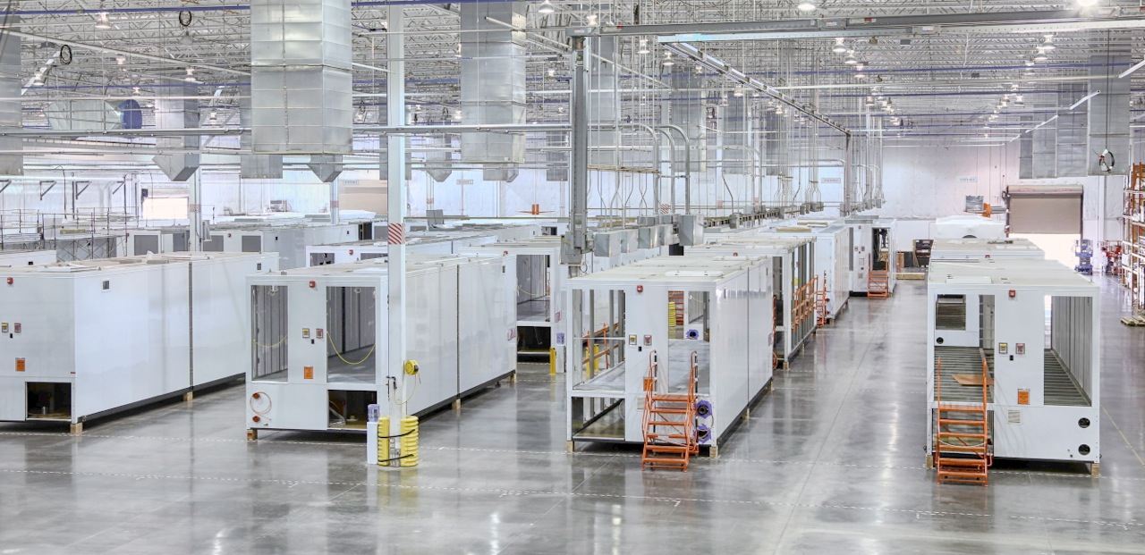
Case Studies

Slide 19
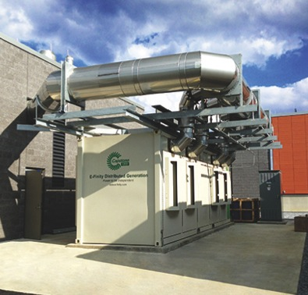
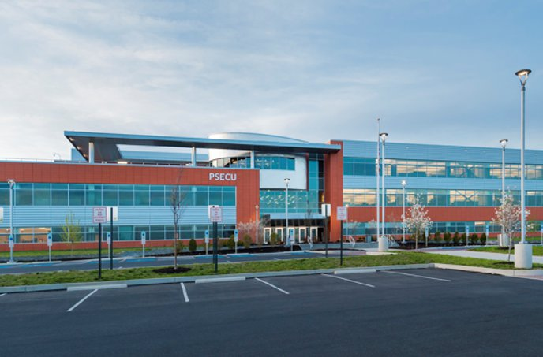
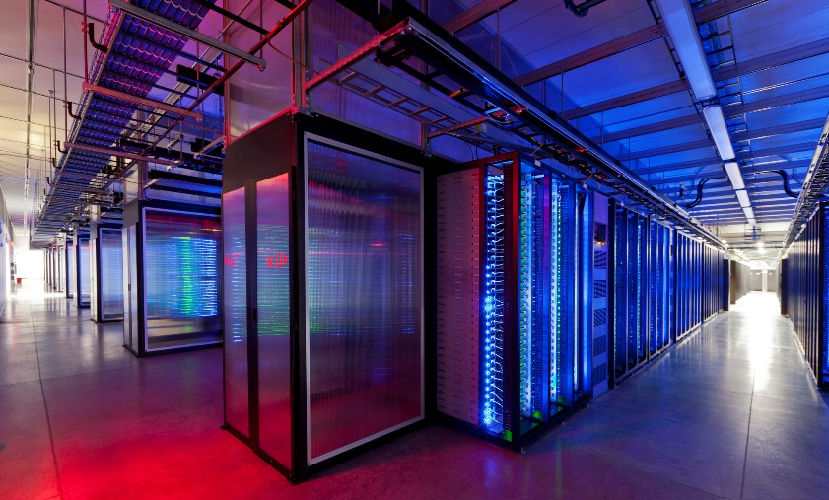
Data Center
PSECU – Harrisburg, PA
  C800 MicroTurbine
  800 kW of Electricity
  Hot Water & Chilled Water Produced
  Primary power to data center (grid connect)
Benefits
  Payback is exceeding the original model
  System helped client achieve LEED Gold status
  Has provided backup power to site multiple times since installation
16

Slide 20
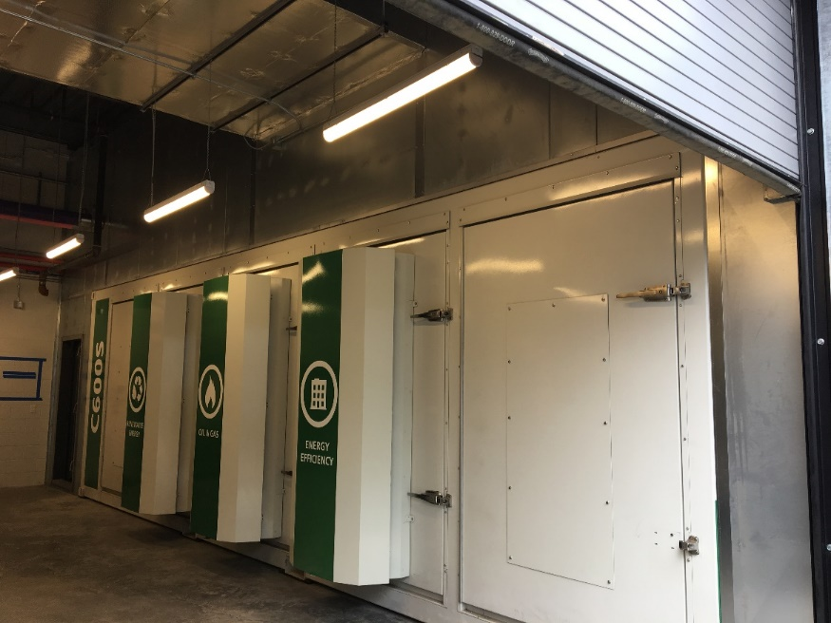
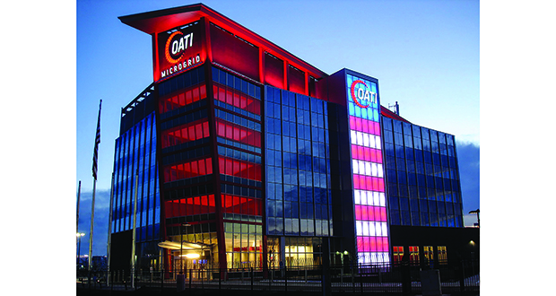
OATI Data Center
Microgrid Solutions
600 kW of Microturbines
125 kW Solar PV
24 kW Wind
125 kW Ensync Battery
1500 kW Diesel Generator
Results
System has 2 modes of operation: “Normal” and “Emergency”
OATI’s Grid mind schedules available distributed generation resources and orchestrates operation of prioritized loads
Microgrid can power 100% of building for several days without grid
ç
Notes:
Open Access Technology International (OATI) Bloomington, MN, headquarters and data center
A 600kW Signature Series MicroTurbine package forms the backbone of the OATI microgrid at their new headquarters and data center building in Bloomington, MN, commissioned in 2017. Integrated in a state-of-the-art microgrid with solar PV, small wind, energy storage and diesel backup, the C600S provides power, heating and cooling in a CCHP application 24/7/365. Not only is this project the centerpiece of OATI's new microgrid business that the company intends to develop for other customers going forward,

Slide 21
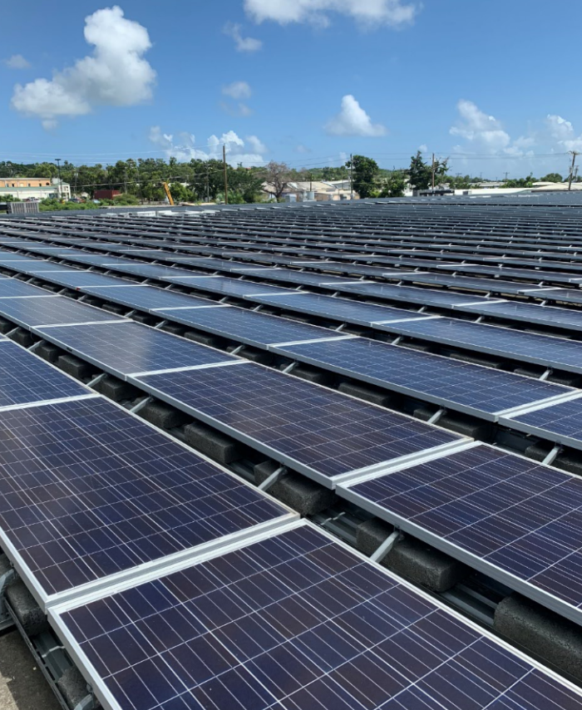
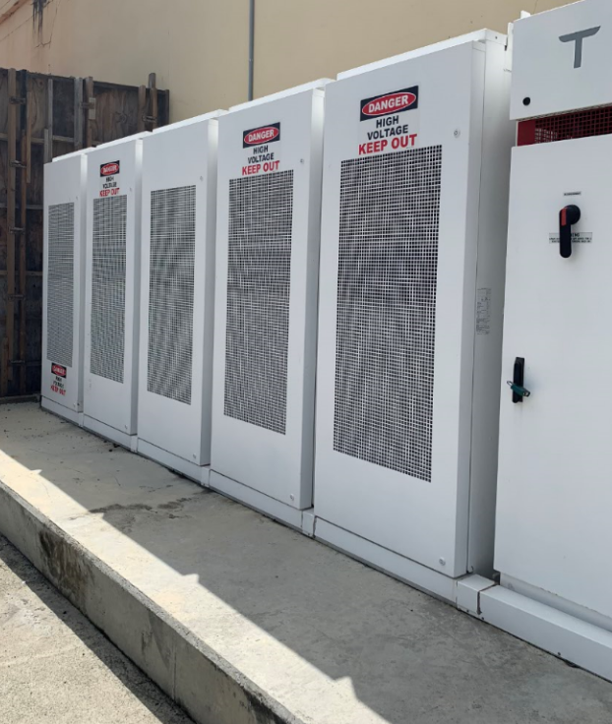
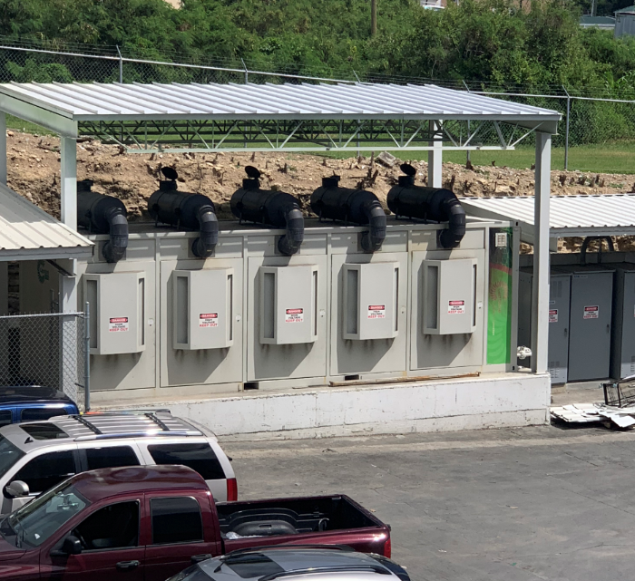
Caribbean Microgrid
USVI Microgrid – St. Croix
C1000 Turbine
750kW Solar
625kW Tesla Battery Storage
Onsite Propane Storage
Results
Microturbines run in parallel with the Solar PV and Tesla batteries
Utility grid is backup
Standalone site
Site “powered” through Hurricane Maria
Customer under 8 year FPP
Notes:
21

Slide 22
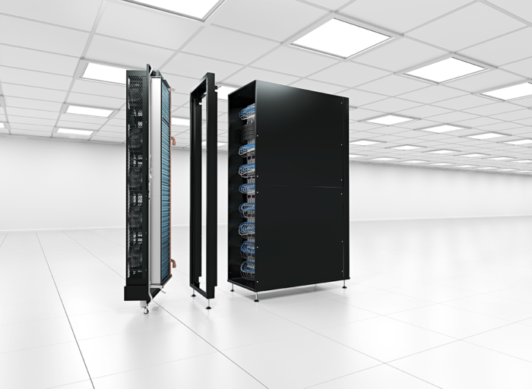
Modular Data Center Integration with in rack cooling capability

Slide 23
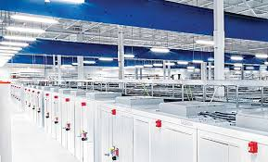
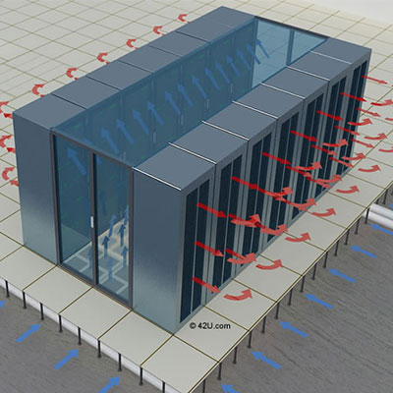

Proper air flow management within the data center is achieved through containing of the hot air on the back side of the rack row; hot aisle containment prevents mixing of cold and hot air and improves power usage efficiency of a cooling system. False ceiling is used for hot air return.
A modular data centre solution leveraging CW with absorption chilling is proposed. Absorption chiller runs on excess heat generated by the Capstone Micro-turbine and thus decreases overall PUE significantly compared to the situation where only electrical chillers or DX cooling would be used.
Generation approach uses highly efficient modular power equipment in its design to maintain efficiency at low utilization.
Distributed power topology is proposed with N+1 energy centre configuration once the data centre is expanded beyond the first phase of 1MW. This allows reduction of the number of power rooms and amount of power equipment (UPS, switchgear) from 10 sets to 6 in a total build out, while still providing 2N redundancy at the rack level. The final deployment of 5MW will have only 17% of unused power, compared to 50% for the 2N block redundant power design.

Slide 24
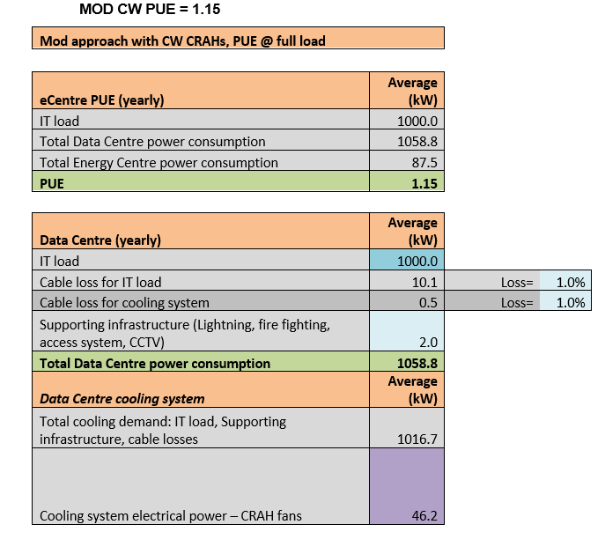
PUE Improvement under chilled water approach

Slide 25
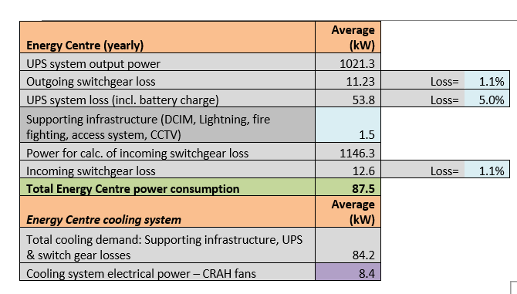
PUE 1.15 versus ~1.7 for traditional brick and mortar

Slide 26
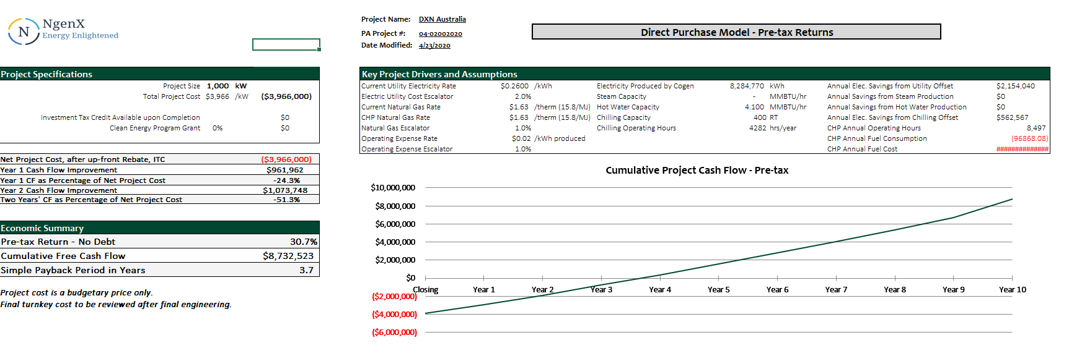
CHP Financial Assessment

Slide 27


Slide 28

Wrap Up

Slide 29
Thank you
Questions?

