Slide 1
Economic Development opportunities in Ghana
Presenter: Elizabeth Larios
Contributors: Rendon Farrell & Sarah Buxton/Plange

Slide 2
Ghanaian Structure
Africa= Continent
Ghana= Country
Regions= States
Accra= Capitol/ Big City
Surrounding Small Cities= Towns
Rural Towns= Villages

Slide 3
Accra
When Stayed in Accra
In a gated community
Across from Moama’s home
Home valued at more than 400,000
Owner retires from London
Has “house help” take care of hime when she is out of town.

Slide 4
Services provided
Prison Ministry
Village Visits including Women entrepreneurship focus groups
Sinchi
Kokrobitey
Royal Kromain
School partnerships

Slide 5
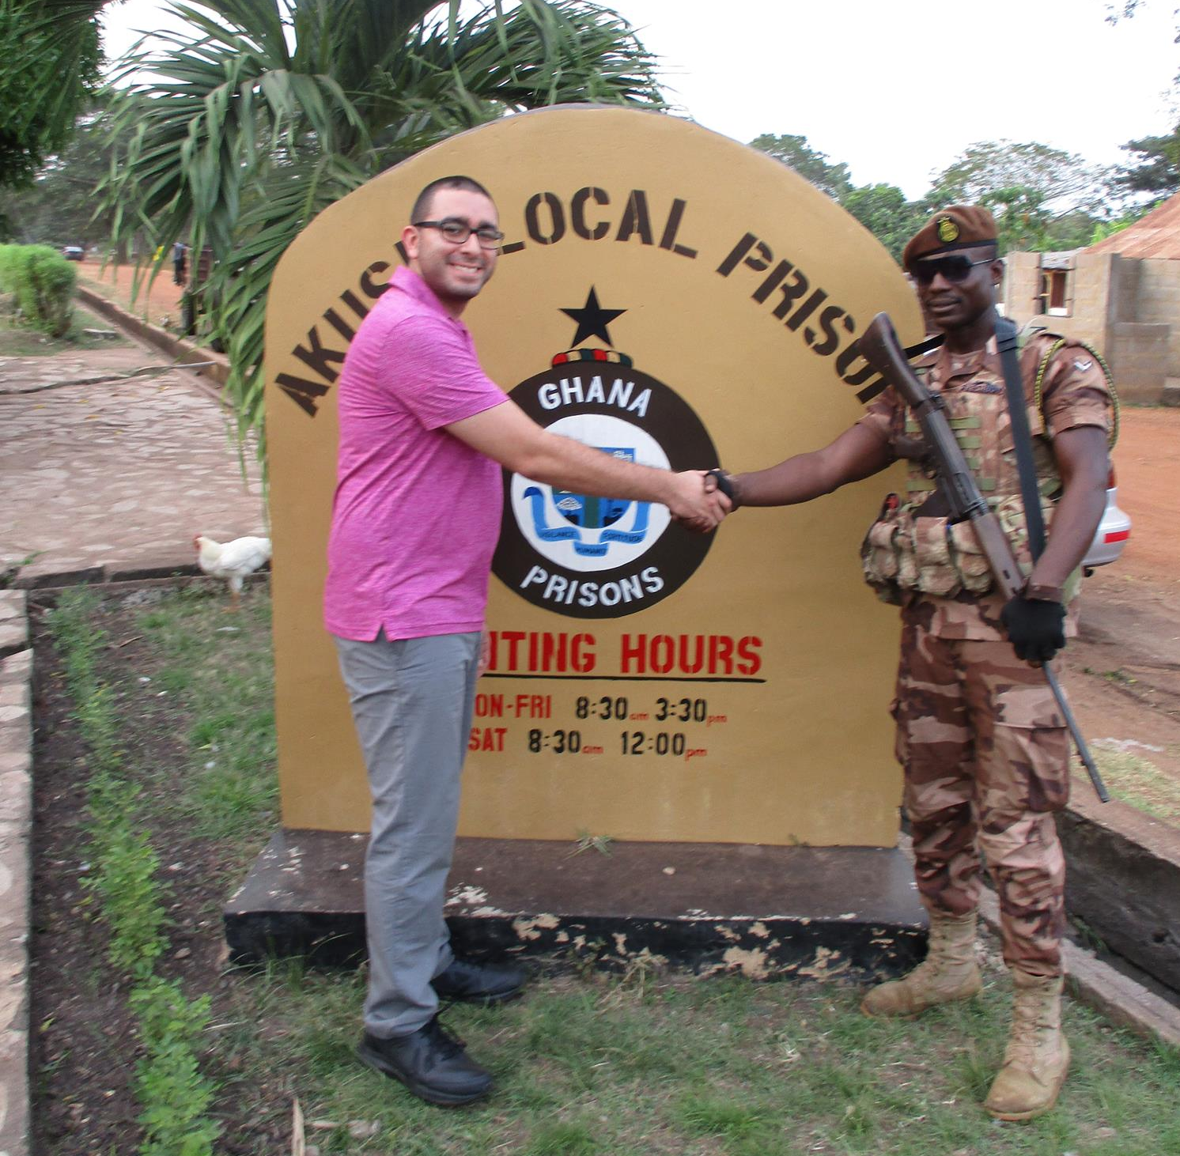
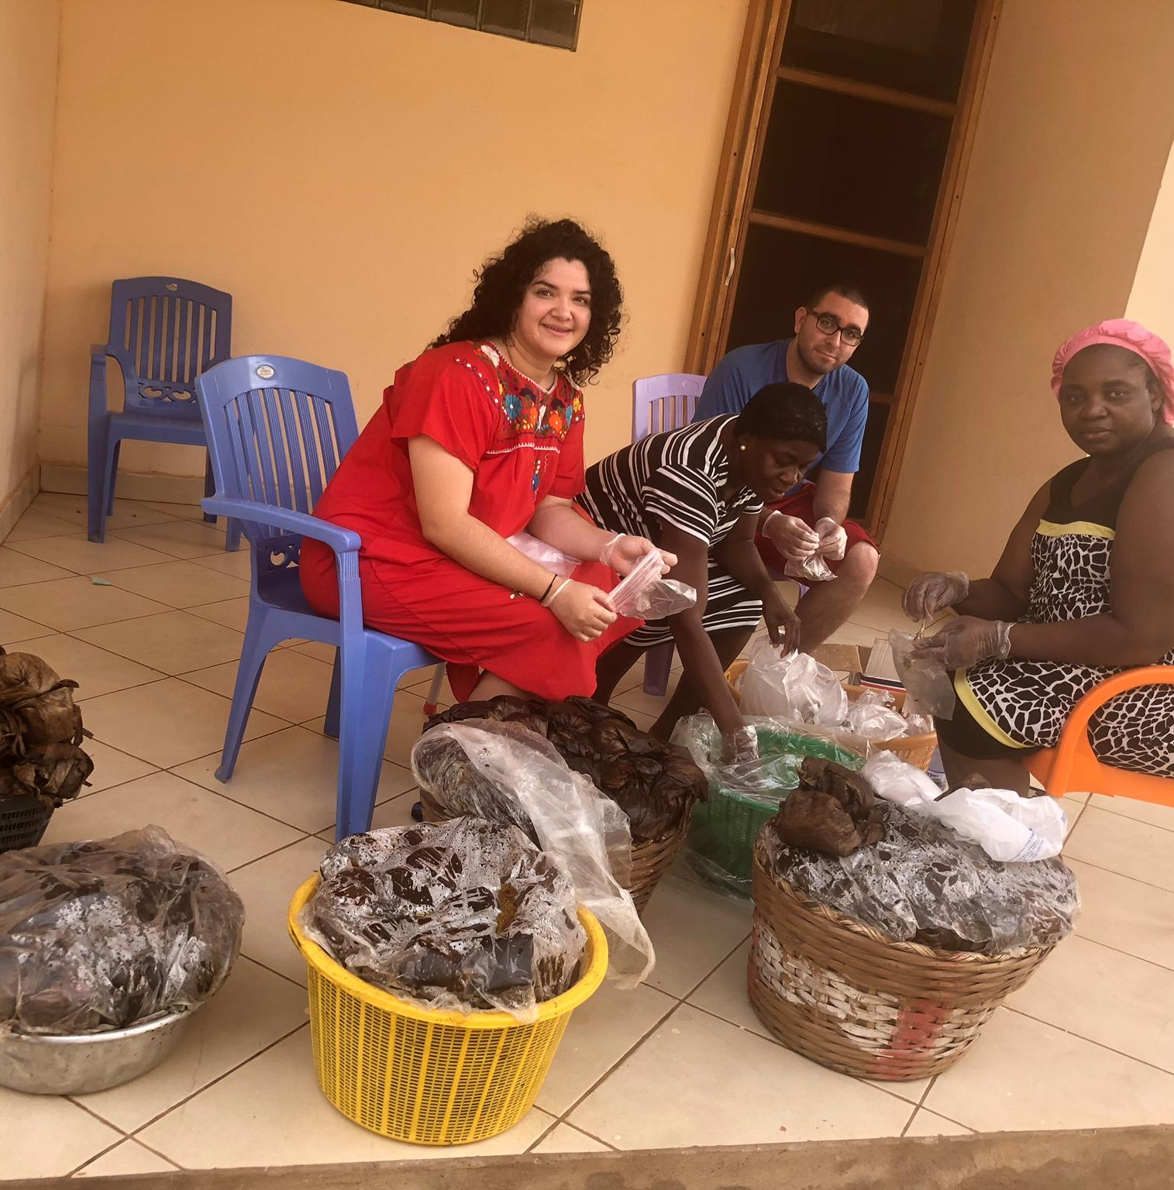
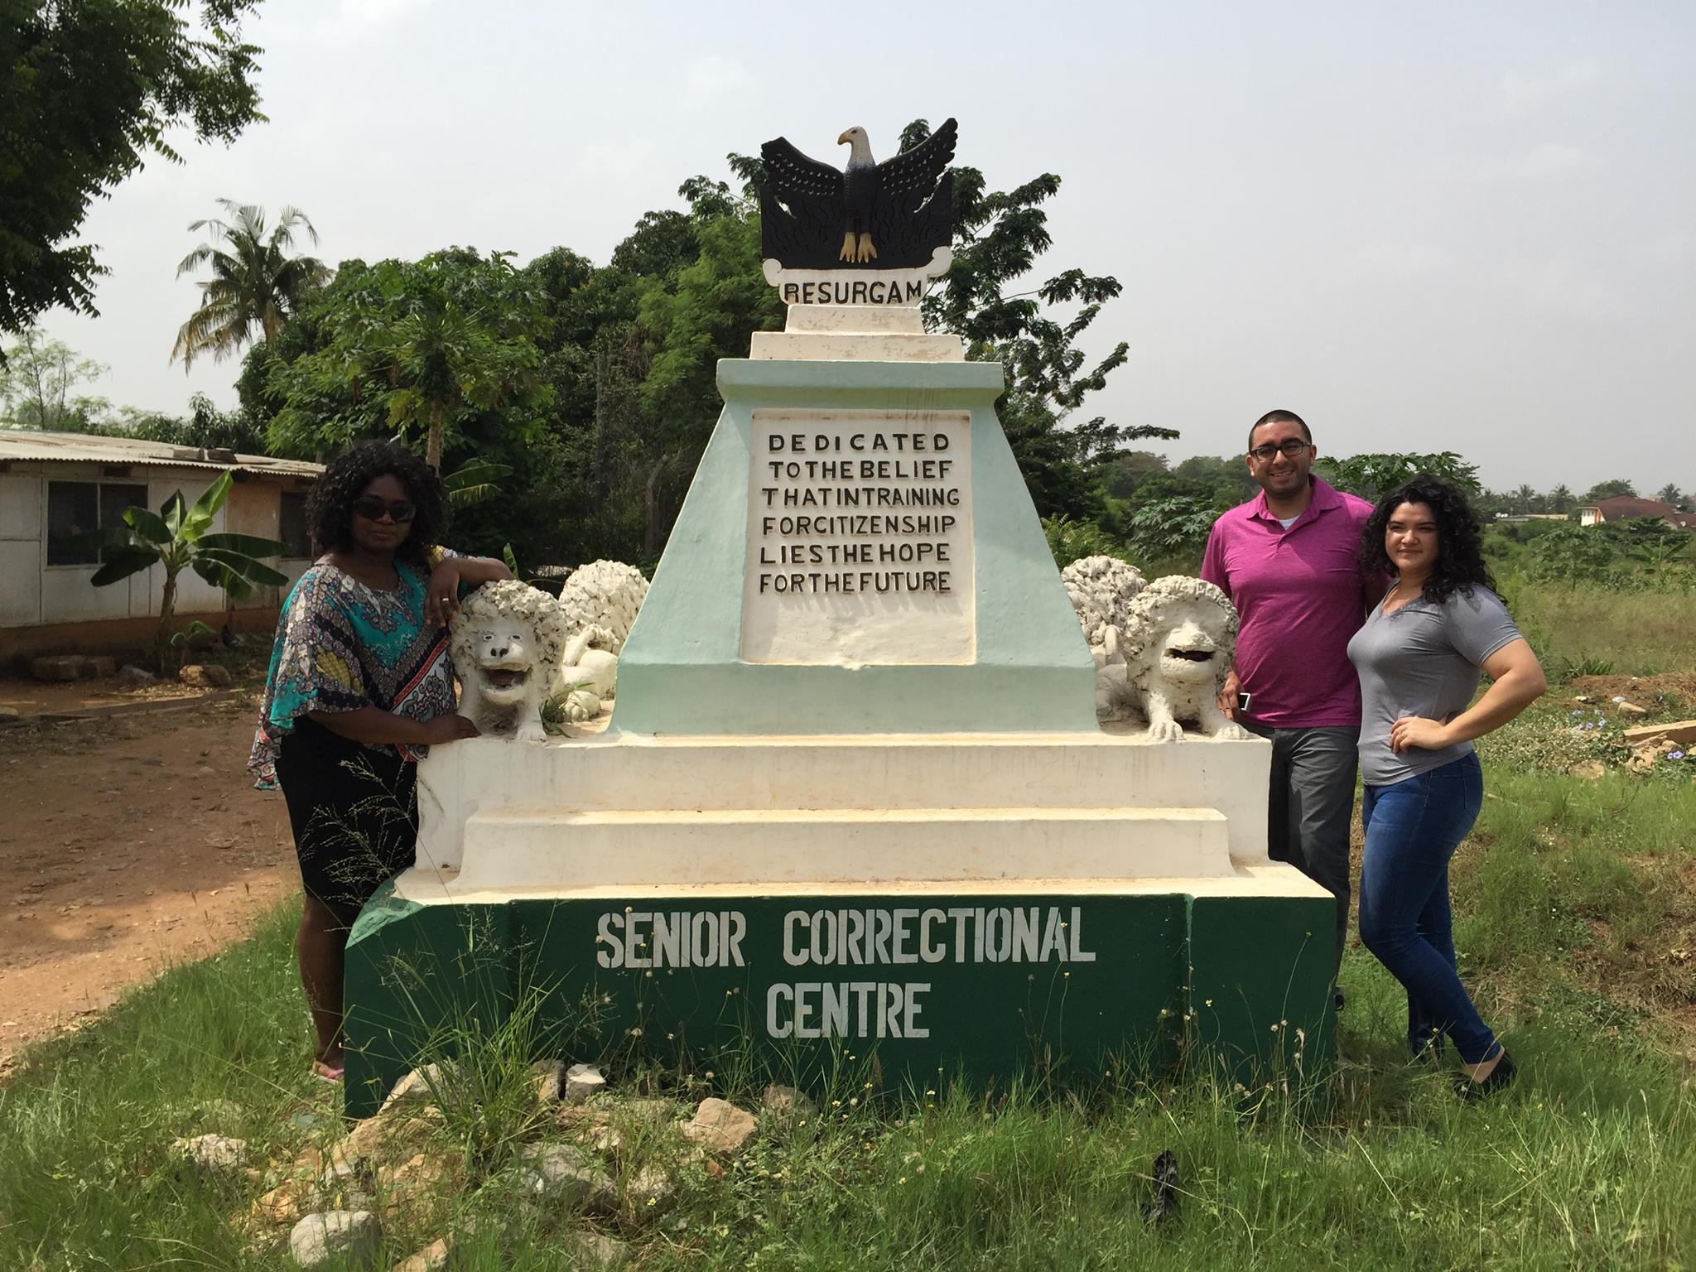
Prison ministry
Visited and encouraged juvenile detention center with bread and message
Met with prison warren and discussed prison structure and needs.
Fed 250 prisoners
Federal funding consists of 1 Cedi per person per day.
Fed once a day.
Need fencing for recreation and technical learning.

Slide 6
Sinchi
On the Volta river
(largest river in western Africa)
Big opportunity for tourism
Close to a port
Future plans of entrepreneurship center
Very small businesses
Very small community
Very hard working willing ladies

Slide 7
Kokrobitey
Fishing Village
Business opportunities are endless

Slide 8
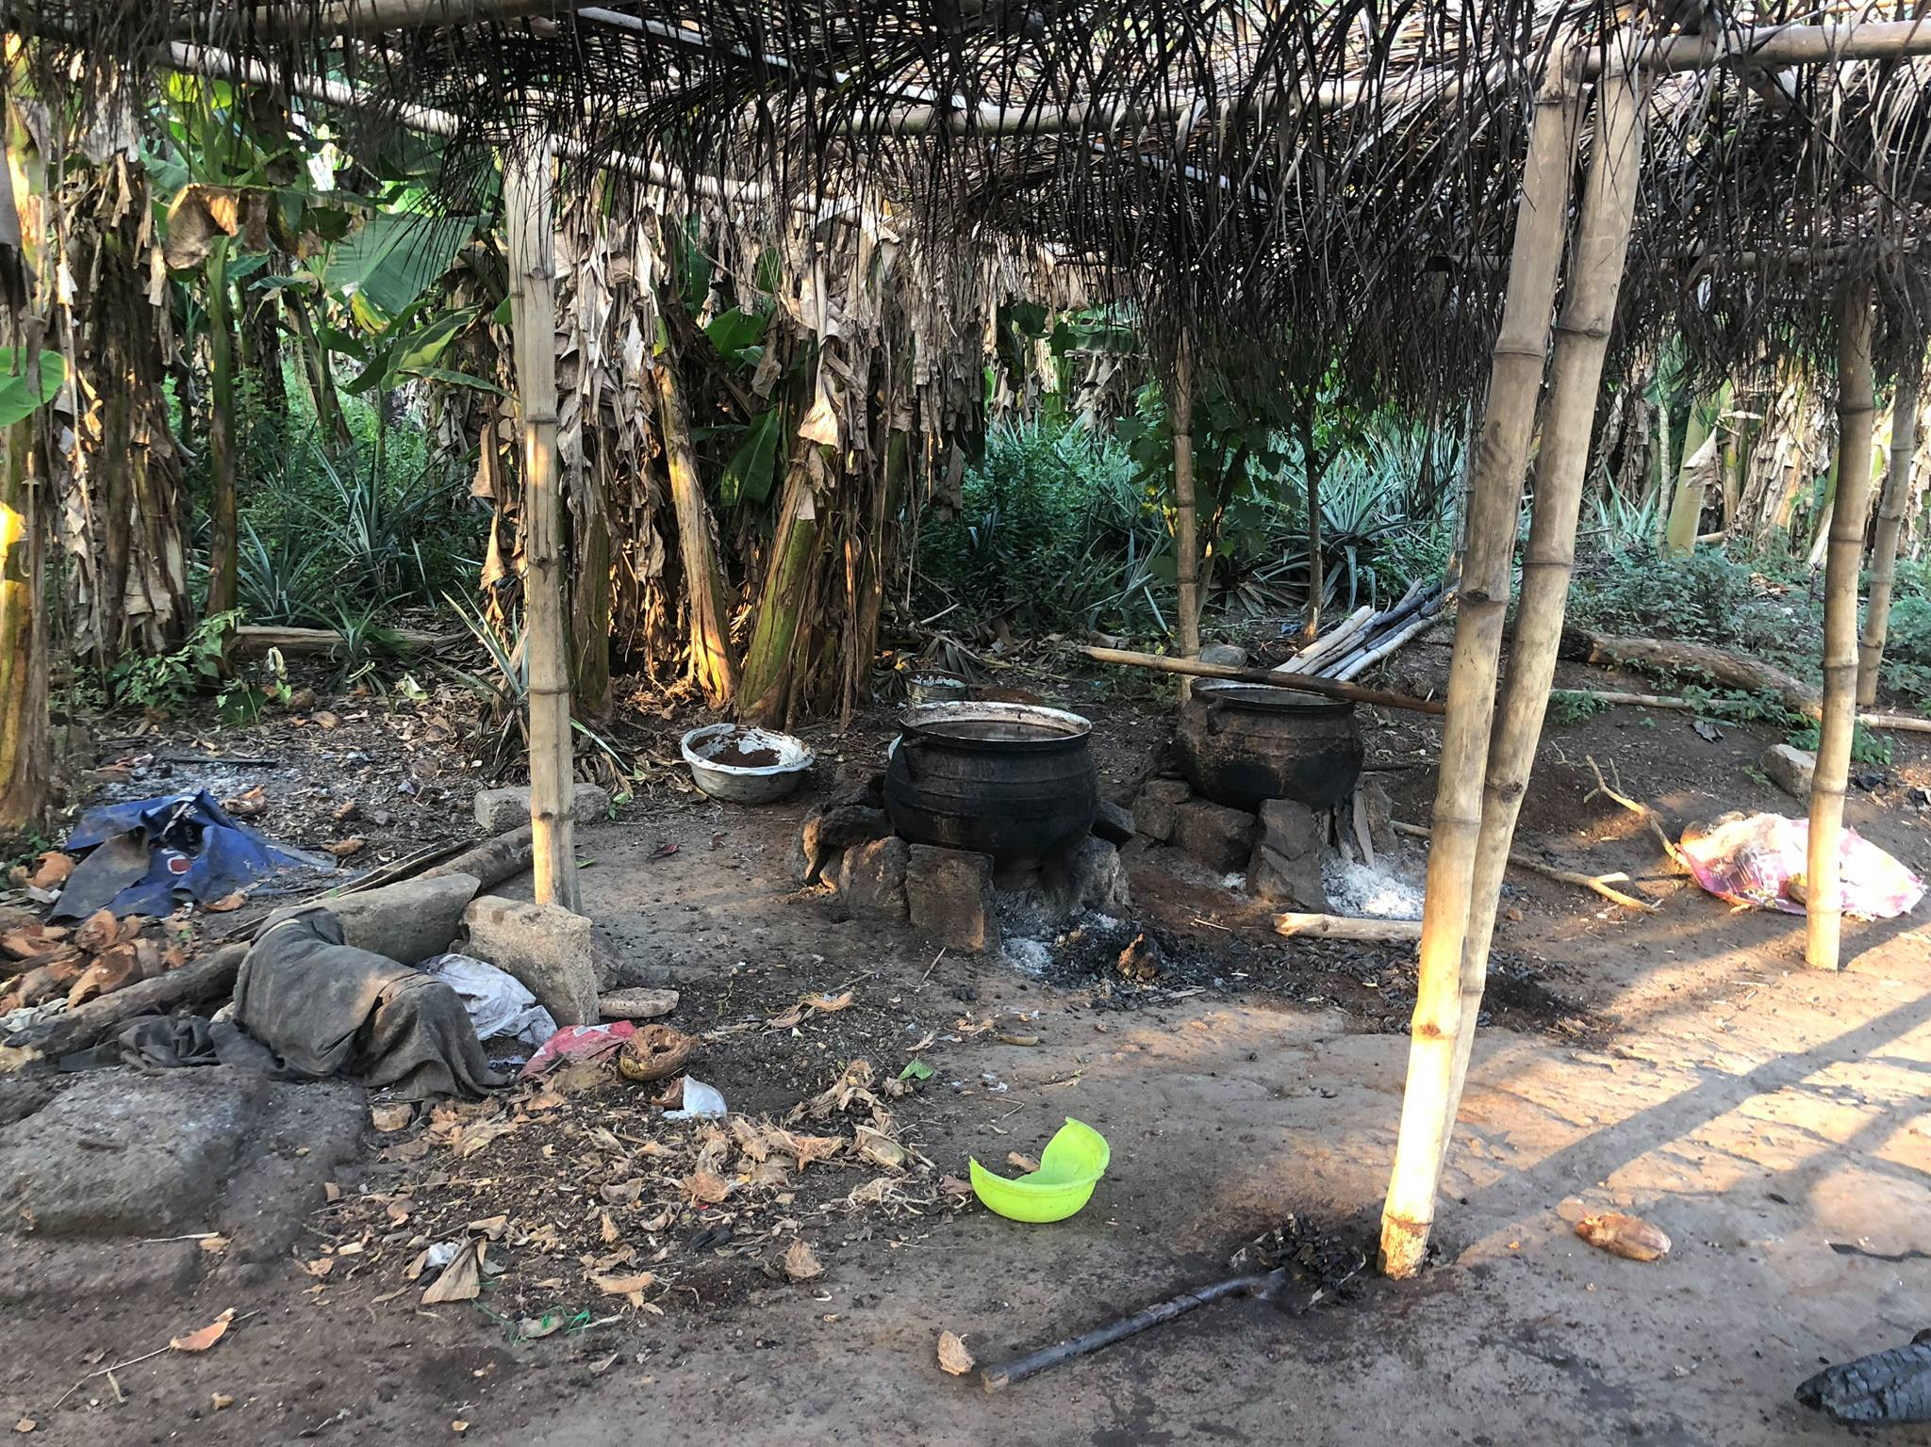
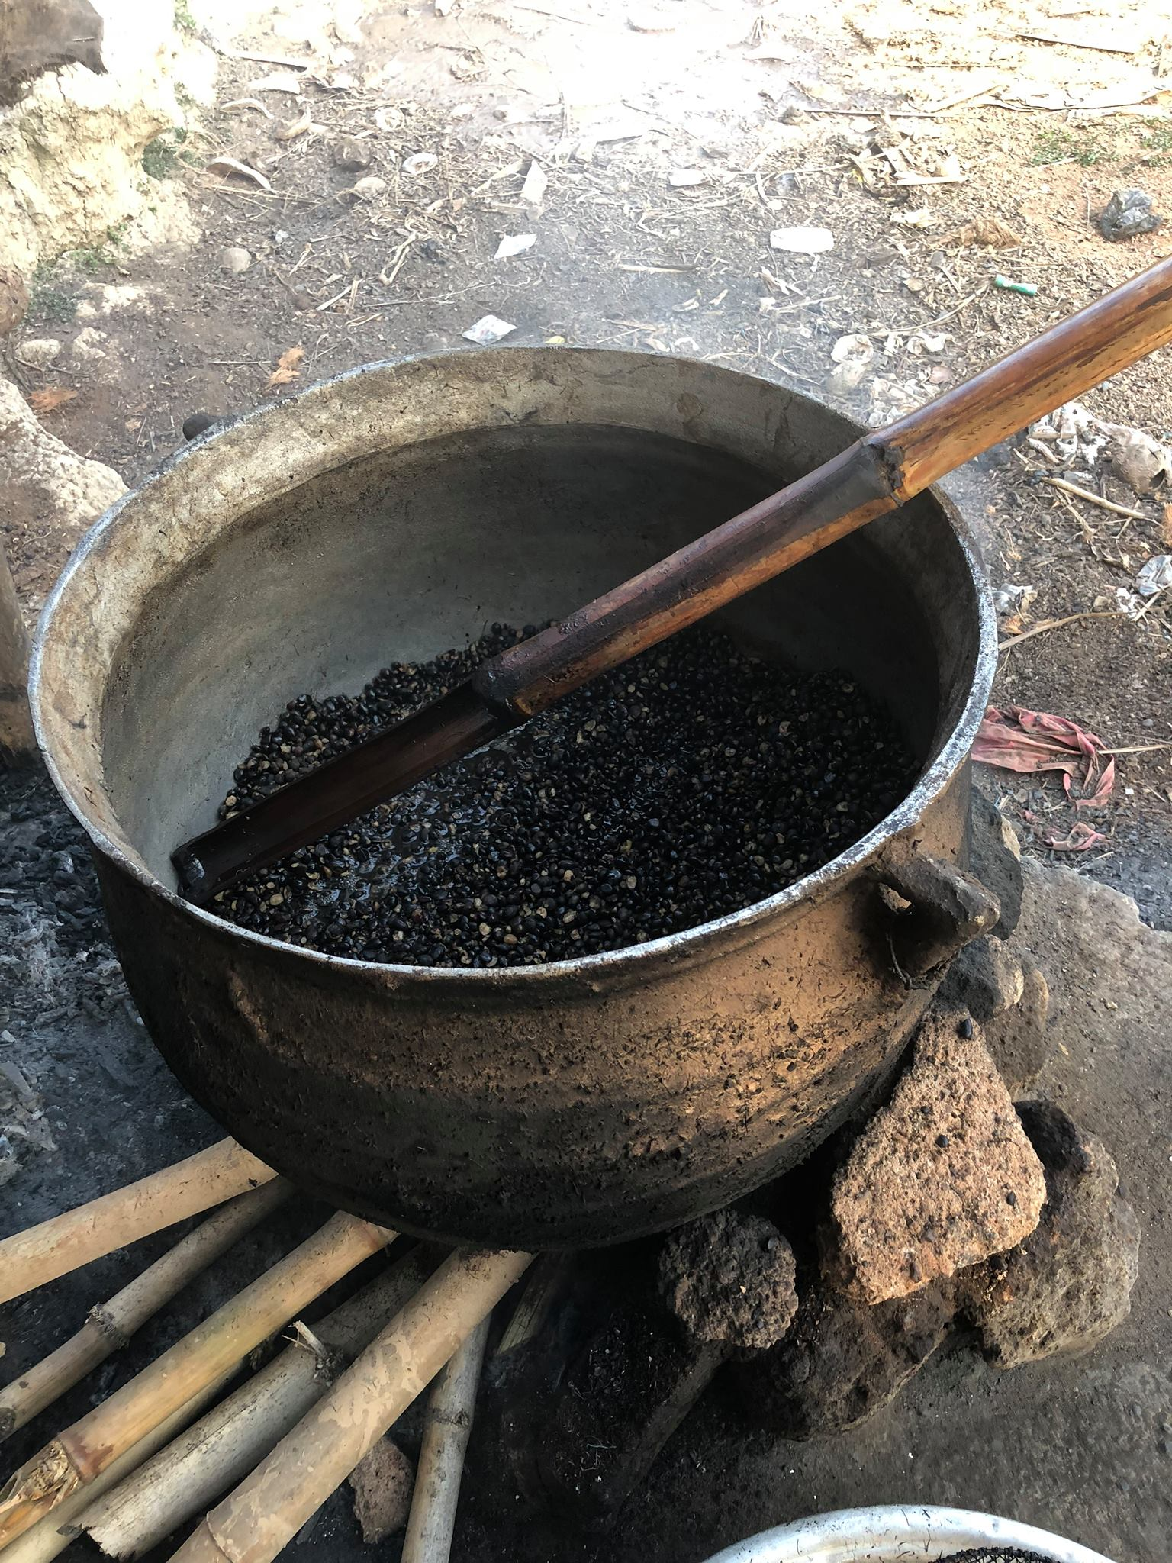
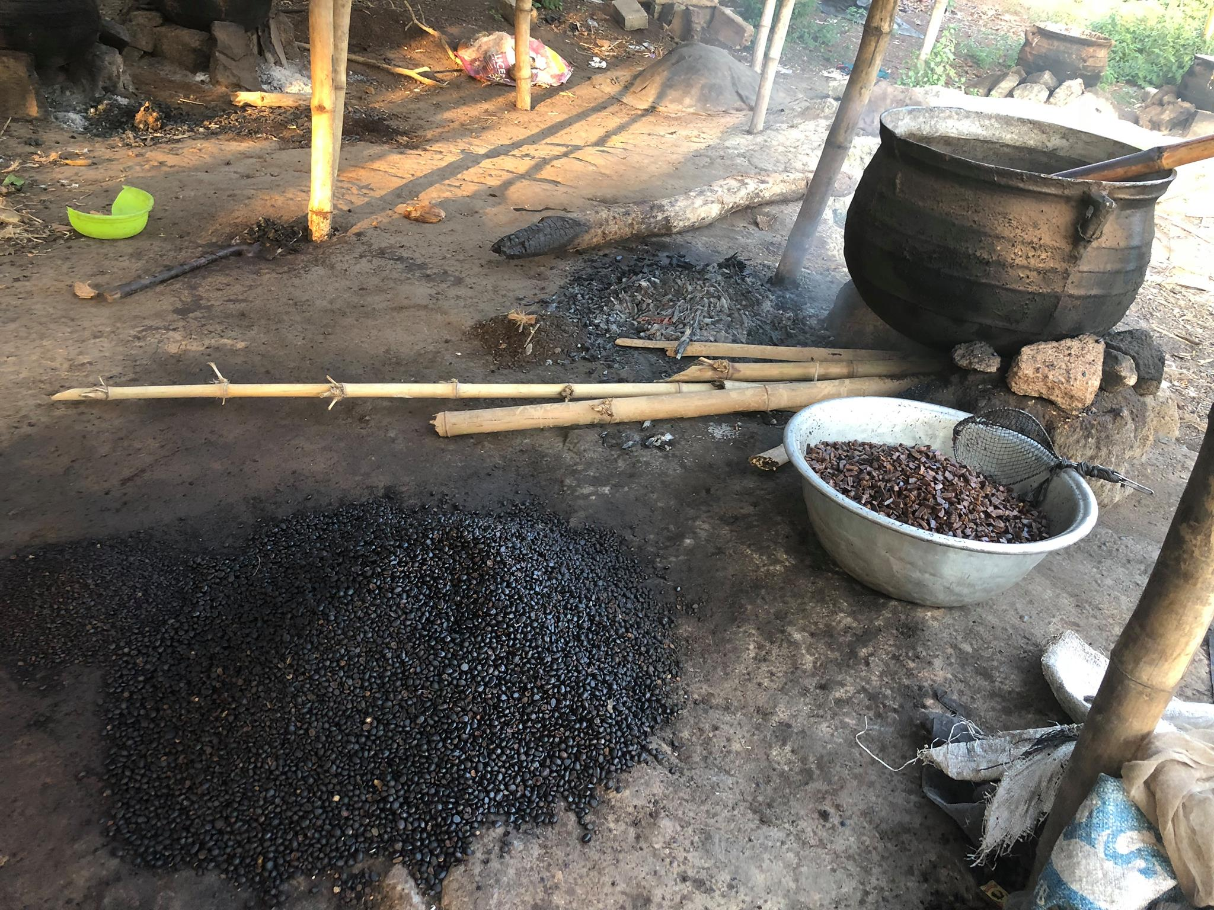
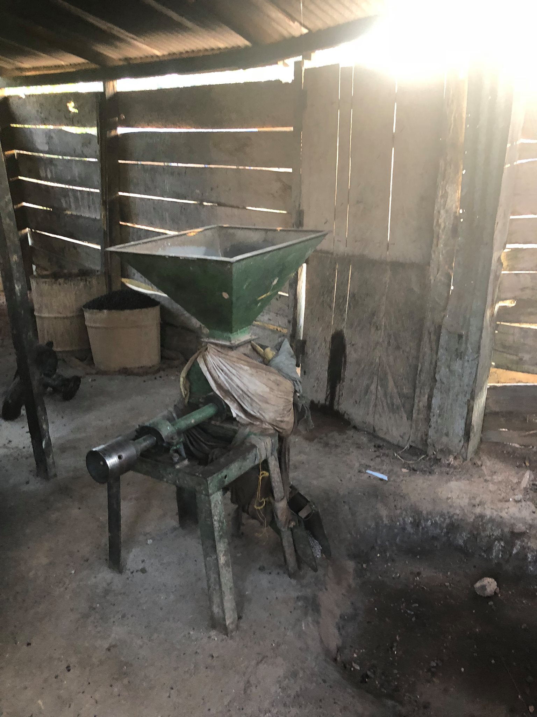
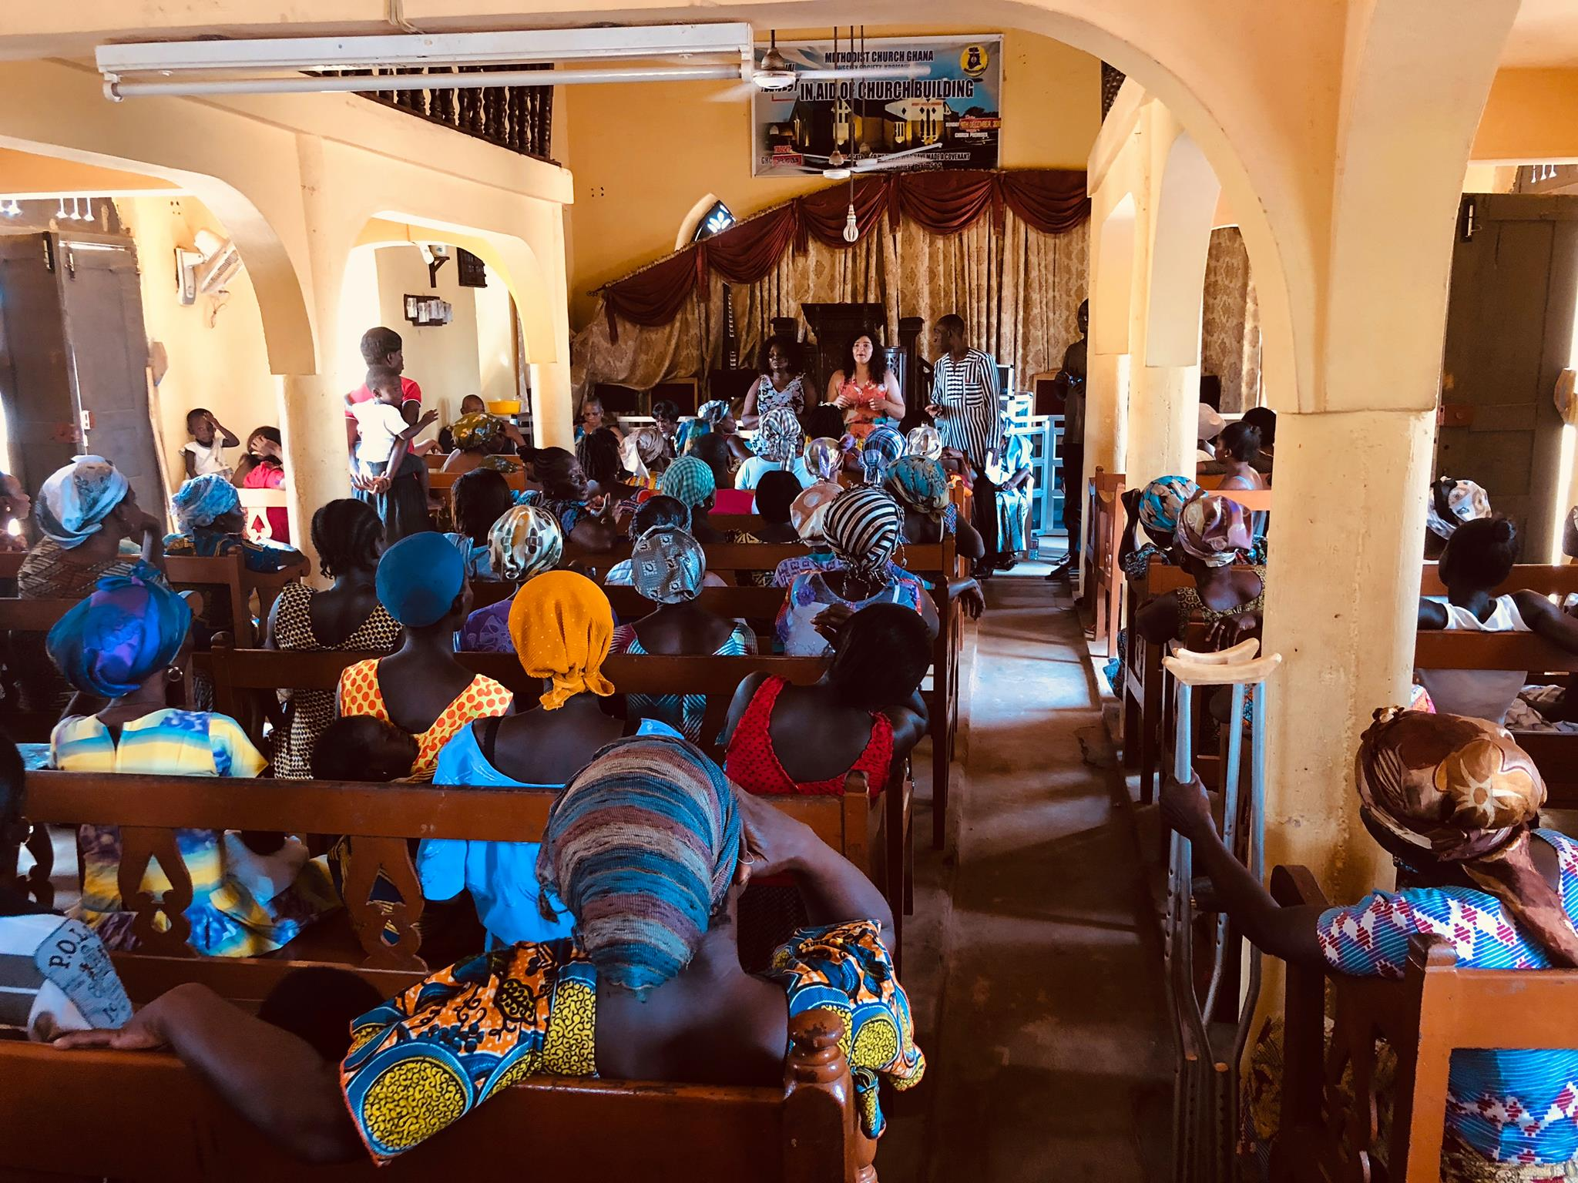
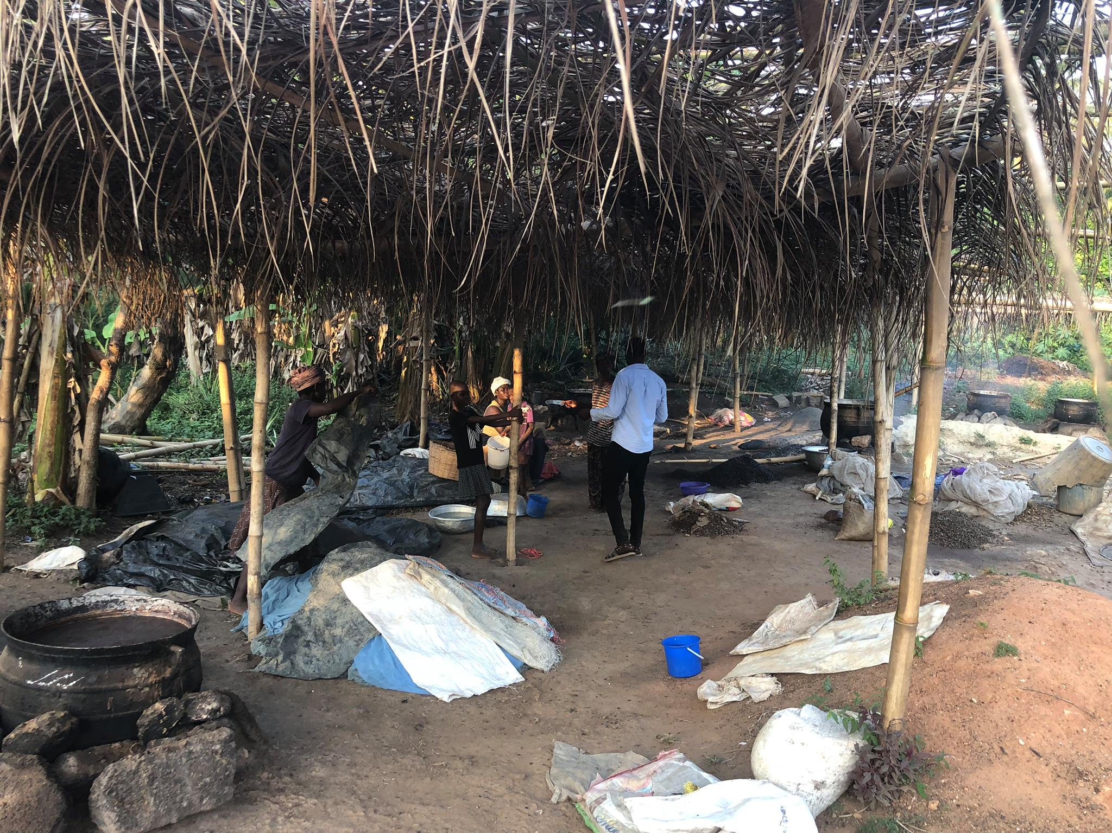
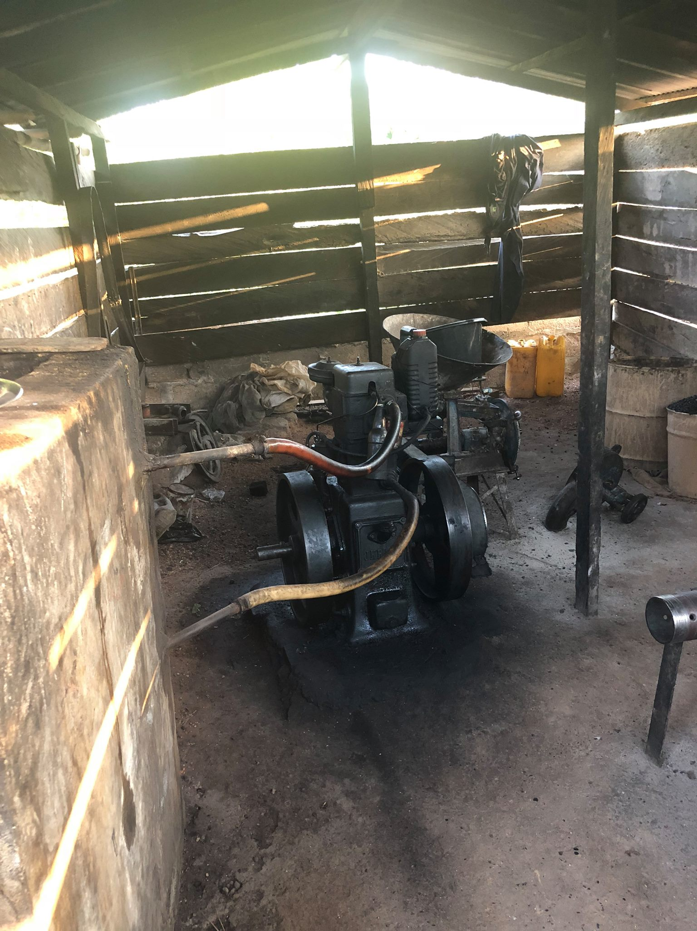
Royal kromain
Oil manufacturing
Machinery
Small, willing yet divided…

Slide 9
School partnerships
Upper Sinchi & Krokro Bité

Slide 10
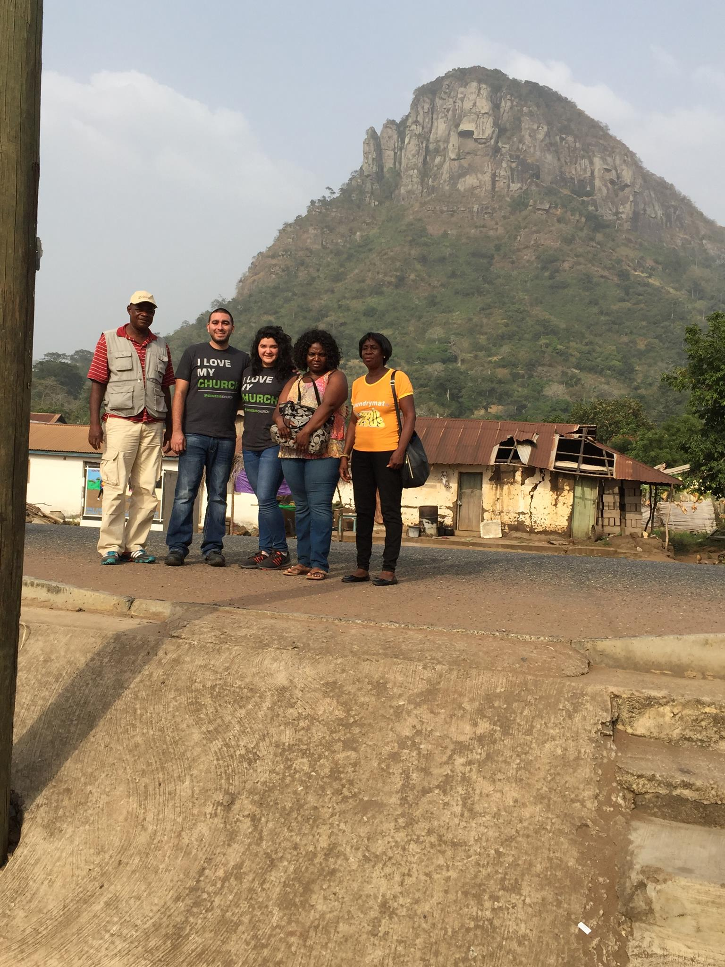
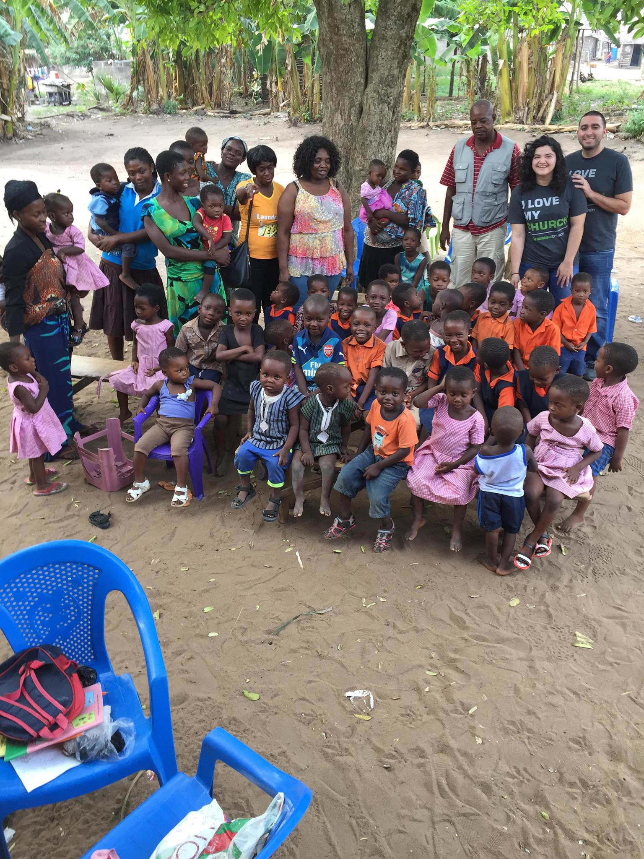
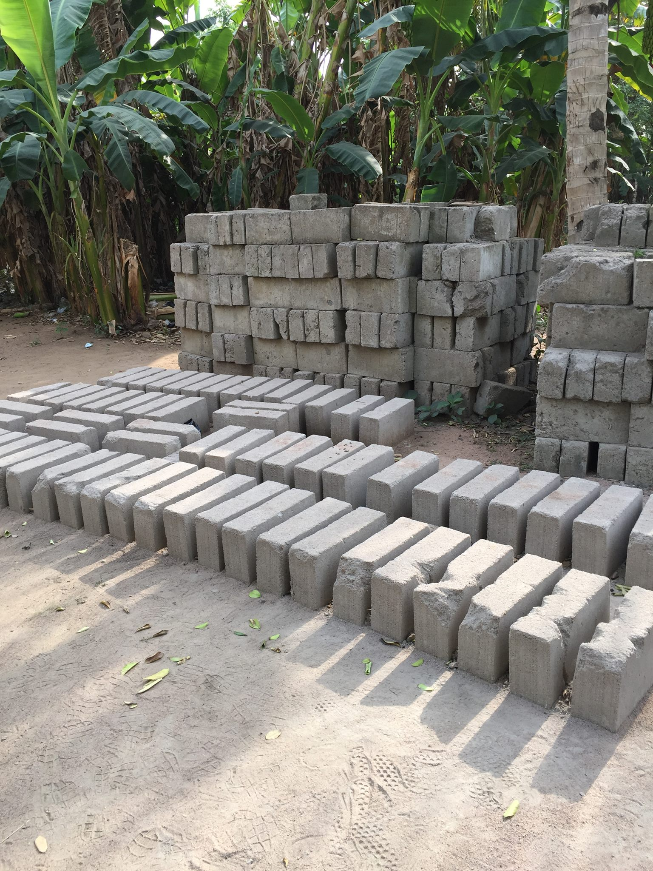
Adakuro
Other side of the river
Under a tree
Foundation ready to go

Slide 11
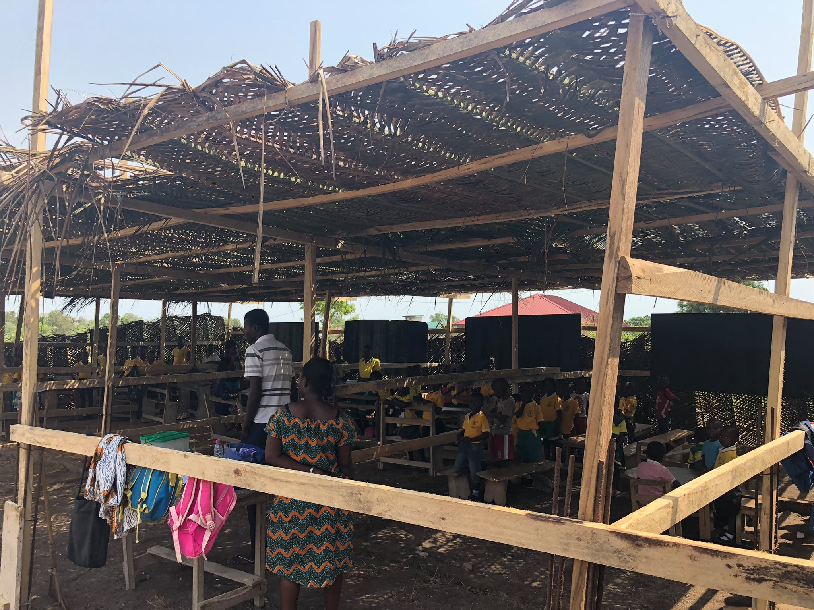
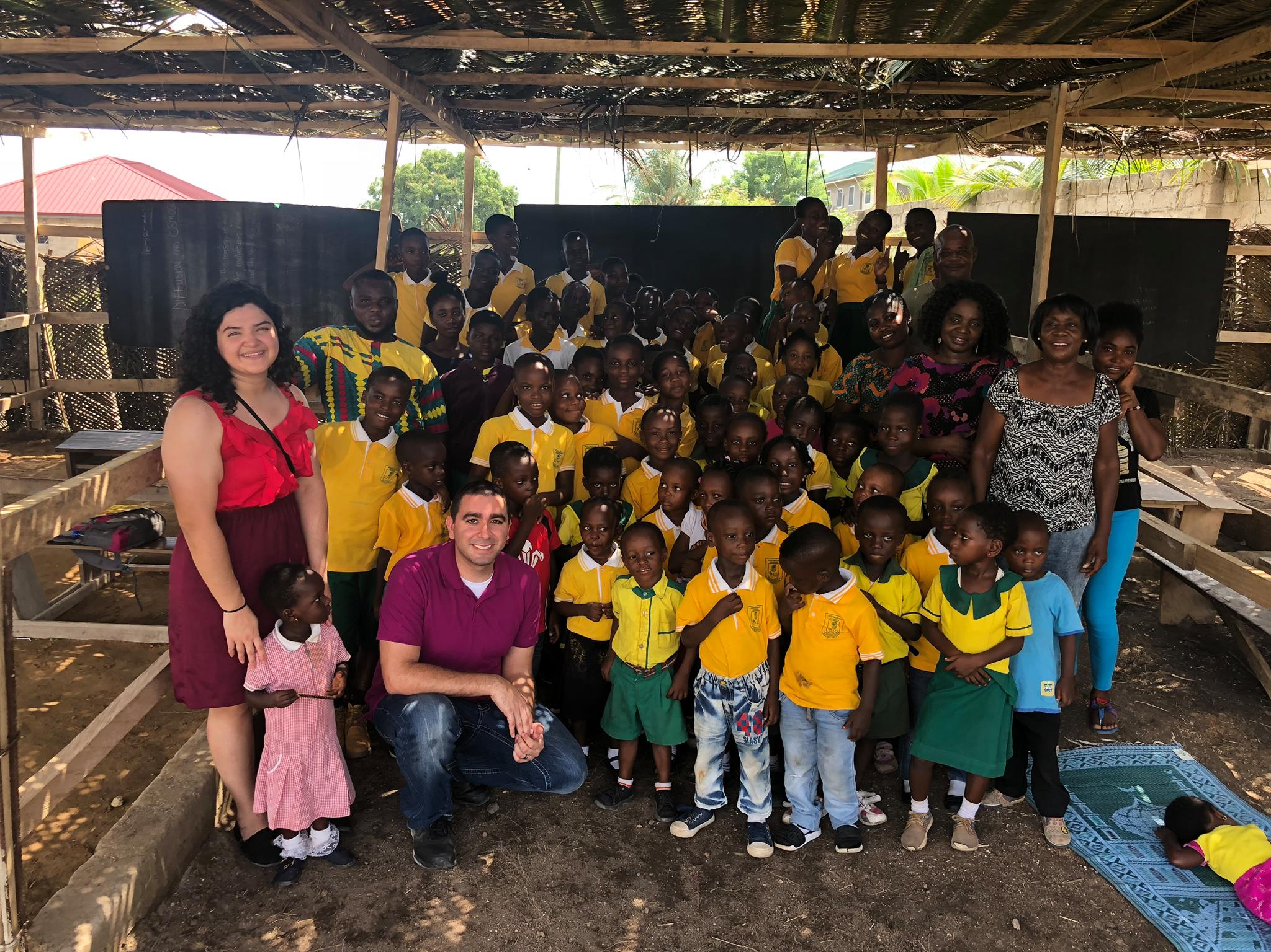
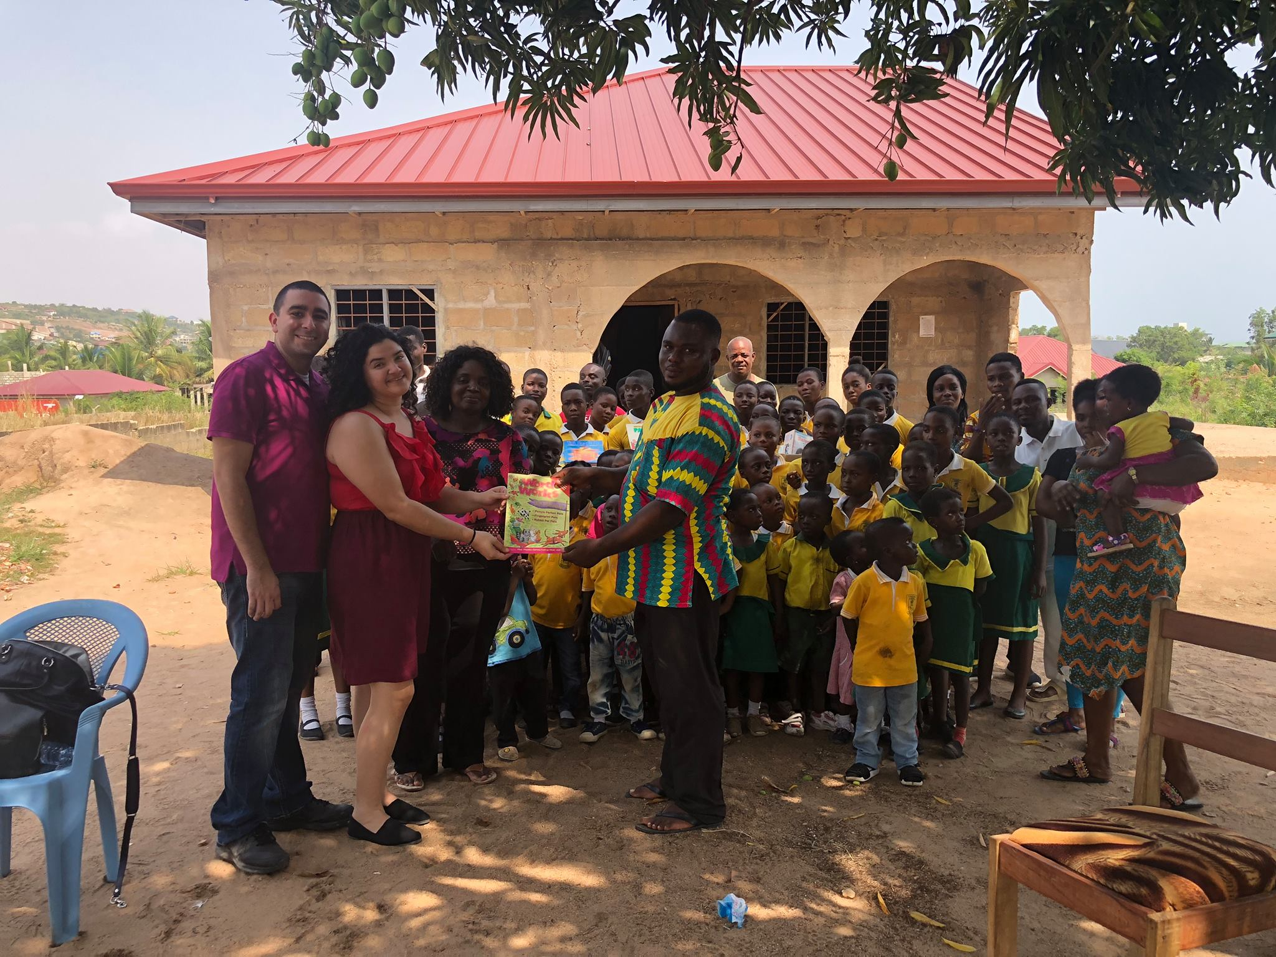
Krokro bité
9 grades under one roof
5 cedis a day
Dozens of educational materials donated

Slide 12
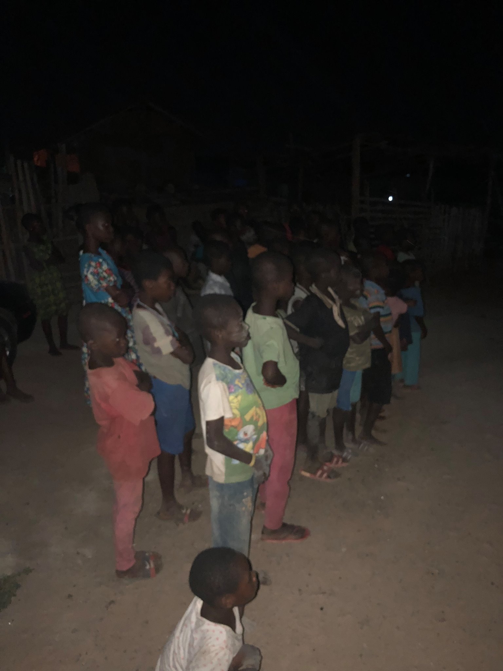
Additional ministry
Royal Kromain Passion of the Christ movie screening
Accra woman’s focus group

Slide 13
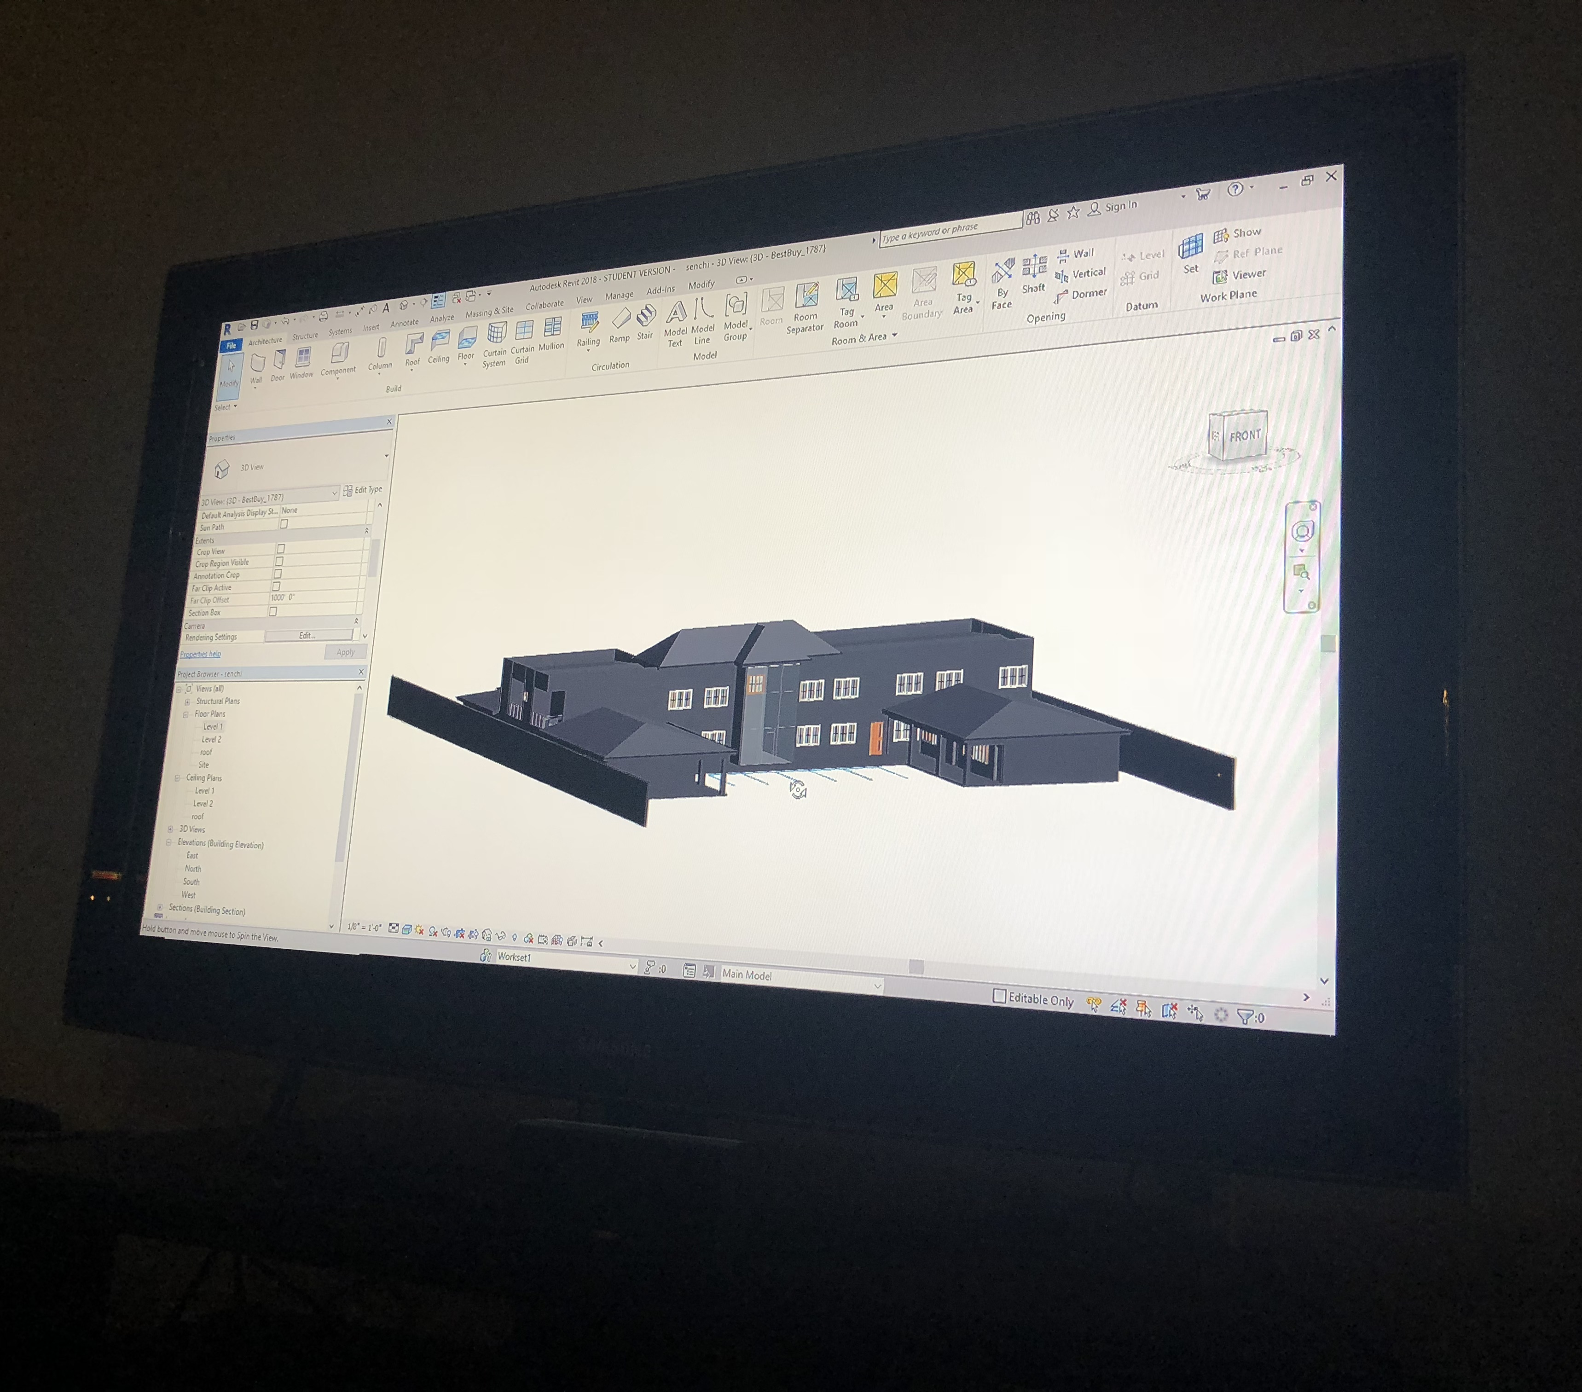
Future plans
Woman’s Entrepreneurship Center

