Slide 1
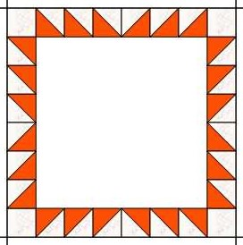
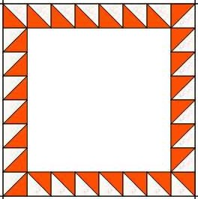
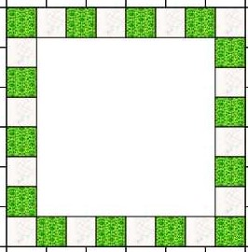
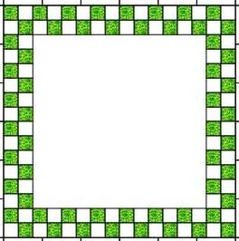
Border Along and Around
Border 1 – February 2020
2” Finished Border
Option 1A
Option 1B
Make 24 – 2” finished Half Square Triangles
Cut 4 2.5” squares for your corners
Make 28 – 2” finished Half Square Triangles
Option 1C
Option 1D
Cut 14 – 2 ½” squares from Color A and 14 – 2 ½” squares from Color B
Make 28 2” finished Four Patches. Start with 1 ½” squares or strip piece and subcut to 1 ½”
Option 1E - Design your own border; it must be 2” finished in order to fit with the subsequent borders

Slide 2
2” Finished Half Square Triangles.
Traditional method, cut 12 background and 12 foreground squares at 2 7/8”; place right sides together, draw a diagonal line and sew ¼ on either side of the line.
Easy Angle – Cut 2 1/2” strips and use the EZ Angle ruler to cut your triangles.
Magic 8 – for Option 1A, cut 3 - 5 3/4” squares of both background and foreground fabrics . Draw two diagonal lines; sew on either side. Cut horizontally and vertically at 2 7/8” and then cut on the diagonals. For Option 1B, you will need 4 additional HSTs.
2” Finished Squares
You will need approximately 35” inches of each color fabric cut into 2.5” squares
2” Finished Four Patch Blocks
Cut 56 – 1 ½” squares of both background and foreground fabrics – OR– cut 90” of 1 ½” strips, sew together, press to the dark and then cut 56 rectangles at 1 ½”. Sew together into four patches
Assembly
Sew together the squares you have made for the right and the left sides of your center block; there will be 6 squares for each side, following the diagram on the front side of these instructions. This strip should measure 12 ½ “. Sew to each side and press away from the center.
Then sew together the squares for the top and bottom of the block. The squares at each end will need to pressed to the center of the strip. These strips should measure 16 ½”. Sew to the top and bottom and press away from the center.

