Slide 1
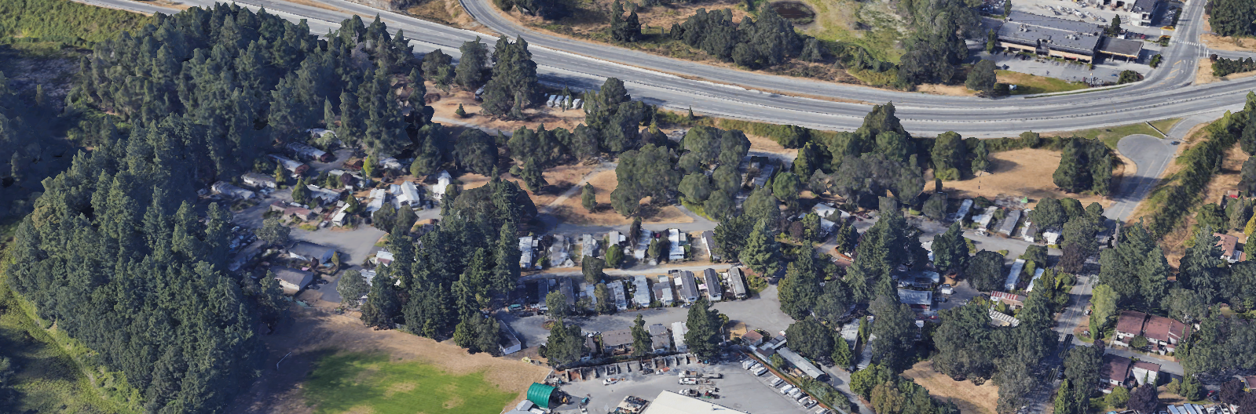
Triway Developments
Introduction and Path Forward

Slide 2
WELCOME!
Thank you for joining us. We are here today to introduce ourselves and give you an overview of the Tri Way MH Park status and what to expect over the next few months.
A big Thank You to the Tri Way Residents Representatives who are taking a proactive approach to ensuring that residents needs, and concerns are heard.
PLEASE HOLD YOUR QUESTIONS TO THE END. You will find many of them will be answered throughout this presentation.
Join us in the lobby for a meet and greet after this meeting.

Slide 3
The Triway Development Team
Jim Hartshorn – President
Robin Achen-Waugh – Logistics and Coordination
Rachael Sansom – Resident’s Liaison
Contact us!
info@triwaydevelopments.ca or 250-384-8024 Extension 300

Slide 4
Current Park and Project Status
The property is under contract to Triway Developments (Not sold)
The rezoning of the land on both sides of the highway to a mixed use Commercial and Residential designation is underway – a 6-month process at minimum. Examples of mixed use in the community include Belmont Market and Eagle Creek (by VGH). Modular/Mobile Homes will be a permitted use in the new zone.
The current Tri-Way Park area will be protected by a Legal “Covenant” that does not allow development of the Park area until Park Residents have been accommodated in accordance with Langford Policy and Provincial Laws.

Slide 5
What does that mean????
The Legal Covenant buys everyone time.
The rezoning of the lands around the Park can proceed while resident’s needs are identified, and a real relocation or compensation plan is agreed to. This will be an extensive and detailed process and we need to get it right for everyone.
Triway Developments cannot honor any agreement with any Park resident until the lands are purchased. The purchase does not occur until the lands are zoned.
The Covenant cannot be removed without the City of Langford Mayor’s signature, to ensure that their policies are upheld.

Slide 6
Rezoning and Covenant Area
Park area to be protected by Covenant (all 78 units)
Extent of Lands to be Rezoned
Future Park area to be determined by Autumn 2020

Slide 7
When will decisions be made?
If the zoning is successful and the purchase of the lands completes, Triway Developments will be in the position accommodate residents.
This could be as early as Autumn of 2020.

Slide 8
In the meantime…..
We have work to do! Triway Developments intends to offer residences a variety of options that may include:
Full compensation in accordance with the law; or
A chance stay or relocate within the existing park; or
Assistance with a move to subsidized housing; or
A purpose-built apartment or condo on or near the Park.
Or other options that become apparent through the Residents needs analysis

Slide 9
When will we see the options?
Before Triway Developments spends time and effort on the opitons analysis, we need to know what your specific individual needs are.
Everyone’s needs are different.
In order to treat everyone fairly, we need to know what your needs are.

Slide 10
Individual Needs Analysis
Tonight, you will receive a questionnaire to fill out that lets us know what your lifestyle needs might be, and what you enjoy about the park currently.
This, and any other personal information and will be kept confidential.

Slide 11
Individual Needs Analysis - Interviews
We wish to interview every resident to further understand your needs. Rachael will be at the Park several times a week and will be able to meet each resident privately for 20-30 minutes.
Appointment times can be scheduled through the Triway office.
Bring your form and a friend or relative if you wish.
These interviews will run from January to the end of March, to ensure everyone has an opportunity to meet.

Slide 12
Options for Residents
Once we have an idea what Residents want and need, we will prepare a series of options for your consideration.
We plan to start this process in April 2020, once the interviews are complete.
We will present these findings to the Residents in the Spring of 2020 at another meeting.

Slide 13
How do I know what’s right for me??
More Interviews!
Some residents will know what they want, however you may need assistance choosing the best option for you. We are here to help you work through the process to determine the best fit.
It is our intention to ensure each resident clearly understands how they can be accommodated for their individual needs and circumstances.

Slide 14
When do I have to decide?
Ideally, each resident will have selected an option by September 2020.
Triway Developments will need to start installing sewers and planning for the park changes once the property sale has closed.
There will be no change to the Park however, until the Autumn of 2021.

Slide 15
What if I want to leave now?
Unfortunately, Triway Developments is not in the position to offer residents the “buy out”, or any other option until it owns the lands.

Slide 16
What’s next?
Consider the questionnaire and fill in as best you can.
Talk to friends and family members.
Make an appointment to meet with Rachael through the Triway Development Office. Bring the questionnaire with you to your interview.

Slide 17
Recap
Triway Developments is working hard to ensure that this is a fair process where you will have a number of options for the future.
This is not a rushed process. You have lots of time to consider your needs, assess your options and make a decision.
Triway Developments will meet regularly with your Residents Representatives to keep the lines of communication open.

Slide 18
For More Information
Triway Developments will set up a website with Frequently Asked Questions (FAQ) that will be updated with general information. www.triwaydevelopments.com
Please call the office and leave a message: Someone will get back to you on the next business day. 250-384-8024 Extension 300.
Email info@triwaydevelopments.com at anytime. Your email will be answered on the next business day.
Please pick up a contact card from Robin before you leave today.

Slide 19
QUESTIONS??

