Slide 1
Theories of Change Worth Believing in
Workshop II:
Making Theories of Change

Slide 2
TABLE OF CONTENTS
01
03
Historical Roots
Practice
02
04
Vocab & Concepts
“Homework” & Third Workshop

Slide 3
About Erik & Western Eval
Erik Dutilly (PhD Education) started the Western Institute for Education Evaluation and Consulting (Western Eval) to provide technical support to organizations working on the most pressing social problems. We work with you to create solutions to education, health, and social problems. Our goal is to leverage evaluation to create a better, safer, and more just world.
WesternEval@gmail.com
(720) 261 - 0602
Notes:
“The reason I began this presentation with those beautiful images and questions is that I think and worry about these big problems. I worry about global climate change, the mistreatment of cultural minorities, and how a community should raise its youth and how youth should be obligated to contribute to society. Like most of you who are passionate about some topic or problem, I want to accompany you on the quest for solutions. My skill set consists of training in research methods, program evaluation, and program design. This is what I can offer the world on our battle against persistent social problems.
To show how grateful I am to have you all here, I want to make you an exclusive offer. Everyone attending can reach out to me and schedule a free 30 minute video or phone call. I’m happy to give advice or talk through any problems. Those 30 mintues are yours.”

Slide 4
What you will learn
Theories of Change (ToC) have two historic roots
ToC Vocabulary, forms, and concepts vary widely
How to build ToC from partial examples and scratch
Documented shortcomings of using a ToC
Future Model
Old Model
New Model
Original model, handed down from the national IHDF model. Qualities of a former way of thinking
Invoking contemporary thinking, new state of science, distinct philosophical commitments.
Qualities of a new way of thinking. Perhaps including previous ideas, perhaps breaking new ground.
Notes:
On the pathway to creating Theories of Change worth believing in, we have to take some begging steps and establish some basic and shared ideas. To that end, today you’ll learn about ToC, that programs almost always have some kind of theory, the role of Grand or Big Theories in your work, and how grand theories and program theories relate to each other. The basic idea is that grand theories lay out how we understand the problem we’re solving and they give structure or backbone to program theories. Program theories or Theories of Change interpret or transform these grand theories into practical steps to solving a local problem.

Slide 5
Introductions
Future Model
Old Model
New Model
Original model, handed down from the national IHDF model. Qualities of a former way of thinking
Invoking contemporary thinking, new state of science, distinct philosophical commitments.
Qualities of a new way of thinking. Perhaps including previous ideas, perhaps breaking new ground.
Notes:
Let’s start by getting to know each other.
Name
Where do you work or what is your interest in ToC/Evaluation
Do you believe that a hot dog is a type of sandwich?

Slide 6
Review in Quotes
“If we make only one point in this book, it is that good theory is an essential aspect of developing successful programs for children and youth.”
Jenson et al., 2013, p. 63.
Future Model
Old Model
New Model
Original model, handed down from the national IHDF model. Qualities of a former way of thinking
Invoking contemporary thinking, new state of science, distinct philosophical commitments.
Qualities of a new way of thinking. Perhaps including previous ideas, perhaps breaking new ground.
Notes:
The big thesis from the last workshop was that programs operate by some kind of theory. There are two kinds of theories: program theories and grand theories. Grand theories are the big ideas about how the social world functions that we should use to design our programs or interventions.

Slide 7
Review in Quotes
“The logic model is a diagram that describes how the program theoretically works to achieve benefits for the participants.”
Savaya and Waysman, 2005, p. 87
Future Model
Old Model
New Model
Original model, handed down from the national IHDF model. Qualities of a former way of thinking
Invoking contemporary thinking, new state of science, distinct philosophical commitments.
Qualities of a new way of thinking. Perhaps including previous ideas, perhaps breaking new ground.
Notes:
Generally definition of a logic model or theory of change

Slide 8
Review in Quotes
“For example, If I want youth to refrain from using illegal drugs, what is my theory as to how to accomplish that outcome? The logic model is supposed to make the program’s theory of change explicit.”
Mertens and Wilson, 2019, p. 230.
Future Model
Old Model
New Model
Original model, handed down from the national IHDF model. Qualities of a former way of thinking
Invoking contemporary thinking, new state of science, distinct philosophical commitments.
Qualities of a new way of thinking. Perhaps including previous ideas, perhaps breaking new ground.
Notes:
One benefit of a diagram is that it lays out the program’s theory

Slide 9
Review in Quotes
“For years practitioners have been serving on... healthfront lines with the implicit assumptions that their efforts...will lead to better overall health in the community.”
Joly et al., 2007, p. 349
Future Model
Old Model
New Model
Original model, handed down from the national IHDF model. Qualities of a former way of thinking
Invoking contemporary thinking, new state of science, distinct philosophical commitments.
Qualities of a new way of thinking. Perhaps including previous ideas, perhaps breaking new ground.
Notes:
When we connect theory to practice, we are assuming that our actions will have a causal effect or impact on the outcomes of importance. It’s surprising then how many people are afraid of evaluation when the programs purport to use resources to make positive change.

Slide 10
Review in Quotes
“Indigenous knowledge values holistic thinking, which contrasts with linear and hierarchical thinking that characterizes much of Western evaluation practice.”
LaFrance, 2004, p. 42
Future Model
Old Model
New Model
Original model, handed down from the national IHDF model. Qualities of a former way of thinking
Invoking contemporary thinking, new state of science, distinct philosophical commitments.
Qualities of a new way of thinking. Perhaps including previous ideas, perhaps breaking new ground.
Notes:
There are other ways of thinking about program theory. Indigenous evaluation practitioners are lukewarm to the notion of a ToC.

Slide 11
Exercise I -
CU Boulder COVID
COVID cases have been steadily climbing in Boulder County. The recent surge is attributed to college students socializing out of school hours. Their behavior threatens the education of countless students and stands to increase COVID mortality in the community. People may needlessly die. What is our program model for intervention?
Future Model
Old Model
New Model
Original model, handed down from the national IHDF model. Qualities of a former way of thinking
Invoking contemporary thinking, new state of science, distinct philosophical commitments.
Qualities of a new way of thinking. Perhaps including previous ideas, perhaps breaking new ground.
Notes:
Since this a workshop and we’re going to dive deep into the practice of creating a ToC, let’s begin with an example. This time, it’ll be a little more serious and contemporary than our last example.

Slide 12
The COVID and CU-Boulder Case
Time
Situation
Actions
Outputs
Outcomes
Goals
Off campus houses and fraternities are fined
Fewer parties occur
Fine students who party
Future Model
Students develop habit of using COVID tests
CU Boulder COVID surge is controlled
COVID cases are climbing among university students
Rapid COVID tests
Old Model
Increasing % of students use tests
New Model
Quarantine and contact trace
Original model, handed down from the national IHDF model. Qualities of a former way of thinking
Invoking contemporary thinking, new state of science, distinct philosophical commitments.
Qualities of a new way of thinking. Perhaps including previous ideas, perhaps breaking new ground.
Designated dorms are occupied by infected students
Fewer opportunities for students transmission
Notes:
Let’s walk through this example that is based on the World Health Organization’s general recommendations for how to handle a pandemic.

Slide 13
ToC Historical Roots
Evaluation Problems
Emerged in the 60s to deal with failing programs
Increase learning in philanthropic orgs
Pushes against “outcomes-based” evaluation
Surface program assumptions
Future Model
Old Model
New Model
Original model, handed down from the national IHDF model. Qualities of a former way of thinking
Invoking contemporary thinking, new state of science, distinct philosophical commitments.
Qualities of a new way of thinking. Perhaps including previous ideas, perhaps breaking new ground.
(Stein, Danielle, and Valters, 2012)
Notes:
There are two historical sources for ToC. The idea of a ToC pushes against a previous (and presently) popular style of evaluation. Think about a ToC as an approach to evaluation that is a modification or improvement based on the shortcomings of previous evaluation practices.

Slide 14
ToC Historical Roots
History - Program Theories
Used to surface underground theories
Increase critical thinking about causal chains
Make explicit the assumptions
Increase dialog and debate about program models
Future Model
Old Model
New Model
Original model, handed down from the national IHDF model. Qualities of a former way of thinking
Invoking contemporary thinking, new state of science, distinct philosophical commitments.
Qualities of a new way of thinking. Perhaps including previous ideas, perhaps breaking new ground.
(Brickmayer and Weiss, 2012)
Notes:
The first historical source of the ToC is from program theories. This was a thrust in philanthropy and program design that wanted to surfrace progam theory and discuss causal chains of actions. The ToC diagram was a tool to do this.

Slide 15
ToC Historical Roots
History - Social Change and Democratic Participation
Participatory, social process of defining programs
Focus on consensus building
Combine a theory of social learning with a theory of action production
For this reason, good ones take time and effort
Future Model
Old Model
New Model
Original model, handed down from the national IHDF model. Qualities of a former way of thinking
Invoking contemporary thinking, new state of science, distinct philosophical commitments.
Qualities of a new way of thinking. Perhaps including previous ideas, perhaps breaking new ground.
(Stein, Danielle, and Valters, 2012)
Notes:
The second source of ToC emerged from social change theory and democratic participation theories. THe idea was that program assumptions and designs were best complete within a participatory framework. That is, ToC are best created socially with live interaction and input. The gist is that program theories could be used for organizational learning and consensus building on a program model. It is uncommon for programs or organizations to take the effort to do this. For better or worse, it is more common for an expert or group of experts to draw a diagram.

Slide 16
ToC Historical Roots
Summary
Emerged in the 60s
Should be used as part of a social process
Work toward stakeholder consensus building
Fundamentally a theory of action supported by a theory of social learning
Future Model
Old Model
New Model
Original model, handed down from the national IHDF model. Qualities of a former way of thinking
Invoking contemporary thinking, new state of science, distinct philosophical commitments.
Qualities of a new way of thinking. Perhaps including previous ideas, perhaps breaking new ground.

Slide 17
ToC Conceptual Vocabulary
Actions
Problem Statement
Inputs
A sentence that explains the baseline situation that inspires the solution. Self-evidence justification for the problem.
Human, financial, and community resources to invest in the program’s success
What the program does with the inputs. The program’s basic implementation.
(Savaya and Waysman, 2005)
Notes:
As we’ll see in a minute, there are many ways to construct a ToC. People use different diagrams and they use different vocab. Some of this is overlap but different vocabularies may indicate different ideas and purposes for the diagrams. Keep this in mind. It makes ToC and Logic Models seem different when they’re not. I’ll use some basic basic vocab.

Slide 18
ToC Conceptual Vocabulary
Goal
Outputs
Outcomes
The direct products of activities, usually measured in volume of work or number of volunteers.
Benefits that come to the target population. Usually come in layers (short, mid, long) and can extend long into the future.
Fundamentally, the desired end state of the program or improved human condition.
(Savaya and Waysman, 2005)
Notes:
As we’ll see in a minute, there are many ways to construct a ToC. People use different diagrams and they use different vocab. Some of this is overlap but different vocabularies may indicate different ideas and purposes for the diagrams. Keep this in mind. It makes ToC and Logic Models seem different when they’re not. I’ll use some basic basic vocab.

Slide 19
Schematic of a ToC
Future Model
Old Model
New Model
Problem Statement
Inputs
Activities
Outputs
Outcomes
Goal
Original model, handed down from the national IHDF model. Qualities of a former way of thinking
Invoking contemporary thinking, new state of science, distinct philosophical commitments.
Qualities of a new way of thinking. Perhaps including previous ideas, perhaps breaking new ground.

Slide 20
Quick Review Quiz
Theory of Change Vocabulary and Concepts
Future Model
Old Model
New Model
Original model, handed down from the national IHDF model. Qualities of a former way of thinking
Invoking contemporary thinking, new state of science, distinct philosophical commitments.
Qualities of a new way of thinking. Perhaps including previous ideas, perhaps breaking new ground.

Slide 28
ToC Vocab and Concepts
Evaluator Insights
Outputs vs. Outcomes
Output - The direct result of activities (e.g., hours worked, people served, dollars given away)
Outcomes - Happen later, are more valuable, and come from outputs (e.g., people develop a habit of volunteerings, homeless are independent now)
Future Model
Old Model
New Model
Original model, handed down from the national IHDF model. Qualities of a former way of thinking
Invoking contemporary thinking, new state of science, distinct philosophical commitments.
Qualities of a new way of thinking. Perhaps including previous ideas, perhaps breaking new ground.
Activities
Outputs
Outcomes
Notes:
The difference between these two ideas is subtle but meaningful. Many evalutins and annual reports from non profits stop at outputs but these are typically easily achieved. For instance, if you’re foundation was giving money to organizations, it’s not surprising that you have money away. That would be an output. The outcome, however, if probably what is more ipmortant and you may not have nearly the impact there.

Slide 29
ToC Vocab and Concepts
Evaluator Insights
What is a program “model”
Models are simplified theoretical notions of the world
They refer to the entire program
They are visually represented by a ToC
Future Model
Old Model
New Model
Original model, handed down from the national IHDF model. Qualities of a former way of thinking
Invoking contemporary thinking, new state of science, distinct philosophical commitments.
Qualities of a new way of thinking. Perhaps including previous ideas, perhaps breaking new ground.
List of activities
The entire Theory of Change
Notes:
The difference between these two ideas is subtle but meaningful. Many evalutins and annual reports from non profits stop at outputs but these are typically easily achieved. For instance, if you’re foundation was giving money to organizations, it’s not surprising that you have money away. That would be an output. The outcome, however, if probably what is more ipmortant and you may not have nearly the impact there.

Slide 30
Diversity of ToC
We’ll practice evaluating each of these ToC diagrams based on the core three criteria:
Plausible (believable)
Doable (can this be done)
Testable (can the theory produce data to be tested?)
Future Model
Old Model
New Model
Original model, handed down from the national IHDF model. Qualities of a former way of thinking
1-
Invoking contemporary thinking, new state of science, distinct philosophical commitments.
Qualities of a new way of thinking. Perhaps including previous ideas, perhaps breaking new ground.
Believable?
2-
Actionable?
3-
Testable?
(Connell and Kubisch, 1998)
Notes:
Now we’ll turn to viewing the diversity of ToC and Logic Models that exist. We can analyze them a few ways nows. You can analyze if the contain some core components and what they are. The secnd thing we can do is evaluate if them according to the three ToC criteria.

Slide 31
Diversity of ToC
Future Model
Old Model
New Model
Original model, handed down from the national IHDF model. Qualities of a former way of thinking
Invoking contemporary thinking, new state of science, distinct philosophical commitments.
Qualities of a new way of thinking. Perhaps including previous ideas, perhaps breaking new ground.
Notes:
This is a super technical and dry version. Here we have a flow chart version of a reading intervention. Let’s run it by our criteria: plausible, doable, and testable.

Slide 32
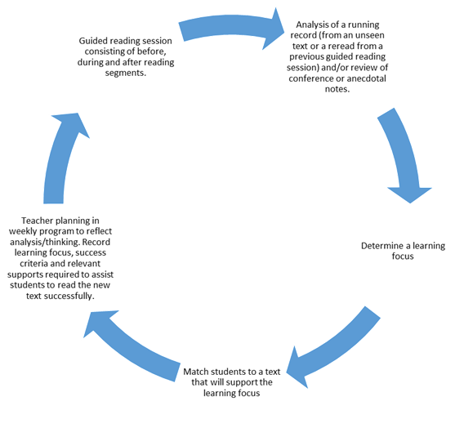
Diversity of ToC
Future Model
Old Model
New Model
Original model, handed down from the national IHDF model. Qualities of a former way of thinking
Invoking contemporary thinking, new state of science, distinct philosophical commitments.
Qualities of a new way of thinking. Perhaps including previous ideas, perhaps breaking new ground.
Notes:
This one comes from a state department of education. Is it plausible, doable, and testable?

Slide 33
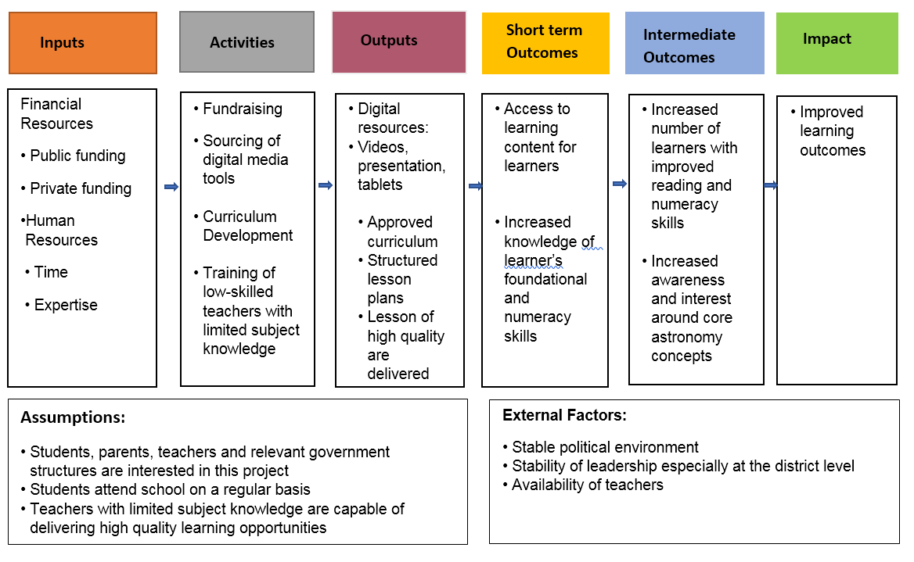
Diversity of ToC
Future Model
Old Model
New Model
Original model, handed down from the national IHDF model. Qualities of a former way of thinking
Invoking contemporary thinking, new state of science, distinct philosophical commitments.
Qualities of a new way of thinking. Perhaps including previous ideas, perhaps breaking new ground.
Notes:
This is from an astronomy literacy program in Sierra Leone.
This is one that is more like a Logic Model. I don’t distinguish between a logic model and a theory of change. But often, they’re drawn differently. ToC can seem more flexible but Logic Models are often pretty rigid. Still, we can observed a few new boxs here.

Slide 34
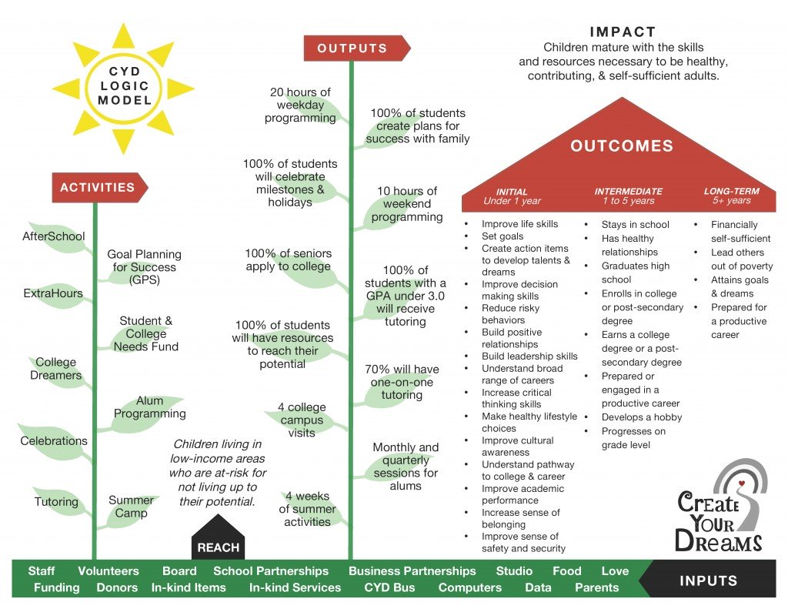
Diversity of ToC
Future Model
Old Model
New Model
Original model, handed down from the national IHDF model. Qualities of a former way of thinking
Invoking contemporary thinking, new state of science, distinct philosophical commitments.
Qualities of a new way of thinking. Perhaps including previous ideas, perhaps breaking new ground.
Notes:
This is from a youth development program in Atlanta, Georgia. It’s a different beast but structurally it is identifcal to the other logical models or ToC that we’ve seen. Can you locate the “inputs”? What do you think of this one?

Slide 35
Diversity of ToC
Davis and colleagues (1989) model for technology adoption
Perceived Usefulness
Future Model
External Variables
Attitude toward using tech
Behavioral intention to use tech
Actual use of tech
Old Model
New Model
Perceived ease of use
Original model, handed down from the national IHDF model. Qualities of a former way of thinking
Invoking contemporary thinking, new state of science, distinct philosophical commitments.
Qualities of a new way of thinking. Perhaps including previous ideas, perhaps breaking new ground.
(Davis et al., 1989)
Notes:
This is a model by Davis et al 1989. It is an explanation of the likelihood of a a person or group of people adopting a technology. Because it’s a research based grand theory, it won’t really track with our input/output frameworks. But, it should function as the backbone how a program convinces children to use grammar spelling checks or adopting a new technology for creating presentations. Does it pass our inspection of plausible, doable, and testable?

Slide 36
The ToC and Arrows
Perceived Usefulness
Future Model
External Variables
Attitude toward using tech
Behavioral intention to use tech
Actual use of tech
Old Model
New Model
Perceived ease of use
Original model, handed down from the national IHDF model. Qualities of a former way of thinking
Invoking contemporary thinking, new state of science, distinct philosophical commitments.
Qualities of a new way of thinking. Perhaps including previous ideas, perhaps breaking new ground.
(Davis et al., 1989)
Notes:
Up to this point, I’ve said very little about the arrows. That’s partly beacuse there isn’t much to say. They typically indicated causal connections between one thing and another. But in the ToC and Logic Models they’re used very liberally. One good practice is that when you use arrows, write in or at least say aloud what you think the arrow means or indicates. This is very important for a project being “Plausible, doable, and testable.” In the case of heavily researched and evaluated models, these arrows will have mathemtaically dervied values so you can tell about how much confidence you would have that a model would function or that one thing would lead to another.

Slide 37
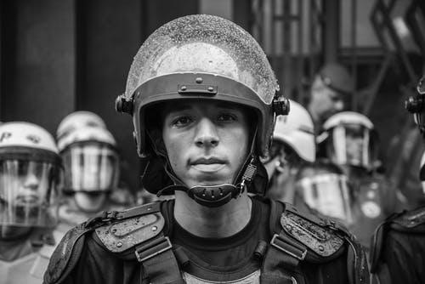
Exercise II - Police Brutality
Across the nation, acts of police brutality have triggered city-wide riots, calls for defunding police, and the indictment of officers. Communities have low levels of trust in the police. In exercise II, you’ll decipher and reconstruct a “technically” sound intervention. After, you’re welcome to critique it.
Future Model
Old Model
New Model
Original model, handed down from the national IHDF model. Qualities of a former way of thinking
Invoking contemporary thinking, new state of science, distinct philosophical commitments.
Qualities of a new way of thinking. Perhaps including previous ideas, perhaps breaking new ground.
Notes:
Since this a workshop and we’re going to dive deep into the practice of creating a ToC, let’s begin with an example. This time, it’ll be a little more serious and contemporary than our last example.

Slide 38
Exercise II: Restoring trust in police
Time
Situation
Actions
Outputs
Outcomes
Goals
Police community volunteer program
Community surveys reveal increase faith in police
Two dozen completed volunteer projects
Recent and historical police brutality leads to social unrest
New firearm trainings created
Police empathize and understand the communities where they work
Processes are in place that build trust between police and community
Police learn and practice new skills
New diversity policies target hiring officers of color
A doubling of the number of officers of color
Police force resembles the community served
Reduced shooting of civilians and increase in other crime prevention strategies

Slide 39
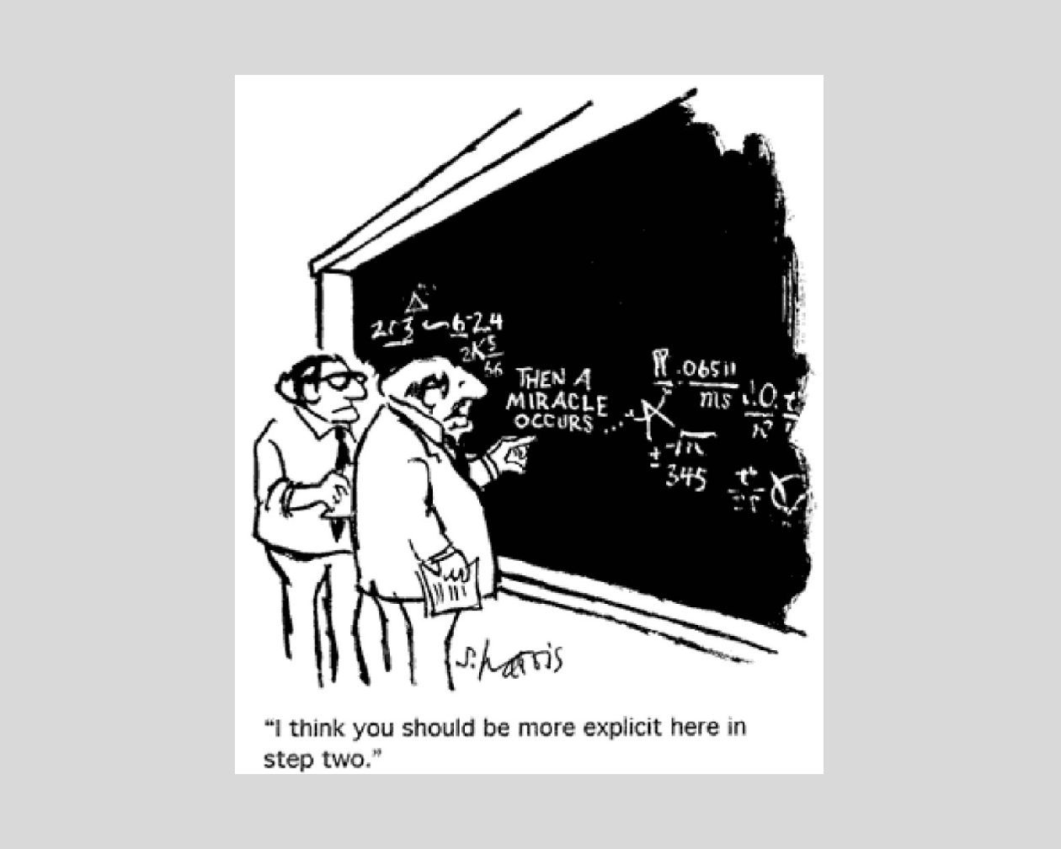
Problems with ToC
Future Model
Old Model
New Model
Original model, handed down from the national IHDF model. Qualities of a former way of thinking
Invoking contemporary thinking, new state of science, distinct philosophical commitments.
Qualities of a new way of thinking. Perhaps including previous ideas, perhaps breaking new ground.
Notes:
This cartoon is funny. But it points to the fact that there is always some more specificity that can be drawn into aToC. ToC can be written or designed at any level so it’s not always a fair critique. But the arrows and boxes always suggest a simplification of reality.

Slide 40
Three critiques
Context
What Theory?
Accountability over Hope
Does the ToC model a social science theory or a program theory? How specific is it exactly and what can we learn from it?
ToC take us down a path where accountability becomes more important than hope. That is, deviations from the ToC are counted as bad.
ToC fall prey to not contextualizing their theory and practice - the people, the setting, and political climate are deemphasized

Slide 41
Three critiques
Never Updated
Given from Outside
Too Linear
Often the ToC is created by upper management or a contractor. Reduces practitioner voice, buy in, and knowledge of the ToC.
ToC always march forward. However, there is rarey time or space for “in the moment” iterative learning and program modification.
ToC can join the collection of files, books, and reports on the dusty shelf. Programs usually change over time.

Slide 42
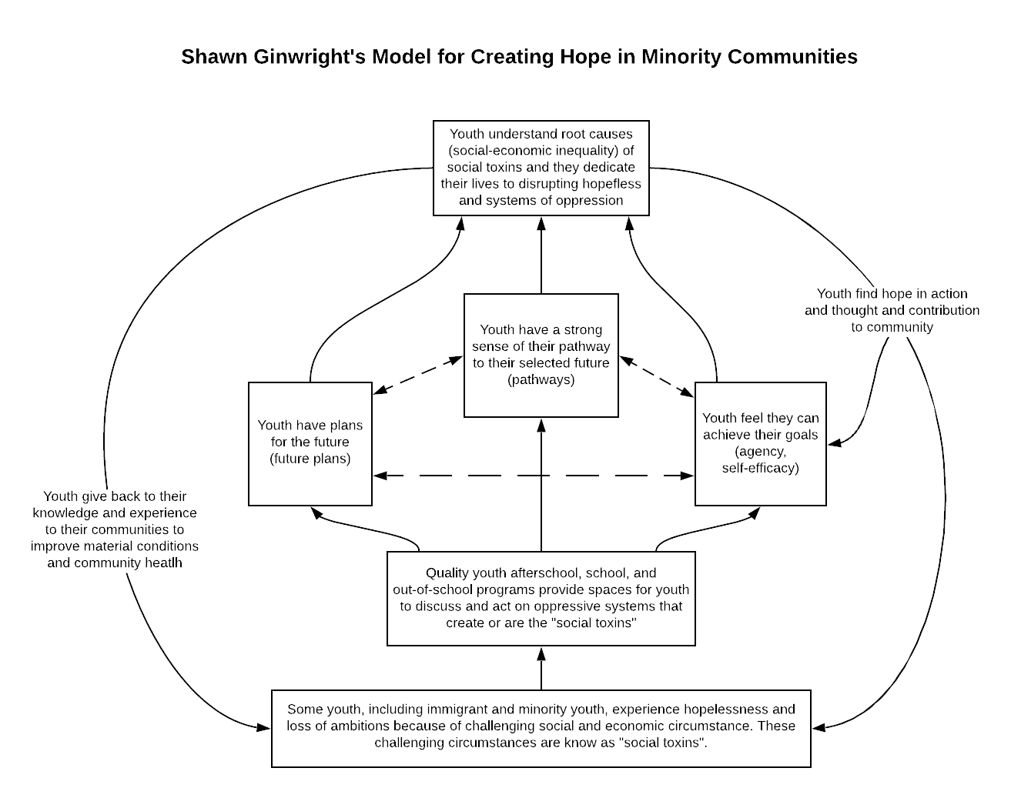
Dr. D’s Example
Future Model
Old Model
New Model
Original model, handed down from the national IHDF model. Qualities of a former way of thinking
Invoking contemporary thinking, new state of science, distinct philosophical commitments.
Qualities of a new way of thinking. Perhaps including previous ideas, perhaps breaking new ground.
Notes:
As we continue to develop our understanding of how to create Theories of Change worth believing, these are the core takeaways.

Slide 43
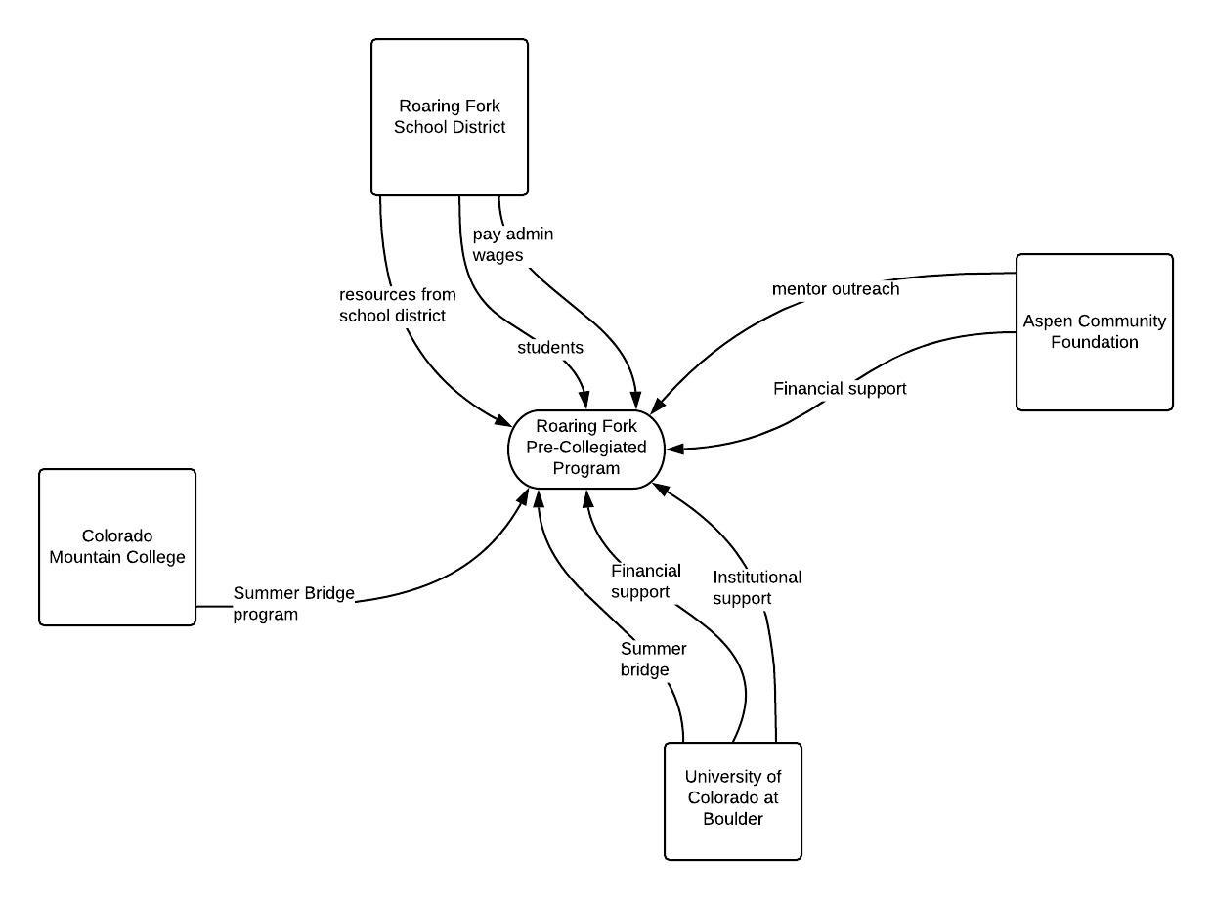
Dr. D’s Example
Input Modeling for a Community Project
Future Model
Old Model
New Model
Original model, handed down from the national IHDF model. Qualities of a former way of thinking
Invoking contemporary thinking, new state of science, distinct philosophical commitments.
Qualities of a new way of thinking. Perhaps including previous ideas, perhaps breaking new ground.
Notes:
As we continue to develop our understanding of how to create Theories of Change worth believing, these are the core takeaways.

Slide 44
Summary
Theories of Change Worth Believing in
Pick the template that works best for your project
Gain clarity on subtle concepts (output vs. outcome)
Advocate for a stakeholder process to create a ToC
Maintain a critical mind and revise the ToC
Include critical contextual and demographic facts
Future Model
Old Model
New Model
Original model, handed down from the national IHDF model. Qualities of a former way of thinking
Invoking contemporary thinking, new state of science, distinct philosophical commitments.
Qualities of a new way of thinking. Perhaps including previous ideas, perhaps breaking new ground.
Notes:
As we continue to develop our understanding of how to create Theories of Change worth believing, these are the core takeaways.

Slide 45
For Next Time
Workshop Session III
Predict problems with a program’s design
Identifying and naming risk and assumptions
Putting it all together
Visit “Western-Eval.com/events” for updates and schedule
Future Model
Old Model
New Model
Original model, handed down from the national IHDF model. Qualities of a former way of thinking
Invoking contemporary thinking, new state of science, distinct philosophical commitments.
Qualities of a new way of thinking. Perhaps including previous ideas, perhaps breaking new ground.

Slide 46
Next Steps
Homework
Use one of the templates to model a program or intervention at your organization. If not, model one that you’d like to create.
Future Model
Old Model
New Model
Original model, handed down from the national IHDF model. Qualities of a former way of thinking
Invoking contemporary thinking, new state of science, distinct philosophical commitments.
Qualities of a new way of thinking. Perhaps including previous ideas, perhaps breaking new ground.

Slide 47
Next Steps
Workshop Session III
October 14th from 1:00 - 2:30 Mountain Standard Time
The World Resists your Theory of Change
Future Model
Old Model
New Model
Original model, handed down from the national IHDF model. Qualities of a former way of thinking
Invoking contemporary thinking, new state of science, distinct philosophical commitments.
Qualities of a new way of thinking. Perhaps including previous ideas, perhaps breaking new ground.
Notes:
In the final workshop of this series, we’ll explore how the world resists our theories and what we can do about it.

Slide 48
Thanks!
Future Model
Old Model
New Model
Original model, handed down from the national IHDF model. Qualities of a former way of thinking
Invoking contemporary thinking, new state of science, distinct philosophical commitments.
Qualities of a new way of thinking. Perhaps including previous ideas, perhaps breaking new ground.

Slide 49
Citations
Brickmayer, J. D., & Weiss, C. H. (2000). Theory-based evaluation in practice: What do we learn?. Evaluation review, 24(4), 407-431.
Connell, J. P., & Kubisch, A. C. (1998). Applying a theory of change approach to the evaluation of comprehensive community initiatives: progress, prospects, and problems. New approaches to evaluating community initiatives, 2(15-44), 1-16. Davis, F. D. (1989). Perceived usefulness, perceived ease of use, and user acceptance of information technology. MIS quarterly, 319-340.
Jenson, J. M., Alter, C. F., Nicotera, N., Anthony, E. K., & Forrest-Bank, S. S. (2013). Risk, resilience, and positive youth development: Developing effective community programs for at-risk youth: Lessons from the Denver Bridge Project. Oxford University Press.
Joly, B. M., Polyak, G., Davis, M. V., Brewster, J., Tremain, B., Raevsky, C., & Beitsch, L. M. (2007). Linking accreditation and public health outcomes: a logic model approach. Journal of Public Health Management and Practice, 13(4), 349-356.
LaFrance, J. (2004). Culturally competent evaluation in Indian country. New Directions for Evaluation, 2004(102), 39-50.
Mertens, D. M., & Wilson, A. T. (2018). Program evaluation theory and practice. Guilford Publications. Chapter 7, "Working with Stakeholders" pg. 209 -244
Rogers, P. J., & Weiss, C. H. (2007). Theory‐based evaluation: Reflections ten years on: Theory‐based evaluation: Past, present, and future. New directions for evaluation, 2007(114), 63-81.
Savaya, R., & Waysman, M. (2005). The logic model: A tool for incorporating theory in development and evaluation of programs. Administration in Social Work, 29(2), 85-103.
Stein, Danielle, and Craig Valters. "Understanding theory of change in international development." (2012).
Weiss, Carol, 2001, “Theory-Based Evaluation: Theories of Change for Poverty Reduction
Programs,” in O. Feinstein and R. Piccioto (eds), Evaluation and Poverty Reduction,
Future Model
Old Model
New Model
Original model, handed down from the national IHDF model. Qualities of a former way of thinking
Invoking contemporary thinking, new state of science, distinct philosophical commitments.
Qualities of a new way of thinking. Perhaps including previous ideas, perhaps breaking new ground.

