Slide 1
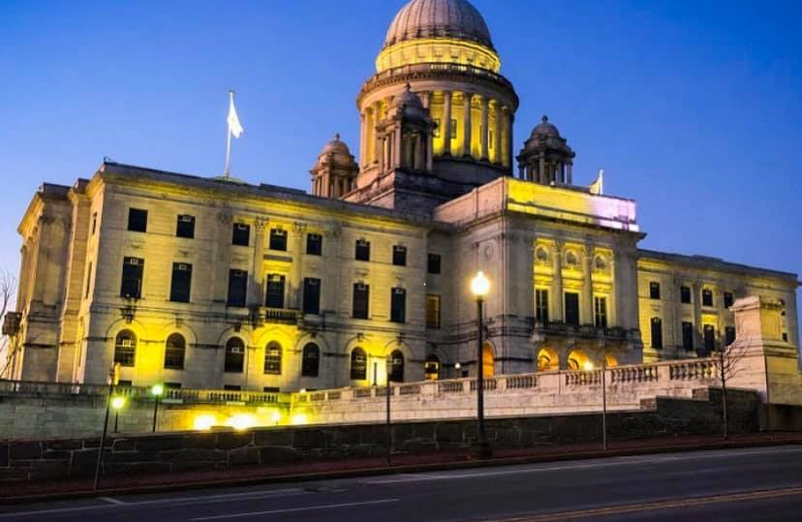
RI Firearm Owners Impact Statement

Slide 2
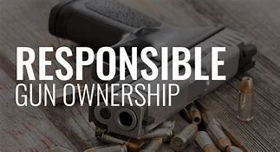
Follow the money
Safety
Social Issues
Economic Impact
Data
Environment
Demographics
As gun owners, we pledge to help reduce gun violence by leading the way in responsible gun ownership and firearm safety.
And we have already begun..

Slide 3

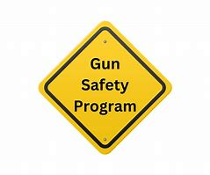



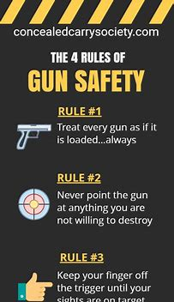



Our Public Safety Programs
Safeguard Program
Stop veteran suicide, etch images of loved ones on firearms.

Slide 4





Empowerment Through
Self-Defense
The Pink Pistols
Pick On Someone Your Own Caliber

Slide 5
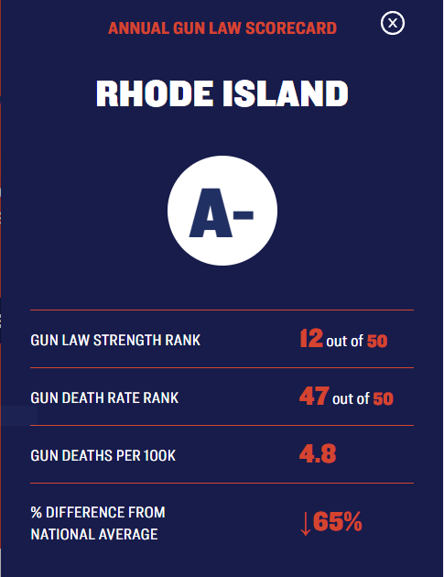
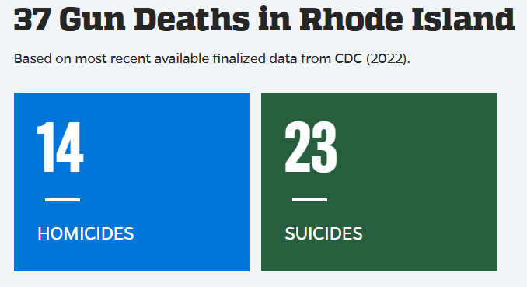
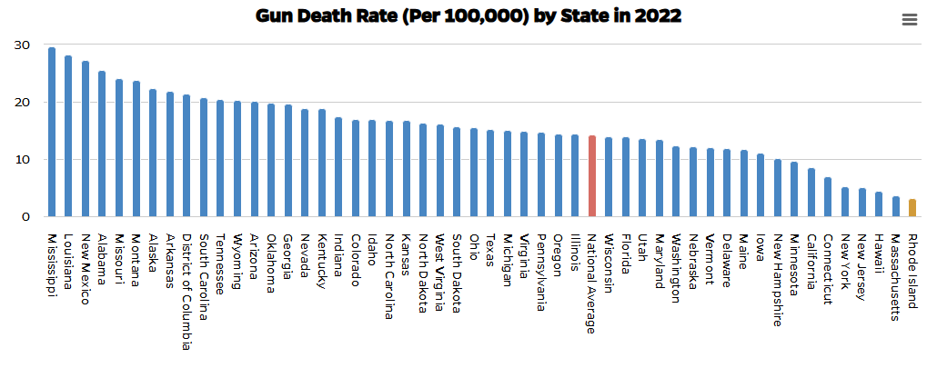
The overall gun death rate decreased nearly 45% in 2022 compared to 2021, mainly due to the decrease in suicides.
Rhode Island had the lowest overall gun death rate and gun suicide rate in the country in 2022.
Providence County had the highest gun homicide rate in the state from 2018 to 2022. Nearly 80% of all gun homicides occurred in Providence County in 2022.
Washington County had the highest gun suicide rate from 2018 to 2022. 61% of all gun suicides occurred in Washington County in 2022.
Rhode Island Stats (CDC)
Leading Cause of Death Heart Disease
Drug Overdose Death Rate 30.1 (per 100,000)
Firearm Death Rate 3.3 (per 100,000)
Homicide Rate 5.9 (per 100,000)

Slide 6
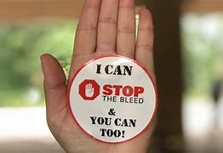
School Safety Programs
The Washington Times
NRA 'School Shield' program awards $600K in grants for school security projects
The National Rifle Association announced Monday that it has awarded over $600,000 in grants to support school security projects in 23 states, organized under the organization’s School Shield program.
NRA Law Enforcement Quarterly
NRA School Shield: A National Program With a Local Focus
Featured in the Spring 2019 issue, the NRA School Shield's Security Assessor Training is helping to standardize the way communities assess school facilities and make our nation's K-12 campuses more secure.
Our Members and Clubs provide this valuable program:
The "Stop the Bleed" campaign is an initiative of the American College of Surgeons, the Committee on Trauma, and the Hartford Consensus. You can learn more about it and purchase a bleeding control kit at BleedingControl.org
NRA School Shield Grant Program Now Accepting Applications for School Security Projects
Available to all accredited non-profit and public K-12 schools, including private and parochial schools, grants are provided by The NRA Foundation for school security improvements and related activities.
Please Note:
These are valuable programs that are available, but not in use here in RI because of the negative stigma against the firearm Community pushed by the anti-gun agendas.

Slide 7
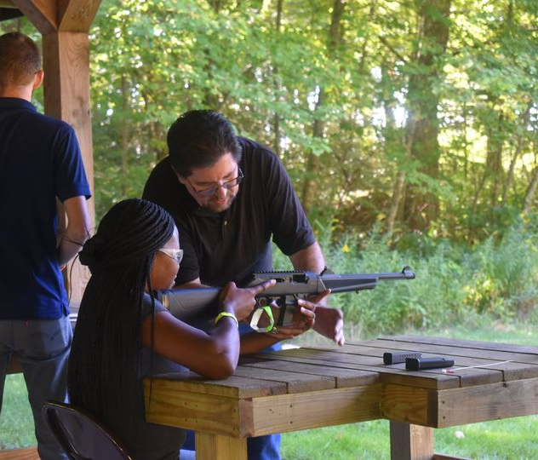
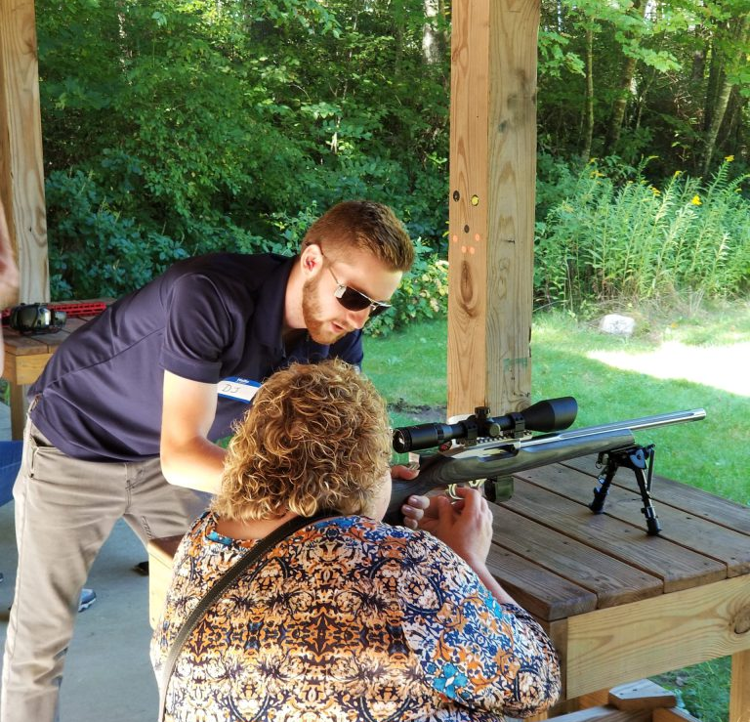
Education
Right here in Rhode Island,
we have:
Over 150 Instructors
We Teach hundreds of classes every year through out the state
We have Rifle, shotgun and pistol Coaches providing training for youth and competitors
Training Counselors who train experienced shooters on how to teach firearm safety and shooting skills to others
We have over 200 Trained Range Safety Officers
Hunter Education Instructors
Youth Hunter Education instruction and programs
Women On Target training
Refuse to be a Victim training
Everyday there are numerous training classes and private lessons teaching firearm safety.

Slide 8
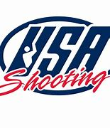
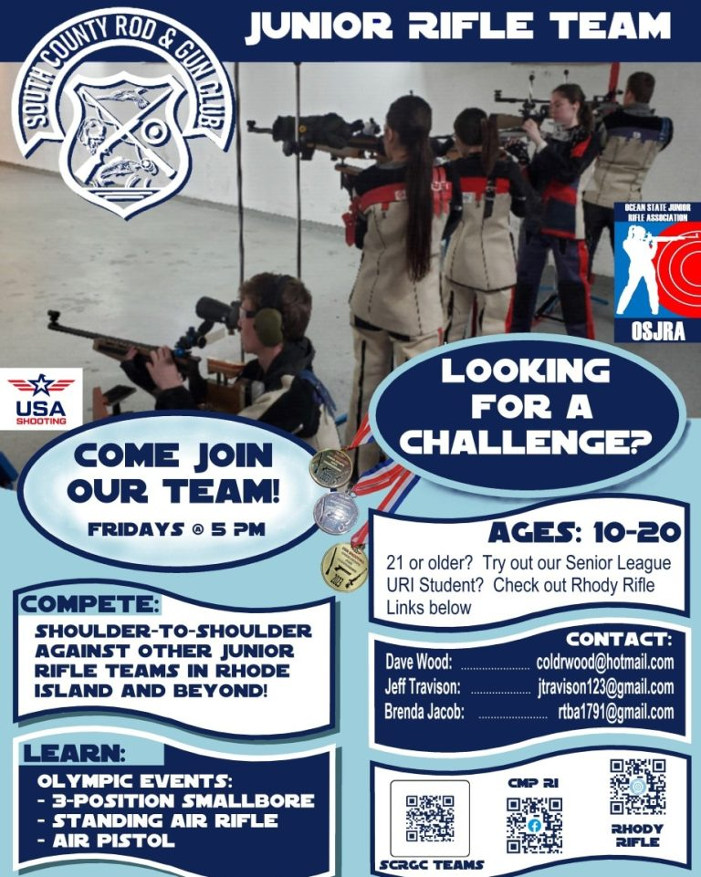
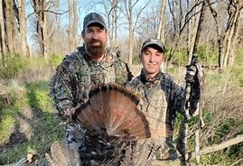
We support our youth
According to the Scholastic Shooting Sports Foundation, participation in youth shooting sport events has increased by 142% over the past 6 years
Scholarships, Awards & Contests
National Junior Shooting Camps
Youth Hunter Education
Matt Light Foundation Youth Hunt
Ocean State Junior Rifle Association representing Rhode Island for 55 Years!
Junior Olympic Training Camp
National Rifle Championships
The Pan Am Games
West Point Academy
MIT
Coast Guard Academy
Hundreds of kids have
participated in the FREE program.

Slide 9
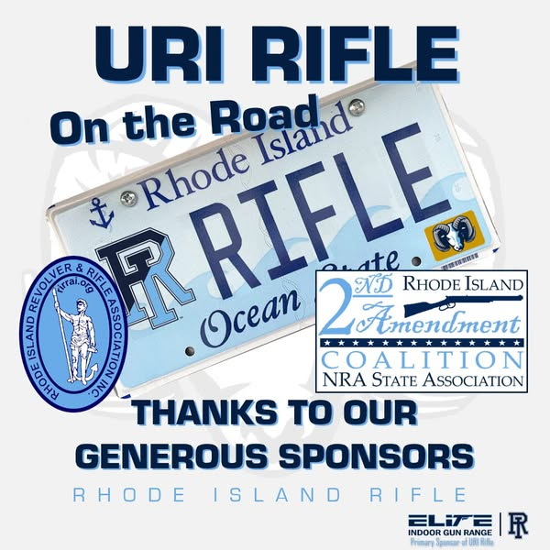

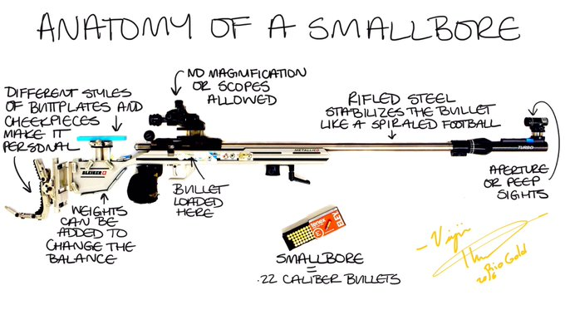

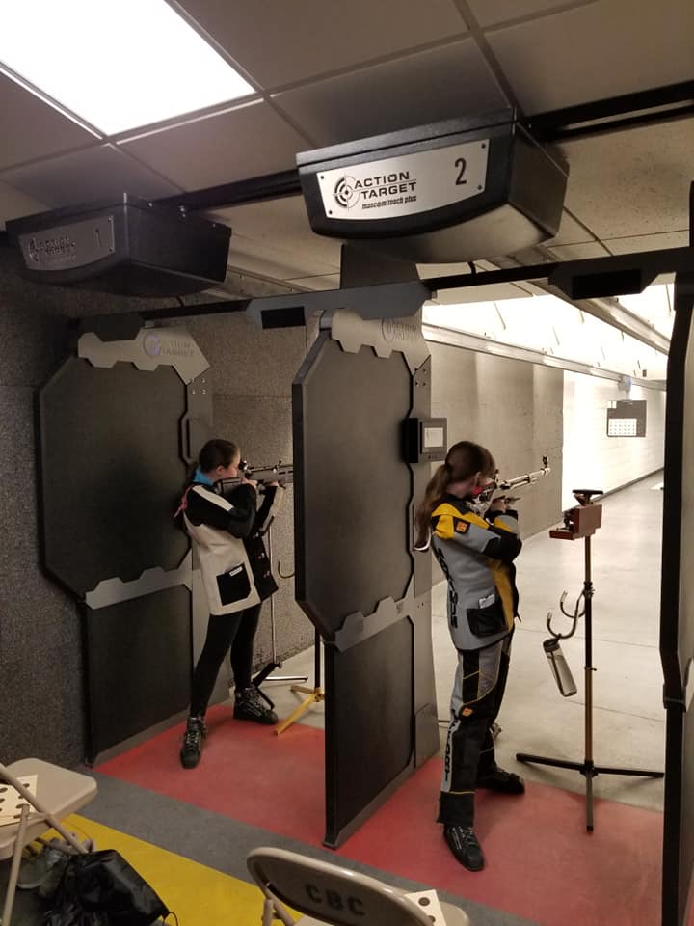
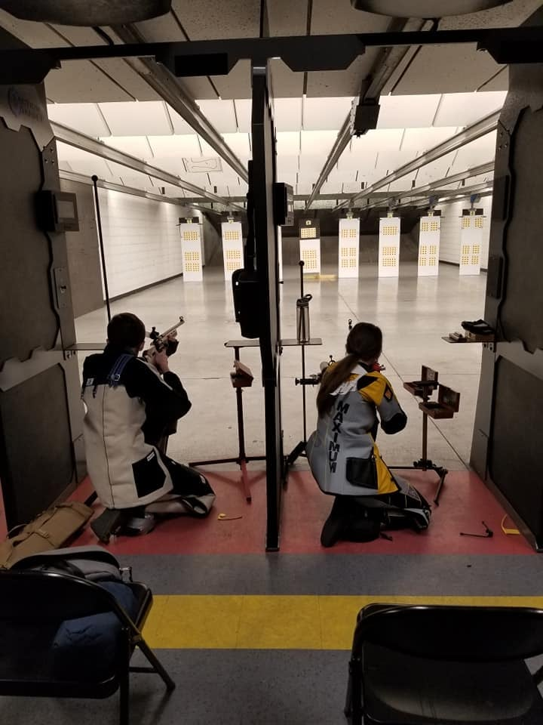
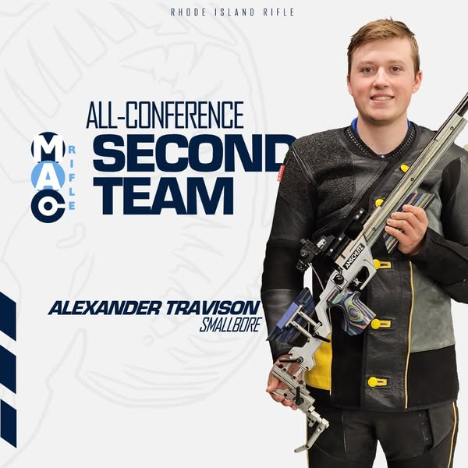
Collegiate Shooting Programs
Nearly 300 colleges and universities in the U.S. offer shooting programs. If you are an experienced competition shooter and are looking for a potential college or university to attend, use the Collegiate Shooting Sports Directory as a resource.

Slide 10
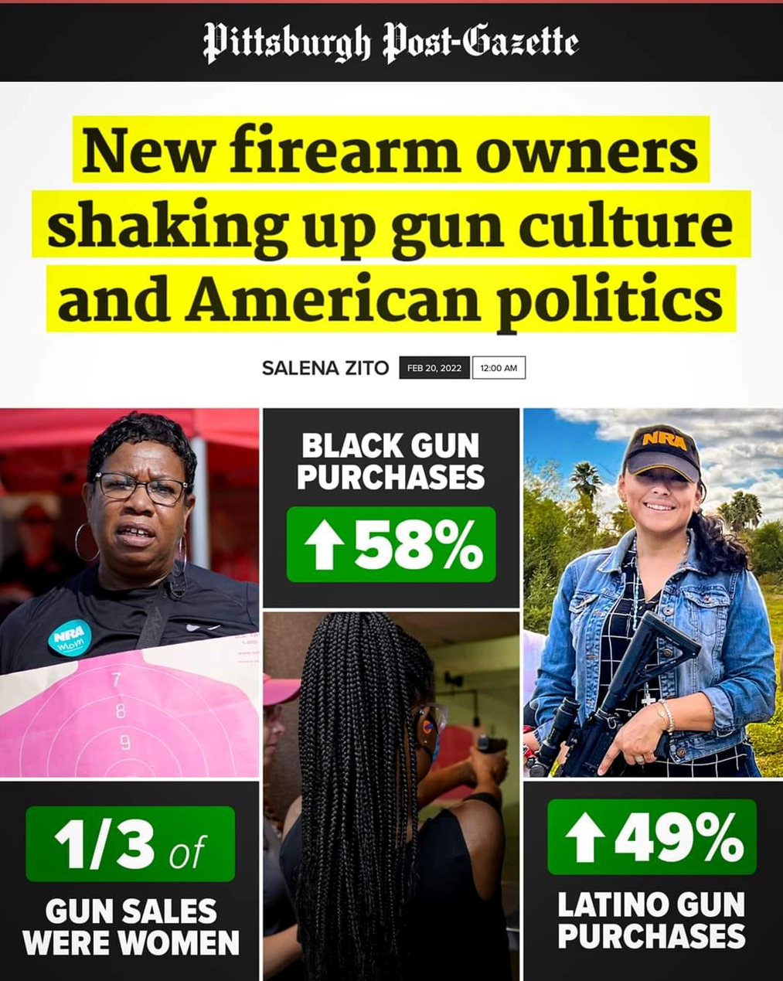
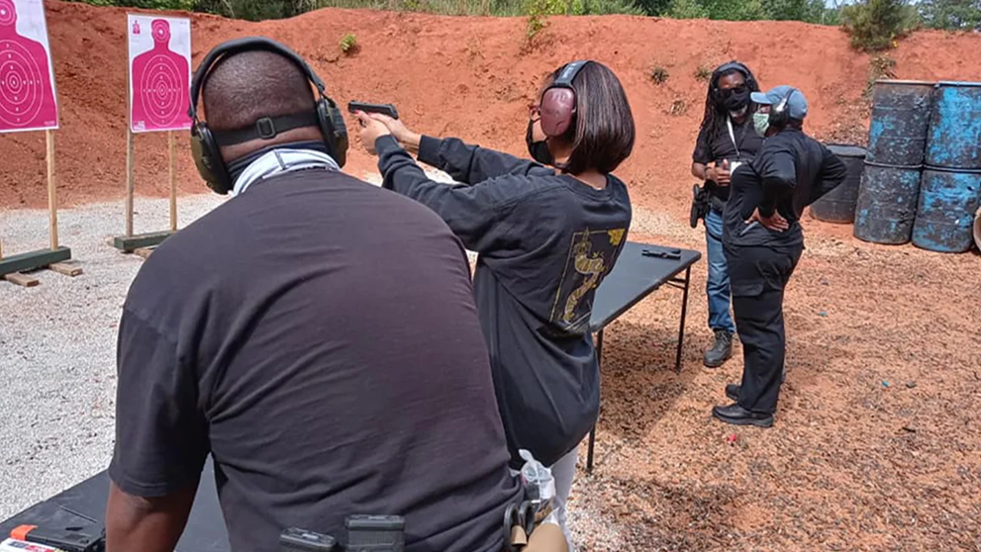
Demographics
Hispanics are the fastest-growing demographic of gun owners, with a 33% increase in ownership from 2017 to 2023.
Women’s firearm ownership has surged by 177.8% since 1993.
1/3 of gun sales are women.
Black Gun purchases up 58%
“Armed Doesn’t Mean Dangerous”
Black gun owners confront stereotypes
Members of the National African American Gun Association work on their aim at a shooting range in this undated photo.
Douglas Jefferson/NAAGA

Slide 11
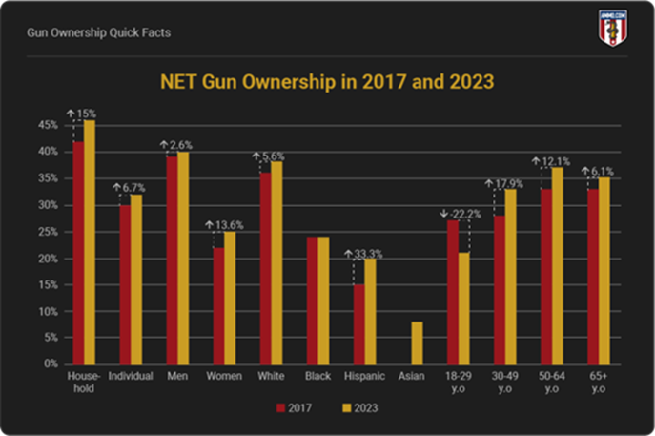

Slide 12
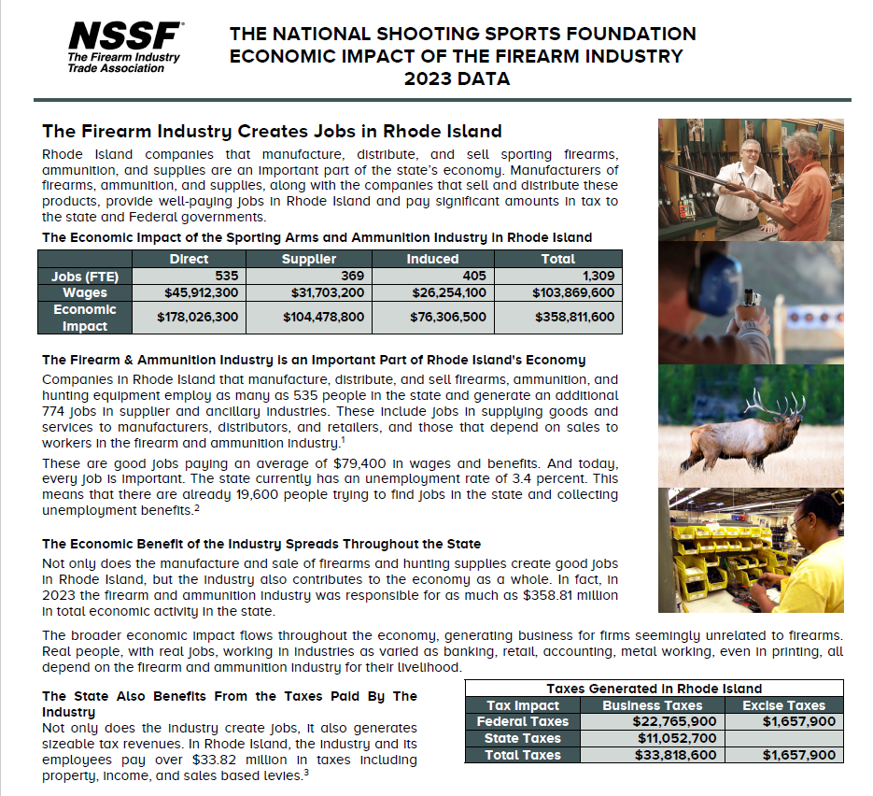
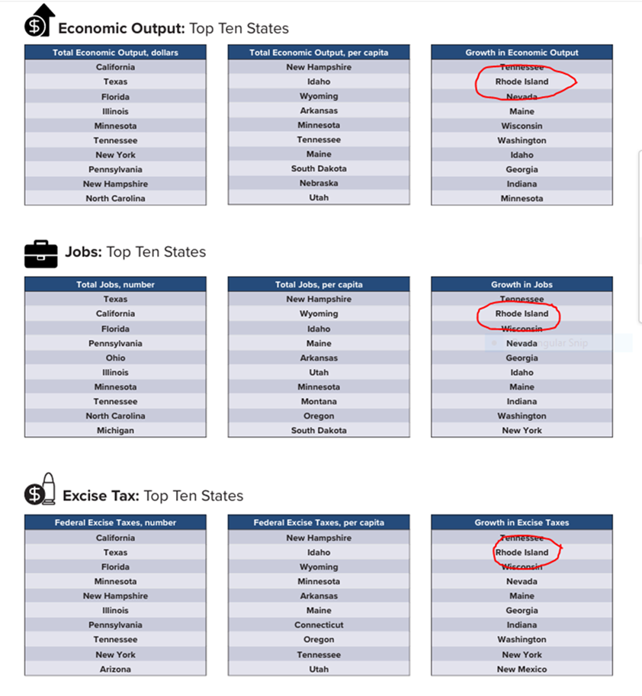



Economics

Slide 13
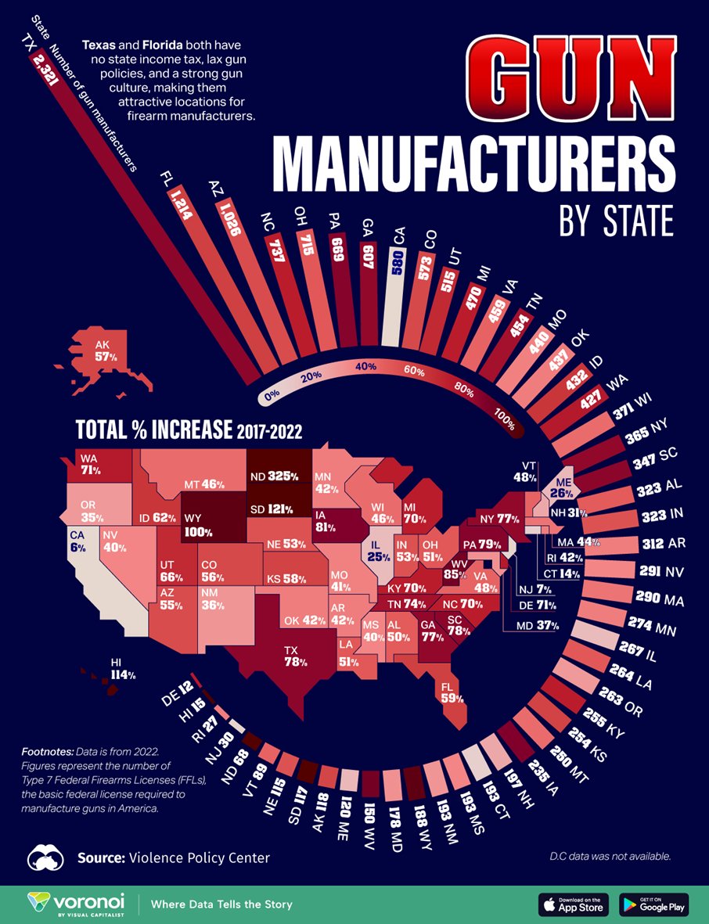
How Rhode Island Ranks In Gun Manufacturing
Rosco, Central Falls
Rosco Manufacturing is an American manufacturer of hard-use precision rifle barrels. Our production facility in Central Falls, RI has over 50,000 square feet of production space with room for high volume capacity. Rosco supplies major gun manufacturers (the world over) with high quality products. Through superior workmanship and unprecedented engineering, our product line continues to exceed expectations and provides a complete solution for the OEM
Bel Air, North Kingstown
Bel Air Mass Finishing Technology is a manufacturer and supplier of finishing technology such as ultrasonic parts cleaners and vibratory tumblers, Bel Air Finishing offers a complete package for precision finishing problems down to processing the wastewater created from the finishing process
Greystone, Lincoln
Greystone Defense Finishing is a high-volume Mil-Spec Anodizing, Plating & Finishing
Supplier focused on the needs of the firearms industry. With plants located in Rhode Island and Virginia, we are ideally suited to service components manufacturers in the Northeast, Southeast and Midwest, and we support gun companies located all across the USA.
ATW Companies, Metalform Manufacturing Operations, Warwick
ATW provides a wide range of fabrication technologies to meet the exacting requirements of industries and diverse technologies for the most critical applications. The company’s motto is “Be the Best…Do it Right,” and they strive to live by this commitment to quality, reliability, innovation, and integrity by continuously adding value to their products and services
Emissive Energy Corp, North Kingstown
Manufactured in Rhode Island by Emissive Energy Corp. INFORCE® lights deliver the quality and strength that people expect from a product from a proud American company. INFORCE also takes its responsibilities to the environment very seriously. Materials harmful to the planet such as lead in the PCB and chromium are never used in any of INFORCE products.
And many more RI ancillary companies benefit from these manufacturers

Slide 14
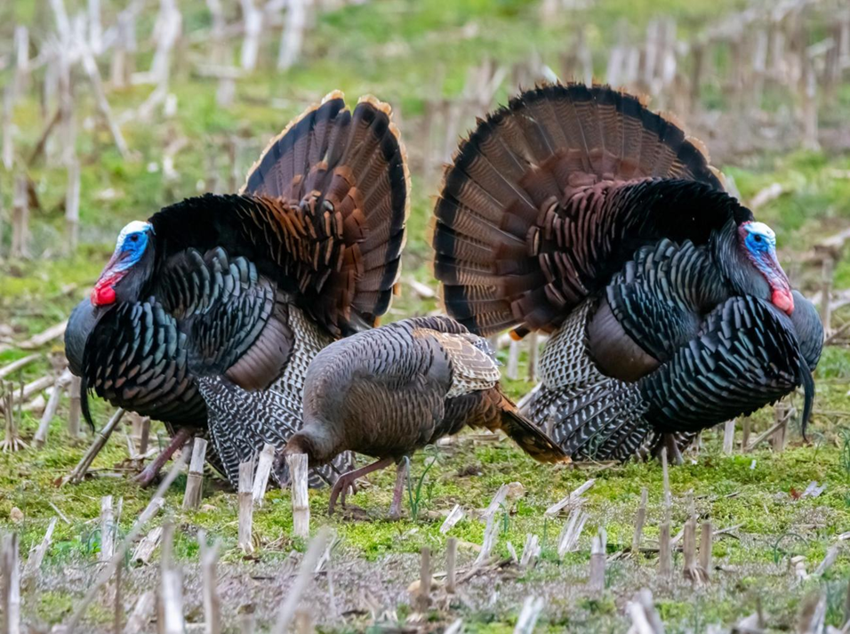
We were green before it was cool
The Federal Aid in Wildlife and Restoration Act, often referred to as the Pittman-Robertson Act, was supported by the firearm industry and approved by Congress in 1937. The Pittman-Robertson Act levied a federal tax on firearms, ammunition and archery equipment at a rate of 10 percent for handguns and 11 percent for long guns, ammunition, and archery equipment. The funds are collected from the manufacturer quarterly and distributed to the states on an annual basis.
Did you know?? There are approximately 40 gun clubs in Rhode Island that have active conservation programs in place to preserve and maintain open space, fields, forests and ponds.
Photo from: Fish & Wildlife | Rhode Island Department of Environmental Management
Rhode Island, hunting and fishing play an important role in connecting people with nature, supporting quality of life and family traditions, and attracting tourism. Fishers and hunters purchase around 70,000 licenses, permits, stamps, and tags each year and contribute more than $235 million to Rhode Island's economy. Revenue generated from license and permit sales support Rhode Island fish and wildlife conservation programs. A critical source of funding, these monies are leveraged to match federal Wildlife and Sport Fish Restoration Program dollars that support outdoor recreational opportunities for fishing, hunting, and boating in Rhode Island

Slide 15
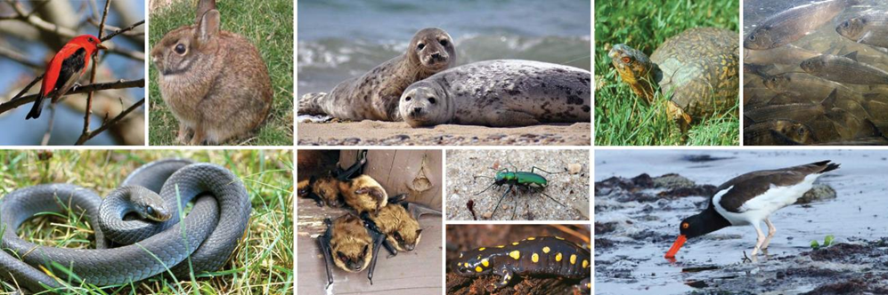
DEM Announces Acquisition of 61-Acre Parcel of Forestland Near Big River Management Area Purchased with U.S. Fish and Wildlife Service Funding
Published on Monday, May 22, 2023
Grants Available to Improve Boat Pump out Facilities to Keep RI Coastal Waters Clean
Published on Thursday, December 05, 2024
Photo from: 2025 State Wildlife Action Plan (SWAP) | Rhode Island Department of Environmental Management
Conservation & Research
The Division of Fish and Wildlife (DFW) shares management responsibility for more than 60,000 acres of land distributed across 15 towns and all counties and is responsible for managing thousands of species of wildlife, including freshwater species. The division serves a wide and diverse segment of the public, from outdoor recreationists ― such as hunters, hikers, mountain bikers, and wildlife watchers ― to the general public and municipalities concerned with nuisance wildlife.
Science Learning Gone Wild! DEM Offers Free Critter Kit Learning Resources for Elementary Educators
Published on Tuesday, August 20, 2024
942 Acres of Forestland in Burrillville Conserved with $1.2M from US Fish & Wildlife Service
Published on Monday, December 02, 2024
This is all possible because of the funds generated by Firearm Owners!

Slide 16
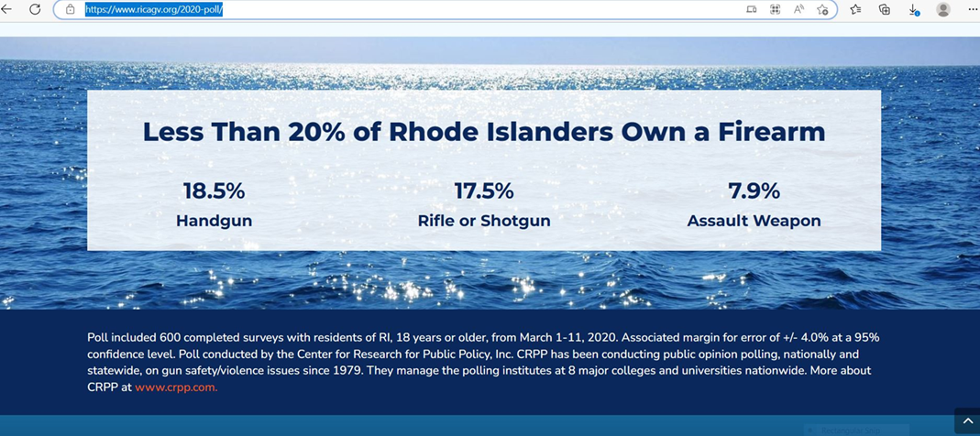
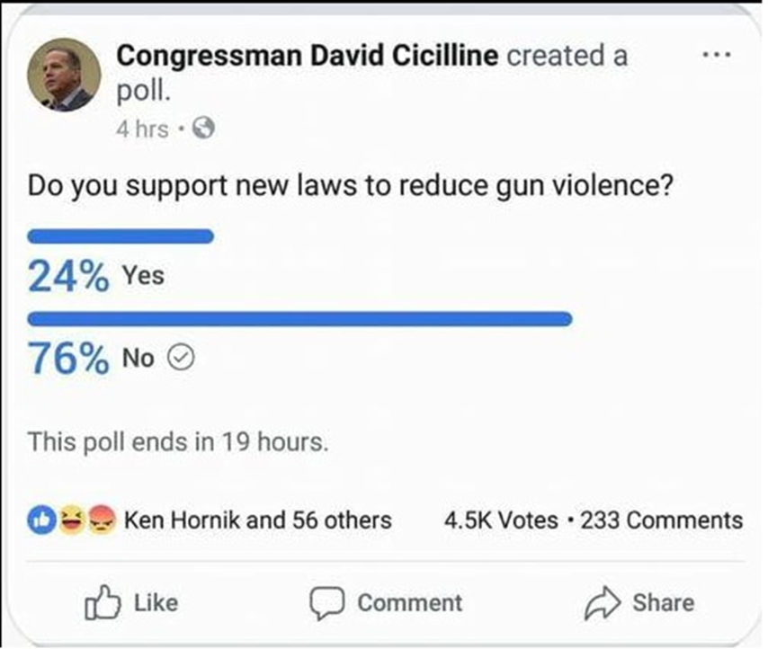
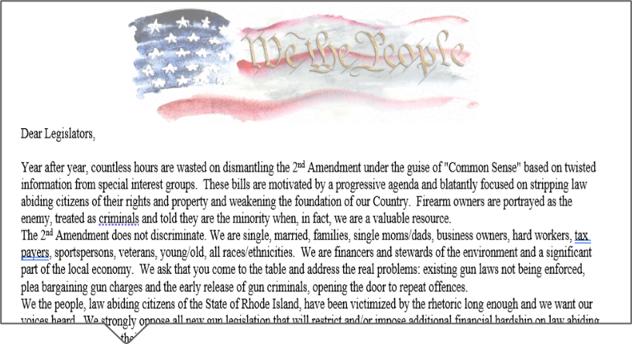


The truth about the numbers…..
This poll was up for less than 2 hours before being taken down by the Congressman.
600 people polled
Firearm community
Petition 2/14/2021 11,458 signatures in 2 weeks.

Slide 17
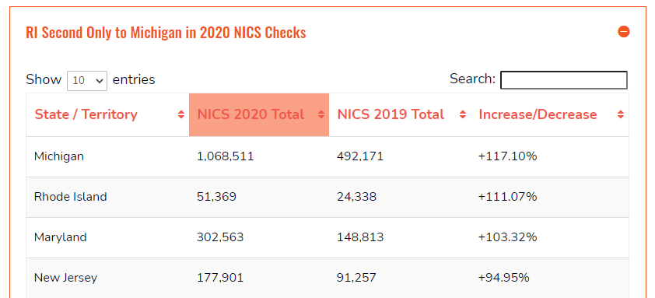
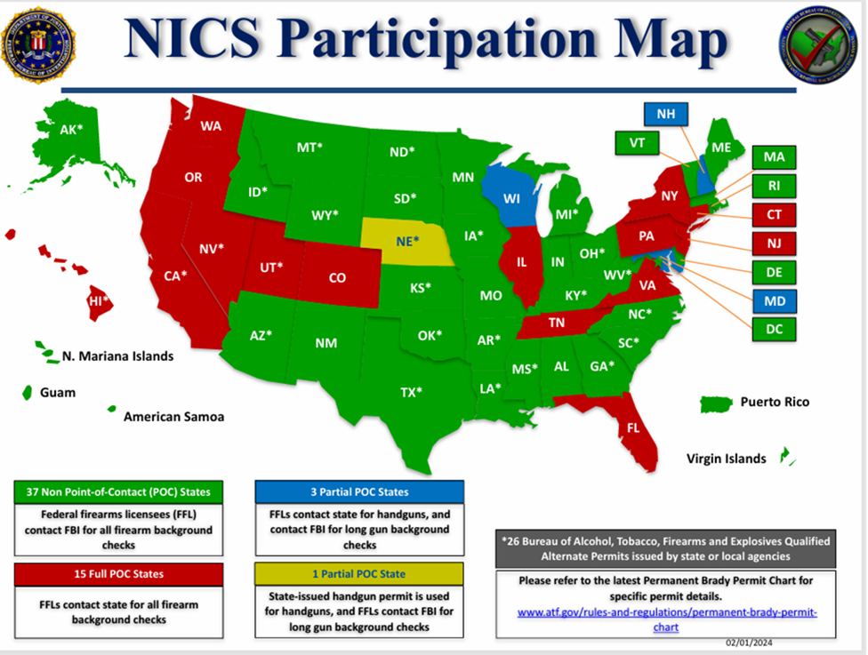
There are over 9,000 licensed hunters in Rhode Island.
In the past 6 years 188,801 firearms have been purchased in Rhode Island.
Purchasers went through a NICS Check and a local background check to purchase.
To be members of a gun club you we require a State or local BCI Check
600 people push polled is NOT an accurate representation of Rhode Island constituents.
Year | NICS Checks
2018 | 25,030
2019 | 21,338
2020 | 51,369
2021 | 37,936
2022 | 27,900
2023 | 25,178
Total Past 6 years | 188,801

Slide 18
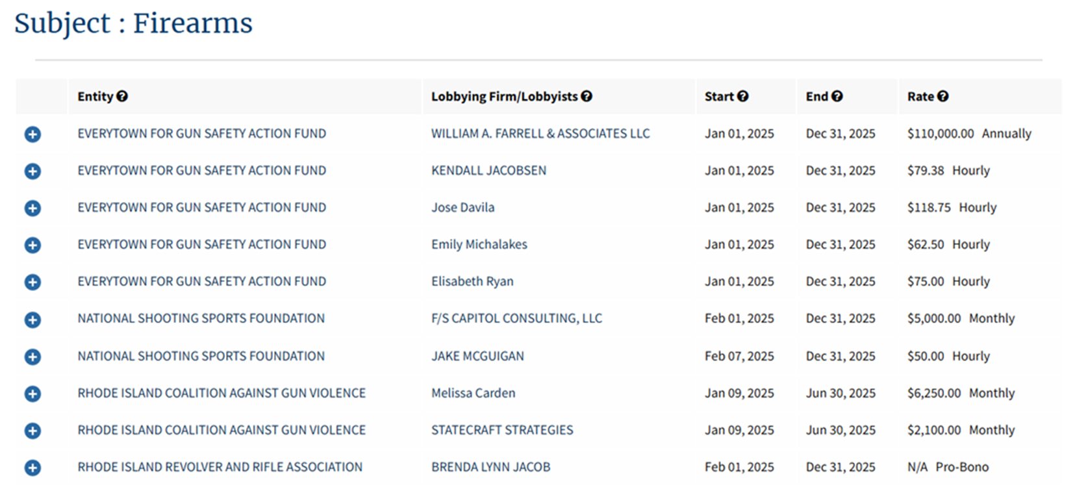
Bloomberg-backed gun regulation group pledges $45 million for election
Everytown for Gun Safety Action Fund July 31, 2024
USAID money showed that
Brady Center to Prevent Gun Violence, which took in $12,809,748 in contributions, Bloomberg's
Everytown’s mapping shows $31,802,725 in contributions with $4,963,214 in grants to states.
List of Rhode Island Gun Lobbyists:
Women Votes!
Planned Parent Hood
RI Coalition Against Gun Violence
Please Note:
RI Gun Owners, Clubs, Associations get their money from members who pay membership fees. No Grants, No millionaires, No Federal funds
In Rhode Island we have traced over 6 Million dollars that have been funneled to candidates thru Independent Expenditure reports over the past few election cycles.
1199 SEIU PAC
RI Values Project

Slide 19
Appendix:
Gun sales rise among Black people as they look for firearm training and education | CNN
NSSF | The Firearm Industry Trade Association
About | Rhode Island Coalition Against Gun Violence
NICS_Firearms_Checks_-_Year_by_State_Type.pdf
Fish & Wildlife | Rhode Island Department of Environmental Management
How Rhode Island Ranks In Gun Manufacturing | Providence, RI Patch
ATW Companies Relocates Metalform Manufacturing Operations To Rhode Island
Rosco Manufacturing
Mapped: Gun Manufacturers by U.S. State
EFGSSF-2022-990-Public-Disclosure-Copy.pdf
Gun Ownership In America: Surprising Statistics And What They Mean For 2nd Amendment Advocates » Concealed Carry Inc
State Data: Rhode Island | Center for Gun Violence Solutions
Black gun ownership is rising – The Bay State Banner
Encouraging Responsible Gun Ownership | Overview | Bureau of Justice Assistance
A new way to stop veteran suicide: images of loved ones on firea
https://www.cdc.gov/nchs/pressroom/states/rhodeisland/ri3.htm
https://publichealth.jhu.edu/center-for-gun-violence-solutions/rhode-island
https://giffords.org/lawcenter/resources/scorecard/?scorecard=RI
https://www.opensecrets.org/
https://www.cdc.gov/mmwr/volumes/73/wr/mm7323a1.htm
Black gun ownership is rising – The Bay State Banner
Encouraging Responsible Gun Ownership | Overview | Bureau of Justice Assistance
A new way to stop veteran suicide: images of loved ones on firea
Self Defense – Domestic Truth Foundation
About – Women for Gun Rights
Self Defense – Domestic Truth Foundation
About – Women for Gun Rights
Please feel free to contact us regarding any of the information in this packet. Our goal is to provide accurate transparent information. We hope this will help you to be an informed Legislator.

Slide 20


WE ARE:
Moms, dads, grandparents, sisters, brothers, business owners, doctors, lawyers, white collar
professionals, blue collar workers, athletes, competitors, Democrats, Republicans, Independents,
Hispanics, Blacks, Latinos, Asians, friends, neighbors and most importantly…. Your constituents.

