Slide 1
EchoLogic Sales Toolkit
Let Your Policies Speak Loud and Clear.
Presented by: [Sales Rep Name]
Date: [Insert Date]

Slide 2
The Challenge
- Inconsistent employee training
- Compliance messages often overlooked
- High video production costs

Slide 3
Our Solution
- AI-Driven, multilingual videos
- No filming or editing
- Fast, 2–4 day turnaround

Slide 4
How It Works
1. Submit your policy or script
2. We generate the video
3. Delivered ready-to-share in 2–4 days

Slide 5
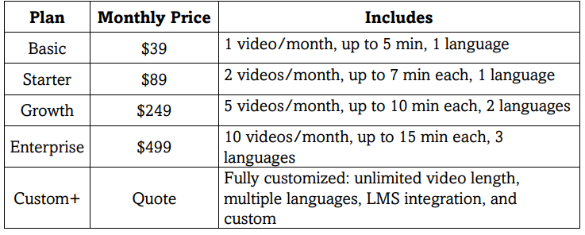
Subscription Plans

Slide 6
Pay-As-You-Go Video Pricing

Slide 7
Use Cases
- Compliance Updates
- Policy Rollouts
- CEO Messages
- New Hire Orientation
- Multi-location Announcements

Slide 8
Why Choose EchoLogic
- No filming/editing
- Multilingual support
- LMS-ready
- Fast turnaround
- Custom avatars

Slide 9
Upsell Opportunities
- Add captions/translations
- Company-branded templates
- Annual subscription bundles
- LMS integrations

Slide 10
FAQs
Q: Is this secure?
A: Yes, NDA + encrypted
Q: Avatar choice?
A: Yes, or create your own
Q: Revisions?
A: One per tier

Slide 11
Get Started
Email: thelogicline@myechologic.com
CTA: 'Get Your First Video Today!'
[Insert QR Code or Sign-Up Link]

