Slide 1









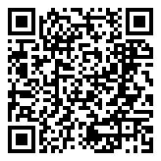
Help Friendswood ISD families-in-need by participating in
Undie
November
SUNDAY
12
FISDCares is collecting packages of NEW socks, underwear, and PJs for kids in need this holiday season. You can help by bringing donations with you to church service on Sunday, November 12. ALL sizes (including adult sizes) needed!
Scan the QR code to donate to FISDCares.
FISDCares is a joint collaboration with Friendswood ISD and Bay Area Alliance helping FISD students and families through challenging times.

