Slide 1
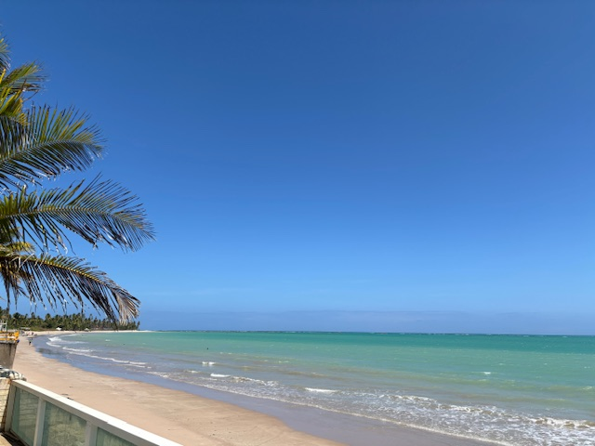
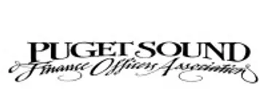

Councilmanic Revenue Options
for Local Governments
T. Robert Hamud, MPA
Project Manager

Slide 2
Councilmanic Revenue Option Presentation
Will give an overview of major revenue options your agency may pursue with a majority vote of the governing board.
Outline the pros and cons of major sources.
“Roundtable” Discussion of What has worked for agencies in the room

Slide 3

Yes or No: Finance and Budget Equals???????

Slide 4




About FCS GROUP
4,000+
Projects
Completed
650+
Public Clients
Served
Utility Rate and Fee Consulting
General Government Financial Analysis
35
Management and Technical Professionals
Utility
Management
Economic and Funding Strategies
36
Years in Operation
Est. 1988
4
Offices in Washington, Colorado, and Oregon

Slide 5
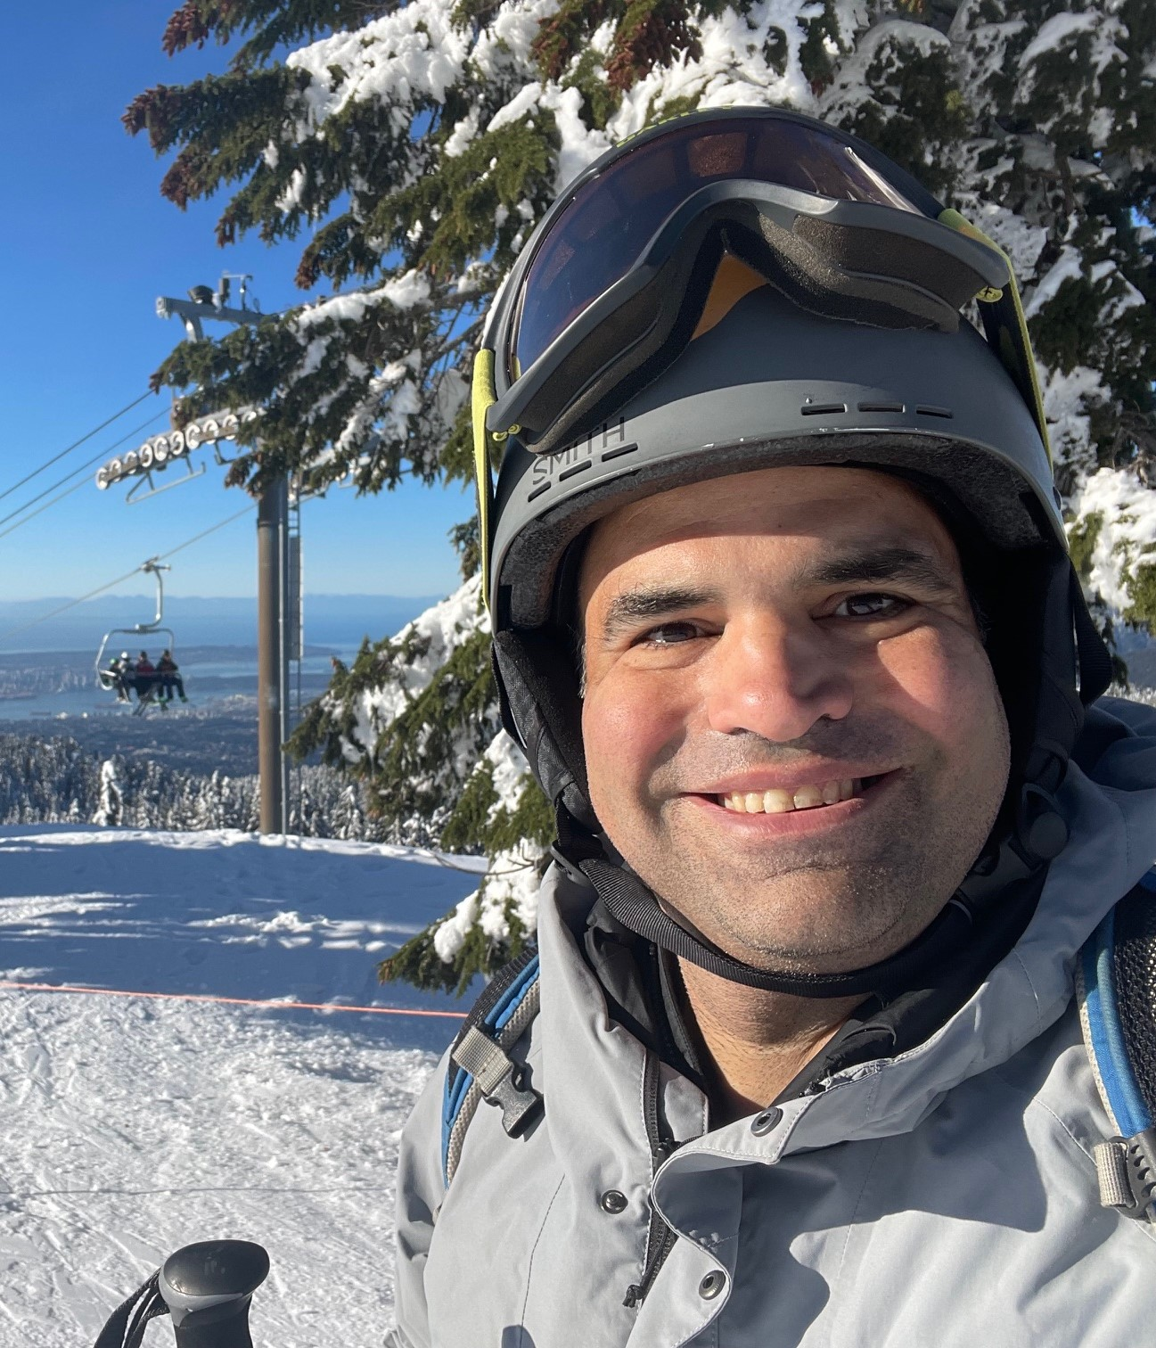
About Me
Cascade County, Montana CFO 2013-2015.
City of Snoqualmie, Finance Director 2018-2021.
City of Issaquah, CFO 2021-2024.
16 years as a budget and finance analyst in state and local government.
MPA University of Utah, concentration in Local Government.
BA in Government, California State University, Sacramento.

Slide 6
Importance of New Councilmanic Revenue Options
Property tax base increases are severely limited by Washington state law.
Sales Tax base rates are capped.
Voter approval for levy lid lifts and/or new sales taxes are difficult.
Identification of long-term, sustainable revenue sources.
Expenditures in most jurisdictions have been outpacing base revenue growth in recent years.
Expiration of ARPA, Inflation Reduction Act, decrease of federal funding sources for multiple years.

Slide 7
Major Revenue Trends-Washington State 2019-23
Sales Tax
In Thousands $

Slide 8
November 2024 Election Roundup
Ballot Measure Type | Pass | Fail
Bond Measures | 0 | 2
EMS Levy | 4 | 1
O&M Excess Levy | 38 | 11
Levy Lid Lift | 10 | 11
Public Safety Sales Tax | 4 | 2
TBD Sales Tax | 2 | 1
Source: MRSC

Slide 9
Overview of Major Councilmanic Revenue Options
Option | Description
Property Tax Levy Maximum/Banked Capacity | Raise local agency taxes to levy maximum and/or take available banked capacity.
Transportation Benefit District | Can assess up to $40 car tab and/or .1% sales tax.
Utility Taxes | Up to 6% on electric, cable, gas, no limit on public utilities.
Business and & Operations Tax (B&O) | Gross receipts tax that can be set by business category and size
Other Business License Fees | Square footage, per employee
Admissions Tax | Taxes on specific events or activities in the jurisdiction
Fee and Fine Revenues | Evaluate at fee revenues for development, recreation, police and fines.

Slide 10

Property Tax Banked Capacity
RCW 84.55.092: Allows jurisdictions to levy maximum capacity dating back to 1986 if not fully taken.
Only takes simple majority of governing board during annual property tax levy meeting.
Will be one year of a “larger” bump in revenues, then council must pass maximum each year, limited at 1% growth plus newly assessed properties.

Slide 11

Transportation Benefit District (TBD) Overview
Authorized by RCW 36.73 for Cities and Counties and other authorized taxing districts for transportation projects.
TBD established by jurisdiction can also be the governing board (such as the City Council also serves as the TBD board)
Can levy up to $40 in annual vehicle license fees and/or (as of 1/1/2022) a councilmanic imposition of a .1% sales tax by a simple majority.
Revenues can be used for a combination of maintenance, operations or capital projects.

Slide 12
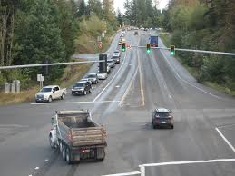
Transportation Benefit District (TBD) Cont’d
TBD sales tax implemented by over 80 jurisdictions in Washington.
Implementing the .1% sales tax does not preclude the jurisdiction to go to voters for up to an additional .2% sales tax.
Repeal can occur by simple majority vote of council.
Proceeds can be used for one-time projects, for example, Snoqualmie used a temporary increase in their vehicle license fees to fund an onramp to I-90.

Slide 13
Puget Sound Selected Sales Tax Rates 2025 (w/TBD)
Source: MRSC Sales Tax Database

Slide 14
Utility Taxes (RCW 35A.82.020)
Council-majority approved tax.
Can be a solid revenue source for your city as it is not subject to the volatility that other revenue sources experience.
Public utilities and overlapping districts within your city can be subject to utility tax by council action.(City of Wenatchee v. Chelan Pub. Utility District 2014).-source MRSC
With some exceptions (telephone and “cord-cutting”) in past years, reliably grows with increase in utility rates.

Slide 15
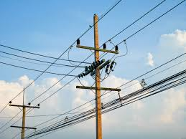
Utility Taxes (Cont’d)
Can be included in your utility rate setting process with public notice (RCW 35.92.450).
Electricity, Natural Gas and Telephone capped at 6%.(RCW 35.21.870)
Prepaid wireless is subject to local Utility Taxes. (TracFone Wireless v City of Renton 2024) –source MRSC

Slide 16
Local Business and Operations Tax (B&O)
(RCW 35.102)
Council-majority approved tax.
Can be applied to businesses with a defined “nexus” within the City.
Can have different categories and rates for different classifications and categories of businesses per RCW.
Stable revenue source, collected quarterly.
Although permitted statewide, as of 2024 there is no City east of the Cascades that has implemented a B&O.
Local consortium, File Local has several member jurisdictions with a single reporting portal.

Slide 17

Business Licenses (RCW 35.90):
Regulated at the local level by City Ordinance.
Can include the following:
  Flat fees scaled by size and category of businesses.
  Fees for square footage of businesses.
  Fees per employee.

Slide 18
Business License Fee Example: Redmond
  A. Reporting by Hours Method. The annual business license fee in 2025 is calculated by determining the number of employee hours (1,920 hours) worked in the City of Redmond in the previous year and multiplying that figure by $0.079688 in 2025. The resulting dollar amount must be rounded to the nearest cent. The City shall allocate $66.00 out of each $153.00 received to the general fund and $87.00 out of each $153.00 received to transportation capital improvements or transportation demand management projects in 2025.
  Source: Redmond Municipal Code 5.04.082

Slide 19

Admissions Taxes (RCW 35.21.280)
Council approved up to one cent per $.20 cents (5%) of the admission charge.
Can be levied on Admission Charges to the Following with Council Approval:
  Season Tickets or Subscriptions.
  Cover Charges.
  Charges for Food and Refreshment when free “entertainment” is provided.
  Charges for the Rental or use of Recreational Facilities and Equipment.
  Charges for Vehicle Parking if charge is based on the number of passengers.

Slide 20
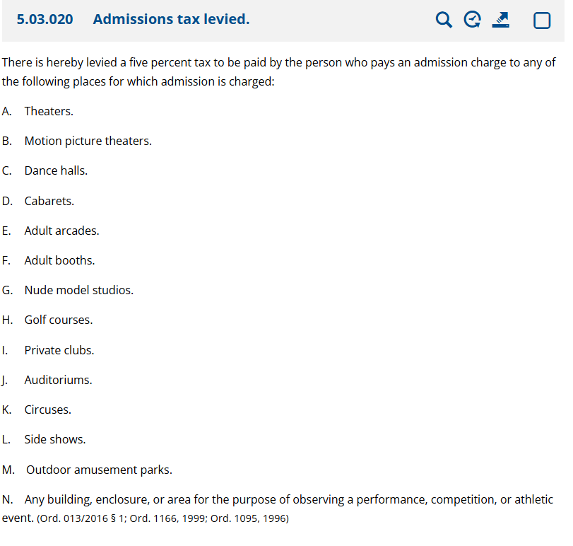
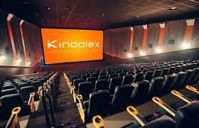
Admissions Tax Ordinance: Monroe Example

Slide 21
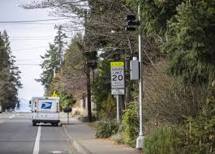
Red Light and Speed Cameras RCW 46.63
New bill passed in 2024, HB 2384 Expanded use of Cameras.
  Existing Law permits red light cameras and school zone speed cameras
  New law expands to include:
    Hospital Speed Zones
    Public Park Speed Zones
    School Walk Zones
    Applies not non-freeway state routes within City limits.
  Other new provision allows for additional camaras to detect speed violations due to higher crash risks (number of cameras is population based).

Slide 22
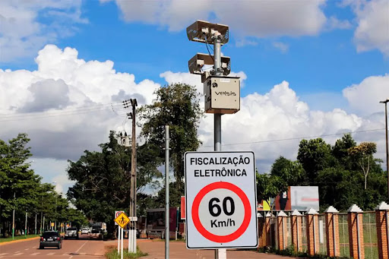
Pros and Cons of Red Light and Speed Cameras
Pros:
  Additional revenue for traffic safety project and operations.
  Safety, reduced accidents at intersections and high-risk areas.
Cons:
  25-50% of the revenue can go to the company managing the cameras.
  Can require additional staff for police and courts to process violations.
  Political/community considerations.

Slide 23
Other Revenue Options
Comprehensive Fee Study
  Development Fees
  Park Fees
  Public Safety Fines and Fees
Franchise Agreement Evaluation
  Cable, Solid Waste, Electricity
Smaller Taxes
  Gambling Taxes
  Parking Taxes
  Lodging Taxes up to 4% (has restrictions)
  Tourism Promotion Fees
  Liquor Profit Distributions (Restricted)

Slide 24

Roundtable Discussion
What Fees and Taxes has your jurisdiction passed?
What works, what doesn’t work?
How have you convinced your council to implement new revenues?

Slide 25
Resources
MRSC Links to Tax Resource and City and County Revenue Guides:
https://mrsc.org/explore-topics/finance/data/tax-and-population-data
City of Seattle B&O Information:
https://www.seattle.gov/city-finance/business-taxes-and-licenses/business-taxes
City of Bellevue Tax Information:
https://bellevuewa.gov/city-government/departments/finance/business-taxes/special-local-taxes
City of Spokane Development Fee Changes:
https://my.spokanecity.org/business/resources/

Slide 26

Thank you! Questions?
T. Robert Hamud
425-615-6234
roberth@fcsgroup.com
www.fcsgroup.com

