Slide 1
Federal Tax and Securities Law Compliance for Bond Issuers
June 10, 2026
Toby Tobler
Clare Riva
Notes:
Good morning and welcome to Fed Tax and Sec
Thank you so much for joining us here today
My name is Toby Tobler, and I’m a partner in Pacifica’s public finance group
Serve as bond and disclosure counsel to counties, cities, SDs, ports and other municipalities
[CR intro]

Slide 2

Additional Resources
    2026 Public Finance Sessions
      Bonds 101: A Municipal Bond Primer
      Bonds 201: Securities Law
      Bonds 201: Tax Compliance
      Ballot Measures and PDC Regulations
    Additional public-finance related materials:
    https://www.pacificalawgroup.com/news-items/library/public-finance/
Notes:
Our focus today is going to be on some of the key post-issuance tax and securities law compliance requirements that you as a bond issuer should be aware of if you have publicly sold or tax-exempt bonds on the market
In other words: bonds that have not matured or been redeemed
Post-issuance compliance is also, of course, important to be thinking about now if you think you might be issuing bonds soon so you can plan for how to tackle these requirements
We’ll do our best to cover the basics today
But these areas of law are defined by rules, exceptions to the rules, exceptions to the exceptions and lots of related minutiae
We’re just going to have time to scrape the surface here today to help make you aware – broad strokes - of what types of things you need to be watching out for
But this overview is by no means comprehensive and we know you will may have other bond and debt-related questions
So before we start, I want to flag some additional resources
First: We are offer free Pacifica U sessions every year we hope you will join us for, if you’d find them helpful
In the months ahead, we plan to host sessions on [read from slide]
We do these remotely over zoom so they are easy to attend
If you’d like to be included, just reach out to us and we’ll make sure you’re on our list
Second: we have loads of great written materials online
Drafted to help issuers understand key aspects of bond issuance
Cover a broad range of topics (including topics we’re delving into today)
We’ve linked the webpage for the articles on this slide
Third—and please consider this a key takeaway for today—
This session is not intended as a “DIY” manual
The most important resource available to you is your Finance Team—your team of outside bond experts
Please: rely on the folks who do this stuff day in/day out
If you’re thinking of issuing bonds, reach out to your bond counsel early
If you’ve got bonds in the market, and you have federal tax questions or disclosure questions, reach out to us
Our job to help you things on track

Slide 3















Pacifica’s Public Law and Finance Team
Helping Washington Communities Build for the Future
Alison Benge
Stacey Crawshaw-Lewis
Emma Daniels
Lanna Do
Rachel Giles-Klein
Deanna Gregory
Jon Jurich
Kristin Patterson
Faith Li Pettis
Clare Riva
Tobias D. Tobler
Matthew J. Segal
Jill Wagner
Mia Wiltse
1191 2nd Ave, Suite 2000, Seattle, WA 98101
T 206.245.1700 | pacificalawgroup.com
Notes:
Here at Pacifica, we have a team of eight public finance attorneys with decades of experience in all types and aspects of bond issuances, including a full, time tax attorney (Alison)
She is our go to for all your most complex tax-related questions
We also have a dedicated, amazing staff including four full-time paralegals who specialize in bonds
We absolutely love this stuff (we really do!) and we’re here to help

Slide 4

Roadmap
    Federal tax requirements
      Arbitrage and rebate
      Private use
      Recordkeeping
    Federal securities law
      Antifraud provisions
      Ongoing disclosure
Notes:
Let’s discuss briefly where we’re headed today
First, I’m going to address federal tax compliance requirements for issuers who sell tax-exempt bonds
Arbitrage and rebate – these are the tax rules that determine the circumstances in which you as an issuer can:
Invest proceeds of a bond issuance at a yield higher than the yield on the bonds; and
Keep that difference (as opposed to rebate it to the IRS)
Private use – The IRS expects that governmental issuers (like yourselves) will issue TE bonds primarily for governmental purposes.
Here, we will discuss the rules re: how much of bond-financed facility may be used for other types of purposes
We’ll also briefly discuss the records you as an issuer must maintain in order to ensure compliance with these rules and survive an IRS audit
Second, my colleague Clare is going to discuss the federal securities laws that apply to publicly-sold bonds
She’ll be walking you through the federal antifraud provisions, and when and how they apply (broadly) to public statements made by municipal officers
And she’ll run through the rules for providing continuing annual disclosure, which all bond issuers sign up for when they issue publicly sold bonds
We will try to leave time for your questions at the end.

Slide 5
Federal Tax Requirements

Slide 6

Legal Framework – Federal Tax Law
Internal Revenue Code and regulations govern:
      Investment and arbitrage of bond proceeds
      How tax-exempt bond proceeds can be spent
      Use of the facility/asset
      Records retention
Notes:
Starting with a very basic point: the ability to issue tax-exempt bonds is a significant benefit for municipalities
Because the interest investors earn on these bonds is excludable from gross income for federal income tax purposes, the issuer, can pay lower interest (or “yield”) over the life of the bonds than would be possible without the exemption.
But the exemption also means the federal government collects less in tax revenue.
Thus, in the eyes of the feds, the tax exemption is a subsidy.
And where there is a subsidy, there are rules with which the beneficiary must comply to satisfy the federal government that the bonds are being used for an appropriate governmental purpose:
Namely, projects that serve the general public and are owned or operated by a governmental entity, such as municipal buildings, highways, and public infrastructure.
The Internal Revenue Code (or “IRC”)—and regulations promulgated under the IRC—are the applicable rules in this space, and they govern:
How municipal issuers may invest bond proceeds, and how much of any positive earnings they get to keep
What they can spend bond proceeds on
Relatedly, how any bond-financed facility or asset can used after it is built and put into service
And what records the bond issuer must retain (and for how long)

Slide 7

Investment Limitations: Arbitrage & Rebate
  “Arbitrage” is the ability to earn yield by borrowing money at a lower rate (by issuing tax-exempt bonds) and investing it at a higher rate
      Positive arbitrage: earnings above the bond yield
      Negative arbitrage: earnings below the bond yield
  Two sets of rules, applying to “gross proceeds”
      Yield restriction: “Can you earn it?”
      Rebate: “Can you keep it?”
Notes:
Let’s start with those investment limitations, which exist because (again) the point of TE bonds is to finance projects with a governmental purpose, not to allow municipal governments to earn arbitrage
By “arbitrage,” I mean the ability to earn yield by borrowing money at a lower rate (by issuing tax-exempt bonds) and investing it in higher-yielding taxable obligation
Positive
Negative
There are two sets of rules that apply
First, there are yield restriction rules which answer the question of, “Are, as an issuer, allowed to earn any positive arbitrage through investing the gross proceeds of the bond issuance”?
Second, there are rebate rules which answer the question of, “If you earned positive arbitrage, are you allowed to keep it or do you have to return it to the IRS”?
Important definition: gross proceeds
means (first and foremost) the sale proceeds you receive when you sell bonds
but also includes the investment earnings themselves, and
any other funds that are a source of payment for the bonds (such as debt service and reserve funds)
[Gross proceeds –
Sale proceeds
Amount received from the sale of the bonds (Issue Price)
Includes amounts used for underwriter’s discount
Investment proceeds: earnings from investments or reinvestment of proceeds
Transferred proceeds
Only applies in refundings
These are proceeds of a refunded issue that remain unexpended after refunding
Treated as transferred to the refunding bonds
Tax documentation at closing will describe any expected transferred proceeds
Replacement proceeds
Debt Service Funds
Reserve Funds
Other amounts that are pledged or expected to be used to pay debt service]

Slide 8
Yield Restriction (Can you earn it?)
  General rule. Gross proceeds must be yield restricted.
  Exceptions. (unrestricted yield)
      As part of a “minor portion” (lesser of $100K or 5%);
      As part of a “reasonably required reserve fund”;
      Investment in “tax-exempt bonds” that are not considered “investment property”;
      During an allowable “temporary period.”
Notes:
Starting with the first test: the Yield restriction rule
General rule: is that investment of gross proceeds must be yield restricted
In other words, the proceeds may not be invested at a yield that is materially higher than the yield on the bonds
Allowable spread depends on type of investment – but general rule is 1/8 of 1%
For fixed rate issues, the bond yield (or “arbitrage yield”) is determined at closing and will be included in the tax certificate and on the Form 8038 or 8038G
Fortunately for issuers, there are several exceptions to the general rule
That is, there are circumstances in which the issuer does not need to yield restrict and can earn a yield higher than the yield on the bonds
What are these exceptions?
“Minor portion” rule allows higher yield investments on the lesser of (i) 5% of issue proceeds or (ii) $100K
Likewise, proceeds may be invested without yield restriction as part of a reasonably required reserve fund
Reserve fund – fund where you keep gross proceeds used as security for repayment revenue bonds (not GO bonds)
[To be “reasonably required,” cannot exceed the least of
(i) 10% of the stated Principal amount of the Bond Issue
(ii) the maximum annual Principal and Interest requirements of the Bonds, or
(iii) 125% of the average annual Debt Service requirements of the Bonds.]
Yield restriction rules do not apply to certain types of tax-exempt bonds that are expressly excluded from the rule by law, such as demand deposit SLGS or certain tax-exempt money market funds
[State and Local Government Series (SLGS) securities are non-marketable U.S. Treasury securities sold directly to state and local government issuers.]
Lastly—and this it the most common exception—issuers may invest proceeds without yield restriction during specified “temporary periods”

Slide 9
Yield Restriction: Temporary Period Exceptions
  Project fund. Three-year temporary period, if Issuer expects:
      85% of sale/investment proceeds will be spent down in period;
      Substantial binding commitment to third party to spend 5% of proceeds on capital projects within 6 months;
      Construction or acquisition will proceed with due diligence.
  Refunding escrow. 90 days from date of issuance.
  Bona fide debt service fund. 13 months.
Notes:
What are the temporary period exceptions?
Project funds do not need to be yield restricted for up to three years if [see slide]
This rule recognizes that bond proceeds are not generally spent immediately for construction projects
Provides administrative ease for issuer in interest rate environment where short-term investment yields exceed bond yield
Temporary period can be extended to five years with a certification from the issuer and a licensed architect that a longer period is necessary to complete the project
Likewise, funds in a refunding escrow do not need to yield restricted if they will be spent down in less than 90 days
And funds in a bona fide DS fund do not need to be yield restricted for up to 13 months
[DS fund must be used primarily to achieve matching of revenues and debt service within each bond year and be depleted at least once each bond year, with reasonable carryover]
Availability of these temporary periods is established based on the reasonable expectations of the issuer, as certified in the Tax Certificate completed at the time of issuance
But what if things change after the bonds are issued and your reasonable expectations don’t bear out?
For example, if you have project funds remaining after the 3-year temporary period
You’re not off the hook – you may need to yield restrict to avoid paying rebate
In other words, there is a continuous monitoring responsibility and if your reasonable expectations are thwarted or change, you should adjust accordingly
If this happens, good idea to contact bond counsel or hire a rebate consultant
You may need to, for instant, start investing proceeds in yield-restricted securities (like demand deposit SLGS)

Slide 10

Rebate (Can you keep it?)
  General rule. Must compute and pay back (rebate) the IRS for difference between the arbitrage yield and bond yield.
      Computation every five years, until date of maturity/redemption
      90% payment required within 60 days of computation (100% within 60 days of final computation date)
      Rebate submitted with Form 8038-T
      Rebate consultant can help!
Notes:
That brings us to the second part of the analysis
Let’s assume you’ve met an exception to yield restriction, and you’ve made positive arbitrage
Remember: that only gets you halfway there.
Next question is: Can you keep it?
General rule: Must compute and pay back (as rebate) the difference between the amount actually earned on the investments and the amount that would have been earned if investments had a yield equal to the yield on the bonds.
When do you have perform this computation?
Some flexibility in choosing computation dates, but cannot be later than 5 years after issue date and every 5 years thereafter
Obligation runs until date of redemption or final maturity of the bonds
Refunding triggers new final maturity
When is payment due?
At least 90% of rebate owed must be paid within 60 days of each computation date
100% must be paid within 60 days of final computation date

Slide 11

Exceptions to Rebate Requirement
  Small issuer exception (issuing no more than $5m in the year)
  Spending exceptions
      Six-month spending exception
      18-month spending exception
      24-month spending exception
  Debt service fund exception
  No exception for reserve funds*
Notes:
Paying rebate is not the end of the world
Simply means you maximized your investment earnings
Just need to monitor and pay as required
And important to track because those amounts because, depending on the interest rate environment, can be significant
Of course, if possible, you want to find a way to keep positive arbitrage
And fortunately there are exceptions to the general rebate rule
Meaning, if you earn arbitrage under an exception to the yield restriction rule and you fit within an exception to the rebate requirement, you can keep those excess earnings
What are the exceptions to rebate requirement?
If you are a government that issues less than $5m during the calendar year of the issue, you are exempt from rebate
There are also spending exceptions:
No rebate is owed for any bond issue if the proceeds are spent within six months
Alternatively, no rebate is owed for any bond issue for a capital project (including acquisitions) provided the proceeds are spent within 18 months on a semiannual spending schedule
Excludes refundings
[semi-annual: 15% by 6mo.; 60% by 12mo.; 100% by 18mo.]
And lastly no rebate is owed for construction financing issues (not including acquisitions), provided the proceeds are spent within two years on a semiannual spending schedule
[semi-annual: 10% by 6mo.; 45% by 12mo.; 75% by 18mo.; 100% by 24mo.]
Amounts earned on bona fide debt service funds are excepted from rebate as long as the total earnings do not exceed $100K in a year
But there is no exception for reserve funds; you must always pay rebate on excess earnings (so even if you can earn it, you can’t keep it) – asterisk - unless you qualify for the small issuer exception
Wrap-up points on arbitrage/rebate:
The tax certificate drafted by your tax counsel and executed at the time of the bond sale is the key reference document
Includes the yield on the bonds
Spells out the reasonable expectations, re: yield restriction, rebate exceptions, replacement proceeds (if any)
Record-keeping is critically important (will return to this)
Track where you stand on your spend-down
To compute rebate
Annual check in during construction period on progress towards goals

Slide 12
Limitations on Private Business Use
  Nonqualified “private activity bonds” = TAXABLE
  Two ways to have private activity bonds:
      Private business use plus private payments/security: 10% or $15m
      Private loans: 5% or $5m
  “Private business use” means:
      Use (directly or indirectly) . . .
      Of a financed facility . . .
      In a “trade or business” . . .
      Carried on by any nongovernmental person.
Notes:
Let’s now move on to a different category of regulation: private business use
Subject to certain exceptions spelled out in the IRC and regulations, the federal government expects the proceeds of tax-exempt municipal bonds to be used primarily for governmental purposes, not private purposes
i.e., not for what the code refers to as “private business use”
Accordingly, rules and regulations require that only a specified percentage of a governmental bond issuance go towards PBU
If the bonds exceed these limitations on PBU, they constitute nonqualified PABs, and are taxable
Two ways for your bonds to qualify as PABs
First, under the “private business tests,” a bond is a PAB if it is part of an issue in which:
more than 10% of the proceeds of the issue or $15M are to be used in the trade or business of any person other than a governmental unit—the “private business use test” and
more than 10% of the payment of principal of or interest on the issue is, directly or indirectly, secured by property used in a trade or business, or derived from payments related to property used in a trade or business
typically met if first prong is met
Private loan test: prohibits governments from providing loans financed by TE bonds to nongovernmental persons and entities if they exceed 5% of the proceeds of an issue or $5M
For today’s purpose I’m focusing on the PBU test because that is where private use issues and questions tend to arise most often
Definition of PBU [on slide]
[private activity bonds:
----------

Slide 13

Limitations on Private Business Use
  “Nongovernmental person”
      Corporations or other business entities
      Federal government
      Natural persons engaged in business
      Nonprofit organizations
  Examples of private business use:
      Private ownership of financed facility
      Lease to a private business user
      Nonqualified management contracts
      Special legal entitlements/priority rights
Notes:
“Nongovernmental person”
[Walk through slide]
Does not include use by other non-federal governmental entities
Common examples of PBU
Most obviously: ownership or lease of bond-financed property
Also, certain nonqualified management contracts for such property, such as food service contracts; parking contracts
Nonqualified –
Based on facts and circumstances
Generally, PBU if management contract provides for compensation based in whole or in part on the net profits of the financed facility
Or if the service provider is treated as the lessee or owner for federal income tax purposes.
Contracts for services incidental to facility’s primary functions (e.g., janitorial) do not constitute PBU
Special entitlements or priority rights
e.g., naming rights, priority use of parking spaces

Slide 14

Private Business Use Exceptions
  General public use
  Incidental use
      Use is nonpossessory
      Not more than 2.5%
      e.g., kiosks, vending machines
  Short term use
      Less than 50 days
      Fair market value payments
      e.g., facility rental
Notes:
Just like with arbitrage and rebate, we are always looking for the exceptions to the rule!
These are three of the most common exceptions to PBU.
General public use
Allowing use by a nongovernmental party on the same basis as to the general public is not considered PBU, even if that party happens to be engaged in business
For example, use of a bond-financed toll bridge by a business vehicle is not PBU.
“General public use,” in this context, typically means use is free or subject to a generally applicable rate schedule
Incidental use exception
Kiosks, vending machines, advertising, payphone…
Uses that are non-possessory
And do not exceed 2.5% of the financed facility
Short Term Use (i.e., facility rentals)
Less than 50 days of use under a single lease or use agreement
Payments must be fair market value
Wrap-up points:
Critical point re: monitoring
On issue date, whether 10% PBU limit is exceeded is based on issuer’s reasonable expectations over the life of the bond
After the issue date, 10% PBU limit can be exceed through any “deliberate action” of issuer (broad)
So, even if your expectation at the time of issuance is that there will be no PBU of you bond-financed facilities, or that there will not be sufficient PBU to exceed the 10% limitations, if those circumstances change during the life of the bonds – and that causes PBU test to be satisfied, your TE bonds are now potentially taxable
Remedial actions
Should definitely be talking to counsel
Redeem or defease nonqualified bonds
Can’t use TE debt
90-day window
Make alternative use of disposition proceeds
e.g., use cash from sale of water facility to build a new fire station
Must reasonably expect to expend proceeds w/n two years
Make alternative use of facility
Private purchaser buys gov’t own facility and then use qualifies as “exempt facility” (e.g., airport) under separate PAB rules
Voluntary Closing Agreement
Enter agreement with IRS to avoid PAB status
Issuer agrees to redeem bonds and pay IRS an amount based on assumption that bonds are taxable until redemption date
-----------------
Time permitting/in response to questions
PBU is generally measured over the term of the bonds based on average annual percent of business use (i.e., average of percentages of PBU during the one-year periods w/n the measurement period)
Measurement period is generally time from when property is placed into service and earlier of
final maturity of any bond financing property or
last day of reasonably expected economic life of property
Steps for calculating 10% limitation:
Determine the amount of PBU allocable to each financed project on an annual basis
Determine the PBU allocable to the bonds on an annual basis
Based on the proceeds allocated to each project
Taking into account any Qualified Equity
Example: 20-story building that is 100pct bond funded
3 floors to be used by a private business for all 20 years of expected life
PBU each year = 15% (not accounting for QE)
“Qualified equity” refers to funds that are:
Proceeds of non-tax advantaged bonds – i.e., taxable bonds; and
Funds that are not derived from a borrowing;
QE funds are spent contemporaneously with bond proceeds on the same project (“same plan of financing”)
PABs
Nonqualified private activity bonds are taxable, but qualified PABs are available to help private parties finance various types of projects that are designated as eligible for tax-exempt financing under the Code
Exempt facilities (airports; docks and wharves; mass commuting facilities; qualified residential rental projects (IRC § 142(d)); qualified green building and sustainable design projects; certain water, sewage, and solid waste facilities; and others); qualified mortgage bonds; qualified small issue bonds; qualified 501(c)(3) bonds (IRC § 145); and others
Often issued as a conduit bond
Issuer is a governmental entity
Proceeds loaned to conduit borrower to finance a qualified capital project or other authorized expenses
Generally have more tax restrictions than governmental bonds

Slide 15
Recordkeeping Requirements
  What records must you retain?
      Basic records relating to the bond transaction (transcript)
      Documents evidencing:
        the expenditure of bond proceeds
        the use of bond-financed property by public or private sources
        all sources of payment for and security of the bonds
      Documents pertaining to the investment of bond proceeds
  For how long must you retain them?
      General rule: for the life of the bonds, plus three years.
      If refunded: for the life of the refunding bonds, plus three years.
Notes:
Need to keep records of compliance with investment, expenditure and use requirements for the whole life of the bonds, plus any refunding bonds, plus 3 years

Slide 16
Post-Issuance Compliance Procedures
  Have written procedures
  Identify responsible person or persons for tax compliance
  Know arbitrage reporting requirements
  Track bond proceeds
  Monitor private use on an ongoing basis
  Have a record retention policy
  Call bond counsel if you have questions or run into issues
Notes:
- Mostly self-explanatory
- Monitoring PBU: someone needs to be aware of changes in use that knows these rules and can talk to bond/tax counsel

Slide 17
Federal Securities Law

Slide 18
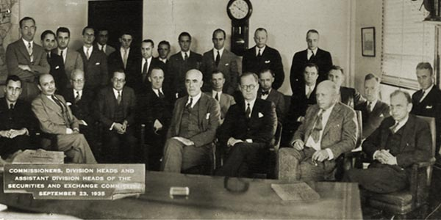
Securities and Exchange Commission (SEC)
Notes:
Very brief history & context
Stock market crashed in 1929 → Great Depression
Newly-elected President Roosevelt and Congress eager to restore investor confidence in stock market
Early 1930s: Congress passed two watershed laws:
The Securities Act of 1933 and
The Securities and Exchange Act of 1934
These acts, together:
Established registration reqs for certain types of securities (not including municipal bonds)
Established antifraud provisions applicable to all securities
Created SEC to enforce these laws
Photo of original SEC regulators
[click] including first SEC Chairman, Joseph Kennedy
Patriarch of Kennedy political family, father of JFK

Slide 19
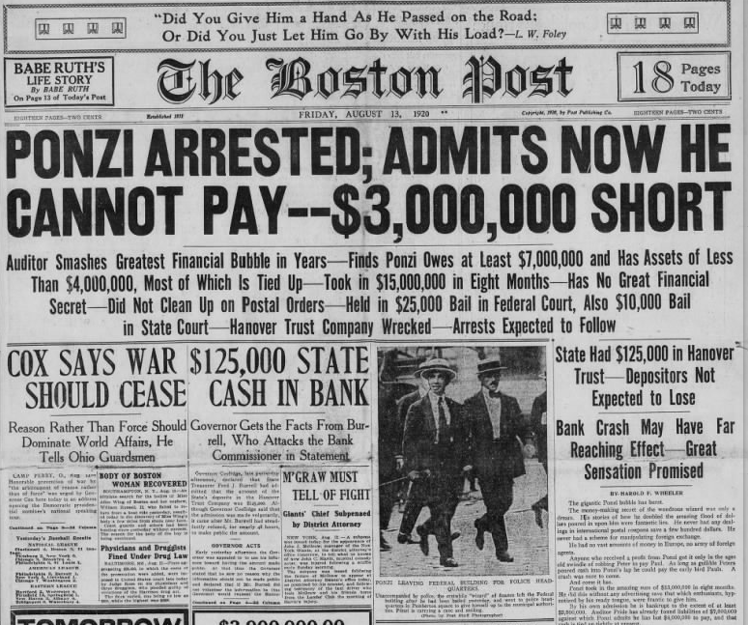

Federal Antifraud Provisions
Rule 10b-5
Sec. 17(a)
Notes:
Among primary purposes of the 1933/1934 laws:
Require disclosure of material information re: securities to allow investors to make informed decision
Prohibit misrepresentation or other fraudulent conduct in connection with the purchase and sale of securities
In short: [click] To protect investors and markets from people like:
Charles Ponzi
Credited with developing the eponymous “Ponzi” scheme
Federal law accomplishes these objectives largely through two antifraud provisions, both applicable to bond issuances:
[click] Rule 10b-5, promulgated under the 1934 Act, and
[click] Section 17(a) of the 1933 Act
We will discuss in detail what these laws prohibit and when they apply, but, in short, these provisions require that:
Any time an issuer “speaks to the market” (will flesh this out)
Statements must be accurate and complete
Violating these laws can result in serious consequences
SEC admin proceedings → sanctions Civil proceedings in federal court; or
Criminal referrals to Dep’t of Justice [click]
And of course - general infamy – don’t let this happen to you!

Slide 20
Federal Antifraud Provisions
    What conduct do these laws prohibit?
    Rule 10b-5. Unlawful in connection with sale of securities:
      To make any untrue statement of material fact, or
      Omit to state a material fact necessary in order to make the statements made, in light of the circumstances, not misleading
    Section 17(a). Unlawful, in the offer or sale of securities, to obtain money or property by means of:
      Any untrue statement of a material fact, or
      Any omission to state a material fact necessary in order to make the statements made, in light of the circumstances, not misleading
Notes:
What do these laws prohibit?
Rule 10b-5: Unlawful, in connection with sale of security, i.e., bonds
to make any untrue statement of a material fact or
omit to state material fact necessary in order make the statements made (in light of the circs) not misleading (a “material omission”)
Section 17(a) – very similar language
Together, in essence: unlawful for an issuer to make a material misstatement or omission in connection with the sale of bonds.
Note: antifraud rules apply to projections, forecasts, and opinions—
that speaker did not actually believe
that rely upon false information, or
that omit material facts

Slide 21

Federal Antifraud Provisions: Materiality
    Misstatement or omission is “material” if:
      Substantial likelihood
      Reasonable bond investor
      Would consider it important to an investment decision
      i.e., misstatement or omission significantly altered total mix of information
    Context matters!
Notes:
Touchstone of 17(a) and 10b-5 is “materiality”
Misstatement/omission must be material to constitute violation
Regulations do not define
But courts have furnished definition, through case law in this area—
[walk through slide]
Standard met where substantial likelihood that a reasonable bond investor would view misstatement/omission as having significantly altered total mix of info available
A key concept: materiality analysis is context dependent
If issuer provides investors with a regular, transparent flow of info (e.g., as part of its continuing disclosure undertaking), a particular errant fact is less likely to significantly alter the total mix of information than if a bond issuer does not provide such regular and transparent information.
Makes intuitive sense:
more complete picture and factual context → investors less likely to rely on a particular errant fact
that errant fact is therefore less likely to qualify as material
Conversely, if disclosure is incomplete and uneven, a particular errant fact is more likely to qualify as material

Slide 22
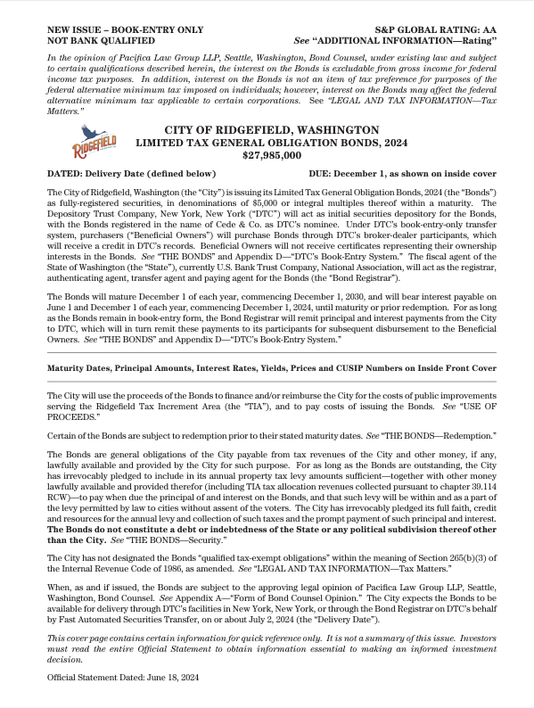
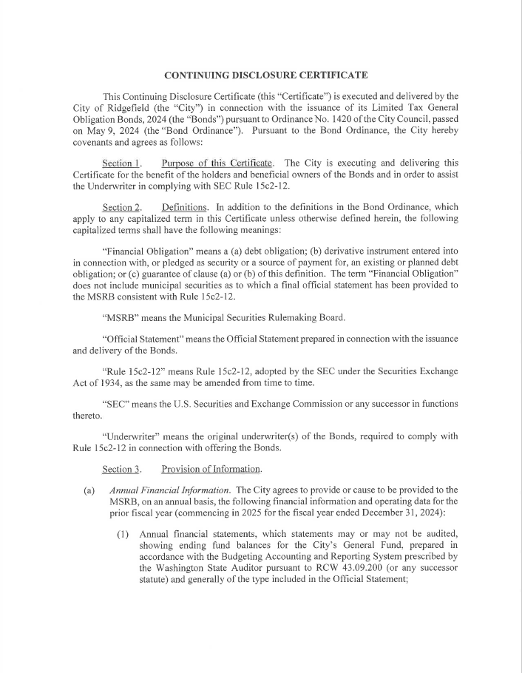
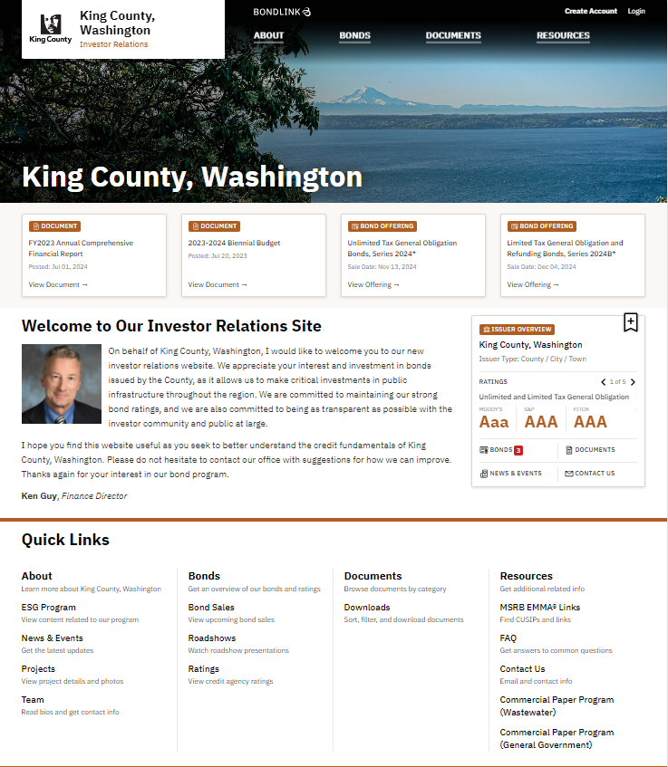
Federal Antifraud Provisions
    When issuer speaks to the market
    Primary disclosure (10b-5, 17(a))
      Preliminary Official Statement
      Official Statement
    Secondary market disclosure (10b-5)
    Voluntary disclosure (10b-5)
      Published information
      Public statements
Notes:
When do these laws apply? Answer: any time issuer “speaks to the market”
What does this mean?
We’ll dive into this
In short: applies whenever issuer makes a statement that can reasonably be expected to reach investors
Occurs in a few different contexts
Most obviously, primary disclosure [click]
Offering docs prepared and published by issuer at the time of the bond issuance (POS, OS)
Again our focus today is on post-issuance compliance so we’re not going to delve deep into them here but we encourage you to attend our PacificaU Bonds 101 or securities law sessions if you want to learn more about primary disclosure
We are going to get into secondary mkt disclosure, where antifraud rules also apply
Here we are referring primarily to filings issuers make to meet post-issuance compliance requirements set out in a continuing disclosure undertaking (will discuss in detail)
And lastly these provisions also apply to info issuer voluntarily publishes, including, e.g.: [CLICK]
Info posted on an investor relations websites
Public announcements/speeches
Press interviews; or
Public reports (e.g., ACFRs)
A quick aside about contexts in which these two provisions apply:
As you can see on the slide, both apply to primary disclosure
But only 10b-5 applies to secondary market disclosure
If the provisions are nearly identical, why does this matter?
Goes to a distinction relating to the state of mind req’d to prove a violation under each provision:
Section 17(a) has a negligence standard.
Meaning, to constitute a violation, municipality or official must have failed to exercise reasonable care in making the material misstatement or omission
Under 10b-5, which applies to secondary disclosure, a slightly more lenient recklessness standard applies
“highly unreasonable,” “extreme departure from standards of ordinary care”
But this distinction is really one for lawyers arguing in Court—you never want it to get this far
Key for an issuer is to ensure that statements that could reasonably reach investors are complete and accurate in all material respects

Slide 23
SEC Staff Legal Bulletin (Feb. 7, 2020)
    Broad interpretation of when an issuer “speaks to the market”:
    Any public statement (at least by officials who may be viewed as having knowledge regarding the financial condition and operation of an issuer) may be reasonably expected to reach investors and therefore be subject to the antifraud requirements.
    Rule 10b5 can apply regardless of:
      Speaker’s intentions;
      Medium of delivery (written, oral);
      Whether disclosure is formal; or
      Whether is issuer is otherwise compliant with an undertaking.
    Statements covered by rule can include:
      Public announcements/speeches;
      Press interviews;
      Public reports (e.g., ACFRs)
      Information posted on a website; or
      Responses to investor cold calls.
Notes:
To recap what we’ve covered so far: antifraud req’s apply whenever issuer speaks to the market
This includes not only the offering documents
But also an issuer’s disclosures after issuing bonds, which can reach investors in secondary market for the bonds, including:
Disclosures made pursuant to contractual continuing disclosure undertaking (which I’ll turn to in a moment), and
Voluntary and informal disclosures
Let’s talk more about voluntary and informal disclosures…
A 2020 staff legal bulletin from the Office of Municipal Securities, SEC made clear how broadly it interprets the scope of 10b5 in this context
[read language in italics]
Let’s unpack, because, in practice, this formulation’s reach is extensive:
[click] [move through list]
The fact that you may otherwise be fully compliant with undertaking will not save you if your voluntary disclosures constitute a material misstatement or omission
(though, as I mentioned before, it may prevent a misstatement or omission from qualifying as material!)
[click] [move through list]
Particularly for munis operating under sunshine laws (WA’s open public meetings acts), and post meetings, minutes, all sorts of information to web, almost everything can reach investors.
Key takeaway: SEC views the scope of the antifraud requirements as very broad, applicable to public statements by those with knowledge of the issuer’s financial and operating condition (including mayors, councilmembers, finance officers, city attorneys)

Slide 24
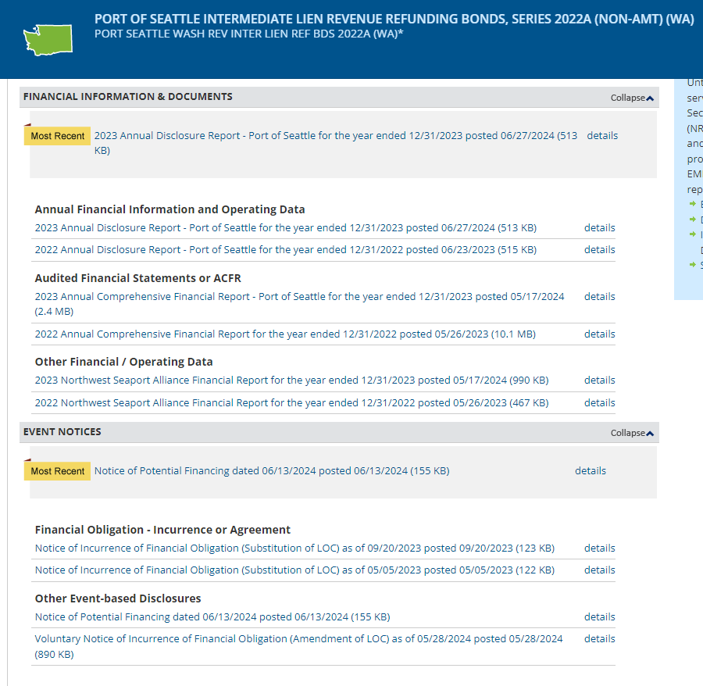
Rule 15c2-12: Continuing Disclosure Undertakings
    Required under SEC Rule 15c2-12
      Applies to all public bond sales
      Duration = the life of the bonds
    Elements of an undertaking:
      Annual financial and operating information
      Notice of “listed” events
    Published on “EMMA”
Notes:
As I’ve noted, apart from voluntary and informal disclosure, Rule 10b-5’s antifraud rules also apply to formal disclosures made to the secondary market through issuer’s contractual CDUs.
Brief detour from discussing antifraud rules to discuss these CDUs: What are they and what do they require issuers to do?
Key rule in this context is SEC Rule 15c2-12:
In effect, requires that, for any public sale of Bonds, issuer enter contractual undertaking to provide the mkt certain ongoing financial and operating information after time of issuance
Obligations of undertaking run with life of bonds (up to 40 years)
Purpose behind rule?
Recognizes that Bonds often traded in secondary market
Disclosures help investors access timely, non-stale info re: the financial state of the issuer responsible for paying debt service
What specific info do undertakings require?
First, certain annual financial and operating information for each FY, including the issuer’s audited financial statements
Typically a few items not included in financial statements, as agreed to in the undertaking
Specific to the security
e.g., For GO bond: info re: annual tax levies and collections
Second, undertakings req notice of occurrence of any of 16 specified events listed in Rule 15c2-12 (will discuss in a moment)
All info must be posted by issuer on the Municipal Securities Rulemaking Board “Electronic Municipal Market Access” system
“EMMA” for short
Official repository for muni securities disclosure, as designated by the SEC
[click and walk through]

Slide 25

Rule 15c2-12: Notice Events
    Sixteen notice events identified in Rule 15c2-12
      Some must always be disclosed
        e.g., rating change
        e.g., defeasances and redemptions
      Others must be disclosed only if material
        e.g., defaults
        e.g., incurrence of a new financial obligation
    Must disclose within 10 business days
Notes:
Let’s now focus on the requirement in each undertaking that the issuer provide notice of any of 16 events specified in Rule 15c2-12
First, what are these specified events (or “notice events”)?
16 of them, and I won’t read them all to you
Fall into two buckets, broadly speaking:
One bucket: events for which issuer must always provide notice, regardless of context, e.g.:
Change in bond rating from credit rating agency
Defeasances/redemptions
Second bucket: events for which issuer must provide if material
e.g., defaults (non-payment-related default)
Most prominently: “incurrence of a new financial obligation” which we’ll circle back to
Timing: Issuer has only 10 business days after receiving notice of ocurrence of event to disclose this info on EMMA

Slide 26
Rule 15c2-12: Notice Events 15 and 16
    Notice Event 15
      Incurrence of a financial obligation
      Agreement to covenants, events of default, remedies, priority rights, or other similar terms of a financial obligation . . .
    Notice Event 16
      Default, event of acceleration, termination event, modification of terms, or other similar events under the terms of a financial obligation
      Any of which reflect financial difficulties
Notes:
Want to focus briefly on two most recent notice events (15 and 15), added to the Rule in Feb. 2019
First, what do they require? In a nutshell:
Event 15 requires notice of incurrence of, or agreement to terms of a material financial obligation
Event 16 requires notice of a default or similar event under one of these financial obligations if the event reflects financial difficulty (e.g., payment-related default)
Quick note on a few limitations:
No disclosure req’d for incurrence of new bonds with OS/CDU
Rule applies only to undertakings entered into after Feb. 2019
To require disclosure, event must be material (we’ll discuss…)

Slide 27

Rule 15c2-12: “Material Financial Obligation”
    “Financial obligation” means
      (i) debt obligation
      (ii) derivative instrument entered into in connection with, or pledged as security or a source of payment for, an existing or planned debt obligation; or
      (iii) guarantee of (i) or (ii)
    “Debt obligation” includes:
      Loans from banks or other governments (e.g., WIFIA, TIFIA, PWTF)
      SEC: financing/capital leases
    “Material” imports case law definition
Notes:
These two notice events raise a couple definitional questions:
What constitutes a “financial obligation”?
When is an obligation or change to a FO “material”?
Let’s start with the definition of “financial obligation.” Here is the definition from the Rule; essentially includes:
Debt;
Swap;
Or a guarantee of either a debt or a swap
What constitutes “debt” in this context?
Includes bank loans or governmental loans
Federal loans (e.g., WIFIA)
State loans (ecology, PWTF)
Warning: also includes leases that operate as a vehicle to borrow money (e.g., capital or financing leases, not operating)
[click] SEC staff has specifically commented that equipment financing leases if material may constitute financial obligations depending on the facts [acceleration; DS covenants]
If you have material financing lease, flag for your bond counsel for further review.
The term “material” shows up in Event 15
Not defined by rule; SEC defers to case law definition
i.e., whether a reasonable investor would find the information important, would alter the total mix of information
Impetus behind two new events is understandable: SEC concerned issuers entering into bank loans not being timely disclosed (if at all), and that investors in secondary mkt therefore weren’t receiving complete info about the debts and related covenants being incurred by issuers
But these requirements are tricky and potentially onerous:
Unlike the first 14 notice events, which relate to the underlying bonds, these two require the issuer to track and notify bondholders about the issuer’s other financial obligations
Issuer must think beyond bonds covered by the CDUs to be aware whenever issuer enters a new material loan agreement…
And file an EMMA notice w/n only 10 days

Slide 28
Rule 15c2-12: Takeaways
    Adopt internal procedures
      Identify individuals responsible for aspects of undertaking
        Compiling annual financial and operating information
        Review and approval of filings for accuracy and completeness
        Completing EMMA filings
      Build institutional knowledge
    Examine how your office tracks “financial obligations”
    Assessing “materiality”
    Training
Notes:
What can issuers to stay on top of this and on top of its continuing disclosure undertaking obligations more broadly?
Adopt internal procedures [see slide]
Should identify individuals responsible for undertaking
Compiling annual filings of financing/operating info
Review/approval of all filings (remember: antifraud rules apply, so all must be materially complete and accurate)
Completing filings on EMMA themselves
And, circling back to our discussion of how issuer’s public statements, including even casual comments, can be subject to antifraud rules: You may wish to designate a disclosure officer(s) to field investor question and avoid inadvertently providing inaccurate or incomplete info.
Should build in oversight and spread institutional knowledge
Want more than one person to understand compliance reqs and have visibility into req’d filings.
Avoid situation where one person has all the responsibility in this area, and takes all info with them when they retire
And of course: Not enough to simply ID those responsible for disclosure
Outline steps for these individuals to follow when developing, reviewing, approving and disseminating disclosures
Recognizing that we’re all busy and imperfect: incorporate multiple levels of review whenever possible for all disclosures that can reasonably be expected to reach investors
We regularly draft these procedures for our clients – reach out to your bond counsel for help
As to Notice Events 15 and 16 more specifically
Examine how you track incurrence of financial obligations—such as new bank loans, state loans, or financing leases—or material changes or financial difficulties relating to such obligations
Ask: How can we ensure that those in best position to know about these events communicate the information in a timely manner (days!) to those responsible for disclosure compliance?
Depending on how decentralized these activities are, you may need very clear procedures requiring timely internal communications regarding material financial obligations
As part of this discussion, might consider how to assess “materiality” for continuing disclosure purposes
A dollar threshold can be a starting point for requiring staff to report financial obligations to those responsible for disclosure
e.g., everything over X dollars gets reported up
But a couple of warnings:
Small loans could in the aggregate reach a material amount
And even a small loan may have features—such as an acceleration remedy—that makes it material
Depending on volume, you may want disclosure officers to see everything that could qualify—even small loans and leases,
Can then review for qualitative factors that may make a small obligation material, and require filing a notice
Next one is self-explanatory: Have disclosure staff attend regular trainings (such as this one) to:
remind staff of scope of antifraud provisions and disclosure obligations
communicate any updates to these rules, which do happen (as we heard today with the Supreme Court’s ruling in Jarksey)
reiterate importance of practicing utmost care in disclosure
We can also come to you – to present to your staff or your electeds!
These are not our ideas – they come from the SEC.
Complying with them is a good way not only to avoid trouble
But also demonstrate good faith if ever subject to investigation
Particular SEC focus in investigations: What policies/procedures did issuer have in place to ensure quality disclosure?

Slide 29
Disclosure Compliance Takeaways
    Develop internal controls and procedures.
      Identify individuals responsible for disclosure process
      Secondary review and approval of primary and secondary market disclosures
    Establish periodic training schedule on federal securities law.
    Carefully scrutinize financial projections.
      Assess underlying assumptions and base year
      Note discrepancies from current year budget or prior statements
      “Bespeaks caution” language
    Be wary of outdated historical information no longer reflecting current conditions; supplement and explain.
    Ensure information provided to intermediaries is materially complete and accurate.

Slide 30
Pacifica’s Public Law and Finance Team
Helping Washington Communities Build for the Future
Alison Benge
Stacey Crawshaw-Lewis
Emma Daniels
Lanna Do
Rachel Giles-Klein
Deanna Gregory
Jon Jurich
Kristin Patterson
Faith Li Pettis
Clare Riva
Tobias D. Tobler
Matthew J. Segal
Jill Wagner
Mia Wiltse
1191 2nd Ave, Suite 2000, Seattle, WA 98101
T 206.245.1700 | pacificalawgroup.com

