Slide 1
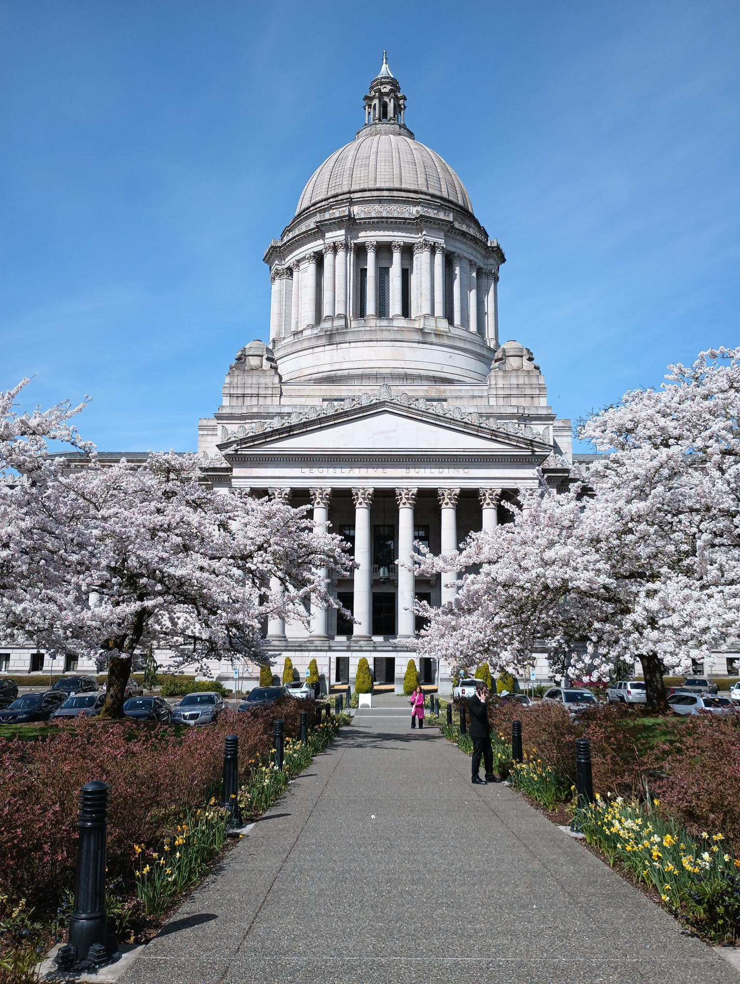
AWC
Legislative
Update

Slide 2
AWC’s Government Relations Team
Candice Bock
Director​
Issue areas – Economic development; federal issues; finance, taxes & budgets; human resources, labor relations & pensions; liability​; open government
Carl Schroeder
Deputy Director​
Issue areas –​Building codes; environment & natural resources; housing & homelessness; land use & planning​
Steven Ellis
Government Relations Advocate​
Issue areas – Public works & infrastructure; telecommunications; transportation; utilities & energy​
​Derrick Nunnally
Government Relations Advocate​
Issue areas – Cannabis; emergency management; general government; human services & behavioral health; public safety & criminal justice​
Sheila Gall
General Counsel​
Issue areas – Finance, taxes, & budgets​
Shayla Nelson
Government Relations Assistant​
Shannon McClelland
Senior Legislative Policy Analyst​
Issue areas – Building codes; environment & natural resources; housing & homelessness; land use & planning​
​Matt Doumit
Legislative Policy Analyst​
Issue areas – Human resources, labor relations, & pensions; liability; general government; open government​
​Brianna Morin
Legislative Policy Analyst​
Issue areas – Federal issues; public works & infrastructure; telecommunications; transportation; utilities & energy​
​Emma Shepard
Legislative Policy Analyst​
Issue areas – Cannabis; emergency management; finance, taxes & budgets; human services & behavioral health; public safety & criminal justice​
​
Jacob Ewing
Special Projects Coordinator​
Issue area – Economic development; federal issues; human services & behavioral health; parks ​
​
​

Slide 3
2025 Legislative Session
105-day Session: January - April
New legislators, new committees, new chairs, 43 legislators with city/county background
Biennial budgets: Operating, Capital, Transportation
Policy focus: Revenue, housing, education
Democrats expand majorities: 30-19 Senate, 59-39 House
Economic environment: Budget shortfall, negative revenue forecasts, high interest rates, inflationary pressure; federal funding uncertainty
Notes:
Last few days of session - Sine die is on Sunday, April 27.
Budgets are usually some of last bills remaining, and this year they are trying to fill a $16 billion shortfall over 4 years.
Governor has 20 days excluding Sundays to sign or veto bills.
AWC tracked 612 bills that impacted cities.

Slide 4
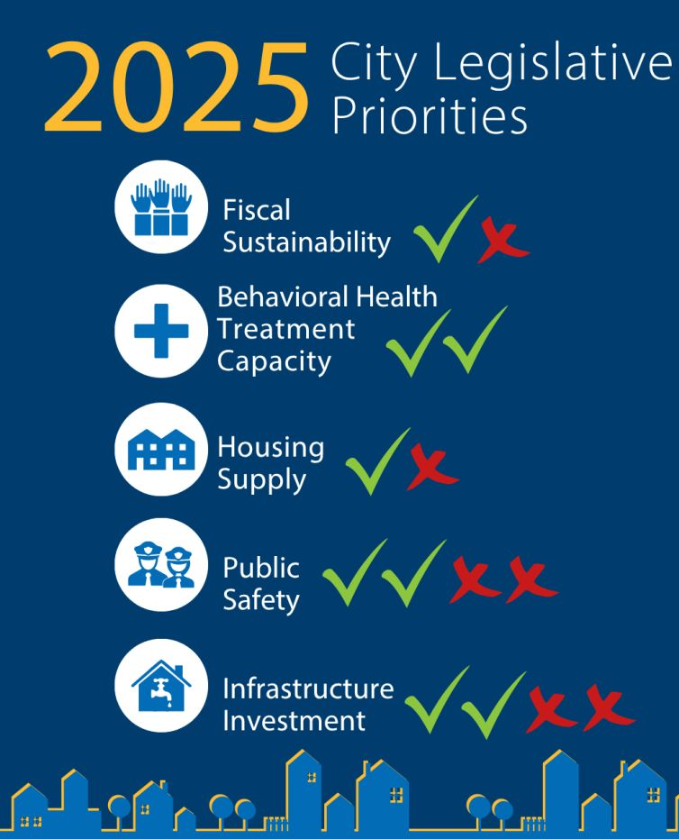
Fiscal Sustainability
Pro: Maintained state-shared revenues for cities in the final budget.
Con: Did not revise the outdated property tax cap.
Behavioral Health Treatment Capacity
Pro: Provided $4 million in grants to fund start-up costs for city co-response programs.
Pro: Passed HB 1811 to develop training for co-response training academy and provide supports for co-responders.
Housing Supply
Pro: Significant capital budget investments in housing and homelessness, including continued funding of Connecting Housing to Infrastructure Program (CHIP) and investments in manufactured home park acquisition and preservation.
Con: Did not pass local option short-term rental tax (SB 5576) or dedicate revenues from closing the storage tax loophole to housing (HB 1907/ SB 5711).
Public Safety
Pro: Passed HB 2015 creating a new $100 million state grant program and new councilmanic local sales tax option for funding public safety programs.
Pro: Increased funding to cities for public defense by $2.7 million for grants.
Con: Maintained 25% cost shift to cities for the cost of the Basic Law Enforcement Academy.
Con: Did not pass HB 1428, which would have increased direct Municipal Criminal Justice Assistance Account distributions by $25 million per biennium.
Infrastructure Investment
Pro: Maintained the Public Works Assistance Account’s (PWAA) dedicated funding streams.
Con: Diverted $288 million from the PWAA to the state general fund, with $100 million in bond backfill for infrastructure investment.
Pro: Dedicated 2.5% of the 6-cent gas tax increase to cities; the 6-cent add-on will grow by 2% annually to account for inflation.
Con: Did not adopt a sustainable transportation revenue source with funding for local preservation, maintenance, and operations.

Slide 5
Significant Issues
Pro: Passed an implementable version of the lot-splitting bill (HB 1096) and unit lot subdivision bill (SB 5559).
Pro: Addressed condominium insurance issues (HB 1403).
Pro: Harmonized uses of local real estate excises taxes (REET), and extended authority for operations and maintenance and housing (HB 1791).
Pro: Adopted the Recycling Reform Act, creating extended producer responsibility for packaging (SB 5284).
Pro: Dedicated $32.5 million to the Brian Abbott Fish Barrier Removal Board for local culvert corrections.
Pro: Created expanded alcohol service areas allowing cities and towns to establish ‘Libation Zones’ in their communities (HB 1515).
Pro: Extended clean energy retrofit dollars dedicated to grants for energy audits of city-owned Tier 1 and 2 buildings into FY 2026.
Pro: Stopped proposal to introduce new vague requirements on city ordinances dealing with camping in public (HB 1380).
Con: Restricted city authority to regulate parking (SB 5184).
Con: Adopted unemployment benefits for striking workers without addressing impacts for public employers (SB 5041).

Slide 6



2025-27 biennial budget outcomes
  $288 million sweep from the Public Works Assistance Account
  $100 million for law enforcement grants in HB 2015
  $62 million to address housing and services for those who are unhoused
  $1.2 billion for homelessness and affordable housing
  $45 million for GMA planning grants
  $6.8 million for MRSC
  $4 million in grants to fund city alternative response teams
  $3.6 million for city public defense grants
  Estimated $36.2 million additional distribution (over six years) from $0.06/gal increase in gas tax
  $310 million for the Transportation Improvement Board, including funding for Small City Pavement and Sidewalks, Complete Streets, and preservation funding
  $83.3 million for Safe Routes to School
  $81.7 million for pedestrian and bike safety
  $9.2 million to address homeless encampments in state rights of way
  $365 million for Public Works Board, including $100 million in additional construction bond authority to make up for PWAA sweep – $100 million available for applications for FY26
  $605 million for Housing Trust Fund + $157 million for other housing programs
  $32.5 million for Brian Abbott Fish Barrier Removal Board for local culverts
  $81 million for CERB capital construction projects
  $125 million for grants funding local clean energy and climate resilience/mitigation projects
Operating
Transportation
Capital
Notes:
The Transportation Budget also includes funding for:
AWC and WSDOT to update their 2013 MOU on construction, operations and maintenance for city streets as part of state highways.
AWC and the Joint Transportation Committee to update a 2019 assessment of city transportation funding needs.
A study exploring new methods to fund sidewalk improvements.
The Capital Budget also invests an additional $100 million in the Connecting Housing and Infrastructure Program.
On May 9, the Public Works Board opened the funding cycle for construction projects in fiscal year 2026. The board announced that the construction funding program “has approximately $100 million available for FY26” but said it “reserves the right to award more or less based on available funds in the Public Works Assistance Account at the time of the awards.” The cycle closes on Aug. 8.

Slide 7
Finance bills
Passed
SB 5315 – Modifying local tax rate notification requirements to DOR
SB 5814 – Modifies certain sales tax to apply them to new categories of transactions – will impact city sales tax
HB 2049 – *Amended to remove change to levy limit up to 3%; Revised version increases certain school local levy authority
Did not pass
HB 1334/SB 5812/SB 5798 – Revise the property tax levy cap
SB 5770, SB 5771, SJR 8203 – Creates a new primary residence property tax exemption
SB 5796 – Establishes payroll tax of 5% on certain employers
Notes:
SB 5315 – Local tax rate notification requirements include ordinance and, for annexations, map and parcels to Department of Revenue
SB 5770, SB 5771, SJR 8203 - Residential property tax exemption on $100,000 or 60% of county median value for primary residence. $300 working families tax credit increase for renters
SB 5796 - Payroll tax of 5% on employers with $7 million in payroll on wages above the Social Security threshold (currently $176,000)

Slide 8
Public Safety & Criminal Justice bills
Passed
HB 1174 – Changes to governance of court interpreters
HB 1596 – Speed-limiting technology devices for certain drivers
HB 2015 – Councilmanic 0.1% sales tax for criminal justice and new $100 million grant program to fund officer and co-responder recruitment and training
HB 1440 – Requires higher standard for civil asset forfeitures, enables forfeiture hearings to move to municipal courts.
Notes:
HB 1174 – Changes provisions for credentialing and requirements to provide court interpreters for persons with limited English proficiency
HB 2015 – Councilmanic 0.1% sales tax for broadly defined criminal justice purposes and a new grant program to fund officer and co-responder recruitment and training
HB 1596 – Intelligent speed assistance device required when driver’s license suspicion from reckless driving/excessive speed
HB 1440 – Updates civil asset forfeiture governance and standard procedures beginning in 2026.

Slide 9
Public Safety & Criminal Justice bills
Did not pass
HB 1113 – Authorize court to release upon substantial compliance
HB 1218 – Change trial competency evaluations
HB 1399 – Law enforcement leadership eligibility & police volunteers
HB 1423 – Authority to use vehicle noise enforcement cameras
HB 1428 – Increase state criminal justice assistance by $25 million
HB 1435/SB 5060 – $100 million for law enforcement hiring grants
HB 1592 – Public defense funding
SB 5775 – Councilmanic public safety sales tax authority and allows cities to impose counties’ unused rate up to 0.3%
HB 1056/SB 5066 – AG investigations of local police departments
Notes:
HB 1218 – Original bill had penalties for exceeding allocated evaluation hearings; latest version had incentives for diversions, could come back next session
HB 1423 – Would have authorized cities to join a pilot program to use automated vehicle noise enforcement cameras to target street racing and excessive, non-music noise
HB 1592 – State funding for 50% of current level of public defense expenses and 100% for new future increases from changes to caseload requirements

Slide 10
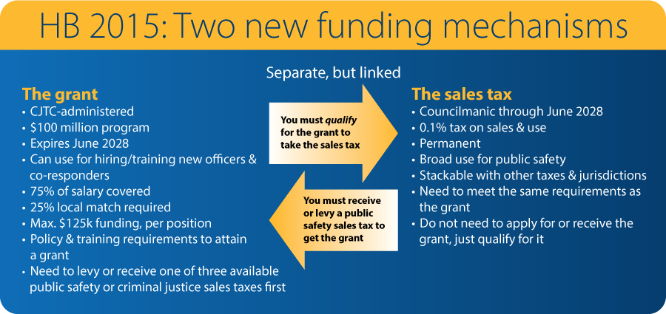

Slide 11
Housing bills
Passed
HB 1183 – Development regulations to promote Passivhaus, façade modulation and parking restrictions.
HB 1353 – Authorize cities to voluntarily adopt an ADU self-certification program
HB 1494 – Minor Multifamily Property Tax Exemption reform
HB 1757 – Follow-on bill regulating conversion of existing buildings to residential
HB 1791 – Harmonizing uses of local REET funds and additional flexibility for housing
HB 5148 – State compliance audit of Housing Element and development regulations
SB 5184 – Significant preemption on on-site parking requirements for cities over 30,000
SB 5559 – Providing standards for unit lot subdivisions
Notes:
HB 1183 – Development regulations & GMA - Requires cities and counties planning under the Growth Management Act to modify setback, height limit, and gross floor area requirements for specified types of developments. Modifies off-street parking and affordable housing unit size requirements.
HB 1353 – ADU self-certification – Optional – a city can operate an ADU self-certification process for registered architects.
HB 1494 – Multifamily Property Tax Exemption reform – Lots of changes.
HB 1757 – Commercial to residential conversions - Cities must comply with the requirements for existing buildings to be used for residential housing no later than June 30, 2026.
HB 1791 – REET flexibility for housing - Restrictions on the use of local REET revenues based on population size and GMA planning are removed, allowing any county or city to use any revenues raised via REET 1 for eligible uses under REET 2, and vice versa.
HB 5148 – State compliance audit of Housing Element (GMA) – now voluntary. BUT SEPA safe harbor for implementation of housing element (nonproject actions).
SB 5184 – Parking preemption – affects cities over 30,000.
SB 5559 – Subdivision reform – GMA cities

Slide 12
Housing bills
Passed
HB 1096 – Requiring cities to provide process for lot splitting
HB 1491 – New requirements for zoning around transit
SB 5571 – Restrictions on city regulation of exterior cladding of buildings
Did not pass
HB 1195 – State compliance review of emergency shelter and housing ordinances
HB 1443 / SB 5332 – Requiring cities to allow RVs as permanent housing
SB 5613 – Challenging new standard for “Clear & objective” development regulations
Notes:
HB 1096 – Lot splitting
HB 1491 – Transit-oriented density
SB 5571 – Regulation of exterior cladding of buildings – Any exterior that complies with state building code must be allowed

Slide 13
Homelessness bills
Passed
HB 1260 – Document recording fee administrative cleanup
HB 1858 – Applying document recording fee to bank-to-bank transfers
Did not pass
HB 1240 – Who pays vehicle residence impounds? (cities)
HB 1380 – State regulation local ordinances related to public camping
HB 1653/SB 5484 – Who pays for vehicle residence impounds? (state)

Slide 14
Transportation bills
Passed
SB 5161 – Transportation appropriations bill
SB 5801 – Transportation resources bill (includes 6-cent gas tax increase)
SB 5595 – “Shared streets” designation
HB 1733 – Relocation expenses due to agency displacement
HB 1774 – Lease of unused highway land
Did not pass
HB 1921 – Road usage charge (similar concept in House budget proposal)
SB 5374 – Tribal representation in local transportation planning
Notes:
SB 5161 & SB 5801 are the Transportation appropriations and resources bills, respectively. The latter included a 6-cent gas tax increase with 2.5% of the increase going to cities, which is estimated to bring cities some $36.2 million over three biennia.
SB 5595 expands city authority to designate nonarterial highways as a “shared street,” to facilitate shared use by pedestrians, bicyclists, and vehicular traffic.
HB 1733 puts the owners of public projects that displace a farm or small business on the hook to reimburse up to $200,000 in relocation costs, up from $50,000, with a fixed two percent annual increase in the maximum payment. However, state agencies’ payments are limited to $100,000 until 2030.
HB 1774 allows WSDOT – when it considers leasing any unused land that it holds for highways to an entity for use as a "community purpose" – to note the social, environmental, or economic benefits of that use in determining whether the lessee is giving adequate consideration for the lease. A "community purpose" is a public benefit purpose such as housing, housing assistance, shelter programs, parks, enhanced public spaces, public recreation, salmon habitat restoration, or public transportation.
HB 1921 establishes a road usage charge of 2.6 cents per mile. Similarly, the House Transportation chair’s proposed budget charged an annual highway use fee based on a vehicle’s combined fuel economy rating (MPG), with higher fees for more-efficient vehicles and an exclusion for battery electric and hybrid vehicles. Neither proposal advanced.
SB 5374 requires counties and cities planning under the Growth Management Act (GMA) to engage with impacted tribal governments when preparing transportation plans. Given unanimous Senate passage, the bill is likely to return next session.

Slide 15
Open Government bills
Passed
HB 1934 – Clarifies PRA exemption for discrimination/harassment investigations redactions to protect employee identities
Did not pass
HB 1765/SB 5707 – Creates a local government email newsletter list PRA exemption
HB 1964 – Requires PRA requester to declare request is for noncommercial purpose
Notes:
HB 1934 is the big one here – it expands the existing PRA exemption for workplace harassment and discrimination records. Current law only requires redaction of names of people involved in an investigation, the bill will also require redaction of other personally identifying information.
Floor amendment: Creates a redaction exemption for complaints made by elected officials. After the investigation is complete and the complainant has been notified of the outcome of the investigation, if an elected government official is a complainant, the name and title of such elected government official shall not be redacted from the investigatory records.

Slide 16
HR & Labor Relations bills
Passed
HB 1213 – Expands job protections under Paid Family & Medical Leave and addresses concurrency with federal Family & Medical Leave Act leave
HB 1308 – Requires employers provide “personnel records” to employees
HB 1821 – Access to payroll records for prevailing wage complaints
SB 5040 – Expands interest arbitration for law enforcement to cities with less than 2,500 population
SB 5503 – Prohibits grievance arbitration settlements from requiring employees to waiving right to future claims
SB 5041 – Makes striking workers eligible for unemployment benefits
Did not pass
HB 1622 – Requires bargaining the management decision to use artificial intelligence related technology
Notes:
HB 1213 - Lowers eligibility requirements and increases job protections for Paid Family Medical Leave, with phase in for small employers. Allows concurrent PFML and FMLA leave
HB 1308 – Public employers will need to treat “personnel record” requests from employees or former employees as they would PRA requests, subject to the PRA’s timelines, enforcement mechanisms, and penalties.
HB 1821 - Expands the definition of "interested party" to include joint labor-management cooperation committees and requires L&I to provide a copy of an employer’s certified payroll records to an interested party for the purposes of enforcing prevailing wage requirements.
SB 5040 - Gives police at small cities and towns with less than 2,500 population access to interest arbitration. May raise costs for certain small city police departments.
SB 5503 – Bill primarily deals with collective bargaining unit formation and PERC hearing procedures. Contains provision prohibiting grievance settlements from requiring employee to waive rights to future claims under state or federal law. Significantly undermines incentive for public employers to offer settlements in grievance cases.
Pending
SB 5041 - Allows striking workers to collect unemployment insurance for up to 4 weeks. Requires final judgment declaring strike illegal (like with public sector workers) to decline or require repayment of benefits. Conference committee.
Did not pass
HB 1622 – requires collective bargaining over the management decision to adopt AI technology, not just the impacts of such decisions as is current law. We expect this bill to return next year.

Slide 17
Environment bills
Passed
HB 1293 – Littering penalty & plastic carryout bag law changes
HB 1497 – Amendments to Organics Management Law & solid waste cart color and labeling requirements
SB 5033 – Requiring PFAS testing of biosolids
SB 5284 – Recycling Reform Act for residential paper & packaging
Did not pass
HB 1303 – Adding environmental justice considerations to SEPA

Slide 18
General Government bills
Passed
HB 1201 – Requires planning for pet sheltering during emergencies
HB 1515 – Expanded outdoor alcohol service areas: “Libation Zones”
Did not pass
HB 1339/SB 5373 – Creates an even-year elections option
HB 1448 – Establishes a ranked choice voting systems option
HB 1710 – Creates a Voting Rights Act (VRA) “preclearance” requirement for local government
HB 1750 – Expands “vote dilution” and “abridgement” claims under the VRA
Notes:
HB 1201 – Requires that local governments update their comprehensive emergency management plans to include provisions for sheltering pets during emergencies. Does include a "to the extent practicable" clause to help relieve some pressure. Bill also requires local governments to provide emergency preparedness information regarding pets on their websites.
HB 1515 – Exciting bill that would allow cities to establish expanded outdoor alcohol services areas within their community. LCB will be the regulatory body overseeing the approval of libation zones. While the bill was brought forward to help communities prepare for the World Cup, libation zones can be utilized for different events (art walk, summer events, holiday events, etc.). Some reporting and public safety requirements for cities that do establish libation zones.
HB 1573 – Expands timing window for oaths from the regularly scheduled meeting of the governing body prior to taking office or up to 10 days prior to taking office TO after certification and the day before taking office.
HB 1811 – Bill codifies the definition of 'co-response'. The goal of this new definition is to help cement co-response as an official recognized form of alternative response and help co-responders better integrate into the 988 and 911 systems.
Did not pass:
HB 1710 – required certain jurisdictions to get VRA “preclearance” from the state before taking certain actions that could impact voting districts or elections. Contained very broad definition for “covered jurisdictions” and “covered conduct” that would have captured many cities for circumstances outside their control, and captured many city actions that typically are not taken with elections in mind.
HB 1750 – Expanded the definition of VRA “abridgement” claims and “dilution” claims, and AWC was concerned that the broad definitions used would simply result in more civil actions against cities.

Slide 19
Public Works & Infrastructure bills
Passed
SB 5627 – Underground utility excavation practices (“Dig Law”)
HB 1549 – Responsible bidder criteria
HB 1633 – Subcontractor licensing requirements
HB 1967 – Design-build public works project bonding
HB 1543 – Compliance pathways for Clean Buildings Performance Standard
Did not pass
SB 5804 – Permanently divert PWAA revenues to fund state culvert obligations
SB 5061 – Prevailing wage at the time work is performed
SB 5176 – Prompt pay on public works projects
HB 1966 – Self-performed public works requirements
Notes:
SB 5627 – Addresses long-standing concerns from the excavator community and encourages the adoption of best practices for locating, marking, and excavating. AWC participated in a stakeholder group that did a significant amount of negotiating and came to many compromises with excavator reps. Big takeaways:
Excavators must physically mark the boundary of the excavation area with white lining or white pin flags and provide notice through the locate service of the “work-to-begin date,” at least 2 full business days and no more than 10 full business days after the notice is given.
Change from current law: if boundary marking is infeasible, the excavator must notify the utility electronically (currently the excavator must communicate directly with the affected facility).
Utility owners must provide positive response to excavators, meaning operators must notify the one-number locator service confirming that the utility has completed marking or has provided available information regarding unlocatable facilities.
The one-number locator service, currently administered through telephone, must create and maintain a web-based platform that provides the same services as the phone service.
General contractors may provide notice on behalf of the excavator and may list multiple excavators on a single notice (but must provide contact information and a unique confirmation code for each excavator listed).
HB 1549 – Updates the state’s criteria for determining a “responsible bidder” on PWs project bids.
Now, to qualify as a responsible bidder, bidders must have:
Completed at least one public works project within the previous three years and not been cited for violating responsible bidder criteria or prevailing wage law within that time period; OR
Have at least one employee or officer that has received the state’s required training in the previous three years.
Bidders must submit an apprentice utilization plan to the awarding agency before receiving the notice to proceed. Contracting agencies may exempt bidders from the requirement.
L&I must develop an apprenticeship utilization plan template, make it available to awarding agencies and bidders, and publish it on L&I’s website.
HB 1633 – Essentially a technical fix bill that cleans up a loophole and increases transparency in the bidding process
Requires that prime contractors, at the time that they bid on a project costing $1 million or more, verify in the bidding documents that any subcontractor they’ve subcontracted to perform HVAC, plumbing, or electrical work on the project are licensed for that work. The contractor may also name itself to do that work if it is licensed to do so.
Prime contractors are given 48 hours to correct errors identified by the project owner regarding license information submitted in the bidding documents.
HB 1967 – Provides that a performance and payment bond is not required for the portion of a design-build contract that includes design services, preconstruction services, and other services that are not public works construction. Bonds must be not less than the dollar value of the contracted amount of the construction portion of the contract.
HB 1543 – Allows Commerce to adopt alternative pathways for building owners to comply with the state Clean Buildings Performance Standard and creates new exemptions and extensions.
SB 5804 – Permanently redirects funding for statewide local infrastructure systems to help the state in meeting its court-ordered obligation to address fish-blocking culverts. Diverts tax revenues currently dedicated to the Public Works Assistance Account so the state could issue $5 billion in bonds to fund projects that improve salmon and steelhead habitats and mitigate the impacts of fish-passage barriers. Funding for removal of both state- and locally owned culverts will remain an issue in future sessions.
SB 5061 – Requires workers be paid the prevailing wage at the time work is performed (as opposed to the prevailing wage in place when the contract was signed). Prevailing wage is updated twice a year - for projects lasting a year or more, this will increase costs to project owners. Before dying, 5061 was amended to require an annual wage adjustment on the anniversary of the contract date (rather than adjustments each time the prevailing wage is recalculated). This bill is a labor priority as is likely to return.
SB 5176 – Requires project owners to make payments on public works projects within 30 days of receipt of a “properly completed” invoice. Late payments are subject to1% interest per month. The bill raises questions about monitoring and enforcing interest charges and allowing enough time for change orders to be fully negotiated. This bill came from recommendations from a 2024 study by CPARB.
HB 1966 - Provides flexibility for public entities to self-perform work under certain circumstances rather than going to bid.

Slide 20
Land Use & Building Codes bills
Passed
HB 1061 – Authorizes cities to allow parking across end of driveway
HB 1135 – Updating process for coming into compliance with GMA after a finding of non-compliance
HB 1688 – Authorizes electric security fences in cities that don’t have codes on the topic, but allows cities to choose later to ban or regulate
SB 5509 – Childcare centers zoning mandate
SB 5558 – GMA comp plan & implementation timelines extension for jurisdictions required to update in 2026
SB 5655 – Changes to calculations regarding childcare occupancy in existing buildings
Notes:
HB 1135 – Cases under a compliance order before the GMHB
HB 1688 – Will preempt city regulation unless you have regulations in place or adopt at any point
HB 1935 – The saga of whether a building permit is a project permit under the Local Permit Review Act comes to an end.
SB 5509 – Requires allows childcare centers in all zones except industrial and open space
SB 5558 – GMA cities - Extends 2026 deadline by 6 months to December 31 + other implementation deadlines for all GMA cities: Design review, middle housing, ADUs
SB 5611 – Impacts binding site plans, common interest community regulation, and Local Project Review Act
SB 5655 – Occupancy load calculation by building official

Slide 21
Land Use & Building Codes bills
Passed
HB 1039 – Authorizes City & tribe contracting for urban services outside UGA
HB 1562 – Requiring greater access to diaper changing stations in public restrooms
HB 1576 – Historic landmark designation – prohibit designation without property owner consent in most cases.
Did not pass
HB 1175 – Requiring cities to allow neighborhood cafes and businesses in residential areas
HB 1254 – Wildland Urban Interface Code reforms
SB 5719 – Requiring all but the smallest cities to use hearings examiners
Notes:
HB 1039 – Expressly allows cities to extend services outside the city and UGA under agreement with tribe and not violate the GMA
HB 1562 – Now required in new construction or remodeled buildings that have a restroom available for the public
HB 1576 – Restricts what can be designated and notice

Slide 22
Other items
Updates to business licensing thresholds for out-of-town businesses
  Need to implement no later than January 1
  Need to adopt ordinance and give BLS notice by October 1
Local B&O tax model ordinance update
Federal funding resources - nlc.org
  Advocacy letters on municipal bonds, CDBG, and federal transportation

Slide 23
Looking ahead to the 2026 political landscape
Federal uncertainty
Fiscal constraint from Governor Ferguson
Election year
Economic uncertainty
Resources will continue to be constrained, policy items will be more realistic
Unlikely to be a heavy revenue focus
Possibility of initiatives & referendums

Slide 24
Developing AWC’s 2026 Legislative Agenda
Legislative Priorities Committee meeting to develop recommendations
Member input
August 18 Member update webinar
September AWC Board will adopt the 2026 agenda

Slide 25
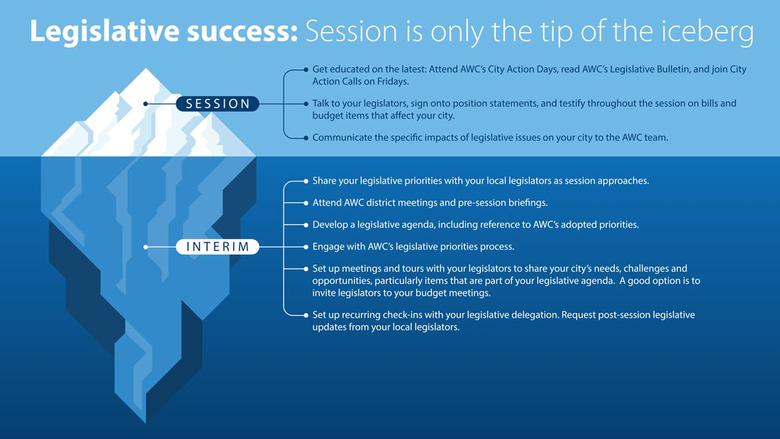

Slide 26

To Do List: Before 2026
Meet with your legislators
Adopt a legislative agenda
Arrange for regular check-in meetings during the legislative session

Slide 27
Questions?

