Slide 1
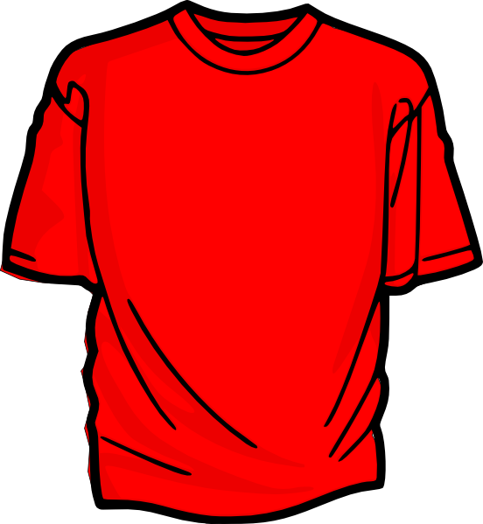
FRONT
BACK
UNIFYING
NEIGHBORHOODS
INSPIRING
TALENTED
YOUTH
#UNITYFXBG
2019

